Slide 1
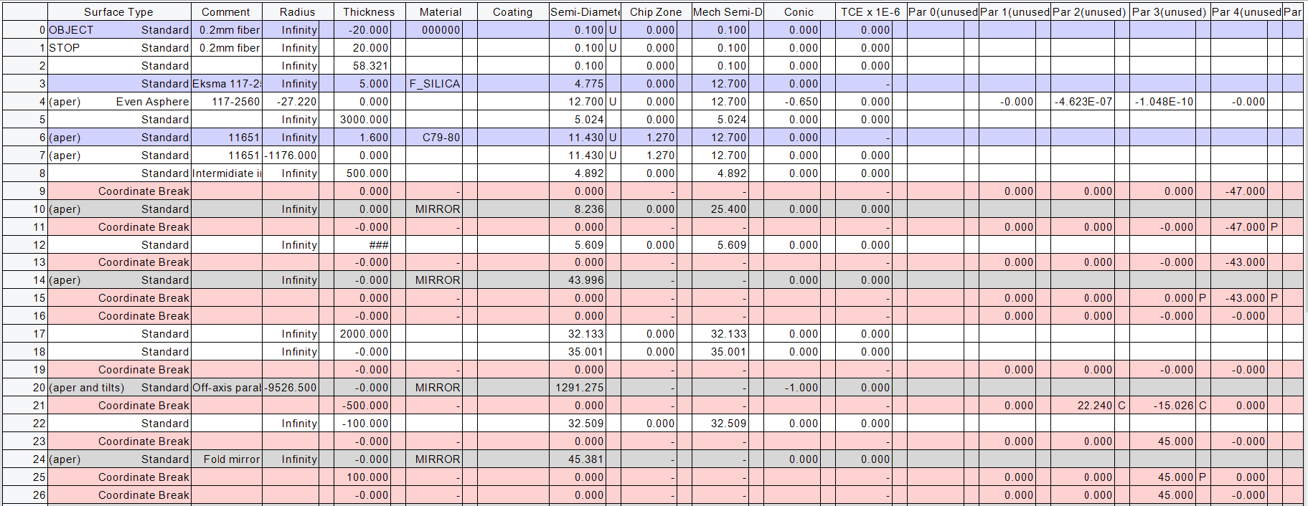
ZEMAX model of LID optics

Slide 2
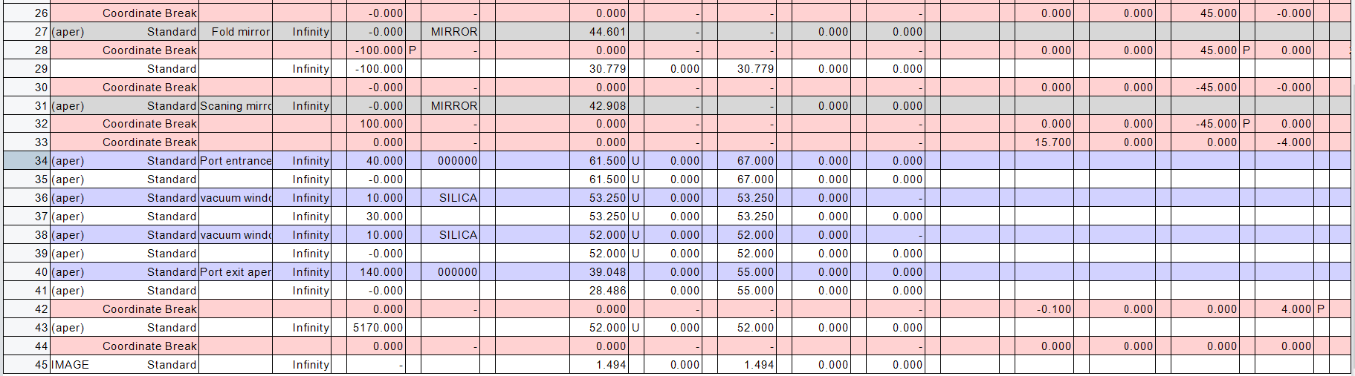
ZEMAX model of LID optics

Slide 3
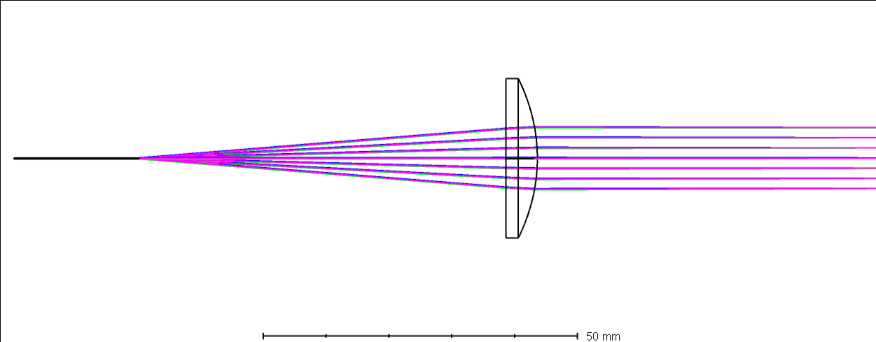
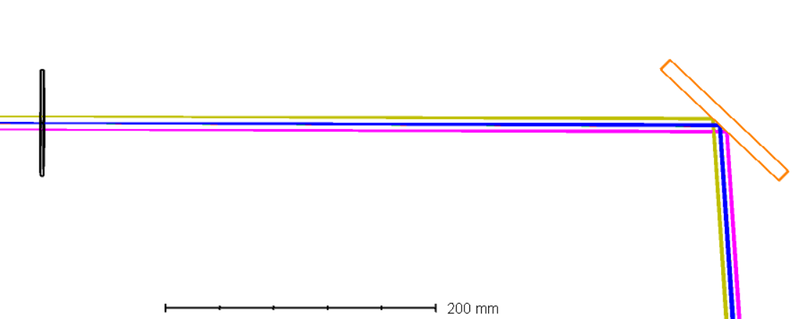
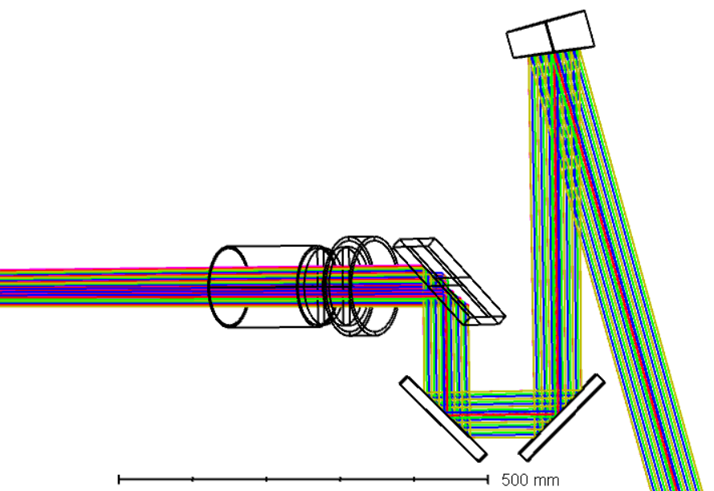
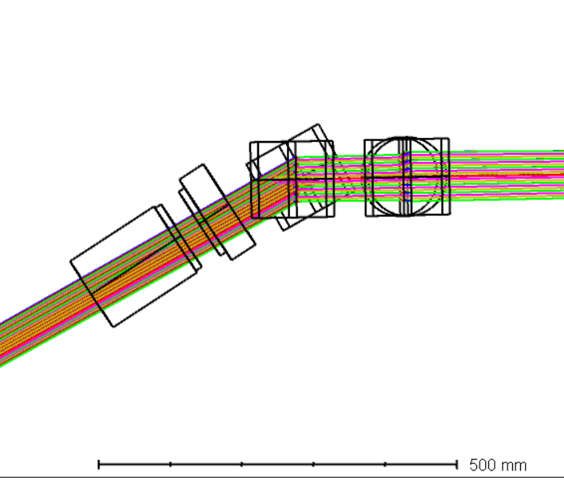
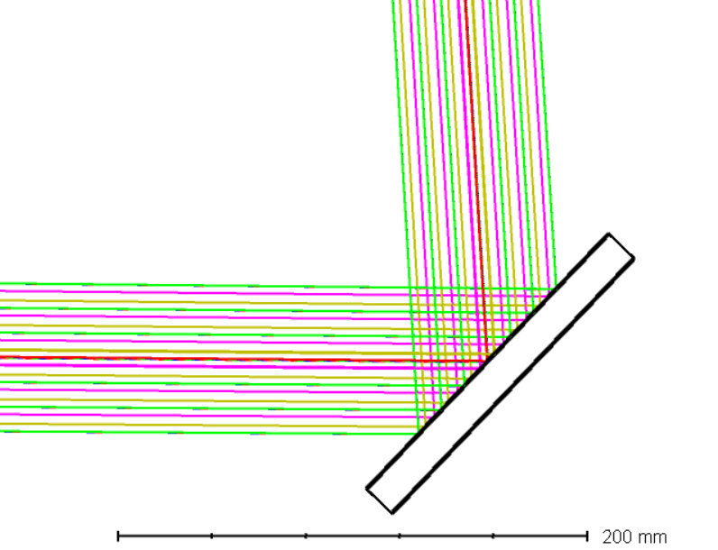
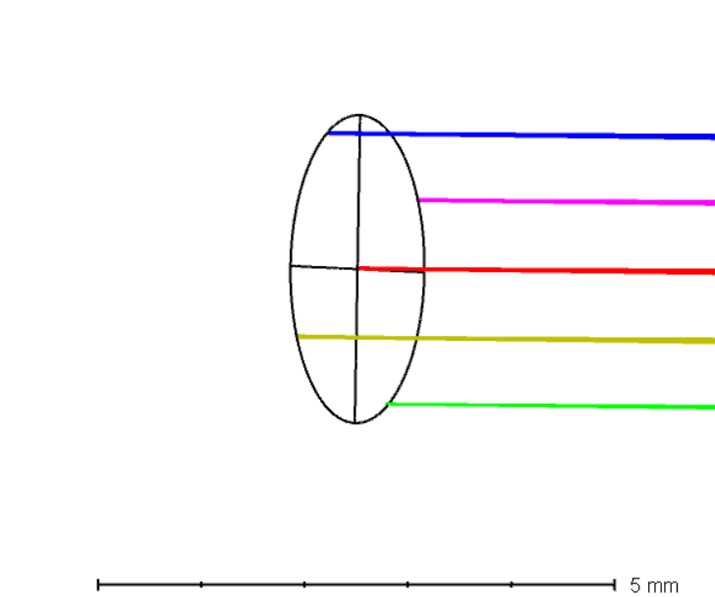
ZEMAX model of LID optics
aspheric lens Eksma 117-2560 D=25.4mm f=60mm
field lens D=76mm f=2615.7mm
metal mirror 120x86mm²
Laser fiber ∅0.2mm
metal parabolic mirror D=110mm f=4763mm
top view
side view
metal mirror 150x106mm²
port window
metal mirrors 150x106mm²

Slide 4
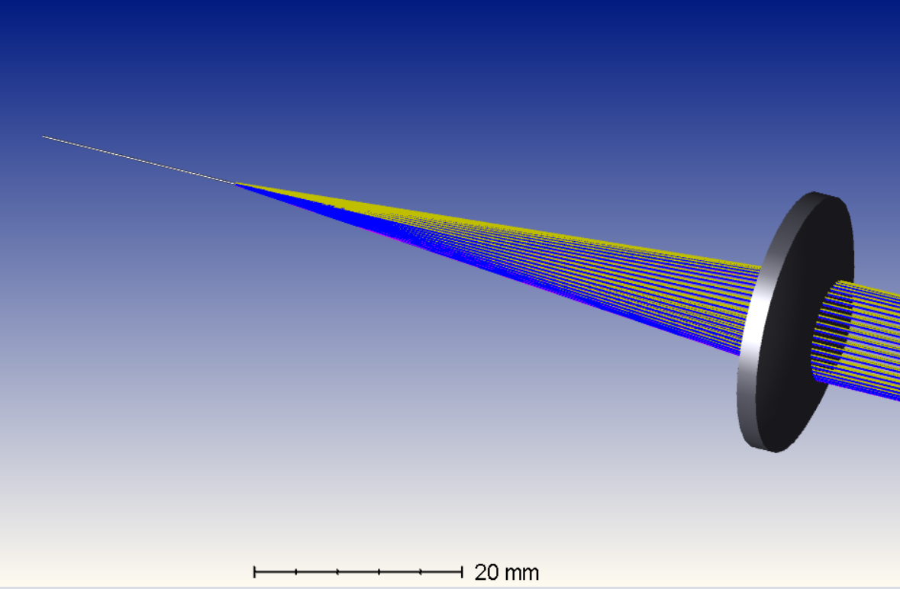
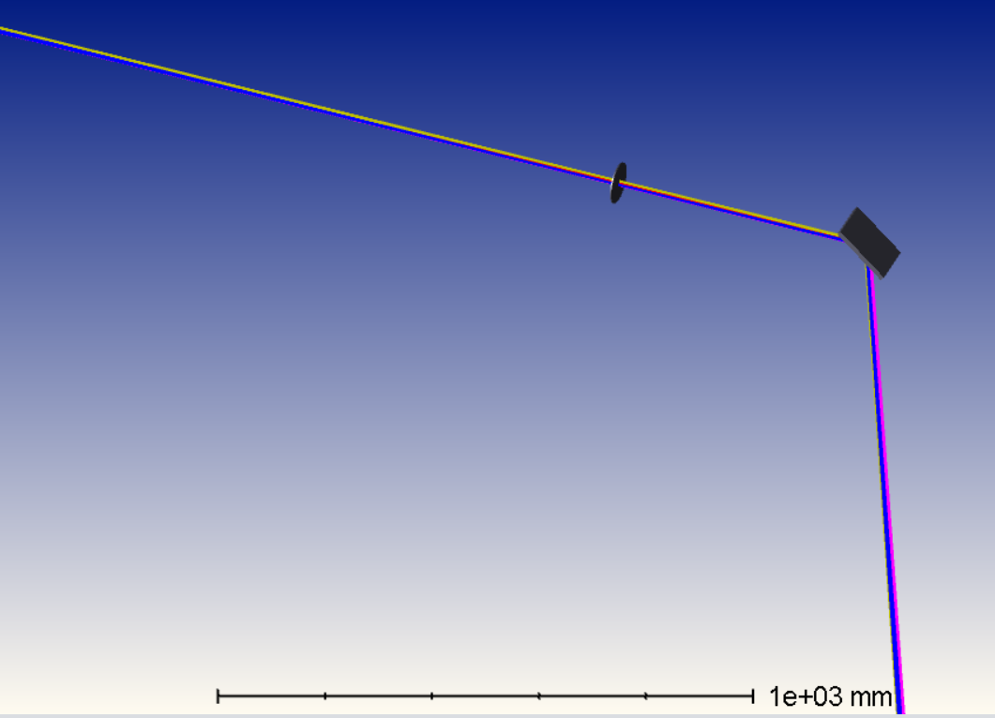
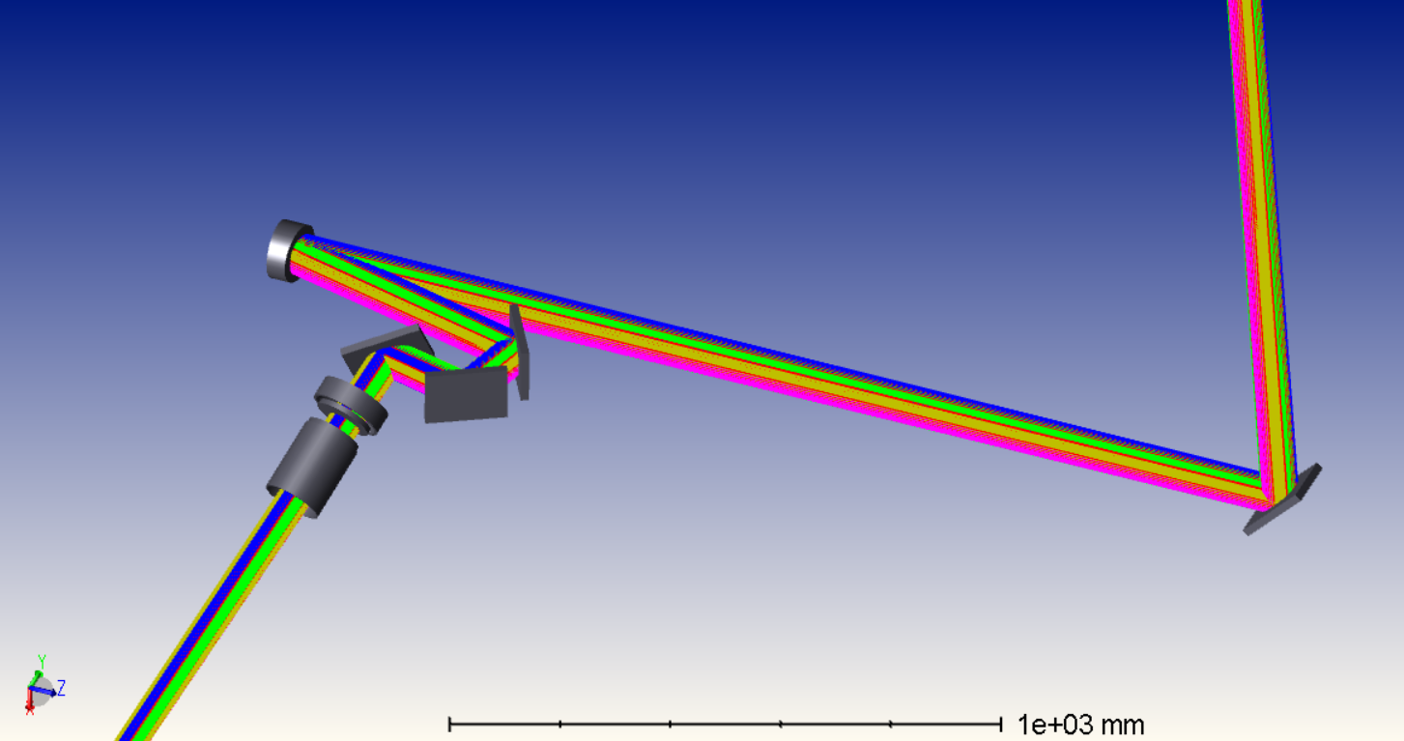
ZEMAX model of LID optics

Slide 5
ZEMAX model of LID optics

