Slide 1

LID Rastering
Thermal simulation (ANSYS) #1
11.3.2020 I Miroslaw Zlobinski et al.

Slide 2
Laser Parameters
earlier:
minimal requirements to reach Be melting at 1550 K from room temperature:
e.g. with 1 ms pulse and 4.5 J absorbed energy on 3 mm diameter spot
This simulation:
1 ms pulse and 3.7 J absorbed energy on 3 mm diameter spot (i.e. 530 MW/m²)
(for comparison: 1D-analytical calculation with temperature-independent material parameters:
temperature increase from 300 K to 1350 K maximum temperature)

Slide 3
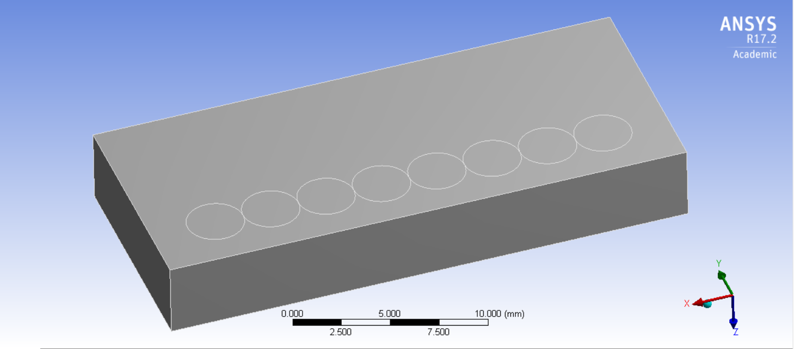
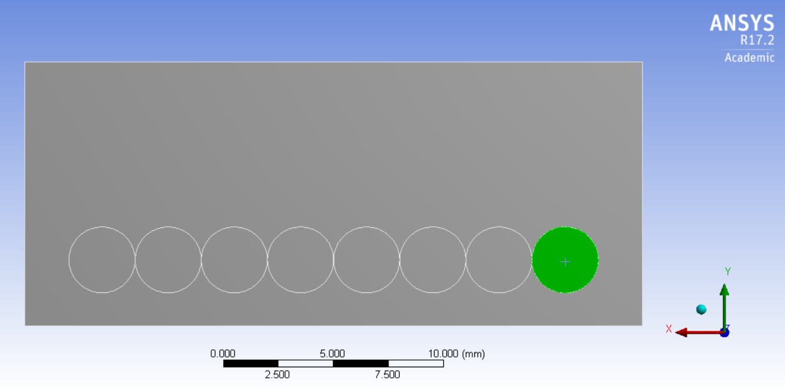
Geometry
1 ITER castellation block
4 mm
28 mm
8 circular laser spots
with 3.0 mm diameter
3.0 mm centre-to-centre distance
here max.: 24 spots (with margin)
[without margin:
max. full coverage: 36 spots (4 x 9)]
12 mm
2
2 mm margin
1.5

Slide 4
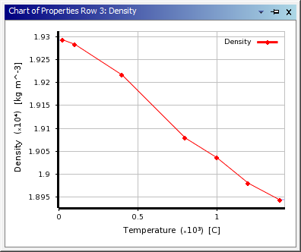
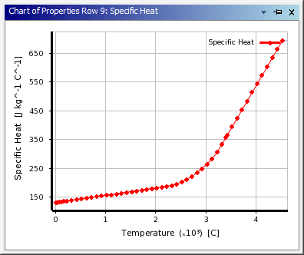
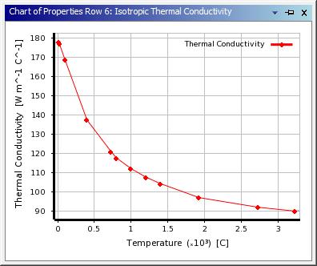
Material parameters
Density
W substrate (temperature dependent heat properties)
no layer
Heat capacity Thermal conductivity

Slide 5
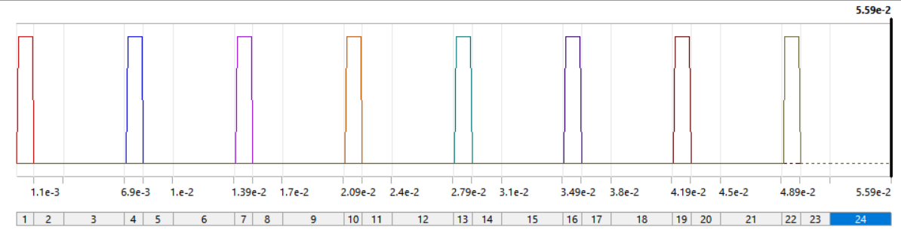
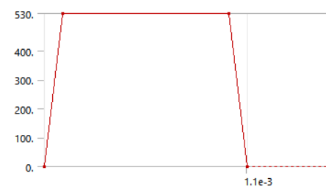
Temporal pulse shape
8 laser pulses, each 1 ms duration, every 7.0 ms (143 Hz)
0
time/s
0.1 ms 1.0 ms
Each laser pulses nearly rectangular with
0.1 ms for rising and 0.1 ms for falling edge
Laser intensity / MW/m²

Slide 6
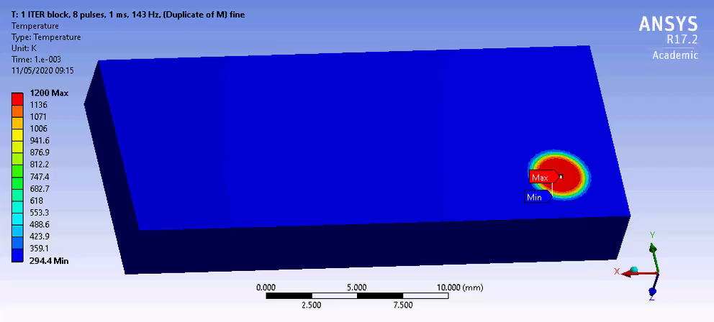
Result Video

Slide 7
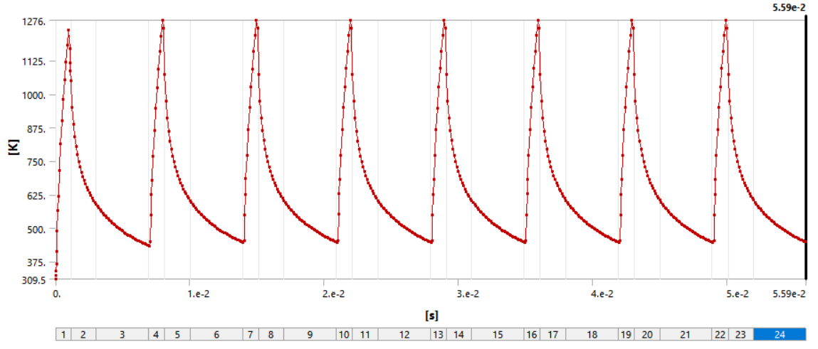
Result: Maximum Temperature vs. time
maximum temperature ca. 1280 K, material cools between pulses, no strong accumulative heating effect
to improve: smaller time step during laser pulse to better calculate maximum temperature

Slide 8
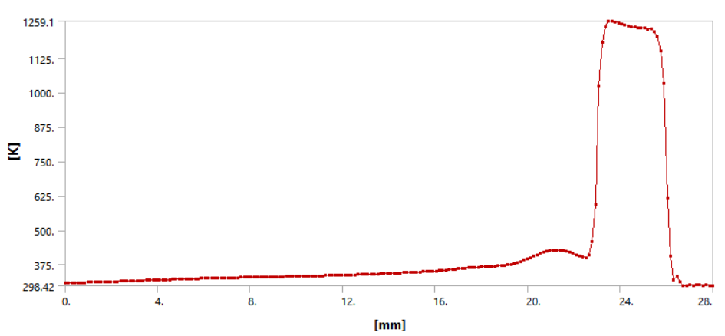
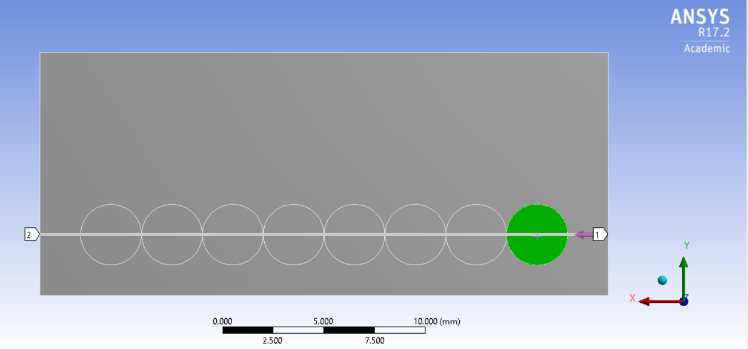
Result MaximumTemperatur vs. time
Spatial temperature distribution at the end of 8th laser pulse (49.9 ms)

Slide 9
End

