Slide 2
The Varenna-model v0.1 implementation status
TSVV3 status meeting, M. Wiesenberger, 31.5.24

Slide 3
Outlook
What do we want to implement?
Executive summary
Existing FELTOR modules
Timestepper
Multispecies considerations
Elliptic solvers
Perpendicular advection-diffusion
Parallel advection-diffusion
Boundary conditions
Collisional closure
Neutrals
Conclusion

Slide 4
Varenna model
4-moment full-F gyrofluid model including FLR effects
with collisional LWL closure reacting (plasma-neutral interactions) and scattering collisions
Consistent particle drifts as a result of underlying gyrokinetic model
Energy and angular momentum conservation
Multispecies: Species symmetry

Slide 5
Implementation status
Module | Status
Magnetic field geometry | ✓
Parallelization MPI+X | ✓
Python interface | ✓
Timestepper | ✓
Multispecies | ✓
Elliptic solvers | ✓
Unit tests for 2nd gyroaverages | ✗
Perpendicular advection-diffusion | ✓
Parallel advection-diffusion | ✓
MMS | ✗
Boundary conditions | ✓
Collisional closure | ✓
Neutrals | ✗
EASY
TEDIOUS but doable
INPUT NEEDED
Magnetic field | Parallelization | Python | Timestepper | Multispecies | Elliptic solvers | 2nd gyroaverages | Perpendicular terms | Parallel terms | MMS | Boundary conditions | Collisional closure | Neutrals

Slide 6
The low hanging fruits
Magnetic field geometry, curvature terms, forcing regions etc.
magneticfielddb Python package
robust, reliable, well-documented
FELTOR numerical modules
MPI+X parallelization
timesteppers, elliptic solvers, dG and FCI methods, …
Python interface pyFELTOR, simplesimdb, xFELTOR,
set up and run simulations
data management
M. Wiesenberger and M. Held, Plasma Phys. Control. Fusion 66, 065003 (2024)
Magnetic field | Parallelization | Python | Timestepper | Multispecies | Elliptic solvers | 2nd gyroaverages | Perpendicular terms | Parallel terms | MMS | Boundary conditions | Collisional closure | Neutrals

Slide 7
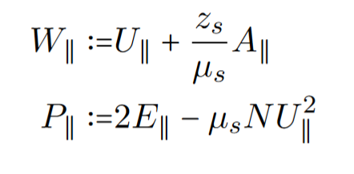
Timesteppers
Problem mass matrix:
preferable from conservative point of view
leads to differential algebraic equation (DAE)
purely implicit solver
„Classic“ solution:
Decouple Ampere law
Need to reformulate model equations:
parallel viscosity needs to remain explicit and thus truncated
…
…
Magnetic field | Parallelization | Python | Timestepper | Multispecies | Elliptic solvers | 2nd gyroaverages | Perpendicular terms | Parallel terms | MMS | Boundary conditions | Collisional closure | Neutrals

Slide 8
Timesteppers II
FELTOR has 50+ different ODE integrators
can be chosen at runtime
ARK 4-2-3 Adaptive embedded ImEx Runge Kutta scheme most likely
Adaptive is quite convenient from a user perspective
No timestep to set that may be too small or too large
Advection explicit – diffusion implicit
[C.A. Kennedy and M.H. Carpenter. Additive runge-kutta schemes for convection-diffusion-reaction equations. Appl. Num. Math., 44(1-2):139–181, 2003]
Investigate time-step variation during turbulence to see advantage over multistep
Magnetic field | Parallelization | Python | Timestepper | Multispecies | Elliptic solvers | 2nd gyroaverages | Perpendicular terms | Parallel terms | MMS | Boundary conditions | Collisional closure | Neutrals

Slide 9
Multispecies
Straightforward in Gyro-fluid model: all species are equal
Except electrons … (no gyro-radius, mass negligible towards ions)
species loop in code
Also for initialisation
State vector in C++ Code
std::array< std::vector< dg::x::DVec >, 4>
4 equations
multiple species chosen at runtime
distributed among MPI GPUs
Magnetic field | Parallelization | Python | Timestepper | Multispecies | Elliptic solvers | 2nd gyroaverages | Perpendicular terms | Parallel terms | MMS | Boundary conditions | Collisional closure | Neutrals

Slide 10
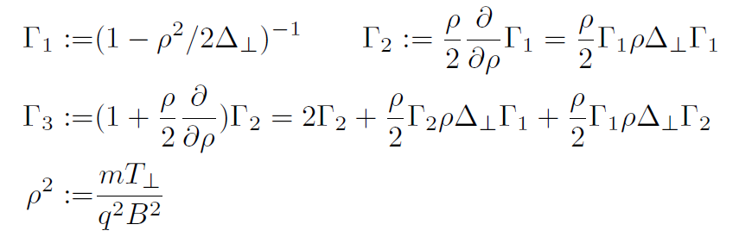
Elliptic solvers
Standard LDG discretization
Symmetric operators
Multigrid – CG
20 Mio points, 16 GPUs
time to solution < 0.1s
M. Wiesenberger and M. Held, Plasma Phys. Control. Fusion 66, 065003 (2024)
Unit tests for 2nd gyroaverage operators missing:
Magnetic field | Parallelization | Python | Timestepper | Multispecies | Elliptic solvers | 2nd gyroaverages | Perpendicular terms | Parallel terms | MMS | Boundary conditions | Collisional closure | Neutrals

Slide 11
Elliptic solvers II
Implicit temperature eq.
GMRES, nonlinear solver?
More performance testing needed
Is Multigrid advantageous?
Side project: Possible higher order FLR
effects via operator functions
gets numerically complicated/expensive quickly in thermal code
No conclusive algorithm yet
*
**
* W. Zholobenko et al. Contrib. Plasma Phys. 60 (2019)
** M. Held and M. Wiesenberger, Nucl. Fusion 63, 026008 (2023)
Magnetic field | Parallelization | Python | Timestepper | Multispecies | Elliptic solvers | 2nd gyroaverages | Perpendicular terms | Parallel terms | MMS | Boundary conditions | Collisional closure | Neutrals

Slide 12
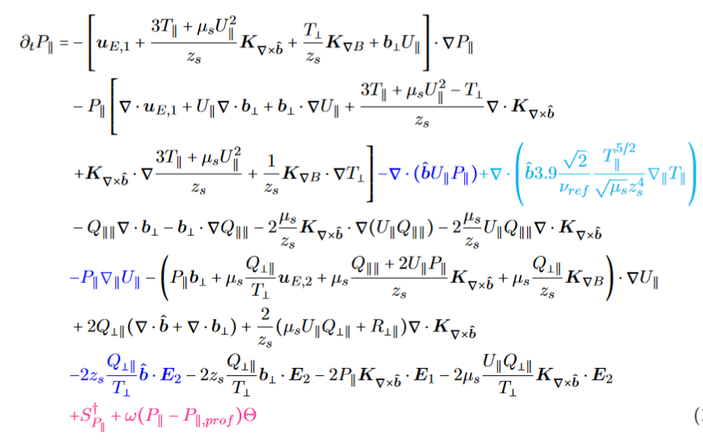
Perpendicular advection-diffusion
dG – upwind scheme well-established and stable needing little diffusion
Tedious to establish unit tests (MMS)
Magnetic field | Parallelization | Python | Timestepper | Multispecies | Elliptic solvers | 2nd gyroaverages | Perpendicular terms | Parallel terms | MMS | Boundary conditions | Collisional closure | Neutrals

Slide 13
Parallel advection-diffusion
Use FV-FCI scheme
[M. Wiesenberger and M. Held, Comput. Phys. Commun. 291, 108838 (2023)]
Staggered grid makes book-keeping tedious
1d unit test available
bachelor thesis A. Christensen (2024)
3d unit test outstanding
Magnetic field | Parallelization | Python | Timestepper | Multispecies | Elliptic solvers | 2nd gyroaverages | Perpendicular terms | Parallel terms | MMS | Boundary conditions | Collisional closure | Neutrals

Slide 14
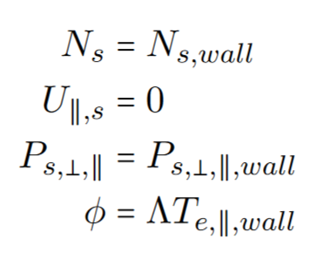
Boundary conditions
FELTOR currently does not have the capability to implement spatially dependent Neumann BC
Magnetic field | Parallelization | Python | Timestepper | Multispecies | Elliptic solvers | 2nd gyroaverages | Perpendicular terms | Parallel terms | MMS | Boundary conditions | Collisional closure | Neutrals

Slide 15
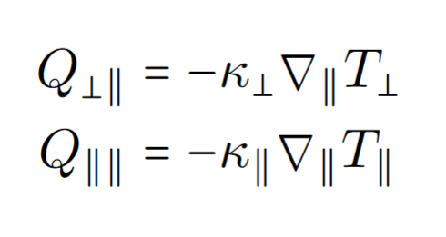
Collisional closure
Collisional terms numerical non-problematic:
Closure term needs flux-limiter?
Better closure relations. Landau – closure?
[Pitzal et. Al, Phys. Plasmas 30, 122502 (2023)]
Magnetic field | Parallelization | Python | Timestepper | Multispecies | Elliptic solvers | 2nd gyroaverages | Perpendicular terms | Parallel terms | MMS | Boundary conditions | Collisional closure | Neutrals

Slide 16
Neutrals
Currently on hold
Interaction terms there but
Input needed:
Theory: which neutral model to use? Advection – diffusion?
Numerics: How to combine 3d neutrals with FCI scheme (low toroidal resolution)
How well does neutral diffusion play with timesteppers
initialization and boundary conditions
At DTU we so far only used 2d neutral models
Magnetic field | Parallelization | Python | Timestepper | Multispecies | Elliptic solvers | 2nd gyroaverages | Perpendicular terms | Parallel terms | MMS | Boundary conditions | Collisional closure | Neutrals

Slide 17
Conclusion
Module | Status
Magnetic field geometry | ✓
Parallelization MPI+X | ✓
Python interface | ✓
Timestepper | ✓
Multispecies | ✓
Elliptic solvers | ✓
Unit tests for 2nd gyroaverages | ✗
Perpendicular advection-diffusion | ✓
Parallel advection-diffusion | ✓
MMS | ✗
Boundary conditions | ✓
Collisional closure | ✓
Neutrals | ✗
Implementation ongoing
Unit testing tedious due to complexity of equations
So far only 1 (minor) numerical short-coming
how high priority should BC have?
Input on neutral model needed

