Slide 1
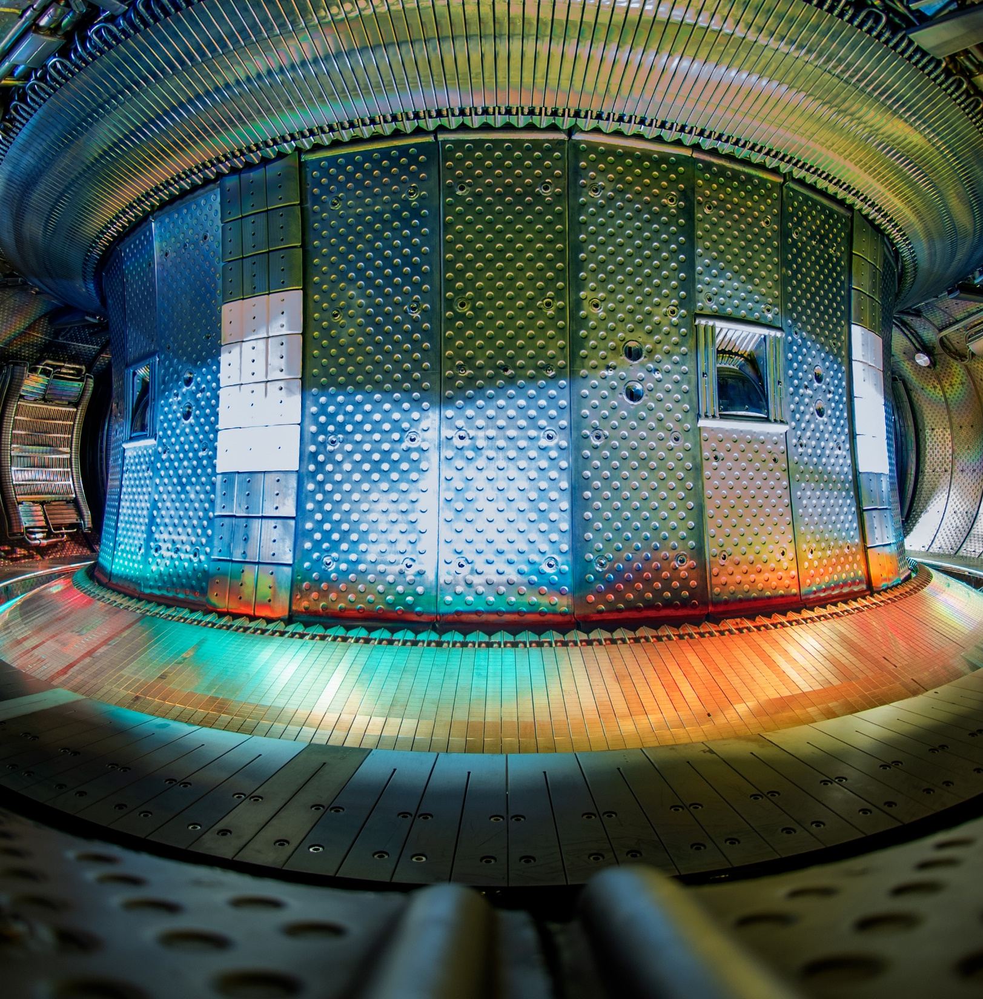





TCV-X21 simulations with SOLEDGE3X
Reference case and power scan
H. Bufferand, G. Ciraolo, R. Düll, G. Falchetto,
N. Fedorczak, Y. Marandet, V. Quadri, M. Raghunathan, N. Rivals, F. Schwander, E. Serre, S. Sureshkumar,
N. Varadarajan, P. Tamain

Slide 2
TCV-X21 experiment
1

Slide 3
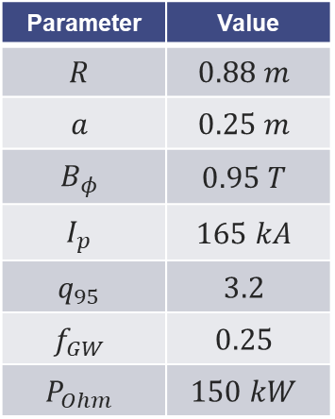

The TCV-X21 case
  TCV-X21 = set of shots on TCV for edge turbulence codes confrontation
    Deuterium Ohmic L-mode, lower single-null
    Low magnetic field for lower $ρ^{⋆}=ρ_{L}/a$
    Low density, targeting sheath-limited regime
Parameter | Value
$$R$$ | $$0.88 m$$
$$a$$ | $$0.25 m$$
$$B_{φ}$$ | $$0.95 T$$
$$I_{p}$$ | $$165 kA$$
$$q_{95}$$ | $$3.2$$
$$f_{GW}$$ | $$0.25$$
$$P_{Ohm}$$ | $$150 kW$$
  Main results in D.S Oliveira, T. Body et al., Nucl. Fusion 62 (2022) [1]
    Public experimental dataset on https://github.com/SPCData/TCV-X21
TCV-X21 magnetic configuration and main edge diagnostics. Figure from [1].

Slide 4




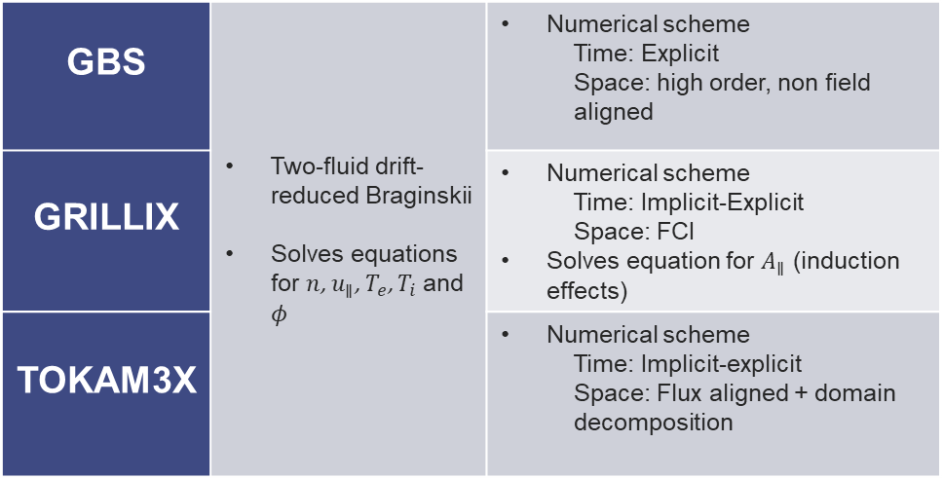
The TCV-X21 case
  Experimental dataset used to benchmark edge turbulence codes (all codes involved in EUROfusion TSVV3 ):
GBS | Two-fluid drift-reduced Braginskii Solves equations for $n$, $u_{∥}$, $T_{e}$, $T_{i}$ and $φ$ | Numerical scheme Time: Explicit Space: high order, non field aligned
GRILLIX |  | Numerical scheme Time: Implicit-Explicit Space: FCI Solves equation for $A_{∥}$ (induction effects)
TOKAM3X |  | Numerical scheme Time: Implicit-explicit Space: Flux aligned + domain decomposition
Comparison between turbulence code simulations of a TCV-X21 shot – poloidal map of the density. On the left panel, the green and blue shaded areas display the particle and energy source respectively. Figure from [1].
Codes status for the code comparison performed in [1]
✗ No Neutrals !

Slide 5
The TCV-X21 case
  Conclusions of [1] show that:
    The three edge turbulence codes are in the right ballpark for predicting OMP profiles
    By comparison, significant mismatch at the divertor targets
    GBS and TOKAM3X were used with non-realistic values for heat conductivities and resistivity for numerical reasons
    Despite targeting low density sheath-limited regime, physics of neutrals and recycling should be included (density mismatch in the divertor between modelling and measurements)

Slide 6
TCV-X21 simulation results – brute force
2

Slide 7
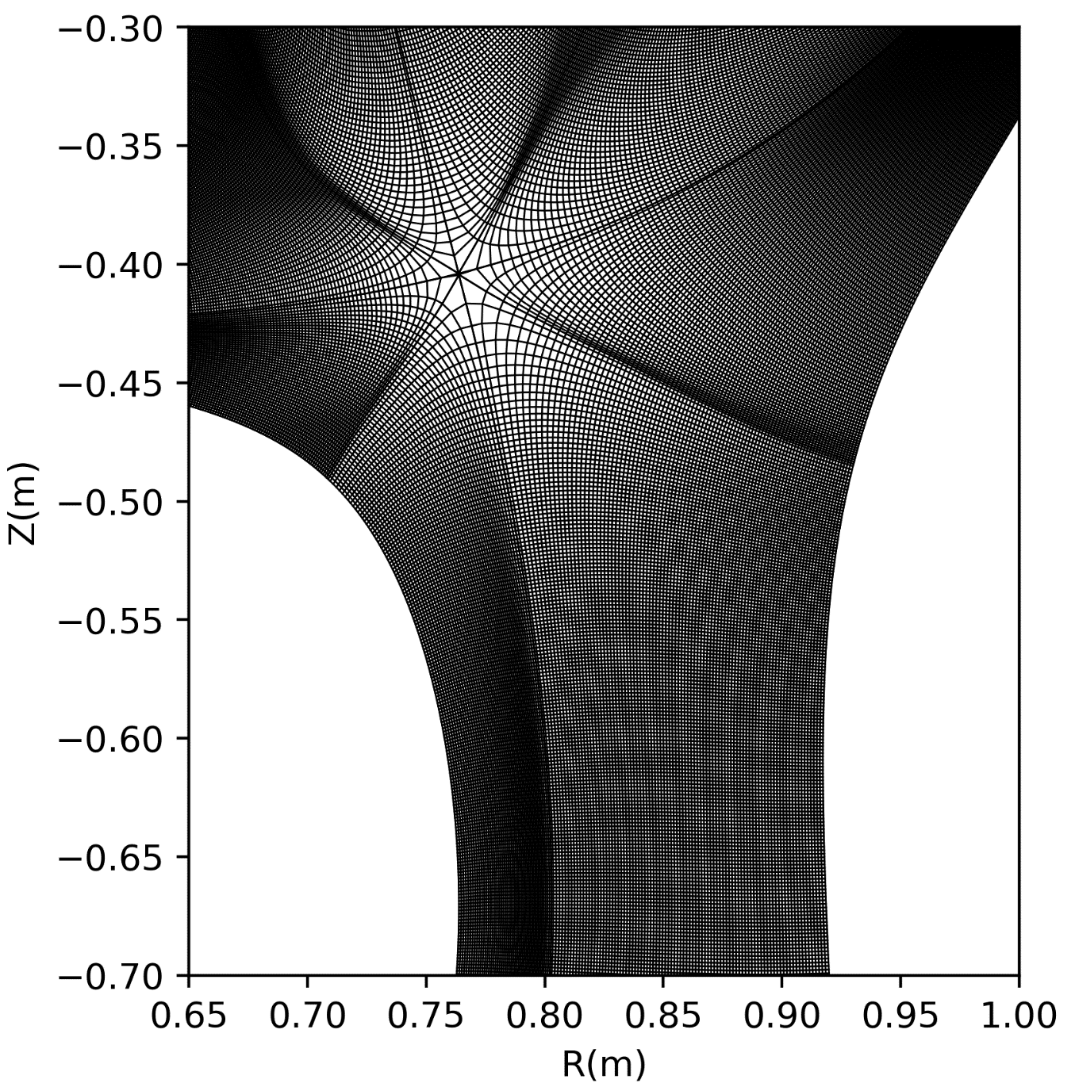
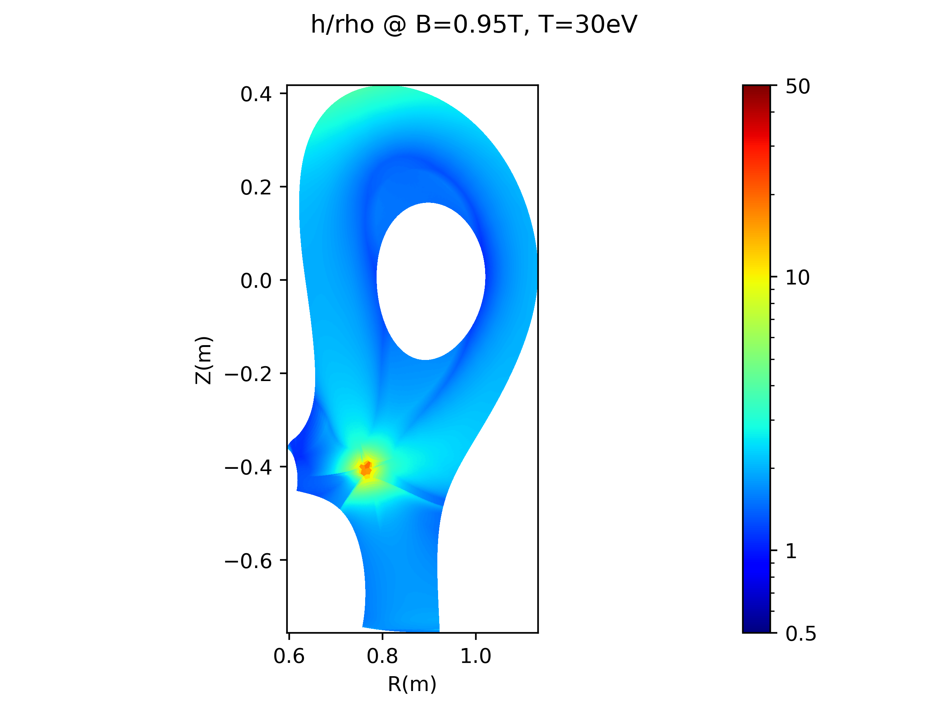

SOLEDGE3X TCV-X21 modeling with neutrals
  First attempt: “brute force approach”
  Simulation grid designed for turbulence:
    Mesh grid based on TCV#51333
    Full scale – full field – wall reshaped
    Resolution $∼2mm$ / about twice $ρ_{L}$
    $N_{ψ}∼220$, $N_{θ}∼13$00, $N_{φ}=64$ (1/4 torus)
    $N_{points}∼17$ millions (85 MDoF)
  Simulation setup:
    Pure deuterium plasma (no Carbon)
    Fluid neutral model ($R=90\%$)
    Injected Power = 120kW
    Gas puff feedback for $n_{sep}=7⋅{10}^{18}m^{−3}$ at the outboard mid-plane

Slide 8
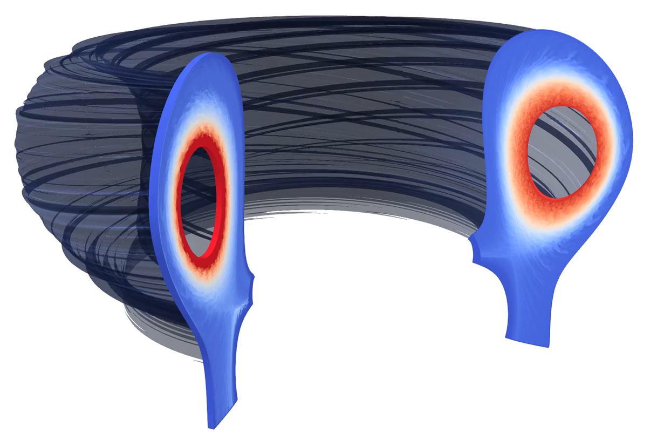
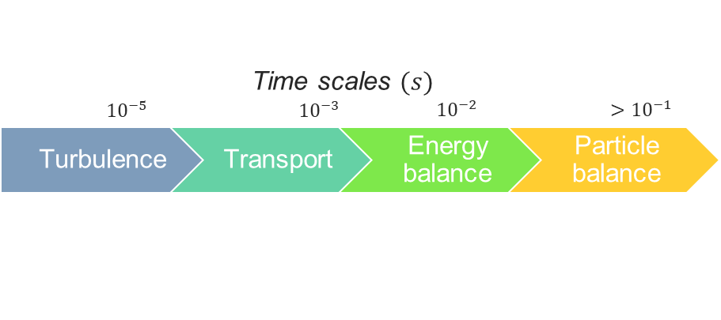
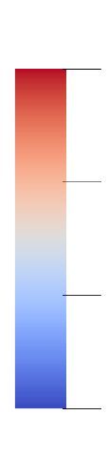









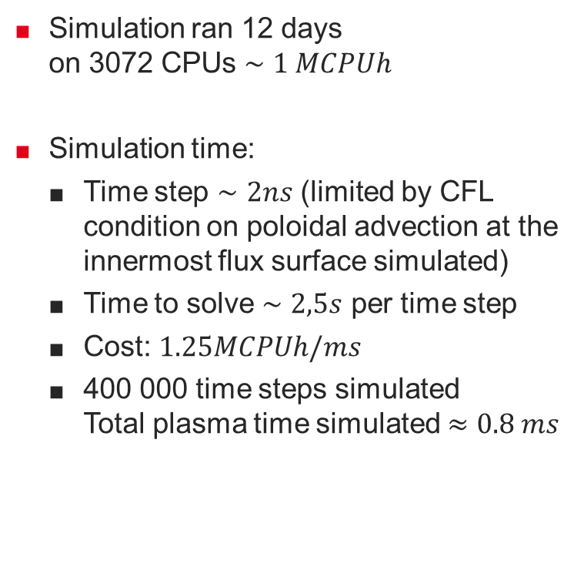


Simulation runtime and status
  Simulation ran 12 days
  on 3072 CPUs $∼1 MCPUh$
  Simulation time:
    Time step $∼2ns$ (limited by CFL condition on poloidal advection at the innermost flux surface simulated)
    Time to solve $∼2,5s$ per time step
    Cost: $1.25MCPUh/ms$
    400 000 time steps simulated
    Total plasma time simulated $≈0.8 ms$
$$n_{e}\left(m^{−3}\right)$$
$$T_{e}\left(eV\right)$$
$$1.5e19$$
$$300$$
$$1.0e19$$
$$200$$
$$0.5e19$$
$$100$$
$$0.8 ms$$
$$0$$
$$0$$

Slide 9
TCV-X21 simulation results – brute force
2
Focus on turbulence

Slide 10
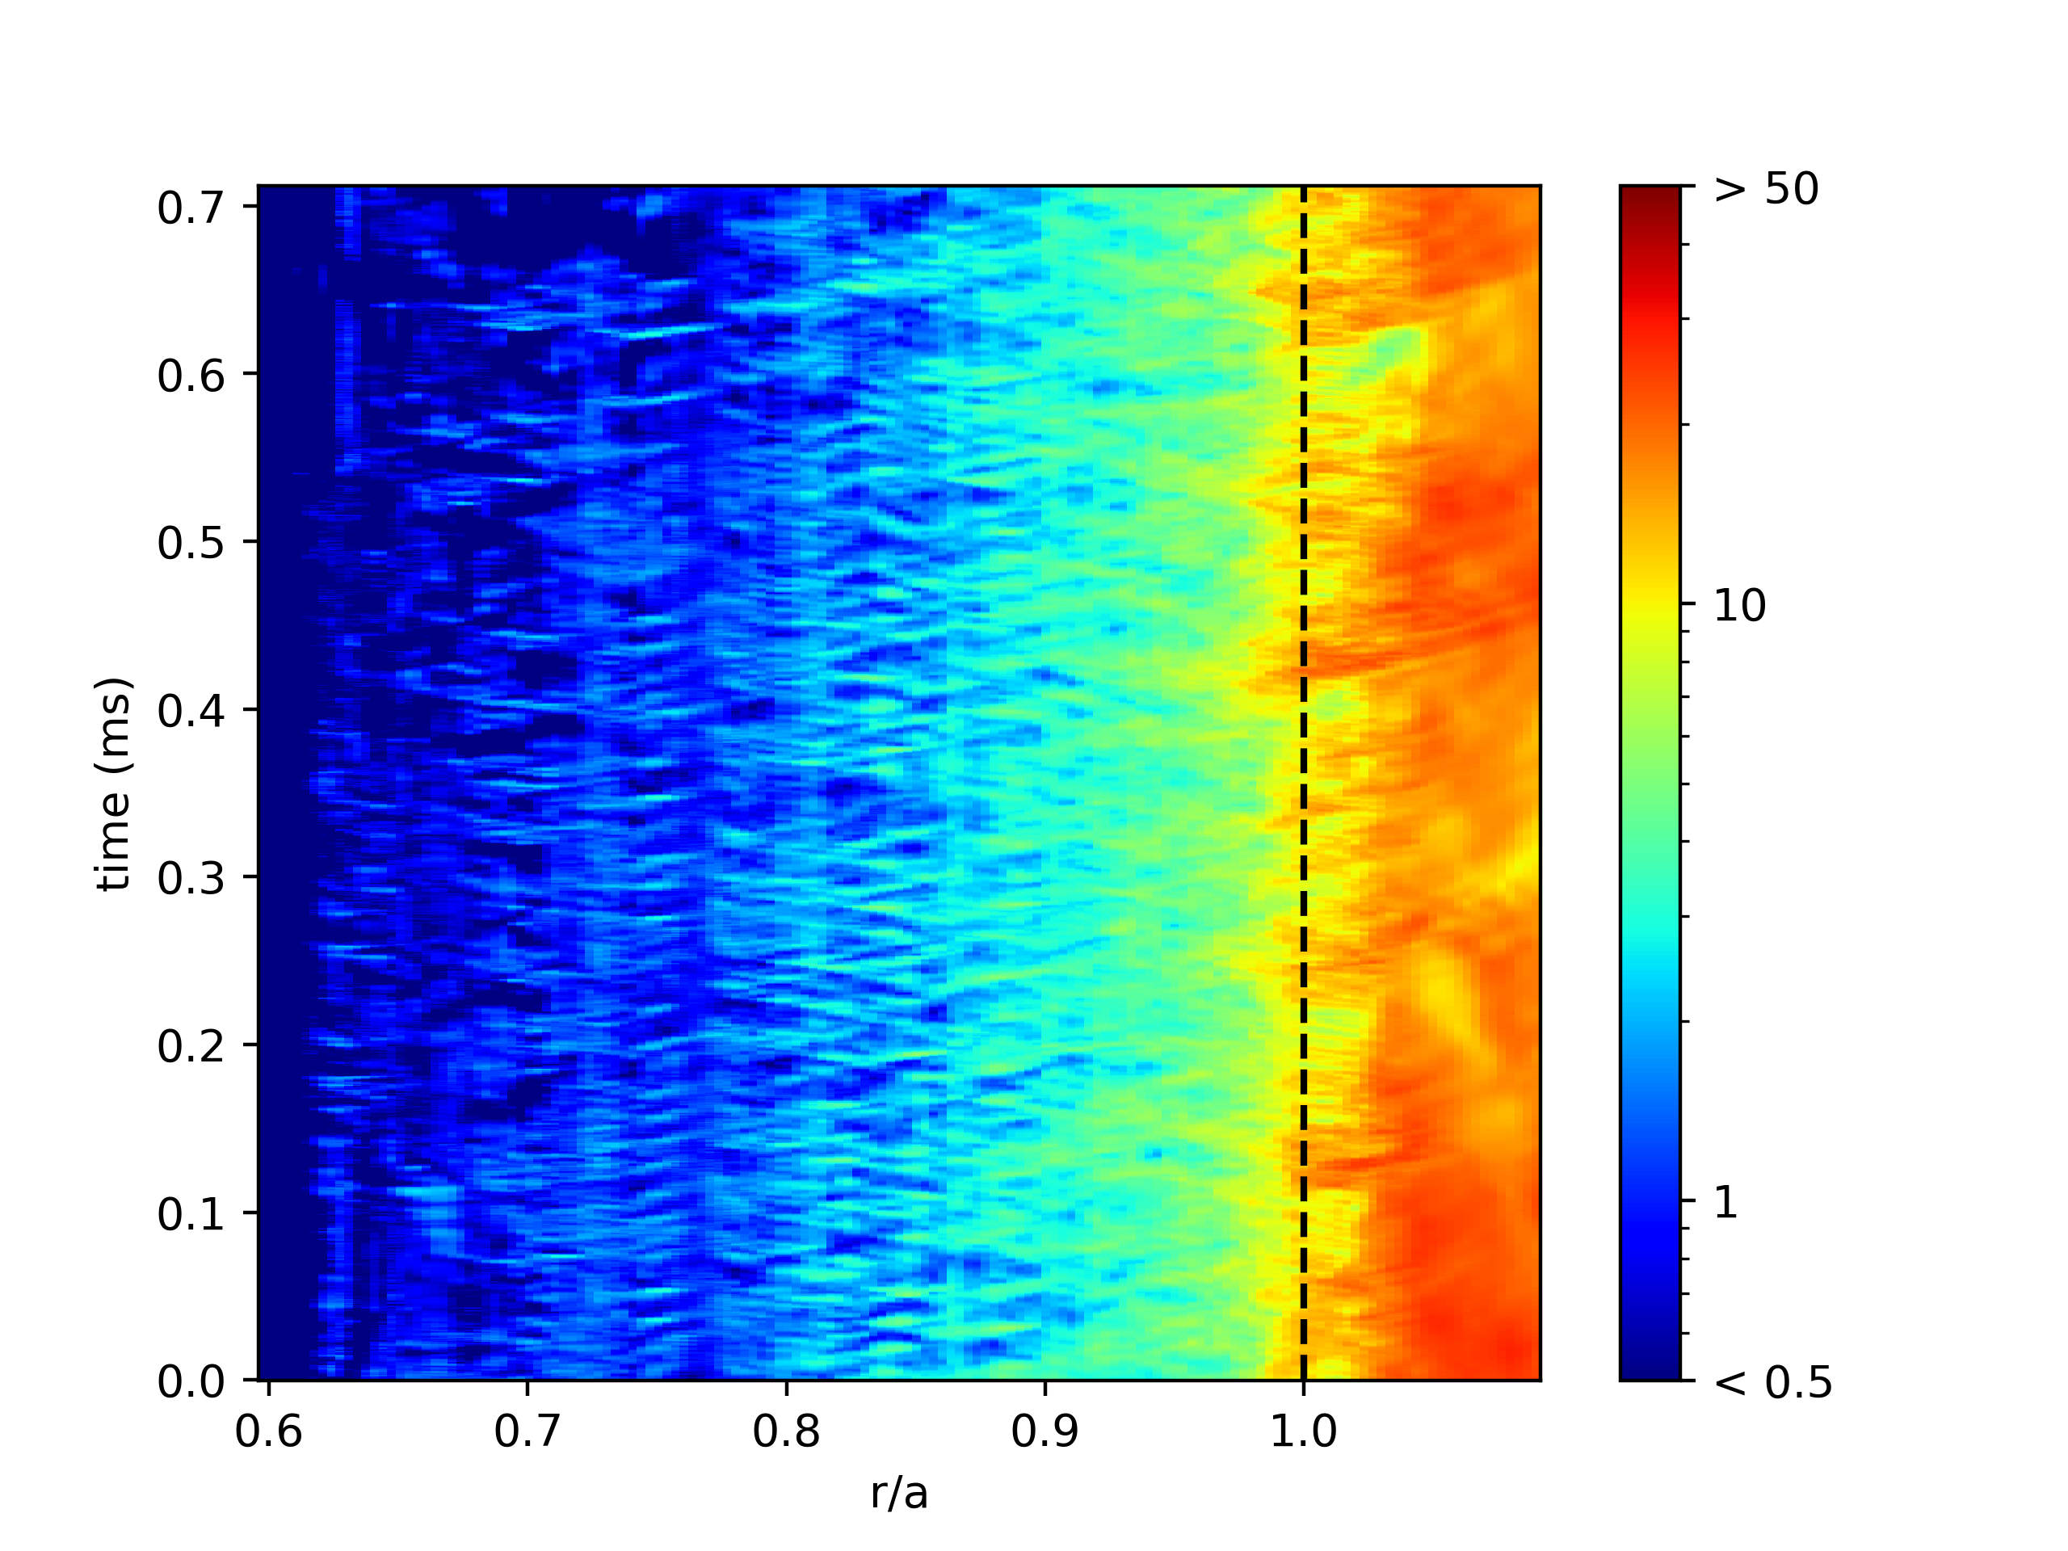
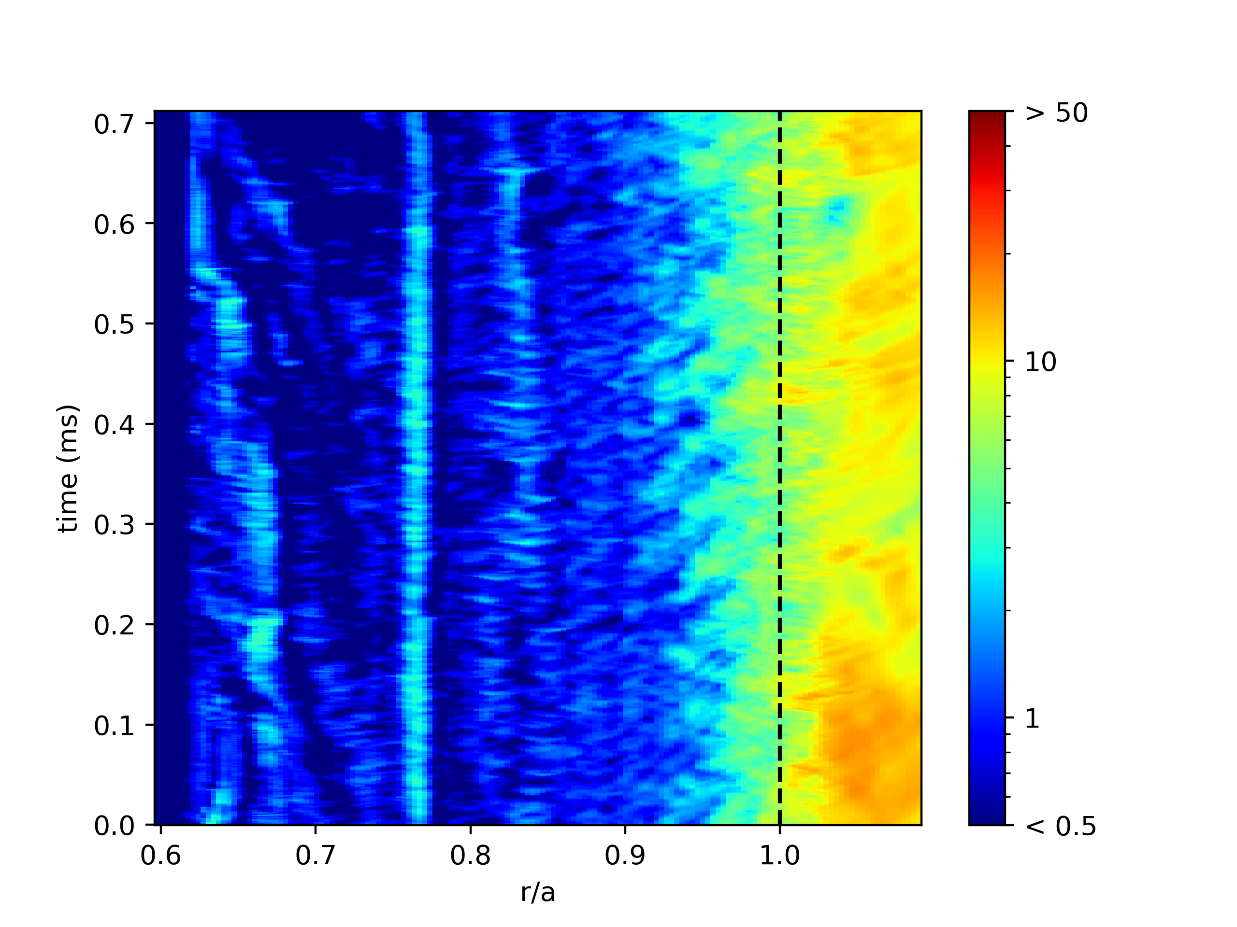
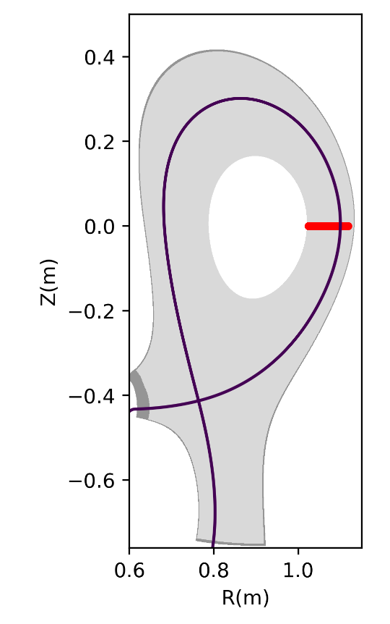
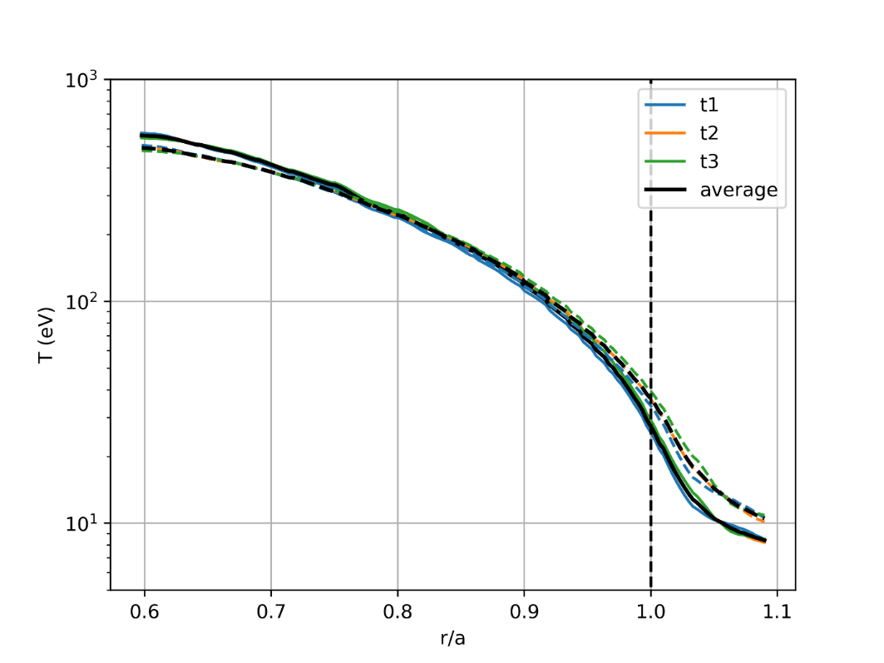
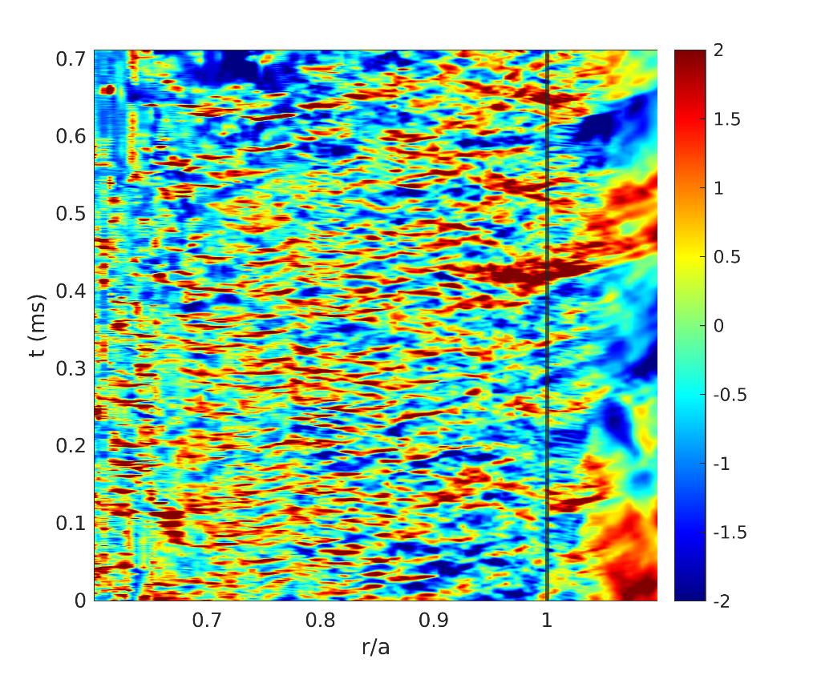
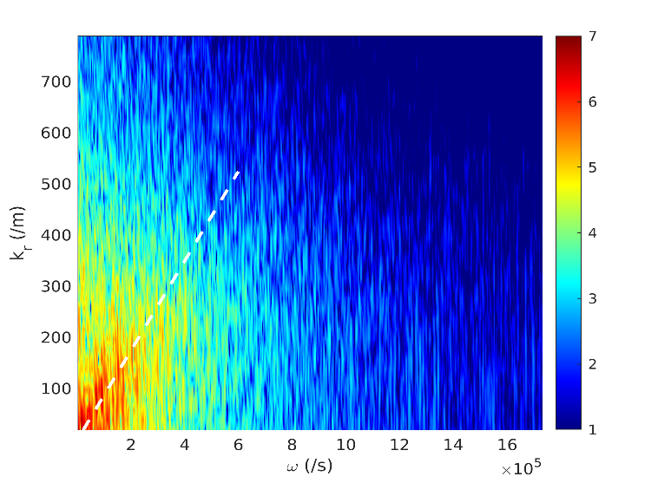
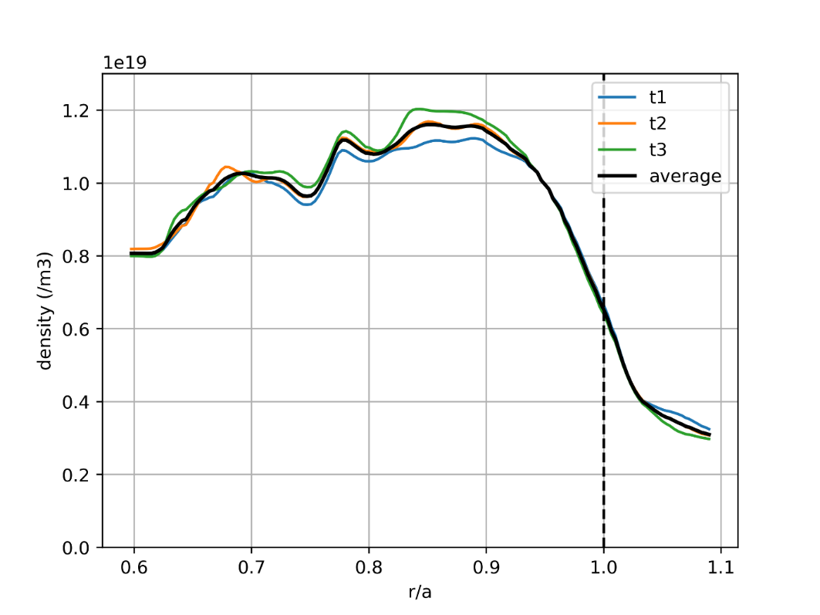
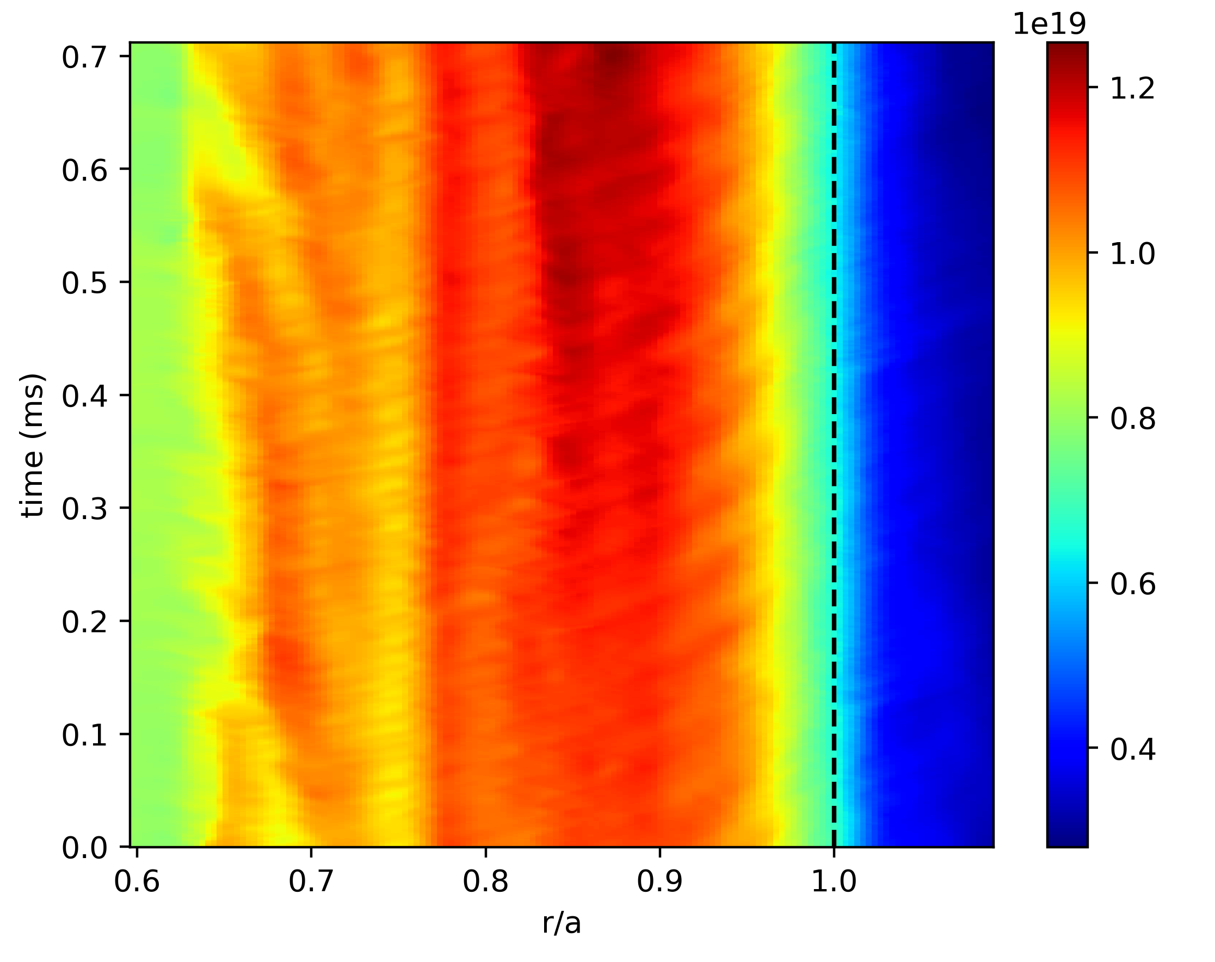


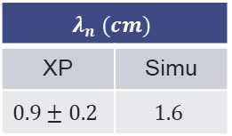

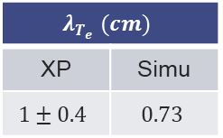



Focus on turbulence: midplane
  Simulation far from quasi-steady state
    Power balance not even reached ($P_{in}=120kW ;P_{out}∼30kW$)
    Turbulence rather established though
$$σ_{T_{e}}/〈T_{e}〉$$
$$σ_{n}/〈n〉$$
$$λ_{T_{e}} (cm)$$
XP | Simu
$$1±0.4$$ | $$0.73$$
$T_{e}$full
$T_{i}$ dashed
Normalizing
$$n_{e} \left(m^{−3}\right)$$
$$v_{r}=1.1 km/s$$
FFT
$$λ_{n} (cm)$$
XP | Simu
$$0.9±0.2$$ | $$1.6$$

Slide 11
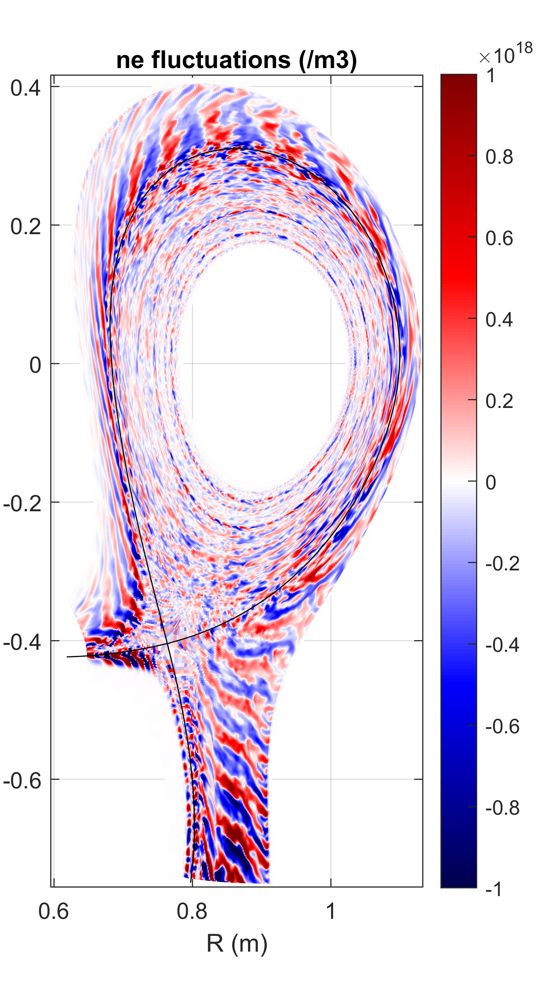
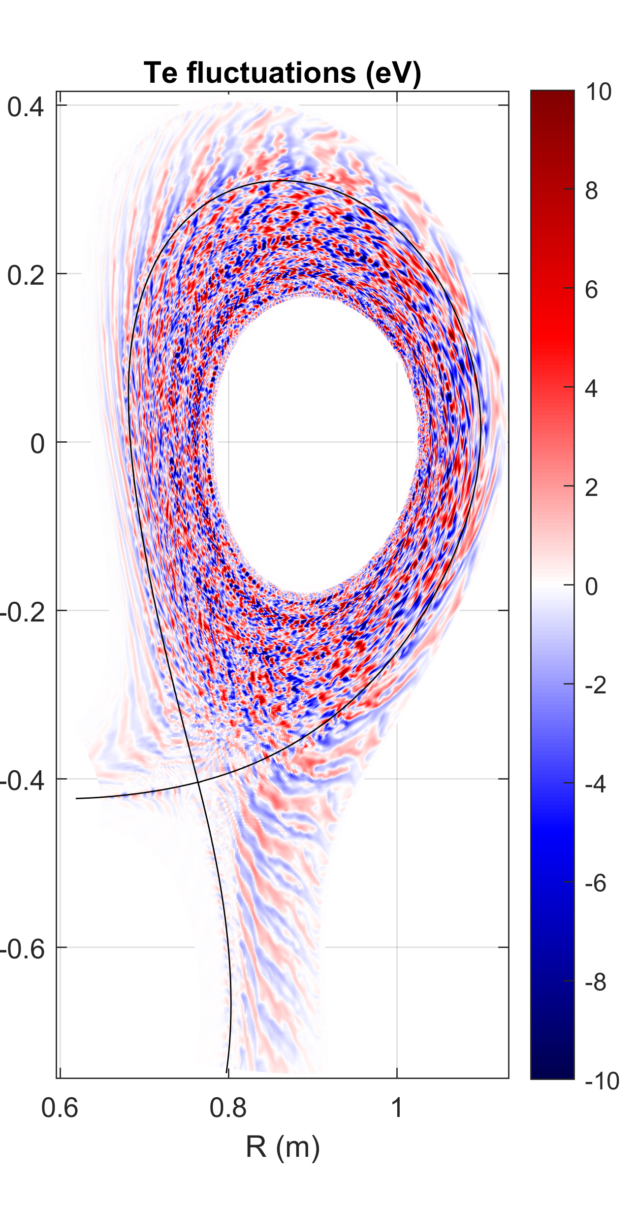
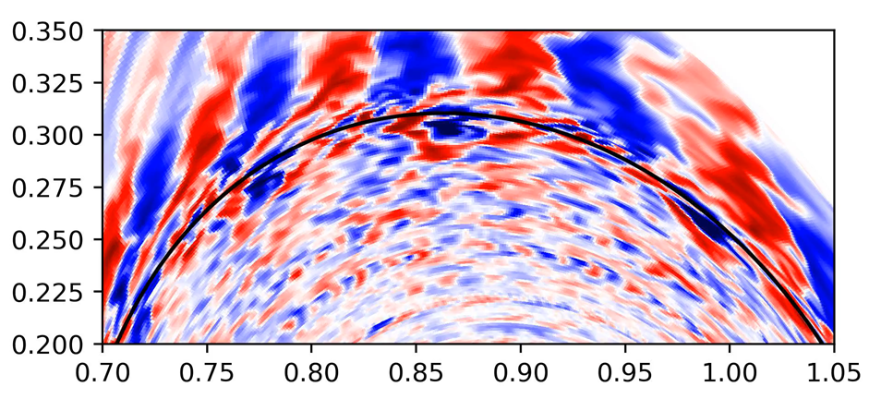
Focus on turbulence: structures
  Structures quite sheared
  Structures cross separatrix at the top

Slide 12
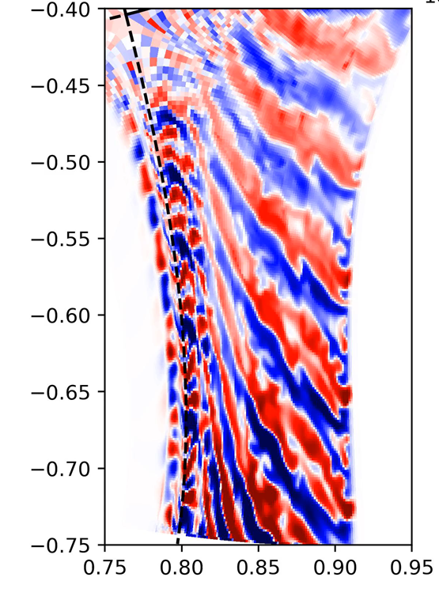
Focus on turbulence: structures
  Structures quite sheared
  Structures cross separatrix at the top
  Density structures along the divertor leg

Slide 13
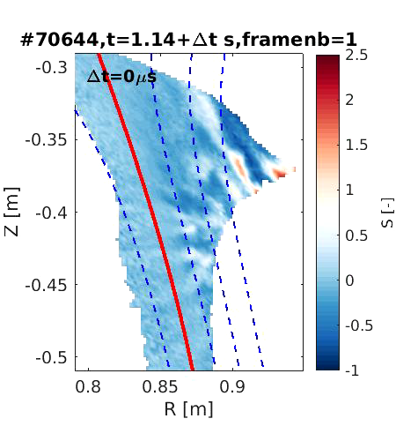
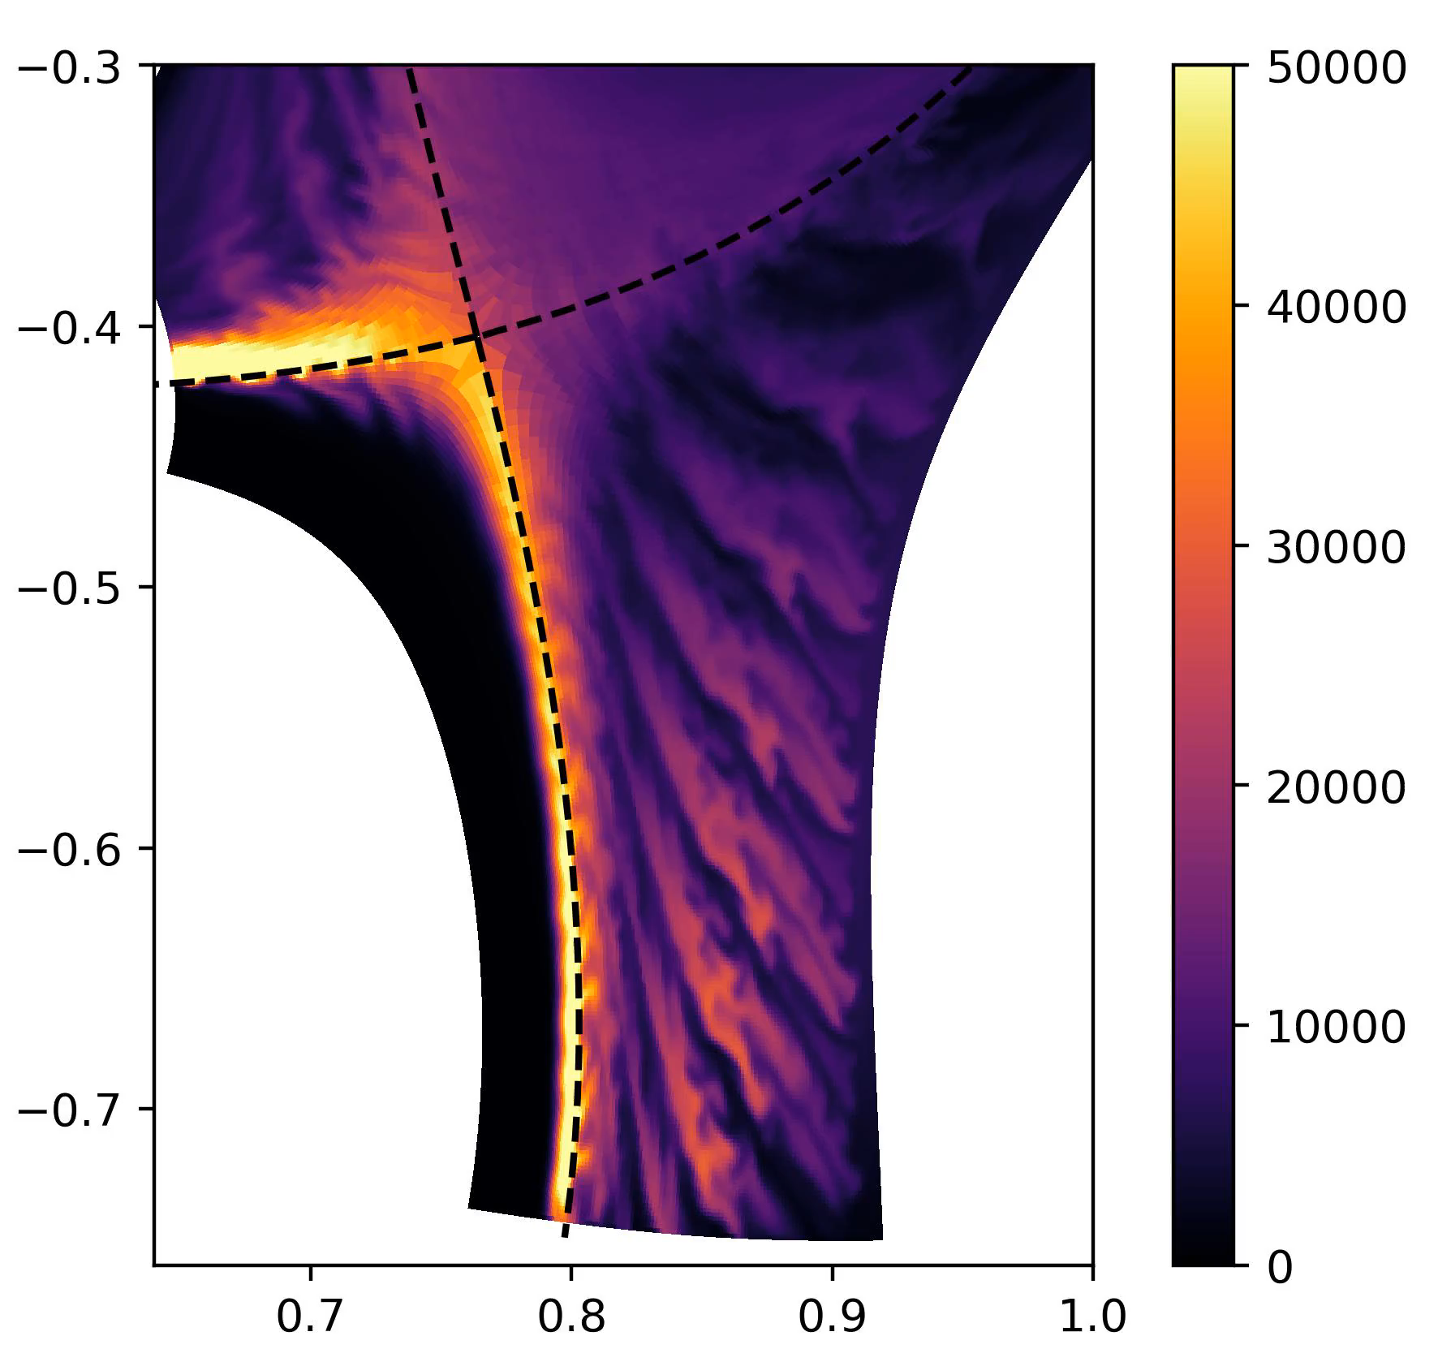
Focus on turbulence: Divertor Localized Filaments
  Divertor Localized Filaments
    Observed experimentally with fast cameras
    C. Wüthrich et al., Nucl. Fusion 62 (2022) [3]
    Distinction between:
      Filaments generated in the main SOL (stretched in the divertor – downward)
      Filaments generated in the divertor
      (‘blobby’ in the diveror – upward)
  Well recovered in the simulation
  → Ability to catch fine turbulence features and scales in realistic divertor conditions
  Instabilities behind to be investigated
    Interchange? Kelvin-Helmholtz?
Experimental data:
Normalized brightness
Video from [3]
Simulation data:
Deuterium atom radiation (W/m3)
Sketch of the gas puff imaging diagnostic on TCV. Figure from [3]

Slide 14
TCV-X21 simulation results – towards long time scales
3

Slide 15
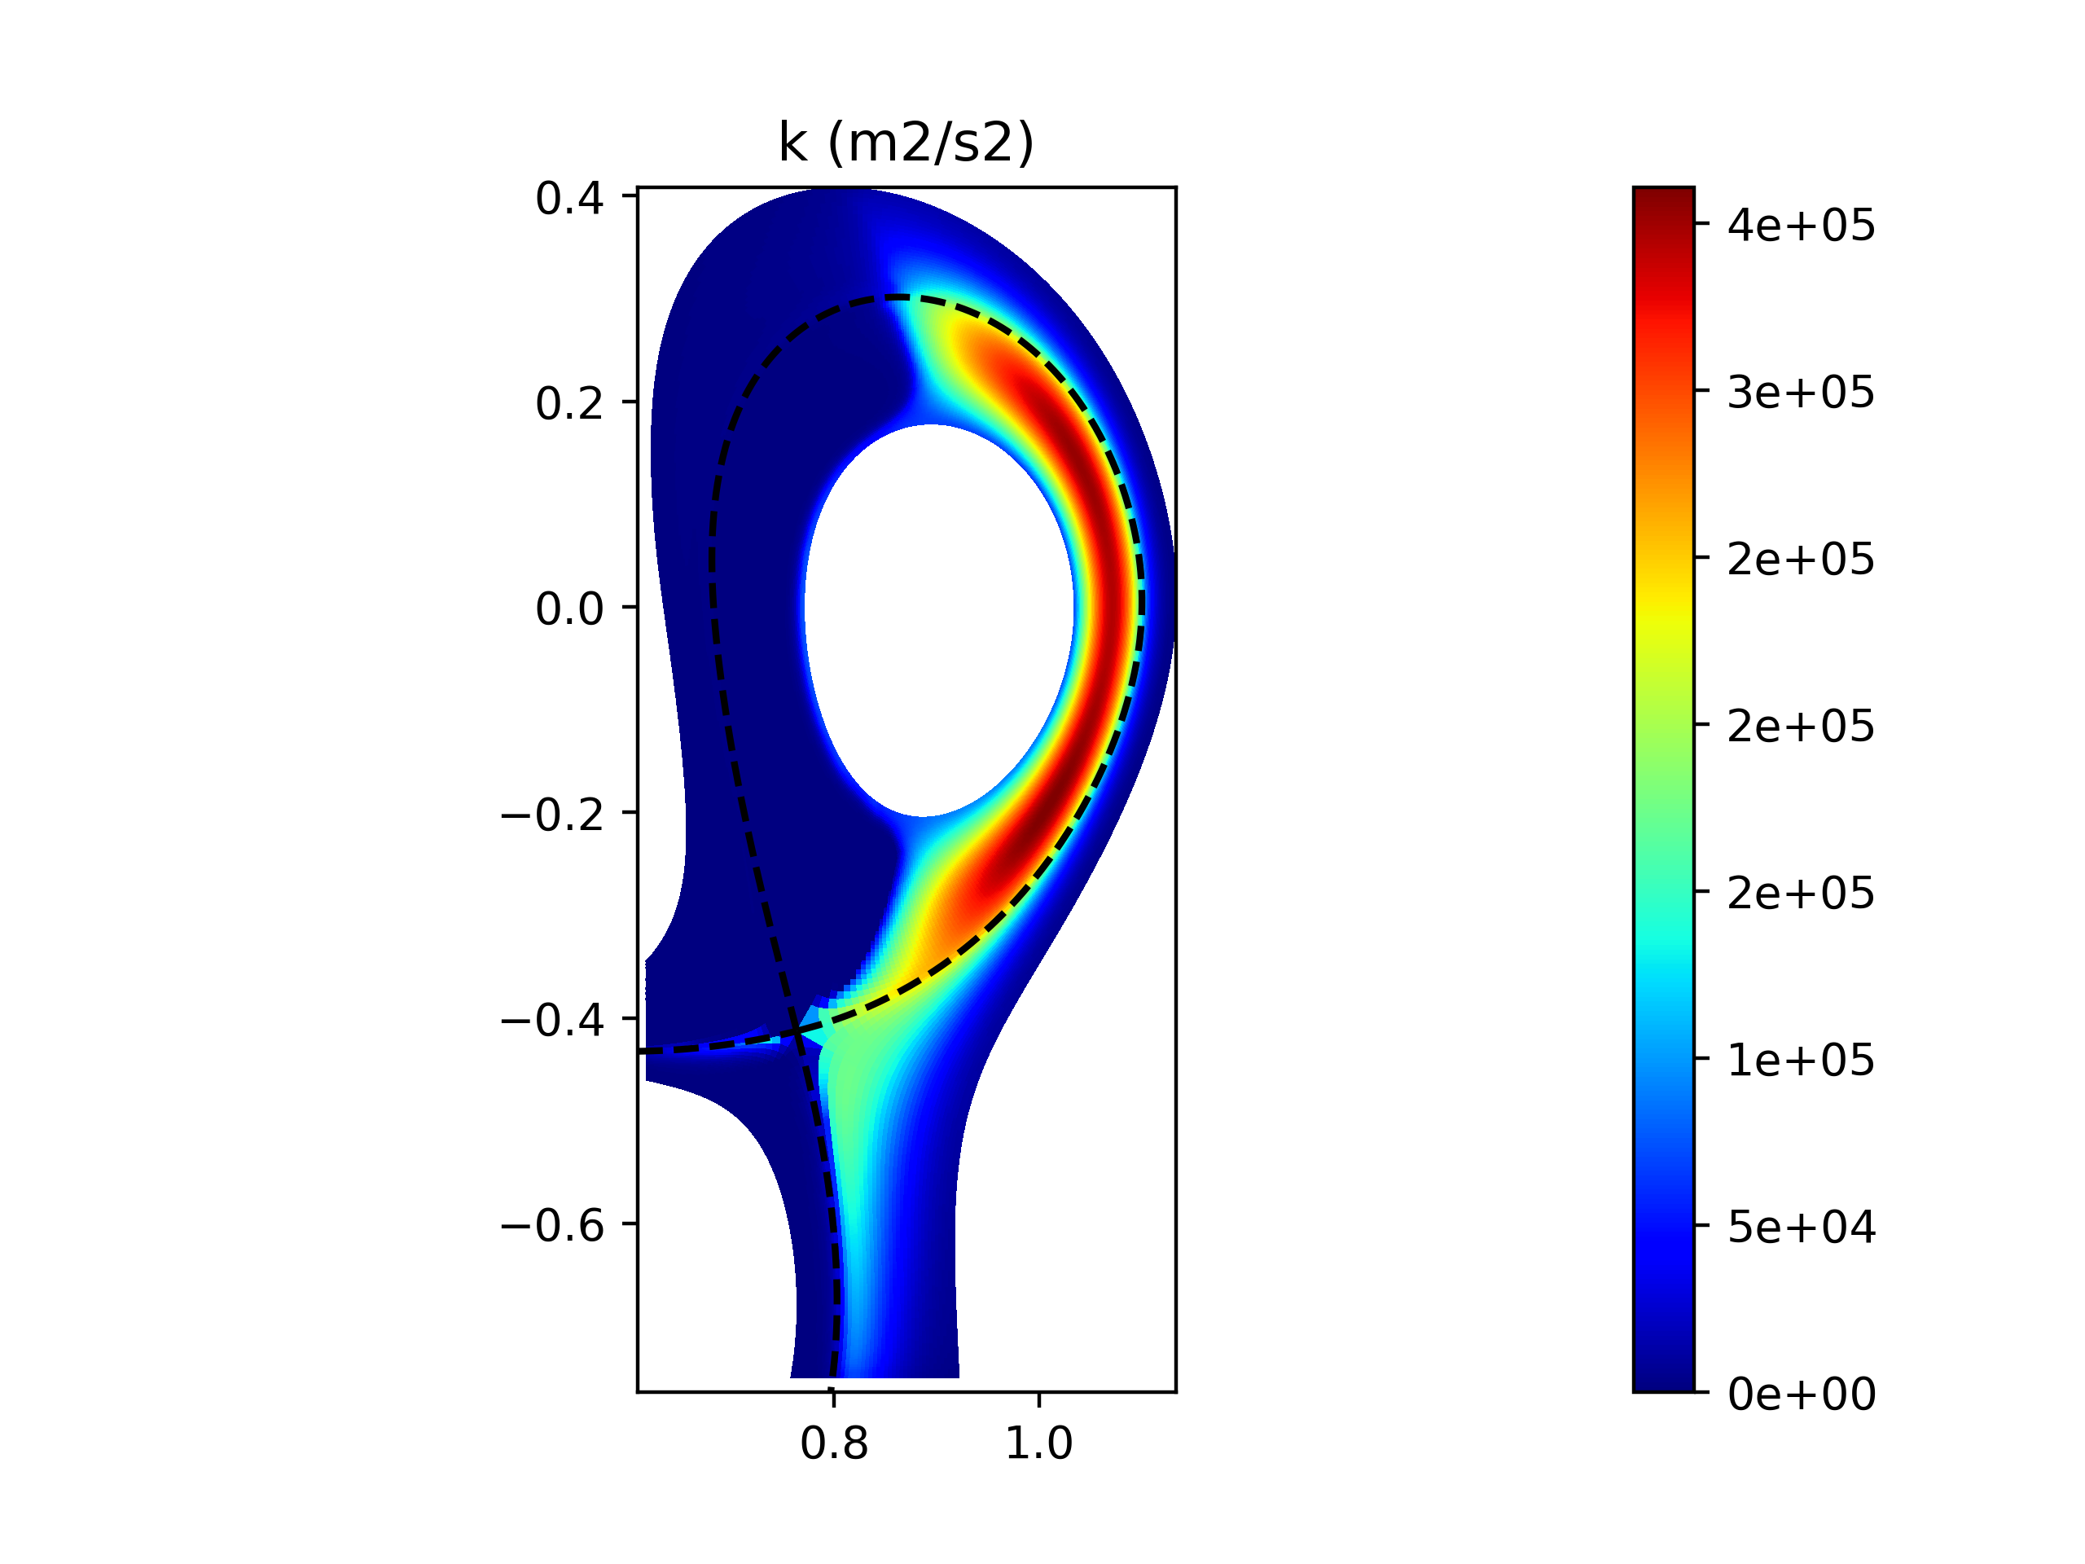
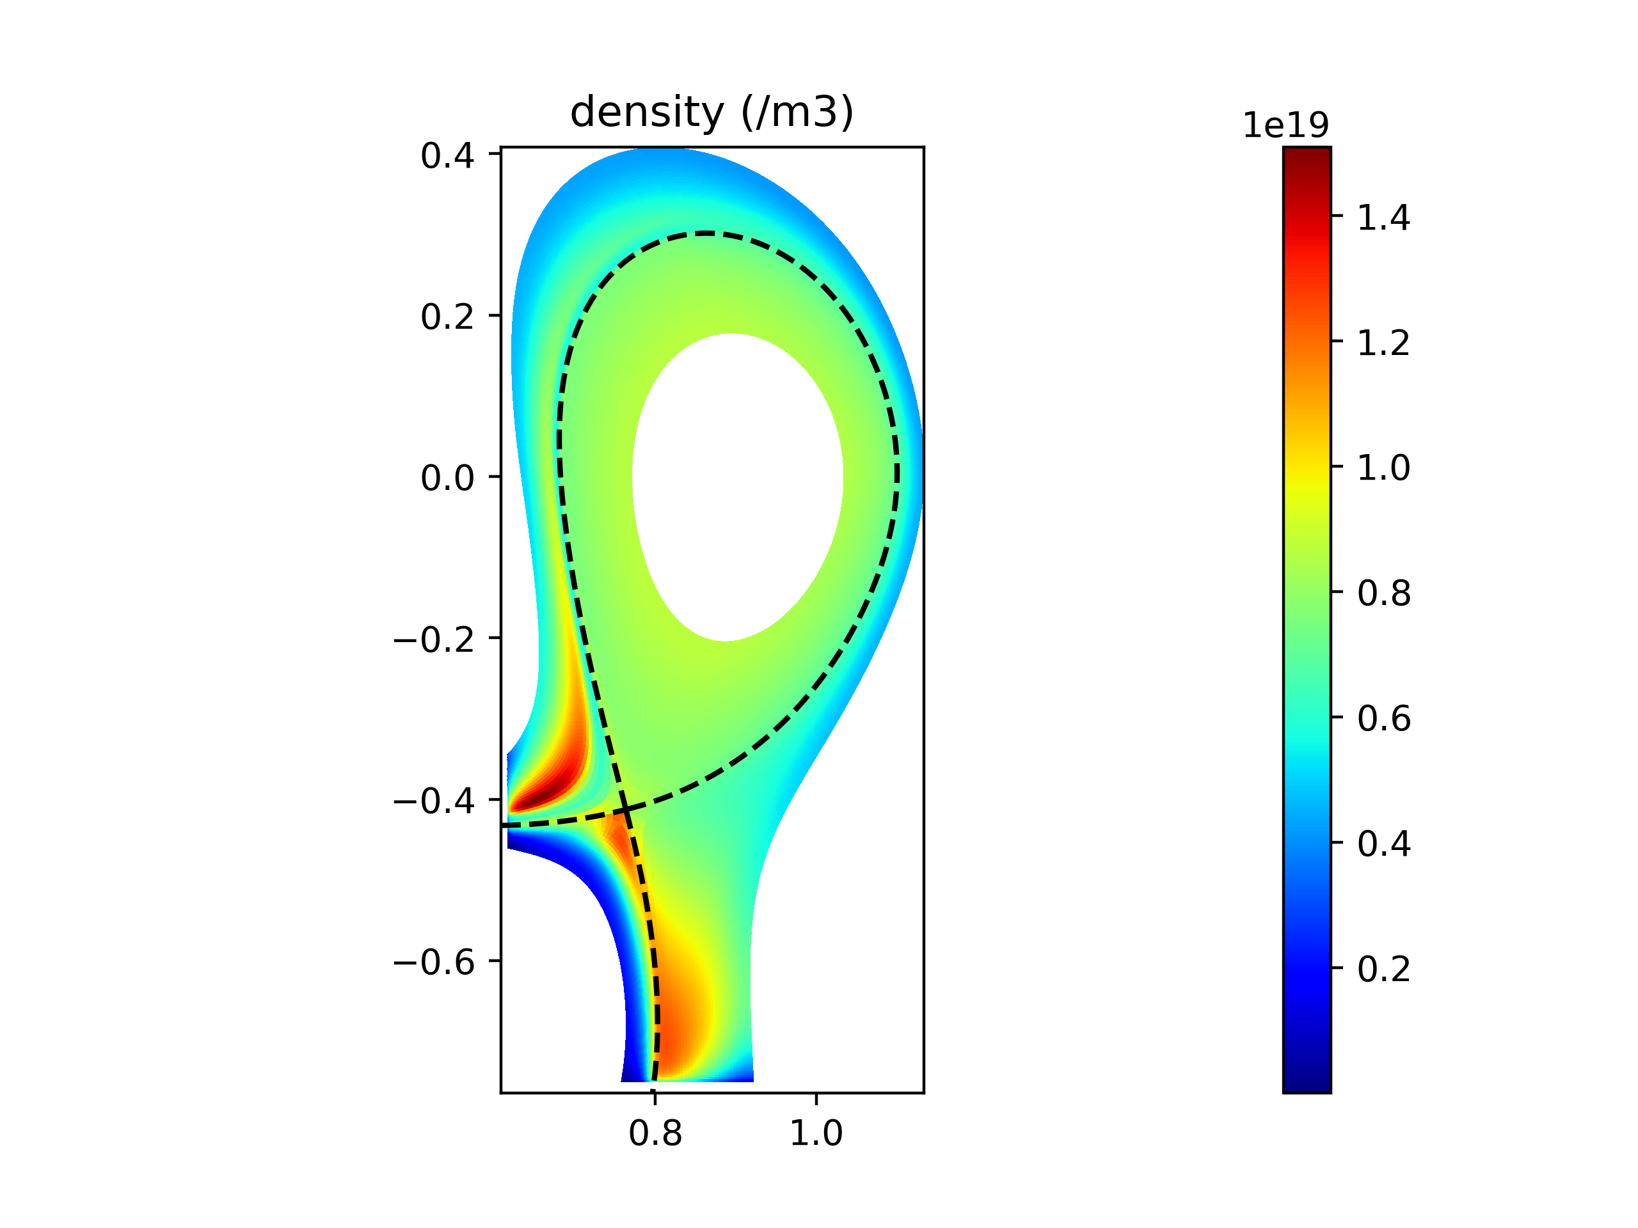
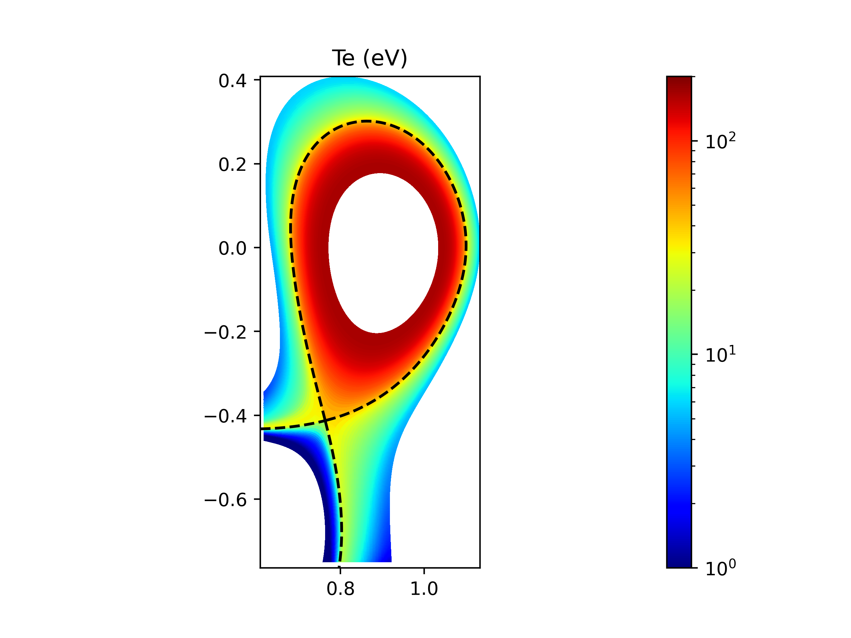
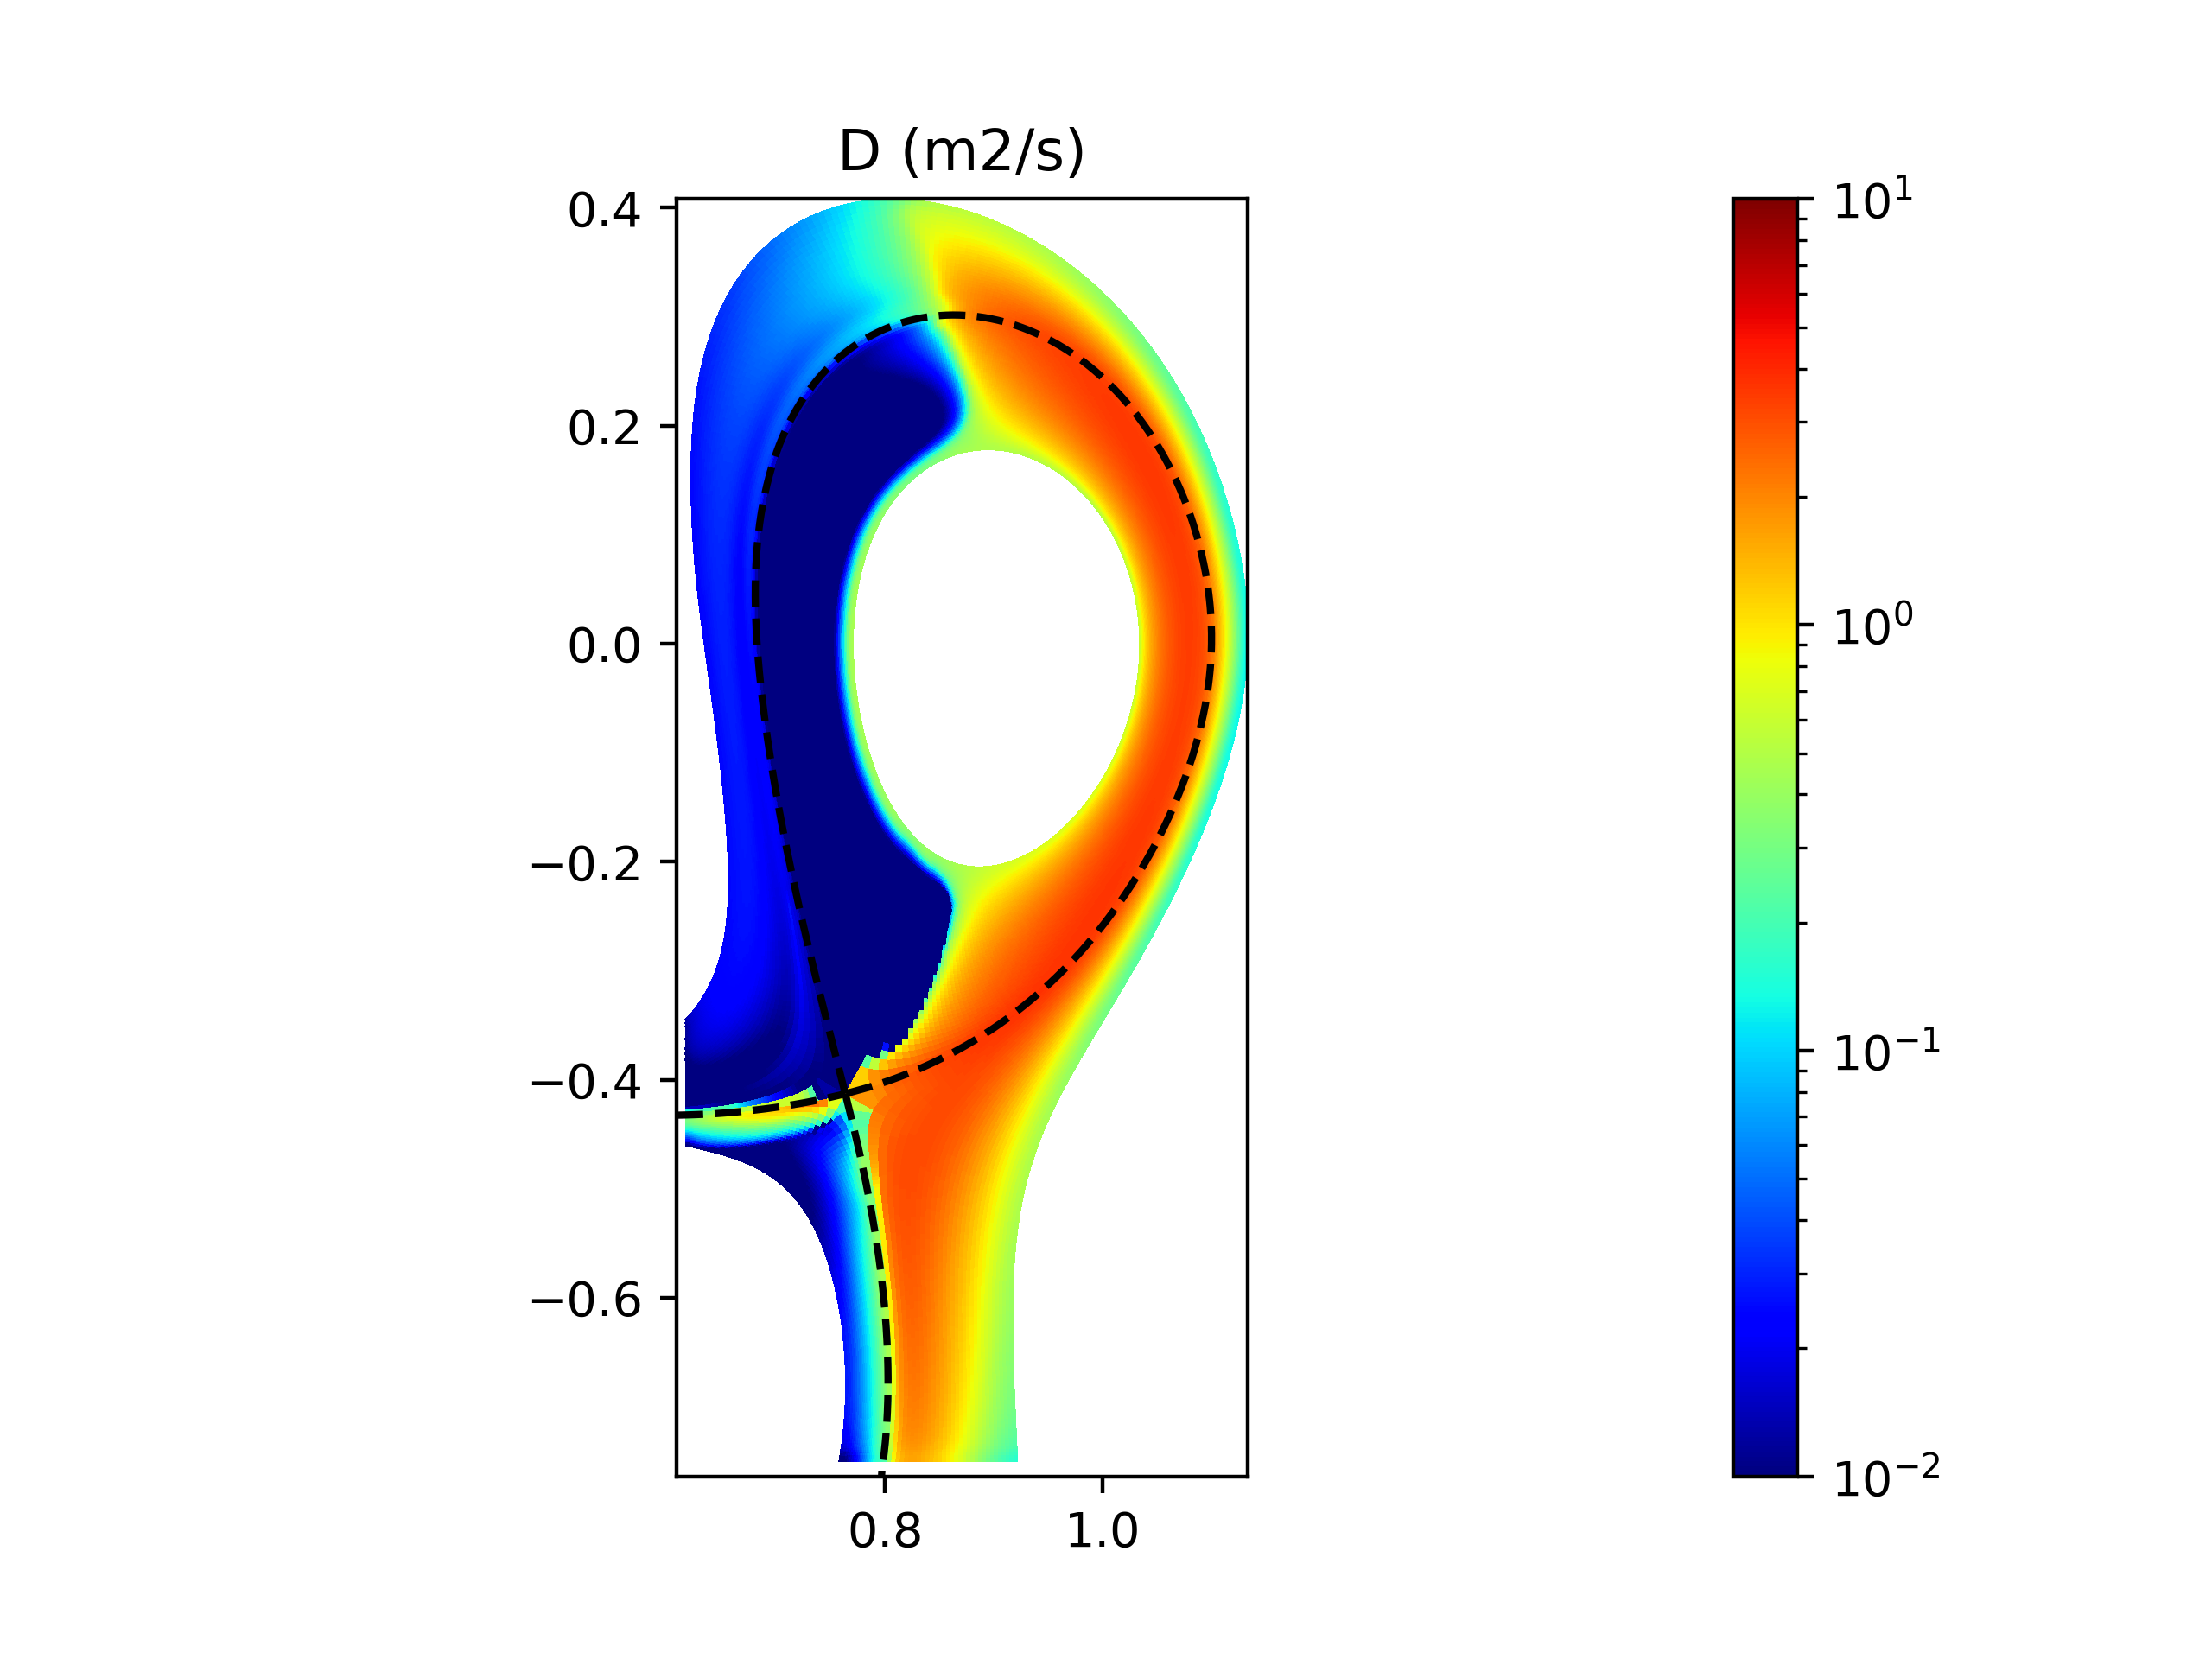
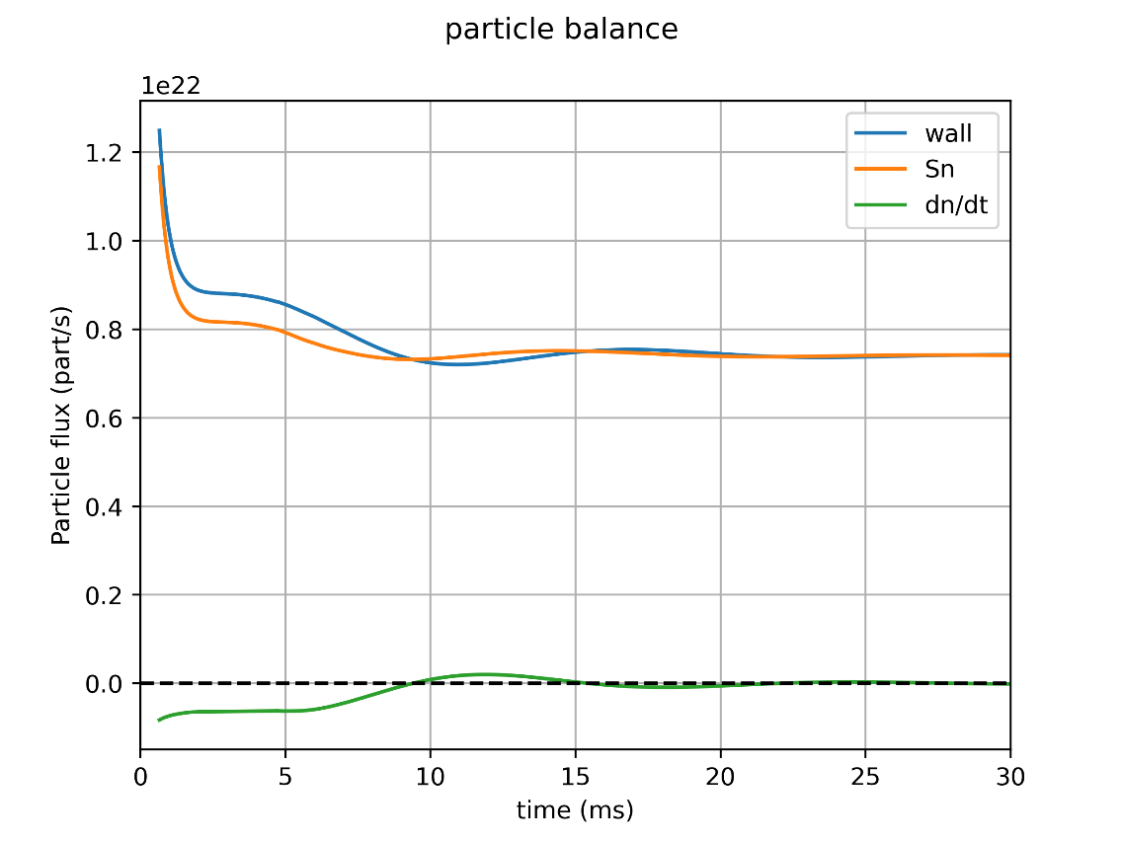
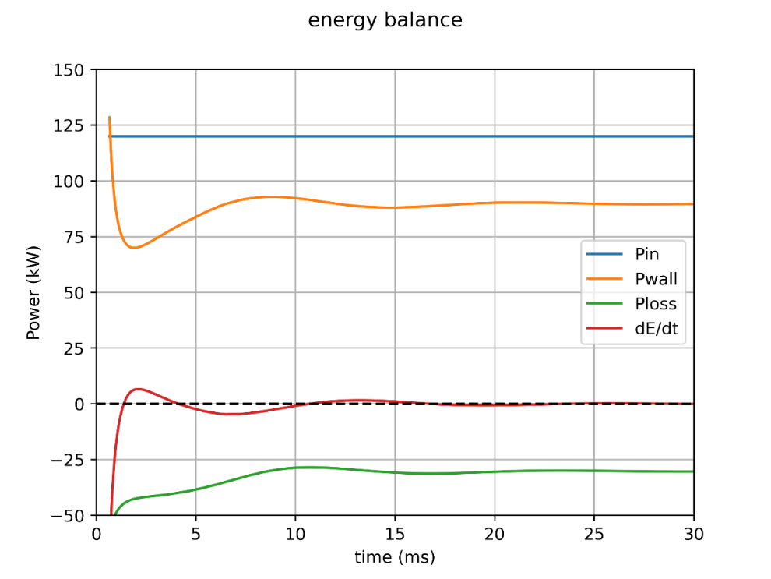

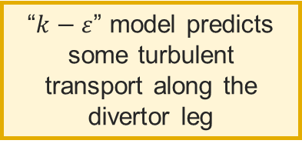

Towards convergence
  Strategies to reach quasi-steady-state with neutrals:
    1. Start from 2D transport cases
      Easy and fast to converge
      (10h on 40 CPUs for $30ms$ of plasma)
      Cost: $13CPUh/ms$
      Requires educated guess for “anomalous” transport coefficients
        Scaling laws
        “$k−ε$” reduced models inspired from CFD:
        turbulence driven by interchange instability
        saturation from scaling laws (semi-empirical)
        S. Baschetti et al., Nucl. Fusion 61 (2021) [5]
“$k−ε$” model predicts some turbulent transport along the divertor leg
$$30 ms$$

Slide 16
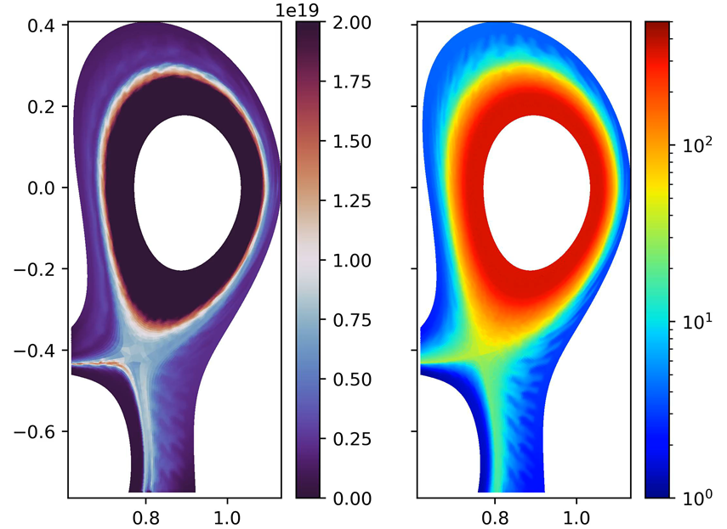
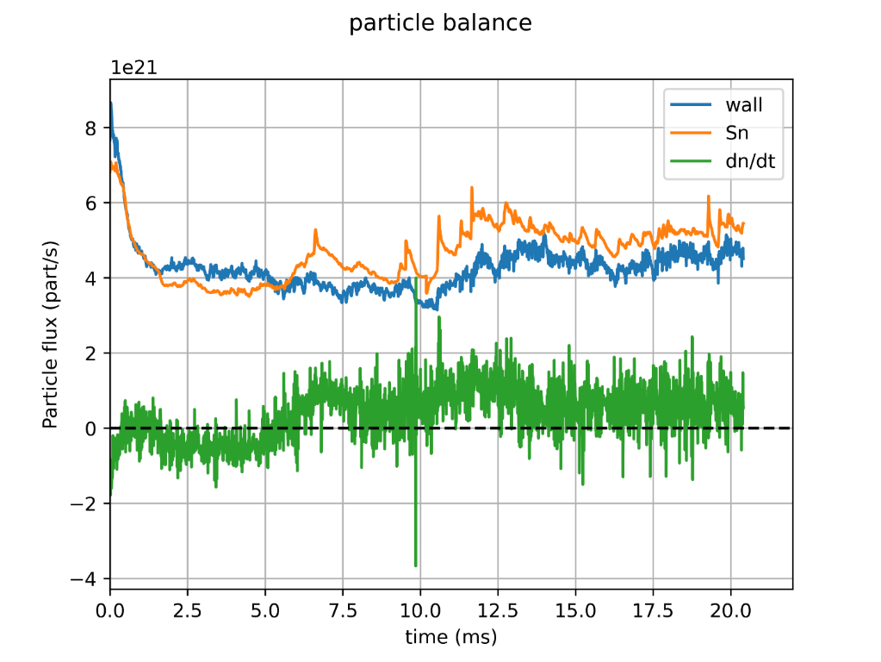
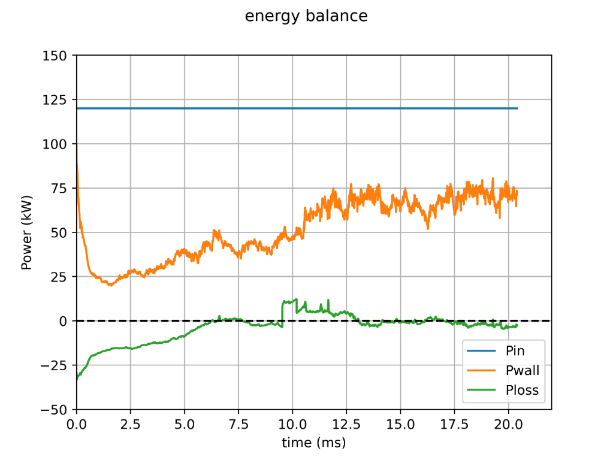




Towards convergence
$$n_{e} (m^{−3})$$
$$T_{e} (eV)$$
  Strategies to reach quasi-steady-state with neutrals:
    2. Run turbulent case on coarse grid (aggressively)
    $N_{ψ}∼100$, $N_{θ}∼700$, $N_{φ}=32$ (1/4 torus)
    $N_{points}∼2$ millions
    → factor 2 in each direction, factor 8 on the number of DoF
      Lower computation cost than fine grid case
      8 days on 2560 CPUs $\sim 0,5MCPUh$ → $20ms$ of plasma
      Cost: $25kCPUh/ms$ [vs $1.25MCPUh/ms$]
      Enables longer plasma time – though is turbulence representative?
$$20 ms$$

Slide 17
TCV-X21 simulation results – towards long time scales
3
Power scan

Slide 18
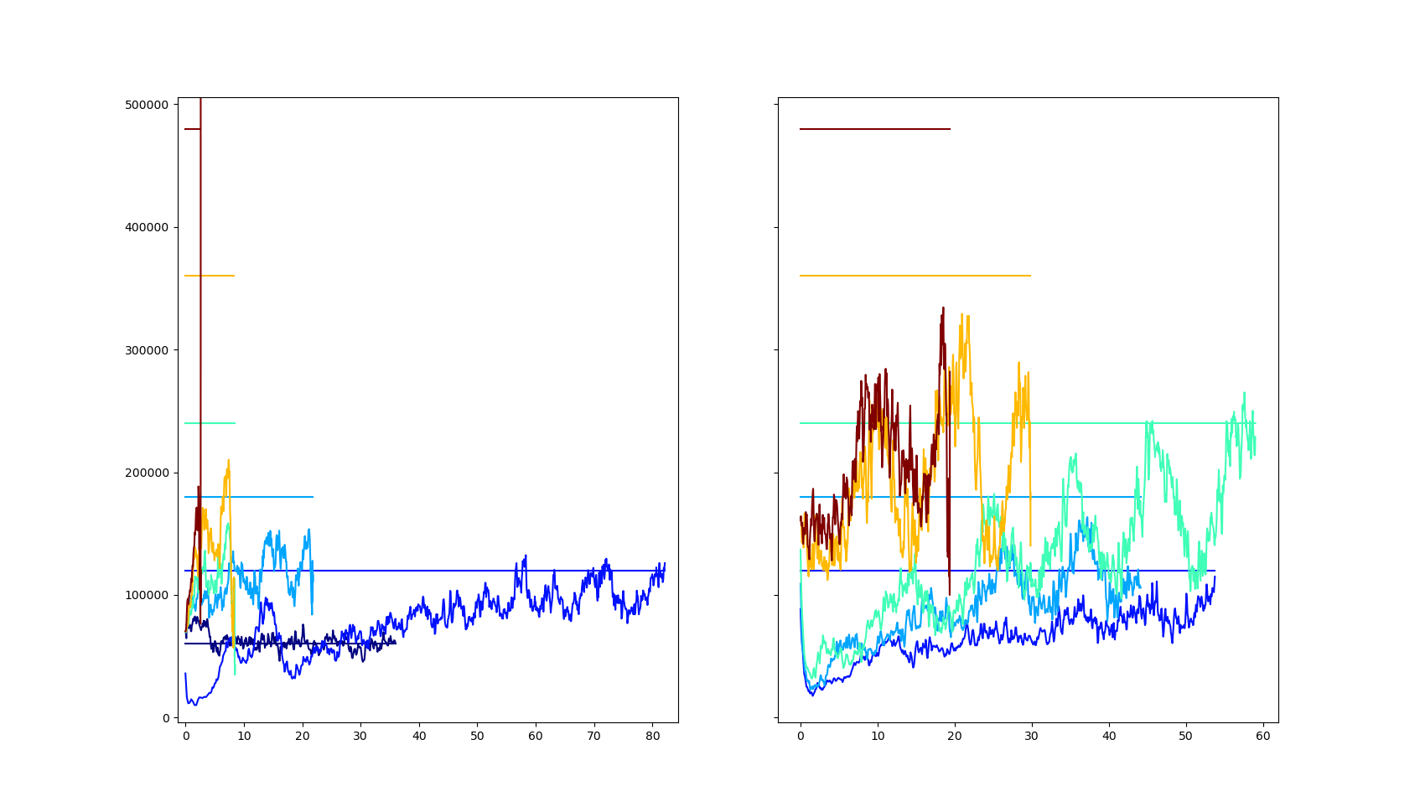




Grand Challenge on Adastra
  New French supercomputer to test → 59MCPUh granted to test
  -- 10MCPUh for SOLEDGE3X
  Power scan based on TCV-X21 equilibrium
$$B=0.9 T$$
$$B=1.8 T$$
 | 0.9T | 1.8T
60 kW | No barrier
120 kW | No barrier | No barrier
180 kW | Barrier | No barrier
240 kW | Barrier | No barrier
360 kW | Barrier | Barrier
480 kW | Barrier | Barrier
$$P_{thresh}≈300kW$$
$$P_{thresh}≈160kW$$
Transition with strong shear at separatrix followed by simulation crash
Power balances for low B and high B power scans
Input (source) and output (wall) power.

Slide 19
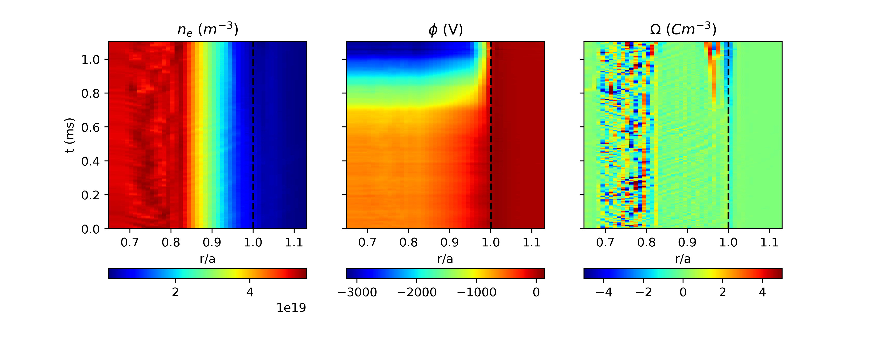
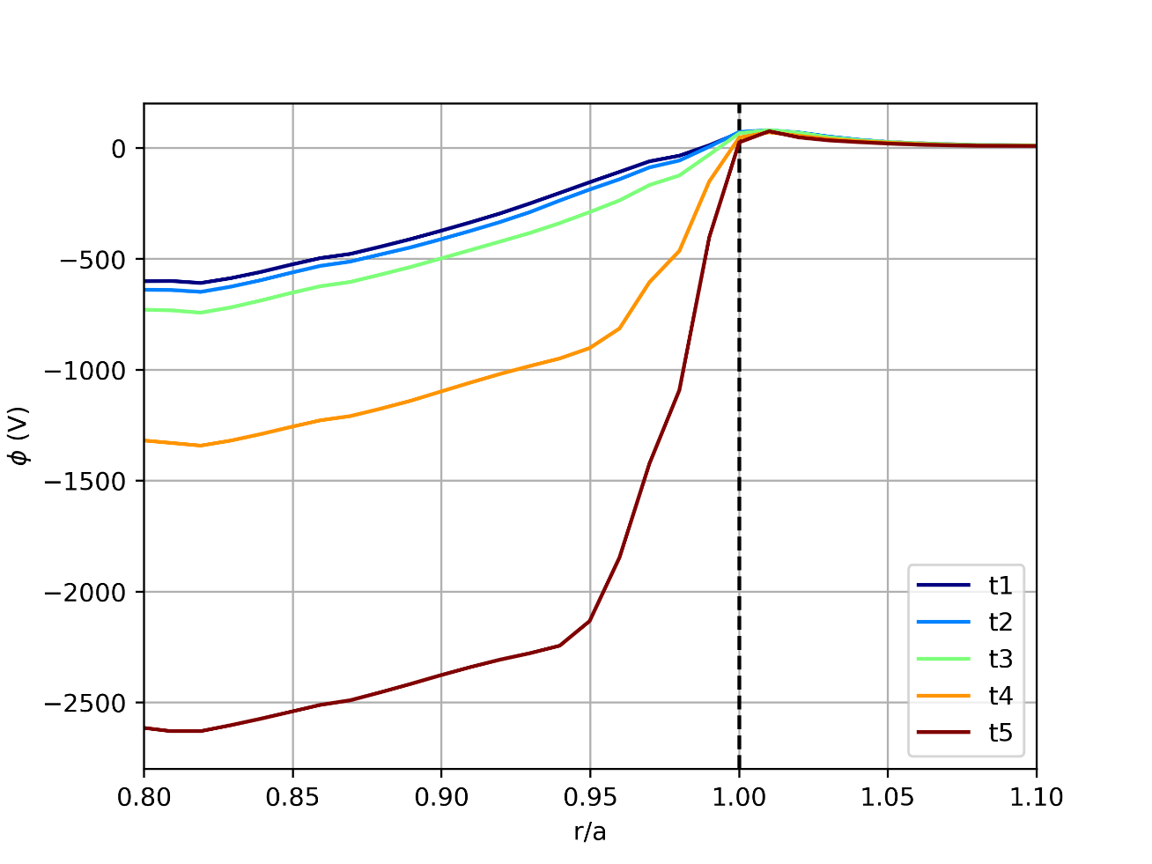
Barrier formation (180kW case @ B=0.9T)
  Barrier characteristic and formation (WIP – speculative)
    Strong ExB shear (potential drops in the edge)
    Strong vorticity dipole near separatrix (diffusive current to compensate for diamagnetic current – polarization current reduced due to ExB shear?)

Slide 20
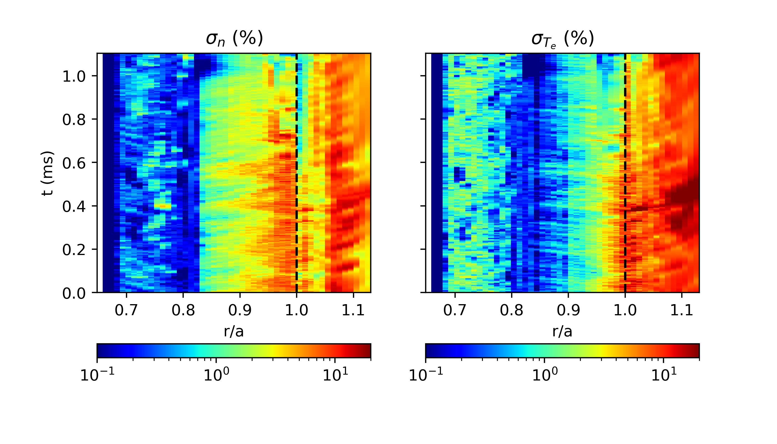
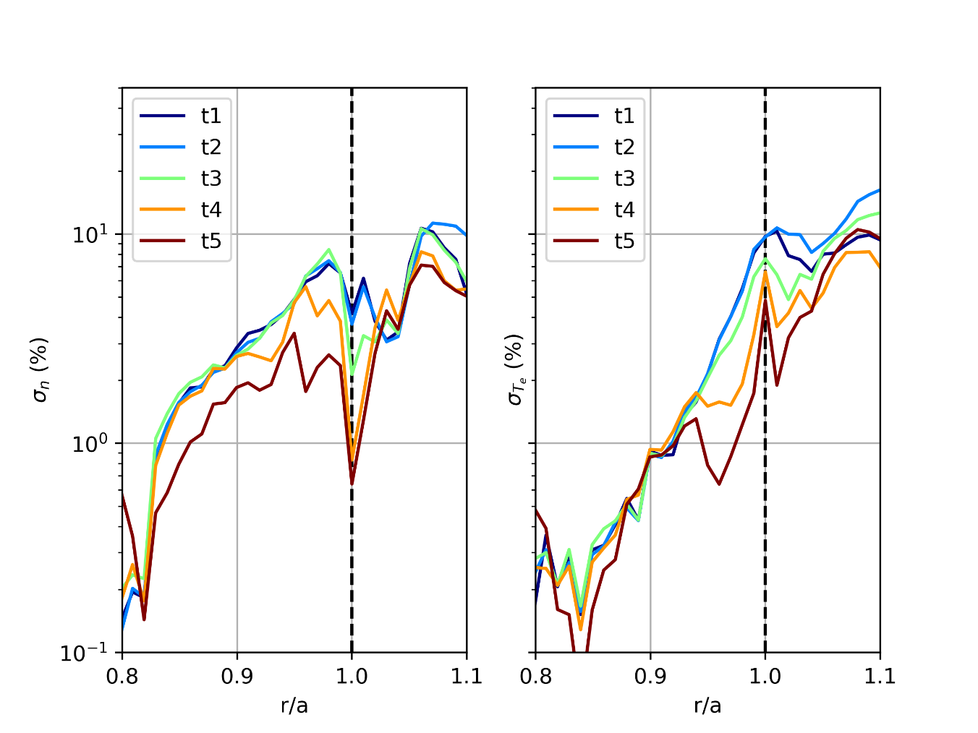
Barrier formation (180kW case @ B=0.9T)
  Barrier characteristic and formation (WIP – speculative)
    Reduction of fluctuation level (before or after barrier formation ?)

Slide 21
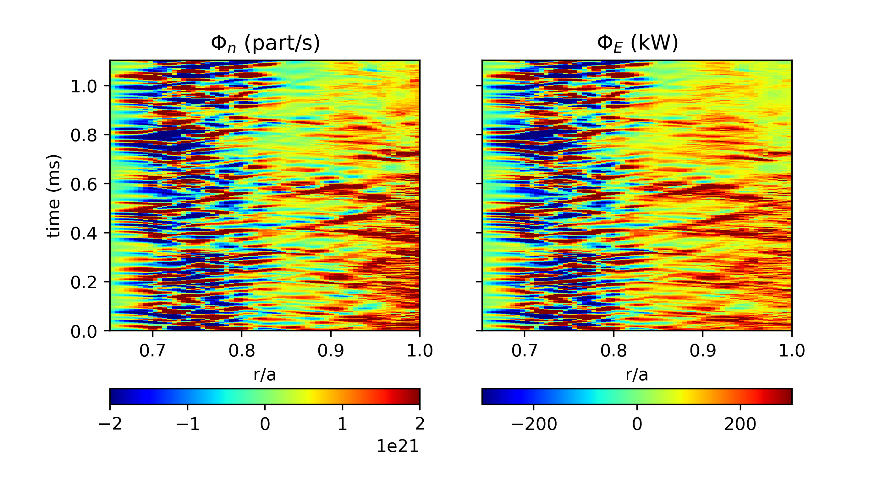
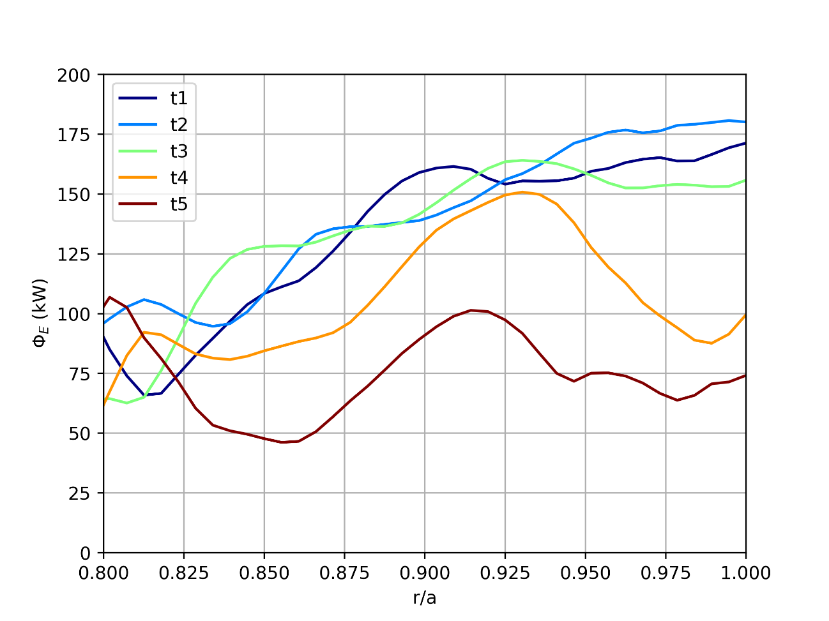
Barrier formation (180kW case @ B=0.9T)
  Barrier characteristic and formation (WIP – speculative)
    Reduction of energy flux ➔ transport barrier
    Steeper profile expected after barrier formation but code crashes due to « too strong » ExB poloidal velocity (sonic)
    Question about energy conservation – where does ExB flow energy come from ? Missing terms in energy equation to be added

Slide 22
Conclusions and Perspectives

Slide 23
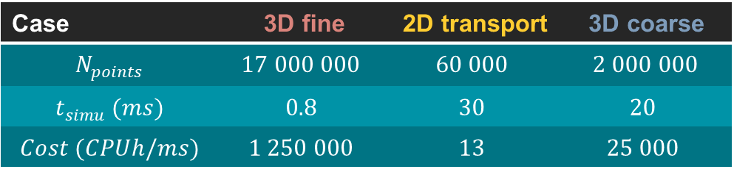
Conclusions and perspectives
  First TCV-X21 simulations with SOLEDGE3X including neutral recycling recovers experimental turbulence features in the divertor such as Divertor Localized Filaments
  Challenge for simulating long time scales with turbulence codes could be addressed by coarse graining + refining strategy
    2D → 3D coarse → 3D fine
  Grand challenge opened opportunity for power scans → barrier formation under investigation
Case | 3D fine | 2D transport | 3D coarse
$$N_{points}$$ | $$17 000 000$$ | $$60 000$$ | $$2 000 000$$
$$t_{simu} (ms)$$ | $$0.8$$ | $$30$$ | $$20$$
$$Cost (CPUh/ms)$$ | $$1 250 000$$ | $$13$$ | $$25 000$$
3Df
3Dc
2D

Slide 24
Thank you for your attention
Contact: Hugo Bufferand
hugo.bufferand@cea.fr

