Slide 2
Non-linearities on neutrals-turbulence interaction
Alexander S. Thrysøe, Anders H. Nielsen

Slide 3
Towards TSVV-3 D5.7

Slide 4
The mean-field approximation
The mean-field approximation is applied in, e.g., multifluid codes to reduce the complexity of the system of equations from the form
$$∂_{t}f+ℒ\left(f\right)=S(f)$$
to an equation of the form
$$ℒ\left(\left\langle f\right\rangle \right)=S(\left\langle f\right\rangle )$$
where $\left\langle f\right\rangle$ a temporal averating of the fields $f$
Due to the strong nonlinearity of transport quantities, using average values can misrepresent the dynamics between them, influenced by the statistics of fluctuating cross-field source terms*
$$ℒ\left(\left\langle f\right\rangle \right)≠\left\langle ℒ\left(f\right)\right\rangle$$
*Havlíčková E et al 2011 J. Nucl. Mater. 415 S471–4, Thrysøe et al 2016 Plasma Phys. Control Fusion 58 044010

Slide 5
The mean-field approximation for the source term
For the neutral interaction source term the form is typically
$$S≈n_{e}n_{n}k$$
where $k=\left\langle σv\right\rangle$ is mostly a function of $T$
Writing $f=n_{e},n_{n},k$ as $f=\left\langle f\right\rangle +\tilde{f}$ we have
$$\left\langle S\right\rangle =\left\langle n_{e}n_{ n}k\right\rangle$$
$$=\left\langle n_{e}\right\rangle \left\langle n_{n}\right\rangle \left\langle k\right\rangle$$
$$+\left\langle n_{e}\right\rangle \left\langle {\tilde{n}}_{n}\tilde{k}\right\rangle$$
$$+⟨n_{n}⟩\left\langle {\tilde{n}}_{e}\tilde{k}\right\rangle$$
$$+⟨k⟩\left\langle {\tilde{n}}_{e}{\tilde{n}}_{n}\right\rangle$$
$$+\left\langle {\tilde{n}}_{e}{\tilde{n}}_{n}\tilde{k}\right\rangle$$

Slide 6
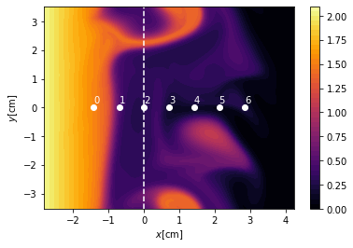
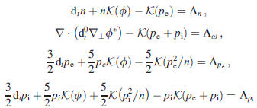
nHESEL equations
nHESEL equations
Drift-reduced Braginskii equations in 2D outer midplane domain
Use TCVX23 profiles for plasma forcing profiles
Synthetic high-resolution probe signals
electron density

Slide 7
nHESEL equations
nHESEL neutral equations
Convective distinct interacting isothermal neutral molecule and atom species

Slide 8
Sources from neutral interactions
charge exchange
molecular ionization
$$H_{2}^{+}+e^{−}$$
$$H+H^{+}+e^{−}$$
$$H_{2}$$
charge exchange
atomic ionization
$$2H$$
$$H^{+}+e^{−}$$
molecular dissociation
atomic ionization

Slide 9
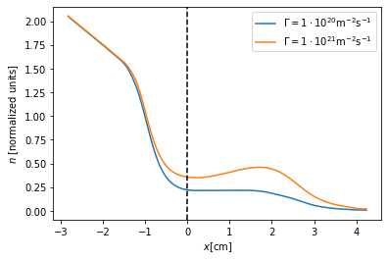
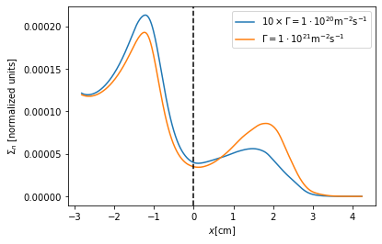
The non-linear response to fueling
Comparison of electron density and density source profiles for two (low and high) fueling scenarios
Next: quantify mean-field appoximation by focusing on the high fueling scenario, consider signal at probe #4

Slide 10
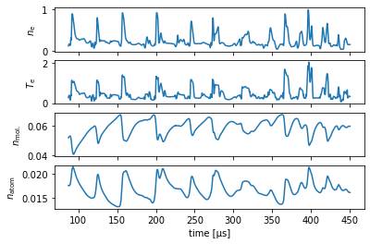
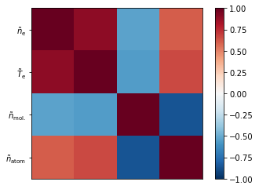
Signals at probe #4
Monitor electron, atomic, molecular densities, and electron temperature
$$\left\langle S\right\rangle =\left\langle n_{e}n_{ n}k\right\rangle =\left\langle n_{e}\right\rangle \left\langle n_{n}\right\rangle \left\langle k\right\rangle +\left\langle n_{e}\right\rangle \left\langle {\tilde{n}}_{n}\tilde{k}\right\rangle +⟨n_{n}⟩\left\langle {\tilde{n}}_{e}\tilde{k}\right\rangle +⟨k⟩\left\langle {\tilde{n}}_{e}{\tilde{n}}_{n}\right\rangle +\left\langle {\tilde{n}}_{e}{\tilde{n}}_{n}\tilde{k}\right\rangle$$
probe signals
correlation matrix

Slide 11
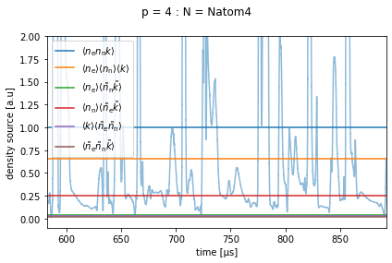
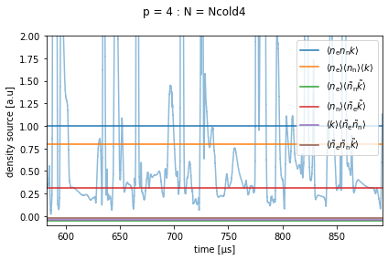
Averaging probe signals
Use approximation $k∝T_{e}$, and $n_{n}=n_{atom},n_{mol.}$, respectively, to assess relative magnitude of averaged source terms (normalized to true average $\left\langle n_{e}n_{ n}k\right\rangle$)
$$n_{n}=n_{atom}$$
$$n_{n}=n_{mol.}$$

Slide 12
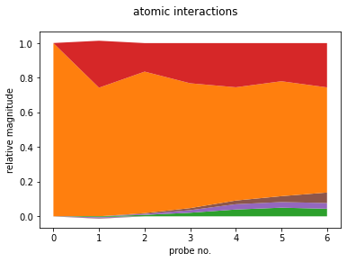
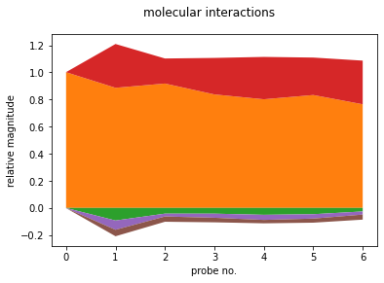
Averaging probe signals
Approximately 60-100% accuracy with $S\left(\left\langle f\right\rangle \right)≈\left\langle S\left(f\right)\right\rangle$
Regional and interaction dependency

Slide 13
Averaging probe signals
For the non-averaged field simulation the relative contribution of the averaged source terms have been quantified
Approximately 60-100% accuracy with $S\left(\left\langle f\right\rangle \right)≈\left\langle S\left(f\right)\right\rangle$
Regional and interaction dependency
The analysis proposes that to good approximation
$$\left\langle S\right\rangle =\left\langle n_{e}n_{ n}k\right\rangle =\left\langle n_{e}\right\rangle \left\langle n_{n}\right\rangle \left\langle k\right\rangle +\left\langle n_{e}\right\rangle \left\langle {\tilde{n}}_{n}\tilde{k}\right\rangle +⟨n_{n}⟩\left\langle {\tilde{n}}_{e}\tilde{k}\right\rangle +⟨k⟩\left\langle {\tilde{n}}_{e}{\tilde{n}}_{n}\right\rangle +\left\langle {\tilde{n}}_{e}{\tilde{n}}_{n}\tilde{k}\right\rangle$$
This, however, does not address the non-linear response to this approximation
We should include the full system of source terms
What happens if we approximate $S\left(n_{e},T_{e,i},n_{n}\right)≈S\left(n_{e},T_{e,i},\left\langle n_{n}\right\rangle \right)$?

Slide 14
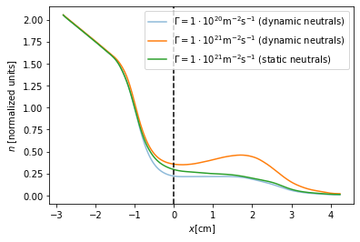
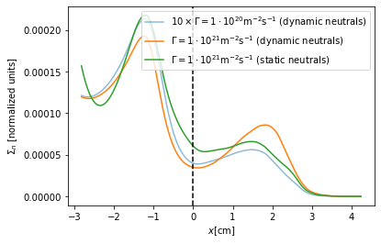
The neutral mean-field simulation
Full simulation with $n_{n}=\left\langle n_{n}\right\rangle$ for $n=atom, mol$. with $Γ=1⋅{10}^{21}m^{−2}s^{−1}$
Source term is similar to $Γ=1⋅{10}^{21}m^{−2}s^{−1}$ in magnitude, but more similar to
$Γ=1⋅{10}^{20}m^{−2}s^{−1}$ in shape
Resulting eletron density profile does not feature the shoulder that emerges with dynamic neutrals

Slide 15
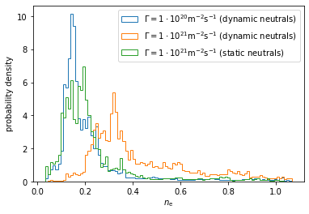
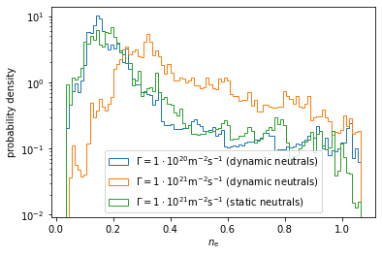
Neutral source terms
The statistical characterization of the probe density signals reveal
Increase of magnitude and broadening of PDF when increasing fueling ratio
Similarity to low-fueling scenario signal for high-fueling, when neutrals are static
$$Γ$$ | $$1⋅10^{20}m^{−2}s^{−1}$$ (dynamic neutrals) | $$1⋅10^{21}m^{−2}s^{−1}$$ (dynamic neutrals) | $$1⋅10^{21}m^{−2}s^{−1}$$ (static neutrals)
Mean | 0.22 | 0.46 | 0.24
Variation | 0.79 | 0.66 | 0.77
Skewness | 2.72 | 1.30 | 2.46
Kurtosis | 7.46 | 0.91 | 6.52

Slide 16
Summary
For the non-averaged field simulation the relative contribution of the averaged source terms have been quantified
Approximately 60-100% accuracy with $S\left(\left\langle f\right\rangle \right)≈\left\langle S\left(f\right)\right\rangle$
Regional and interaction dependency
Highest fluctuating contribution from $n_{e},T_{e}$ correlation
The absence of neutral fluctuations in a full simulation, however, quenches certain non-linear filamentary feedback mechanisms such as shoulder formation from local ionization

Slide 17
Outlook
Implementation of direct source input to nHESEL
Add $S\left(\left\langle n_{e}\right\rangle \left\langle n_{n}\right\rangle \left\langle k\right\rangle \right)$ to study (in addition to $S\left(n_{e},\left\langle n_{n}\right\rangle ,k\right)$)
Study impact of noisy source terms

