Slide 1
Edge plasma turbulence simulations
in detached regimes
with the SOLEDGE3X code
V. Quadri, P. Tamain, H. Bufferand, N. Rivals, R. Düll, G. Ciraolo, S. Sureshkumar, N. Varadarajan and the SOLEDGE3X team.
Leuven workshop TSVV3| 29/05/2024

Slide 2
Outlines
Modeling TCV-X23 with SOLEDGE3X
Experimental dataset
Simulations set-up & strategy
Convergence as criticality
Different plasma conditions obtained
Self – organization of turbulence in high density regimes
Plasma properties
Turbulence properties
Transport properties
Summary

Slide 3
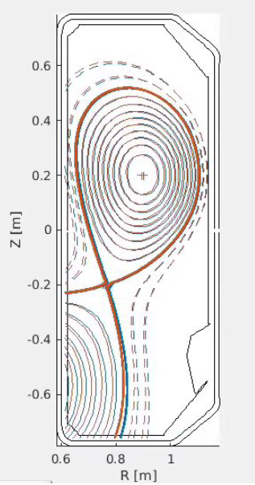
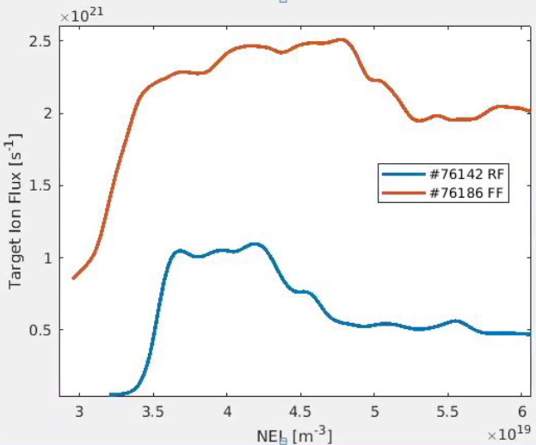
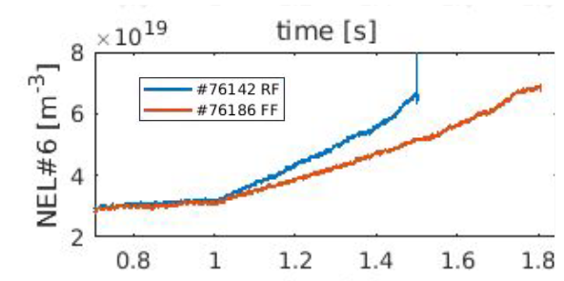
Modeling TCV-X23 experiments with Soledge3x
Why TCV-X23? Configuration which extends the scenario for turbulent codes validation up to detachment.
LSN deuterium L- Ohmic plasma discharges
longer and stable outer leg.
A specific shot in direct magnetic field (#761886) is modeled:
$P_{sep}=140 kW$
Two levels of density: $n_{sep}=0.5E19 m^{−3}$ (attached case), $n_{sep}=1.2E19 m^{−3}$ (detached case).
Fig. 1 Measurements for line integrated average density passing through the magnetic axis (NEL #6) in time, target ion flux w/r NEL #6 and TCV-X23 magnetic equilibrium [courtesy of D. Sales de Oliveira et SPC team].

Slide 4
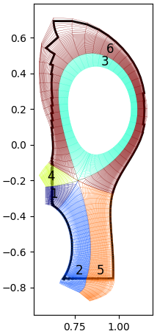
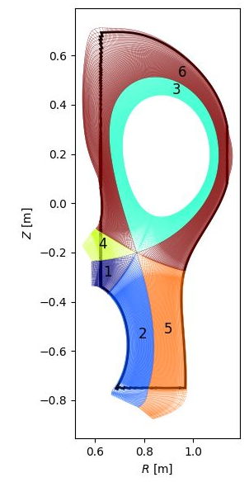
Modeling TCV-X23 experiments with Soledge3x
2D
3D
Strategy: 2D simulations served as a starter for 3D.
2D mean field simulations used to obtain the two density plasma backgrounds.
From 2D convergence, restart in 3D at higher resolution w/ turbulence.
Z$[m]$
Fig. 2 The SOLEDGE3X meshes used for 2D mean field transport (left) and 3D turbulent transport (right) [P. Tamain].
R$[m]$
Outlook: closer to a proper plasma background for particle balance, w/r to evolve it from scratch [V. Quadri et al, https://doi.org/10.1002/ctpp.202300146].
Convergence (~75%) still challenging, due to
Increased resolution in 3D
Neutrals recycling
Very slow transient phase for both plasma backgrounds, where turbulence properties are not going to evolve.

Slide 5
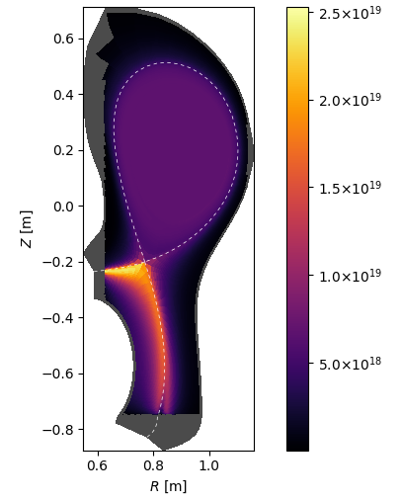
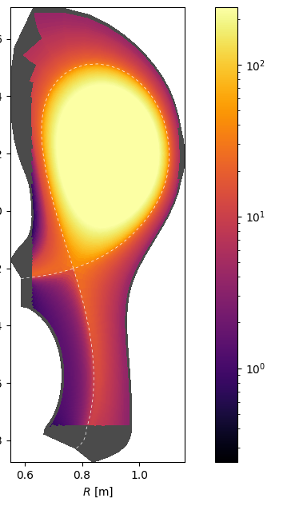
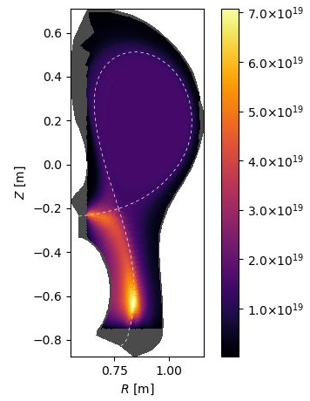
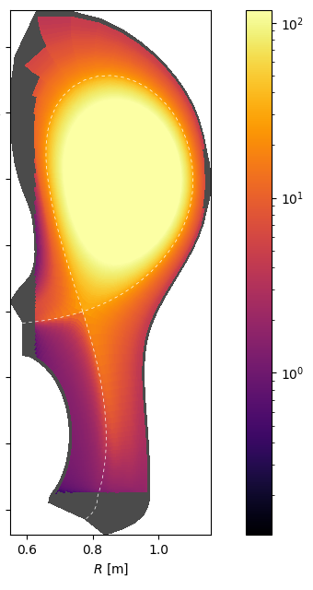
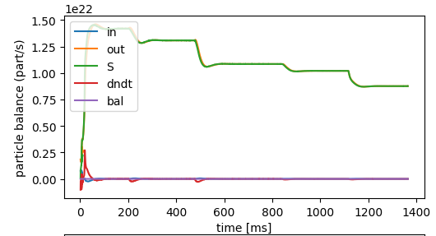
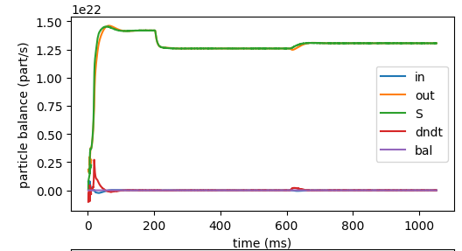
Plasma conditions provided by 2D mean field cases
$$n_{e−} [m^{−3}]$$
$$T_{e−} [eV]$$
$$n_{e−} [m^{−3}]$$
$$T_{e−} [eV]$$
$$n_{sep}=$$
$$0.5E19$$
$$m^{−3}$$
$$n_{sep}=$$
$$0.5E19$$
$$m^{−3}$$
$$n_{sep}=$$
$$1.2E19$$
$$m^{−3}$$
$$n_{sep}=$$
$$1.2E19$$
$$m^{−3}$$
Attached
Converged
Detached
Converged

Slide 6
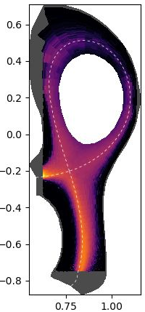
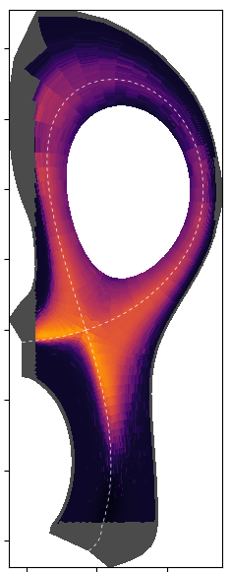
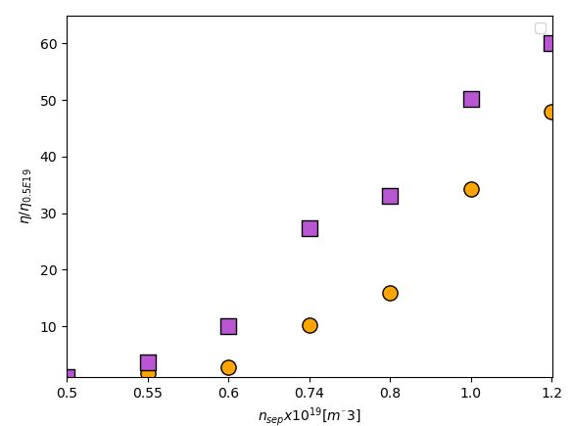
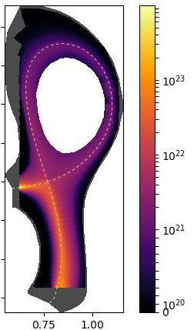
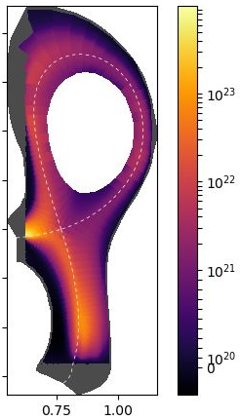
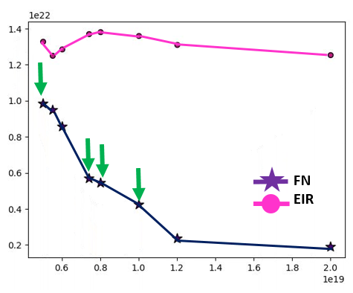
FN vs EIRENE: testing FN assumptions
1. Estimation of collisionality via $η\sim {\left(\frac{T_{e}}{n_{e}}\right)}^{−\frac{3}{2}}scan$
2. Realistic localization of the ionization source $S_{n}$
$Δη$same range w/ and w/out EIRENE
FN
EIR
$$\frac{η}{η_{0.5E18}}$$
EIRENE
FN
EIRENE
FN
$$n_{sep}=$$
$$0.5E19$$
$$n_{sep}=$$
$$0.5E19$$
$$n_{sep}=$$
$$1.2E19$$
$$n_{sep}=$$
$$1.2E19$$
However, still far from being perfect
Qualitative OK, quantitative NOK
$$n_{sep} [×19 m^{−3}]$$
$$max\left(Γ_{e^{+}, ψ}\right) [m^{−2}s^{−1}]$$
FN seems to rollover before EIRENE
FN fluxes amplitude much lower
fluid neutrals model in Soledge3X will need refinements
$$n_{sep} [×19 m^{−3}]$$

Slide 7
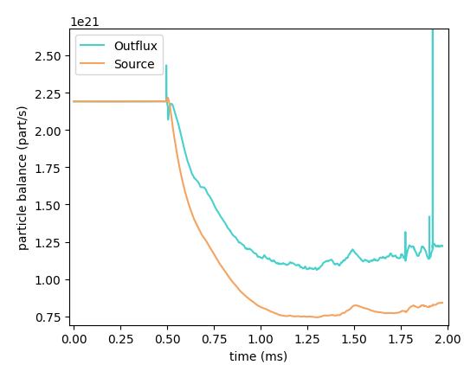
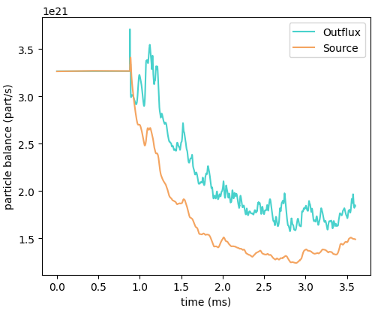
From 2D convergence, restart in 3D at higher resolution w/ turbulence.
Transit to 3D turbulence
2D
mean field
Statistical analysis on turbulence
Outlook: closer to a proper plasma background for particle balance, w/r to evolve it from scratch [V. Quadri et al, https://doi.org/10.1002/ctpp.202300146].
Convergence (~75%) still challenging, due to
Increased resolution in 3D
Neutrals recycling
Very slow transient phase for both plasma backgrounds, where turbulence properties are not going to evolve.
Transit to 3D turbulence
2D
mean field
Statistical analysis on turbulence
Fig. 3 Time traces of particle influx given by the ionization source and particle outflux for the two density cases, $n_{sep}=0.5E19 m^{−3}$(left) and $n_{sep}=1.2E19 m^{−3}$ (right).

Slide 8
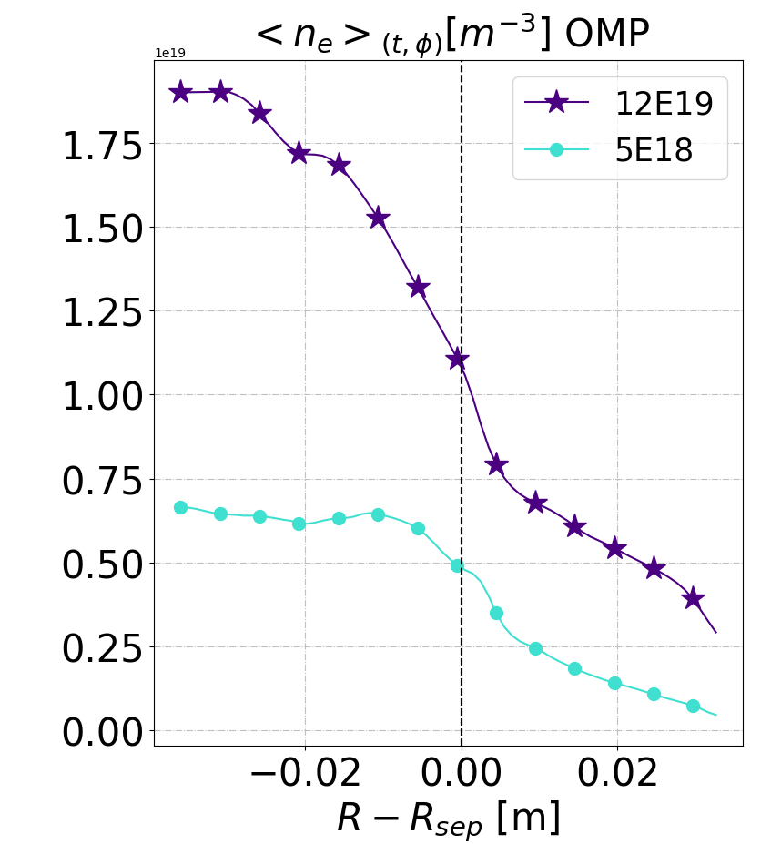
From 2D → 3D: two different densities at the sep with turbulence
Puff: $2.7E+21 [\frac{part}{s}]$
Puff: $1.3E+21 [\frac{part}{s}]$

Slide 9
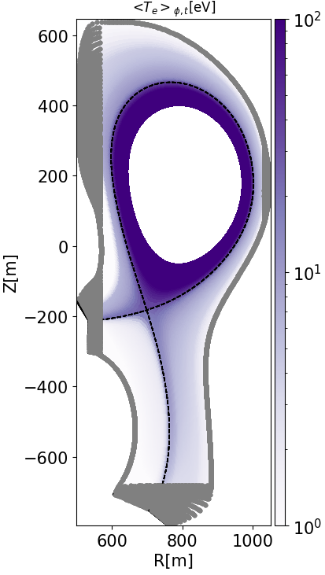
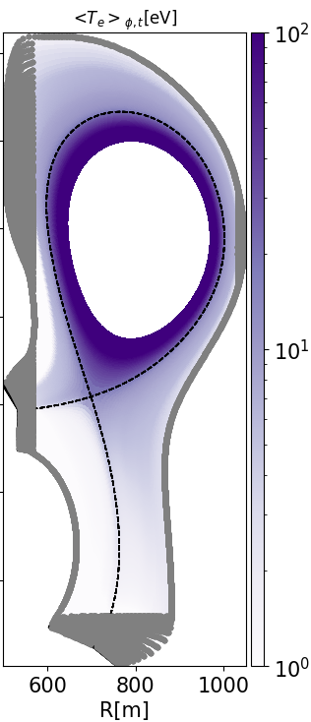
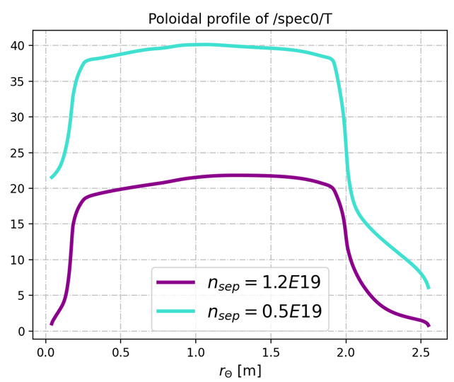
Different plasma conditions for the two density cases
$$T_{e}[eV]$$
$$T_{e}[eV]$$
$$n_{sep}=$$
$$0.5E19$$
$$m^{−3}$$
$$n_{sep}=$$
$$1.2E19$$
$$m^{−3}$$
$$T_{e}[eV]$$
Inner target
Outer mid-plane
Outer target
Fig 5. Poloidal profile at the first SOL flux surface of the time and toroidal averaged $T_{e}$for $n_{sep}= 0.5E19 m^{−3}$and $n_{sep}=1.2E19 m^{−3}$. Time and toroidal averaged maps of $T_{e}$for $n_{sep}= 0.5E19 m^{−3}$(left) and $n_{sep}=1.2E19 m^{−3}$ (right).
~ 1eV!

Slide 10
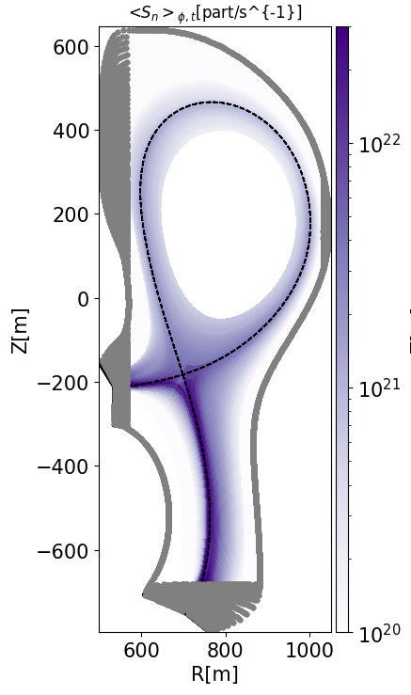
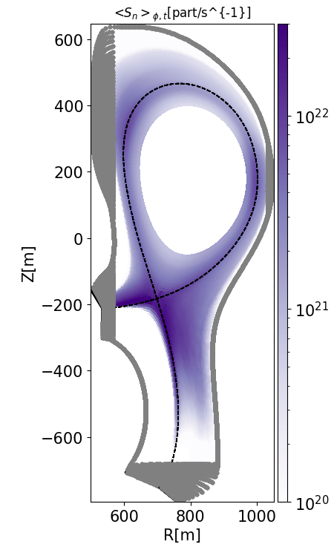
Different plasma conditions for the two density cases
$$S_{n}[part /s^{−1}]$$
High density case is detached!
$$n_{sep}=$$
$$0.5E19$$
$$m^{−3}$$
$$n_{sep}=$$
$$1.2E19$$
$$m^{−3}$$
Fig. 4 Time and toroidal average ionization source $S_{n}[part /s^{−1}]$ for $n_{sep}= 0.5E19 m^{−3}$ (left) and $n_{sep}=1.2E19 m^{−3}$ (right).

Slide 11
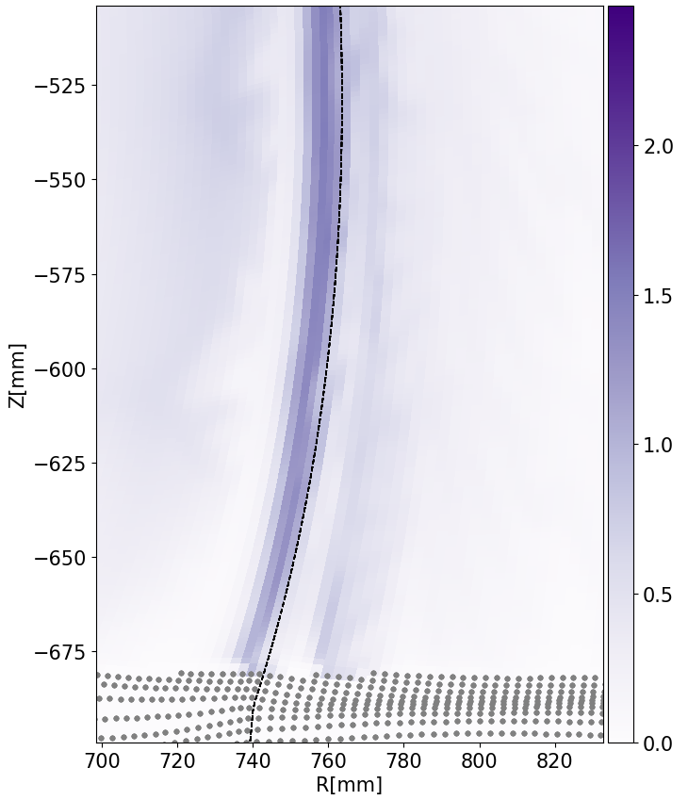
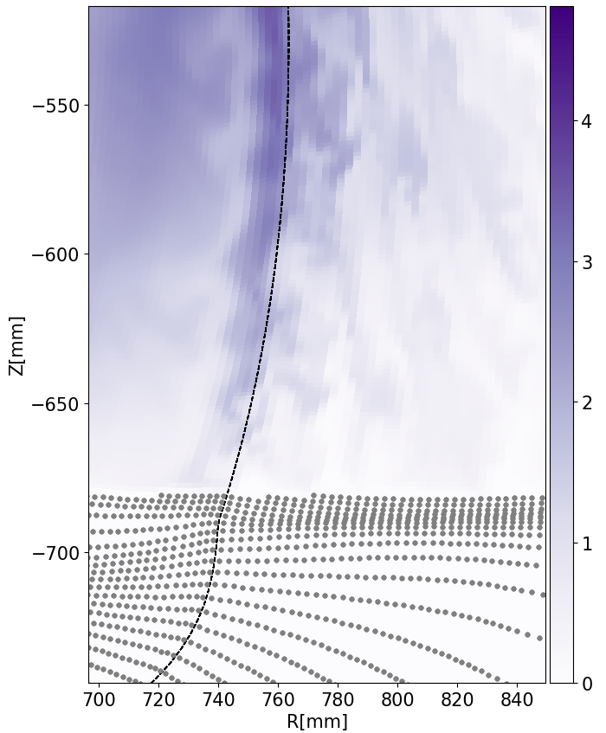
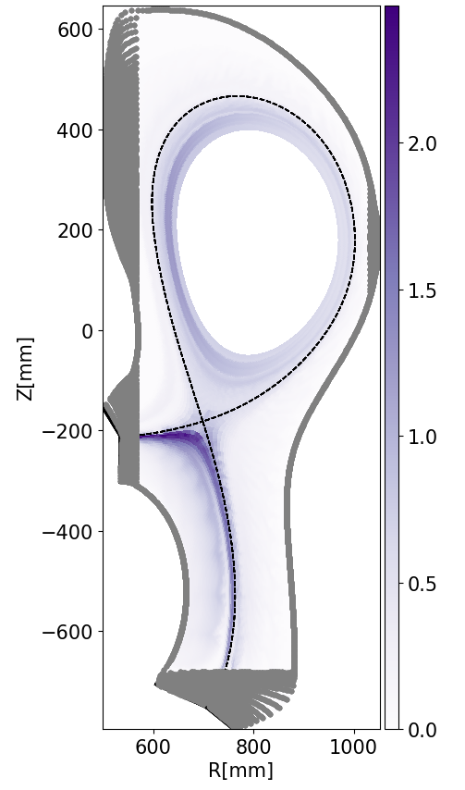
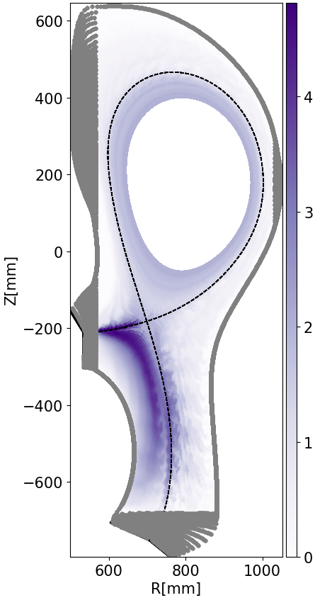
Different plasma conditions for the two density cases
Turbulence structures immediately exhibit qualitatively differences depending on the density level.
$n_{e} −{\overline{n}}_{e}$ ${[m}^{−3}]$
$$n_{sep}=$$
$$0.5E19$$
$$m^{−3}$$
$$n_{sep}=$$
$$1.2E19$$
$$m^{−3}$$
Commonly, turbulent transport dominates transverse fluxes both in the main SOL and in the divertor.
Specific turbulent activity all along the outer divertor leg up to the target.

Slide 12
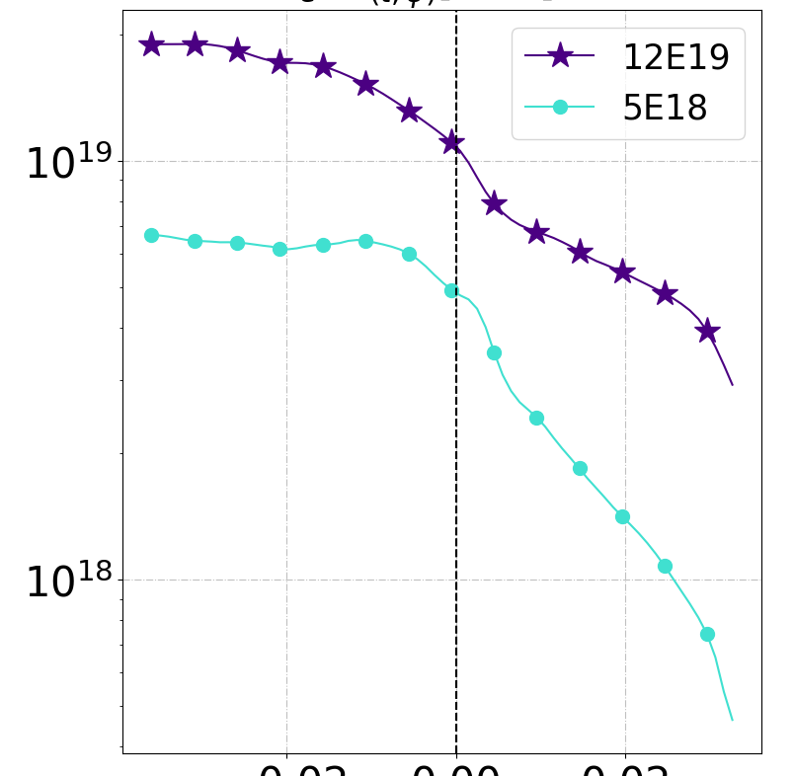
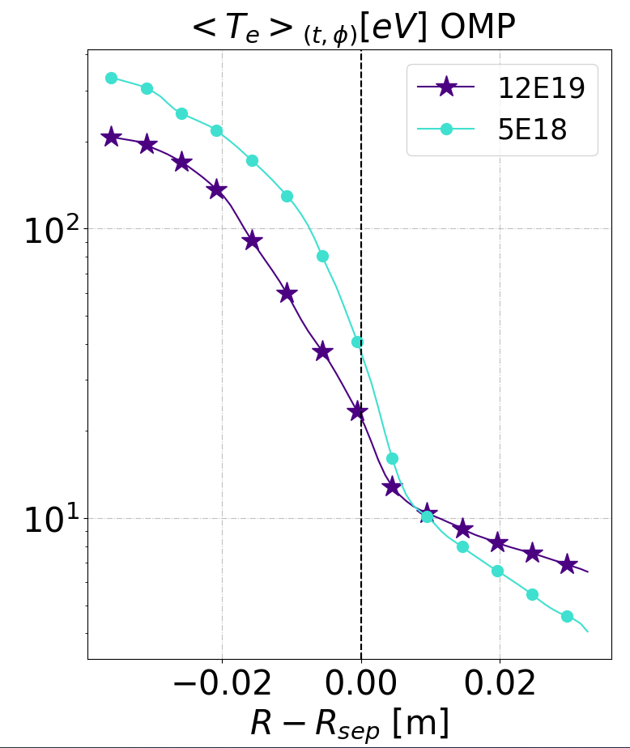
Time-averaged radial profiles
OMP
Outer target
Mid-divertor
1. Plasma properties
The density is globally higher where we aimed for the simulation to have higher values.
At the midplane, the profiles match the values imposed by the experiments but are still evolving.
The temperature is higher for the low-density case in the edge, and slightly higher in the near SOL.
Temperature profiles flatten in the far SOL around 10 eV.
$$<n_{e}>_{\left\{t, φ\right\}} \left[m^{−3}\right]$$
PFR
SOL
PFR
SOL
PFR
SOL
PFR
$$<T_{e}>_{\left\{t, φ\right\}} \left[eV\right]$$
SOL
Fig 6. Radial profiles of the time and toroidal averaged electron density $n_{e} [m^{−3}]$ (upper) and temperature $T_{e} [eV]$ (bottom) for the two density cases, $n_{sep}= 0.5E19 m^{−3}$and $n_{sep}=1.2E19 m^{−3}$ at the outer midplane (left), outer target (cent) and mid divertor (right).

Slide 13
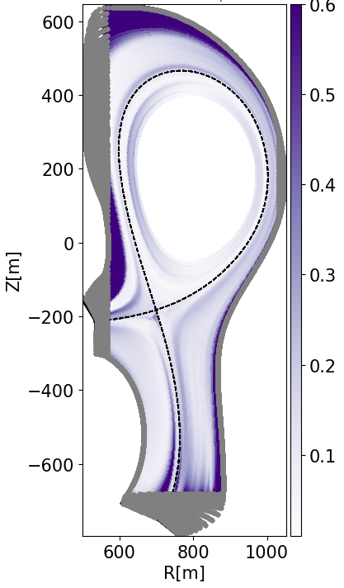
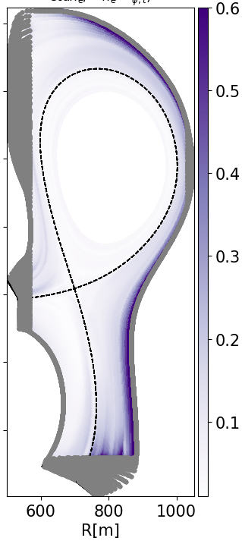
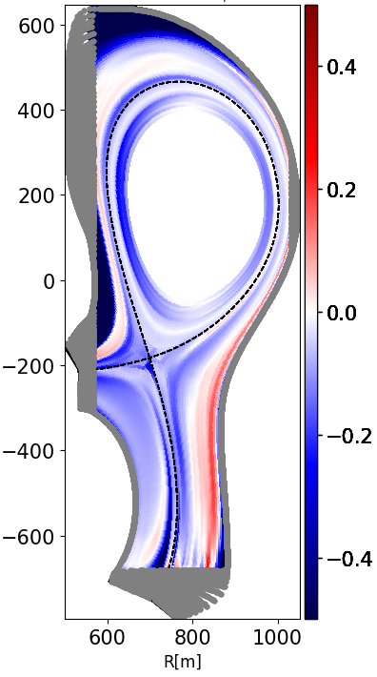
Impact on turbulence properties
$$Δ\left[{\left(\frac{σ_{n_{e}}}{<n_{e}> }\right)}_{high}−{\left(\frac{σ_{n_{e}}}{<n_{e}> }\right)}_{low}\right]$$
2. Turbulence properties
Relative fluctuations level of $n_{e}$ ($\frac{σ_{n_{e}}}{<n_{e}> }$)
Density fluctuations appear to increase with density itself.
However, fluctuations rate is globally larger for the low density case in the whole SOL (except some specific locations)
$$n_{sep}=$$
$$0.5E19$$
$$m^{−3}$$
$$n_{sep}=$$
$$1.2E19$$
$$m^{−3}$$

Slide 14
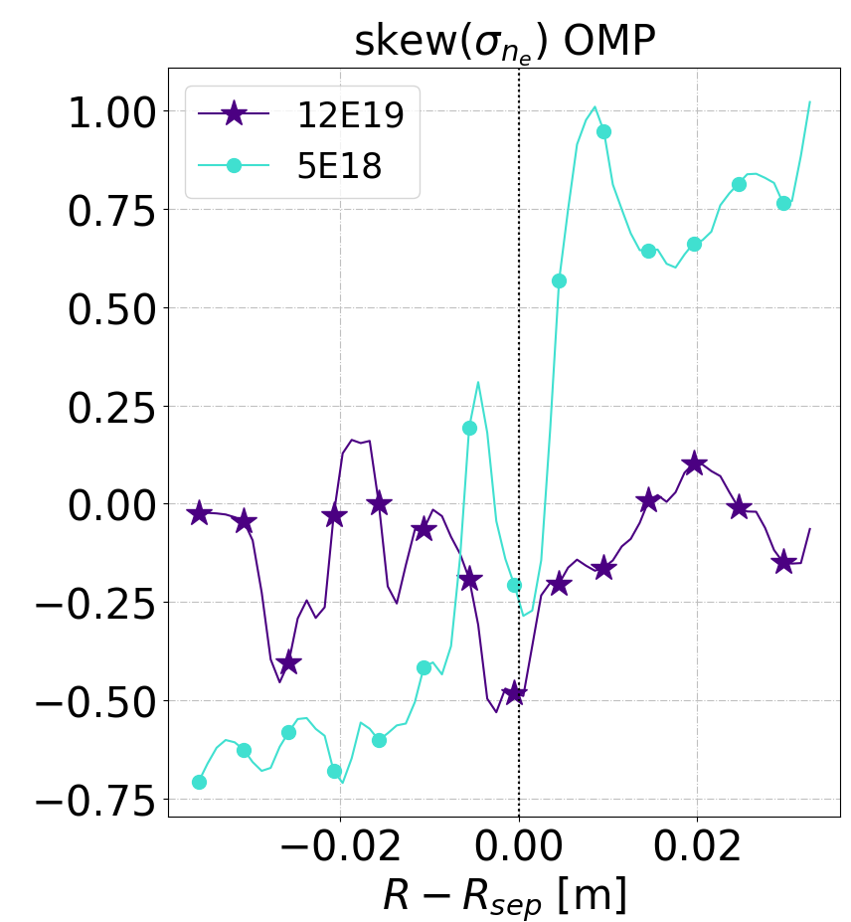
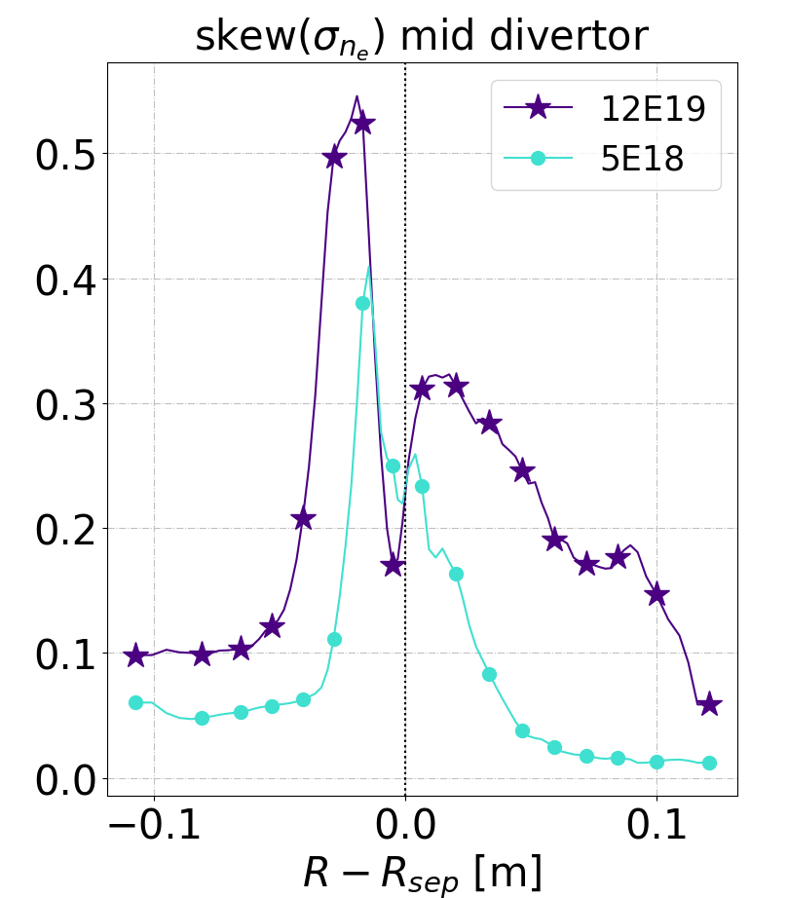
Impact on turbulence properties
The relative fluctuations are higher in the SOL, while they decrease at the separatrix where the increase in density is faster than the increase in absolute fluctuation level.
Globally, density fluctuations rate seems not so impacted: the amplitude of the fluctuations is not varying so much.
Skewness is strongly poloidal asymmetric.
Negative inside the separatrix; increasing positively for the ttached case [consistent w/ Zweben, MAST experimental dataset]
Flat and not skewed for the high density case at the MP

Slide 15
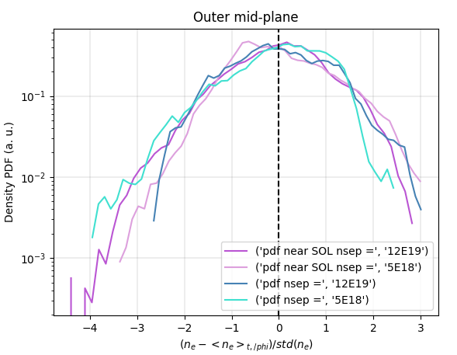
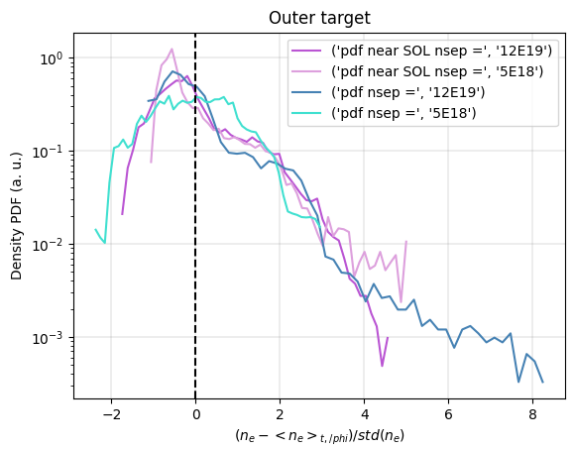
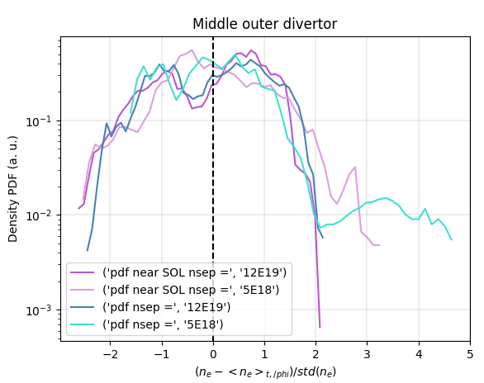
Impact on turbulence properties
Near SOL
Far SOL

Slide 16
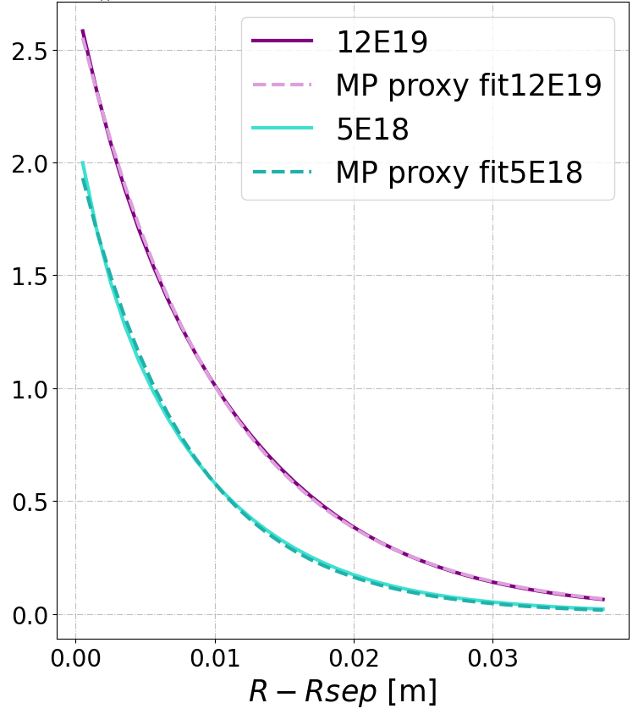
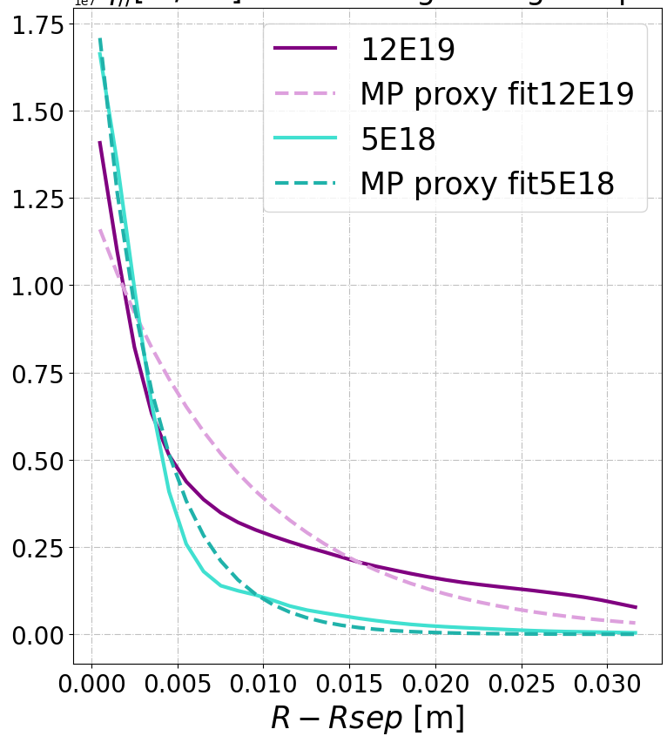
Heat flux channel width
$q_{∥}[\frac{W}{m^{2}}]$ 2D mean-field
$q_{∥}[\frac{W}{m^{2}}]$ 3D turbulence
$$1e7$$
$$1e7$$
3. Transport properties
$$q_{peak}≈n \left(γ_{e}T_{e}+γ_{i}T_{i}\right)\sqrt{(T_{e}+T_{i}) }$$
Single exponential fit
Single exponential fit
Clear change in the profiles for MF vs turbulence.
Fig. 8 MF & turbulence comparison of parallel heat fluxes peaks at the mid-plane for $n_{sep}=0.5E19 m^{−3}$ and $n_{sep}=1.2E19 m^{−3}$ via single exponential fit.
$$\sim ×1.3$$
$$\sim ×2.5$$
$$n_{sep}[m^{−3}]$$ | $$λ_{q}\text{[}\text{mm}\text{]}$$ | $q_{peak}[\frac{W}{m^{2}}]$
$$0.5E19$$ | $$7.87$$ | $$2.0E7$$
$$1.2E19$$ | $$10.24$$ | $$2.7E7$$
$$n_{sep}[m^{−3}]$$ | $$λ_{q}\text{[}\text{mm}\text{]}$$ | $q_{peak}[\frac{W}{m^{2}}]$
$$0.5E19$$ | $$3.35$$ | $$1.75E7$$
$$1.2E19$$ | $$8.71$$ | $$1.4E7$$
In turbulence simulations, the “average” $λ_{q}$ in detachment has increased by a factor of 2.5.

Slide 17
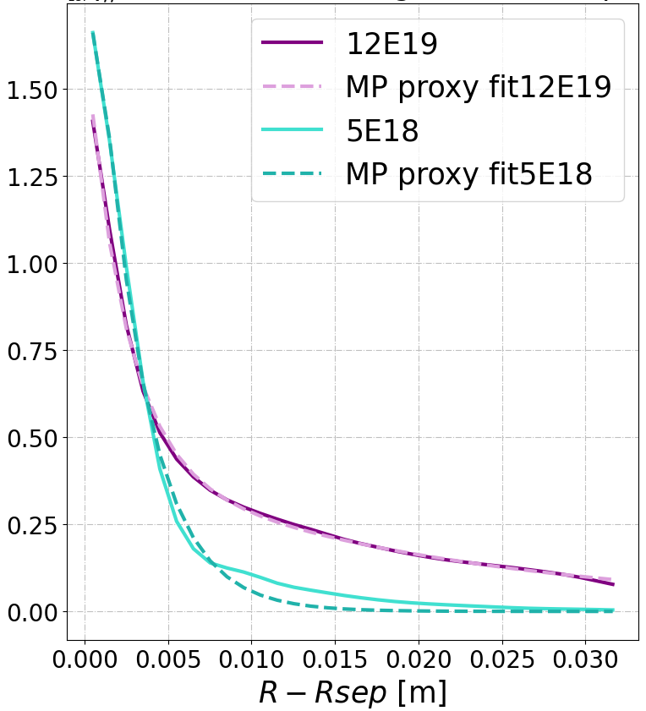
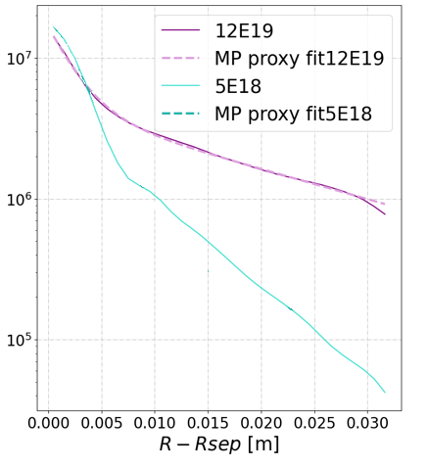
Heat flux shoulder appearance in high density case
$q_{∥}[\frac{W}{m^{2}}]$ 3D turbulence
$$1e7$$
linear fit 5E18
Double exponential fit
Appearance of a far SOL shoulder in the heat flux decay
log
$$n_{sep}[m^{−3}]$$ | $λ_{q, NEAR}$ [mm] | $q_{peak, NEAR}[\frac{W}{m^{2}}]$ | $λ_{q, FAR}$ [mm] | $q_{peak, FAR}[\frac{W}{m^{2}}]$
$$0.5E19$$ | $$\sim 1$$ | $$1,6E7$$ | $$\sim 10$$ | $$2.1E5$$
$$1.2E19$$ | $$2.35$$ | $$1.24E7$$ | $$20.3$$ | $$4.4E6$$
$$\sim ×21‼‼$$

Slide 18
Exctrating the diffusion maps for 2D mean field
$$D_{⊥}\left[\frac{m^{2}}{s}\right]$$
Clear change in transport due to density regimes, with very different amplitudes.
Larger transport coefficients in the high density cases with respect to the low density case.
Particle transport is indeed strongly enhanced.
$$n_{sep}=$$
$$0.5E19$$
$$m^{−3}$$
$$n_{sep}=$$
$$1.2E19$$
$$m^{−3}$$

Slide 19
Summary
Restarting from mean field simulations helps to establish turbulence on the desired plasma background.
Turbulence simulations can adequately access high-density regimes; even if not fully converged, the turbulence properties will not change significantly during a very long transient period.
Significant changes in global and local properties of both plasma and turbulence are observed transiting from low to high density regimes.
By increasing the density, a significant volume of plasma is migrating along the divertor region leading to a broadening of the SOL.
The appearance of a far SOL shoulder is observed in the detached case.
Outlook: All the data for comparison with experiments are available. What is next?

Slide 20
Backup Slides

Slide 21
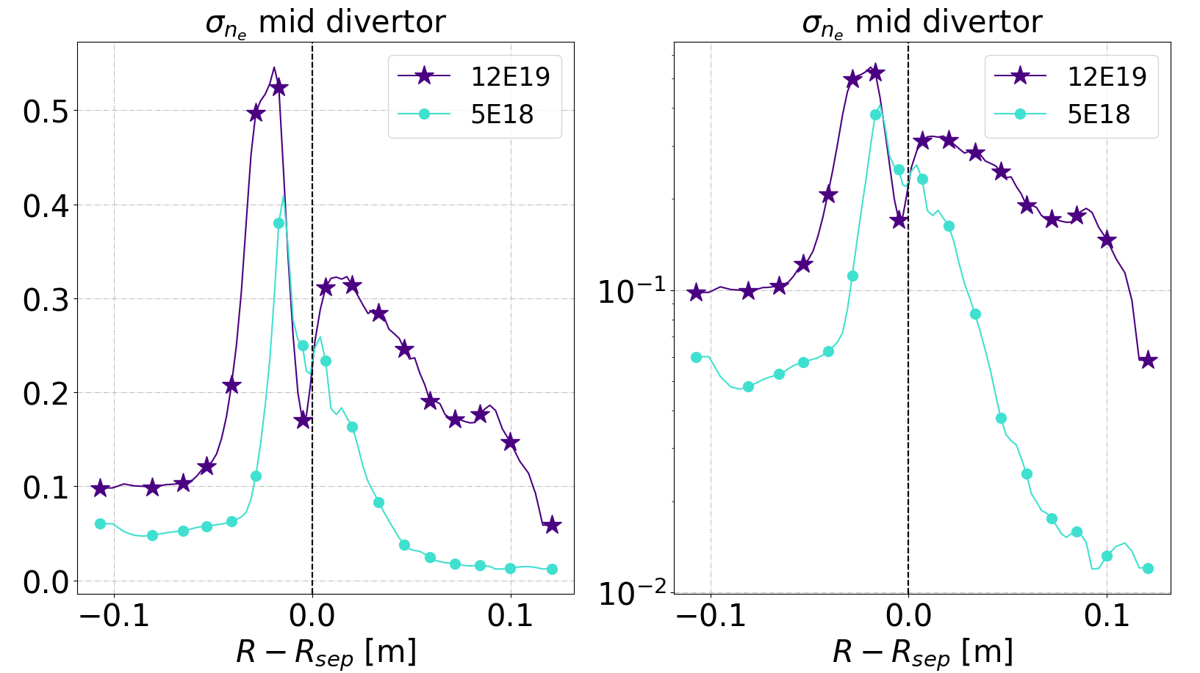
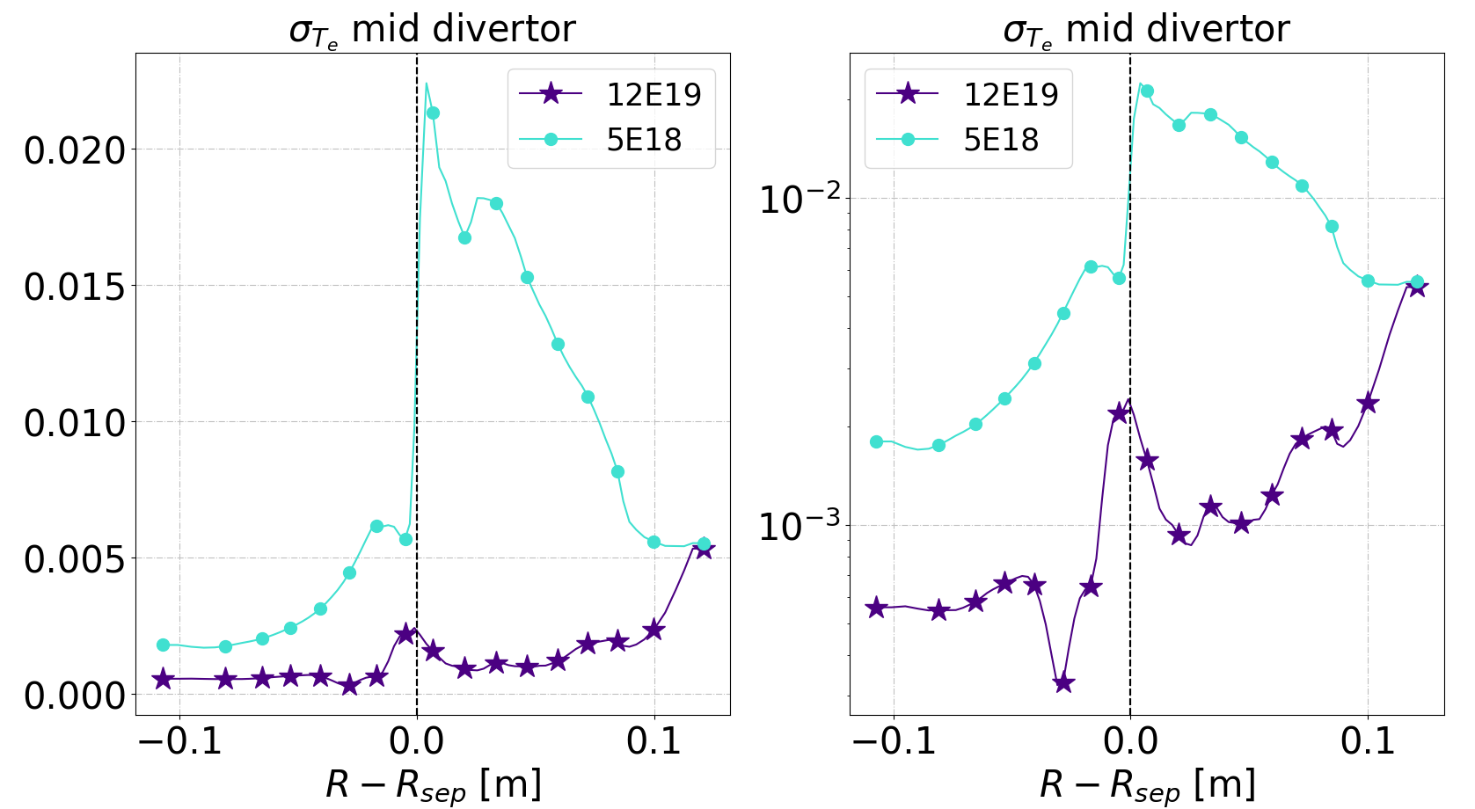
${n_{e}, T}_{e}$ mid divertor

Slide 22
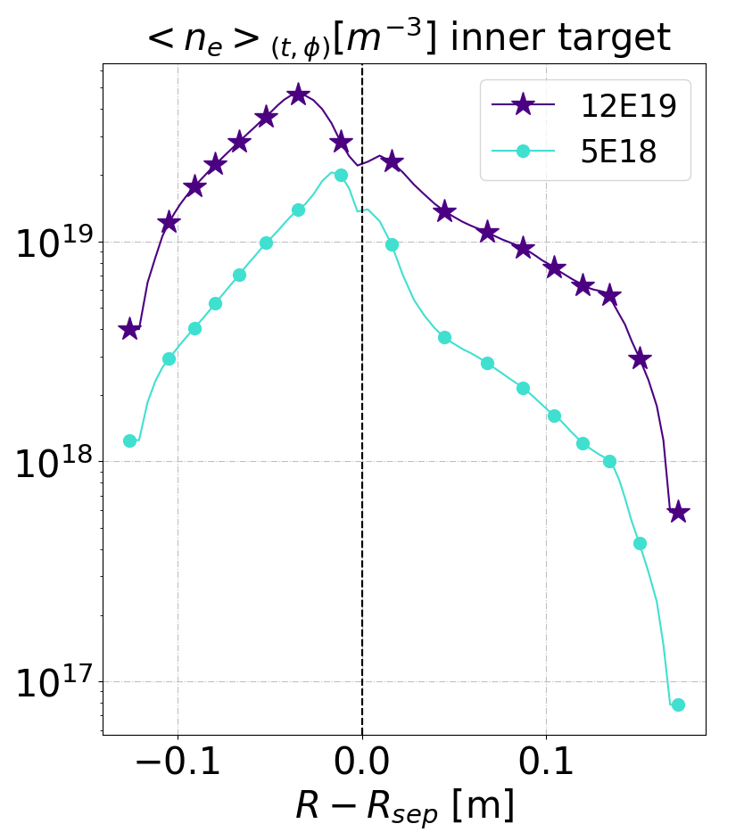
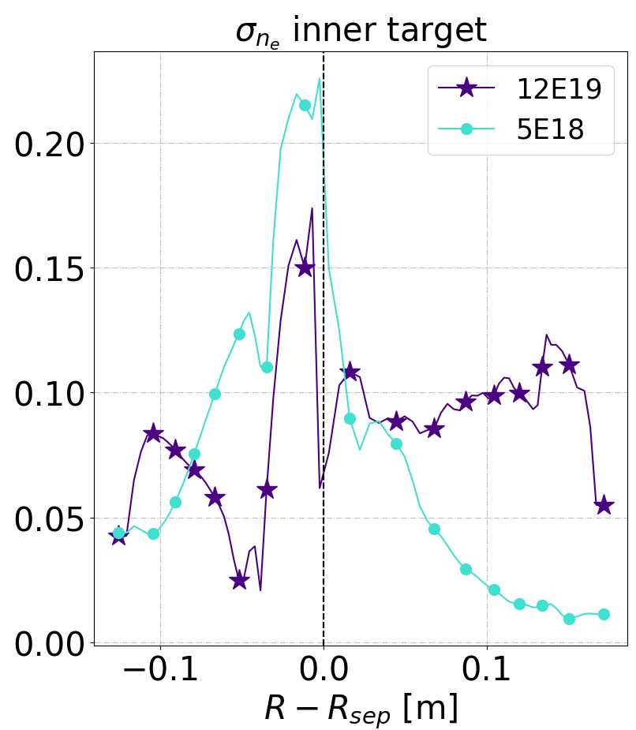
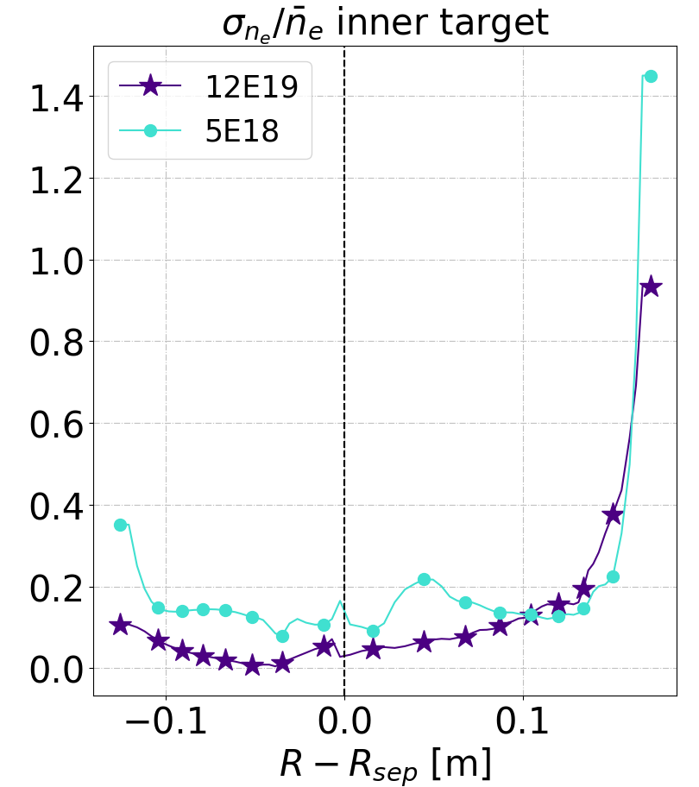
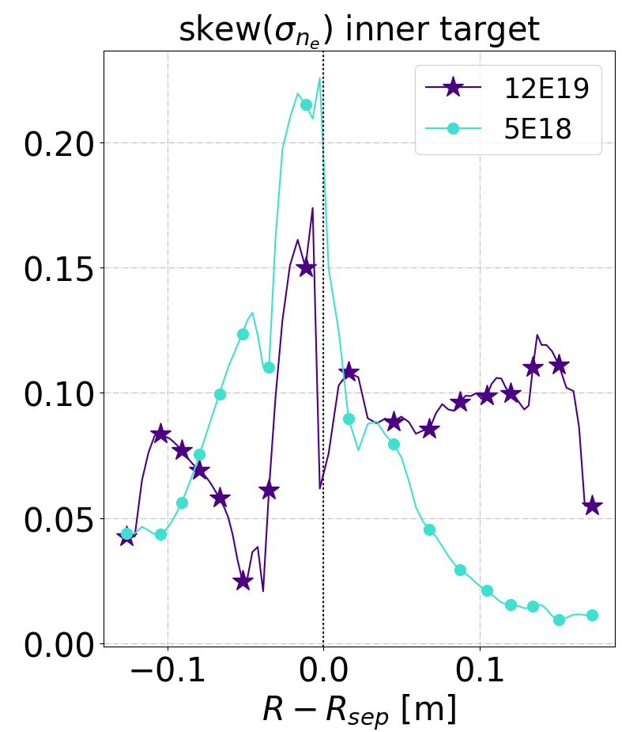
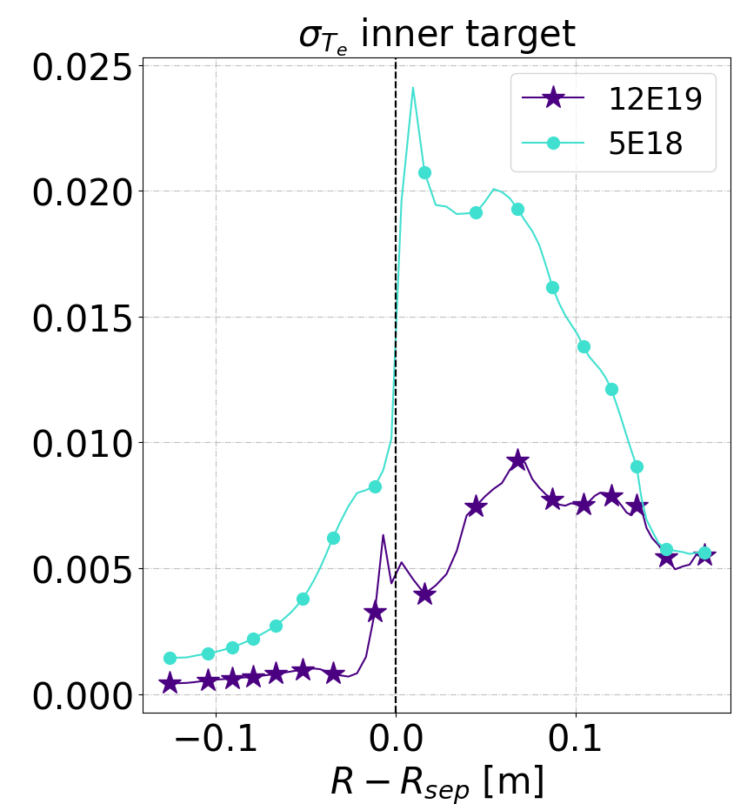
${n_{e}, T}_{e}$ inner target

Slide 23
$n_{e}$ absolute vs relative fluctuations 3 poloidal positions

Slide 24
$n_{e}$ absolute + relative fluctuations 3 poloidal positions

Slide 25
$T_{e}$ turbulence properties different poloidal locations

Slide 26
$n_{n}$ OMP and mid divertor

Slide 27
$n_{n}$ turb properties OMP and mid divertor

Slide 28
$T_{i}$ OMP and mid diverto

Slide 29
Ti turb properties

Slide 30
Density fluc time evolution
OMP
Outer strike point
Mid divertor

Slide 31
Different plasma conditions for the two density cases
$S_{n}[part /s^{−1}]$
Turbulence structures exhibit already qualitatively differences depending on the density level.
$$n_{sep}=$$
$$0.5E19$$
$$m^{−3}$$
$$n_{sep}=$$
$$1.2E19$$
$$m^{−3}$$
Z$[m]$
Commonly, turbulent transport dominates transverse fluxes both in the main SOL and in the divertor.
Specific turbulent activity all along the outer divertor leg up to the target.

Slide 32
Diffusion map $n_{sep}= 0.5E19$

Slide 33
Diffusion map $n_{sep}=1.2E19$

Slide 34
$$1.2E19$$
$$0.5E19$$

Slide 35
Strong drop of the heat fluxes at the targets
Not possible to perform an Eich fit there
$q_{∥}[\frac{W}{m^{2}}]$ outer target
$q_{∥}[\frac{W}{m^{2}}]$ inner target
$$1e6$$
$$1e7$$

