Slide 1


Progress in turbulence simulations in stellarators
Zeno Tecchiolli, Antonio Coelho, Joaquim Loizu, and Paolo Ricci
Ecole Polytechnique Federale de Lausanne (EPFL), Swiss Plasma Center (SPC), CH-1015 Lausanne, Switzerland
TSVV3 annual workshop 2024 - Leuven, May 29 - 31

Slide 2
Importance of edge turbulence in stellarators
The characterisation of plasma turbulence in the edge of fusion devices is crucial for the power exhaust problem
3D magnetic configurations allow for a general turbulent dynamics:
Low iota profiles are characterised by filaments attached at their flux surfaces with skewness close to zero along the SOL and no blobs [C. Killer, 2020]
High-iota have a turbulent spectra closer to the tokamak one, with blobs born deeper in the plasma contributing to the cross-field transport [H. Tanawa, 2012]
Global quasi-coherent modes have been observed in different machines with low poloidal and toroidal mode number [S.B. Ballinger, 2021]

Slide 3

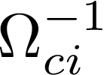
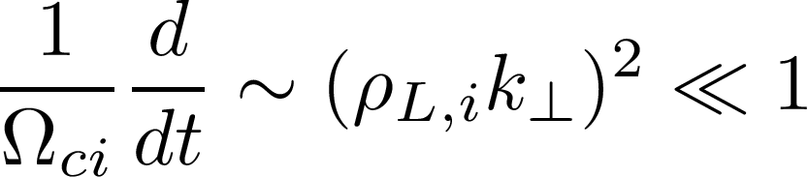





Drift-reduced Braginskii equations to simulate the boundary plasma
Cold plasma in the edge is highly collisional, , and turbulence time-scale is longer than
Drift-reduced approximation [Zeiler, 1999]:
Similar equations for given by momentum and energy conservation
System is closed by Poisson for obtained form quasi-neutrality and charge
conservation,
diamagnetic convection
parallel flow
convection
polarisation convection
source

Slide 4

GBS solves the drift-reduced Braginskii equations
GBS is a two fluid, global, flux-driven code to simulate turbulence evolving such equations in time in toroidal coordinates
No separation between equilibrium and fluctuating quantities
Simulate the entire volume to avoid BCs at the core-edge interface
Density and temperature sources generate gradients for turbulence driving
Losses at the wall (pre-sheath boundary conditions)
Reaching a quasi-steady-state: balance between turbulence transport, losses at the wall and sources
GBS used in the past decade to simulate tokamaks [Giacomin, 2022]; now it can simulate
turbulence in 3D magnetic fields [Coelho, 2021].

Slide 5
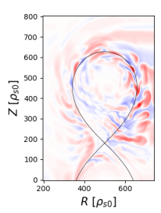
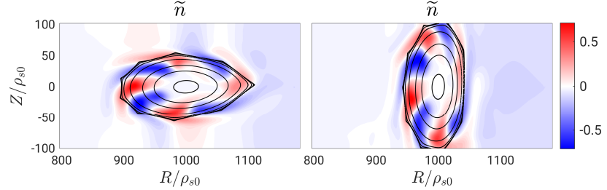



Global coherent mode dominates the dynamics
First global fluid turbulent simulation for a 5-field-period stellarator via Dommashk potentials [Coehlo 2021]
Field aligned global coherent mode with dominates the dynamics with no turbulence broadband or blobs
Structures with different size rather than in tokamaks

Slide 6
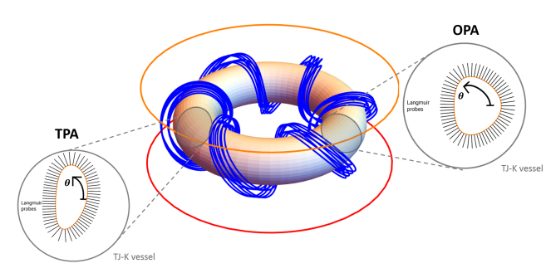
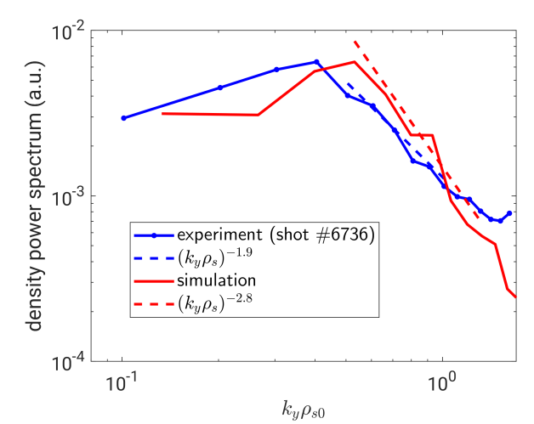

Successful experimental validation with TJK stellarator
Experimental validation in TJK [Coehlo 2023]
Low temperature and small machine with Braginskii model valid in all the domain
Well recovered power spectrum
Turbulent transport is mainly due to global low-m modes

Slide 7
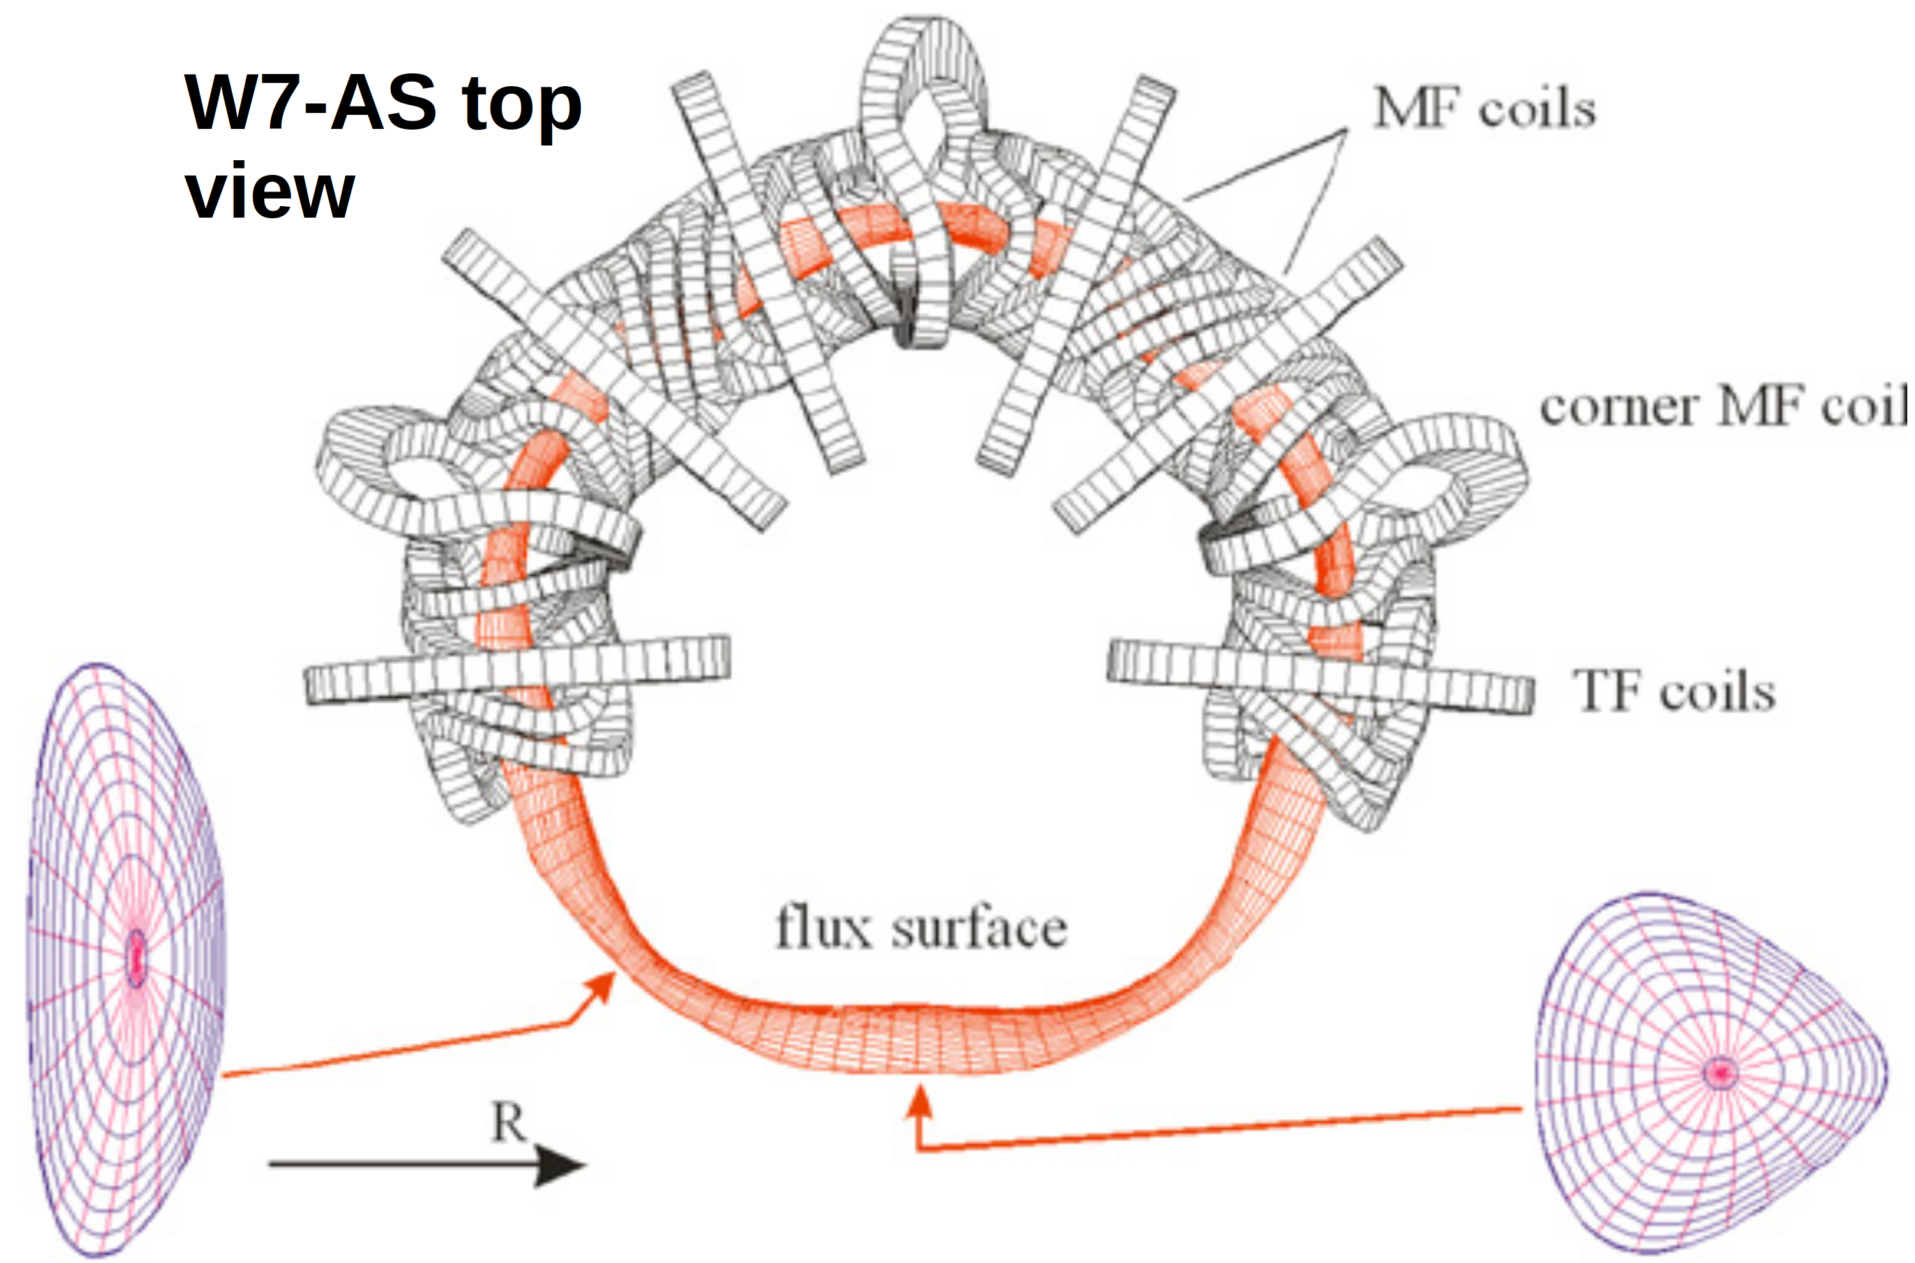
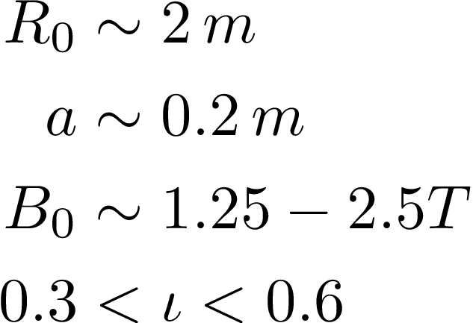
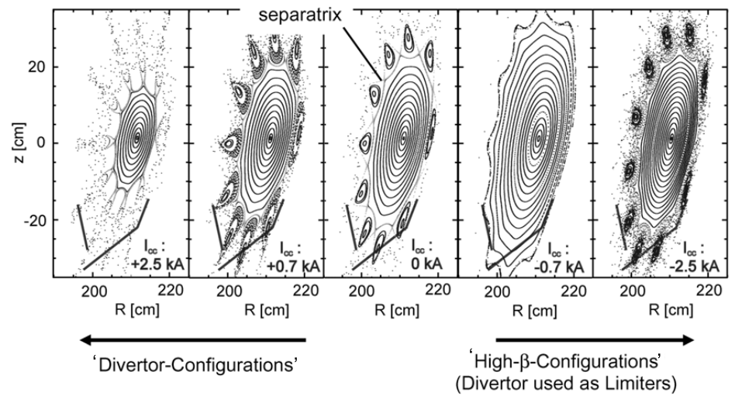

Simulating W7-AS stellarator for turbulence studies in mid-size machines
Great flexibility in vacuum magnetic cofigurations
Typically, in the edge
Large body of literature on experimental measurements [Hirsch, 2008]

Slide 8


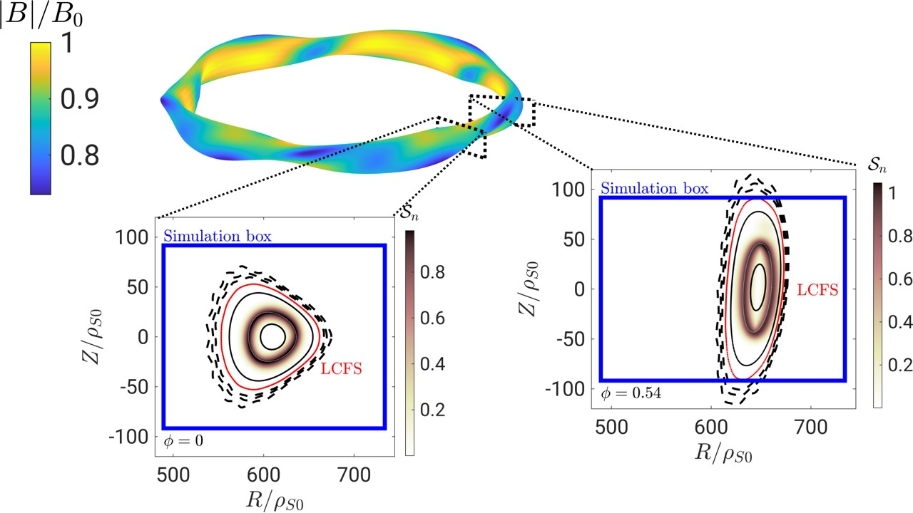
Limited W7-AS in a GBS box
Simulating reference configuration via Dommashk potentials in a scan from quarter-size to full-size

Slide 9
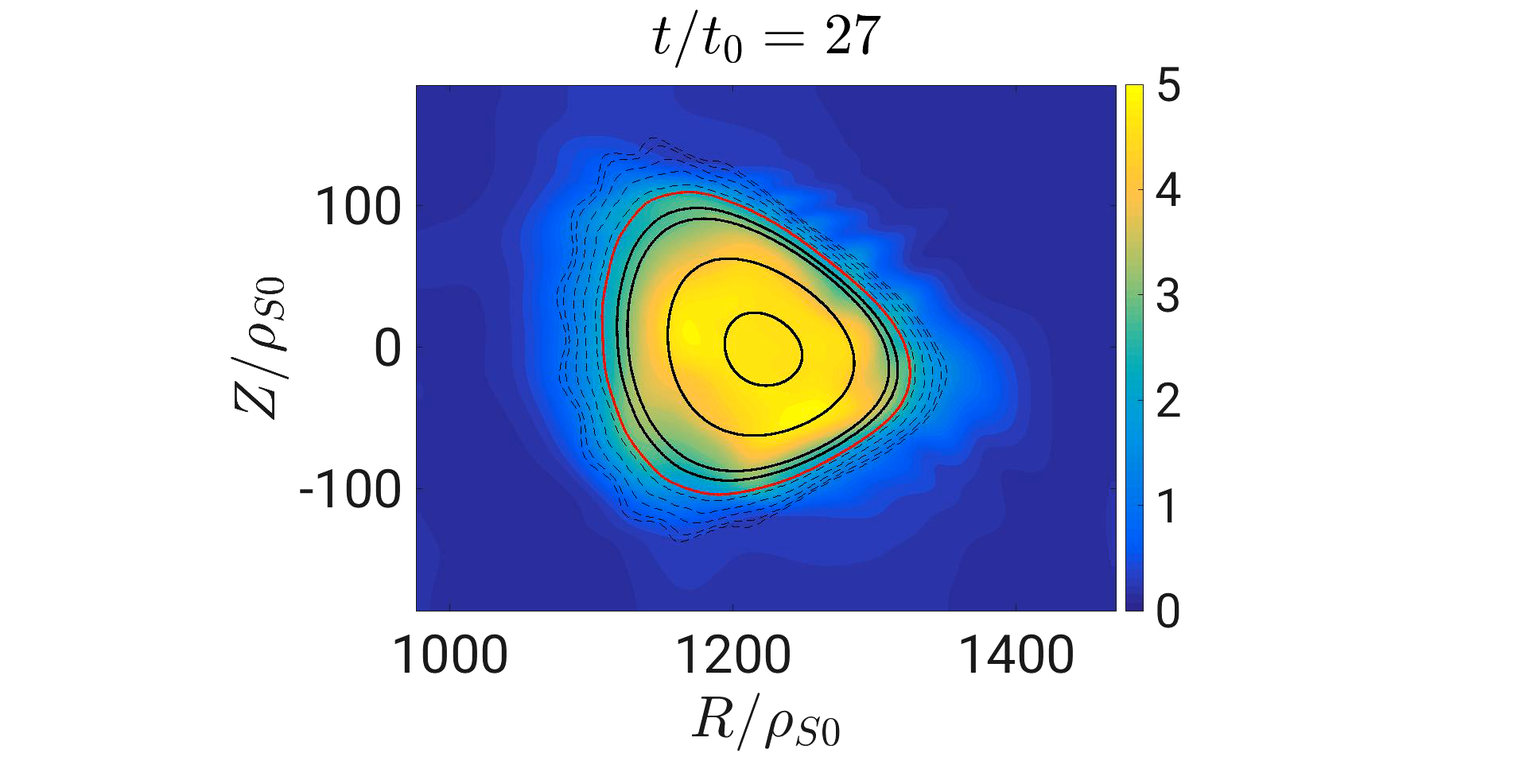
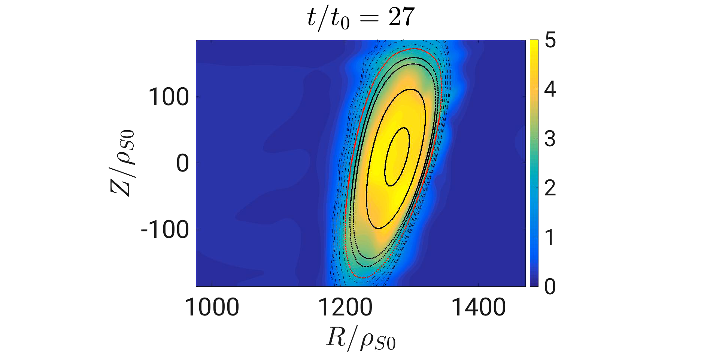
Movie of full density in the steady state

Slide 10
Heat and particles deposited at the limiter position

Slide 11
Time averaged profiles
Confinement particles and heat within the LCFS
Radial electric field changing sign at the LCFS from negative values to positive as in experiments [Brakel, 1997]
Recovering W7-AS optimized Pfirsch-Schluter current modulation [Hirsch, 2008]

Slide 12
Both coherent mode and broadband turbulence observed
Field aligned turbulent spectra shows a superposition of dominant mode and turbulent spectra with decaying exponent of 2.2 in line with experimental measurements between 2 – 4 [Bleuel, 2002]
Density and temperature fluctuations in phase as in experiments [Pfeiffer, 1998]
Inclined structures of the order of few centimeters poloidally and a factor 2 radially [Bleuel, 2002]

Slide 13
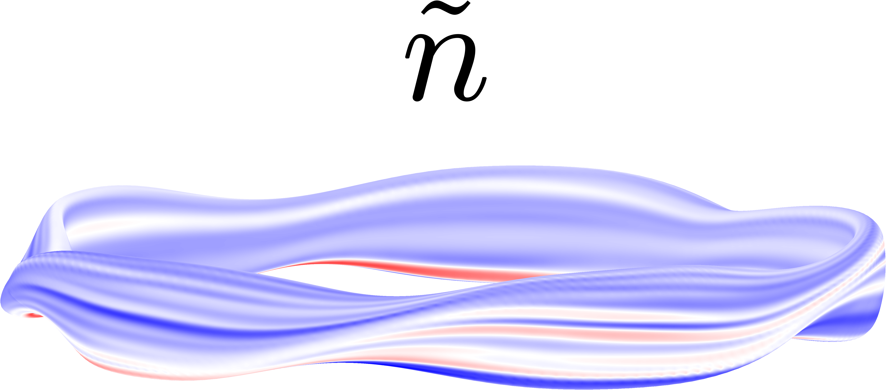


Inside the LCFS a global field aligned mode with (n, m) = (2, 5)
with flat experimentally documented [Bluel, 2002]
Dominant toroidal mode number breaks the magnetic field periodicity, underlying the importance of simulating the full domain
Such macroscopic modes with m = 5 have been observed in experiments in the edge in intermediate beta configurations with x-ray tomography [Hirsch, 2008]

Slide 14
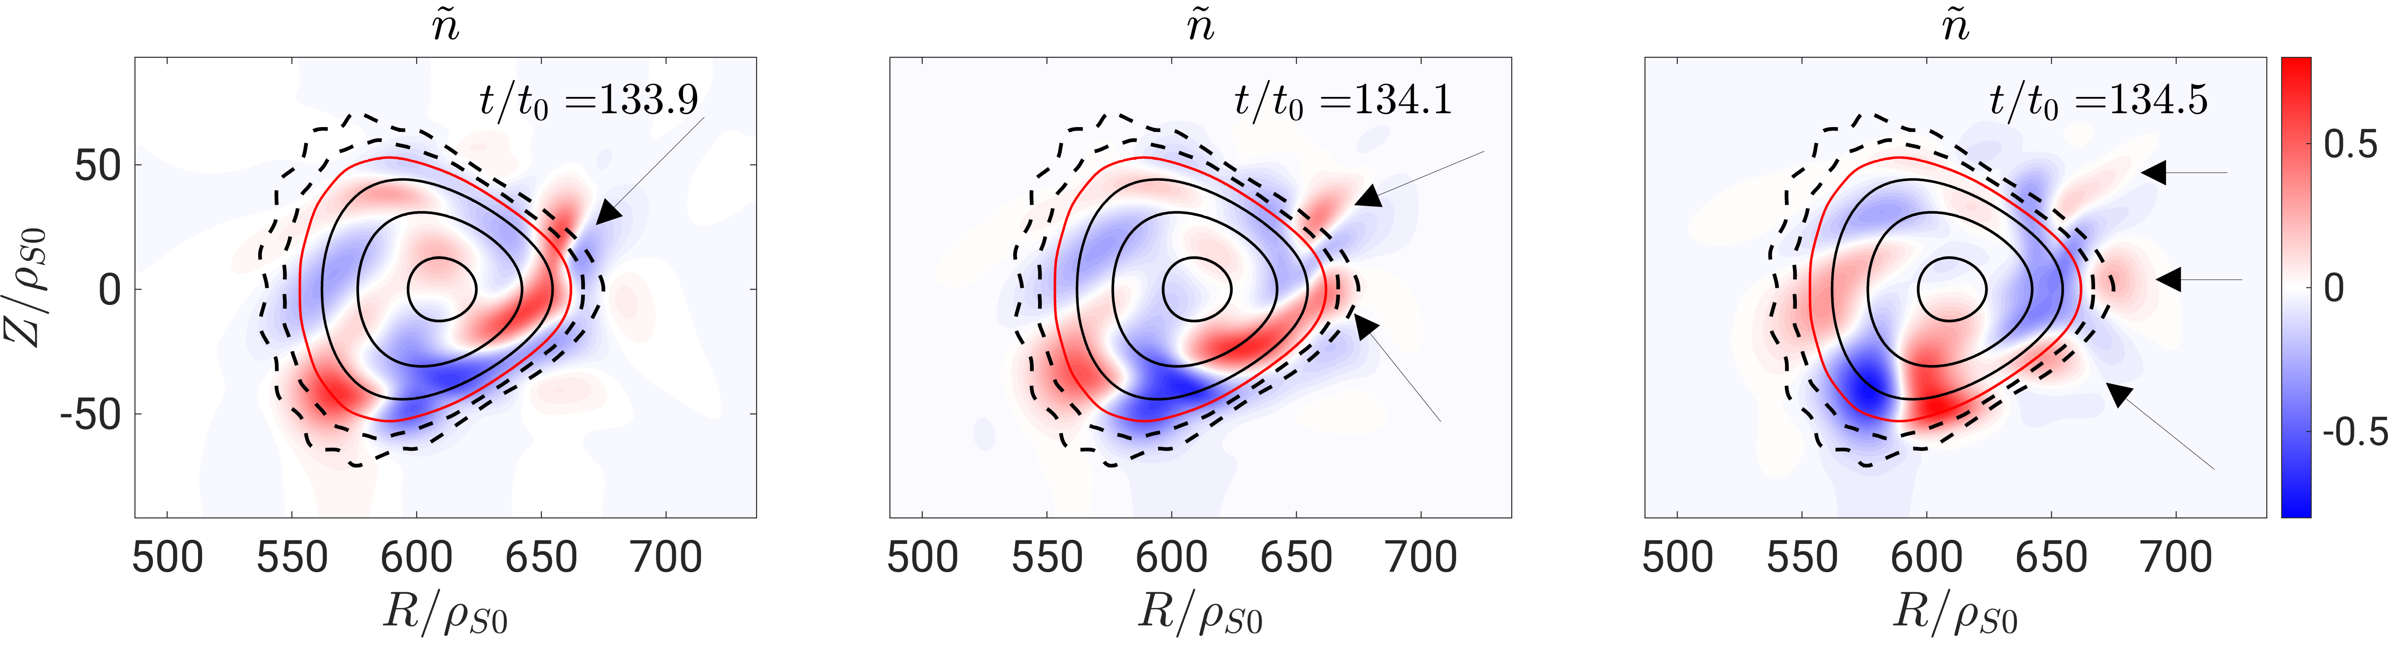
Blobs originating at the LCFS and propagating in the SOL
Blobs have been documented in W7-AS [P. Simon 2014, D.A. D’Ippolito 2011]

Slide 15
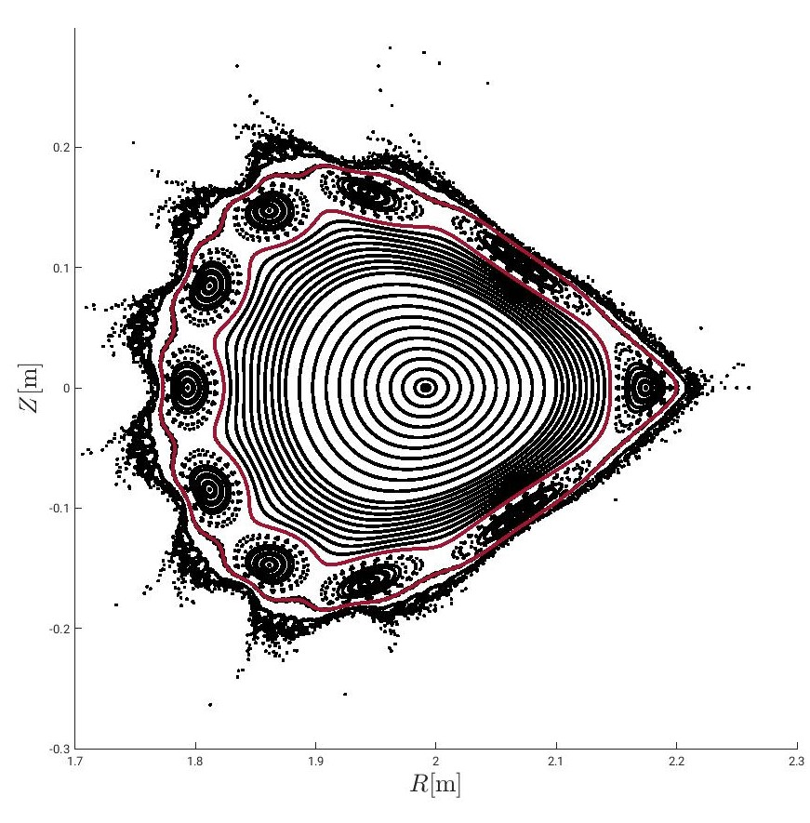
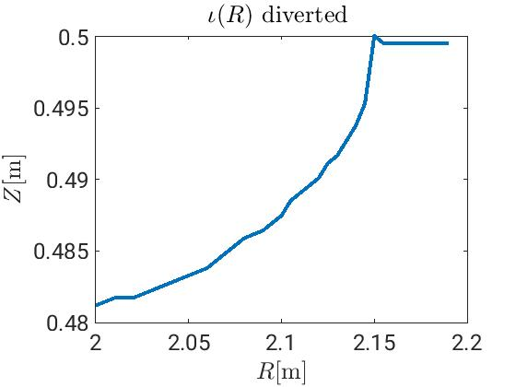
Outlooks
Simulating a double-limited W7-AS qualitatively reproduced the experimental properties in the edge
Understanding the nature of the mode in the simulation (ballooning or drift wave) and characterizing the turbulent ExB flux
Determining the cause of the inclination of the structures in the radial poloidal plane via reversing the magnetic field, excluding between local shear effects or the radial shear of the poloidal velocity.
Simulating an island-diverted configuration for analysing the islands influence on turbulent dynamics

Slide 16
