Slide 1
An electromagnetic model for SOLEDGE3X
3D plot of the simulation
R. Düll* , H. Bufferand, E. Serre, P. Tamain, V. Quadri, N. Rivals, G. Ciraolo, S. Sureshkumar, N. Varendarajan and the SOLEDGE3X team.
This work was granted access to the HPC/AI resources of CINES/IDRIS/TGCC under the allocation 2022 A0120510482 made by GENCI and to the HPC resources of Aix Marseille University financed by the project Equip@Meso (ANR 10 EQPX 29 01). This work has been carried out within the framework of the EUROfusion Consortium, funded by the European Union via the Euratom Research and Training Programme (Grant Agreement No 101052200 — EUROfusion). Views and opinions expressed are however those of the author(s) only and do not necessarily reflect those of the European Union or the European Commission. Neither the European Union nor the European Commission can be held responsible for them.

Slide 2
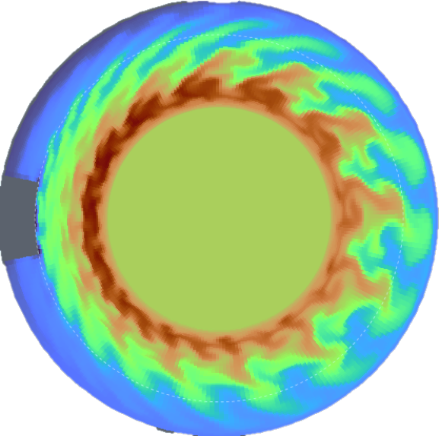
Outline
1.
Electrostatic versus Electromagnetic models
2.
A new vorticity system for Soledge3X
3.
Verification and validation of the model
4.
Electromagnetic turbulent simulations
5.
Conclusions and perspectives

Slide 3
1
Electrostatic versus electromagnetic models

Slide 4
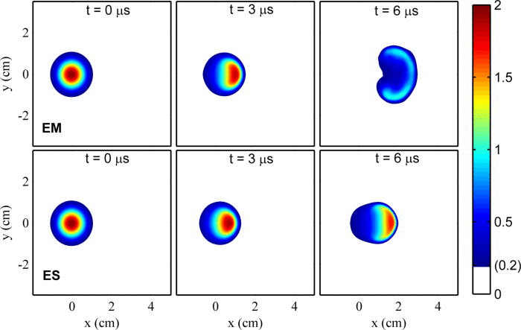
Do we need electromagnetic effects in electrostatic turbulence ?
Non-negligeable effects on edge transport
EM response to external magnetic field variations (e.g. ripple)
Impact on divertor heat transport [Xu et al, NF 2019]
EM flutter stabilizes EM turbulent structures [Zhang et al, NF 2024]
Towards the LH transition
Existence of drift Alfvén turbulence [Scott, PPCF 1997]
Impact on filament shape in turbulent blob propagation [Lee et al, JNM 2015]
Turbulent simulations on large machines (e.g. ITER) require electromagnetic effects
Stronger effects for high-$β$ plasmas
Electron inertia becomes mandatory
Constrain the shear Alfvén wave speed to physical values [Dudson et al, PPCF 2021]
Improvement of the numerical stability [Stegmeir et al, PoP 2019]
Propagation of a plasma blob
from [Lee et al, JNM 2015]
top: electromagnetic, bottom: electrostatic
Key parameter: $β=\frac{p}{p_{mag}}=\frac{enT}{B^{2}/2μ_{0}}$

Slide 5
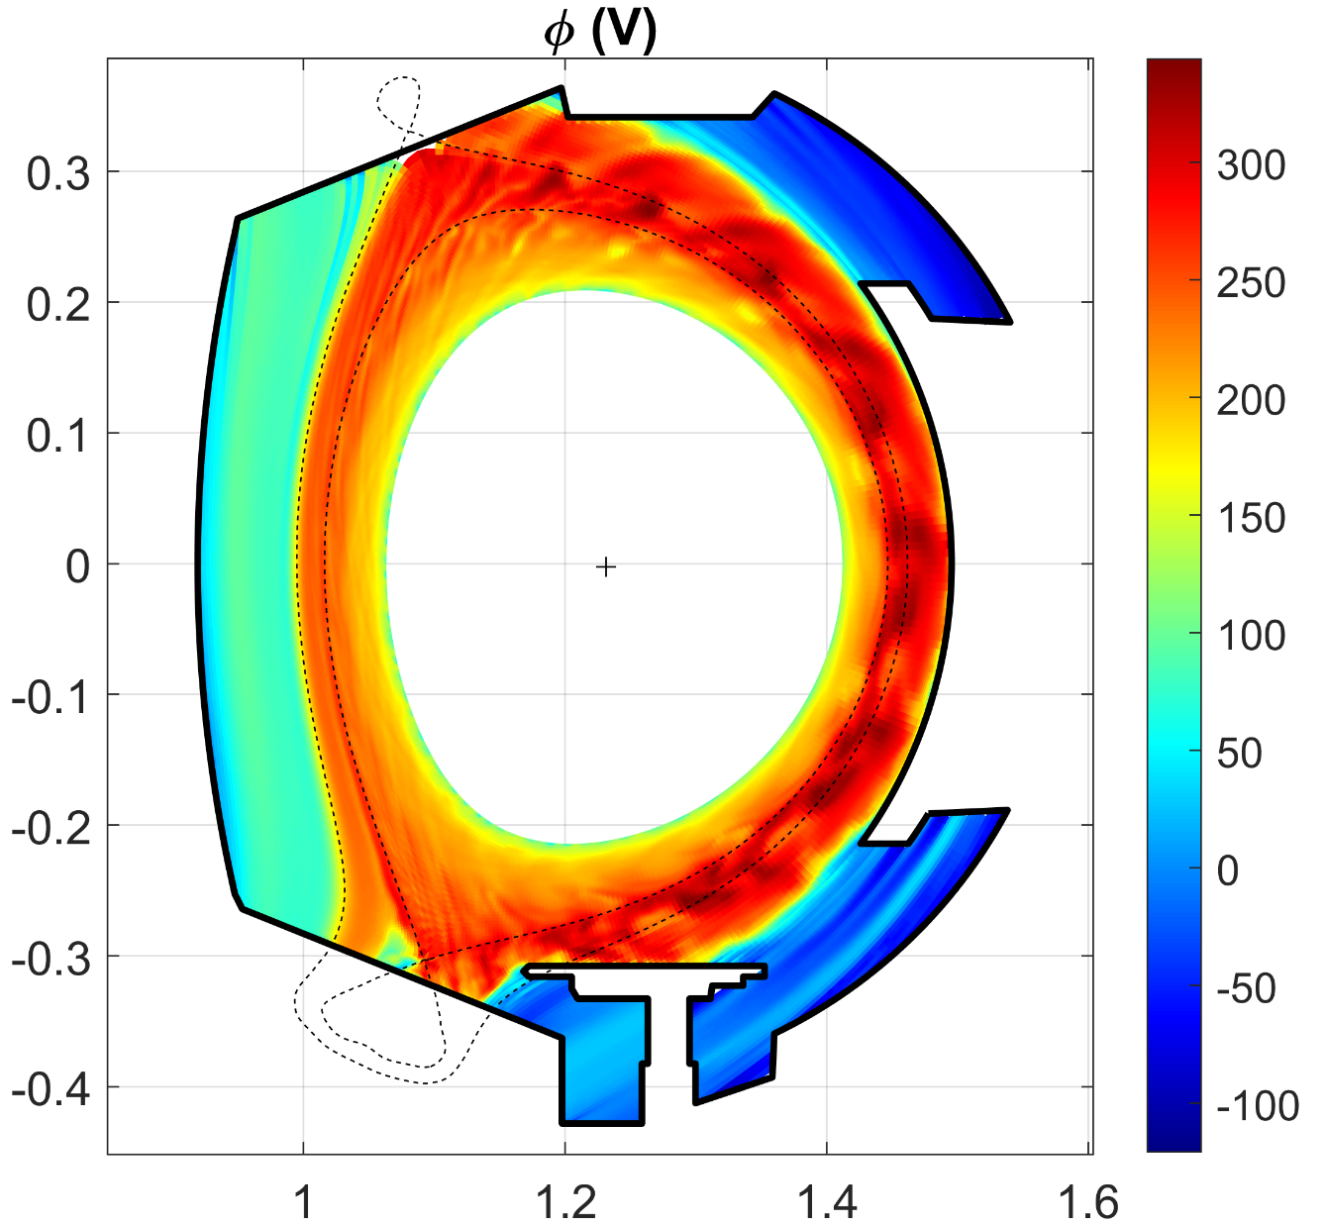
The electrostatic vorticity equation
The electric field for $E×B$drifts is obtained from the potential: $E_{⊥}={−∇}_{⊥}Φ$
The potential appears in:
the vorticity $Ω=∇⋅\left[\frac{m_{i}n_{i}}{{eZ}_{i}B^{2}}∇_{⊥}Φ+ \frac{m_{i}}{{eZ}_{i}^{2}B^{2}}∇_{⊥}p_{i}\right]$
for the polarization current $∇⋅j_{∥}b=−∂_{t}Ω+∇⋅j_{Ω}$
the parallel electric field $E_{∥}b=−∇_{∥}Φ$
for Ohm‘s law $j_{∥}=σ_{∥}\left(E_{∥}+\frac{1}{en_{e} }{(b⋅∇}_{∥}p_{e}+R_{e,∥ })\right)$
The quasineutral assumption $∇⋅j^{tot}=0$ leads to the „vorticity“
equation on $Φ:$
WEST turbulent profile
$$∇⋅\frac{m_{i}n_{i}}{{eZ}_{i}B^{2}}∂_{t}∇_{⊥}Φ+∇⋅\left({σ_{∥}∇}_{∥}Φ\right)b{=∇⋅\left(σ_{∥}\frac{1}{en_{e} }{(∇}_{∥}p_{e}+R_{e,∥ })\right)b+∇⋅\left(j^{∗}+j_{S}+j_{Ω}\right)b}^{}$$
Ratio between
diffusion coefficients:
$$>{10}^{6}$$
High anisotropy →poor numerical condition !

Slide 6
A new vorticity system for Soledge3X
2

Slide 7
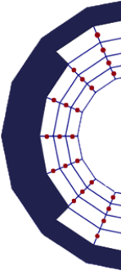
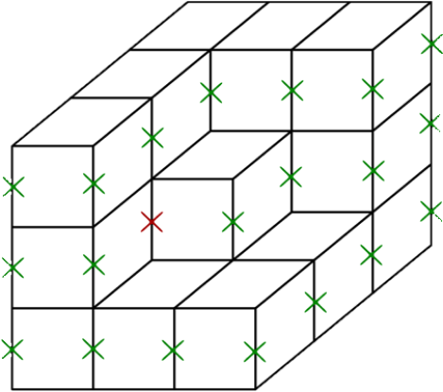
Magnetic induction in the vorticity equation
Implicit system on 3 fields: electric potential $Φ$; parallel magnetic vector potential $A_{∥}$; parallel current density $j_{∥}$
$$∇⋅\left(\frac{m_{α}n_{α}}{B^{2}}∂_{t}∇_{´⊥}Φ\right)=∇⋅\left(j_{∥}b\right)+∇⋅j_{⊥}$$
$$ηj_{∥}+\frac{m_{e}}{n_{e}e^{2}}\left[∂_{t}j_{∥}+∇⋅\left(j_{∥}v_{j}\right)\right]= −b⋅∇Φ −∂_{t}A_{∥}+\frac{b⋅∇p_{e}}{e}+R_{∥,e}$$
$$∇⋅\left({∇_{⊥}A}_{∥}\right)=μ_{0}j_{∥}$$
Vorticity equation
Ohm‘s law
Ampère‘s law
Boundary conditions for $A_{∥}$ and $j_{∥}$ :
Dirichlet $A_{∥}^{BC}$=0 on the sheath and tangential wall
Sheath current $j_{∥}^{BC}=j_{sat}\left(1−e^{Λ−Φ/T_{e}}\right)$
Improved matrix condition expected with a finite electron mass
- Parallel diffusion coefficient on $Φ$: $\frac{1}{η_{∥}}→\frac{1}{η_{∥}+μ}$
with $μ=m_{e}/(m_{u} n_{e}δ_{t})$
$A_{∥}$ and $j_{∥}$ are defined on a poloidally and toroidally staggered grid

Slide 8
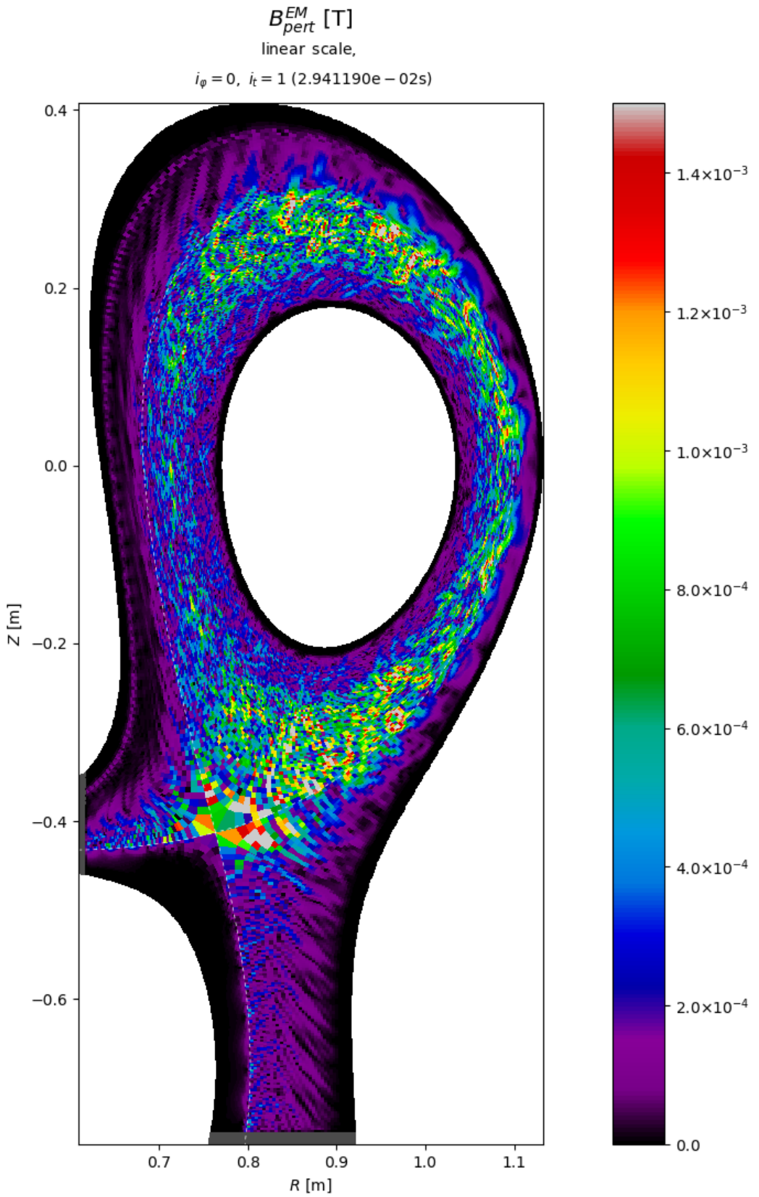
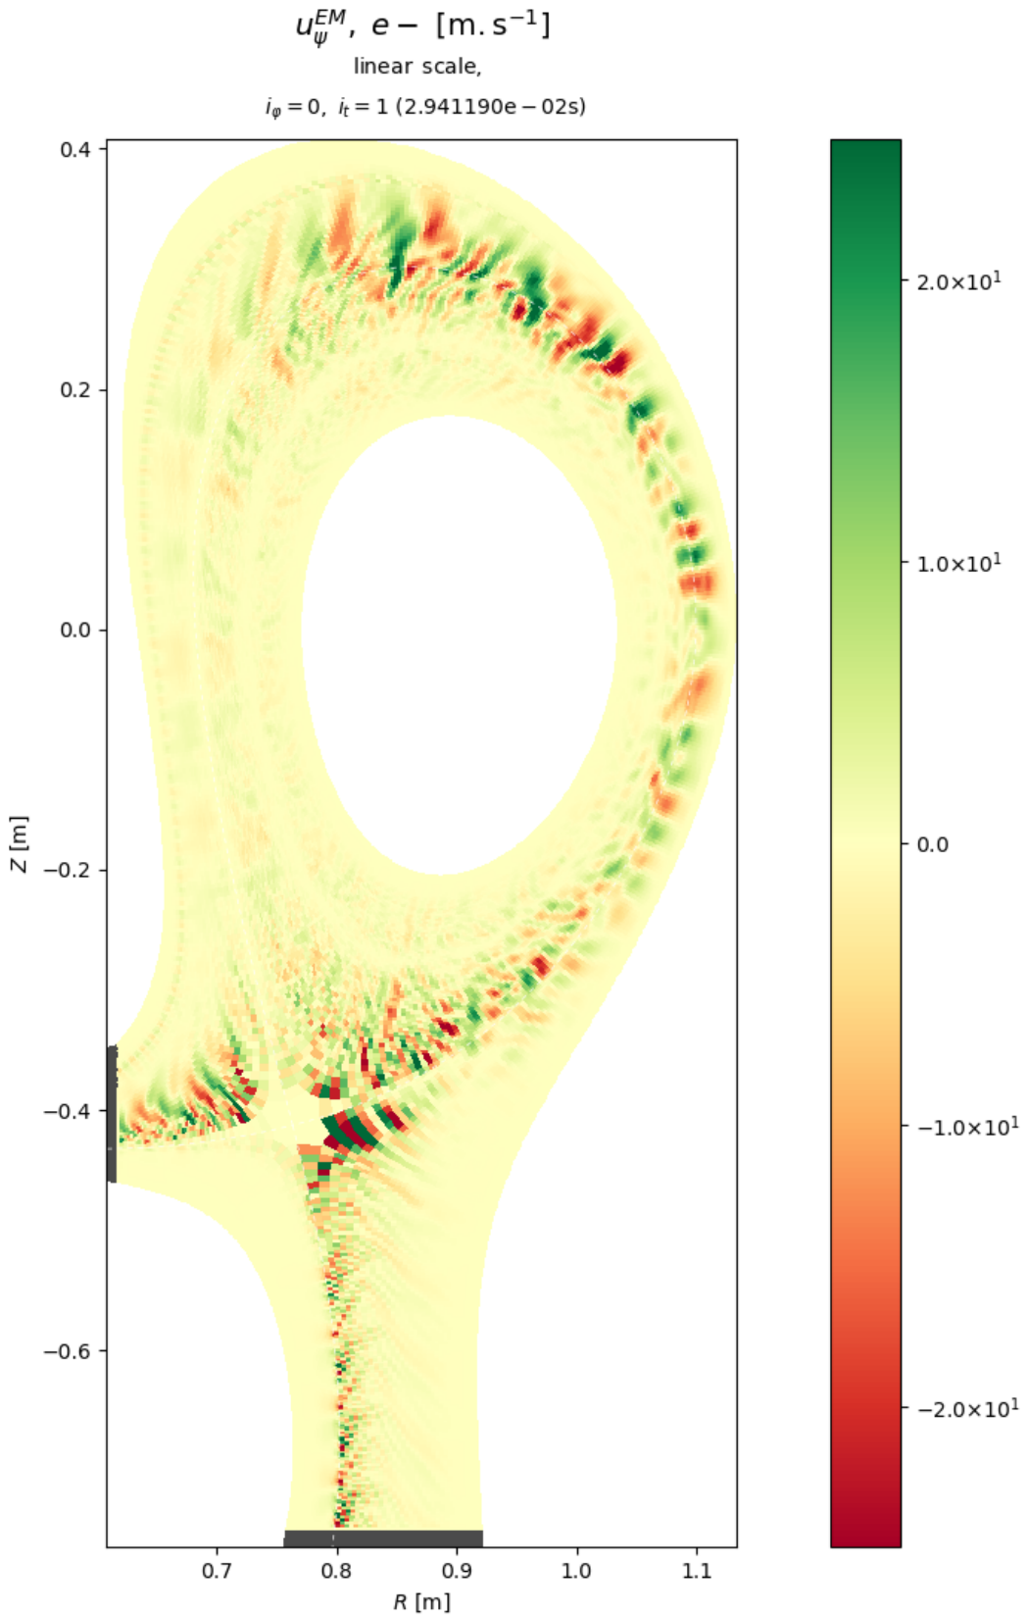
Electromagnetic flutter
Definition of the electromagnetic potential:
$$∇×A=B$$
Assume small perturbations of the equilibrium magnetic field:
$$B=B_{eq}+\tilde{B}$$
From the value of the toroidal perturbation field ${\tilde{A}}_{∥}$:
$$\tilde{B}=\left(∇×b_{eq} \right){\tilde{A}}_{∥}−b_{eq}×∇{\tilde{A}}_{∥}$$
The perturbation field $\tilde{b}$ is calculated from${ \tilde{A}}_{∥}$at the previous timestep
$\tilde{b}$ is considered for the advection and the parallel diffusion of the conserved fluid quantities:
ion density $n_{i}$
ion momentum $n_{i}v_{i}$
electron and ion temperature $T_{e}$ and $T_{i}$
Amplitude of the perturbation field $\tilde{|B}|$ (left) and radial flutter drift velocity (right) for a TCV case with $B_{t}=0.95T$
The plasma $β$ is $\sim {10}^{−3}$ at the core, $\sim {10}^{−4}$ at the separatrix and below $\sim {10}^{−5}$ in the far SOL

Slide 9
Model verification and validation
3

Slide 10
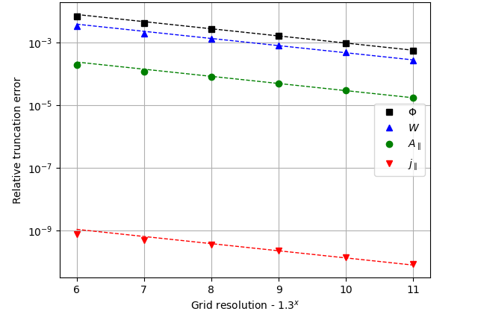
MMS verification
Use the method of manufactured solutions [Roache, SFMA 2019] to check the new system on $Φ$, $A_{∥}$ and $j_{∥}$
Define arbitrary initial profiles and apply analytic source terms to maintain a steady-state solution
The change within one timestep estimates the numerical error
$ψ−θ$ view
$ψ−φ$ view
Estimated numerical errors for different 3D mesh resolutions.
The total number of points was increased by a factor ~2.2 between each run.
The dashed lines indicate the theoretical 2nd order convergence.

Slide 11
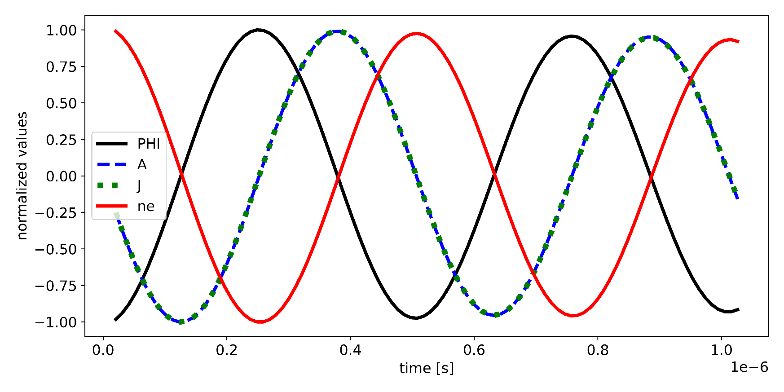
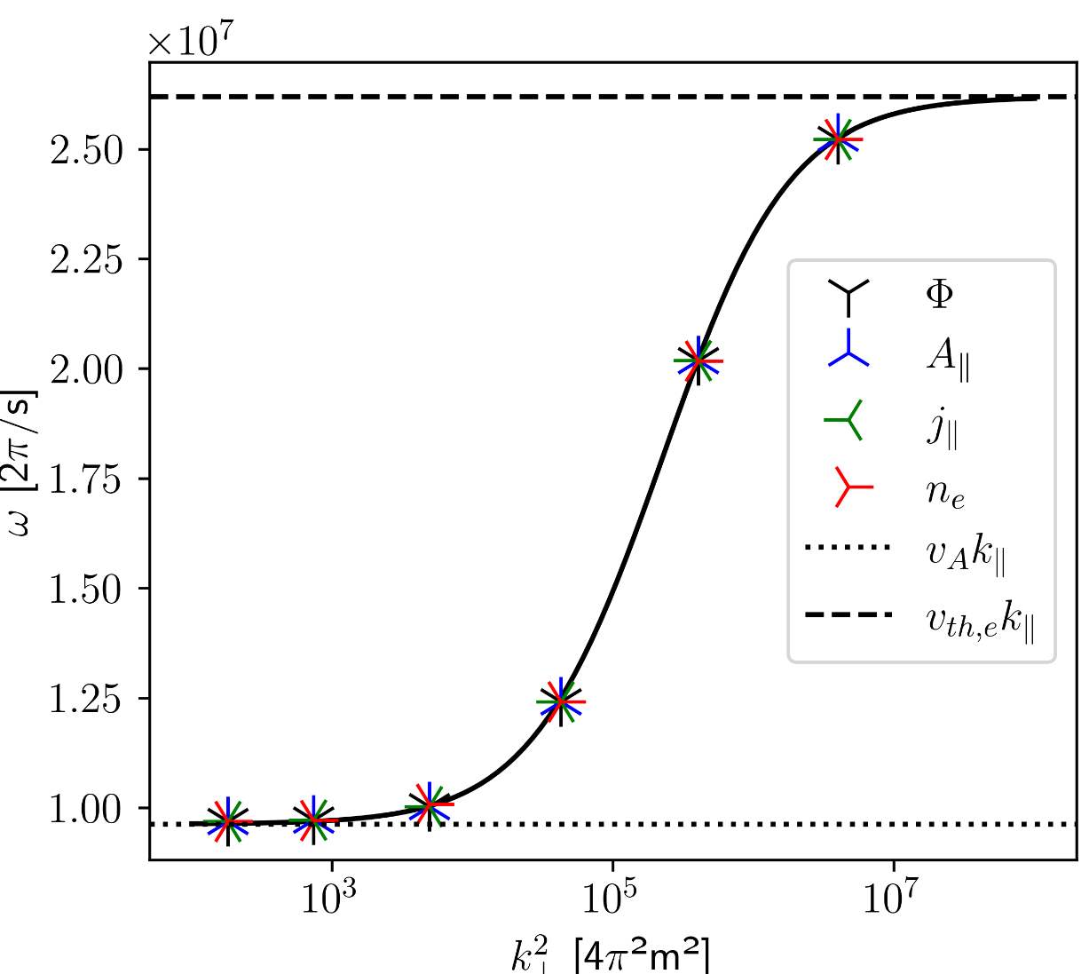
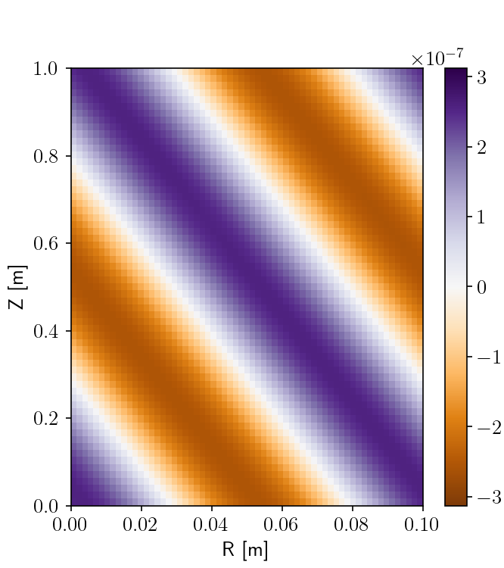
Linear validation
Consider the four-field model on a SLAB domain with uniform magnetic field. Only evolve $n_{e}$, $Φ$, $j_{∥}$ and $A_{∥}$
$∂_{t}n_{e}=\frac{1}{e}∇⋅j_{∥}b$
$$∇⋅\left[\frac{m_{i}n_{i}}{B^{2}}∂_{t}∇_{⊥}Φ\right]=∇⋅\left(j_{∥}b\right)$$
$${\frac{1}{σ_{∥}}j}_{∥}+\frac{m_{e}}{n_{e}e^{2}}∂_{t}j_{∥}=\left({\frac{T_{e}}{e}∇_{∥}\ln{n_{e}}−∇}_{∥}Φ\right)⋅b −∂_{t}A_{∥}$$
$$∇⋅∇_{⊥}A_{∥}=−μ_{0}j_{∥}$$
We expect a decaying standing wave with frequency:
$$ω_{0}^{2}≈\frac{v_{A}^{2}+Kk_{⊥}^{2}}{1+Ck_{⊥}^{2}}k_{∥}^{2}$$
The parallel wave speed is bound by:
Alfvén wave group velocity $v_{A}^{2}= \frac{B^{2}}{m_{i}n_{i}μ_{0}}$ for low $k_{⊥}$
Electron thermal speed $v_{th,e}^{2}=\frac{K}{C}=\frac{eT_{e}}{m_{e}}$ for high $k_{⊥}$
$$A_{∥} [T⋅m]$$
Simulation on a 3D SLAB with 63 points per dimension

Slide 12
Electromagnetic turbulent simulations
4

Slide 13
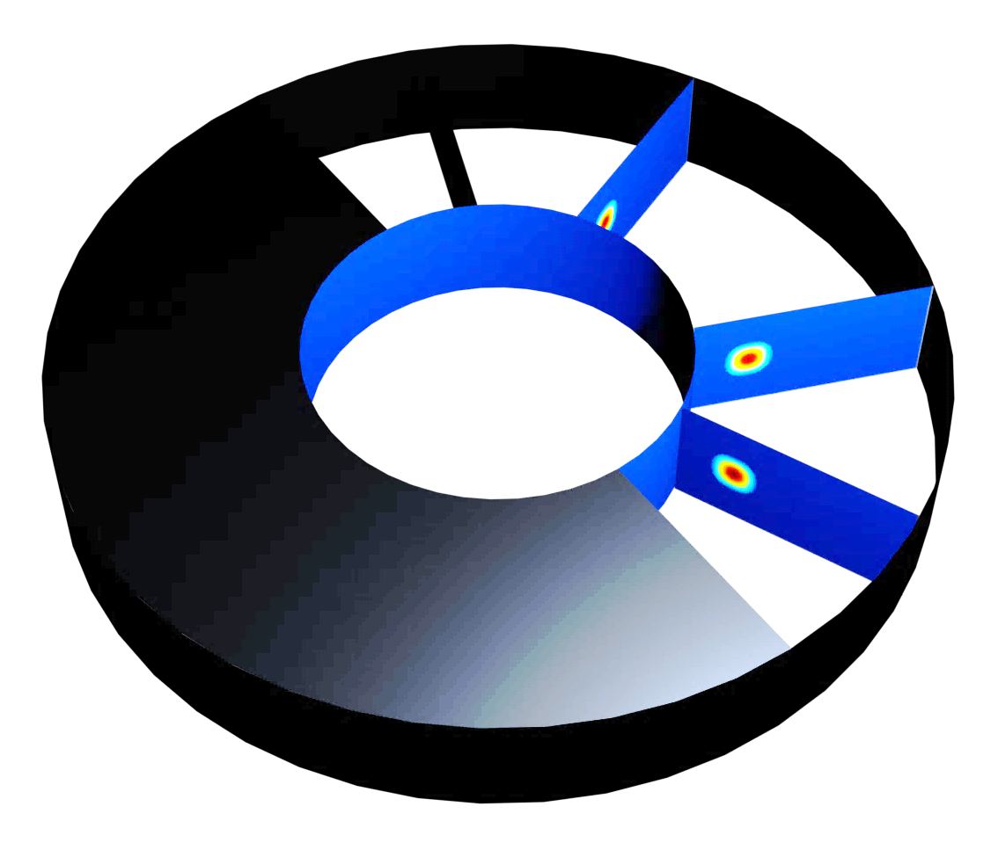
Inductive effects on plasma blobs
We consider a single blob that evolves in a curved slab geometry.
The blob is initialized as a local density perturbation of a background plasma with a high $β≈{10}^{−2}$ where magnetic induction has a strong impact on the formation of the turbulent filaments.
As the blob diffuses into the background plasma, Its 𝛽 value decreases and classic drift wave dynamics dominate again

Slide 14
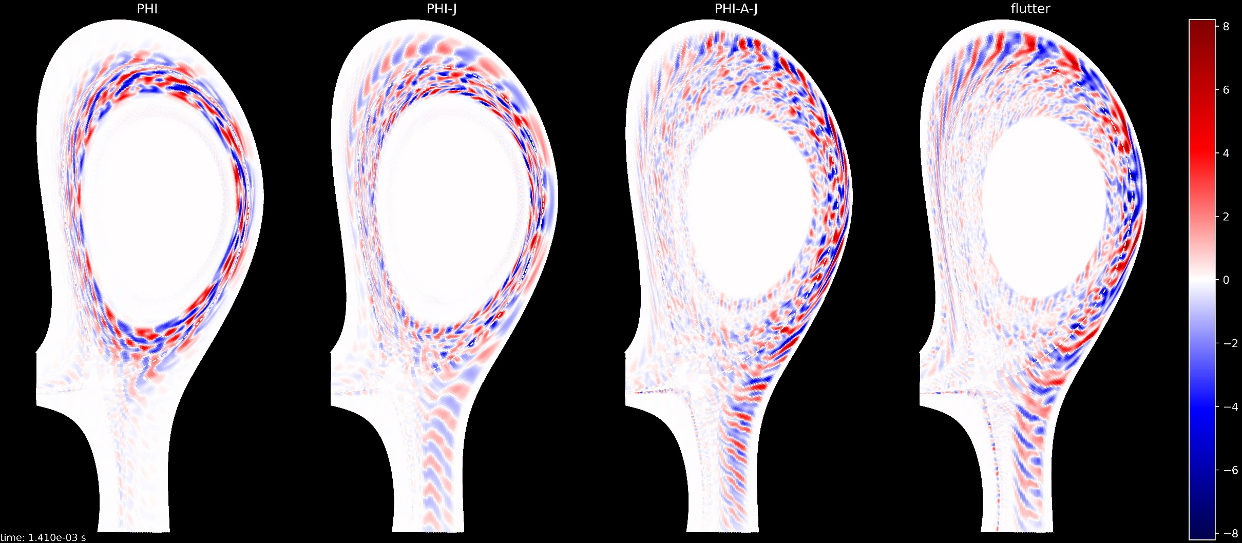
Impact on turbulence with the TCV-X21 case (1)
Simulation of a quarter of a torus with ~2e6 cells
Density feedback on the separatrix to $n_{sep}=7⋅{10}^{18} part/m^{3}$
200kW ohmic heat source and fluid neutrals with 90% recycling
Toroidal perturbations of the electron temperature $T_{e}$ [eV] after 1.4ms simulated time

Slide 15
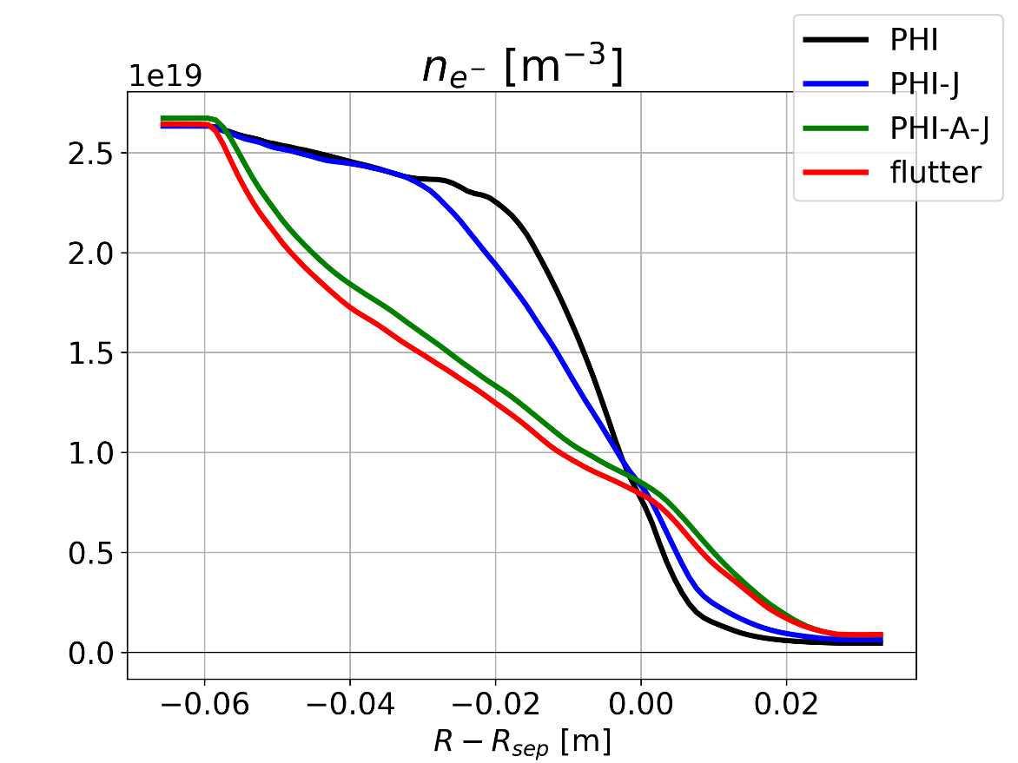
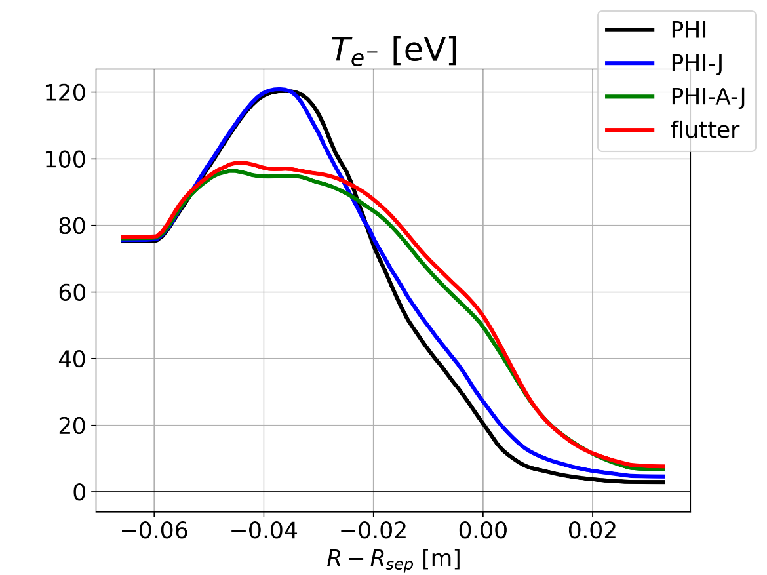
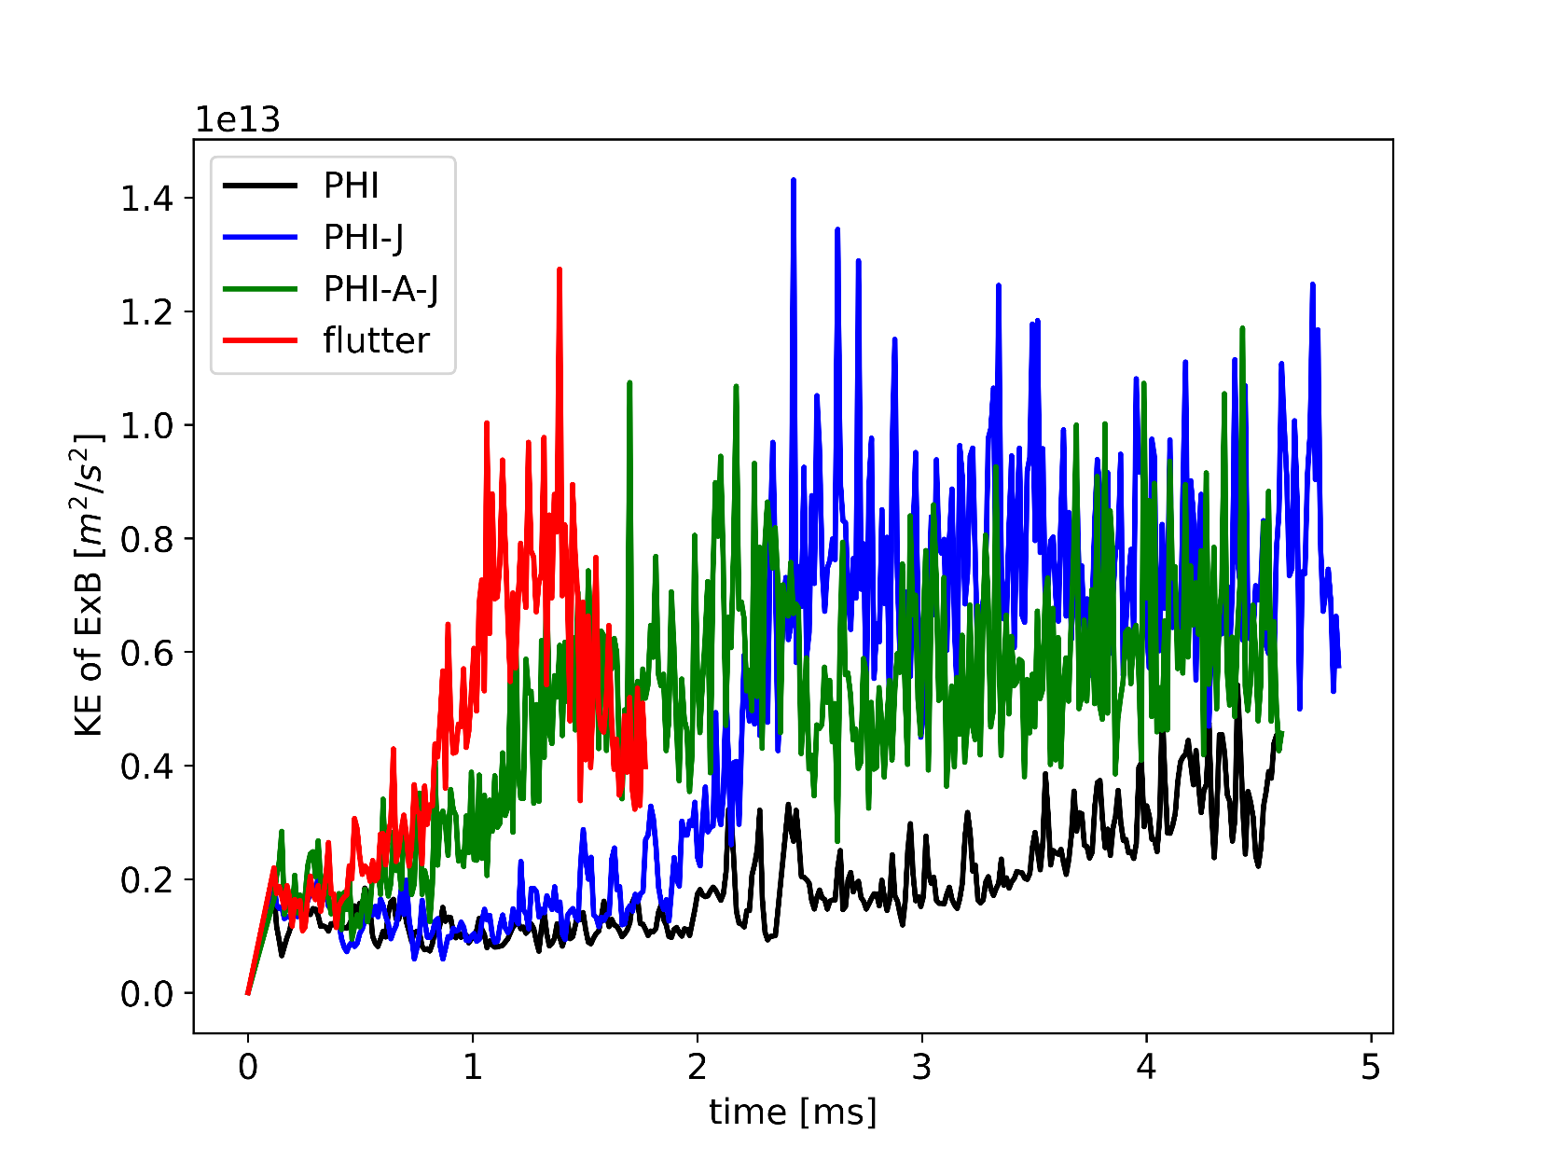
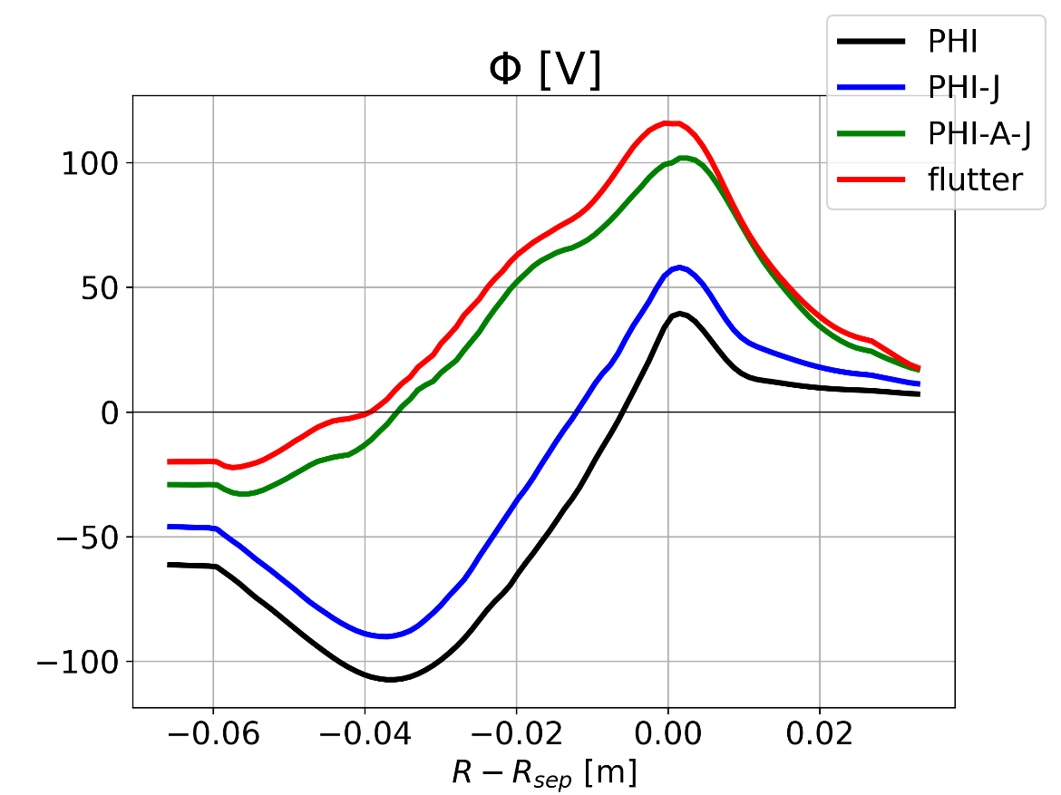
Impact on turbulence with the TCV-X21 case (2)
Total kinetic energy of the ExB drift velocity over the full simulation time
Mean profiles at the OMP after 1.8ms averaged over the toroidal direction and the last 40 available plasma saves

Slide 16
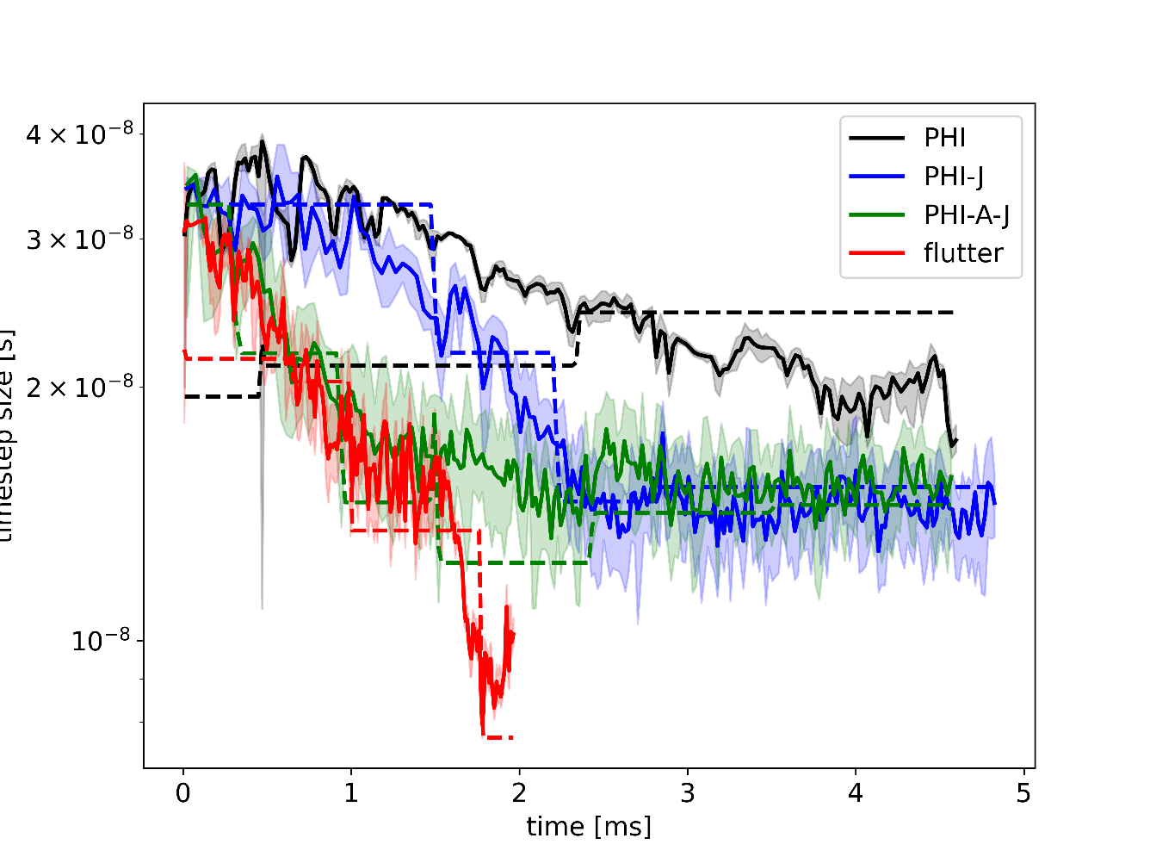
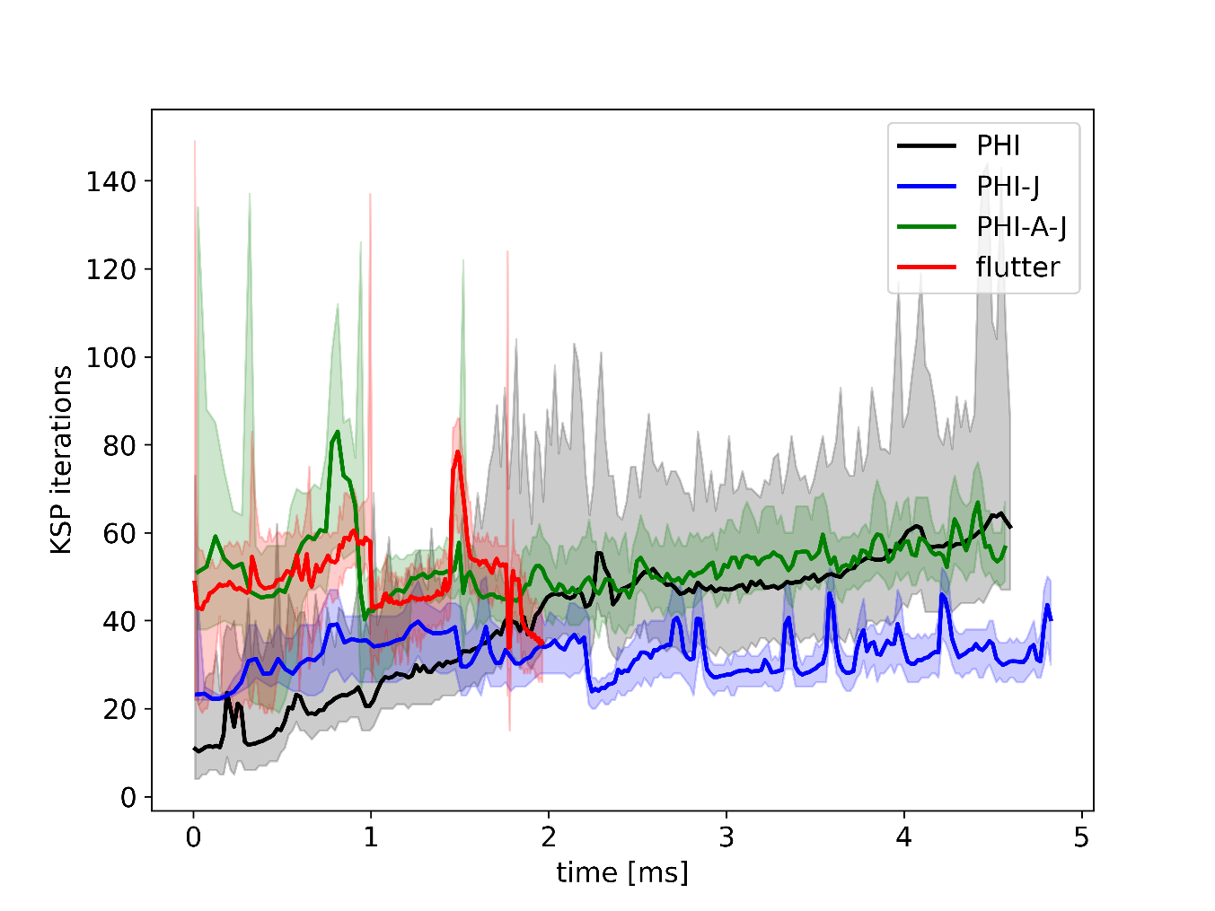
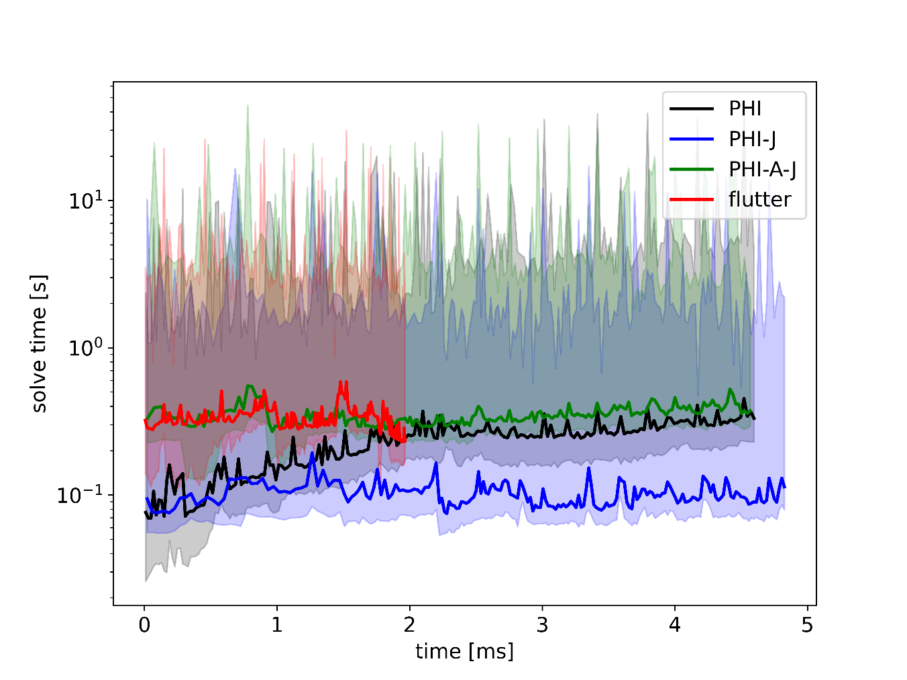
Numerical implications
Simulations run on MARCONI with 768 cores on 16 nodes
PETSc iterative solver: GMRES with multigrid GAMG preconditionner
1 – optimal timestep size (to match theCFL condition) 2 – number of iterations of the implicit solver 3 – CPU time spent on the vorticity system per timestep
Electron inertia reduces the computing time
Magnetic induction only slightly decreases the performance compared to the electrostatic reference

Slide 17
Conclusion
5

Slide 18
Conclusion
Addition of two new fields to the SOLEDGE3X model:
the parallel electromagnetic vector potential $A_{∥}$ known from Ampère’s law
generates magnetic induction in the parallel electric field
causes small perturbations to the magnetic equilibrium
A finite electron mass to reduced Ohm’s law causing inertia of the parallel current density $j_{∥}$
improves the numerical stability
constrains the Alfvén wave speed
Verification via the Method of Manufactured Solutions and validation on a linear test case
Even at low $β$, electromagnetic effecs impact drift-wave turbulence
Magnetic induction affects blob propagation and filament formation
Flattening of mean profiles and increased turbulent transport
Flutter only has a local impact on filament shapes
Additional numerical costs for electromagnetic effects remain within limits

Slide 19
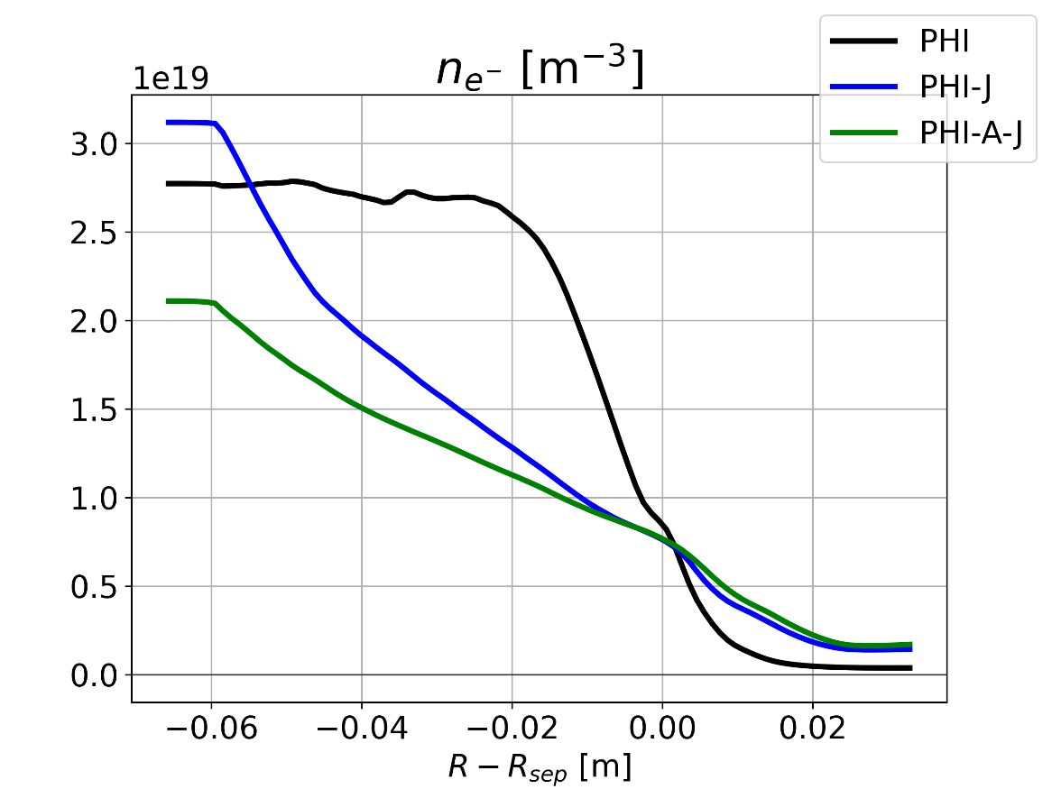
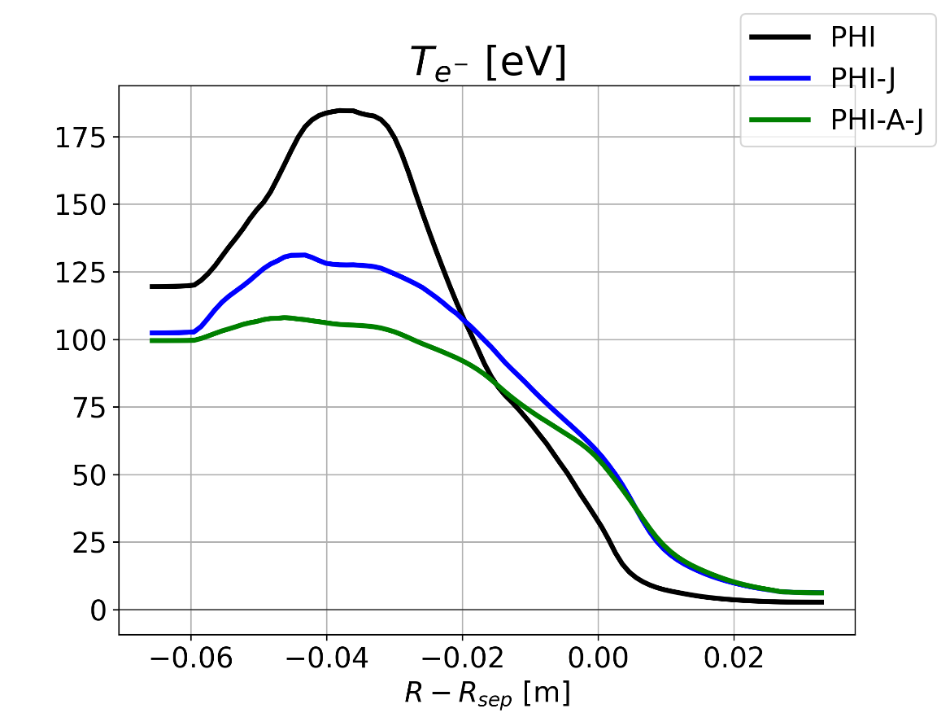
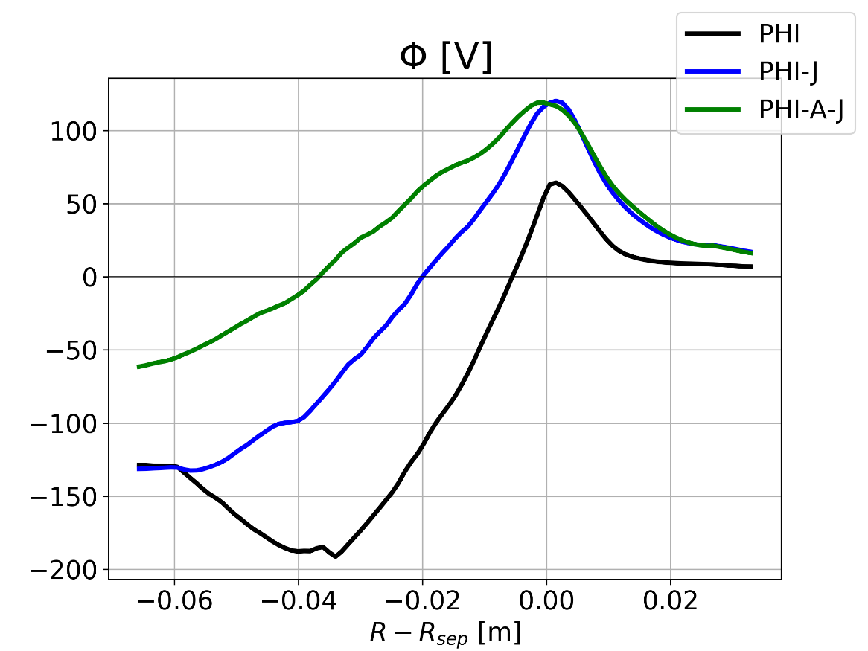
Backup: OMP mean profiles after 4.5ms
after 1.8ms:
after 4.5ms:

