Slide 1
Preliminary analysis of the turbulent transport in SOLEDGE3X + update on parallel Model
O. Renders, W. Dekeyser, M. Baelmans
KU Leuven, Department of Mechanical Engineering, Leuven, Belgium

Slide 2
Content
(Preliminary) Analysis SOLEDGE3X:
Motivation
Postprocessing scripts: methodology
First results (feedback previous workshop):
Decomposition of particle and energy fluxes
Poloidal maps of turbulence characteristics & Diffusion coefficients
First test: shearing?
Outlook
Update on parallel model: re-interpretation of particle picture

Slide 3
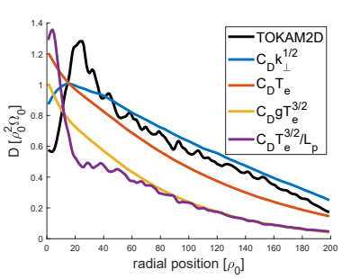
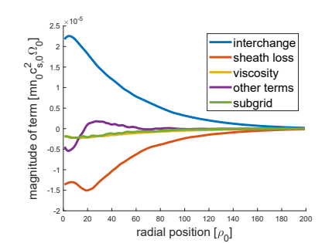
Motivation
Coosemans et. Al.:
development of a reduced turbulence model for plasma edge, based on 2D plasma turbulence simulations (TOKAM2D), and found:
$⇒$3D turbulence simulations
$\overline{p^{′}∇⋅v_{E}^{′}}→$ $\sim −\left(\tilde{T}\overline{n^{′}v_{E}′}+\overline{nv_{E}^{′′}T^{′′}}\right)⋅∇lnB²$
$$−D∇\overline{n}$$
$$−\overline{n}χ∇\tilde{T}$$
(if turbulent flux would only originate from ExB-drift)
$$\overline{φ^{′}∇_{∥}J_{∥}′}→∇_{∥}\overline{φ^{′}J_{∥}′}$$

Slide 4
Postprocessing scripts: methodology
Plasma state snapshot
Plasma state snapshot
Toroidally Averaged
Snapshot
“Batch” averaged State
Totally averaged state
$$n^{i}$$
$$p^{i}$$
$${\left(nv_{E}\right)}^{i}$$
$${\left(pv_{E}\right)}^{i}$$
$${\left\langle n\right\rangle }_{φ}^{i}$$
$${\left\langle p\right\rangle }_{φ}^{i}$$
$${\left\langle nv_{E}\right\rangle }_{φ}^{i}$$
$${\left\langle pv_{E}\right\rangle }_{φ}^{i}$$
$${\left\langle n\right\rangle }_{φ,t}^{I}$$
$${\left\langle p\right\rangle }_{φ,t}^{I}$$
$${\left\langle nv_{E}\right\rangle }_{φ,t}^{I}$$
$${\left\langle pv_{E}\right\rangle }_{φ,t}^{I}$$
$${\left\langle n\right\rangle }_{φ,t}^{ }$$
$${\left\langle p\right\rangle }_{φ,t}^{ }$$
$${\left\langle nv_{E}\right\rangle }_{φ,t}^{ }$$
$${\left\langle pv_{E}\right\rangle }_{φ,t}^{ }$$
$$n^{i}$$
$$p^{i}$$
$${\left(nv_{E}\right)}^{i}$$
$${\left(pv_{E}\right)}^{i}$$
“Batch” averaged QoI’s
Totally averaged QoI’s
(+) Figures today produced with this meth.
(-) [Limit scope on balance of turbulence identifiers]
(-) Verification of functions still to be done
(-) UQ atm unkown
(-) $Δ_{t}=20$snaps.
${\tilde{T}}^{I}={\left\langle p\right\rangle }_{φ,t}^{I}/{\left\langle n\right\rangle }_{φ,t}^{I}$
$${\tilde{v_{E}}}^{I}$$
$${\overline{\left(p^{′}v_{E}^{′}\right)}}^{I}$$
$${\tilde{T}}^{ }$$
$${\tilde{v_{E}}}^{ }$$
$${\overline{\left(p^{′}v_{E}^{′}\right)}}^{ }$$
Aim: Uncertainty information

Slide 5
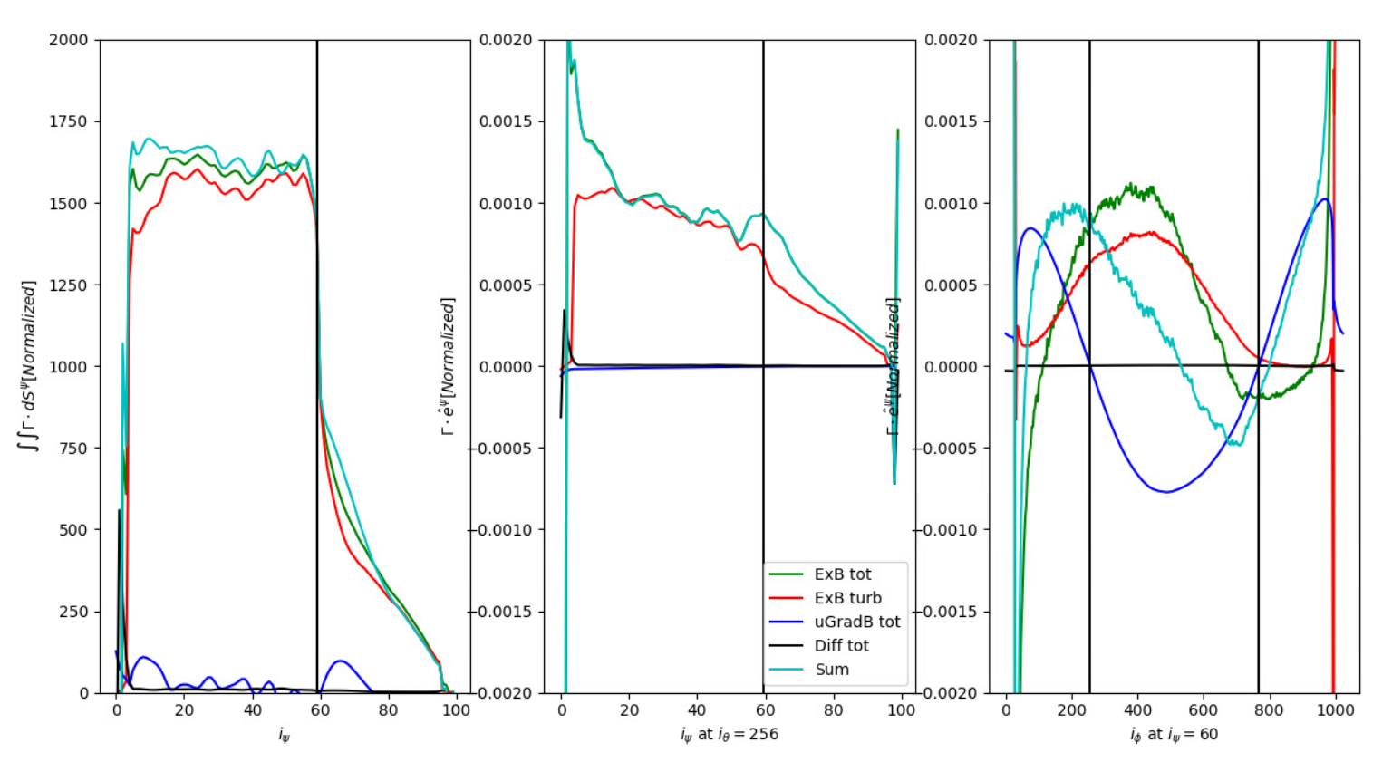
Decomposition of particle fluxes
Note: all are in normalised units

Slide 6
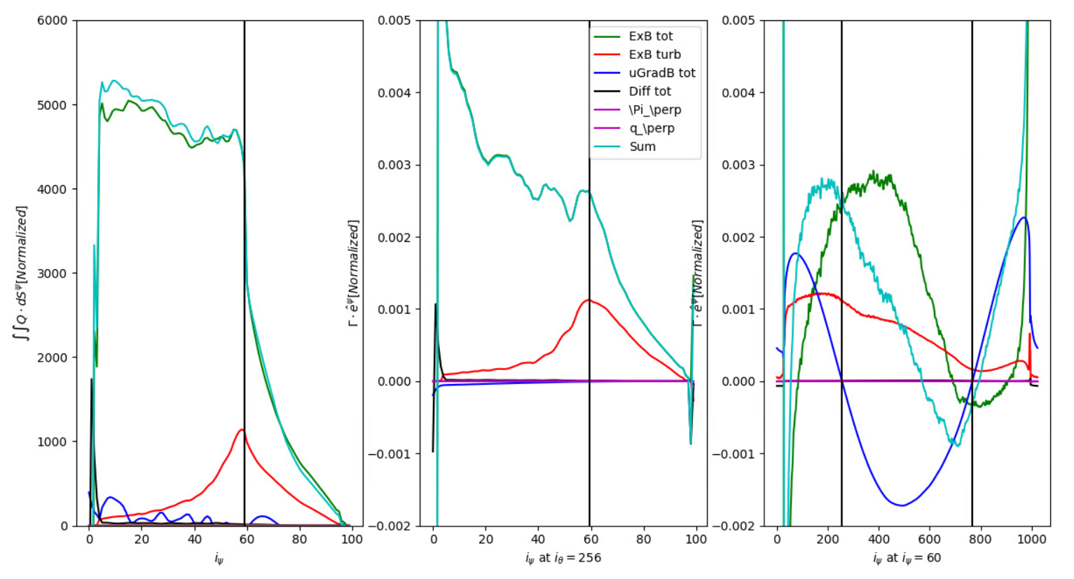
Decomposition of energy fluxes
Note: all are in normalised units
$\tilde{T}\overline{n^{′}v_{E}′}+\overline{nv_{E}^{′′}T^{′′}}$ is dominant contribution (at OMP / FS-integral)

Slide 7
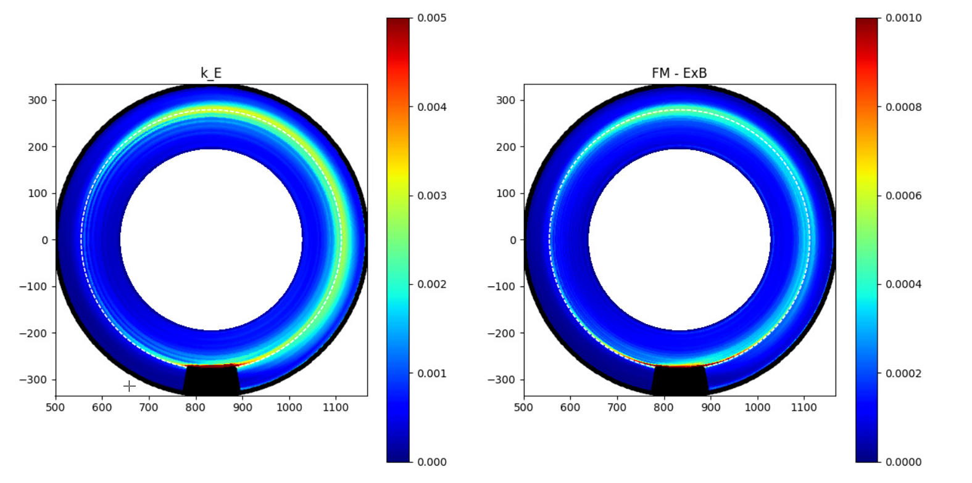
Poloidal maps of turbulence characteristics
Note: all are in normalised units
$$ω=∇×V_{E}$$
$$ξ=\frac{\overline{nmω^{2}"}}{2}$$

Slide 8
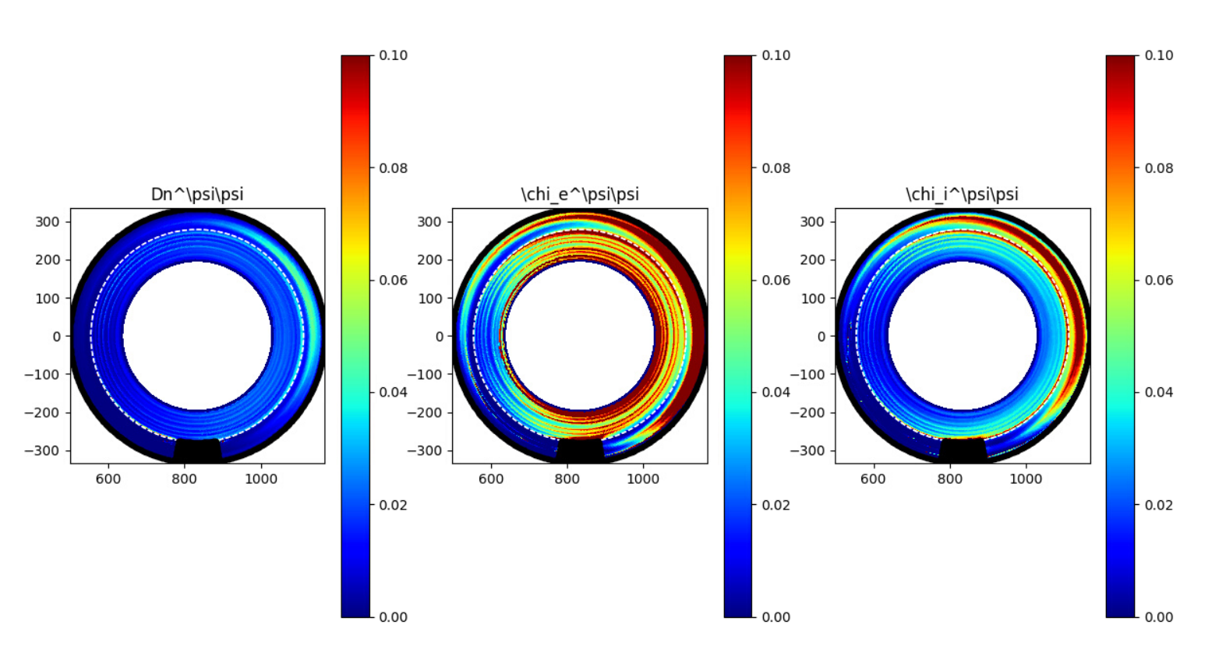
Poloidal maps of Diffusion coefficients
$$D_{simple}=\left[\begin{matrix}D_{ψψ} & 0 \\ 0 & D_{θθ}\end{matrix}\right]=D^{i,i}e_{i}e_{i}$$
Note: all are in normalised units
‘Classical dependency’: $q_{ano}∝∇\tilde{T}$

Slide 9
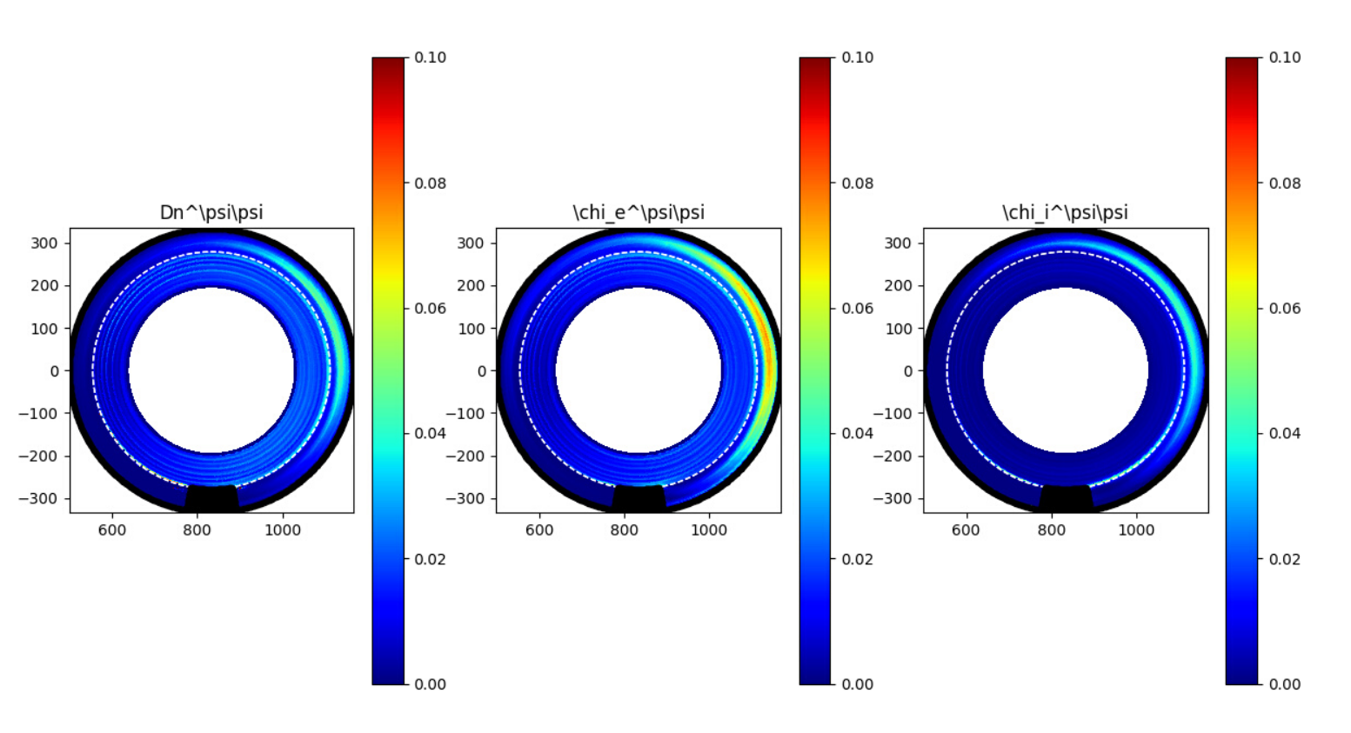
Poloidal maps of Diffusion coefficients
Note: numerical factor
could be ~5/3
Note: all are in normalised units
Alternative dependency: $q_{ano}∝∇\overline{p}?$
(Would imply $χ_{p}=0$ for an isothermal plasma simulation ...)

Slide 10
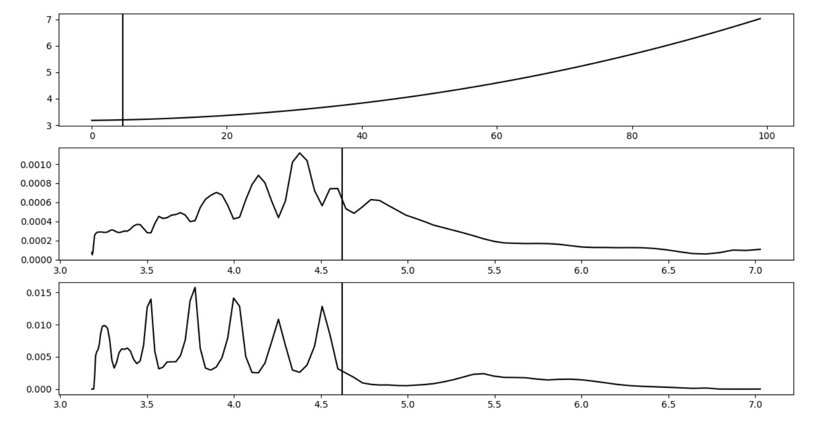
Resonant magnetic surfaces?
Note: all are in normalised units
Inner midplane profiles:
Safety factor [turns]
$$i_{ψ}$$
$$k_{E}$$
Safety factor [turns]
With periodicity 4, indeed $\frac{14,,,18}{4}$
$$D_{n}^{ψψ}$$
Safety factor [turns]

Slide 11
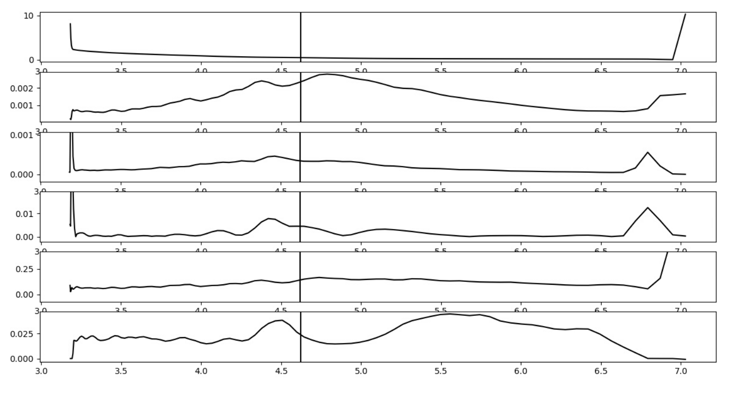
First test: shearing?
Note: all are in normalised units
$$n$$
$$k_{E}$$
$$ξ$$
$$||∇\tilde{U_{E}}+∇{{\tilde{U}}_{E}}^{T}−…||$$
$k_{E}$/$ξ$
$$D_{n},ψψ$$

Slide 12
Outlook
Verification of my routines/functions
Further investigation on turbulent transport (upstream)
Shearing rate (definition)?
Analysis balance of turbulence characteristics ($k_{E}$, $ξ$)
Closure model proposal/development
Limiter / Divertor configuration with neutrals (?)
GRILLIX analysis
Notes:
I.e. how to model the diffusivities

Slide 13
Update on parallel model
Original formulation [PET19] couldn’t converge in ‘more radially outward’ locations.
Origin: momentum conservation and assumption of fixed ionisation zone
First adaptation:
Ansatz: Variable length of ionisation zone based on ‘importance criteria’ for the iz-reaction rate at entrance of the zone
Problem: model would predict very low temperatures at target (-> ‘detached’)
Second adaptation:
Artifically limit size of izZone to remain ‘attached’
Consequence: model prediction compared to SOLPS-ITER worse

Slide 14
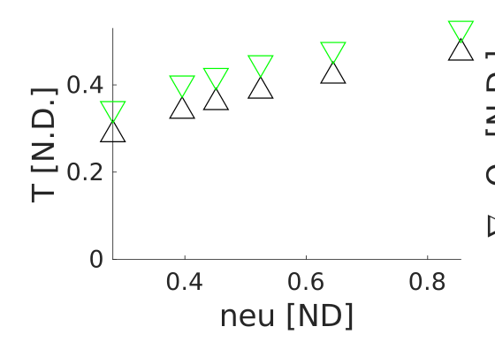
Update on parallel model
Note: all are in normalised units
But:
Never explicitly used (within model) that $Γ_{∥}^{i}=ax_{∥}$!
Hence, i.s.o. neutrals leaking away from izZone, can assume all would ionize within FT (as in SOLPS), which improved match

Slide 15
Note: interpolating to finer grids
(Note: when performing first simulations on a coarser mesh and then naively interpolating the plasma fields n,p,W to the finer mesh, the potential profile changed ‘very’ much leading to not convergence of the model. [However it is also noteworthy that potential profile changes, so also the ExB motion will.]
=> in stead of naively interpolating W to the fine grid, the potential was interpolated and then W was determined so that it would give rise to the SAME potentials. [I.e. by evaluating the discretised equation for phi and inferring what the W would need to be.])

