Slide 1
Observation of FMM-like behaviour in MMG configuration
C. Killer, D. Cipciar, J. Geiger

Slide 2
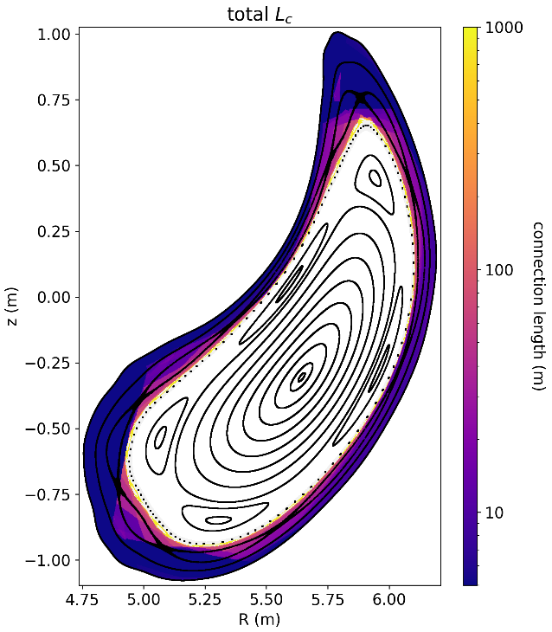
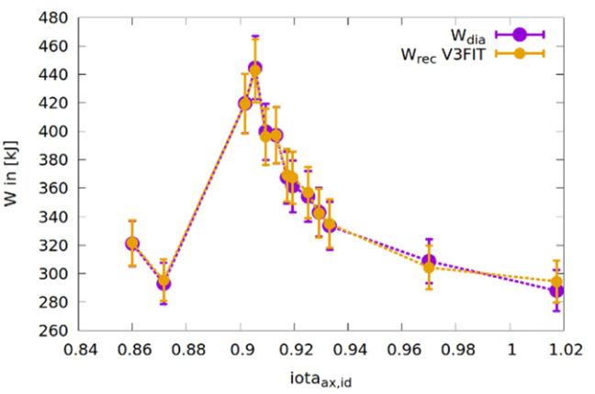
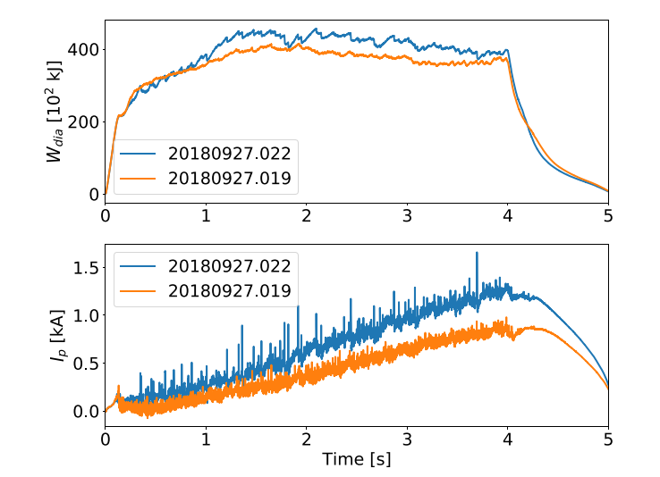
Recap: interesting observations in FMM configuration
FMM configuration(s) have 5/5 islands just inside LCFS, SOL is “limited”
improved energy confinement (including adjustment for plasma volume)
[T. Andreeva et al 2022 Nucl. Fusion 62 026032]
intermittent crashes of W_{dia}, associated with mode activity in many diagnostics
phenomenology is limited to a certain iota range
island size plays a role
→ how universal is this behavior for W7-X?
[A. Krämer-Flecken]
[G. Wurden, T. Andreeva, N. Chaudhary, D. Cipciar, A. Krämer-Flecken, …]

Slide 3
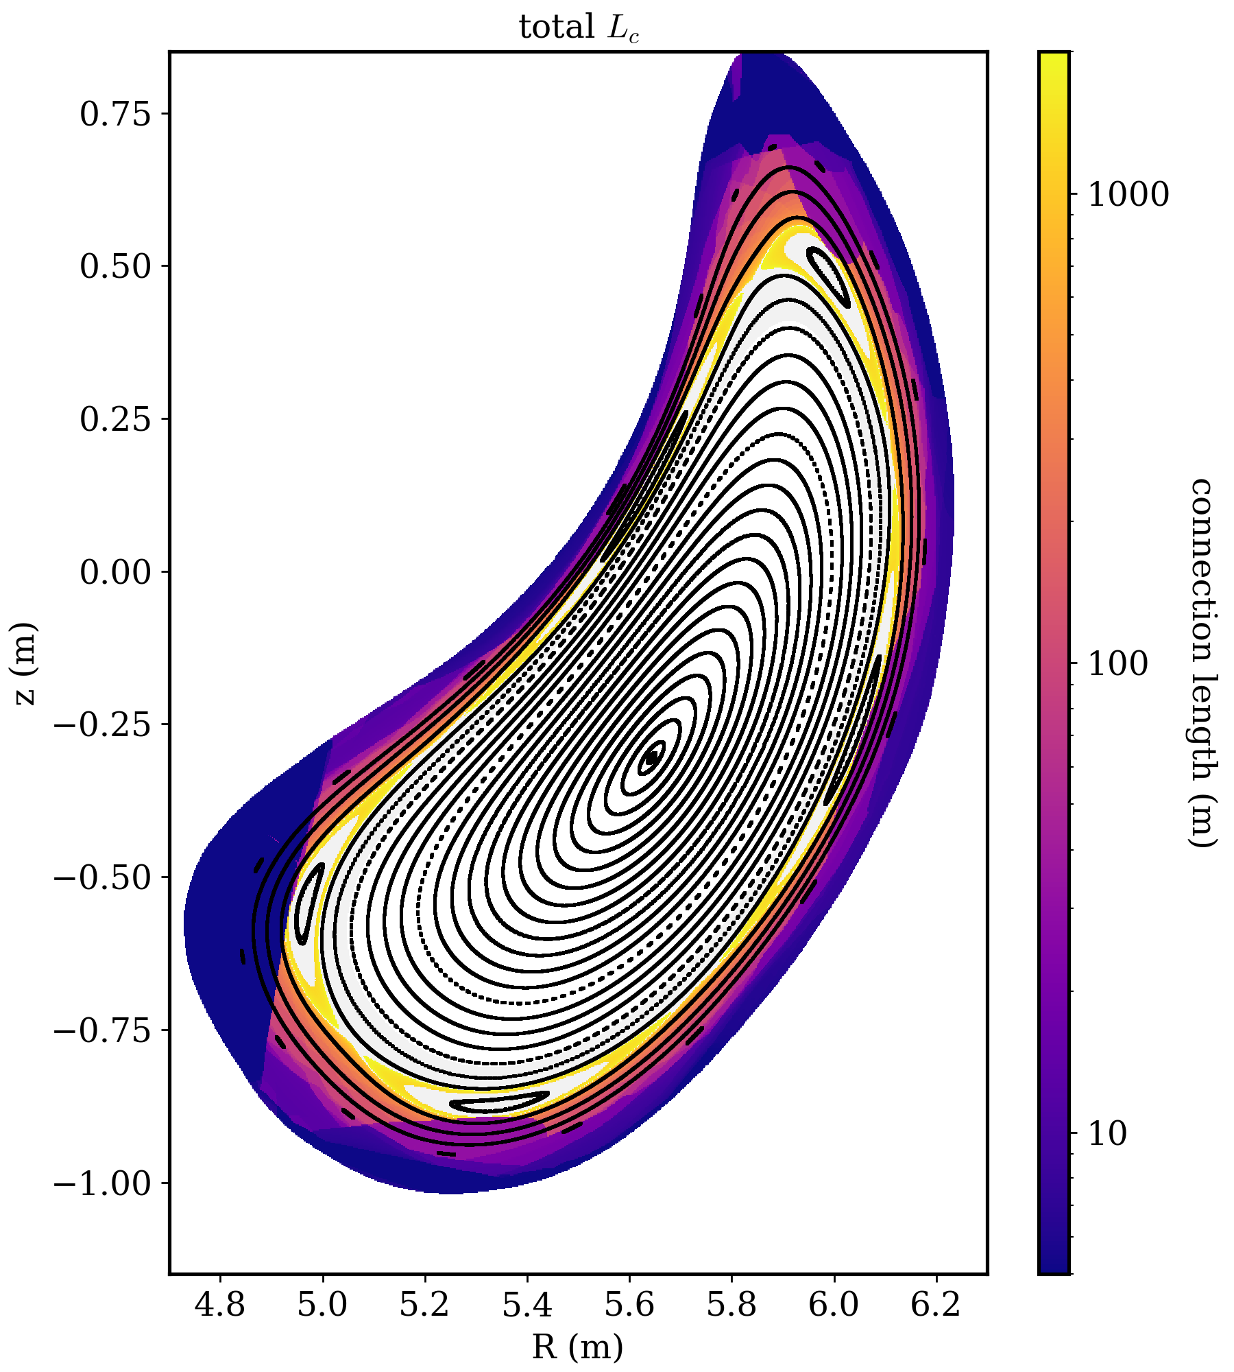
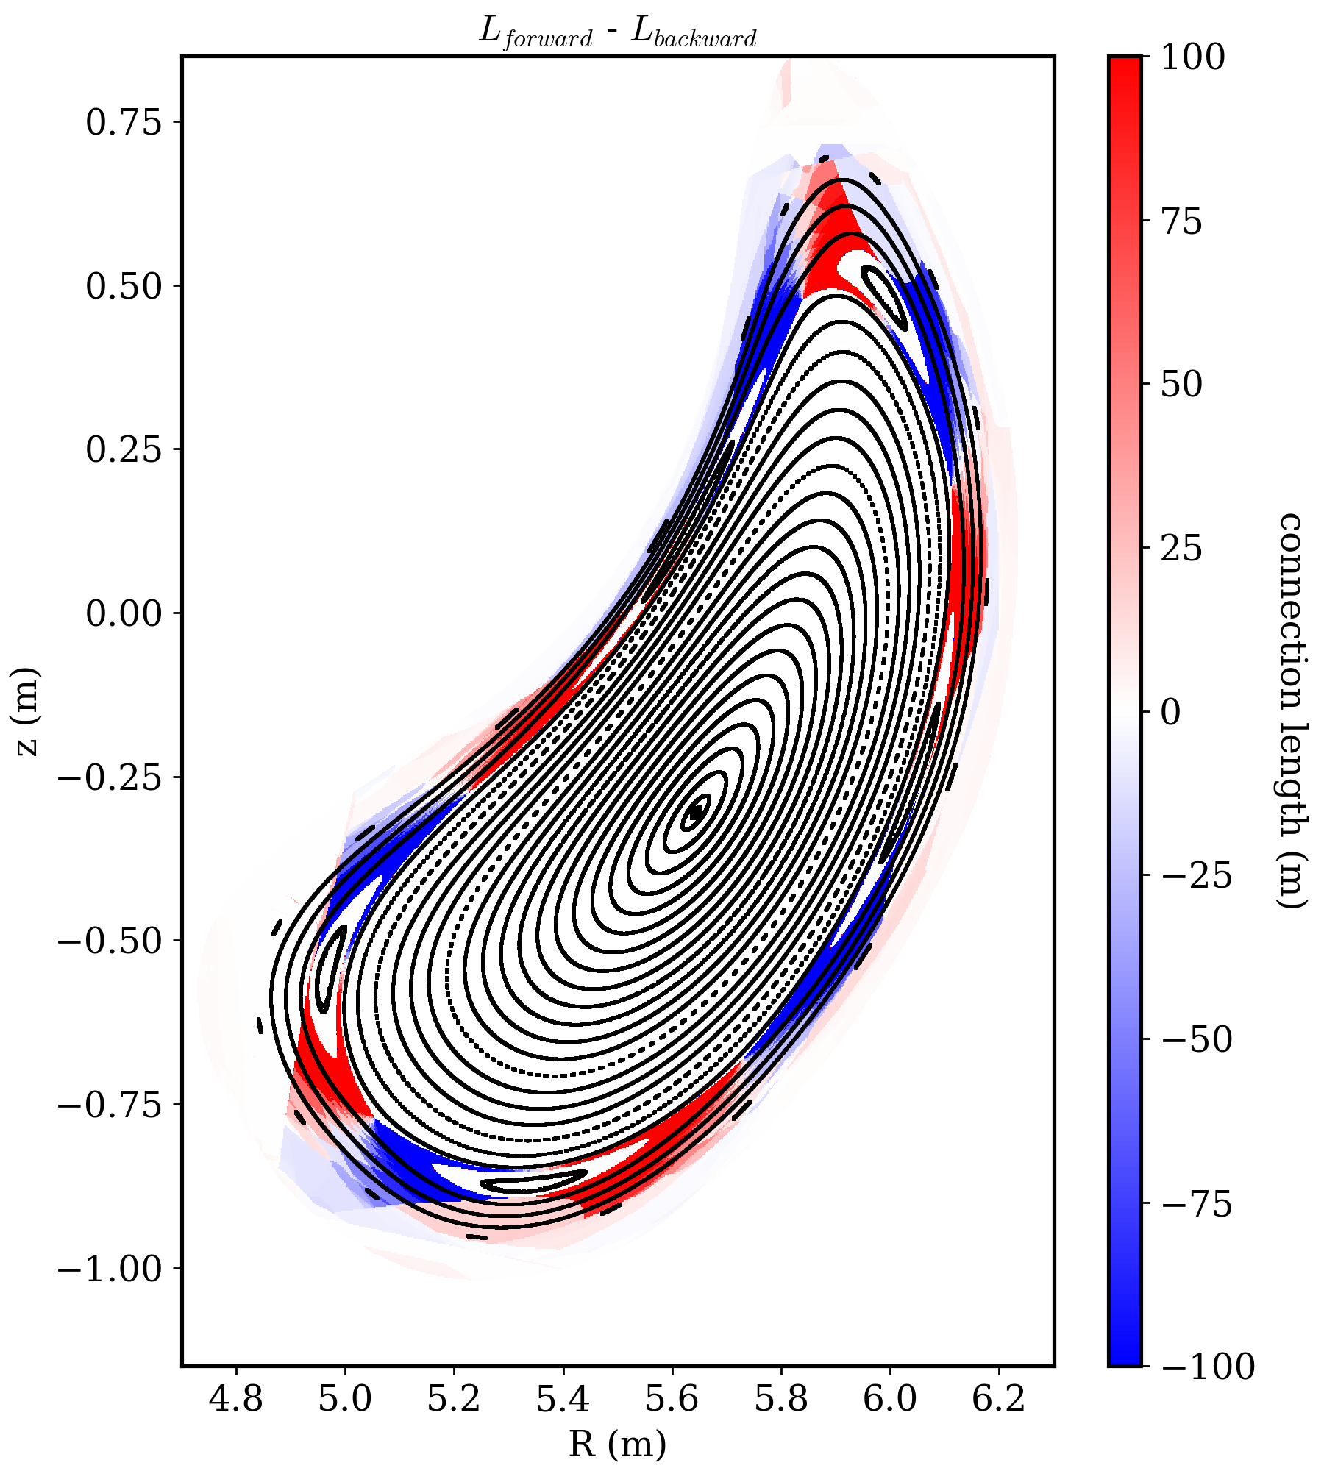
MMG000 island position
MMG000: vacuum field line tracing, I_{cc}=0 , no accounting for iota offset from coil deformation
almost a limited configuration!
very long but still finite (>1000m) connection lengths surrounding the islands
L_{c} difference plot shows that this is still an island divertor configuration

Slide 4
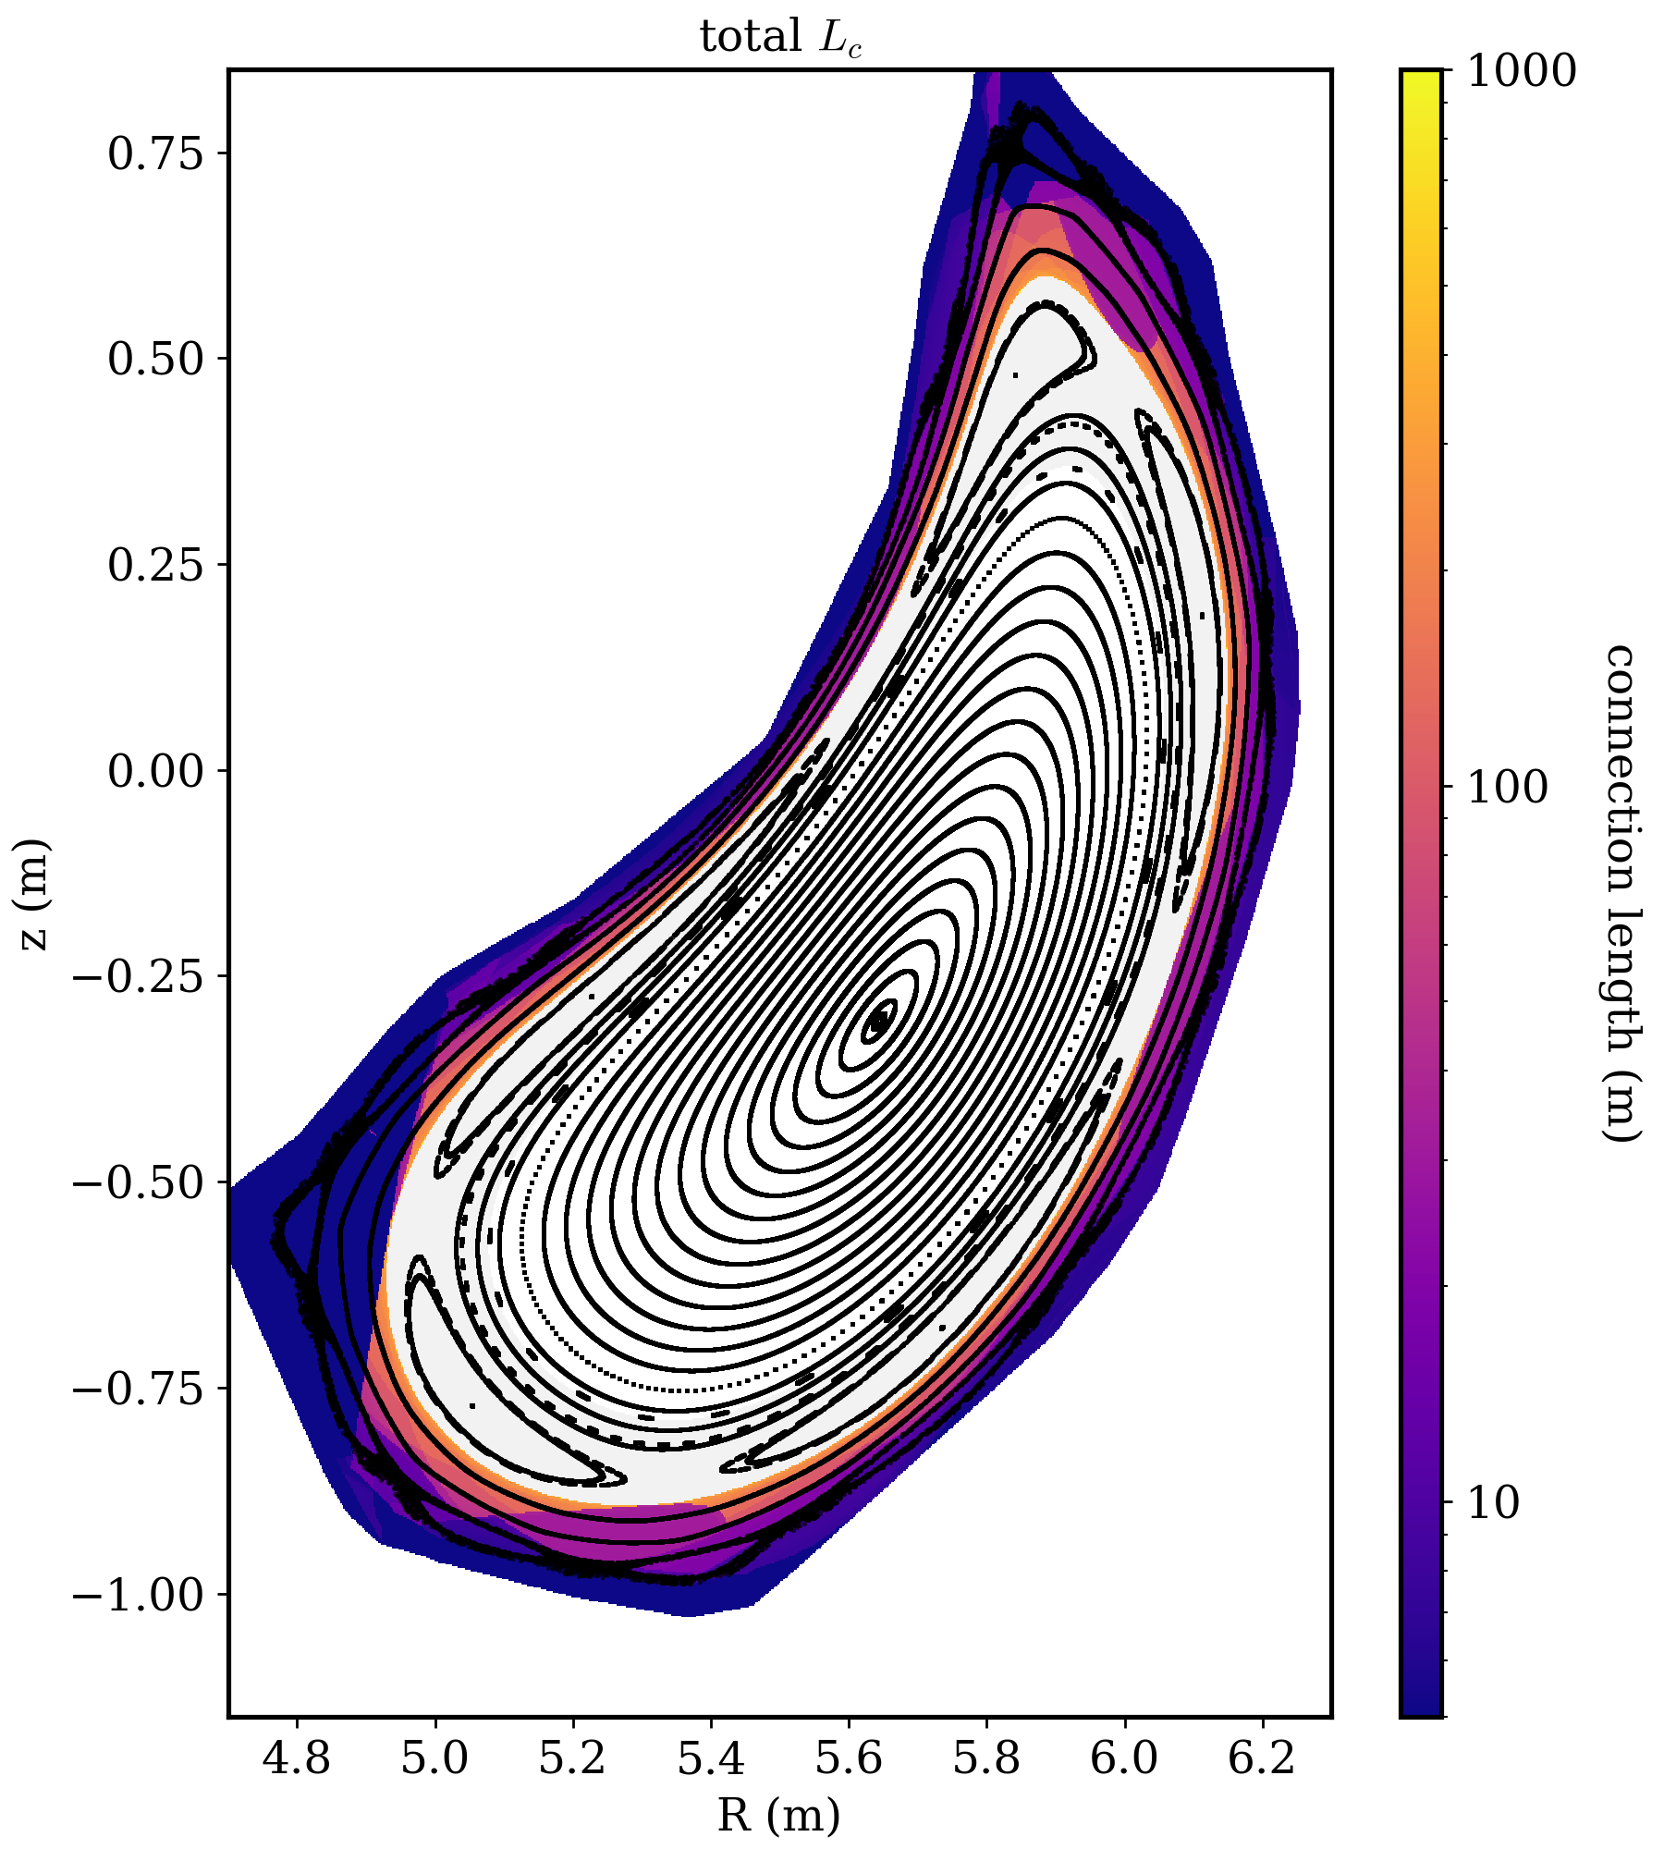
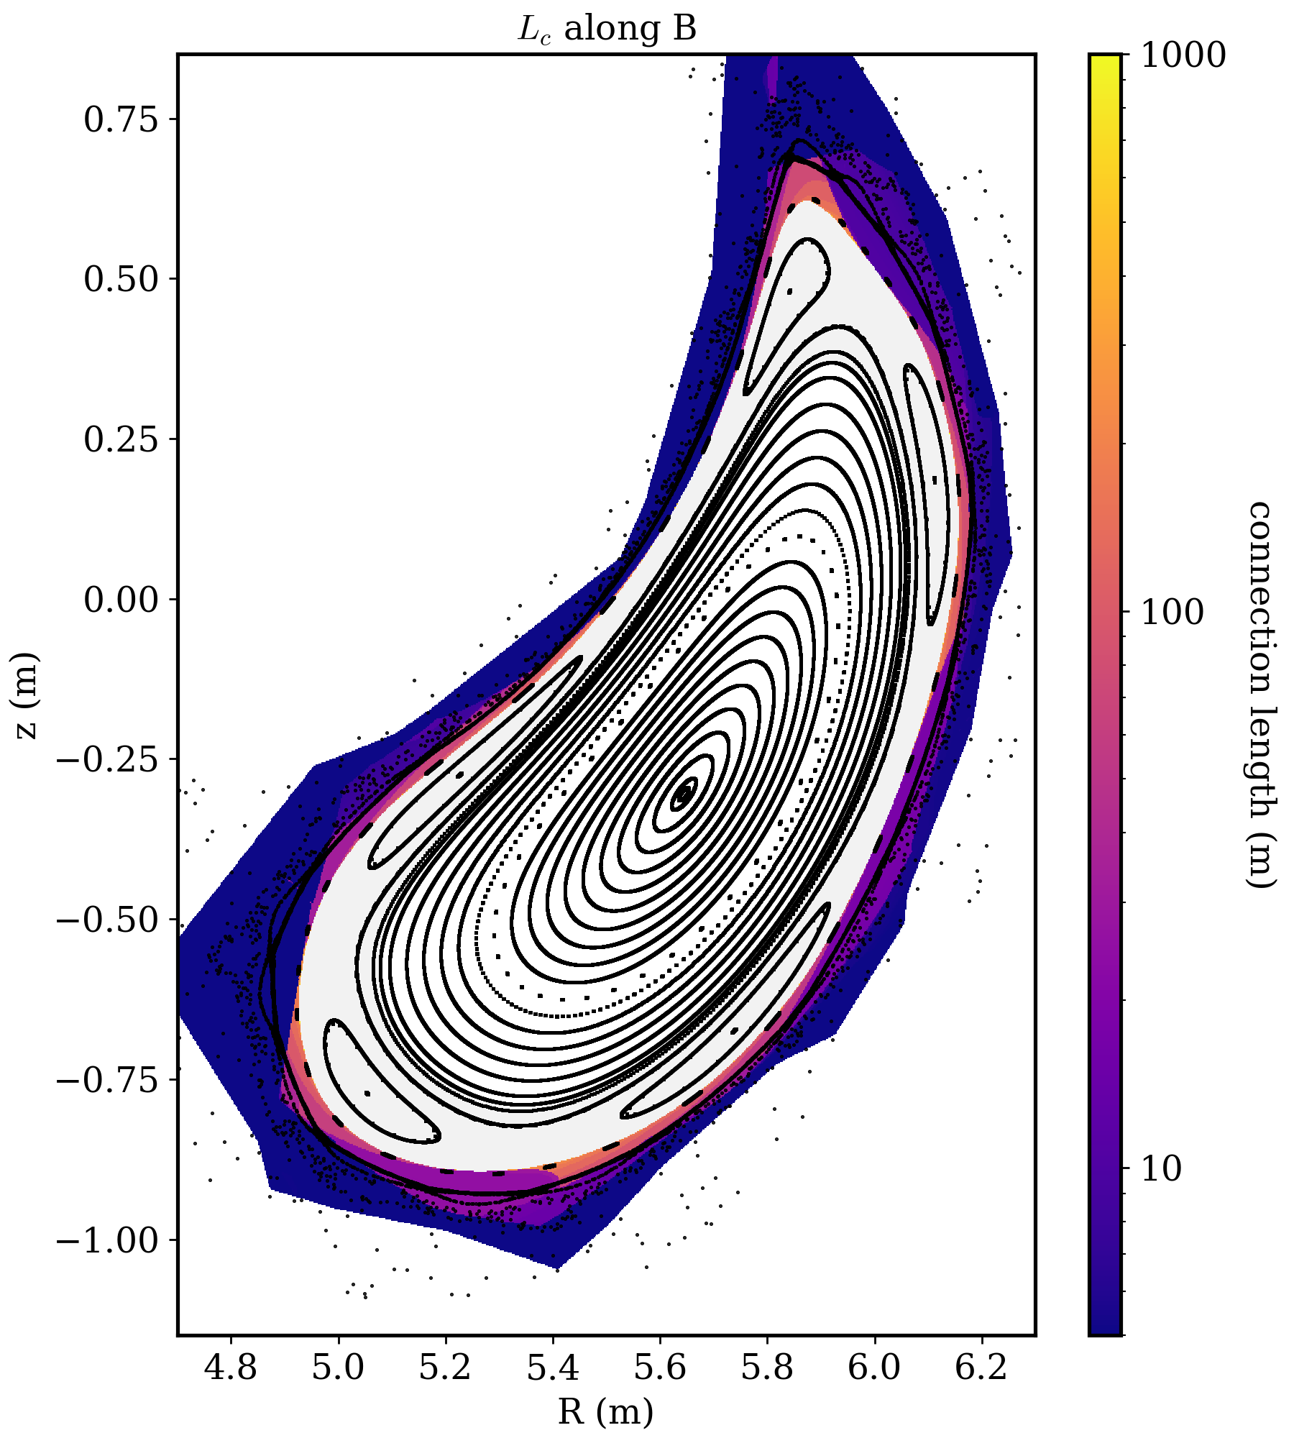
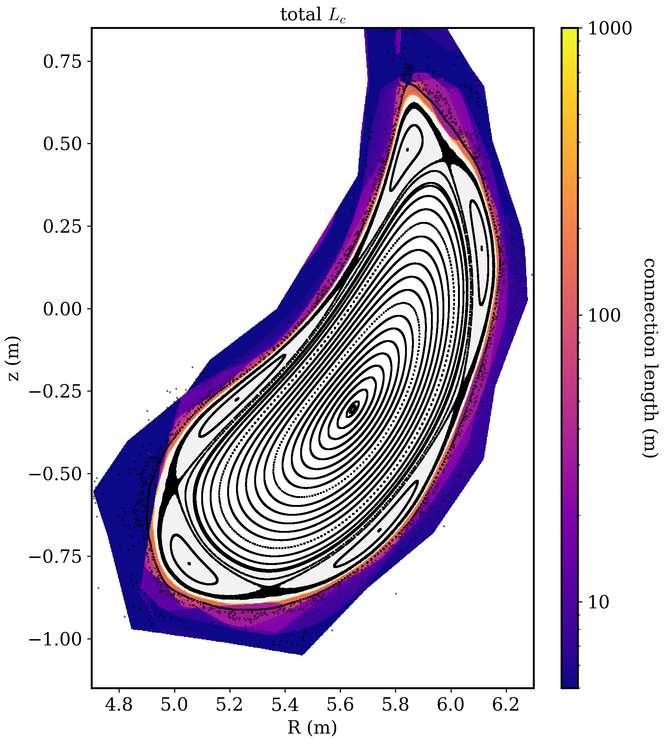
MMG000 island compensation via control coils
all configurations with negative I_{cc} appear to be limited configurations (islands inside LCFS)
attempt 5/5 compensation for low beta → seems already overcompensated, with “flipped” 5/5 islands appearing
attempt 5/5 compensation for high beta → again seems over-compensated
attempt over-compensation of 5/5 islands → large flipped islands
I_{cc}=--1100A
I_{cc}=--1700A
I_{cc}=--2500A

Slide 5
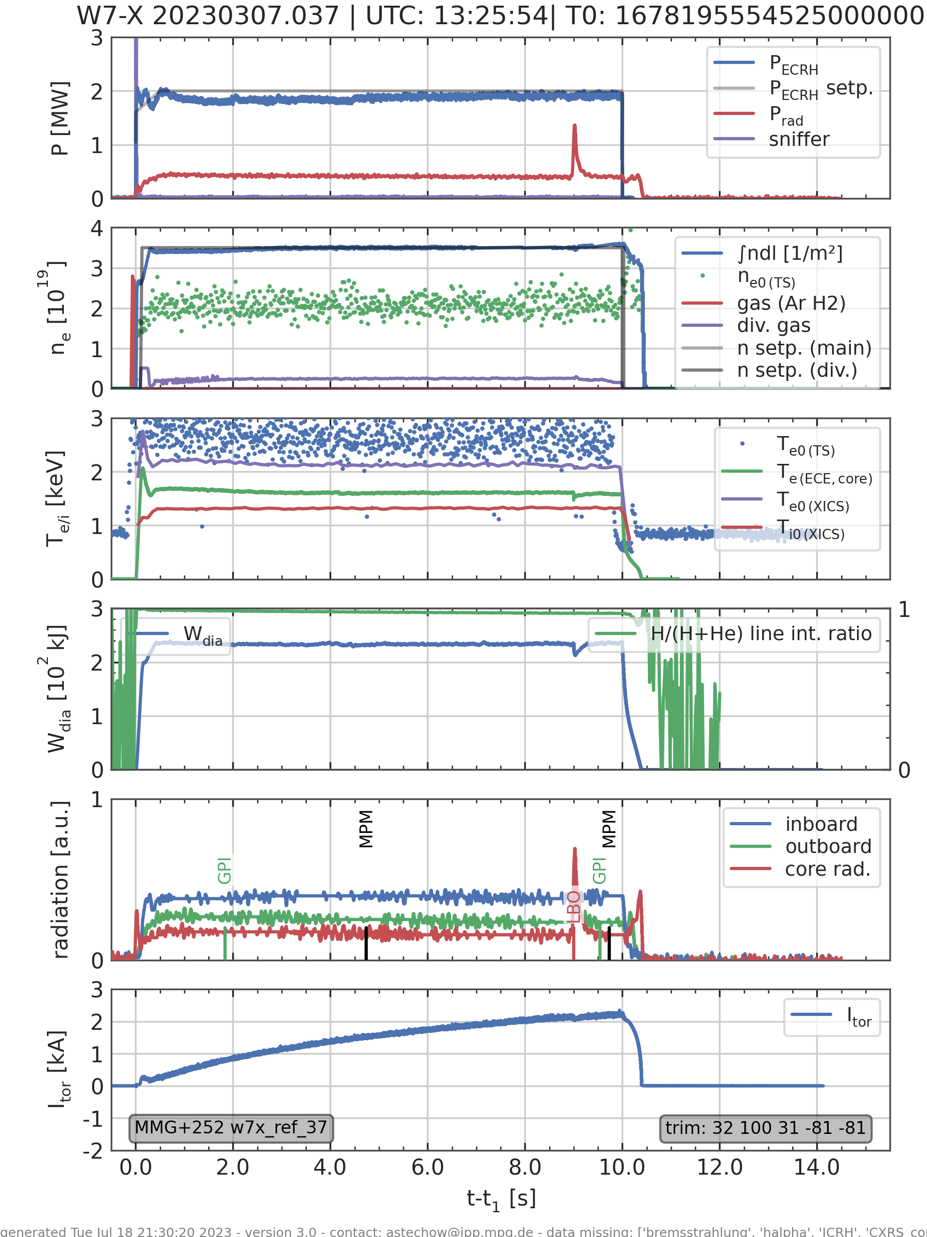
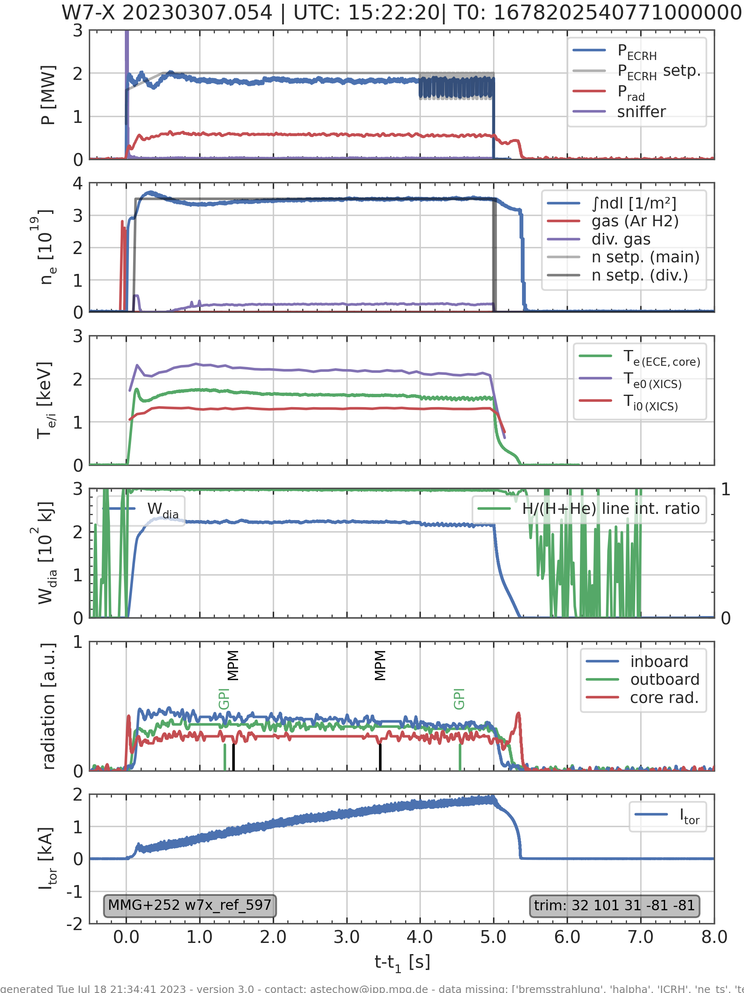
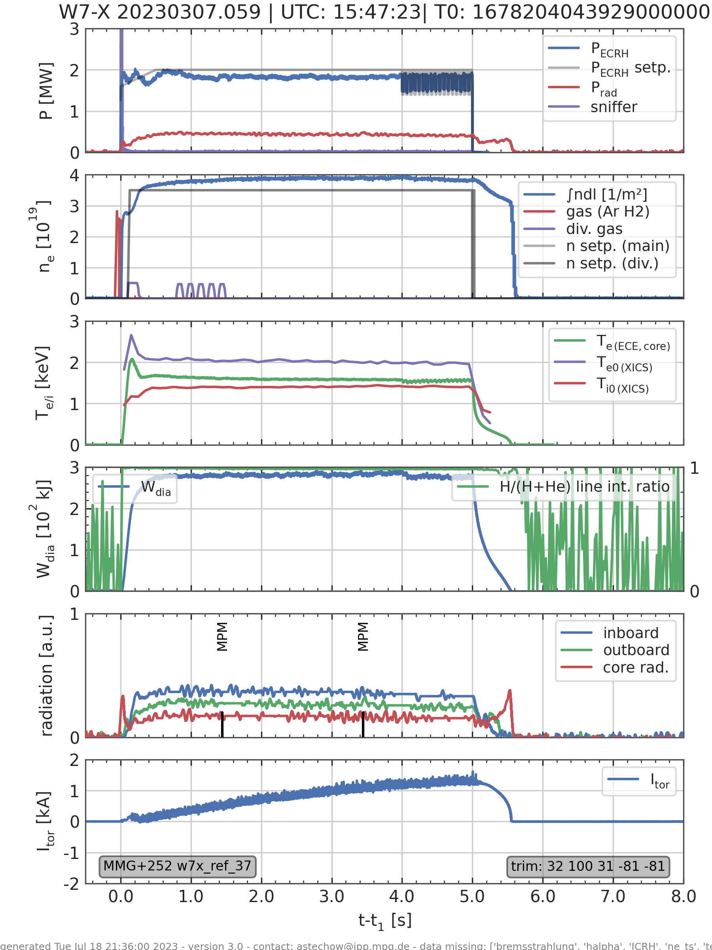
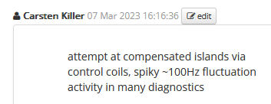
2MW , 3.5e19 plasmas: comparison of I_{cc} settings
I_{cc}=0A
I_{cc}=++1500A
I_{cc}=--1100A
240kJ
230kJ
280kJ
quiet
quiet
bursts

Slide 6
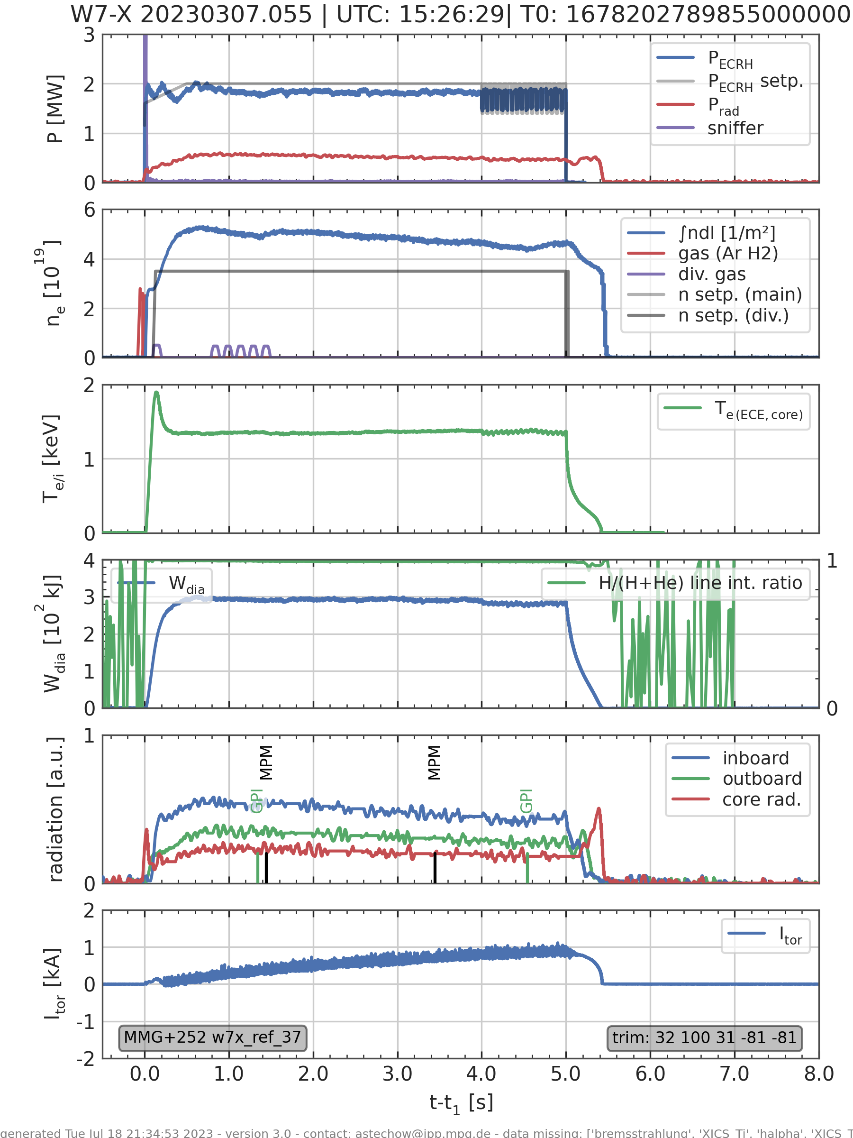
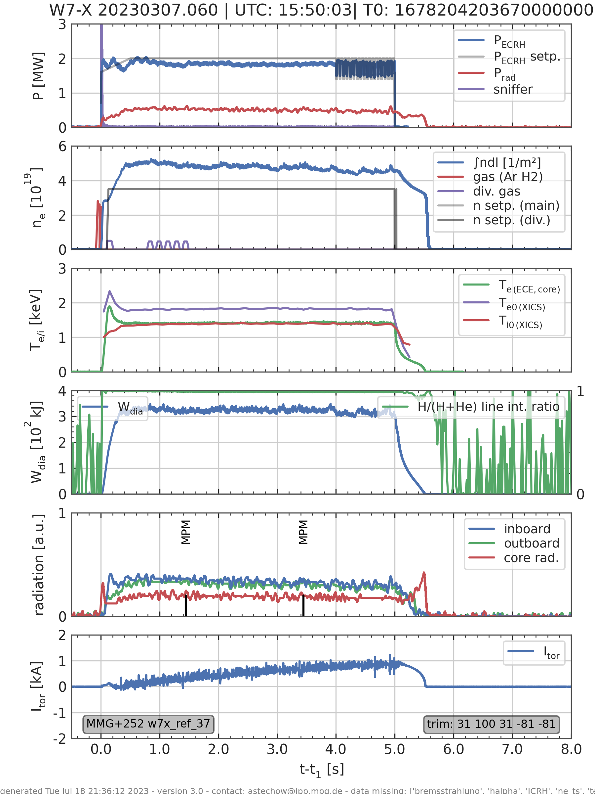
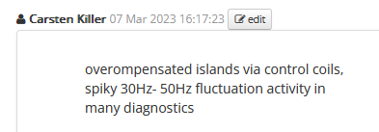
limited configurations have worse density control → compare programs with higher density (~5e19)
I_{cc}=--1100A
I_{cc}=--2500A
290kJ
320kJ
bursts
massive bursts

Slide 7
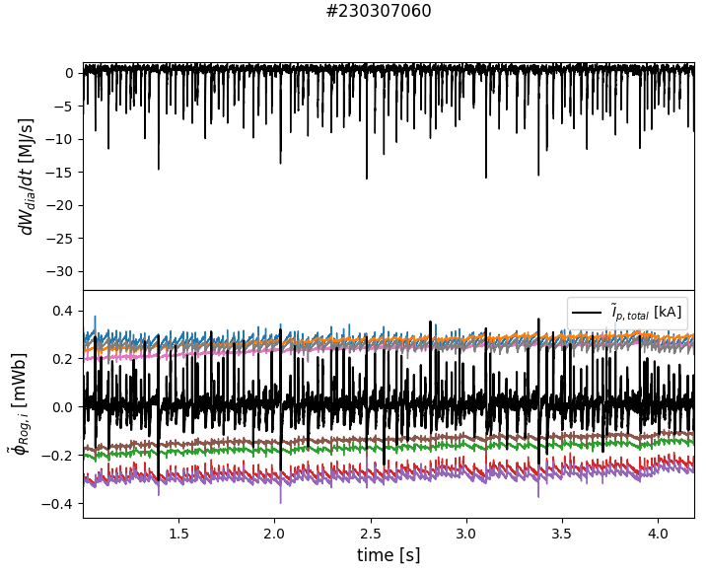
bursty mode activity in MMG000 with I_{cc}=--2500A is quite similar to FMM002
intermittent bursts with repetition of some 10Hz
associated with fast drops / “crashes” of W_{dia}
strong signature in magnetic (and many other) diagnostics
[D Cipciar]

Slide 8
close-up view of one burst event
MPM poloidal array of V_{f} probes
extremely high positive V_{f} associated to W_{dia} loss
temporal substructure of event
poloidal gradient of event
[D Cipciar]

Slide 9
side remark on weirdness regarding density control
these two programs were run with completely identical settings, except for control coils
I_{cc}=++1500A
(divertor configuration)
I_{cc}=--1100A
(limited configuration)
(this is just He beam, no effect on general plasma)
good density control
density overshoots and stays high without fueling
density control strongly depends edge topology!

Slide 10
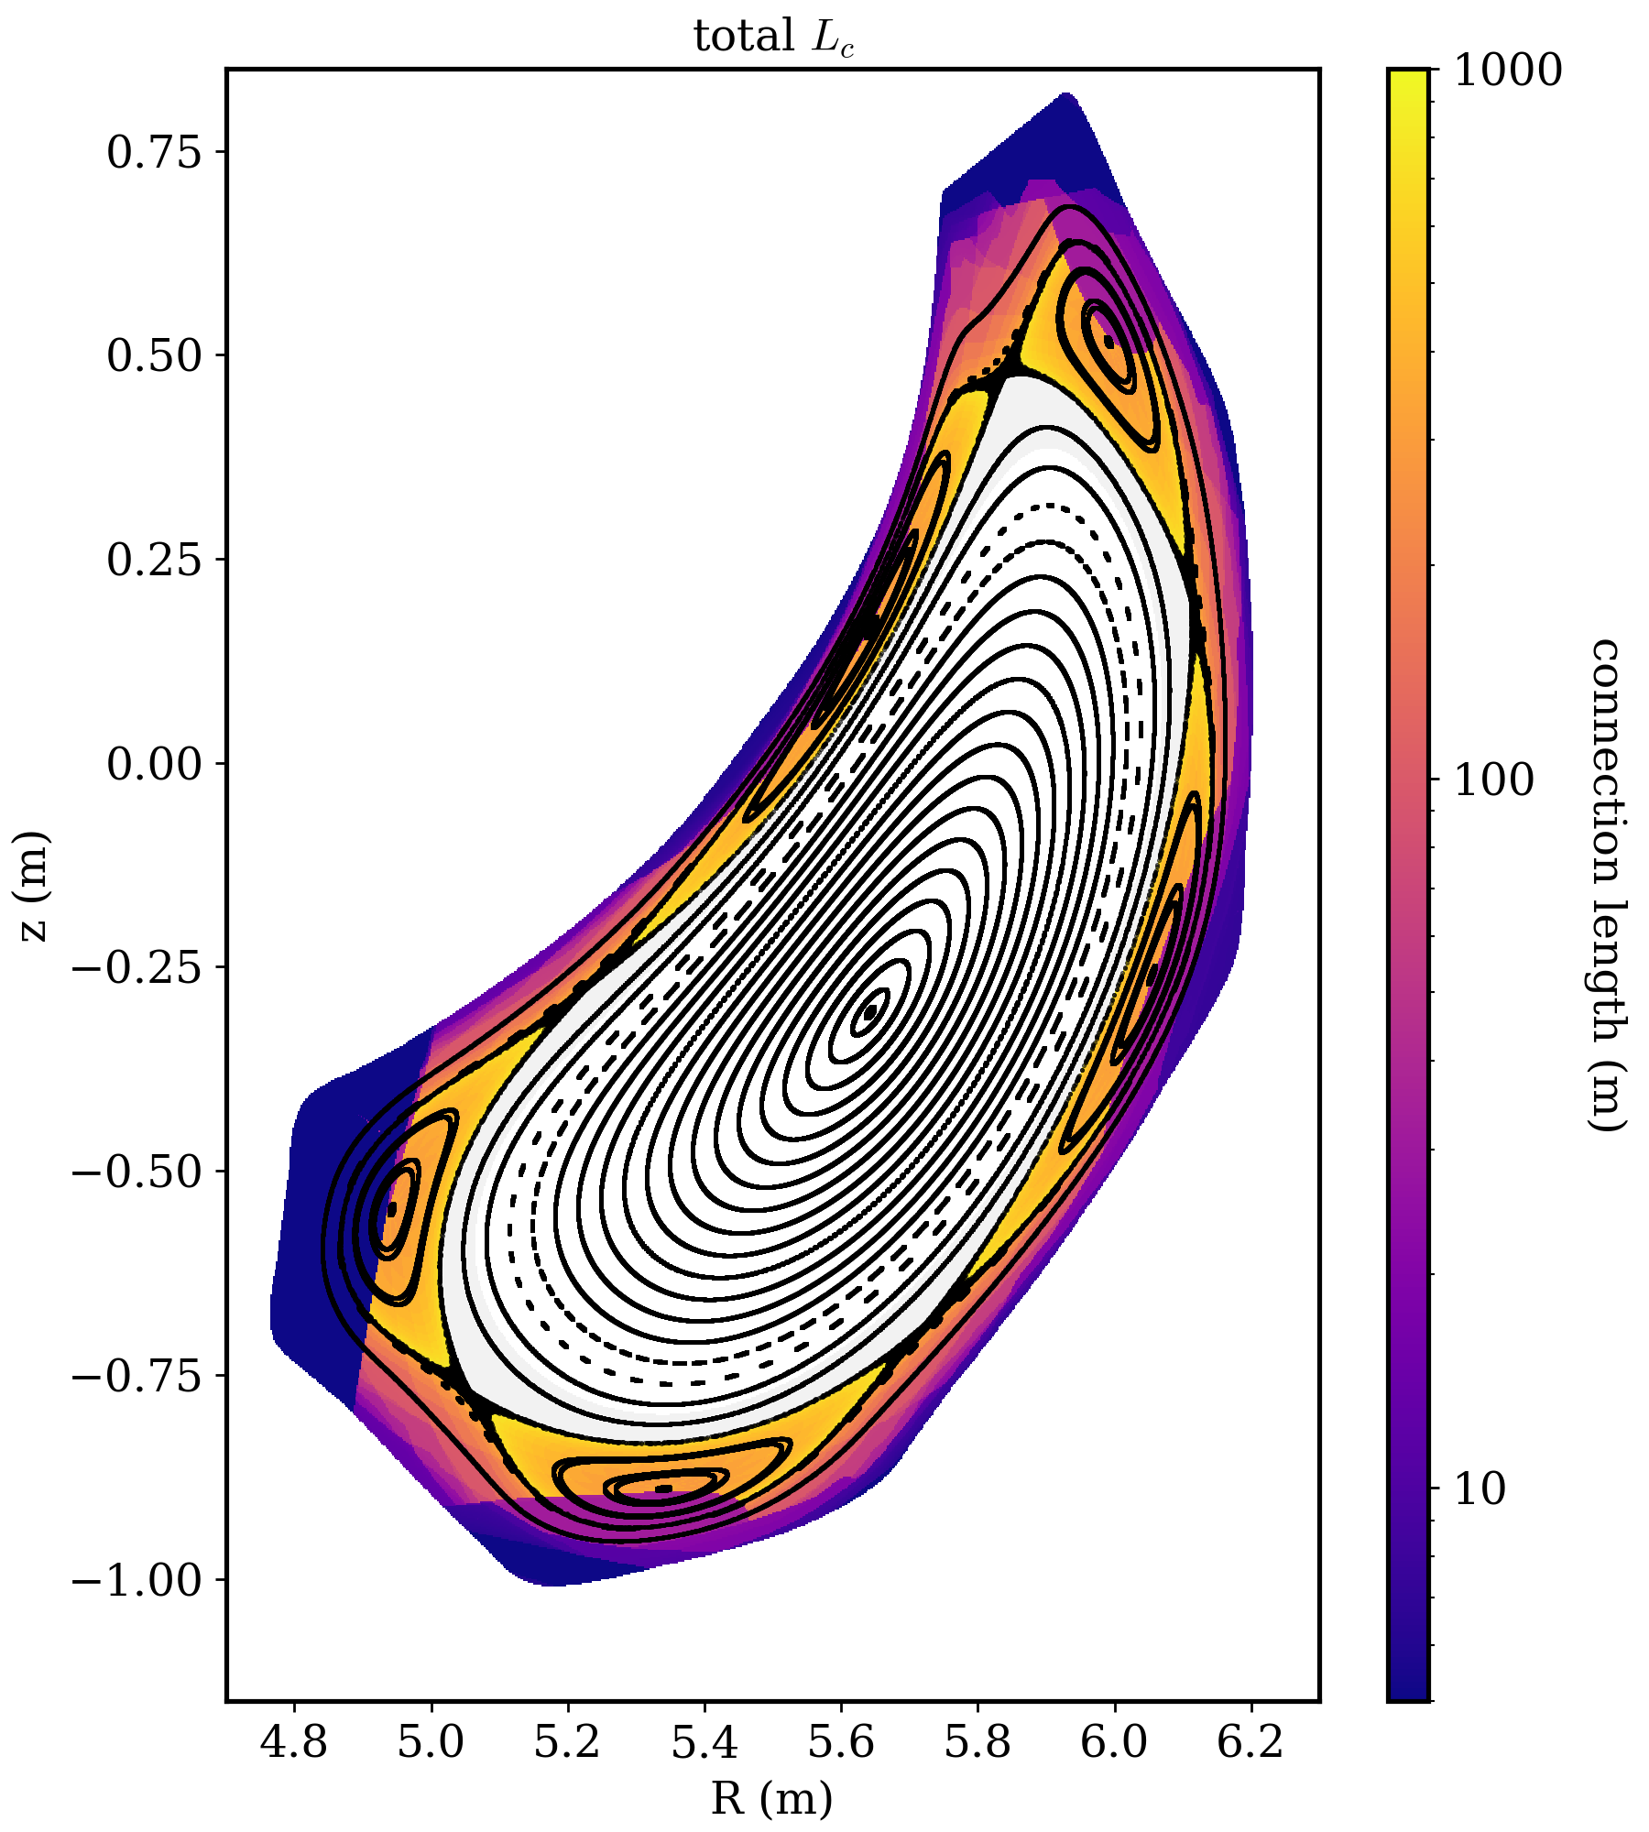
MMG000 with increased island size (I_{cc}=++1500A)
regular island divertor configuration
interesting SOL physics: potential maps and poloidal T_{e} gradients from MPM probes
MMG000+2520
I_{cc}=+1500A
[Killer EPS2023/PSI2024]

Slide 11
Summary
MMG configuration was run in OP2.1 in limited configurations with 5/5 islands inside LCFS
similar phenomenology to FMM: increased W_{dia} and strong intermittent bursty mode activity (W_{dia} crashes)
confinement improvement and crash intensity depend on detailed island geometry (via control coils)
→ for the first time it has been shown that the “FMM phenomena” are not restricted to that configuration but appear also in other settings with 5/5 islands being inside the LCFS
more difficult density control in limited configurations
To do:
check IR loads (transition from divertor to limited configuration)
check beta effects for reconstruction (MMG is more susceptible to beta effects)
assess role of iota offset by coil deformation in MMG (not known for this configuration)

