Slide 1


Impurities in long-pulse operation of W7-X
50th EPS Conference on Plasma Physics
Monika Kubkowska
Institute of Plasma Physics and Laser Microfusion, Warsaw, Poland
M. Jakubowski², M. Krychowiak², A. Dinklage², M. Gruca¹, S. Jablonski¹, L. Syrocki¹, B. Buttenschoen², F.Reimold², Yu Gao², G. Fuchert², S. Lazerson², D. Naujoks², U. Neuner², O. Grulke², V. Winters², D. Zhang² and the W7-X team
¹Institute of Plasma Physics and Laser Microfusion, Warsaw, Poland
²Max-Planck-Institut für Plasmaphysik, Greifswald, Germany
This scientific paper has been published as part of the international project co-financed by the Polish Ministry of Science and Higher Education within the programme called 'PMW'.
Work done under EUROfusion WPW7X

Slide 2
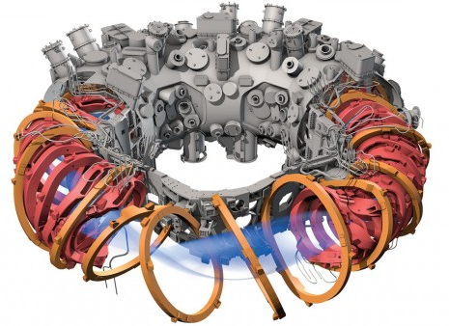
Outline
Motivation
Wendelstein 7-X
Impurities in W7-X’s long pulses in dettached and attached divertor configuration
Summary

Slide 3
Outline
Motivation
Wendelstein 7-X
Impurities in W7-X’s long pulses in dettached and attached divertor configuration - ECRH heated plasma
Summary

Slide 4
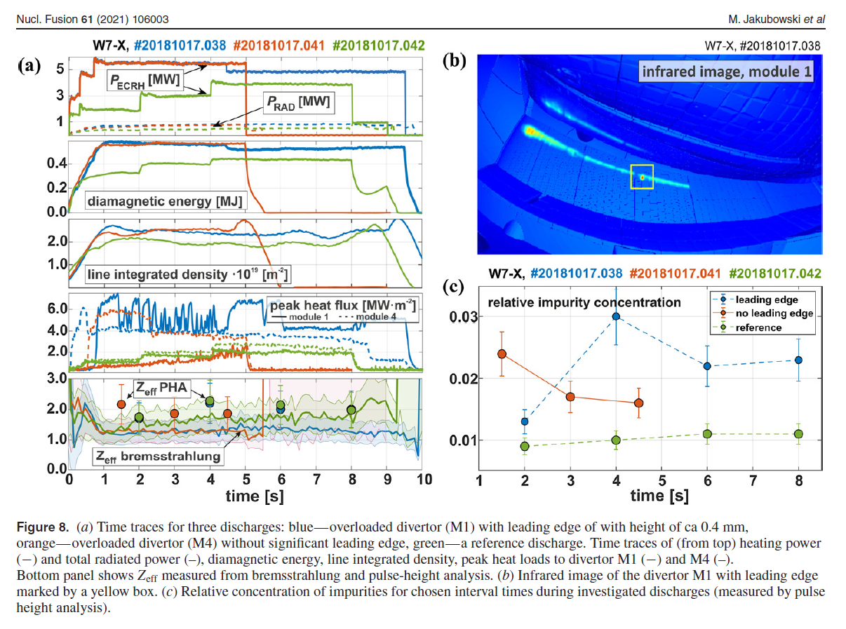
Long pulse operation
Extending plasma pulse length is essential for an economically viable fusion reactor.
The goal of the W7-X is to demonstrate the high performance with high power and quasi-continuous operation.
In W7-X OP1.2b experiments despite a high influx of C into the SOL during discharges with dedicated overloading of the leading edges, the plasmas remained stable. Zeff stayed below 1.5 throughout the discharge, and radiation increased at the plasma edge only.
Long-time scale processes could play a role, like wall recycling or erosion.

Slide 5
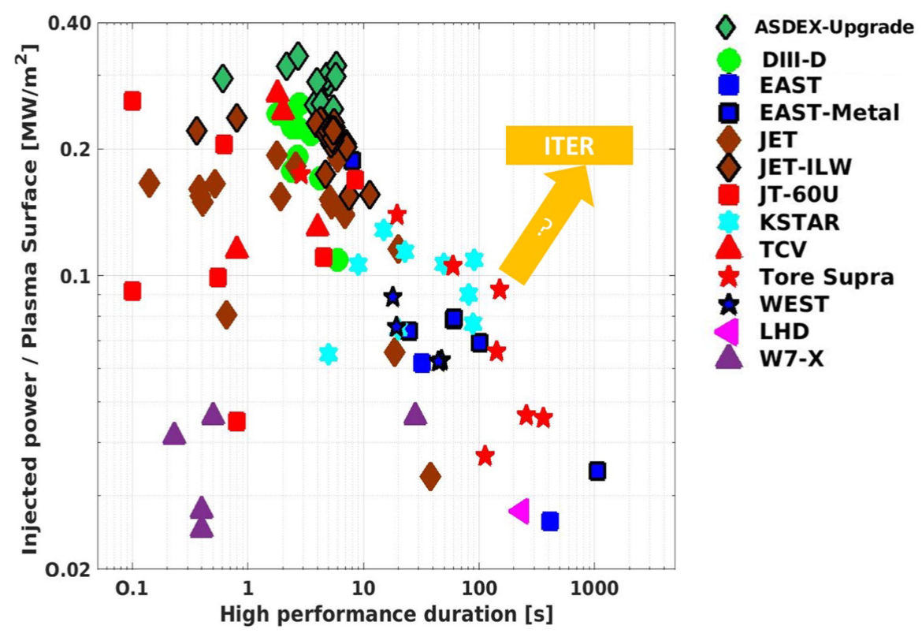
Long pulse operation in fusion devices
Plasma heating power normalized to the plasma surface (P/S in MW m2) vs the high-performance duration.
The highest values of P/S have been obtained on the ASDEX Upgrade with a tungsten wall, but it is limited in duration by the machine’s technical capability (no active cooling and normal conducting magnet).
For ITER, the expected ratio of P/S is in the range of 0.2 MW m⁻², to be sustained from 100 s up to 3000 s (when adding the externally injected power to the self-alpha heating power produced by the D-T fusion reactions, P is in the range of 150 MW).
X. Litaudon et al., Nucl. Fusion 64 (2024) 015001

Slide 6
Long pulse operation in fusion devices
Plasma heating power normalized to the plasma surface (P/S in MW m2) vs the high-performance duration.
The highest values of P/S have been obtained on the ASDEX Upgrade with a tungsten wall, but it is limited in duration by the machine’s technical capability (no active cooling and normal conducting magnet).
For ITER, the expected ratio of P/S is in the range of 0.2 MW m⁻², to be sustained from 100 s up to 3000 s (when adding the externally injected power to the self-alpha heating power produced by the D-T fusion reactions, P is in the range of 150 MW).
For W7-X P/S values are in the range 0.03-0.05 for a typical long pulse scenario
W7-X: 0.05MW/m²
detached
attached
X. Litaudon et al., Nucl. Fusion 64 (2024) 015001

Slide 7
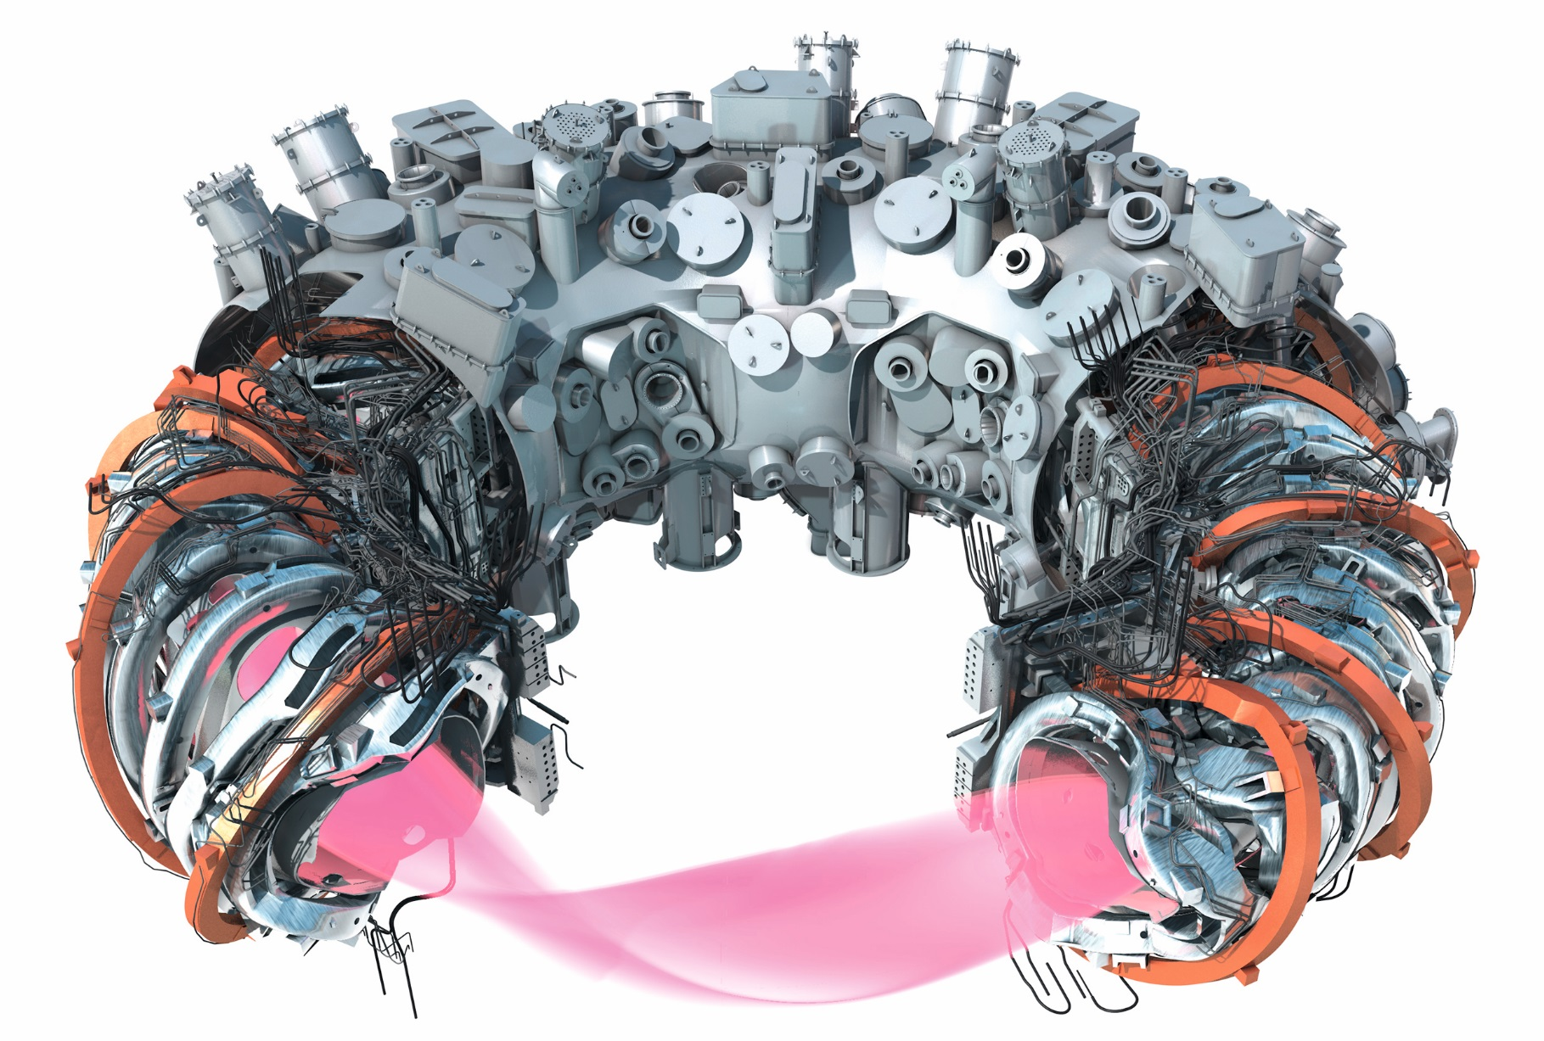
Introduction to Wendelstein 7-X
Major radius R = 5.5 m
Minor radius r = 0.5 m
Plasma volume V = 30 m³
Long pulse operation (30 min)
Water cooled island divertor
P_{ECRH} = 8.5 MW
P_{NBI} = 6.6 MW
P_{ICRH} = up to 1.5 MW
R
r
©IPP
A. Langenberg, PLASMA-2023 conference

Slide 8
Introduction to Wendelstein 7-X
W7-X Status / Achievements:
4 experiment campaigns (2015-2022): OP1.1, OP1.2a/b, OP2.1
~15 months of plasma operation
Main plasma parameters close to NC^{[1]} expectations:
        T_{i} = 3.0 keV^{[2]}, n_{e} = 1.4 x 10²⁰ m^{-3[3]}
        W_{dia} = 1.1 MJ^{[2]}, t_{E} = 0.3 s^{[2]}
Long pulse operation 480 s^{[4]}, stable detachment^{[5]}
No impurity accumulation issues^{[6]}
©IPP
[1] C. Beidler, H. Smith, A. Alonso et al. Nature 596 (2021)
[2] S. Bozhenkov, Y. Kazakov, O. Ford et al. Nuclear Fusion 60 (2020)
[3] G. Fuchert, K. Brunner, K. Rahbarnia et al. Nuclear Fusion 60 (2020)
[4] H.-S. Bosch, P. van Eeten, O. Grulke et al. Fusion Engineering and Design 193 (2023)
[5] M.W. Jakubowski, et al. Nucl. Fusion 61 (2021)
[6] Th. Wegner, J.-P. Bähner, B. Buttenschön et al. Journal of Plasma Physics 89 (2023)
A. Langenberg, PLASMA-2023 conference

Slide 9
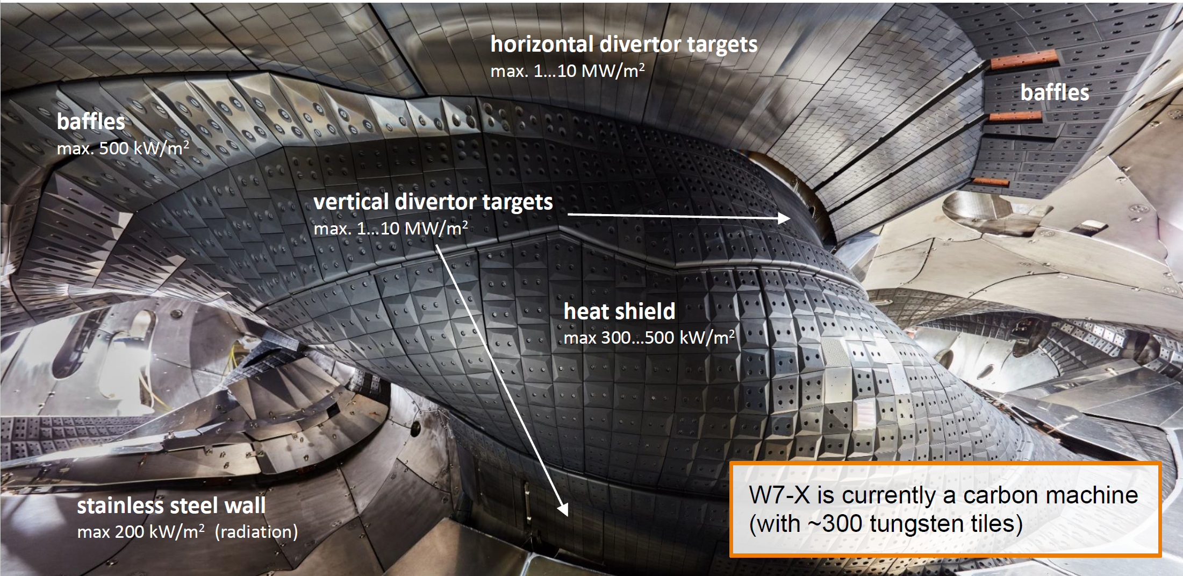
Introduction to Wendelstein 7-X

Slide 10
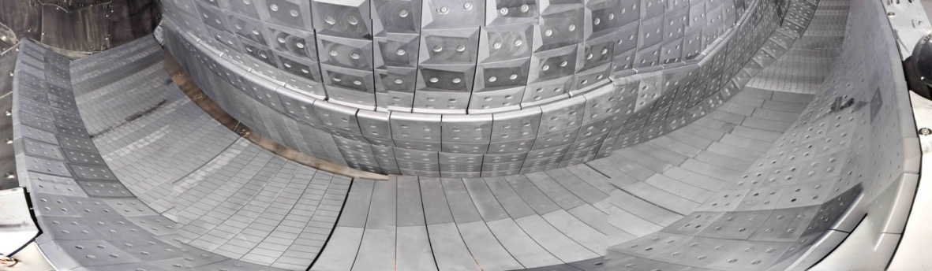
W7-X timeline
OP1.1
OP1.2
OP2
OP3
2015 / 2016
5 MW
4 MJ
6 sec
2017 / 2018
8 MW
200 MJ
100 sec
2022 - 2026
10 MW
1GJ, →18 GJ
30 minutes
202x …
Heating upgrades
18 GJ
30 minutes
…
Inertial cooling
Inertial cooling
Water-cooling of PFCs
carbon-free device
graphite divertor in OP1.2, 10 MW/m²
10

Slide 11
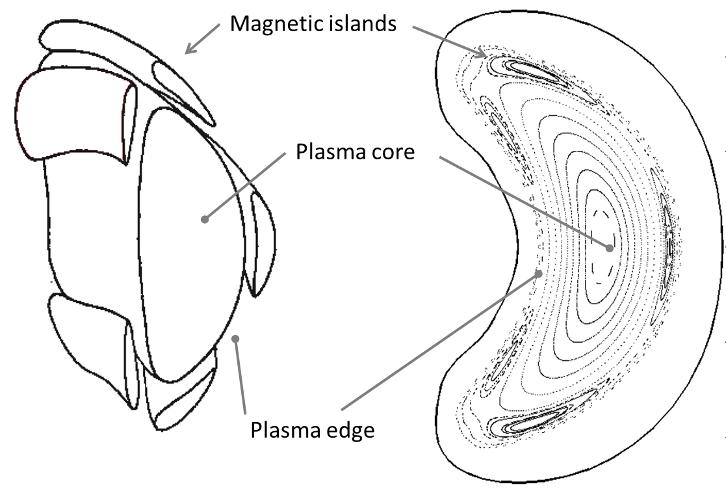
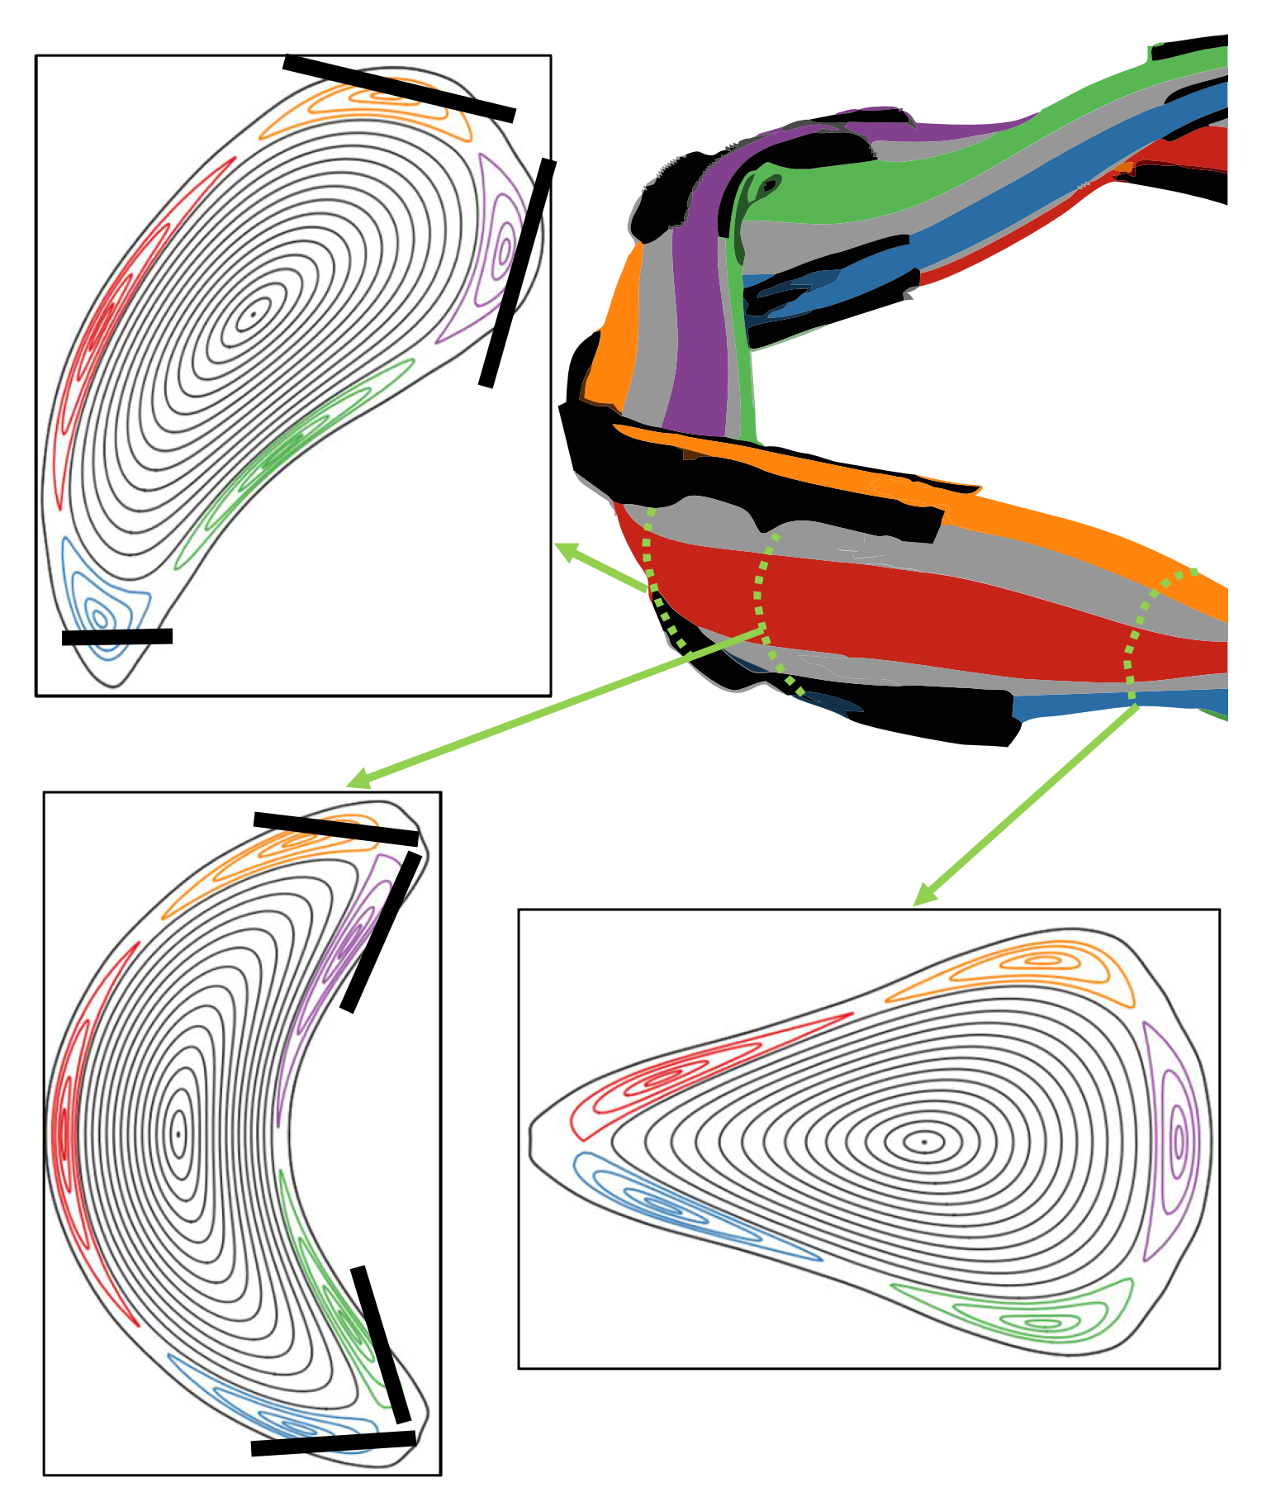
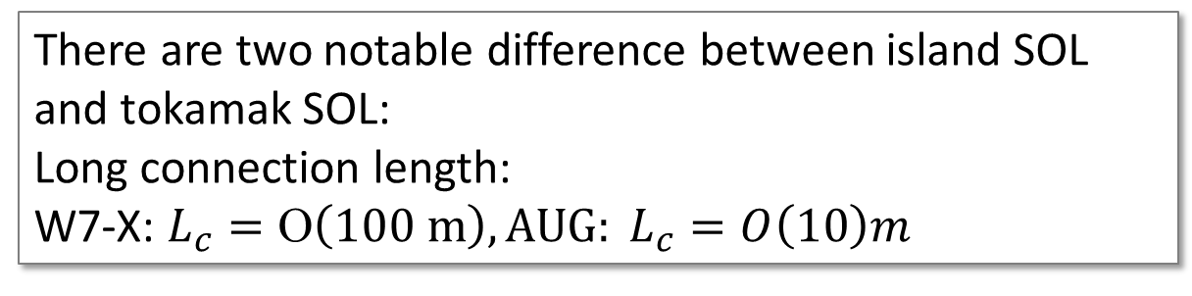
W 7-X: Island divertor: exhaust for helical plasma
W7-X wants to demonstrate high power, high performance at steady-state
10 separate divertor units, adapted to the shape of the flux surfaces
Large magnetic islands (standard: 5/5 ) form so-called island divertor.
Open field lines guide ions lost from the confined plasma to the divertor targets. Islands form SOL.
There are two notable difference between island SOL and tokamak SOL:
Long connection length:
W7-X: $L_{c}=Ο\left(100 m\right), {AUG: L}_{c}=O\left(10\right)m$

Slide 12
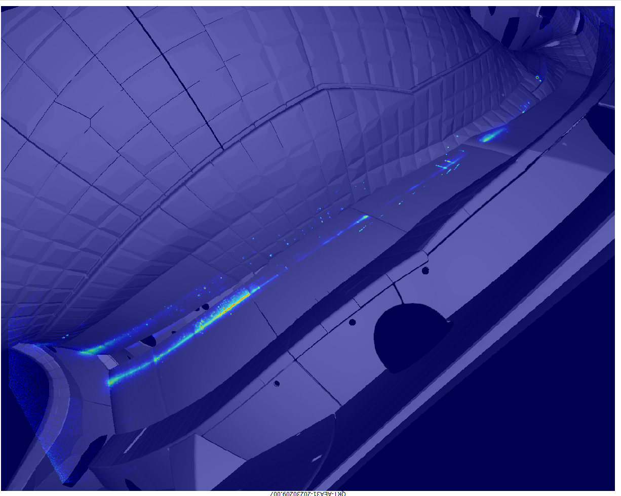
W 7-X: Island divertor
Thermography shows strike lines of island divertor
Island divertor at W7-X in standard configuration forms two strike-lines on horizontal and vertical target

Slide 13
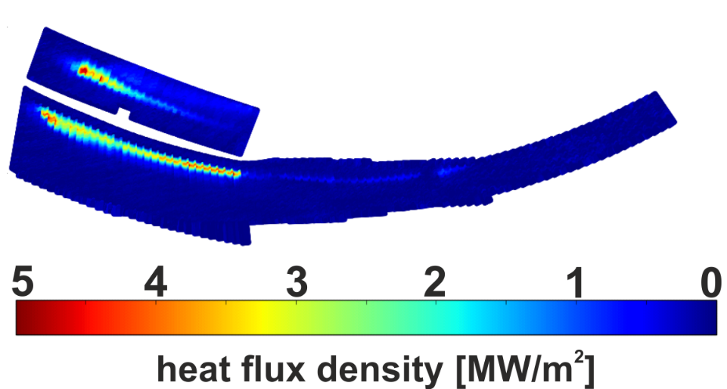
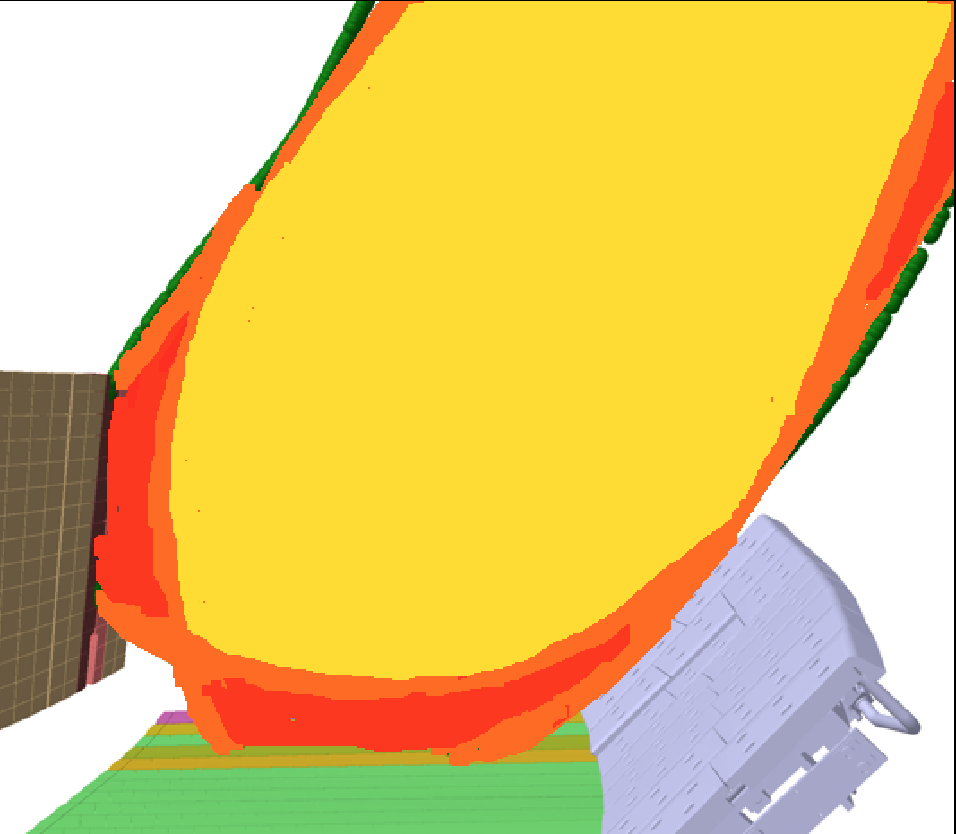
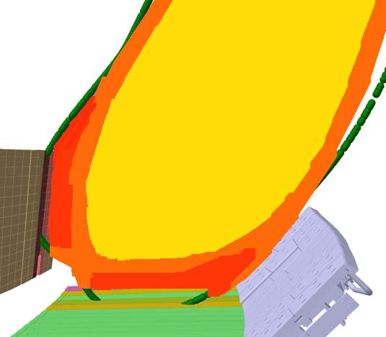
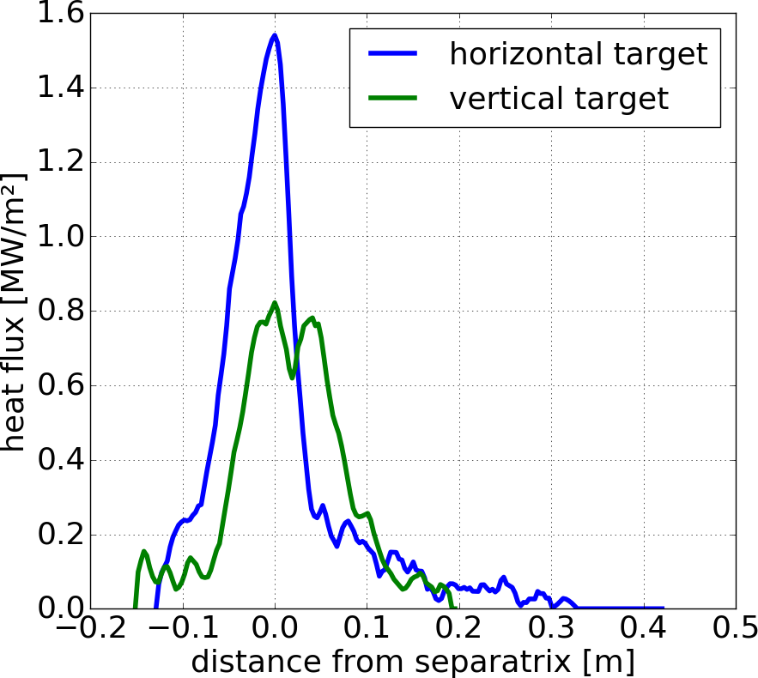
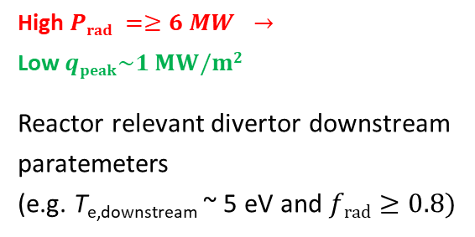
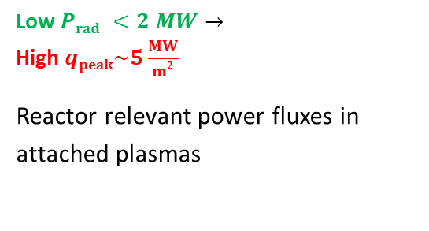
Long pulse development at Wendelstein 7-X
Research conducted at the W7-X allows the study of certain aspects of fusion reactors.
Future reactor will operate with power fluxes of up to 5 MW/m².
→ In stellarator-based 500 MW reactor about 80-85% of total heating power needs to be radiated away
→ In Wendelstein 7-X with P_{ECRH} = 7 MW we cannot have both requirements simultaneously.
Attached plasma
Detached plasma
heat flux [MW/m²]
Low $Prad <2 MW→$
High $qpeak\sim 5\frac{MW}{m2}$
Reactor relevant power fluxes in attached plasmas
High $Prad =≥6 MW →$
Low $qpeak\sim 1 MW/m2$
Reactor relevant divertor downstream paratemeters
(e.g. T_{e,downstream} ~ 5 eV and $frad≥0.8)$
D. Zhang, et al , PRL, 2019

Slide 14
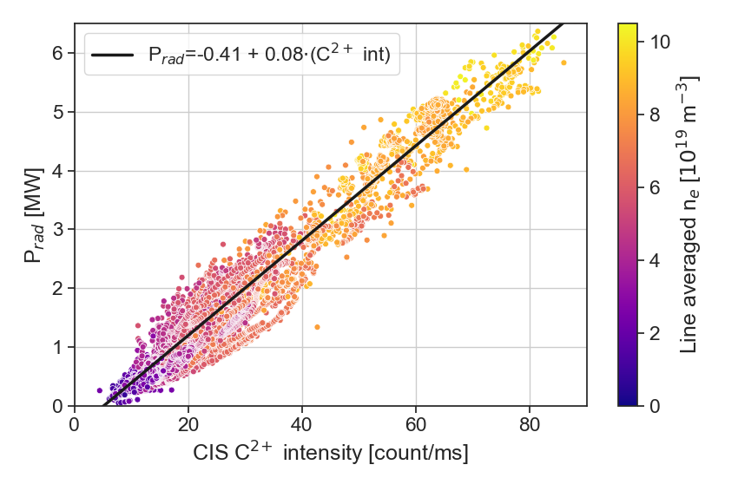
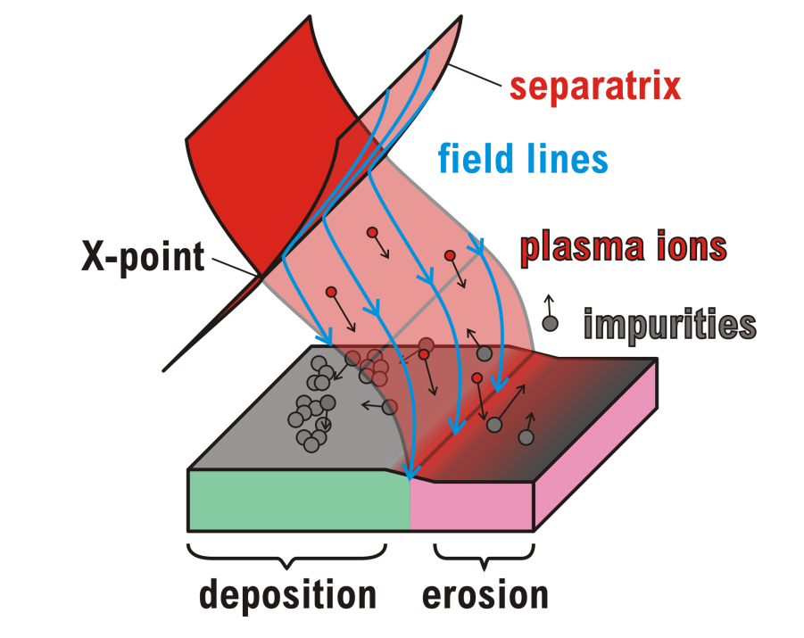
W7-X detached long pulse scenarios
Plasma radiation proportional to C2+ intensity and plasma density
Obtaining detachment with help of intrinsic impurities (carbon) is rather straightforward at W7-X.
Carbon is released from the plasma facing components (mostly due to oxygen sputtering)
In order to reach certain level of radiated power we need to increase carbon concentration at the plasma edge (via plasma density).
V. Perseo et al 2021 Nucl. Fusion 61 116039

Slide 15
W7-X detached long pulse scenarios in OP1.2b
Detached discharge in OP1.2b – W7-X with inertially cooled divertor
line integrated density is raised to a level above 1e20 m⁻², in that case the plasma radiated power fraction was at level exceeding 0.8 (f_{rad} ≥ 0.8) and peak heat flux below 0.5 MW/m².
What is important that the average effective ion charge Zeff, obtained from the spectroscopic bremsstrahlung measurements, was constant at the level around 1.5
M. Jakubowski et al 2021 Nucl. Fusion 61 106003
O. Schmitz et al 2021 Nucl. Fusion 61 016026

Slide 16
W7-X detached long pulse scenarios
No significant increase of impurity during the discharge,
The main contribution to Z_{eff} comes from carbon as the divertor’s material

Slide 17
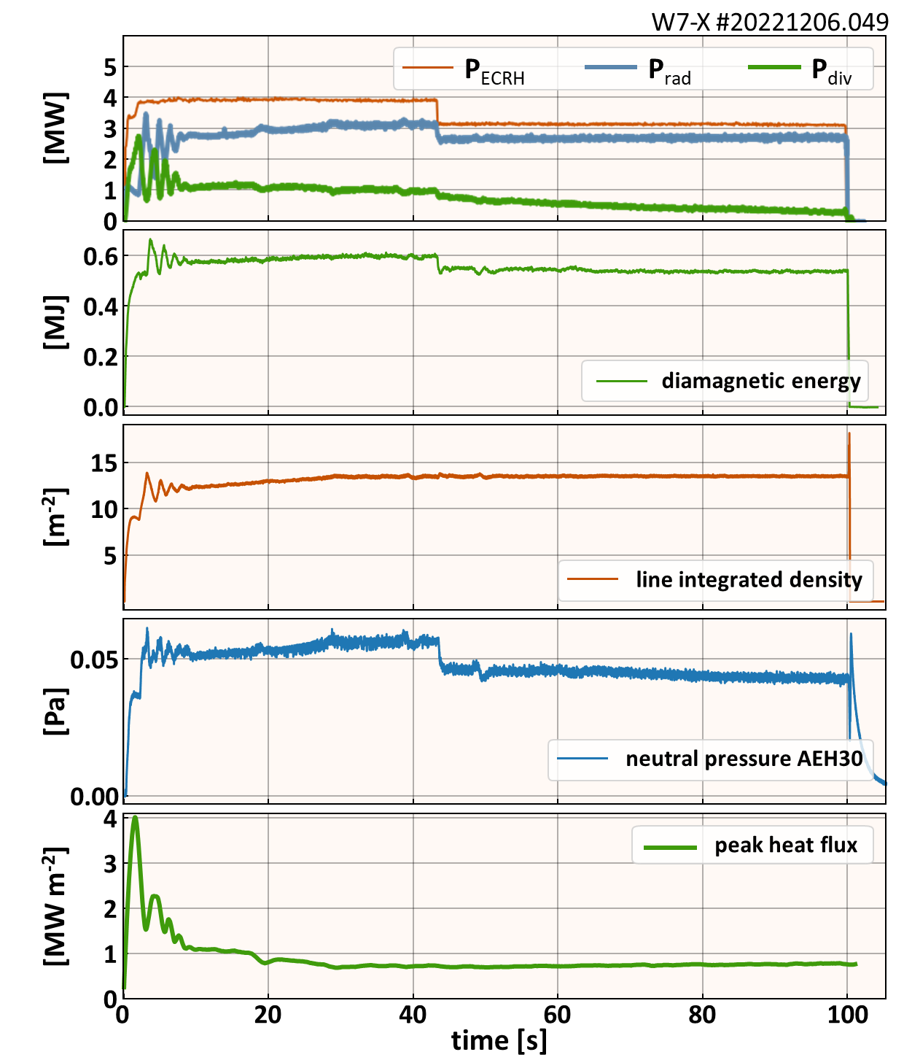
W7-X detached long pulse scenarios
prolonged in OP2.1 to 100 s
with actively water cooled divertor configuration
The oscillations seen in the transition period are artefacts due to the feed-back controller settings, which results in changes in Prad and automatically divertor power loads.

Slide 18
W7-X detached long pulse scenarios in OP2.1
prolonged in OP2.1 to 100 s
CVI line intensity looks rather stable
O lines intesity little increase but it doesn’t affect the Zeff value which are below 2 over the discharge

Slide 19
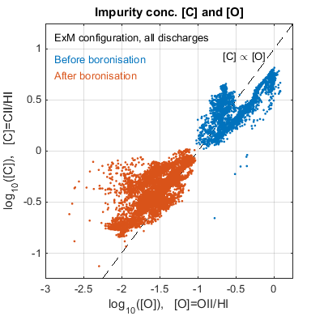
Lower carbon contents at the plasma boundary due to boronizations
Inefficient absorption O2 ECRH
After 3 boronizations
T. Wauters et al. Nuclear Materials and Energy 17 (2018) 235
Boronization produces boron dominated layer on a PFC, which has a strong ability to getter oxygen.
  In OP1.2: Oxygen reduced by a factor of 10 (or a lot more, in some cases)
  Carbon reduced by about a factor of 7, to large degree due to much lower oxygen content at the plasma edge.

Slide 20
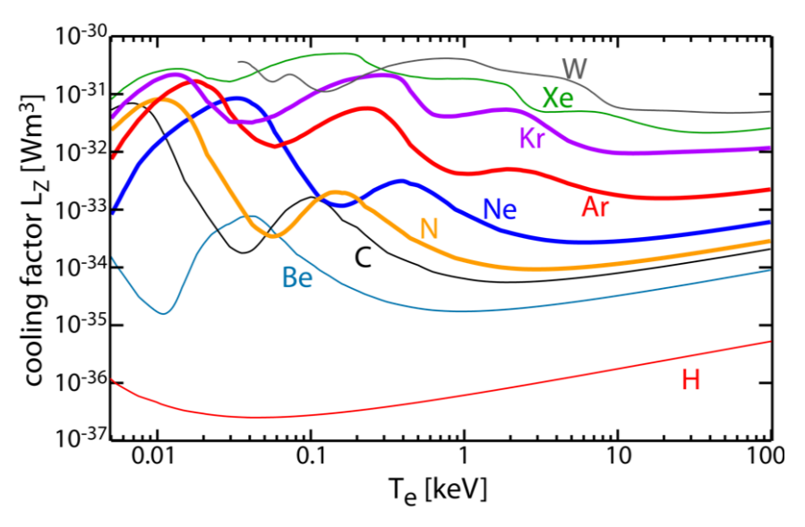

Choice of seeding impurities for heat load control
The choice of impurities or the mix of several impurities will depend on the expected temperature range, the achievable impurity density n_{Z} and ne.
As the SOL at W7-X is supposed to operate at plasma electron temperatures of few to 10 eV the choice of impurities is limited to low- or medium-Z species, e.g. N2 or Ne.
Especially nitrogen seems to be attractive impurity as it L_{Z} characteristics is similar to carbon
Cooling factor for a set of intrinsic and seeded impurities
L_{z} calculated for coronal equilibrium [1]
$$q_{rad}^{imp}\sim n_{e}n_{Z}L_{Z}(n_{e},T_{e}, τ)$$
SOL of island divertor at Wendelstein 7-X
M. Wischmeier, et al., IAEA-FEC TH/P7-5 (2018)

Slide 21
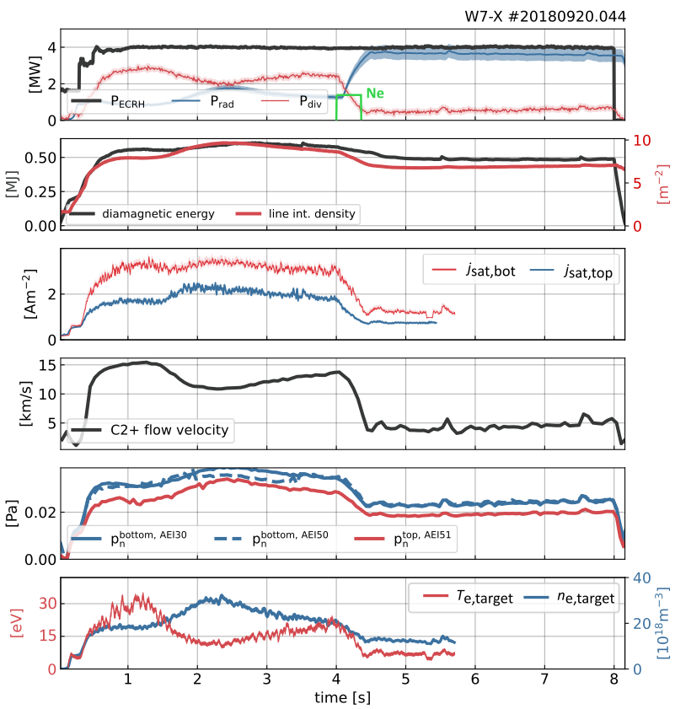
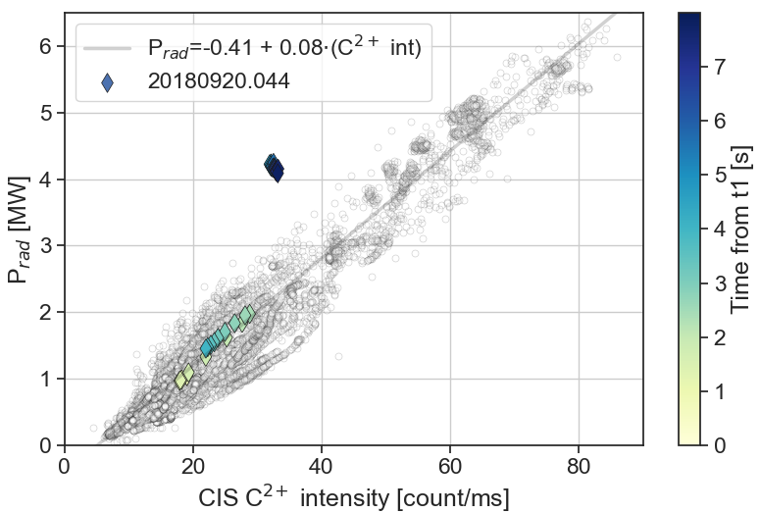
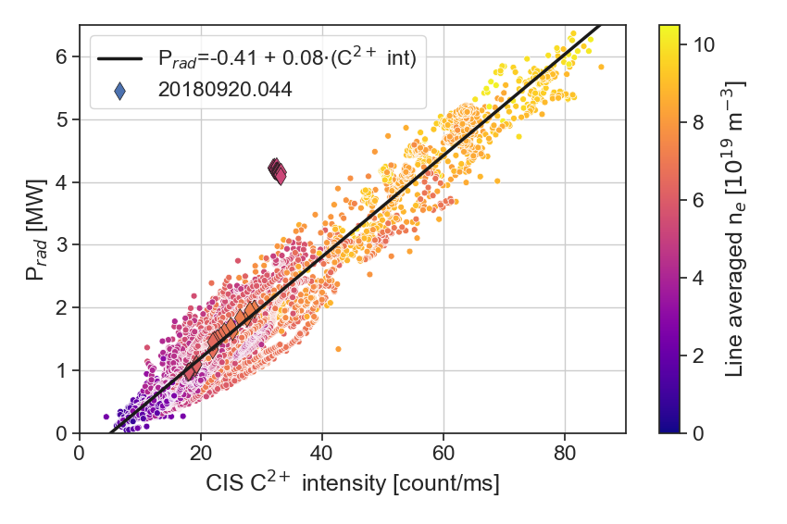
Detachment with neon seeding long lived due to high recycling of Ne
OP1.2b
M.W. Jakubowski, et al., PSI 2022
F. Effenberg, et al. Nuc. Fus. 59, 106020 (2019).
C + remaining Ne
C + Ne
C
C + remaining Ne
C + Ne
ΔP_{rad} ≈ 1.5 MW
C

Slide 22
Neon seeding lead to detachment very similar as the intrinsic detachment
OP2.1
To increase n_{e} Ne every 2.5 s was puffed which kept P_{rad} baseline constant at f_{rad} = 0.8 in the first 18 s of discharge (gyrotrons dropped after 18 s).
Ne was almost constant at the level of 1.3×10²⁰ m⁻² during the entire discharge.
averaged heat flux distribution on the divertor plate in the t=8-15 s shown, the peak heat flux during the detached phase for Ne seeding stay at the very low level, remaining almost everywhere below 0.5MW/m2.
Ne line intensities of the higher ionization levels oscillate with each puff after an initial increase, but the baseline remains constant -> no Ne accumulation in the plasma core
No significant C and O changes
Seeded impurity does not affect the core plasma
Radiation fraction in the confined plasma region is higher – max radiation is at higher temperatures

Slide 23
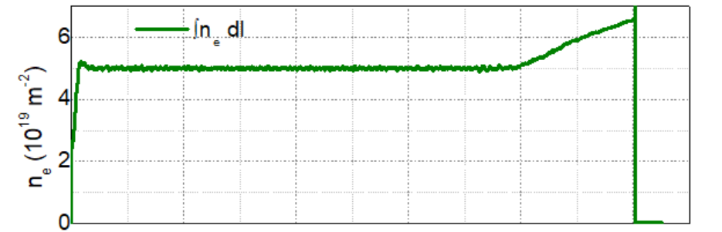
The longest OP1.2b discharge with attached divertor
The radiation fraction f_{rad} during the entire programme was about 30%, which resulted in a fully attached divertor plasma.
n_{e} was stable till t = 80s. As in the previous campaign the divertor units were not water-cooled their surface temperature was increasing throughout the experiments.
During this program it reached the surface temperatures above 1000°C. This resulted in the stronger emission of impurities, e.g. oxygen or water molecules from the divertor target plates, which increased plasma radiation and plasma density in the last phase of the discharge.

Slide 24
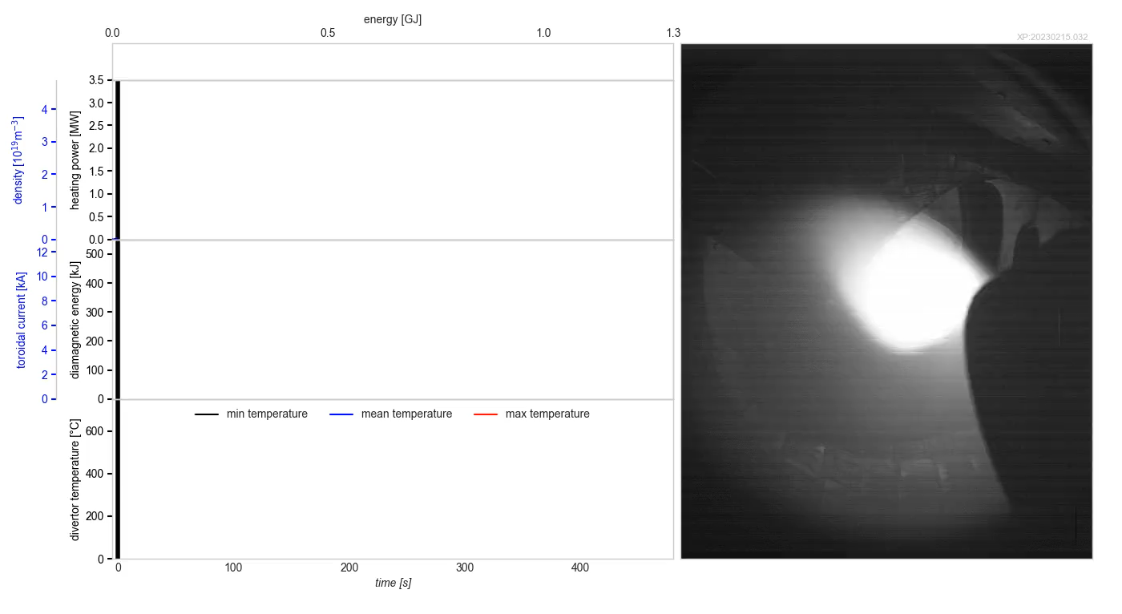
Record heating energy of 1.3GJ w/ attached divertor in OP2.1
O. Grulke, 29th FEC IAEA conference

Slide 25
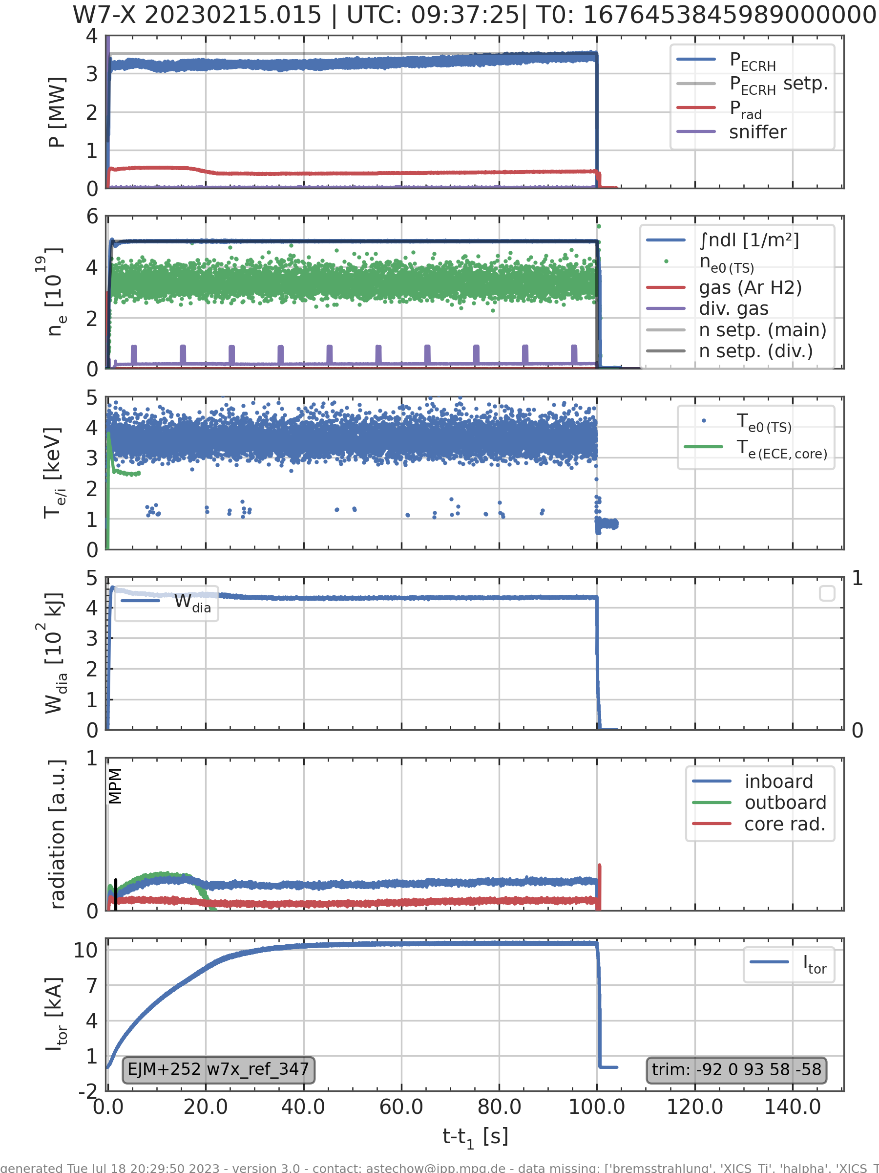
Attached divertor configuration – similar to the record pulse
Results from PHA spectra simulations

Slide 26
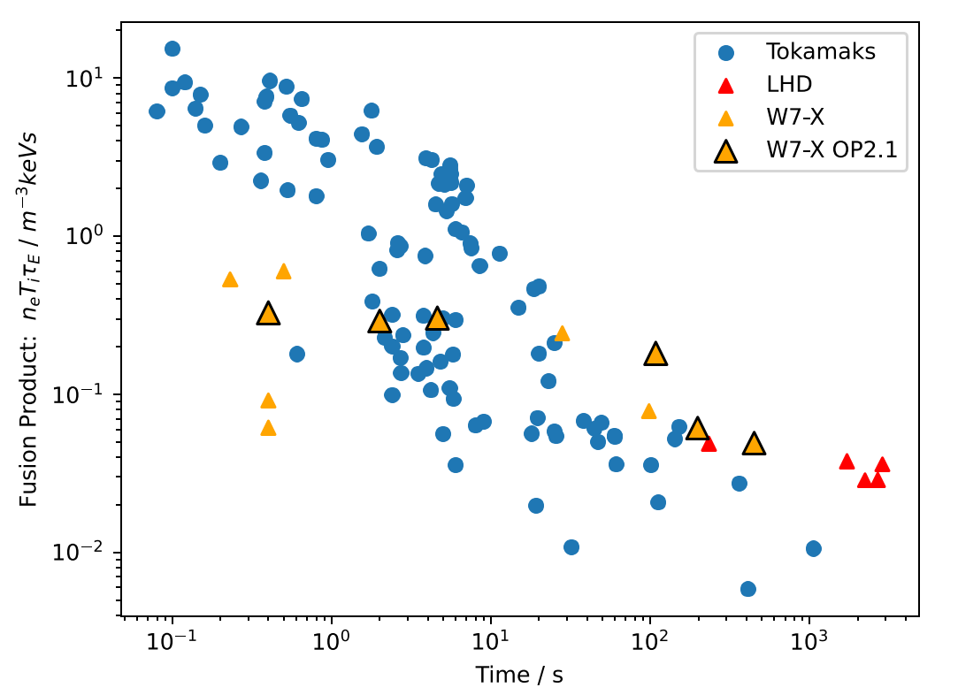
Summary
First campaign with water-cooled plasma facing components (incl. HHF divertor) allowed to gain first experience with long pulse scenarios:
    8 minute attached plasma
    >100 s detached plasma
    W7-X ECRH plasma is resilient to impurity accumulation in spite of long pulse scenarios with high plasma radiation.
    Both Ne and C are suitable for power dissipation in the long pulse discharges.
112 s
480 s

Slide 27
Thank you for your attention!
Work done under EUROfusion WPW7X

Slide 28
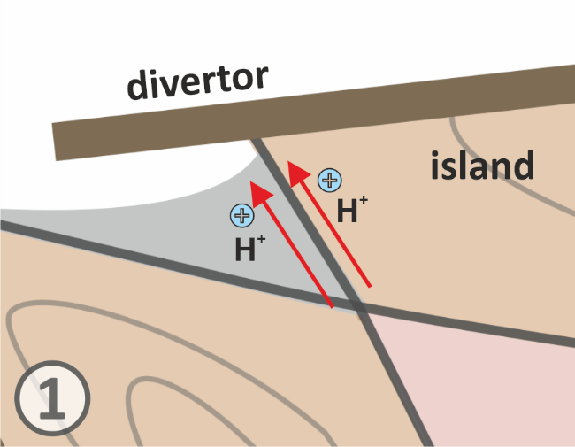
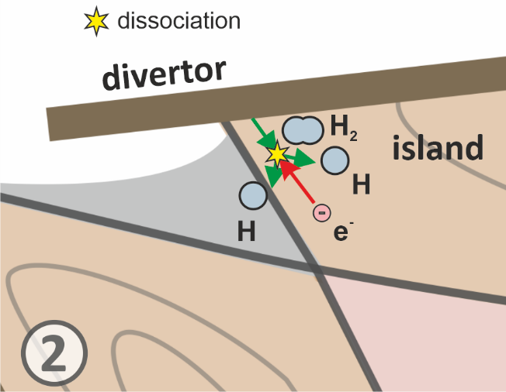
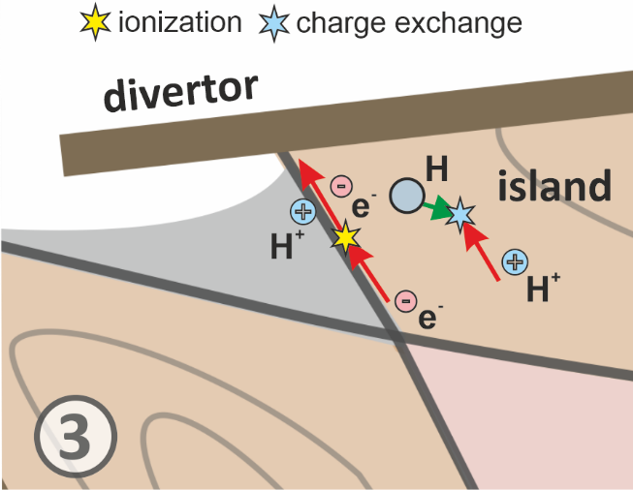
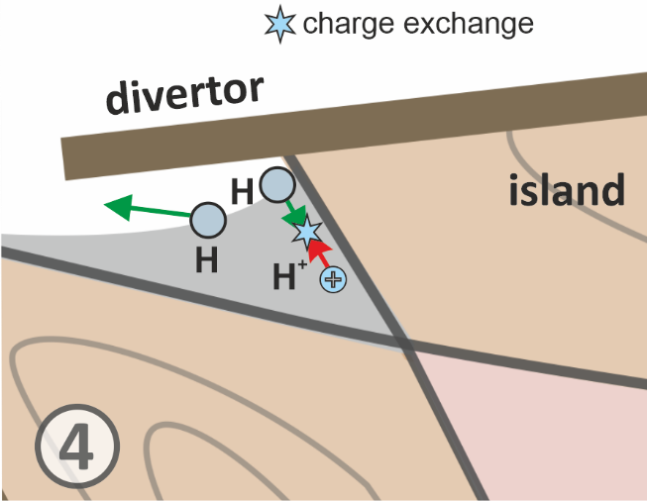
W7-X: attached and detached divertor configuration
Attached (touching):
Hot plasma (20 eV – 100 eV) in direct contact with divertor plates → higher heat loads.
Stronger particle flux → particles arrive at higher rate.
Detached (not touching)
Colder plasma (< 5 eV) in direct contact with divertor plates → Power radiated away, low heat loads.
Higher recycling of particles

