Slide 1
Two flux model for shallow magnetic field incidence on the divertors
A Pandey, M Endler, Y Gao and the W7-X Team
Max-Planck Institüt für Plasmaphysik, Greifswald 17491, Germany

Slide 2
Abstract
In the case of shallow magnetic field incidence on a floating surface in contact with the plasma, the structure of the sheath above the surface is expected to exhibit substantial deviations from that observed at steeper angles of incidence. A simple ``two-flux model" is proposed to represent the physical phenomena and sheath formation above the floating surface for small angles. The model basically proposes that a correction is required in the calculation of ion flux to the walls, which only becomes important for small incidence angles (< 10 deg). It is shown that the ion flux to the floating surface gets significantly modified at shallow incidence angles along with the total sheath drop. The model yields easily computable equations for determining particle fluxes and sheath potential drop. Additionally, the model inherently produces a condition for sheath reversal. The model is further utilized to estimate heat flux deposited on the surface. The ratio of experimentally observed heat flux deposited on the divertor and the conventional particle flux, often referred to as the sheath transmission coefficient, exhibits seemingly unphysical values at small angles. This peculiar behavior of the sheath transmission coefficient is also elucidated by the model.

Slide 3
Plasma wall interface
Quasineutral Magnetic presheath
Space charge sheath
z
Magnetic sheath exit / Quasi neutral region exit (QN exit)
Plasma
B
$${\overline{v}}_{∥}\left(x=0\right)=C_{s}$$
α
$$v_{∥}$$
Sheath
$$v_{⊥}$$
wall
x = 0
x
x = L

Slide 4
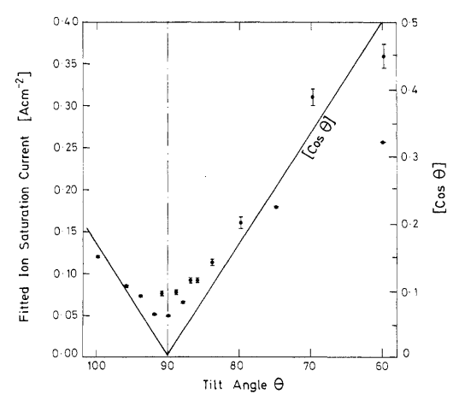
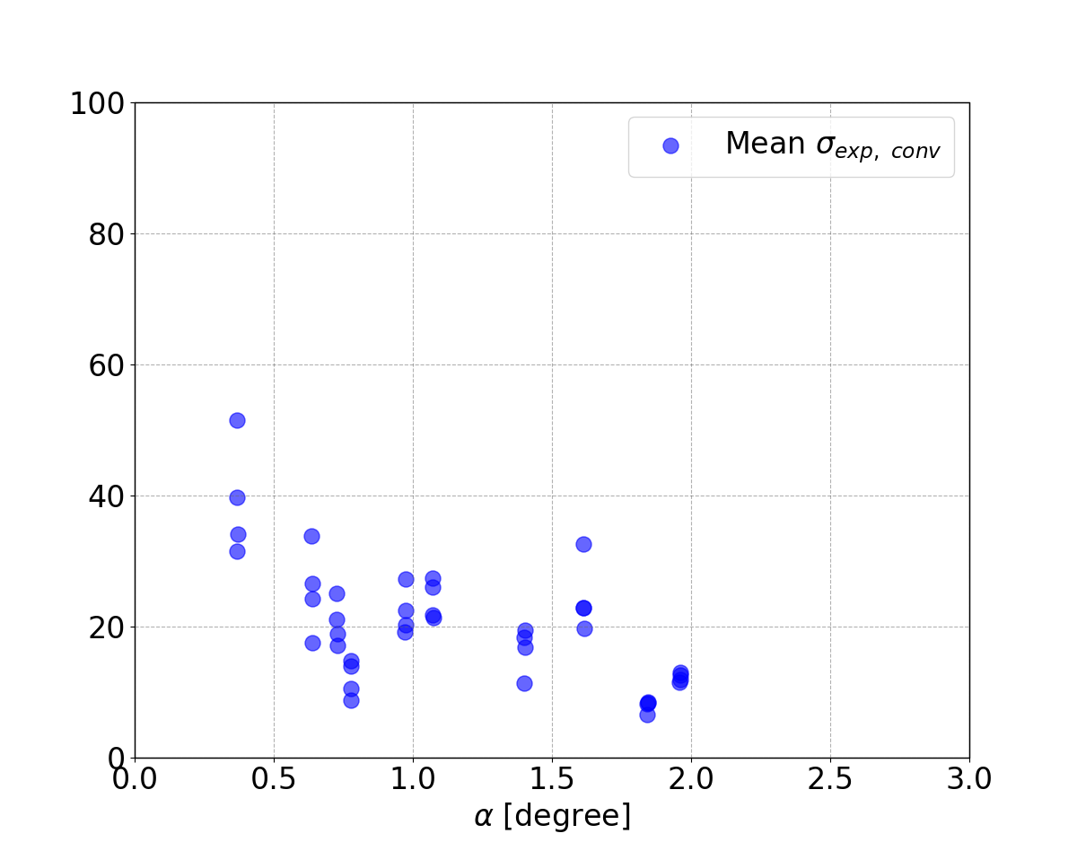
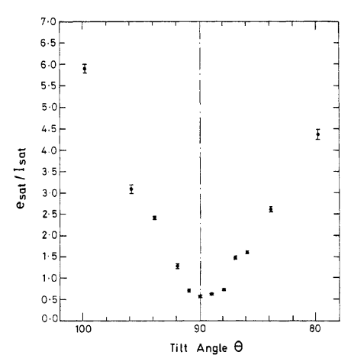
Motivation:
[1] G F Matthews et al 1990 PPCF 32 1301
Stangeby [1] showed that for hydrogen plasma Debye sheath disappears at $α<5^{∘}$ and Bohm criterion is not followed, but he assumed a fixed sheath drop.
Stangeby [1] and Tskhakaya [2] postulate sheath reversal at $α<{1.3}^{∘}$.
PIC simulations [3] for near parallel incidence show
a change in sheath drop with angle of incidence
sheath reversal for near-parallel incidence
Change in ion flux from the expected value
. Experiments at the DITE tokamak showed [6]:
Deviations in ion saturation current patterns from sin α at incidence angles around or below α = 10⁰.
At shallow angles, the electron saturation current to ion saturation current ratio drops below 1, and the measured floating potential becomes less negative and even positive for near-parallel incidence.
TFTR experiments also showed “a substantially higher heat flux at tangency point (near-parallel incidence) than is calculated conventionally.”
$$σ_{exp, conv }=\frac{Exp. Heat Flux}{Γ_{i}T_{e}\sin{α}}=\frac{Exp. Heat Flux}{n_{e}C_{S}T_{e}\sin{α}}$$
[Sin α]
[Sin α]
No practical sheath model for $α<5^{∘}$. Only PIC simulations.
-10
0
10
20
30
These experimental findings at small magnetic field incidence angles are not explained comprehensively by existing sheath models.
[1] P.C. Stangeby Nucl. Fusion 52 083012 (2012)
[2] Tskhakya and Kuhn Journal of Nuclear Materials 313-316 (2003)
[3] J Moritz et al Physics of Plasmas 26, 013507 (2019)
[4] Cohen and Ryutov Physics of Plasmas 5, (1998)
[5] Geraldini, Journal of Plasma Physics 87, (2021)
-10
0
10
Tilt angle α

Slide 5
Scope of this paper
This paper is an attempt to include the “last orbit effect” of the ion and derive an expression for the ion flux on a plasma facing wall in a magnetized plasma for shallow incidence angles
The result is a first order approximation of the ion flux on the plasma facing wall
What is not included:
effect of drifts in the sheath
the transport equation is not solved
Including these physical aspects is important to calculate the potential (density) profile

Slide 6
Parallel Ion flux
Parallel ion flux at x = 0 [8]:
$Γ_{i, ∥}(x=0)=\int_{v_{∥}>0}^{∞}{{v_{∥}f}_{i}\left(v_{∥}\right)d^{3}v }$
$f_{i}\left(v\right)=n_{i, mse} {\left(\frac{m_{i}}{2πT_{i}}\right)}^{\frac{3}{2}}exp\left(−\frac{m_{i}}{2T_{i}}{\left(v −\overline{v}\left(x\right)\right)}^{2}\right)$
For ions → mean speed: ${\overline{v}}_{i, ∥}\left(x=0\right)=C_{s}$
$Γ_{i, ∥}\left(x=0\right)≈ n_{e}C_{s}$
$Γ_{i, x}\left(x=0\right)= Γ_{i, ∥}\left(x=0\right)\sin{α}=n_{e}C_{s}\sin{α}$
$$Magnetic$$
$$sheath entrance$$
[8] R. Chodura Physics of Fluids 25, 1628–1633 (1982)

Slide 7
Closed and Open orbits
The Ions which spend less than one gyro period in the magnetic presheath would exit the magnetic presheath relatively unaffected ([5] A Geraldini PPCF 2018) = open orbit
This condition can be written as: $τ_{C}<\left(\frac{ρ}{\tan{α}}\right)/v_{∥}$
This condition also provides a lower limit for the perpendicular velocity $v_{i, ⊥}^{l}$required for ions to exit the QN region along their gyration path in one gyration , given by:
$$v_{i, ⊥}^{l}=2 πv_{i, ∥}\tan{α}$$
For open-orbit ion population:
${|v}_{i, ⊥}|>v_{i, ⊥}^{l}$
${|v}_{i, ⊥}|=χ2 πv_{i, ∥}\tan{α}$; $χ∈\left(1, ∞\right)$
$q=\frac{\tan{α}}{v_{i,⊥}/v_{i,∥}}=\frac{1}{2πχ}$
Closed- orbit ion population $|v_{i, ⊥}|<v_{i, ⊥}^{l}$

Slide 8
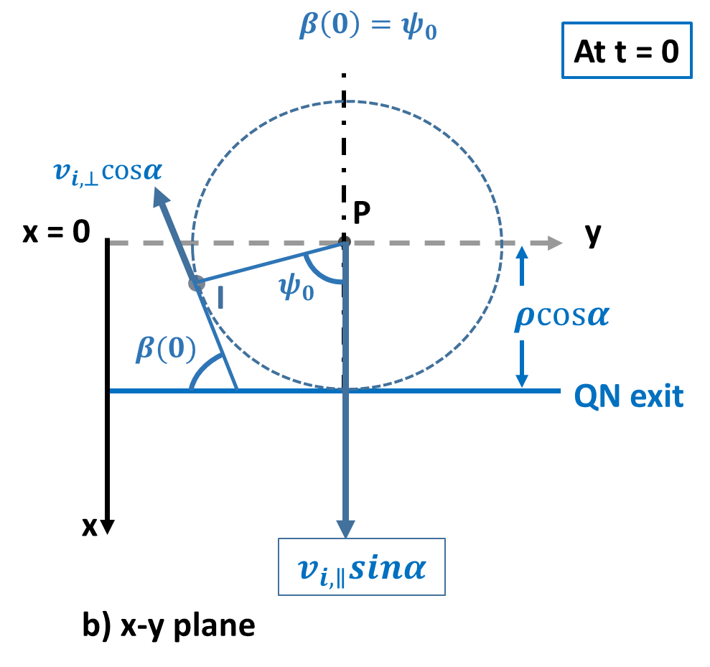
Open-orbit ion flux [nomenclature - 4, 5] Assumption: For high $v_{⊥}$ the gyro-orbit is not affected by the electric field in the magnetic presheath [9]
$v_{i, x}\left(t\right)=v_{∥}\sin{α}−v_{⊥}\cos{α}\sin{β}(t)$
${β(t)\text{ = }ψ}_{0}+ω_{i}t ; ψ_{0}∈[0, 2π]$
For open-orbits: $\left\langle \sin{β}(t)\right\rangle ≠0$
$q{ψ_{0}=\cos{β}}_{c}+qβ_{c} −1$ [9]
$q=\frac{\tan{α}}{v_{i,⊥}/v_{i,∥}}=\frac{1}{2πχ}$
[4] Cohen and Ryutov Physics of Plasmas 5, (1998)
[5] Geraldini, Journal of Plasma Physics 87, (2021)
[9] Parks and Lippman P Physics of Plasmas 1, (1994)

Slide 9
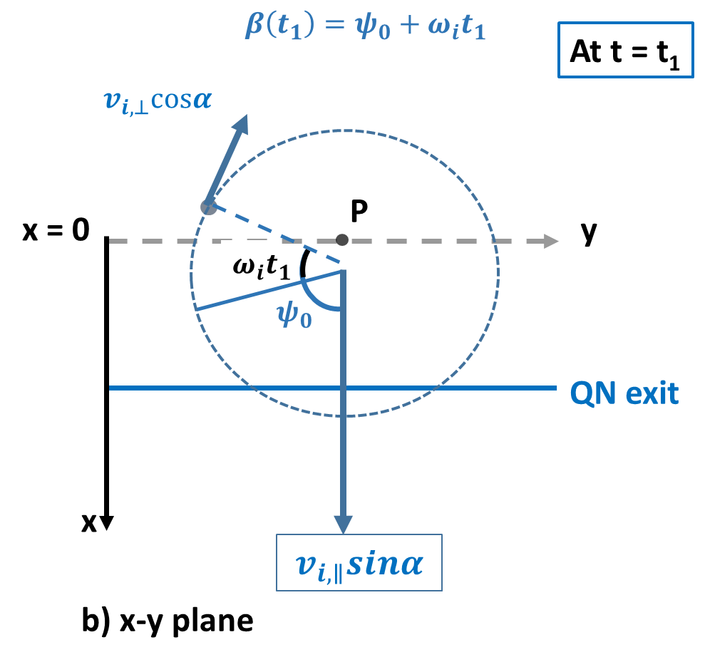
Open-orbit ion flux Assumption: For high $v_{⊥}$ the gyro-orbit is not affected by the electric field in the magnetic presheath [9]
$v_{i, x}\left(t\right)=v_{∥}\sin{α}−v_{⊥}\cos{α}\sin{β}(t)$
${β(t)\text{ = }ψ}_{0}+ω_{i}t ; ψ_{0}∈[0, 2π]$
For open-orbits: $\left\langle \sin{β}(t)\right\rangle ≠0$
$q{ψ_{0}=\cos{β}}_{c}+qβ_{c} −1$
$q=\frac{\tan{α}}{v_{i,⊥}/v_{i,∥}}=\frac{1}{2πχ}$
[4] Cohen and Ryutov Physics of Plasmas 5, (1998)
[5] Geraldini, Journal of Plasma Physics 87, (2021)
[9] Parks and Lippman P Physics of Plasmas 1, (1994)

Slide 10
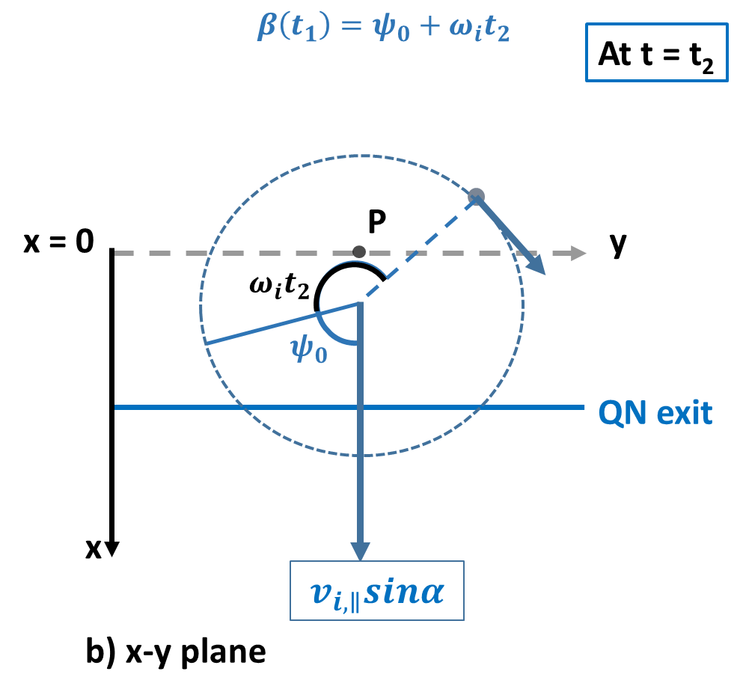
Open-orbit ion flux Assumption: For high $v_{⊥}$ the gyro-orbit is not affected by the electric field in the magnetic presheath [9]
$$β\left(t_{2}\right)=ψ_{0}+ω_{i}t_{2}$$
$v_{i, x}\left(t\right)=v_{∥}\sin{α}−v_{⊥}\cos{α}\sin{β}(t)$
${β(t)\text{ = }ψ}_{0}+ω_{i}t ; ψ_{0}∈[0, 2π]$
For open-orbits: $\left\langle \sin{β}(t)\right\rangle ≠0$
$q{ψ_{0}=\cos{β}}_{c}+qβ_{c} −1$
$q=\frac{\tan{α}}{v_{i,⊥}/v_{i,∥}}=\frac{1}{2πχ}$
[4] Cohen and Ryutov Physics of Plasmas 5, (1998)
[5] Geraldini, Journal of Plasma Physics 87, (2021)
[9] Parks and Lippman P Physics of Plasmas 1, (1994)

Slide 11
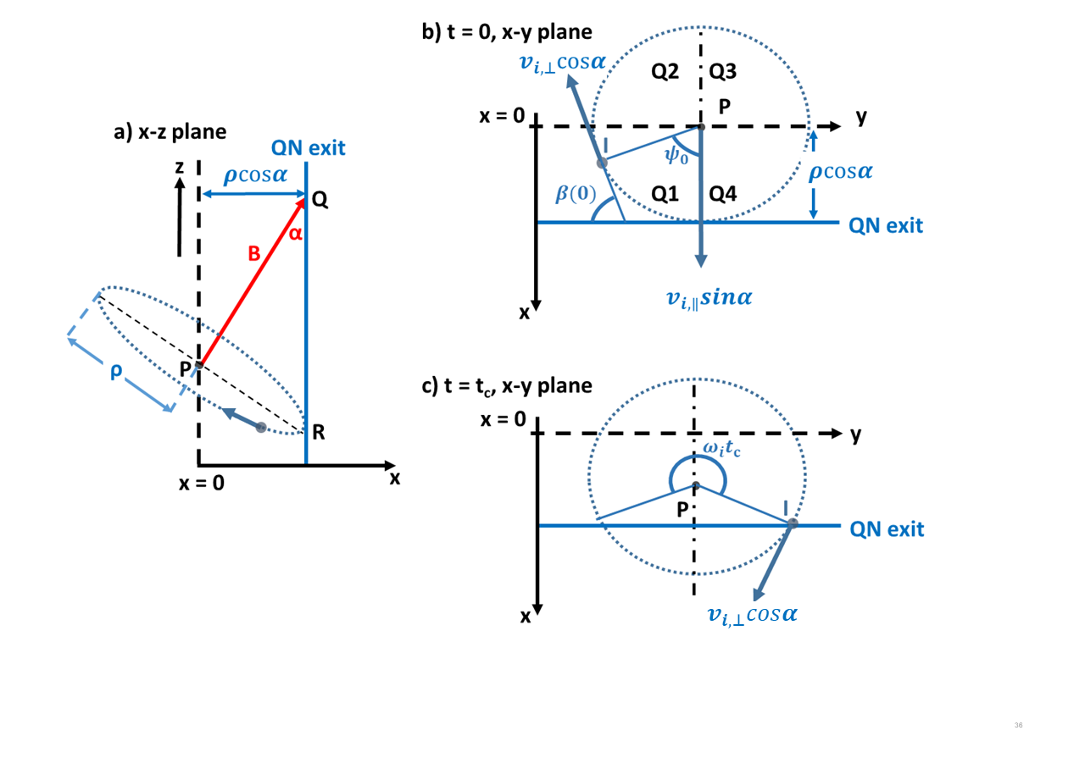
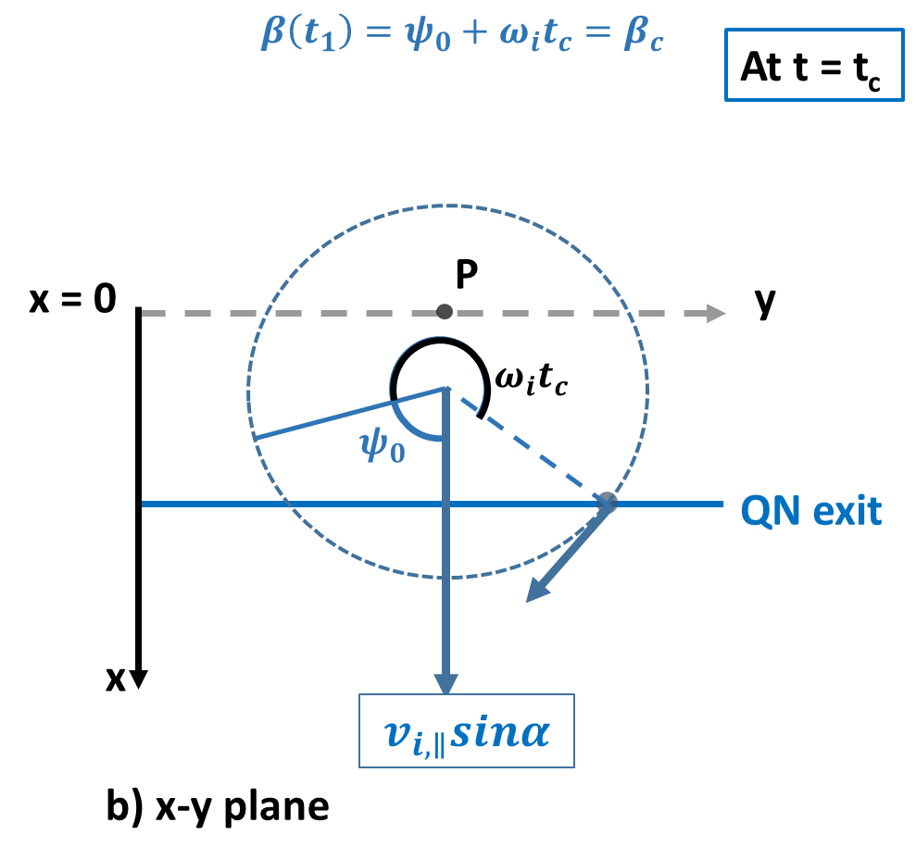
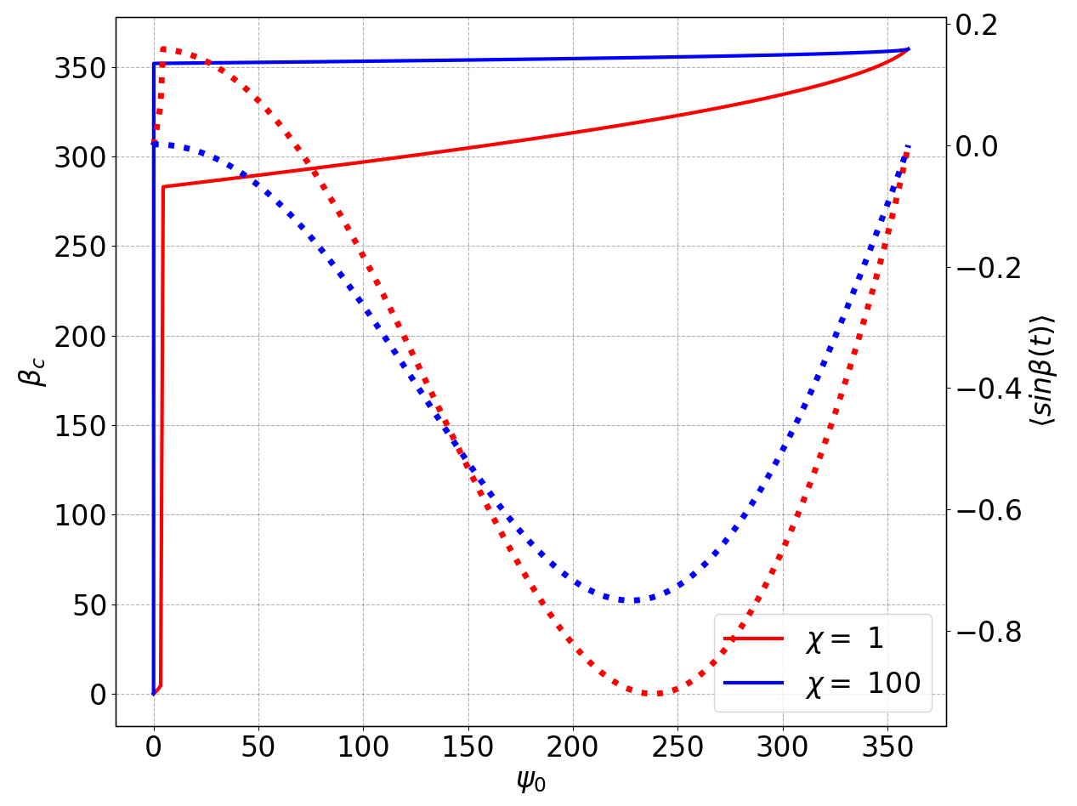
Open-orbit ion flux Assumption: For high $v_{⊥}$ the gyro-orbit is not affected by the electric field in the magnetic presheath [9]
$$β\left(t_{c}\right)=ψ_{0}+ω_{i}t_{c}=β_{c}$$
$v_{i, x}\left(t\right)=v_{∥}\sin{α}−v_{⊥}\cos{α}\sin{β}(t)$
${β(t)\text{ = }ψ}_{0}+ω_{i}t ; ψ_{0}∈[0, 2π]$
For open-orbits: $\left\langle \sin{β}(t)\right\rangle ≠0$
$q{ψ_{0}=\cos{β}}_{c}+qβ_{c} −1$
$q=\frac{\tan{α}}{v_{i,⊥}/v_{i,∥}}=\frac{1}{2πχ}$
$$\overline{\left\langle \sin\left(β_{c}\right)\right\rangle }≈−0.36$$
[4] Cohen and Ryutov Physics of Plasmas 5, (1998)
[5] Geraldini, Journal of Plasma Physics 87, (2021)
[9] Parks and Lippman P Physics of Plasmas 1, (1994)

Slide 12
Open orbit ion flux
$v_{i, x}\left(t\right)=v_{∥}\sin{α}−v_{⊥}\cos{α}\sin{β}(t)$
$v_{i, x}\left(t\right)=v_{s_{1}}\sin{α}+v_{s_{2}}\cos{α}$
For ion flux to the wall:
$v_{i, x}>0$
$v_{s_{2}}>{−v}_{s_{1}}\tan{α}={−v}_{i}^{n};$
$v_{i, ⊥}=\sqrt{v_{s_{2}}^{2}{+v}_{s_{3}}^{2}} >v_{i, ⊥}^{l}$
$Γ_{i, open}=\sum_{j=1}^{5}{\int_{ls_{3j}}^{{u_{s}}_{3j}}{\int_{l_{s2j}}^{{u_{s}}_{2j}}{\int_{l_{s2j}}^{{u_{s}}_{1j}}{v_{i, x}f_{i}\left(v\right) dv_{s_{1}}dv_{2}dv_{3}}}}}$
$Γ_{i, IO}=\sum_{j=1}^{5}{\int_{ls_{3j}}^{{u_{s}}_{3j}}{\int_{l_{s2j}}^{{u_{s}}_{2j}}{\int_{l_{s2j}}^{{u_{s}}_{1j}}{v_{s_{2}}\cos{α}f_{i}\left(v\right) dv_{s_{1}}dv_{2}dv_{3}}}}}$
$Γ_{i, total}=n_{e, mse}C_{s}\sin{α}+Γ_{i, IO}$
Included in the gyro-averaged flux calculation
Group | $v_{s_{2}}$limits lower, upper | $v_{s_{3}}$limits lower, upper
1 | $${0, v}_{i, ⊥}^{l}$$ | $$v_{i, ⊥}^{l}, ∞$$
2 | $$v_{i, ⊥}^{l}, ∞$$ | $$−∞, ∞$$
3 | $${0, v}_{i, ⊥}^{l}$$ | $${−∞, v}_{i, ⊥}^{l}$$
4 | $$−v_{i}^{n}, 0$$ | $$v_{i, ⊥}^{l}, ∞$$
5 | $$−v_{i}^{n}, 0$$ | $${−∞, v}_{i, ⊥}^{l}$$
Incomplete orbit

Slide 13
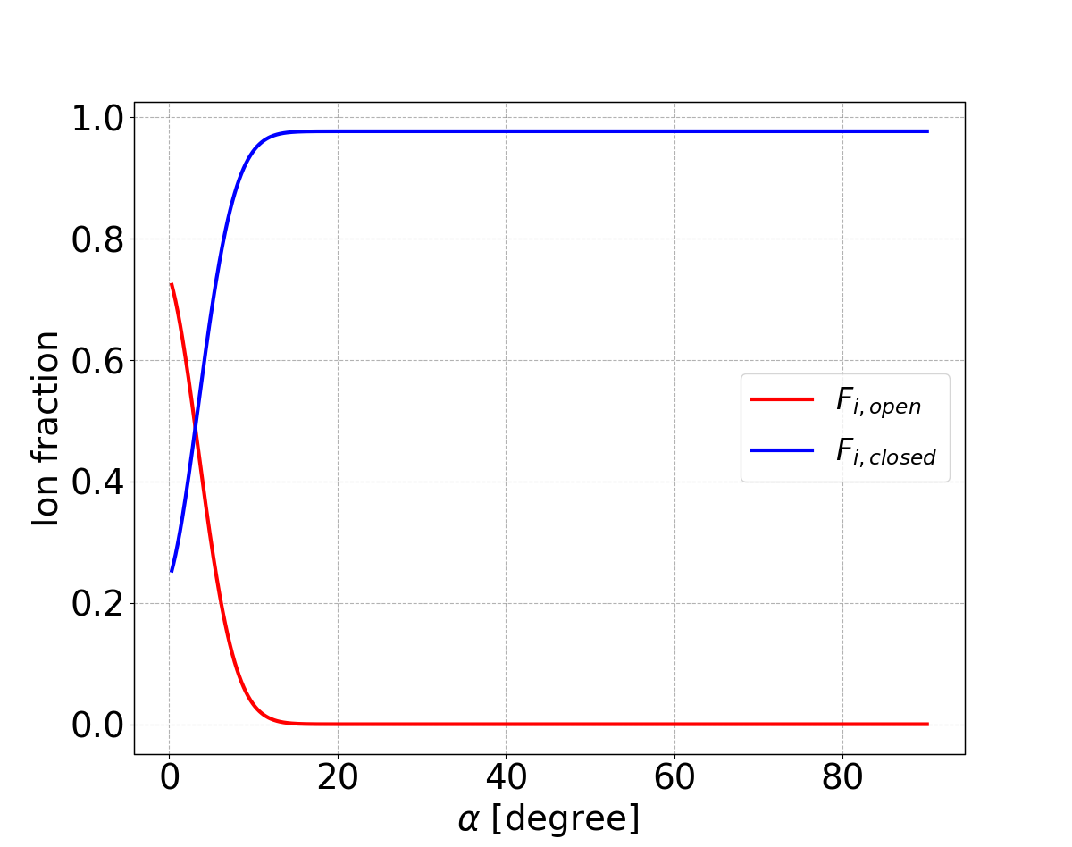
Results: Ion fractions
For $T_{e}=T_{i}=30 eV, n_{e, mse }={10}^{19}m^{−3},$
$$V_{f}=0 V, α>0.3^{o}$$
$F_{i, open}=\sum_{j=1}^{5}{\int_{ls_{3j}}^{{u_{s}}_{3j}}{\int_{l_{s2j}}^{{u_{s}}_{2j}}{\int_{l_{s2j}}^{{u_{s}}_{1j}}{f_{i}\left(v\right) dv_{s_{1}}dv_{2}dv_{3}}}}}$
$F_{i, total}=\int_{−∞}^{∞}{\int_{−∞}^{∞}{\int_{0}^{∞}{f_{i}\left(v\right) dv_{s_{1}}dv_{2}dv_{3}}}}$
$F_{i, closed}= F_{i, total} −F_{i, open}$
$F_{i, open}=\frac{1}{4}\left(1−r_{v}\right)[\left(1+r_{c}\right)\left(1+r_{v}\right)+1]$
where, $r_{v}=erf(\sqrt{a}v_{i, ⊥}^{l})$, $r_{c}=erf(\sqrt{a}C_{s})$

Slide 14
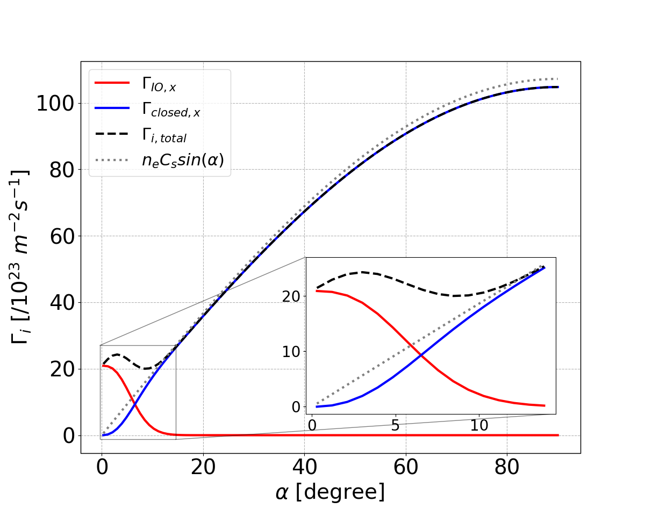
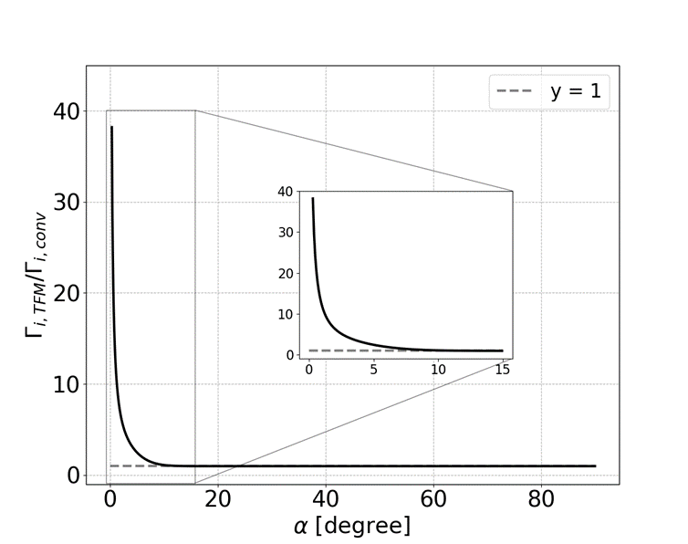
Results: Ion flux
For $T_{e}=T_{i}=30 eV, n_{e, mse }={10}^{19}m^{−3},$
$$V_{f}=0 V, α>0.3^{o}$$
Total ion flux at the wall:
$Γ_{i, total}=n_{e, mse}C_{s}sin\left(α\right)+Γ_{i, IO}$
$Γ_{i, IO}=n_{e, mse}\frac{\left(1−r_{v}\right)\left(1+r_{c}\right)K_{s}+e_{v}(1+r_{c})}{4\sqrt{aπ}}$
$K_{s}=\frac{e_{b}e_{c}(1+r_{A})}{\left(1+r_{c}\right)\sqrt{h^{2}+1}} −e_{v}$
$e_{v}=\exp{{\left(−a{(v}_{i, ⊥}^{l}\right)}^{2})}, e_{b}=\exp\left(\frac{{\left(2aC_{s}\right)}^{2}}{4A} \right), e_{c}=\exp\left(−aC_{s}^{2}\right), r_{A}=\operatorname{erf}\left(\frac{aC_{s}}{\sqrt{A}}\right), A=a\left(h^{2}+1\right), h=\tan{α}$
Total electron flux at the wall:
$Γ_{e,total}=\exp\left(−\frac{δV_{sh}}{T_{e}}\right)\sin{α}\int_{0}^{∞}{g_{e}\left(v_{e, ∥}\right)d^{3}v }=\frac{1}{4}n_{e}c_{e, mse}\sin{α}\exp\left(−\frac{δV_{sh}}{T_{e}}\right)$

Slide 15
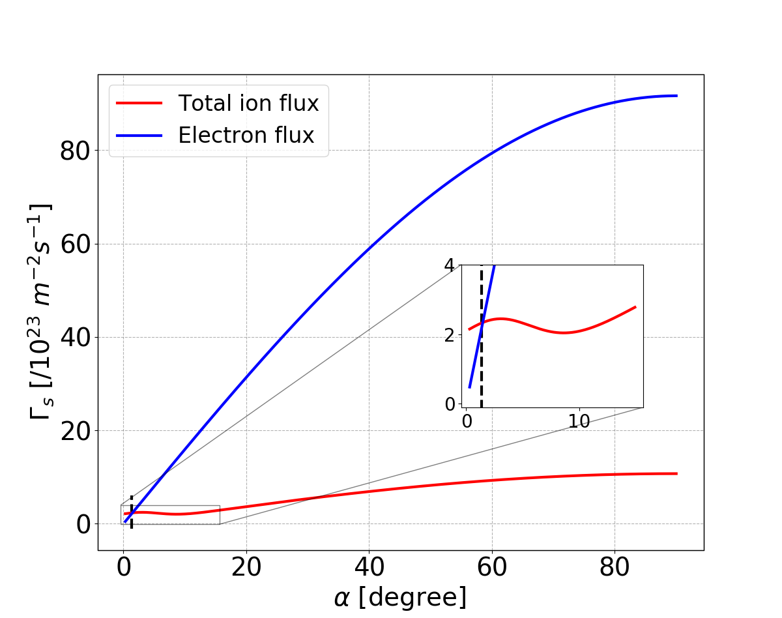
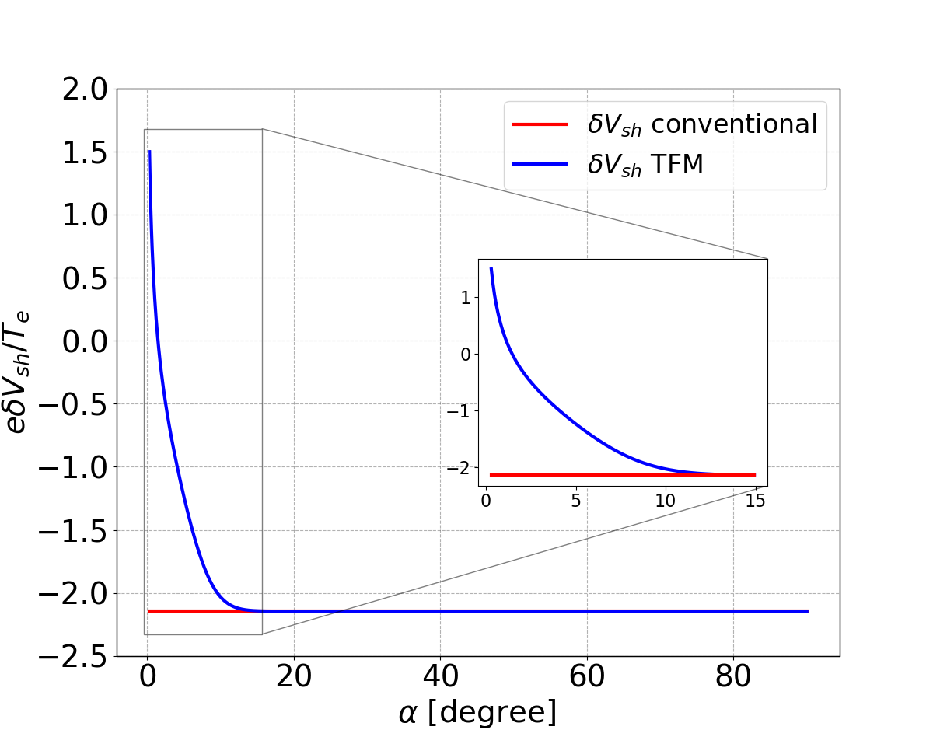
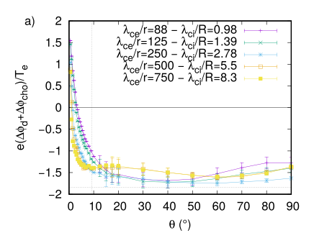
Sheathdrops
Ion flux becomes greater than electron flux for $α<{1.4}^{o}.$
Total Sheathdrop: $δV_{sh}={−(V}_{plasma} −V_{f})$
Floating condition: $Γ_{i, total}\left(α\right)=Γ_{e, total }\left(α\right)$
[7] J Moritz et al Physics of Plasmas 26, 013507 (2019)

Slide 16
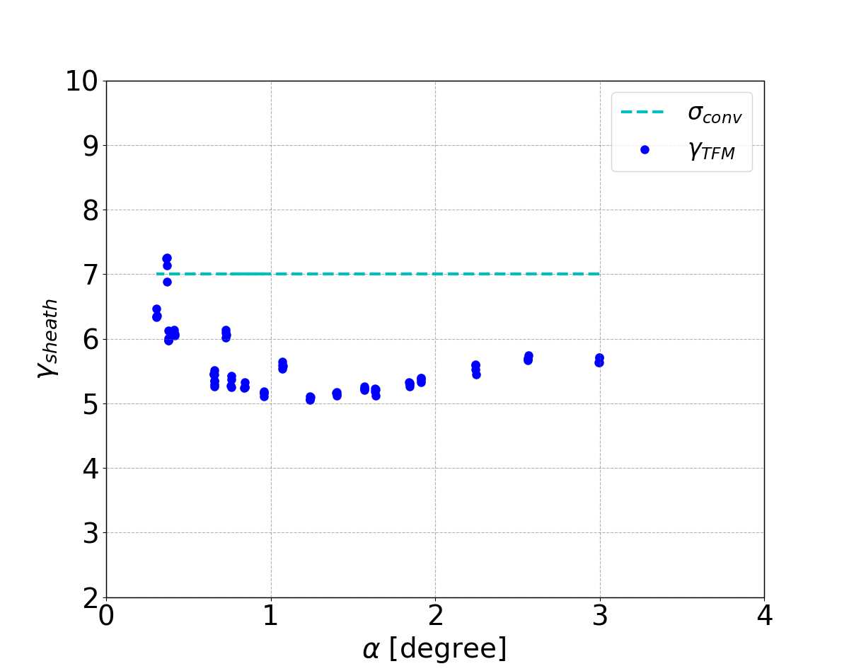
Sheath Transmission Coefficient
Divertors in W7-X are grounded and not floating: The particle and heat fluxes should be adjusted accordingly [10, 11]. $V_{p}$ is obtained using floating potential ($V_{f}$) from LP data and sheathdrop from the model, $V_{p}=V_{f}+δV_{sh}$ and $V_{w}=0.$
$Γ_{i, w}(V_{w})=\left\{\begin{aligned}Γ_{i, mse}, V_{w}<V_{p} \\ Γ_{i, mse}\exp\left(\frac{eδV_{pw}}{T_{e}}\right) , V_{w}≥V_{p}\end{aligned}\right.$
$Γ_{e, w}(V_{w})=\left\{\begin{aligned}Γ_{e mse}\exp\left(\frac{−eδV_{pw}}{T_{e}}\right), V_{w}<V_{p} \\ Γ_{e, mse}, V_{w}≥V_{p}\end{aligned}\right.$
$δV_{pw}=V_{p}−V_{w}$
Sheath transmission coefficient
Ions: $γ_{i}\left(V_{w}\right)=\frac{Q_{i}\left(V_{w}\right)}{Γ_{i, W}T_{e}}$
Electrons: $γ_{e}(V_{w})=\frac{Q_{i}\left(V_{w}\right)}{Γ_{i, W}T_{e}}$
Total sheath transmission coefficient: ${γ=γ_{i}+ γ}_{e}$
$$\frac{Q_{i}\left(V_{w}\right)}{eT_{e}}=\left\{\begin{aligned}2.5Γ_{i, w}(V_{w}), V_{w}<V_{p} \\ \left(2.5 −δV_{pw}\right)Γ_{i, w}\left(V_{w}\right), V_{w}≥V_{p}\end{aligned}\right.$$
$$\frac{Q_{e}\left(V_{w}\right)}{eT_{e}}=\left\{\begin{aligned}(2+δV_{pw})Γ_{e, w}(V_{w}), V_{w}<V_{p} \\ 2Γ_{e, w}\left(V_{w}\right), V_{w}≥V_{p}\end{aligned}\right.$$
[10] R L Merlino, American Journal of Physics, 75 (2007).
[11] P Stangeby, The Plasma Boundary of Magnetic Fusion Devices, Chapter 25.

Slide 17
SUMMARY
Introduction of a Two-Flux Model: The model examines the interaction between magnetized plasma and wall. It accounts for the flux contributed by ions due to incomplete orbits “last orbit effect” trajectories.
Increased Ion Flux at Grazing Incidence: The model provides an explanation for the experimental deviations in the ion flux pattern from the sin(α) trend.
Sheath Drop Calculation: The model calculates the sheath drop between the plasma and a floating wall based on electron and cumulative ion fluxes to ensure no current flows from the plasma to the wall.
Explanations for Elevated Sheath Transmission Coefficient: The model provides explanations for unrealistically high values of the sheath transmission coefficient observed in experimental data for incidence angles smaller than 1º, which existing theories cannot explain.
Heat flux on the divertor: The heat flux deposited on the divertor due to the ions does not follow the $\sin{α}$ pattern and could be substantially different from the expected value using conventional ion flux.

Slide 18
Additional Slides

Slide 19
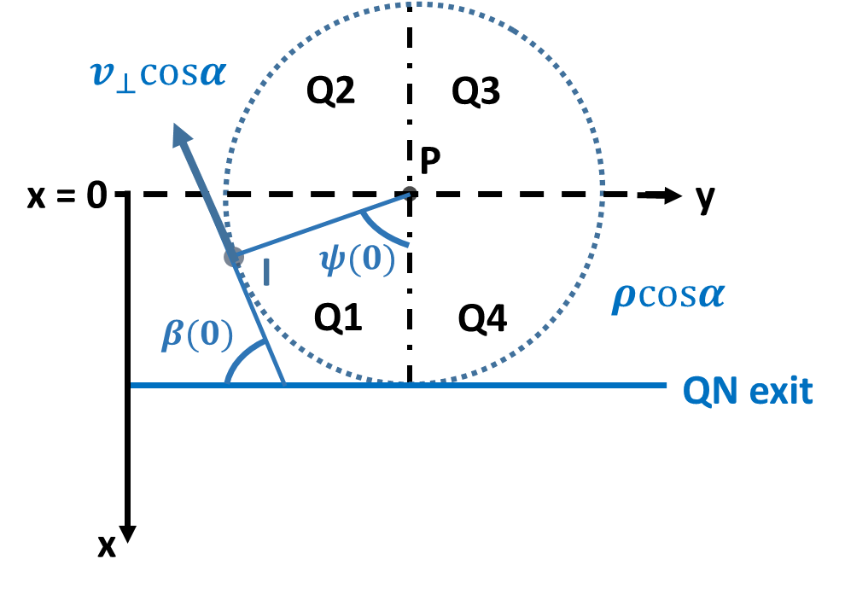
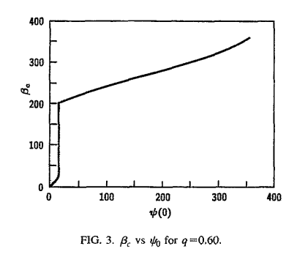
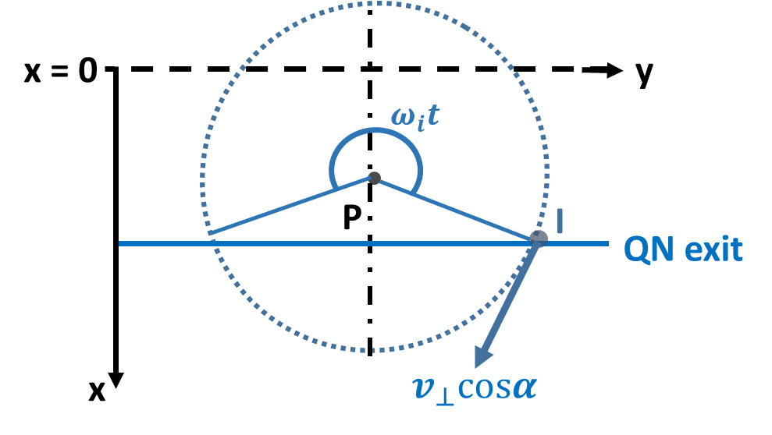
Open-orbit ion flux ([4] Cohen and Ryutov (Physics of Plasmas 5, (1998)), [5] Geraldini, (Journal of Plasma Physics 87, (2021) ) Assumption: For high $v_{⊥}$ the gyro-orbit is not affected by the electric field in the magnetic presheath ([6]. Parks and Lippman P Physics of Plasmas 1, (1994)).
At t = 0
$v_{i, x}\left(t\right)=v_{∥}sin\left(α\right)−v_{⊥}cos\left(α\right)sinβ(t)$
$β\left(t\right)=ψ_{0}+ω_{i}t$; $ψ_{0}∈[0, 2π]$
$β_{c}$ is the angle of incidence of the ion on the QN exit
For closed orbits (orbits in the y-z plane):$\left\langle sinβ(t)\right\rangle =0$ and $v_{i, x}=v_{∥}sin\left(α\right)$
For open-orbits: $\left\langle sinβ(t)\right\rangle ≠0$
$q{ψ_{0}=cos(β}_{c})+qβ_{c} −1$ [6]
$q=\frac{tan(α)}{v_{i,⊥}/v_{i,∥}}=\frac{1}{2πχ}$
$ψ_{0}^{crit}=\frac{{\left(1−q^{2}\right)}^{1/2}+qcos^{−1}{\left(1 −q^{2}\right)}^{1/2} −1}{q}$
$$v_{∥}sin(α)$$
b) x-y plane
At t = t
$$ψ_{0}^{crit}$$
$$v_{∥}sin(α)$$

Slide 20
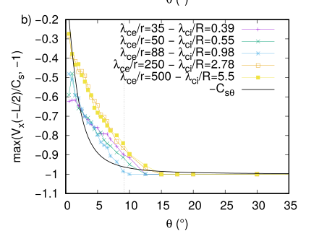
Effective speed of exiting the Magnetic sheath

Slide 21
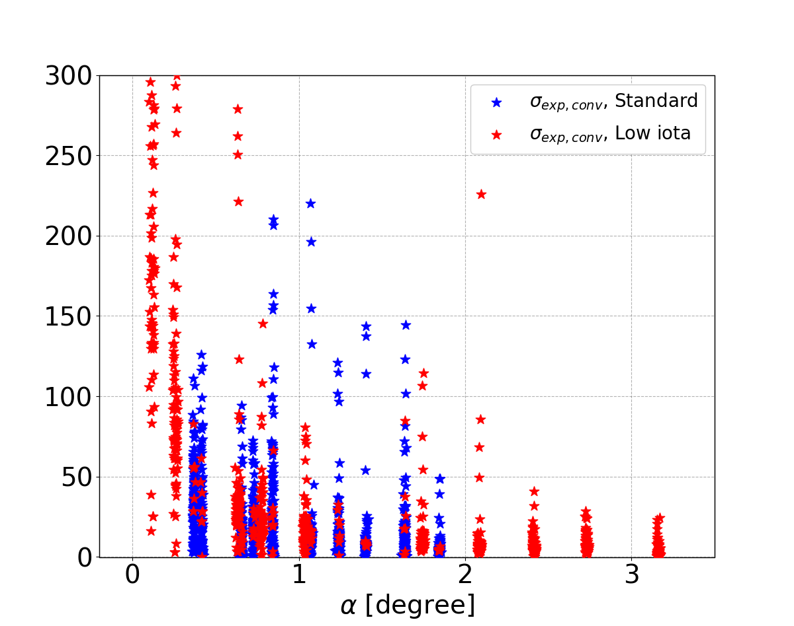
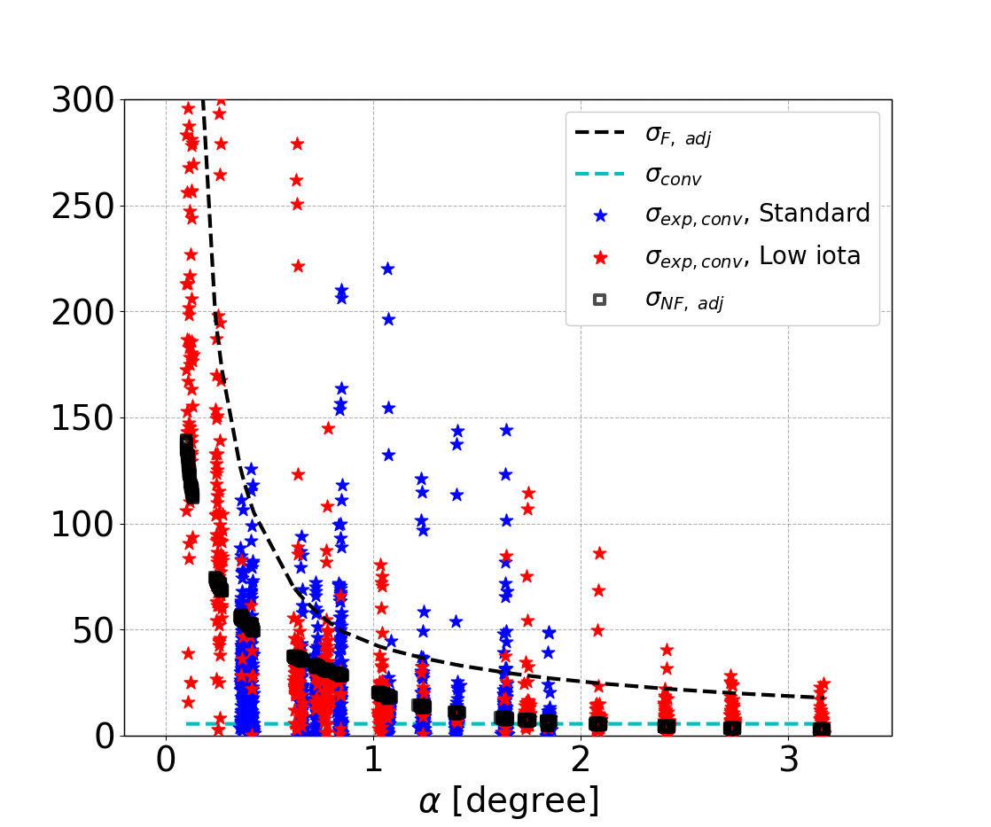
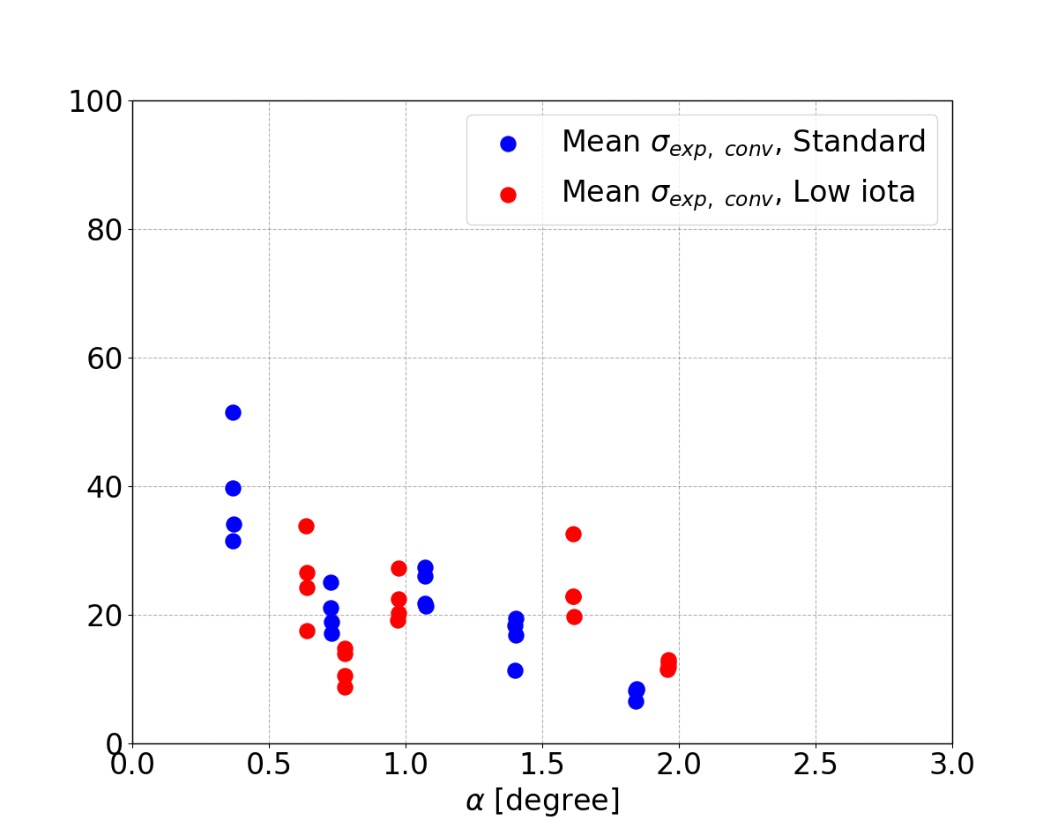
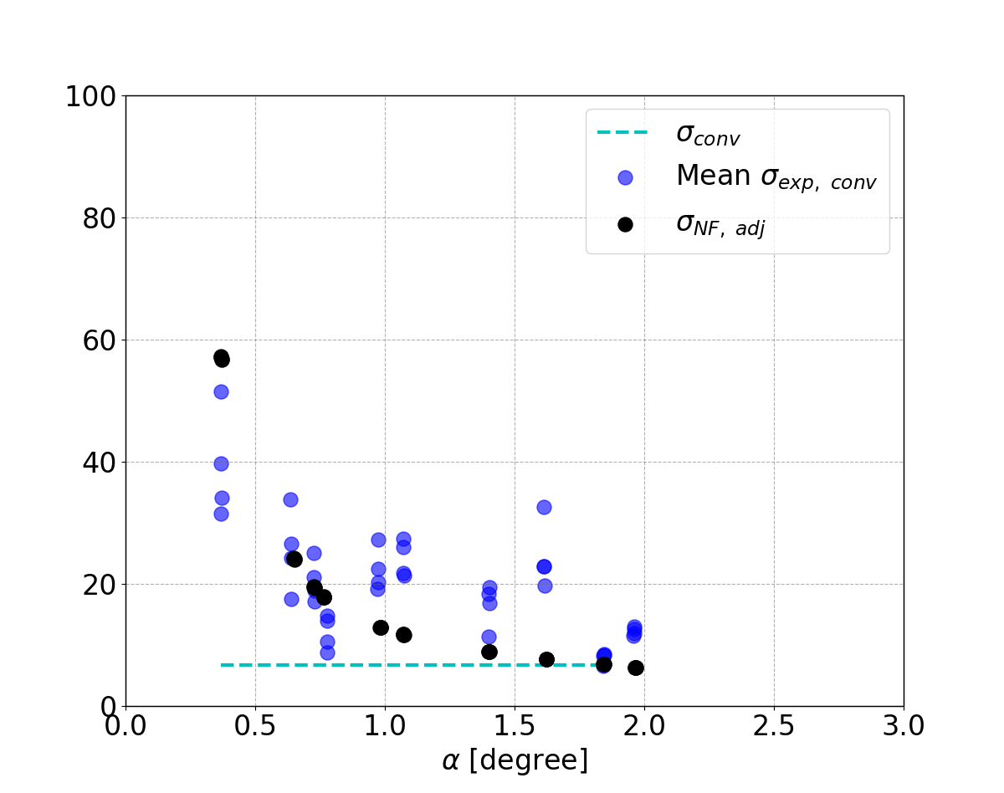
Sheath Transmission Coefficient
Sheath transmission coefficient [8. P. Stangeby, The Plasma Boundary of Magnetic Fusion Devices, (Taylor & Francis, 2000).]:
Ion: $γ_{i}=\frac{(Σ_{i}Γ_{i, W}+{δ\left(V_{Plasma}\right)V}_{sh}Γ_{i, W})(1−R_{E})}{Γ_{i, W}T_{e}}$
$Σ_{i}=2.5$ for the calculation shown
$δ\left(V_{plasma}\right)=0 for V_{plasma}<0,$
$δ\left(V_{plasma}\right)=1 for V_{plasma}>0,$
Electrons: $γ_{e}=(2Γ_{e, W}+{δV}_{PW }Γ_{e, W})/Γ_{e, W}T_{e}$
Total sheath transmission coefficient: ${γ=γ_{i}+ γ}_{e}$
If we use conventional ion flux:
$σ_{exp, conv }=Exp. Heat Flux/n_{e}C_{s}T_{e}\sin{α}$
$σ_{ conv }=(2.5+2+V_{sh})(1 −R_{E})$
$R_{E}=0.2$ for H⁺ on C.
$σ_{NF, adj }=Modeled Heat Flux non floating surface/n_{e}C_{s}T_{e}\sin{α}$
$σ_{F, adj }=Modeled Heat Flux floating surface/n_{e}C_{s}T_{e}\sin{α}$

Slide 22
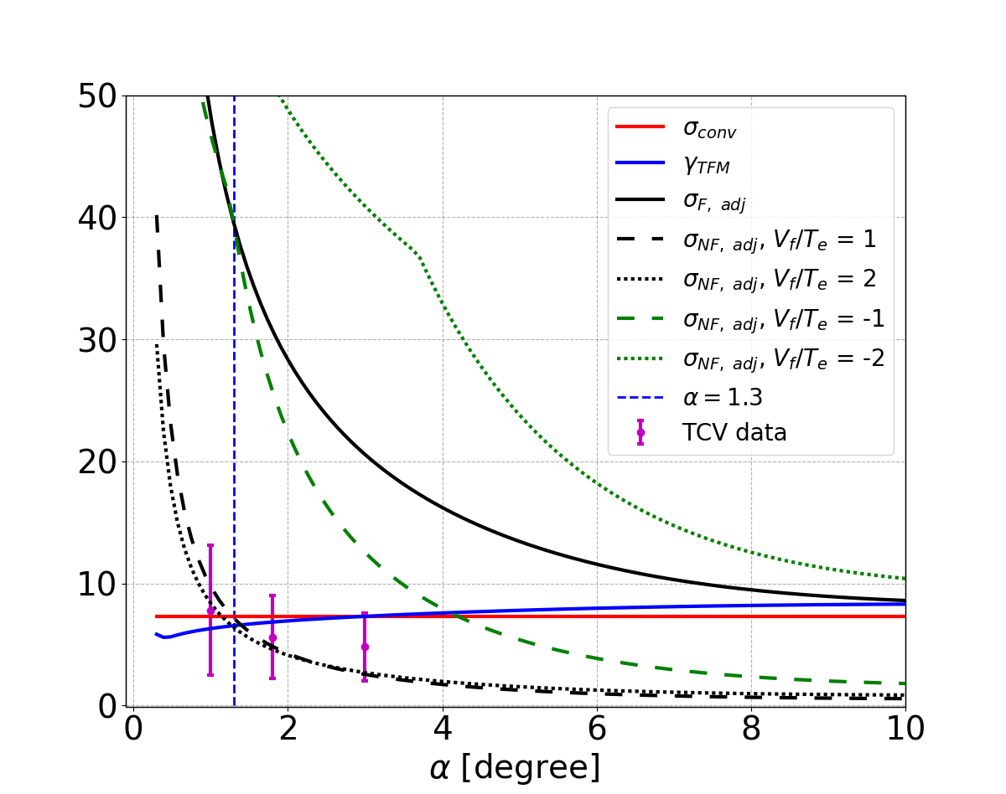
Effect of SOL currents
SOL currents would affect the value of floating potential on the divertor surface
The floating potential can affect the deposited heat flux by changing the ion flux on the grounded divertor
An example with ion mass = $4m_{H}$ is shown in the figure for different floating potential values
TCV data with D-He plasma [Marki_2007] is also plotted for comparison

Slide 23
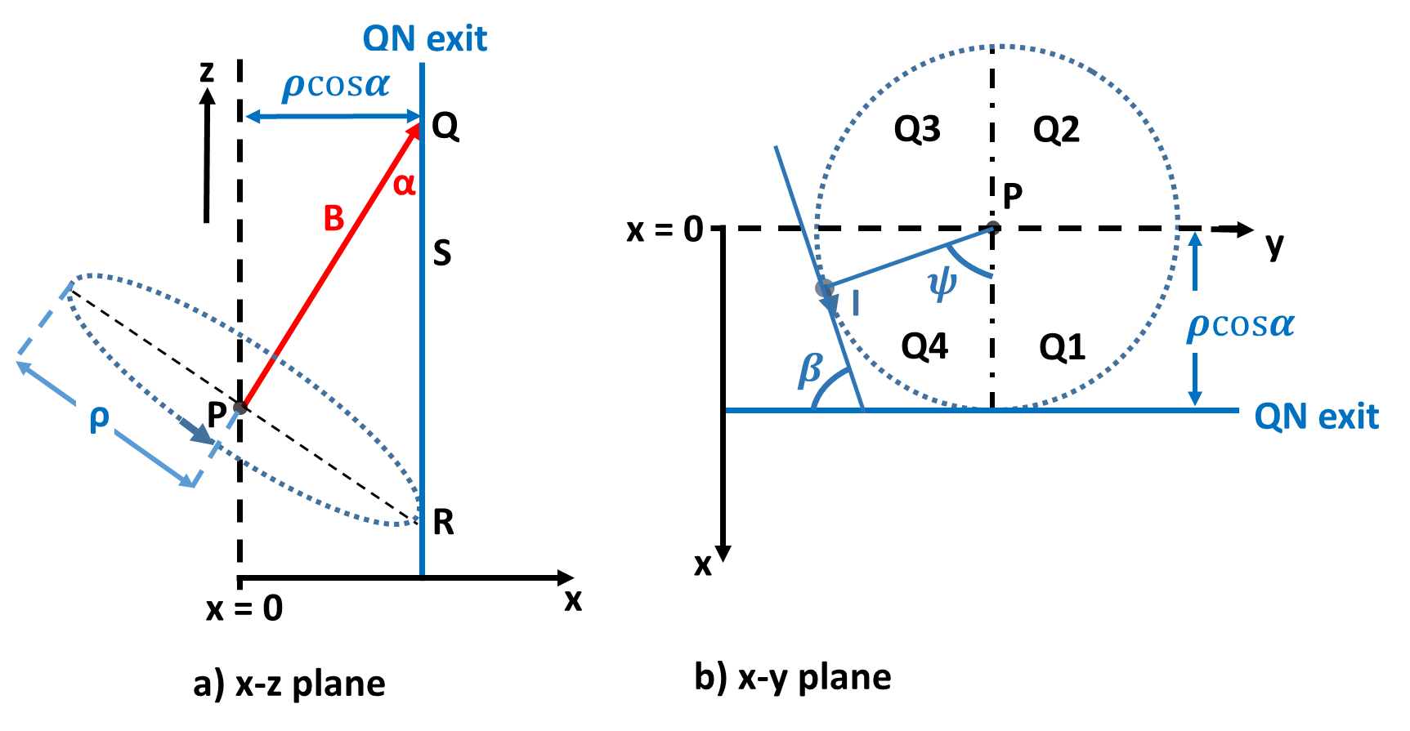
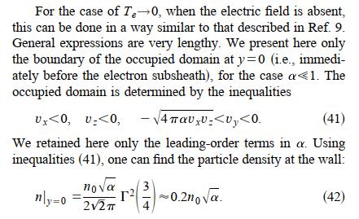
Explanation for the contradiction with Cohen and Ryutov (Physics of Plasmas 5, (1998))/Geraldini, (Journal of Plasma Physics 87, (2021) )
Cohen and Ryutov derive a limit for the speed in x-direction:
$v_{x}^{C}=\sqrt{4παv_{⊥}v_{∥}}$ → This comes from taking the motion of the ion with initial phase = 0: initial phase it arbitrary and doesn’t have to be zero.
They integrate the Maxwellian distribution from 0 to $v_{x}^{C}$ to get the fraction of open orbit ions (“last orbit effect”).
They derive an expression for open-orbit density at the wall which decreases with decreasing incidence angle.
Cohen and Ryutov, PoP 1998

Slide 24
Geraldini, Cohen and Ryutov’s explanation A. Geraldini, J. Plasma Phys. 87, (2021) Cohen, Ryutov Physics of Plasmas 5, 808–817 (1998)

Slide 25
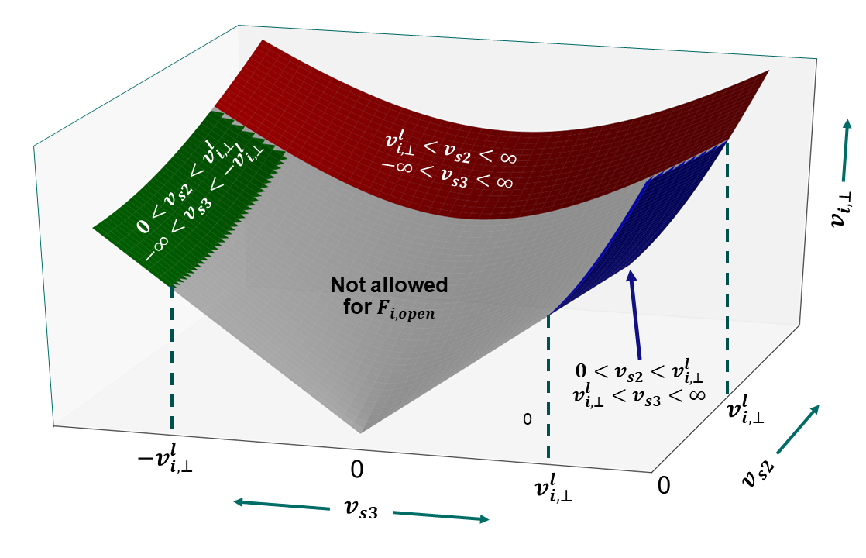
Allowed velocities

