Slide 1

Implementation of radiation transport in EIRENE
Ray Chandra
19 November 2024

Slide 2
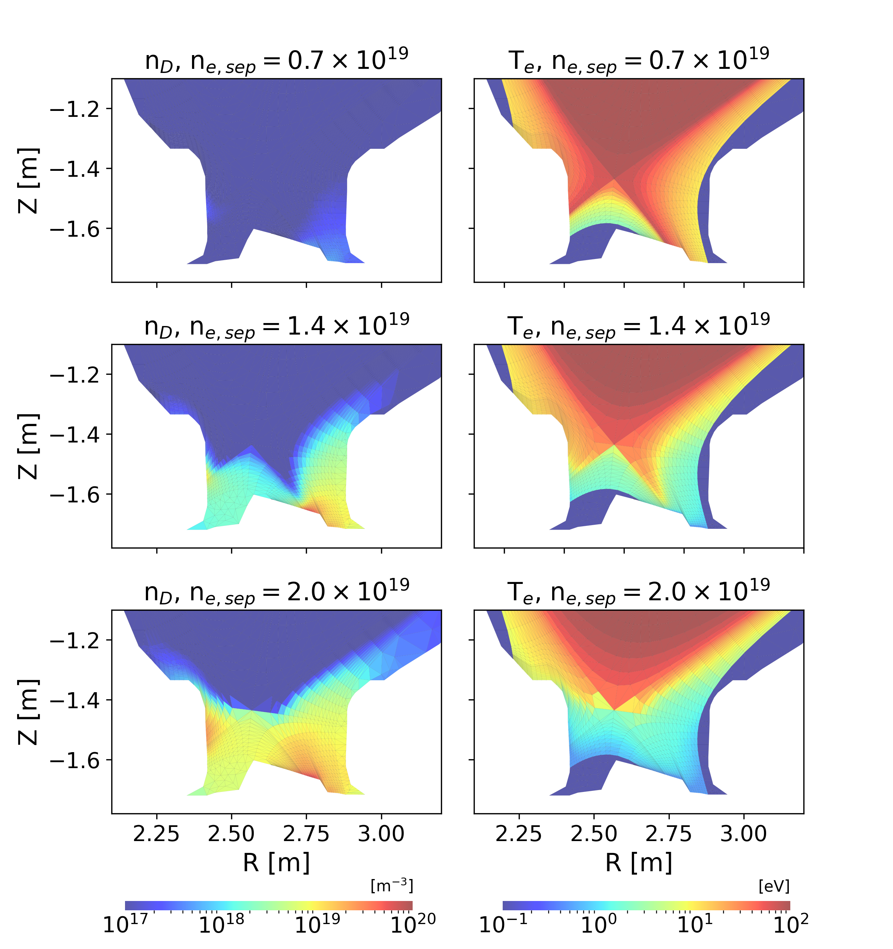
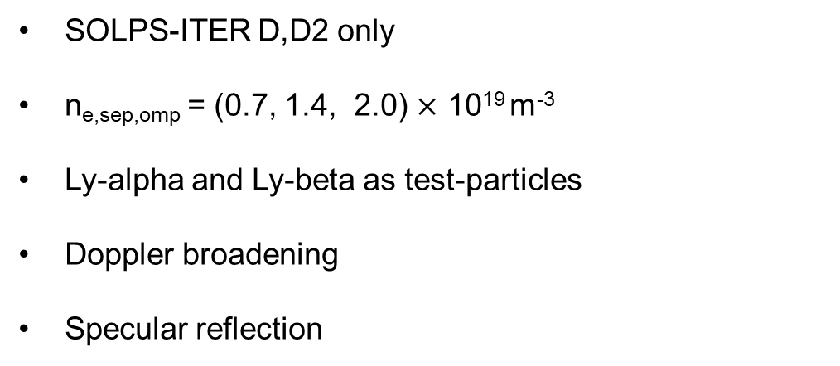
PSI 2024: application of photon transport model for synthetic diagnostic of JET-ILW L-mode plasmas
SOLPS-ITER D,D2 only
n_{e,sep,omp} = (0.7, 1.4, 2.0) $×$ 10¹⁹ m⁻³
Ly-alpha and Ly-beta as test-particles
Doppler broadening
Specular reflection

Slide 3
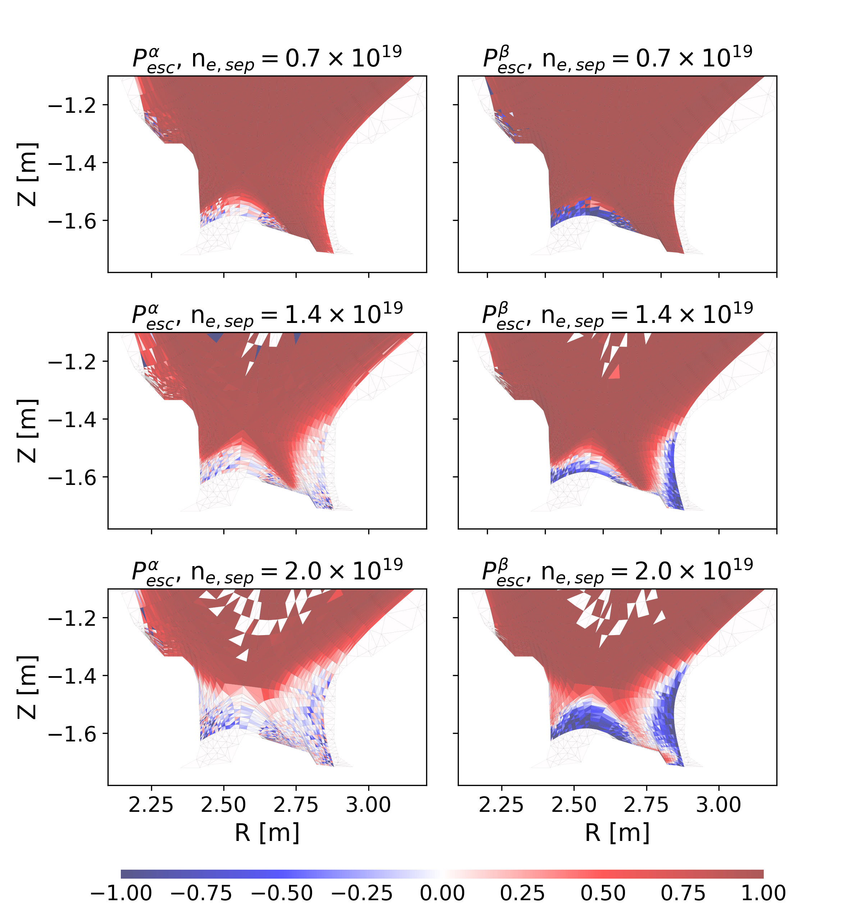

PSI 2024: application of photon transport model for synthetic diagnostic of JET-ILW L-mode plasmas
Population escape factor, P_{esc} :
$$θ_{esc}=1−\frac{abs}{ems}$$
Opacity increases for both line radiations going from low-recycling to detached conditions.
In high-recycling and detached regimes, there are opaque regions of Ly-𝛽 which are highly non-local.

Slide 4
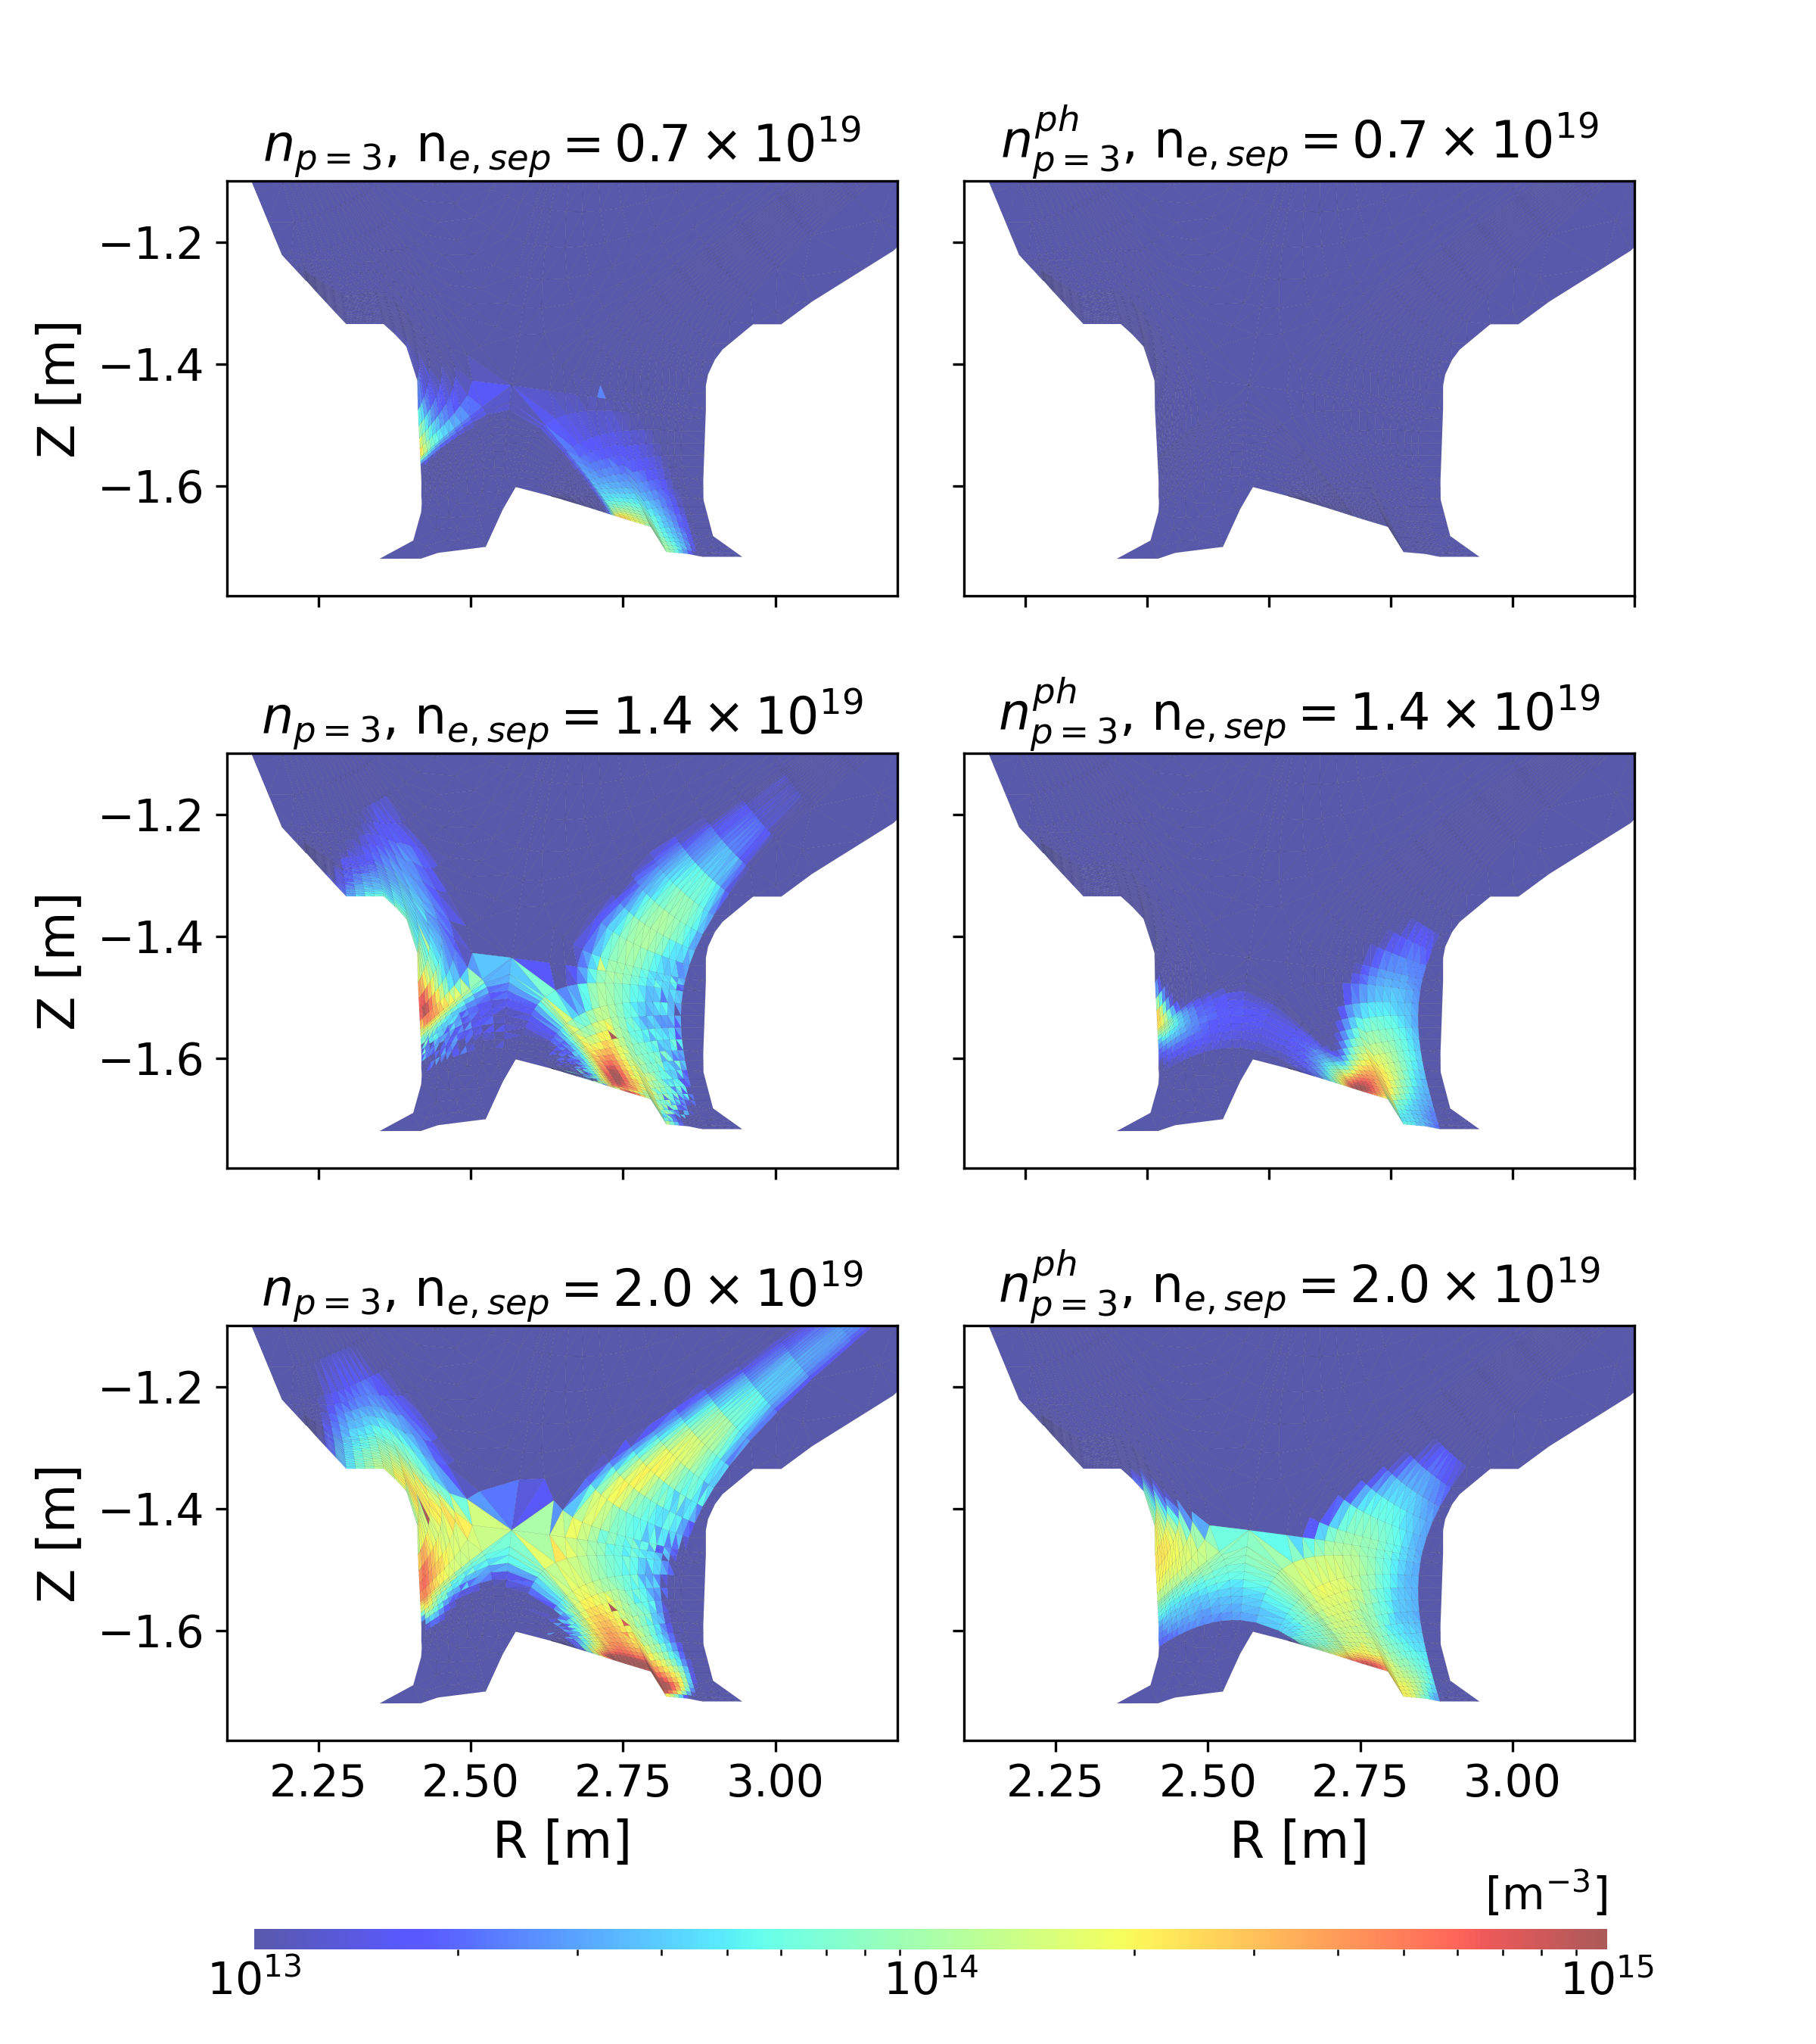
PSI 2024: Increase of n_{p=3} from Ly-𝛽 absorption
In high-recycling and detached regimes, there are opaque regions of Ly-𝛽 which are highly non-local.
n_{p=3} from electron excitation, n^{ph}_{p=3} from Ly-𝛽 photon absorption.

Slide 5
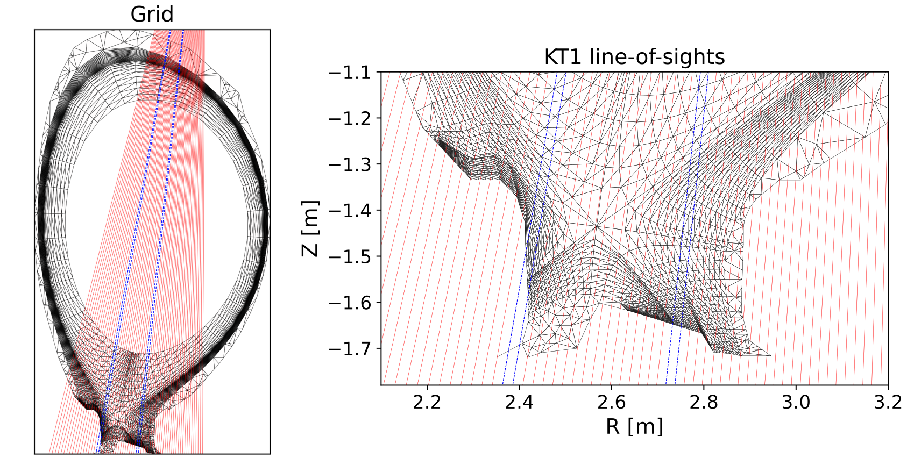
PSI 2024: Increase of n_{p=3} from Ly-𝛽 absorption
In high-recycling and detached regimes, there are opaque regions of Ly-𝛽 which are highly non-local.
n_{p=3} from electron excitation, n^{ph}_{p=3} from Ly-𝛽 photon absorption.
Synthetic diagnostic from VUV-vis spectrometer KT1 line-of-sights

Slide 6
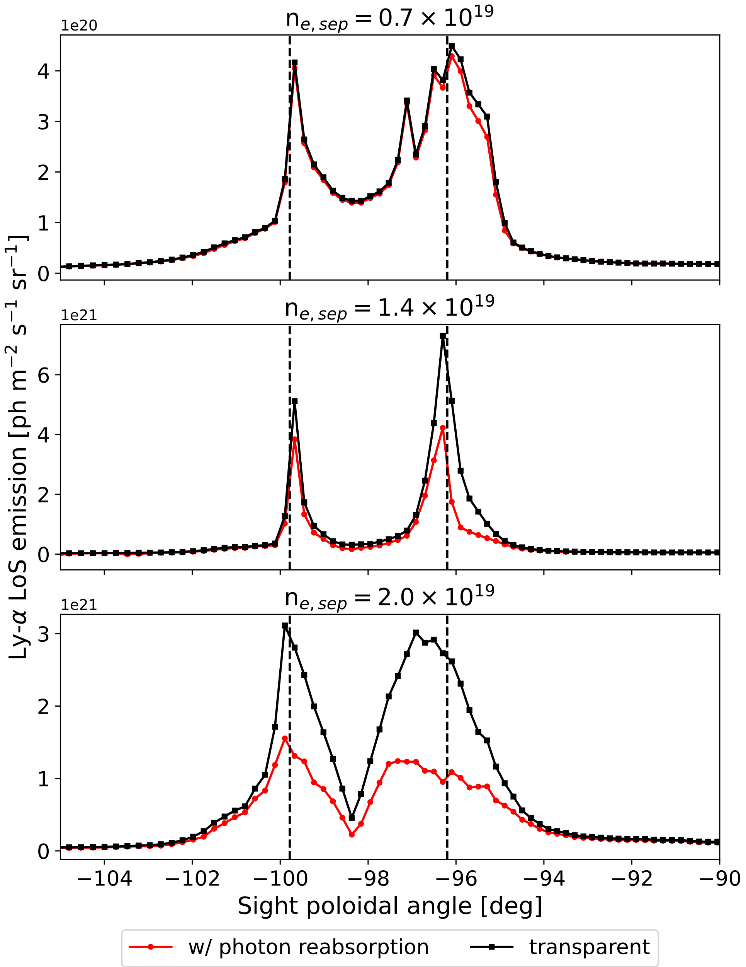
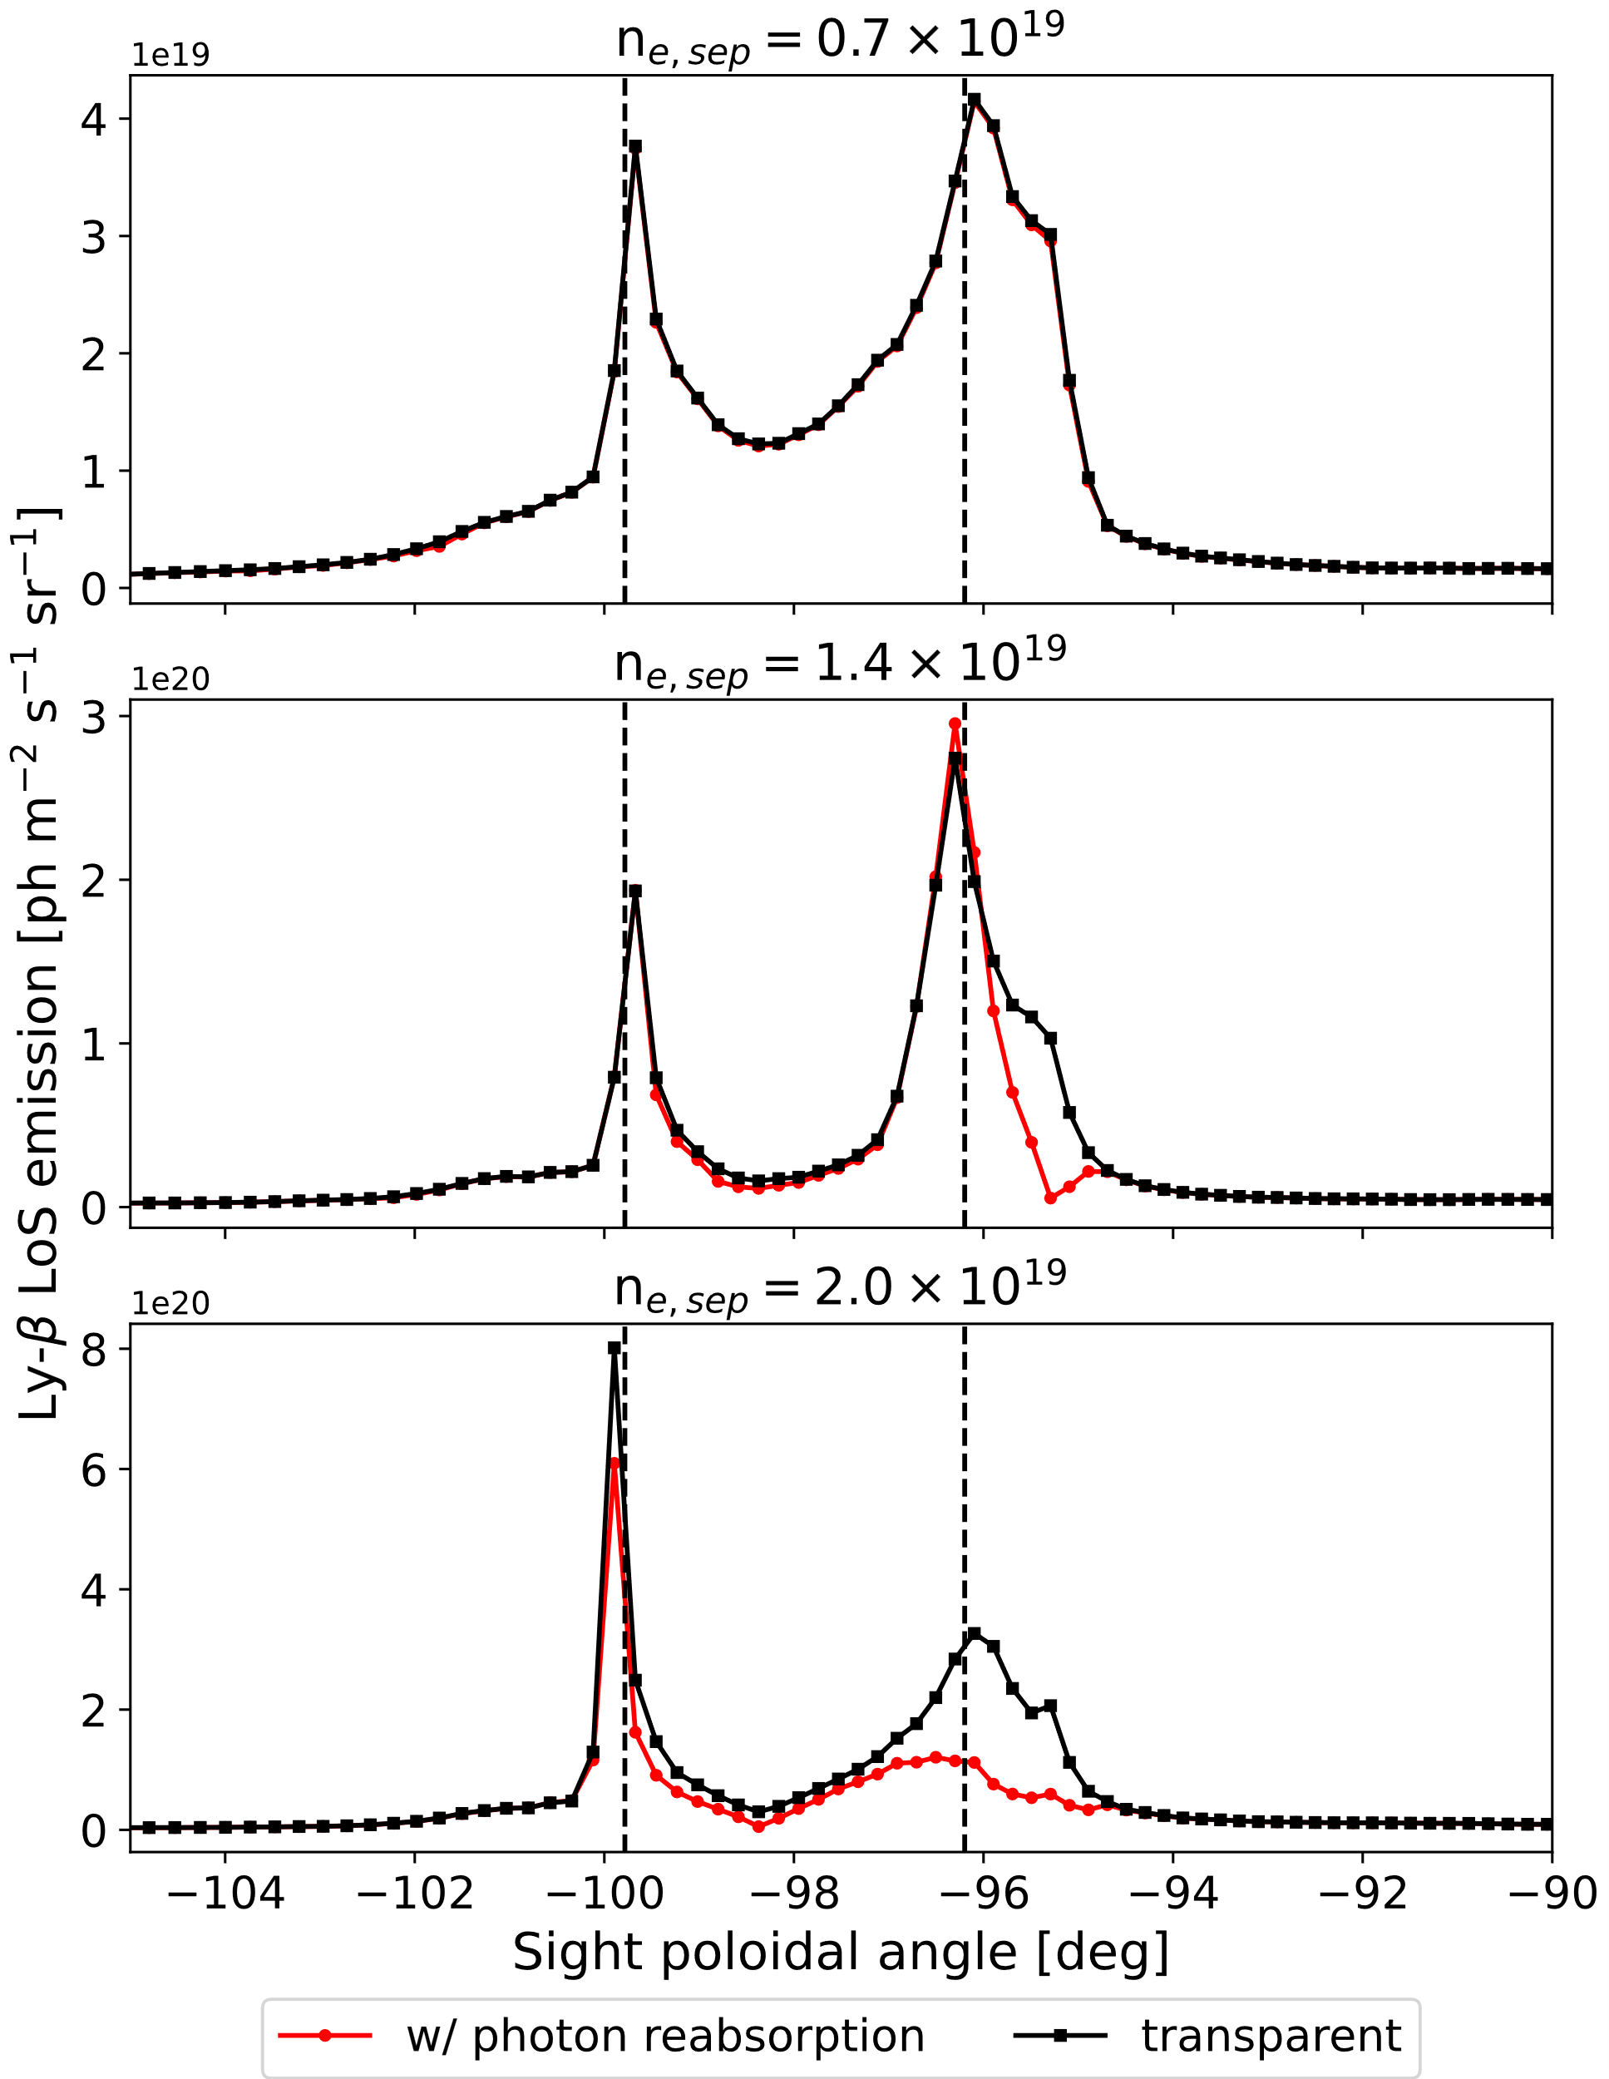
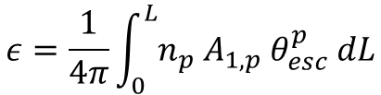
PSI 2024: Ly-𝛼 emission reduced by a factor of 2-3, Ly-𝛽 by a factor of 2 in detached regime
Emissivity:
$$ε=\frac{1}{4π}\int_{0}^{L}{n_{p}{ A}_{1,p}{ θ}_{esc}^{p} dL}$$

Slide 7
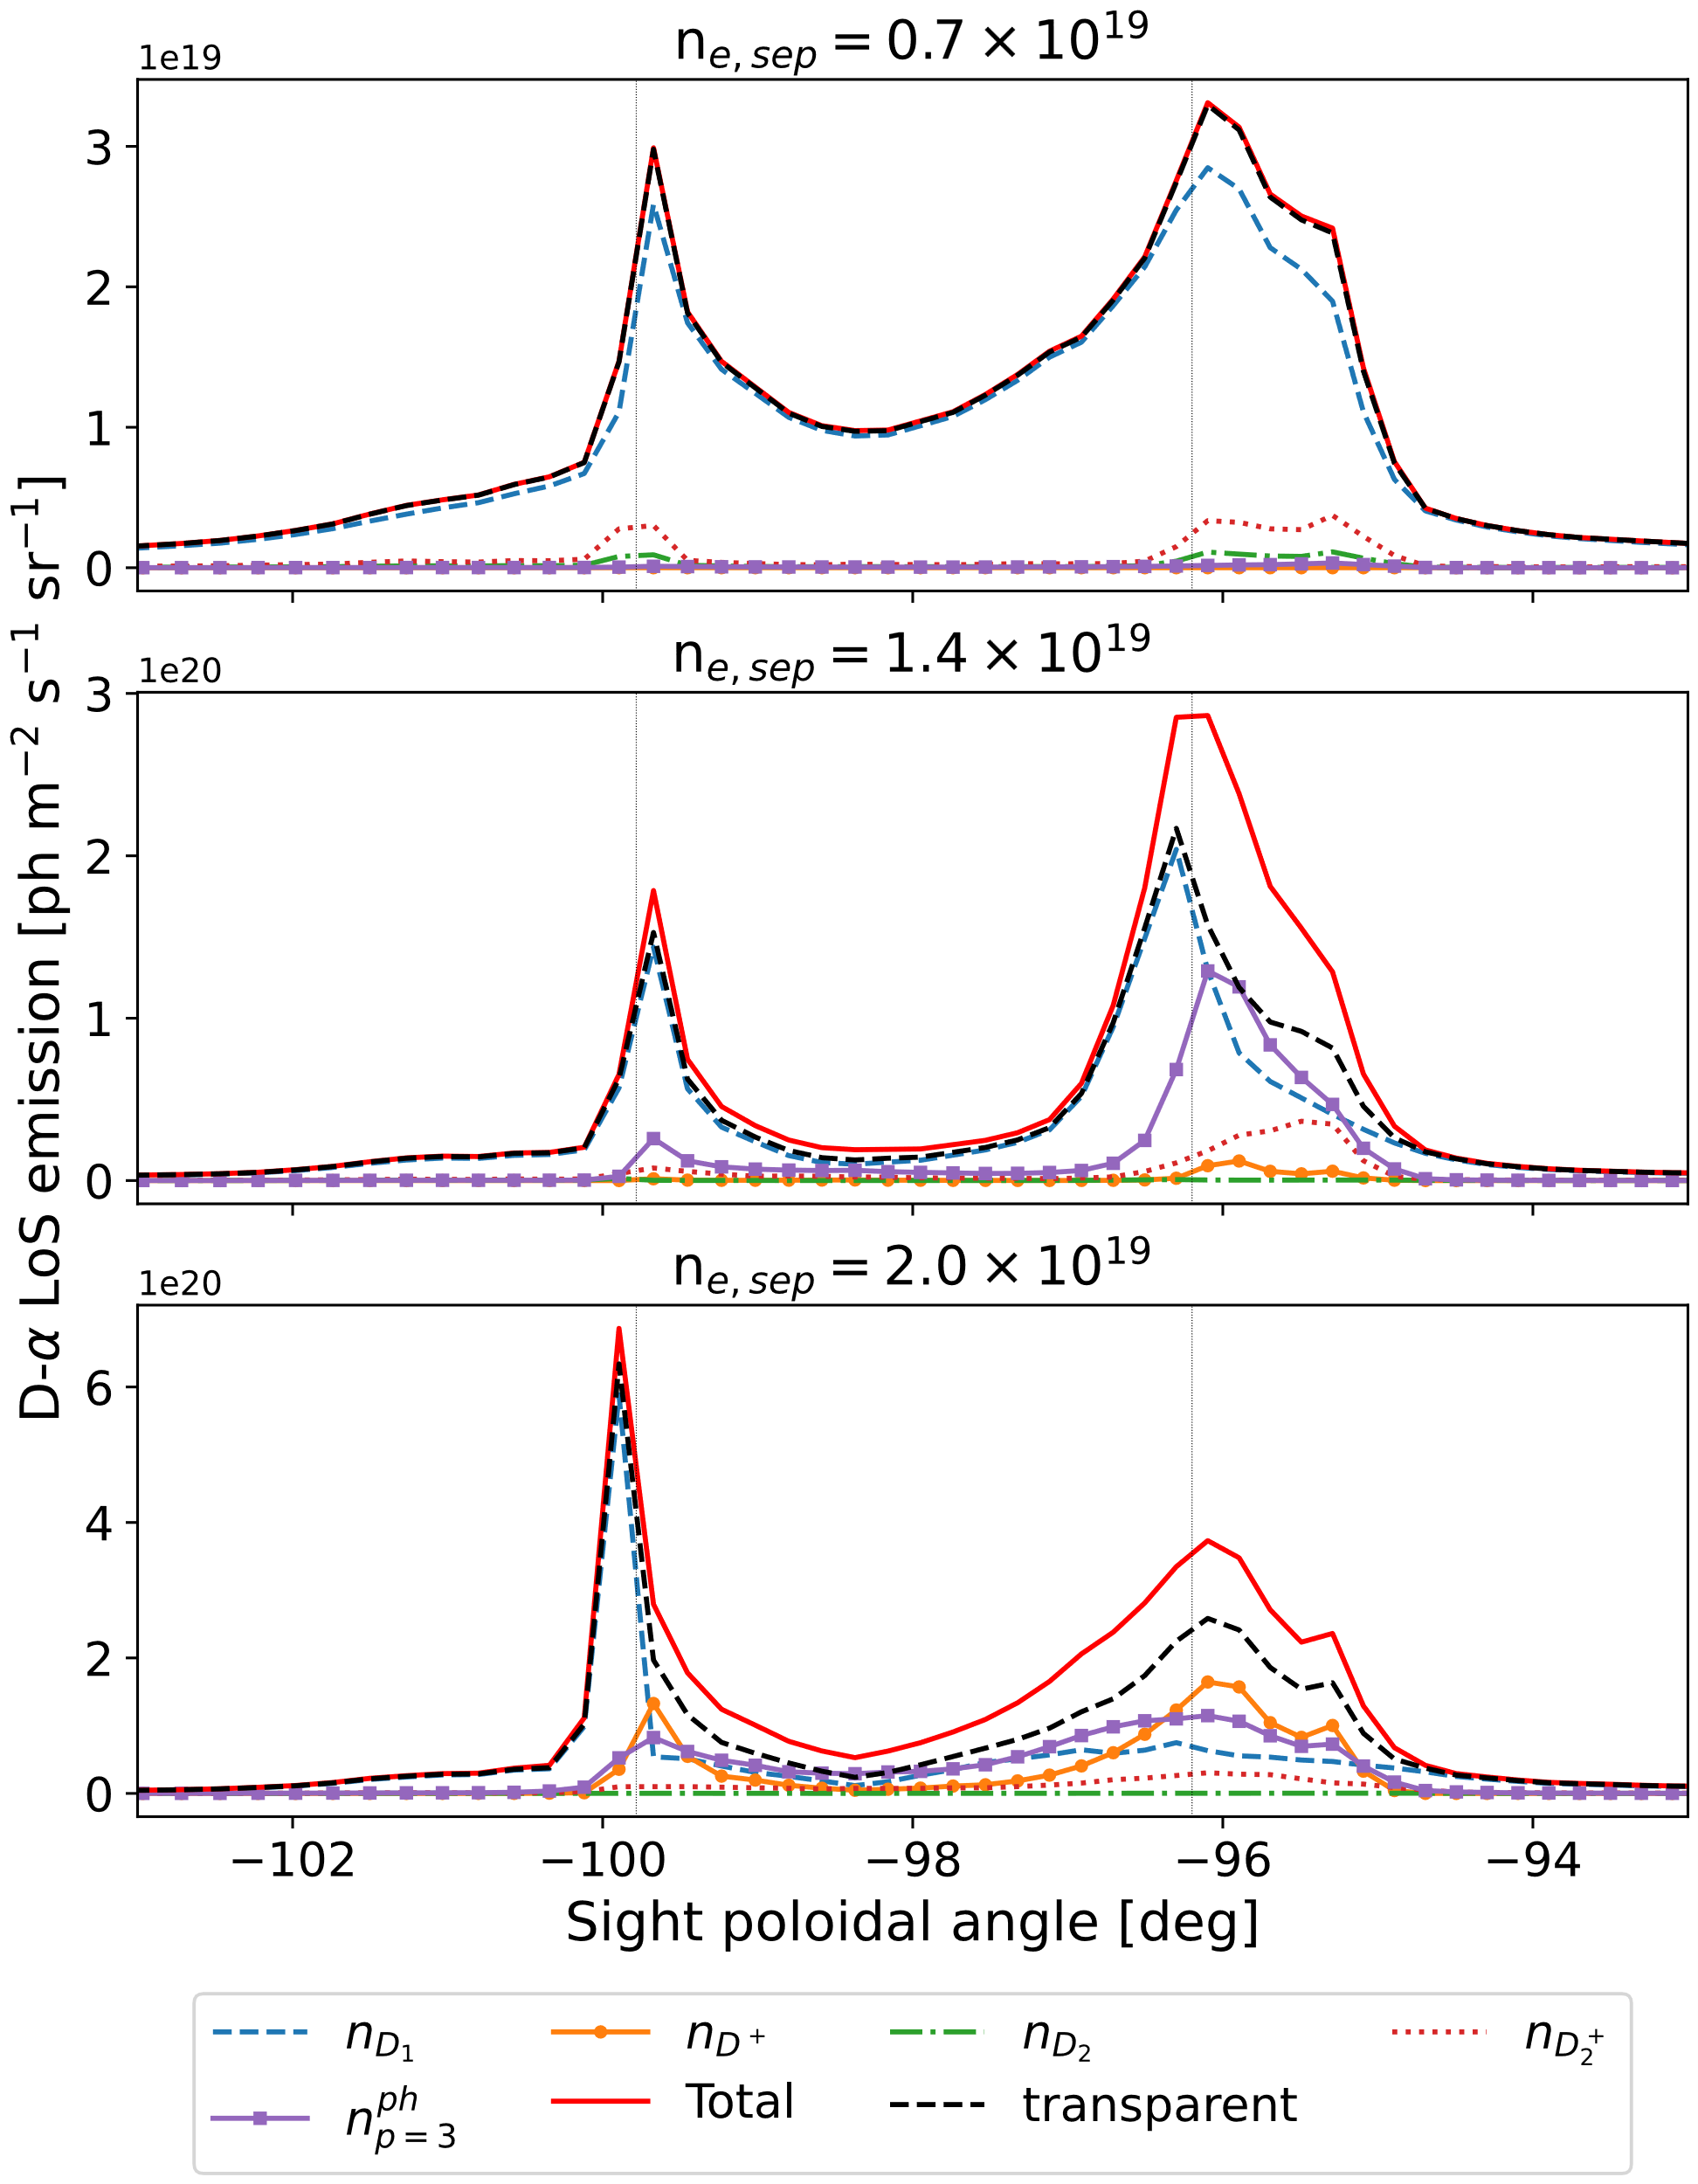
PSI 2024: D-𝛼 enhancement by Ly-𝛽 absorption
Contribution of D-𝛼 from Ly-𝛽 absorption equal to electronic excitation in high-recycling, leading to 2x enhancement
Contribution of D-𝛼 from Ly-𝛽 absorption equal to electronic excitation and atomic recombination in detachment, leading to 1.5x enhancement
R. Chandra et al. JNME 2024:
https://doi.org/10.1016/j.nme.2024.101794

Slide 8
Photon tracing in EIRENE – now a branch in JuGit
Based on feature/SOLPS_event_limit branch
Passed the preparation, build and run pipelines (except EMC3)
Failed the test pipeline (new compare?)

Slide 9
For 2025:
Compile RC/photon_transport in a SOLPS-ITER environment for B2.5 coupling
  No interface changes, so should(?) work
  JET-ILW L-mode cases reconverged – publication, introduction to new feature
  EIRENE Manual document update
  Ready for feature deployment
2. Prepare CI pipelines for photon transport

