Slide 1
On Intensity, Relativity, Shift & Compression – Video data archiving at W7-X
S.Fischer¹, L.Vandevenne², P.Perusek³, M.Grün¹, A.Holtz¹, M.Grahl¹, J.Pribošek³, J.Alakuijala² and the W7-X team¹
¹ Max Planck Institute for Plasma Physics, Greifswald, DE - ² Google Research, Zurich, CH - ³ Cosylab, d. d., Control System Laboratory, Ljubljana, SI
Credit: MPI for Plasma Physics 3rd party images used in this presentation without specific credit are sourced from http://pixabay.com and used under the terms of their content license / CC0

Slide 2
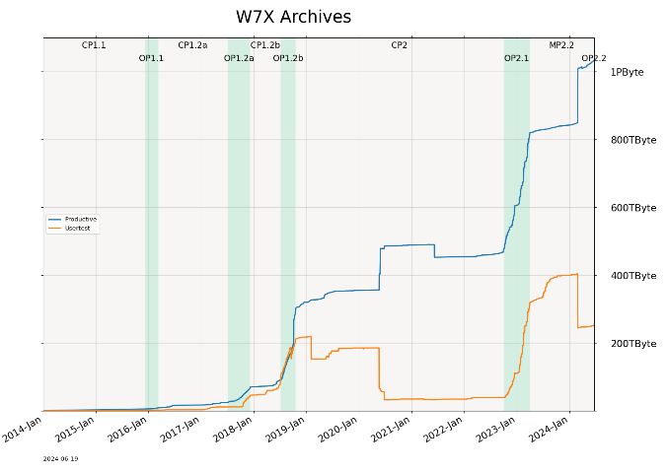
Wendelstein 7-X
E5-CoDaC Software Development
Stellarator type experimental fusion device
400+ physicists, engineers, technicians & personnel
70+ diagnostic systems
1.3+ Petabyte of archived data
OP2.2 upcoming end of Q3
1 campaign / year from now on
Credit: MPI for Plasma Physics, Photo: Ben Peters
13 Software Engineers
1 long term external contributor
1 intern
We are hiring! (on premise in beautiful Greifswald)

Slide 3
Agenda
Video compression
Basics
Digital images
Compression schemes
State of the art
Challenges @W7-X
Fusion Power Video
History
Algorithm
Implementation @W7-X
Outlook
Call for standardization
Digital images | Compression | S.o.t. Art | Challenges | FPV History | FPV Algorithm | FPV@W7X | Outlook | Standardization

Slide 4
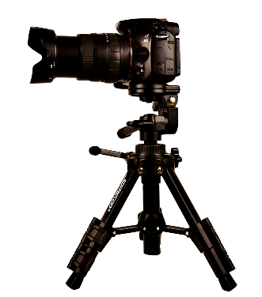
Basics – Digital images: 2D/3D arrays of relative intensity
Its all relative
Its all relative
8 bit / pixel
0 8 16 24 32 40 48 56 64 72 80 88
…
…
P0
P1
16 bit / pixel
0 8 16 24 32 40 48 56 64 72 80 88
…
P0
P1
12 bit / pixel (short / 16 bit aligned)
…
0 8 16 24 32 40 48 56 64 72 80 88
…
…
P0
P1
12 bit / pixel (bit packed)
200
180
180
…
0 8 16 24 32 40 48 56 64 72 80 88
P0
P0P1
P1
P2
P2P3
P3
P4
P4P5
P5
P6
P6P7
P7
200
212
200
175
120
175
8 bit / channel (component, e.g. [r, g, b])
32 bit / pixel (int / 32 bit aligned)
…
0 8 16 24 32 40 48 56 64 72 80 88
…
R0
G0
B0
(A0)
R1
G1
B1
(A1)
24 bit / pixel (interlaced)
0 8 16 24 32 40 48 56 64 72 80 88
…
…
R0
G0
B0
R1
G1
B1
…
24 bit / pixel (de-/non interlaced)
…
…
…
0 8 16 24 W*H*8+0 +8 +16 2*W*H*8 +8 +16 +24
R0
R1
R2
G0
G1
G2
B0
B1
B2
intensity aperture
exposure
Digital images | Compression | S.o.t. Art | Challenges | FPV History | FPV Algorithm | FPV@W7X | Outlook | Standardization

Slide 5
Basics – Compression schemes – bit stream level
Compression = transport the same information with less data
Reliance on patterns & their frequency
Þ
randomness/noise is the enemy
Space/Bandwidth
Compute
P0
P0
P1
P1
P2
P2
P3
P3
P4
P4
P5
P5
Bit packing •
Run length encoding •
Dictionary encoding •
Variable length encoding •
P0
P0P1
P1
P2
P2P3
P3
P4
P4P5
P5
A
A
A
A
b
b
C
C
C
d
e
e
4
A
2
b
3
C
1
d
2
e
A
b
c
A
b
c
a
b
A
b
c
D
0
0
1
0
2
0=Abc 1=ab 2=D
0
0
0
0
0
1
0
0
1
0
0
0
1
0
0
1
1
0
0=Abc 10=ab 110=D
Digital images | Compression | S.o.t. Art | Challenges | FPV History | FPV Algorithm | FPV@W7X | Outlook | Standardization

Slide 6
Basics – Compression schemes – predictive encoding
Predict the next value based on previous one(s)
Subtract the predicted from the actual value
Þ
Good prediction: Variable length encoding (maybe even RLE) is very effective
(bad prediction Ü encoding effect low/negative)
In images, predictions can utilize spatial coherence – in video also temporal
4
4
5
6
5
5
3
4
4
3
4
5
13
14
15
16
16
17
18
20
20
21
22
21
Prediction: Each value is equal to its predecessor
Good prediction: values of/around 0 are dominant
Bad prediction: values vary a lot
4
42
23
6
15
-7
8
9
9
27
-4
5
4
0
1
1
-1
0
-2
1
0
-1
1
1
13
1
1
1
0
1
1
2
0
1
1
-1
4
38
-19
-17
9
-22
15
1
0
18
-31
9
Digital images | Compression | S.o.t. Art | Challenges | FPV History | FPV Algorithm | FPV@W7X | Outlook | Standardization

Slide 7
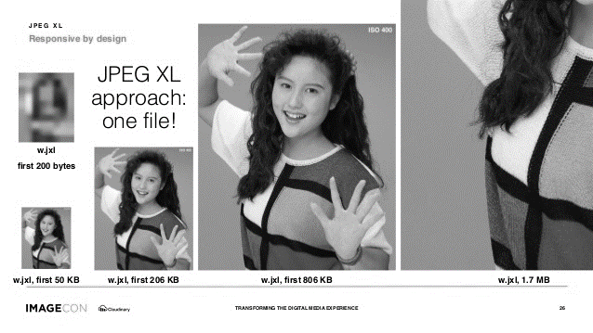
Basics – Compression schemes – loss & progress
original
►
Com-pressed
►
Decom-pressed
≠ ? =
Lossless – visually lossless – lossy compression
(lossy: the original cannot be identically reconstructed from the compressed)
(visually lossless: apply the above, limited to a level not perceivable to the human eye)
Progressive encoding
Reduce bit depth
Reduce resolution
Reduce high frequencies
0,0
1,0
2,0
3,0
Credit: Imagecon 2019 - Jon Sneyers
0,1
1,1
2,1
3,1
Encode high level details first
Progressively add more details later in the bit stream
0,2
1,2
2,2
3,2
0,3
1,3
2,3
3,3
0,0
2,2
1,1
3,3
1,2
2,1
0,3
3,0
1,0
3,2
0,2
2,3
2,0
0,1
3,1
1,3
0,0
0,0
3,0
0,0
1,0
2,0
3,0
0,0
1,1
1,1
2,1
0,1
1,1
2,1
3,1
2,2
2,2
1,2
2,2
0,2
1,2
2,2
3,2
3,3
0,3
3,3
0,3
1,3
2,3
3,3
Digital images | Compression | S.o.t. Art | Challenges | FPV History | FPV Algorithm | FPV@W7X | Outlook | Standardization

Slide 8
State of the art
How do people archive images / videos for scientific use?
They don’t (archive them)
Throw most away (after selecting an important few)
Store them uncompressed (aren’t that many & storage is cheap)
Compress utilizing general bit stream compressors (or compressing FS)
Store lossy/visually lossless, utilizing (HW supported) standard video compressors
Get creative with lossless H264
Cut bit depths down to 8-10 bpp grayscale
(Mis-)use chroma planes of YUV
And you?
Digital images | Compression | S.o.t. Art | Challenges | FPV History | FPV Algorithm | FPV@W7X | Outlook | Standardization

Slide 9
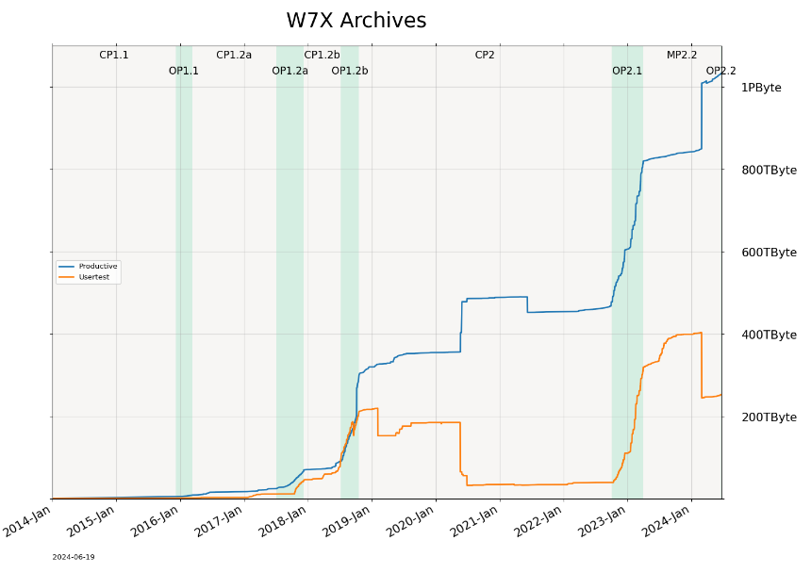
Challenges at Wendelstein 7-X – machine level
Long Pulses & lots of Cameras
Stellarators (in theory) support continuous operation
Goal of W7-X: 30 minutes
Archiving/compression required in (near) real time
Present: ~100 cameras – .8 to 5.5 MP – 25 to 400 FPS (+ analyzed data)
Example OP2.1: Divertor thermography + Halpha + EDICAM:
35 cameras + 12x thermal: ~.8PByte raw data
Data swamp
Risk: relevant potions are hard to find -> a lot of archived data is rarely/never read
Fast (overview) access needed to support filtering
Digital images | Compression | S.o.t. Art | Challenges | FPV History | FPV Algorithm | FPV@W7X | Outlook | Standardization

Slide 10
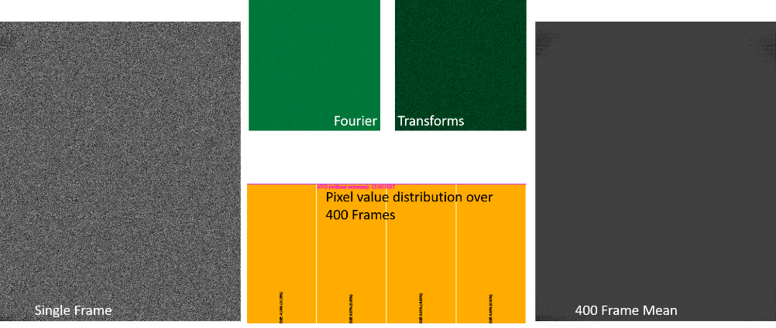
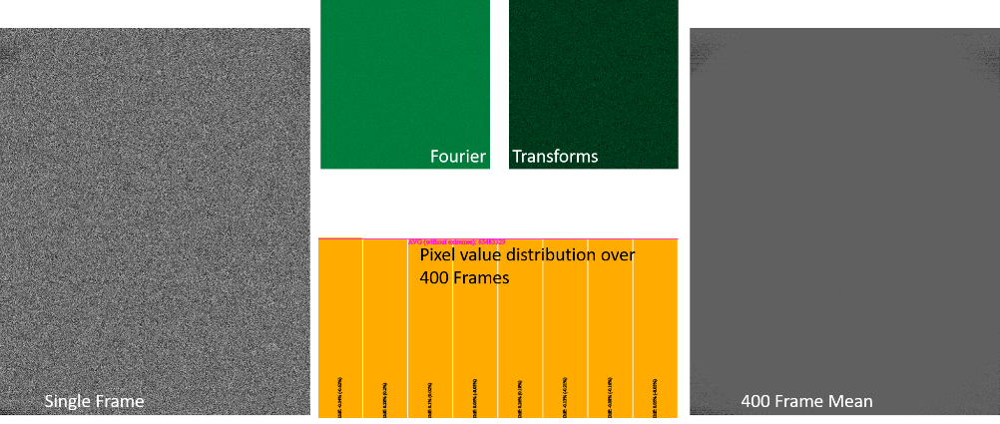
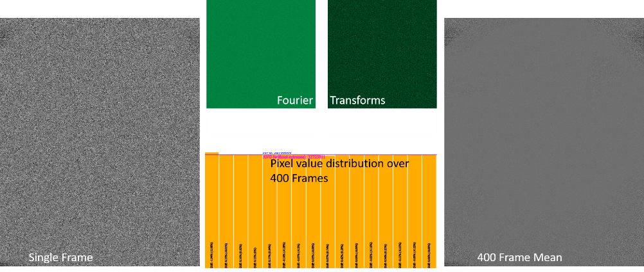
Challenges at Wendelstein 7-X – camera level
White noise
Some cameras are very noisy
White noise is incompressible
(Non-)Alignment of pixel data
You need to know
Complicates finding the non-noisy part & assess the relativity
Requirement for lossless
Lossly compression not only looses scientific data, but changes it
There also could be a Nobel Prize hidden in those bits we loose…
15 14 13 12 11 10 9 8 7 6 5 4 3 2 1 0
Digital images | Compression | S.o.t. Art | Challenges | FPV History | FPV Algorithm | FPV@W7X | Outlook | Standardization

Slide 11
Fusion Power Video – A short history (I)
Reference: Intel Xeon, 3.4GHz, 24 cores; 128GB RAM, Geforce GTX 2060 6GB X% compression ⬄ compressed size is X% of raw size data from 2020
We need to compress losslessly – what options do we have?
Bit stream compressors: ZSTD on fast – 60% of RT, 60% compression
JPEG lossless: 8 bpp only
H264: >10 bpp only with expensive commercial solutions (not tested)
H265/VP9: (max. 12 bpp) – 550% of RT, 25% compression
FFV1: 300% of RT, 50% compression
FFVHUFF/Dirac: < 90% of RT, >90% compression
What about HW support? (Nvidia CUDA – Intel QSV lossy only)
JPEG2000 CUDA: ~100% of RT, 77% compression (commercial codec, expensive)
H264/265 CUDA: only <= 10bpp
8/10 MSB in Y, remainder in U plane: 80% of RT, 36% compression
8/10 MSB in grayscale, remainder in separate stream (bit packing): 60% of RT, 33% compression (~6% MSB)
Digital images | Compression | S.o.t. Art | Challenges | FPV History | FPV Algorithm | FPV@W7X | Outlook | Standardization

Slide 12
Fusion Power Video – A short history (II)
New upcoming, promising standard: JPEG XL
Contacts to JPEG XL developers lead to cooperation with Google Research, Zurich
Supported with in depth domain knowledge
Analyzed samples of real world W7-X videos
Identified, implemented & open sourced low compute, high impact W7-X specific compression scheme
Collaboratively evolved the C++ implementation
https://github.com/google/fusion-power-video
pro:
Support for lossless & 16+bpp
Moderate compute resources
(upcoming) open standard & open source
con:
not yet finalized (2020)
Reference implementation not ready for reference testing
Digital images | Compression | S.o.t. Art | Challenges | FPV History | FPV Algorithm | FPV@W7X | Outlook | Standardization

Slide 13
Fusion Power Video – Algorithm Details
? = clamp(
min(N,E),
N + E - NE,
max(N,E))
Preview
¼ x ¼, 7bpp
Preview
compressed
Preview
N
NE
?
E
Raw input image
Left aligned input
High plane (8 MSB)
High plane
High plane
compressed
High plane
⊝
Delta Frame
Low plane (0-8 MSB)
Low plane
compressed
Low plane
⊝
Left Shift to Alignment
Plane Splitting
Delta Prediction
Clamped Gradient Prediction
brotli Stream Compression
Digital images | Compression | S.o.t. Art | Challenges | FPV History | FPV Algorithm | FPV@W7X | Outlook | Standardization

Slide 14
Fusion Power Video – Implementation at Wendelstein 7-X
Where did we go from there?
Java wrapper around the C++ library
Performance issues at JNI boundary: copy ops & incompatible asynchrony frameworks
Full reimplementation in native Java
Exception: brotli compression (uses brotli4j JNA wrapper of libbrotli)
Columnar serialization format
Batches of e.g. 100 frames, non-interlaced planes => efficient extraction
For now: duplicates schema & delta frame with each batch
Example results from OP2.1:
Savings: 0.5 Petabytes of Archive storage
Digital images | Compression | S.o.t. Art | Challenges | FPV History | FPV Algorithm | FPV@W7X | Outlook | Standardization

Slide 15
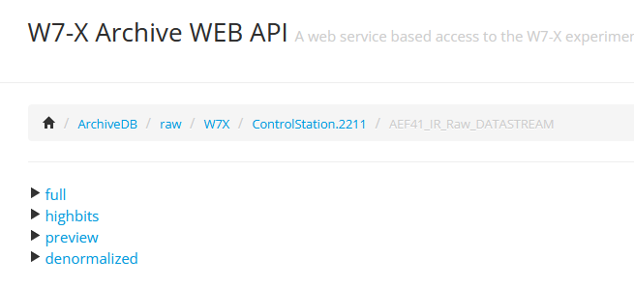
Fusion Power Video – Implementation at Wendelstein 7-X
How to work with FPV data from W7-X ArchiveDB?
Decompression is fully transparent to the reader
SignalAccess and WebAPI offer 4 separate signals:
full: left aligned 16 bpp (values 0 – 65535)
highbits: left aligned 8 bpp MSBs (values 0 – 255)
preview: left aligned 8 bpp, 4x4 subsampled (values 0 – 254)
denormalized: reconstructed original alignment, 16 bpp (values camera dependent)
Current limitations:
Client side decompression using Java API (SignalAccess) – including full data download even for preview
MultiSignalReader cannot read more than one signal from n FPV stream at a time
No public API offering the amount of alignment shift between full & denormalized
With compression, we pay space savings with compute: reading is slower than on raw data
Digital images | Compression | S.o.t. Art | Challenges | FPV History | FPV Algorithm | FPV@W7X | Outlook | Standardization

Slide 16
Outlook
Try to go open source
Implement read optimizations for preview & high planes
Prevent delta frame duplication
Directly use FPV preview in W7X DataMonitor
Allow WebAPI Archive uploads with compression / of compressed data
Since it is standardized these days: evaluate jpegXL
Would offer colored images, maybe multispectral, maybe float images, more generalized image compression
Compare performance of FPV preview and progressive jpegXL
Compare performance of FPV high byte only extraction and progressive jpegXL
maybe combine approaches for future jpegXL based lossless video compression scheme
Digital images | Compression | S.o.t. Art | Challenges | FPV History | FPV Algorithm | FPV@W7X | Outlook | Standardization

Slide 17
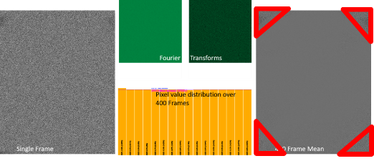
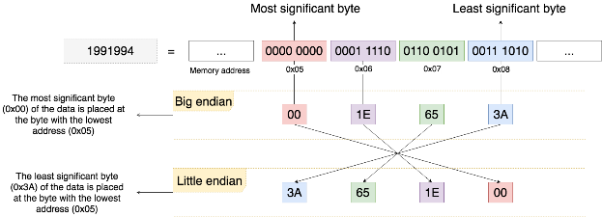
From first principles – a call for standardization
Let all be aligned to the left!
When working with relative intensity images, normalize everything to 65,535
Don’t stuff your tummy with waste!
Before compressing images, remove what’s of no value
All power to the little people!
Almost all compute hardware today (for integers) is Little Endian – use it
All types are not created equal!
Generally, IEEE floating point does more harm than help – prefer fixed point == integer
Credit: Uy Nguyen
0.1 + 0.2 != 0.3 0/0 != 0/0 -0 == +0
Digital images | Compression | S.o.t. Art | Challenges | FPV History | FPV Algorithm | FPV@W7X | Outlook | Standardization

Slide 18
Questions?
Thank you very much for your attention!
Simon Fischer
simon.fischer@ipp.mpg.de
@simon-fischer-24255a109
@percurious
*

