Slide 1
DEMO ramp-up/down studies:
status of the RU/RD simulations with RAPTOR
Olivier Sauter, Simon Van Mulders et al
Swiss Plasma Center – EPFL
Lausanne, Switzerland

Slide 2
Short Summary
Continued focussing on ramp-down
Previous simulations showed that as low as 0.05MA/s is necessary to remain below li=1.7 at 5MA.
Significant low/negative edge j region observed from simulation
Indications from CREATE that we still may have some margins with the profiles provided
S. Van Mulders, PhD student, added density equation and used work from A. Teplukhina to start optimizing ramp-down trajectory:
  Cost function ~ int (Ip*dt),
  Constraints: li < limit, q₉₅ not decreasing, nel/n_{G}<1

Slide 3
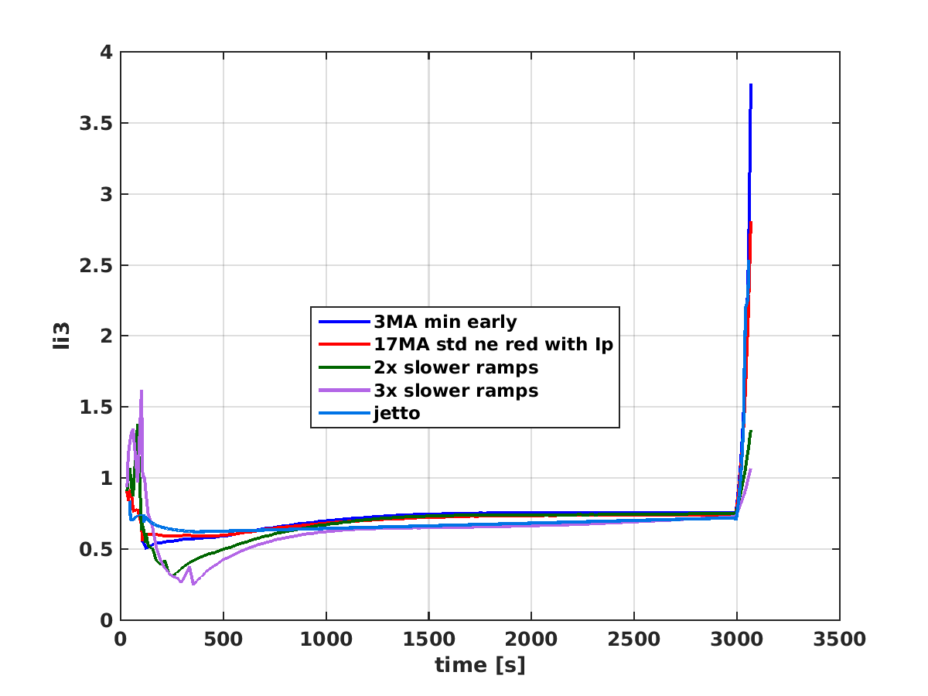
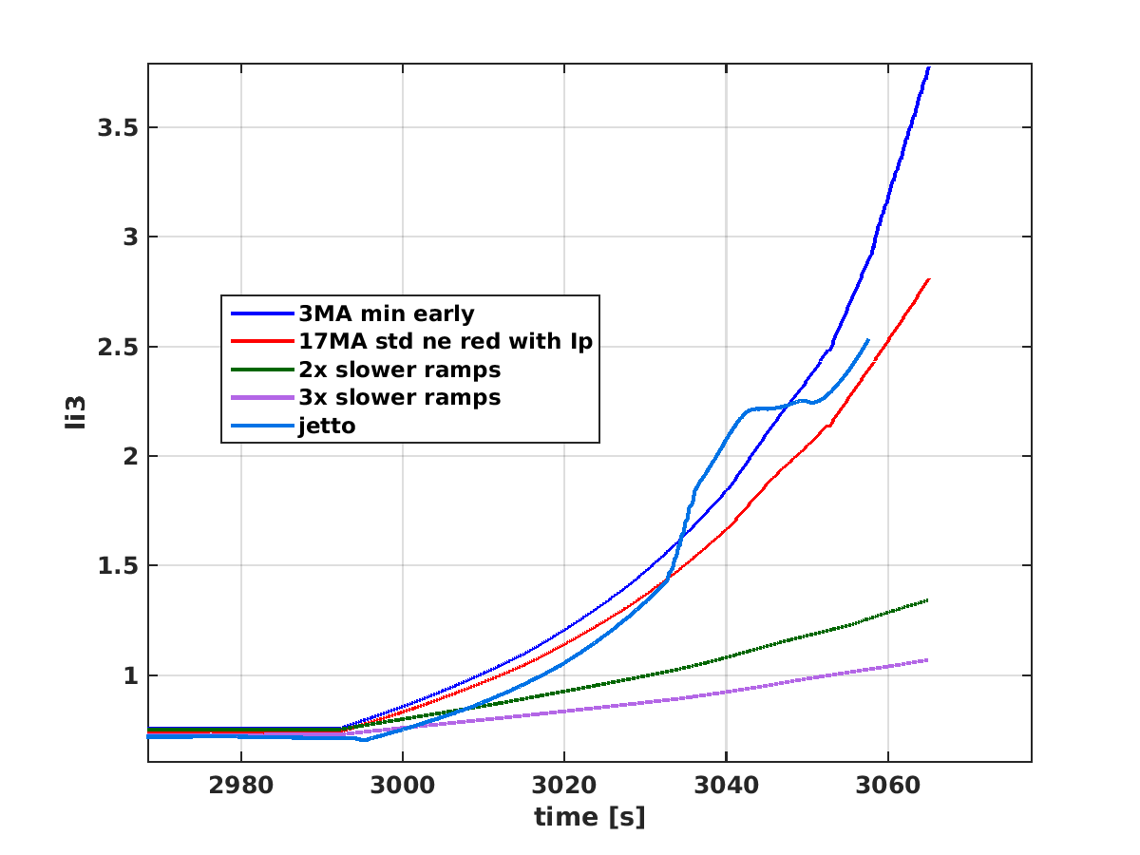
Previous results: Effects of ramp-rates
0.1MA/s instead of 0.2MA/s reduces by more than a factor of 2 li(t) in ramp-down (but not 0.07MA/s)
Ramp-up depends also on other effects (like L-H transition, etc)

Slide 4
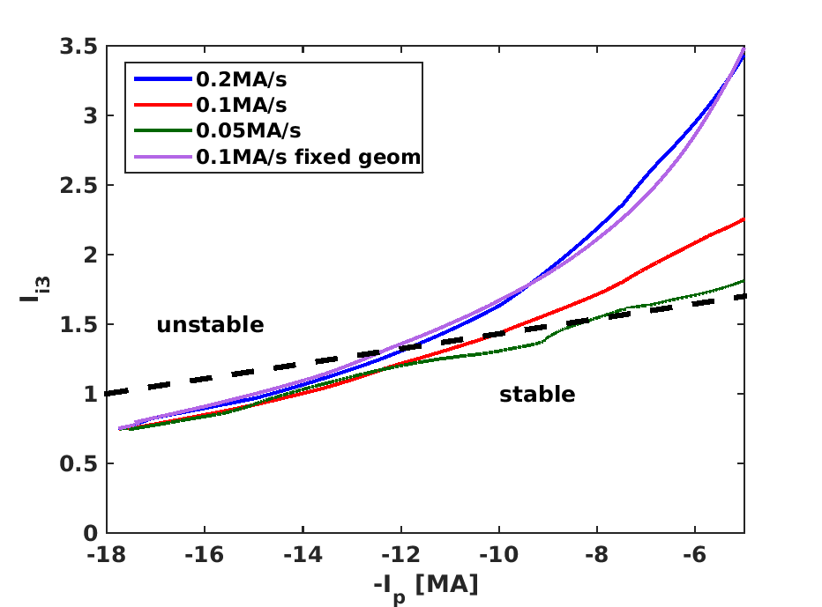
Comparing with Mattei’s limits
OK at high Ip, but would require ~0.05-0.1 for Ip<10MA
Initial computations of growth rates using eqdsk with RAPTOR profiles from 0.2MA/s simulation may prove stable, to be confirmed by CREATE

Slide 5
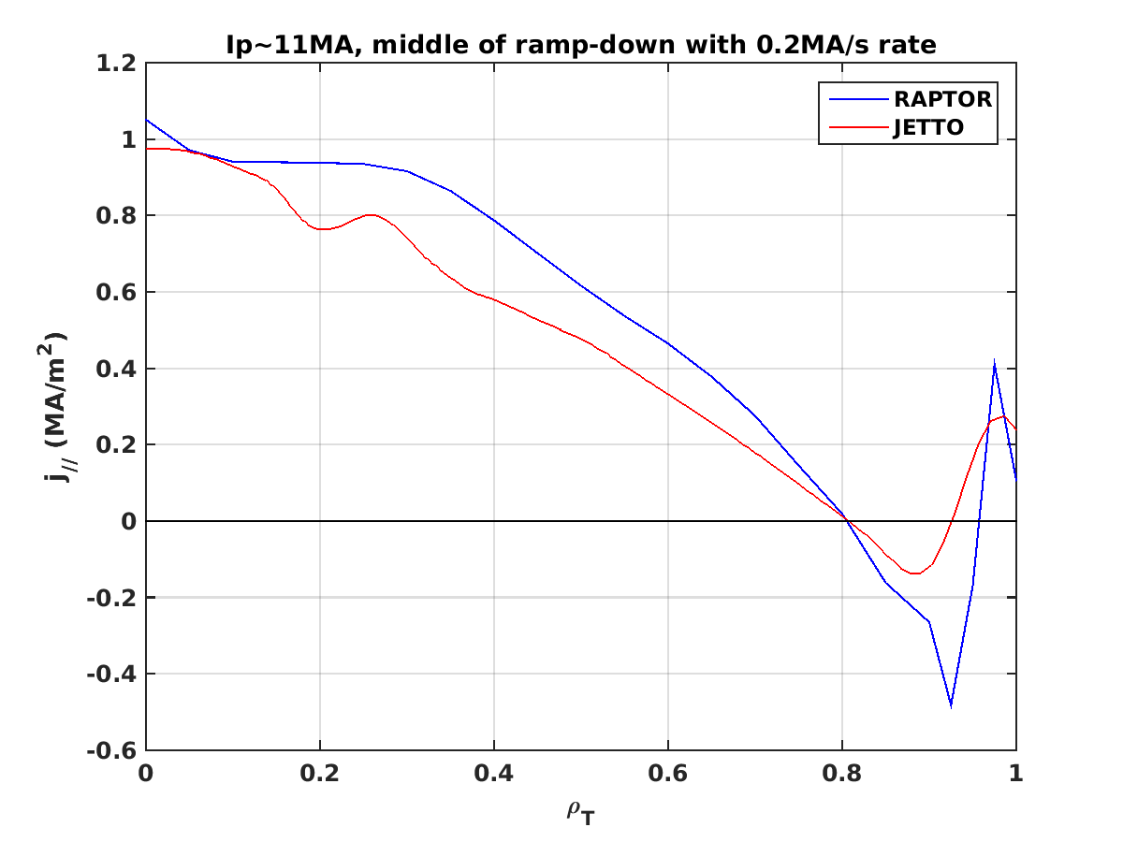
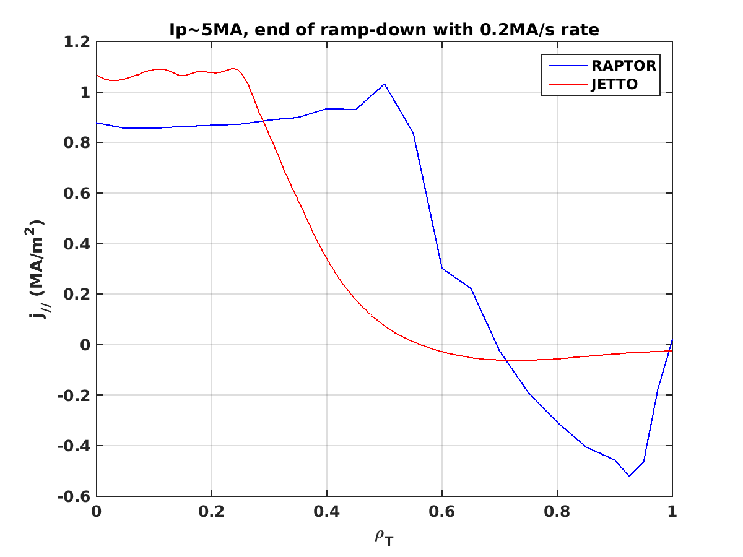
Comparing with Mattei’s limits
Can have large negative current density, especially late in ramp-down with small Ip, which can be unstable (also for n=1, to be checked)

Slide 6
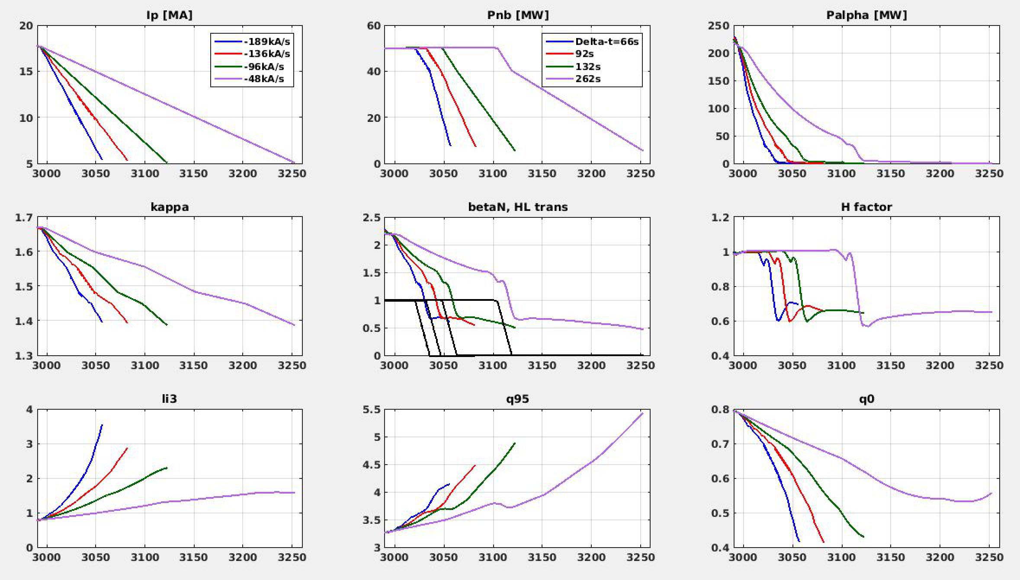
Starting point for optimization
4 «end of ramp-down» timings when Ip=5MA and optimize. NBI power with similar relative timings to have H-L in midlle of ramp near 10MA

Slide 7
Effect of change of dIp/dt rate and kappa
Main first effect on li is fast then slow Ip ramp-down, but kappa changes end of ramp-down li(t)

Slide 8
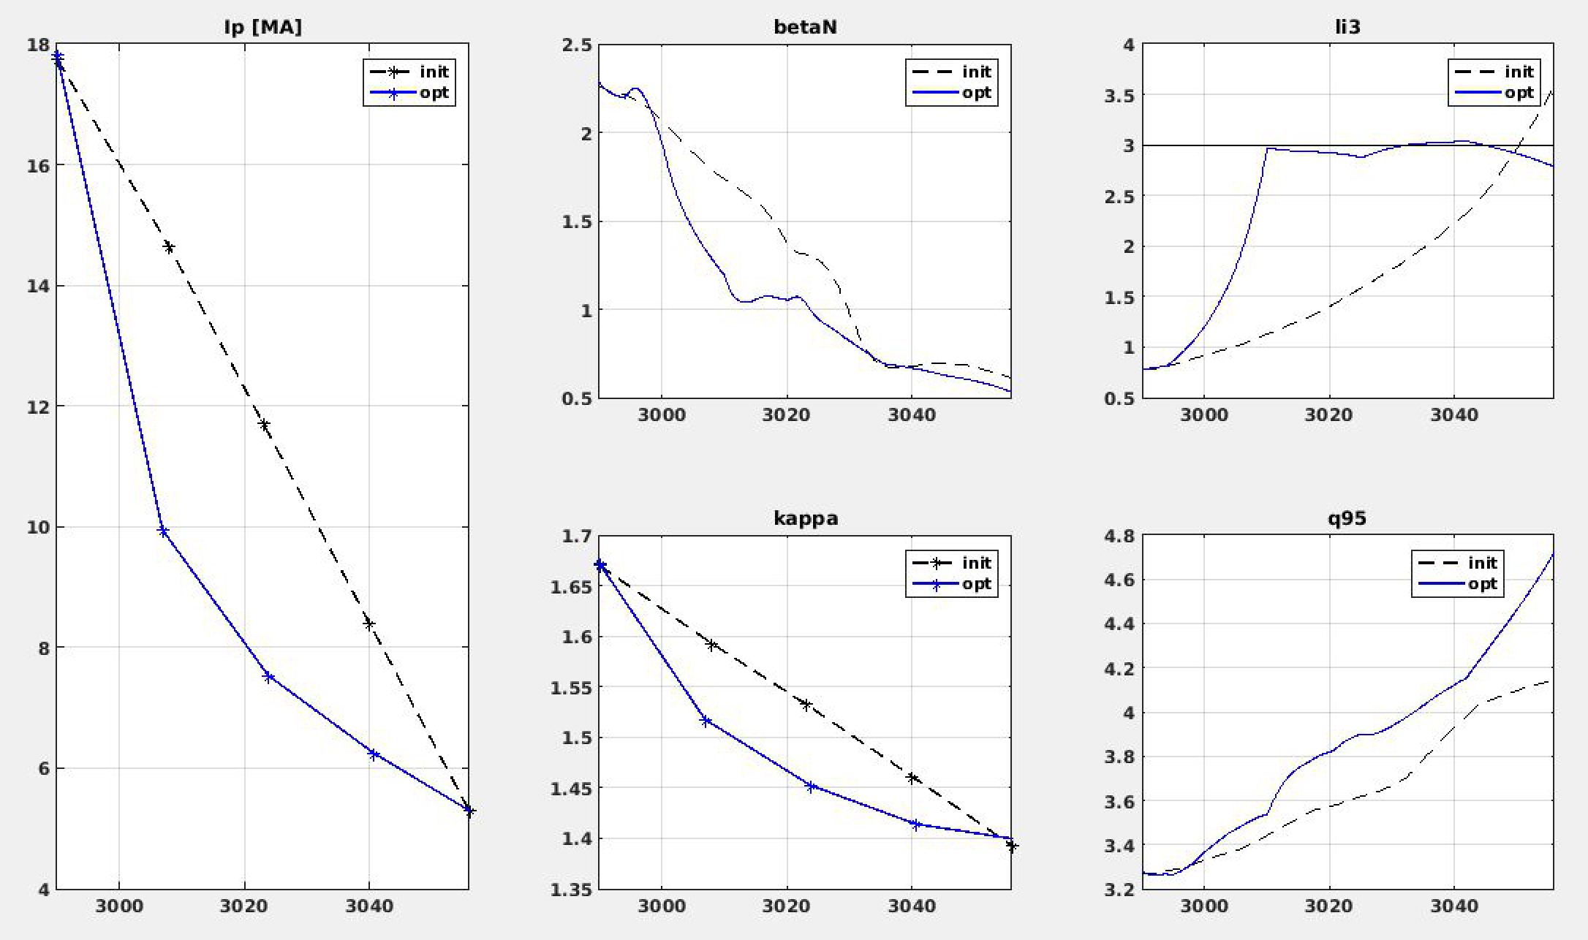
With 0.2MA/s rate on average, best is li<3
Fast ramp-down case ~0.2MA/s; Can find a trajectory with li<3; No solution with li<2

Slide 9
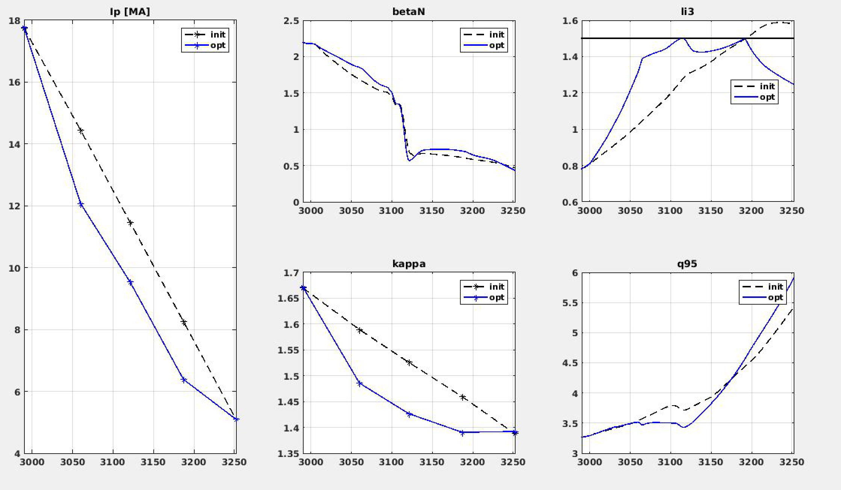
With 0.05MA/s rate on average, easy
Slow ramp-down case: ~0.05MA/s Easy to get li<1.5

Slide 10
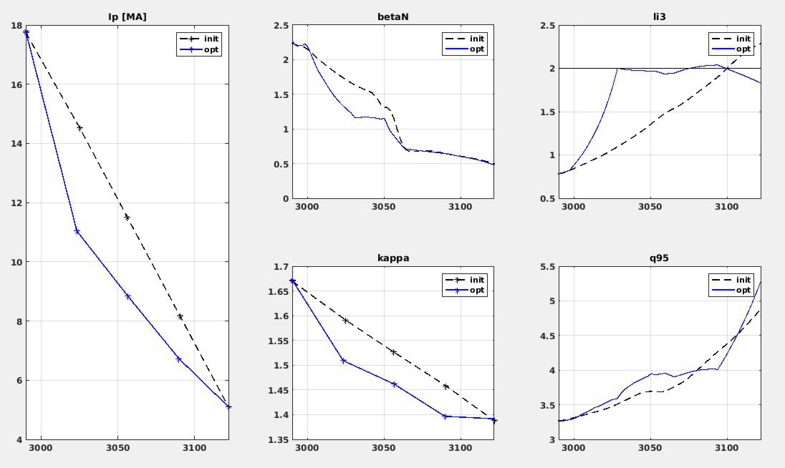
With 0.1MA/s rate on average, ok for li<2
Medium ramp-down case: ~0.10MA/s

Slide 11
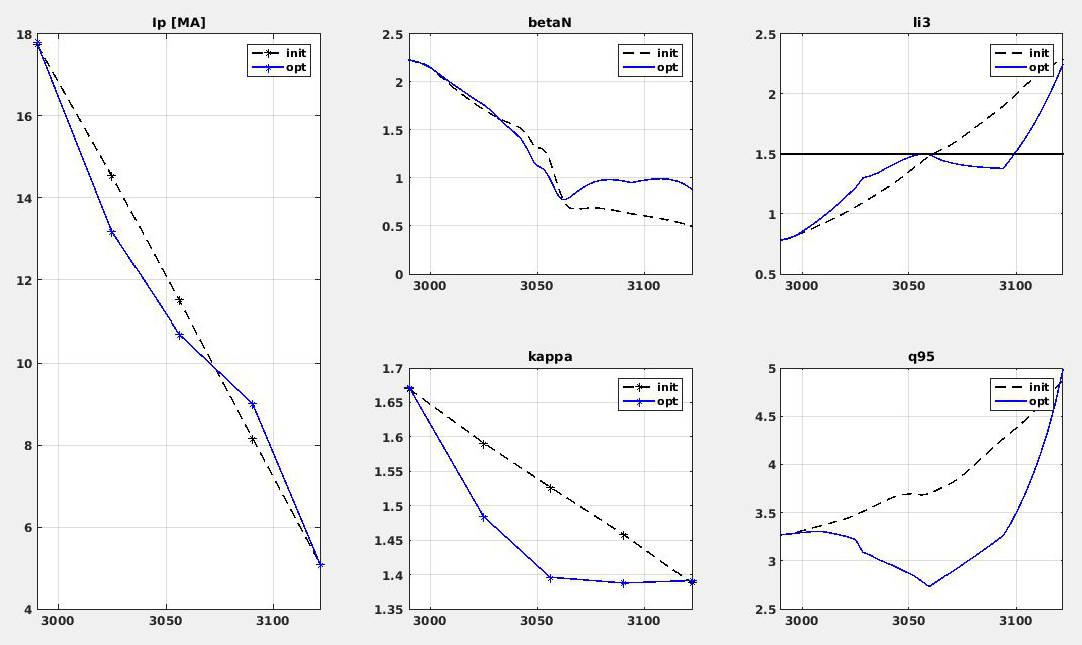
With 0.1MA/s, not ok for li<1.5
Medium ramp-down case: ~0.10MA/s
Kappa drops too fast and q95<3
Similar difficulties for 0.15MA/s case and li<2 constraint

Slide 12
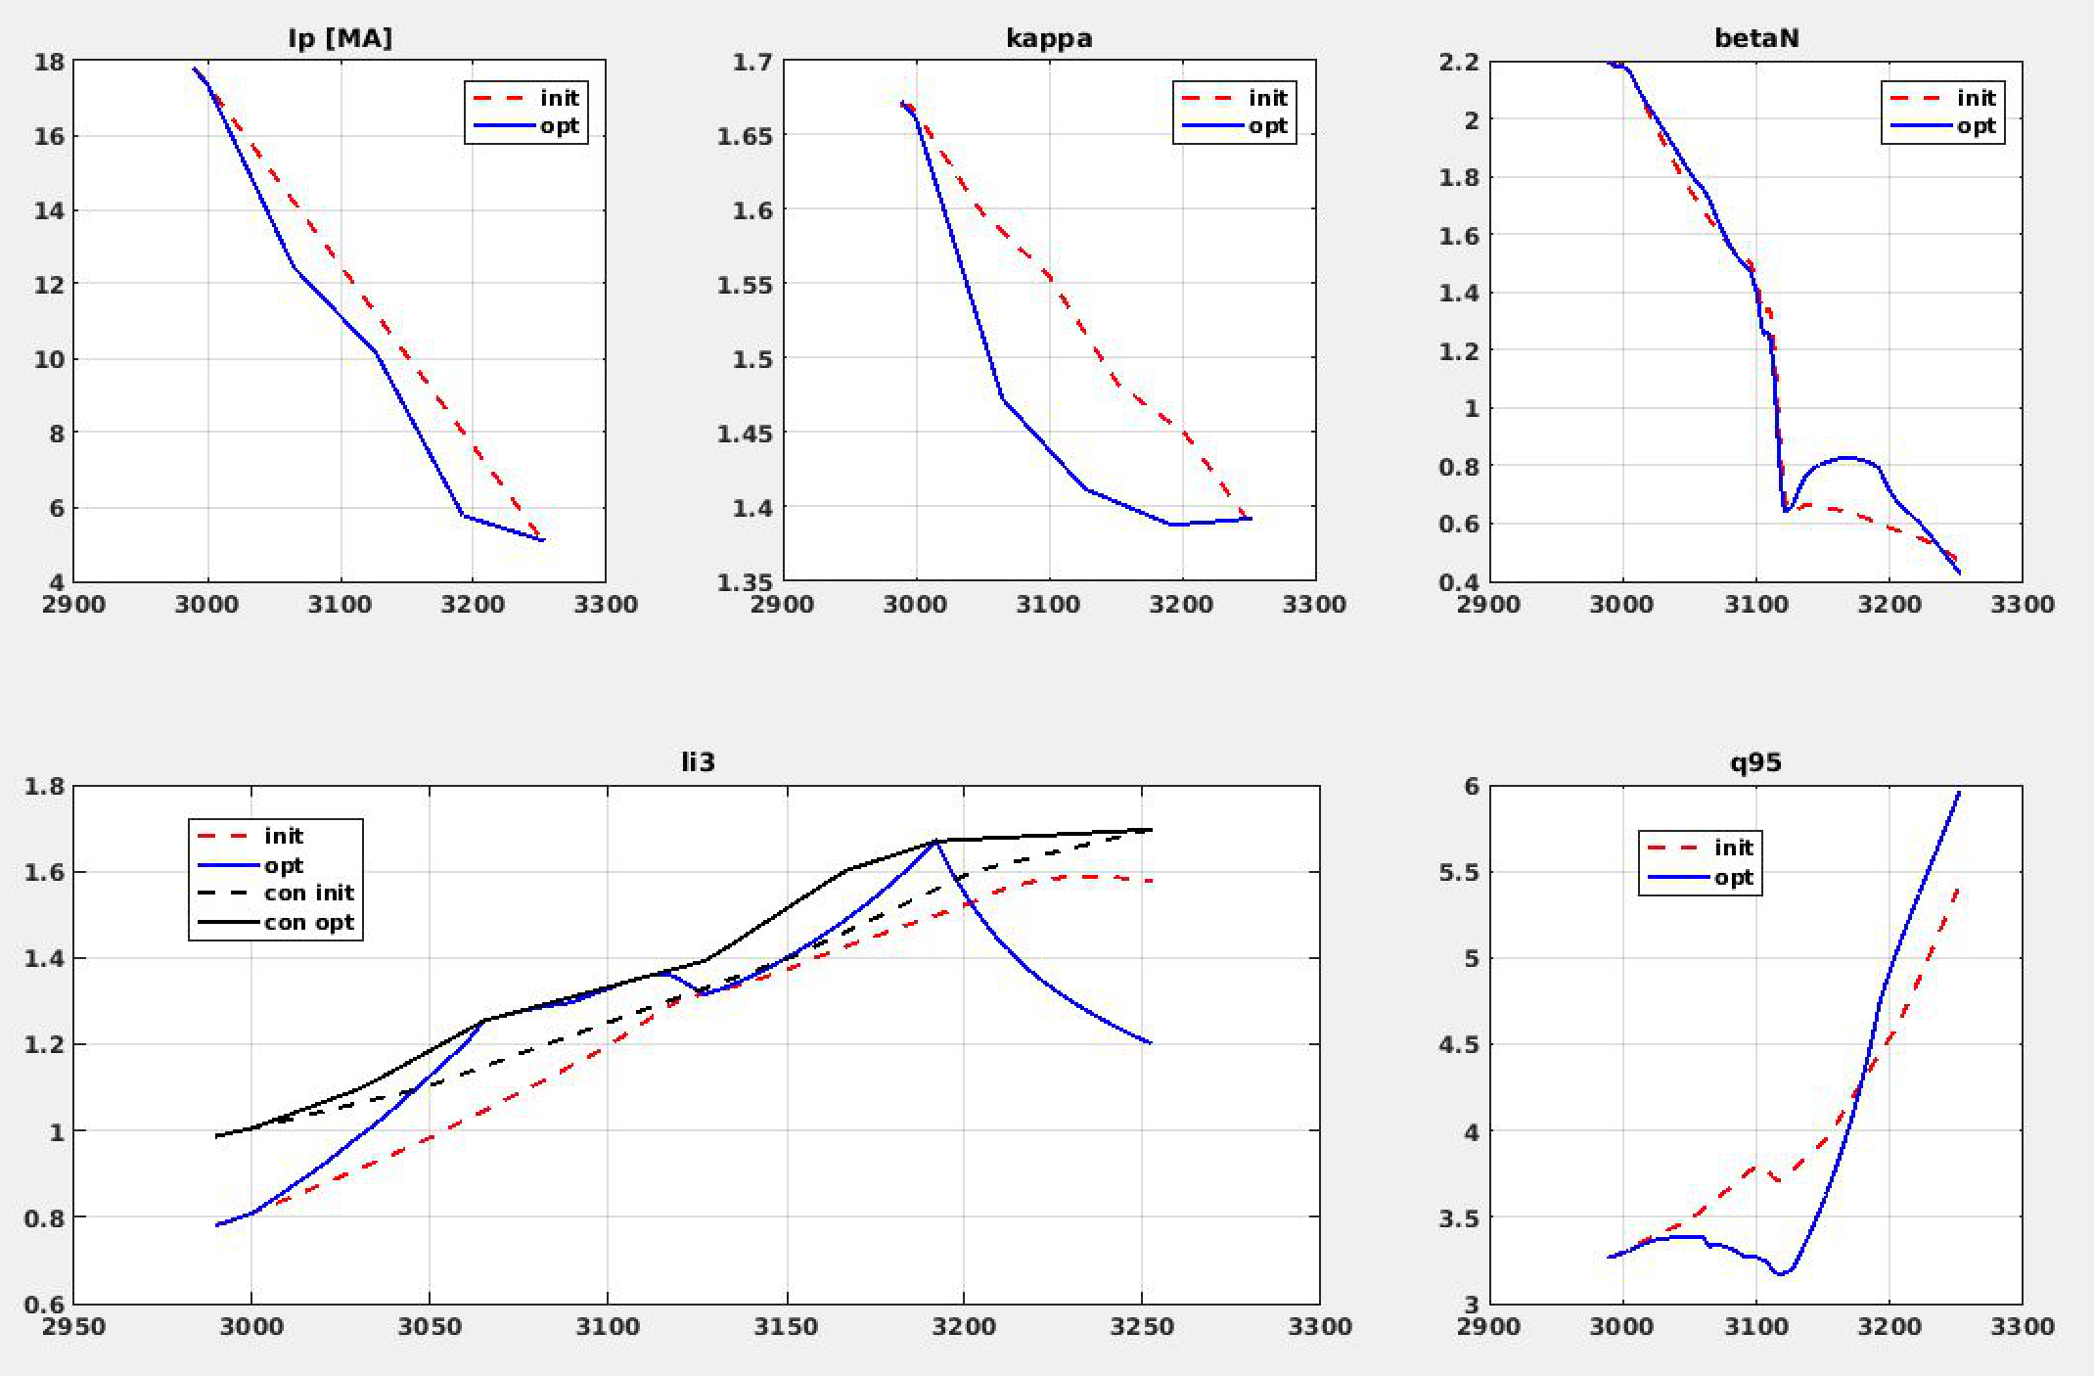
With 0.05MA/s and li(IP) limit from CREATE
Medium ramp-down case: ~0.05MA/s
Constraints also Ip ramp in H-mode

Slide 13
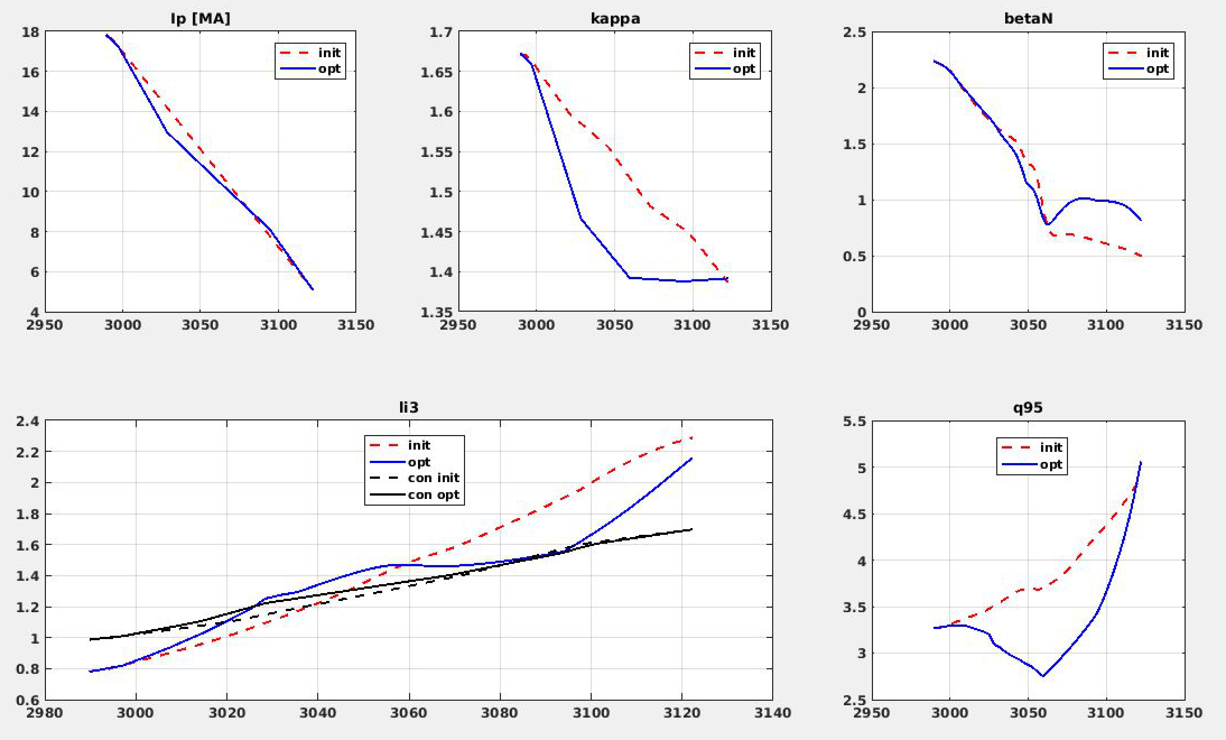
With 0.10MA/s, not ok for li(Ip)
Medium ramp-down case: ~0.10MA/s
Kappa drops too fast and q95<3

Slide 14
Next steps
Propose trajectory to be run with ASTRA and compare with RAPTOR li(t) to «calibrate» and then further optimize
We will 0.1MA/s target with constraint li(Ip) slightly relaxed
Sensitivity study
Look at ramp-up if any thing to improve? to discuss cost funtion

