Slide 1

Simulations were carried out in Marconi and Marenostrum-IV supercomputers. This work has been funded by the Spanish Ministry of Science, Innovation and Universities under grant PID2021-125607NB-I00 and PID2021-123175NB-I00 and was carried out within the framework of the EUROfusion Consortium, funded by the European Union via the Euratom Research and Training Programme (Grant Agreement No 101052200 - EUROfusion). Views and opinions expressed are however those of the authors only and do not necessarily reflect those of the European Union or the European Commission. Neither the European Union nor the European Commission can be held responsible for them.
First experimental observation of zonal flows in the optimized stellarator Wendelstein 7-X
I-135
D. Carralero¹, T. Estrada¹, J. M. García-Regaña¹, E. Sánchez¹, T. Windisch², A. Alonso¹, E. Maragkoudakis¹, C.Brandt², K. J. Brunner²,
C. Gallego-Castillo³, K. Rahbarnia², H. Thienpondt¹, and the Wendelstein 7-X Team
¹ Laboratorio Nacional de Fusión. CIEMAT, 28040 Madrid, Spain. ² Max-Planck-Institut für Plasmaphysik, D-17491 Greifswald, Germany.
³ DAVE(ETSIAE), Universidad Politécnica de Madrid, Plaza Cardenal Cisneros 3, Madrid, Spain

Slide 2
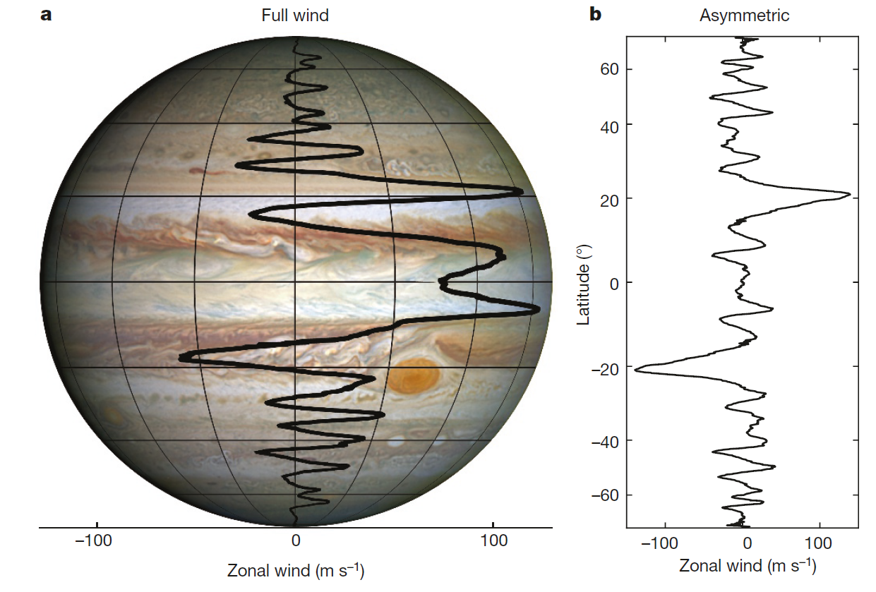
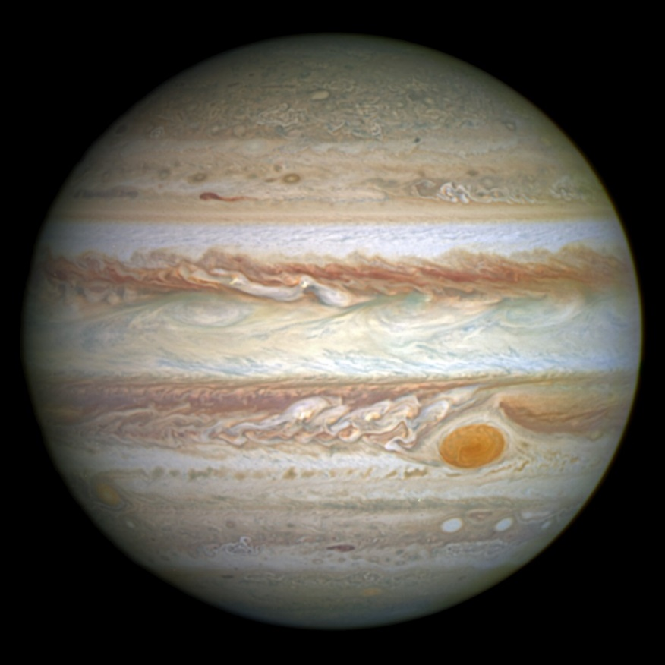
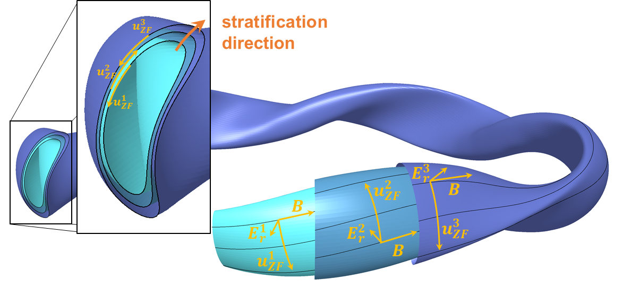
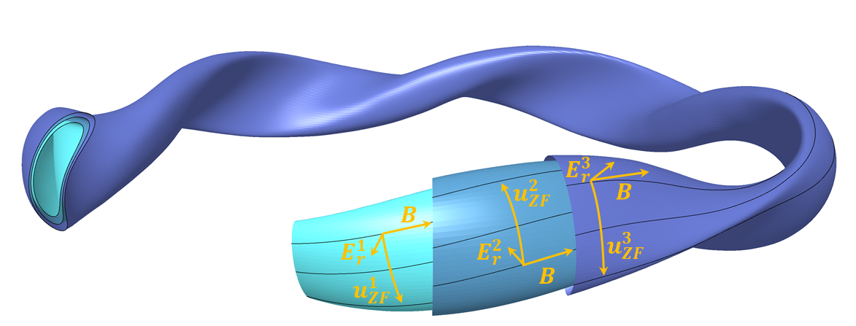


Zonal flows are a universal feature of stratified turbulence
stratification direction
$$u_{ZF}^{1}$$
Y. Kaspi, Nature, 2018
$$u_{ZF}^{2}$$
NASA, ESA, and A. Simon (Goddard Space Flight Center)
Zonal flows manifest as system-sized flows perpendicular to the stratification:
In planetary atmospheres, ZF take the form of latitude-uniform winds in the cloud layer.
In magnetic fusion, ZF take the form of surface-uniform oscillations of the ExB flow.
1

Slide 3
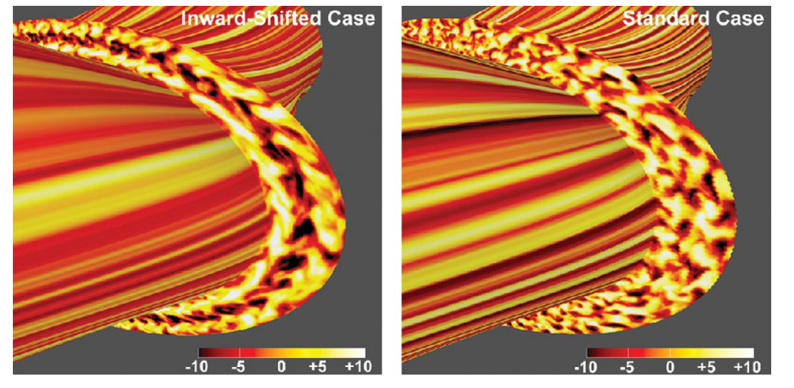
Effect of zonal flows on magnetic confinement systems
strong ZF
weak ZF
strong ZF
weak ZF
φ
φ
Z. Lin, Science, 1998
T.-H. Watanabe, PRL, 2008
Zonal flows take place along flux surfaces and cause no direct radial transport. However, ZF interact with the rest of plasma turbulence, indirectly regulating turbulent transport.
Key mechanisms include:
Suppression of turbulence by shear flows
Determination of the saturated turbulence state
Activation of large-scale damped modes at finite β
ZF is positive for confinement
[H. Biglari, PF-B, 1990]
ZF is positive for confinement
[P. Diamond, PPCF, 2005]
ZF is negative for confinement
[P. W. Terry, NF, 2015]
2

Slide 4
Relevance of ZF for a stellarator fusion reactor
Stellarator optimization has solved NC transport, but performance is below expectations due to turbulence:
Since 2015, Wendelstein 7-X has achived scenarios incompatible with high NC transport [1].
Wendelstein 7-X
Major radius | 5.5 m | Magnetic field (on axis) | 2.5 T
Minor radius | 0.55 m | Plasma volume | 30 m³
[1] C. Beidler, Nature,
3
4 5

Slide 5
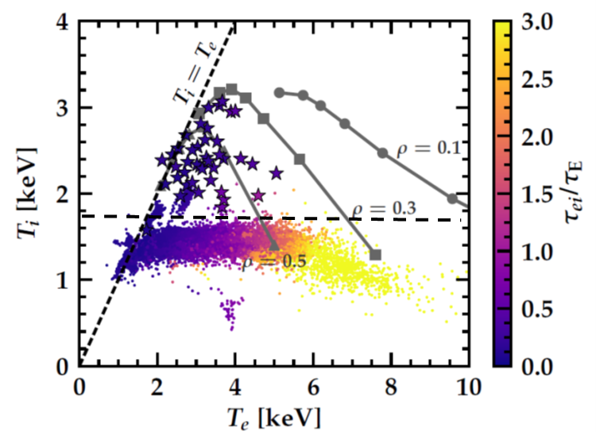
Relevance of ZF for a stellarator fusion reactor
Stellarator optimization has solved NC transport, but performance is below expectations due to turbulence:
Since 2015, Wendelstein 7-X has achived scenarios incompatible with high NC transport [1].
Core T_{i} is “clamped” well below expected values and can only achieve high performance when turbulence is suppressed [2, 3].
Performance in baseline scenarios is not sufficient for a reactor.
ZF may be critical to control turbulence in a stellarator reactor
Optimization reduces turbulent transport by enhancing ZF [4].
Reduced turbulence in LHD wrt. W7-X has been linked to strong ZF [5].
We can not predict ZF activity in reactor relevant scenarios
So far, ZF have only been detected in mid-size stellarators. Models can not be validated in high β, low ν conditions.
“Modest χ^{ano}” NTSS prediction
T_{i} “clamp”
S. Bozhenkov, EPS, 2019
In order to predict the future performance of a stellarator reactor we need to detect ZF and study experimentally their impact in turbulent transport in reactor-relevant plasmas
Baseline (f_{c} ~ 0.7)
Reactor
High performance
(f_{c} ~ 1.2)
A. Alonso NF 2022, D. Carralero PPCF 2022
[1] C. Beidler, Nature, 2021 [2] M. N. A. Beurskens, NF, 2021 [3] S. Bozhenkov, NF, 2020
[4] H. Sugama, PRL, 2005 [5] F. Warmer, PRL, 2021
3

Slide 6
Relevance of ZF for a stellarator fusion reactor
Stellarator optimization has solved NC transport, but performance is below expectations due to turbulence:
Since 2015, Wendelstein 7-X has achived scenarios incompatible with high NC transport [1].
Core T_{i} is “clamped” well below expected values and can only achieve high performance when turbulence is suppressed [2, 3].
Performance in baseline scenarios is not sufficient for a reactor.
ZF may be critical to control turbulence in a stellarator reactor
Optimization reduces turbulent transport by enhancing ZF [4].
Reduced turbulence in LHD wrt. W7-X has been linked to strong ZF [5].
We can not predict ZF activity in reactor relevant scenarios
So far, ZF have only been detected in mid-size stellarators. Models can not be validated in high β, low ν conditions.
“Modest χ^{ano}” NTSS prediction
T_{i} “clamp”
S. Bozhenkov, EPS, 2019
In order to predict the future performance of a stellarator reactor we need to detect ZF and study experimentally their impact in turbulent transport in reactor-relevant plasmas
(like the ones we expect to achieve in W7-X with full heating power and low field)
Baseline (f_{c} ~ 0.7)
Reactor
High performance
(f_{c} ~ 1.2)
A. Alonso NF 2022, D. Carralero PPCF 2022
[1] C. Beidler, Nature, 2021 [2] M. N. A. Beurskens, NF, 2021 [3] S. Bozhenkov, NF, 2020
[4] H. Sugama, PRL, 2005 [5] F. Warmer, PRL, 2021
3

Slide 7
Outline
Introduction
Experimental detection of ZF at W7-X
  Main experimental signatures of ZF
  0-phase LRC
  Low frequency
  Electrostatic character
  Mesoscale structures
Verification with gyrokinetic codes
    Simulation of ZF in realistic conditions
    Comparison to experiments
Summary

Slide 8
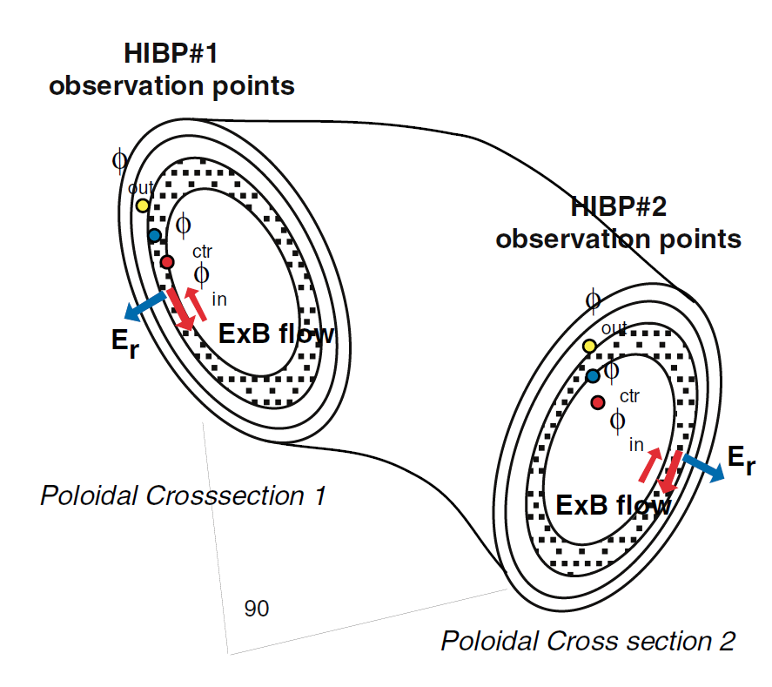
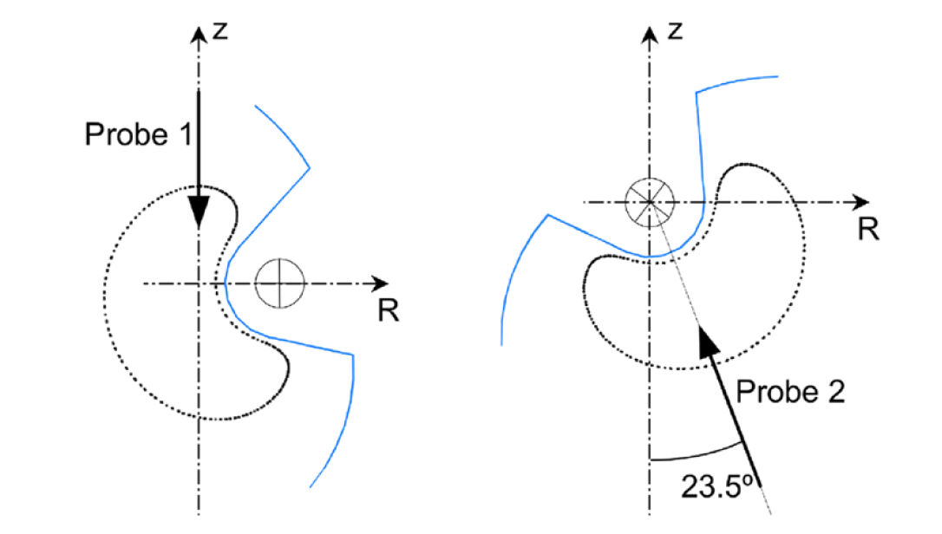
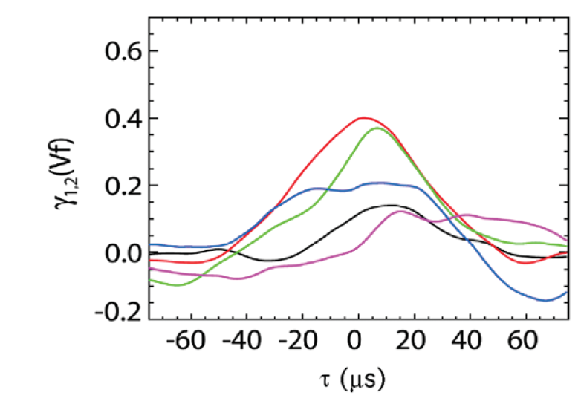
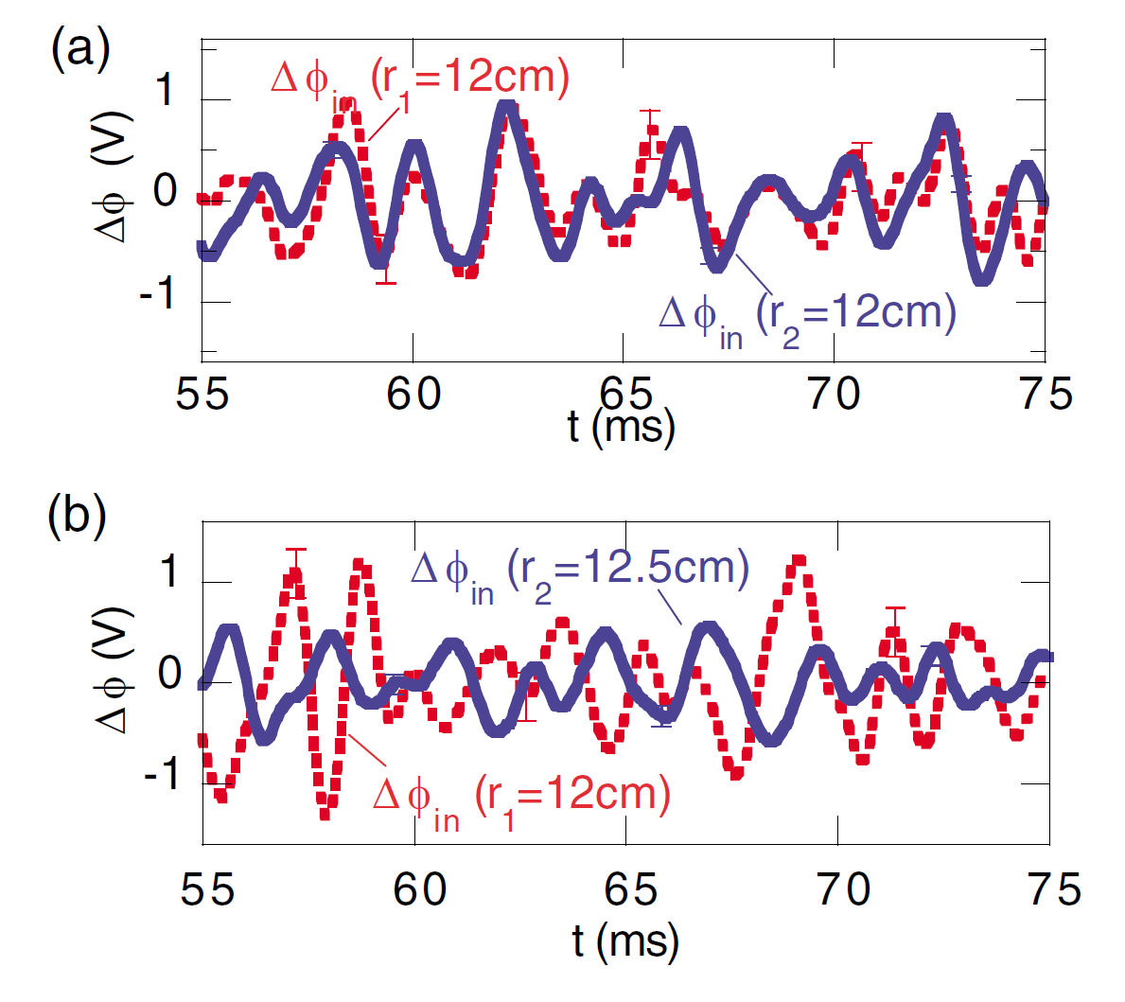
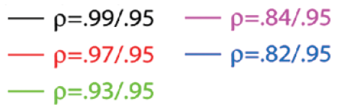
How can ZFs be detected experimentally?
Zonal flows manifest as surface-uniform oscillations of the ExB flow.
Long Range Correlations (LRC) are the main experimental signature.
Detected with duplicated diagnostics measuring potential or flows: probes, HIBP, Doppler reflectometry.
CHS
TJ-II
A. Fujisawa, PRL, 2004
M. A. Pedrosa, PRL, 2008
4

Slide 9
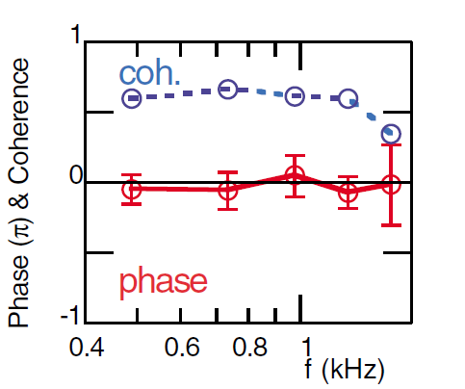
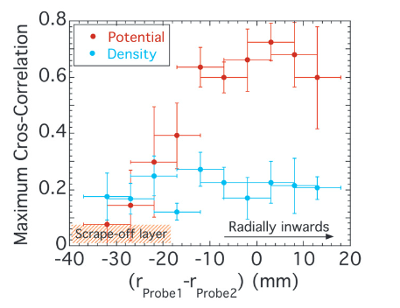
How can ZFs be detected experimentally?
Zonal flows manifest as surface-uniform oscillations of the ExB flow.
Long Range Correlations (LRC) are the main experimental signature.
Detected with duplicated diagnostics measuring potential or flows: probes, HIBP, Doppler reflectometry.
Other experimental features are:
Low frequency oscillations (0.1-1 kHz range)
Density fluctuations are a small correction of potential fluctuations.
Vanishing k|| means no electron response: electrostatic fluctuations.
CHS
TJ-II
A. Fujisawa, PRL, 2004
C. Hidalgo, EPL, 2009
4

Slide 10
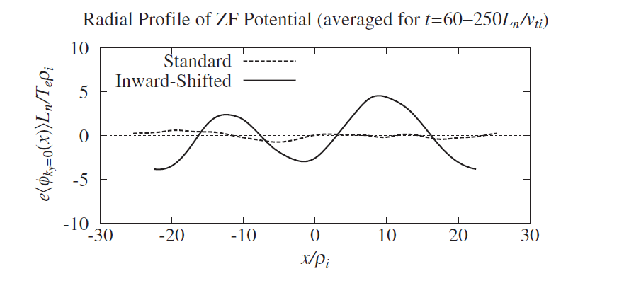
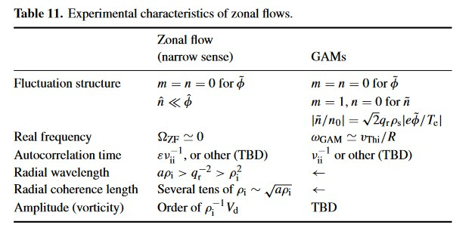
How can ZFs be detected experimentally?
Zonal flows manifest as surface-uniform oscillations of the ExB flow.
Long Range Correlations (LRC) are the main experimental signature.
Detected with duplicated diagnostics measuring potential or flows: probes, HIBP, Doppler reflectometry.
Other experimental features are:
Low frequency oscillations (0.1-1 kHz range)
Density fluctuations are a small correction of potential fluctuations.
Vanishing k|| means no electron response: electrostatic fluctuations.
Radial coherence length of tens of ρ_{i}
T.-H. Watanabe, PRL, 2008
P. Diamond, PPCF, 2005
4

Slide 11
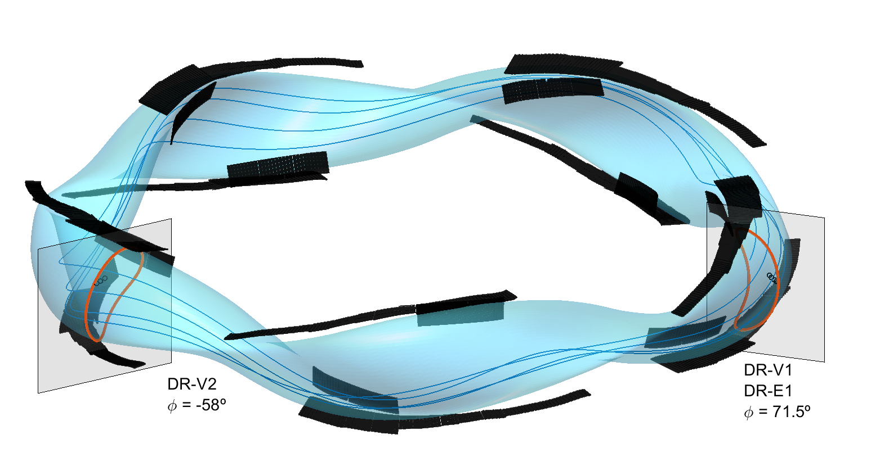
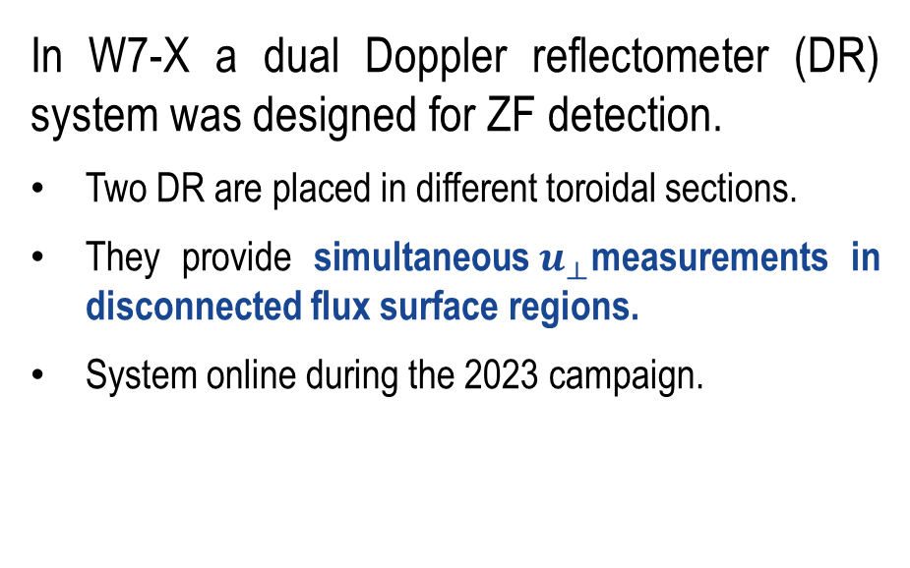
Long range correlations as main ZF signature
In W7-X a dual Doppler reflectometer (DR) system was designed for ZF detection.
Two DR are placed in different toroidal sections.
They provide simultaneous$u_{⟂}$measurements in disconnected flux surface regions.
System online during the 2023 campaign.
DR-V2
DR-V1/E1
5

Slide 12








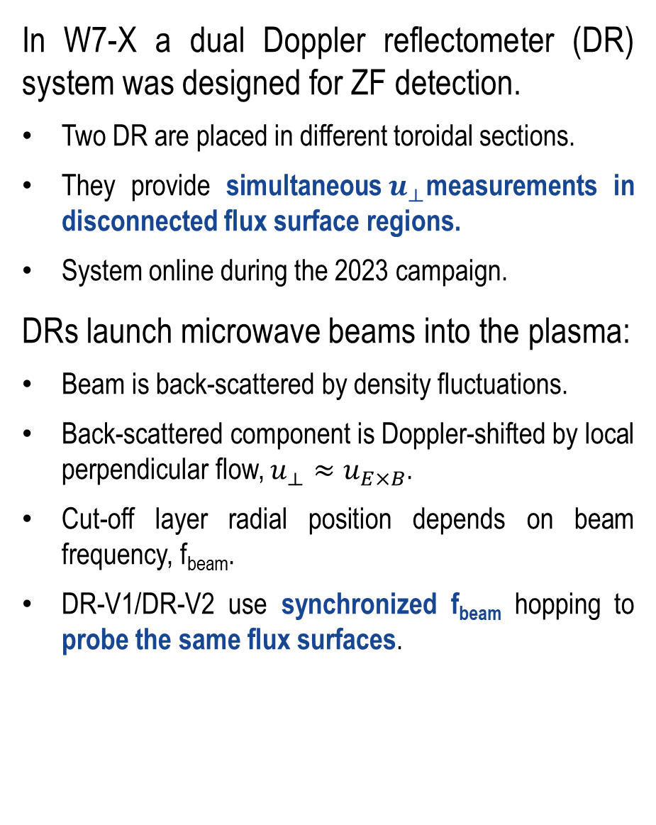
Long range correlations as main ZF signature
In W7-X a dual Doppler reflectometer (DR) system was designed for ZF detection.
Two DR are placed in different toroidal sections.
They provide simultaneous$u_{⟂}$measurements in disconnected flux surface regions.
System online during the 2023 campaign.
DRs launch microwave beams into the plasma:
Beam is back-scattered by density fluctuations.
Back-scattered component is Doppler-shifted by local perpendicular flow, $u_{⟂}≈u_{E×B}$.
Cut-off layer radial position depends on beam frequency, f_{beam}.
DR-V1/DR-V2 use synchronized f_{beam} hopping to probe the same flux surfaces.
$$k_{⟂}≈2k_{0}\sin{θ}$$
$$u_{⟂}$$
$$k_{0}$$
$$∆{\text{f}}_{D}≈2πk_{⟂}u_{⟂}$$
5

Slide 13
Flow LRC have been detected in W7-X
Beam frequency / radial position
f_{beam} [GHz]
ρ
time [ms]
DR standard operation is carried out in baseline ECRH plasmas and consists in a fine f_{beam} sweep (50-75 GHz)
Almost all radial positions are covered.
DR-V2 quality strongly reduced for ρ < 0.5
Results can be grouped in three main regions:
Inner core: noise background level.
Outer core: Irregular oscillation, ZF-like match!
Edge: large, regular oscillations. Out of phase.
6

Slide 14
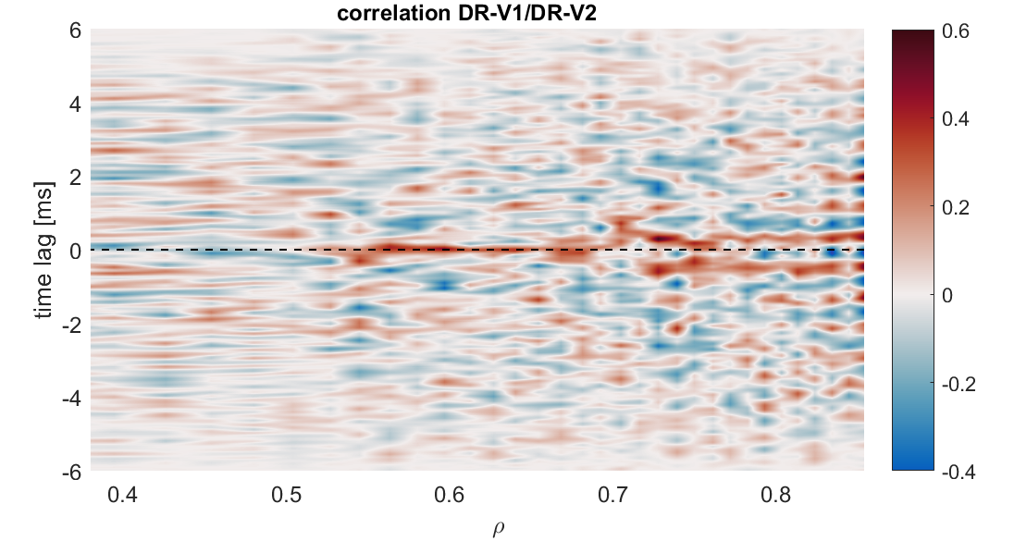
Flow LRC have been detected in W7-X
Results can be grouped in three main regions:
Inner core: noise background level.
Outer core: Irregular oscillation, ZF-like match!
Edge: large, regular oscillations. Out of phase.
No correlation
6

Slide 15
Flow LRC have been detected in W7-X
Results can be grouped in three main regions:
Inner core: noise background level.
Outer core: Irregular oscillation, ZF-like match!
Edge: large, regular oscillations. Out of phase.
High 0-phase correlation
No correlation
6

Slide 16
Flow LRC have been detected in W7-X
Results can be grouped in three main regions:
Inner core: noise background level.
Outer core: Irregular oscillation, ZF-like match!
Edge: large, regular oscillations. Out of phase.
High 0-phase correlation
π-phase correlation
No correlation
6

Slide 17
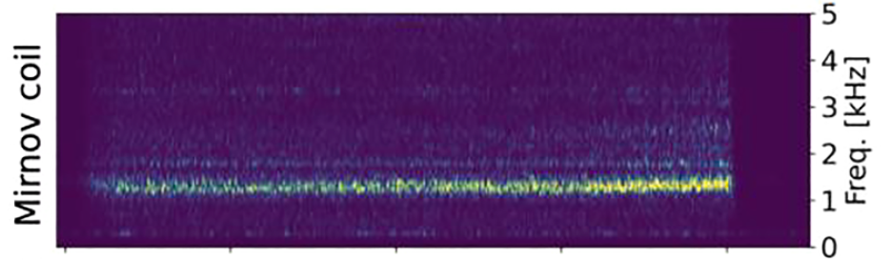
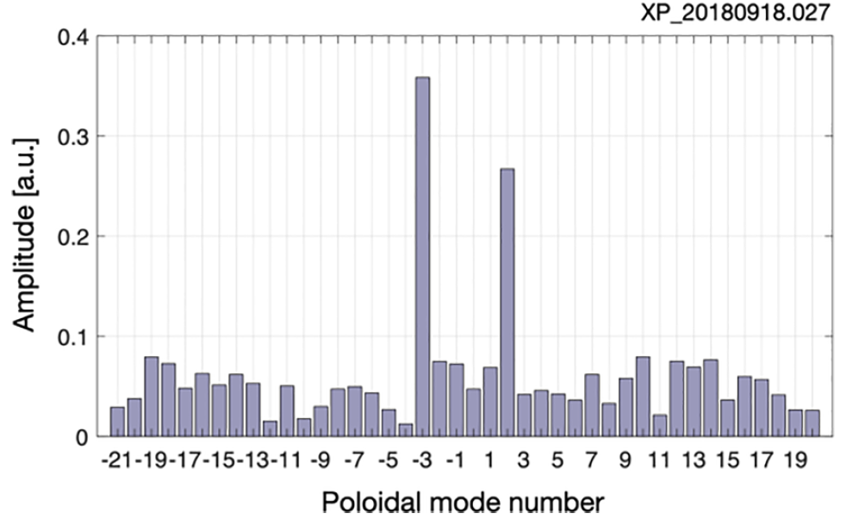
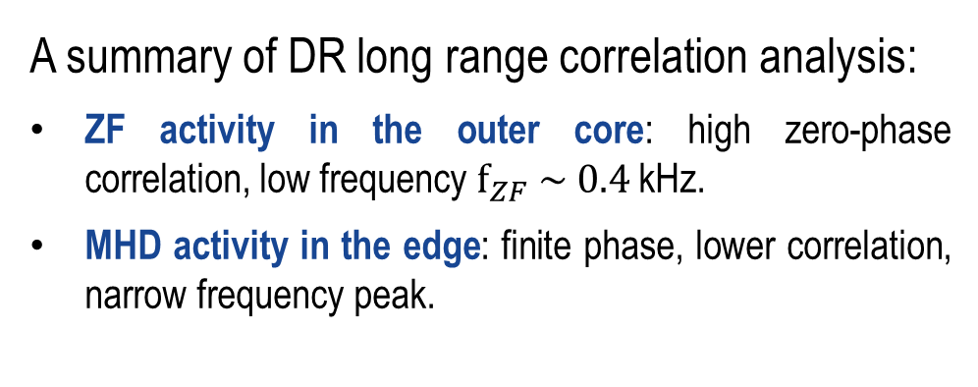
A first physical interpretation
1.1-1.2 kHz
A summary of DR long range correlation analysis:
ZF activity in the outer core: high zero-phase correlation, low frequency ${\text{f}}_{ZF} \sim 0.4$ kHz.
MHD activity in the edge: finite phase, lower correlation, narrow frequency peak.
ZF
MHD mode
statistical significance threshold
A 1.2 kHz, m=-3, n=2 MHD mode of has been reported in the edge in similar discharges.
Detected by visible/IR cameras, Mirnov, probes, diamagnetic loop, etc.
High 0-phase correlation
π-phase correlation
No correlation
S. Ballinger, NME, 2021
7

Slide 18
Are other parameters oscillating along with the DR-measured flow?
ZF are supposed to be electrostatic and have no density component.
Correlation to measurements from other diagnostics is carried out:
DR-V2
DR-V2
DR-V1/E1
DR-V1/E1
8

Slide 19
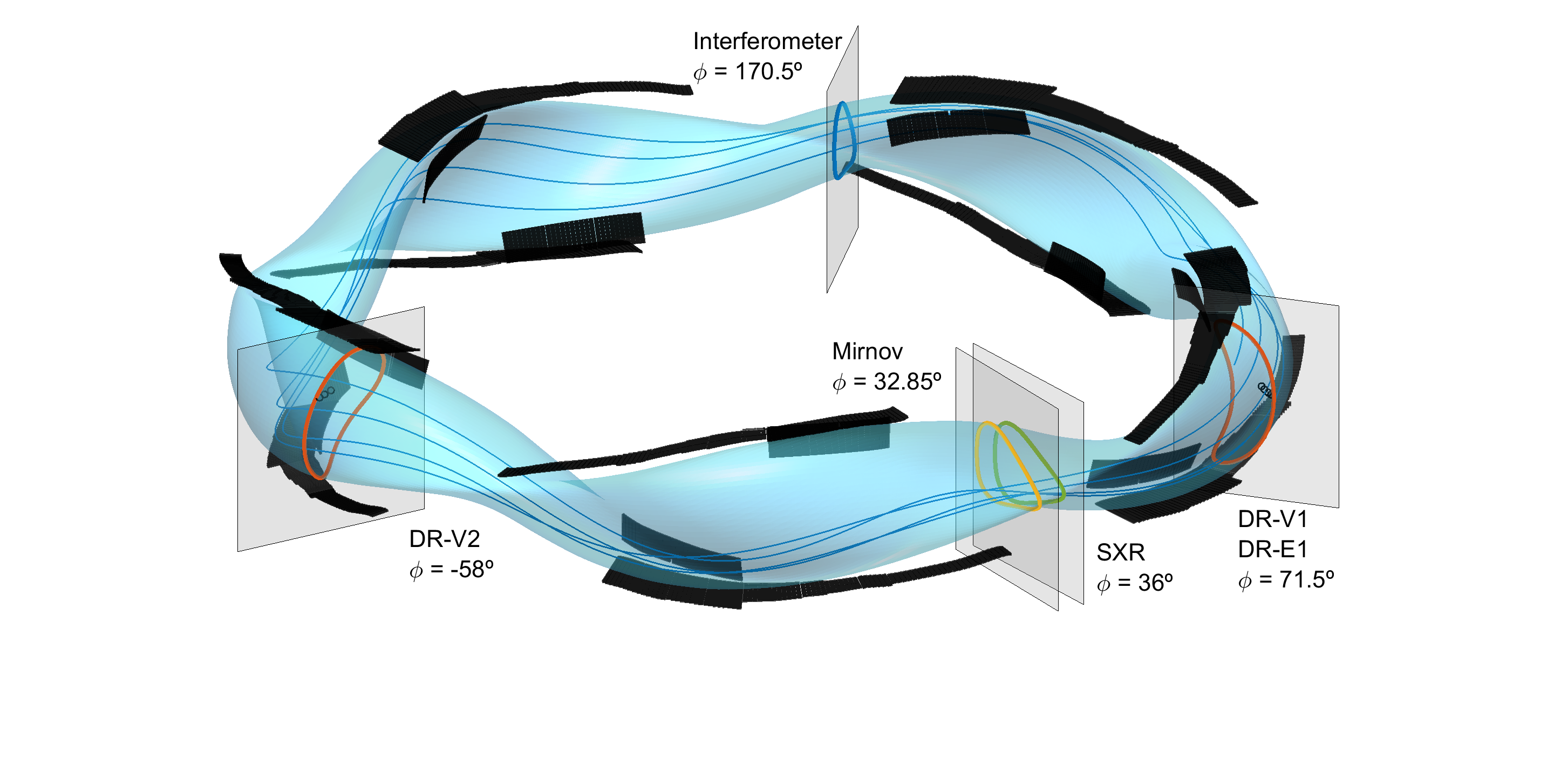
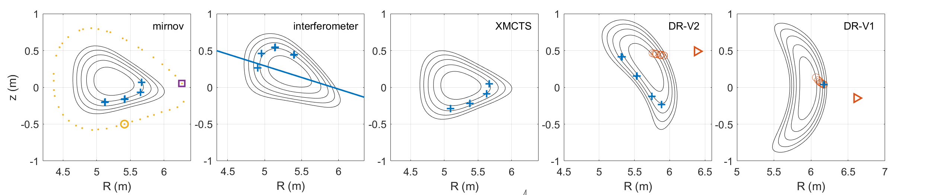
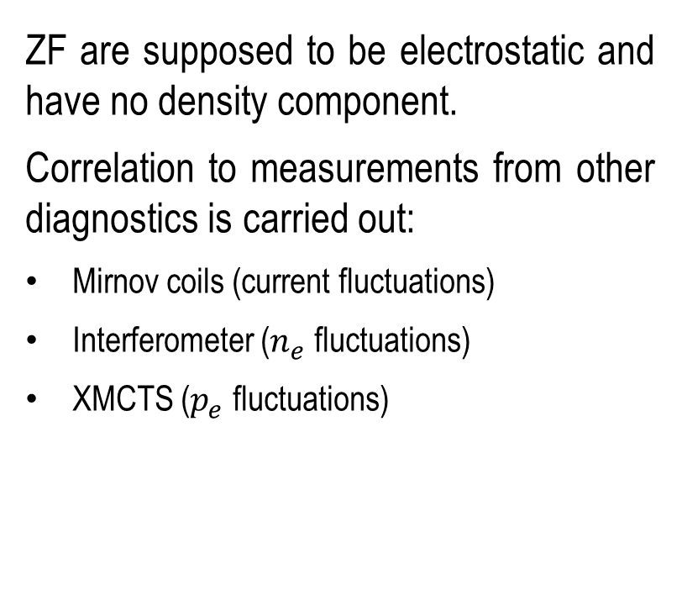
Are other parameters oscillating along with the DR-measured flow?
ZF are supposed to be electrostatic and have no density component.
Correlation to measurements from other diagnostics is carried out:
Mirnov coils (current fluctuations)
Interferometer ($n_{e}$ fluctuations)
XMCTS ($p_{e}$ fluctuations)
8

Slide 20
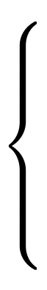
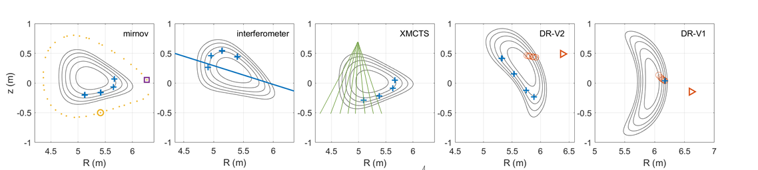
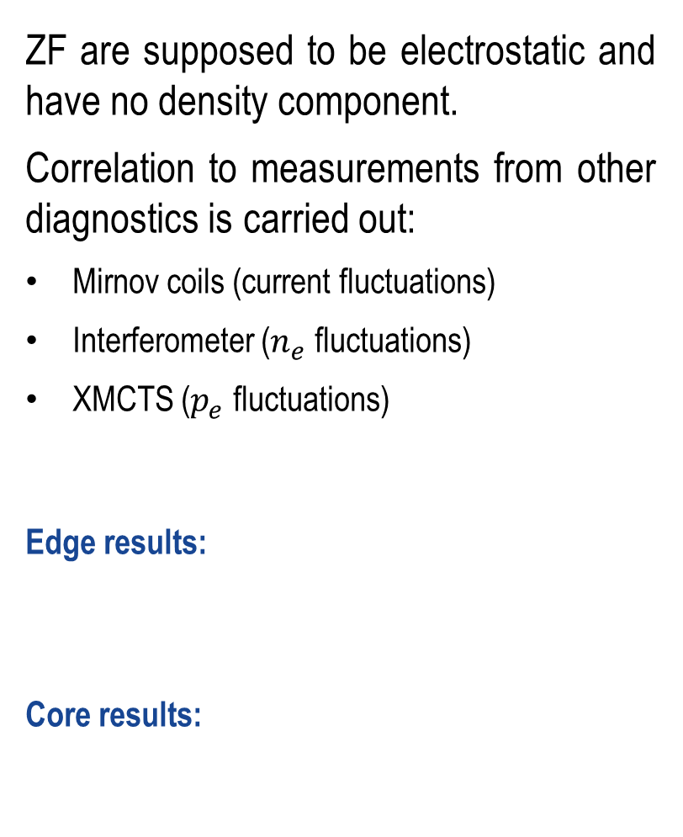
Zonal oscillations are electrostatic, have no density component
ZF are supposed to be electrostatic and have no density component.
Correlation to measurements from other diagnostics is carried out:
Mirnov coils (current fluctuations)
Interferometer ($n_{e}$ fluctuations)
XMCTS ($p_{e}$ fluctuations)
Edge results:
Core results:
Correlation to other diagnostics
Multiple phases (m,n>0)
Consistent with MHD mode in literature
This analysis confirms the ZF character of the outer core oscillation!
Only DRs are correlated
Consistent with ZF behavior
9

Slide 21
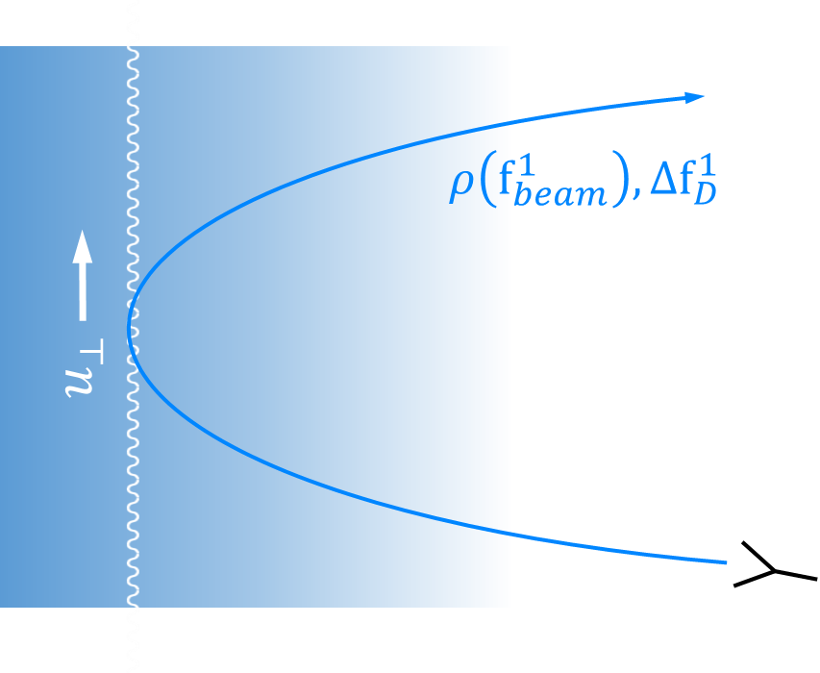



An additional DR to measure the radial scale
A third DR (DR-E1) is used to measure the radial scale of the ZF structure:
Exact same location as DR-V1.
$$∆ρ_{ZF}$$
DR-E1
$$e_{⟂}$$
DR-V1/E1 antenna
$$ρ$$
10

Slide 22
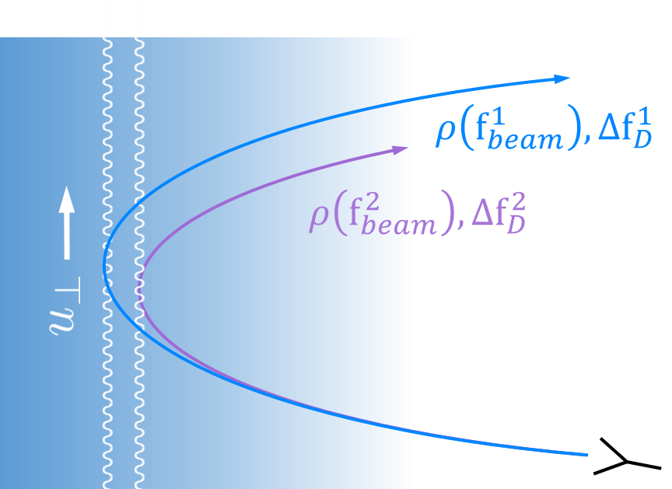

An additional DR to measure the radial scale
A third DR (DR-E1) is used to measure the radial scale of the ZF structure:
Exact same location as DR-V1.
Using different f_{beam}, a Δρ can be set between the two measurements.
By DR-V1/E1 correlation, radial coherence length can be calculated:
  If Δρ < Δρ_{ZF,} DR-V1 and DR-E1 signals display high coherence.
$$∆ρ_{ZF}$$
DR-E1
DR-V1
$$e_{⟂}$$
$$∆{\text{f}}_{D}^{1}≅∆{\text{f}}_{D}^{2}$$
DR-V1/E1 antenna
$$ρ$$
10

Slide 23
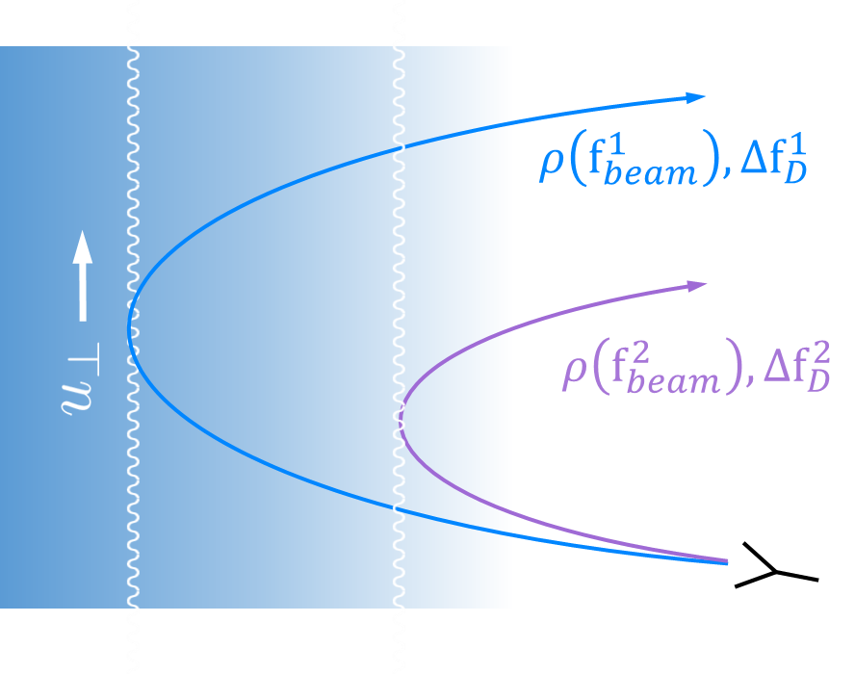

An additional DR to measure the radial scale
A third DR (DR-E1) is used to measure the radial scale of the ZF structure:
Exact same location as DR-V1.
Using different f_{beam}, a Δρ can be set between the two measurements.
By DR-V1/E1 correlation, radial coherence length can be calculated:
  If Δρ < Δρ_{ZF,} DR-V1 and DR-E1 signals display high coherence.
  If Δρ > Δρ_{ZF,} DR-V1 and DR-E1 are not correlated.
$$∆ρ_{ZF}$$
DR-E1
$$e_{⟂}$$
DR-V1
$$∆{\text{f}}_{D}^{1}≠∆{\text{f}}_{D}^{2}$$
$$ρ$$
DR-V1/E1 antenna
10

Slide 24
The oscillation shows a ZF-like radial scale
A third DR (DR-E1) is used to measure the radial scale of the ZF structure:
Exact same location as DR-V1.
Using different f_{beam}, a Δρ can be set between the two measurements.
By DR-V1/E1 correlation, radial coherence length can be calculated:
  If Δρ < Δρ_{ZF,} DR-V1 and DR-E1 signals display high coherence.
  If Δρ > Δρ_{ZF,} DR-V1 and DR-E1 are not correlated.
Experimental setup: DR-E1 fixed at radial position, DR-V1 performs fine frequency scan around it.
Δρ
ZF region
DR-E1
$$e_{⟂}$$
DR-V1
$$∆{\text{f}}_{D}^{1}≠∆{\text{f}}_{D}^{2}$$
$$ρ$$
DR-V1/E1 antenna
11

Slide 25
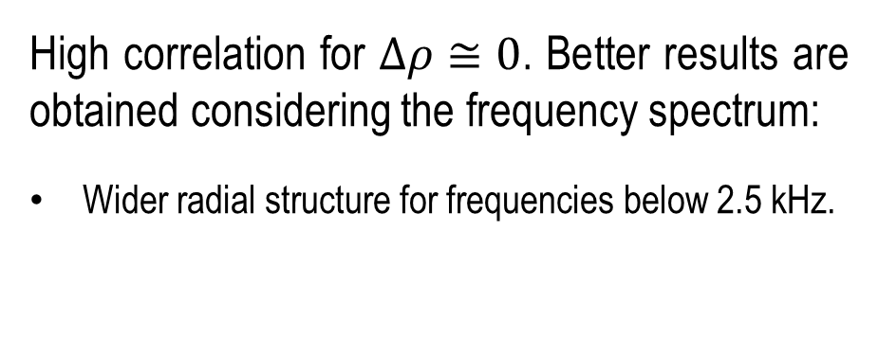
The oscillation shows a ZF-like radial scale
Δρ
ZF region
High correlation for $∆ρ≅0$. Better results are obtained considering the frequency spectrum:
Wider radial structure for frequencies below 2.5 kHz.
Coherence DR-V1/E1
11

Slide 26
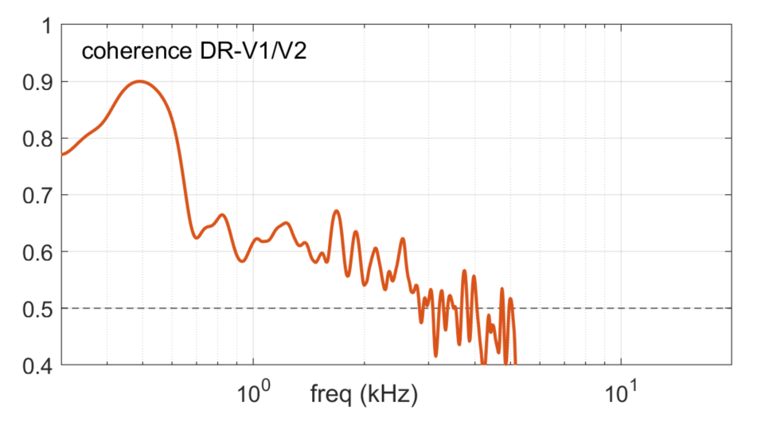
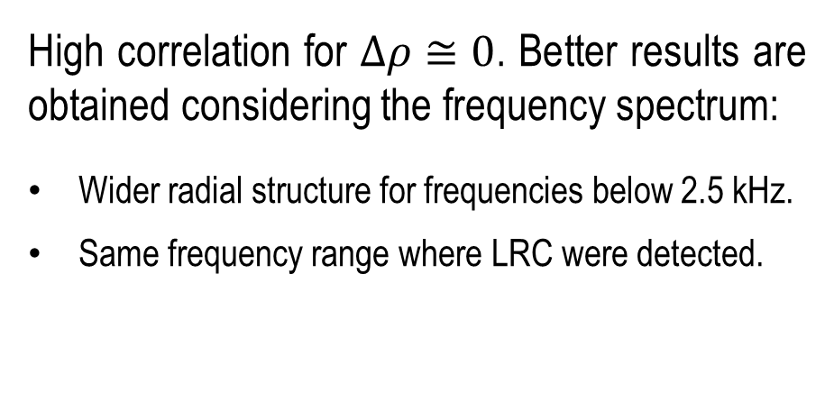
The oscillation shows a ZF-like radial scale
Δρ
ZF region
High correlation for $∆ρ≅0$. Better results are obtained considering the frequency spectrum:
Wider radial structure for frequencies below 2.5 kHz.
Same frequency range where LRC were detected.
Coherence DR-V1/E1
0.4-2.5 kHz
8-20 kHz
11

Slide 27
The oscillation shows a ZF-like radial scale
Δρ
Broad radial region matches LRC ZF frequency range!
ZF region
High correlation for $∆ρ≅0$. Better results are obtained considering the frequency spectrum:
Wider radial structure for frequencies below 2.5 kHz.
Same frequency range where LRC were detected.
Coherence DR-V1/E1
0.4-2.5 kHz
8-20 kHz
11

Slide 28
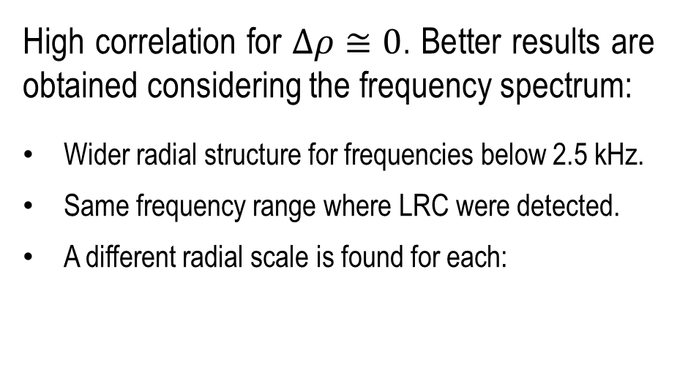
The oscillation shows a ZF-like radial scale
Δρ
ZF region
High correlation for $∆ρ≅0$. Better results are obtained considering the frequency spectrum:
Wider radial structure for frequencies below 2.5 kHz.
Same frequency range where LRC were detected.
A different radial scale is found for each:
Coherence DR-V1/E1
0.4-2.5 kHz
8-20 kHz
11

Slide 29
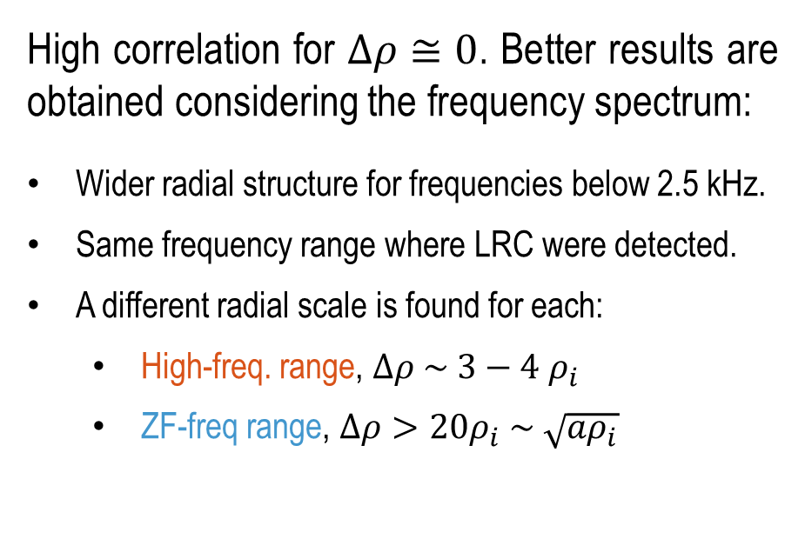
The oscillation shows a ZF-like radial scale
Δρ
ZF region
High correlation for $∆ρ≅0$. Better results are obtained considering the frequency spectrum:
Wider radial structure for frequencies below 2.5 kHz.
Same frequency range where LRC were detected.
A different radial scale is found for each:
  High-freq. range, $∆ρ \sim 3−4 ρ_{i}$
  ZF-freq range, $∆ρ>20ρ_{i} \sim \sqrt{aρ_{i}}$
Coherence DR-V1/E1
0.4-2.5 kHz
8-20 kHz
11

Slide 30


Outline
Introduction
Experimental detection of ZF at W7-X
  Main experimental signatures of ZF
  0-phase LRC
  Low frequency
  Electrostatic character
  Mesoscale structures
Verification with gyrokinetic codes
    Simulation of ZF in realistic conditions
    Comparison to experiments
Summary
  Detected by disconnected dual DR
  Broad range activity between 0.4-2.5 kHz
  No correlation with $n_{e}$, $p_{e}$, current fluctuations
  Radial correlation reveals $∆ρ_{ZF}\sim 20ρ_{i}$

Slide 31
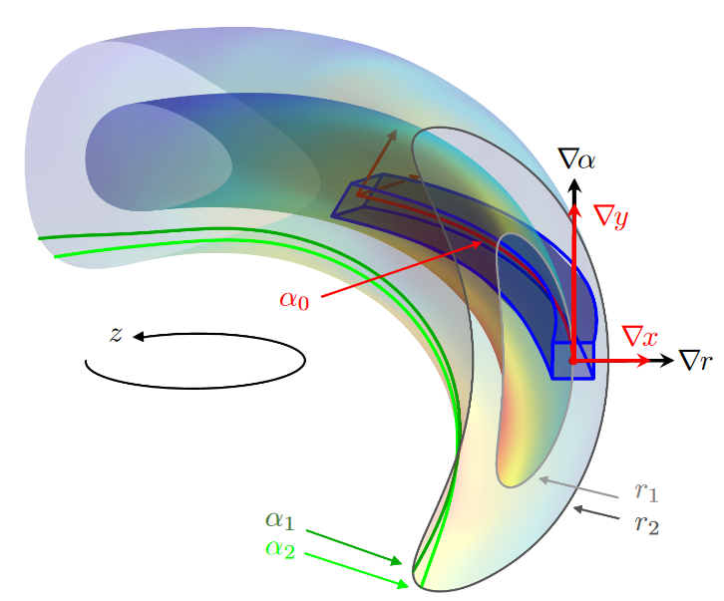
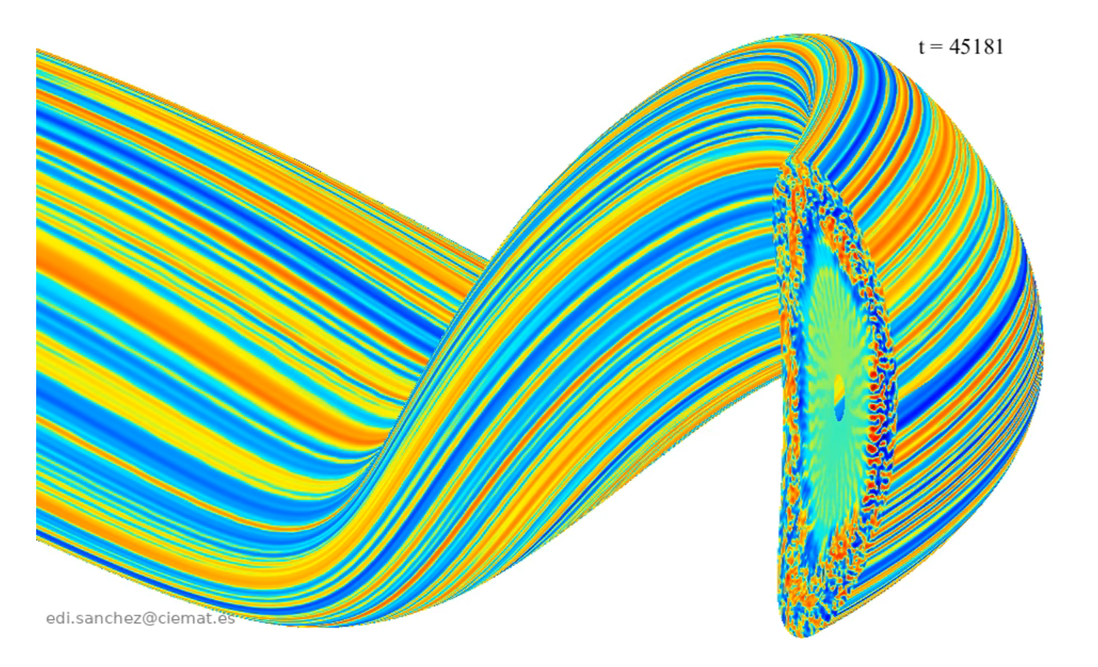
Gyrokinetic simulations are carried out with realistic profiles
Non-linear GK simulations are carried out to substantiate the experimental characterization of the ZF:
EUTERPE
radially global (0.2 < ρ < 0.9 domain)
adiabatic electrons
flux tube (ρ ~ 0.6) @ DR-V1 position
kinetic electrons
stella
R. Kleiber, CPC, 2024; E. Sánchez, JPP, 2020; E. Sanchez, NF, 2023
M. Barnes, JPP, 2019; A. González, NF 2024,
Courtesy E. Sanchez
H. Thienpondt, submitted NF, 2024
12

Slide 32
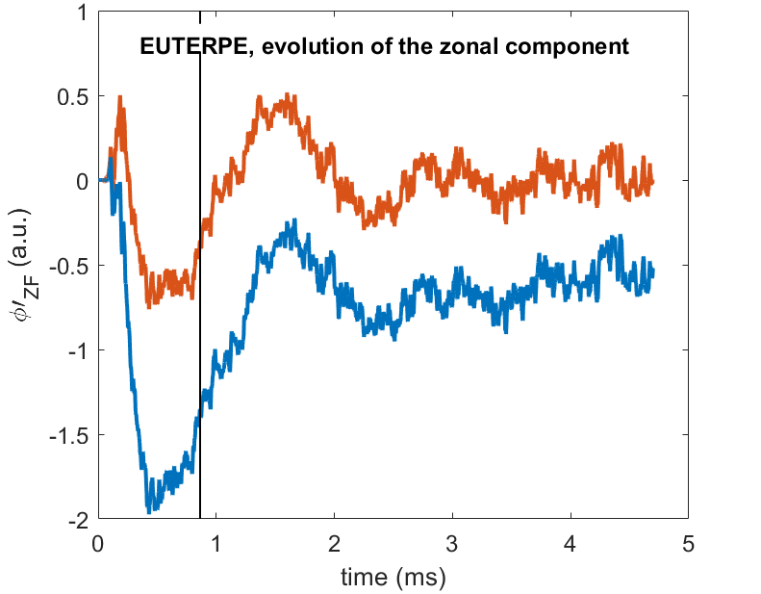
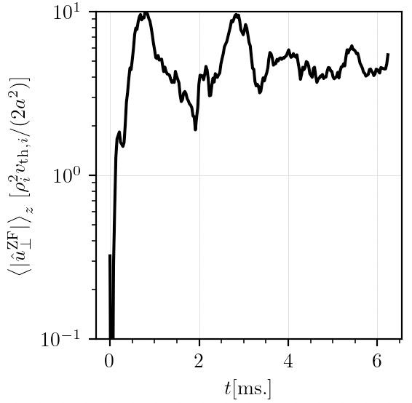
Gyrokinetic simulations are carried out with realistic profiles
Non-linear GK simulations are carried out to substantiate the experimental characterization of the ZF:
EUTERPE
Low frequencies make these simulations are extremely intensive in computation resources.
radially global (0.2 < ρ < 0.9 domain)
adiabatic electrons
flux tube (ρ ~ 0.6) @ DR-V1 position
kinetic electrons
stella
filtered
2∙10⁵ CPU-hours
unfiltered
10⁶ CPU-hours
stella, evolution of the zonal component
12

Slide 33
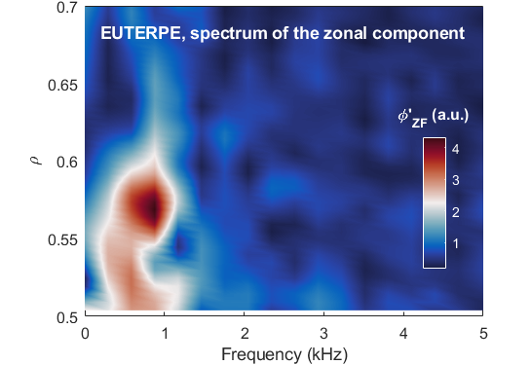
Simulation results
Remarkable agreement is achieved between simulations and experiment:
The frequency peak is quantitatively reproduced by both stella and EUTERPE (470 and 580 Hz vs. 500 Hz)
Qualitative agreement in the ZF frequency range limit (2 and 1.5 kHz vs 2.5 kHz)
The global simulation captures correctly the radial region where the activity is observed (ρ < 0.6)
13

Slide 34
Outline
Introduction
Experimental detection of ZF at W7-X
  Main experimental signatures of ZF
  0-phase LRC
  Low frequency
  Electrostatic character
  Mesoscale structures
Verification with gyrokinetic codes
    Simulation of ZF in realistic conditions
    Comparison to experiments
Summary
  Detected by disconnected dual DR
  Broad range activity between 0.4-2.5 kHz
  No correlation with $n_{e}$, $p_{e}$, current fluctuations
  Radial correlation reveals $∆ρ_{ZF}\sim 20ρ_{i}$
  Carried out with EUTERPE and stella
  Remarkable agreement with experiment

Slide 35
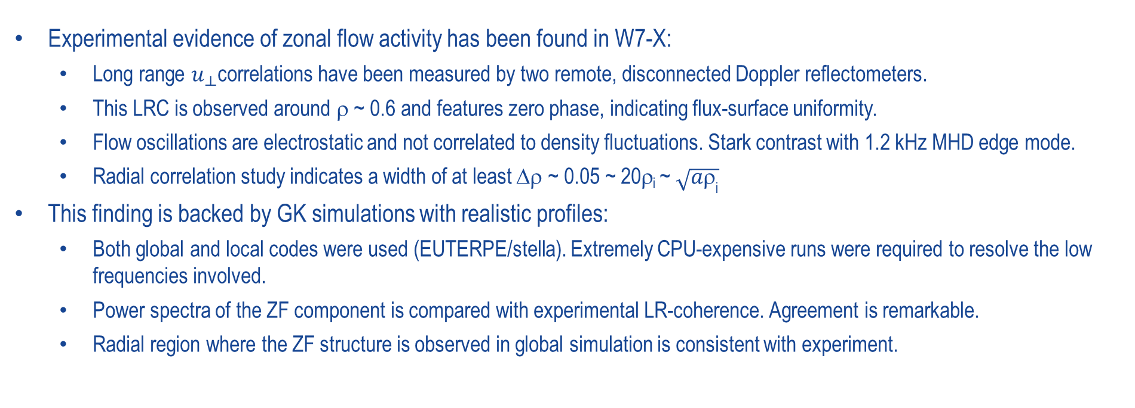
Summary
Experimental evidence of zonal flow activity has been found in W7-X:
  Long range $u_{⟂}$correlations have been measured by two remote, disconnected Doppler reflectometers.
  This LRC is observed around ρ ~ 0.6 and features zero phase, indicating flux-surface uniformity.
  Flow oscillations are electrostatic and not correlated to density fluctuations. Stark contrast with 1.2 kHz MHD edge mode.
  Radial correlation study indicates a width of at least Δρ ~ 0.05 ~ 20ρ_{i} ~ $\sqrt{a{\text{r}}_{\text{i}}}$
  This finding is backed by GK simulations with realistic profiles:
    Both global and local codes were used (EUTERPE/stella). Extremely CPU-expensive runs were required to resolve the low frequencies involved.
    Power spectra of the ZF component is compared with experimental LR-coherence. Agreement is remarkable.
    Radial region where the ZF structure is observed in global simulation is consistent with experiment.
The presence of ZF in Wendelstein 7-X has been confirmed, and a first characterization has been carried out.
This result paves the way for ZF model validation in a machine capable of reactor-relevant plasmas.
14

Slide 36
Additional Slides

