Slide 1
Extending enhanced-performance scenarios after pellet injection in TJ-II stellarator. I. García Cortés, K. McCarthy & TJ-II team
CIEMAT, Madrid (Spain): D. Medina-Roque, T. Estrada, B. van Milligen, N. Panadero, A. Baciero, A. Cappa, R. Carrasco, J. M. Fontdecaba, R. García, J. Hernández-Sánchez, F. J. Hernanz, B. López Miranda, F. Medina, M. Navarro, J. L. de Pablos, I. Pastor, P. Pons, J. de la Riva, M. C. Rodríguez, D. Tafalla, and TJ-II team.
UC3M, Madrid (Spain): V. Tribaldos, L. García, B. Carreras.
NSC KIPT Kharkiv (Ukraine): O. O. Chmyga and O. S. Kozachok,
50th EPS Conference on Plasma Physics, Salamanca, Spain 8-12 July 2024
This work has been partially financed by grants PID2020-116599RB-I00 and PID2022-137869OB-I00 funded by MCIN/AEI/10.13039/501100011033.

Slide 2
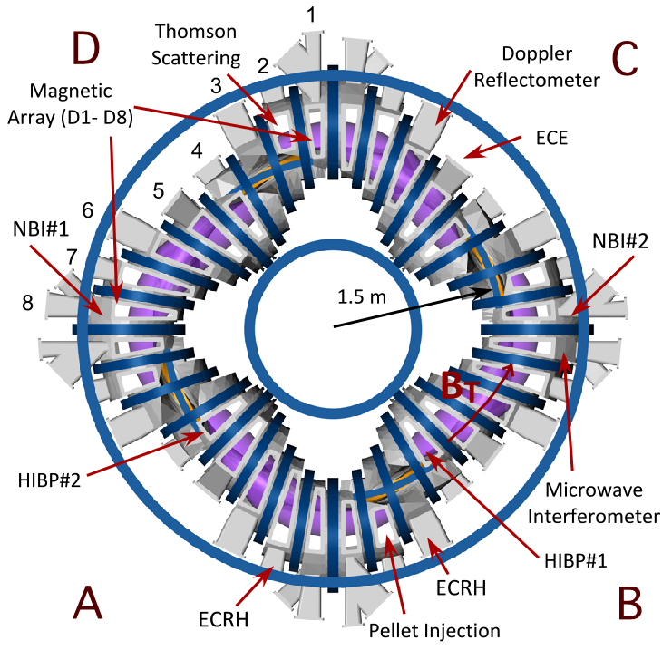
The TJ-II Stellarator
4-period flexible heliac-type stellarator
R = 1.5 m, a = 0.19 m,
V =~1 m³, t ≤300 ms, B₀ = 0.98 T.
i₀/2π = 1.2 to 2.2
~500 kW ECRH (53.2 GHz)
n_{e0} ≤1.7x10¹⁹ m⁻³
T_{e0} ≤1.5 keV
~1 MW of through-port NBI (30 keV)
n_{e0} ≤1.2x10²⁰ m⁻³
T_{e0} ≤ 400 eV
T_{i0} ≤ 200 eV
I. García-Cortés et al. 50th EPS Conference on Plasma Physics, Salamanca, Spain 8-12 July 2024

Slide 3
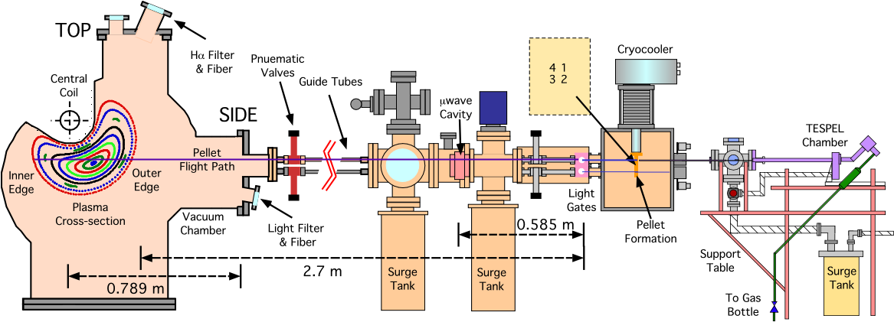
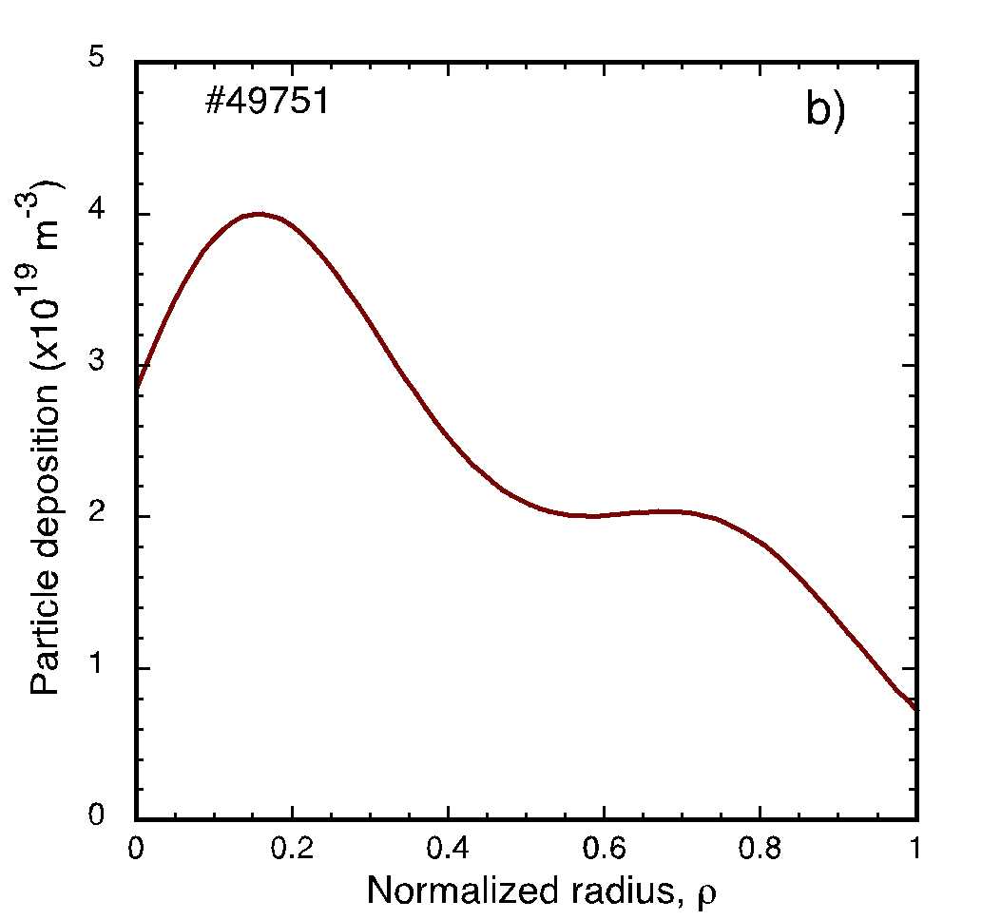
TJ-II Pellet Injector
4 H Pellets per shot.
Typical sizes:
2.4 x 10¹⁹ H
1.4 x 10¹⁹ H
0.8 x 10¹⁹ H
0.5 x 10¹⁹ H
HPI2
2.2×10¹⁹ H atoms
V_{p} = 710 m/s
<n_{e}> = 1.9x10¹⁹ m⁻³
S. K. Combs et al., Fusion Sci. Tech. 64 (2013) 513.
K. J. McCarthy et al, Proc. Sci (ECPD2015) 134.
N. Tamura et al., Rev. Sci. Instrum. 87 (2016) 11D619
K. J. McCarthy et al, EPL 120 (2017) 25001.
N. Panadero et al., Nucl. Fusion 58 (2018) 026025.
K. J. McCarthy et al, Nucl. Fusion 61 (2021) 076014.
I. García-Cortés et al. 50th EPS Conference on Plasma Physics, Salamanca, Spain 8-12 July 2024
Notes:
The pellet injector is a pipe-gun type injector that can provide up to 4 hydrogen pellets per discharge.These are delivered to the plasma outer edge through straight guide tubes that have in-line diagnostics for velocity and mass measurement. Two of the lines direct pellet through the magnetic axis while the nearest approach for the other guide tubes is at rho = 0.35. Pellet ablation is followed using Halfa filterscopes.
In NBI heated plasmas pellets can penetrate well beyond the magnetic axis. Since detaching plasmoids drift outwards and downwards, the pellet deposition profile is peaked near the centre, as shown here.
Pellets injection times are pre-programmed, thus we can adjust time delays between them as required.

Slide 4
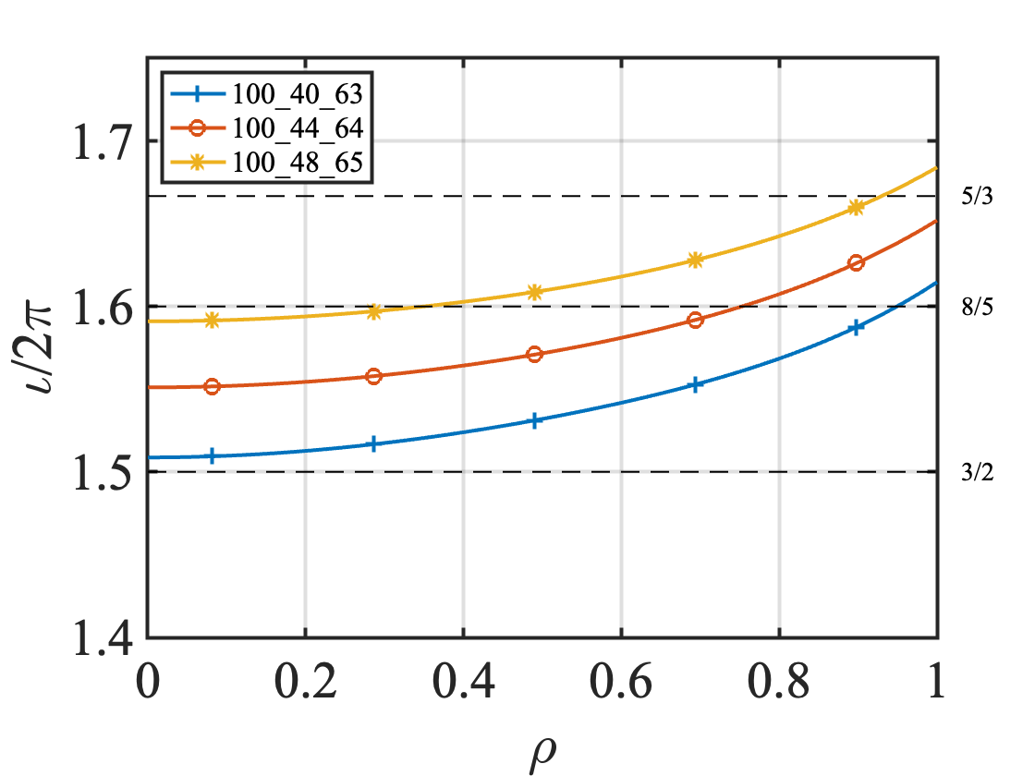
Extending operational regime of TJ-II plasmas
NBI PLASMAS
Heating power (400 - 900 kW, Co/CNTR)
Plasma wall conditioning (Boron plus lithium coating)
Mag. configuration 100_HX_65: 42,44,48
τ_{E} (ms)
τ_{E}^{ISS04} (ms)
τ_{E} = W_{dia} / (P_{abs} − dW_{dia}/dt)
τ_{E}^{ISS04}= 0.5 · (0.134 · a^{2.28} · R^{0.64} · P_{abs}^{−0.61} · <n_{e}>^{0.54} · B^{0.84} · ι_{2/3}^{0.41})
H. Yamada et al., Nucl. Fusion 45 (2005) 1684. Scaling Law ISS04
M. A. Ochando et al. 41EPS (2014) Norm. factor TJ-II (NBI) 0.5
I. García-Cortés et al., PoP 30 (2023) 072506.
K. J. McCarthy et al., Nucl. Fus. 64 (2024) 066019.
Notes:
On the left, black and purple data points are representative plasma confinement times when fuelling is by gas-puff or wall recycling. Red, blue and green points are for NBI plasmas with pellet injection. The selected plasmas have different heating powers, different magnetic configurations (3) and for boron-lithium wall conditions.
The main difference between points above, below or on the diagonal line is the type of plasma fuelling. In TJ-II core fuelling is a key parameter to enter this enhanced phase. This is achieved using pellet injection.

Slide 5
Extending operational regime of TJ-II plasmas
NBI PLASMAS
Heating power (400 - 900 kW, Co/CNTR)
Plasma wall conditioning (Boron plus lithium coating)
Mag. configuration 100_HX_65: 42,44,48
τ_{E} (ms)
PI: target density: (1 - 2) x10¹⁹ m⁻³
Pellet time sequence: Δt ⩬ τ_{E}
Deep core fuelling induces enhanced performance in NBI plasmas in TJ-II.
Best confinement observed to date.
τ_{E}^{ISS04} (ms)
τ_{E} = W_{dia} / (P_{abs} − dW_{dia}/dt)
τ_{E}^{ISS04}= 0.5 · (0.134 · a^{2.28} · R^{0.64} · P_{abs}^{−0.61} · <n_{e}>^{0.54} · B^{0.84} · ι_{2/3}^{0.41})
H. Yamada et al., Nucl. Fusion 45 (2005) 1684. Scaling Law ISS04
M. A. Ochando et al. 41EPS (2014) Norm. factor TJ-II (NBI) 0.5
I. García-Cortés et al., PoP 30 (2023) 072506.
K. J. McCarthy et al., Nucl. Fus. 64 (2024) 066019.
Notes:
On the left, black and purple data points are representative plasma confinement times when fuelling is by gas-puff or wall recycling. Red, blue and green points are for NBI plasmas with pellet injection. The selected plasmas have different heating powers, different magnetic configurations (3) and for boron-lithium wall conditions.
The main difference between points above, below or on the diagonal line is the type of plasma fuelling. In TJ-II core fuelling is a key parameter to enter this enhanced phase. This is achieved using pellet injection.

Slide 6
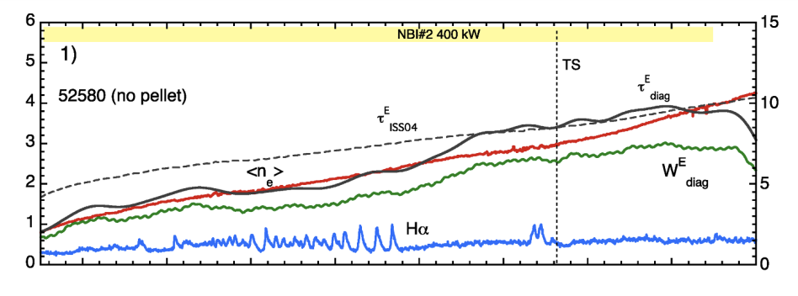
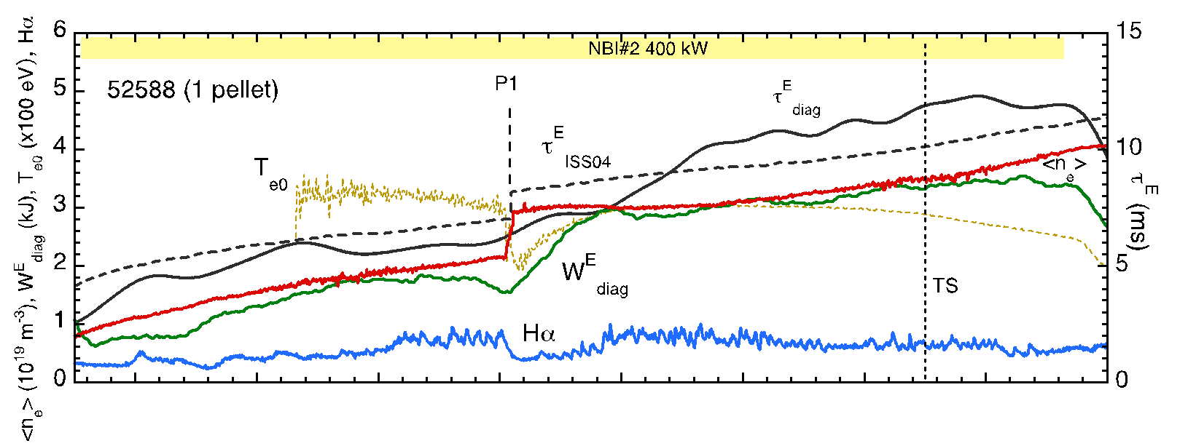
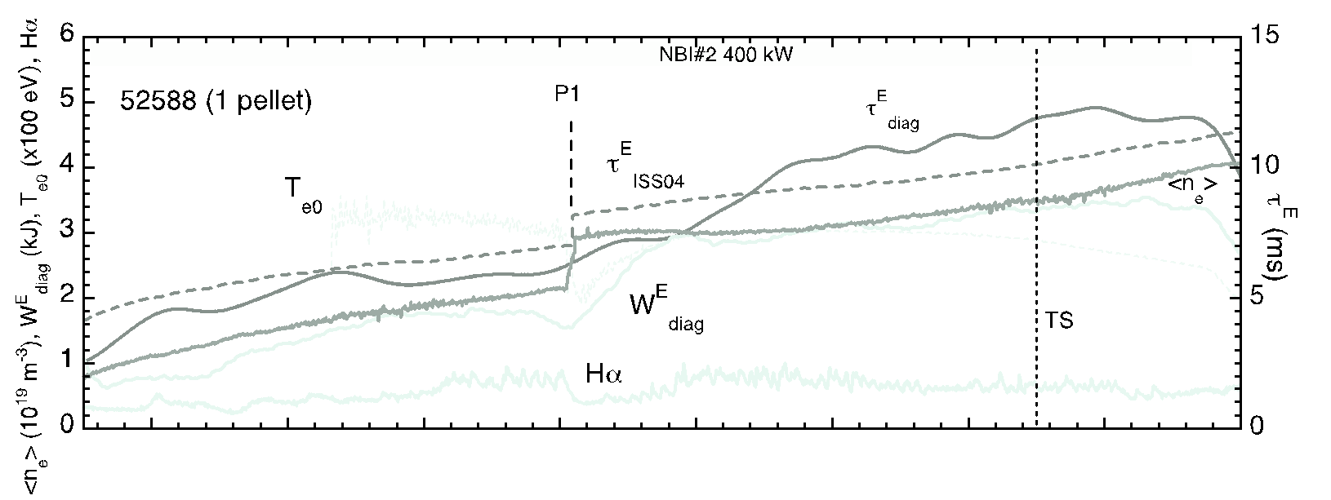
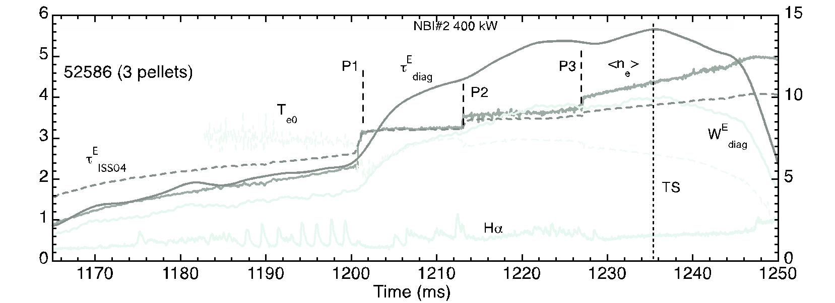
Multi-pellet injection into NBI-phase
NBI 400kW
τ_{E}^{ISS04}
τ_{E}
w/o PI
<n_{e}>
W_{dia}
w/ PI
w/3 PI
K. J. McCarthy, I. García-Cortés et al., Nucl. Fus. 64 (2024) 066019.

Slide 7
Multi-pellet injection into NBI-phase
τ_{E}
w/o PI
NBI 400kW
τ_{E}^{ISS04}
<n_{e}>
Pellet: 1.4x10¹⁹ H
Target density: 1.5 - 2x10¹⁹ m⁻³
W_{dia}
Injection of a single pellet (>10¹⁹ H) causes a Pellet-induced Enhanced Confinement (PiEC) phase.
Significant increase of W_{E} and τ_{E}
τ_{E}
w/ PI
τ_{E}^{ISS04}
W_{dia}
w/3 PI
K. J. McCarthy, I. García-Cortés et al., Nucl. Fus. 64 (2024) 066019.

Slide 8
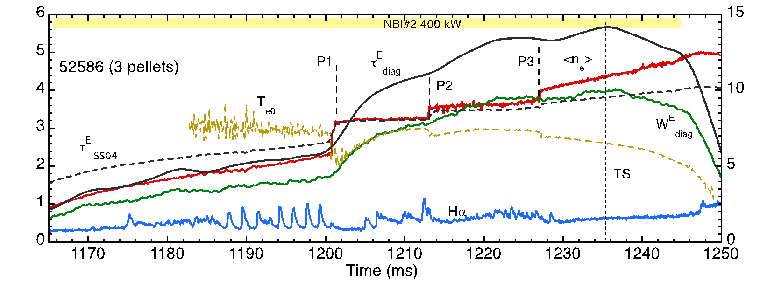
Multi-pellet injection into NBI-phase
NBI 400kW
τ_{E}
w/o PI
τ_{E}^{ISS04}
<n_{e}>
P1: 1.4x10¹⁹ H
P2: 0.5x10¹⁹ H
P3: 0.5x10¹⁹ H
PI: target density 1.5 - 2 x10¹⁹ m⁻³
Pellet time sequence Δt ⩬ τ_{E}
W_{dia}
τ_{E}
w/ PI
τ_{E}^{ISS04}
W_{dia}
Additional pellets further increase the stored energy and confinement quality f = τ_{E} / τ_{E}^{ISS04} > 1
τ_{E}^{ISS04}
τ_{E}
w/3 PI
K. J. McCarthy, I. García-Cortés et al., Nucl. Fus. 64 (2024) 066019.

Slide 9
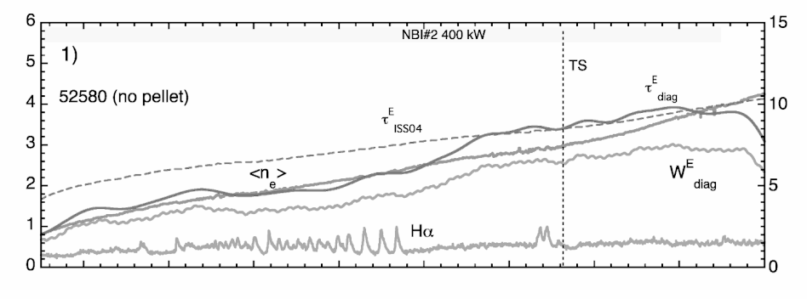
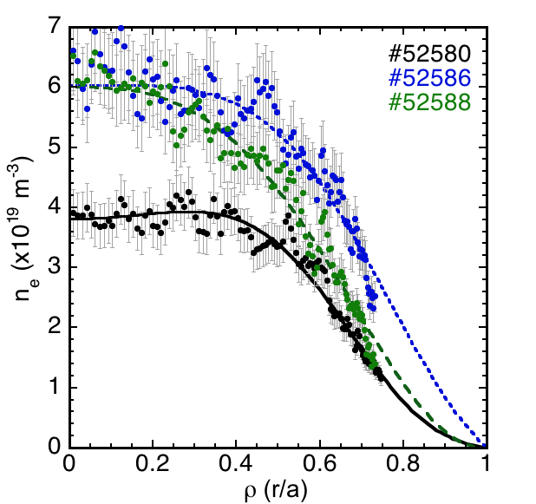
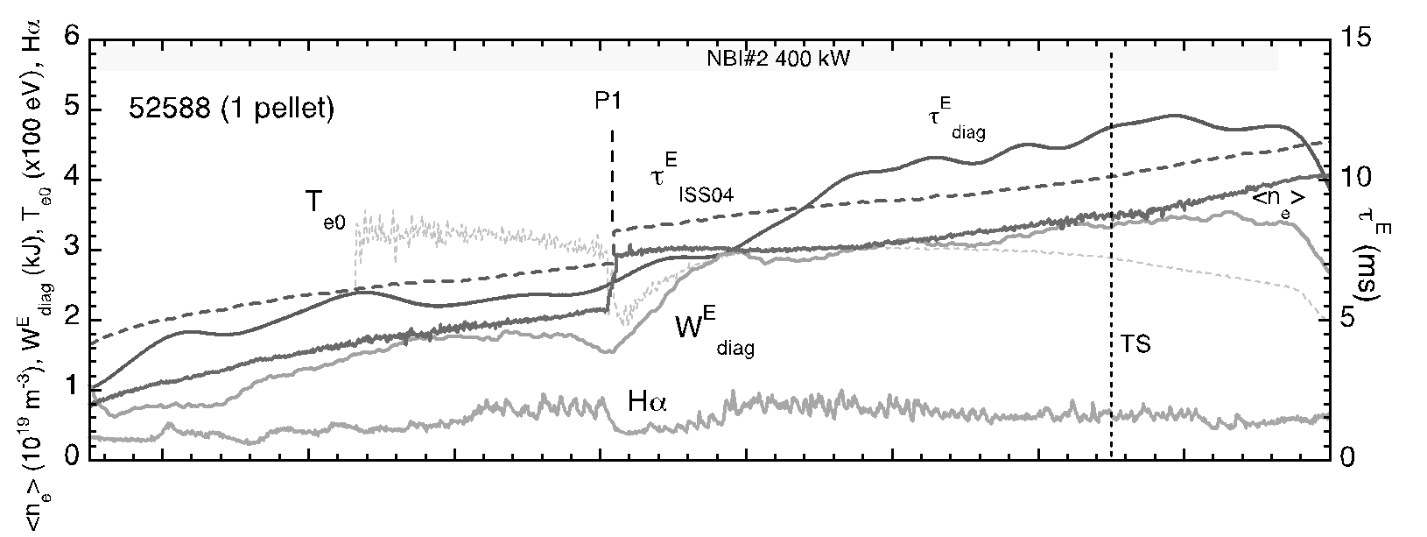
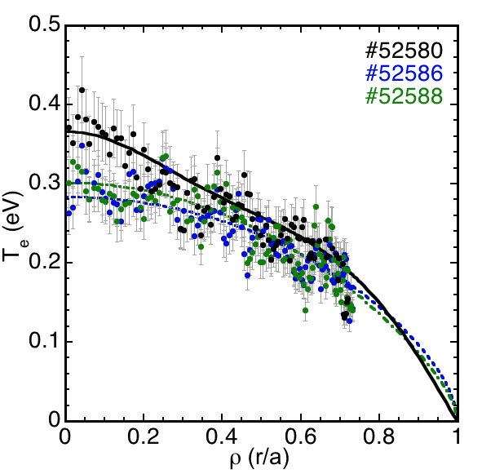
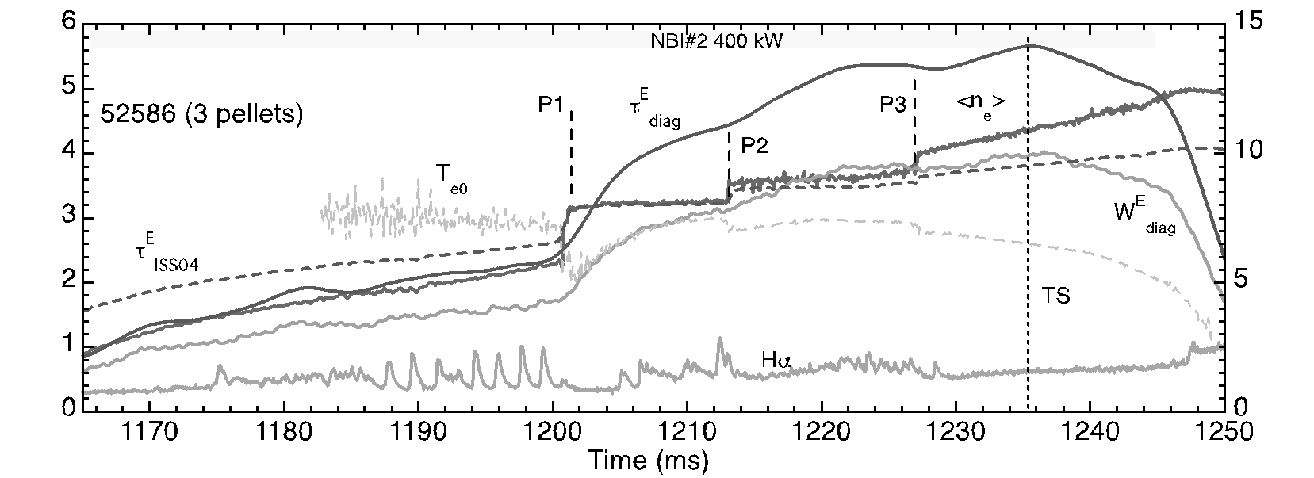
Multi-pellet injection into NBI-phase
electron density
NBI 400kW
τ_{E}
τ_{E}^{ISS04}
τ_{E}
τ_{E}^{ISS04}
Peaking n_{e0}/n_{e} ON/OFF
1.28 for #52580 (no PI)
1.72 for #52588 (1 PI)
1.4 for #52586 (3 PIs)
electron temperature
τ_{E}^{ISS04}
τ_{E}
Notes:
When we look at TS profile we see than single pellet increases the core density profile while additional small pellets broaden it. In contrast pellets have a minor effect on the T_{e} profile.

Slide 10
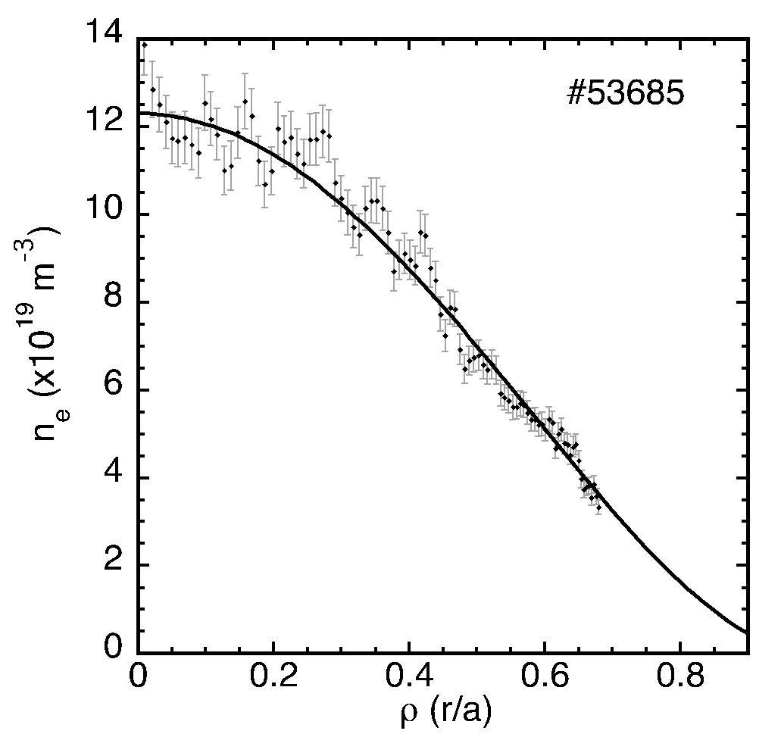
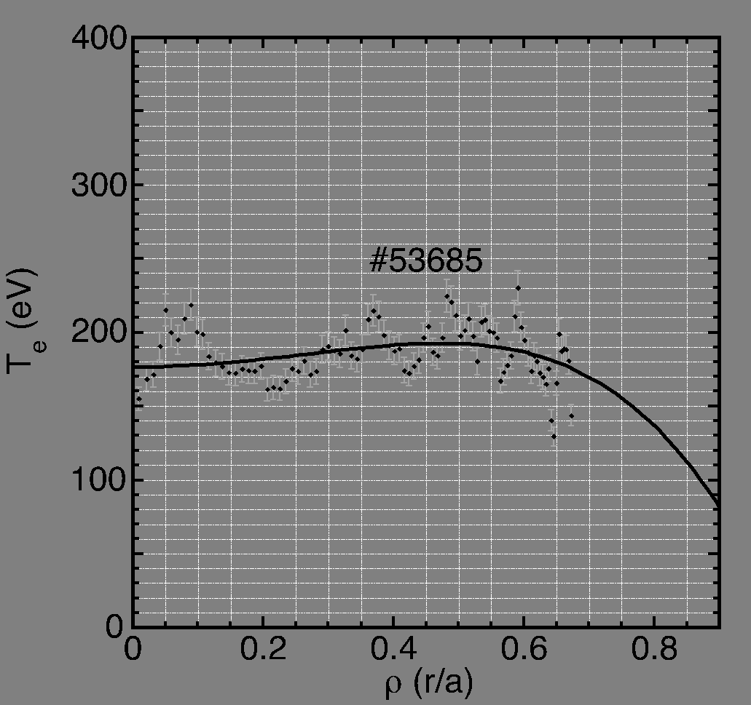
Highest TJ-II densities achieved by largest PI
NBI (480kW)
P1: 3.5x10¹⁹ H
P2: 1.7x10¹⁹ H
P3: 1.4x10¹⁹ H
PI: low target <ne> (10¹⁹ m⁻³)
Three large pellets induce a very high density peaking factor, n_{e}(0)/<n_{e}> = 2
By controlling pellet settings and plasma target conditions is possible to shape density profiles and achieve record values
I. García-Cortés et al. 50th EPS Conference on Plasma Physics, Salamanca, Spain 8-12 July 2024

Slide 11
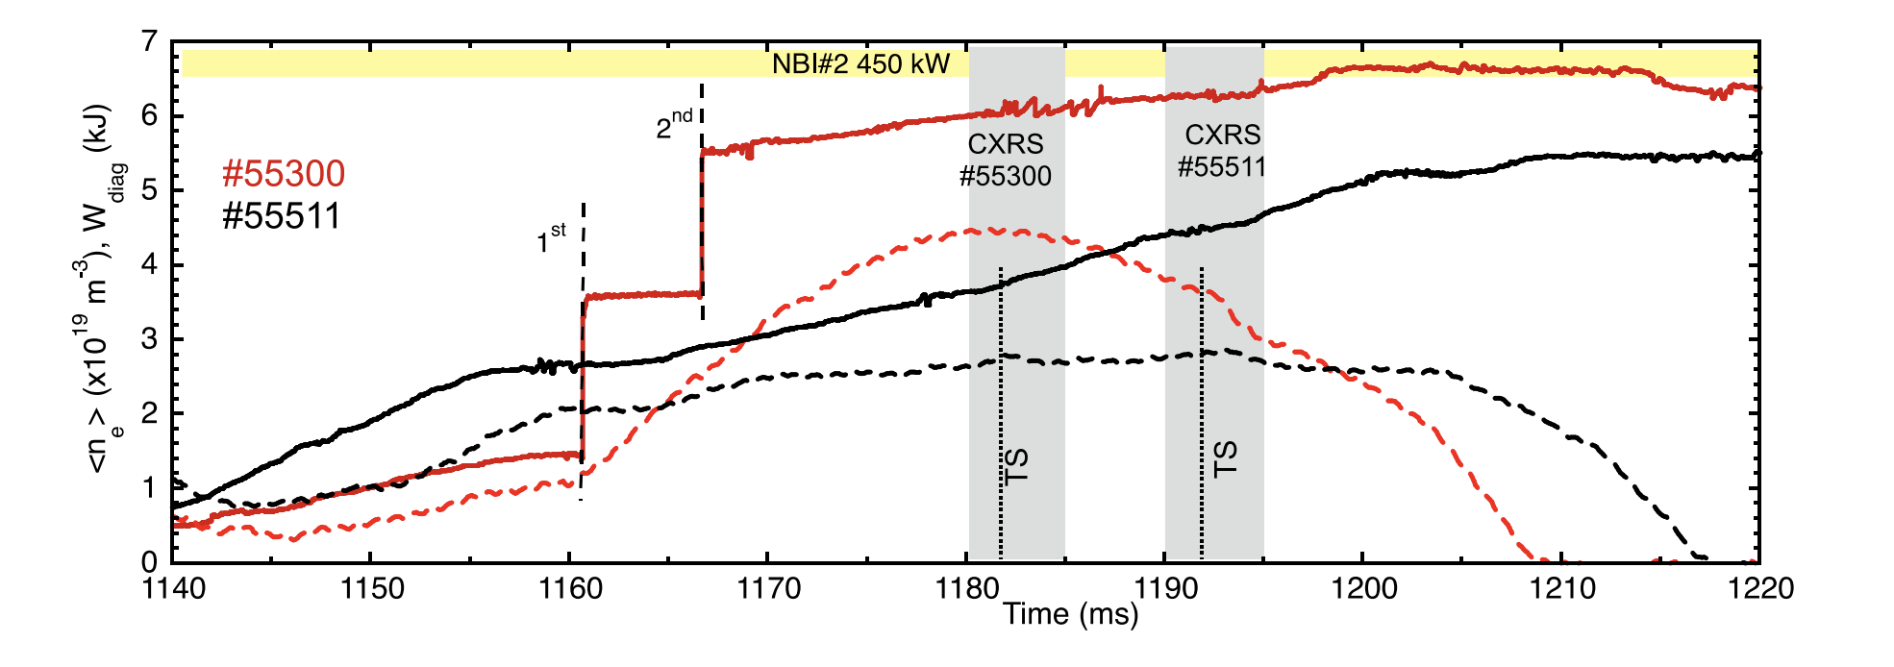
Density and temperature profiles (TS, CXRS)
<n_{e}>
NBI (450kW)
PI: low target density (10¹⁹ m⁻³)
2 large pellets
P1: 2.0x10¹⁹ H particles
P2: 1.4x10¹⁹ H particles
W_{dia}
density (TS)
electron temp. (TS)
ion temp. (CXRS)
PiEC: T_{e} is similar for reference and PI plasmas, n_{e} & T_{i} show clear rises after PI.
Better coupling between thermal electrons and ions
Significant ion contribution to plasma energy during PiEC
I. García-Cortés et al. 50th EPS Conference on Plasma Physics, Salamanca, Spain 8-12 July 2024

Slide 12
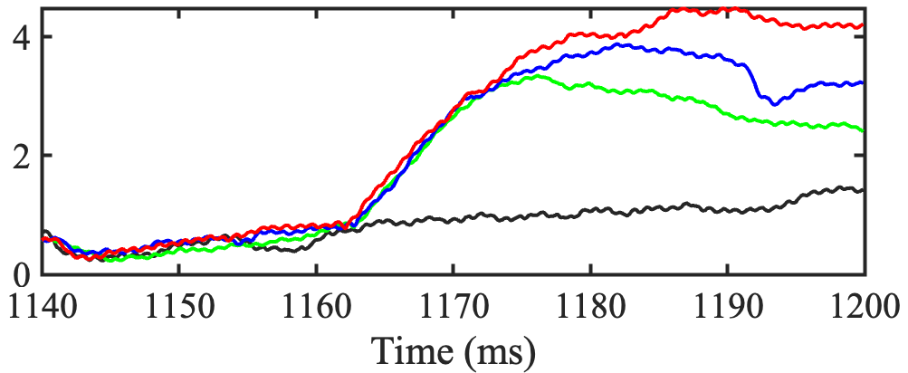
Effect of pellets on E_{r} shear
100_48_65
E_{r} gradient is measured at 2 DR channels: rho = 0.8, and rho = 0.7.
E_{r} shear (dE_{r} / dr) at rho= 0.75 increases after each PI.
The maximum lasts about 10 ms before tending towards the reference level after 20 - 30 ms
Multi-pellets keep this E_{r} shear at maximum level, this being coincident with longer energy confinement times.
In these experiments, there exists a clear relationship between observed improvement and the evolution of E_{r} shear.
dE_{r}/dr (kV/m²)
#53666 REF
#53662 1PI
#53664 2PI
#53665 3PI
#53666 REF
#53662 1 PI
#53664 2PI
#53665 3PI
W_{dia} (kJ)
I. García-Cortés et al. 50th EPS Conference on Plasma Physics, Salamanca, Spain 8-12 July 2024

Slide 13
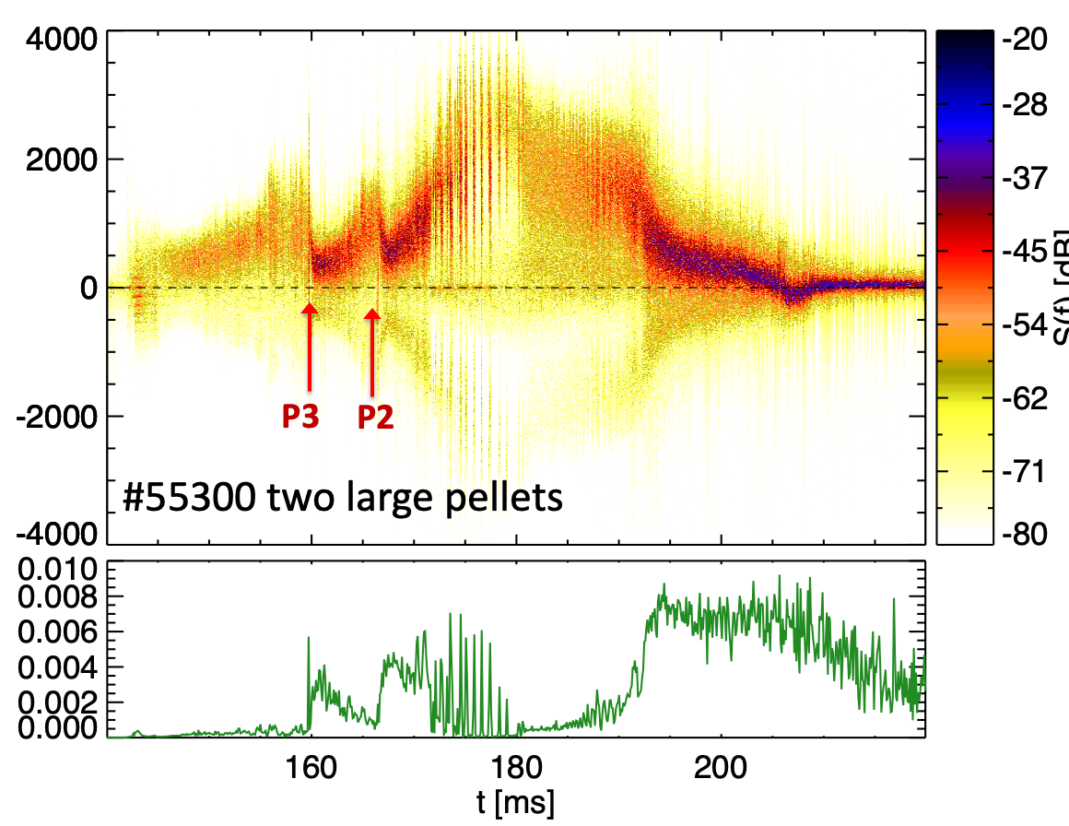
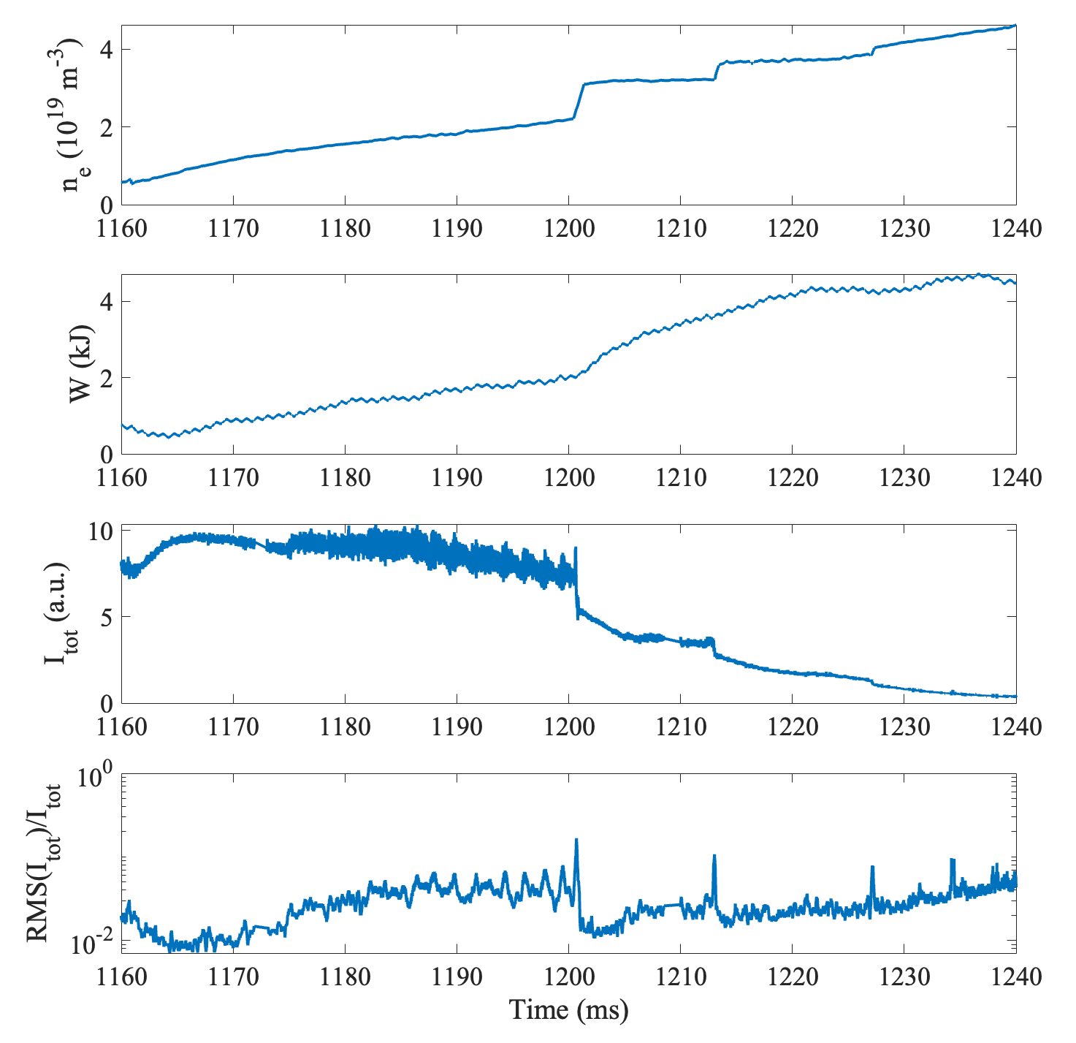
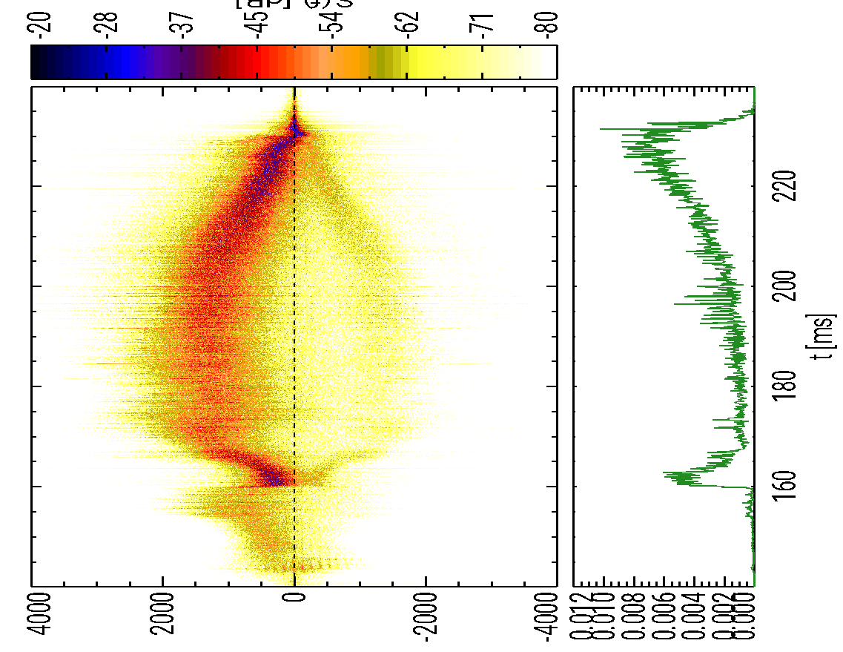
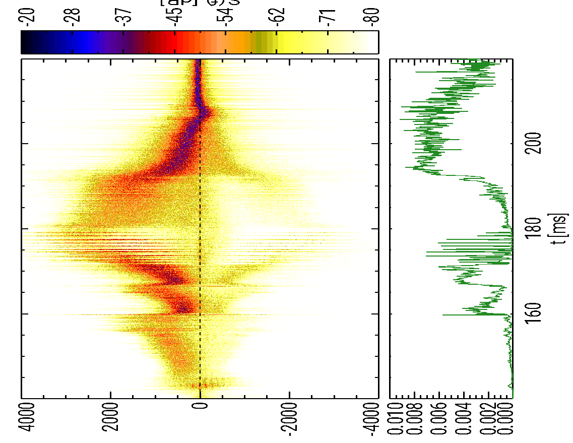
Effect of pellets on plasma turbulence
DR (ρ = 0.85)
HIBP (ρ = 0.5)
More negative E_{r} after PIs in gradient region.
Maximum energy when minimum turbulence.
∼
Repeated suppression of turbulence after PI
ñ and φ
PiEC
PiEC
PiEC
P2
P2
P2

Slide 14
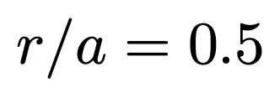
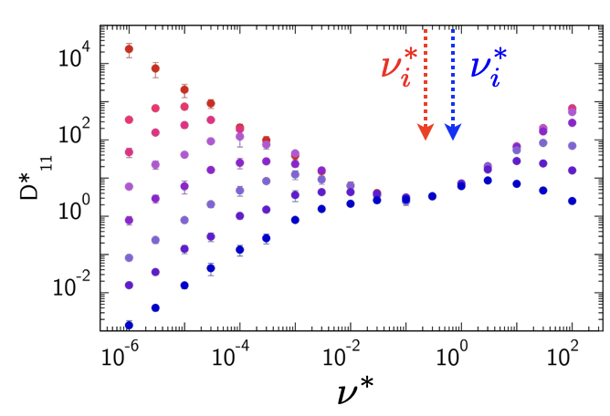
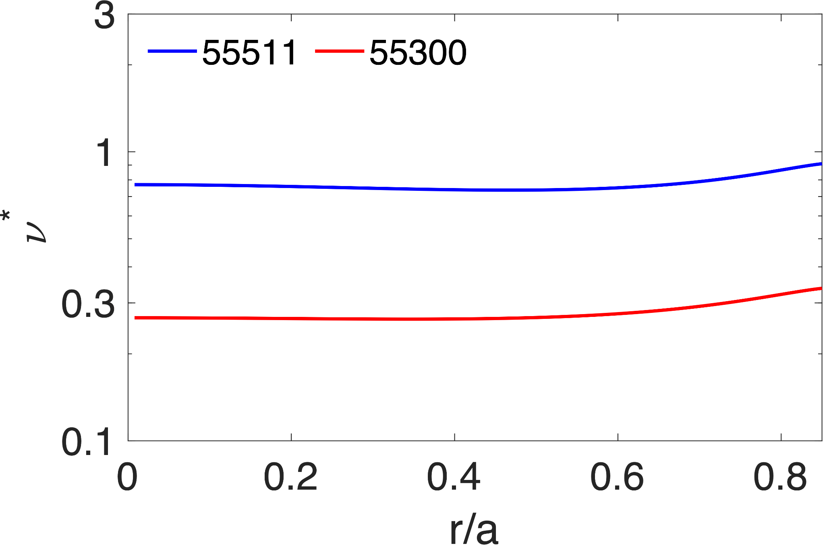
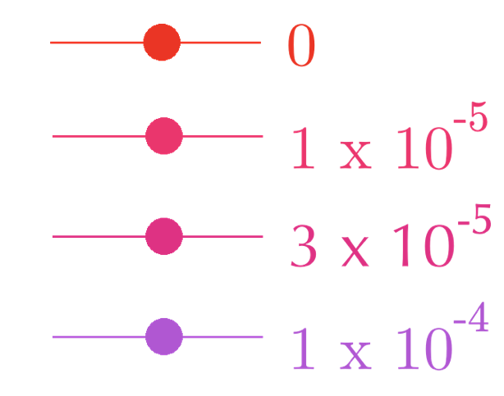
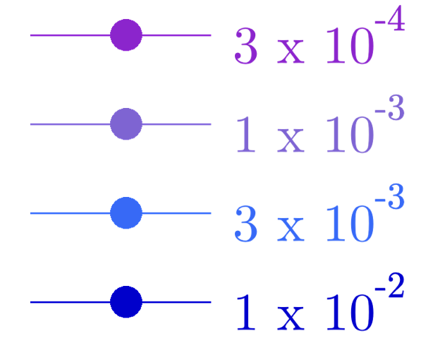
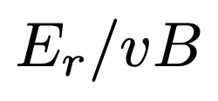
Simulations
NC simulations indicate that from #55511 to #55300 there is a reduction of collisionality and an change from the Pfirsch-Schlüter to the Plateau regime.
Integrated NC heat fluxes of 55 kW for #55511 (no PI) and 122 kW for #55300 (1 PI) represent a small fraction of the 350 kW NBI power. Turbulence may play a role in PiEC.
V. Tribaldos et al. P3-071, Thursday 11th July
Role of magnetic configuration is studied by
Resistive interchange MHD code.
MHD activity associated with edge rational surface (here: 5/3) could facilitate the formation of zonal flows / transport barriers in the gradient region.
L. García et al. P3-074, Thursday 11th July

Slide 15
Summary
Best TJ-II performance has been achieved after pellet injection(s) (>10¹⁹ H) into its NBI-heated phase (PiEC). W_{E}^{diag} and τ_{E} increase after PI, τ_{E} / τ_{E}^{ISS04} >> 1
PiEC is characterized by increased n_{e}(ρ) & T_{i}(ρ) but similar T_{e}(ρ) and by a more negative density gradient around ρ = 0.6.
A Bifurcation is observed in performance trajectory. Interesting for intermachine comparison.
Shaping density gradient by tailoring pellet settings and plasma target conditions.
Density and ϕ fluctuations reduced by PI.
Multi-pellets keep the E_{r} shear at maximum level, near the gradient region.
NC simulations agree qualitatively, but not quantitatively, with experimental results.
The mechanisms that lead to PiEC require further study – turbulence.
I. García-Cortés et al. 50th EPS Conference on Plasma Physics, Salamanca, Spain 8-12 July 2024

Slide 16
Backup slides
I. García-Cortés 50th EPS Conference on Plasma Physics, Salamanca, Spain 8-12 July 2024

Slide 17
Summary of reference and pellet-injection plasmas
Discharge | n_{e0} (x10¹⁹ m⁻³) | T_{e0} (eV) | T_{i0} (eV) | W^{E}_{max} (kJ) | τ^{E}_{diag} (ms) | τ_{ISS04} (ms) | τ^{E} / τ_{ISS04} | β_{norm}* (%) | β₀* (%)
55300⁺⁺ | 9.0 | 285 | 185 | 4.4 | 13.9 | 12.4 | 1.12 | 0.94 | 1.88
55313⁺ | 6.2 | 325 | 160 | 3.8 | 11.8 | 10.7 | 1.11 | 0.68 | 1.4
55511 | 5.8 | 325 | 15 | 3.0 | 8.5 | 10 | 0.85 | 0.54 | 1.12
55308 | 3.2 | 300 | 130 | 2.0 | 9.0 | 9.8 | 0.92 | 0.32 | 0.6
β^{Sudo}(%) = 0.55 P_{abs}^{0.77} B^{−0.82} a^{−0.69} R^{−0.6} = ∼0.56% [S. Sudo]
Predicted β_{norm}(%) for 100_44_64 is 3% [A. Varias]
+ = 1 PI, ++ = 2 PIs, * = at W^{E}_{max}
450 kW through-port counter NBI power
S. Sudo et al., Nucl. Fusion 30 (1990) 11.
A. Varias et al., Nucl. Fusion 30 (1990) 2597.

Slide 18
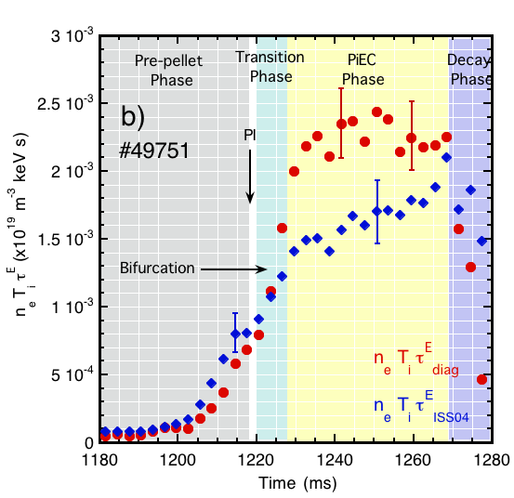
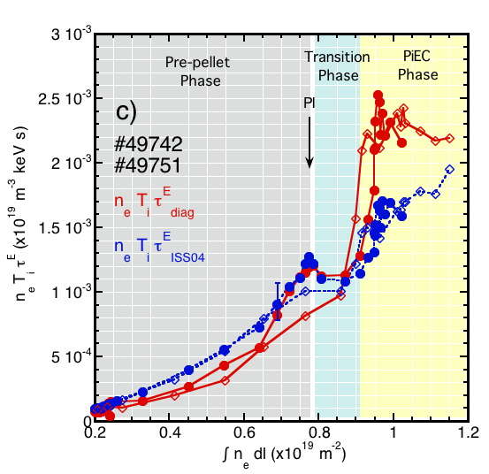
Pellet fuelling enhances the triple product
n_{e} · T_{i} · τ^{Ε} (x 10¹⁹ m⁻³ keV s)
n_{e} · T_{i} · τ^{Ε} (x 10¹⁹ m⁻³ keV s)
Clear bifurcation in triple product, n_{e} · T_{i} · τ^{Ε}, towards an improved confinement branch when compared to branch product predicted by ISS04 scaling law.
Transition phase (5-10 ms) previous to PiEC phase
I. García-Cortés, K. McCarthy et al., PoP 30 (2023) 072506.

Slide 19
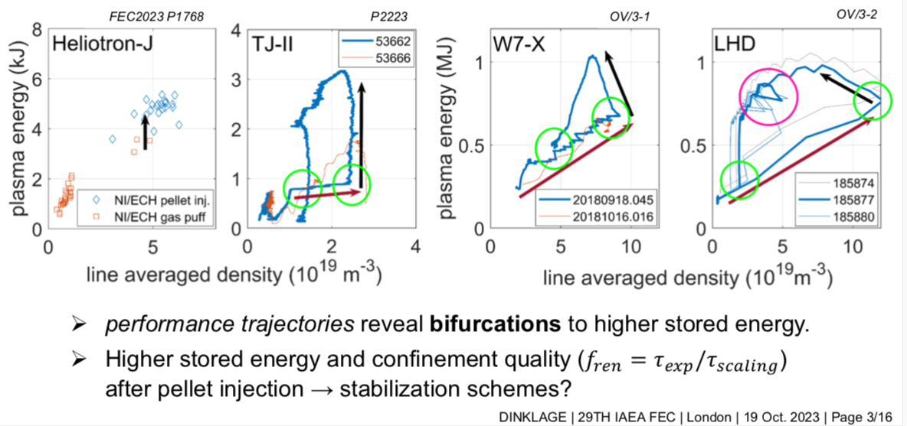
Inter-machine performance comparison
A. Dinklage et al., to be sent to NF (2024).

