Slide 1
Linear devices capabilities for boronisation studies
Joint WP TE and WP PWIE Technical Meeting on Plasma Wall Interactions in full W devices
Andrei Goriaev
LPP-ERM/KMS
A. Houben, A. Adriaens, O. Marchuk, M. Rasiński, M. Sackers

Slide 2
Outline
Linear plasma device - PSI-2
  Technical capabilities
Toroidal magnetized system – TOMAS
  Technical capabilities
FZJ facilities and expertise for boronization studies
First PSI-2 experiments on boron layer erosion from W samples
  FIB/SEM analysis
  Spectroscopy data
Preparation of TOMAS exposure experiments for first boron-coated W
  Sample preparation
  Plasma analysis
Further steps
  PSI-2
  TOMAS

Slide 3
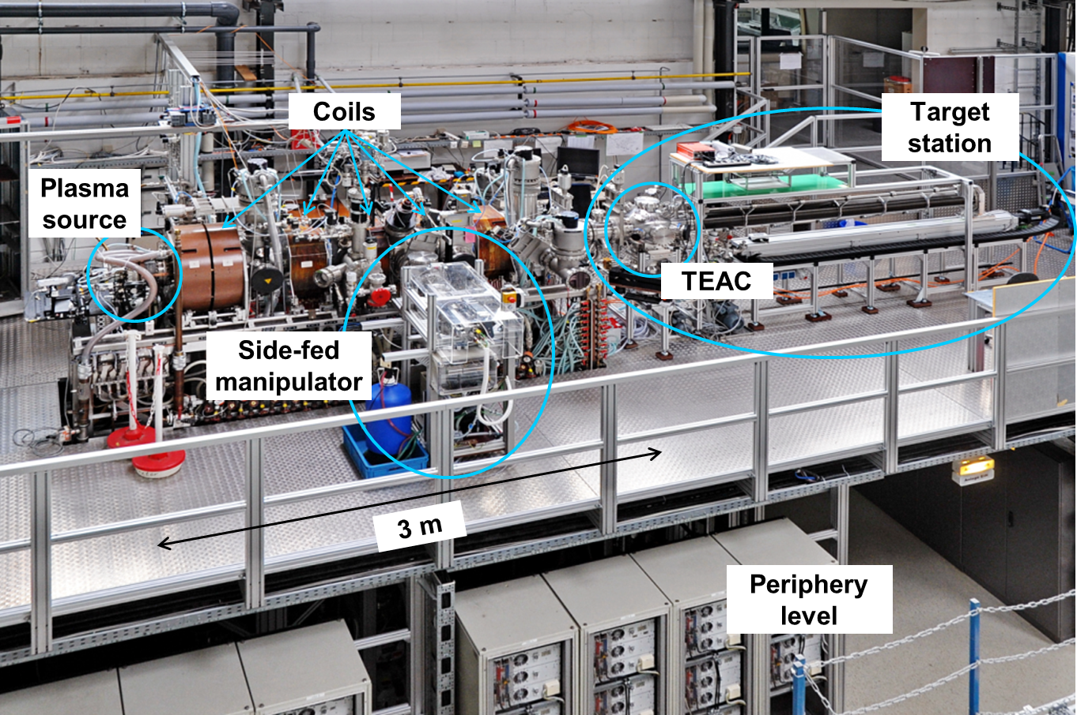
Linear plasma device PSI-2
Facility is operated by FZJ
Facility description:
High current, low pressure, steady-state arc source, flexible target exchange and analysis chamber, sophisticated sample holder, in-situ analysis of erosion and fuel retention (QMB, LID-QMS and LIBS)
A non-nuclear reference for JULE-PSI (operated in the High temperature materials lab)

Slide 4
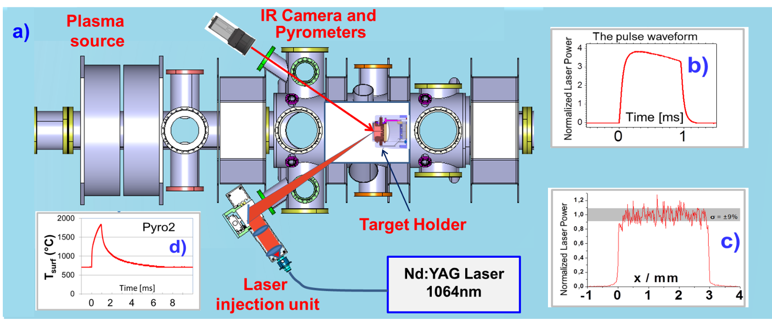
PSI-2: technical capabilities
Parameter | PSI-2 | ITER divertor
Electron temperature | 1 - 20 eV | ~1 - 10 eV
El. density | ~10¹⁶ - 10¹⁸ m⁻³ | ~10²⁰ - 10²¹ m⁻³
Particle flux | ~10²⁰ - 10²² m⁻²s⁻¹ | ~10²⁴ - 10²⁵ m⁻²s⁻¹
Particle fluence | up to ~10²⁶ m⁻² per exposure | ~10²⁶ - 10²⁷ m⁻² per pulse (400 s)
Incident ion energy | ~10 - 300 eV (negative bias) | ~10 eV
Wall (sample) temperature | 300 - 1800 K | 500 - 1500 K
Impurities | W, He, Ar, Ne, N | Be, W, He, Ar, Ne, N
Laser based pulsed heat load system
Transients (ELMs, disruptions) can be simulated by laser irradiation
Fluence per experiment is ~10x – 100x higher than in pulsed tokamaks
Exposure parameters can be pre-selected to simulate particular ITER conditions
ELM-like heat pulse
Nd:YAG laser wavelength 1064 nm
laser energy 32 J
absorbed power density: 0.38 GW/m²
pulse duration: 0.5 ms (f = 10 Hz)

Slide 5
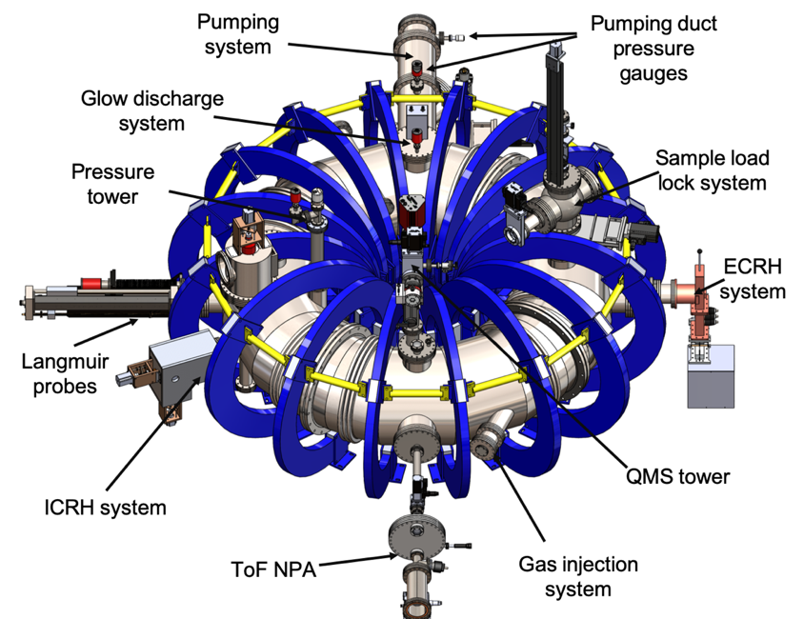
Toroidal magnetic field plasma device - TOMAS
Facility is operated by LPP-ERM/KMS and FZJ
Facility description:
Low pressure, steady-state GD and MW sources and pulsed RF source, flexible target exchange and analysis chamber, sophisticated sample holder
Plasma characterization with Langmuir probes, ToF NPA, RFEA, QMS, MW interferometry, NIR/VIS/UV spectrometer, fast camera
complementary research on wall conditioning methods, plasma production and plasma–surface interaction studies
Parameter | Value
Volume | 1.1 m³
Major Radius | 0.78 m
Field on axis | 125 mT
Minor Radius | 0.26 m
RF frequency | 10–50 MHz
RF power | up to 6.0 kW
EC frequency | 2.45 GHz
EC power | 0.6–6.0 kW
GD power | 9 kW

Slide 6
TOMAS: technical capabilities
Parameter | TOMAS (GD) | TOMAS (EC) | TOMAS (IC)
Electron temperature | ~ 1 – 10 eV | ~ 1 – 40 eV | ~ 10 – 70 eV
El. density | ~10¹³ – 10¹⁴ m⁻³ | ~10¹⁶ – 10¹⁷ m⁻³ | ~10¹⁵ – 10¹⁶ m⁻³
Average neutral particle energy | – | ~ 5 – 15 eV | ~ 10 – 150 eV
Neutral Particle flux | – | ~10¹⁵ – 10¹⁶ m⁻²s⁻¹ | ~10¹⁶ – 10¹⁷ m⁻²s⁻¹
Ion flux density | ~10⁻² – 10⁻¹ Am⁻² | ~10⁻¹ – 10⁰ Am⁻² | ~10⁻¹ – 10⁰ Am⁻²
Incident ion energy | ~10 – 300 eV | ~1 – 5 eV | ~1 – 15 eV
Wall (sample) temperature | 300 – 850* K | 300 – 850* K | 300 – 850* K
Impurities | Ar, N, C, Cu | Ar, N, C, Cu | Ar, N, C, Cu
VD — video diagnostics, PD — photodetector, OES — optical emission spectroscopy, MW — microwave system for ECWC, RFEA — residual field energy analyzer, QMS — quadrupole mass spectrometer, ToF NPA — time-of flight neutral particle analyzer, VG — vacuum gauges, RF — radio frequency system for ICWC, TP — triple probe, SP — single probe, GD — glow discharge system for GDC
The sample load-lock system allows for
Local measurements of ion energy spectra
Material sample exposure as PFC and inside plasma
* Active heating

Slide 7
“Synergy ” of FZJ devices, tools and diagnostics for boronization studies
FZJ has all the necessary facilities and competencies to tackle a wide range of boronization studies
Sample preparation (1x1 cm²) (see talk by A. Hakola)
  Manufacturing, polishing, annealing
  Boron coating by physical vapor deposition (PVD) using RF magnetron sputter device
  Deuterium insertion close to substrate during deposition process
Sample pre-characterization and post-mortem analysis
  Boron layer characterization (crystal phase, microstructure, thickness and elemental composition)
  -> XRD, FIB/SEM, EDX
  Deuterium content -> NRA, TDS
Sample exposure to ITER – relevant plasmas
  PSI-2
    Transient ion flux and fluence plasmas for erosion and isotope exchange studies
    ELM, disruptions influence on boron coated PFCs
  TOMAS
    ICWC and GDC wall conditioning plasmas
    Simulation of fuel removal and boron layer erosion by charge-exchange neutrals
Modelling support (see talk by D. Matveev)

Slide 8
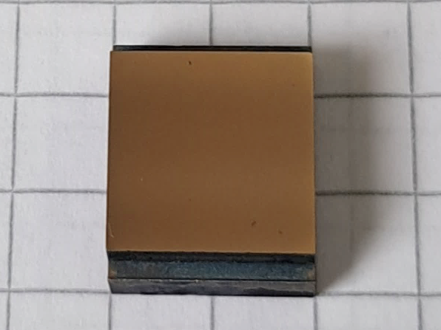
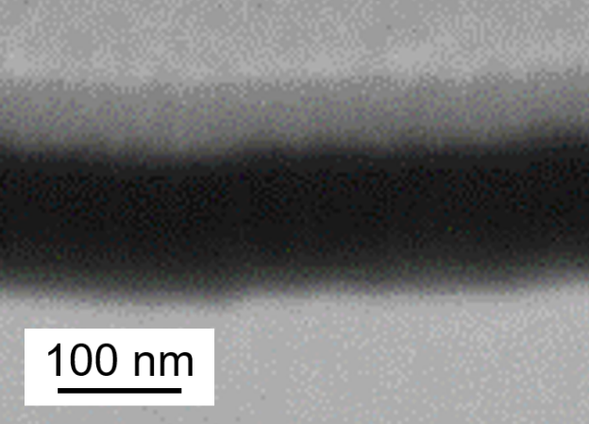
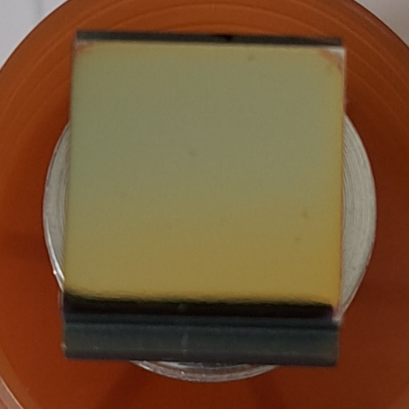
Deuterium plasma exposure of B layers at PSI-2
Boron layer fabrication: Magnetron sputter deposition at FZ Jülich
RF-mode with pure boron target and Ar plasma, ~ 6 h deposition -> ~115 nm thickness on polished and annealed W PSI-2 substrates -> Fig. 1 (more details about characterization see talk by A. Hakola)
Deuterium plasma exposure at PSI-2 for B erosion studies:
Deuterium plasma: ion energy: ~40 eV; density: 4e21 m⁻²s⁻¹
Simultaneous imaging spectroscopy for boron, calibrated
Non-cooled PSI- sample holder with Mo mask (Fig. 2)
Two exposures: identical plasma conditions, identical samples, different exposure times: a) 70 s, b) ~26 min
Comparison: B erosion time from FIB/SEM analysis and spectrometer data:
Case a) 70 s: first try to see B by spectrometer: visible remains of boron layer, PSI-2 profile visible (Fig. 3) -> FIB/SEM studies
Case b) ~26 min: no remains of boron layer, detailed imaging spectrometer signal data -> Analysis of spectrometer data
Estimation of B layer erosion time possible!
Fig. 1
Fig. 2 W with B
Other 7 sample:
W dummy
Fig. 3
SEM (FIB)
Pt
B
W
A. Houben, O. Marchuck, M. Rasiński, M. Sackers
2024-09-17
8

Slide 9
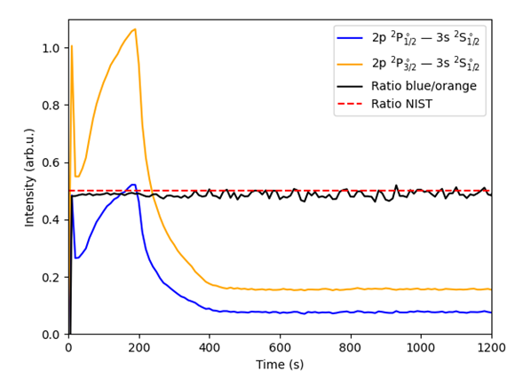
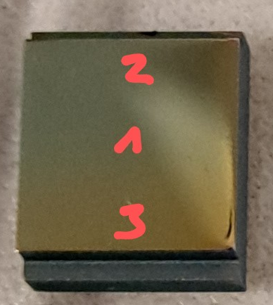
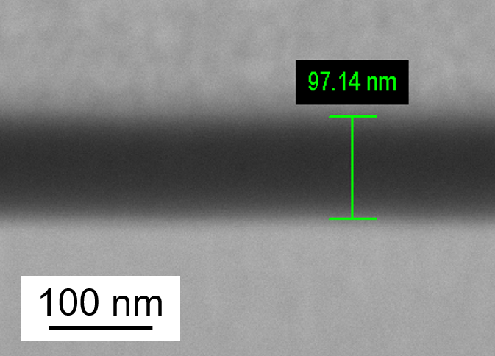
Deuterium plasma exposure of B layers at PSI-2
Comparison: B erosion time from FIB/SEM analysis and spectrometer data:
Case a) 70 s plasma exposure
Measurement of the remained B layer thickness at three different positions by FIB/SEM:
higher erosion
lower erosion
Higher erosion region: Pos. 2: ~85 nm B -> erosion rate: ~0.43 nm/s
Lower erosion region: Pos. 1 and 3: ~97 nm B -> erosion rate: ~0.26 nm/s
Case b) ~26 min plasma exposure
B I line intensity versus exposure time:
Interpretation: 3 zones:
1) up to 200 s:
high erosion zone
2) 200 s to 400 s:
low erosion zone
3) from 400 s:
background signal
Higher erosion: zone 1 -> erosion rate: ~0.575 nm/s
Low erosion: zone 2 -> erosion rate: ~0.29 nm/s
SEM (FIB)
@ Pos. 3
Please note: Preliminary results, further analysis and estimation of error bars is ongoing!
Outlook: other ion energies / temperatures at PSI-2, similar experiments at TOMAS
Very good agreement of erosion rate between the values obtained by FIB/SEM and spectroscopy!
+ It is possible to observe the boron (erosion) by spectroscopy!
A. Houben, O. Marchuck, M. Rasiński, M. Sackers

Slide 10
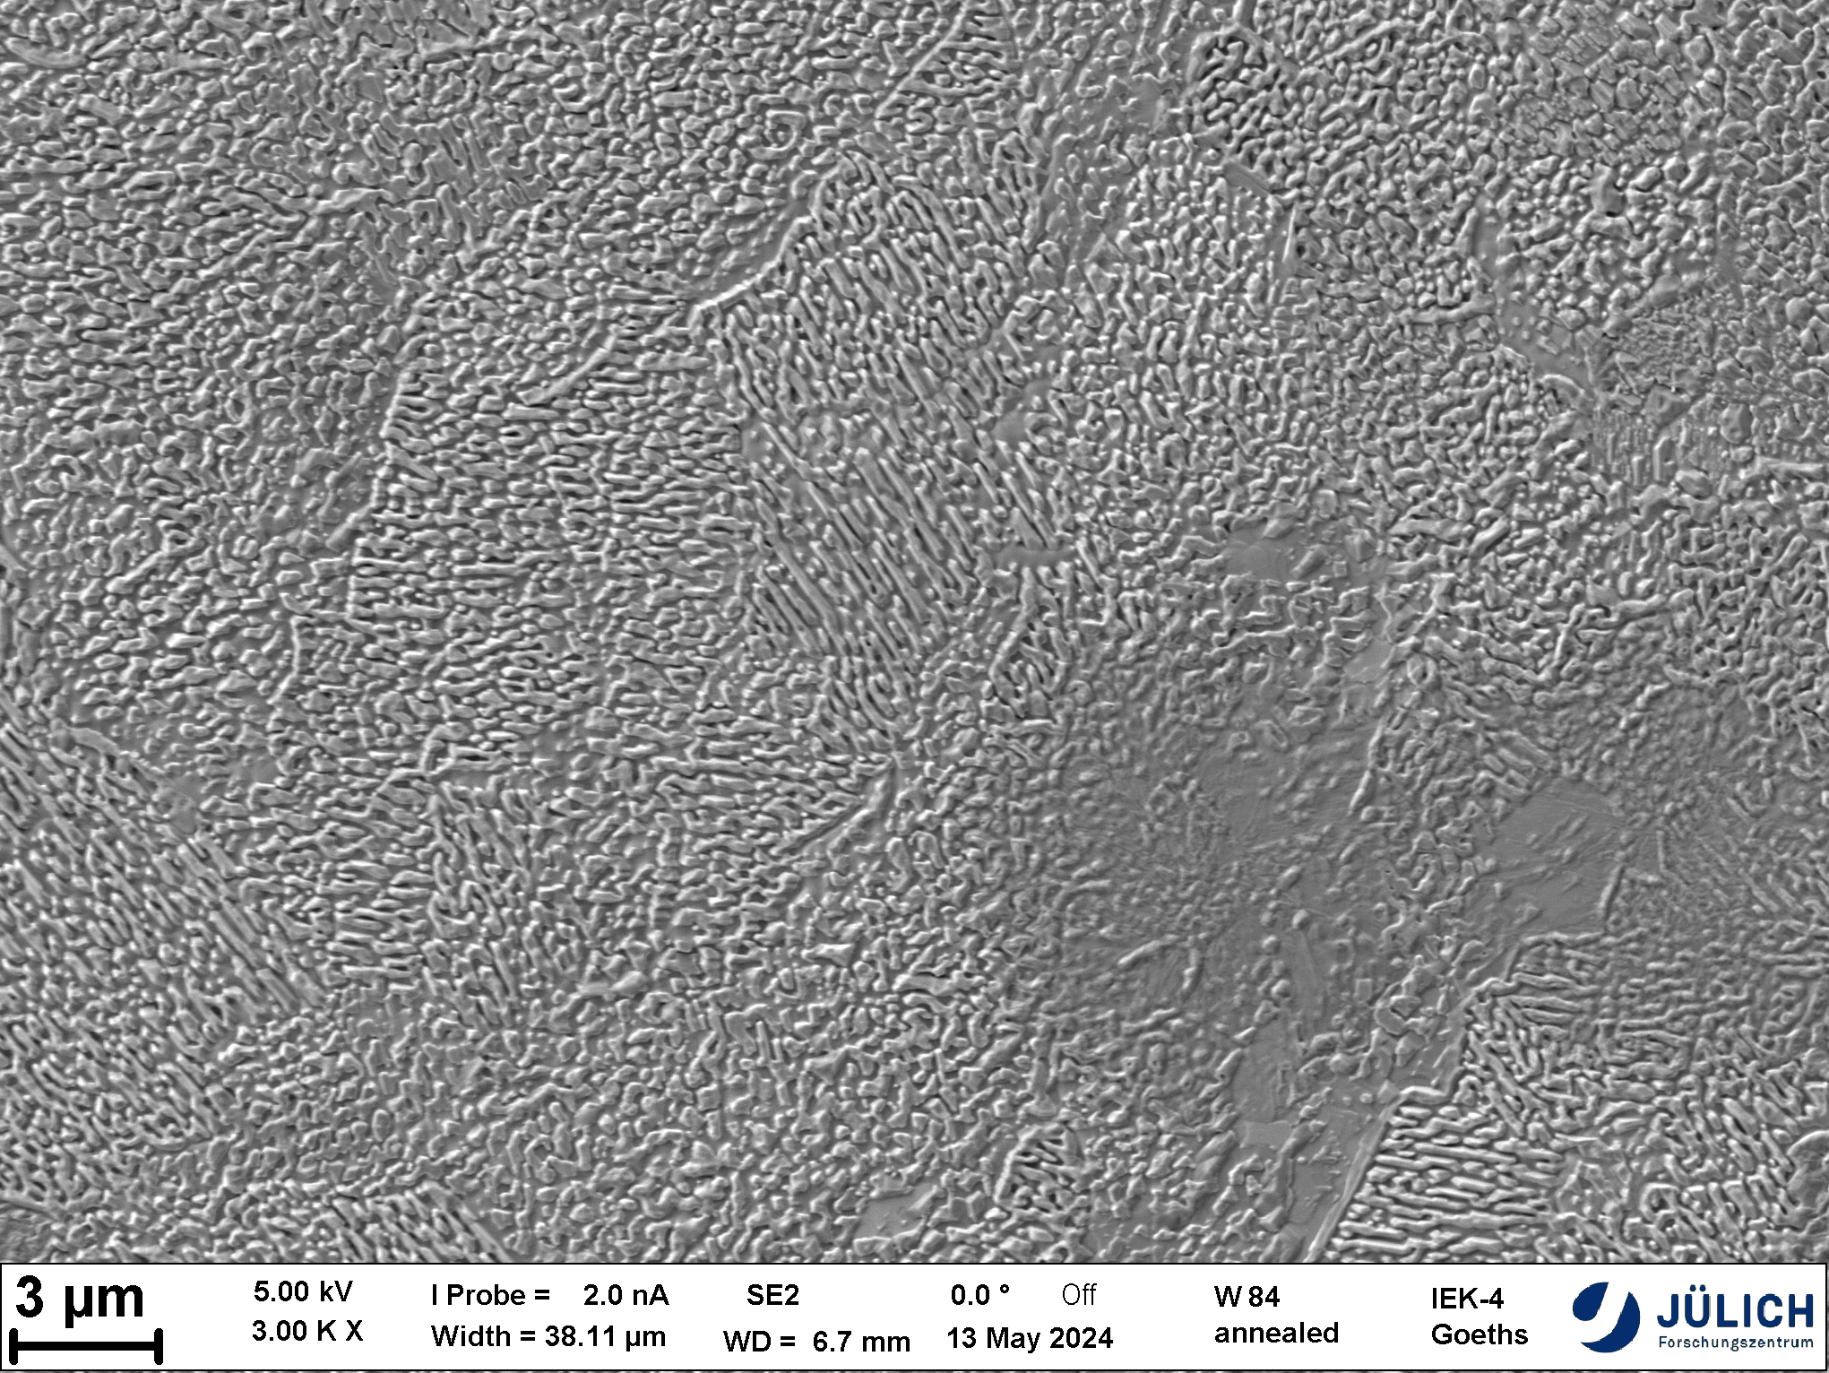
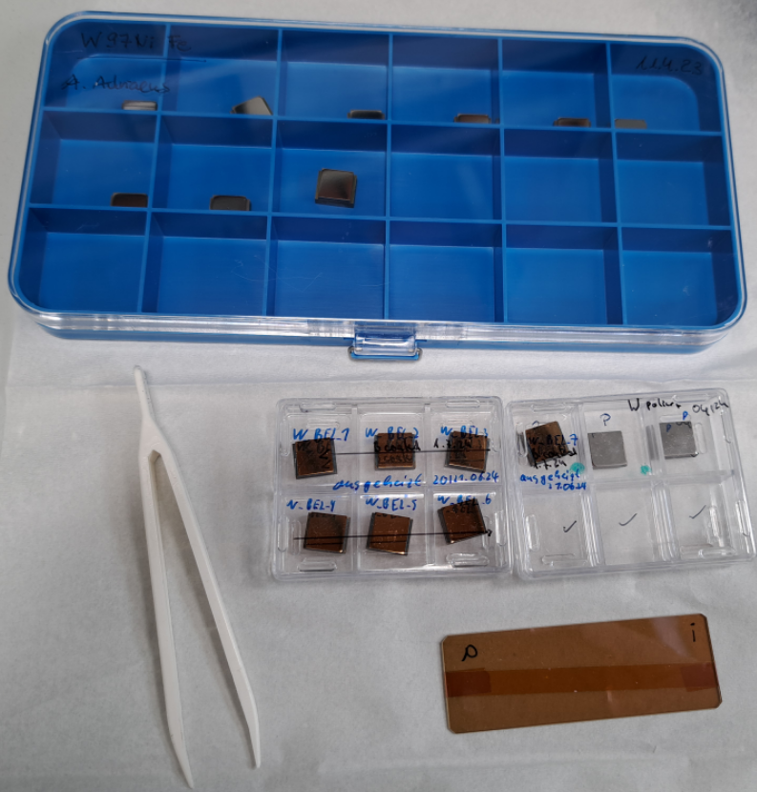
TOMAS contribution to W7-X boronization studies
ICWC operation at future W actively cooled divertor
Samples preparation and analysis
Samples (9 of each species provided by W7-X team) -> polished
Pure W
  annealed
  issues with surface roughness - > replaced by FZJ samples (only 7)
  coated ~ 100 nm (similar to previous case)
W95Ni3.5Cu1.5
W97Ni2Fe1
W95Ni3.5Fe1.5
Sample surface characterization (coated pure W samples)
Boron coating thickness by FIB/SEM
Boron coating density by IBA
Profilometry (on exposed samples) -> additionally
Exposure with W mask without active sample heating
A. Houben, A. Adriaens

Slide 11
TOMAS contribution to W7-X boronization studies
Studies of ICWC influence on boronized wall at reduced (1.7/1.8 T) magnetic field operation
Plasma characterization and exposure parameter selection
ICWC plasma parameters
  ~ 40 MHz
  Input power of 1.5 kW, 3.5 kW and 5.5 kW (2 samples per exposure)
  Hydrogen neutral pressure of 1e-4 mbar
Estimation of plasma exposure time (modelling of erosion rates)
  Neutral particle energy distribution (ToF NPA)
  Ion energy distribution (RFEA + Saha equation)
Comparison with boron-coated graphite sample exposure
  Preliminary analysis -> experimental erosion rates = 10 * theoretical erosion rates
A. Houben, A. Adriaens

Slide 12
Further steps
Energy dependency of isotope exchange in PSI-2
  detailed analysis of the erosion and fuel exchange of the B:D layer by a hydrogen plasma
  Test of in-situ diagnostics on B:D layers (spectroscopy, LID-QMS, LIBS)
Studies of fuel retention/removal (by ICWC and GDC, W samples) on TOMAS
  Commissioning of deuterium plasmas on TOMAS - > October 2024
In-situ diagnostic commissioning on TOMAS (erosion and isotope exchange)
  Imagine spectroscopy
  Sample load-lock system upgrade - > 1st half of 2025
  Installation of LID-QMS - > 2nd half of 2025

