Slide 1
Modelling capabilities for boronization studies
D. Matveev with input from T. Wauters, K. Schmid, S. Rode, M. Shoji, K. Afonin, E. Hodille, …
17.09.2024 | Campus Arts et Métiers d’Aix-en-Provence, France
Joint WP TE and WP PWIE Technical Meeting on Plasma Wall Interactions in full W devices

Slide 2
Introduction
Boronization
Goals: Reduction of impurity content, W erosion and fuel recycling
Questions: Boronization layer uniformity, life time and fuel retention
Modelling topics:
  Glow discharge boronization (GDB)
  Boronization with impurity powder dropper (IPD)
  Boronization layer lifetime, B transport and re-deposition
  Fuel retention in co-deposited boron layers and fuel removal

Slide 3
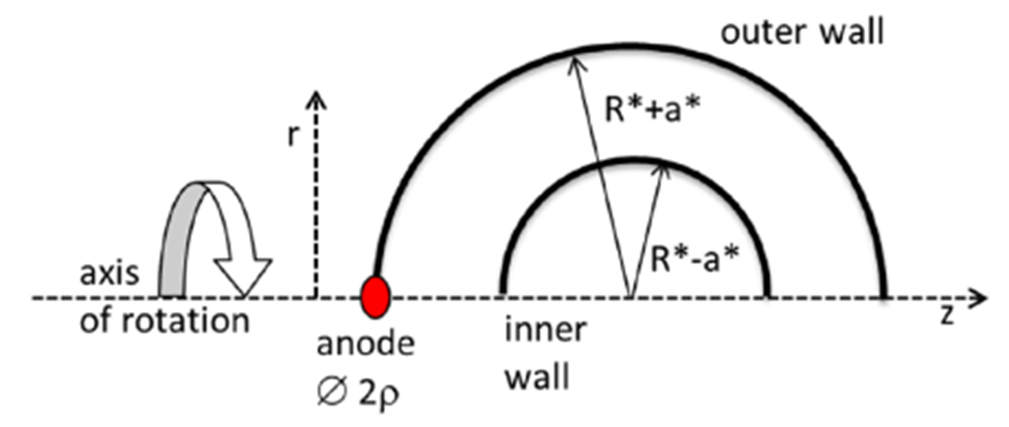
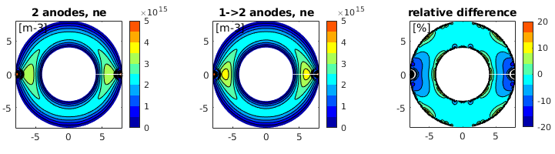
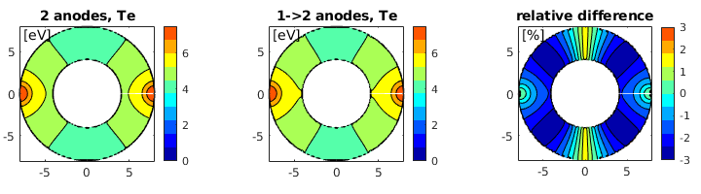
Modelling input to ITER GDB system design [ T. Wauters et al, PSI 2024 ]
Glow Discharge modelling to obtain spatial distribution of plasma parameters
  Multispecies fluid model [1, 2]
  Thermal and fast (cathode fall) electrons
  2D geometry in cylindrical coordinates
  Extended to He and He + H₂ (from diborane) plasma
  Limitation: only 2 isolated anodes on opposite sides possible
Max 20%
Thermal ne
in H₂ GDC
sum of contribution of separate anodes
max of contribution of separate anodes
Te in He GDC
Max 2%
[1] G. J. M. Hagelaar et al, PPCF 57 (2015) 025008
[2] D. Kogut et al, PPCF 57 (2015) 025009

Slide 4
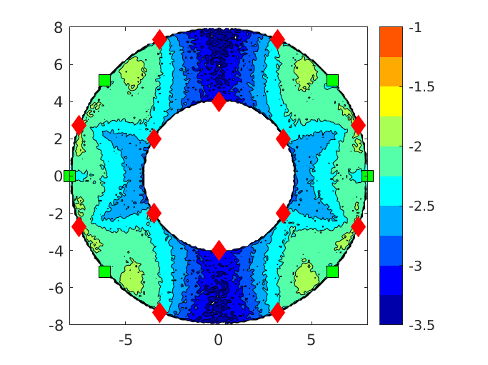
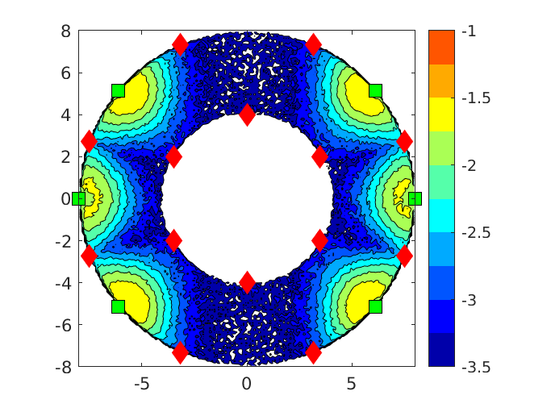
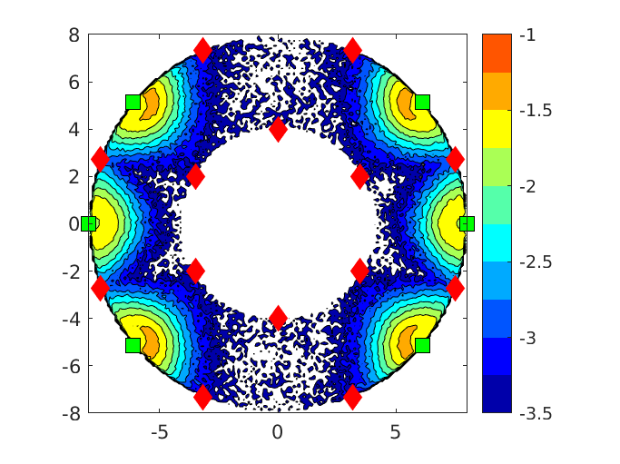
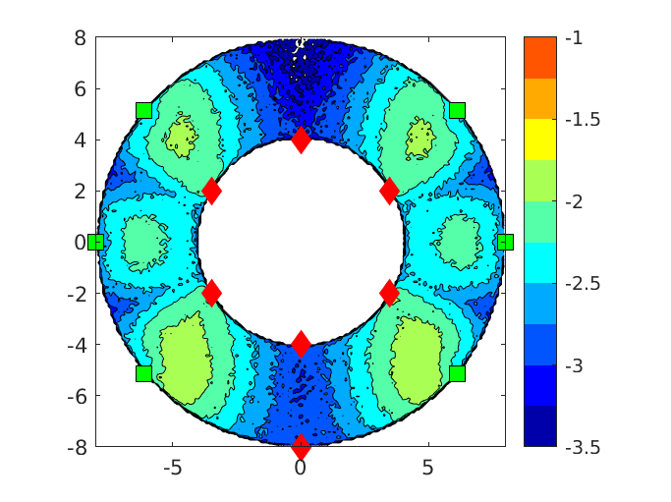
Modelling input to ITER GDB system design [ T. Wauters et al, PSI 2024 ]
Tracing of Diborane (B₂H₆) molecules (2D) until e-impact ionization [3] or dissociation [4]
  Accounting for elastic scattering on background neutrals (total cross-sections)
A
B
A: 88/12 He/H₂, 0.3 Pa, Gas: 8 LFS and 6 HFS
B: 75/25 He/H₂, 0.3 Pa, Gas: 8 LFS and 6 HFS
C: 88/12 He/H₂, 0.5 Pa, Gas: 8 LFS and 6 HFS
D: 88/12 He/H₂, 0.3 Pa, Gas: 1 LFS and 6 HFS
B₂H₆ reacts near anodes, for better uniformity:
low total P, low H₂ content
more anodes and gas injection locations
injections away from anodes
Open questions: 2D vs 3D, reaction ≠ deposition
C
D
[3] R. Basner et al, J. Chem. Phys. 118 (2003) 2153
[4] A. Lloret et al, Int. J. Mass Spectrom. Ion Process. 62 (1984) 89
B₂H₆ injected at ♦ Anodes located at ■

Slide 5
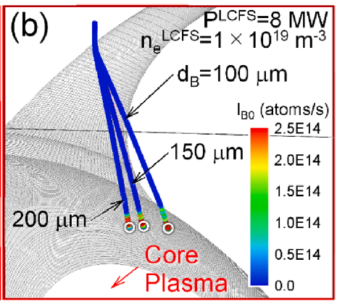
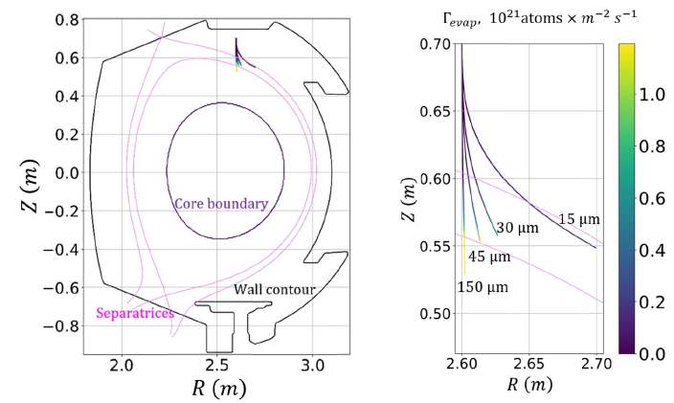
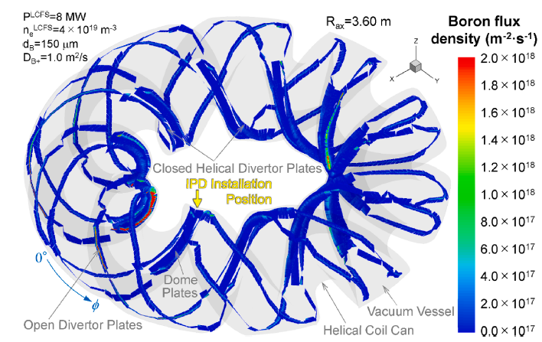
Modelling boron transport for real-time wall conditioning with IPD
Boron powder injection during plasma operation
Requires plasma background, e.g. EMC3-EIRENE [5] or SOLEDGE-EIRENE [6]
Requires dust transport simulations, e.g. DUSTT[5] or DIT [6]
Dust evaporation map as source of atomic B:
  impurity transport and PWI simulations with ERO2.0 [5]
  self-consistent plasma response [6]
Disagreements with experiment
(effect on ne, Te, O-II line intensity)
due to lack of B recycling and B layer effect on O and D recycling
LHD
WEST
[5] M. Shoji et al, NME 25 (2020) 100853
[6] K. Afonin et al, NF 63 (2023) 126057

Slide 6
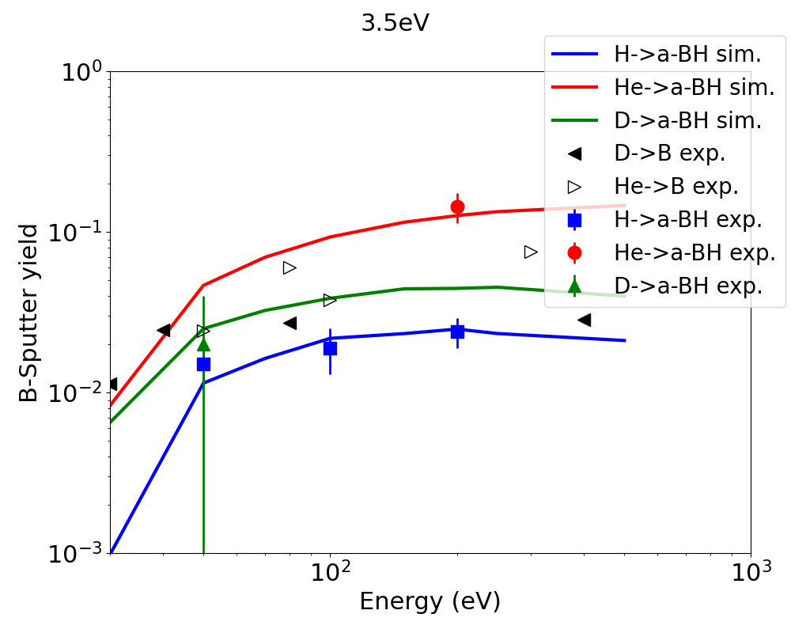
Boron impurity transport modelling with ERO2.0 and WALLDYN
Modelling of B transport including PWI
Requires plasma background, e.g. EMC3-EIRENE [K. Schmid PSI 2024] or SOLPS [S. Rode PSI 2024]
Initial B either as wall material (layer) or from dust evaporation map as source of atomic B
Boron atoms/ions ionization and recombination cross-sections from ADAS
Requires PWI data for boron layers!
Courtesy: K. Schmid
a-B:H layers sputter ~1.5 to 2x more than pure B [7, 8]
SDTrimSP „best“ match to exp data with Esb of 3.5 eV
Chemical erosion much lower than a-C:H [9], neglected so far
Requires yield database for mixed materials
  WALDYN (B layer lifetime): D, Ne, B, W → B/W mix
  ERO2.0 (diagnostic mirrors): B, Fe → B/Fe/Mo
[7] PhD A. Annen (1997) unpublished
[8] „Sputtering data“ IPP report 9/82 (1993)
[9] A. Annen and W. Jacob, Appl. Phys. Lett. 71 (1997) 1326

Slide 7
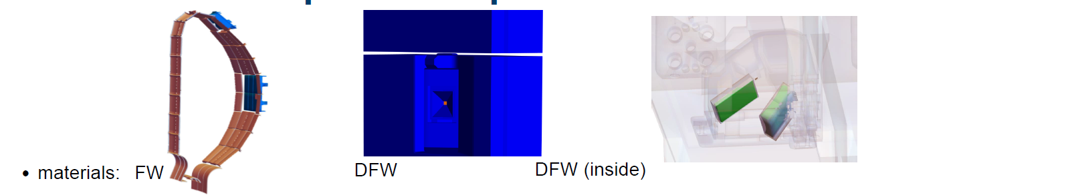
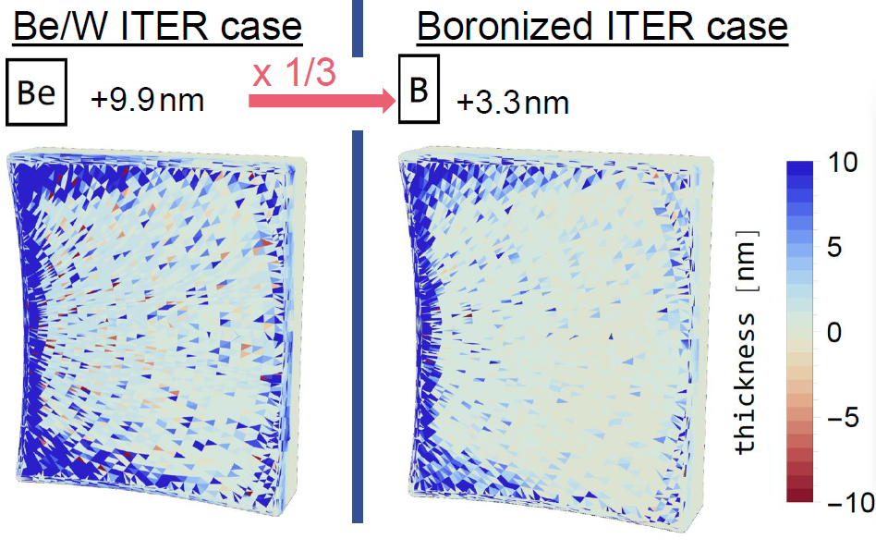
Boron impurity transport modelling with ERO2.0 and WALLDYN
ERO2.0 modelling of impurity deposition on diagnostic mirrors in ITER [S. Rode et al, PSI 2024]
Multi-staged simulation [10]:
Main chamber
Diagnostic port
Duct with mirrors
Compare Be and B cases
(infinite wall source)
1
Be/B
2
3
D
Reduced B deposition compared to Be deposition is inline with reduced B erosion by D
(from standard SDTrimSP),
thus reduction of total B vs total Be influx
8x10⁶ s
H-mode
plasma
[10] S. Rode et al, NME 38 (2024) 101564

Slide 8
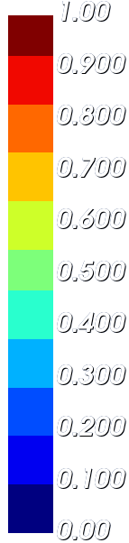
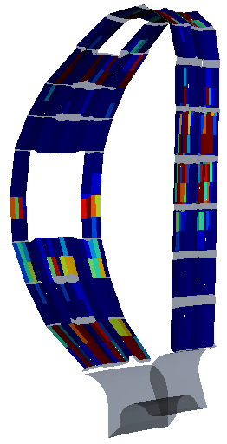
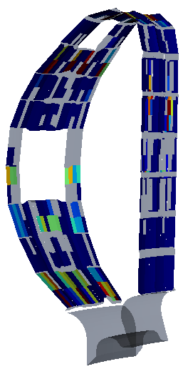

Boron impurity transport modelling with ERO2.0 and WALLDYN
WALLDYN3D modelling of boronization layer lifetime in ITER [K. Schmid et al, PSI 2024]
Hot stagnant far SOL case - 3D plasma solution from EMC3-EIRENE (as earlier for Be case [11])
Initial uniform 100 nm boronization layer
gross erosion >> net erosion
$${10}^{20}\left(m^{−2}s^{−1}\right)$$
t=0
B “local” re-deposition replenishes eroded B
This is dynamic process that subsides as the main chamber B source depletes
Need to account for surface composition dynamics
  gross erosion underestimates the lifetime
  net erosion overestimates the lifetime
[11] K. Schmid, NME 33 (2022) 101230

Slide 9
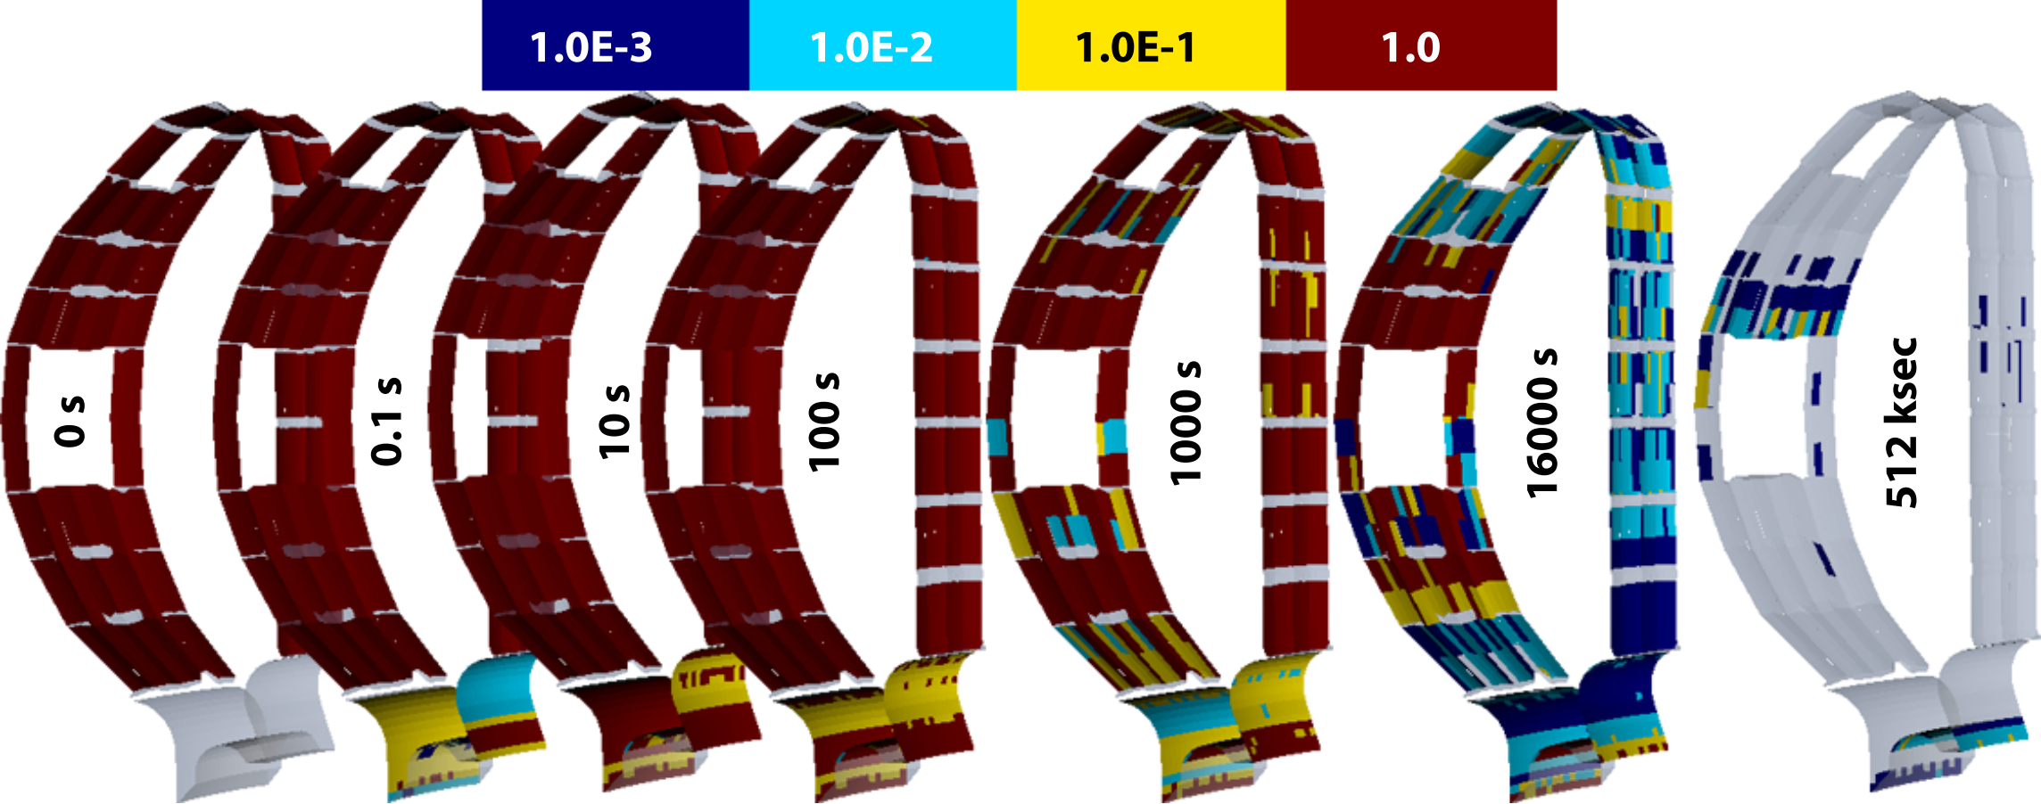
Boron impurity transport modelling with ERO2.0 and WALLDYN
WALLDYN3D modelling of boronization layer lifetime in ITER [K. Schmid et al, PSI 2024]
Hot stagnant far SOL case - 3D plasma solution from EMC3-EIRENE (as earlier for Be case [11])
Initial uniform 100 nm boronization layer
Surface concentration of B
Plasma-wetted areas are quicky eroded (~1000 s)
Eroded B initially forms deposited layers in the divertor
As main chamber source depletes, deposition zones turn to erosion zones
B finally ends up mostly below inner divertor target
[11] K. Schmid, NME 33 (2022) 101230

Slide 10
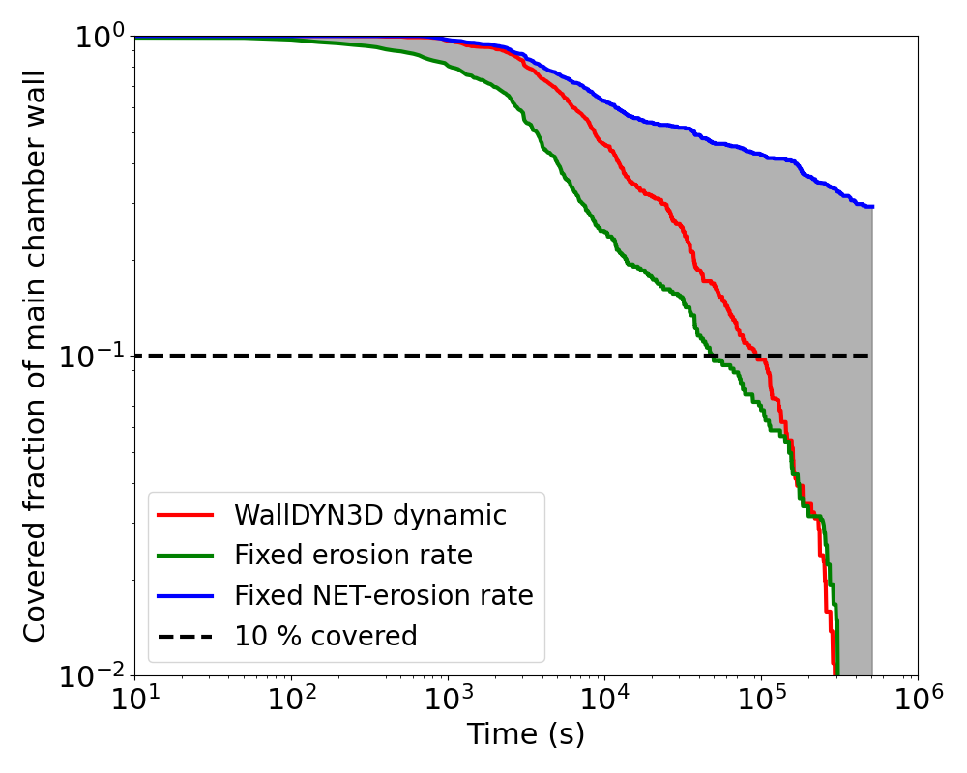

Boron impurity transport modelling with ERO2.0 and WALLDYN
WALLDYN3D modelling of boronization layer lifetime in ITER [K. Schmid et al, PSI 2024]
Hot stagnant far SOL case - 3D plasma solution from EMC3-EIRENE (as earlier for Be case [11])
Initial uniform 100 nm boronization layer
Fraction of first wall area
still covered with 20% of initial layer
Fixed thickness reaction zone RZ
Infinite Bulk
Homogeneous depositon/erosion
Time varying composition
Small thickness for correct dynamics
Source or sink to keep RZ constant
Fixed composition e.g. pure W
$$Γ^{Bulk}$$
Limitation of the WALLDYN 2 layer surface model: deposition > RZ thickness is forgotten: „limited memory“
Only a problem when there is a transition from net deposition to net erosion as for the case of B-layer
Not an issue for Be calculations with „infinite“ Be source
Current prediction for B are qualitative, new surface model under development
[11] K. Schmid, NME 33 (2022) 101230

Slide 11
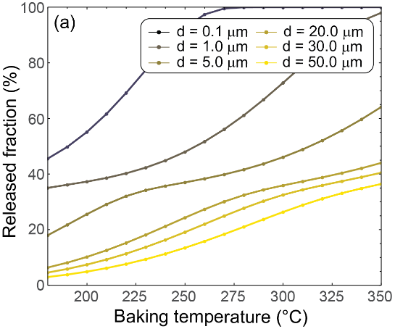
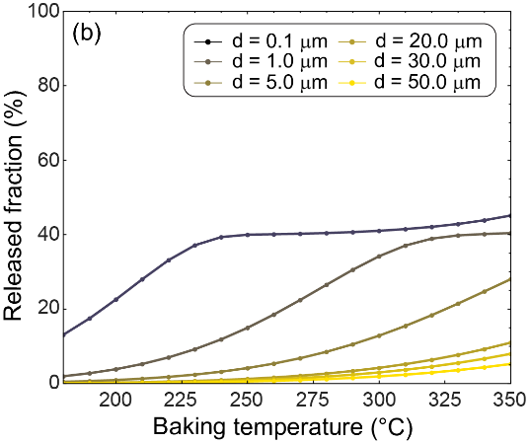
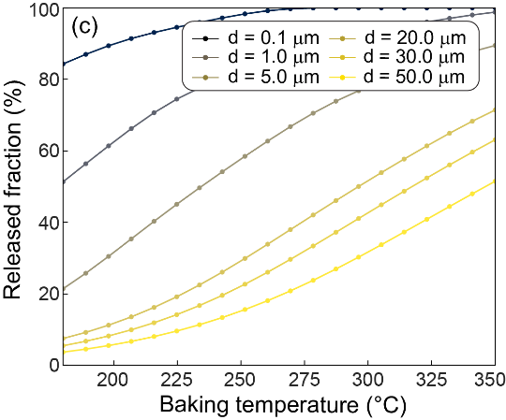
Modelling of fuel removal from a-B:H layers
Need for consistent / relevant experimental data: example of baking efficiency
Requires data on hydrogen content and de-trapping energies in B layers
Using standard diffusion-trapping models (here CRDS [12] and MHIMS [13]) parameterized
based on literature data on thermal outgassing from co-deposited B:H layers [14, 15, 16]
Baking simulations (2 weeks) for different layer thicknesses (H/B = 0.5) and bake temperatures
CRDS based on [14]
CRDS based on [15]
MHIMS based on [16]
[12] D. Matveev et al, Phys. Scr. T171 (2020) 014053
[13] E.A. Hodille et al, JNM 467 (2015)
[14] A. Annen et al, J. Non-Cryst. Solids 209 (1997) 240
[15] T. Nakahata et al, JNM 367 (2007) 1170
[16] Y. Oya et al, JNM 329 (2004) 870

Slide 12
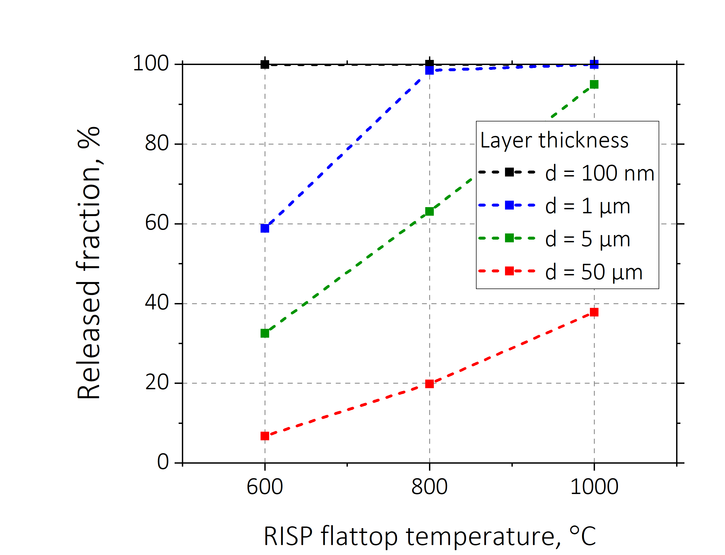
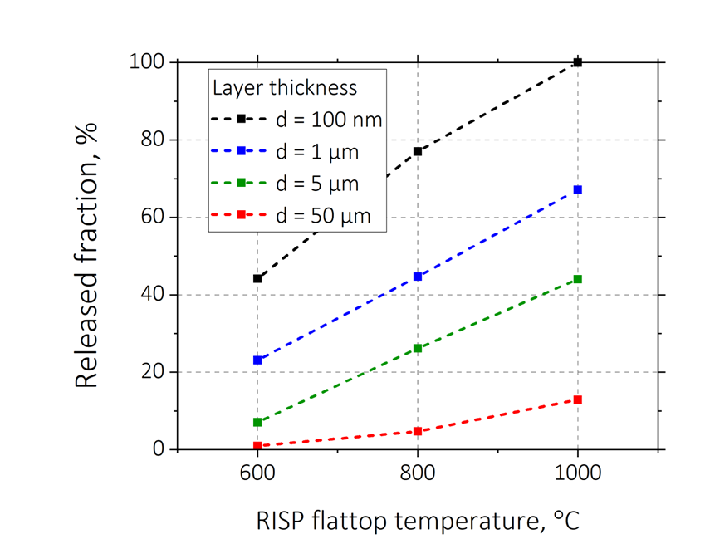
Modelling of fuel removal from a-B:H layers
Need for consistent / relevant experimental data: example of removal by plasma heating
Requires data on hydrogen content and de-trapping energies in B layers
Using standard diffusion-trapping models (here CRDS [12] and MHIMS [13]) parameterized
based on literature data on thermal outgassing from co-deposited B:H layers [14, 15, 16]
Raised Inner Strike Point (RISP) plasma (heating only) for different layer thicknesses (H/B = 0.5)
and RISP flat-top temperatures (10s)
CRDS based on [14]
CRDS based on [15]
Baking not efficient for d > ~10 μm
Plasma heating efficient for ~5 μm
Higher temperature = more removal
Longer heating phase at same temperature – little gain in removal
[12] D. Matveev et al, Phys. Scr. T171 (2020) 014053
[13] E.A. Hodille et al, JNM 467 (2015)
[14] A. Annen et al, J. Non-Cryst. Solids 209 (1997) 240
[15] T. Nakahata et al, JNM 367 (2007) 1170
[16] Y. Oya et al, JNM 329 (2004) 870

Slide 13
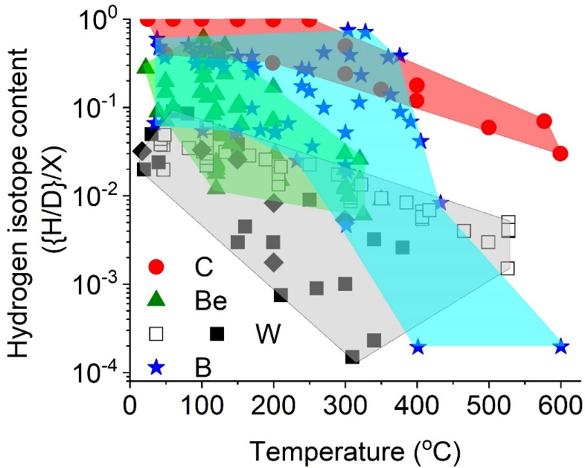
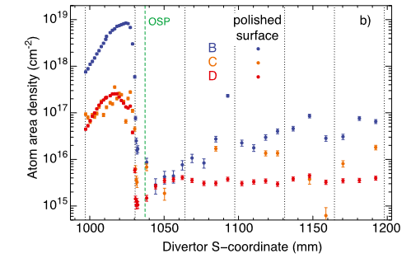
Modelling of fuel removal from a-B:H layers
Notes on H content in a-B:H layers
Conservative assumption for ITER modelling H/B = 0.5
Tokamak layers indicate lower content:
Alcator C-mod: ~0.1 (GDC boronization)
ASDEX Upgrade: <0.1 (outer divertor), ~0.2 (midplane)
Literature review of H retention in B [S. Krat 2023]
0.5 H/B
[K. Krieger et al, NME 34 (2023) 101374]
ASDEX Upgrade
outer divertor

Slide 14
Summary
There are established modelling frameworks for boronization modelling via GDB and IPD
  For GDB modelling more flexible geometry and extension of B transport up to actual deposition required
  For IPD modelling current attempts still have decoupled plasma effects and PWI
  (self-consistent plasma modelling lacks PWI, B edge transport relies on B-free plasma background)
Boron transport and PWI modelling with ERO2.0 and WALLDYN is similar to Be cases with caveats
  Sputtering data for deposited a-B:H layers (e.g. from boronization with B₂H₆) is scarce
  Different layer types can have different sputtering yields (up to x2 compared to pure B ?)
  Neglecting chemical erosion to be justified (though at least x10 lower than for a-C:H)
  Issue with local transition from deposition to erosion: two layer surface model has “limited memory”
Fuel retention and removal modelling have major uncertainties due to lack of data to restrict the models
  Data on H content and retention properties in layers from lab experiments is scattered, can be different from tokamak layers (as seen for Be). General conclusions for baking and plasma heating similar to Be.
Further questions: Does all eroded B end up as dust in remote areas? Is some B pumped as volatile species?
Thank you for your attention!

