Slide 1
Analysis capabilities and reference layers for boronization studies
Joint WP TE and WP PWIE Technical Meeting on Plasma Wall Interactions in full W devices
Antti Hakola
On behalf of the WPTE and WPPWIE teams

Slide 2
What we want – and can – investigate within PWIE (and TE)?
Main goals of the analysis programme for B-containing layers
Determine the composition (B, D, W, impurities) of the layers
Assess the formation of oxides on the layers and their impact on the layer characteristics
Investigate the structure, morphology, and chemically distinct phases of the layers
Obtain insights on the stability of the layers in different conditions
Compare information available from measurements during the tokamak operations
Main goals of the programme for producing reference B layers
Investigate the impact of varying physical parameters on the characteristics of the boron layers
Develop methods to produce representative boron layers to (i) those originating from boronizations and (ii) those resembling co-deposits in tokamaks
It is clear that in the absence of real in situ measurements obtaining reliable conclusions remains a challenge – but we will still obtain useful pieces of information on the properties of boron-based layers in tokamaks!

Slide 3
Which labs can contribute to the analysis programme?
We have ~15 beneficiaries (and many more in terms of laboratories) identified to perform measurements
Ion-beam measurements (RBS, NRA, PIXE, (TOF-)ERDA, SIMS,…) → determining sample composition and elemental depth profiles
CIEMAT, ENEA, FZJ, IAP, IST, JSI, MPG, NCSRD, RBI, VR, VTT – large number of labs, especially with accelerator capabilities supported by PWIE (FZJ, IST, JSI, MPG, NCSRD, RBI, VR, VTT)
Microscopy investigations (SEM, TEM, FIB,…) → characterizing the surface structure and morphology
CEA/AMU, CIEMAT, FZJ, IPPLM, MPG, NCSRD – analysis of a limited subset of samples from different experiments
Laser-based methods (LIBS, LIDS, LIAS, Raman,…) → studying layer structure, phase formation, and hydrogen content
CEA, FZJ, maybe CU and UT – number of samples from relevant experiments for analyses to be discussed
Other tools (XRD, XPS, TDS, GDOES,…) → complementary techniques for extracting structure of the layers, chemical fingerprint, and total fuel inventory
IAP and JSI – TDS, XPS, and GDOES (IAP, CIEMAT) capabilities
NCSRD and IST – XRD capabilities
FZJ, MPG, CEA/AMU – TDS possibilities
Main task will be assessing who can do what and for which samples to avoid fragmentation yet make full use of the available resources

Slide 4
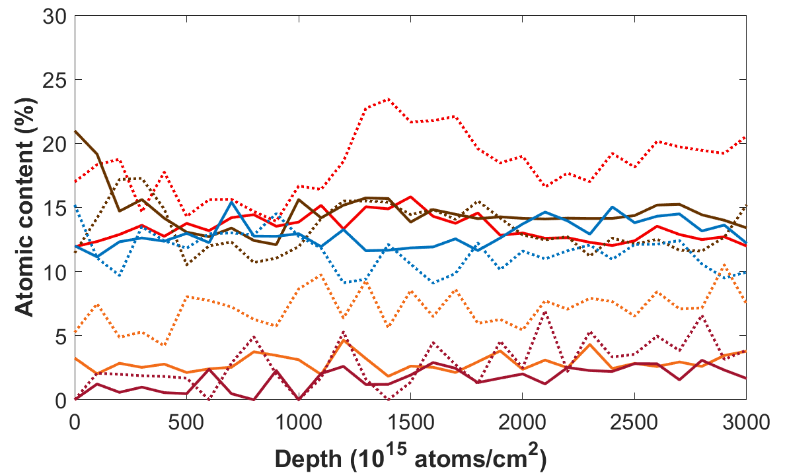
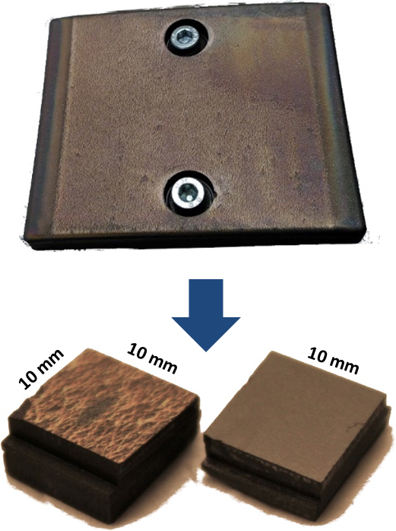
Ongoing analysis activities of boron-containing samples (VR)
Aim: Investigation of the near-surface composition of TEXTOR samples exposed to TOMAS plasmas (ICWC and GDC) and new analysis capabilities for B-containing samples
ICWC experiments (see figures at the bottom):
Efficient O and H removal from the surface in He, ¹⁰B increase relative to other elements
Efficient O and C removal in H₂ plasmas, no clear isotope exchange effects observed
New analysis capabilities:
In situ ion beam analysis during annealing and ion irradiation of as-deposited layers
Resonant-NRA at low energies combined with RBS for the desired high-sensitivity and –resolution studies
before exposure
C
O
after exposure
¹⁰B
H
D
L. Dittrich, E. Pitthan Filho et al. (VR)

Slide 5
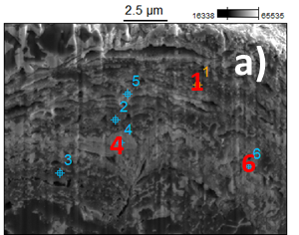
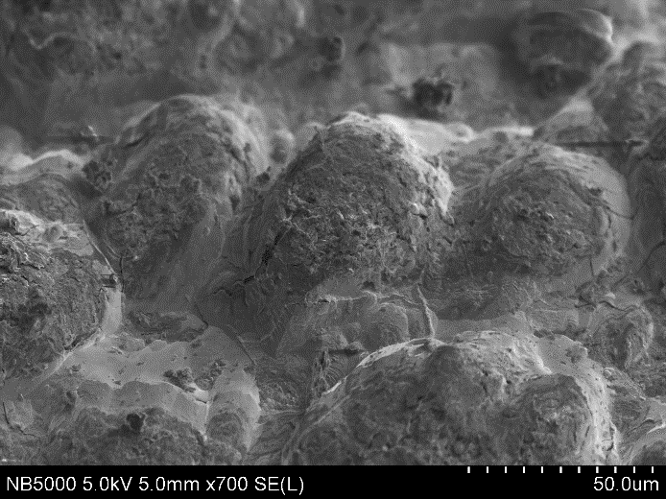
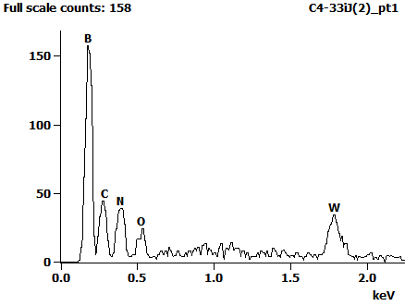
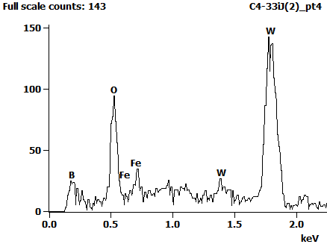
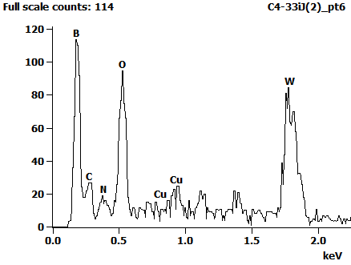
Ongoing analysis activities of boron-containing samples (IPPLM)
Aim: Microscopy (SEM, EDX) investigations of thick B-rich co-deposited layers from WEST
b) pt. 1
56 µm
50 µm
40 µm
c) pt. 4
d) pt. 6
5 µm
5 µm
20 µm
Strong differences in the chemical composition between different samples, co-deposits, and sublayers in the μm-scale
E. Fortuna et al. (IPPLM)

Slide 6
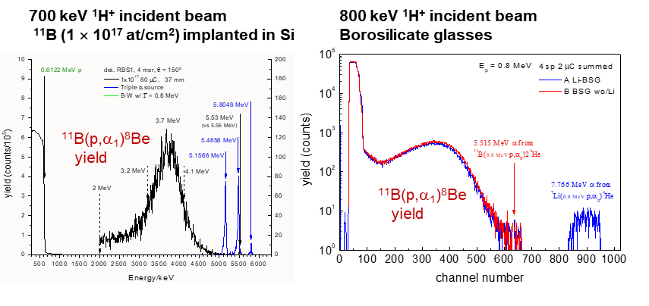
Ongoing analysis activities of boron-containing samples (IST)
Aim: Further develop capabilities for using the ¹¹B(p,α₁)⁸Be nuclear reaction for B quantification in ion-beam analyses
Appears to be possible, thus providing a potential complementary tool to the traditionally applied RBS and NRA
R. Mateus et al. (IST)

Slide 7
Capabilities to produce B-containing reference layers
Several labs have expressed their willingness to produce boron reference layers
ENEA – Pulsed Laser Deposition (PLD) and HiPIMS magnetron sputtering devices available
Can vary the morphology and crystallinity of the layers as well as their impurity content (oxygen)
Substrates can be patterned by chemical etching before producing the layers on top
IAP – HiPIMS magnetron sputtering and Thermal Vacuum Arc (TVA) systems available
Possibility to alter the gas content of the layers and sample temperature in a controlled manner
Thickness can be varied from a few nm to several μm
FZJ – existing magnetron sputtering system adapted to the production of B layers
Samples can be directly used in PSI-2 experiments
VR – magnetron sputtering system at Uppsala to produce pure and mixed B layers
VTT – magnetron sputtering system at University of Helsinki to produce B layers for isotope exchange experiments
Potentially also other contributors → TBD

Slide 8
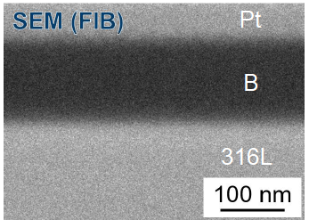
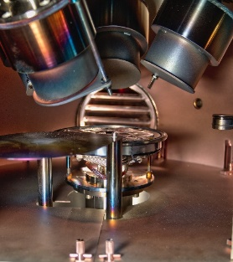
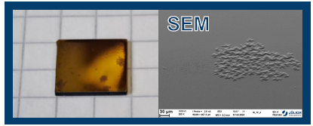
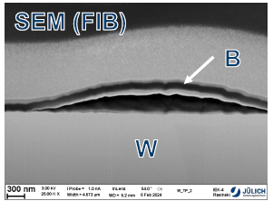
Ongoing activities in producing boron layers (FZJ)
Boron layer fabrication and characterization in laboratory conditions
Boron layer fabrication in laboratory conditions: Magnetron sputter deposition
RF-mode with pure B target and Ar plasma, 5.5 h deposition → ~100 nm thickness, W and steel substrates
Annealing at 1000°C (W) or 550°C (steel) in vacuum → stable, no peeling, no change of layer
Fig. 1
Characterization:
XRD: amorphous; XPS: pure B, no B oxide observed so far!
SEM(FIB): smooth, dense, homogeneous layers (see Fig. 1)
EDX: oxygen on interface to W or steel, less in B layer, but hard to interpret
Fig. 2
Interesting features:
B on W: after some weeks: purple dots (see Fig. 2) → detachment of B layer from substrate → ‘blister’, dependent on W substrate surface before deposition, especially W oxide (see Fig. 3)
B on steel: ‘blister’ formation after longer time (~ several months) in air (humidity?)
Fig. 3
A. Houben et al. (FZJ)

Slide 9
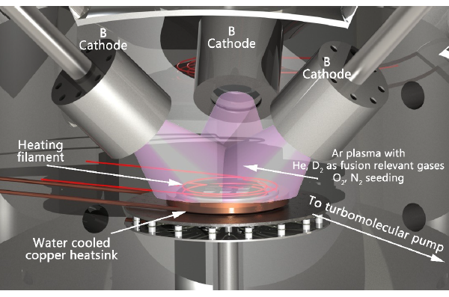
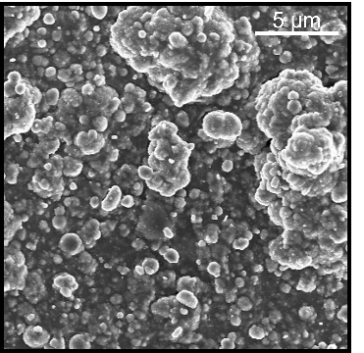
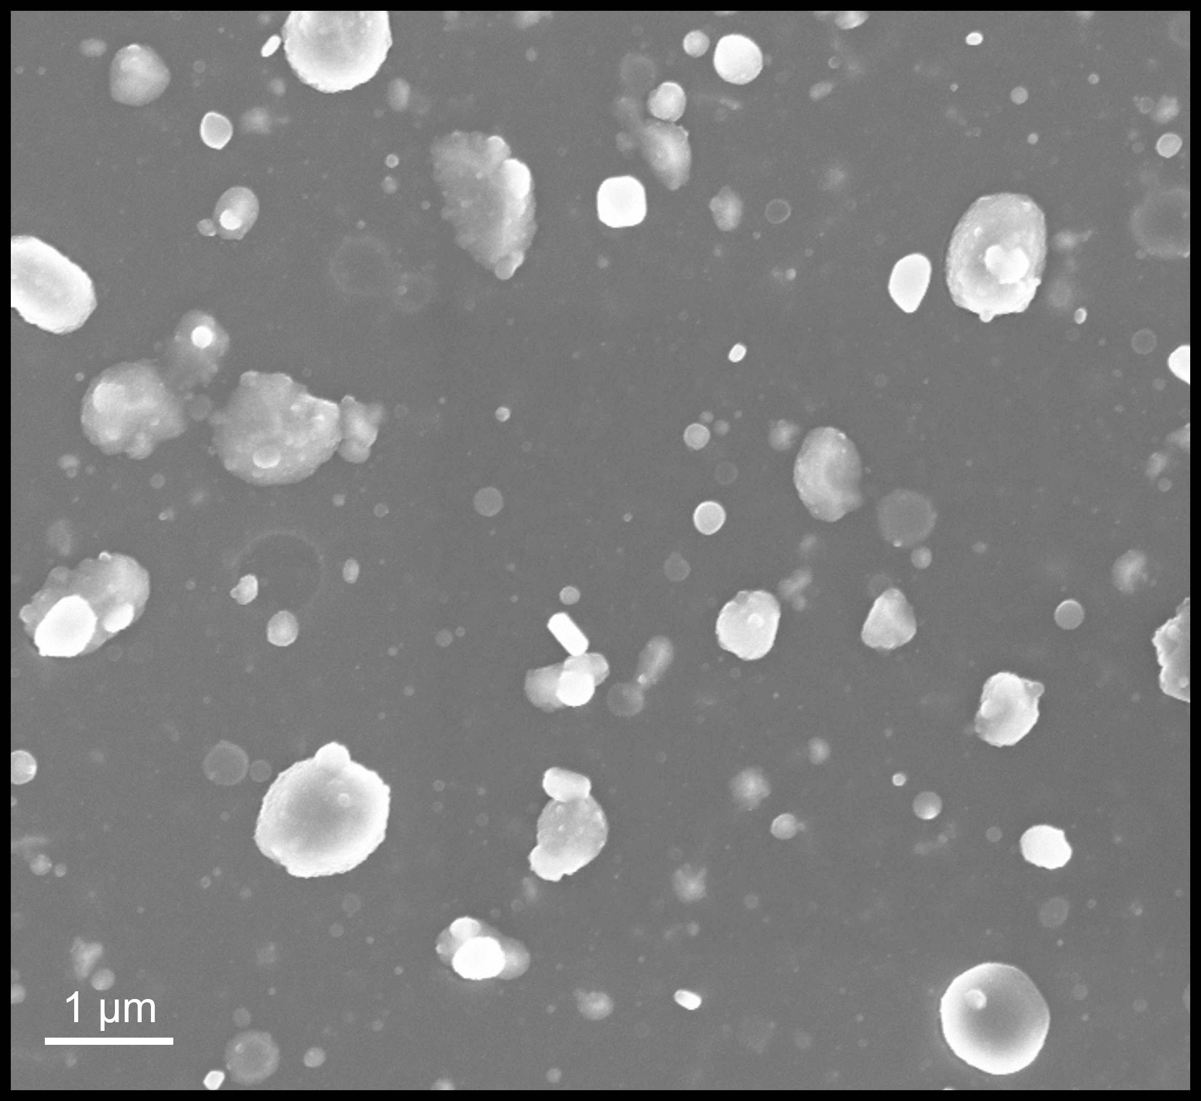
Ongoing activities in producing boron layers (IAP, ENEA)
TOP
Existing devices adapted to B layers
IAP: magnetron sputtering, Ar+D₂ mixture; different gases can be added and several parameters varied (surface temperature, ion energy, gas fluxes, discharge type,…)
ENEA: pulsed laser deposition (PLD); optimized for producing multilayers and mixed coatings and altering the morphology of the samples
Thickness can be varied flexibly from a few nm to several micrometers
First results for IAP samples (see middle figure)
hardness is affected by the deposition conditions
a strong relationship between deposition conditions and the total amount of deuterium released (retained) – example: influence of bias voltage
First results for ENEA samples (see right figure)
Morphologies from compact to porous, annealing can also change the crystal structure of the films
Growth of boron, instead of boron oxide, possible at low base pressures
C. Porosnicu et al. (IAP), D. Dellasega et al. (ENEA)

Slide 10
Plans for the period 2024-2025: analyses and layer production
Surface analyses – focus on pre-characterization of reference layers and samples from ongoing experiments (TOMAS, PSI-2, MAGNUM,…)
Work already ongoing @ FZJ, IAP, IST, VR (under ENR project)
Reference layers – focus on varying process parameters to identify recipes to produce good proxies for boronization layers and co-deposits
Work already ongoing @FZJ, IAP, VR
These include already agreed samples for permeation studies (JSI) and delamination investigations (UKAEA)
Several ideas proposed where to put the emphasis in the near future
Study differences between pure B and mixed B+W layers, including layer stability and compound formation (IAP, NCSRD,…)
Effect of temperature, thermal treatment, and inclusion of H/D or O on the properties of B layers (CEA, IAP,…)
Investigate erosion and re-deposition characteristics of B layers upon exposure to plasmas (FZJ, VR,…)
Composition and microstructure of B+W mixed and stacked layers (ENEA, VR,…)
Damage formation and layer changes upon exposure to plasmas or ion beams (IST)
Impact of B layers on isotopic exchange characteristics (VTT)
Phase identification in B+W layers and B diffusion (IST, NCSRD,…)
Discussion points
Shall we concentrate on emulating co-deposits rather than layers from boronizations?
Should one produce a protective, passivating layer on top?

Slide 11
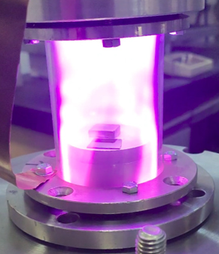
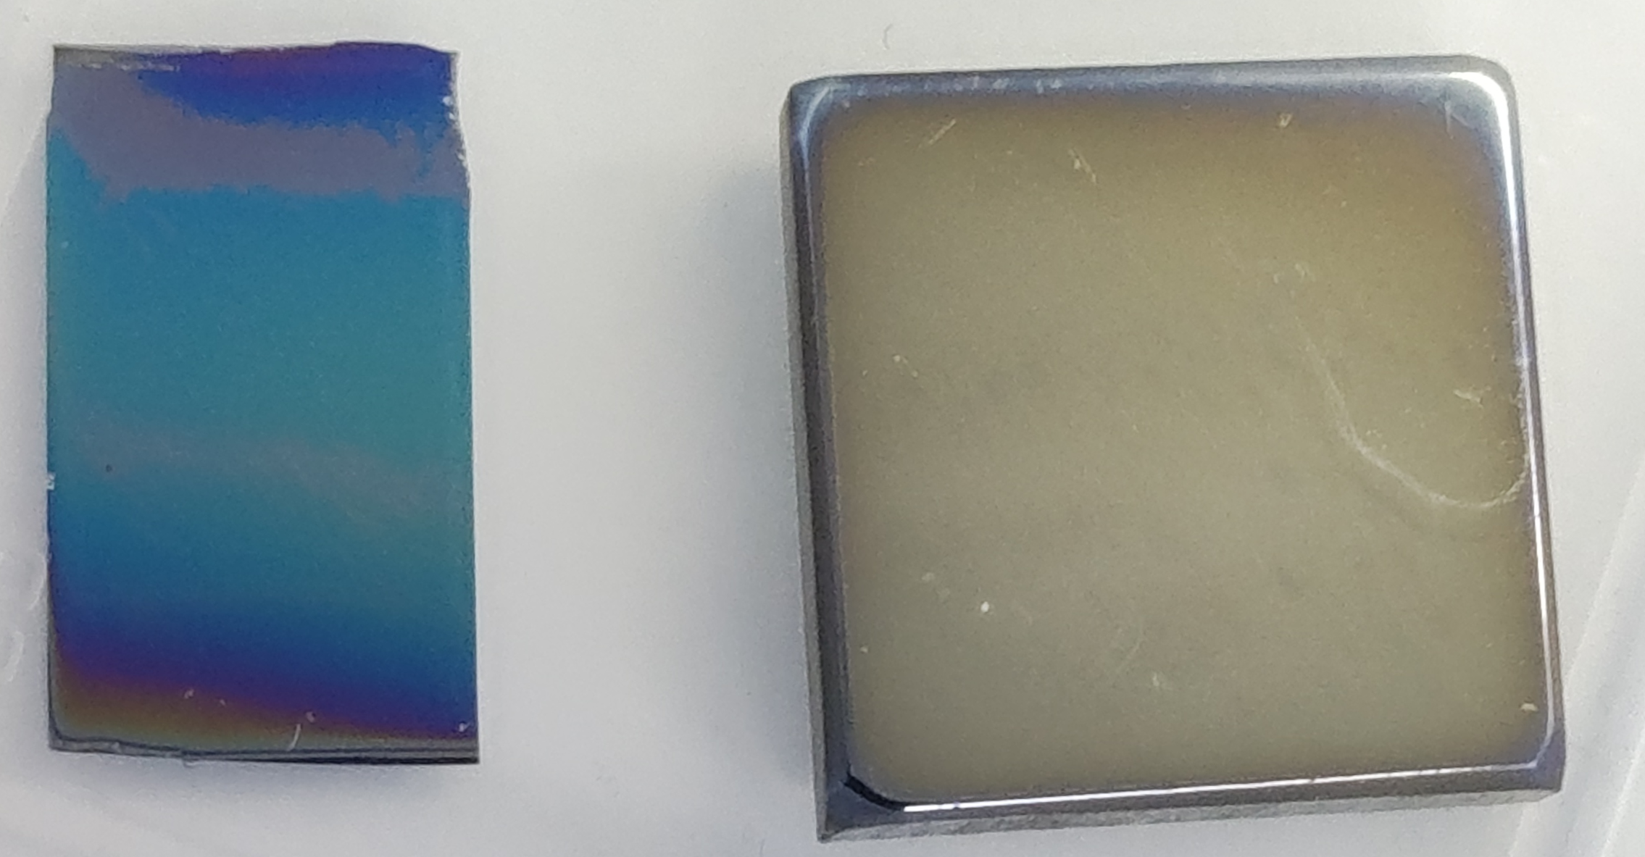
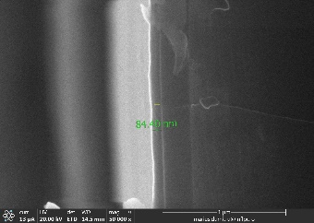
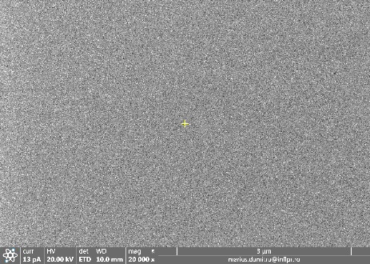
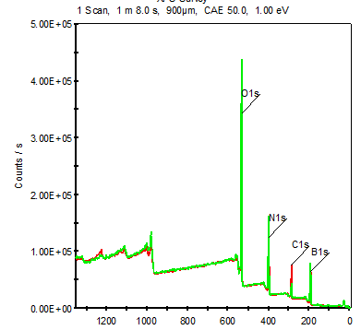
Concluding remarks
Good analysis capabilities available for studying the properties of B layers
B is not a particularly difficult element to be measured by the various methods
Two stable isotopes (¹⁰B and ¹¹B) provide an additional tool for measurements
CAVEAT: B shows complicated chemistry and is highly reactive, thus all types of phases can be formed
Several labs can produce B reference layers for experiments (linear devices, laboratories, tokamak experiments,…)
Mainly utilizing magnetron sputtering
Various parameters can be tailored during the production (morphology, structure, gas inclusions,…)
CAVEAT: Reactivity with O indicates that measurements should be done as soon as possible after production or in situ
Reproducing boronization layers remains a challenge while production of layers simulating co-deposits poses an ”easier” exercise
We already have lots of data from AUG and WEST to set the targets for sample production and analyses
IAP has recently come up with a new RF-PECVD setup with diborane B₂H₆ as precursor
Parallel-plate capacitively coupled RF discharge : thin (10~100 nm) and smooth boron films
S. Vizireanu et al. (IAP)
thickness 84 nm

