Slide 1
Boronisation studies : current status of knowledge and plans for 2024-2025 within WP TE
TE-PWIE workshop, September 17, 2024
E. Tsitrone
Many thanks to the RT-06 RTC : Y. Corre, K. Krieger, A. Widdowson and the AUG and WEST team (V. Rohde, A. Gallo, E. Geulin, M. Diez, C. Martin …)
Acknowlegments to the ITPA DivSOL « Report on the new ITER baseline with a W wall, issues and open R&D questions” (V. Rohde, S. Masuzaki, T. Wauters for the Boronisation section)

Slide 2
Outline
EU has a good portfolio of metallic machines to study boronisation in support of the new ITER baseline : AUG and WEST
Current status of knowledge on boronisation from WP TE devices
Impact of boronisation on plasma operation
Distribution of boron layers in the vessel
Plans for AUG/WEST in 2024-2025
Summary

Slide 3
Outline
EU has a good portfolio of metallic machines to study boronisation in support of the new ITER baseline : AUG and WEST
Current status of knowledge on boronisation from WP TE devices
Impact of boronisation on plasma operation
Distribution of boron layers in the vessel
Plans for AUG/WEST in 2024-2025
Summary

Slide 4
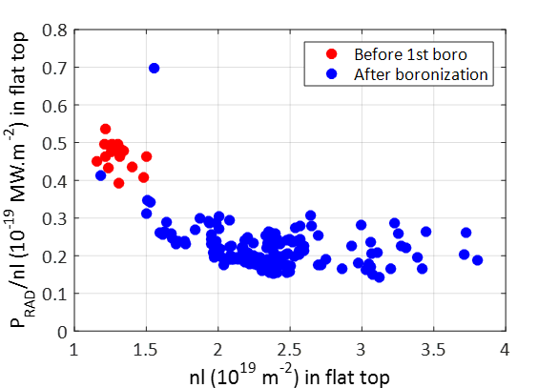
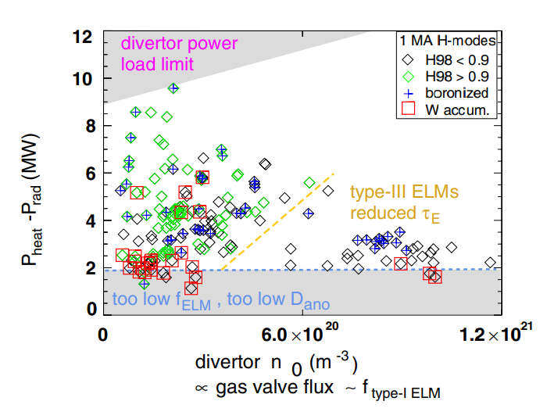
Boronisation opens up the operational domain
  WEST : 1st boronization was key in early days of operation
  Usual reduction of oxygen contamination / radiated power
  Improved breakdown conditions
    Avoidance of Runaway Electrons (high level of impurities ➔ narrow operational window for burn-through)
  Higher density operation achievable
[J. Bucalossi et al., NucFus 2022]
  AUG : boronization required for low density operation
  Usual reduction of oxygen contamination / radiated power
  Widens H mode operation space w/o W accumulation
  Low density / high Te operation achievable after fresh boronisation (AT, RMP ELM suppression, fast ion scenarios ...)
[A. Kallenbach et al., Nuc Fus 2009]
Both devices use boronisation for initial conditioning after venting

Slide 5
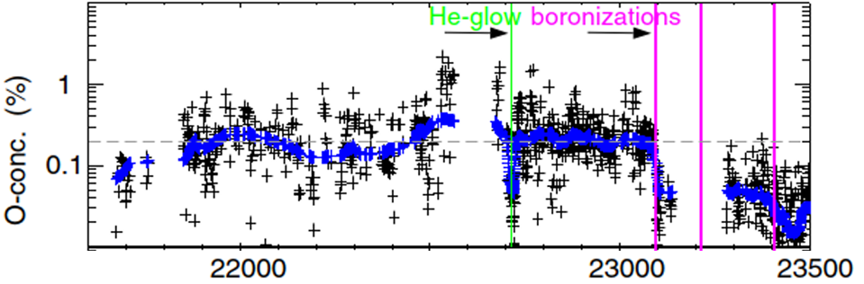
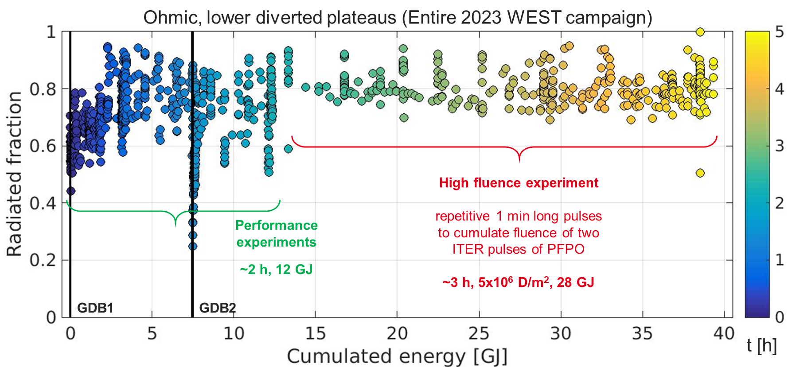
Operation without boronisation is possible but requires specific tuning
  AUG : successful restart w/o GDB in full W configuration performed
  Plasma restart possible, ~ 1500 pulses before GDB
  Operational limit : W core accumulation / core radiative losses compared to core heating (ELM frequency)
  Recipe : use ECRH for central heating / operate at large gas puff
AUG
[A. Kallenbach et al., NF 2009]
  WEST : successful long pulse operation w/o boronisation
  Operation w/o boronisation for dedicated PWI campaigns where no modification of wall conditions required
  High D fluence campaign (> 400 long pulses, ~ 30 GJ of coupled energy, ~3h of plasma) : no evolution of the radiated fraction in the ohmic phase
WEST
[A. Gallo et al., submitted to NME ]

Slide 6
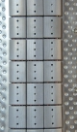
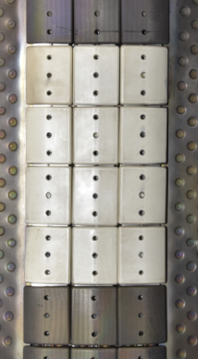
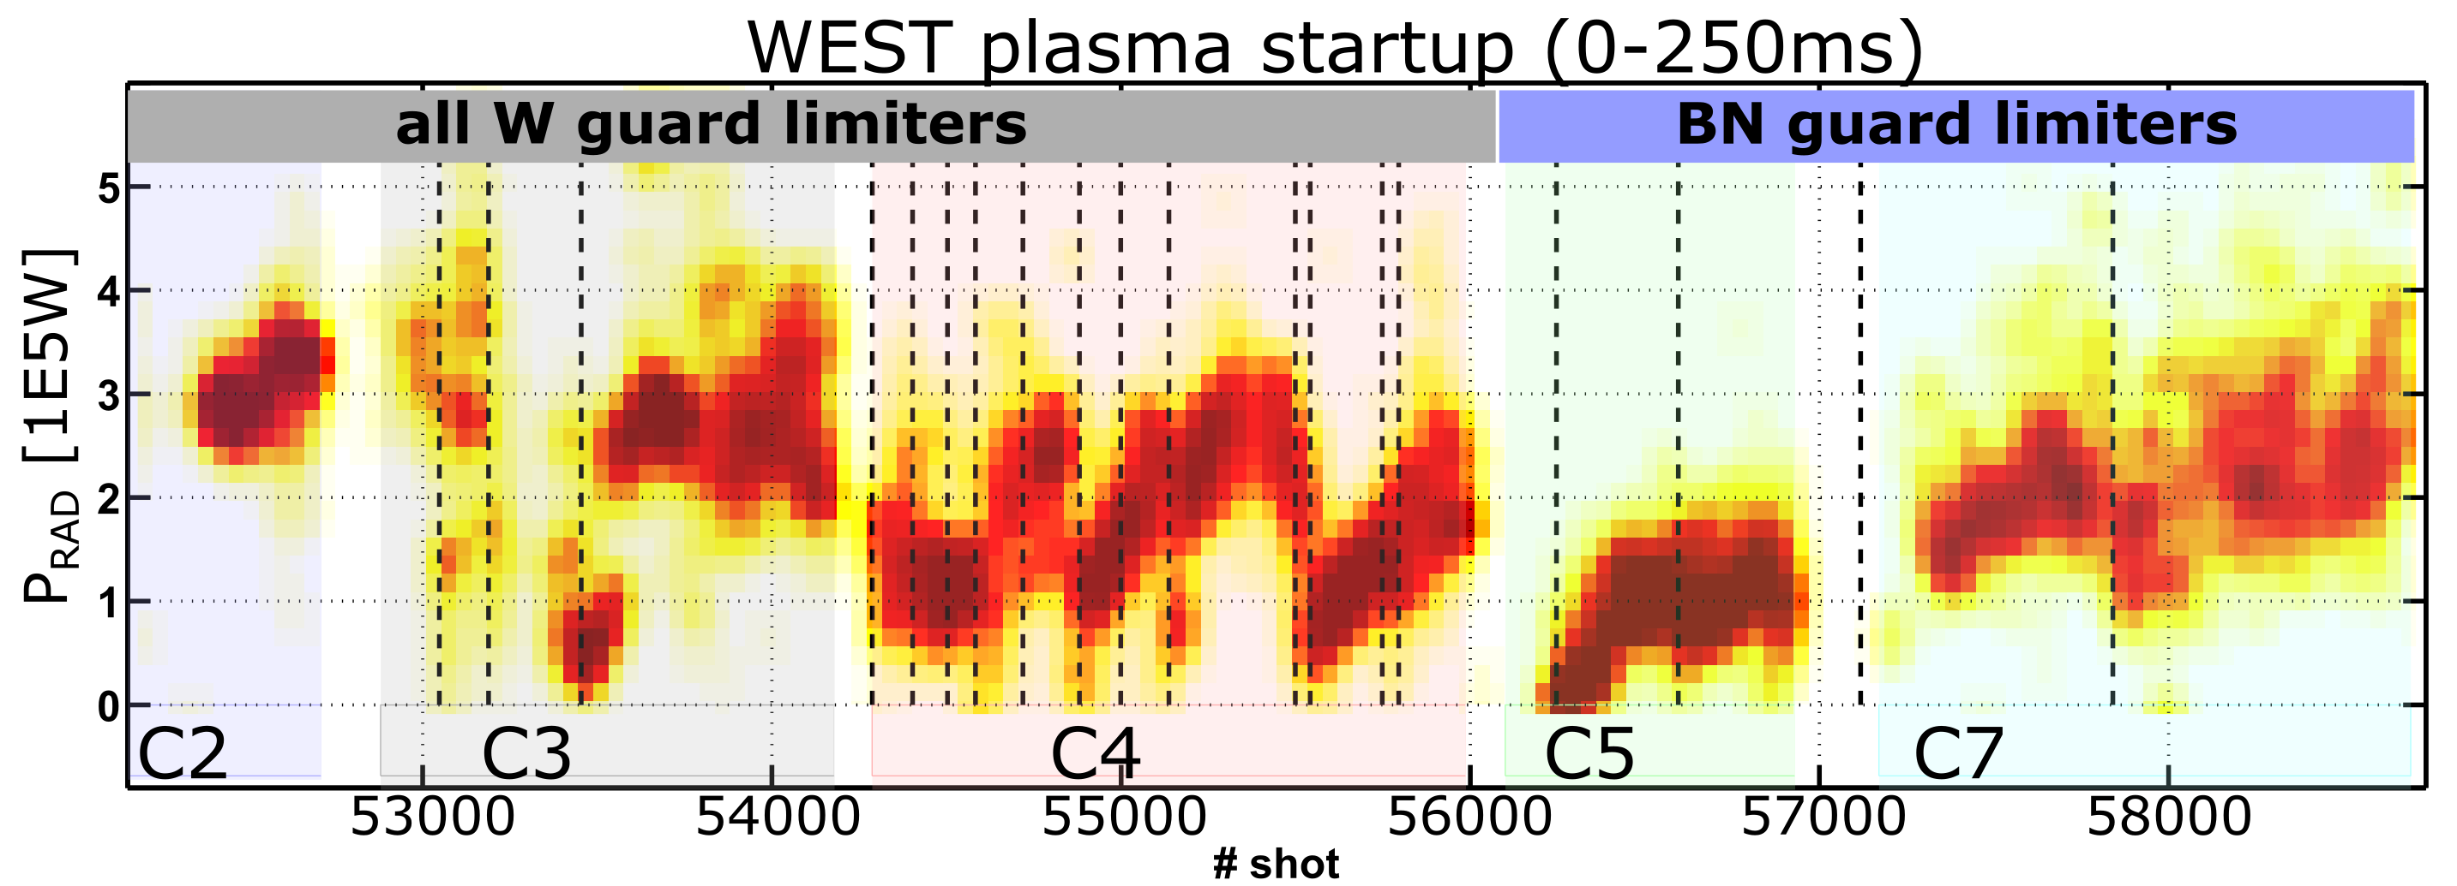
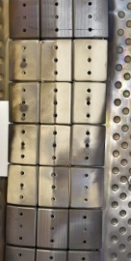
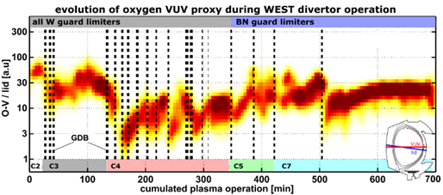
Boronisation “lifetime” : several time constants involved
  WEST : impact on radiated power:
    Plasma breakdown :
      strong reduction in radiated power, recovery 40-60 pulses
    Limiter phase
      Less pronounced reduction in radiated power, faster recovery (~10 pulses)
    Diverted phase (LSN) :
      Reduction in radiated power vanishes rapidly (~ few pulses)
Learning curve
      Caveat : comparison difficult as boronisation conditions (nb of anodes, B consumption, T_{wall}…) + recipe for plasma breakdown / ramp up / flat top scenario evolves
  AUG :
    Short term (recycling, B coverage in strike point area) vs long term (O level) effects also evidenced
[A. Gallo et al., APS 2022]
[J. Bucalossi et al., IAEA 2023, submitted to Nuc Fus]

Slide 7
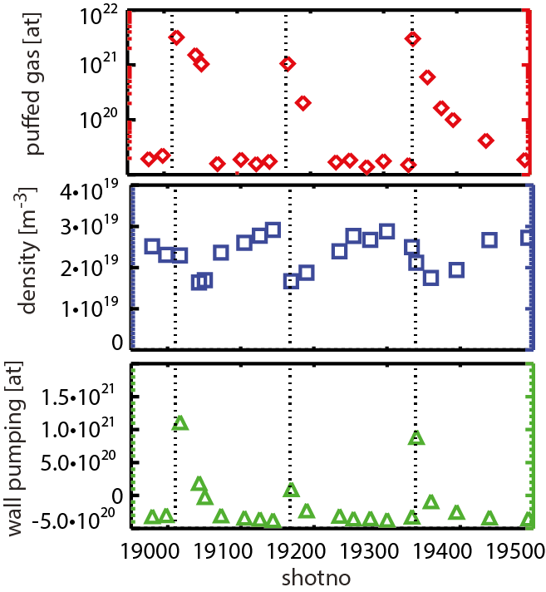
Boronisation transiently reduces recycling, but has little long term impact on fuel retention
  AUG : boronisation transiently reduces recycling
    B layers from boronization increase D wall pumping during 1 or 2 days of operation (Reduced D recycling at boronized W surfaces, stronger D gas puff needed to reach given density)
    Hard to quantify impact of B layers on overall D retention as B layers get eroded from PFCs ==> requires repetitive GDB and fixed scenario
AUG
  WEST : modest/short term impact of boronisation on fuel retention for long pulse operation
    Particle balance repeated before / after boronisation on long pulse (~1 minute)
    Strong impact on 1st short ohmic pulse : strong increase in gas puff needed to reach equivalent density (x2)
    Modest (inverse) impact after ~100s of plasma on fuel retention during long pulse
[V. Rohde et al., JNM 2007, A. Kallenbach et al., Nuc Fus 2009 ]
[E. Tsitrone et al., ITPA DivSOL meeting, Kyoto, Feb 2024]

Slide 8
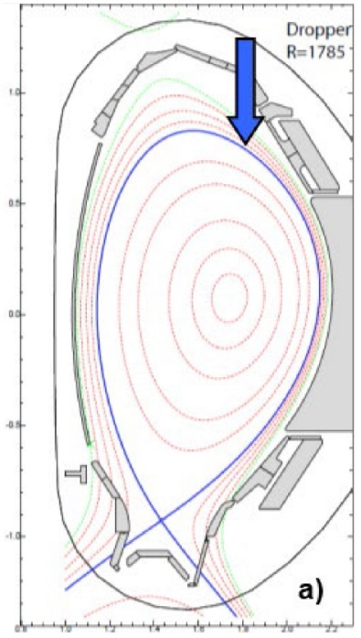
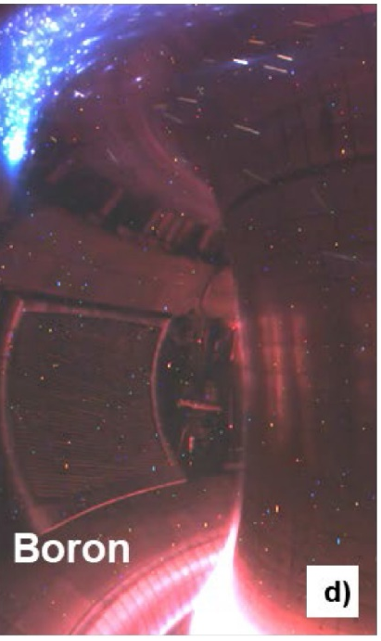
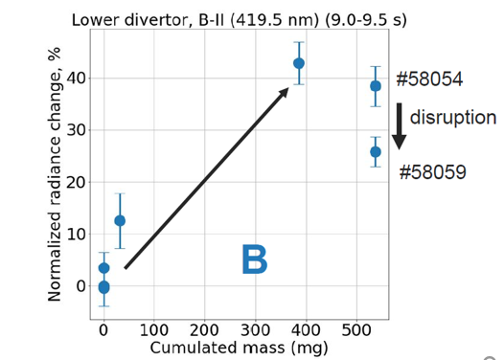
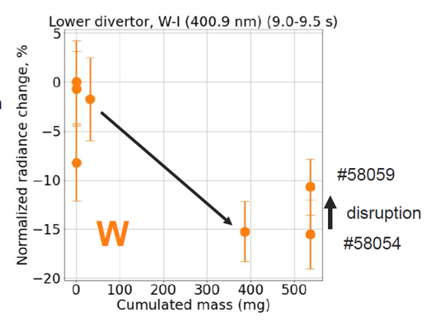
Impurity powder dropper : risk mitigation for ITER
WEST and AUG equipped with IPD : deposition channels / local distribution of B different from GDB
➔ Can extend the lifetime of deposited boron layers on areas prone to rapid erosion
AUG
[R. Lunsford, NucFus 2019]
WEST
[K. Afonin, NME 2024]
  Wall conditioning evidenced on both machines
    Beneficial effects on wall pumping, reduction of oxygen content and radiated fraction in both devices
    Improved confinement observed in both devices
    Large B rate can have adverse effect (up to disruptions)
    During the drop in WEST : increased W sputtering, but reduced W core transport , beneficial impact above threshold
    Main chamber in AUG : local limiter B coverage much larger than for conventional GDB : margin for drop rate
[R. Lunsford, NME 2024]
[K. Krieger, NME 2023]

Slide 9
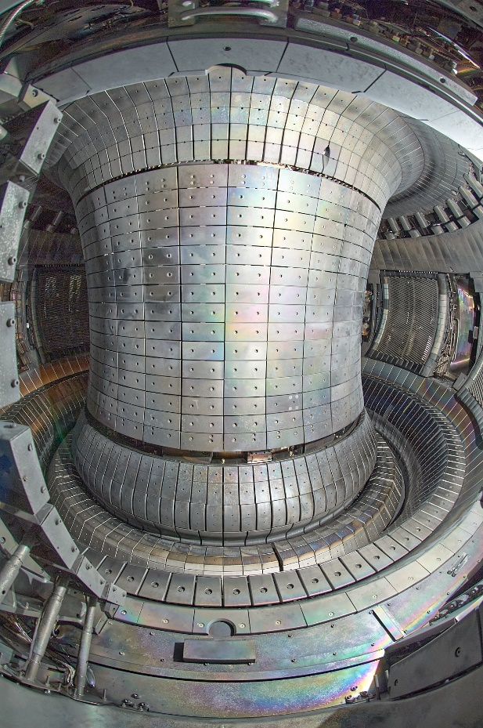
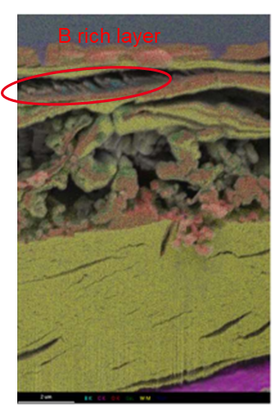
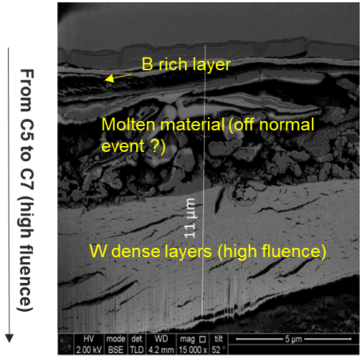
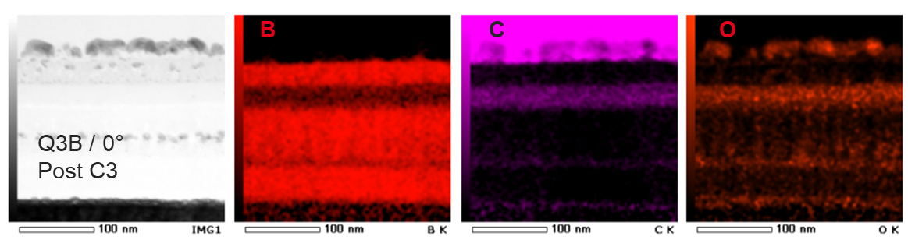
Complex structure of B layers found in tokamaks
  WEST : non uniform B layers evidenced
    Divertor : B rich layer found in HFS deposits (far SOL)
    First wall : non uniform poloidal / toroidal deposited layer thickness, B rich layers interleaved with W oxide layers
  AUG :
    Whitish unstable B layers found when venting : cleaned after each campaign with wet wiping
WEST divertor deposits after the C7 campaign
W
O
B
[C. Martin, submitted to PSI 2024]
WEST first wall deposits after C3
[E. Bernard, PSI 2022, R. Sakamoto, private com.]
[Courtesy V. Rohde]
  In both machines :
    Difficult to disentangle impact of C and B
    Wide D/(B+C) range : from 0.1 to 0.4

Slide 10
Outline
EU has a good portfolio of metallic machines to study boronisation in support of the new ITER baseline : AUG and WEST
Current status of knowledge on boronisation from WP TE devices
Impact of boronisation on plasma operation
Distribution of boron layers in the vessel
Plans for AUG/WEST in 2024-2025
Summary

Slide 11
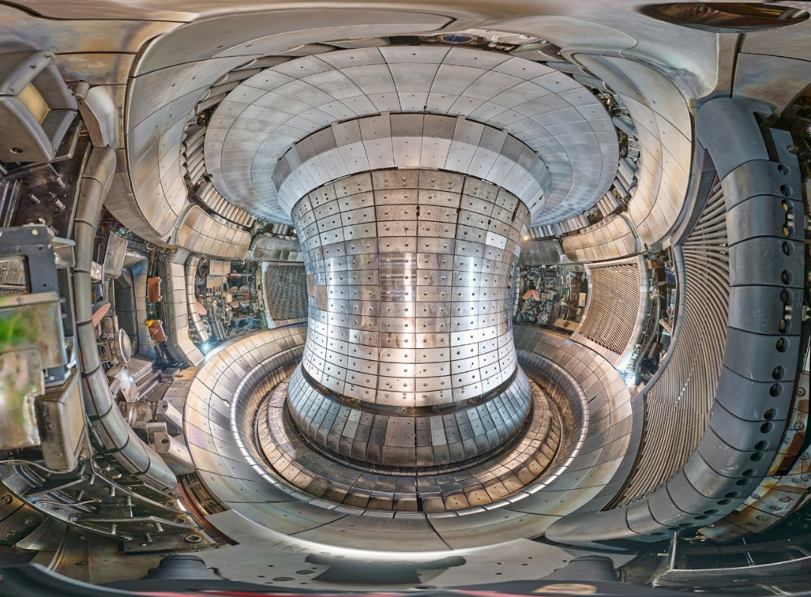
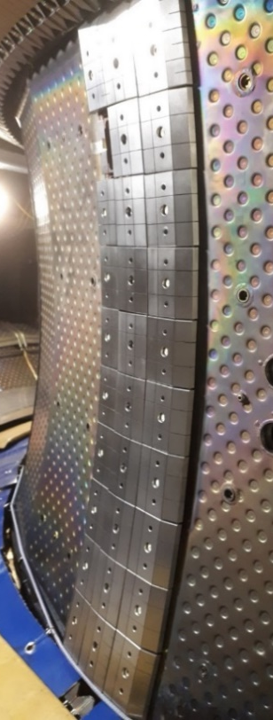
Specific features of WEST / AUG for the 2024 / 2025 campaigns
  WEST :
    Change of inner / outer bumper tiles from BN back to W
    Boronisation collector probe available in 2025 (LTS available)
    Longer term : LIBS (LID QMS) for in situ measurements
  AUG :
    Restart after long shutdown with new upper divertor
    Manipulators available for sample exposure during boronisation (LTS available)
    New diagnostics for material migration (QMB)
New upper divertor for AUG – September 2024
WEST ready for phase 2 – summer 2021
[Courtesy V. Rohde]
September 2024

Slide 12
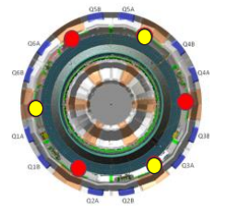
Plans for 2024 : focus on B layer uniformity
Similar restart plan for both AUG/WEST
  Test (briefly ) start up without boronisation :
    WEST : restart w/o GDB for a few days
    AUG : restart w/o GDB for 1 day or until required data (spectroscopy …) available
    NB : restart presently planned on both machines by ~mid October (stay tuned to WP TE news)
  Perform “half” boronisation :
    WEST : 3 of 6 anodes, ITER ref temperature (70°C), no collector probe available in 2024 (will be repeated in 2025 with collector probe, exposing W and SS samples), LTS
    AUG : 2 of 4 anodes, room temperature, samples exposed in manipulators + LTS + new QMB
  Perform “full” boronisation :
    WEST : 6 anodes at 70°C, no collector probe available in 2024 (will be repeated in 2025 with collector probe, exposing W and SS samples), LTS
    AUG : 4 anodes, room temperature, samples exposed in manipulators + LTS + new QMB
    On both machines : perform start up limiter studies on W inner bumpers for each phase (tbc)
Reference shots required to be repeated for comparison of no boro / half boro / full boro

Slide 13
Longer term plans on AUG/WEST
Call for 2025 experimental proposals now open !
  Scientific objectives of RT06 (Preparation of efficient Plasma Facing Components (PFC) operation for ITER, DEMO and HELIAS) : increased focus on boronisation
    Quantify local power load distributions on castellated and shaped PFCs for ITER and DEMO…
    Assess the impact of sustained high power / high particle fluence plasma …
    Quantify material erosion sources from metallic walls under ITER relevant plasma conditions …
    Quantify fuel retention in devices with metallic walls, with a focus on long pulse operation (using recent fuel retention diagnostic upgrades such as laser-based diagnostics where available) and including impact of boronisations
    Determine fuel-removal in metallic devices in conditions relevant for ITER (including the impact of boronisation) and extrapolate to DEMO
    Assess efficiency and lifetime of conditioning methods in metallic devices, with a focus on boronisation
  Deadline October 11
    All details on WP TE wiki :
https://wiki.euro-fusion.org/wiki/WPTE_wikipages:_Call_for_proposals_2025

Slide 14
Outline
EU has a good portfolio of metallic machines to study boronisation in support of the new ITER baseline : AUG and WEST
Current status of knowledge on boronisation from WP TE devices
Impact of boronisation on plasma operation
Distribution of boron layers in the vessel
Plans for AUG/WEST in 2024-2025
Summary

Slide 15
Summary
  Boronisation routinely used in AUG / WEST :
  After a vent and/or to access specific plasma conditions
      High Z material coverage by B in plasma exposed area (transient)
      Reduction of D recycling / enhanced wall pumping (transient)
      O gettering (➔ decrease of W sputtering by impurities) (longer term)
    Used to gain experimental time (“kitchen physics” based on TEXTOR recipe)
    B chemistry complex (and largely unknown in tokamak conditions)
  New focus as required for full W ITER configuration :
      Optimize boronisation parameters for ITER (electrodes, injection points, wall temperature etc ➔ design) and assess frequency required (conservative IO estimate : up to once every 2 weeks)
      Impact of B on fuel retention / removal (D/B, disentangling B vs C)
      Increased modelling capabilities needed (B deposition from GDB, subsequent B migration during plasma operation, fuel uptake / removal and O gettering)
  Synergies between PWIE / TE : well controlled experiments in linear devices (parametric dependencies) vs integrated tokamak experiments + post mortem analysis of tokamak exposed samples

