Slide 1
In and ex situ analysis capabilities for W source studies
Joint WP TE and WP PWIE Technical Meeting on Plasma Wall Interactions in full W devices
Antti Hakola
On behalf of the WPTE and WPPWIE teams

Slide 2
How can we investigate W sources under TE and PWIE?
We can rely on
(i) in situ spectroscopic and other (e.g., camera) techniques during plasma experiments
(ii) post mortem analyses of exposed samples/components
Whilst the former is ”straightforward” to be implemented (but potentially the analyses are difficult), the latter requires special samples AND dedicated experimental time (manipulators)
Consider using samples with marker layers or marker structures
Consider using marker-gas injections (like WF₆)
Consider using isotopically enriched samples
Consider using witness samples and/or QMBs (where applicable)
Analysing the outcomes of sample exposures sets strict requirements for the tools applied and samples used
Possibility to distinguish W or its proxies from other elements & careful selection of the W proxies
Capabilities to separate different W isotopes from each other
Decent depth resolution for identifying multiple marker layers
Micrometer scale spatial resolution in case of rough surfaces
Samples not to show too shallow (or steep) features/structures to result in measurable erosion/deposition
Several experiments carried out on tokamaks (AUG, WEST), linear devices (PSI-2, MAGNUM-PSI,GyM), and laboratories – with varying conclusions → easier to determine gross W source than the net one

Slide 3
Which labs can contribute to the analysis programme?
Several laboratories identified suitable for analyses – please note that this list may not be fully exhaustive
Ion-beam measurements (RBS, NRA, PIXE, (TOF-)ERDA) → determining elemental sample composition
JSI, MPG, RBI, VR, VTT, IST – both broad-beam and microbeam facilities for measuring concentrations of W and other elements
Microscopy investigations (SEM, FIB, EDX) → detailed picture of layers on the surface or erosion of ”rulers”
FZJ, IPPLM, MPG – production of FIB markers and identification of (sub)layers on the samples
Sputter depth profiling (SIMS, XPS, LIBS, GDOES) → evaluating elemental depth profiles
VTT, FZJ, IAP, JSI – reconstructing depth profiles and multilayer structures down to several micrometers
Different isotopes can be probed (SIMS)
X-ray tools → 3D visualisation of extended (and complicated) surfaces
IAP – micro X-ray tomography applied to monitor changes in the morphology of various surfaces, including areas of erosion
Here we need to carefully assess which samples should/can be analysed by which technique and in which order to obtain the information that helps us in determining W erosion and deposition

Slide 4
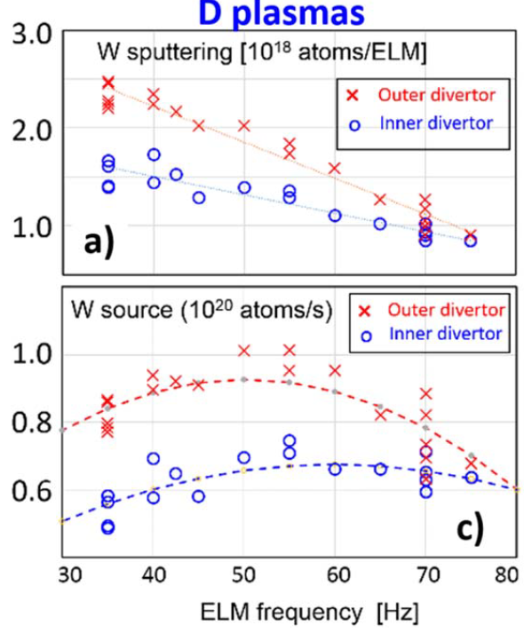
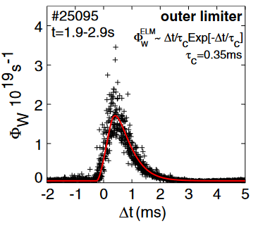
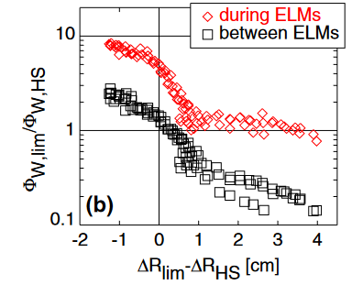
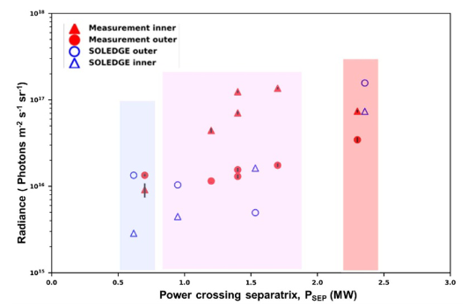
In situ analysis of W sources – gross erosion
W sources can be routinely measured and analyzed from spectroscopy data in multiple machines
Example of W source rate (AUG limiter) during an ELM
R. Dux et al. Nucl. Fusion (2011)
Limiter vs. heat-shield W source from AUG with relative distance from the separatrix
WEST W source as a function of power across the separatrix together with simulation results
C. C. Klepper et al. Plasma Phys. Control. Fusion (2022)
W source from JET divertor as a function of ELM frequency
A. Huber et al. Phys. Scr. (2021)
Same techniques demonstrated to be applicable to W proxies (Au, Mo, Pt,…)
Notes:
(

Slide 5
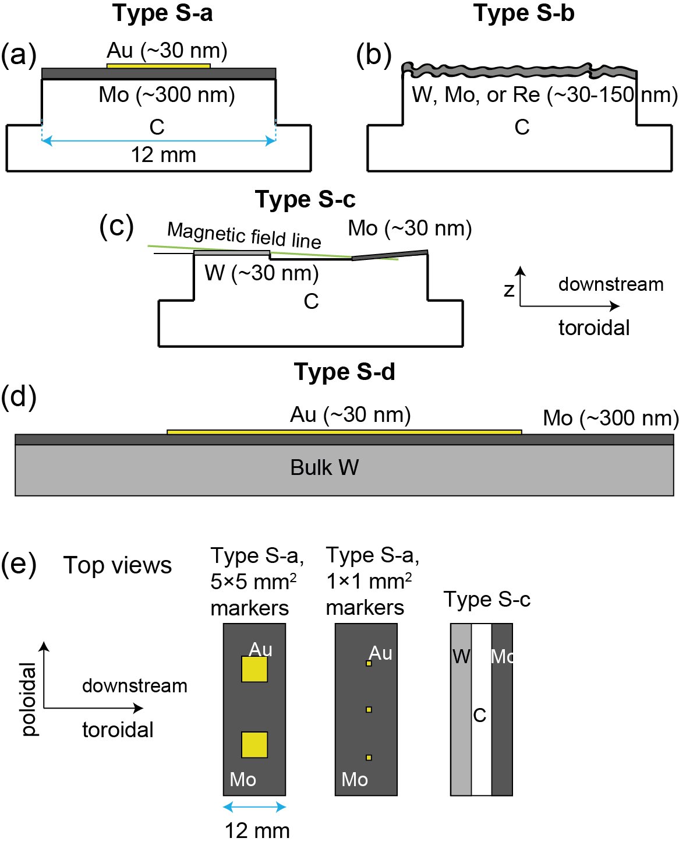
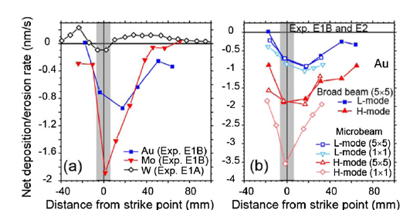
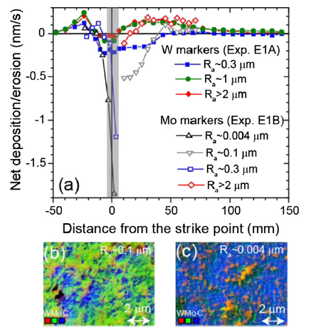
Ex situ analysis of W sources – marker samples exposed to plasmas
Marker experiments can reveal net – and sometimes gross – erosion in different exposure conditions and for varying materials, multilayer structures, and surface conditions
Discharge-resolved erosion studies
AUG: varying marker samples exposed to L-mode (Exp. E1A, E1B) and H-mode plasmas (Exp. E2) → net erosion profiles for modelling
Increasing roughness leads to reduced net erosion but surface features need to be carefully considered
Main tools: IBA and SEM/EDX
A. Hakola et al. Nucl. Fusion (2021)
Marker samples best suited for cases where they can be exposed during a limited set of discharges
A. Hakola et al. (VTT)

Slide 6
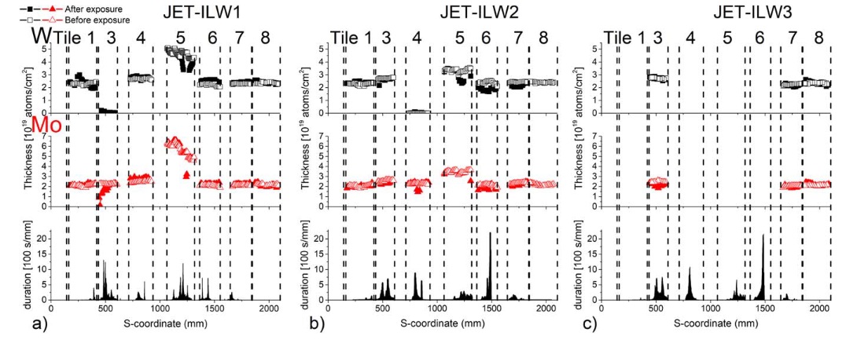
Ex situ analysis of W sources – marker samples exposed to plasmas
Marker experiments can reveal net – and sometimes gross – erosion in different exposure conditions and for varying materials, multilayer structures, and surface conditions
Campaign-integrated erosion data
Typically obtained from multilayer marker structures (like W + Mo + W+ Mo + substrate)
Main tools: IBA, SIMS, SEM/EDX
JET: co-deposits largely dominated by Be (JET-specific), in other devices B is the most prominent impurity
M Balden et al. Phys. Scr. (2021)
S Krat et al. Phys. Scr. (2020)
WEST: strong variations in the erosion-deposition patterns throughout the analyzed tiles, patterns evolve with the campaign

Slide 7
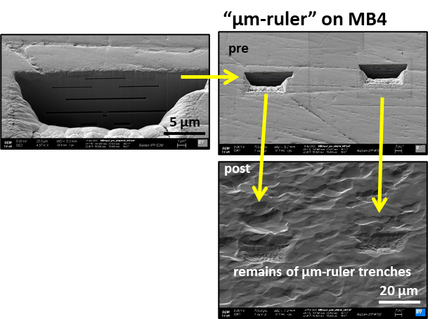
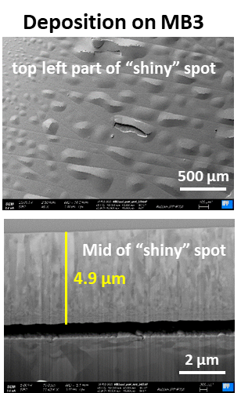
Ex situ analysis of W sources – marker samples for bulk components
For bulk samples, one can consider using μm-scale “rulers” realized on the samples
Example from MAGNUM-PSI - exposure to high-flux conditions
Parameters: 550°C by Ar plasma beam (10²⁷ Ar/m², impact energy 5-65 eV) + 10⁴ ELM-like 1-ms pulses (by laser)
Erosion determined for the ten µm-rulers prepared on the mock-up → both erosion and deposition visible
µm-thick deposits (with potentials of delamination) observed at the center of plasma beam spot at the highest energy
Applying rulers requires erosion to be measurable (but not too large) and not everything covered by deposits
M. Balden, T. Morgan, M. Rasinski et al. (MPG, DIFFER, FZJ)

Slide 8
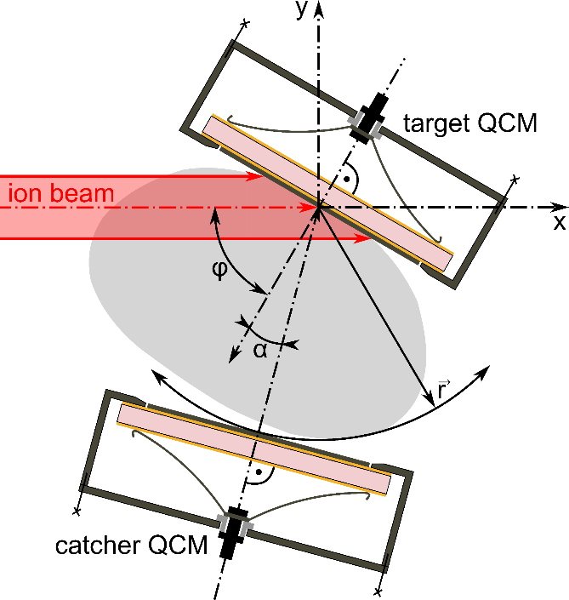
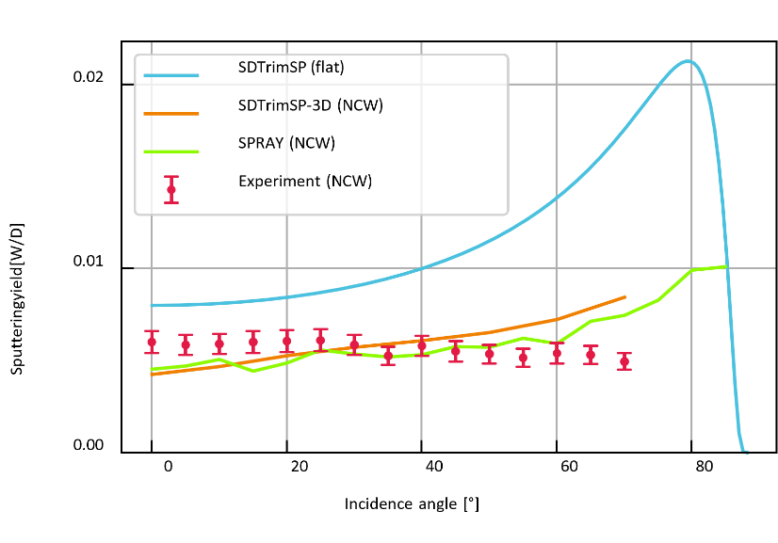
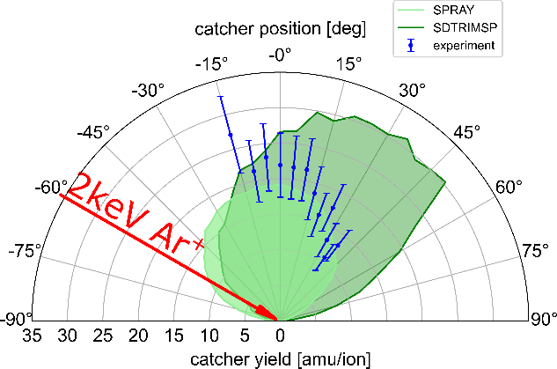
Ex situ analysis of W sources – QMBs for accurate sputtering studies
Quartz Micro Balances applied to sputtering yield studies for W samples with varying morphologies
example: 1keV D on structured W
ion beams (H, D, He, O, Ne, Ar,…) at 500 eV-5 keV directed onto samples
QMBs monitor the sputtering processes
$\frac{{∆f}_{Q}}{f_{q}}=− \frac{{∆m}_{Q}}{m_{Q}}$
mass change rates on the target down to 10⁻⁹ g/cm²/s (~10⁻⁴ W monolayers/s) can be detected
Direct target erosion experiments: thin films deposited on QCM substrates, angular dependence of sputter yields can be quantified
example: 2keV Ar on flat W
vacuum chamber
Catcher measurements: sputtered particles collected using catcher QCMs; angular distribution of ejecta can be probed
D
2
ion gun
Wien-filter
ion beam
target
Ar
φ
α
D
2
catcher
J. Brötzner et al. Nucl. Mater. Energy (2023)
M. Fellinger et al. (ÖAW)
Applicable also for linear devices and potentially tokamaks

Slide 9
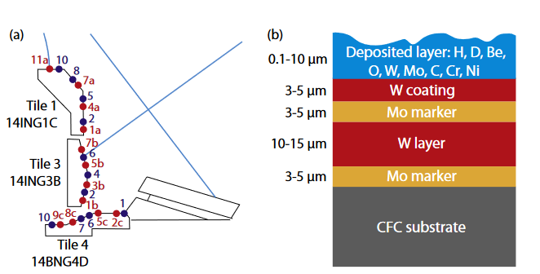
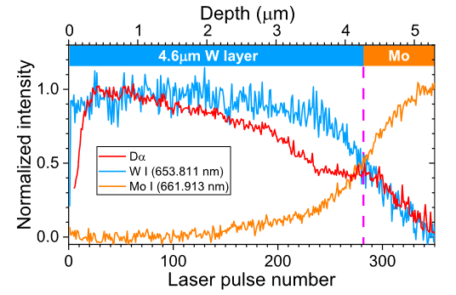
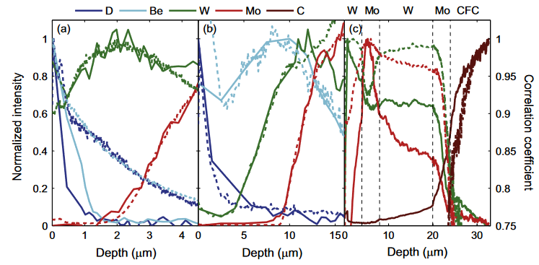
In between in situ and ex situ – LIBS and other laser-based tools
JET marker tiles
LIBS tested in laboratories, efforts ongoing in obtaining in situ data during plasma operations
PSI-2 exposure
H. Van der Meiden et al. Nucl. Fusion (2021)
Depth profiles can be relatively easily recorded – but post processing would benefit from short pulses with low energy (and possibly flat-top profiles)
J. Karhunen et al. J. Nucl. Mater. (2015)

Slide 10
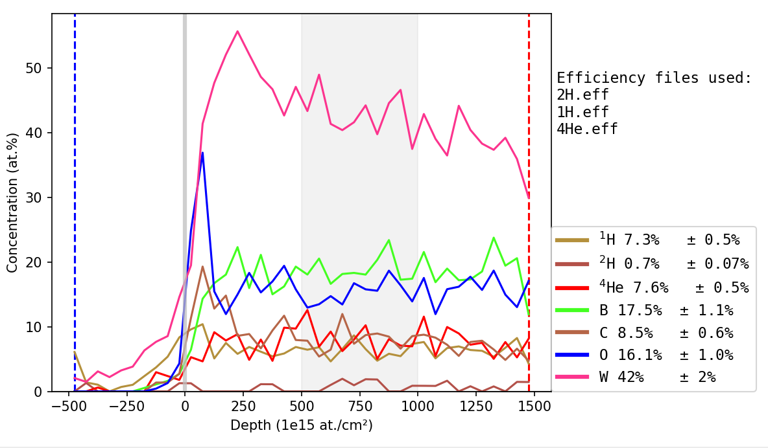
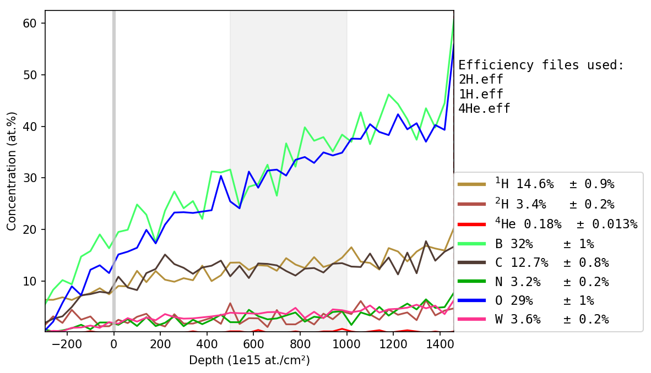
Plans for the period 2024-2025
Focus on samples originating from experiments in tokamaks (AUG, WEST) and linear devices (GyM, PSI-2, MAGNUM,…)
In concert with programmatic priorities of WPTE – next talk by Y. Corre – participating labs have enough resources to start working on with the available samples even at a short notice
New data to be expected from long-term samples (e.g, AUG wall probes) and reference layers exposed in linear devices
Main research questions to be addressed
Gross vs. net erosion – can we do that reliably for all the different experiments?
Sufficient spatial and depth resolution – to also investigate samples with 3D shapes?
Distinguishability of the different elements and isotopes?
Development needs for algorithms and tools to post process the measured data?
Difference in erosion/deposition patterns between hydrogenic and helium plasmas
How to handle very rough samples?
Sample production – definition of parameters well in advance
TOF-ERDA – ”smooth” vs. ”rough” sample (WEST C4 campaign samples from erosion zone and area with thick deposits)

Slide 11
Concluding remarks
Similarly to the boron layers, analysis capabilities are readily available for studying W erosion and deposition
Mainly routine techniques but interpretation of the measurement data may be tricky in realistic conditions
Applicability of new ideas (e.g., FIB rulers on bulk W pieces) requires demonstration in tokamaks
Several labs can produce W reference layers for experiments (linear devices, laboratories, tokamak experiments,…)
Same set of devices available as for the B samples, now even more possibilities around
Various parameters can be tailored and thickness can be controlled up to several micrometers
For marker samples, finding a perfect proxy for W is an issue – several boundary conditions to be met simultaneously
Should show properties close to those of W but at the same should be distinguishable from it

