Slide 1

2024-2025 Summary and Plans for Tungsten Source Studies within WPPWIE
Joint WPTE and WPPWIE Technical Meeting on
Plasma-Wall Interactions in full-W devices
Sebastijan Brezinsek
Forschungszentrum Jülich
Heinrich-Heine-Universität Düsseldorf
J.W. Coenen, A. Hakola, K. Schmid, A. Kirschner, J. Likonen, H. van der Meiden. M. Reinhart (PSO), and D. Douai (CO)

Slide 2
Revised ITER first wall material selection and new research plan
Old ITER plan: Use full-W first wall in ITER at the later stage of exploitation once main ITER goals (Q=10 and 400s & Q=5 and 5000s) with Be/W material mix were achieved!
New ITER plan: Start with full-W first wall, demonstrate plasma compatibility and control, demonstrate low retention and low dust production for the regulator, and show as soon as possible Q=10 for 100s (=> compensate the delay)
See T. Wauters et al.
Basic scientific input to the ITER decision to change the first wall:
Successful operation in full-W and full-C devices (with boron for wall conditioning)
Experience from JET operation with W divertor
Experience from AUG operation in full-W PFCs with start-up “without” boronisation
Progress in knowledge regarding operation with W (ECRH, RF design etc.)
Identified issues:
Tungsten first wall requires a new wall conditioning strategy in ITER as main technique „use Beryllium“ gone
Be gettered oxygen and ensured low pollution of the plasma core, has a moderate erosion source due to
absence of severe chemistry (contrast to C) and has a low radiation potential (contrast to W)
Residual O in the vessel and associated W sputtering can endanger start-up and Q=10 due to high core radiation
ITER strategy:
ITER reached out to community to address open questions, develop risk mitigation strategies, cure problems, make predictions => ITPA, EUROfusion WPs, ITER partners … => results feed into ITER new Research Plan
General observation:
JET with “W divertor + Be wall” behaves in general like AUG “with W divertor + W wall + transient B coverage”
ITER has made enormous effort to predict PWI with Be and a lot of knowledge can be translated to B

Slide 3
ITER relevant topics
Critical issues for ITER:
Boronisation is not a long-term solution for regular use in ITER, but a risk mitigation for start-up and in case of leaks etc.
Need to be prepared for the “clean” full-W operation
  W source and influx estimates during limiter phase in the ramp-up
  W source and influx estimates during steady-state phase and during ELMs (small ELMs or unexpected ELM excursion)
  W source and influx estimates during RMP application with lobes reaching the apron of the divertor
  Role of CXN, impurities and plasma ions in main chamber erosion (wall distance / 3D shaping)
  Role of (prompt) redeposition in the W source and influx estimation (semi-detached divertor regime)
  W source and influx diagnostic capability (main chamber) including reflections (expand use of available diagnostics)
  Properties of co-deposited W layers under ITER-like conditions (actively cooled divertor)
  Dust conversion factors from W co-deposits into W dust
Need to validate predictive full-W PWI simulations with plasma-PWIE code packages used for ITER on existing full-W devices and on relevant conditions (e.g. dedicated campaign with reasonable fluence and dedicated samples for analysis)

Slide 4
Studies in PWIE
W source studies in WPPWIE
Key work on W source estimates and influx already done in recent years for “divertor conditions” in tokamaks / linear devices
Focus in WPPWIE up to 2025:
  W sources as function of different W grades or material properties (new materials, crystal orientation, compounds, retention, damaged) in view of DEMO needs => SP A, SP B, SP C and SP X
  Properties of prompt re-deposited and co-deposited W and associated erosion yields => SP B & SP D
  Surface roughness evolution at medium and high flux / fluence => SP B & SP D
  Impact of He on W properties and sputtering => SP B and SP D
  Simulation of W sources and influxes in the divertor and the main chamber of ITER
  Support of AUG, WEST and JET experiments regarding post-mortem analysis => SP B and SP E
  Support of AUG, WEST and JET regarding W erosion, transport, and deposition (reference cases) => SP D
  Atomic and molecular data validation of W and W collision-radiative models => SP X & SP D
Tokamak experiments are in close collaboration with WPTE and dedicated experiments on full-W devices
DEMO activities are linked to WPs in the new EUROfusion technology departments (WPDIV, WPMAT, WPPRD)
A. Kirschner et al.
T. Morgan et al.

Slide 5
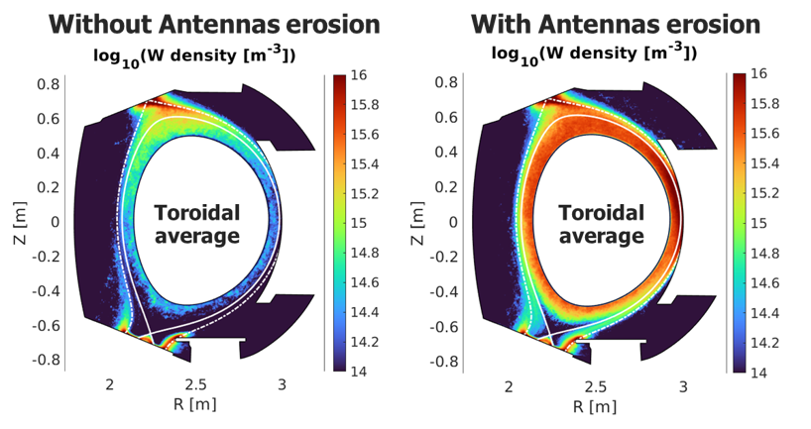
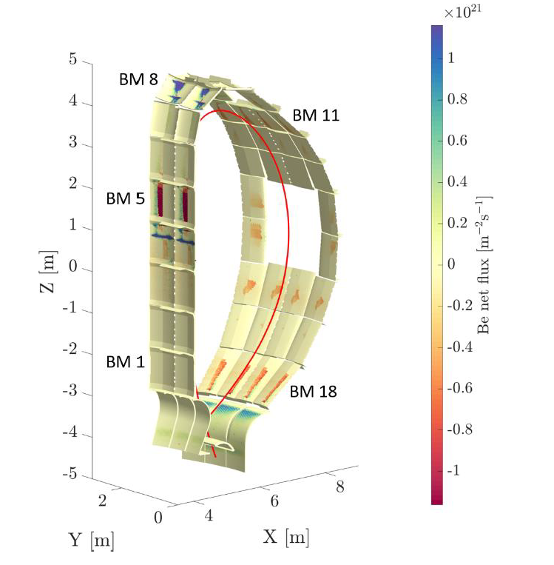
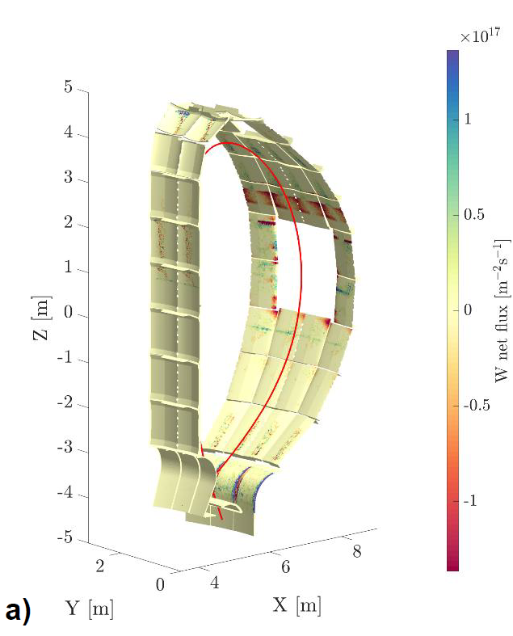
Examples: PWIE simulations with ERO2.0 andWallDYN-3D
For dedicated PWIE-related plasmas are simulations done for WPTE devices to address systematic PWI questions and benchmark codes
Predictive modelling is done for ITER in collaboration with IO providing plasma background information
Challenges:
  Benchmark experiments with the codes are only partially in the regime ITER will operate: semi-detachment, seeding, wall clearance, etc.
  Benchmark experiments only in a few cases with full set of data from spectroscopy and post-mortem analysis for ONE plasma
  Physics processes in ITER might be in different operational corner: CXN vs. impurity ions vs. plasma ions in first wall / limiters
Full-W WEST with SOLEDGE/ERO2.0
Be/W vs. Full-W ITER with SOLPS/ERO2.0
S. di Genova et al.
A. Eksaeva et al.
Focus on CXN implementation in the codes (poloidal, energy, angular resolved) for JET and beyond => H. Kumpulainen in SP D
Benchmark on experiments with manipulators and materials with different energy threshold positioned at different radial position (with TE)
Need of an AUG & WEST reference experiment in semi-detached operation and material samples (AUG with “closed” divertor)

Slide 6
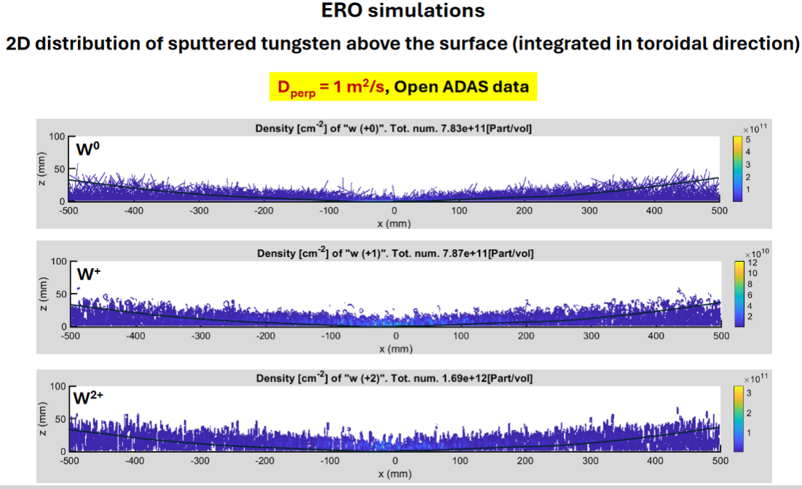
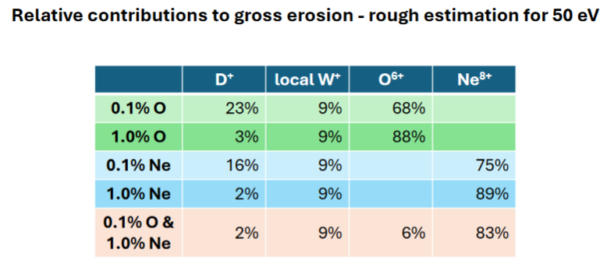
ERO simulations of limiter start-up conditions in ITER
Critical ITER question regarding W start-up addressed
  EAST experiments early 2024
  ITER used EAST data to indicate self-regulation of W (as seen in TEXTOR)
  ERO simulations of start-up conditions (using symmetry assumptions)
  to determine the gross/net W erosion and prompt redeposition factor
  Provision of benchmark data from well-diagnosed limiter plasmas in WEST or AUG with good spectroscopy and plasma background
A. Kirschner et al.

Slide 7
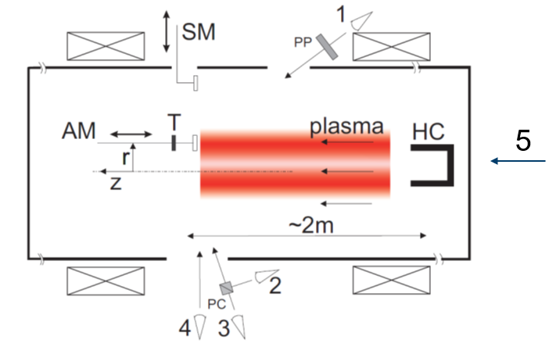
PSI-2 spectroscopic studies: Angular and Energy Distribution of sputtered W
PSI-2 arrangement for gross erosion studies
PSI-2 is used to study basic physics question and processes related to W
Spectra from different W crystal structures: poly-, mono (100) and (111)
Energy/velocity (VDF) and angular distribution function (ADF) of sputtered tungsten via Doppler-emission model
Benchmark of W atomic data and of sputtering codes (MD, TRIM, etc..)
Time-resolved W morphology change documentation
Benchmark to ERO2.0 simulations for single cases of manifold of plasmas, but usually, Ar or He plasmas as W sputtering too low with D!
Validate properties of actual W material pre- and post-tokamak exposure
and check impact on global W migration date in simulation codes
5 lines of sight an multiple spectrometers
WI at 498 nm
M. Sackers et al.
O. Marchuk et al.
Note: in PSI-2 as in GYM, the majority of W escapes from the plasma column
Difference in W erosion yields only 25% in energy range of 60-160 eV

Slide 8
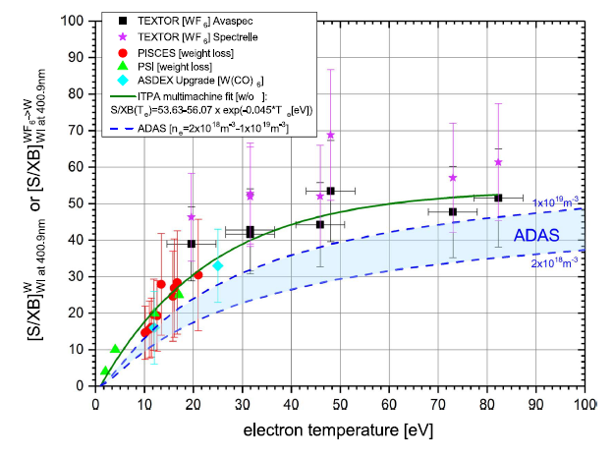
PSI-2 spectroscopic studies: Collision-radiative models for W
PSI-2
PSI-2 is used to study basic physics question and processes related to W
Further test of atomic data for WI and WII (e.g. ADAS, & Auburn)
Identify suitable lines beyond W I=400.8nm and WII=434.8nm in visible range
Role of ground state population vs. metastables
Complex ground state population in W
  In TEXTOR population in different levels found
  In PSI-2 predominantly in the ⁵D₀ ground state
Considering new experiments with W(CO)₆ evaporation like by Steinbrink et al.
LIF and TALIF set-up in PSI-2 to measure active absolute densities
Validate data for tokamak simulations using W atomic data
Grotian diagramm from NIST
S. Ertmer phd thesis
S. Brezinsek Phys. Scr. 2017

Slide 9
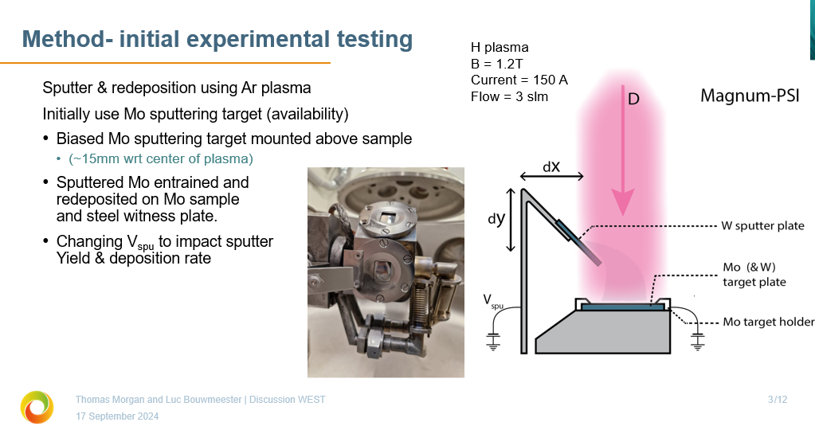
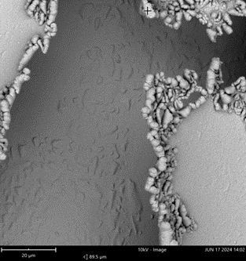
MAGNUM-PSI: Simulation of WEST high fluence campaign
MAGNUM-PSI is used to mimic WEST high fluence campaign
Mimic high W influx from WEST main chamber into W divertor by artificial impurity source
Test experiments in Ar plasma to get high W source in plasma
Final step: try to mimic ITER conditions => Lower W flux from wall into divertor => different balance of W erosion/deposition
Flaking Mo layers observed

Slide 10
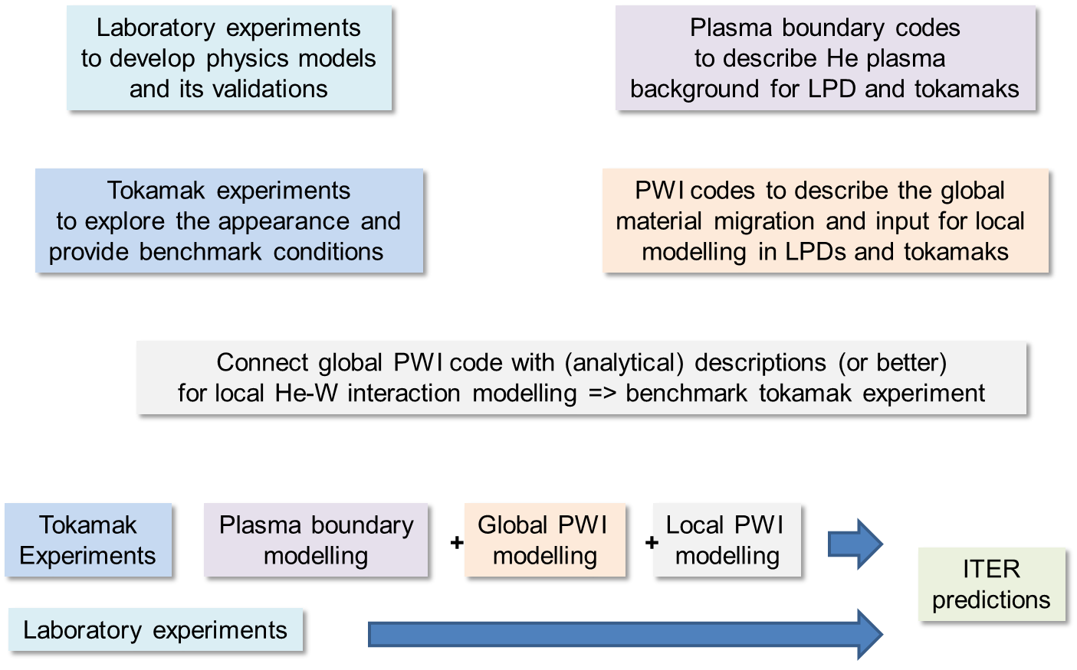
Completion of He-W studies in AUG, WEST and JET (linked to ITPA)
Open topics related to W erosion
to be done in 2024-2025:
Simulation of local PWI including model for W fuzz in AUG
PSI-2 experiment mimic WEST conditions (material, plasma, temperature and impurities) showing now W fuzz
Analysis of JET tile 5 : LIBS (post-mortem likely later)

Slide 11
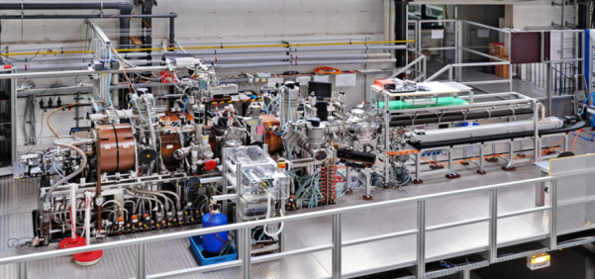
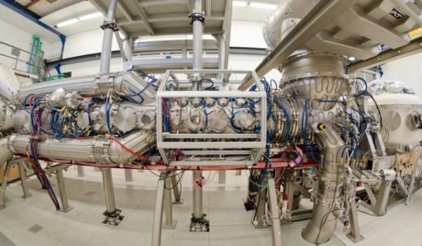
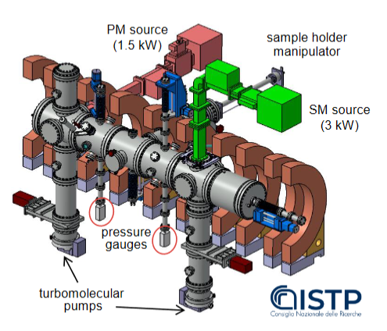
Plasma facilities within WPPWIE
PSI-2:
Medium flux and fluence
MAGNUM-PSI
and UPP:
High flux and
fluence
GyM:
Low flux and fluence
Facilities complement each other in
parametric space and diagnostic capabilties
Bridge to tokamak experiments via
modelling tools for plasma and PWI simulations
regarding W
Extrapolation towards ITER

Slide 13
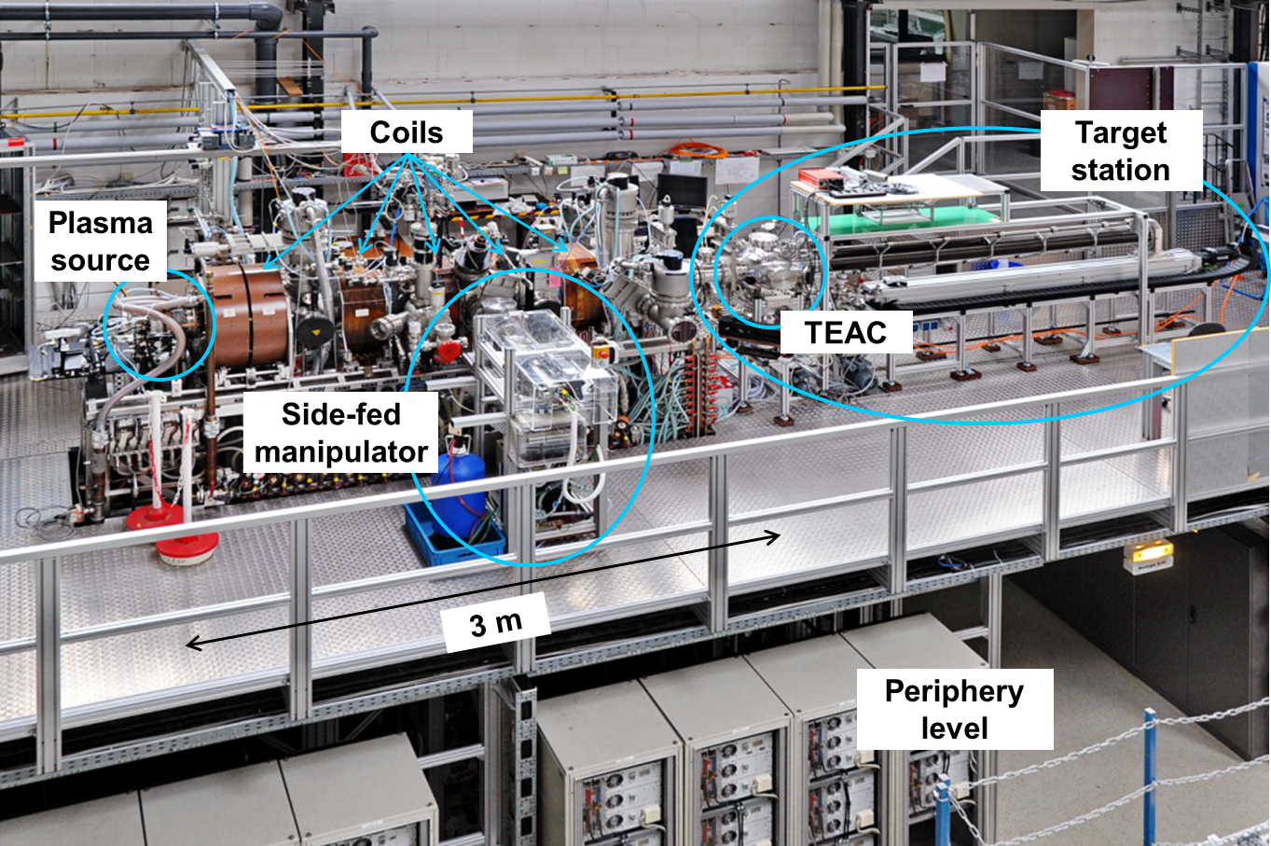
PSI-2 set-up

