Slide 1
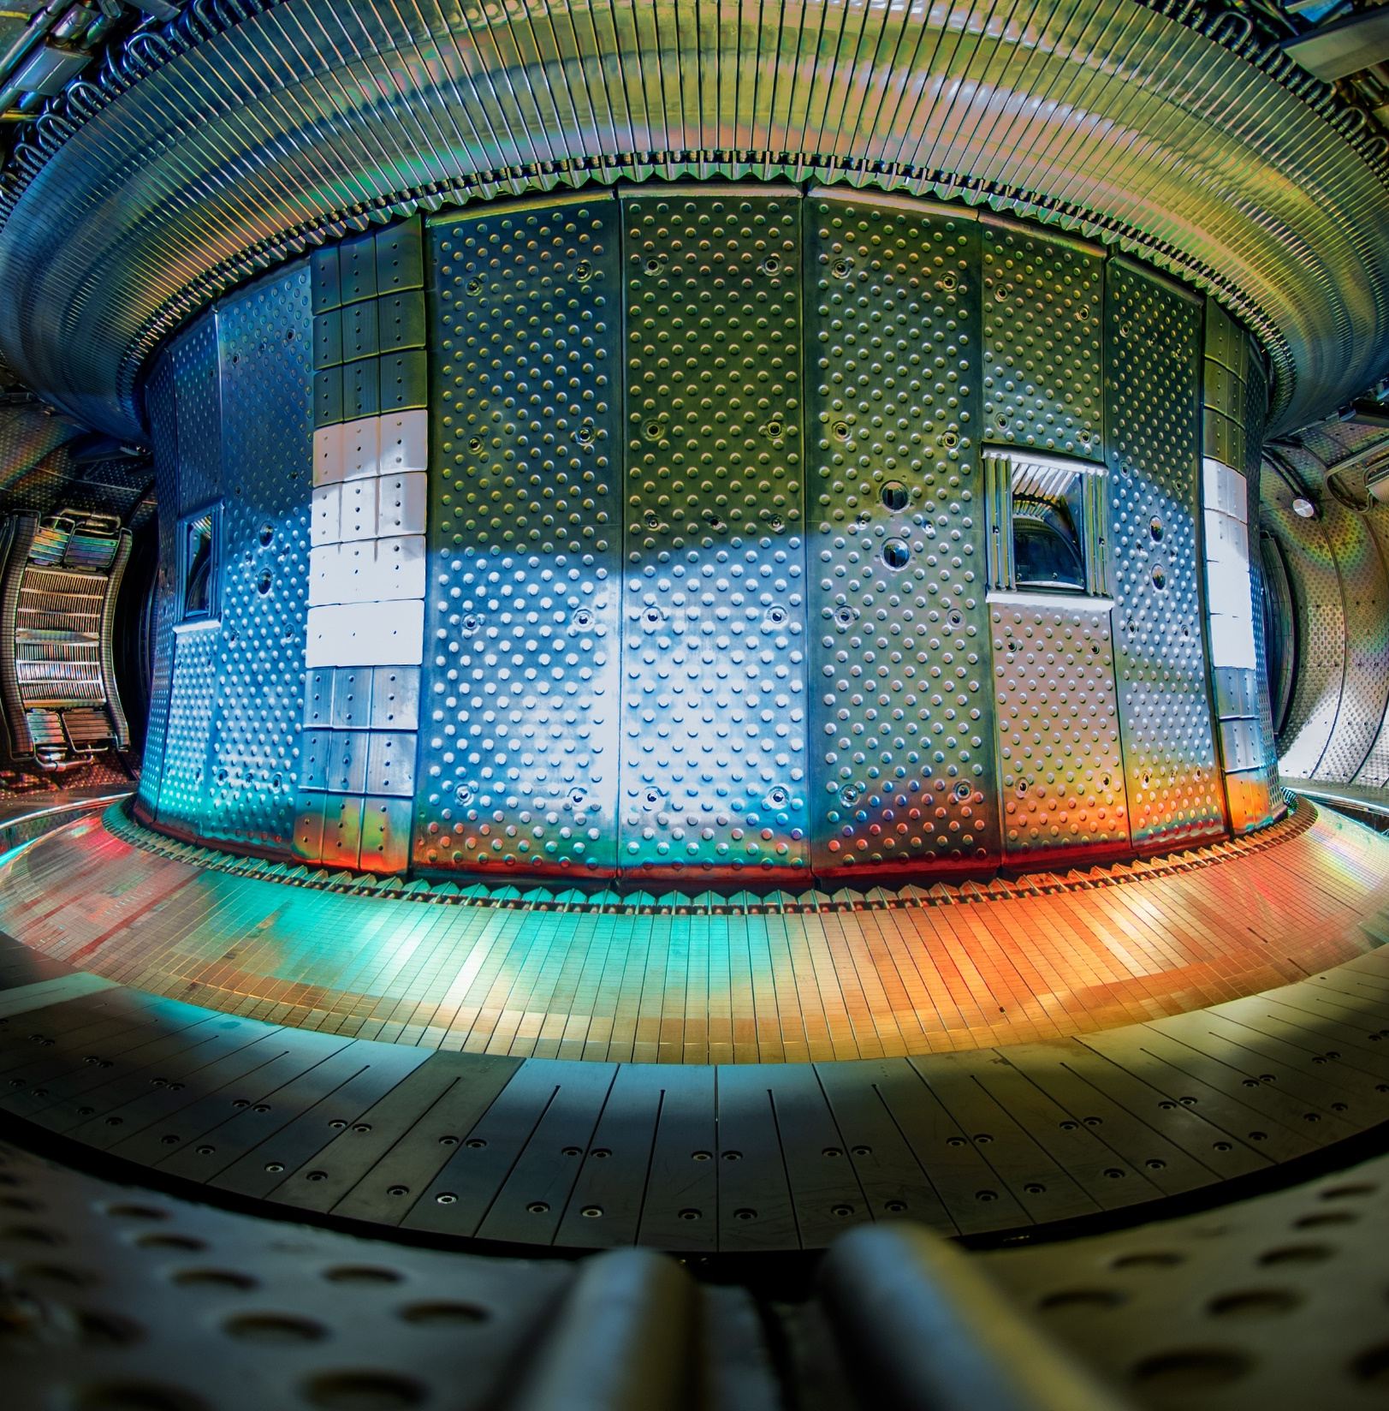



WEST capabilities for W damage studies
17th of September 2024
Aix En Provence
M. Richou¹, A. Durif¹, M. Diez¹, W. Wirtz², D. Dorow-Gerspach², Y. Corre¹, J. Gaspar³, and the WEST team
1. CEA,IRFM; 2. FZJ; 3. IUSTI

Slide 2
Outline
WEST vs ITER divertor
ITER grade divertor – technologies
Modulated heat and particle loads
Study the evolution of damage in WEST
Conclusions

Slide 3
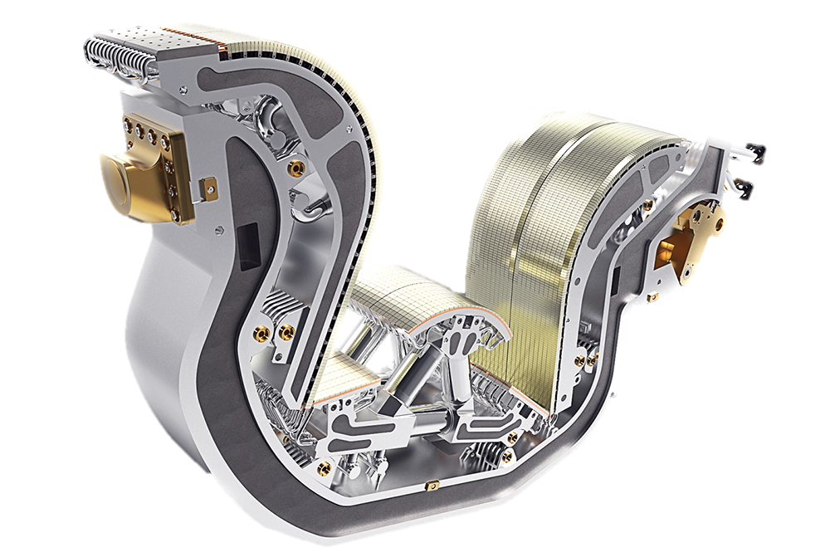
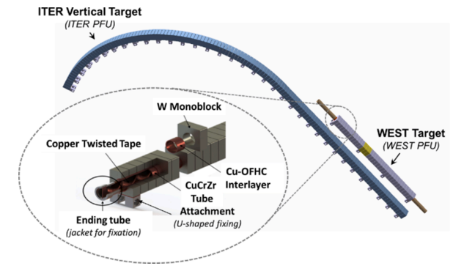
1. WEST vs ITER divertor
  Same monoblock technology, same geometrical shape of the monoblocks, same thermohydraulic conditions
  12 sectors of 38 Plasma Facing Units of 35 MB
  WEST lead to study on the ITER grade divertor the evolution of damage induced by PWIE
    1) Damage induced by tokamak operation (runaway, type I ELMS, steady state…)
    2) Damage artificially created or already existing (pre-damage) before tokamak operation, for the study of their evolution under tokamak operation
WEST ready for phase 2 – summer 2021
500 mm
3

Slide 4
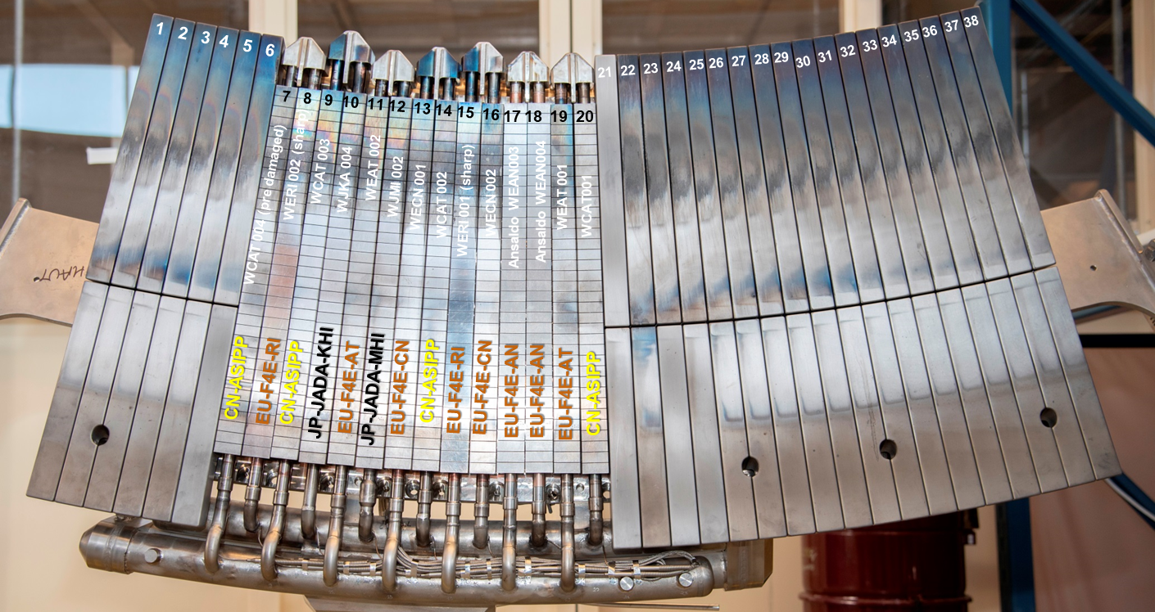
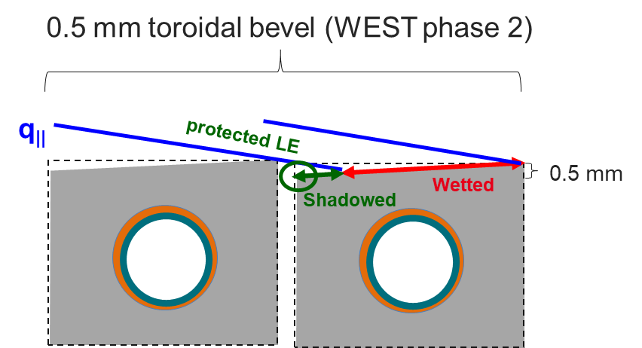
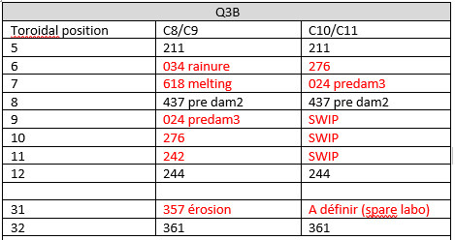
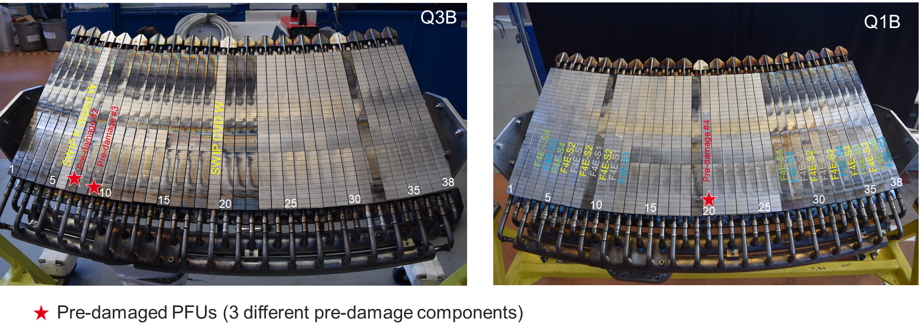
2. ITER grade divertor – available technologies
  Different plasma facing surface shape (non-bevel (Phase 1) vs bevel (Phase 2))
  Different manufacturers (ASIPP, F4E, SWIP)
    Different CuCrZr
    Different plasma facing materials: tungsten (AT&M, ALMT, SWIP), tungsten alloy (W-K from SWIP)
    Different swirl heat treatment (fretting issue induced by the swirl contact into the CuCrZr tube)
    Different joining technologies
C4 (2019) : 14 ITER like PFU
Notes:
Photos de mathilde des différents secteurs mis dans WEST au cours des campagnes

Slide 5
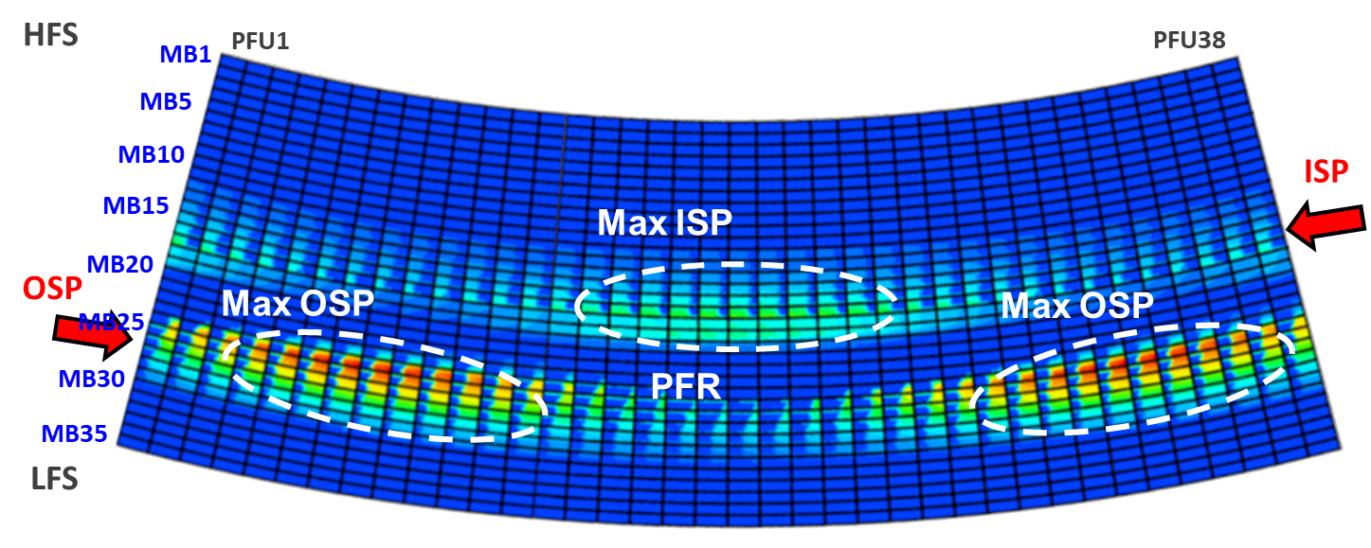
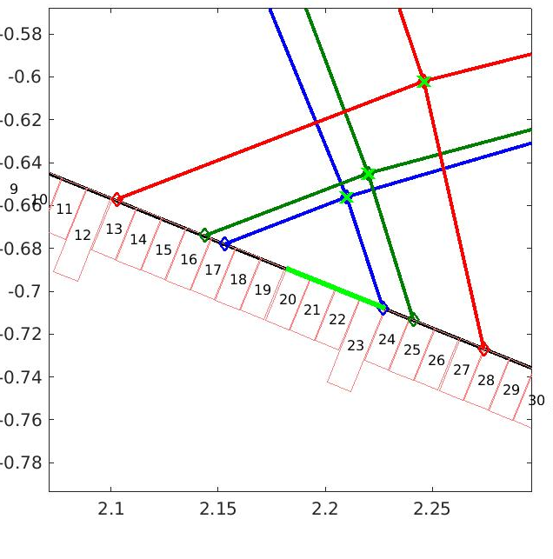
3. Modulated heat and particle loads (1/3)
WEST divertor heat/particle load pattern modulated by ripple
Toroidal bevel to protect leading edge (ITER) : local monoblock shadowing
Heat load “on demand” :
  Difference between PFUs (position on the divertor),
  Difference within a PFU
  On purpose monoblock loading (Inner Strike point from blocks 13 to 17 – Outer strike point from blocks 23 to 28)
  On purpose misalignment
# 54356 & # 60205 & # 58027
Shadowing by the toroidal bevel
Simulated heat load deposition (PFCflux code)
5

Slide 6
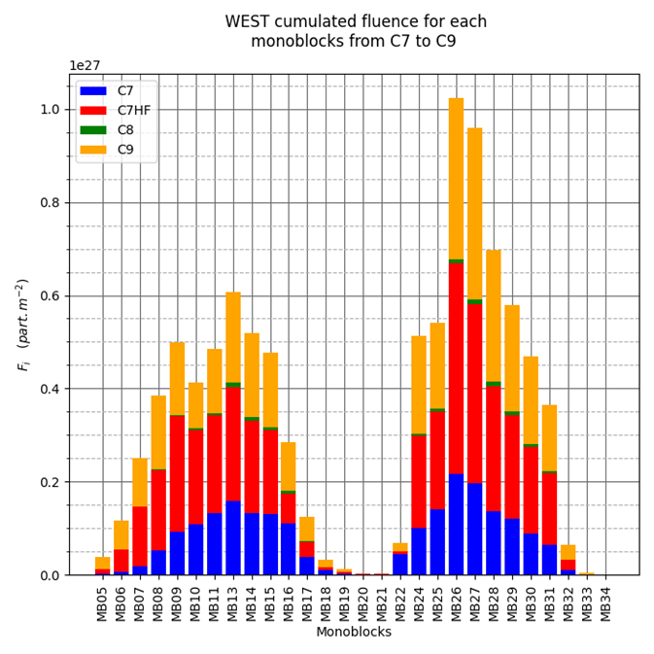
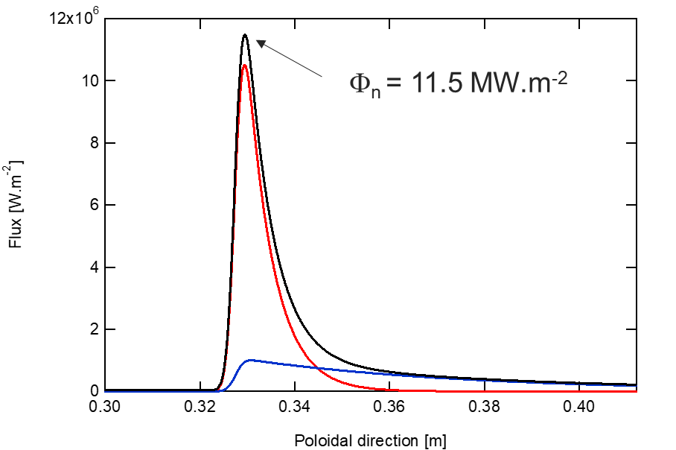

3. Modulated heat and particle loads (2/3)
Types and range of heat loads:
Parallel heat flux during disruptions : up to 600 MW/m²
  ITER relevant plasma exposure cumulated on monoblocks
    plasma duration (10 h), heat load (~10 MW.m-2 in steady state on the top surface), fluence (6 ITER PFPO)
  Expected Type I ELMS : 50-100 kJ/m² (significantly below the tungsten melting threshold), 50 Hz,
Gunn, NME,2021
Durif, Phys. Scr., 2022
[J. Gunn & A. Huart]
groove
$$λ_{q,near}^{t}=5.5 mm$$
$λ_{q,far}^{t}=47 mm$
[Y. Anquetin]
MB28
Notes:
The disruption thermal cycle is composed of 3 ms heating (a ramp up for 1 ms and a ramp down for 2 ms)which is representative of thermal quench duration (in ASDEX [19]) followed by 97 ms cooling (Figure 2)which is the time needed to reach homogeneous coolant temperature on the entire tungsten block
Melting treshold : As a reference, an energy fluence of 1.0 MJ/m2 is sufficient to cause shallow surface melting of W

Slide 7
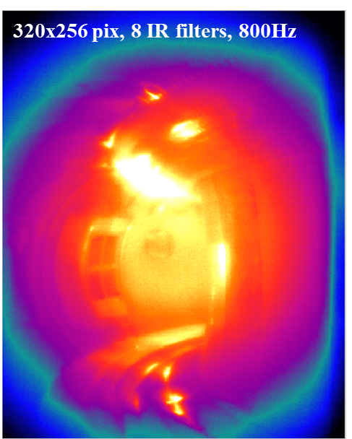
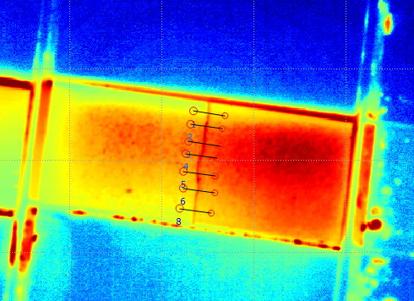
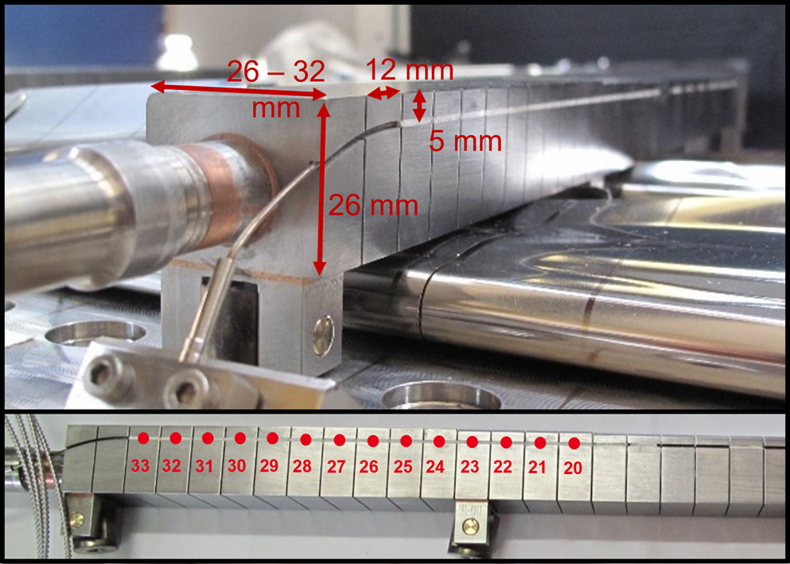
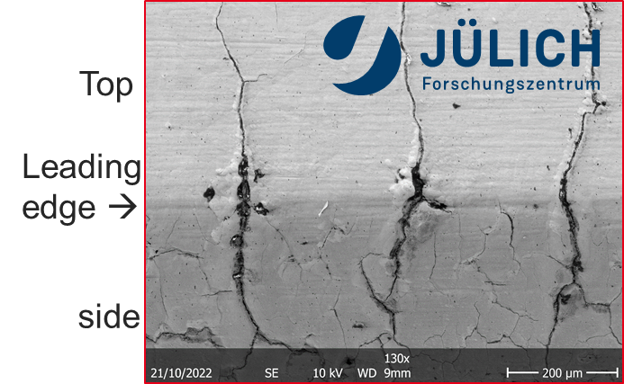
4. Study the evolution of damage in WEST
    Use of diagnostics during the WEST operation
      Use of visible spectroscopy
      Use of fast IR camera
      Use of FBG, infrared data (very high resolution, wide angle…)
    Maintain and develop the models to understand the potential damage evolution
    ➲ Crack formation: T-REX modeling (Adapted to steady state, cycling loading)
    ➲ Crack propagation : J-Integral
    …
    Characterize the damage (before and after WEST operation) (Visual, microscope…)
K. Zhang, Fus. Eng and Des., 2022
Fast IR camera
VHR image
FBG implementation
Cracks
12 mm
Notes:
Visible (assess the impact of damage on particle ejection during plasma operation)
Fast IR camera (runaway energy) Synchrotron emission detection with Fast IR camera during RE experiments on WEST
FBG (assess the impact of plasma)

Slide 8
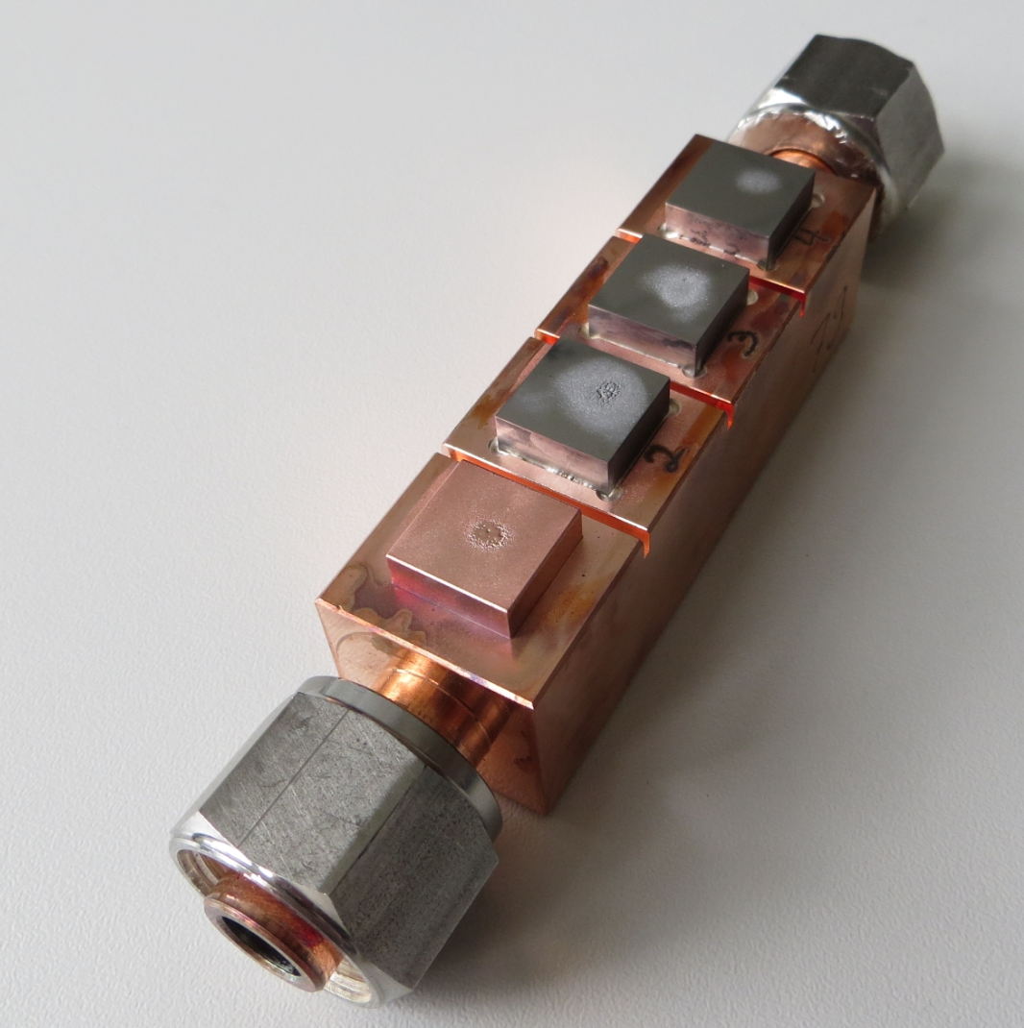
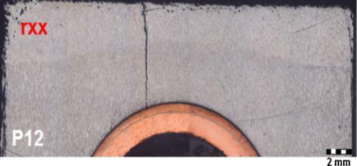
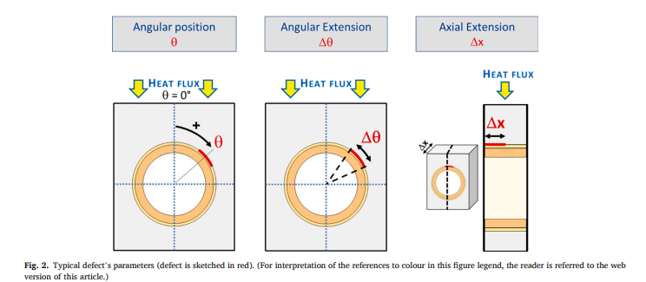
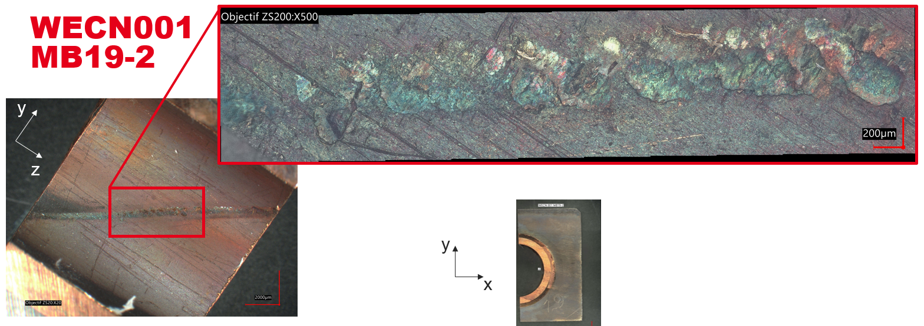
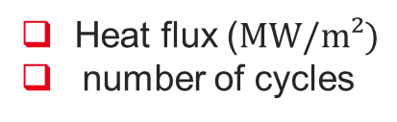

Damage of interest
Heat flux factor ($MW/m²\sqrt{s}$),
number of pulses
Base temperature
Induced by transient, high energy event:
Pre-damage (e-beam, neutral, plasma…),
On purpose in WEST (runaways, in future type I ELMs, …)
M. Richou et al., Nuclear Fusion, 2022
Induced and evolved under steady – state loading:
Heat flux ($MW/m²)$
number of cycles
Pre-damage (e-beam, neutral, plasma…)
G. Pintsuk et al., Fusion Engineering and design, 2013
Fretting
CuCrZr surface temperature
Cooling conditions
M. Ramaniraka, NME, 2022
Fabrication: Thermal imperfection size (θ,Δθ, Δx)
S. Baydoun, SOFT conference, 2024
Pre-damage ?
On purpose in WEST
Pre-damage (fabrication)
Notes:
Swirl tape inserted in the divertor cooling pipes is used to increase the component thermal efficiency by enhancing turbulence.
But micro-oscillatory motion between the swirl tape and the pipe leads to fretting wear (flow-induced vibrations
Pre-damaged interface component (PFU#266 / MB#13):
Aim: Provide Structural Health Monitoring (SHM) keys for ITER/DEMO to monitor and follow in real time non expected hot spots related to internal PFU defects via IR diagnostics

Slide 9
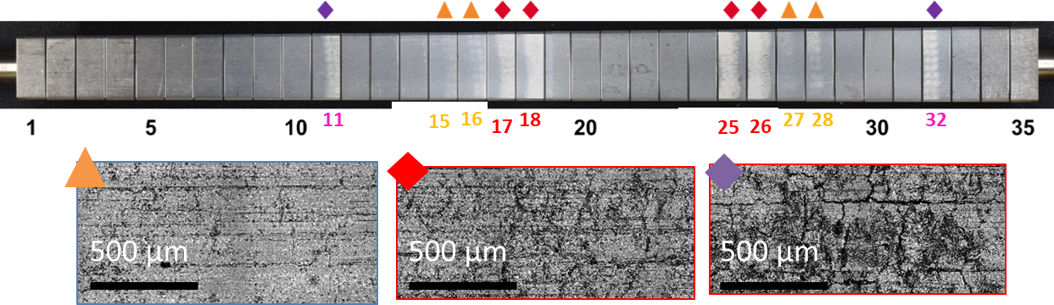
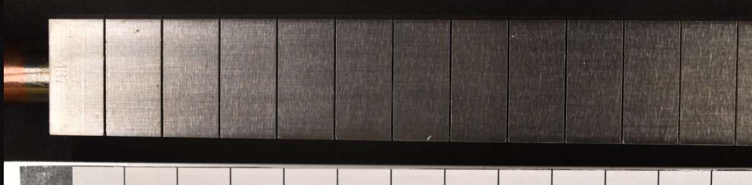
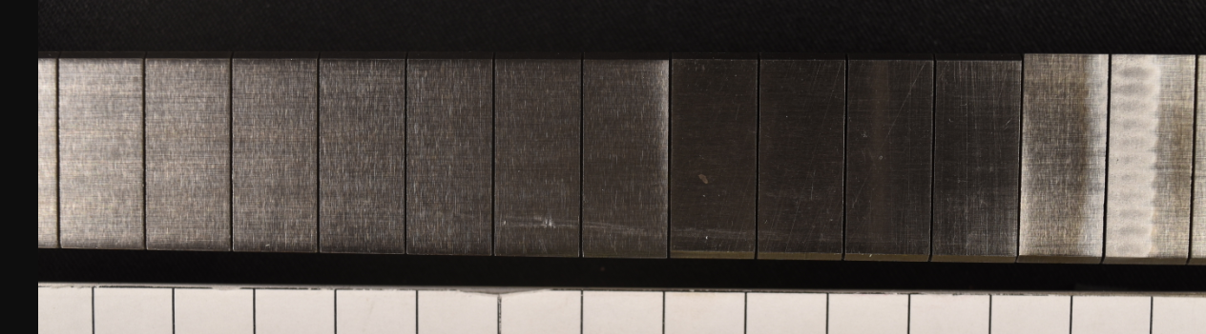
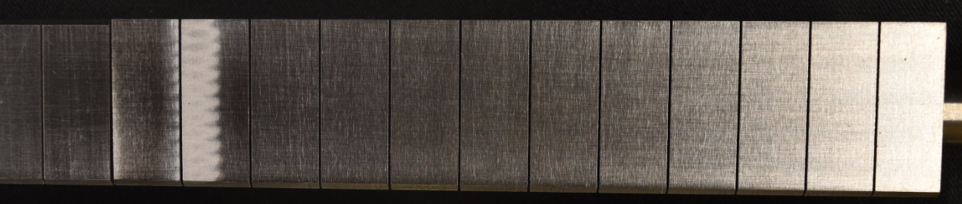
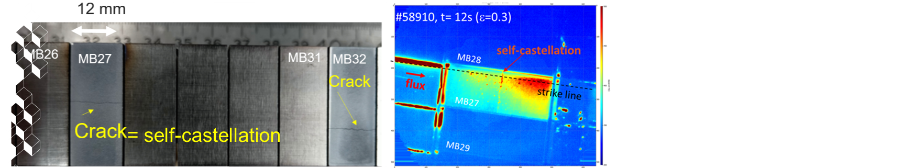
Damage tested in WEST since 2018 ?
PFU pre-damage#1: Transient pre-damage (3 types of damage) (C3/C4 – 2018-2019)
PFU pre-damage#2: Transient pre-damage (1 type of damage) (C7/C8/C9 2023 –2024)
PFU pre-damage#3: Steady state fatigue pre-damage (C8/C9 2023-2024)
PFU pre-damage#1
PFU pre-damage#2
PFU pre-damage#3
M. Richou et al., Nuclear Fusion, 2022
Y. Corre et al., Nuclear Materials and Energy, 2023
M. Richou et al, Nuclear Fusion, 2024
A. Durif, PSI conference, 2024
9

Slide 10
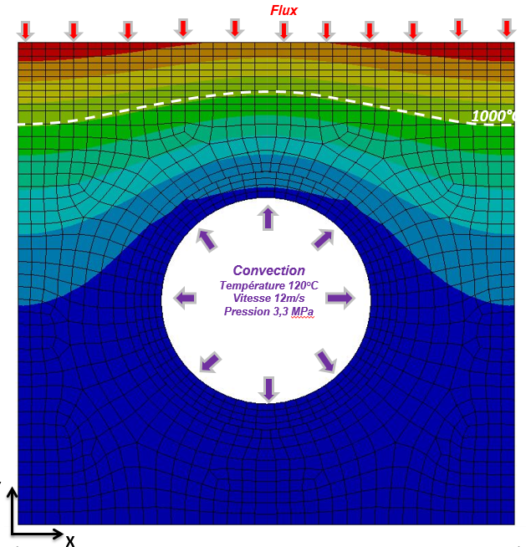
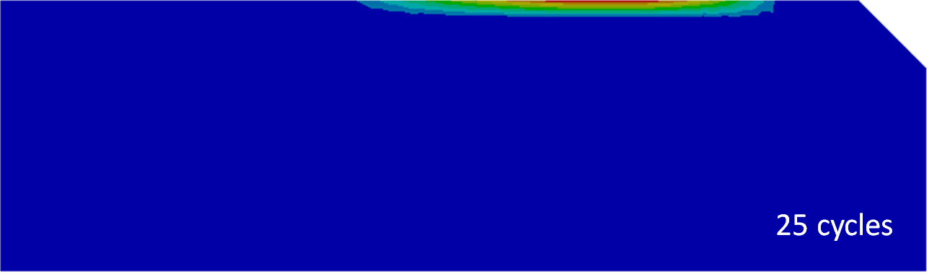
Modeling- Focus on T-REX
  Aim: Assess When, Where and How cracks should initiate in tungsten based on the accumulation of plastic strain (Take into account the real geometry)
Heat Flux (t)
Convection (t)
dpa(constant)
1
softening
(recrystallization) gradient
Already used for studies related to WEST, ITER or DEMO
Need a tool to link the output from T-REX/ J-integral to the end of life time
Thermal gradient
Thermal modelling
A. Durif et al, Phys. Scr., 2022
Durif et al, J. Nuc. Mat., 2022
A. Durif et al, Fus. Eng. and Des., 2023
Q. Tichit et al, NME, 2023
T (t)
softening fraction (t)
Stress
W (dpa=0)
&
Softened W (dpa >0)
W (dpa>0)
Softened W (dpa=0)
2
Strain
Mechanical modeling
Strain (t)
Stress (t)

Slide 11
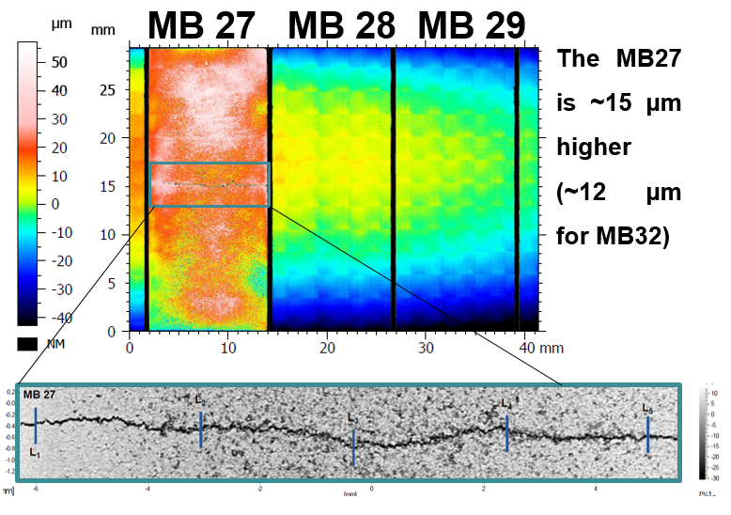
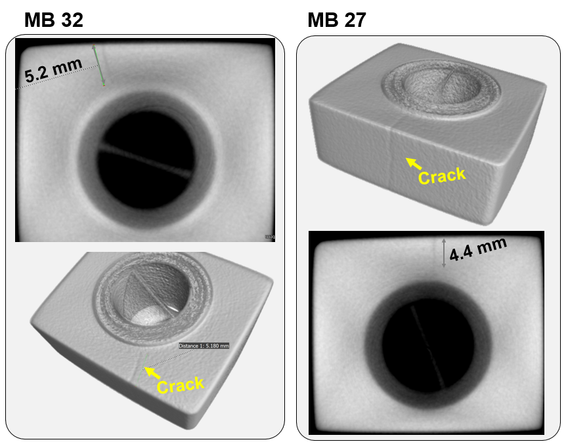
Characterization (1/2)
  Confocal & profilometry analysis (Crack, roughness)
  High energy X-Ray tomography (6 MeV) (In depth crack)
MB31
A.Durif et al., PFMC conference, 2023
11

Slide 12
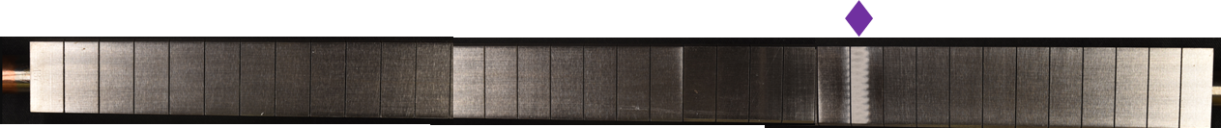
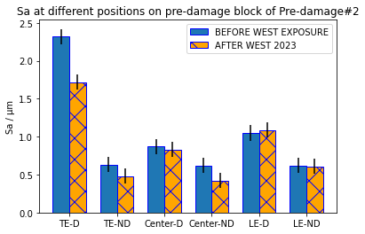
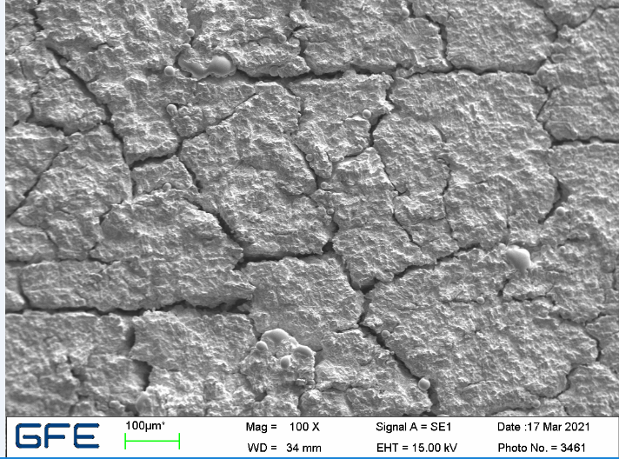
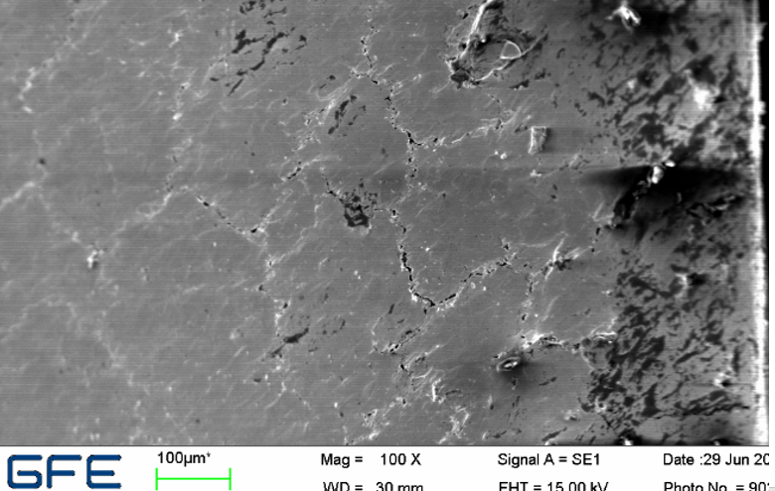
Characterization (2/2)
Trailing edge
Block 25
Before WEST exposure
TE-D
-26%
TE-ND
Non exposed to plasma
Center-D
-5%
After WEST exposure
Center-ND
-24%
-32%
LE-D
LE-ND
Leading edge
M. Richou et al., Nuclear Fusion, 2024
From material studies, arithmetical roughness (Sa/ µm) is adapted to characterize damage on polished material (Sa=0.1 µm)
For WEST components, after WEST campaigns: equivalent variation of Sa for non-damage and damage zone and increase of Sa for parts not exposed to plasma
After WEST campaigns, cracks are filled with deposit -> Sa measurement is not adapted
Need to develop alternative characterization ( Sq ??)

Slide 13
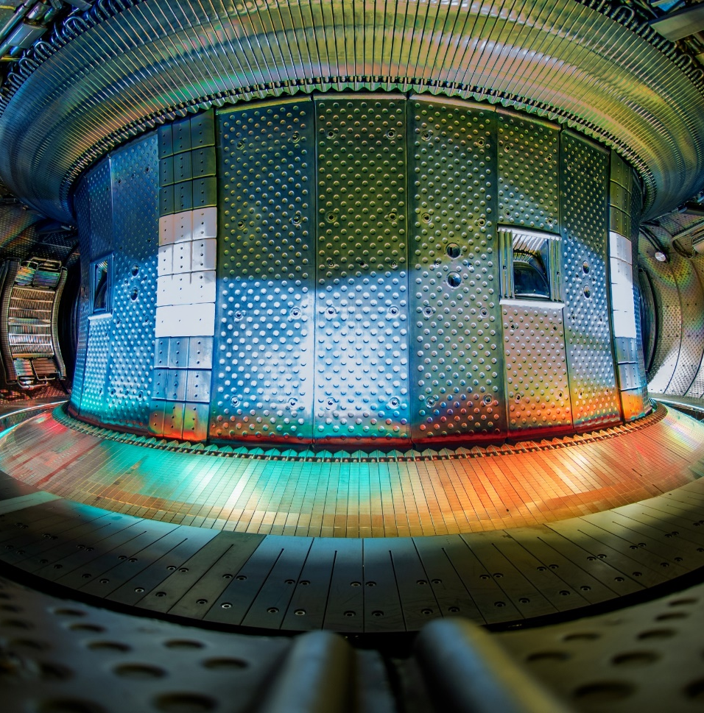
Conclusions and prospects
WEST can provide modulated heat and particle loads
WEST heat load capabilities : runaways, disruptions, steady state (up to 10 MW/m² on the top surface)
Flexibility of WEST heat loading by positioning damage adequately on the lower divertor
Analysis of the effect of WEST operation on damage evolution/formation
Need
Need of modeling tool to provide the link between observation and PFC life time assessment
Need to develop characterization tools to assess the damage before and after WEST exposure
Prospects
  WEST could be used to test ITER first wall joining technology (Inner bumper…)
  Future capabilities : Type I ELMs

Slide 14
Thank you for your attention

