Slide 1

WP PWIE W damage studies in 2024-2025
Joint Workshop WPTE/WPPWIE
Jan W.Coenen
Forschungszentrum Jülich Gmbh, Institut FOR Fusion Energy and Nuclear Waster Management IFN-1 52425 Jülich, Germany,

Slide 2
SPA– 2023 / 2024 - Overview
Focus on damage evolution of ITER-like MBs
(including WEST MBs)
Recrystallisation evolution in W (incl. modelling)
Focus on ITER-like MBs testing under multiple seeding, species, ELMs, and He
Plasma qualification of new materials for DEMO and other toroidal facilities (e.g. W7-X)
Disruption-like loading for DEMO (incl. OLMAT)
Melting of MBs => MEMETO modelling)
KIPT as possible during cicumstances
Viability of advanced plasma-facing materials for DEMO-assessed including prototype materials such as W VPS on steel (with WPBB). Lifetime assessment linked to WEST, MAGNUM-PSI, GLADIS and JUDITH testing. (DEMO)
Characterisation of exposed WEST W-PFCs regarding recrystallization and damage. Further studies on material recrystallization physics incl. µ-CT studies (ITER).
Exposure of DEMO baseline W mono-blocks (from WPDIV) in MAGNUM-PSI at high plasms fluence and mixed seeding species (DEMO)
Benchmark of MEMOS-U and new MEMENTO code with W melt experiments in ASDEX Upgrade and WEST (with WPTE). (ITER+DEMO)
SP A.1 Synergistic Load Studies of Plasma-Facing Materials for ITER & DEMO
SP A.2 High Particle Fluence Exposures of Plasma-Facing Components for ITER
SP A.3 Advanced Materials under thermo-mechanical and plasma loads
SP A.4 High Temperature performance of Armour Materials: Recrystallization and Melting
Participants: CEA, CIEMAT, DIFFER, DTU, FZJ, JSI, KIPT, LPP-ERM-KMS, MPG, VR,
Strong Link to ITPA DivSOL – DSOl44

Slide 3
Results 2023 / 2024 – WPPWIE
SP A.1 Synergistic Load Studies of Plasma-Facing Materials for ITER & DEMO

Slide 4
Tasks to be performed:
Establish a test matrix for Materials utilized in WEST and ITER with respect to updated load specifications. in the available devices (DIFFER, FZJ, MPG)
Study the impact of synergistic loads on ITER and DEMO relevant baseline Materials (tungsten, W-FGMs on Steel) and new materials developments with Laser (Laser at PSI-2) and e-beam (JUDITH) as well as steady-state plasma exposure (He, H). A special focus will be the qualification of these materials under high cycle numbers and seed-impurities exposure. (FZJ)
Post-mortem analysis will characterize the induced surface modifications and damages as well as investigate changes of the materials properties due to e.g. recrystallization behavior and/or surface morphology changes. (FZJ, MPG, DIFFER, KIPT)
Determine underlying mechanisms of evolution of crack propagation in materials for ITER and current day devices. (FZJ, DIFFER, KIPT, MPG)
Qualify W materials for use in W7-X. (MPG, FZJ)
Synergy effects from sequential stationary (PSI-2 / MAGNUM-PSI) and transient (QSPA) plasma loads. (DIFFER, MPG, FZJ, KIPT)
Studies of fatigue cracks formation in deformed/re-crystalized W, fatigue damage of W_{f}/W wires, latticing W etc. (FZJ)
Combination of pulsed and steady state loading (e.g. behavior of QSPA pre-damaged targets in PSI-2, JUIDTH compared with reference samples). (FZJ, KIPT)
Study the Behavior of pre-cracked samples under edge loading conditions - links to HHF facilities such as JUDITH and WEST. (DIFFER, FZJ)

Slide 5
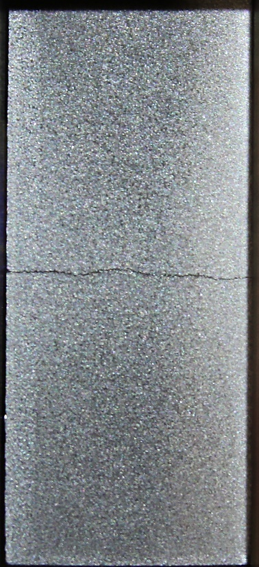
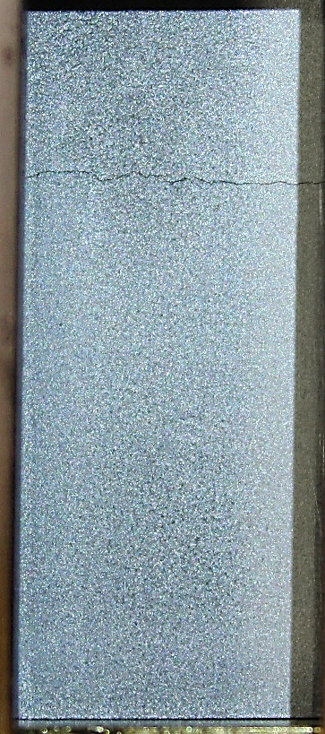

SP A.1 Synergistic Load Studies of Plasma-Facing Materials for ITER & DEMO: FZJ
Generation of distinct macro cracks within the WEST PFU MBs
MB width has influence on the power density/stresses needed to generate a macro crack
MB 27: @ 24 MW/m²
  Cycle: 1 - 20
MB 32: @ 20 MW/m²
  Cycle: 21 – 40
High pulse number tests of PIM W grades
PIM-W alloys show comparable or better fatigue performance to the as-received pure tungsten grade in terms of damage category and crack formation
more detailed investigations of the induced damages indicate that especially surface modifications like roughening due to plastic deformation and the particle induced nanostructures are less severe/pronounced
Deliverable: PWIE-SP A.1.T-T003-D001
Facilities: JUDITH 2 / PSI-2 or Modelling: -

Slide 6
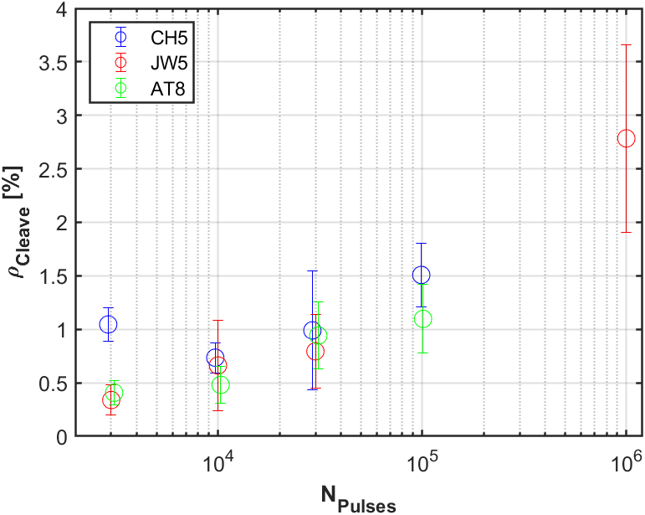
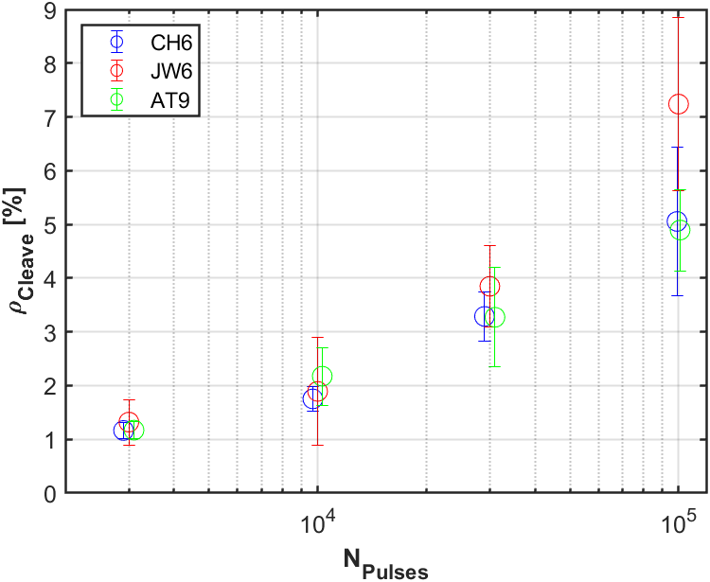
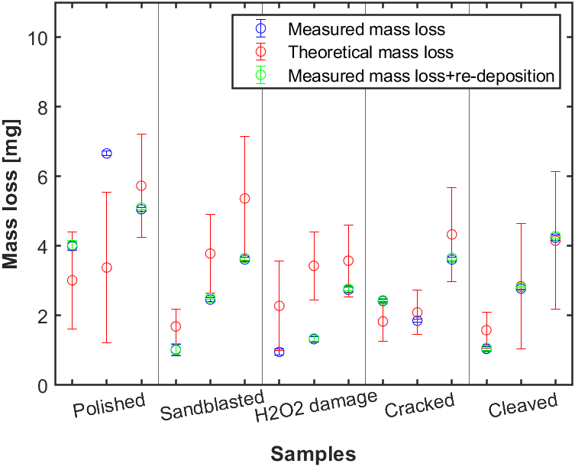



SP A.1 Synergistic Load Studies of Plasma-Facing Materials for ITER & DEMO: DIFFER
Goal:
Understand crack initiation and growth for different tungsten grades under different plasma and ELM=like loading conditions
Approach:
Step 1: Magnum-PSI H plasma loading at different surface temperatures combined with either laser loading to create ELM-like damage, or different surface preparation steps (polish, sandblast, H₂O₂ etching)
Step 2: Magnum-PSI Ar plasma loading at low flux and low temperature to create sputtering conditions with low re-deposition conditions to determine effect of surface finish on erosion
Results:
T_surface = 1150 °C
T_surface = 1500 °C
Average fluence 1st - 2nd - 3rd exposure per surface morphology:
  0.95*10²⁴ m⁻²
  1.5*10²⁴ m⁻²
  2.2*10²⁴ m⁻²
cleave
Using the “Cleave density (ρ_Cleave) – Area of cracks to quantify surface damage(Black area) – Logarithmic growth behaviour
Implication ITER/DEMO: Lifetime estimations possible when damage limit is placed
Mass erosion by sputtering:
Not increased by damage due to S-S and Transient heat loading (Cracked/Cleaved)
Decreased by roughness (Sandblasted/H₂O₂ damage)
Implication ITER/DEMO: No erosion cascade due to cracking/cleaving of surface
Deliverable: PWIE-SP A.1.T-T003-D002 / PWIE-SP A.1.T-T003-D006
Facilities: Magnum-PSI and DIFFER IBF

Slide 7
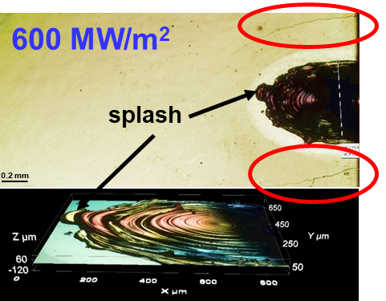
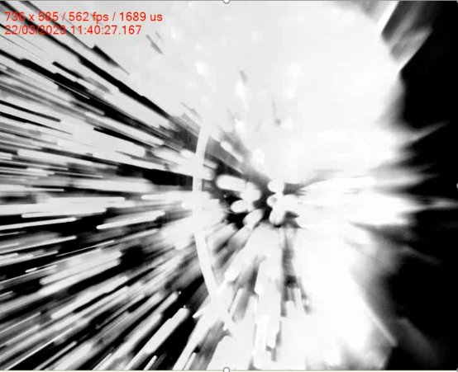
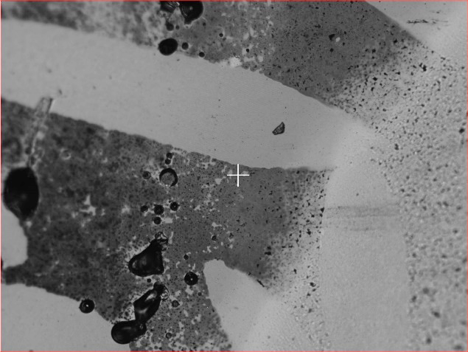
SP A.1 Synergistic Load Studies of Plasma-Facing Materials for ITER & DEMO: CIEMAT
D003: EXPLOITATION OF OLMAT AS HHF facility in comparison with QSPA and GLADIS
  Fatigue studies at F_{HF} = 5.2±1.6 MW /m²s^{0.5}: small cracking at 641 pulses of ITER-like W. No cracking at 950 pulses of PM-Wf/W. Next year more pulse number.
  Disruption studies at edges like in WEST: fragile cracking of ITER-like W confirmed. Massive particle emission of PM-Wf/W, not seen in PSI-2. Likely by Gaussian shape of laser beam (now beam is flatter)
Fatigue at F_{HF} = 5.2±1.6 MW /m²s^{0.5}
Disruptions at mean 600 MW/m²
ITER-like W
Wf/W
ITER-like W
Wf/W
MASKED
1100 MW/m²
EXPOSED
50 µm
2 µm
50 µm
Intergranular cracking in ITER-like W
Mass loss in PM-Wf/W from compression by the mask.
ITER-like W cracks at laser spot. Ablation from 1100 MW/m²
Particle emission (ablation) from 750 MW/m² in PM-Wf/W.
Deliverable: PWIE-SP A.1.T-T003-D003
Facilities: OLMAT 5 days

Slide 8
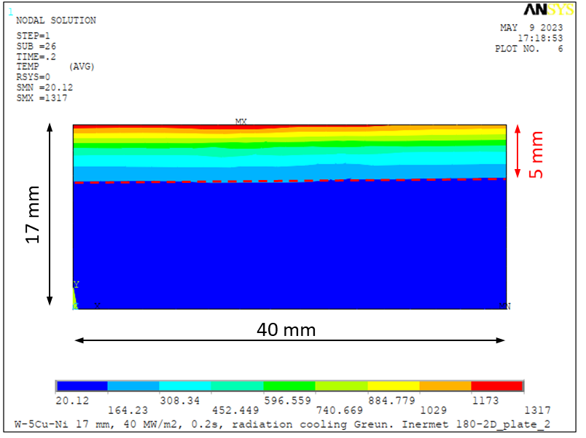
SP A.1.T-T001-D004: Qualification of W-Heavy Alloys for use in W7-X
Motivation: Transition of W7-X from graphite materials to W materials for divertor target and baffle plates.
Moderate steady-state heat fluxes up to 10 MW/m² allow to consider W heavy alloys materials
  reduced material & manufacturing costs expected
Objective: Examination of material behaviour under short transients of 40 MW/m², 200 ms duration similar to NBI shine trough events. These experiments were performed to extend the investigation of actively cooled W heavy alloys materials. The experiments were performed on adiabatically loaded material samples since the penetration depth of the heat wave similar to the 5 mm tile thickness of the active components. In order to ensure better comparability with the actively cooled samples, castellated samples were investigated. The castellation corresponds to the tile dimensions of the actively cooled samples.
Deliverable: PWIE-SP A.1.T-T003-D004
Status: completed
Facilities: HHF test facility GLADIS, 7 operating days
Fig. 1: FEM simulation of the temperate field of a
40 MW/m², 200 ms loaded W5NiCu plate (half model)

Slide 9

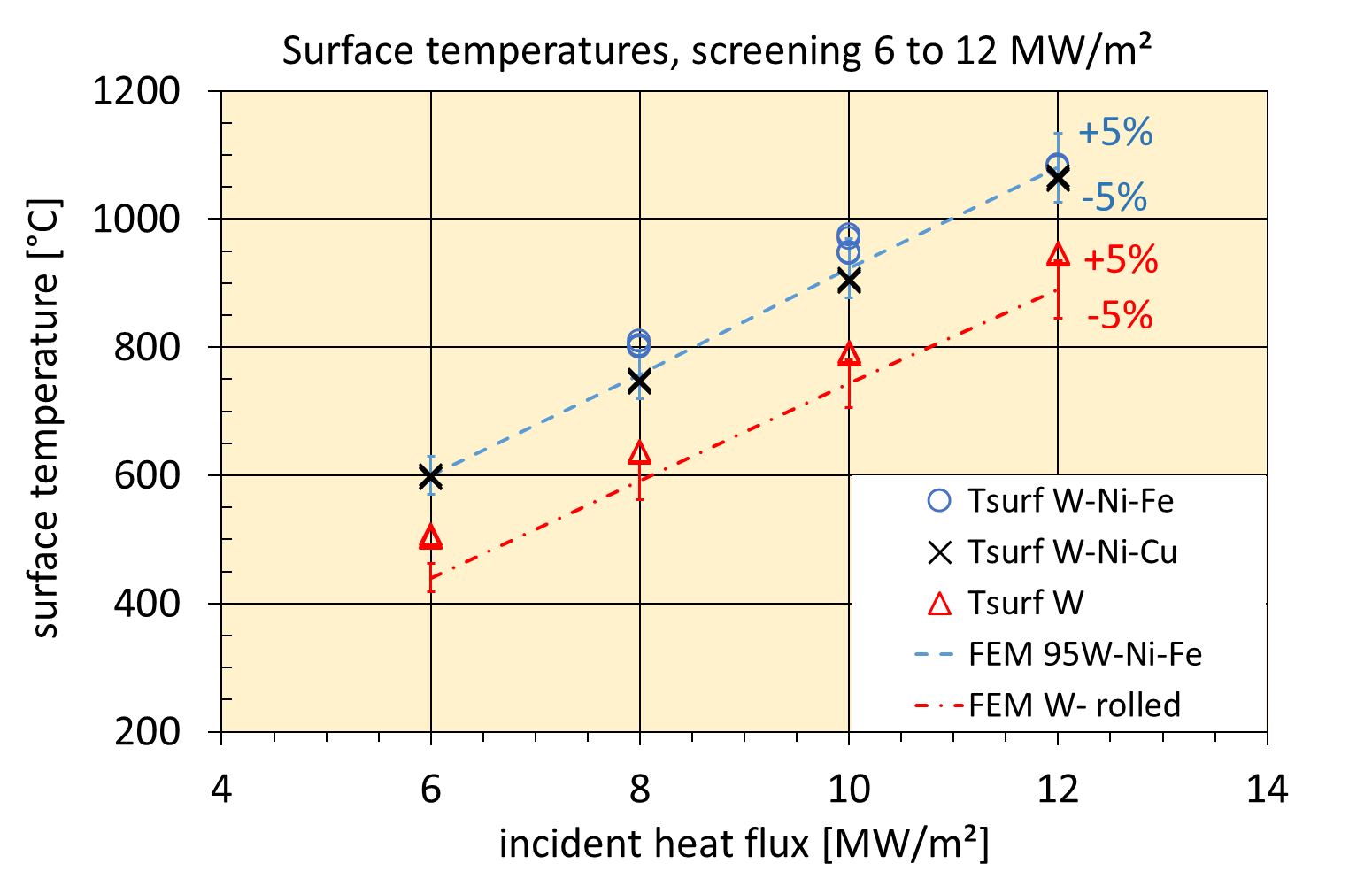
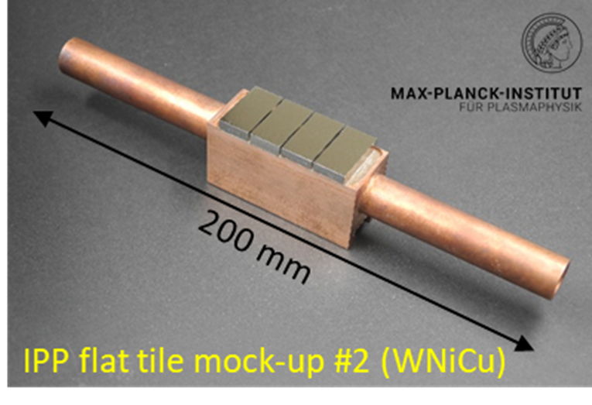
SP A.1.T-T001-D004: Results of Qualification of W-Heavy Alloys for use in W7-X
Results: Fig 2 & 3 show for comparison an already tested actively cooled mock-up equipped with W heavy alloys and the corresponding surface temperatures for heat fluxes from 6 to 12 MW/m².
Fig. 2: Actively water-cooled flat tile mock-up tested in 2022.
Fig. 3: Comparison of surface temperatures of different W alloys.

Slide 10
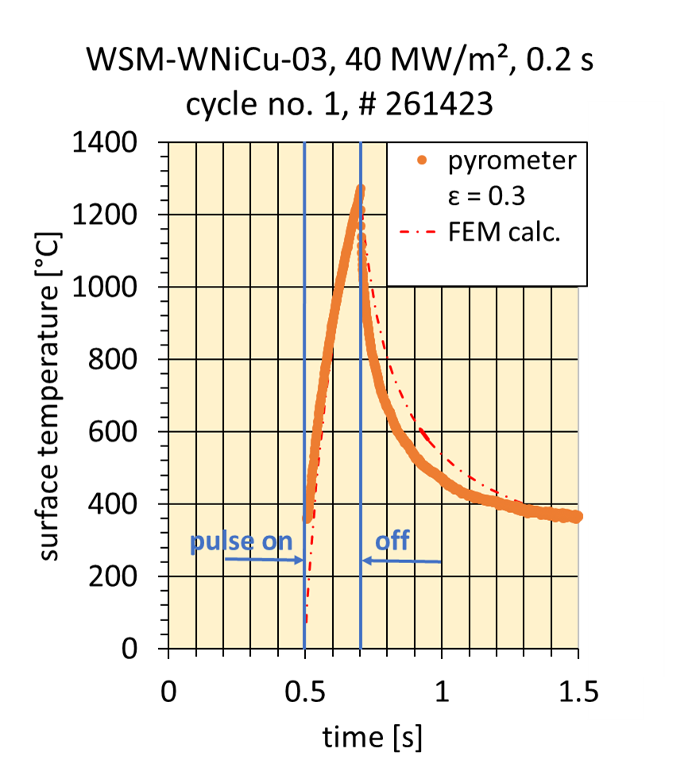
SP A.1.T-T001-D004: Results of Qualification of W-Heavy Alloys for use in W7-X
Results:
Table 1 summarizes the tested commercially available W heavy alloys.
Fig. 3 Transient loading of WNiCu, compared to FEM prediction

Slide 11
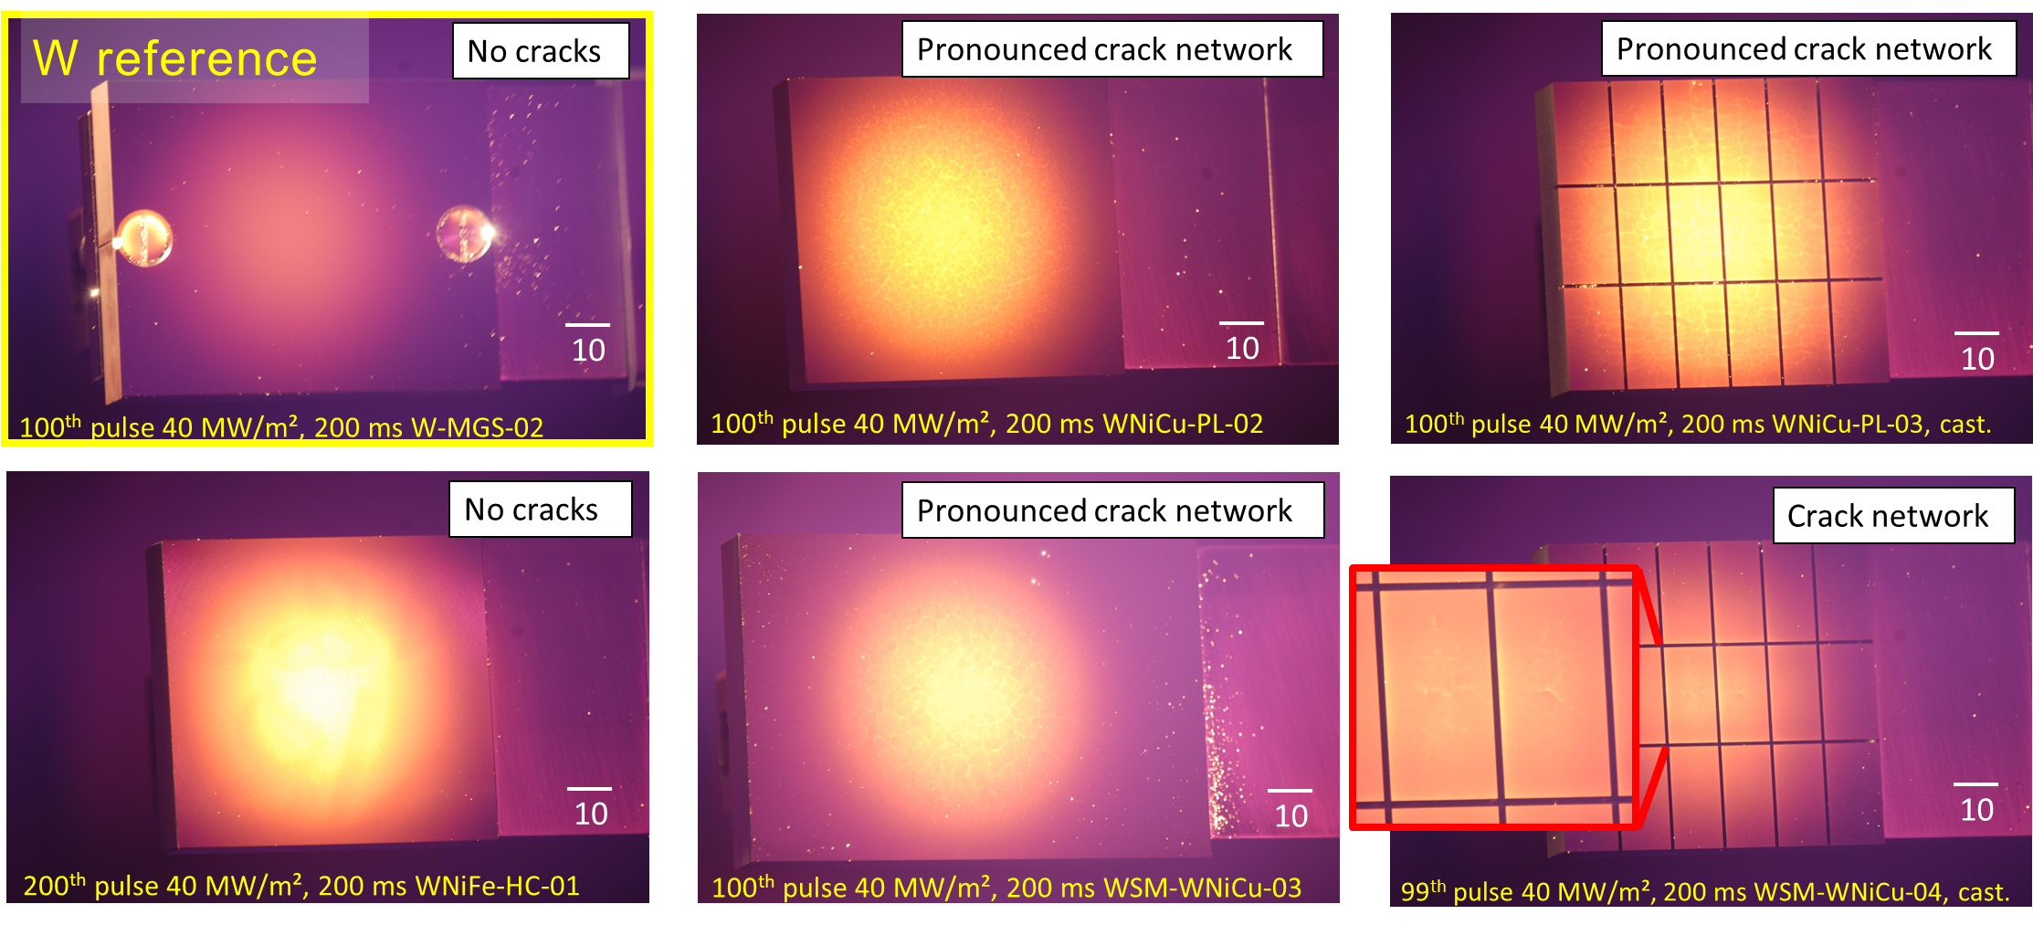
SP A.1.T-T001-D004: Results of Qualification of W-Heavy Alloys for use in W7-X
Fig 4: CCD images at the end of cycling of different W-Ni-Cu alloy samples compared to a pure W tile. As can clearly be seen from the images a crack network developed from the centre of both W-Ni-Cu alloy samples. For the castellated sample WSM-W95NiCu the cracking is strongly suppressed. No, or minor cracking occurred during loading of the W-Ni-Fe samples.

Slide 12
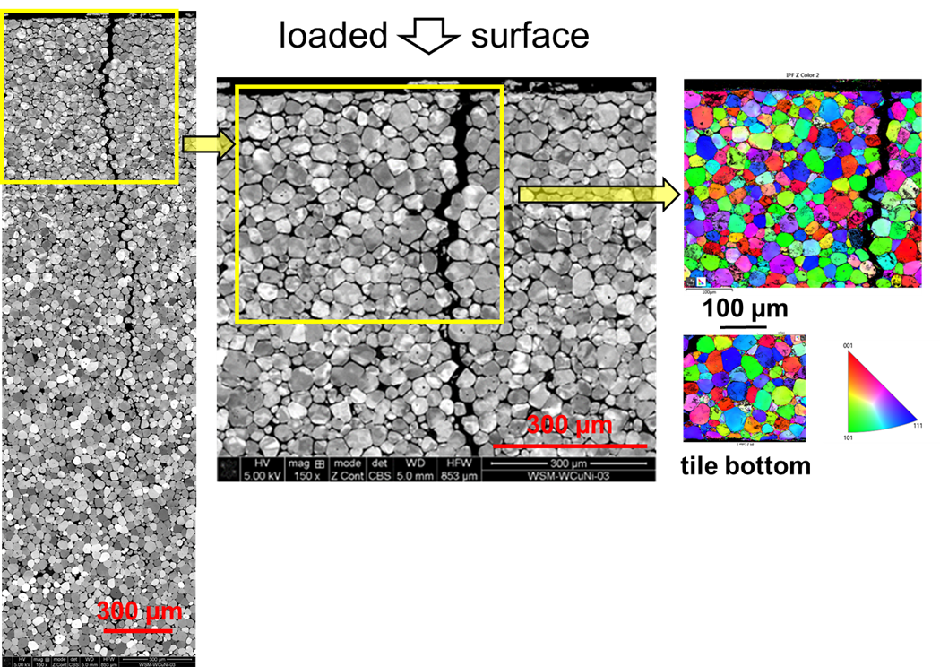
SP A.1.T-T001-D004: Results of Qualification of W-Heavy Alloys for use in W7-X
Fig 5: Scanning electron microscopy images of the uncastellated W-Ni-Cu alloy sample WSM-W95NiCu after loading with 100 pulses of 40 MW/m², 0.2s. The crack has developed within the Ni-Cu matrix. The EBSD images show a strong deformation of W grains as well as of the Ni-Cu matrix in the heat loaded part of the sample compared to the tile bottom side.

Slide 13
SP A.1.T-T001-D004: Results of Qualification of W-Heavy Alloys for use in W7-X
Conclusions:
The successfully performed adiabatically transient loading up to 40 MW/m² and the cyclic long pulse loading of actively water-cooled flat tile mock-ups up to 12 MW/m² confirmed the suitability of W heavy alloys as PFM for divertor applications up to 10 MW/m² heat load.
Depending on the design of a component, a limited number of such short transient events up to a temperature of about 100 K below matrix melting could be accepted as shown from the results of castellated samples. Cyclic steady-state operation up to 1100 °C in the case of W-Ni-Fe, respectively 900 °C for W-Ni-Cu should be achievable.
Related publication:
B. Böswirth, H. Greuner, S. Elgeti, T. Höschen, K. Hunger, H. Maier, R. Neu,
Qualification of W Heavy Alloys as Plasma Facing Material, Nuclear Materials and Energy Vol 38 2024,
https://doi.org/10.1016/j.nme.2023.101563
Deliverable: PWIE-SP A.1.T-T003-D004
Facilities: HHF test facility GLADIS, 7 operating days

Slide 14
Results 2023 / 2024 – WPPWIE
SP A.2 High Particle Fluence Exposures of Plasma-Facing Components for ITER

Slide 15
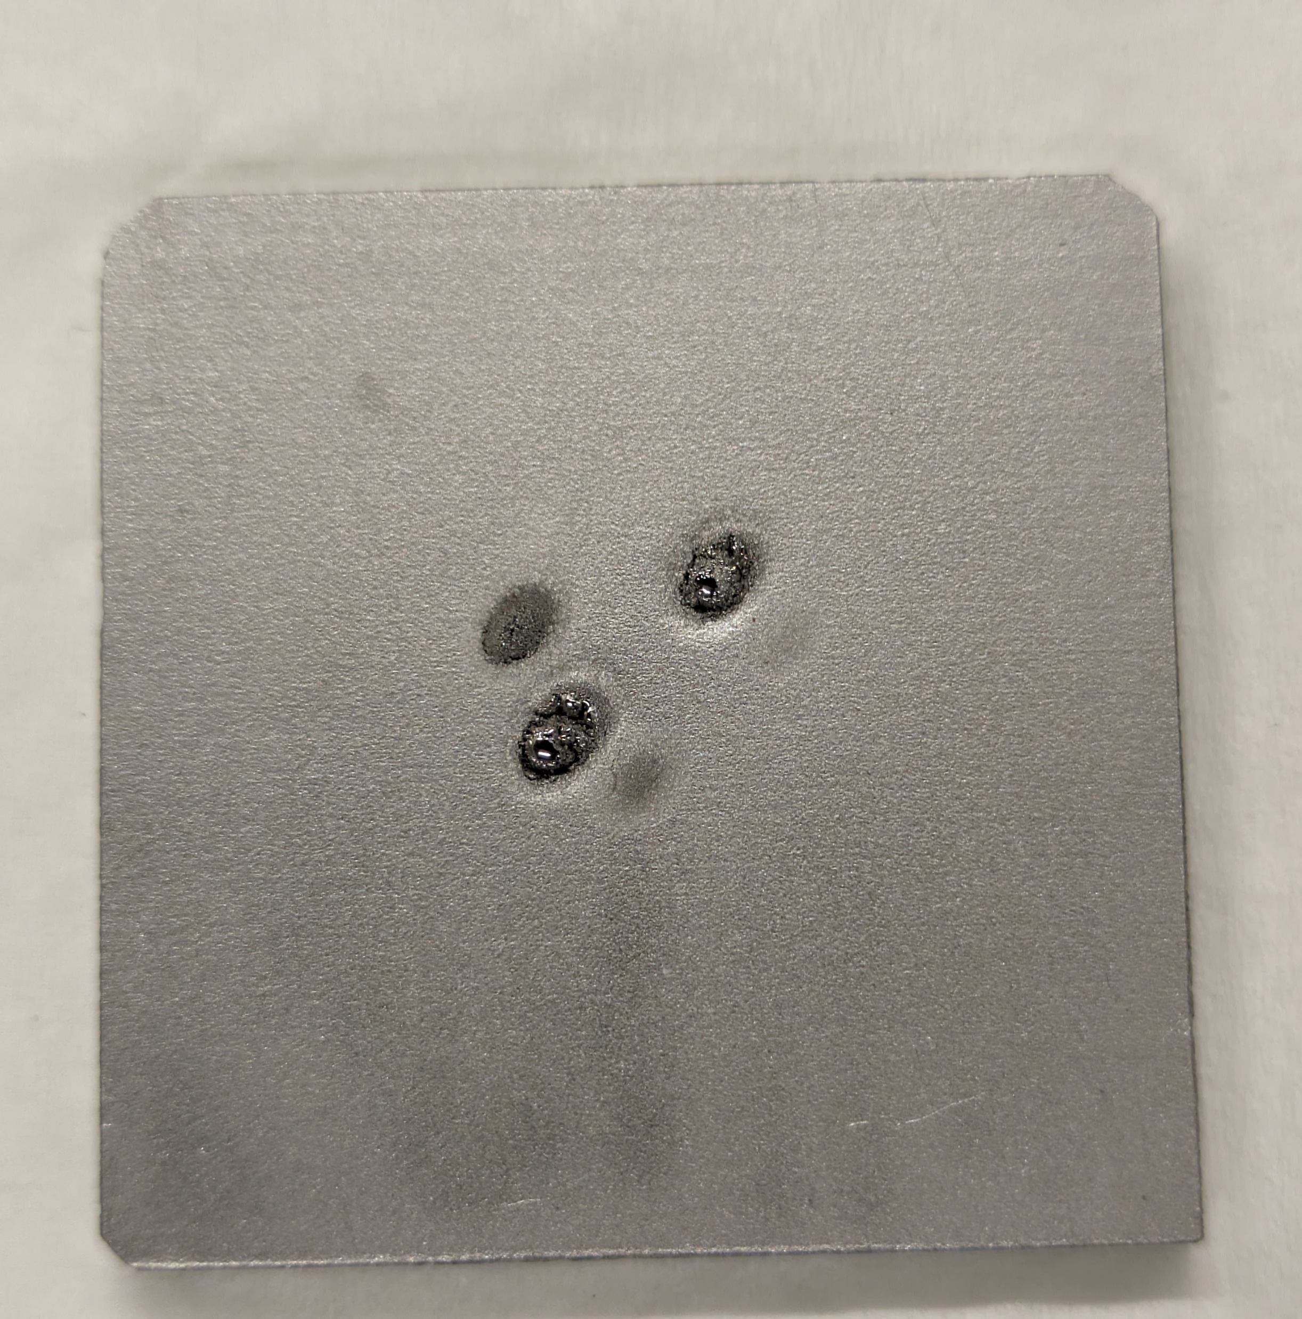
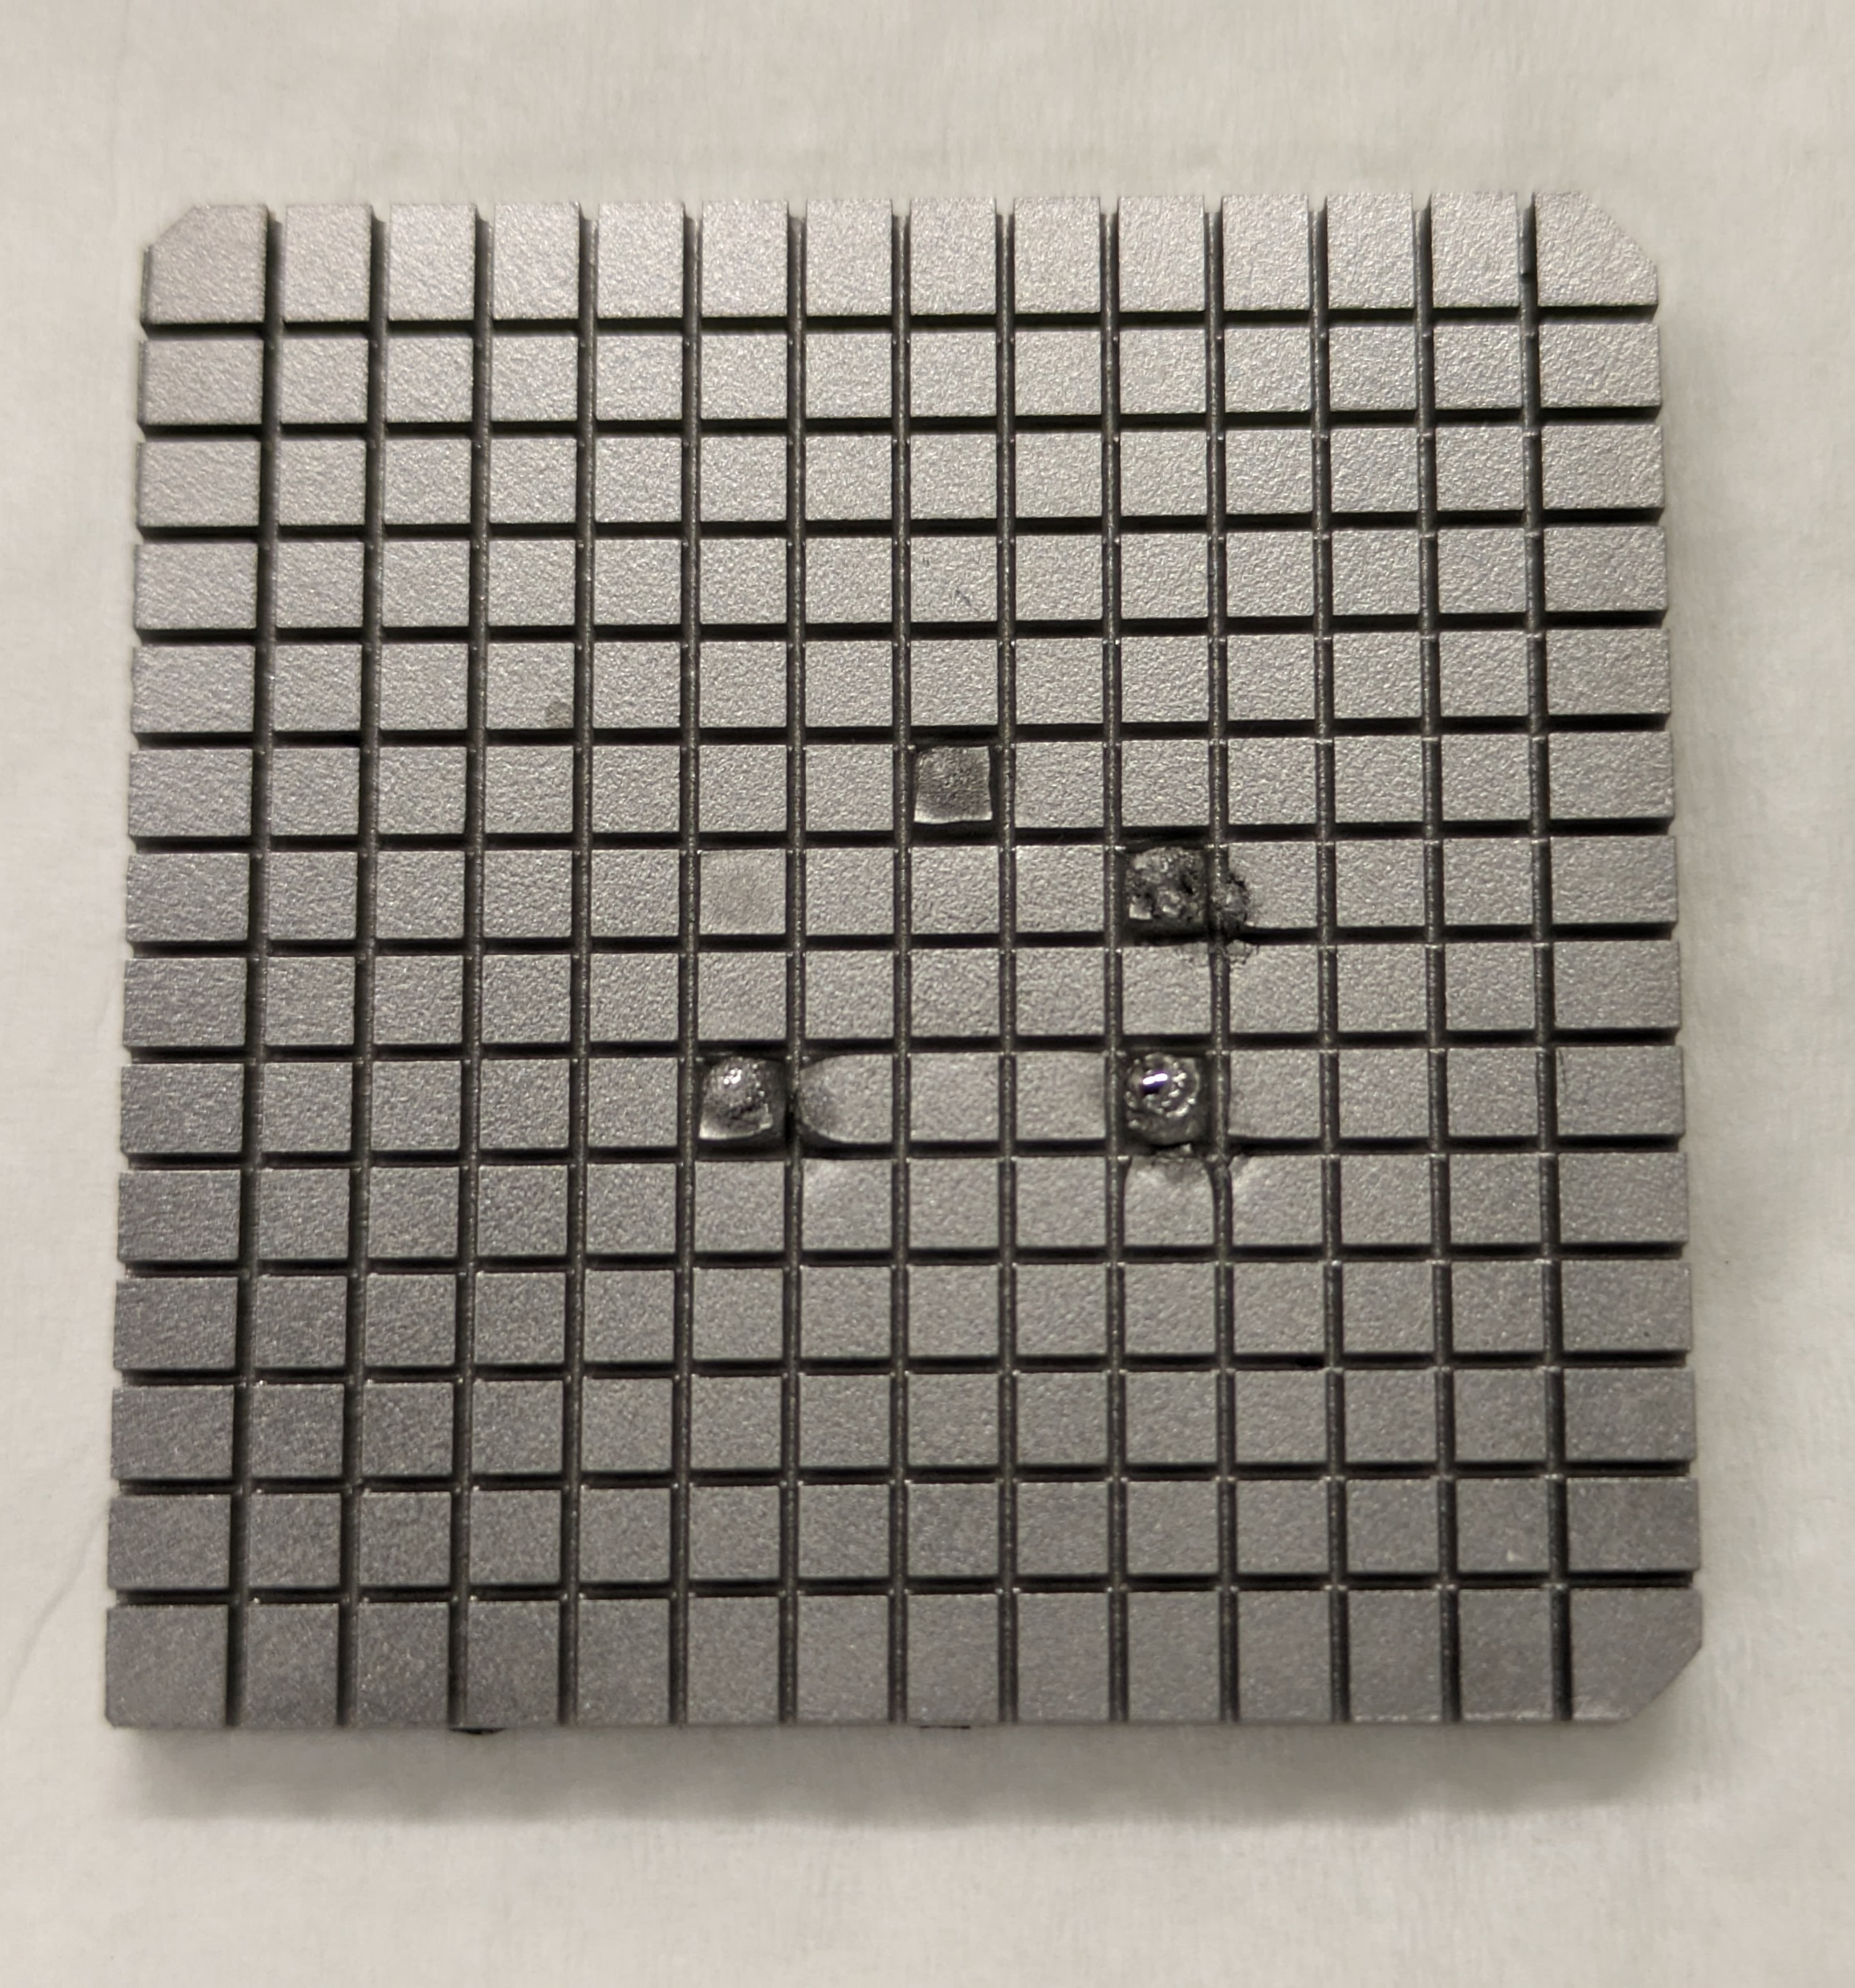
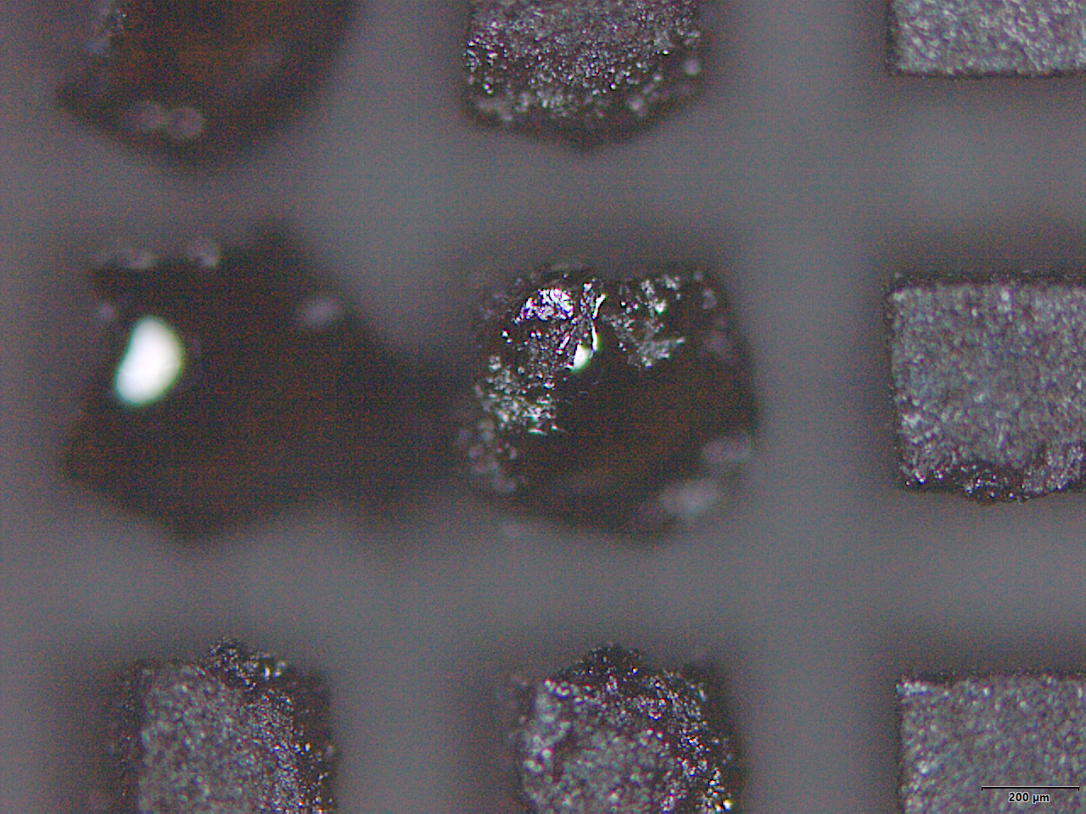
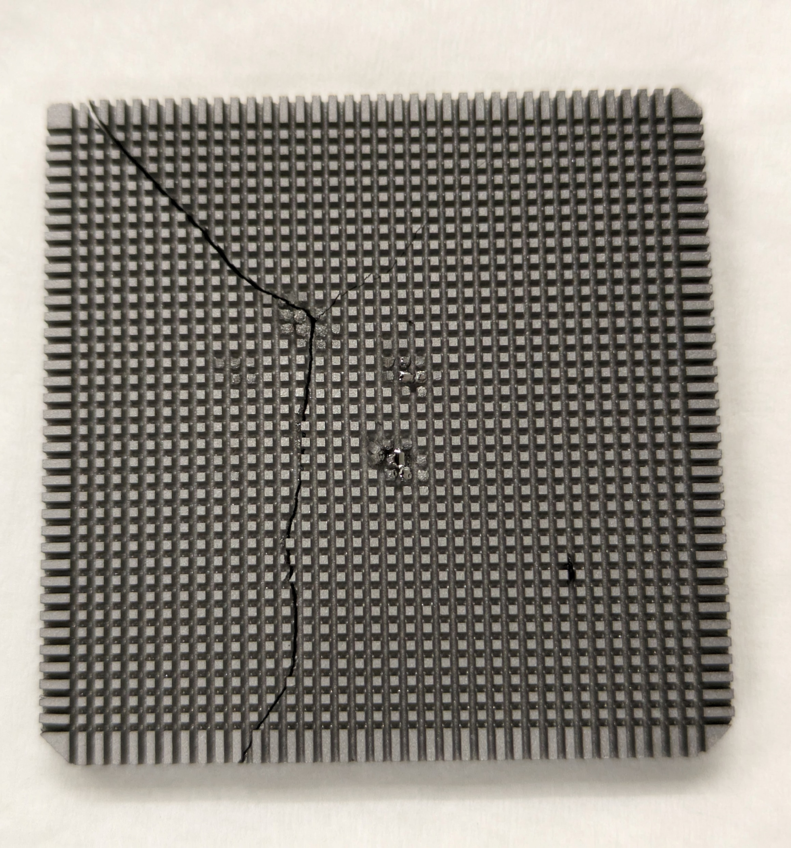
SP A.2 High Particle Fluence Exposures of Plasma-Facing Components for ITER : DIFFER
Background: Slow transients will result in high temperatures, large stresses and increased sputtering- performance of W materials under these conditions?
Goal:
To what extent is large-scale deformation due to localized nature of laser?
Does this damage saturate or continue over time?
Does it pose an increased erosion/melting risk?
Approach:
Magnum-PSI exposures with T_{surf}>2000 °C, ELM pulses from LASAG
Use different sized W blocks with size < laser spot or > laser spot
Results:
Experiments completed, shows strong damage/melting behaviour
Thermal response of castellated samples shows worse damage, in contrast to FEM modelling
Further analysis ongoing in 2024
Laser power (kW) | N_{pulses}
4.4 | 10²
4.4 | 10³
4.4 | 10⁴
4.4 | 10⁵
8.1 | 10⁴
12.2 | 10⁴
No castellations
Large castellations
Locally melted castellations
Small castellations
Deliverable: PWIE-SP A.2.T-T003-D001
Facilities: Magnum-PSI
Linked WP or TSVV: n/a

Slide 16
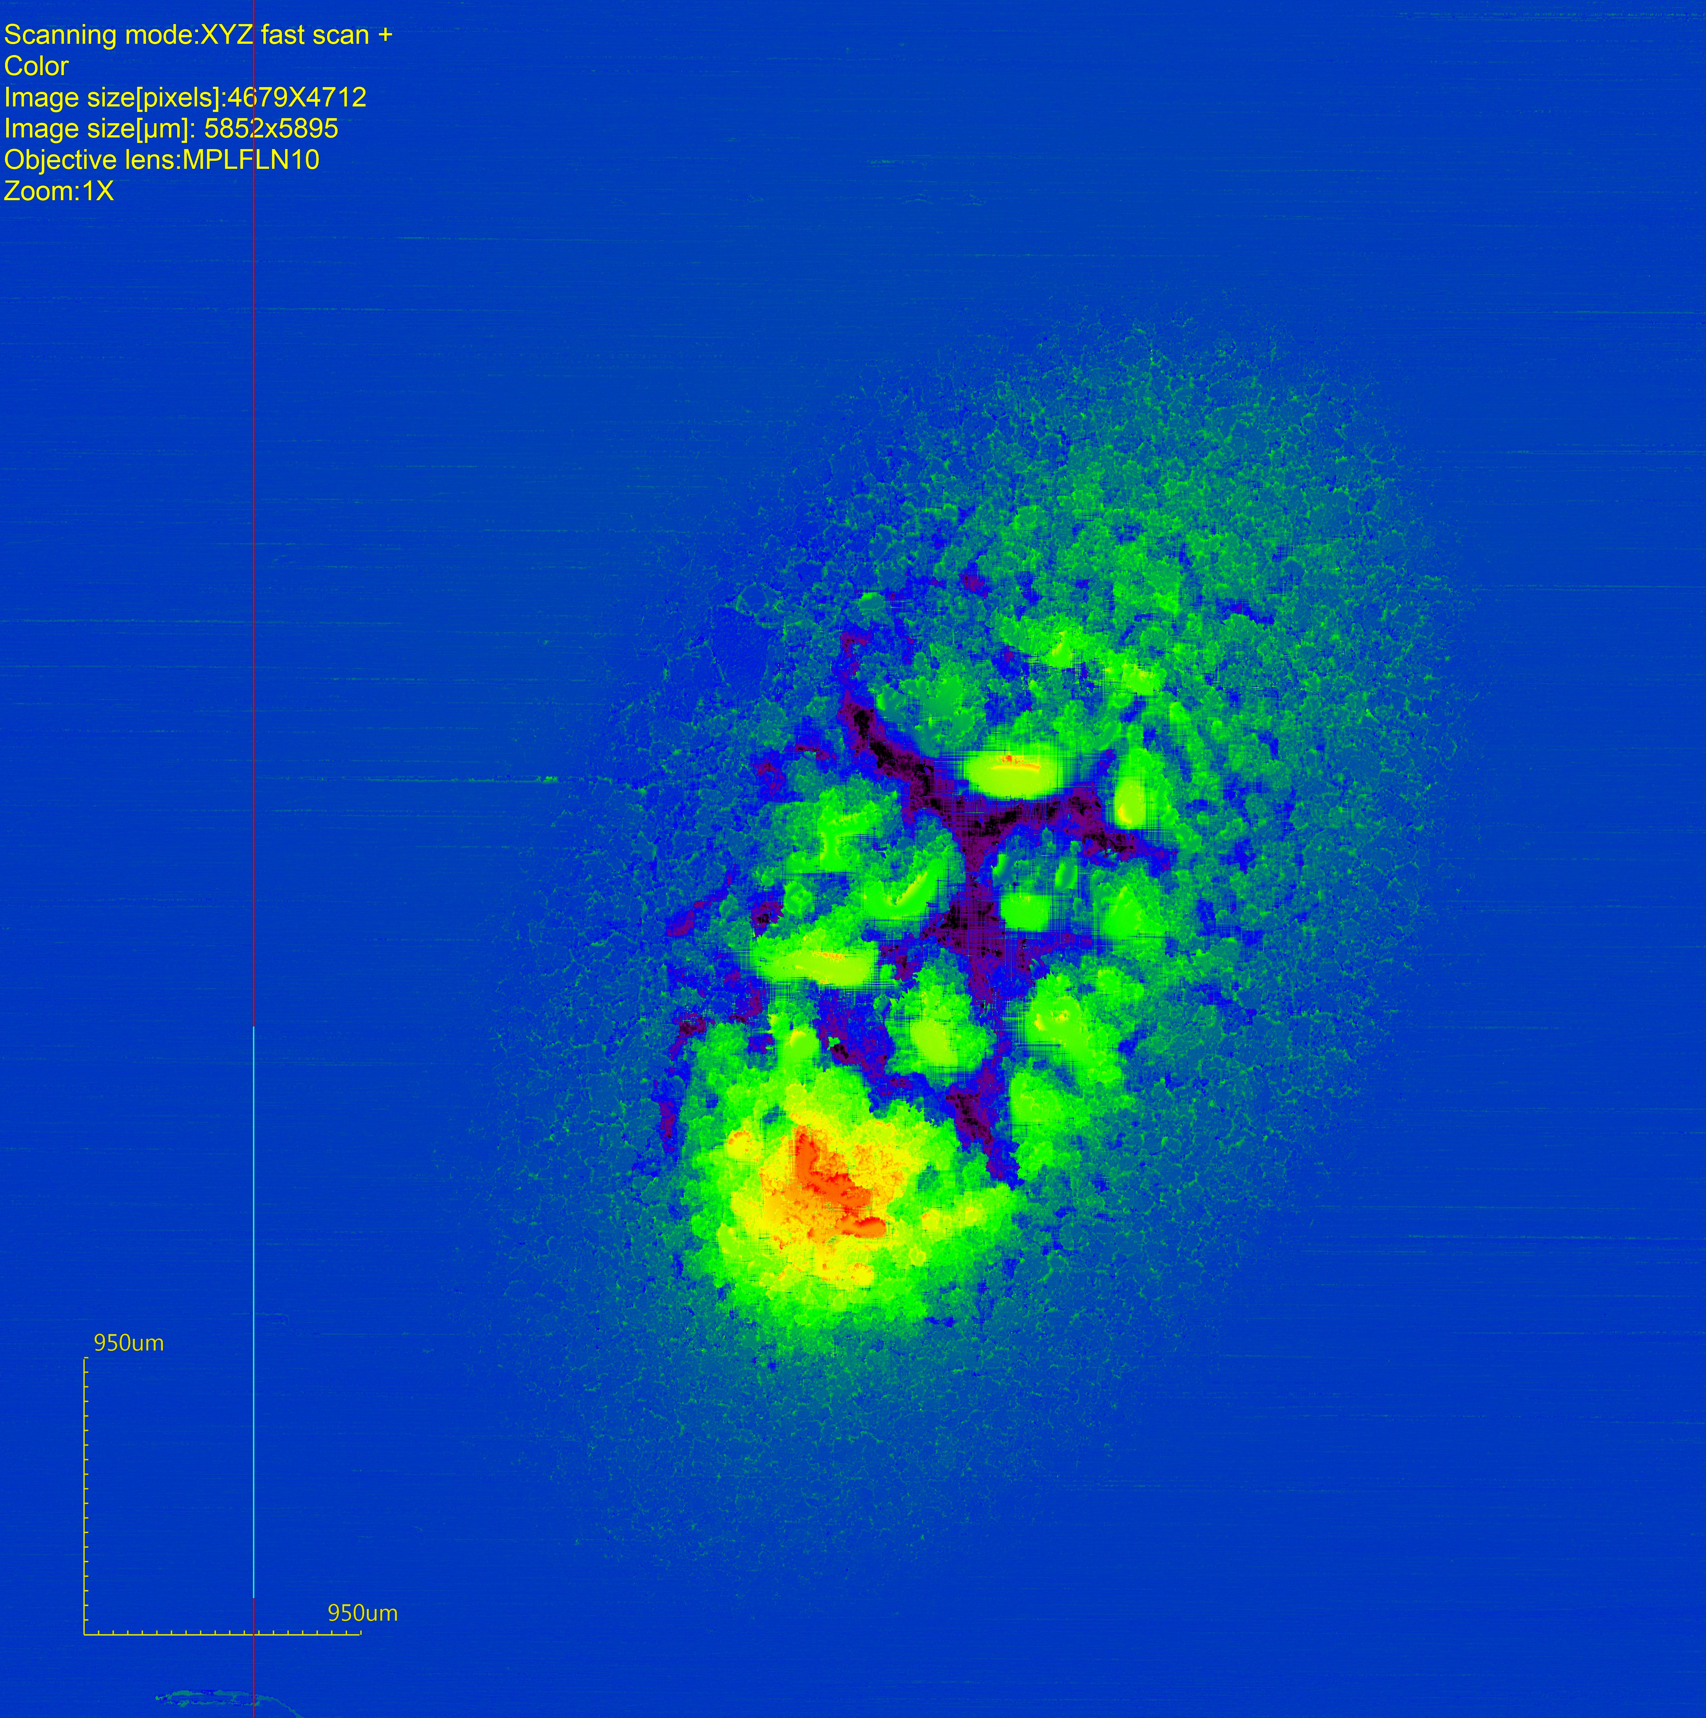
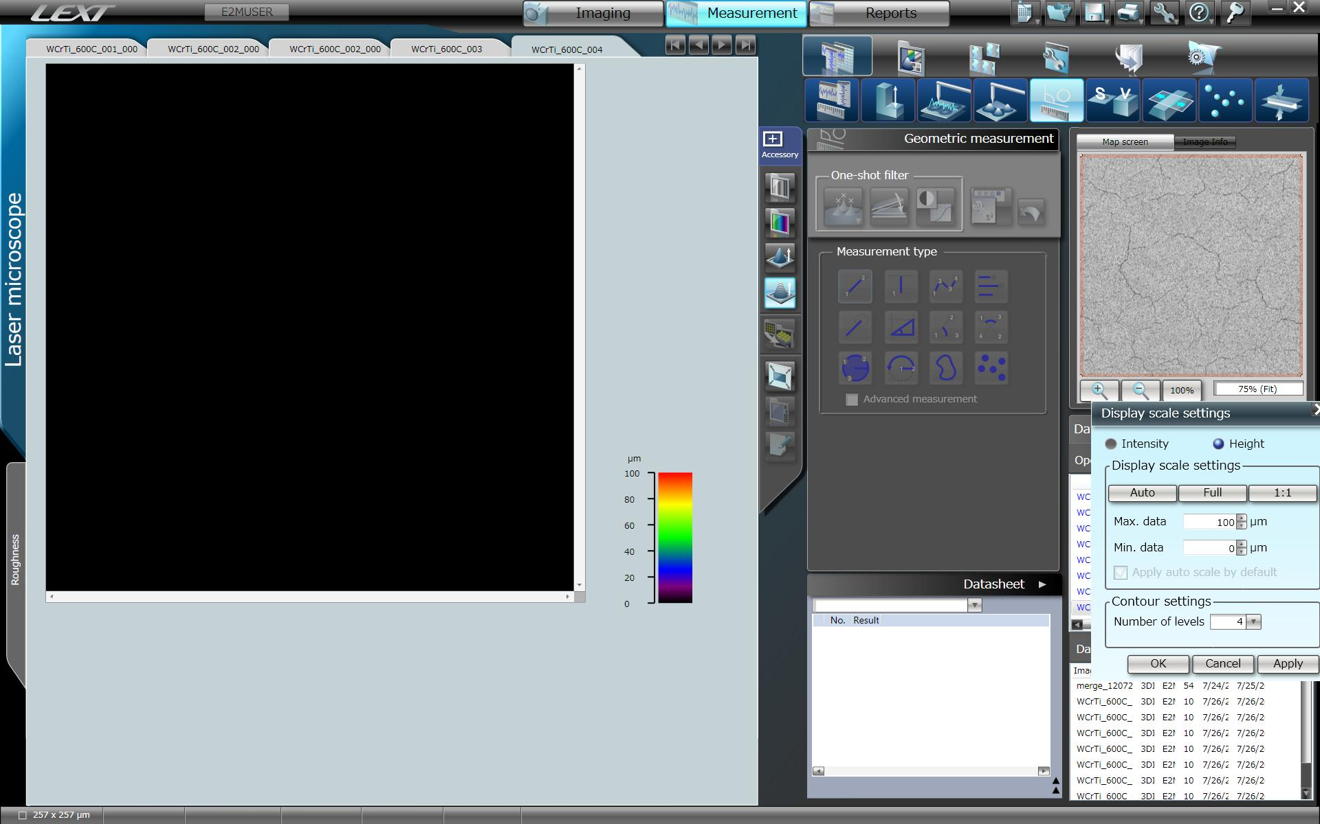
SP A.2 High Particle Fluence Exposures of Plasma-Facing Components for ITER : MPG
Pre- and post characterization of W monoblock mock-ups with microscopy tools
These two mock-ups were exposed at Magnum-PSI to study the performance of the W monoblocks under
slow transient loading conditions → Two approaches:
A) high surface temperatures + ELM-like loading
  2000 °C by high-flux linear plasma beam of Magnum-PSI
  (pure and seeded with He, Ne, Ar)
  + 10⁵ ELM-like 1 ms pulses with 0.1-02. GW/m² (by laser)
    → Laser-exposed area: extremely roughened
    (area protruding several hundreds of µm)
    → He seeding in plasma beam: 10-100 nm He bubbles
B) Sputtering & redeposition under high flux conditions
125_post_x06y16-spot_1127
1 mm
690 µm
0
1 mm

Slide 17
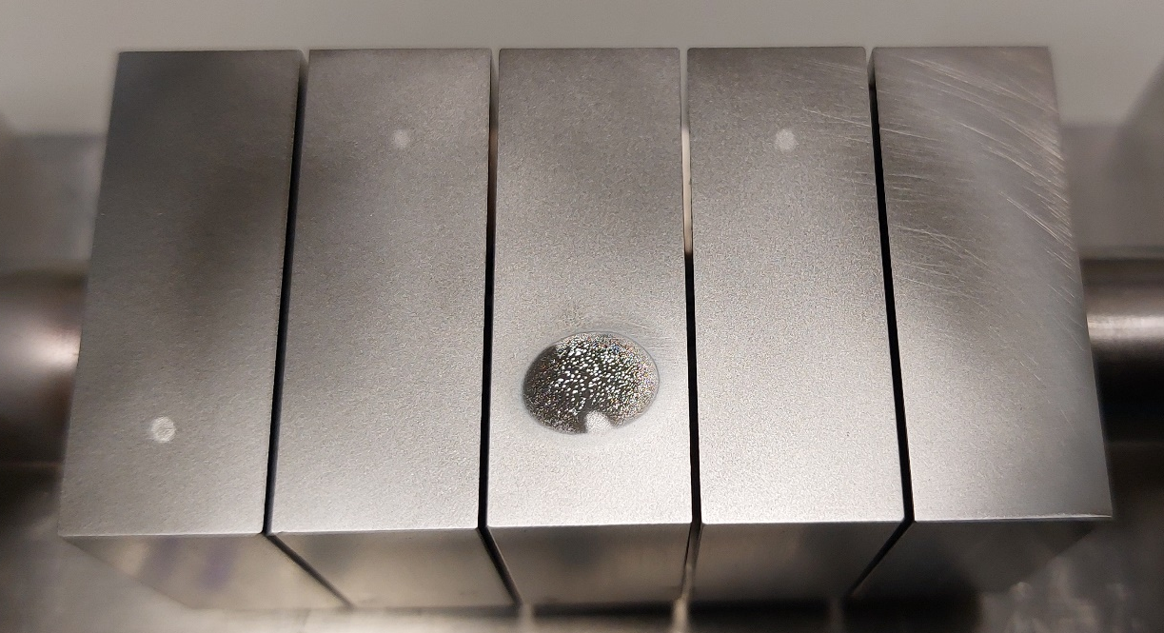
SP A.2 High Particle Fluence Exposures of Plasma-Facing Components for ITER : MPG
Pre- and post characterization of W monoblock mock-ups with microscopy tools
These two mock-ups were exposed at Magnum-PSI to study the performance of the W monoblocks under slow transient loading conditions → Two approaches:
A) high surface temperatures + ELM-like loading
B) Sputtering & redeposition under high flux conditions
  550 °C by Ar plasma beam (10²⁷ Ar/m²)
  with different impact energy (5 – 65 eV)
  (+ 10⁴ ELM-like 1ms pulses (by laser)
  Erosion determination envisaged by “µm-ruler”
    Higher erosion than expected:
    µm-ruler nearly complete eroded
    (erosion assessment still possible)
    µm-thick deposit (with potentials of delamination)
    observed in center of plasma beam spot with highest energy
Exposure conditions:
fix: 1e27 Ar/m²; T_{surf}=550 °C; 1e4 laser pulses
- variation: ΔT=250…970 K; float. … 60V; expected sputter depth: 0…19 µm
MB4/071
-45 V; 6.7 µm;
ΔT=400 / 400 K
MB2/089
-35 V; 2.3 µm;
ΔT=400 / 530 K
“µm-ruler” on MB4
Deposition on MB3
top left part of “shiny” spot
5 µm
pre
500 µm
MB5/070
float.; 0 µm;
ΔT=480 / 970 K
MB3/083
-60 V; 19.1 µm;
ΔT=460 / 280 K
MB1/102
float.; 0 µm;
ΔT=240 / 250 K
Mid of “shiny” spot
post
4.9 µm
Deliverable: PWIE-SP A.2.T-T003-D002
Status: completed
Facilities: SEM-Auriga
2 µm
remains of µm-ruler trenches
20 µm

Slide 18
Results 2023 / 2024 – WPPWIE
SP A.3 Advanced Materials under thermo-mechanical and plasma loads

Slide 19
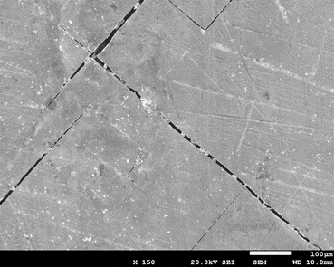
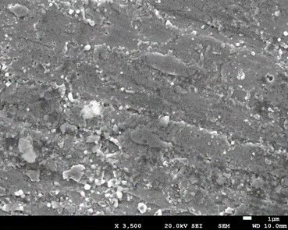
SP A.3 Advanced Materials under thermo-mechanical and plasma loads: KIPT
Unfortunately, QSPA experiments were affected by the war in Ukraine.
First results of the studies of the parameters of plasma streams generated by the QSPA-M using mixed hydrogen (95 %) and helium (5 %) gases as a plasma-forming substance in the accelerating channel were obtained.
The parameters of mixed hydrogen and helium plasma were found to be similar to those of pure hydrogen plasma both with and without a magnetic field in QSPA-M
The influence of H&He plasma on tungsten is found to be similar to pure hydrogen exposures, at least for small fluences. (The paper was published in journal Problems of Atomic Science and Technology. 2023. №1(143) p. 63).
Deliverable: PWIE-SP A.3.T-T003-D004
Status: in progress
Facilities: QSPA – limited during 2023

Slide 20
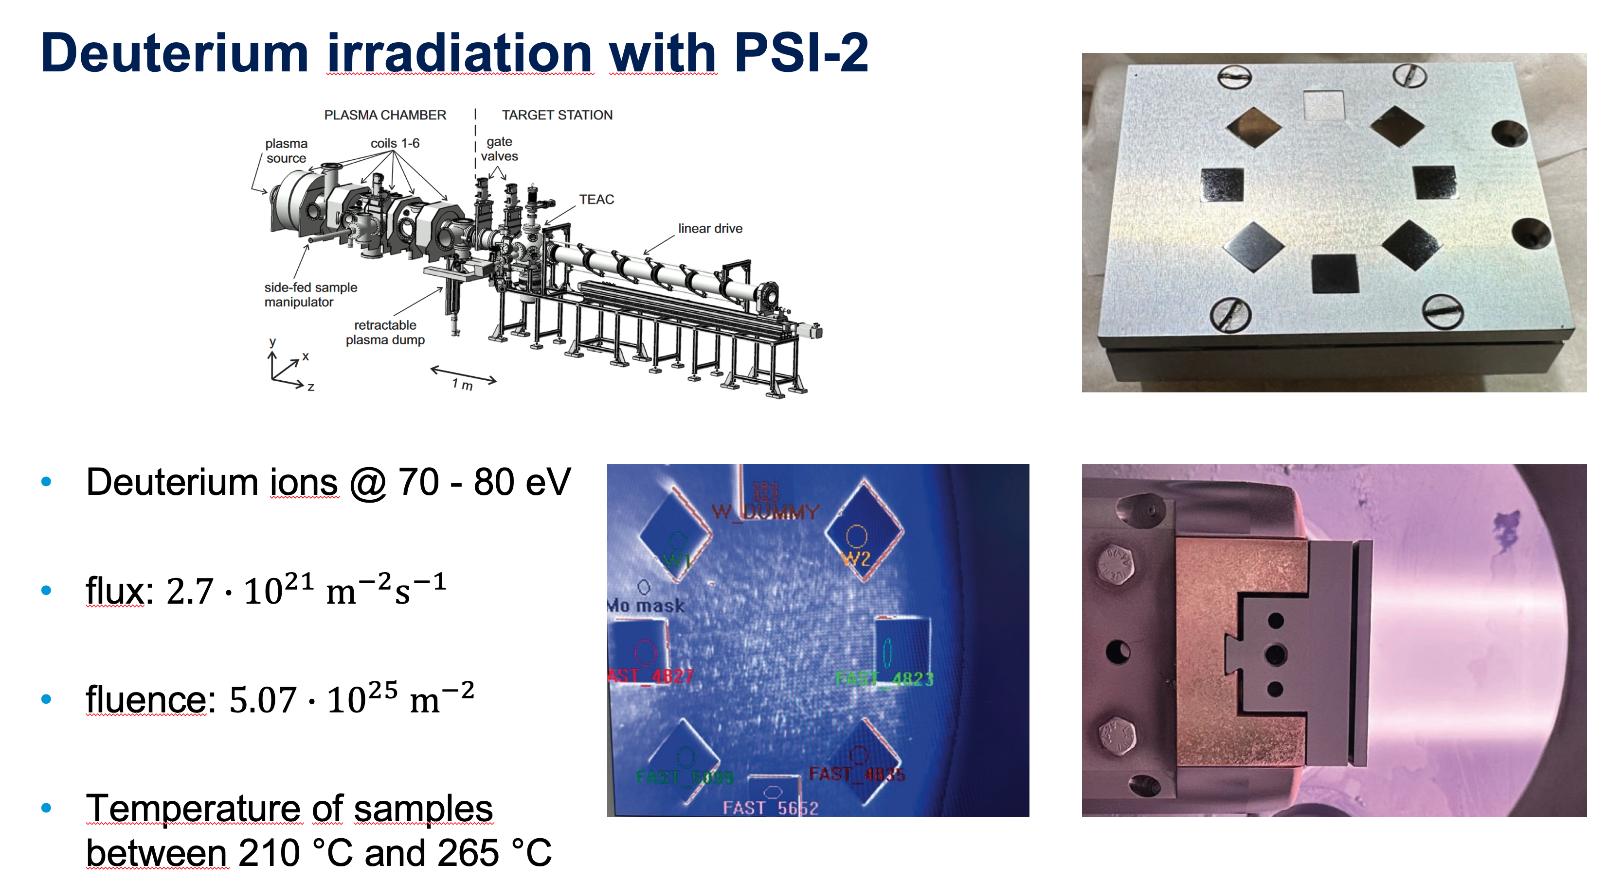
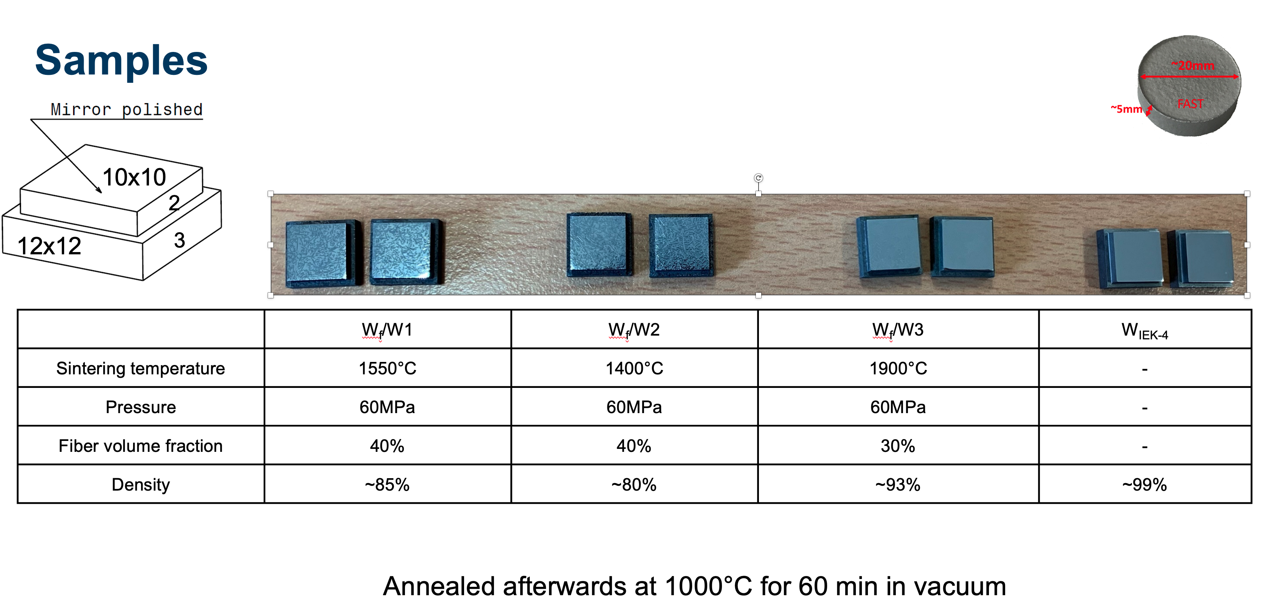
SP A.1 Analysis of Material behavior e.g. under Plasma and heat loading ….. (FZJ)
WCr Y SMART Materials
Deliverable: PWIE-SP A.3.T-T003-D001
Status: Completed
Facilities: JUDITH 2 / PSI-2 or Modelling: -
Linked WP or TSVV: -

Slide 21
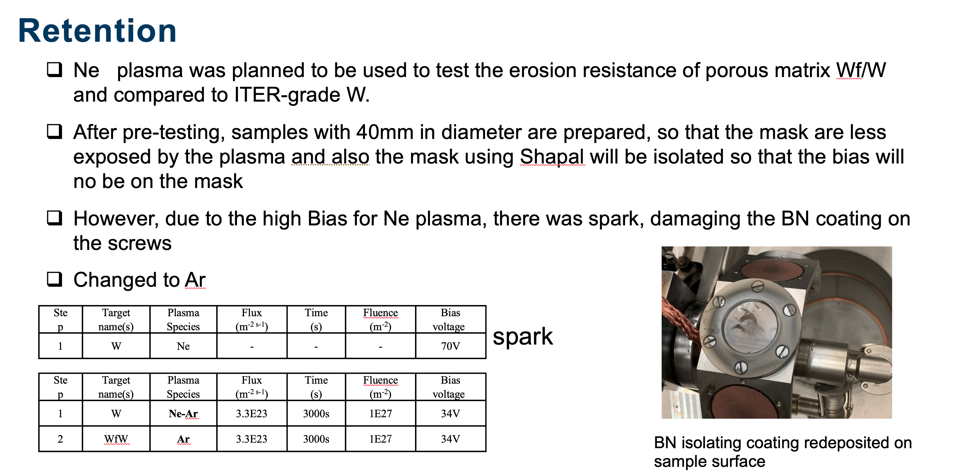
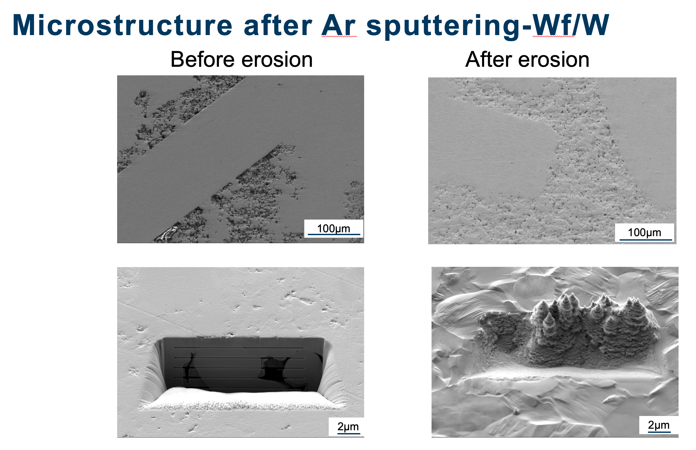
SP A.1 Analysis of Material behavior e.g. under Plasma and heat loading ….. (FZJ)
W composites and Erosion
Deliverable: PWIE-SP A.3.T-T003-D001
Facilities: JUDITH 2 / PSI-2 or Modelling: -
Linked WP or TSVV: -
PSI Exposure of FGM (KIT) Completed

Slide 22
Results 2023 / 2024 – WPPWIE
SP A.4 High Temperature performance of Armour Materials: Recrystallization and Melting

Slide 23
Deliverable ID | Deliverable Title
D001 | Assessment of hydrogen impact on material properties linked to ITER relevant PFUs (CEA)
D002 | Annealing of chosen tungsten-based materials and quantification of recrystallization kinetics (DTU)
D003 | Development and validation of the MEMOS-U code (link with WPTE – WEST/AUG) (VR)
D004 | Influence of plasma pre irradiation with heat loads near surface recrystallization on surface damaging with heat loads above the melting threshold (KIPT)
D005 | Analysis for PSI-2 exposed materials, focusing on recrystallization (FZJ)
D006 | Development and validation of the MEMOS-U code (link with WPTE – WEST/AUG) (VR) (2022 Transfer)
D007 | Influence of plasma pre irradiation with heat loads near surface recrystallization on surface damaging with heat loads above the melting threshold (KIPT) (2022 Transfer)
Deliverable Owner | Beneficiary | PM | Deliverable (Team)
M. Richou | CEA | 6 | D001
W. Pantleon | DTU | 7 | D002
S. Ratynskaia | VR | 12 | D003 (S.Ratynskaia, P.Tolias, L.V. Ignitchouk F. Castello)
I. Garkusha | KIPT | 30 | D004
M. Rasinski | FZJ | 4 | D005 ( M. Rasinski, A. Kreter, M. Vogel)
S. Ratynskaia | VR | 1 | D006 (2022 Transfer)
I. Garkusha | KIPT | 4,95 | D007 (2022 Transfer)
Total |  | 64,95

Slide 24
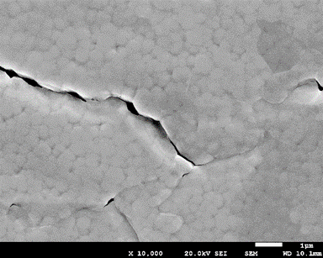
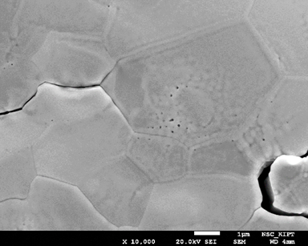
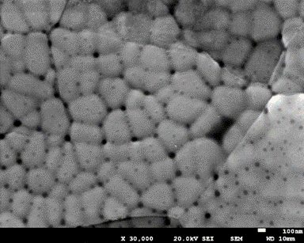
SP A.4 High Temperature performance of Armour Materials: Recrystallization and Melting : KIPT
Analysis of surface modification in fusion materials during repetitive transient plasma pulses, which caused tungsten melting, was performed for previously exposed samples.
Fine cellular structures with a typical cell size of 150…500 nm were observed in the re-solidified layer for IGP W, AM W/WTa, and EUROFER samples due to influence of the Bénard-Marangoni instability on on the macro-grain solidification process..
EUROFER
IGP tungsten with Transversal grain orientation
Deliverable: PWIE-SP A.4.T-T003-D004 / PWIE-SP A.4.T-T003-D007
Status: in progress
Facilities: QSPA : 0 days (Due to the war in Ukraine) or Modelling none:
Linked WP or TSVV:
The paper was published in journal Prob. At. Sci and Tech. 2023, #5, p. 15

Slide 25
WP PWIE: Outlook
2025
Notes:
Please Indicate your subproject

Slide 26
Outlook

Slide 27
Overview
Extend to work on Materials for COMPASS-U
Continuation of work on pre-damaged materials
Include more work on FGMs
Closer links to DSOL 44

Slide 28
Operational limits for Divertor Components
DSOL 44
  Objectives :
    Assess potential critical failure modes and corresponding end of life criteria
    Define and perform joint experiments testing the limits identified above for the ITER divertor
    Identify diagnostics that would be relevant to monitor in situ PFC damage evolution and/or precursors of failure mode
  Initial focus :
    Impact of monoblock macro-cracking (or the so called self castellation observed after cycling under high steady state heat loads) as a potential failure mode.
  Devices involved:
    Full W tokamaks : AUG, EAST, WEST
    Linear device : Magnum-PSI, PSI-2
    HHF facilities : HADES, JUDITH-2

Slide 29
