Slide 1
Background and introduction
PSD Meeting on the EUROfusion workplan for the transition of JT60-SA to W
Carlo Sozzi
WPSA PL

Slide 2
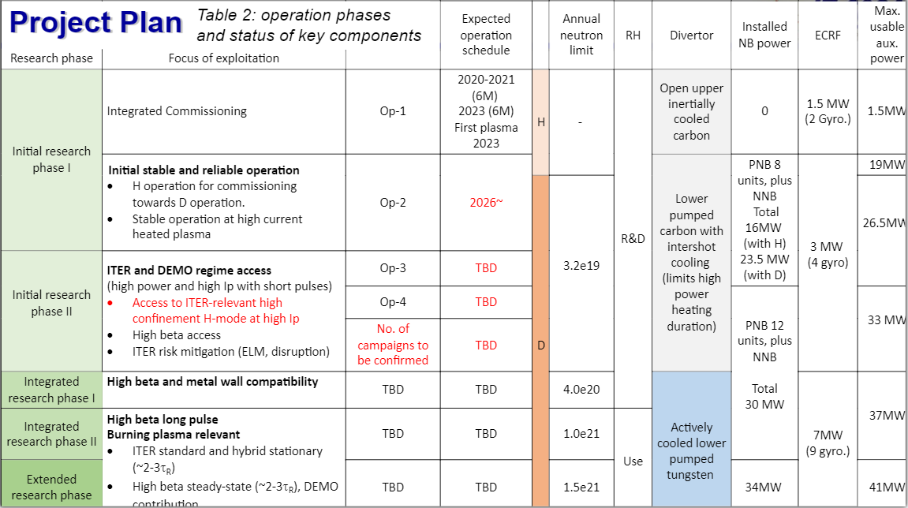
Preparation of transition of JT-60SA to W wall and divertor
Background
Actively cooled C divertor “no longer” in the JT-60SA schedule
Conclusions from the last BA Coordination Meeting (April):
Investigation has started regarding transition to tungsten PFC
Report prepared by Experiment Team
Project Plan updated
(my note: documents not available)
Depending on the final scope of work to be undertaken to reinforce the EF coils, the time required for M/E1 is expected to increase by between 2 and 6 months

Slide 3
Preparation of transition of JT-60SA to W wall and divertor
Aim of this meeting
Develop the items, the sequence and the time schedule of the actions to be performed to support C=>ACW (Assuming the installation of the W PFCs after OP4)
Agree on the main EuF interest driving the change
Support main JT-60SA mission of high beta, long pulse, in W
Go for W as fast as possible accepting limitations in performances
…
Identify the existing tasks in EuF contributing to the workplan
Identification of the key contact persons in each one of the contributing WPs or other EuF areas
Identify possible gaps and how to fill them [for the 2025 programme]
Proposal for the organization of the work [2024]

Slide 4
Topics and contributors (first list for discussion)
WPTE, liaising with the JT-60SA Experiment Team JG, EC, (MW) + nominated experts
identification and proposal of the scientific objectives for the transition
propose and coordinate preparatory modelling, analysis, experiments on the operating machines
develop requirements for the enhancements program
WPDIV, liaising with F4E MR, RN?
development of the PFC components coherently with the identified scope and requirements
WPPWIE SB?
Input on Plasma-Wall interaction and optimal PFC shaping
Test of components
WPSA, liaising with F4E (CS, JA)
Development of the enhancements projects coherent with the identified requirements
assist the implementing agencies in procurement, testing and commissioning of the enhancements
Collection of the previous experiences of a similar change (AUG, WEST, JET…)
Others?
(e.g. W7X ongoing for a similar change,…)
…

Slide 5
For the discussion

Slide 6
W topics: physics
W divertor and W wall: physics modelling needed for the preparation
Divertor heat load calculations
Scenario development and simulations for ELM control (small ELM regimes, X point radiator, detachment…)
Study of tungsten transport in C phase (availability of W sources during C-ACD phase)
Estimation of the supplementary additional heating and possible optimization of the heating mix (NB also NOT directly related to the W environment but rather to the scientific objectives of the research phase, e.g. ICRF). Also evaluate the needs in terms of radial power density
Assessment of the disruption forces and machine limits with the W wall
Indicate their priorities for the enhancements
Experiments (or link to existing experiments)
…

Slide 7
W topics: technology
W divertor and W wall: technology aspects
Wall and Divertor PFC components design
PFCs shaping
Test and qualification plan of PFCs
Design and implementation of a boronization system
Radiative divertor studies: assessment, possibly design and implementation of gas injection system
Upgrade and/or Development of diagnostics for W influx monitoring, W concentration measurement, W transport (visible cameras, IR cameras, thermocouples, Langmuir probes, pyrometers, spectroscopy…)
Implementation of additional heating
Control requirements: assessment of the capabilities for plasma position and shaping, X point(s), strike points sweeping etc
Control requirements: revision/upgrading of the protection system, including disruption management (prevention, avoidance, mitigation, runaway electrons)

Slide 8
Proposal for the organization of the work [2024]
Preparation of a draft workplan
Draft → mid-July incl. meeting
Workplan preparation meeting (this meeting and follow-up)
Existing activities
Identify gaps
Identify test to be done and their planning
Consolidate first version for September (including resources)
KOM with detailed breakdown of activities → after PSD planning meeting
Organization:
Default: Keep the existing tasks, activities and organization as they are
Organize periodic meetings among the contact persons to share information (every 2 months ?)
Implement corrections (if and when needed) to activities within the existing structure
If and when activities should be started, consider case by case where to implement them. Adjust resource when needed

Slide 9
Preparation of the transition to the tungsten wall (SARP 4, 2018)
The transition to the tungsten wall will imply a large number of additional technical and operational requirements for the main scenarios of JT-60SA. As drawn from the experience in JET and AUG, the following prerequisite should be examined prior to the transition to the tungsten wall:
High density/large gas puff will be required in the W-wall to avoid W influx and accumulation. This needs to be tested well in non-inductive scenarios in particular.
Some of the ECRH power will be dedicated to W control and this needs to be tested in advance in relevant scenarios by injecting W or high Z species.
Shine-through with the available NB power needs to be re-assessed for scenarios.
Integrated disruption control and mitigation system will be required systematically to avoid or mitigate electro-magnetic and heat loads in high performance scenarios. This will need to be prepared in advance of the transition to W.
New wall protection system and associated set of diagnostics (IR camera, thermocouple, Langmuir probes, pyrometers, spectroscopy, etc) will need to be installed and commissioned.
ELM energy impact assessment, ELM mitigation and control or small ELM regime should be established before the installation of the new wall.
Tungsten sputtering and erosion in the main chamber need to be minimized by careful plasma control clearance.
Physics of low collisionality will be more difficult to access with the metallic-wall, therefore this part of the program should be done before the transition.
Many of these points are also related to ITER and DEMO research issues and therefore should strongly contribute to the development of DEMO scenario design.

Slide 10
Announcement of this meeting
The idea is to put the basis for a workplan for the EUROfusion contribution to the transition of JT-60SA from carbon to metal wall in the framework of the BA agreement.
For this we would like to
collect information about the already existing activities in the various areas of work in Eurofusion, confirm the name of contact persons, identify possible missing contacts
agree on the essential items of work we should develop
discuss the actions list and the way forward.
To help this you are kindly requested to prepare 1-2 slides with
the list and a brief description of the activities ongoing (in WP- SA, TE, PWIE, in the JT-60SA Experiment Team, PMU) which are relevant to the topic
links to documents, presentations, reports etc that is worthy to share among us
Indico page https://indico.euro-fusion.org/event/3203/

