Slide 1
Edge/SOL modelling activities in WPSA in support to JT-60SA transition to W
G. Falchetto WPSA Code Management Area Coordinator

Slide 2
2024 – New task
SA-SE.CM.M.03-T007: Assessment of SOL and divertor plasma conditions in JT-60SA with W wall in high performance scenarios
Plasma edge/SOL modelling of JT-60SA scenario with SOLEDGE3X and SOLPS-ITER transport codes -in support to PFC design - under request of F4E
The modelling with SOL/edge codes will have as objective:
Define the radiative patterns necessary to ensure a sustainable load to the divertor, that will guarantee achievement of the performance required by the core plasma.
Generate a set of fundamental parameters for optimising core scenarios (<Te>sep, neutral penetration, impurity concentration).
Evaluate the thermal loads at the divertor and first wall.
Team: Luca Balbinot, Giulio Rubino, Krzysztof Galazka (IPPLM), Guido Ciraolo (CEA)
Resources: 8PM + 5PM AR IPPLM
KOM 19/03 with F4E :
agreed to start from technical constraints on PFC
investigate most challenging scenario – using core BC from integrated modelling (eg Romanelli NF 57, 2017)
Modelling can first provide: CX & photons to the dome, power fluxes using optical approximation

Slide 3
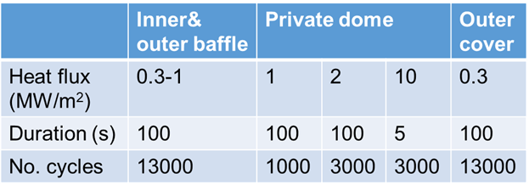
Deliverable : provide thermal loads at the divertor and wall in support to PFC design.
D1 - SOLPS-ITER modeling of a provided JT-60SA high performance scenario with tungsten wall and Ne or mixed impurity seeding (without drifts). - G Rubino (ISTP CNR Bari)
D2 – SOLEDGE3X modeling of a provided JT-60SA high performance scenario with tungsten wall and Ar or mixed impurity seeding - L Balbinot (Univ Tuscia) + CEA
+ IPPLM K Galazka – COREDIV/TECXY
Technical constraints from F4E:
Engineering loads in the tungsten divertor PFCs (except targets).
Ensuring T< 1000 °C for steady state operation everywhere.
Inputs from QST Nakano san:
JT-60SA DMS https://users.jt60sa.org/?uid=238J7D
Scenario 2
Geometry: https://users.jt60sa.org/?uid=25KZ3G
Equilibrium and other data: https://users.jt60sa.org/?uid=24VEMJ
Gas puff ports not in DMS/from PID.
First Task technical meeting 26/03
monthly follow up with F4E/WPDIV
Next meeting 29/07

Slide 4
Outcomes of the SOLEDGE/SOLPS modelling (update Balbinot Rubino 27/06)
Power exhaust ! Critical issue
● Power density flux can be reduced below 10MW, but with high density and high impurity concentration
● Possible strong impact on core performance
● Study of the effect of λq predictability ongoing (with SOLEDGE/Ar seeding)
Pumping
● SOLPS: Assessment of the effect of albedo in attached conditions (pure D)
➔ pumping rates rescaled as the albedo
➔ No effect of the albedo on subdivertor conditions
● SOLEDGE: evaluate the effect of divertor geometry and strike points position
➔ Pumping rate can be increased with both solutions
Conclusions on power exhaust mitigation
● Even in case of compatible power load (PmaxOT < 10MW/m2) sputtering is a major issue
● In the case of detachment onset the problem is mitigated, but must be investigated
● Compatibility with core must be addressed
● The effect of λq predictability will be addressed
Can pumping rate be increased?
● A strong increase in the pumping capability is observed when the ionization front locates above the V-shaped corner
➔ Neutrals (molecules) are now able to reach the subdivertor
● The (D2) pressure sits to ~ 1Pa Γpump ~ 1.5e22 D/s
● The analysis strengthens the possibility to increase the pumping rate by acting on the geometry (either no corner or higher SP)

Slide 5
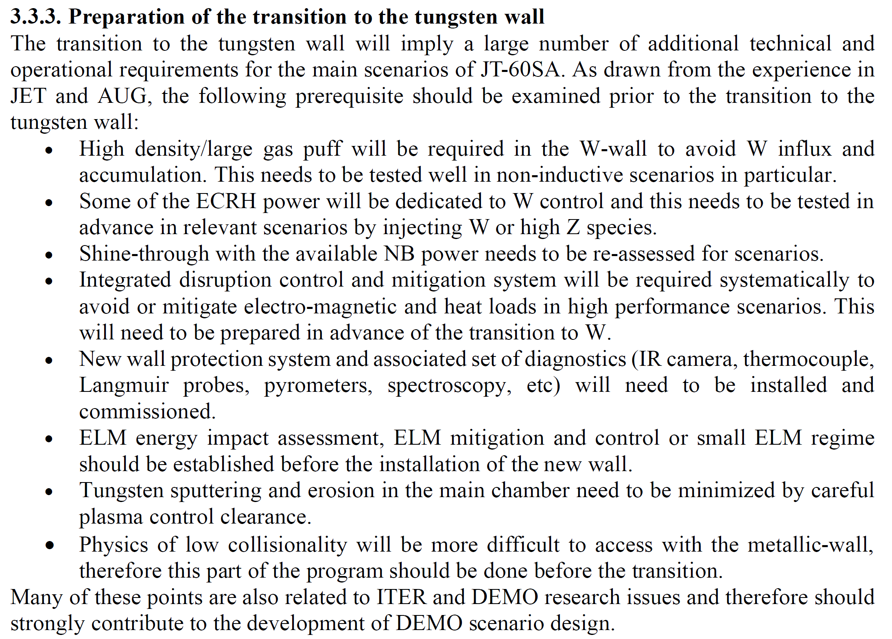
JT-60SA Research Plan v4.0 2018, Sec. 3, page 58

Slide 6
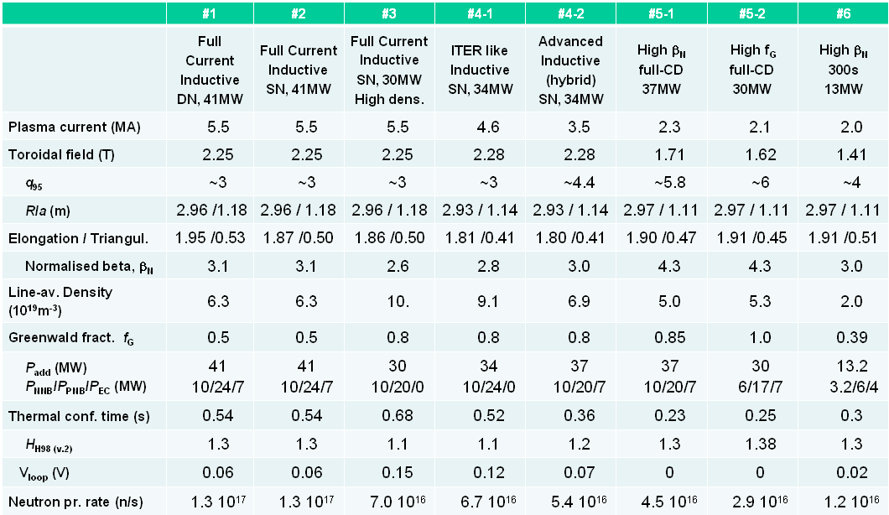


EU publications on W divertor modelling for JT-60SA
K. Gałązka et al., "Numerical analyses of JT-60SA with tungsten divertor by COREDIV code", Plasma Phys. Contr. Fusion 59 (2017) 045011.
R. Zagórski et al., "Numerical analyses of baseline JT-60SA design concepts with the COREDIV code", Nucl. Fusion 57 (2017) 066035.
G. Rubino et al., "Assessment of Scrape-Off Layer and divertor plasma conditions in JT-60SA with tungsten wall and nitrogen injection", Nuclear Materials and Energy 26 (2021) 100895.

Slide 7
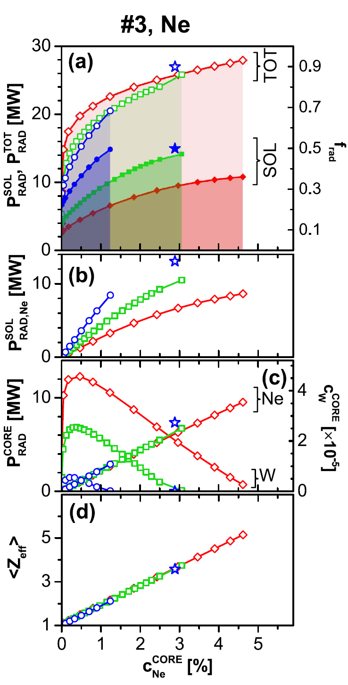
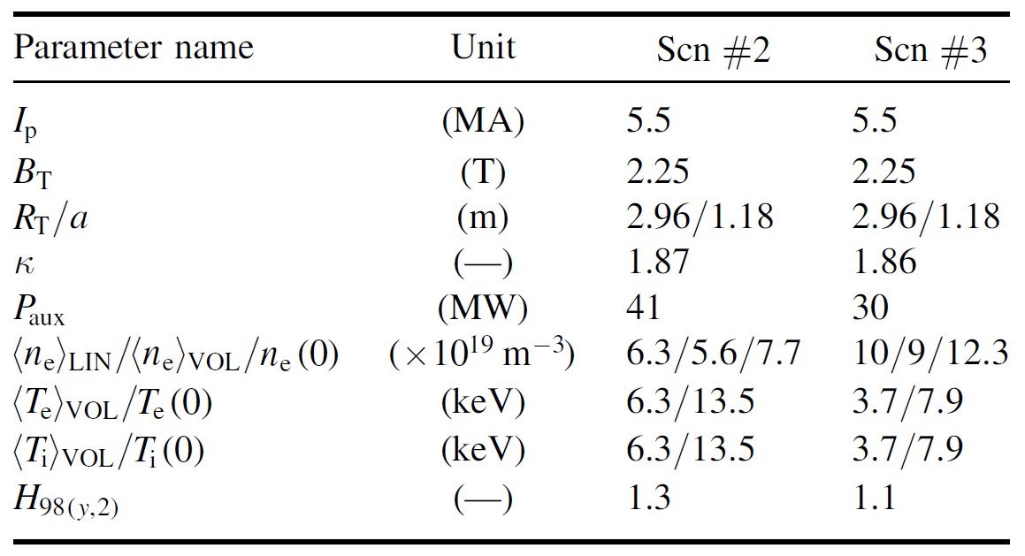
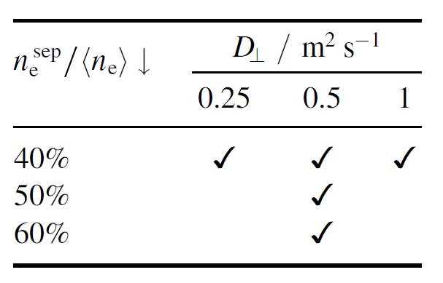
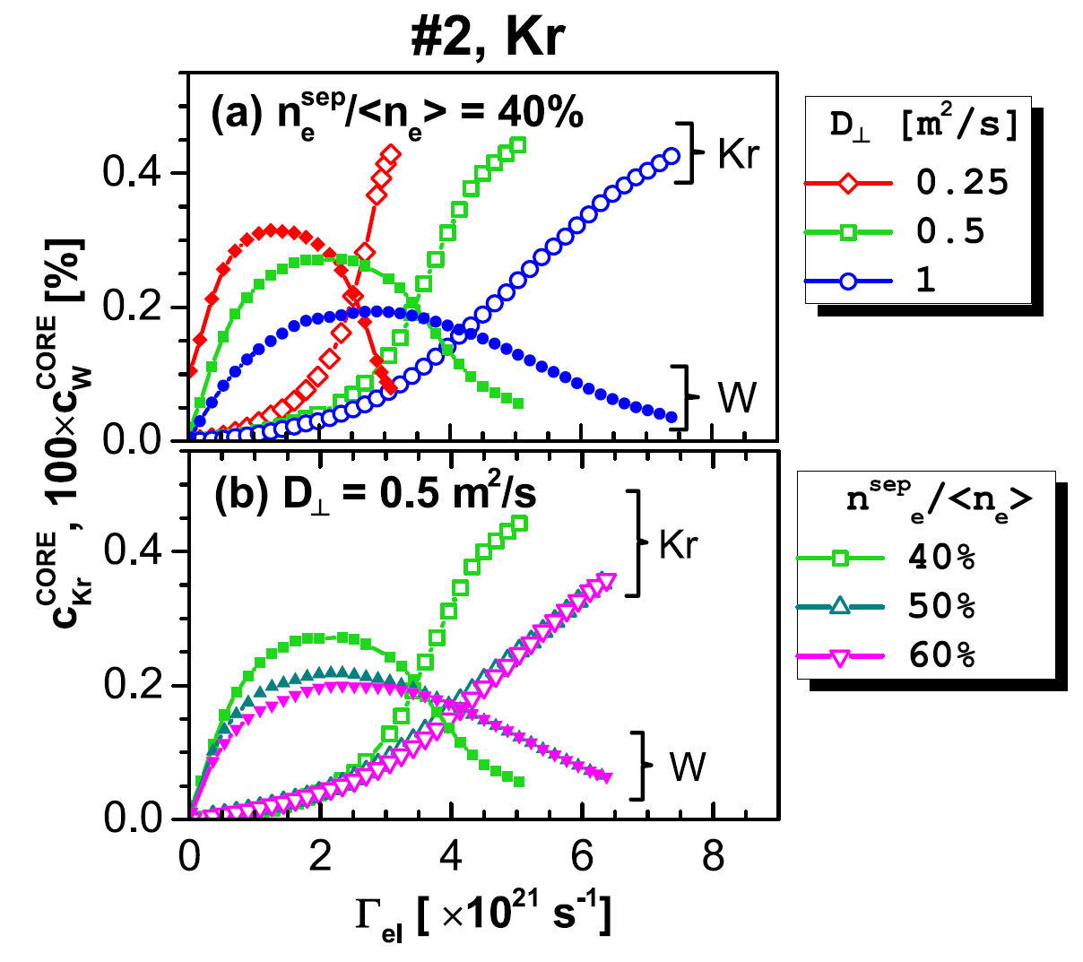
Modelling with COREDIV : W-PFC
K. Gałązka et al., "Numerical analyses of JT-60SA with tungsten divertor by COREDIV code", Plasma Phys. Contr. Fusion 59 (2017) 045011.
Main conclusions:
Scenario #2: strong seeding, possibly by Kr,
mandatory →however with high Z_{eff}
→ very narrow operation window
Scenario #3: comfortable operation window, similar to the C-PFC case, moderate Ne seeding

Slide 8
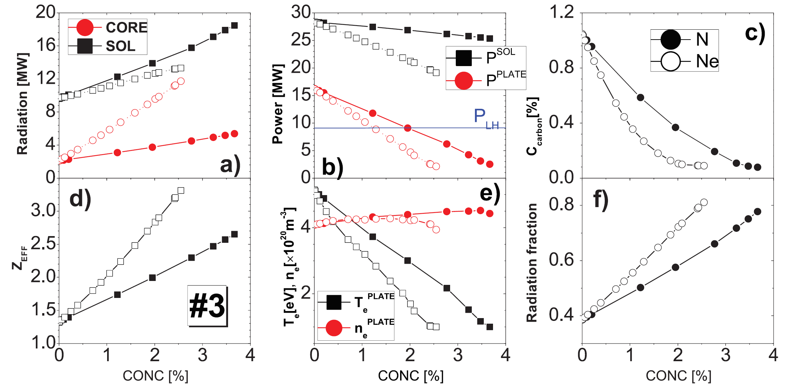
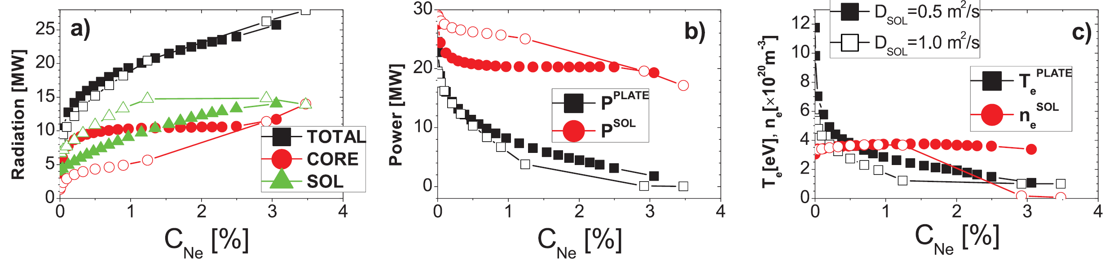
Modelling with COREDIV : C/W comparison
R. Zagórski et al., "Numerical analyses of baseline JT-60SA design concepts with the COREDIV code", Nucl. Fusion 57 (2017) 066035.
For scenario #3 in C, the regime of detachment on divertor plates can be achieved with N or Ne seeding.
For scenario #2, the C and seeding impurity radiation does not effectively reduce power to the targets.
Kr seeding might help to get semi-detached conditions.
C
W
For a W divertor, the power load to the plate is mitigated by seeding and the central plasma dilution is smaller compared to the C divertor.
For scenario #3 with Ne seeding, full detachment is predicted.
For scenario #2, Ar seems
to be an optimal choice

Slide 9
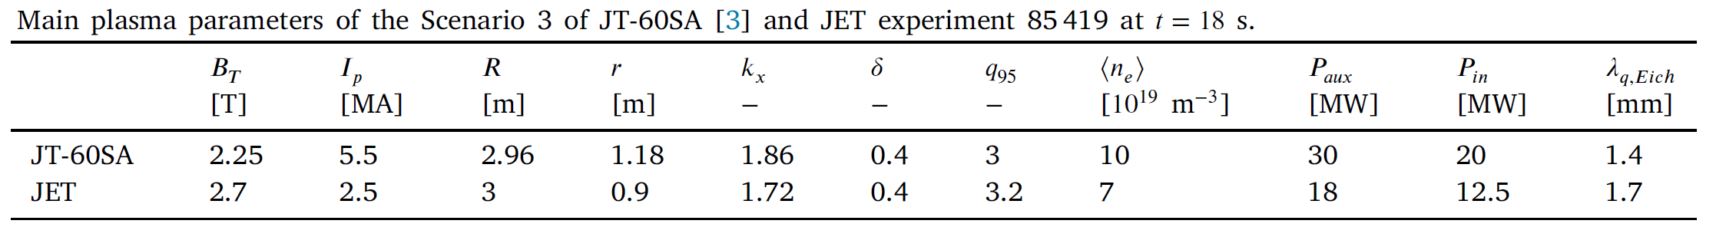
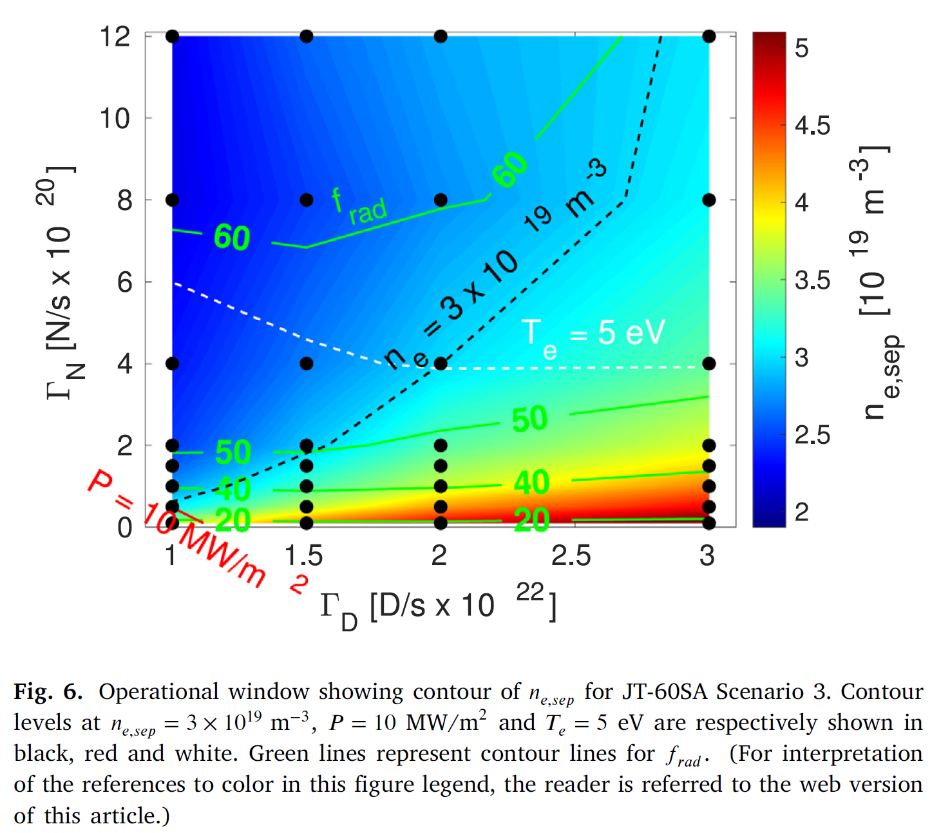
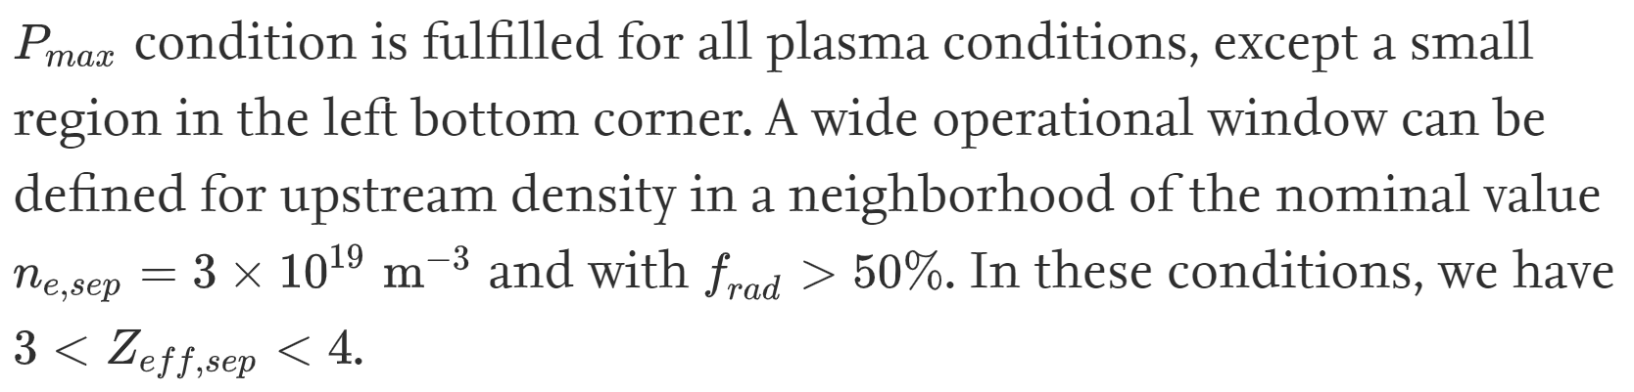
Modelling with SOLPS-ITER : W-PFC
G. Rubino et al., "Assessment of Scrape-Off Layer and divertor plasma conditions in JT-60SA with tungsten wall and nitrogen injection", Nuclear Materials and Energy 26 (2021) 100895.
engineering limits in steady state defined by 𝑃_{𝑂𝑇} < 10 MW/m² and 𝑇_{𝑒} = 5 eV at outer target.
N seeding considered

Slide 10
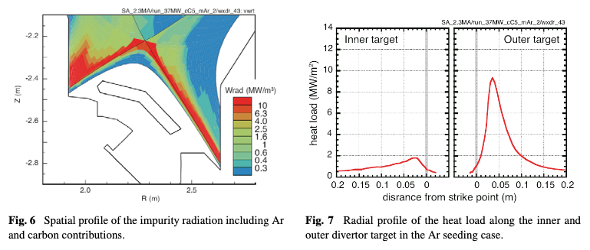
  Call for volunteers on simulation
Scenario development in line with research plan
Scenario #2 (5.5 MA/2.3 T, 41 MW heating, Γ_{div} < XX MW/m²):
  Piotr Chmielewski (SOFT 2024) on-going
  Yamoto to start
Scenario #3 (5.5 MA/2.3 T, 30 MW, 0.8 n_{e}/n_{e}^{GW})=> done
  Kawashima,,, many others
Scenario #4 ITER-like(4.6 MA/2.3T): on-going (Yamoto, QST)
Scenario #5 like (2.3 MA/1.7T, 24 MW heating, Γ_{div} < 10 MW/m²) done
  N. Hayashi NF 58 (2018) 0660011
Scenario #5 like (2.3 MA/1.7T, 37 MW heating, Γ_{div} < 10 MW/m²) done
  K. Hoshino Contrib. Plasma Phys. 54 (2014) 404
P_{Ar}=14 MW
P_{C}=13 MW
Γ_{Ar}=0.86 Pam³/s
Γ_{D2}=7.0 x10²¹/s
S_{pump}=50 m³/s
D=0.3 m²/s
χ = 1.0 m²/s
n_{e}^{sep}=1.5x10¹⁹/m³

Slide 11
  Call for volunteers on simulation
2. Physics studies in line with research plan
  Radiation transport (Dα / He I)
  Neutral compression (geometry effect)
  Multi-impurity simulation (C+Ne/Ar+He) => already available with SONIC
  Time-dependent SONIC + core transport model
  Impurity-impurity collision
  H/D transport
  Elastic collision (ex. He+D⁺)
  He metastable
  Molecules (HeH, HD, D₂ ,,,)
  W transport (ImpGyro + SONIC coupling)
  PWI simulation (MD + PWI + Edge plasma code coupling)
  3D simulation
QST concentrates on Scenario #2 development.
Any contributors from EU side?

Slide 12
References integrated modelling
M. Romanelli et al “Investigation of sustainable high-β scenarios in theJT-60SA C-wall », Nuclear Fusion 57 (2017) 116010
Scenario #5.1
N. Hayashi et al., “Predictive modelling of JT-60SA high-beta steady-state plasma with impurity accumulation”, Nuclear Fusion 58 (2018) 066001

