Slide 1

WPDIV
M. Richou, R. Neu
PSD Meeting on the EUROfusion workplan for the transition of JT60-SA to W
19 th oj July 2024

Slide 2
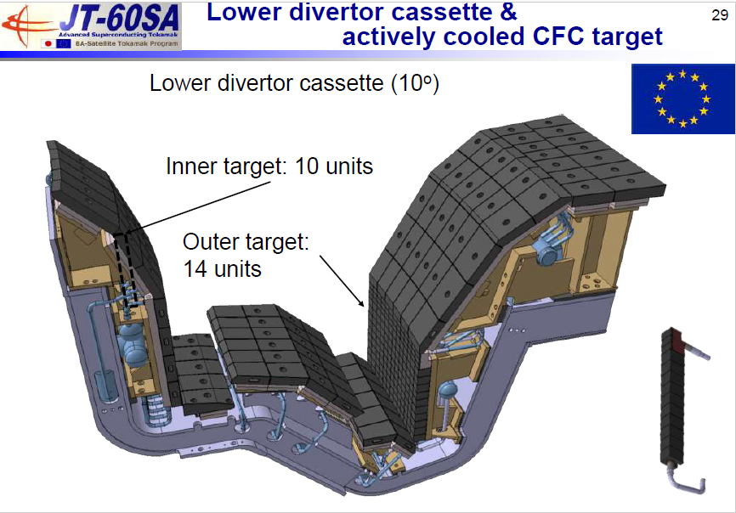
2
WPDIV-JT60SA (Main objectives)
For the C-ACD, the objective of WPDIV JT-60SA subproject consists in providing support to F4E to run the C-ACD series manufacturing (thermo-mechanical analysis, Electromagnetic loads analysis, mechanical testing, high heat flux tests)
For the W-ACD, WPDIV JT-60SA subproject has the responsibility to design and develop the W-ACD by full scale prototype manufacturing and high-heat-flux testing. For this, the first assumption, in order to save cost and R&D time, is to keep the same interfaces and boundary conditions as the ones taken for the design of C-ACD (heat flux, cooling capability, interfaces…), while developing PFC solution(s) compatible with an industrial fabrication
➲ Started in 2024, to be continued in 2025:
For the W-ACD, support to F4E

Slide 3
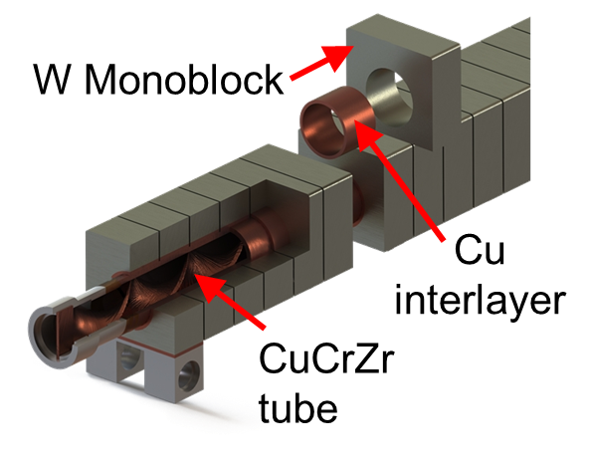
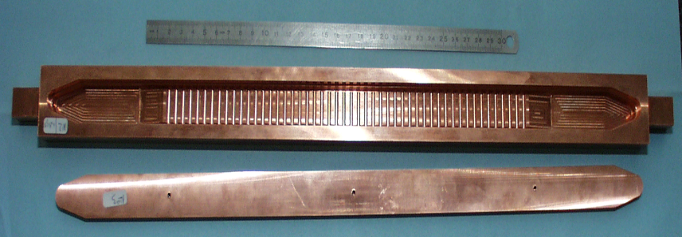


Assessed concepts
3
Monoblock
20 MW/m²
~28 mm
Flat tile
10-15 MW/m²
W – 3 mm
Interlayer – 1 mm
3 mm
27 mm
Heat sink ( TZM, CuCrZr…)
$$φ 12 mm$$
-Mature fabrication
Design limit for JT60SA defined in 2024
Under study by F4E (mock-up planned to be manufactured)
32 mm
-Mature fabrication for W/CuCrZr
Design limit defined in 2023
Under study by F4E (mock-up manufactured)
Enhanced – WPDIV focus from a manufacturing point of view
WPDIV
Schematic cut view
Example of Hypervapotron mock-up
10-25 MW/m²
Fabrication maturity under investigation
Design limit defined in 2024
First manufacturing autumn 2024
491 mm
CuCrZr
6
6
6
CuCrZr

Slide 4
Involvement from design to manufacturing
Experimental – Academic
Innovation : Development of hydraulic set-up to define adequate hydraulic correlation
Manufacturing
Innovation : CuCrZr additive manufacturing
Use of conventional manufacturing process (Hot Isostatic pressing available at CEA) already proven to work
Use of W or W alloy available in industry (feedback from WPDIV W7X)
Design and shaping
Thermo-mechanical analysis - Methods used for other components no new development to help in the definition of the design limit
Shaping of plasma facing surface
Enhanced concept (conical shape, task with Jamie Gunn)
Conventional flat tile surface as support to F4E need consideration assembly tolerances
Aside but to take into account in EUROfusion : Diagnostic to measure evolution of the W-PFCs

