Slide 1
Upgrade/adaptation of subsystems (heating, diagnostics etc) to support W-wall operation
PSD Meeting on the EUROfusion workplan for the transition of JT60-SA to W
Carlo Sozzi
WPSA PL

Slide 2
Switch to W
Transition to W wall involves a number of modifications and upgrades to be taken into consideration, besides the choice of the technology solution for the PFCs and the physics modeling
Heating mix
Diagnostics
Protection system
Other supporting technologies and technical aspects
DISCLAIMER: this is just a tentative list of items not to forget in developing the planning (to be complemented and analyzed in deep)

Slide 3
Conclusions (from FSD Science Coordination Meeting on the transition of JT-60SA to W, - 26 March 2024)
Transition to W wall involves a number of modifications and upgrades to be taken into consideration, besides the choice of the technology solution for the PFCs, the physics modeling and preparation experiments
Upgrading of the heating mix toward more central electron heating, and consider risks (NBI shinethrough, EC stray)
Extend divertor and wall monitoring diagnostics
Extended revision of the spectroscopy diagnostics for W source and transport
revision/upgrading of the protection system, including disruption management (prevention, avoidance, mitigation, runaway electrons)
Tasks table

Slide 4
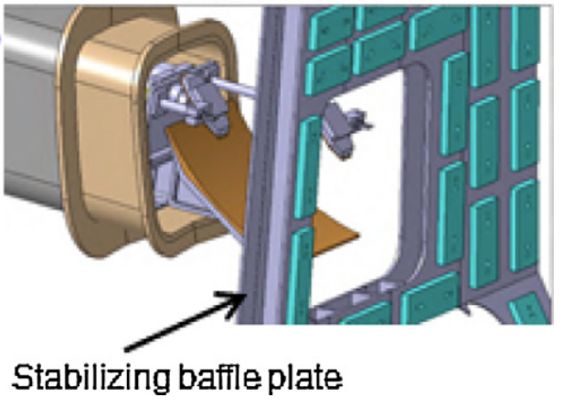
Upgrading of the heating mix toward more central electron heating
3 MW of ECRF power foreseen until OP4, 7 MW later (from OP5, y>2029)
The power of 3MW of ECRF seems marginally sufficient for stabilization of NTM(2,1) in fully inductive scenario (Ip=5.5 MA) at low density 7.6 10¹⁹, insufficient at high density (1.1 10²⁰).
Similar (slightly better) for hybrid scenario
https://idm.euro-fusion.org/?uid=2R8S4H&version=v1.1,
https://www.epj-conferences.org/articles/epjconf/pdf/2012/14/epjconf_ec2012_02017.pdf
Impurity control requires central electron heating (ρ<0.2), power amount to be evaluated (1~2 in AUG https://iopscience.iop.org/article/10.1088/0029-5515/51/8/083013/pdf )
Scaling law not known (hopefully NOT plasma volume, V_{JT-60SA}≈10 V_{AUG}) (JG just suggested 3-7 MW on the basis of JET)
Foreseen power already low for the development of high beta scenario in C
Full system 9 sources≈7MW to plasma
3 launchers X 2 WGs +
1 launcher X 3 WGs with limited steering
Limited accesses => develop specialized (compact) launchers for core heating, no (or) minimal steering? (4x1.5 MW sources might fit in the 4th launcher)
Under consideration also the upgrading existing equipment e.g. from 1MW/tube to 1.5MW

Slide 5
ECRF: possibility to be assessed
Full system 9 sources for about 7MW to plasma, distributed in
3 launchers X 2 WGs, full steering capabilities (2 of them being installed in ME1)
Foreseen 1 launcher X 3 WGs with limited steering, not yet developed
To overcome limited accesses => develop a specialized (compact) launcher for core heating, with no (or minimal) steering
WG diameter/ port size =80mm/480mm
4x (or 6x) gyrotron sources might fit in the 4th launcher
Some margins to increase the power/gyrotron at 110 and 138 GHz, for limited pulse duration
Under consideration also the upgrading existing equipment e.g. from 1MW/tube to 1.5MW

Slide 6
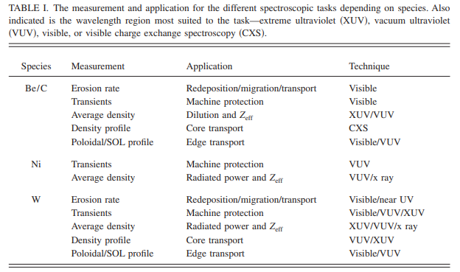
Emission (spectroscopic) diagnostics
C=>W Change of the dominant impurity
W has 74 ionization stages
Change in the wall material results in qualitatively different spectroscopic needs with respect the C wall for spectroscopic diagnostics in the visible, extreme ultraviolet, vacuum ultraviolet, and x-ray spectral regions
Erosion rate
Melting
Redeposition
Transport and core concentration
Radiated power and Zeff
Revision needed for physics, operational and machine protection tasks
O’Mullane et al. Rev. Sci. Instrum. 77, 10F520 2006

Slide 7
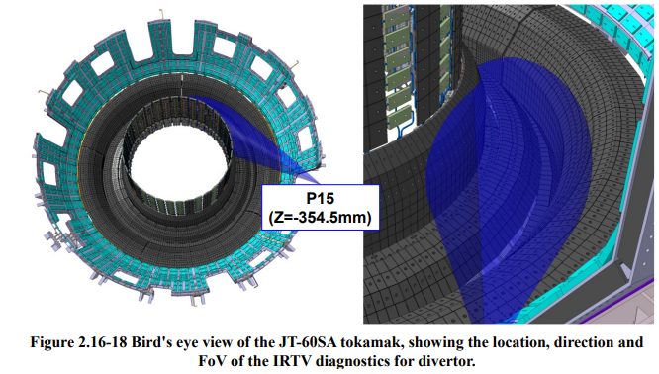
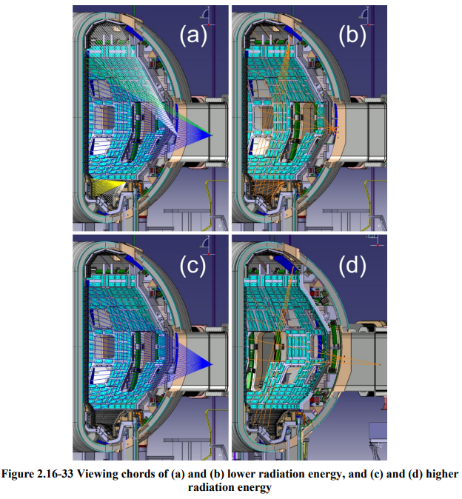
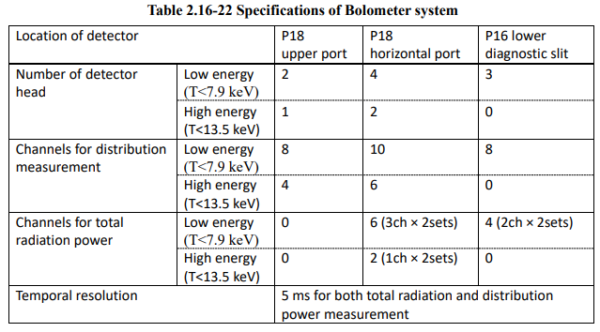
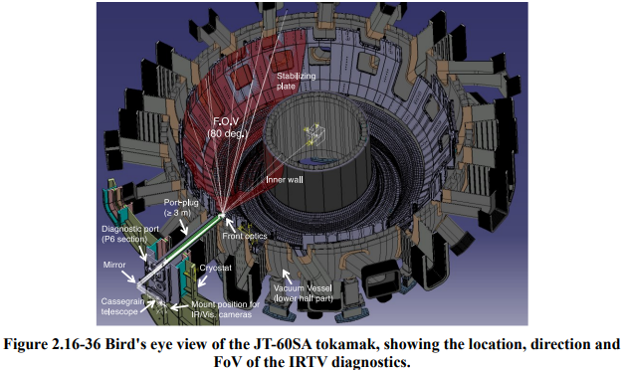
Divertor and wall monitoring diagnostics
Infrared TV camera （divertor and wide FoV）
Bolometry）
Field-of-view ~20° , 1 cm spatial resolution
Previous review performed by EU experts indicate some weak point (coverage, spatial resolution, number of covered sectors)
Field-of-view ~80° , 2 cm spatial resolution

Slide 8
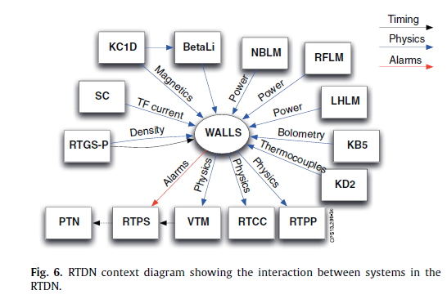
revision/upgrading of the protection system
For reference: The JET real-time plasma-wall load monitoring system (Valcarcel, FED 89 2014 243–258)
Thermal monitoring of the first wall (IR cameras)
Surface temperature calculation of the limiter tiles and the bulk energy of the divertor tiles => Vessel Thermal Map uses the surface temperature map, to raise alarms in case of hot-spots.
Integration in a system providing a model-based thermal map (not relying on IR data)
Calculation of the power density deposition
Distance to the plasma boundary
Divertor strike point position
Alarm condition when machine’s operational limits exceeded
JET REAL TIME DATA NETWORK and interaction among systems (diagnostics, heating, models, protection)
From C to W: More stringent requirements on plasma position and current control to minimize the possibility of damages
Vertical stabilization
Shape Controller
Termination management system
Disruption management
De Tommasi, FED 89 (2014) 233–242

Slide 9
Other items to be developed
Long pulse operation also requires
Upgrade of the primary water cooling system
Motor generator for high power-long pulse
Development of remote handling: if and when is needed
Not necessary for the installation of W PFCs (tbc)
Necessary after campaigns with high performance, long pulses (tbc)

Slide 10
Preparation of the transition to the tungsten wall (SARP 4, 2018)
The transition to the tungsten wall will imply a large number of additional technical and operational requirements for the main scenarios of JT-60SA. As drawn from the experience in JET and AUG, the following prerequisite should be examined prior to the transition to the tungsten wall:
High density/large gas puff will be required in the W-wall to avoid W influx and accumulation. This needs to be tested well in non-inductive scenarios in particular.
Some of the ECRH power will be dedicated to W control and this needs to be tested in advance in relevant scenarios by injecting W or high Z species.
Shine-through with the available NB power needs to be re-assessed for scenarios.
Integrated disruption control and mitigation system will be required systematically to avoid or mitigate electro-magnetic and heat loads in high performance scenarios. This will need to be prepared in advance of the transition to W.
New wall protection system and associated set of diagnostics (IR camera, thermocouple, Langmuir probes, pyrometers, spectroscopy, etc) will need to be installed and commissioned.
ELM energy impact assessment, ELM mitigation and control or small ELM regime should be established before the installation of the new wall.
Tungsten sputtering and erosion in the main chamber need to be minimized by careful plasma control clearance.
Physics of low collisionality will be more difficult to access with the metallic-wall, therefore this part of the program should be done before the transition.
Many of these points are also related to ITER and DEMO research issues and therefore should strongly contribute to the development of DEMO scenario design.

