Slide 1
Global temperature gradient-driven and flux-driven gyrokinetic simulations on positive and negative triangularity
G. Di Giannatale ¹⁾, A. Balestri ¹⁾ , A. Bottino ²⁾, S. Brunner ¹⁾, M. Murugappan ¹⁾ , L. Villard ¹⁾
EPFL, SPC, CH-1015 Lausanne, Switzerland
Max Planck Institute for Plasma Physics, Garching, Germany

Slide 2
ORB5 - Code, equations and approximations
ORB5 is an EM, flux-driven, global, PIC GK code based on a Lagrangian variational description [Tronko PoP 2016, 2019; Tronko PPCF 2017]
ORB5 solves a full-f Vlasov equation, in spite of $δf$ splitting used as control variate. The total distribution function is represented as $f=f_{0}(ζ, t)+δf$and only $δf$is discretized using markers
It leads to noise reduction
The initial phase space is sampled with markers. Such markers are evolved and their orbits are followed during the simulation in the 5D phase space
Fields solved with 2nd and 3th order B-splines
The code is massively parallelized, with both distributed memory (MPI) and shared memory (OpenMP) models. It is GPU-enabled (OpenACC). It has been ported on many clusters (Leonardo, Piz-Daint, Summit, Marconi, M100 etc..)

Slide 3
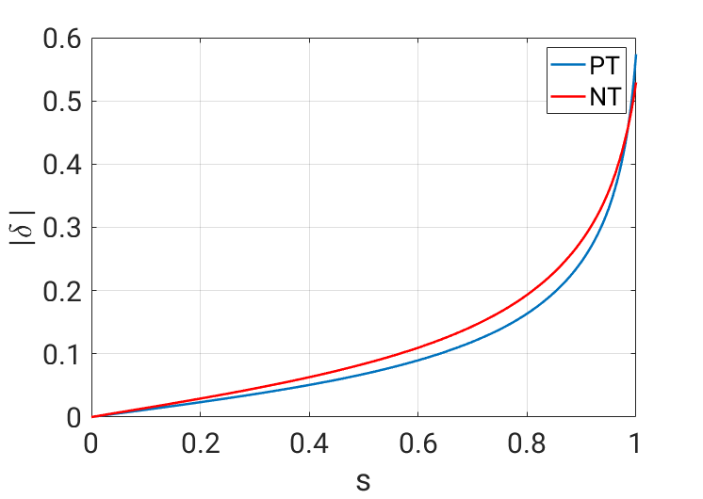
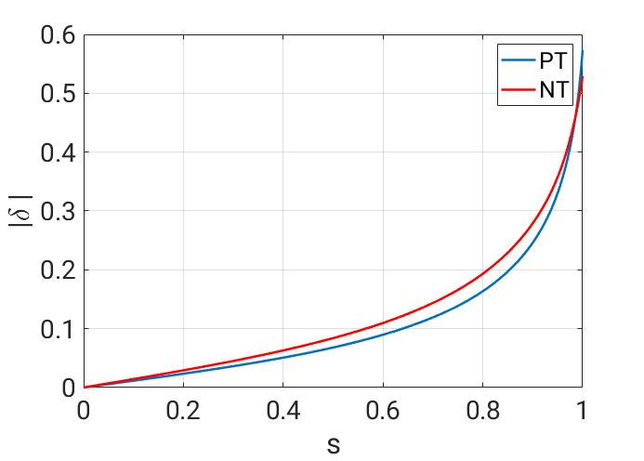
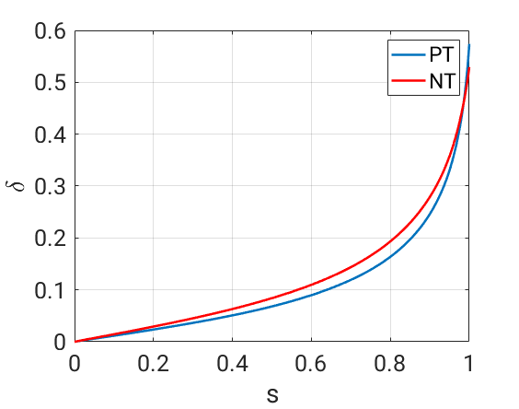
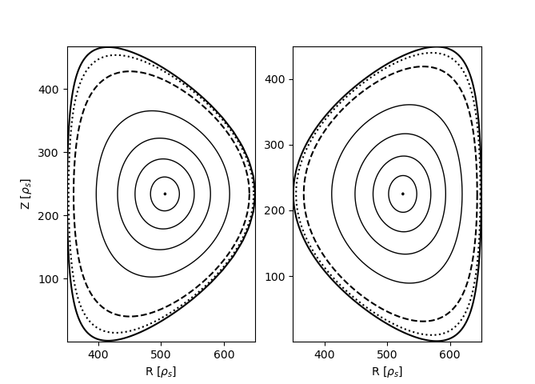
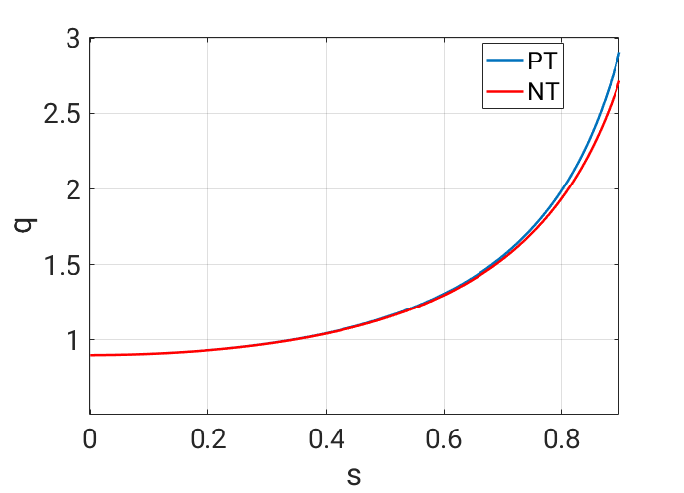
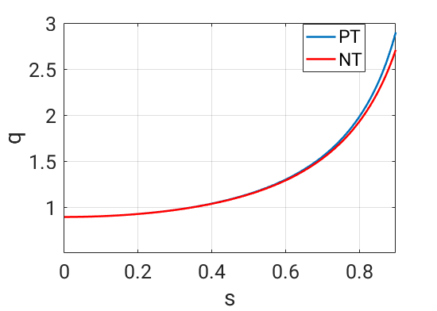
Reconstructed equilibria
Equilibria obtained with CHEASE 2 TCV equilibria have been taken, #60797 (PT) and #58499 (NT) (Fontana 2020 PPCF)
Radial coordinate in this presentation:
$$s=\sqrt{ψ_{p}/ψ_{p}\left(a\right)}$$
$$d$$
$$δ≔d/a$$

Slide 4
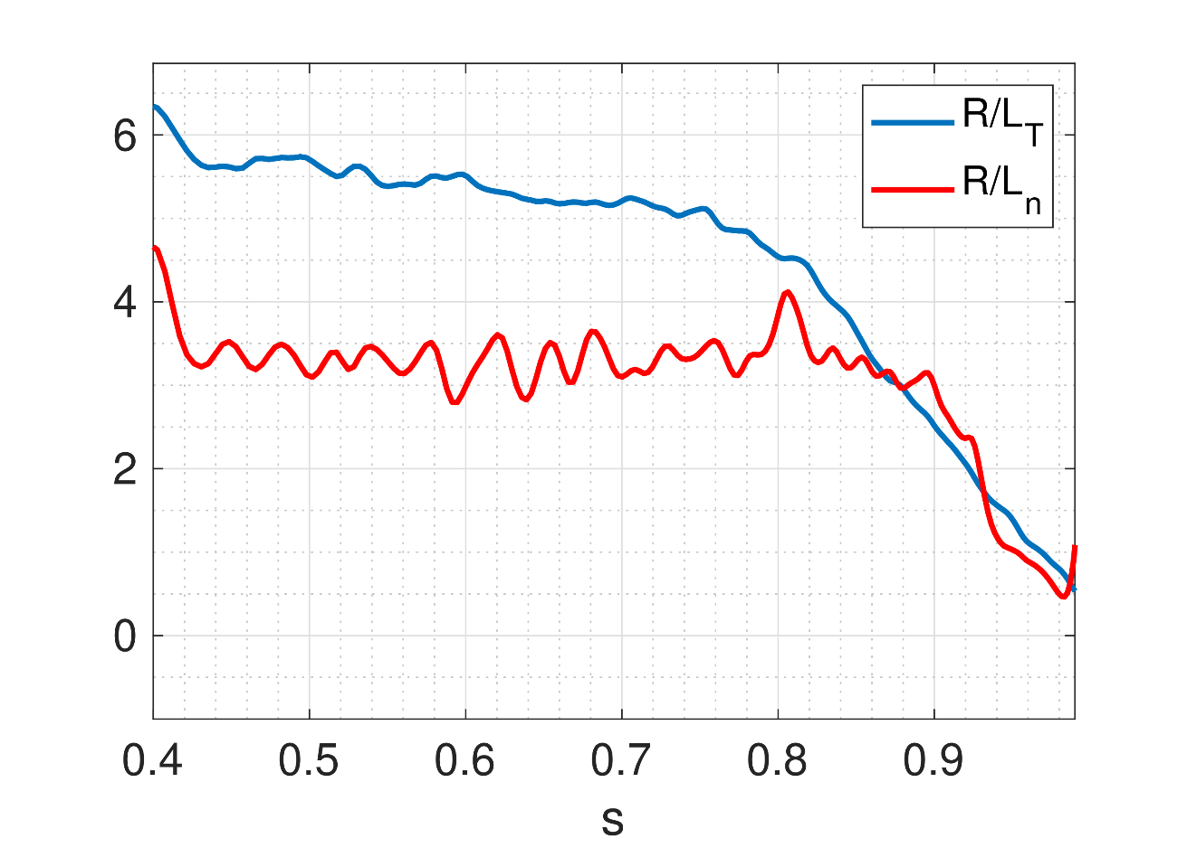
Flux-tube GENE simulations setup
Miller parametrization on the selected flux-surfaces
Logarithmic gradients chosen as converged collisionless global ORB5 simulations

Slide 5
Outline of the simulations
Linear flux-tube simulations
Collisionality scan
Gradient-driven flux-tube simulations
Collisionless and collisional
Global Temperature-gradient driven simulations
Collisionless and collisional
Flux driven simulations
Collisionless and collisional

Slide 6
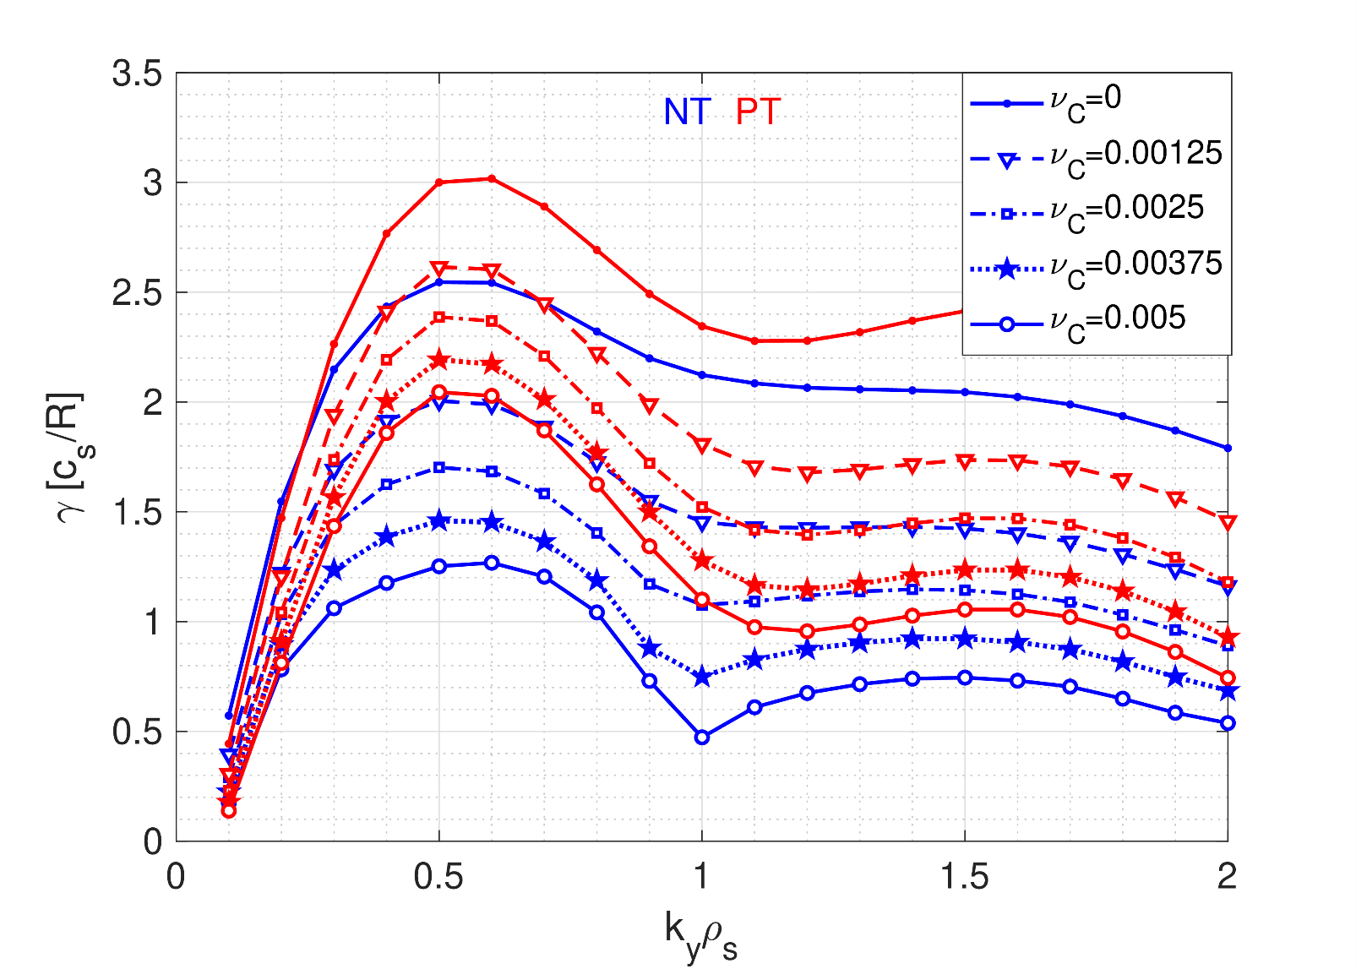
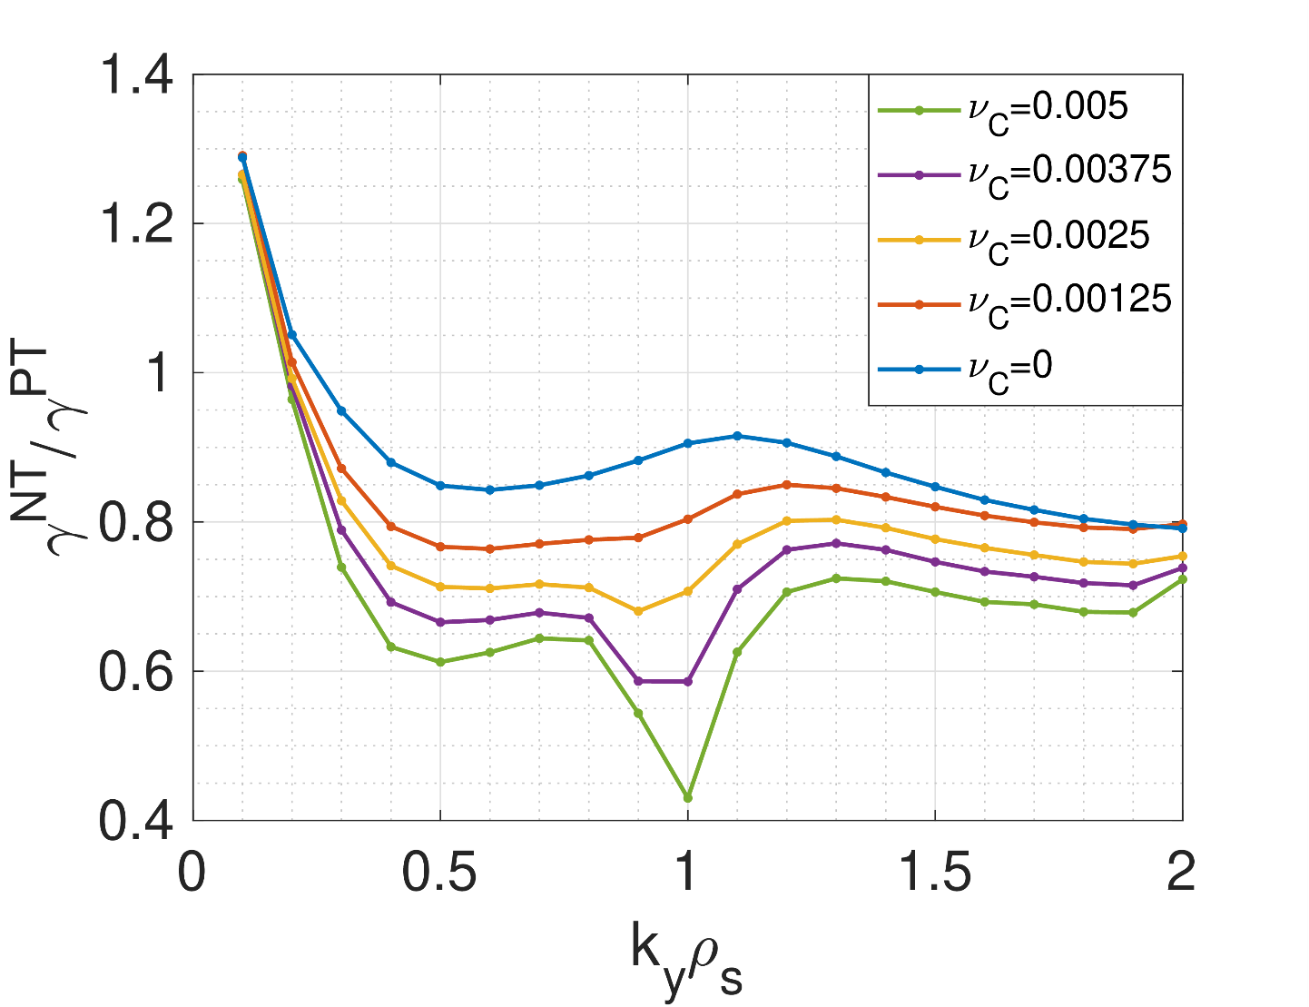
Linear analysis
Linear analysis have been performed at several radial position and NT has always lower growth rates compared to PT for both ITG and TEM modes (real frequencies).
Collisionality reduces the growth rate for both PT and NT making NT more advantageous ($γ^{NT}/γ^{PT}$ decreases with collisionality).

Slide 7
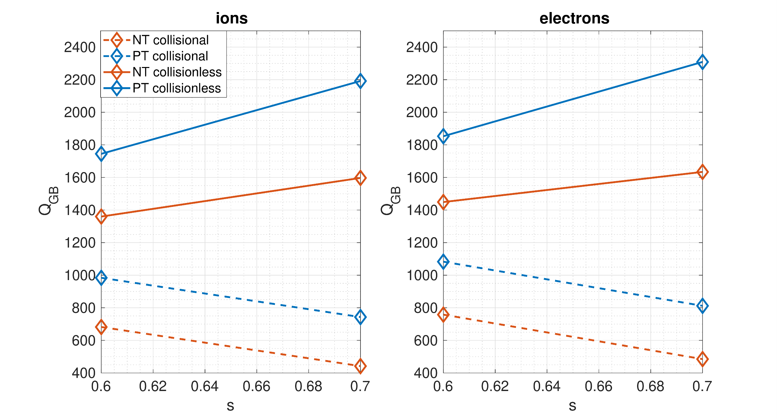
Nonlinear flux-tube simulations (GENE)
2 nonlinear flux-tube simulations ($s=0.6, 0.7$)
Collisionless simulations do agree with ORB5 results, i.e. $Q_{i}/Q_{e} ≃1$
Collisions make ion and electron heat flux decrease, keeping the ratio $Q_{i}/Q_{e} ≃1$ Maximum Q is shifted at lower radial location
Effect on the electron channel is well understood
Effect on the ion channel is unclear
To be clarified

Slide 8
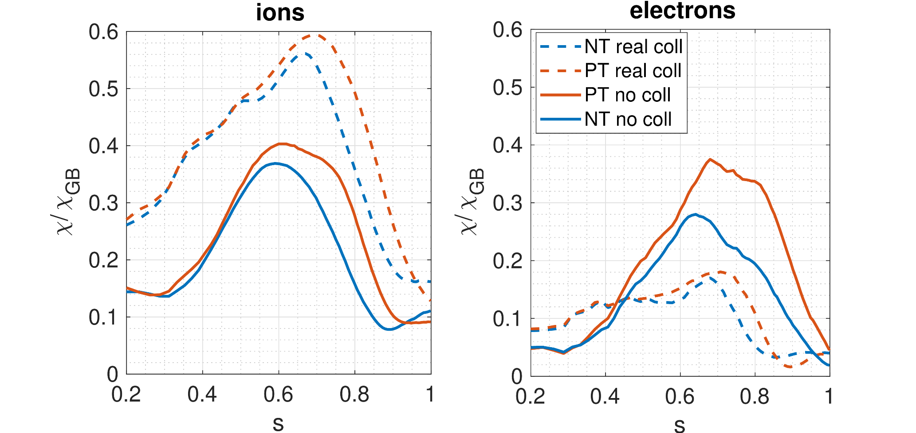
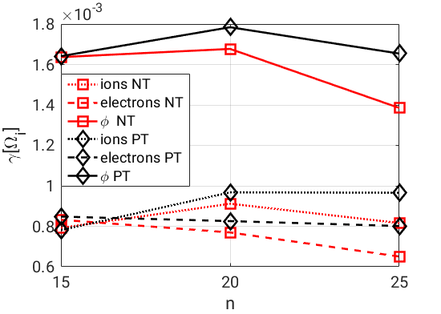
Temperature-gradient-driven global simulations (ORB5)
The effect of collisions on the electrons is the same as in the flux-tube
Ion heat flux has an opposite trend compared to flux-tube simulations: it grows
Linear results

Slide 9
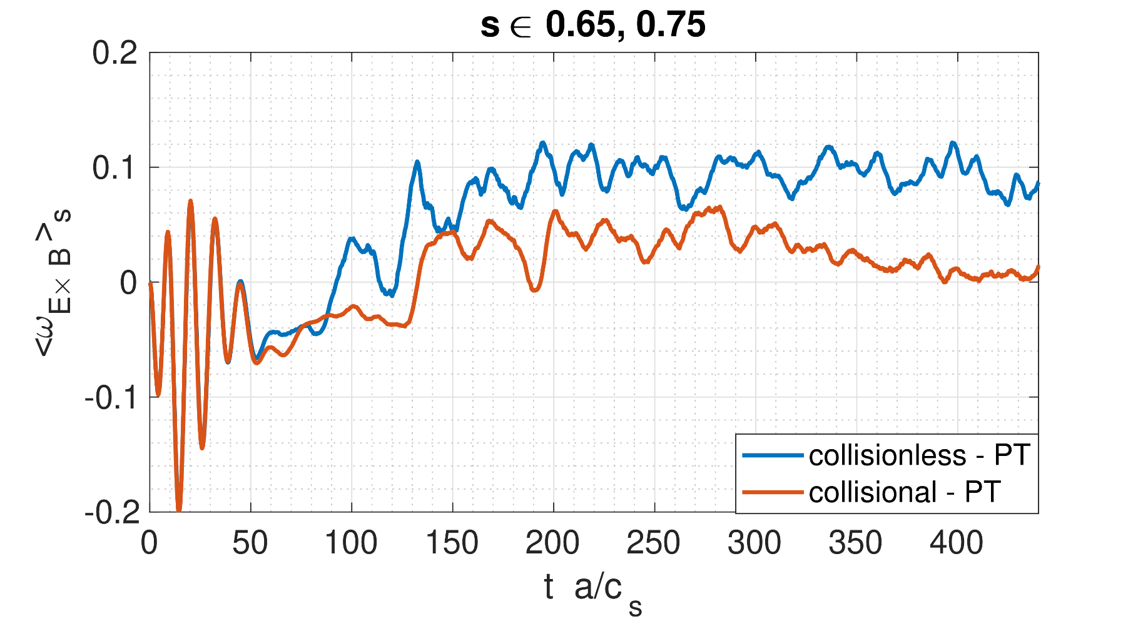
Temperature-gradient-driven global simulations (ORB5)
The effect of collisions on the electrons is the same as in the flux-tube
Ion heat flux has an opposite trend: heat flux grows
Explained through the ZF dynamics: collisions damp ZFs that are the main players for ITG saturation → ion heat flux saturates at higher values

Slide 10
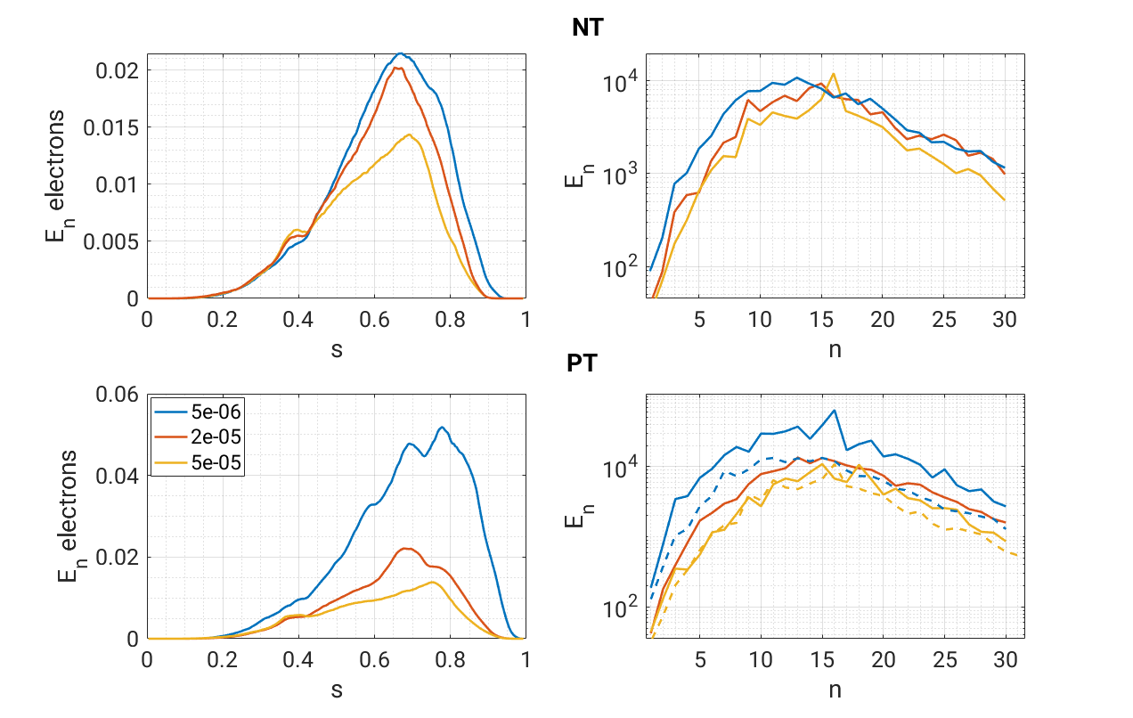
Collisions – electrons energy flux spectrum
Clear effects on the electron energy flux spectrum:
At low n (TEM) there is a strong reduction when collisions are inserted and the difference PT/NT fades out
At high n (TEM-ITG) the effect is also very strong but PT has still higher flux than NT
$E$ flux electrons
collision
$E$ flux electrons
collision

Slide 11
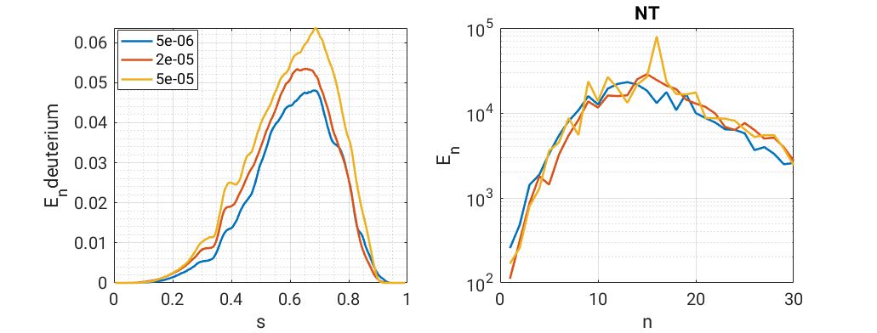
Collisions – ions heat flux spectrum
For the low n part of the spectrum of ion heat flux there not the same drop as for electrons
Consistent with linear simulations
The high n part of the spectrum goes up with collisions
Overall, collisions do increase the heat flux
collisions
$E$ flux ions

Slide 12
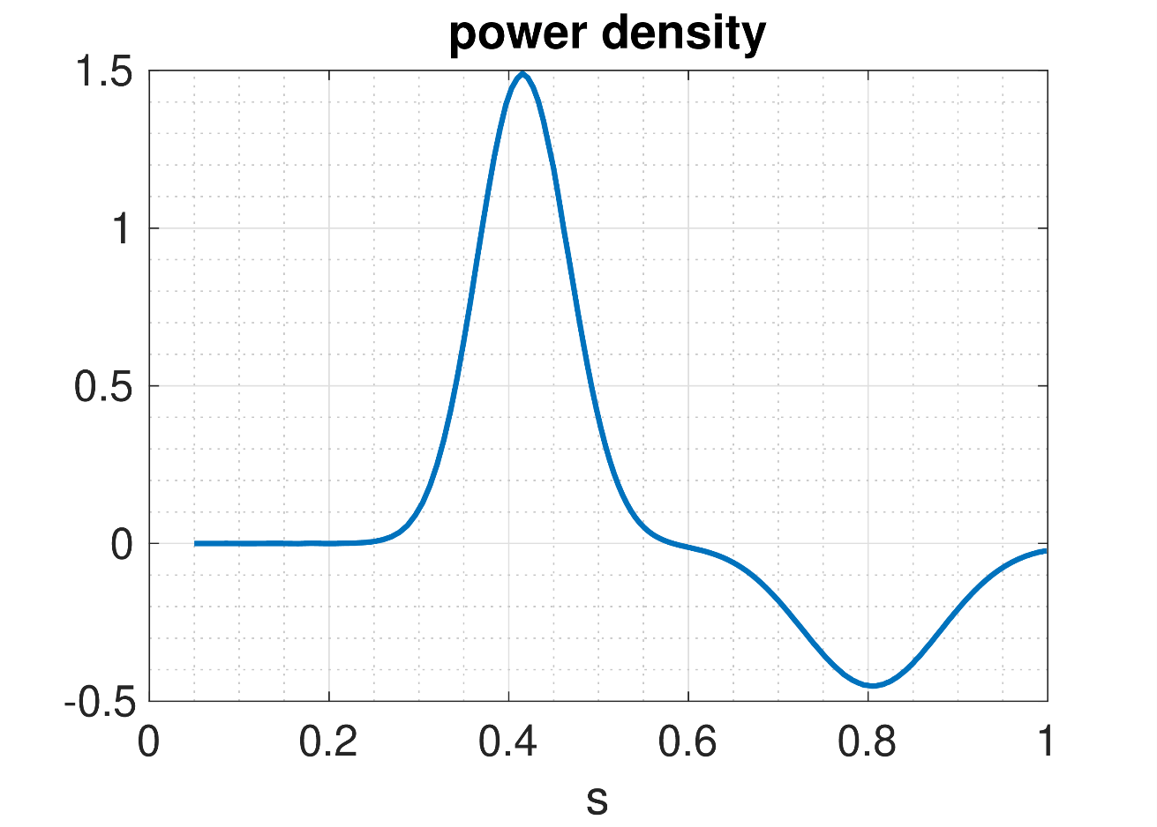
Flux-driven simulations
Flux-driven simulations are more self-consistent compared to GD simulations
Input power contains both source and sink
However the integral is > 0 and an additional region is inserted (s>0.9) to dissipate what is left
Three simulations per triangularity:
Collisionless
Real-collisionality (Fontana 2020 NF)
i-i collisionality increased x10
Control variate adaptation scheme is used [M. Murugappan PhD]

Slide 13
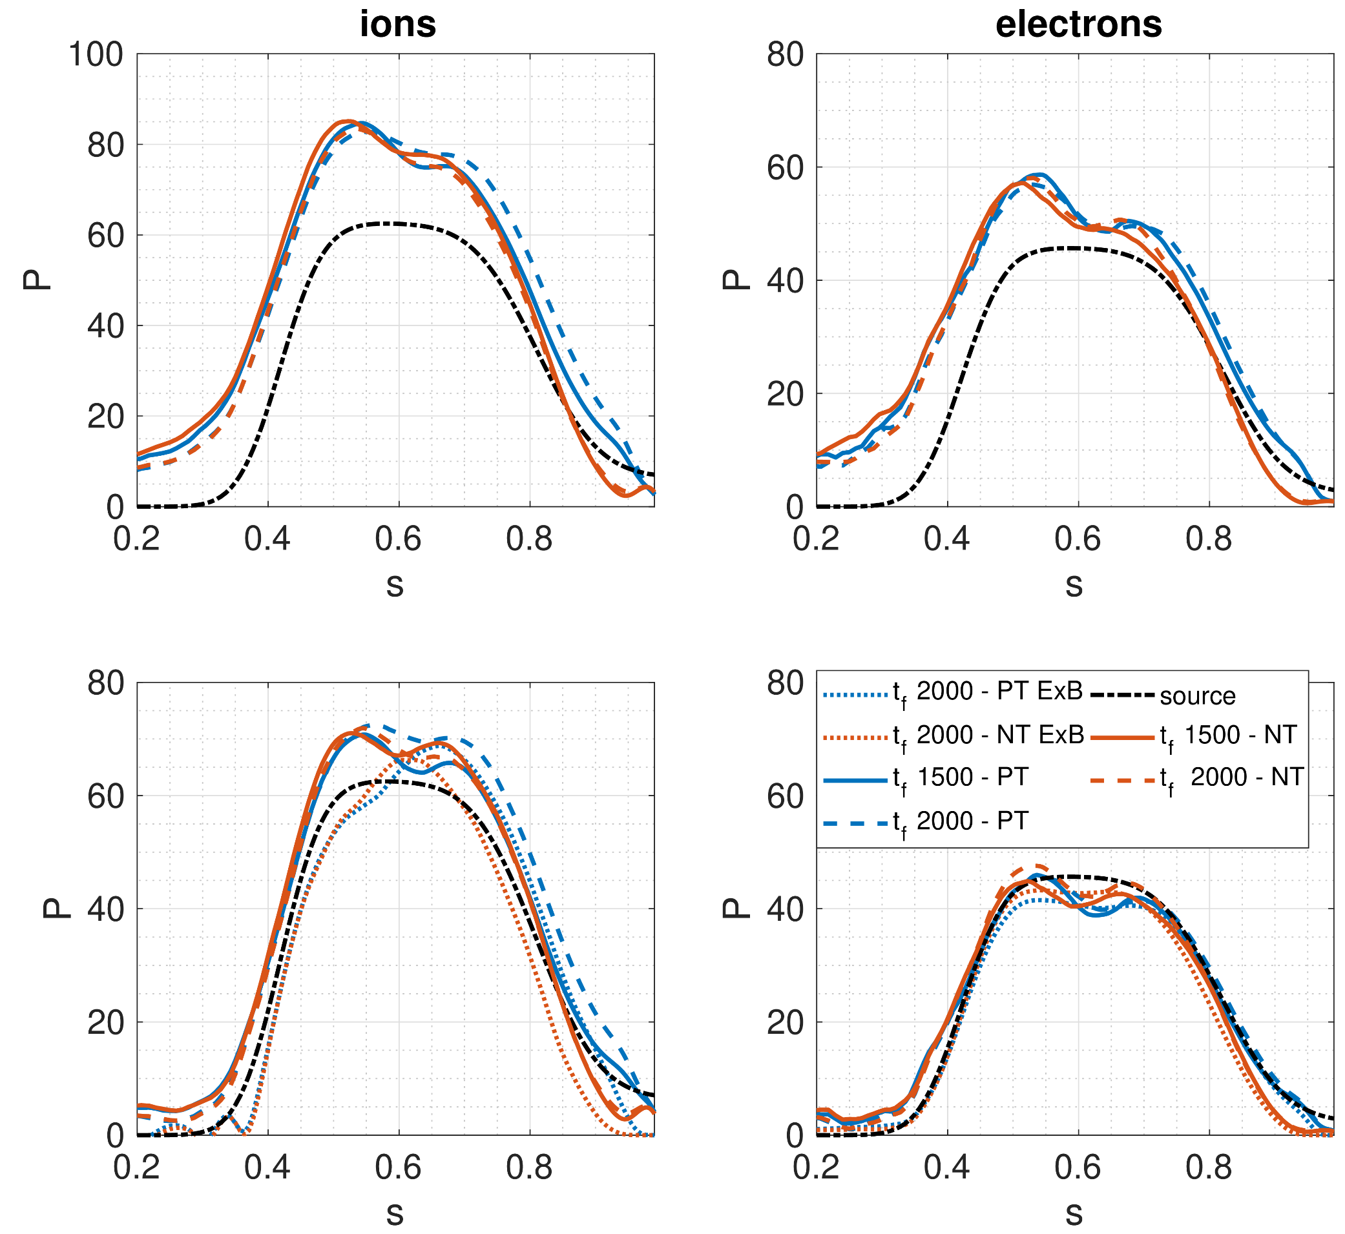
Collisionless case
How are the simulations going? In which state are they?
Heat flux balance is respected but there is still an evolution of density profile with change of instability drive
Energy flux
Heat flux

Slide 14
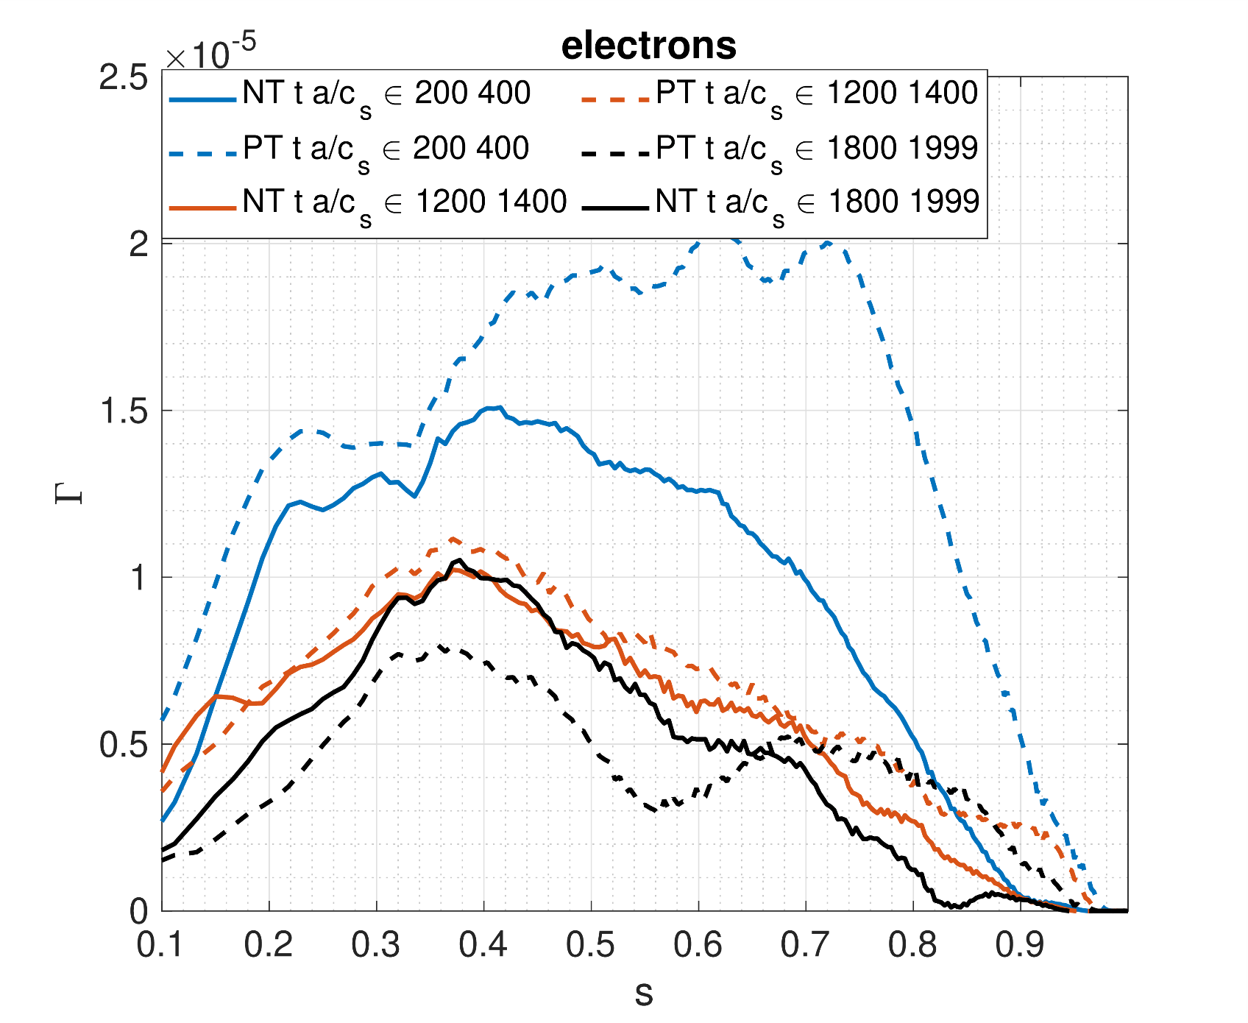
The change of the drive
The heat losses are compensated by the input power
Nevertheless profiles are still evolving

Slide 15
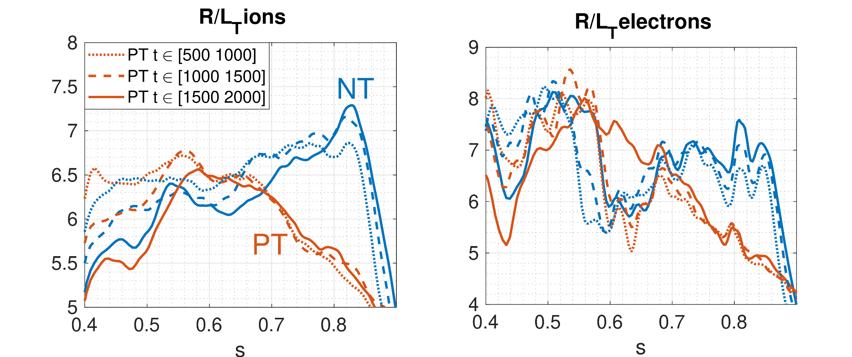
Collisionless case
Spontaneous development of a pedestal for NT!
Both ions and electrons channels

Slide 16
Collisionless case
Work in progress for the flux-driven collisional cases
So far $R/L_{T}$ evolution is coherent with Temperature gradient driven results
Long ($t a/c_{s} >600$) runs with collisions not very reliable: signal/noise, i.e. a measure of how much the system respond to GK modes versus how much the system develops non-GK modes, becomes small → simulation unreliable
We can start a new simulation using as initial profile the final profile of another simulation

Slide 17
Unfortunately there are complications… as usual…
Does the initial profile affect the results? It seems so..
The ratio of the fluxes at the end of simulation 1 and at the beginning of simulation 2 is not the same
Ions flux is consistent, electrons flux is not. Much lower at the end of the first simulation
How much starting from a non-turbulent state does change the turbulent feature?

Slide 18
ZF shearing rate at different collisionality

Slide 19
Conclusions and future work

