Slide 1
Simulations and experiments of the Fast Ion confinement on Negative and Positive triangularity plasmas on TCV
J. Poley-Sanjuán, A. Jansen V. Vuuren, et. al., and the TCV and EuroFusion teams
TCV – 23

Slide 2
Outline:
Introduction
Experimental scenarios on TCV: close match in experimental conditions
Numerical studies in TRANSP and ASCOT5
Conclusions and future outlook
TCV – Internal Campaign, 2023

Slide 3
Outline:
Introduction
Experimental scenarios on TCV: close match in experimental conditions
Numerical studies in TRANSP and ASCOT5
Conclusions and future outlook
TCV – Internal Campaign, 2023

Slide 4
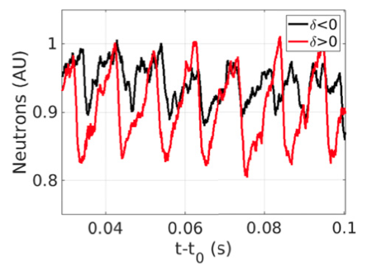
Introduction: lack of dedicated studies of
FI confinement in NT/PT quiescent plasmas
Fast Ions (FI) are key for self-sustained heating in fusion plasmas
There are studies upon FI confinement in NT/PT with MHD activity [1,2]
These shown similar FI confinement properties in NT/PT [1,2]
There is a lack of dedicated studies to compare the FI confinement in NT/PT on MHD-quiet plasmas to further validate this conclusion
[1]
TSVV-02, Lausanne Sep-2024
[1] Vallar, M., Nuclear Fusion, 62(2), 026028 (2022).
[2] Van Zeeland, Nuclear Fusion, 59(8), 086028 (2019).

Slide 5
Outline:
Introduction
Experimental scenarios on TCV: close match in experimental conditions
Numerical studies in TRANSP and ASCOT5
Conclusions and future outlook
TCV – Internal Campaign, 2023

Slide 6
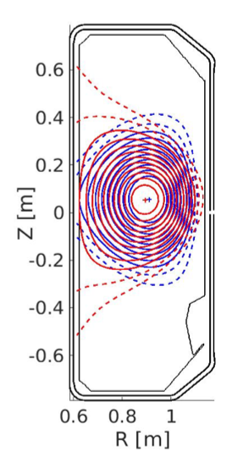
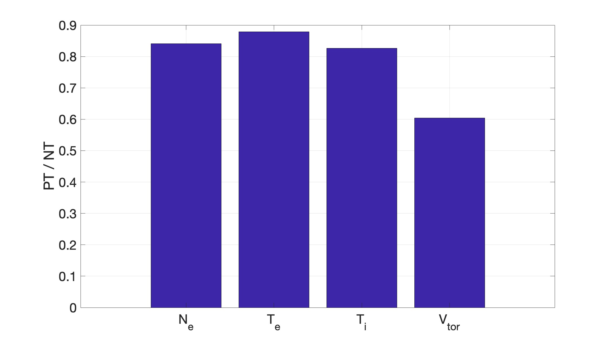
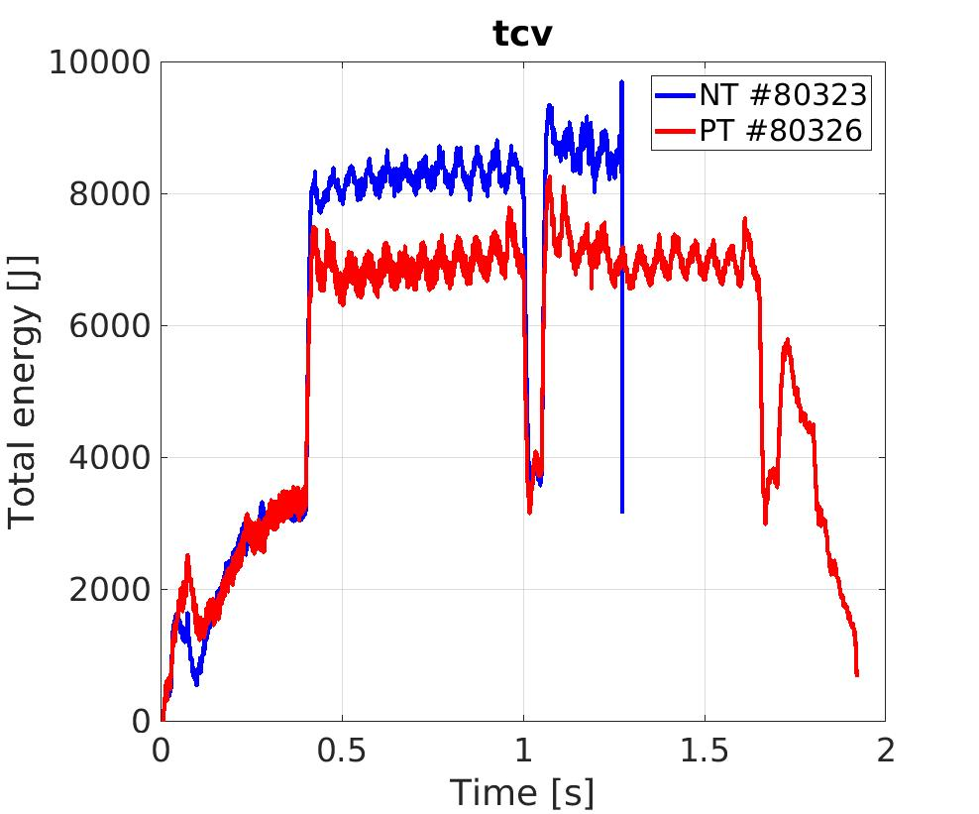
Experimental scenarios: good match in shapes, plasma volume
NT #80323, 𝛅 = -0.25
Plasma’s shape and position matched to have similar fast ion birth rates
Plasma’s Te, Ne, Ti, and Vtor are enhanced in NT
Larger plasma’s total energy in NT
PT #80326, 𝛅 = -0.25
TSVV-02, Lausanne Sep-2024
Thomson volume averaged
CXRS averaged (0.5 s)

Slide 7
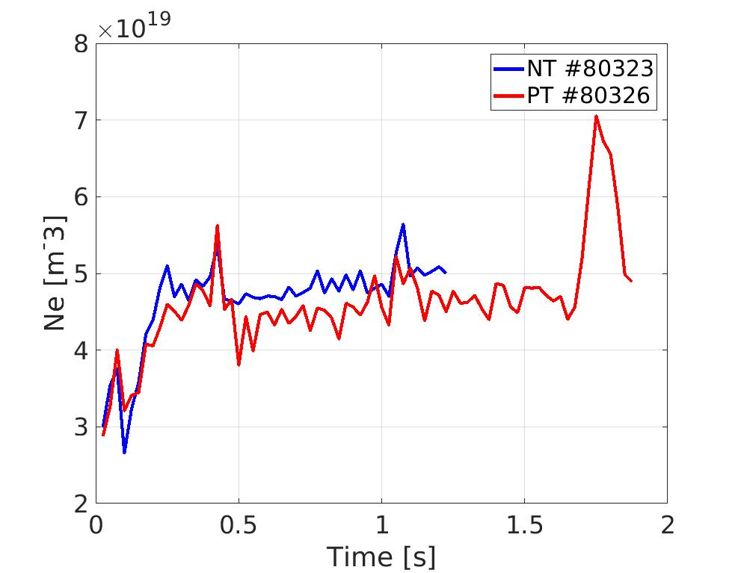
Experimental scenarios: enhanced Ne
NT #80323, 𝛅 = -0.25
Larger Ne in NT as in ECRH cases [3]
PT #80326, 𝛅 = -0.25
Thomson on-axis
TSVV-02, Lausanne Sep-2024
Thomson volume averaged
CXRS averaged (0.5 s)
[3] A. Balestri, PPCF, 66(6), 065031. (2024).

Slide 8
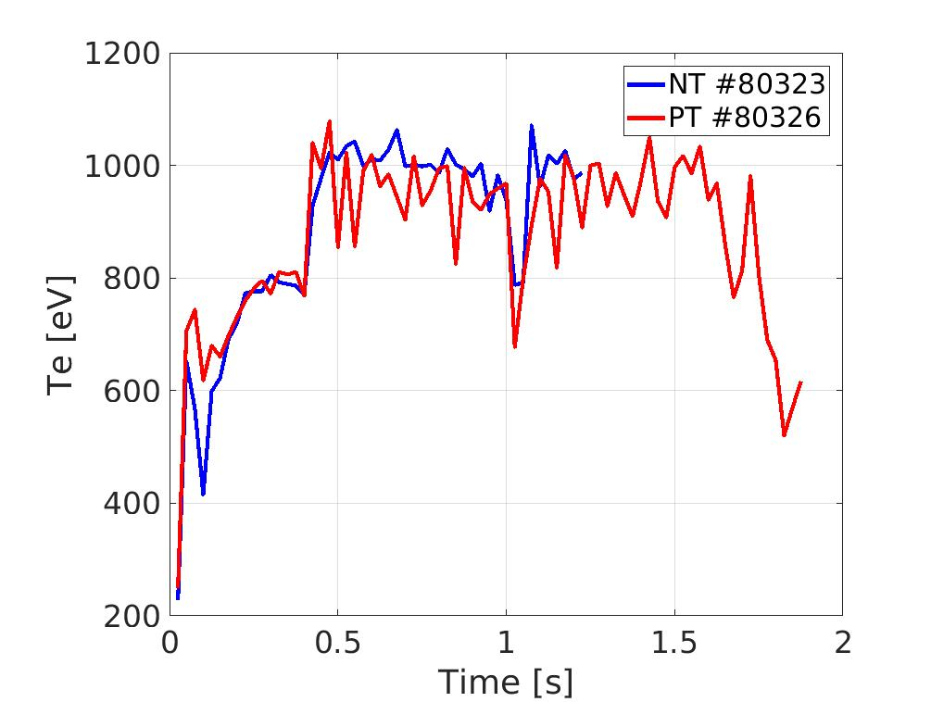
Experimental scenarios: similar Te
NT #80323, 𝛅 = -0.25
No clear difference in Te
PT #80326, 𝛅 = -0.25
Thomson on-axis
TSVV-02, Lausanne Sep-2024
Thomson volume averaged
CXRS averaged (0.5 s)

Slide 9
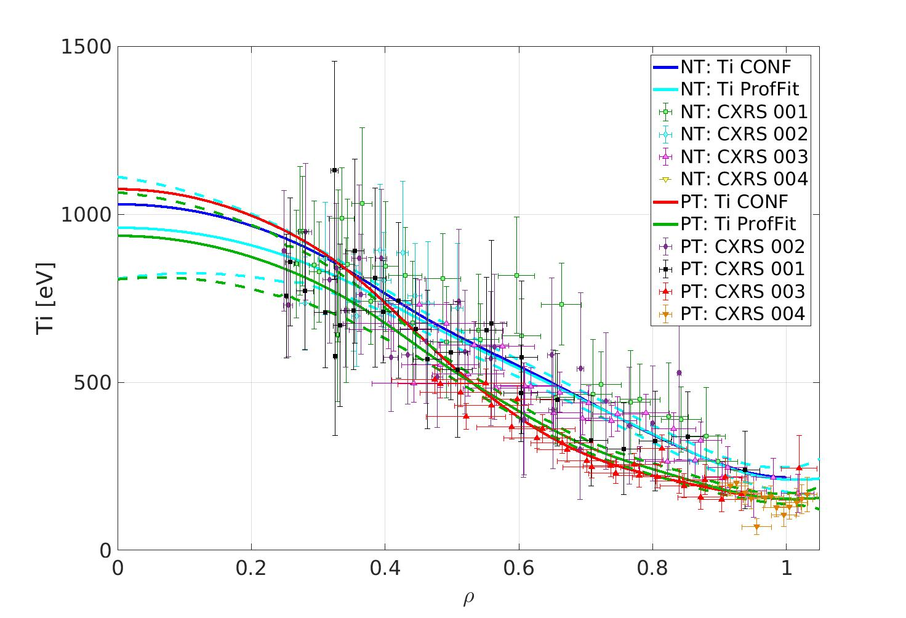
Experimental scenarios: higher Ti
NT #80323, 𝛅 = -0.25
Higher discrepancy in Ti than Ne and Te
PT #80326, 𝛅 = -0.25
CXRS – 0.5 s
TSVV-02, Lausanne Sep-2024
Thomson volume averaged
CXRS averaged (0.5 s)

Slide 10
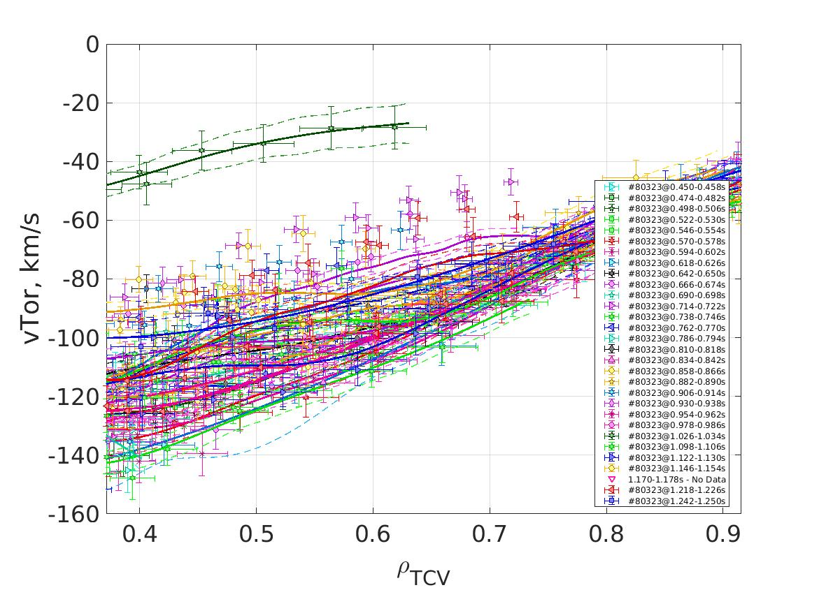
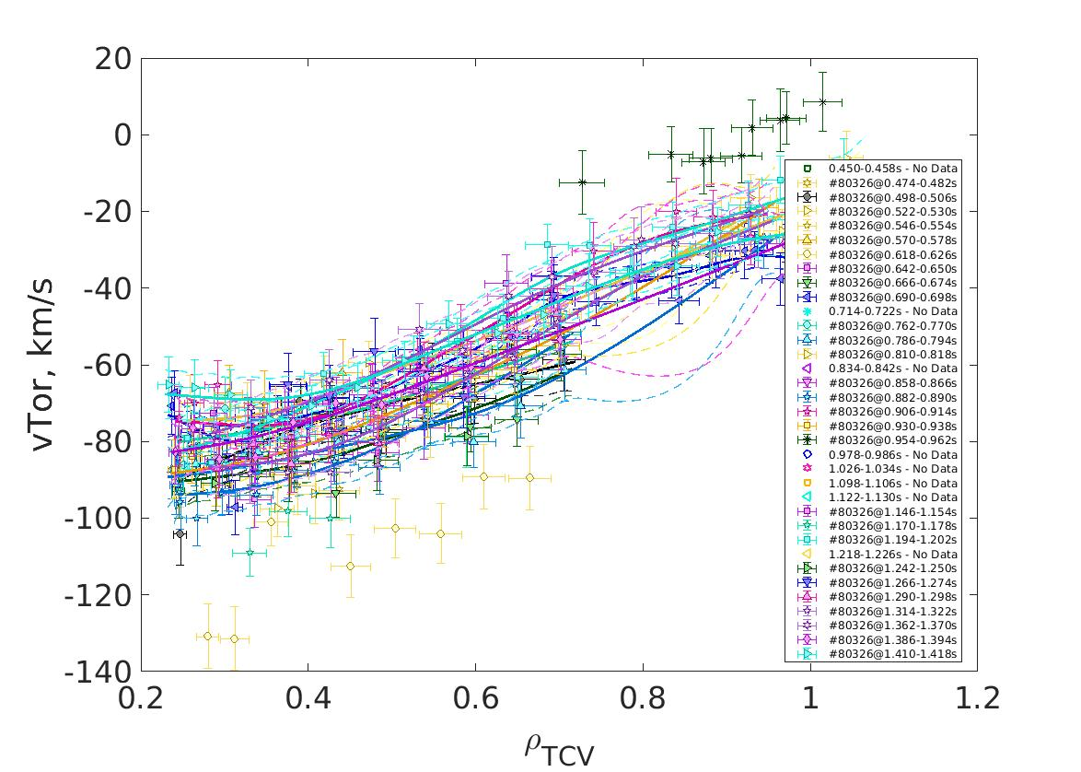
Experimental scenarios: significant Vtor change
CXRS – 0.5 s
NT #80323, 𝛅 = -0.25
NT #80323
Plasma’s toroidal rotation velocity is a 40 % larger in NT
PT #80326, 𝛅 = -0.25
TSVV-02, Lausanne Sep-2024
PT #80326
Thomson volume averaged
CXRS averaged (0.5 s)

Slide 11
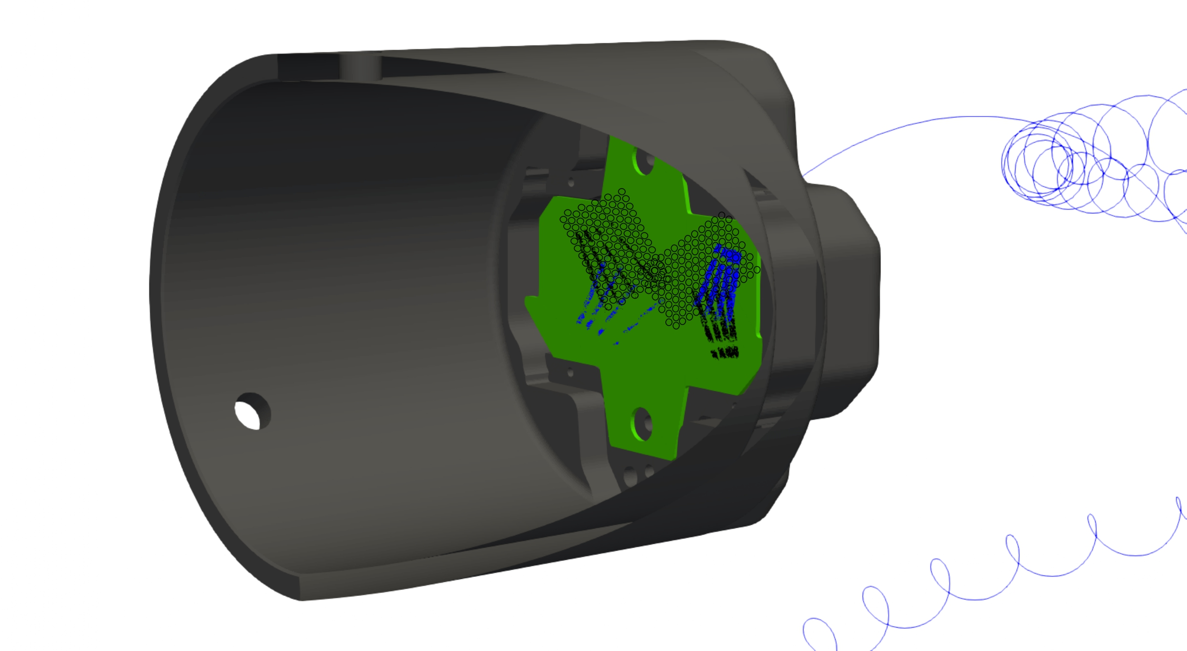
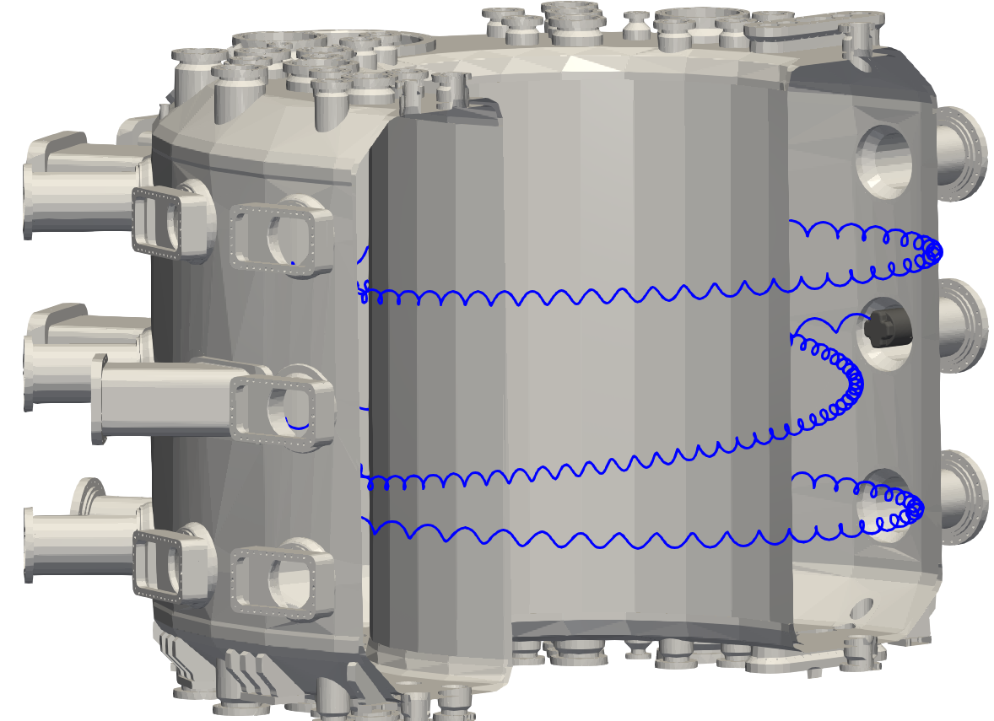
Fast Ion Losses measurements: FILD
Fast Ion losses are measured with the Fast Ion Loss Detector (FILD)
Fast Ion losses that reach FILD’s location can be collimated and measured
Light emission from fast ion strike points
Fast Ion
TSVV-02, Lausanne Sep-2024
FILD
FILD’s CMOS camera records the strike points of FIs on the FILD’s scintillator
These allow to retrieve the apparent FI’s velocity-space

Slide 12
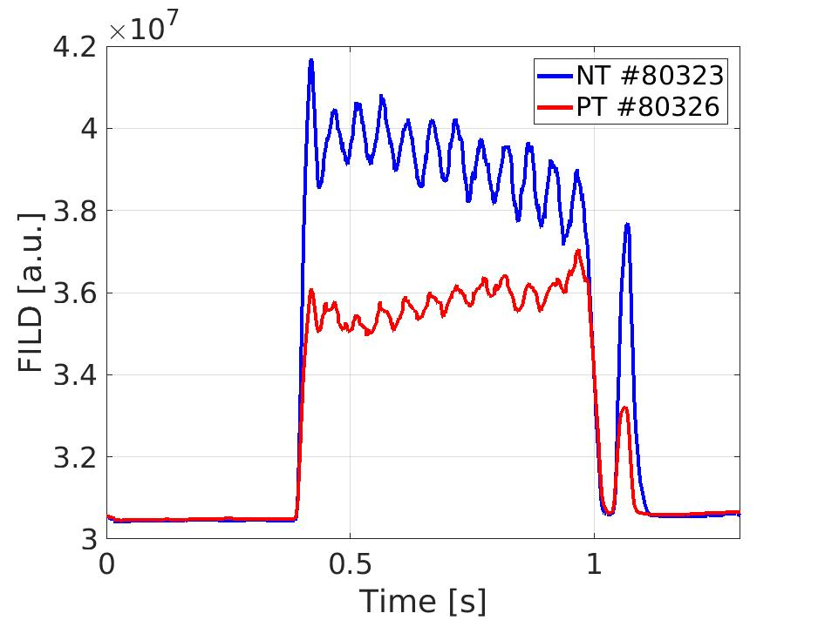
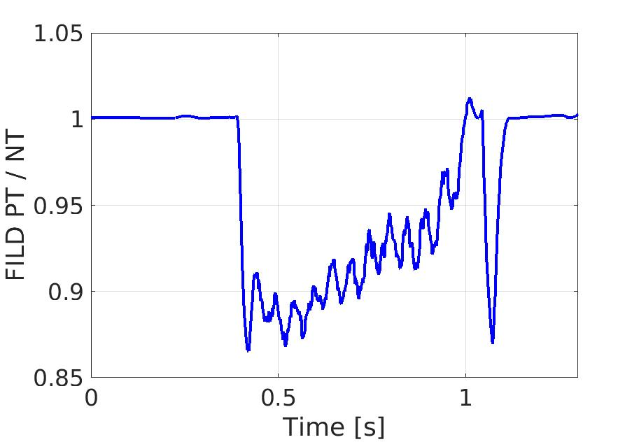
Experimental scenarios: higher FILD signal level in NT
A larger FILD signal level in NT than PT, translated into larger FI losses measured by the FILD in NT
Other FI diagnostics (FIDA, CNPA) show similar signal levels between both cases
TSVV-02, Lausanne Sep-2024
FILD PT / NT ratio

Slide 13
Outline:
Introduction
Experimental scenarios on TCV: close match in experimental conditions
Numerical studies in TRANSP and ASCOT5
Conclusions and future outlook
TCV – Internal Campaign, 2023

Slide 14
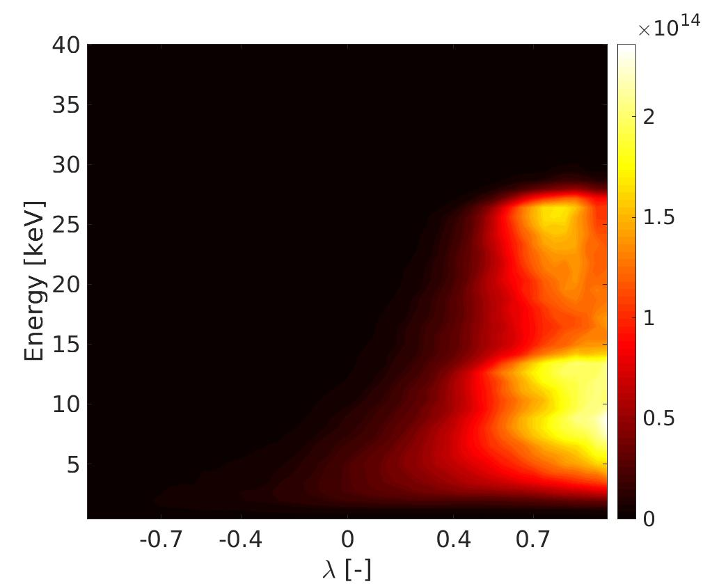
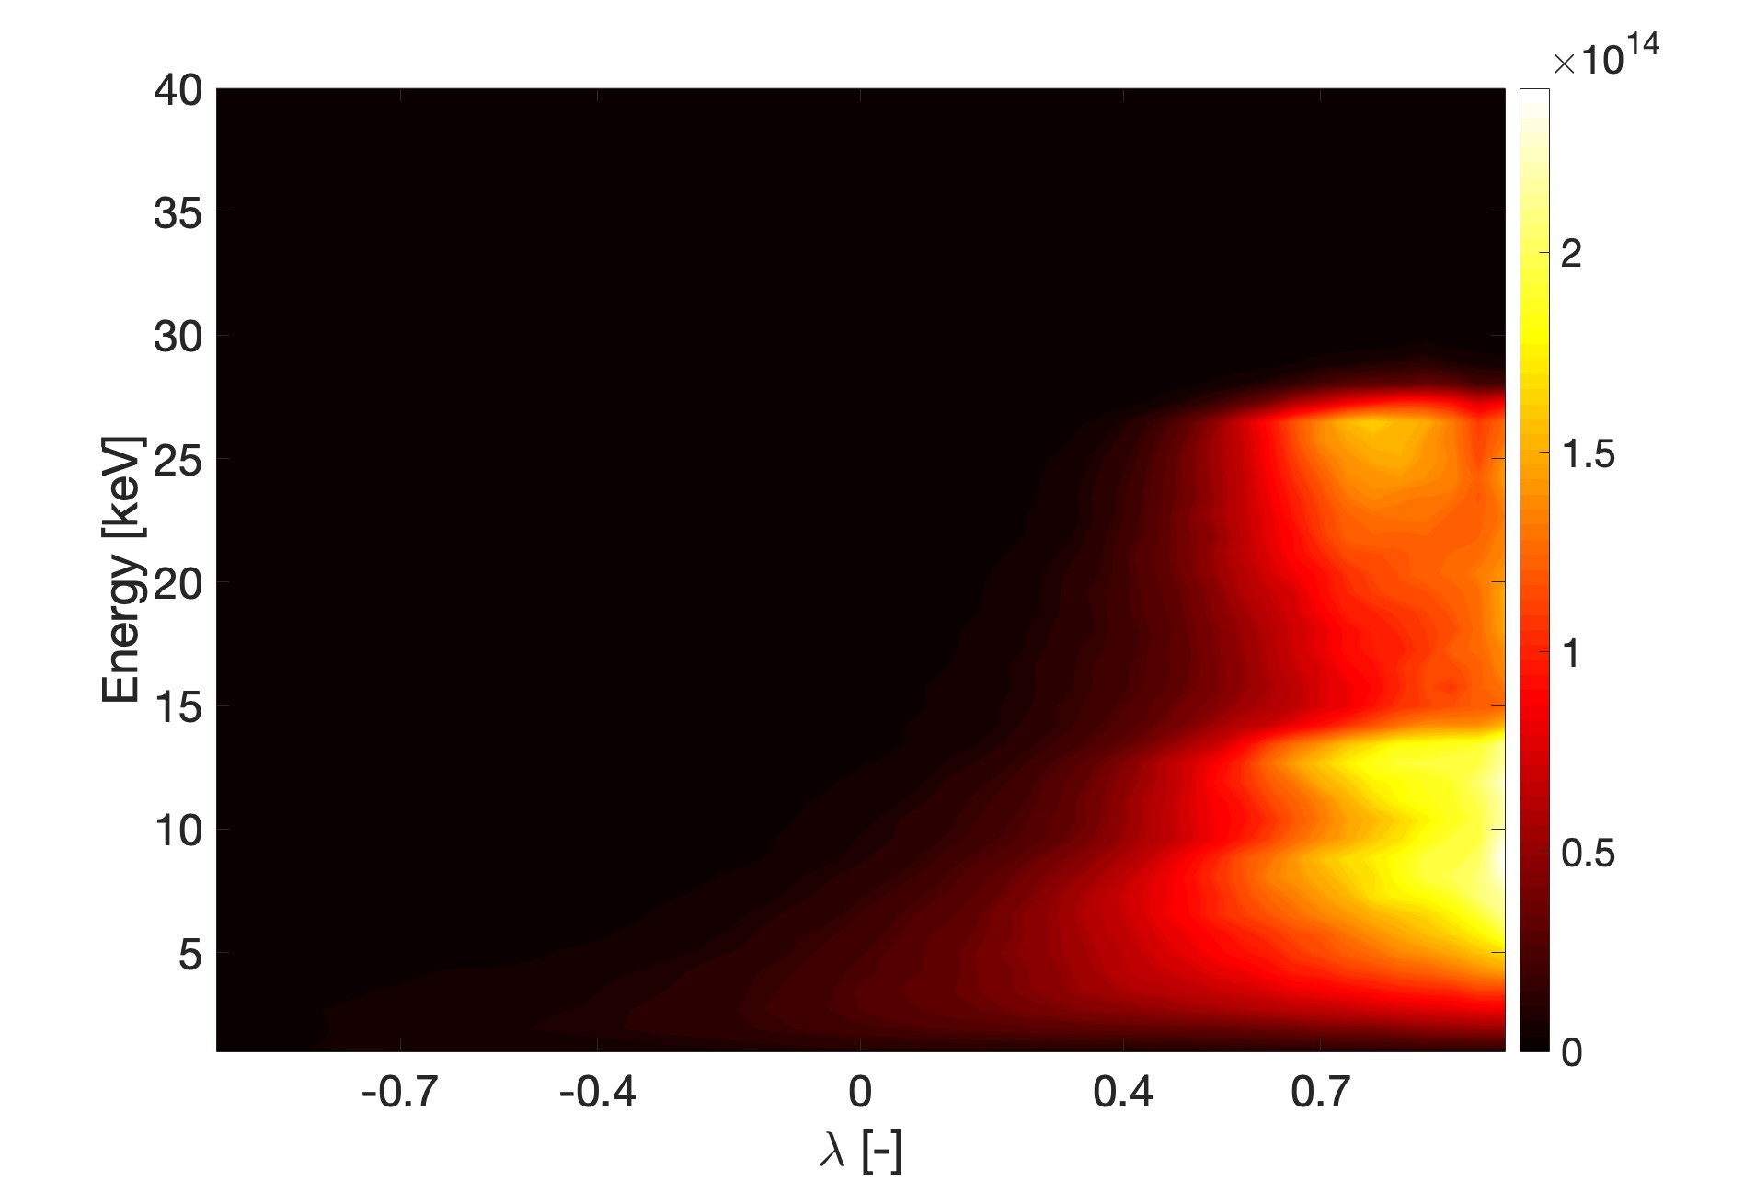
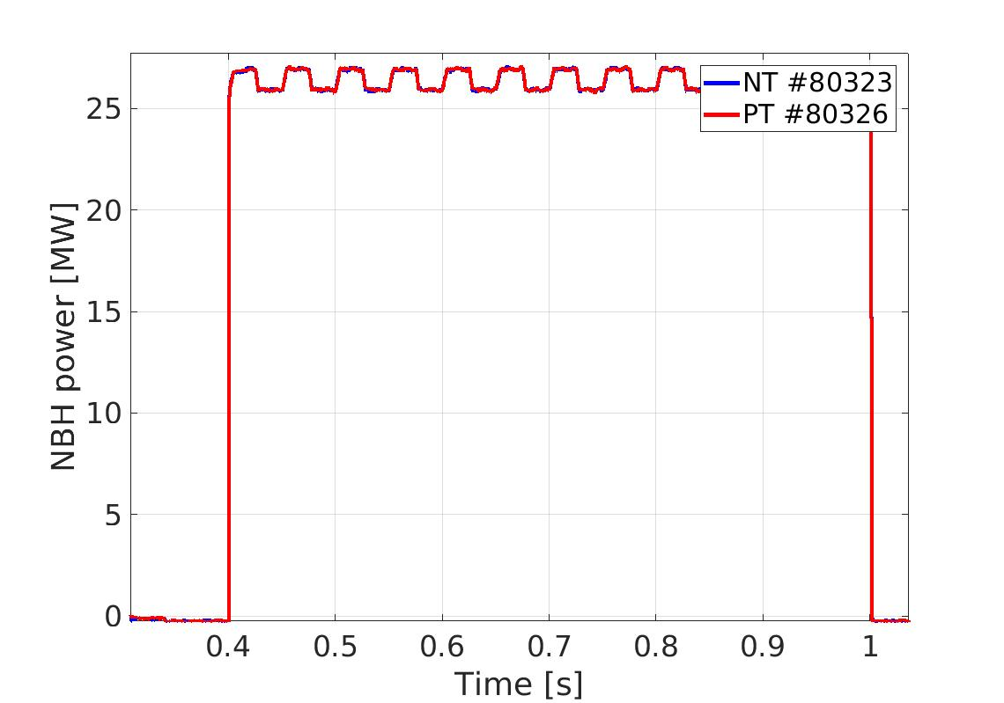
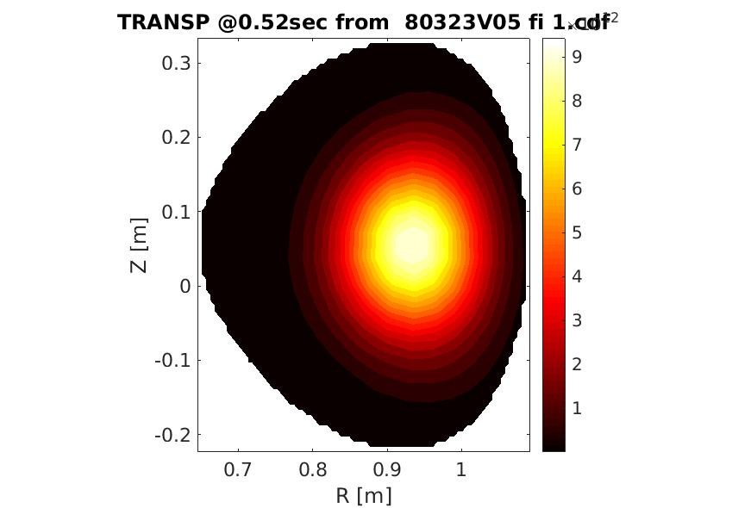
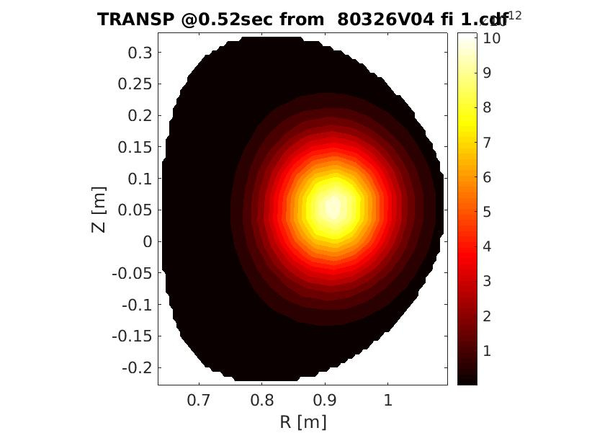
FI distribution: close match between both cases
NBI modulations help for modelling validation (neutron, orbit loss)
A close match in FI distribution in NT/PT
TSVV-02, Lausanne Sep-2024

Slide 15
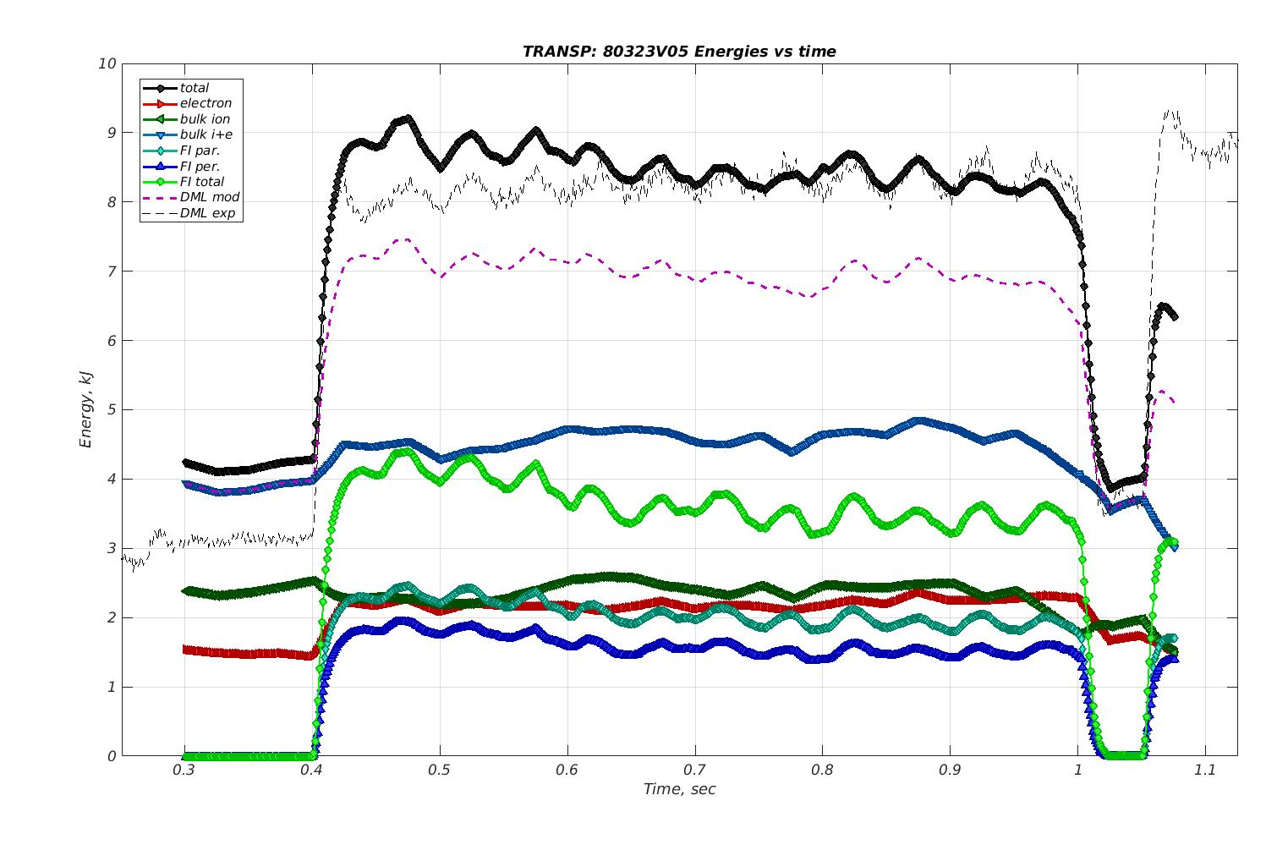
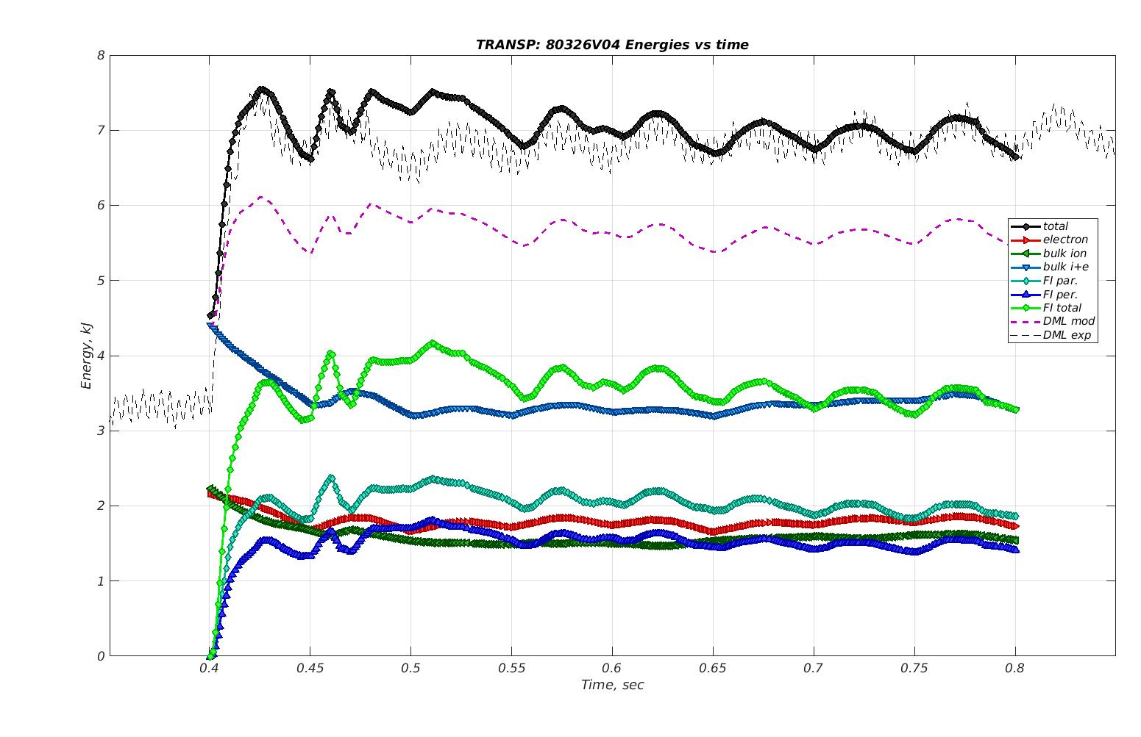
Close accord with exp. total energy
Agreement with exp. total energy in NT/PT from 0.5 s on
TRANPS’ overprediction at 0.5 s for NT ascribed to overestimated W_{thermal}
Total energy
FI contribution
NT #80323
PT #80326
NT #80323
TSVV-02, Lausanne Sep-2024

Slide 16
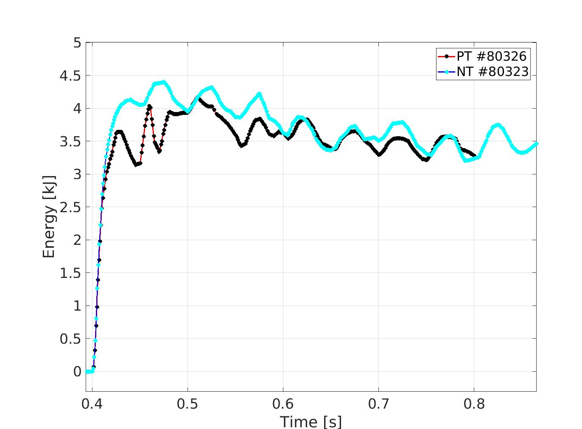
TRANSP: FI content is highly similar between NT and PT
Fast Ion energy
NT #80323
PT #80326
TRANSP predicts similar FI content in NT and PT
The difference in W_{total} is, thus, attributed to higher thermal energy in NT than in PT; result of higher Ne, Te and Ti
TSVV-02, Lausanne Sep-2024

Slide 17
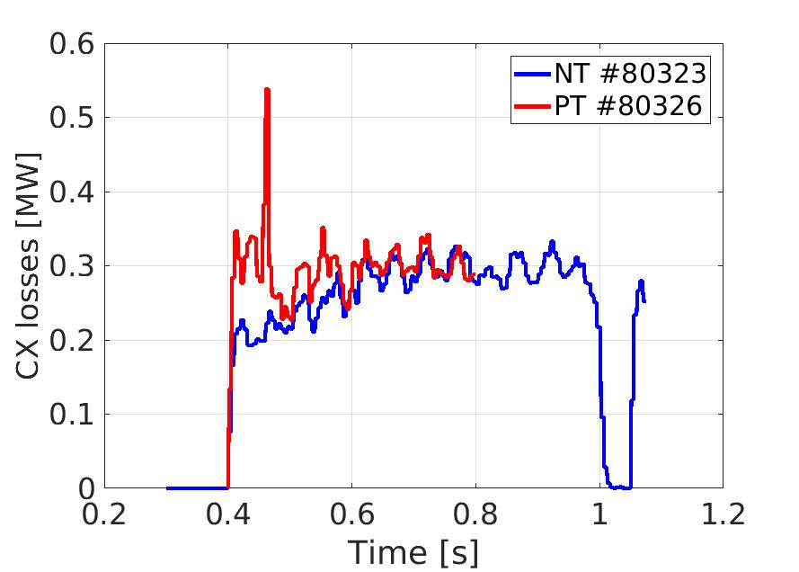
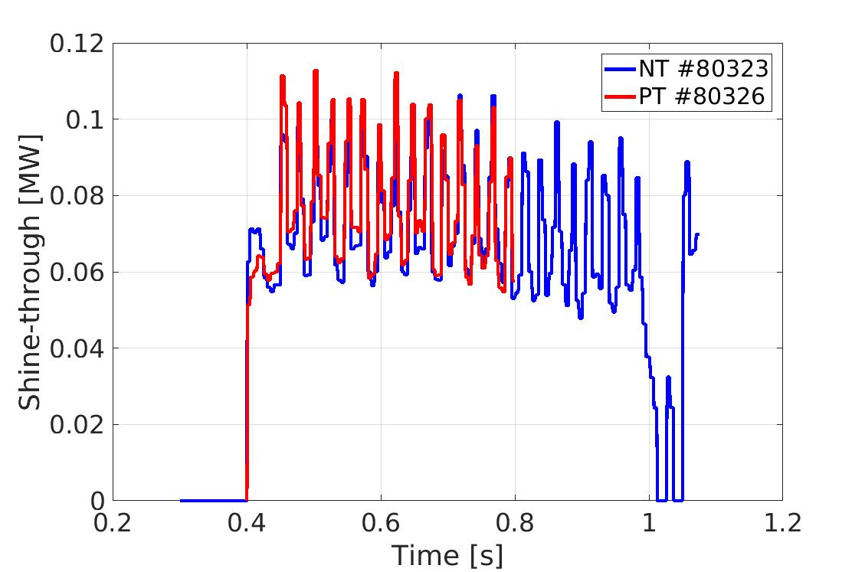
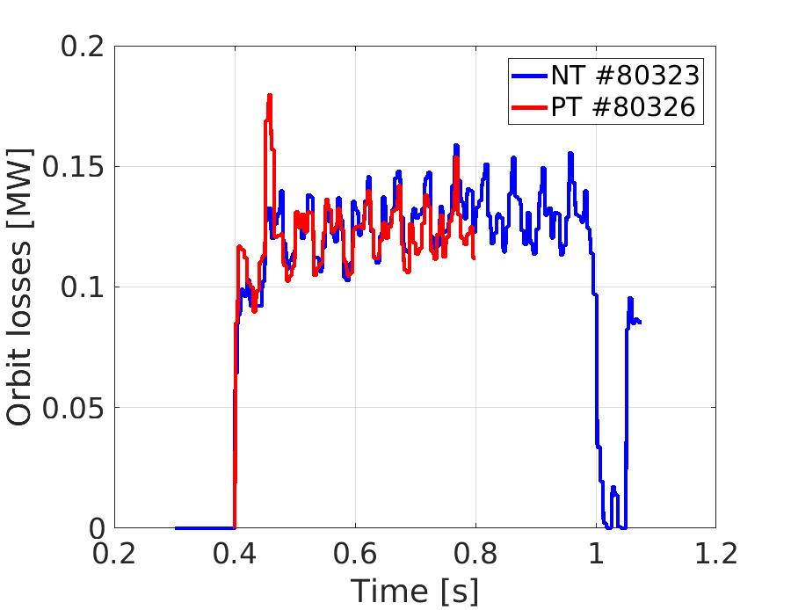
NBH power losses are also similar
CX losses are slightly larger in PT, linked to a larger gas injection and, thus, larger neutral density
Shine-though and orbit loss are very alike
NT #80323
PT #80326
Charge Exchange (CX)
Shine-through
Orbit loss

Slide 18
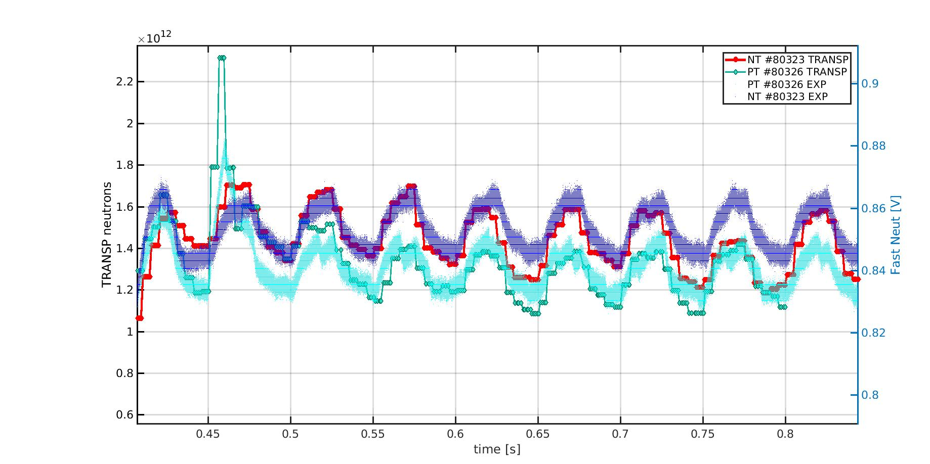
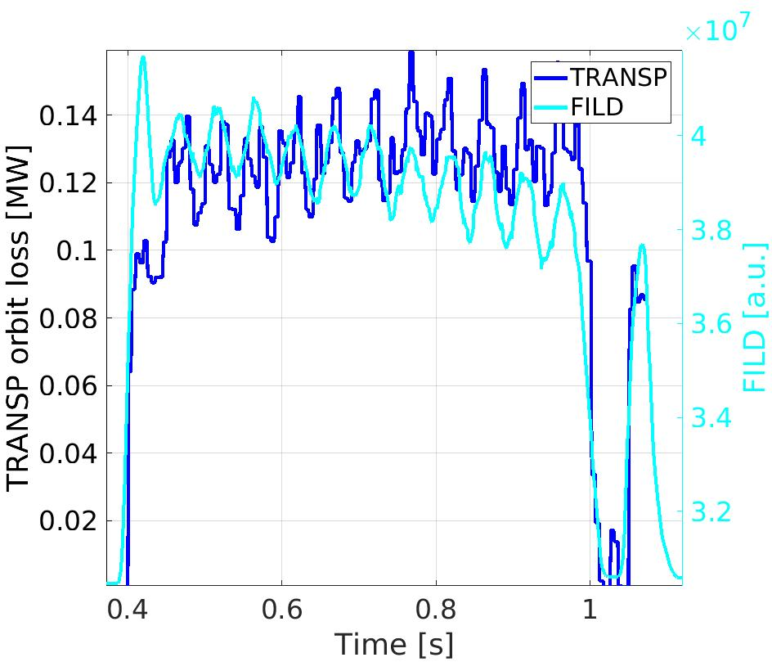
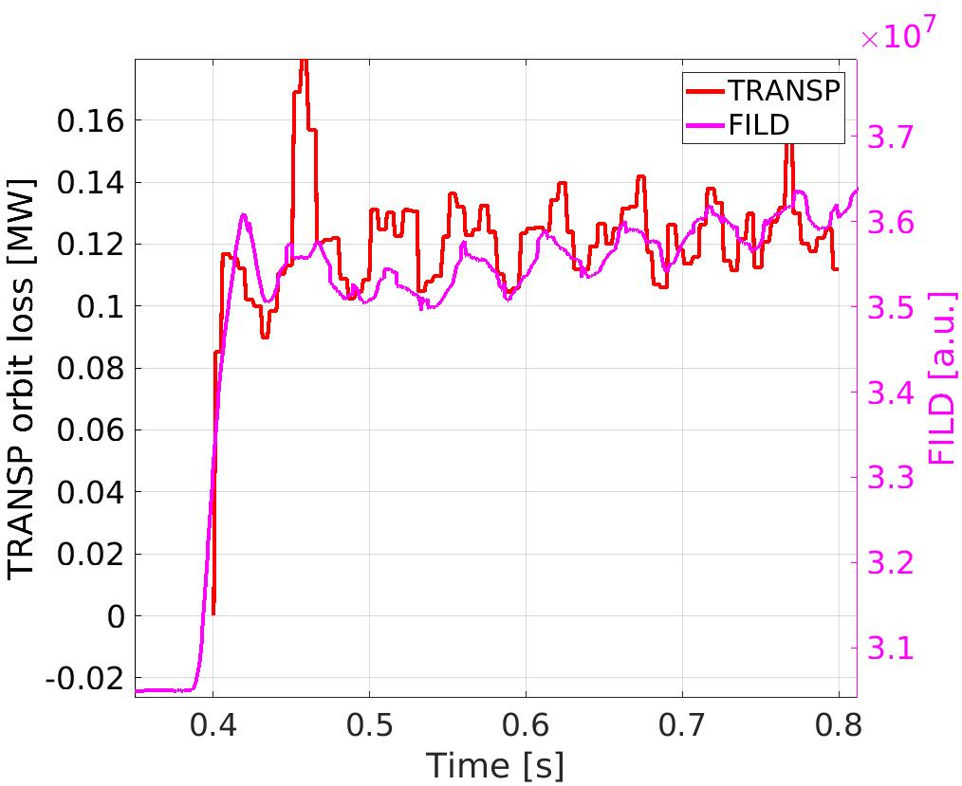
TRANSP neutrons closely reproduce the experimental traces
NT #80323, -.-.-.
PT #80326, -.-.-.
TRANSP reproduces the experimental change in the neutron rate and the orbit losses (FILD region)
This further validates the TRANSP simulations for these cases
Neutrons
TSVV-02, Lausanne Sep-2024
Orbit Losses
NT #80323
PT #80326

Slide 19
To better understand the FILD signal, ASCOT5 orbit following is used
NT
PT
Passing FI losses orbits in NT and PT
Larger time outside of confined plasms in NT
TSVV-02, Lausanne Sep-2024

Slide 20
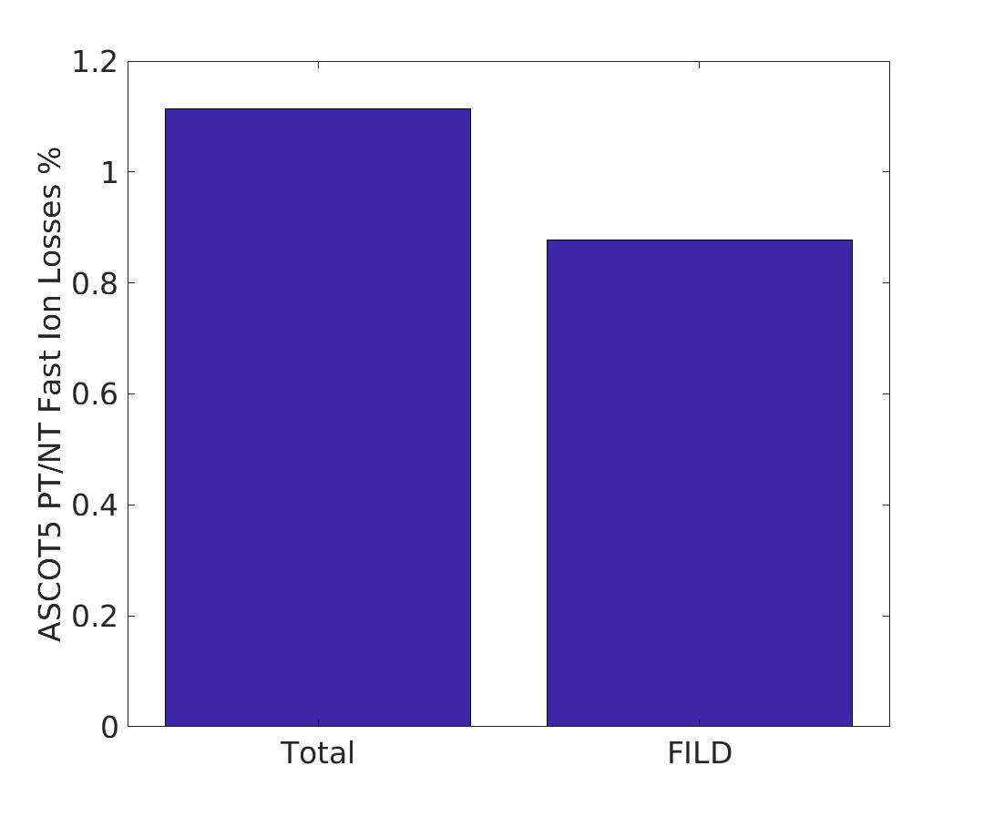
ASCOT5 predicts larger FI losses on the FILD in NT
Similar passing FI losses orbits in NT and PT
ASCOT5 matches the experimental ratio of FI losses on the FILD: larger in NT than PT
The total losses are, however, slightly larger in PT (as in TRANSP)
ASCOT5
FILD
TSVV-02, Lausanne Sep-2024

Slide 21
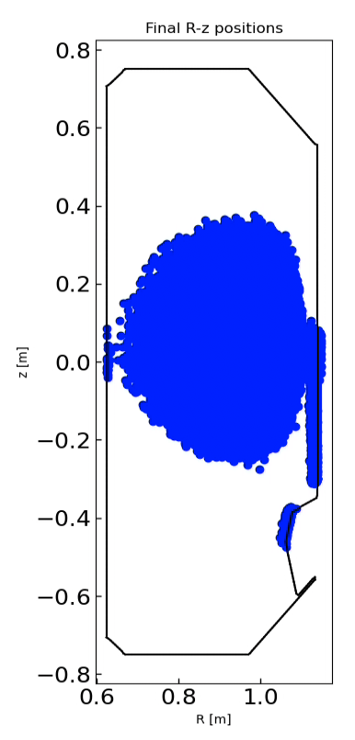
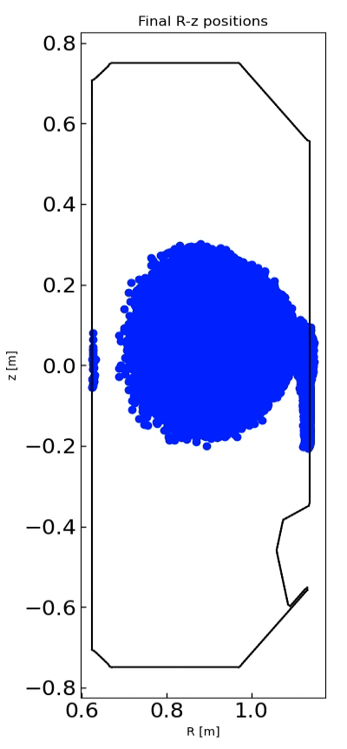
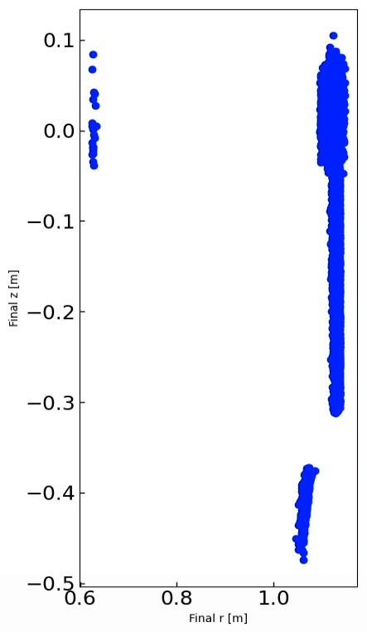
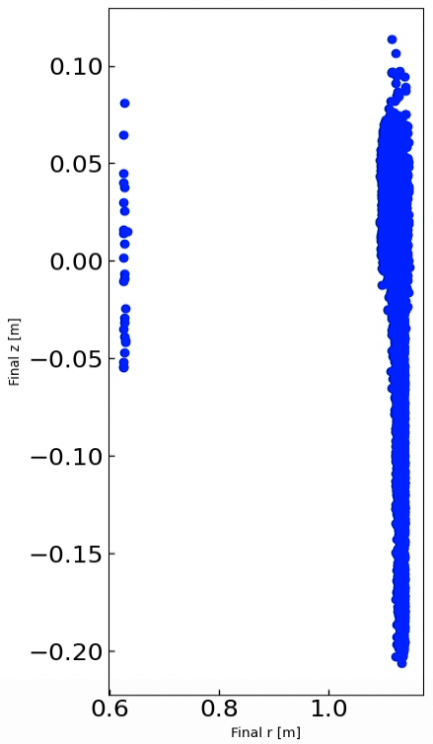
The strike points are much more spread in the LFS in NT; larger plasma’s cross section
NT #80323
PT #80326
TSVV-02, Lausanne Sep-2024

Slide 22
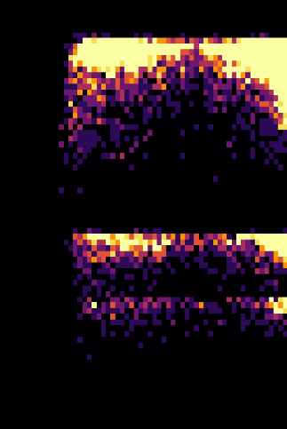
ASCOT5 modelling also predicts similar FIL’s velocity space
PT #80326
The main NBH energies are identified (25, 12, 6 keV)
The pitch corresponds to passing FIs from booth the HFS and LFS
The spread in energy and pitch is ascribed to collisional scattering
TSVV-02, Lausanne Sep-2024
PT #80326

Slide 23
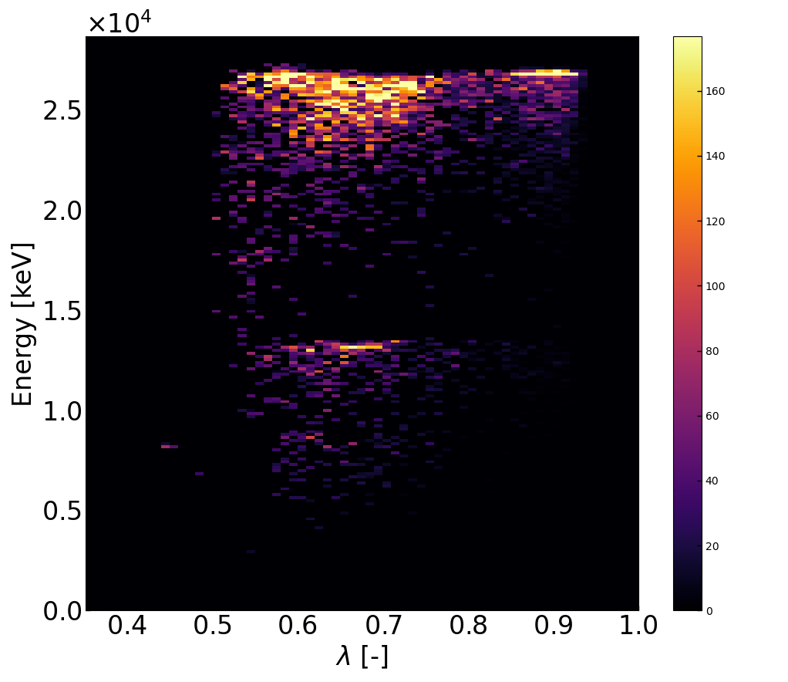
ASCOT5 modelling also predicts similar FIL’s velocity space
NT #80323
Larger population with high pitch (>0.8) and with the main energy of the NBH
This indicates that the larger amount of FILs on the FILD correspond to prompt losses
TSVV-02, Lausanne Sep-2024
NT #80323

Slide 24
Larger amount of prompt losses in the FILD NT vs PT
The simulation time of the markers hitting the FILD validates the hypothesis
The main discrepancy is at short simulation time, corresponding to the prompt losses
TSVV-02, Lausanne Sep-2024

Slide 25
Outline:
Introduction
Experimental scenarios on TCV: close match in experimental conditions
Numerical studies in TRANSP and ASCOT5
Conclusions and future outlook
TCV – Internal Campaign, 2023

Slide 26
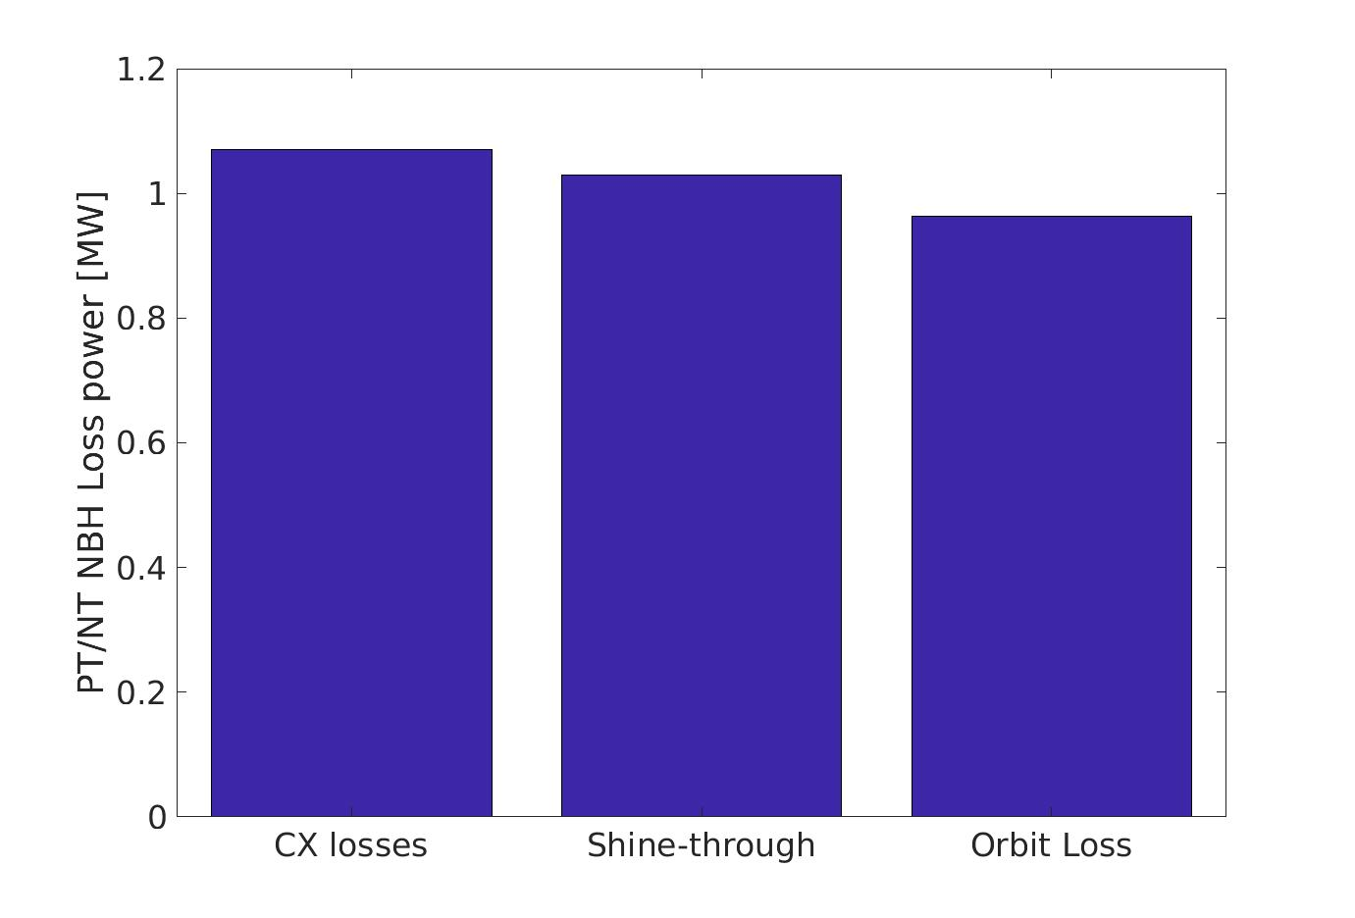
Conclusions:
TRANSP
Avg: 0.495 s – 0.8 s
Experiments of NT L-mode plasmas on TCV show that there is no clear detriment nor improvement of the FI confinement in NT vs PT
Simulations performed in TRANSP exhibit a good agreement with the experiment: this indicates that the FI transport is neoclassical
TRANSP shows, thus, that there is not a detriment nor improvement of the FI confinemen in NT vs PT
Finally, ASCOT5 allows to understand the discrepancy in the FILD signal as a geometrical consequence rather than a poorer FI confinement
TCV – Internal Campaign, 2023
ASCOT5

Slide 27
BACK - UP

Slide 28
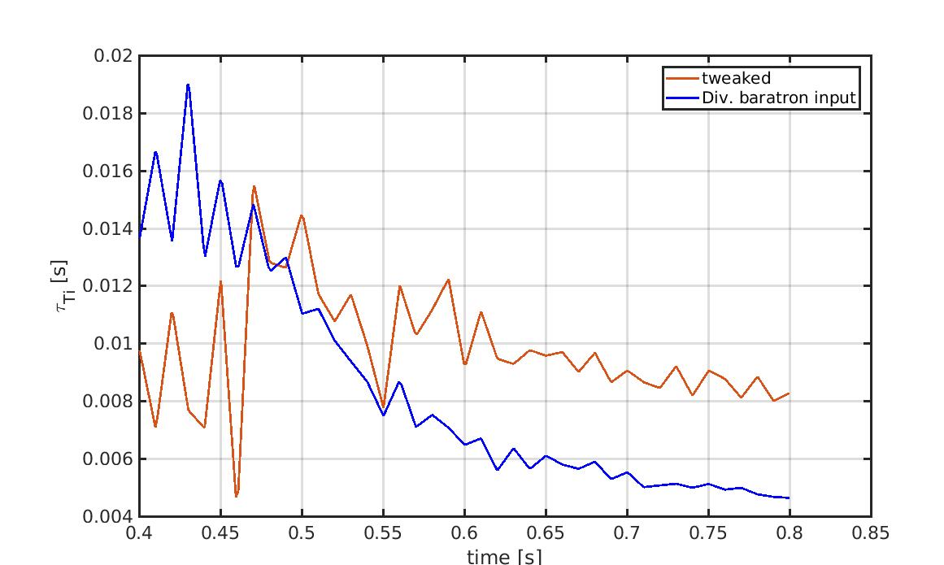
Quiescent NT vs PT: good match with DML
The non-tweaked has as input the ion conf. time-scaled from the baratron in the divertor
The tweaked one has been scaled with the mean value of the midplane and divertor baratrons. On top of that, It has been manually adjusted to match the DML.
#80326

Slide 29
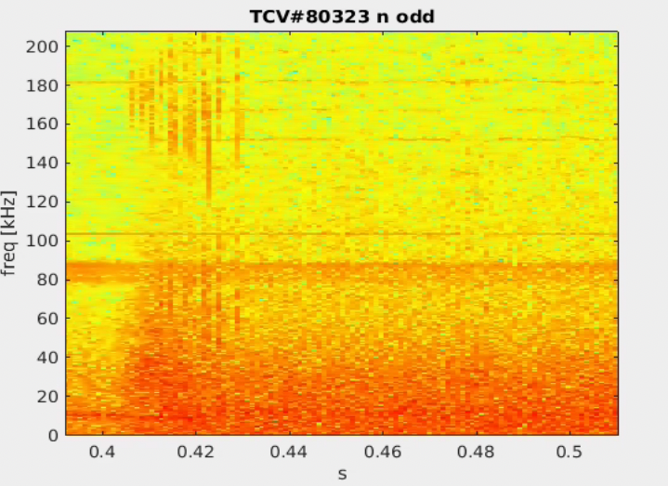
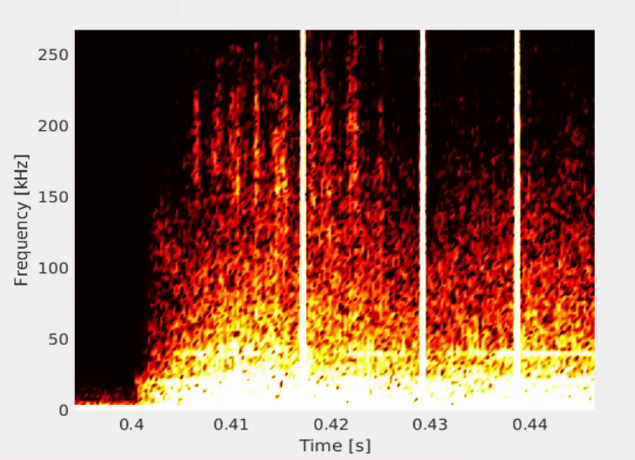
The mismatch partially explain by MHD activity
Both the magnetics and the FILD show MHD activity at the beginning of the NBI phase
Magnetics
FILD

