Slide 1
Experimental studies of fast particles in TCV negative triangularity plasmas
Anton Jansen van Vuuren, J. Poley, A. Karpushov, S. Mazzi, M. Dreval and the TCV and WPTE RT09 EUROfusionTeams
Date: 24/09/2024

Slide 2
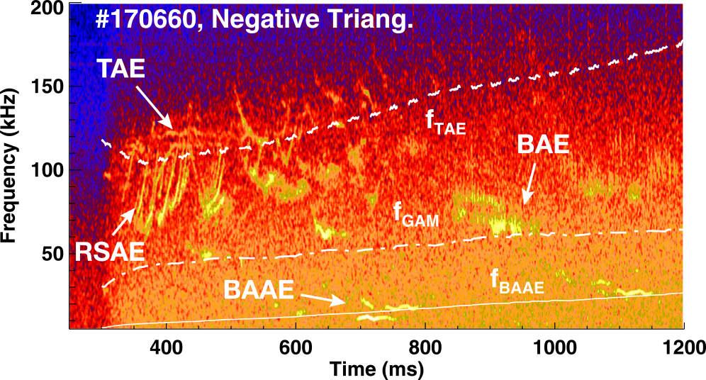
Introduction
DIII-D
NT plasmas exhibit improved thermal plasma confinement w.r.t PT.
But there are few experimental studies on fast-ion confinement in NT plasmas (see [1]).
Numerical studies [2, 3] have found that for the same plasma input TAE grow rates are slower in NT.
[1] M.A. Van Zeeland et al 2019 Nucl. Fusion 59 (top figure)
[2] Y. Ghai et al 2021 Nucl. Fusion 61
[3] P. Oyola et al 2023 IAEA FEC (bottom figure)

Slide 3
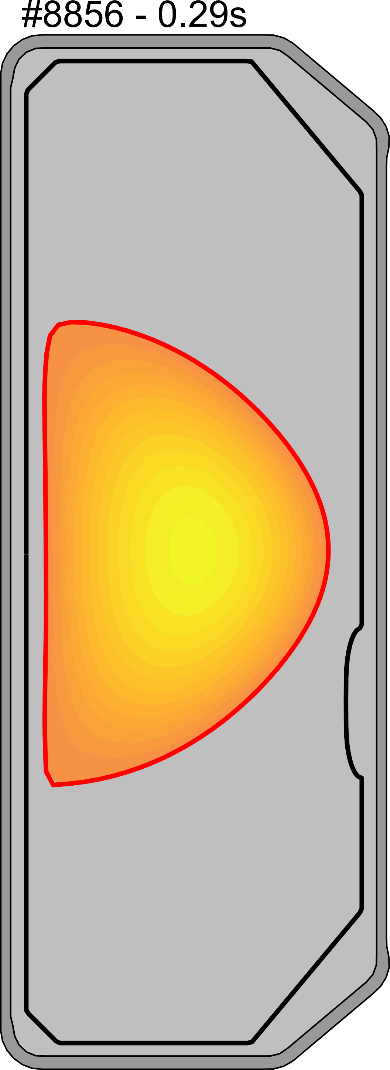
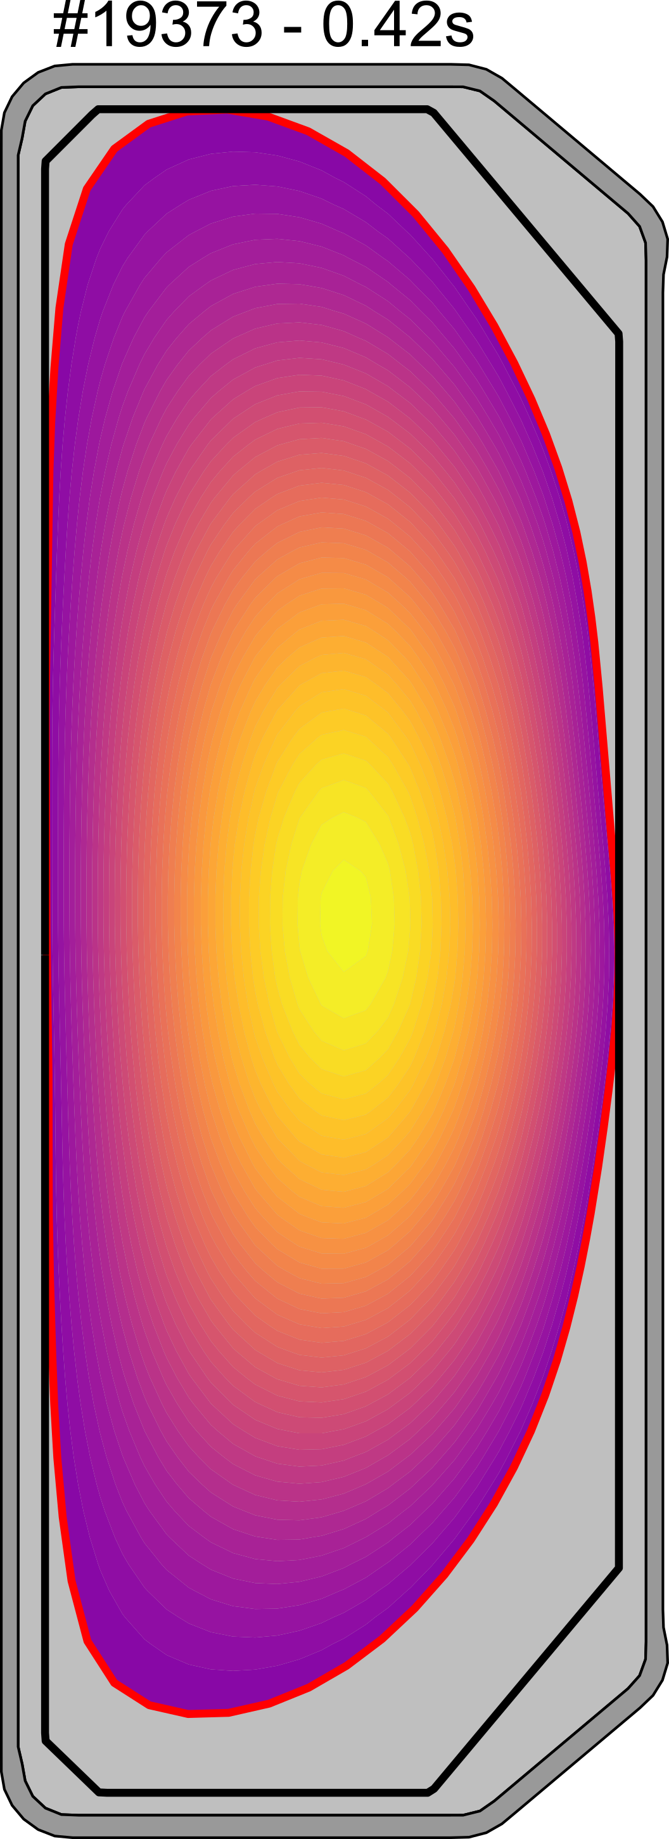
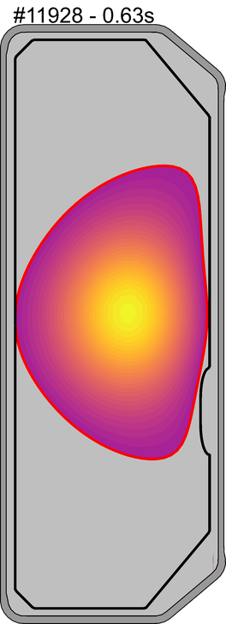
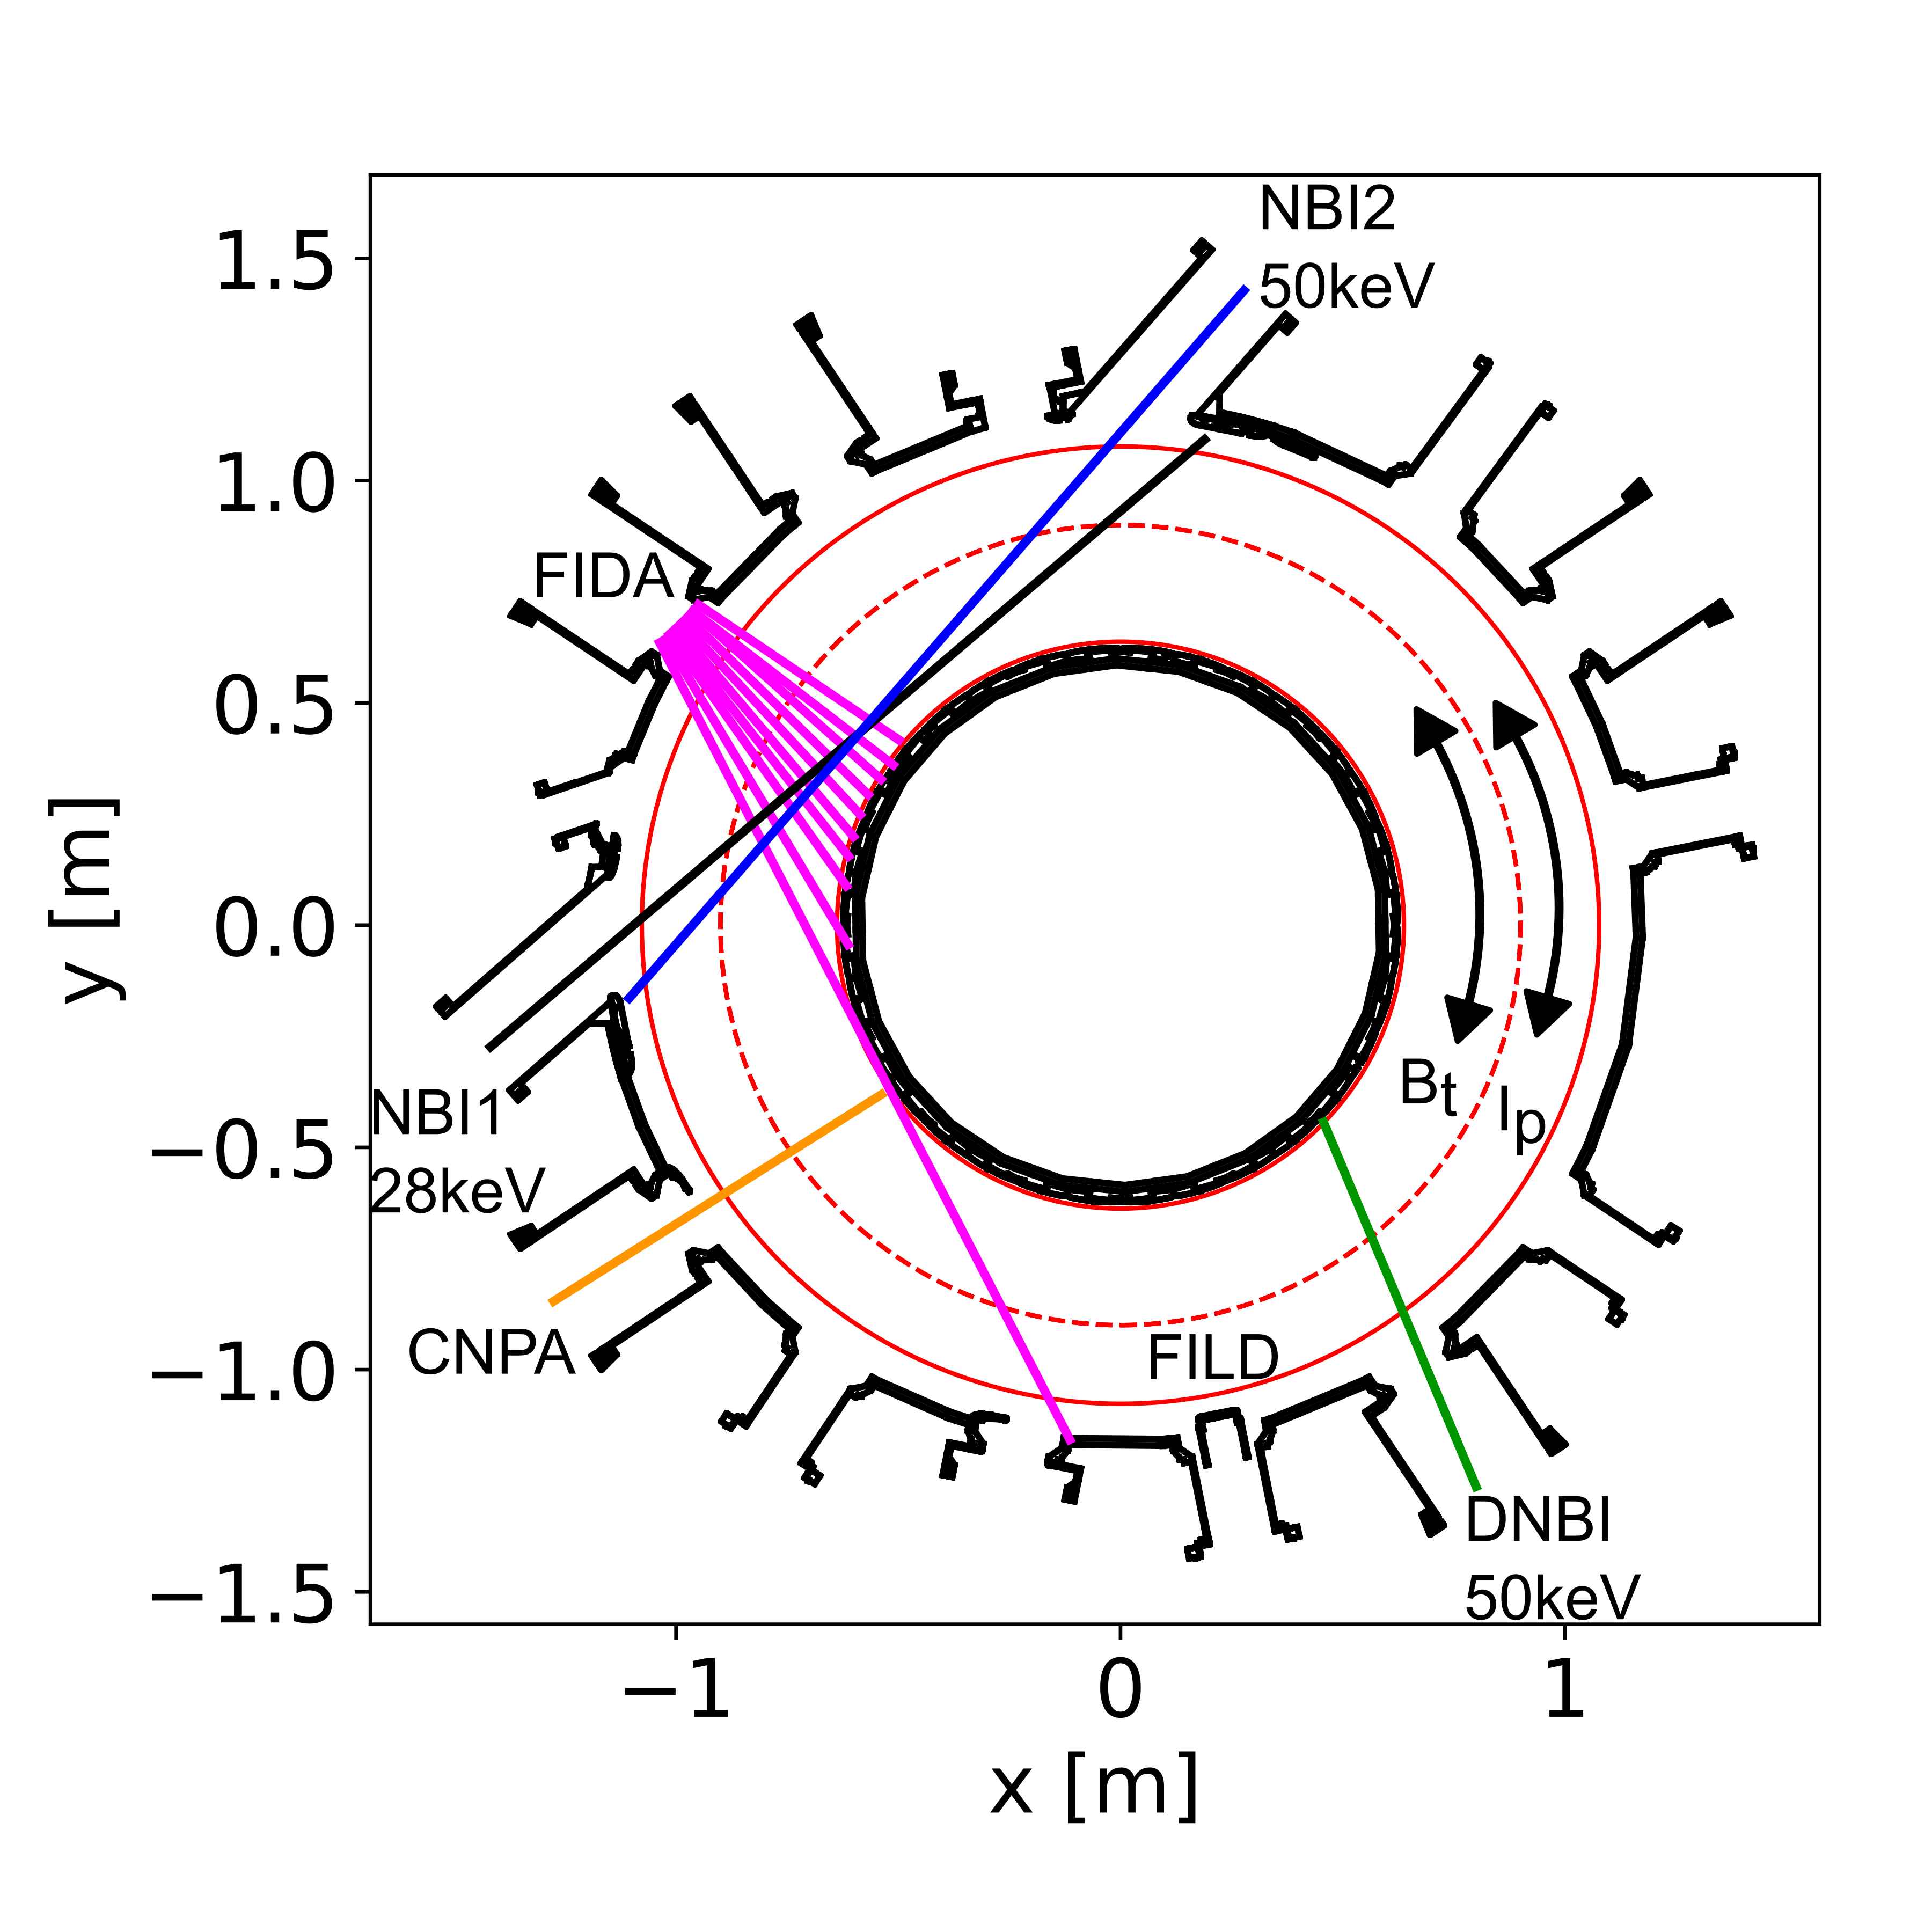
Introduction
TCV is ideal for studying NT plasmas due to its flexible shaping capabilities.
Additionally, TCV has two (1MW) NBI heating beams to produce fast-ion populations, as well as up to 2MW ECRH.
TCV has several diagnostics to infer fast-ion confinement including FIDA, FILD, NPA and Neutron detectors

Slide 4
Outline
NT vs PT experiments conducted at TCV
MHD quiescent NT and PT scenario
Various MHD modes observed in NT
Investigation of AEs
Conclusions and outlook

Slide 5
Outline
NT vs PT experiments conducted at TCV
MHD quiescent NT and PT scenario
Various MHD modes observed in NT
Investigation of AEs
Conclusions and outlook

Slide 6
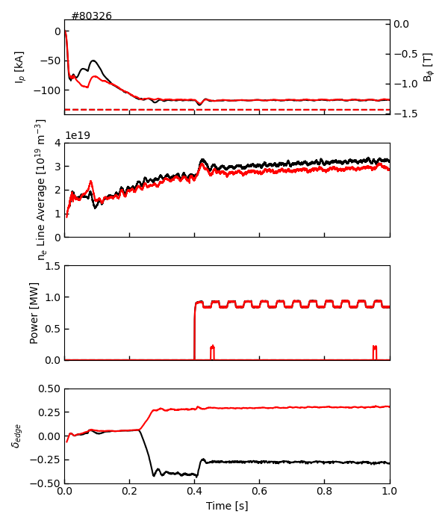
MHD quiescent NT plasma scenario developed
NT: 80323
Experiments were caried out with limited NT plasma shapes and strong (1MW) co-NBI heating.
The goal was to obtain a MHD quiescent scenario to compare against neoclassical modelling
NT plasmas found to be susceptible to various MHD modes, but at low I_{p}~120kA and around z=5cm plasma are MHD quiescent.
δ ~ -0.3
δ ~ +0.3
PT: 80326

Slide 7
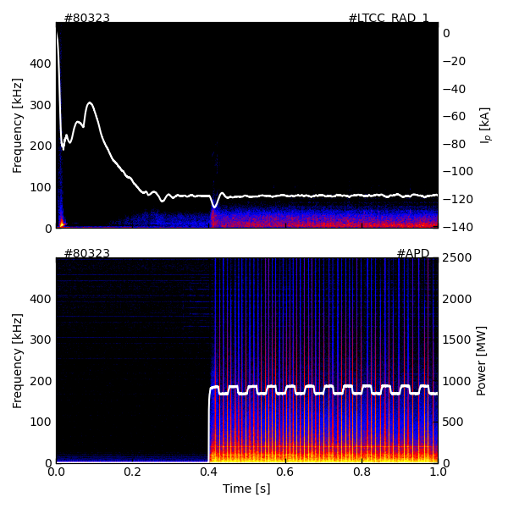
MHD quiescent scenario successfully established
Magnetics
Experiments were caried out with limited NT plasma shapes and strong co-NBI heating
The goal was to obtain a MHD quiescent scenario to compare against neoclassical modelling
NT plasmas found to be susceptible to various MHD modes, but at Ip 120kA, z= 5cm plasma are MHD quiescent
FILD

Slide 8
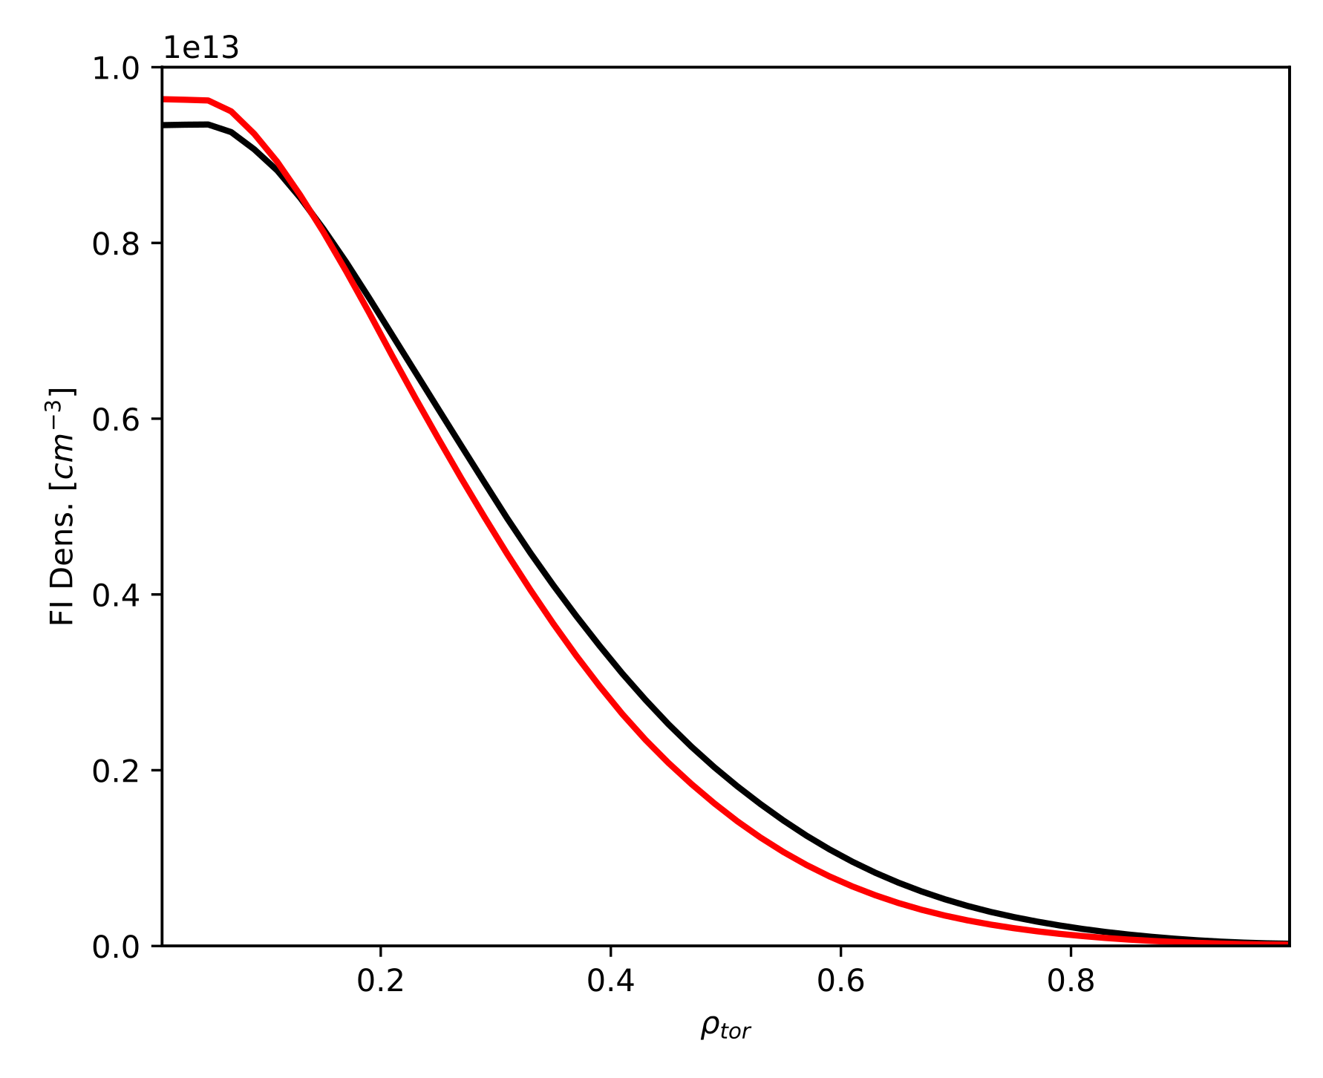
Similar FI confinement between NT and PT
Modelling using the TRANSP and ASCOT codes reproduce experimental data well, as reported by J. Poley in previous talk.
Thus, in the absence of strong MHD modes, fast-ion transport in NT appears neoclassical.
Furthermore, for similar plasma conditions NT show similar fast-ion content as in PT plasmas.
Therefore, NT is not particularly detrimental to fast-ion confinement!
t = 0.54s
NT: 80323
PT: 80326

Slide 9
Outline
NT vs PT experiments conducted at TCV
MHD quiescent NT and PT scenario
Various MHD modes observed in NT
Investigation of AEs
Conclusions and outlook

Slide 10
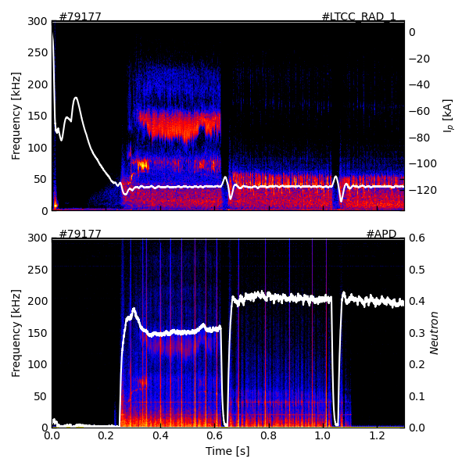
Various MHD modes are often observed in NT that expel FIs
Magnetics
NT plasmas were found to be susceptible to various beam driven modes. In this example moving the plasma to z ~ 1cm several modes appear.
Strong chirping modes were often observed in both NT and PT scenarios.
These modes have a strong impact on fast-ion confinement, significantly decreasing the neutron rate and observed in the FILD.
FILD

Slide 11
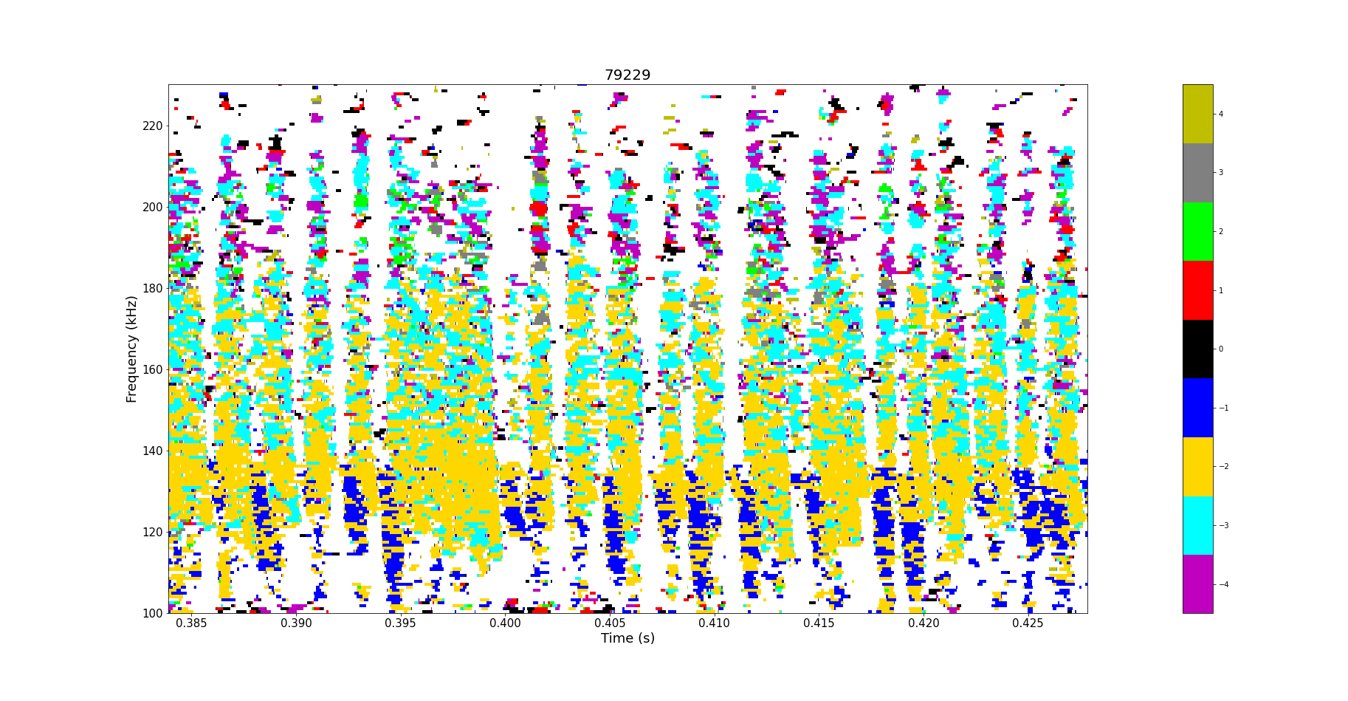
Strong chirping modes often observed in NT scenarios
Magnetics
NT plasmas found to be susceptible to beam driven modes. In this example moving the plasma to z ~ 1cm several modes appear
Strong chirping modes were observed in both NT and PT scenarios.
These modes have a strong impact on fast-ion confinement, significantly decreasing the neutron rate and observed in the FILD.
These modes appear to have multiple mode numbers, possible leading to efficient transport of Fis.

Slide 12
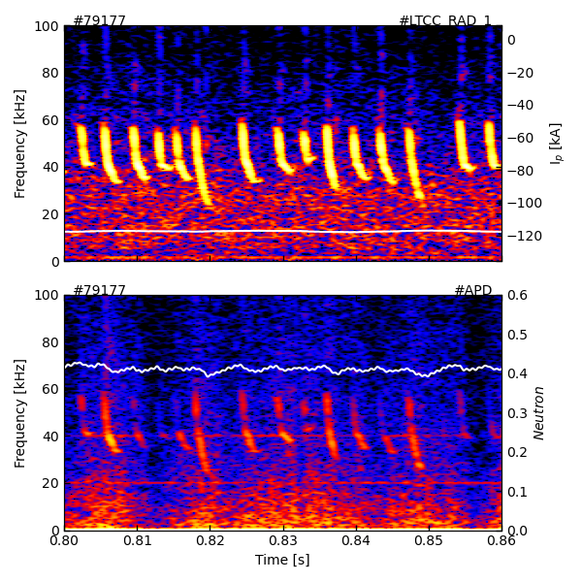
Fishbone and Sawteeth modes observed in NT plasmas
Magnetics
Furthermore, a common observation has been lower frequency modes, especially fishbones
Although these modes produce losses observable in the FILD measurements, the absolute losses appear much weaker w.r.t chirping modes.
Sawteeth in NT vs PT plasmas have been studied by M. Vallar et al. 2022 Nucl. Fusion 62. FIDA measurements showed larger retirstribution in NT than PT.
FILD

Slide 13
Outline
NT vs PT experiments conducted at TCV
MHD quiescent NT and PT scenario
Various MHD modes observed in NT
Investigation of AEs
Conclusions and outlook

Slide 14
Investigation of AEs in NT vs PT plasmas in TCV
P. Oyola et al 2023 IAEA FEC
Alfven Eigenmodes are a serious concern for fast-ion confinement in future machines.
Modeling [1] has suggested that TAE amplitudes are lower in TCV like plasmas, thus a systematic experimental investigation
Studies of TAEs in PT found that counter injection is necessary (often highly off-axis z~12cm).
Developed a scenario with on-axis heating, at low plasma current, using ECRH for longer fast-ion slowing down times.

Slide 15
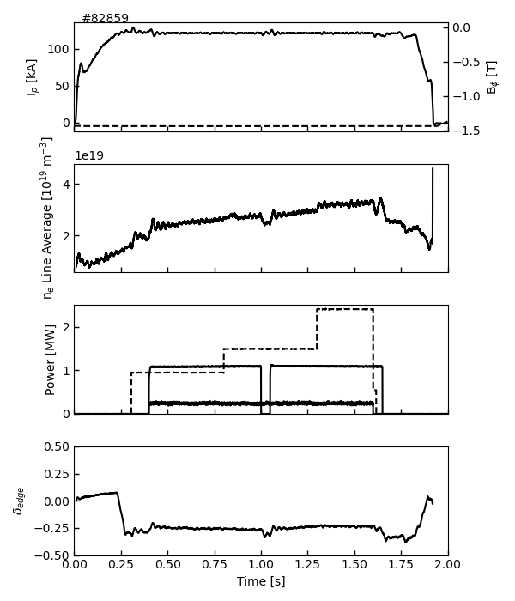
AEs in NT plasmas on TCV using counter NBI
NBI1 in counter injection used, with NBI2 at low power to probe AE modes with FILD.

Slide 16
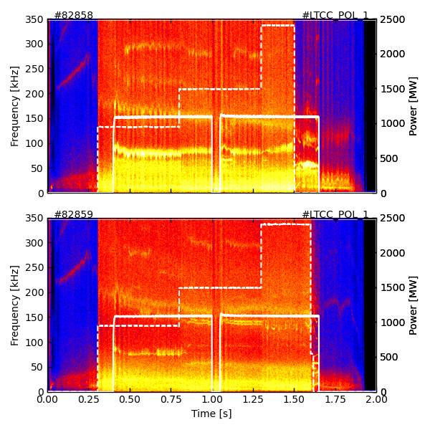
Low freq. mode needed to be suppressed with ECRH
NBI1 in counter injection used, with NBI2 at low power to probe AE modes with FILD.
Typically observe that an EGAM like mode below 100kHz dominates the MHD spectrum in NT. Weak TAE like modes observed.
By using localised ECRH heating (ρ ~ 0.4), we’re able to suppress the GAM and observe TAE clearly.
Magnetics
EGAM
Magnetics
TAE

Slide 17
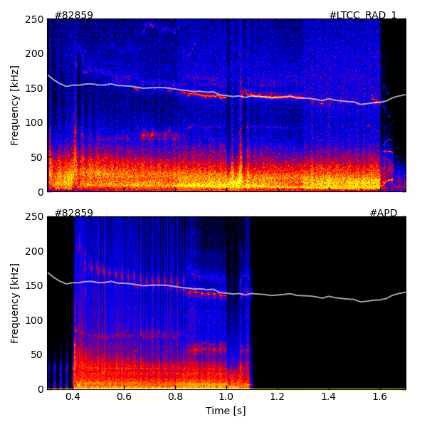
TAE clearly observable in FILD, freq. used to localize mode
NBI1 in counter injection used, with NBI2 at low power to probe AE modes with FILD.
Typically observe that an EGAM like mode below 100kHz dominates the MHD spectrum in NT. Weak TAE like modes observed.
By using localised ECRH heating (ρ ~ 0.4), we’re able to suppress the GAM and observe TAE clearly.
TAE calculated* to be around ρ ~ 0.85, and losses seen in FILD.
Magnetics
TAE
ρ ~ 0.85
FILD
FILD retracts
*Based on formula in W.W. Heidbrink PRL 71 (1993)

Slide 18
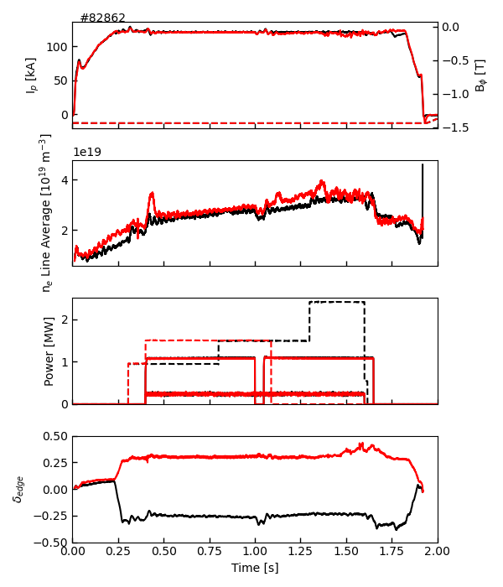
Mirrored PT discharge carried out to compare NT vs PT
Mirrored PT plasma experiments performed to compare to NT discharges.
Good match in plasma conditions and mirrored absolute triangularity value.
NT: 82859
PT: 82862

Slide 19
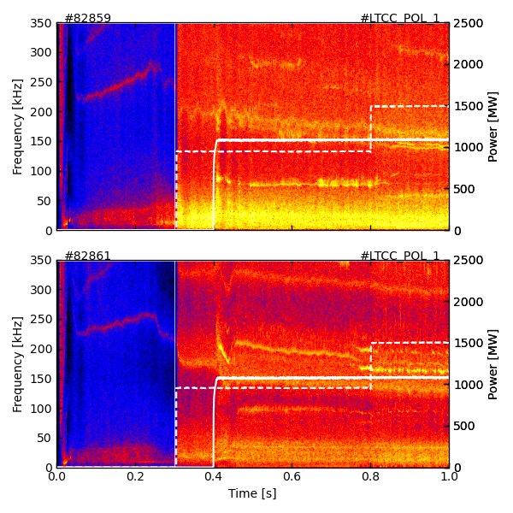
TAEs in PT easy to reproduce and larger amplitude on
Mirrored PT plasma performed to compare to NT discharges.
Good match in plasma density and mirrored absolute triangularity value.
Low. frequency GAM seen to have lower amplitude in PT scenario with TAE amplitude larger.
Further analyses to be done on comparison of TAEs in NT vs PT, lots of data available!
NT: 82859
PT: 82862
TAE

Slide 20
Outline
NT vs PT experiments conducted at TCV
MHD quiescent NT and PT scenario
Various MHD modes observed in NT
Investigation of AEs
Conclusions and outlook

Slide 21
Final remarks
Systemic experiments to study the confinement of fast-ions in NT vs PT plasmas has been carried out during the 2023-2024 TCV campaigns.
A scenario of MHD quiescent NT and mirrored PT plasmas has been established, showing similar FI confinement properties in both scenarios.
A multitude of MHD modes have been observed in NT plasmas, with strong chirping modes observed to cause significant fast ion confinement degradation.
Experiments to study TAEs in NT vs PT plasmas has been carried out on TCV, with TAEs found to be driven unstable when GAMs could be suppressed using localized ECRH.

Slide 22
Outlook
Analyses of experimental data is ongoing and significant further modelling efforts are needed to quantify the differences between MHD induced FI-transport in NT vs PT.
Modelling of fast-ion transport using ASCOT5 with perturbation fields calculated from MHD codes such as MARS-F (LIGKA, MEGA ?) are planned.
Large set of experimental data available for theoretical comparison!

