Slide 1




Edge transport analysis of PT and NT in high power tokamak scenarios
P. Innocente, P. Muscente, L. Aucone, P. Mantica, A. Mariani, TCV team and ASDEX Upgrade team
2024 TSVV2 Annual meeting

Slide 2
Summary
Edge transport modeling in present devices to asses transport parameters
  TCV PT-H and NT modeling different power same core temperature (2023)
  TCV PT-L and NT at same power
  AUG PT-L/PT-H and NT at low/medium power
Modeling of DTT with extrapolated parameters
  SN-PT and SN-NT in pure D at low power
  SN-PT and SN-NT
Self consistent turbulent modeling
  TCV PT-H and SN-NT with S3X

Slide 3
Edge transport modeling in present devices
(DTT shapes)

Slide 4
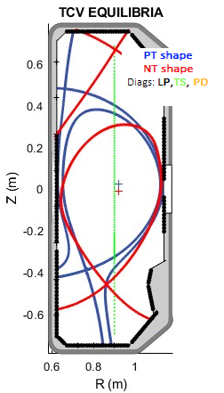
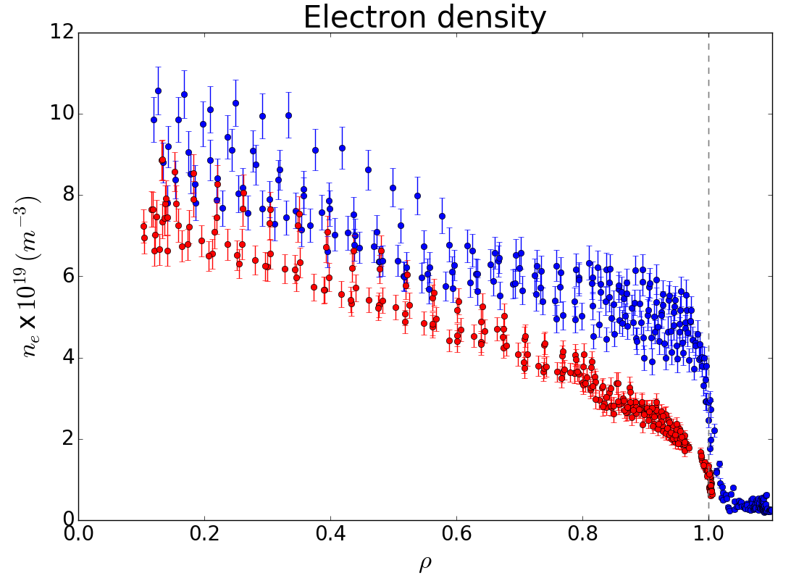
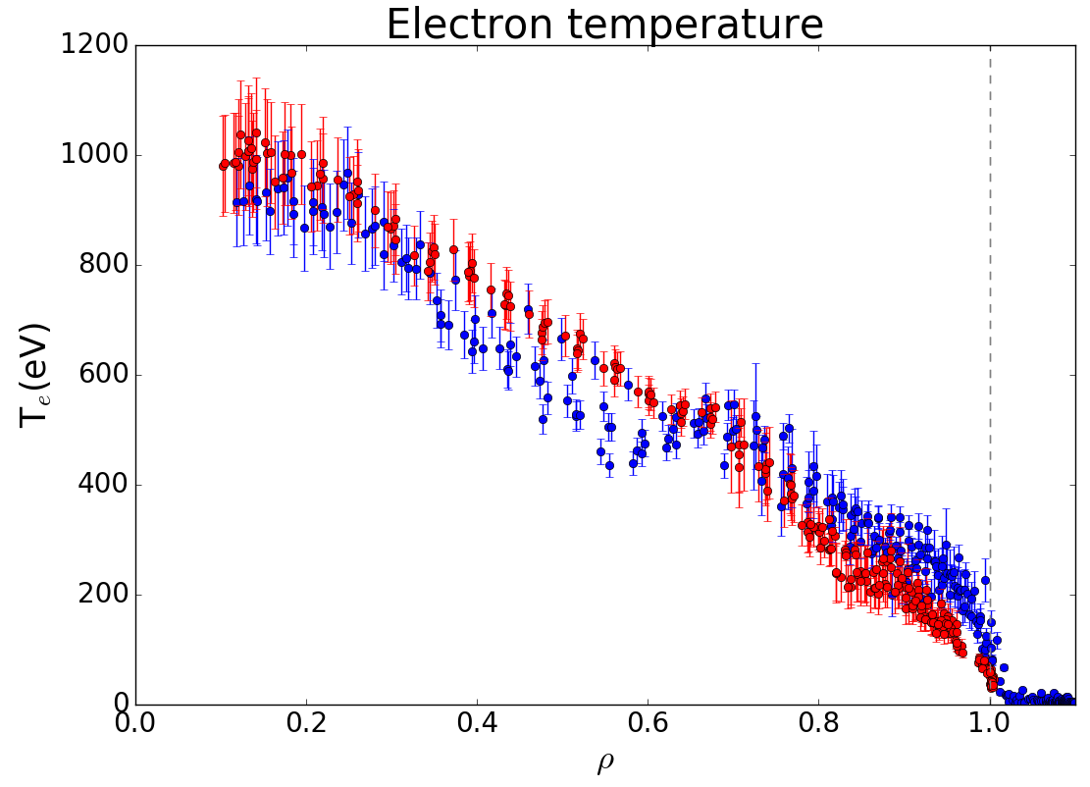
TCV: PT-H and NT same core temperature
Pulses
PT-H#76702 VS NT#76735
Similar features
Magnetic divertor configuration: SN
B_{T} ≃ 1.4 T for TCV
I_{plasma} ≃ 200/174 kA for TCV
DTT Triangularity
PT → δ_{top}≃ +0.35; δ_{bottom}≃ +0.45
NT → δ_{top}≃ -0.35; δ_{bottom}≃ +0.07
Input power (NBI only)
P_{Tot} = 1090 (NBI) + 204 (P_{OH}) kw
P_{RAD,IN}=290 kW
P_{SOL}=1040 kW
P_{Tot} =424(NBI) + 155 (P_{OH}) kW
P_{RAD,IN} = 124 kW
P_{SOL} = 455 kW
➔ NT has a similar T and slightly lower density for much smaller power

Slide 5
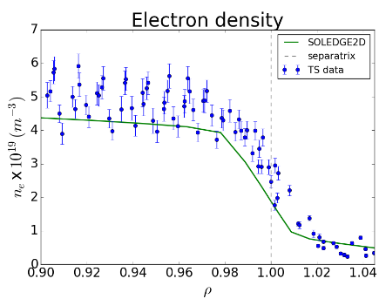
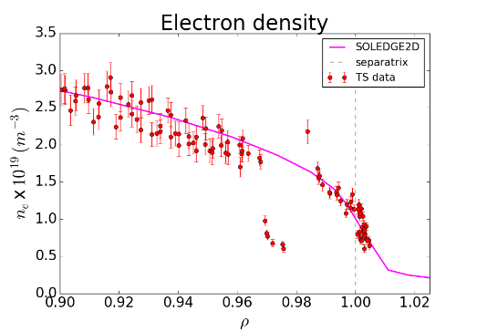
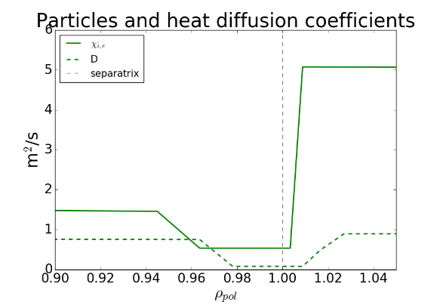
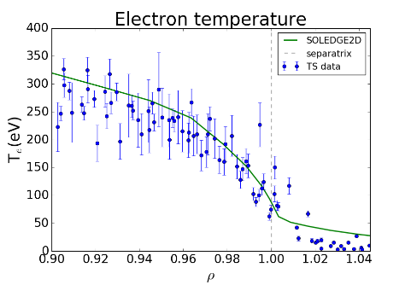
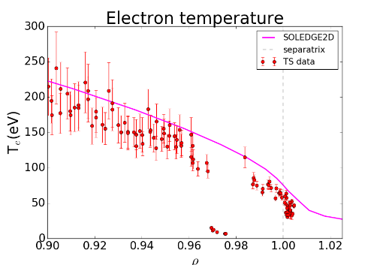
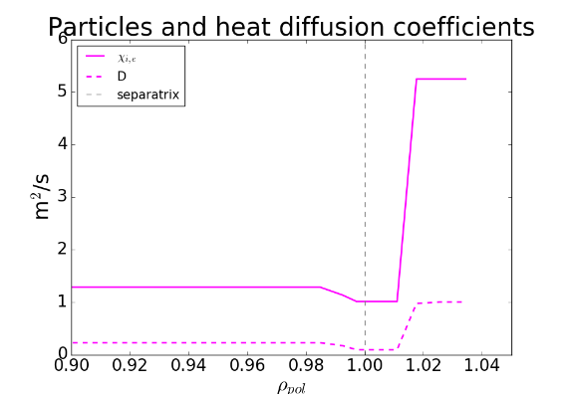
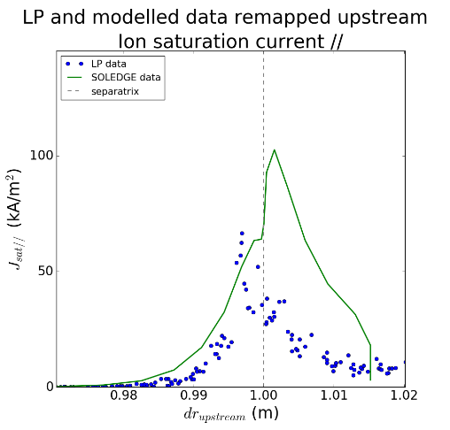
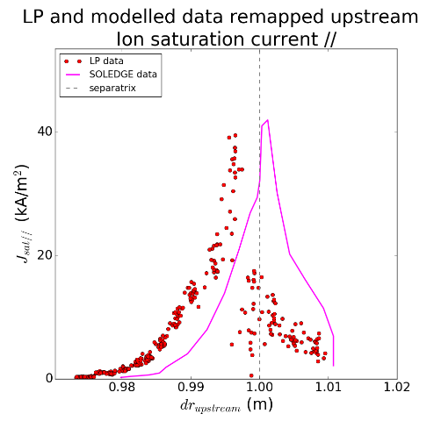
TCV: PT-H and NT same core temperature
#76702 – PT-H
NT#76735 – NT-L
D_{sep} =0.08
χ_{sep} = 0.54
D_{sep} =0.095
χ_{sep} = 1.01
PT-H & NT-L have similar particle diffusion (but narrow barrier)
NT-L has about a twice heat diffusion than PT-H

Slide 6
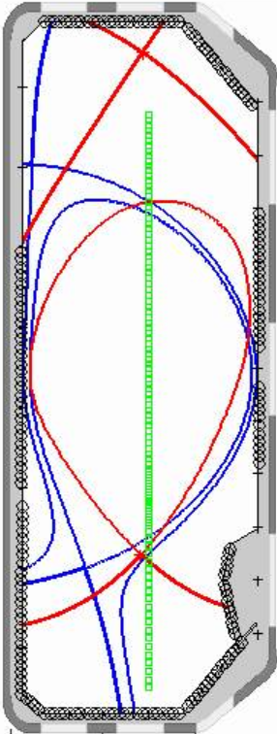
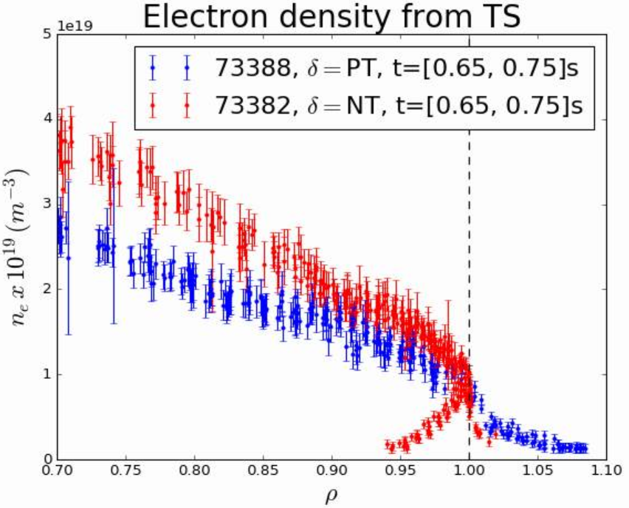
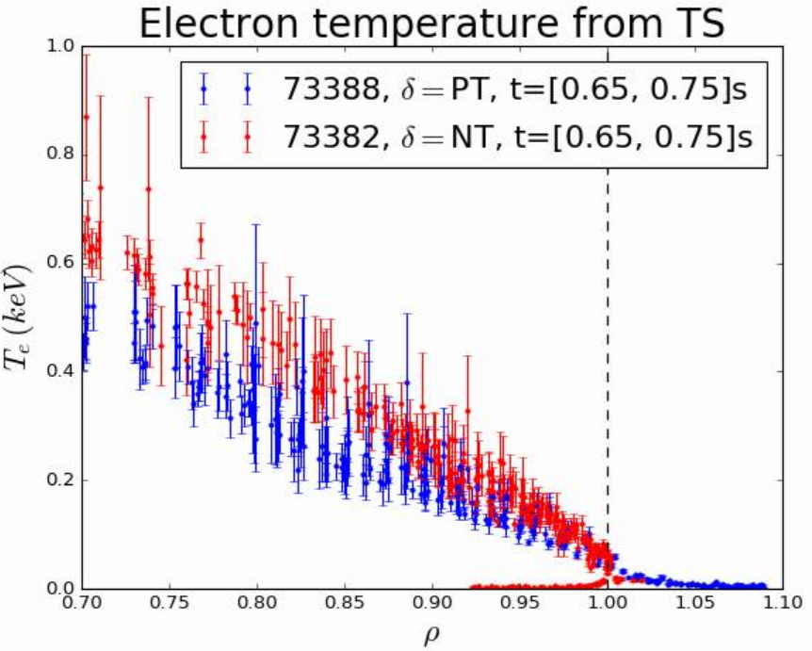
TCV: PT-H and NT similar power
Pulses
PT-L#73388 VS NT#73382
Similar features
Magnetic divertor configuration: SN
B_{T} ≃ 1.4 T for TCV
I_{plasma} ≃ 256/240 kA for TCV
DTT Triangularity
PT → δ_{top}≃ +0.40
NT → δ_{top}≃ -0.22 ; δ_{bottom}≃ +0.0
Power (NBI only)
P_{Tot}=418 (NBI) + 350 (P_{OH}) kw
P_{RAD,IN}=149 kW
P_{SOL}=619 kW
P_{Tot} →418 (NBI) + 264 (P_{OH}) kW
P_{RAD,IN} = 123 kW
P_{SOL} = 559 kW
➔ In the core NT has higher T and density for lower power

Slide 7
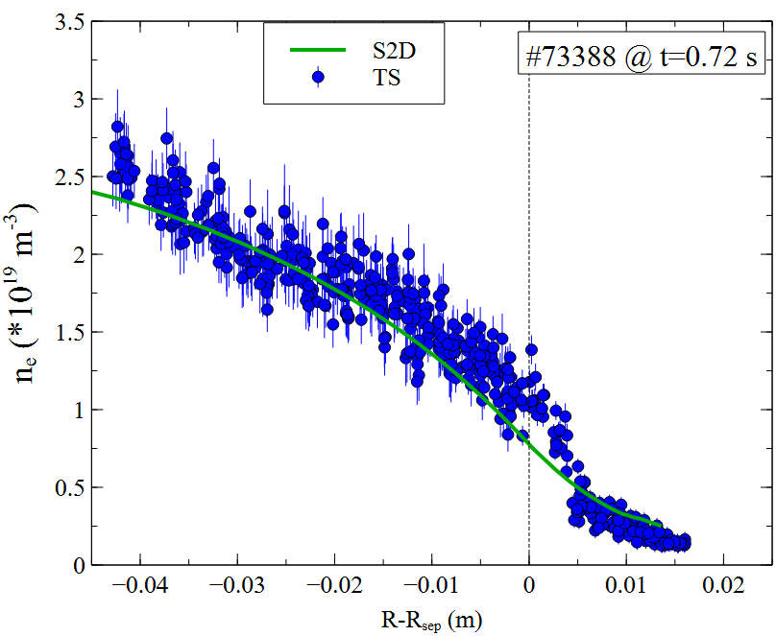
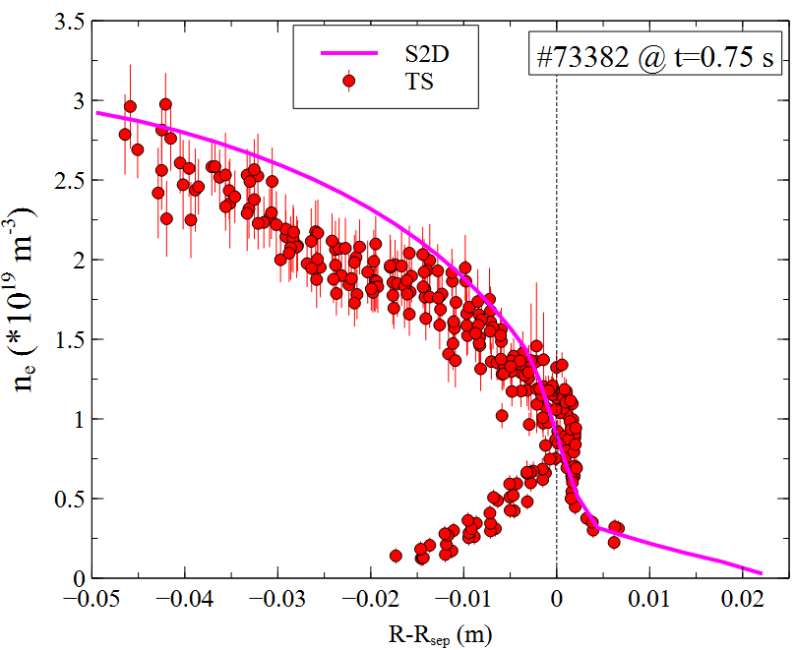
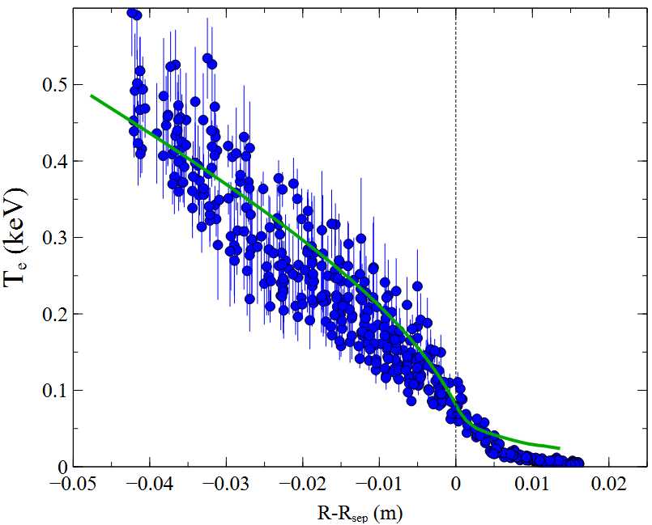
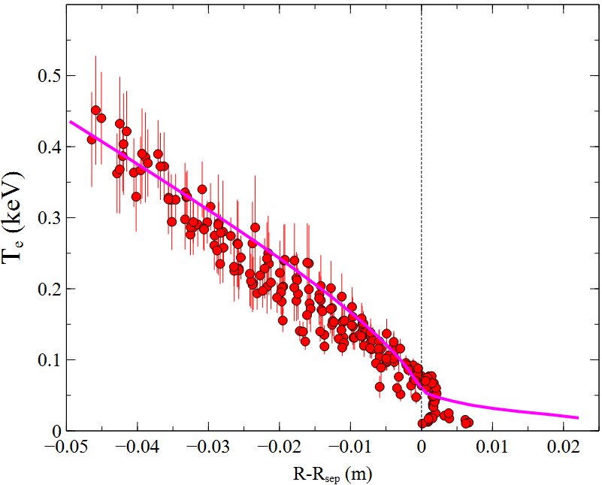
TCV: PT-L and NT similar power – modeling OMP
Good matching of OMP profiles
But some improvements are still possible
TS points below the x-point

Slide 8
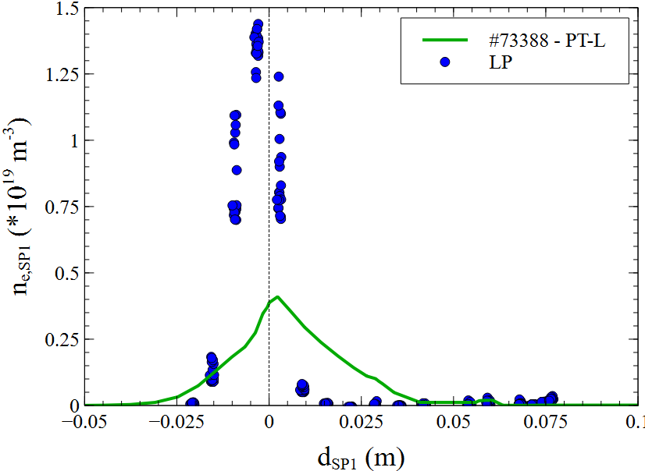
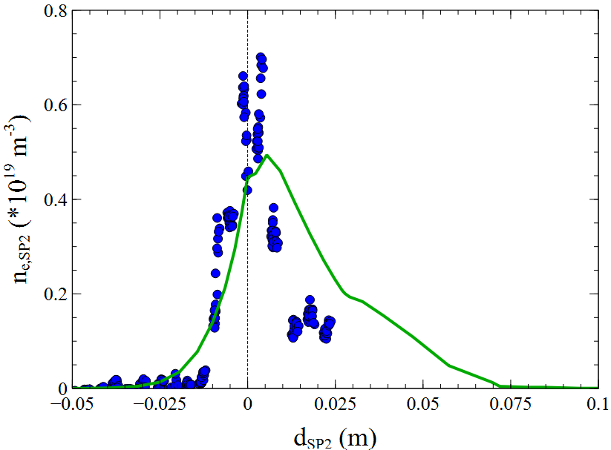
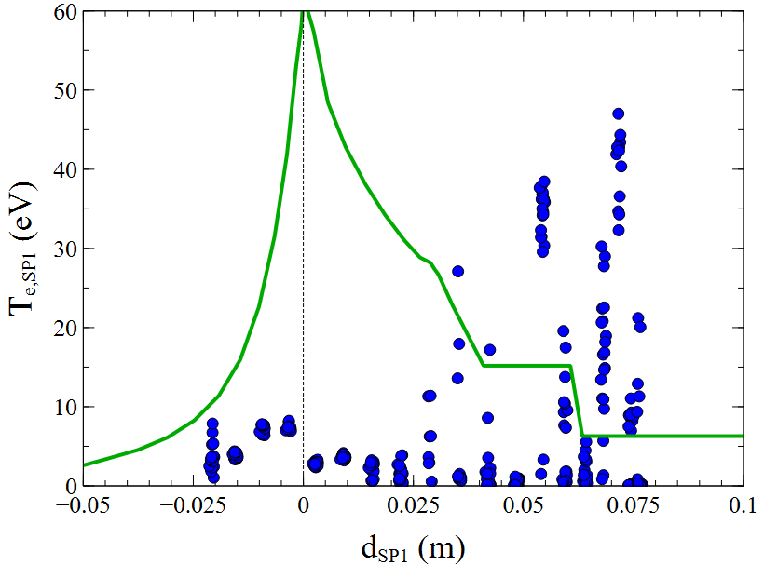
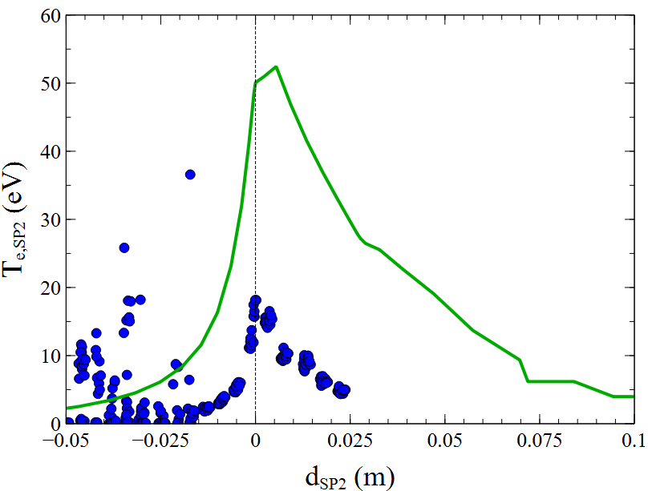
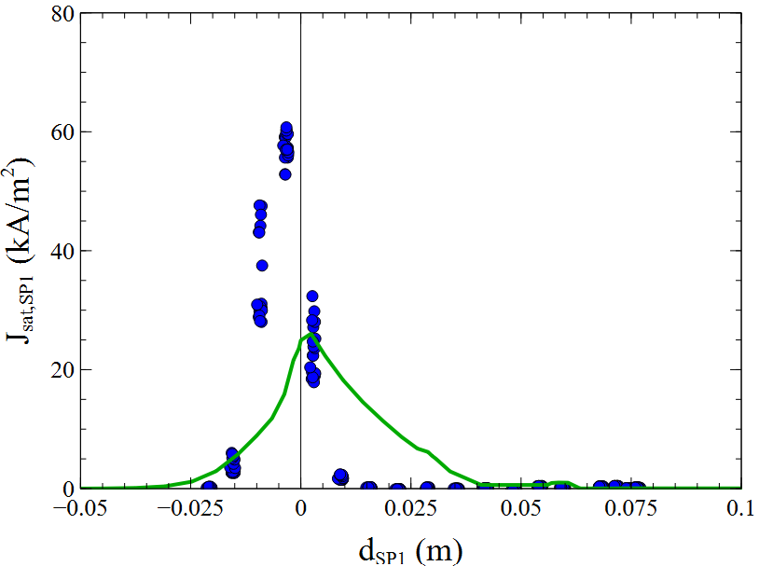
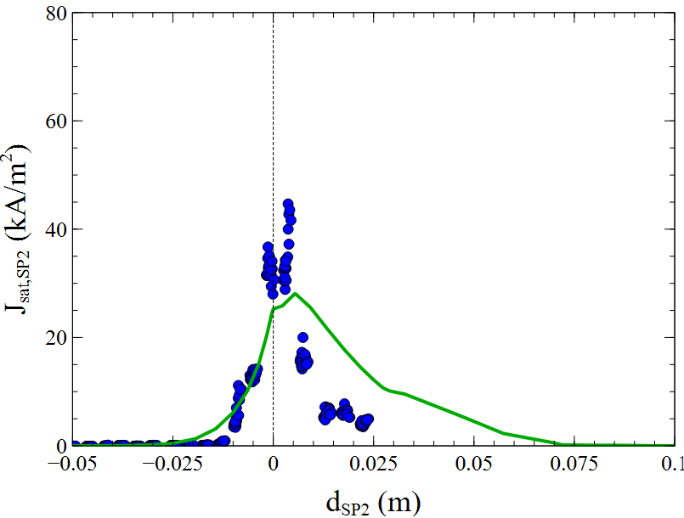
TCV: PT-L and NT similar power – modeling OMP
PT-L modeling at targets
Reasonable agreement for density and _{Jsat}
Higher experimental J_{sat} ➔ particle diffusivity is slightly underestimated

Slide 9
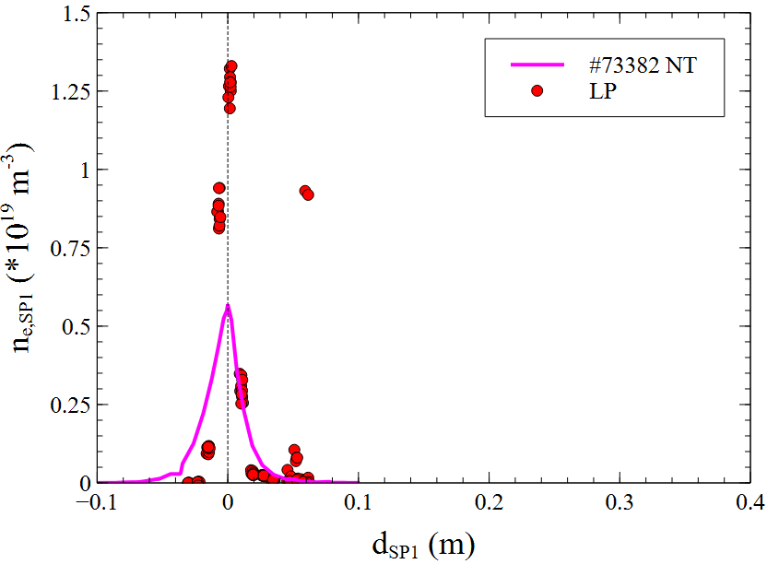
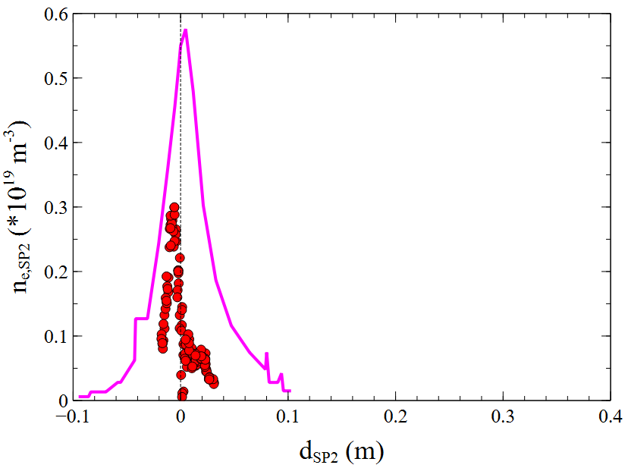
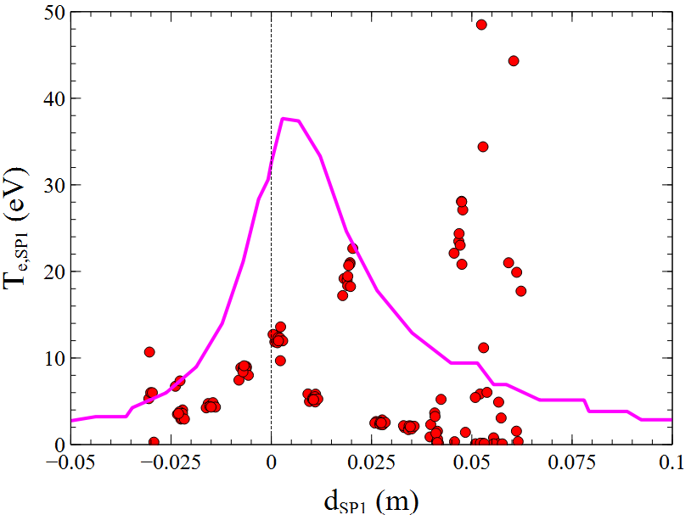
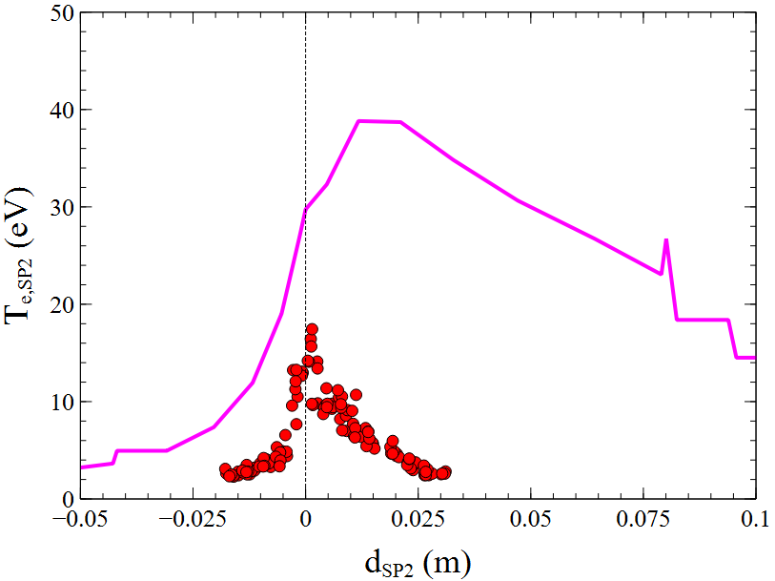
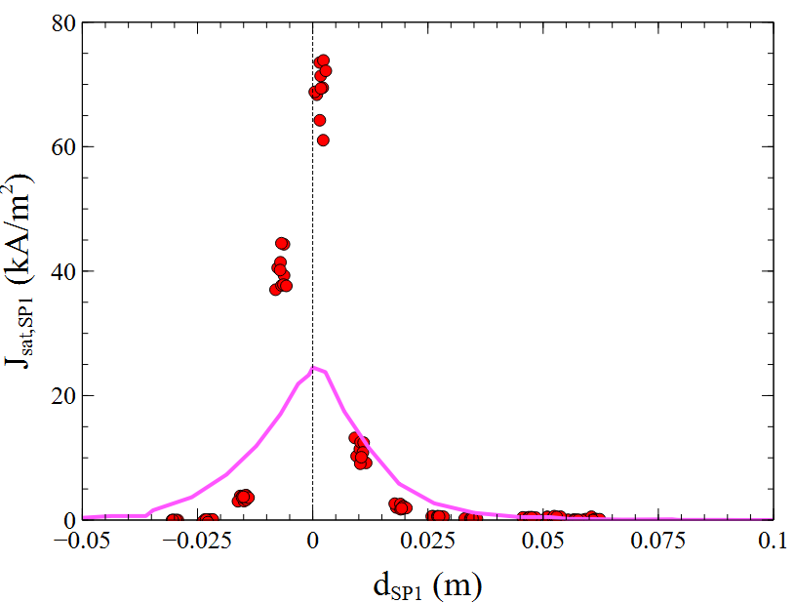
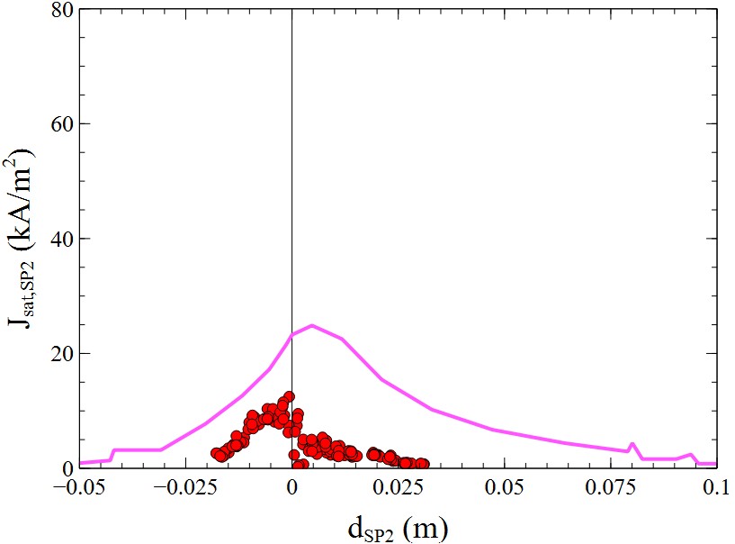
TCV: PT-L and NT similar power – modeling targets
NT modeling at targets
Reasonable agreement for density, temperature and J_{sat}
In/out under/overestimation of density and J_{sat} probably due to missing drifts in modeling
But In/Out averaged value seems ok

Slide 10
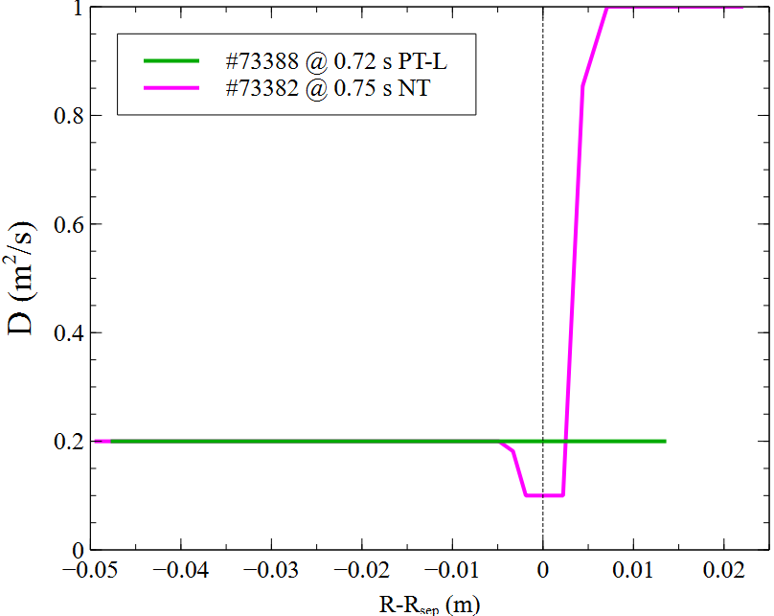
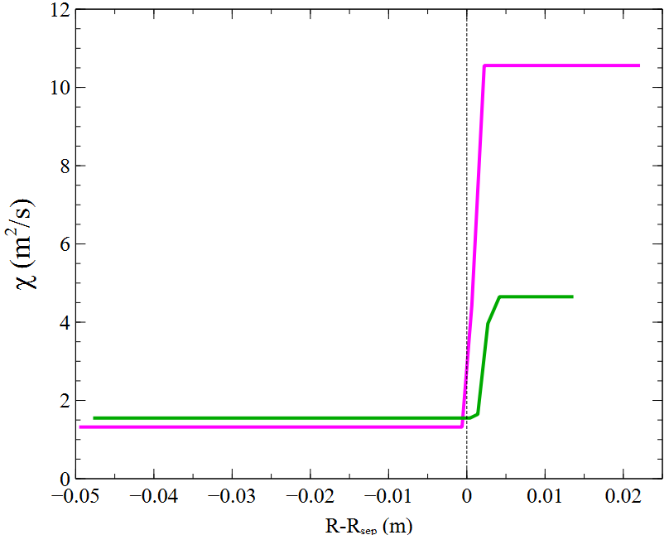
TCV: PT-L and NT similar power
Transport parameters
NT still shows a narrow edge barrier in particle diffusion like in previous modeling with a similar minimum value
Heat conductivity is smaller in NT than in PT-L
NT heat conductivity is higher but not far from previous NT edge modeling
But the small barrier in NT heat conductivity is not present (but probably it can be introduced without a relevant profile variation)

Slide 11
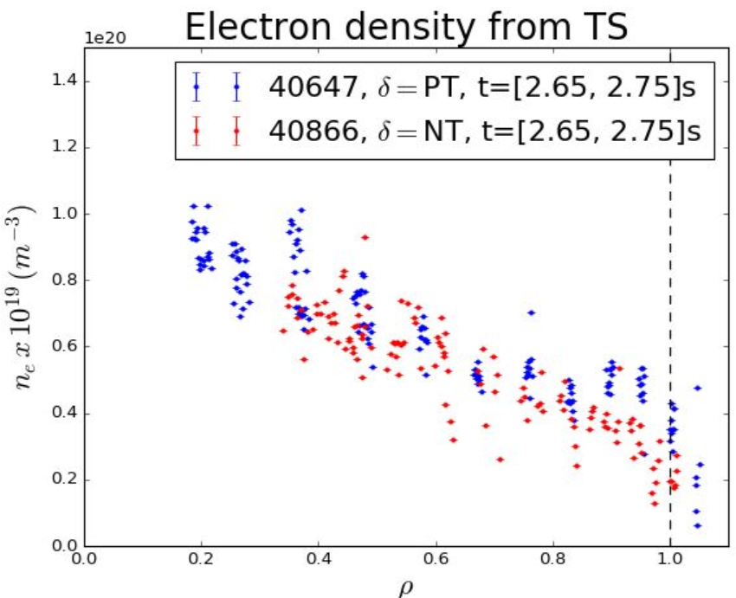
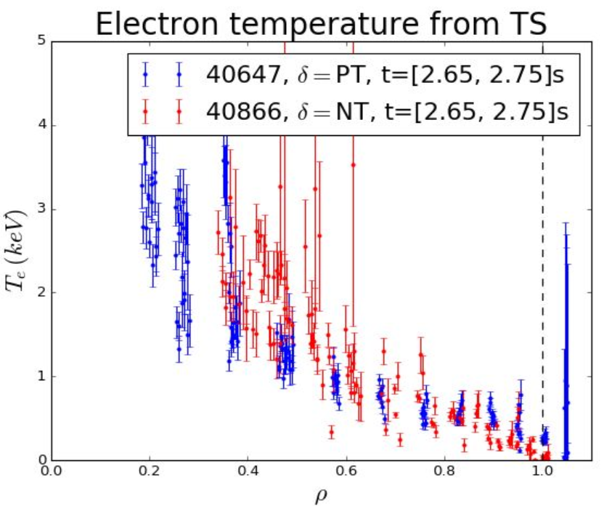
AUG: similar temperature
Pulses
PT-H #740647 @2.7 s VS NT#40866 @ 2.7 s
Similar features
Magnetic divertor configuration: SN
B_{T} ≃ 2.5 T
I_{plasma} ≃ 600/60 kA
DTT Triangularity
PT → δ_{top}≃ +0.4; δ_{bottom}≃ +0.5
NT → δ_{top}≃ -0.28; δ_{bottom}≃ +0.09
Power (ECHR only)
P_{T} → 1460 (ECHR) + 180 (P_{OH}) kw
P_{RAD,IN}= 808 kW
P_{SOL}=778 kW
NT →1485 (ECRH) + 194 (P_{OH}) kW
P_{RAD,IN} = 1160 kW
P_{SOL} = 519 kW

Slide 12
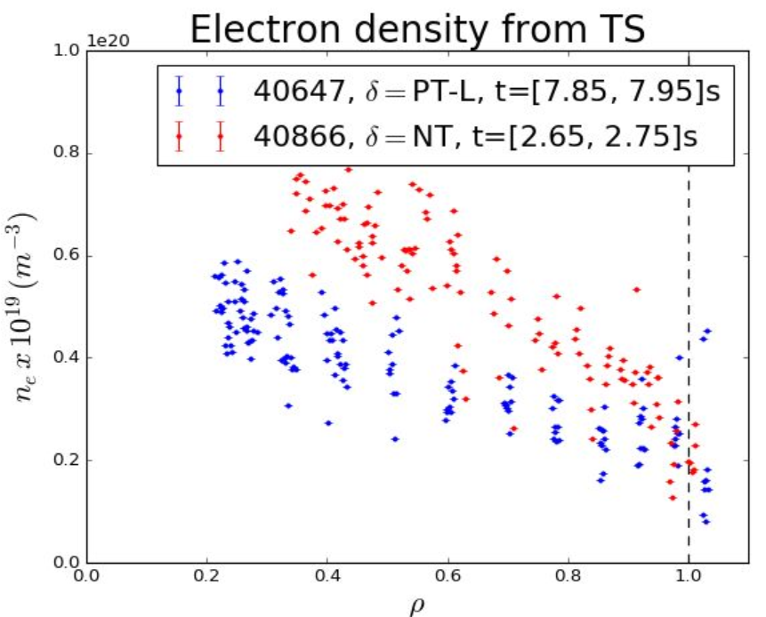
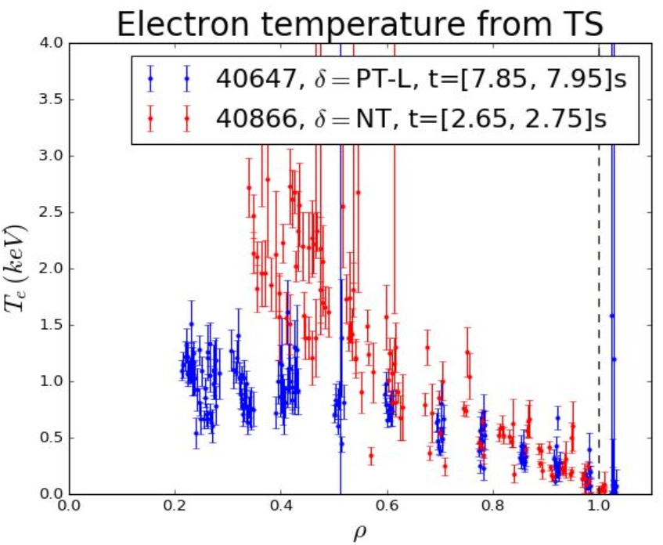
AUG: similar power
Pulses
PT-L#740647 @7.9 s VS NT#40866 @ 2.7 s
Similar features
Magnetic divertor configuration: SN
B_{T} ≃ 1.4 T
I_{plasma} ≃ 600/600 kA
DTT Triangularity
PT → δ_{top}≃ +0.4; δ_{bottom}≃ +0.5
NT → δ_{top}≃ -0.28; δ_{bottom}≃ +0.09
Power (ECHR only)
P_{T} → 583 (ECHR) + 360 (P_{OH}) kw
P_{RAD,IN}= 365 kW
P_{SOL}=580 kW
NT →1485 (ECRH) + 194 (P_{OH}) kW
P_{RAD,IN} = 1160 kW
P_{SOL} = 519 kW

Slide 13
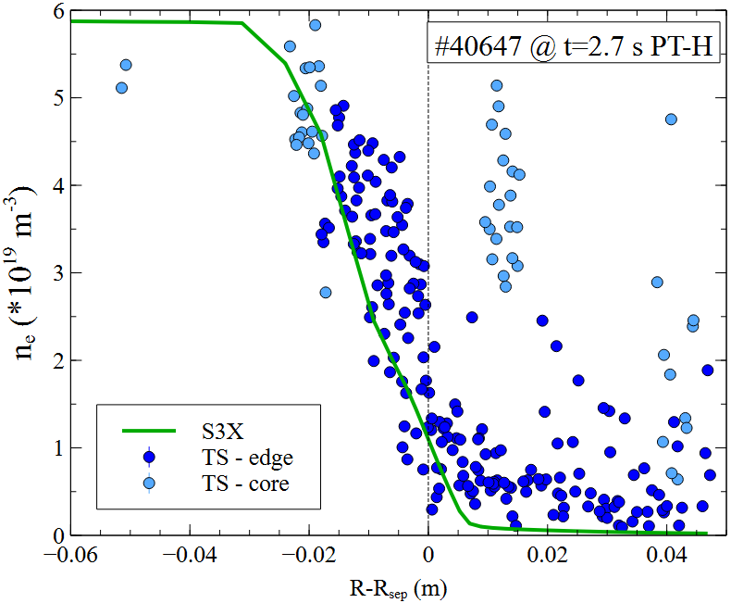
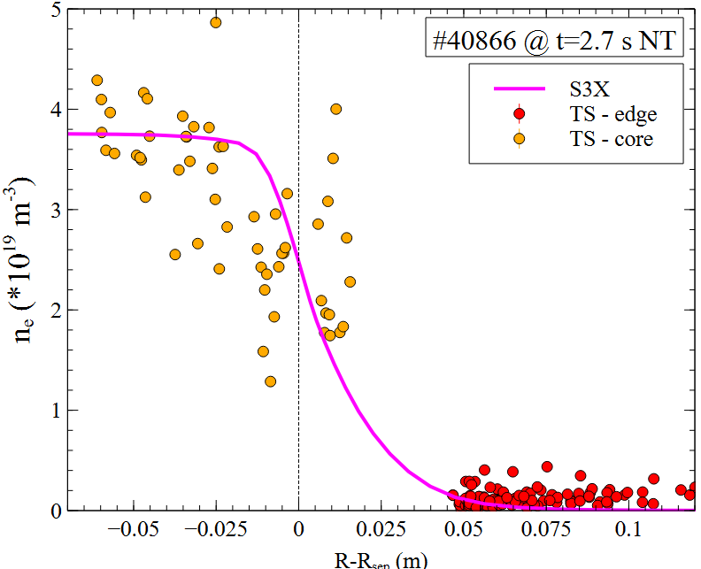
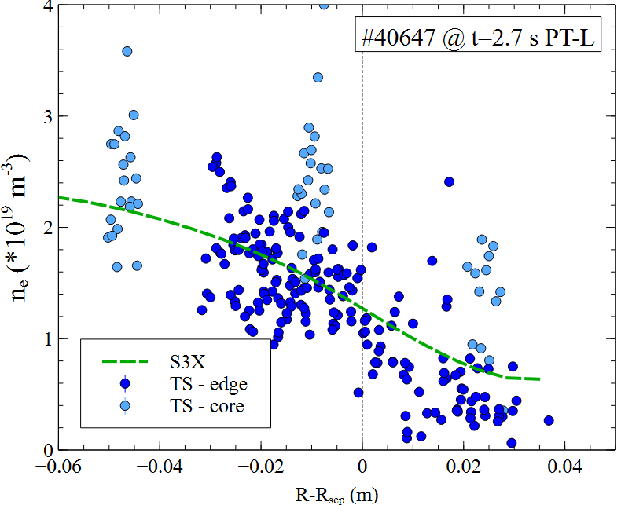
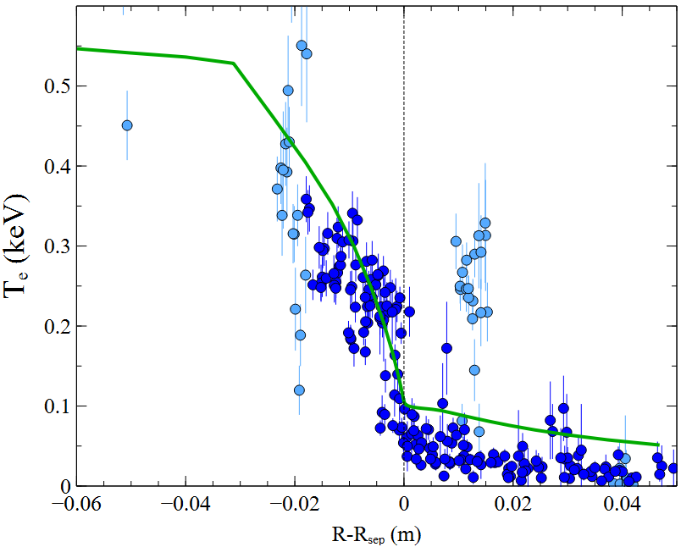
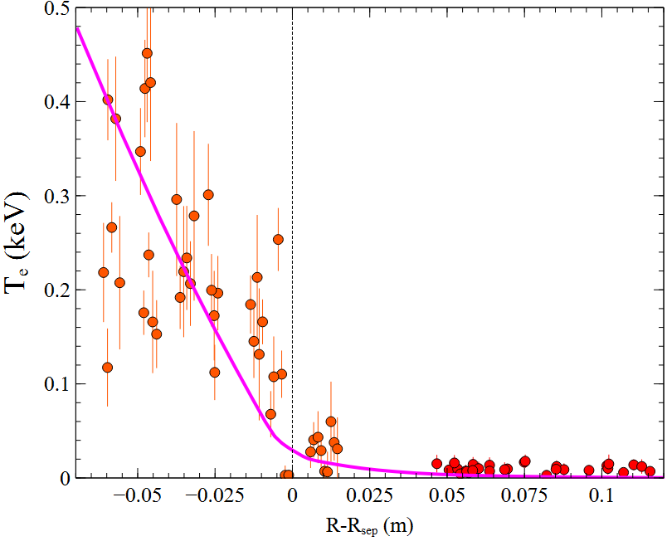
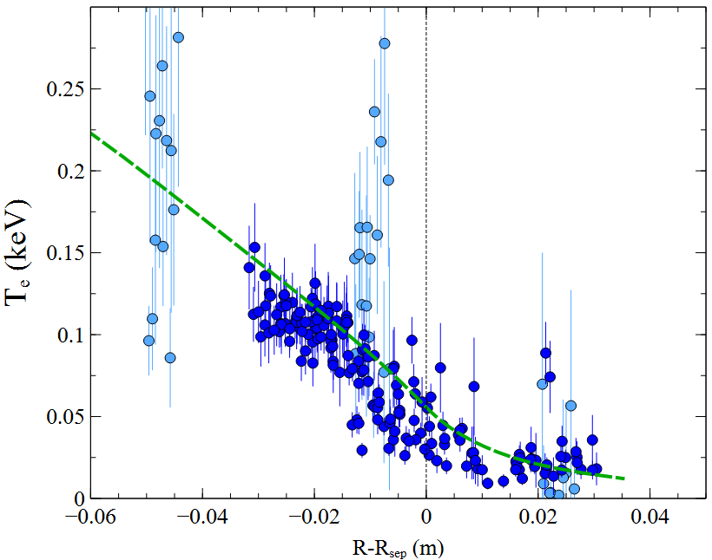
AUG: Edge modeling comparison at OMP
PT-H mode
NT-L mode
PT-L mode
Poor quality of some TS data
Transport values (in particular inside the separatrix) closed to their final values
Still to be optimized transport profiles in PT-L and some adjustment required in PT-H

Slide 14
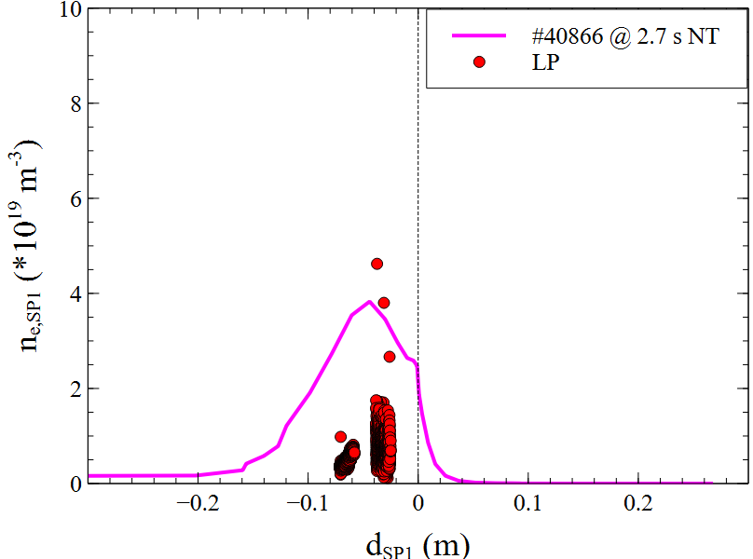
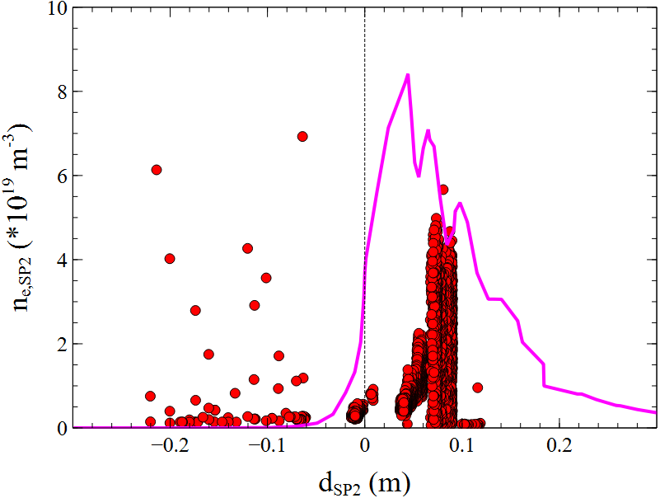
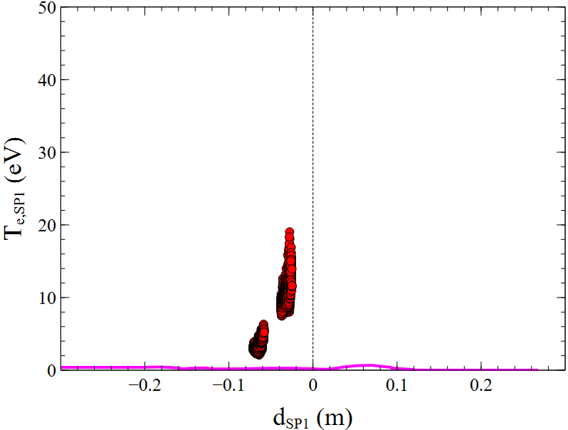
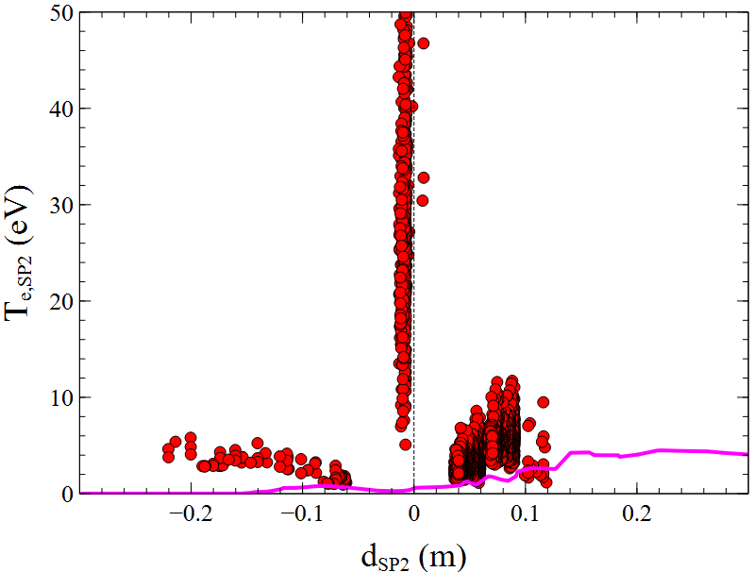
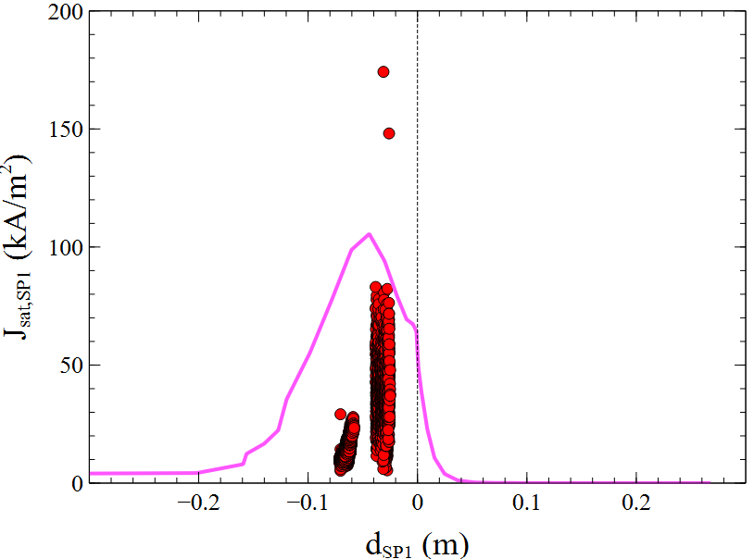
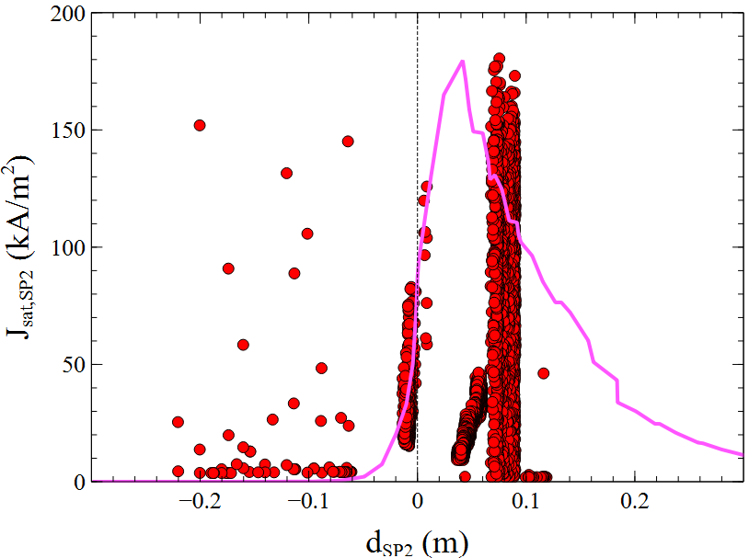
AUG: Edge modeling comparison at targets
NT Langmuir probe data
Poor quality of Langmuir probe data
(due to NT strike point position and equilibrium reconstruction)
But density and J_{sat} amplitude relatively well matched
Comparison with D_{α} is underway
Waiting for #40647 data for SN-PT

Slide 15
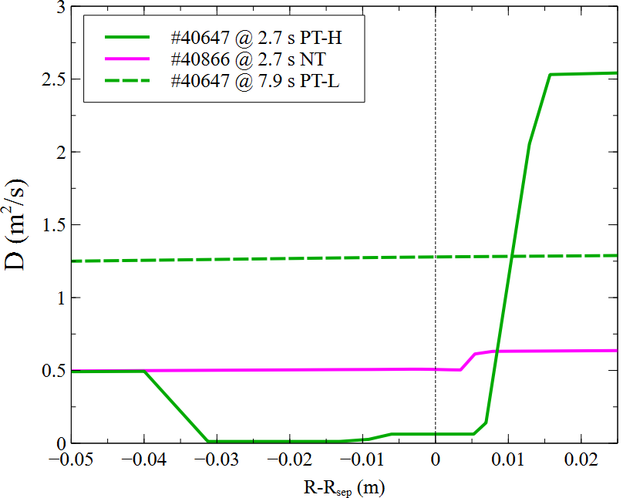
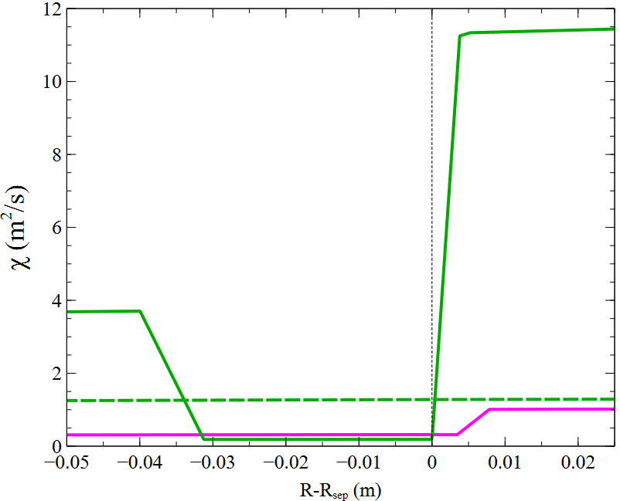
AUG: comparison PT-H ⬄ NT ⬄ PT-L
Transport parameters
In AUG the prticles diffusion seems much smaller in PT-H than in NT at the transport barrier (but the result could depend from poor quality of data)
Heat conductivity instead is not much different between PT-H and NT
Inside the separatrix particles diffusion and heat conductivity are much higher in PT-L than in NT
Transport estimation might be improved with better data (some are coming)
In any case it is confirmed than NT transport is in between PT-H and PT-

Slide 16
To DTT modelling

Slide 17
DTT PT H-mode full power scenario prediction
For core performance
from core modelling^{[6]}
B_{T} = 6 T
I_{p} = 5.5 MA
H-mode
→Core radiation ≅ 15MW
Power = 45MW
~ 2% Neon
For detachment
from edge modelling^{[7]}
P_{inner boundary}=30MW*
(considering ELMs losses)
+
diffusion parameters estimated^{[8]}
n_{sep} ~ 8x10¹⁹
D₂ ~ 9.5x10²²
→ Z_{eff,core} ~ 2.2
P_{rad,SOL+edge} ~ 25MW
Neon ~ 0.075x10²² molecules/s
→detachment
Single Null
δ_{up} = 0.33
δ_{bottom} = 0.35
*P-10MW_{core_rad}-5_{ELMs}
[6] I. Casiraghi et al 2023 Plasma Phys. Control. Fusion 65 035017
[7] P. Innocente et al 2022 Nucl. Mater. Energy 33 101276
[8] L. Balbinot et al 2023 Nucl. Mater. Energy 34 101350

Slide 18
From DTT PT H-mode to DTT NT «L-mode»
We want
- Z_{eff,core} ~ 3 for core performance
- Detachment for PEX performance
We impose
P_{inner boundary}= 36MW (no ELMs)
In NT there is no limitation in n_{sep} unlike PT where n_{sep} affects the L-H threshold power, but we have to limit the core density to reach high temperature (low loop voltage) for this reason
➔ n_{sep} < ~ 9x10¹⁹
Neon/argon puffing
Diffusion extrapolated to TCV studies
Single Null
δ_{up} = -0.3
δ_{bottom} = 0.05
D₂
Ne or Ar

Slide 19
From DTT PT H-mode to DTT NT «L-mode» / diffusion
Starting from TCV transport
ratio between PT H-mode and NT diffusion in the different main point
Extrapolate D and χ for NT DTT starting from PT
H-mode transport foreseen for DTT^{[8]}
assuming χ_{i}= χ_{e} (as in TCV)
NT
PT
D (m²/s)
D_{sep} NT= 0.03
D_{sep} PT= 0.02
ρ_{pol}
m²/s
D
Χ
V_{pinch}
_{ν}
χ_{sep} NT= 0.30
χ_{sep} PT= 0.15
Χ (m²/s)
PT
NT
ρ_{pol}
ρ_{pol}
[8] L. Balbinot et al 2023 Nucl. Mater. Energy 34 101350

Slide 20


DTT: SN-PT ⬄ SN-NT
NT modeling with neon and argon is still ongoing/non-stationary
n_{sep}= 9-10⋅10¹⁹ m⁻³ partially above target value
T_{sep} is lower in NT than in PT due to the higher density
T recovers in the core due to the chosen constant heat diffusivity (but this requires a further experimental assessment)
In DTT much smaller gas-puffing is required to the lower pumping efficiency (pumping slots are far from strike points)

Slide 21






DTT: SN-PT ⬄ SN-NT
A higher Z_{eff} is necessary in NT than in PT
A much higher radiation seems necessary in NT to detach
In NT a lot of radiation is inside the separatrix
The main problem of NT seems related to the short length of the external leg
➔ It is difficult to detach at the external strike point
The internal strike point detached quite early but is unable to drive the detachment of the external one
P_{rad}=21.1 MW
P_{rad,IN}=2.6 MW
Z_{eff}=2.36
P_{rad}=32.8 MW
P_{rad,IN}=20.5 MW
Z_{eff}=3.44

Slide 22
Turbulent modeling with S3X

Slide 23








Steps to turbulent modeling
From S3X-EIRENE
to fluid neutrals
still 2d transport model

Slide 24










Turbulent modeling of PT & NT
Modeling is very far from stationarity but crash problems seems partially solved
PT case shows a clear effect of turbulence with well developed structures
Smaller amplitude structures are present also in NT as well as initial drifts effect
Average profiles at OMP show agreater variations in density

Slide 25










2D fluctuation amplitude plots PT & NT
Fluctuation amplitude is higher in PT than in NT but it can depend on the status of the modeling
Fluctuations are localized in the low field side for PT
Fluctuations are more poloidally symmetric in NT

Slide 26
Conclusions
A first comparison of the edge transport parameters was performed in TCV showing the presence in NT of a narrow particle transport barrier at the separatrix
In TCV the transport parameters around the separatrix for the NT configuration are between PT-H and PT-L
The edge transport modeling in AUG partially confirms the TCV results in terms of transport values in NT configuration between PT-H and PT-L, but further modeling on pulses with better measurements is needed to finalize the results
The transport profiles extrapolated from those resulting from the TCV modeling were used to model the DTT scenario in NT configuration. The detachment seems particularly difficult at the outer impact point due to the short leg.
The turbulent modeling was started with S3X code for previously modeled PT and NT pulses. The computation times are quite long, but the first effects of turbulence are already present in the modeling

Slide 27
Spare slides

Slide 28








2D fluctuation in one section PT & NT

Slide 29
TCV pulse #76702 – PT H-mode (δ_{top} = +0.4)
GAS PUFFING:
MAIN PARAMS discharge
valve | 0,7 s
1 | D2: xxx mbar/s xxxe20 molecules/s →xxxe20 atom/s
2 | -
3 | -
Time =0,7s (NBI-only phase)
I_{p} | -200 kA
<n_{e}> (FIR) | xxx x 10¹⁹ m⁻³
T_{e} max (TS) | xx keV
B_{T} at R=0,88m | -1.42 T
DENSITY_BC (in overview_hmode.jscp)
time | 0,7 s
NBI electrons/s - Density_BC (flux) | 2.77e20
POWER
time | 0,7 s
P_rad_tot | 406 kW
P_divertor | 116 kW
P_bulk | 290 kW
P_NBI (with the loss due to the duct) | 1090 kW
P_ICRH | -
P_OHM | 204 kW (V=1.02 V)
ELMs power | Xxx kW
P_inp = P_NBI + P_OHM + P_ICRH – P_rad_tot – P_ELMs = xxx W (without impurity)
P_inp = P_NBI + P_OHM + P_ICRH –P_ELMs = (with impurity)

Slide 30
TCV pulse #76735 – NT (δ_{top} = -0.35)
GAS PUFFING:
MAIN PARAMS discharge
valve | 0,7 s
1 | D2: xxx mbar/s xxxe20 molecules/s →xxxe20 atom/s
2 | -
3 | -
Time =0,7s (NBI-only phase)
I_{p} | -174 kA
<n_{e}> (FIR) | xxx x 10¹⁹ m⁻³
T_{e} max (TS) | xx keV
B_{T} at R=0,88m | -1.42 T
DENSITY_BC (in overview_hmode.jscp)
time | 0,7 s
NBI electrons/s - Density_BC (flux) | 2.77e20
POWER
time | 0,7 s
P_rad_tot | 202 kW
P_divertor | 78 kW
P_bulk | 124 kW
P_NBI (with the loss due to the duct) | 424 kW
P_ICRH | -
P_OHM | 155 kW (V=0.89 V)
ELMs power | Xxx kW
P_inp = P_NBI + P_OHM + P_ICRH – P_rad_tot – P_ELMs = 377 W (without impurity)
P_inp = P_NBI + P_OHM + P_ICRH –P_ELMs = (with impurity)

Slide 31

TCV pulse #73388 – PT L-mode (δ_{top} = +0.4)
GAS PUFFING:
MAIN PARAMS discharge
valve | 0,7 s
1 | D2: 1,79mbar/s 1,36e20 molecules/s →2.72e20 atom/s
2 | -
3 | -
Time =0,7s (NBI-only phase)
I_{p} | -256 kA
<n_{e}> (FIR) | 2,84 x 10¹⁹ m⁻³
T_{e} max (TS) | 1,1 keV
B_{T} at R=0,88m | -1.42 T
DENSITY_BC (in overview_hmode.jscp)
time | 0,7 s
NBI electrons/s - Density_BC (flux) | 1.55e20
POWER
time | 0,7 s
P_rad_tot | 223 kW
P_divertor | 74 kW
P_bulk | 149 kW
P_NBI (with the loss due to the duct) | 418 kW
P_ICRH | -
P_OHM | 350 kW (V=1.37)
ELMs power
P_inp = P_NBI + P_OHM + P_ICRH – P_rad_tot – P_ELMs = 545 W (without impurity)
P_inp = P_NBI + P_OHM + P_ICRH –P_ELMs = (with impurity)

Slide 32
TCV pulse #73382 – NT L-mode (δ_{top} = -0.22)
GAS PUFFING:
MAIN PARAMS discharge
valve | 0,7 s
1 | D2: 0,5e20 molecules/s →1,0e20 atom/s
2 | -
3 | -
Time =0,7s (NBI-only phase)
I_{p} | -240 kA
<n_{e}> (FIR) | xx x 10¹⁹ m⁻³
T_{e} max (TS) | xx keV
B_{T} at R=0,88m | -1.42 T
DENSITY_BC (in overview_hmode.jscp)
time | 0,7 s
NBI electrons/s - Density_BC (flux) | 1.5e20
POWER
time | 0,7 s
P_rad_tot (core/div) | 220 kW
P_divertor | 97 kW
P_bulk | 123 kW
P_NBI (with the loss due to the duct) | 418 kW
P_ICRH | -
P_OHM | 264 kW (V=1.1 V)
ELMs power | 0
P_inp = P_NBI + P_OHM + P_ICRH – P_rad_tot = 462 kW (without impurity)
P_inp = P_NBI + P_OHM + P_ICRH – P_bulk = (with impurity)

Slide 33

AUG 40647

Slide 34

AUG 40866

