Slide 1
Information on INDICO management tool
Matthias Otte

Slide 2
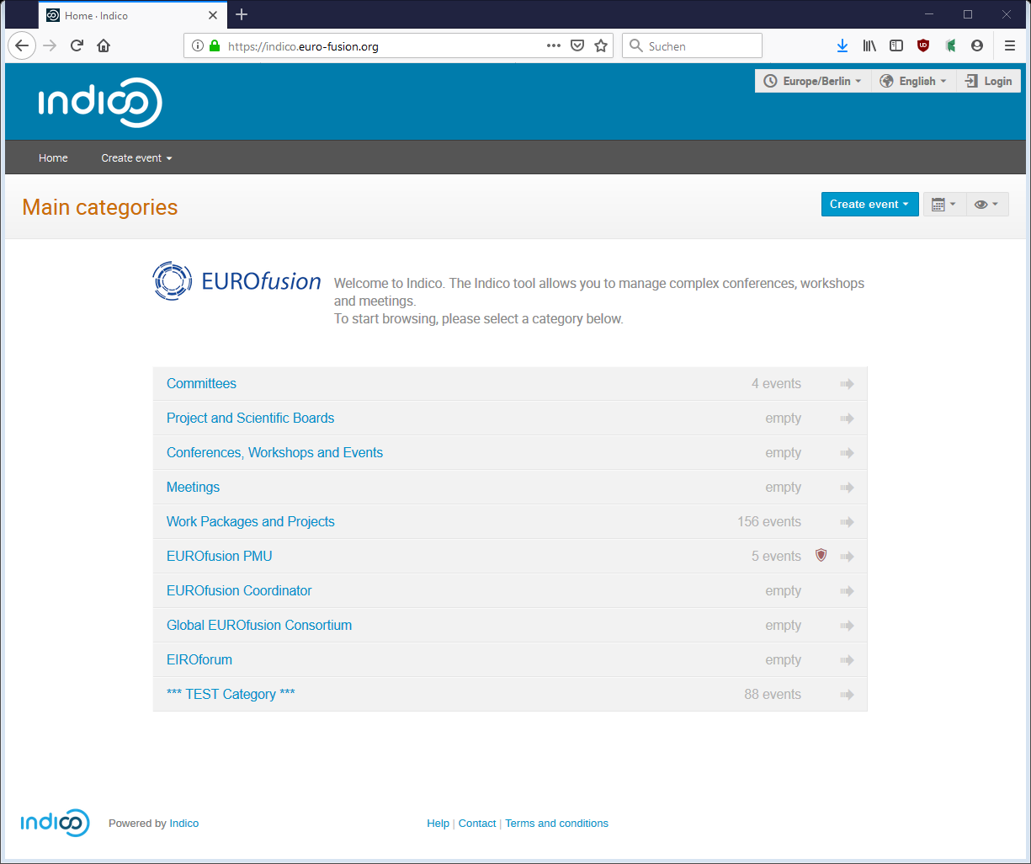
From FusionTV to INDICO
FusionTV (EUROfusion) https://tv.euro-fusion.org/ will be stopped on 30 June 2020
Replacement by INDICO (developed at CERN) as management tool https://indico.euro-fusion.org/:
Booking of conferences, workshops and meetings
Uploading and sharing documents and calendars
Events and uploaded files will not expire
No integrated video conference system
Major changes:
Only persons with a valid EUROfusion accounts can create events!
Guest access to protected resources can only be granted through Access Keys(‘PIN’) for events.
Guests can never upload documents!

Slide 3
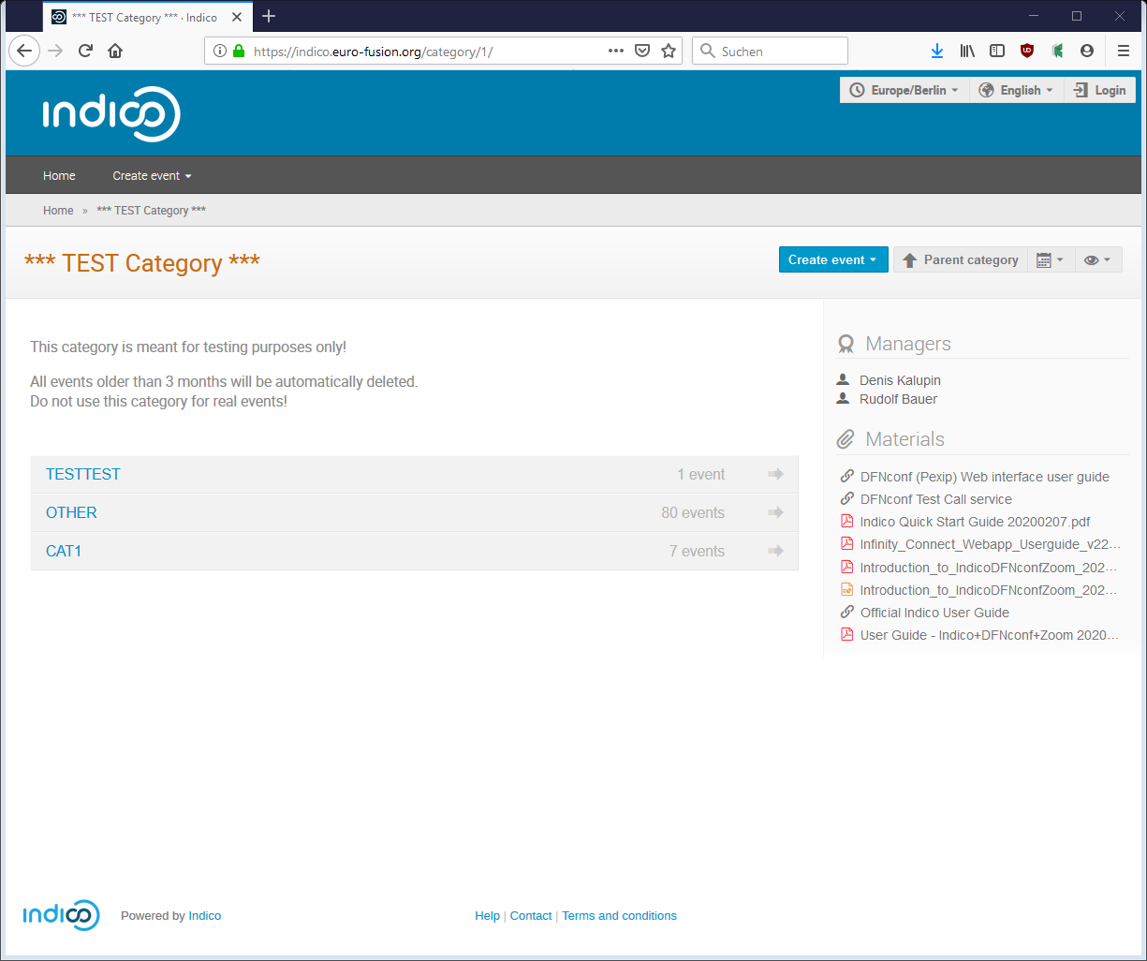
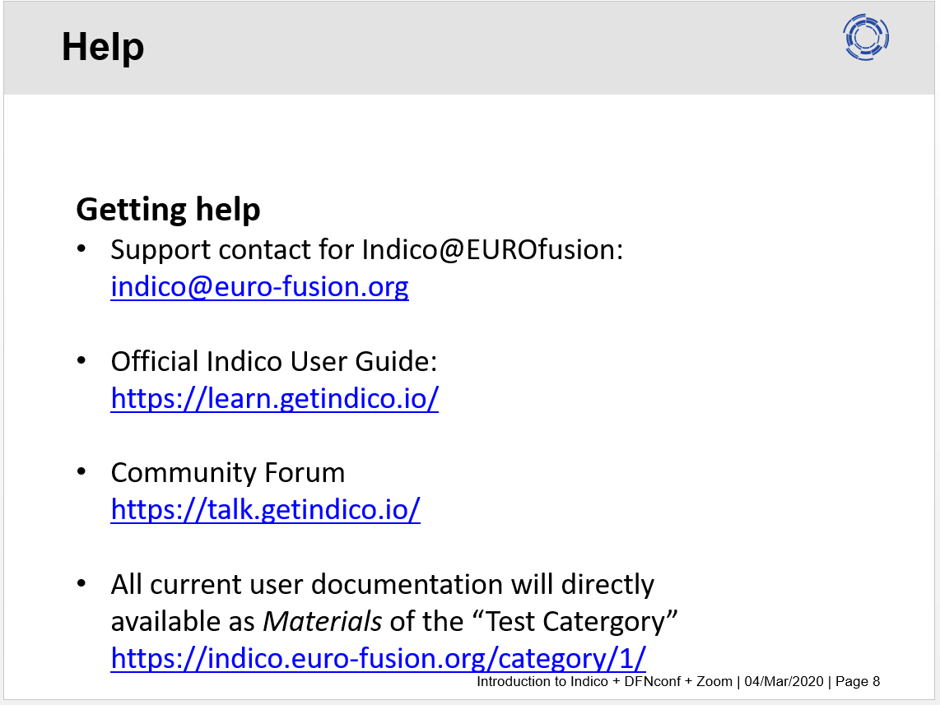
First glance information
Check “Quick start Guide” and “Introduction to Indico…” on https://indico.euro-fusion.org/category/1/

Slide 4
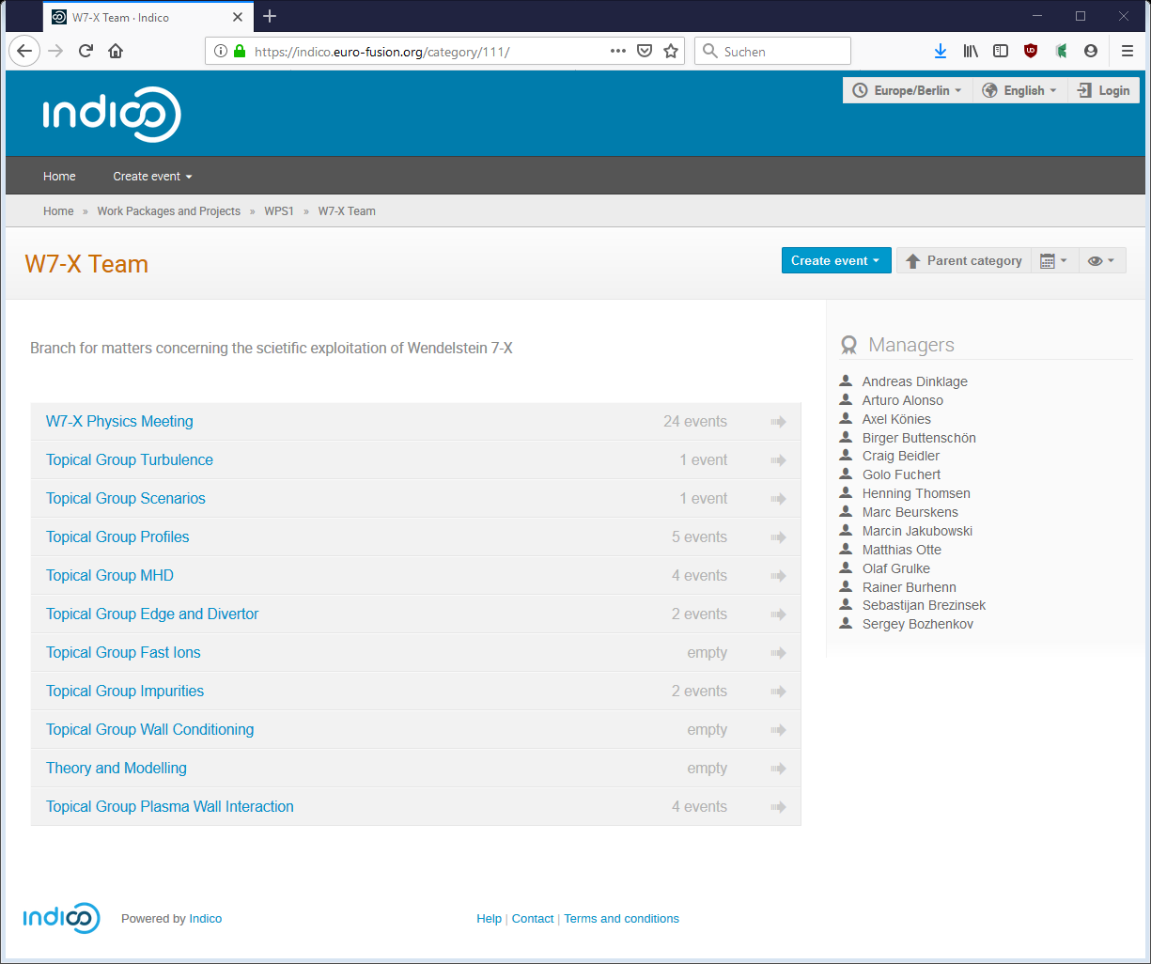
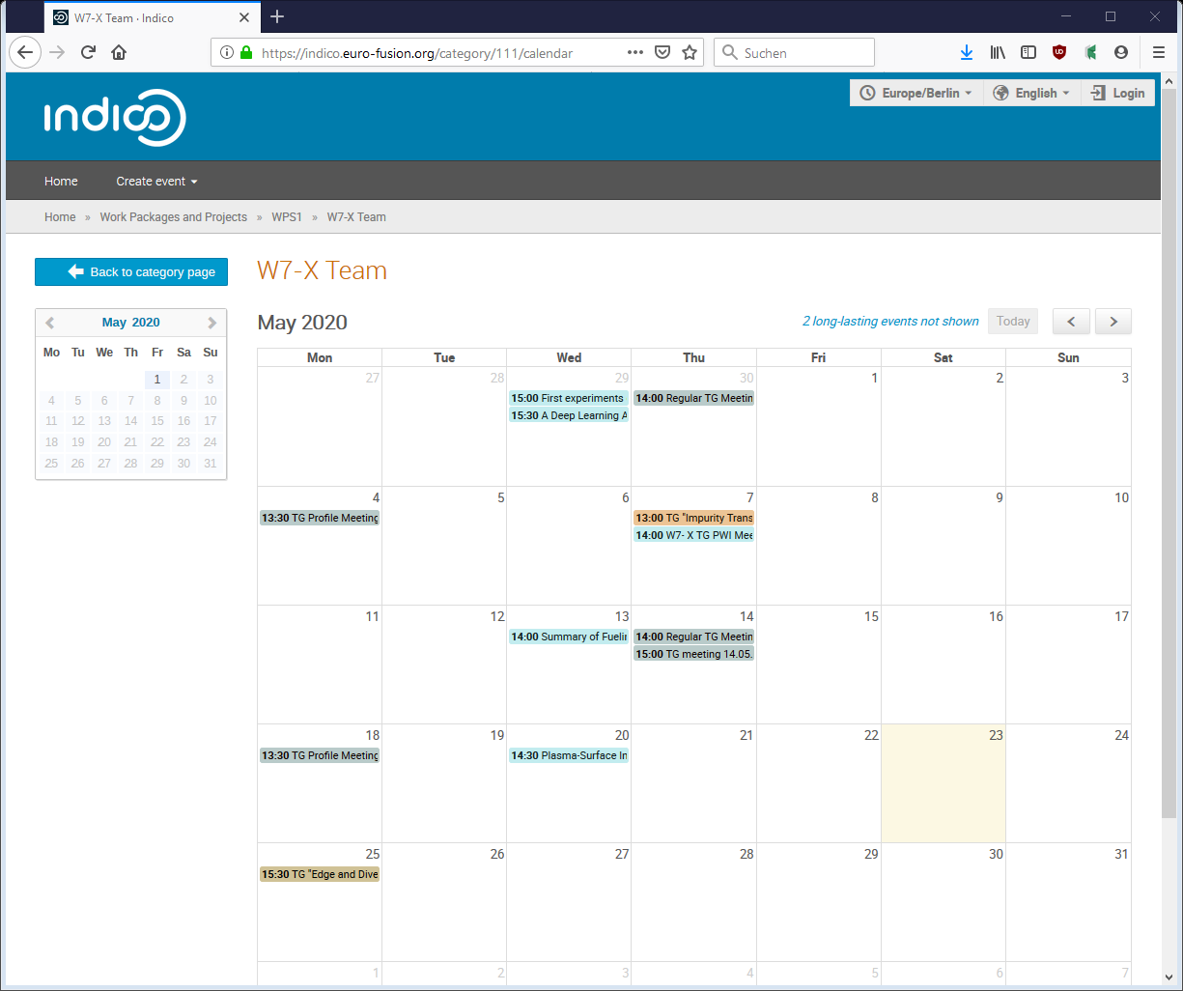
Access to W7-X Topical Groups
W7-X Topical Groups:
https://indico.euro-fusion.org/category/111/
W7-X Topical Groups calendar view:
Import all events (even w/o VPN connection) into Outlook, Google or Thunderbird via: https://indico.euro-fusion.org/export/categ/111.ics?from=-31d&apikey=09323d13-7312-4a0d-abc3-43d2ea7ad331

Slide 5
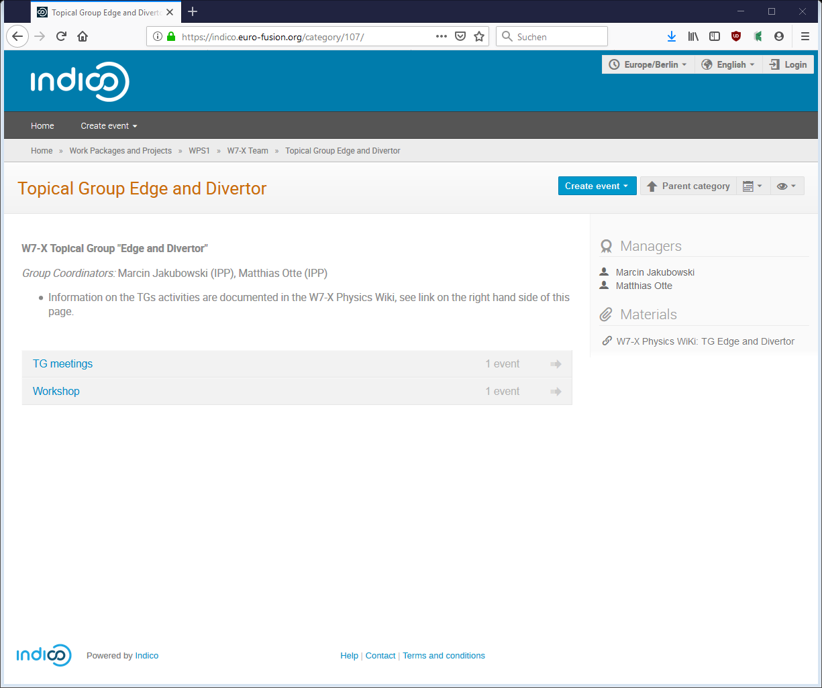
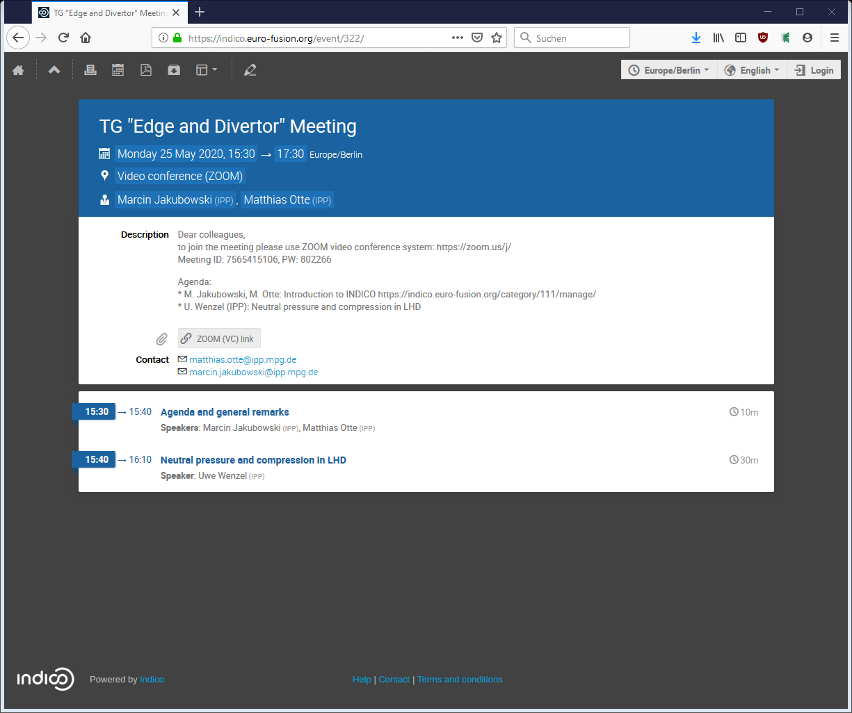
Events in TG “Edge and Divertor”
W7-X Topical Group “Edge and Divertor”:
https://indico.euro-fusion.org/category/107/
Example event (add. material not yet uploaded)
Link to TG Wiki

