Slide 1
Neutral pressure and compression in LHD 2020-04-20 U. Wenzel, G. Motojima, V. Haak, S. Masuzaki

Slide 2
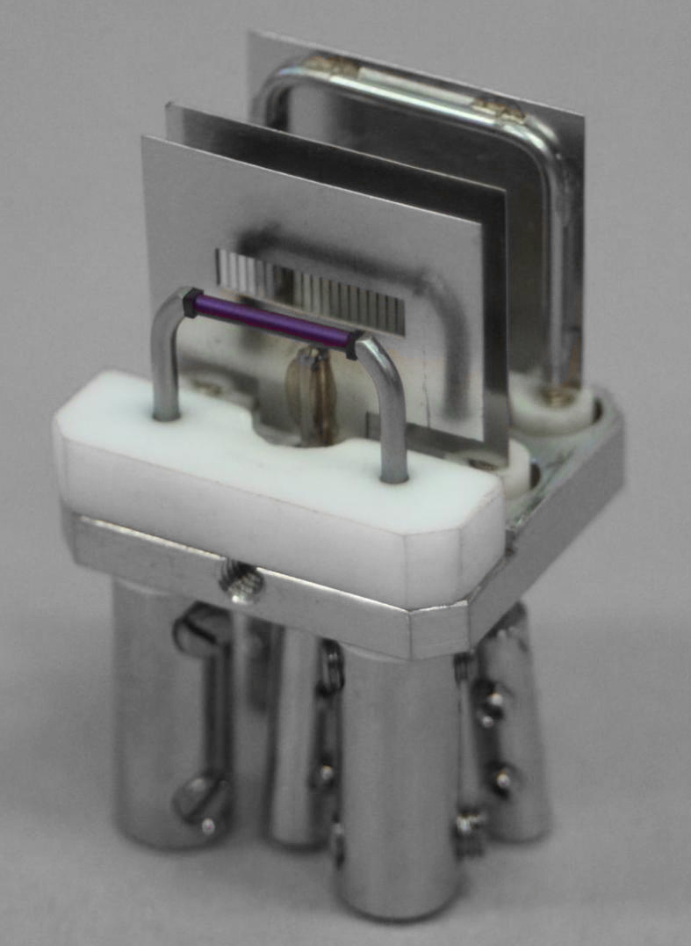
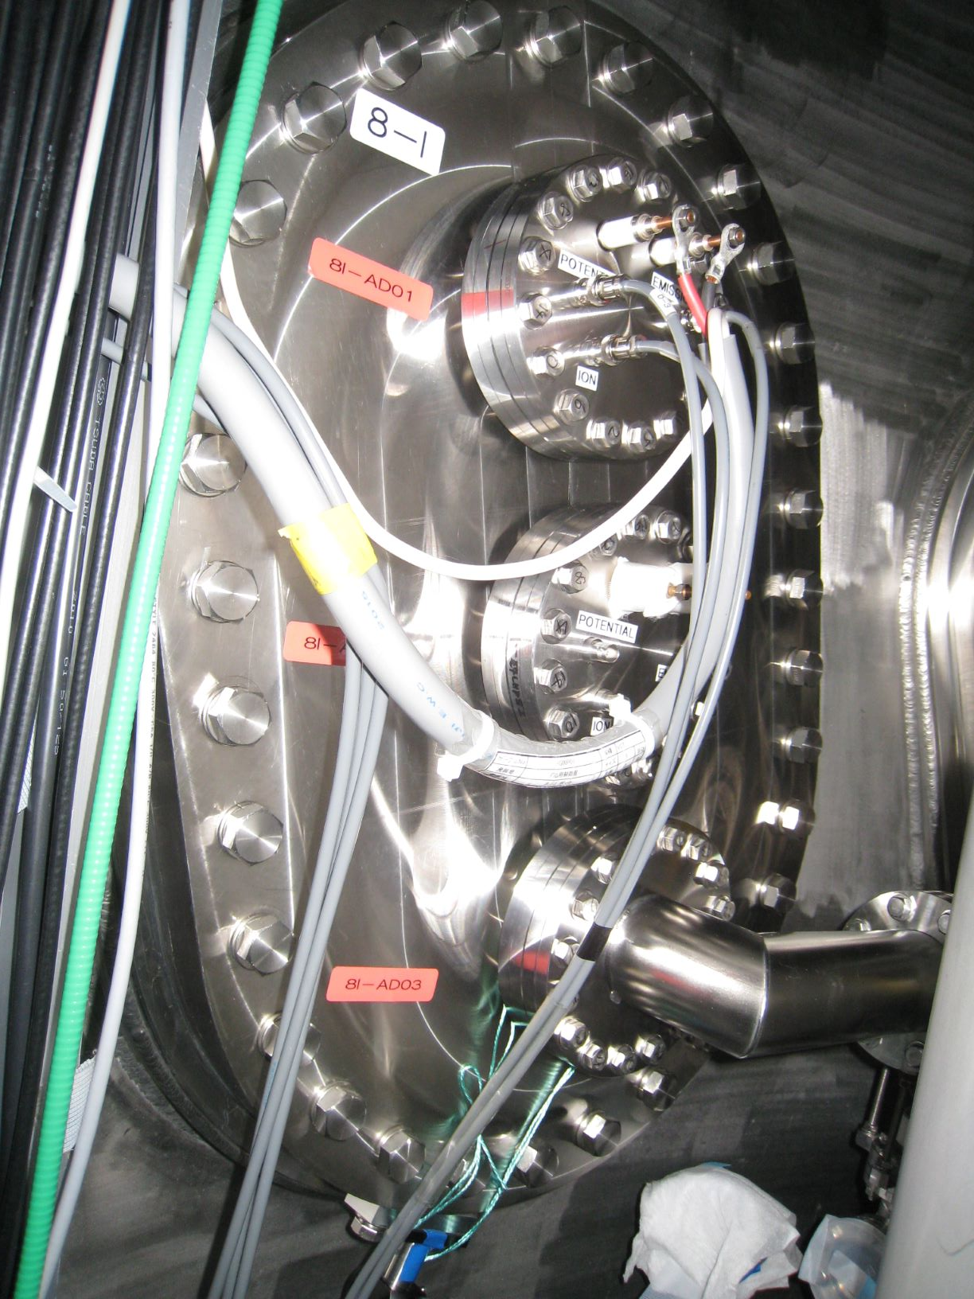
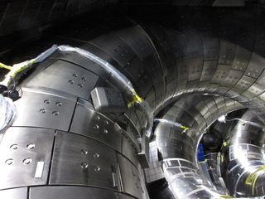
Motivation -> Test of LaB₆ emitters in a neutron environment 20 % ¹⁰B, ¹⁰B is very sensitive to neutron capture
9kura
Subject of the master thesis of Victoria Haak, not reported here.

Slide 3
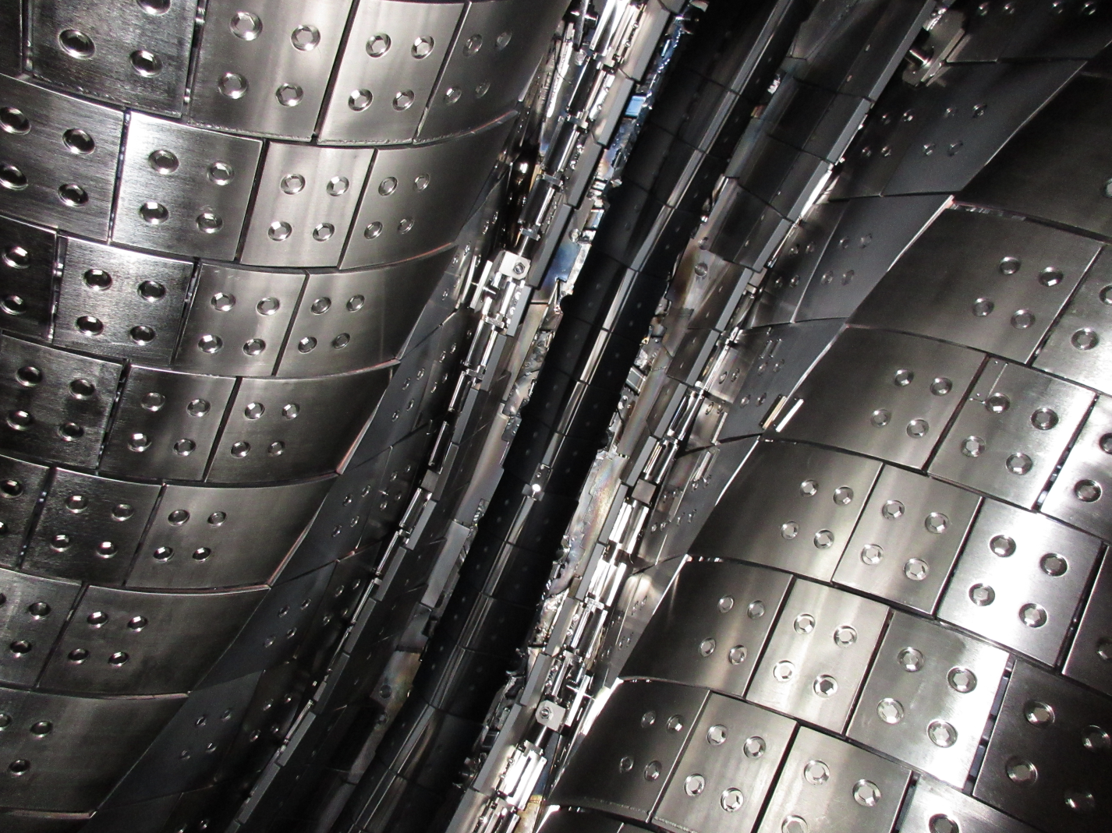
Helical divertor in LHD
Fully closed, not pumped.
Works in the inboard shifted
Configuration only
Divertor slit in front
Of the 8i

Slide 4
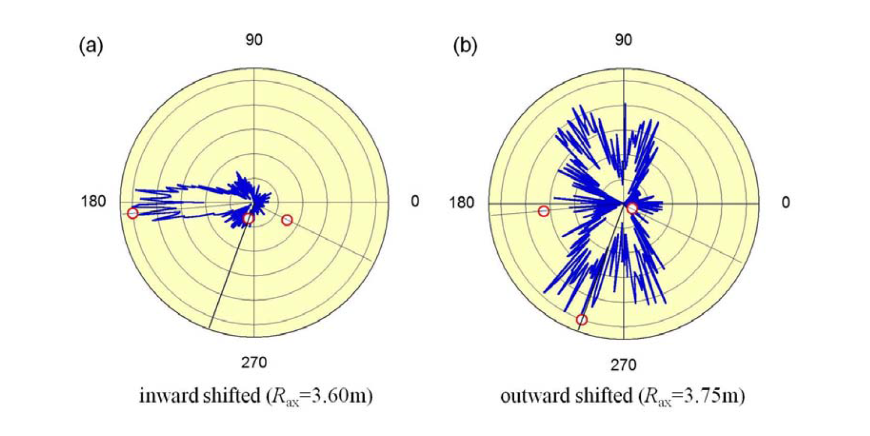
Pressure gauge positions
Morisaki et al. First results of closed
helical divertor experiment in LHD
8.5U
9kura
8I

Slide 5
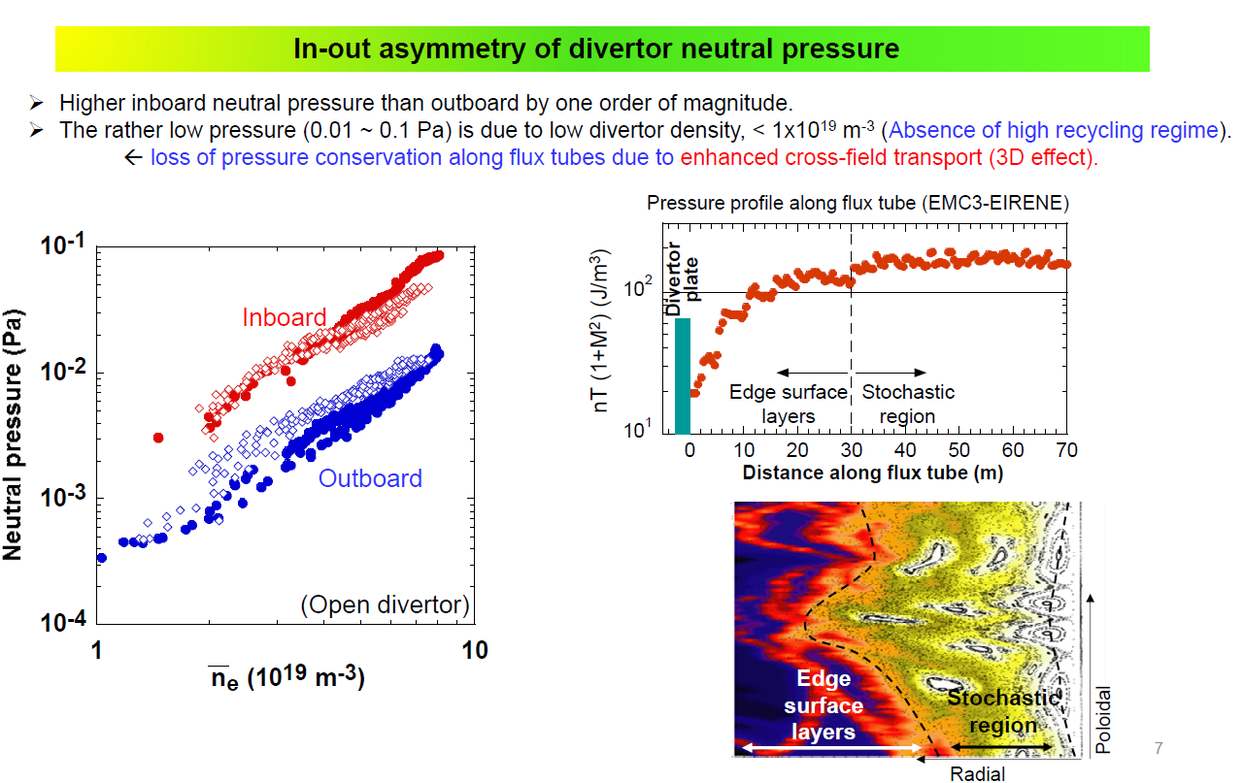

Slide 6
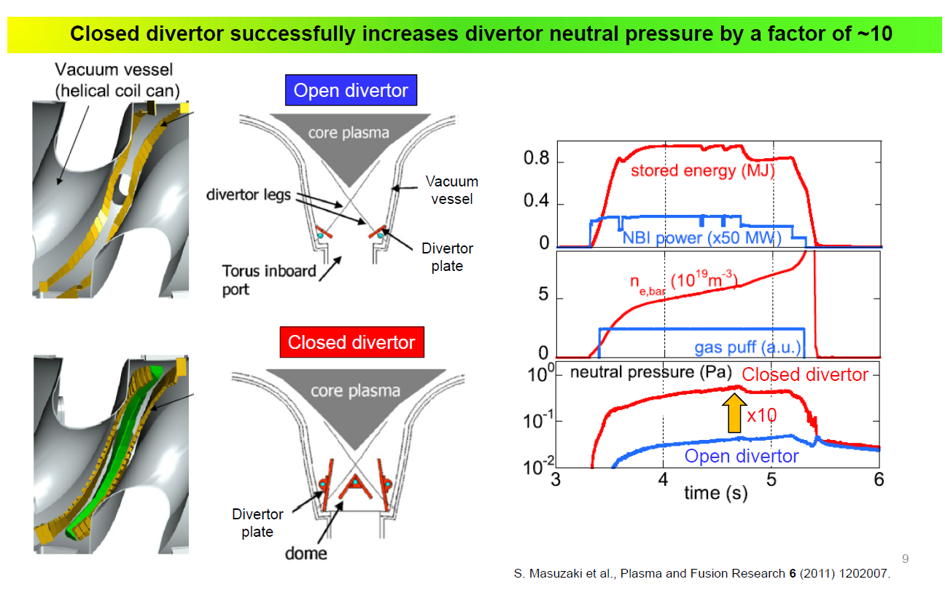

Slide 7
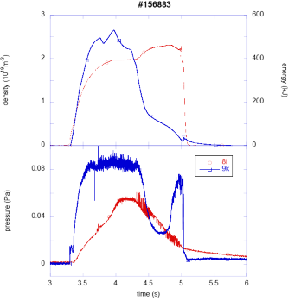
LHD 156883 – 2 LaB6 pressure gauges are operational
ne = 2e19 m-3
The pressure in 9k follows the
density and the energy Wdia
Particle confinement
P is in the 10⁻⁴ mbar range
Delay between 9k and 8i
of almost 1 s
Recombination
peak

Slide 8
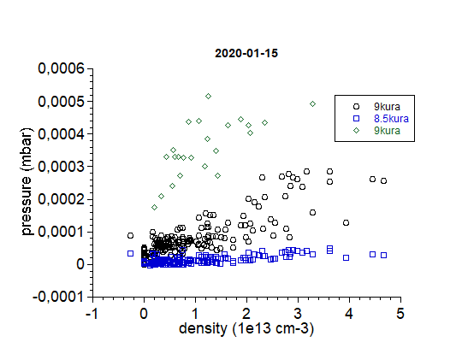
Data Set 2020-01-15 - All Pressures over Density
Reduced
data
set
High pressure in 9kura
is unexpected!
Will not be used as a reference
for the in vessel pressure
Instead 8.5u position will be used
which is in the vessel on top
9kura
8i
8.5u

Slide 9
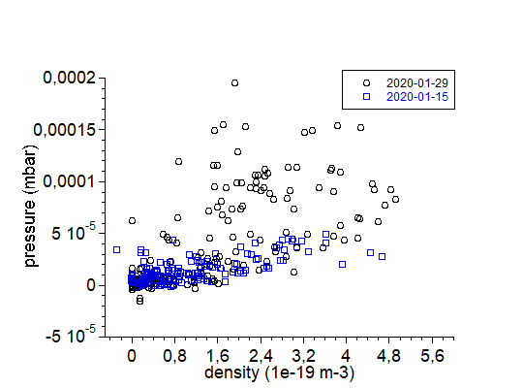
Comparison of 8.5u position from 2020-01-15 and 2020-01-29
Do not use 9kura, but 8.5u
2020-01-29 large scatter
3 data sets
Outward shifted cryopump on
Inward shifted cryopump on
Inward shifted cryopump off
On 2020-01-15 in-vessel
pressure follows density

Slide 10
Data Set 2020-01-29 - Divertor Pressure 8i over Density
Outward shifted config. p_{div} saturates
Inward shifted config. p_{div} ~ n_{e}

Slide 11
Data Set 2020-01-29 – In-Vessel Pressures over Density
Outboard shifted configuration pressure increases (it is more isotropic)

Slide 12
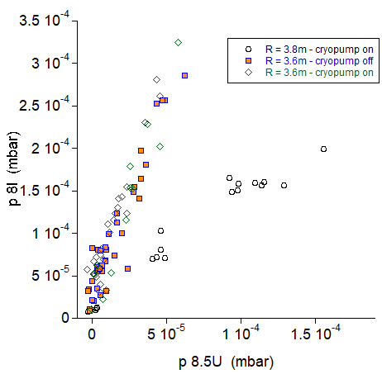
Data Set 20-01-29 – correlation p 8.5U – p 8i - compression
R= 3.6m inboard shifted
Neutral compression about 6
R= 3.8m outboard shifted
No neutral compression
No influence of cryo pumping on
the neutral compression in the
inboard shifted configuration

Slide 13
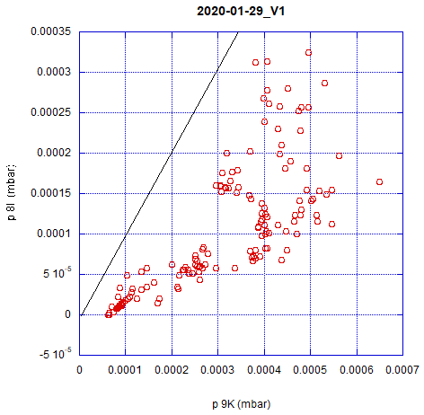
Data Set 20-01-29 – Correlation Divertor-Outboard Pressures
Compression
>1
Divertor pressure 8i is always smaller
Particle source from the 9kura position is not „seen“ by the divertor in 8i position.
Compression
< 1

Slide 14
Summary
Both LaB6 pressure gauges are functional. We got some information about the performance with neutrons → Victorias master thesis.
Results
Outboard pressure (9kura position) is very high – was not used up to now because it contradicts modeling
Neutral compression is typically 6 in the inward shifted configuration when related to the pressure on top, no influence of the cryopumps on neutral compression in the data set 2020-01-2
Influence of magnetic configuration:
Lower in-vessel pressure in the inboard shifted configuration (reasonable)
Higher neutral compression in the inboard shifted configuration (about 6) compared to the outboard shifted configuration (no significant compression)

Slide 15
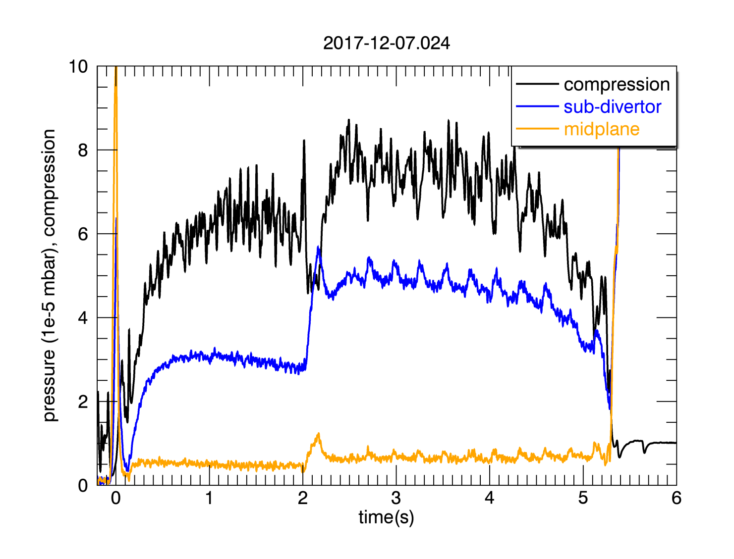
Comparison to W7-X
Similar maximum divertor pressures of 2e-3 mbar obtained in W7-X and in LHD → exhaust would be similar
The neutral compression of 6 in the inward shifted configuration in LHD is comparable to W7-X OP1.2a
In general in LHD the pressure in the vacuum vessel is higher to W7-X → lower compression ratios in LHD.
LHD -- 2020-01-29
P 8.5U 4e-5 mbar
P 8i 2.5-e4 mbar

