Slide 1
Briefing
PSD Management Meeting
M. Wischmeier
Plasma Science for ITER, DEMO and stellarators department → PSD
3rd of September 2024

Slide 2
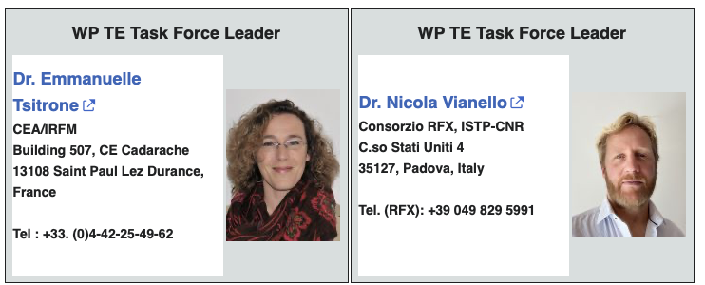
Welcome
Pending approval by GA
New TFLs for Work Package Tokamak Exploitation
Additional Deputy Task Force Leader is Dr. Valentin Igochine from IPP/MPG

Slide 3
Schedules
Cancel General PSD Management Meeting on September 17th – conflict with STAC VNS review
Bureau on September 13th in Lausanne
AWP Meeting for PSD: Monday, 7. October 2024 at 13:00 to Wednesday, 9. October 2024 at 12:00 in person for 2 TFLs + Jeronimo (for SA Experiment Team) and PLs; plan is to do this jointly with DSD → agenda is being drafted and hope to circulate it mid-September (AWP 2025 + possible topics on AI, TSVV activities and outlook by TFLs/PLs on priorities for 26/27 as input for discussion) – interest in organizing a social activity one evening (e.g. bowling?) – else we just organize dinners.
GA on 9/10th of October remote
PB on October 30th in person – proposed is a joint PB together with DSD – detailed agenda to be proposed
PSD-DCT meetings starting 4th of September and scheduled bi-weekly until end of 2024

Slide 4
Administrative
Analysing 2024 budget spending across WPs
AWP planning needs solid outlook for 2025 as we expect underspending across WPs for 2024; presently aware that mission budget for PWIE in 2025 is very critical
Reporting: analysing the level 3 and technical report reporting across work packages to homogenize the quality → aim is to provide a concise and meaningful reporting about activities that involve contributions by participants and reduce the number of level 3 reporting
PMU is also working on providing better guidelines for drafting resource loaded and non-resource loaded calls

Slide 5
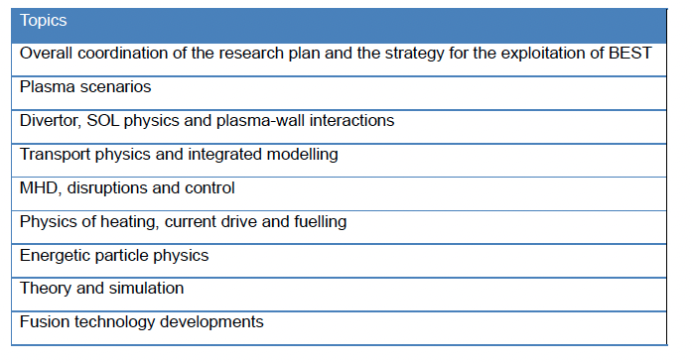
Call for Coordinators to develop joint Research Plan for BEST
The PLs and TFLs are welcome to propose candidates for the PSD department to contact

