Slide 1

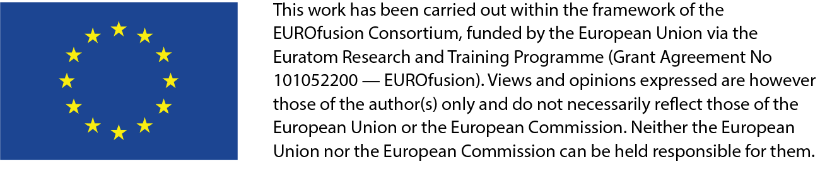
TSVV-5 regular VC,
30.08.2024
ModCR progress
D.V.Borodin et al.

Slide 2
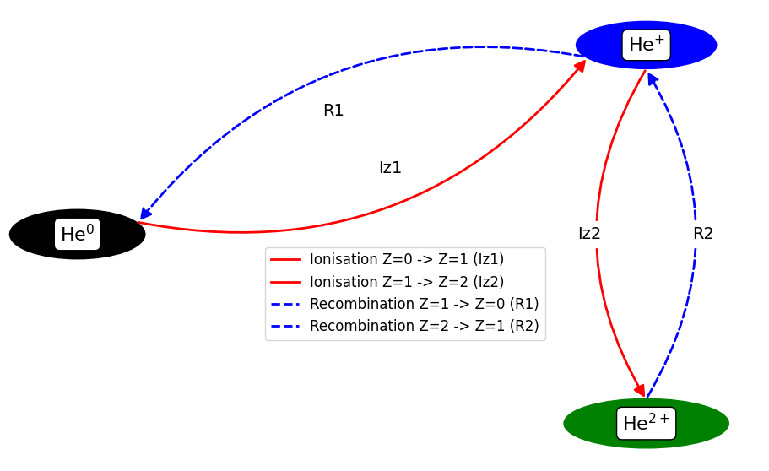
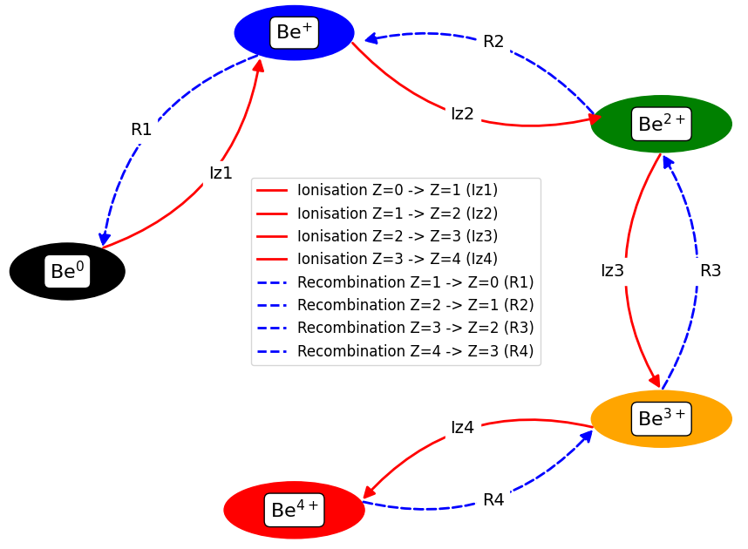
Trivial case – charge states in Be (and He?..)
He-like
He-like
MS
GS
MS
GS
MS
GS
Established ADAS’96 dataset (GCR) – adf11:
“scd”/”acd” – ionisation/recombination
“qcd”/”xcd” – quasi-MS cross-coupling
All linear – easy to compare with Ploutous, observable transition matrix

Slide 3
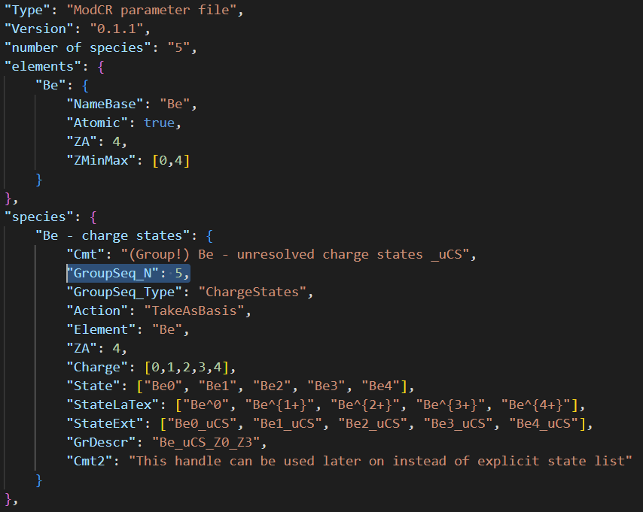
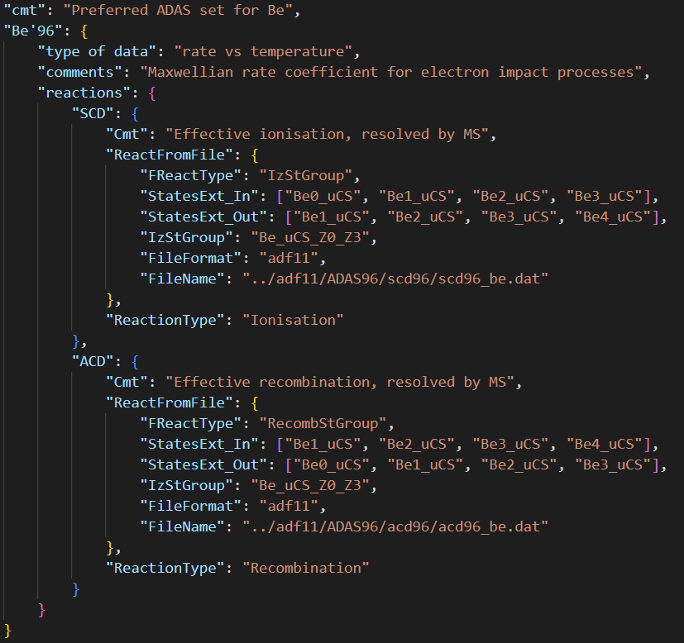
Input (json) of state sequences provided
States are read as INDIVIDUAL ones
(“GrDescr”) can be used later on as well…
➔ Nothing is “carved in stone”, format is evolving

Slide 4

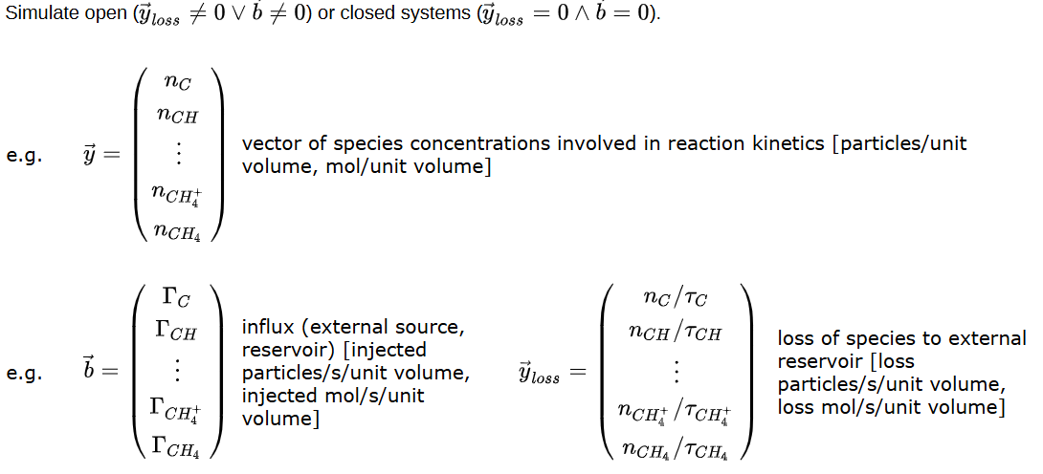
Ploutous solver math basis:
Master rate equation:
Collisional-Radiative Models Re-examined
P T Greenland, D Reiter
First published: 12 March 2007
https://doi.org/10.1002/ctpp.2150380146

Slide 5
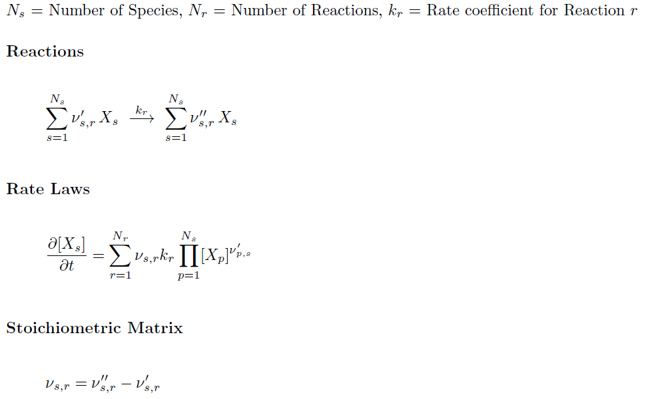
‘StoichioMatr’ approach
Reiser, D., von Keudell, A. & Urbanietz, T. Determining Chemical Reaction Systems in Plasma-Assisted Conversion of Methane Using Genetic Algorithms. Plasma Chem Plasma Process 41, 793–813 (2021). https://doi.org/10.1007/s11090-021-10159-6
Very good fits with the Ploutous-like CRM files
General and abstract (no problem to treat e, p, e-e etc. driven transitions inside single matrix – “reservoirs”)
  Abstractisation of reactions in the main loop of EIRENE is one of the ModCR goals
  “ModCol”-like reaction types (branching…) can be spared
Extra step with “StoichioMatr’” will allow keeping the basic database on particular solver run (can be several even by single ModCR start)
No linearity is implied

Slide 6
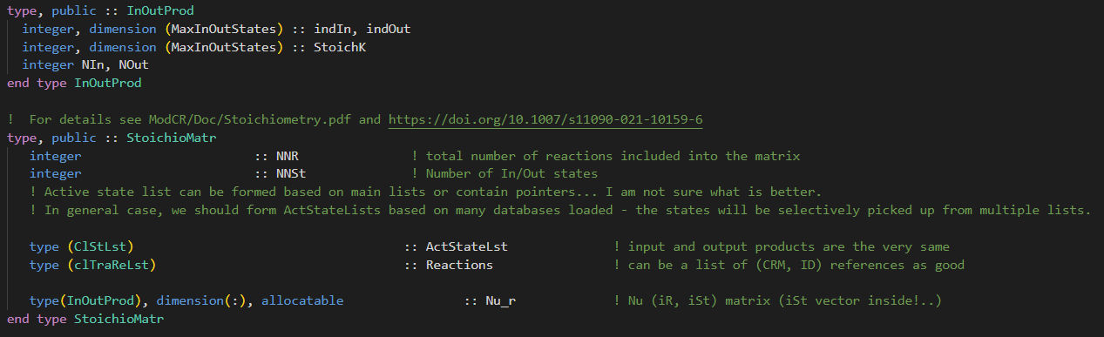
Significant development since May this year:
Huw Leggate:
CI provided (just GNU for now), already proved itself to be really useful
  → iFort is needed, more tests should come with alongside further code evolvement
Reorganised species/states types, provided 2D interpolation, reading of adf11 with proper allocation etc.
Provided new fancy error handling and logging (“report” subroutine)
Dmitriy Borodin:
Reorganised ADAS DB, added ’96 adf11 data
In progress: conception and incorporating the stoichiometric matrix approach

Slide 7
Thanks for the attention!

Slide 8
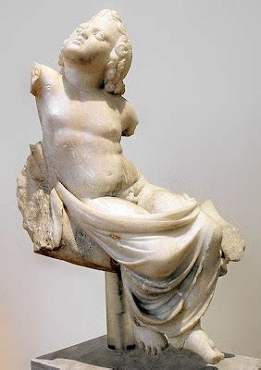
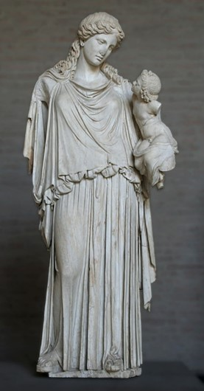
PLOUTOS can be used to
www.eirene.de
to import/export data (JSON, tabular, etc.)
to produce input data for EIRENE and for other codes with CRMs
  ➔ load/improve/save the developed configuration (selected reactions and parameters) including starting from the standard pre-sets
to check data for consistency and abnormal features
do sensitivity studies:
  ➔ understand A&M side of the problem and identify the most significant processes (among the selected ones)
Table contain data sources and type(s), ”generation”,
➔ TBC: the use cases references (e.g. ITER SimDB).
Both statues are at
Glyptothek, Munich.
EIRENE

Slide 9
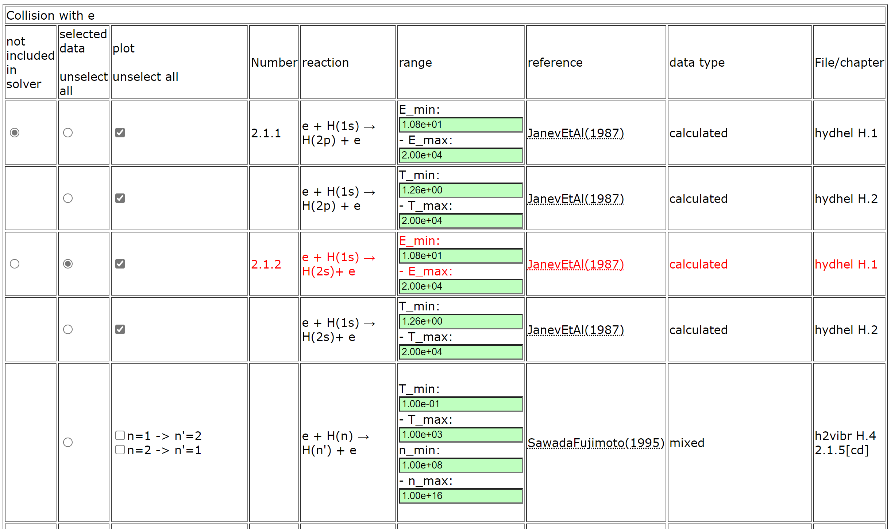
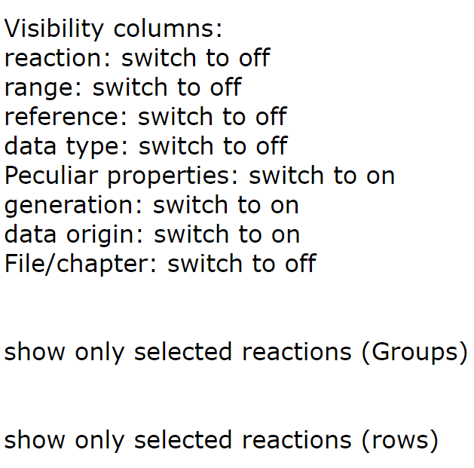
PLOUTOS – (H₂ 2022/23 case)
Buttons to adjust table content

Slide 10
Molecular-assisted recombination (MAR)
CX-DR chain (MAR):
p+H₂(v=4) → H + H₂⁺
e+H₂⁺ → H* + H
Significant role in low temperature plasmas: divertors, detached regimes, linear plasma devices
Requires sophisticated molecular models (e.g. resolved by vibrational states v)
Other processes like MAD(dissociation) compete…

Slide 11
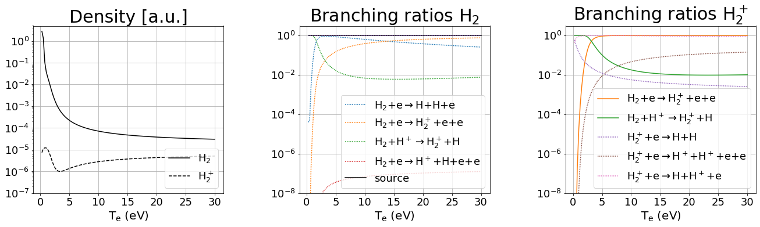
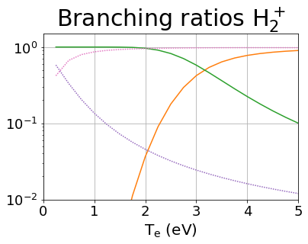
CRM FOR MOLECULES: leading reactions
EU-DEMO
low temperature (T < 2eV) leading reaction chains:
MAD
MAR/MAD competition at very low temperature
H₂+H⁺→ H₂⁺+H H₂⁺+e → H+H⁺+e
H₂+H⁺→ H₂⁺+H H₂⁺+e → H+H
MAR

Slide 12
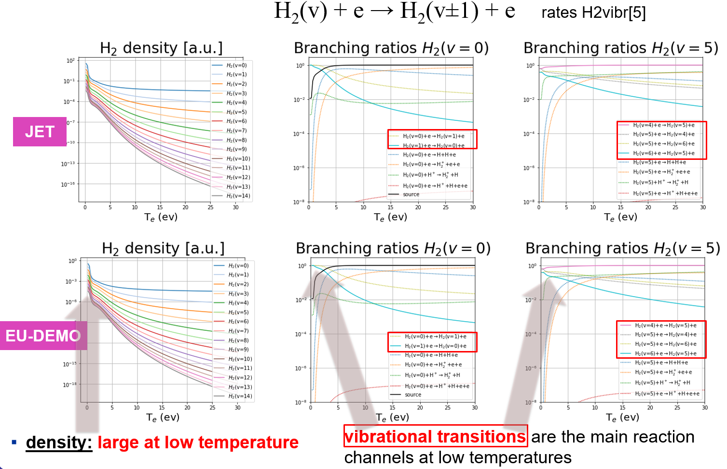
Effect of resolution by vibrostates
F.Cianfrani et al.,
EPS-2022
Fully in line with the EIRENE and other CRMs:
“Up to 40% reduction in effective dissociation rate due to transport of vibrational states”
A.Holm, M.Groth, et al.,
PET, CPP 2021

Slide 13
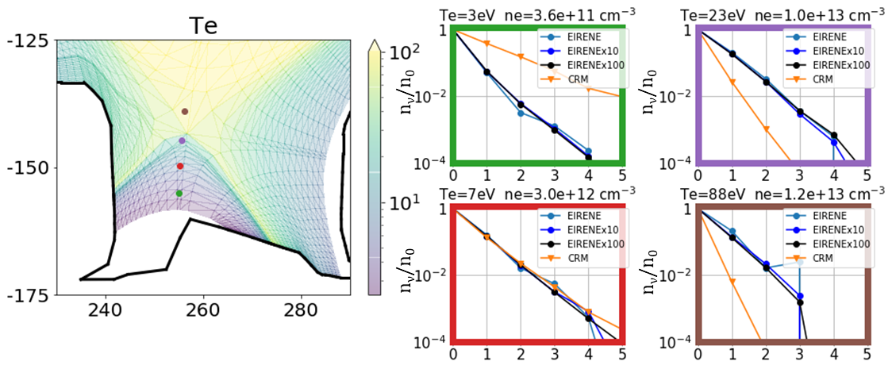
Standalone CRM vs EIRENE (statistic issues)
Standalone CRM
→ overestimates at low temperature
→ underestimates at large temperature
the excited state population
SOURCE H₂(v=0)
EIRENE: 793’300 histories
EIRENEx10: 7’933’000 histories
EIRENEx100: 79’330’000 hist.

Slide 14
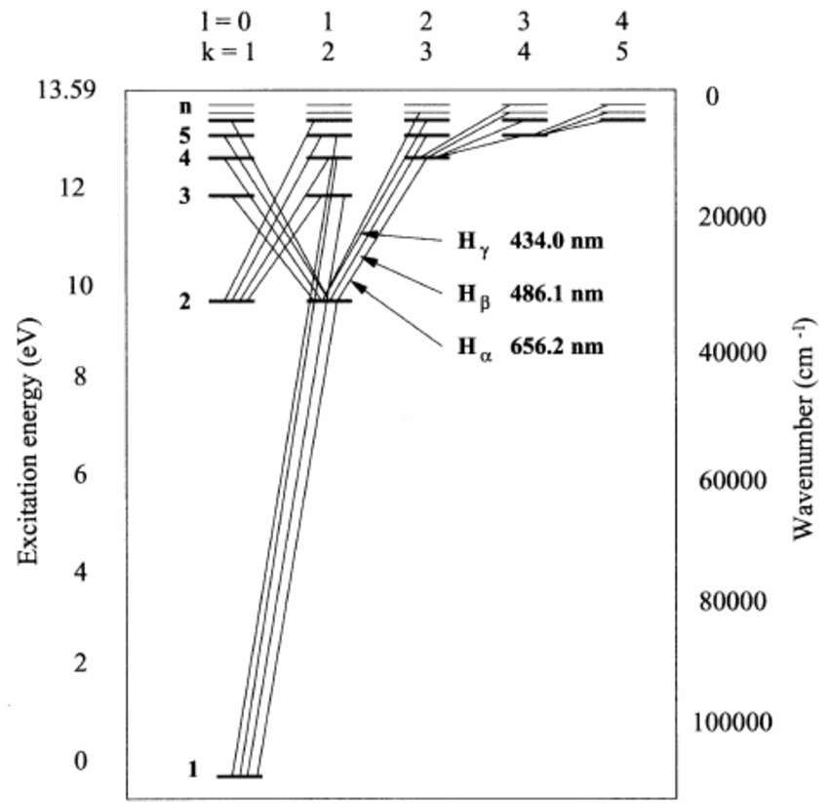
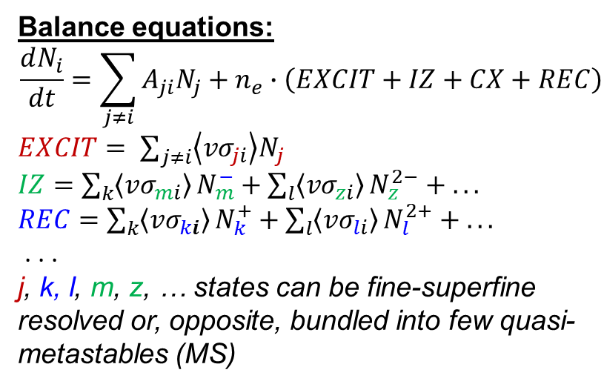
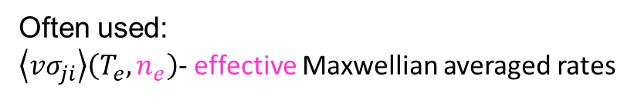
Collisional-Radiative Models (CRM)
Grotrian diagram for atomic H (D, T)
Balance equations:
$$\frac{dN_{i}}{dt}=\sum_{j≠i}{A_{ji}N_{j}}+n_{e}∙\left(EXCIT+IZ+CX+REC\right)$$
$EXCIT= \sum_{j≠i}{\left\langle {vσ}_{ji}\right\rangle N_{j}}$
$IZ=\sum_{k}{\left\langle {vσ}_{mi}\right\rangle }N_{m}^{−}+\sum_{l}{\left\langle {vσ}_{zi}\right\rangle }N_{z}^{2−}$ $+ . . .$
$REC=\sum_{k}{\left\langle {vσ}_{ki}\right\rangle }N_{k}^{+}+\sum_{l}{\left\langle {vσ}_{li}\right\rangle }N_{l}^{2+}$ $+ . . .$
. . .
j, k, l, m, z, … states can be fine-superfine resolved or, opposite, bundled into few quasi-metastables (MS)
Ry=13.6eV
CRM = list of states + transition data
Often used:
$\left\langle {vσ}_{ji}\right\rangle \left(T_{e},n_{e}\right)$- effective Maxwellian averaged rates

Slide 15
CRM solvers available
CRM (technically) = reaction data + SOLVER
$$\frac{dN_{i}}{dt}=0$$
Most solvers solve algebraic stationary system of equations
The solver is often much less valuable than the A&M data collection
this statement is underlined even by the developers of the very well established and mostly up-to-date YACORA model
For transport modelling like EIRENE, solver do matters!
CRM containing molecular species is even more complex, e.g. one needs to track more processes and more states (vibrational, rotational).
EIRENE pre-calculates rates for each volume cell (e.g. for various T_{i}/T_{e} ratios).
D.Wünderlich and U.Fantz,
Atoms 2016, 4(4), 26

Slide 16
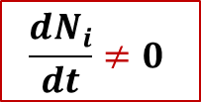
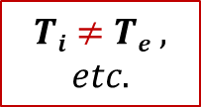

New CRM Solver for EIRENE concepted
This CRM is aimed to precompute rate coefficients accounting for all parametric dependences (n_{e}, T_{e}, but also T_{i}, …) in contrast with currently used polynomial fits (AMJUEL, …) + add a number of levels/processes not accounted for at this time
The internal states (e.g. rovibrational states in molecular species) are to be tracked with a flexible a flexible control over this resolution (as separate specie or variable).
The nonstationary solution for balance equations should be the default one
(with the stationary only as a useful option).
The solver should be modular, thus usable standalone or even in various codes.
The improved A&M data input should be readable and structured (for starters JSON, potentially also HDF5). It should be pre-processed mostly automatic and easily exchanged with other codes and tools. We need tools for visualisation and testing.
  The only way to meet the exploding amounts of data from RMPS and CCC for molecules (with resolution by rovibrational states)
  IAEA GNAMPP assists, but also reveals the challenges
$$Ti≠Te ,$$
$$etc.$$
$$\frac{dN_{i}}{dt}≠0$$
$$Why not$$
$$also ERO?..$$
Not only performance and reliability to be improved, but additional physics can be provided!

Slide 17
Transport code variations and commons: CRMs
Property | EIRENE | ERO, ERO2.0
Ab initio | Yes (iterations with fluid code, e.g. with B2.5 → “SOLPS-ITER”) | No, test-particle approximation on a given plasma BG (e.g. from SOLPS)
Gyro-motion | Guiding centre approximation | Full-resolved, detailed 3D wall elements, surface sheath
Plasma-wall interaction | Less detailed locally, often no 3D | More detailed: 3D, sheath, etc.
PWI impact on plasma | Yes, also “advanced fluid neutrals”, “wall reservoirs” etc. | In general NO (certain effects were introduced…)
Both approaches have clear advantages and range of appropriate tasks, both packages are highly demanded by ITER, EU-DEMO and other fusion-relevant devices!
➔ Moreover, they often support each other (plasma BGs from various CFD-EIRENE used and tested in ERO)
However, the subtasks for treatment of atomic and molecular processes in plasma are very similar!
Break-up of the molecular species in plasma
Ionisation and other processes affecting charge and energy, thus transport
Synthetic spectroscopy for comparison with diagnostics
Similar A&M process treatment challenges!

Slide 18
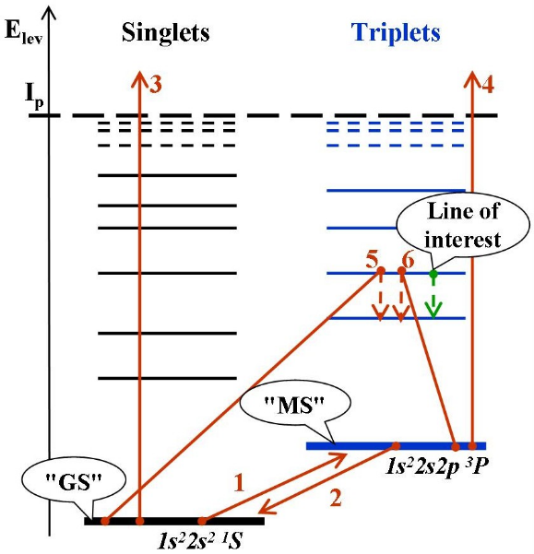
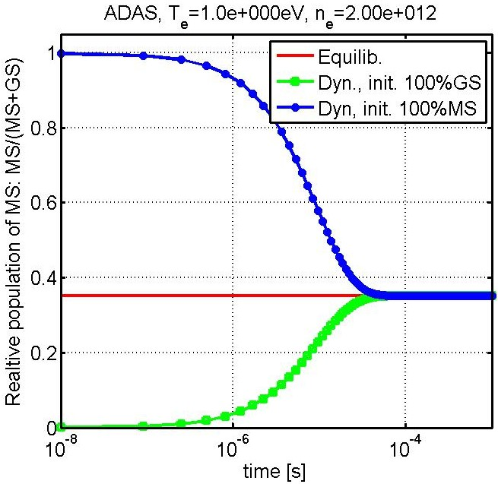
MS-effect for BeI (“generalised” MS 10⁻⁴s)
The system of 2 balance equations can be solved analytically . . .
ADAS, T_{e}=1eV, n_{e}=2*10¹²cm⁻³
Effective rates:
1,2) transitions <Ex..> between "GS" and "MS"
3,4) ionizations <Iz..> from "GS" and "MS"
5,6) line intensity (PEC – photon emission coefficient), contributions from "GS" and "MS"
MS-population tracking was introduced into ERO and demonstrated to be of significance by applications to PISCES-B, PSI-2 and JET-ILW (neutral Be, He, W)
For WI dedicated ADAS dataset was developed; various lower states bundling options (~10) tested etc.

Slide 19
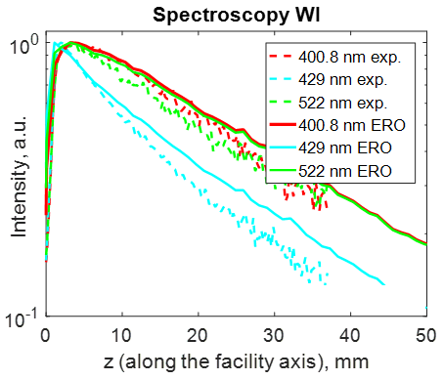
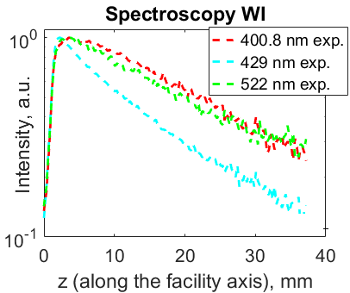
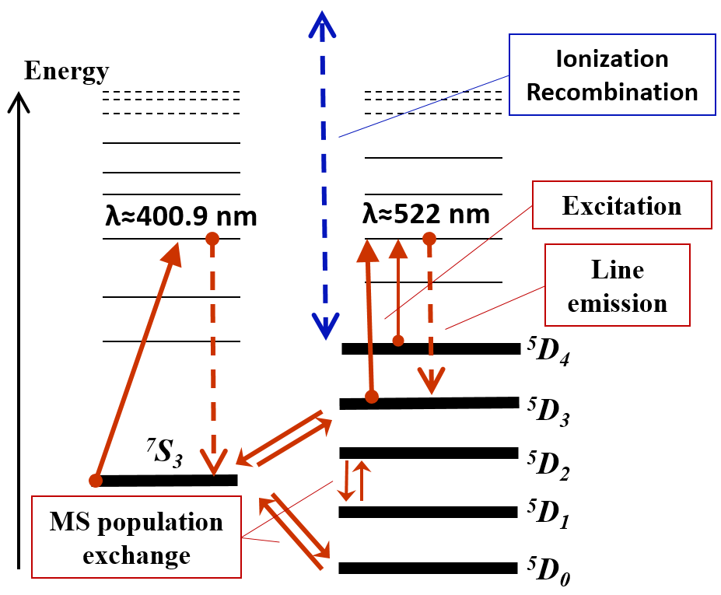


MS-effect for WI (PSI-2 linear plasma device, JET)
(PSI-2)
(PSI-2)
(PSI-2)
W⁰
line Intensity [a.u.]
line Intensity [a.u.]
ERO:
λ = 400, 429, 522 nm
Ar → W
target
Ar → W
target
Multiple options for state bundling are worth considering
Test in tokamak (JET ITER-like Wall): MS tracking reduces simulated line intensity by x1.7!
Dedicated ADAS’18 dataset
A.Eksaeva PhD-thesis, 2020

Slide 20
ModCR interaction with EIRENE and other tools
YACORA
EIRENE
CRM condensing
(“ColRad”)
Interface
Standalone
EIRENE
Main loop
(“folneout”)
ModCR
Ploutos
ModCR
Flexible input files (JSON)
EIRENE
Post-processing
(spectroscopy, etc)
Data sources
MCCC, R-matrix, …

Slide 21

ModCR flow chat (standalone)
Input file (JSON)
CRM
Species
States
Transitions
Settings
New input
file (JSON)
Ploutos
Output file1
(JSON)
CRMs
Output file X
Tasks
Solver(s)
Task
Manipulate CRM
Analyse CRM
Solve (set of) case(s)
Produce output
Stationary
Dynamic
Analysis

Slide 22
Pipelenes of CRMs
ModCR
ModCR
Pick up +
combine
Pick up +
combine
CRMs
(JSON)
CRMs
(JSON)
CRMs
…
Analyse (eigenvec.)
Analyse (eigenvec.)
Test +
correct
Test +
correct
Ploutos
Alternatives!
Peculiar data, processes, assumptions
SA CRM
Solver
Data sources
AMJuel,
MCCC, R-matrix,
…
Branching ratios, S/XBs
Other practical data

Slide 23

New code (also library for EIRENE): “ModCR”
Should provide BOTH standalone and build-in CRM for EIRENE
  Therefore written in modern Fortran
  Linked with Ploutos (uses the same JSON files for I/O)
  Non-stationary approach utilising up-to-date Sundails solver (CVODE++) for stiff ODE systems (algebraic stationary option also available for control)
The whole specie-state and reaction basis is inside, however the code should form the list of “active states”
  Provide different resolution on states being tracked
  Provide flexible border for tracking of MC species and internal state populations as variables
  Provide data processing pipe lines (easy to reproduce with updates)
All functionality available in EIRENE (e.g, photon tracing) must be preserved!
The code should be modular (library, API) for use in EIRENE, EIRON (toy model for parallelisation), ERO…
This
is unique and justifies creation of the new code

