Slide 1

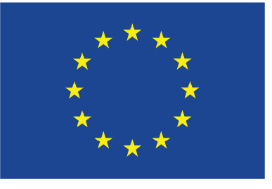
Meeting on unified A&M data policies,
25-27 Nov, 2024 in FZ Jülich
A&M Data in EIRENE, dedicated tools PLOUTOS and ModCR
D. Borodin¹, H.J. Leggate², J. Romazanov¹, T. Dittmar¹, X. Bonnin³, M.Groth⁴, R.Chandra⁴, Y.Marandet⁵, D.Harting¹, D.Reiser¹, S.Brezinsek¹
¹Forschungszentrum Jülich
GmbH, Germany
²Dublin City University, Ireland
³ITER Organization, France
⁴Aalto University, Finland
⁵Aix-Marseille Univ., France
This work has been carried out within the framework of the EUROfusion Consortium, funded by the European Union via the Euratom Research and Training Programme (Grant Agreement No 101052200 — EUROfusion). Views and opinions expressed are however those of the author(s) only and do not necessarily reflect those of the European Union or the European Commission, neither of the ITER organisation. Neither the European Union nor the European Commission can be held responsible for them.

Slide 2
Outline
Introduction to EIRENE Monte-Carlo (MC) multispecies transport solver:
➔ role of A&M data and associated tools
MC challenges (statistics) and ODE solution alternative:
➔ Balance equations, collisional-radiative models (CRM)
➔ Non-stationary effects e.g. metastables (MS)
New kinetic module under development – “ModCR”
➔ Can be used both, standalone and inside EIRENE
Physics learned from standalone CRMs
➔ Significance of vibrational states
➔ Detachment characterisation with spectroscopy
Summary and conclusions

Slide 3
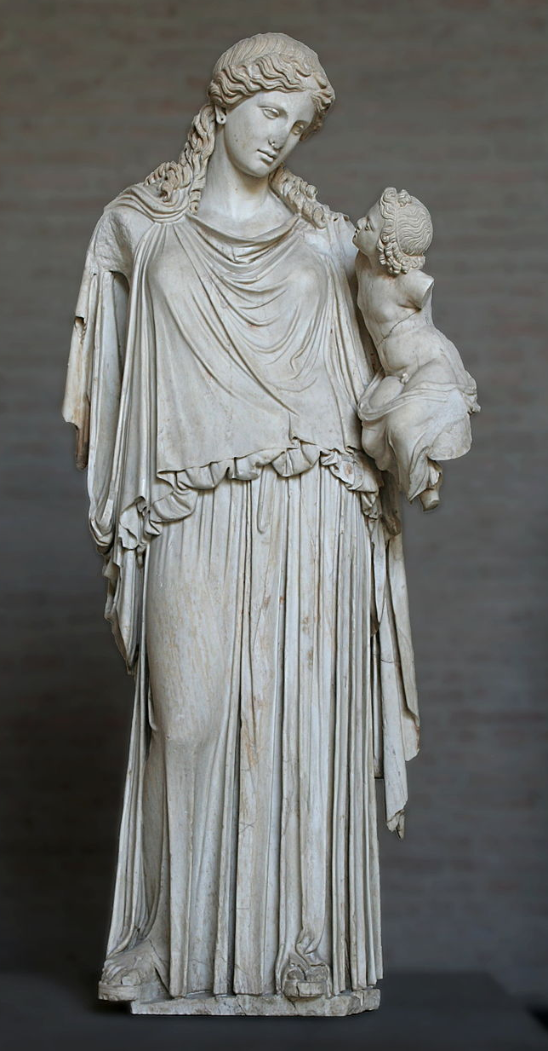
The EIRENE MC code: related packages and tools
EIRENE code (PLOUTOS and other tools) http://www.eirene.de/
FZJ is EIRENE origin, however fluid side of EIRENE-CFD packages often are developed elsewhere, e.g.:
2D SOLPS-ITER (B2.5-EIRENE)
3D EMC3-EIRENE
SOLEdge3X-EIRENE (with turbulence)
- many others …
Eirene with the infant Ploutos
Statue by Cephisodotus the Elder
Glyptothek, Munich.
The atomic/molecular data accumulations were for decades supported by IAEA
Hydhel, H2Vibr, AMJuel, Hydkin - PLOUTOS (new)
ADAS (external)

Slide 4
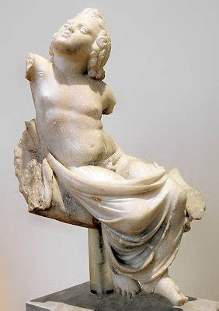
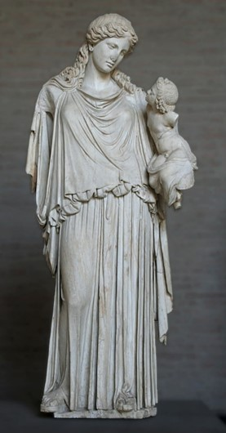
PLOUTOS can be used to
www.eirene.de
to import/export data (JSON, tabular, etc.)
to produce input data for EIRENE and for other codes with CRMs
  ➔ load/improve/save the developed configuration (selected reactions and parameters) including starting from the standard pre-sets
to check data for consistency and abnormal features
do sensitivity studies:
  ➔ understand A&M side of the problem and identify the most significant processes (among the selected ones)
The table contains data sources and type(s), ”generation”, other info …
➔ we plan adding simulation case references.
Both statues are at
Glyptothek, Munich.
EIRENE

Slide 5
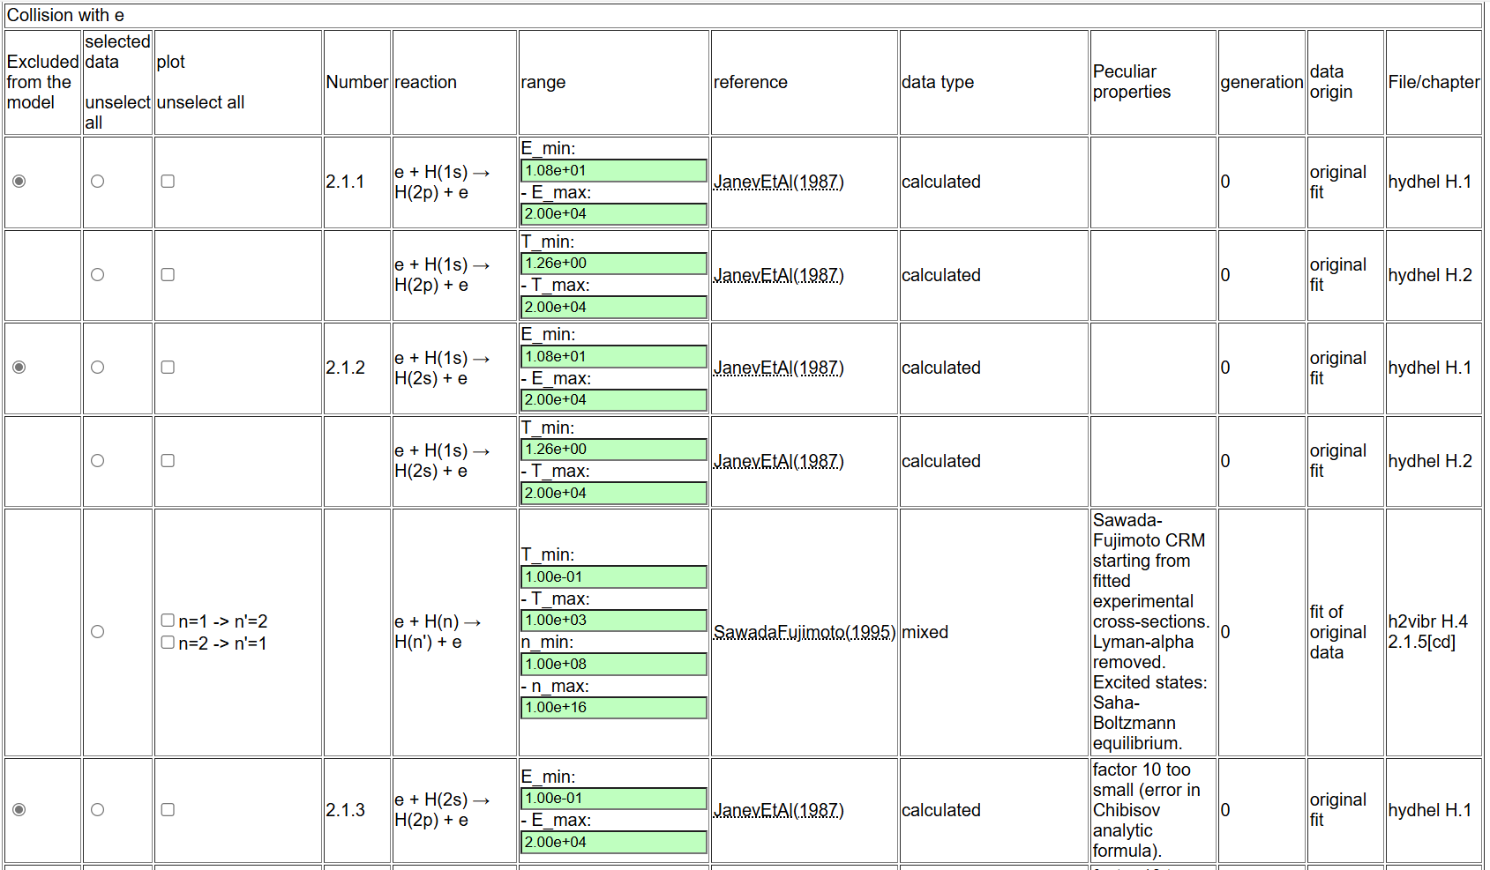
Technical solutions in Ploutos - 1
All columns can be turned on/off
Reactions grouped by types
Rows: one can turn on/off only selected for the CRM

Slide 6
Technical solutions in Ploutos - 2
All the data is based on the same human-readable files (JSON-based Ploutos format)
  We need to go on “JSON schema” for proper comments.
  We exploit the opportunities of the web-interface including providing solver and routine plotting.
  Populating of the data is not really progressing due to manpower availability.
Publication references are JSON file – updateable in 1 go, single information locations, Git-versioned. Links in documentation, website, Ploutos data – all are linked to the same file.
One can use a set of standard “pre-sets” for CRMs or even develop an own one. Each CRM is a file, which can be used a base for further modifications.
  The users are often focussed on rather not massive, but critical from physics database variations.
  We need to document and assess sensitivity of any significant changes. ➔ “data generations”.
The data contain clear references to the sources, data types (several categories) and “generation”.
  Generation is a set of declared quality standards (always growing!)
  Versioning (Git) is parallel to “generation”.
  We will mostly have data of various generations in the system.
  Having single generation for all of e.g. Ploutos data or its subgroups is a hard compromise… for now probably best to keep “for each particular data set”.

Slide 7
EIRENE: collisional-radiative model (CRM) challenges
EIRENE often uses effective (“condensed”) rates tabulated from a CRM.
isotopes: D₂, T₂, H₂, DT, HD, …, Be-H/D/T, N-xxx, …
vibrational (and rotational) states in molecules
treating non-stationary effects e.g. metastables (MS) in atoms (e.g. He)
improving performance for simulations on ITER/DEMO scales
facilitate UQ and design with EIRENE
control the exploding amounts of data

Slide 8
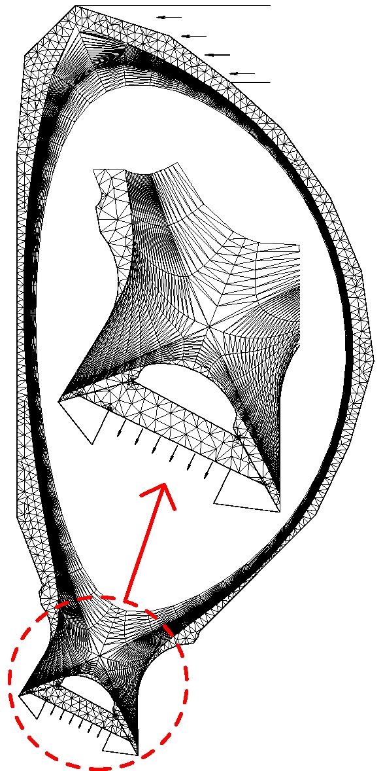
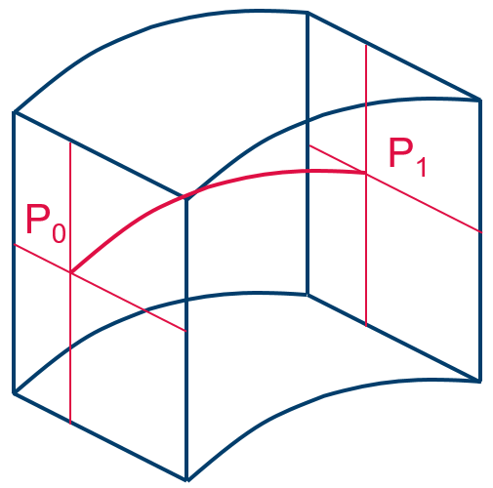
What is EIRENE in a nutshell (e.g. in SOLPS)?..
Macroscopic:
Microscopic:
Plasma flow parameters
EIRENE-NGM: a 3D3v MC multi-species transport code incl. radiation transfer, kinetic
or F-K hybrid.
CFD codes (computational fluid dynamic):
B2, Edge2D, EMC3, SOLEdge3X, etc…
3D EIRENE volume cell
2D or 3D Volume grid (e.g. tetraeder) adopted for current magnetic configuration
CRMs
(HYDKIN, AMJUEL, ADAS, …)
for atomic and molecular neutrals H,H*,H₂,H₂(v),H₂*,H⁻,H₂⁺,…, impurities
Ionisation, CX, recombination etc.
Source terms (Particle, Momentum, Energy)
Photon tracing
opacity, extra ionisation, ….
R.Chandra et al., EPS-2023

Slide 9
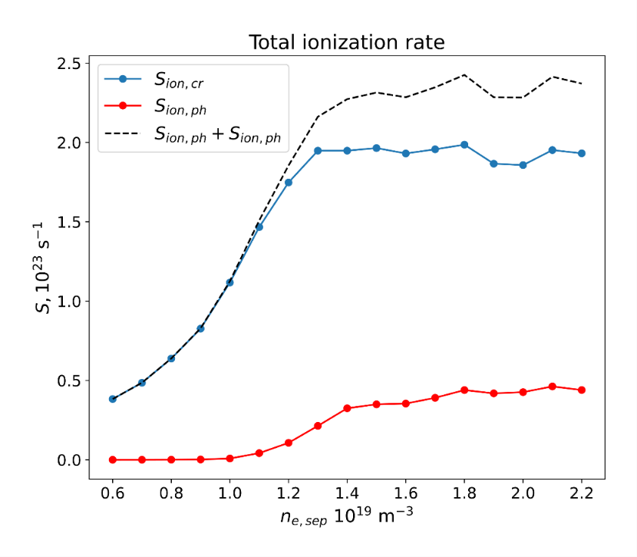
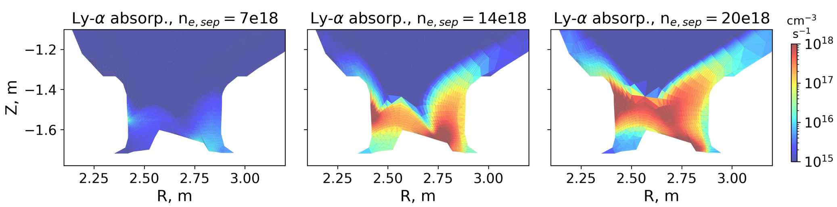
Ly-α and Ly-β opacity – D ionisation
Photon absorption adds up to ~20% of total CR ionization rate in detached conditions
‘Extra’ ionization contribution from
Ly-α and Ly- β photon absorption:
increases population of excited D neutrals
extra ionisation
R. Chandra et al.
EPS 2023 P1-001

Slide 10
Outline
Introduction to EIRENE Monte-Carlo (MC) multispecies transport solver:
➔ role of A&M data and associated tools
MC challenges (statistics) and ODE solution alternative:
➔ Balance equations, collisional-radiative models (CRM)
➔ Non-stationary effects e.g. metastables (MS)
New kinetic module under development – “ModCR”
➔ Can be used both, standalone and inside EIRENE
Physics learned from standalone CRMs
➔ Significance of vibrational states
➔ Detachment characterisation with spectroscopy
Summary and conclusions

Slide 11
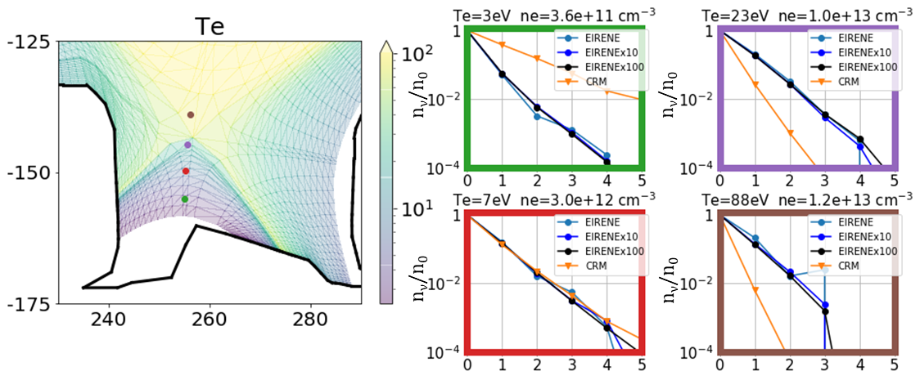
Standalone CRM vs EIRENE (statistic issues)
?
?!.
Standalone CRM
→ overestimates at low temperature
→ underestimates at large temperature
the excited state population
?
SOURCE H₂(v=0)
EIRENE: 793’300 histories
EIRENEx10: 7’933’000 histories
EIRENEx100: 79’330’000 hist.

Slide 12
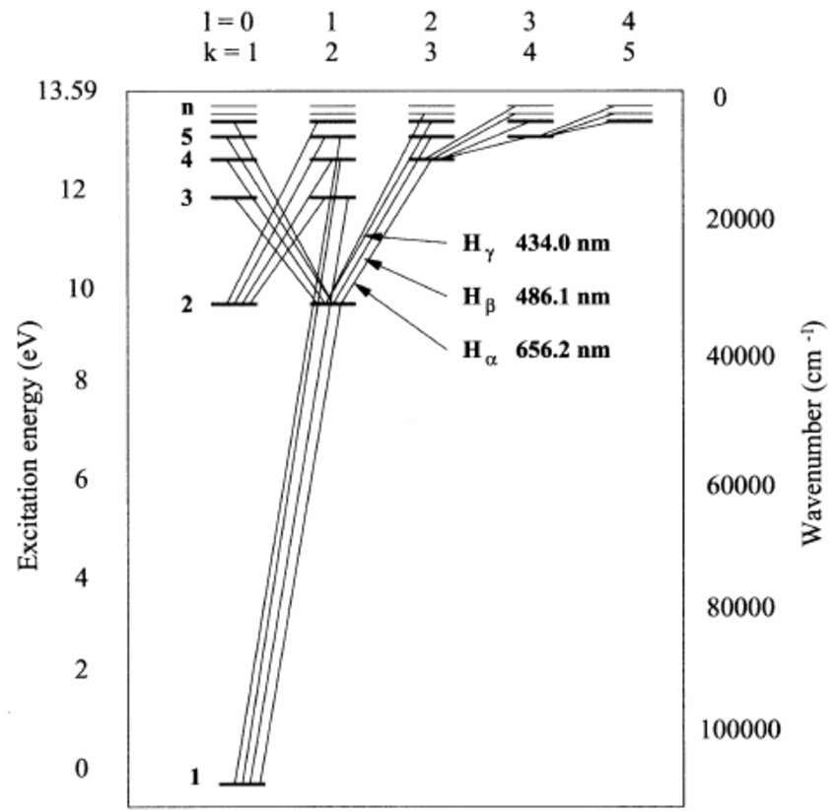
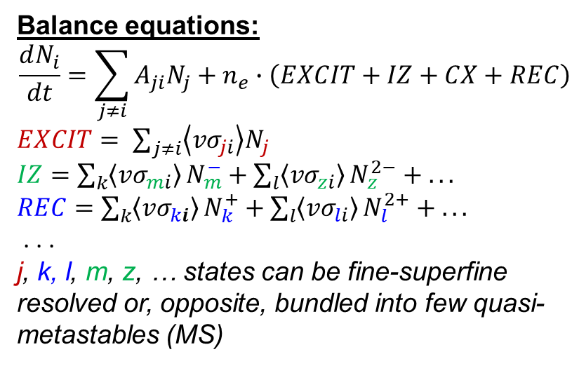
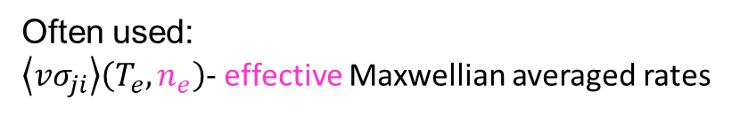
Collisional-Radiative Models (CRM)
Grotrian diagram for atomic H (D, T)
Balance equations:
$$\frac{dN_{i}}{dt}=\sum_{j≠i}{A_{ji}N_{j}}+n_{e}∙\left(EXCIT+IZ+CX+REC\right)$$
$EXCIT= \sum_{j≠i}{\left\langle {vσ}_{ji}\right\rangle N_{j}}$
$IZ=\sum_{k}{\left\langle {vσ}_{mi}\right\rangle }N_{m}^{−}+\sum_{l}{\left\langle {vσ}_{zi}\right\rangle }N_{z}^{2−}$ $+ . . .$
$REC=\sum_{k}{\left\langle {vσ}_{ki}\right\rangle }N_{k}^{+}+\sum_{l}{\left\langle {vσ}_{li}\right\rangle }N_{l}^{2+}$ $+ . . .$
. . .
j, k, l, m, z, … states can be fine-superfine resolved or, opposite, bundled into few quasi-metastables (MS)
Ry=13.6eV
CRM = list of states + transition data
Often used:
$\left\langle {vσ}_{ji}\right\rangle \left(T_{e},n_{e}\right)$- effective Maxwellian averaged rates

Slide 13
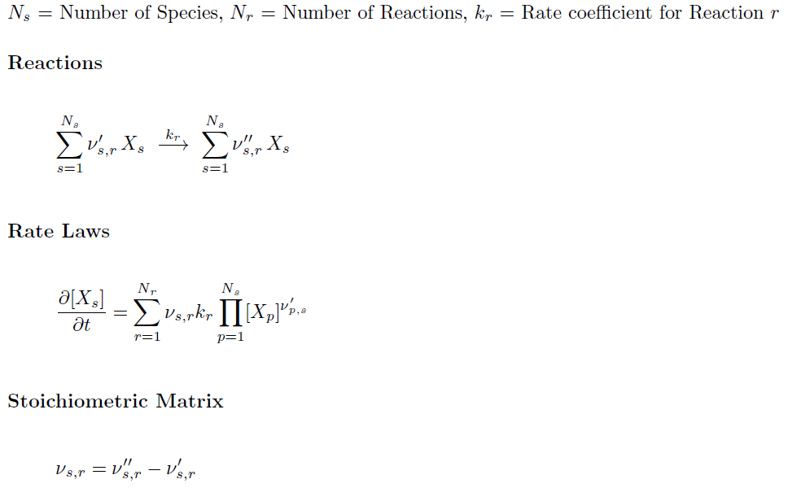
‘StoichioMatr’ approach
Reiser, D., von Keudell, A. & Urbanietz, T.
Determining Chemical Reaction Systems in Plasma-Assisted Conversion of Methane Using Genetic Algorithms.
Plasma Chem Plasma Process 41, 793–813 (2021).
Very good fits with the Ploutous-like CRM files
General and abstract (no problem to treat e, p, e-e etc. driven transitions inside single matrix – “reservoirs”)
  Abstractisation of reactions in the main loop of EIRENE is one of the ModCR goals. Aim: minimise branching by reaction type
Extra step with “StoichioMatr’” will allow keeping the basic database on particular solver run (can be several even by single ModCR start)
No linearity is implied

Slide 14
CRM solvers available
CRM (technically) = reaction data + SOLVER
$$\frac{dN_{i}}{dt}=0$$
Most solvers solve algebraic stationary system of equations
The A&M data collection is often main focus of development
Good example is well established and most up-to-date YACORA model
For sophisticated transport modelling like EIRENE, solver do matters!
CRM containing molecular species is even more complex, e.g. one needs to track more processes and more states (vibrational, rotational).
EIRENE pre-calculates rates for each volume cell (e.g. for various T_{i}/T_{e} ratios).
D.Wünderlich and U.Fantz,Atoms 2016, 4(4), 26

Slide 15
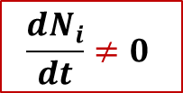
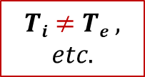

New CRM Solver for EIRENE concepted
This CRM is aimed to precompute rate coefficients accounting for all parametric dependences (n_{e}, T_{e}, but also T_{i}, …) in contrast with currently used polynomial fits (AMJUEL, …) + add a number of levels/processes not accounted for at this time
The internal states (e.g. rovibrational states in molecular species) are to be tracked with a flexible a flexible control over this resolution (as separate specie or variable).
The nonstationary solution for balance equations should be the default one
(with the stationary only as a useful option).
The solver should be modular, thus usable standalone or even in various codes.
The improved A&M data input (encapsulated data - JSON, potentially also HDF5). We need tools for visualisation and testing.
  Meet the exploding amounts of data for molecules
  (with resolution by rovibrational states)
$$Ti≠Te ,$$
$$etc.$$
$$\frac{dN_{i}}{dt}≠0$$
$$Why not$$
$$also ERO?..$$
Not only performance and reliability to be improved, but additional physics can be provided!
➔ For instance, what if detachment is caused by non-stationary effects?!..

Slide 16
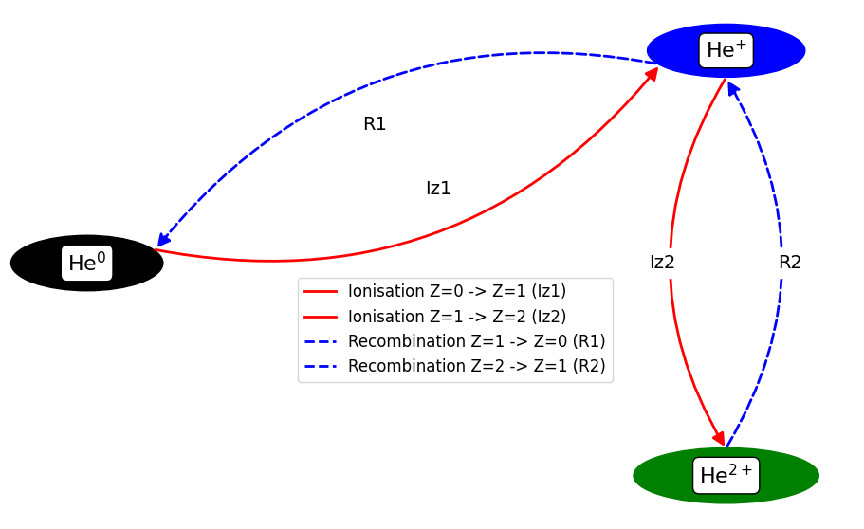
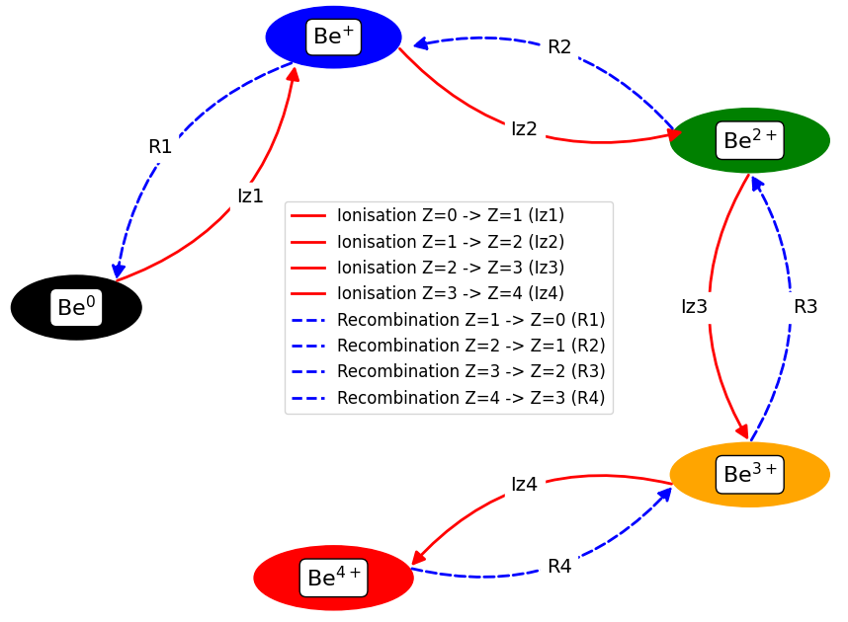
Trivial case – charge states in Be (and He?..)
Role of metastable (MS) states…
He-like
He-like
MS
GS
MS
GS
MS
GS
Established ADAS’96 dataset (GCR) – adf11:
“scd”/”acd” – ionisation/recombination
“qcd”/”xcd” – quasi-MS cross-coupling
All linear – easy to compare with Ploutous, observable transition matrix

Slide 17
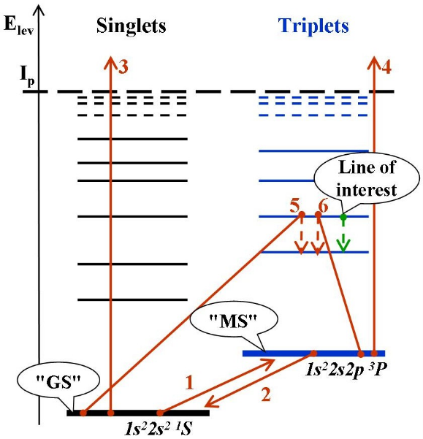
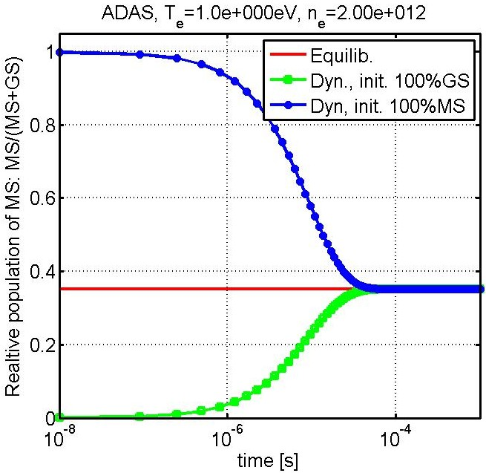
MS-effect for BeI (“generalised” MS 10⁻⁴s)
The system of 2 balance equations can be solved analytically . . .
ADAS, T_{e}=1eV, n_{e}=2*10¹²cm⁻³
Effective rates:
1,2) transitions <Ex..> between "GS" and "MS"
3,4) ionizations <Iz..> from "GS" and "MS"
5,6) line intensity (PEC – photon emission coefficient), contributions from "GS" and "MS"
MS-population tracking was introduced into ERO and demonstrated to be of significance by applications to PISCES-B, PSI-2 and JET-ILW (neutral Be, He, W)
For WI dedicated ADAS dataset was developed; various lower states bundling options (~10) tested etc.

Slide 18
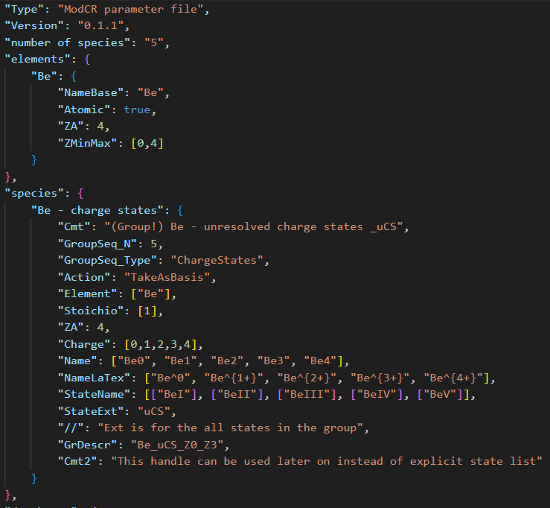
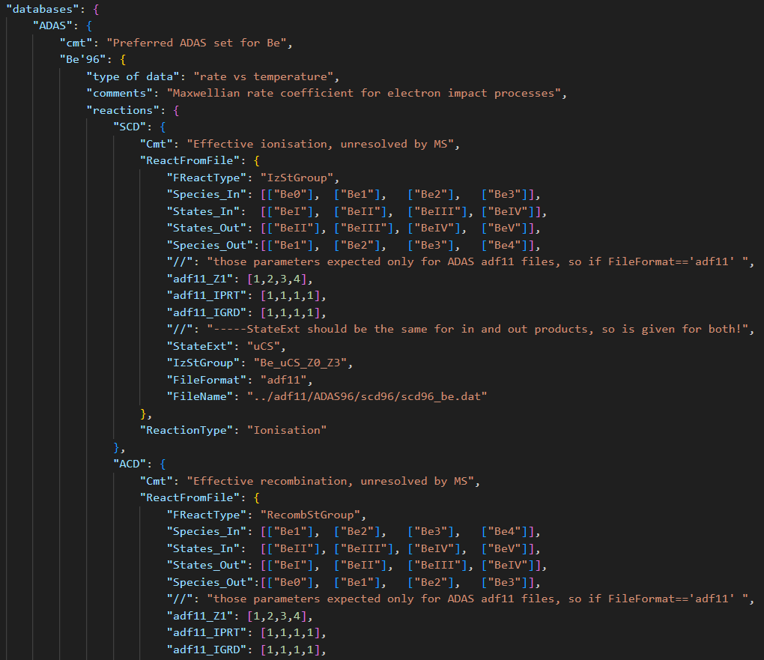
CRM organisation – reference JSON files
States are read as INDIVIDUAL ones or groups!
→ “GrDescr” can be used later on as a tag…

Slide 19
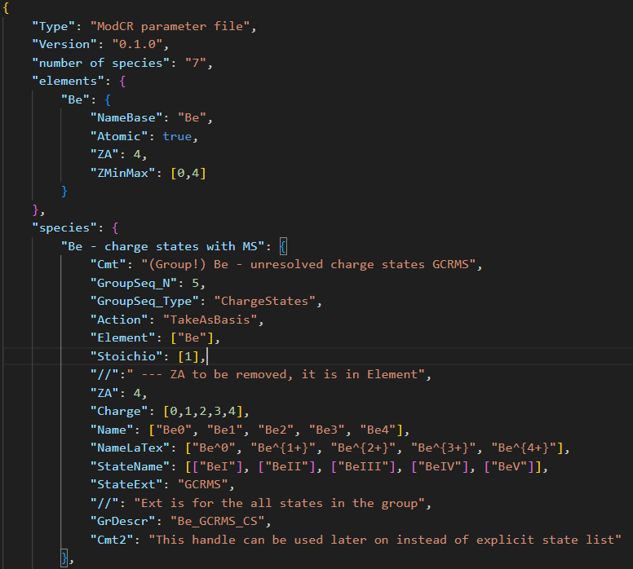
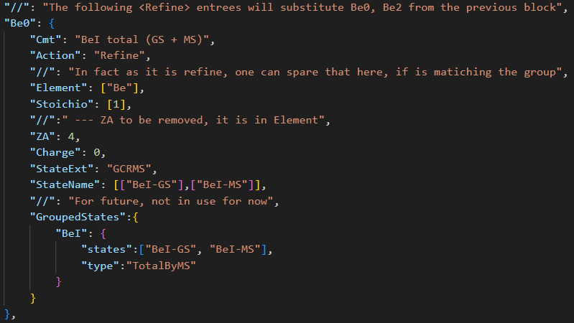
JSON reference files – essential coding part
We try to make as little as possible routine (similar) edit contributions by user (or Ploutos).
By that we end up in a kind of language-based data processing (DP) e.g. “refine” command.
We actively use JSON encapsulation, e.g. not all parameters are in use, versioning is easy etc.
Comments: we need start using JSON schema.

Slide 20
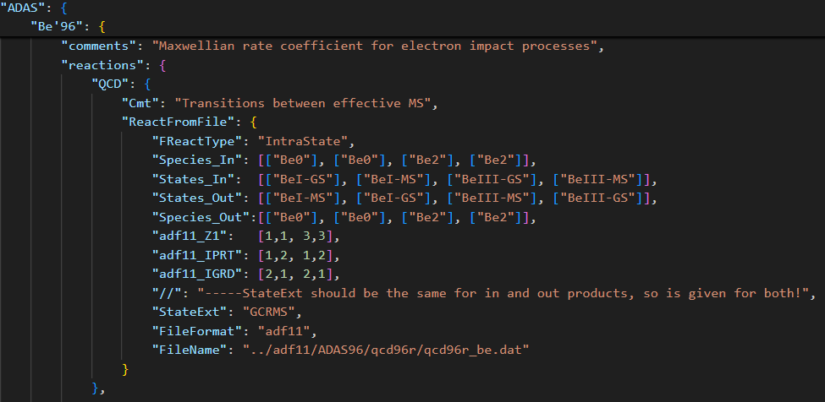
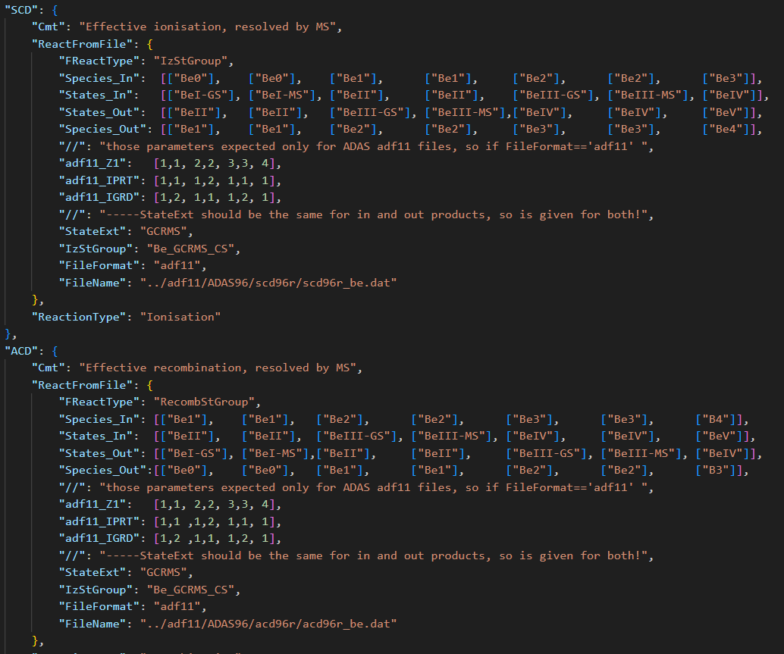
JSON reference files – scripting flexibility
Species/states are just string tags → flexibility!
It does not prevent those to contain physical parameters and quantum numbers.
We can simply script non-trivial parts incl. with python or other external processing.
If later automatic solutions are provided, JSON allows flexible transitions, cross-checking etc.

Slide 21
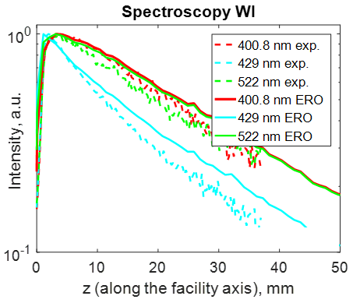
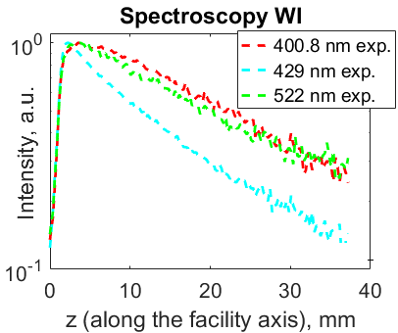
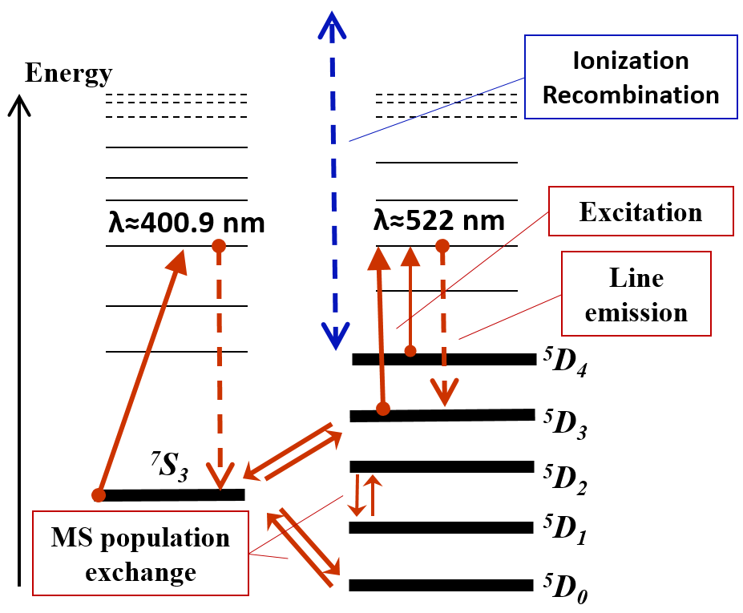


MS-effect for WI (PSI-2 linear plasma device, JET)
(PSI-2)
(PSI-2)
(PSI-2)
W⁰
line Intensity [a.u.]
line Intensity [a.u.]
ERO:
λ = 400, 429, 522 nm
Ar → W
target
Ar → W
target
Multiple options for state bundling are worth considering
Test in tokamak (JET ITER-like Wall): MS tracking reduces simulated line intensity by x1.7!
Dedicated ADAS’18 dataset
A.Eksaeva PhD-thesis, 2020

Slide 22
Outline
Introduction to EIRENE Monte-Carlo (MC) multispecies transport solver:
➔ role of A&M data and associated tools
MC challenges (statistics) and ODE solution alternative:
➔ Balance equations, collisional-radiative models (CRM)
➔ Non-stationary effects e.g. metastables (MS)
New kinetic module under development – “ModCR”
➔ Can be used both, standalone and inside EIRENE
Physics learned from standalone CRMs
➔ Significance of vibrational states
➔ Detachment characterisation with spectroscopy
Summary and conclusions

Slide 23
ModCR interaction with EIRENE and other tools
YACORA
EIRENE
CRM condensing
(“ColRad”)
Interface
Standalone
EIRENE
Main loop
(neutral transport)
ModCR
Ploutos
ModCR
Flexible input files (JSON)
EIRENE
Post-processing
(spectroscopy, etc.)
Data sources
MCCC, R-matrix, …

Slide 24

ModCR flow chat (standalone)
Input file (JSON)
CRM
Species
States
Transitions
Settings
New input
file (JSON)
Ploutos
Output file1
(JSON)
CRMs
Output file X
Tasks
Solver(s)
Task
Manipulate CRM
Analyse CRM
Solve (set of) case(s)
Produce output
Stationary
Dynamic
Analysis

Slide 25
Pipelenes of CRMs
ModCR
ModCR
Pick up +
combine
Pick up +
combine
CRMs
(JSON)
CRMs
(JSON)
CRMs
…
Analyse (eigenvec.)
Analyse (eigenvec.)
Test +
correct
Test +
correct
Ploutos
Alternatives!
Peculiar data, processes, assumptions
SA CRM
Solver
Data sources
AMJuel,
MCCC, R-matrix,
…
Branching ratios, S/XBs
Other practical data

Slide 26

New code (also library for EIRENE): “ModCR”
Should provide BOTH standalone and build-in CRM for EIRENE
  Therefore written in modern Fortran
  Linked with Ploutos (uses the same JSON files for I/O)
  Non-stationary approach utilising up-to-date Sundails solver (CVODE++) for stiff ODE systems (algebraic stationary option also available for control)
The whole specie-state and reaction basis is inside, however the code should form the list of “active states”
  Provide different resolution on states being tracked
  Provide flexible border for tracking of MC species and internal state populations as variables
  Provide data processing pipe lines (easy to reproduce with updates)
All functionality available in EIRENE (e.g, photon tracing) must be preserved!
The code should be modular (library, API) for use in EIRENE, EIRON (toy model for parallelisation), ERO…
This
is unique and justifies creation of the new code

Slide 27
Transport code variations and commons: CRMs
Property | EIRENE | ERO, ERO2.0
Ab initio | Yes (iterations with fluid code, e.g. with B2.5 → “SOLPS-ITER”) | No, test-particle approximation on a given plasma BG (e.g. from SOLPS)
Gyro-motion | Guiding centre approximation | Full-resolved, detailed 3D wall elements, surface sheath
Plasma-wall interaction | Less detailed locally, often no 3D | More detailed: 3D, sheath, etc.
PWI impact on plasma | Yes, also “advanced fluid neutrals”, “wall reservoirs” etc. | In general NO (certain effects were introduced…)
Both approaches have clear advantages and range of appropriate tasks, both packages are highly demanded by ITER, EU-DEMO and other fusion-relevant devices!
➔ Moreover, they often support each other (plasma BGs from various CFD-EIRENE used and tested in ERO)
However, the subtasks for treatment of atomic and molecular processes in plasma are very similar!
Break-up of the molecular species in plasma
Ionisation and other processes affecting charge and energy, thus transport
Synthetic spectroscopy for comparison with diagnostics
Similar A&M process treatment challenges!

Slide 28
Outline
Introduction to EIRENE Monte-Carlo (MC) multispecies transport solver:
➔ role of A&M data and associated tools
MC challenges (statistics) and ODE solution alternative:
➔ Balance equations, collisional-radiative models (CRM)
➔ Non-stationary effects e.g. metastables (MS)
New kinetic module under development – “ModCR”
➔ Can be used both, standalone and inside EIRENE
Physics learned from standalone CRMs
➔ Significance of vibrational states
➔ Detachment characterisation with spectroscopy
Summary and conclusions

Slide 29
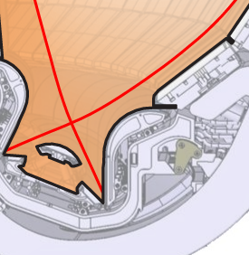
ITER: (semi-)detached regime is foreseen
ITER Divertor is highly dissipative (mainly by radiation)
Detachment means that both heat and ion fluxes are extinguished at the wall (divertor target)
  Heat conduction zone
  Impurity radiation zone
  H⁰/D⁰/T⁰ ionization zone
  (T_{e} > 5 eV)
  Neutral friction zone
  Recombination zone
  (T_{e} < 1 eV)
This general picture of the detachment onset is partially a result of decades-long studies including systematic EIRENE modelling.
➔ Non-stationary A&M effects?..
Courtesy R.A.Pitts

Slide 30
Molecular-assisted recombination (MAR)
CX-DR chain (MAR):
p+H₂(v=4) → H + H₂⁺
e+H₂⁺ → H* + H
Significant role in low temperature plasmas: divertors, detached regimes, linear plasma devices
Requires sophisticated molecular models (e.g. resolved by vibrational states v)
Other processes like MAD(dissociation) compete…

Slide 31
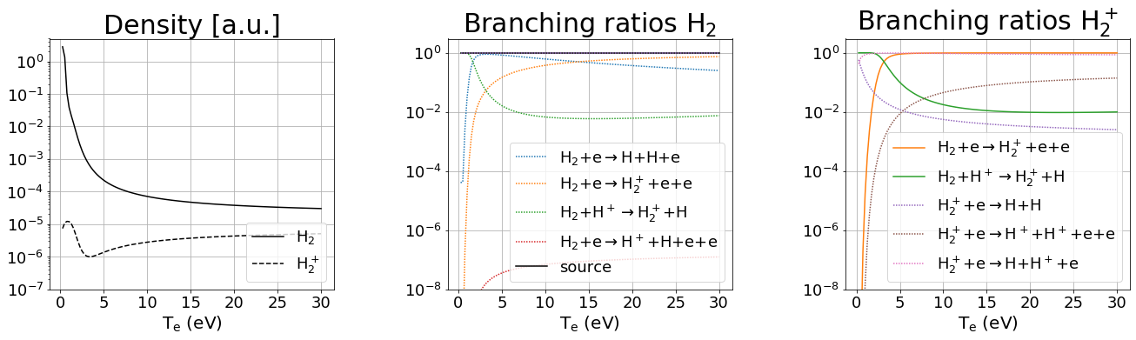
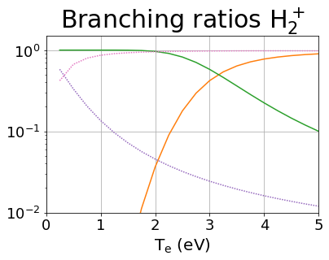
CRM FOR MOLECULES: leading reactions
EU-DEMO
low temperature (T < 2eV) leading reaction chains:
MAD
MAR/MAD competition at very low temperature
H₂+H⁺→ H₂⁺+H H₂⁺+e → H+H⁺+e
H₂+H⁺→ H₂⁺+H H₂⁺+e → H+H
MAR

Slide 32
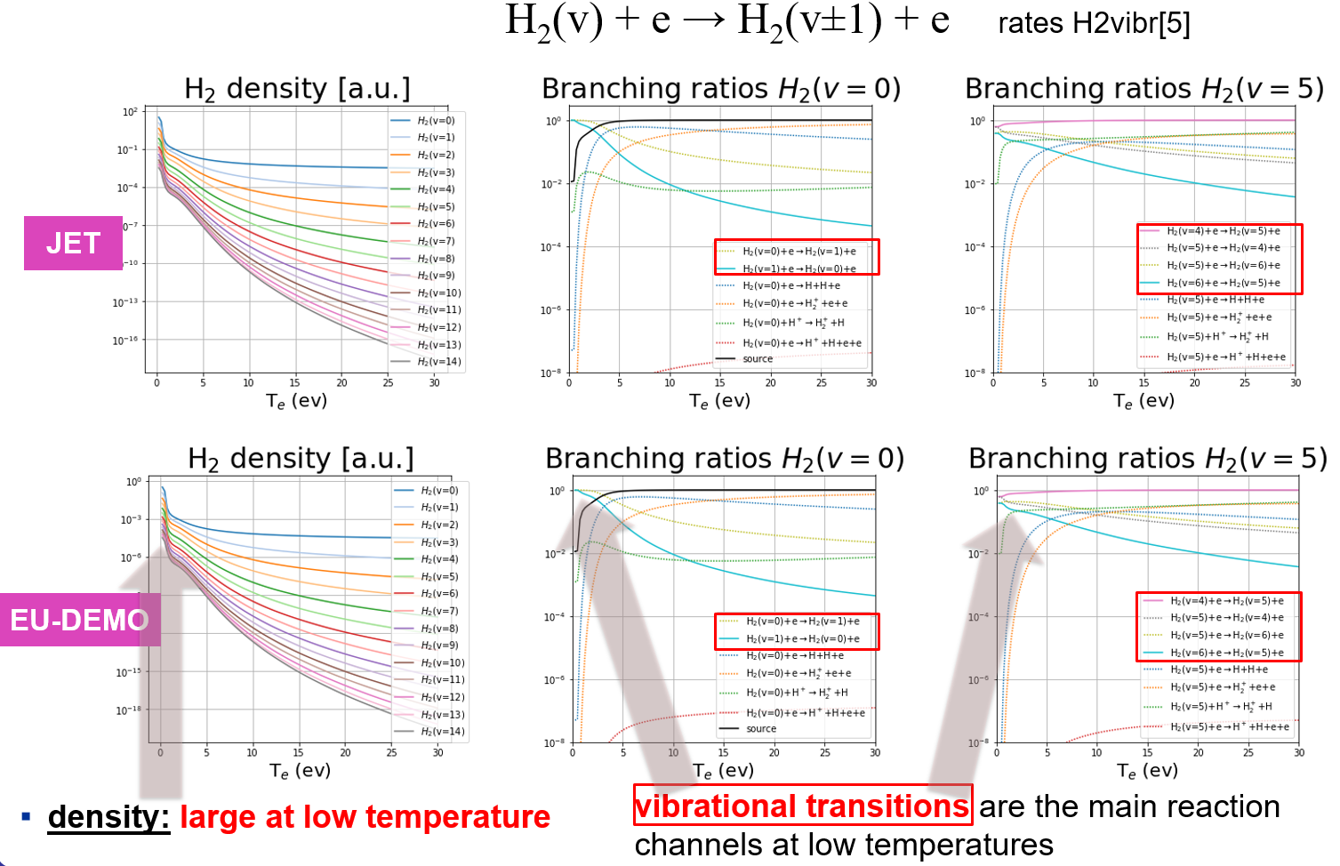
Effect of resolution by vibrostates
F.Cianfrani et al.,
EPS-2022
Fully in line with the EIRENE and other CRMs:
“Up to 40% reduction in effective dissociation rate due to transport of vibrational states”
A.Holm, M.Groth, et al.,
PET, CPP 2021

Slide 33
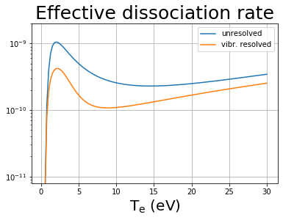
EU-DEMO – effect of resolution by vibrostates
F.Cianfrani et al.,
EPS-2022
Fully in line with the EIRENE and other CRMs:
JET modelling:
“Up to 40% reduction in effective dissociation rate due to transport of vibrational states”
A.Holm, M.Groth, et al.,
PET, CPP 2021

Slide 34
Summary and conclusion
CRMs are essential part of EIRENE and similar transport codes
  They pose both performance and data amount challenges
  Sorting out the proper data is a challenging process requiring common excepted policy
  ADAS (and other sources) deep integration is unavoidable – APIs are necessary.
The MC approach for species should be combined with flexible tracking of external state calculated by ODE solution
  New tools (Plutous, ModCR) are in development
  Flexible border between MC and ODE solution will allow performance optimisation and error estimations
Even a standalone approach can provide very useful physical results
  Strong impact of vibrational states was demonstrated, MAD/MAR competition related with the plasma parameters in detached plasma … isotope effect studies ongoing.
  Indispensable for CRM testing, data compilation and physics understanding
  Universal module usable in transport codes and standalone should open even more opportunities!

Slide 35
Thanks for the attention!

Slide 36
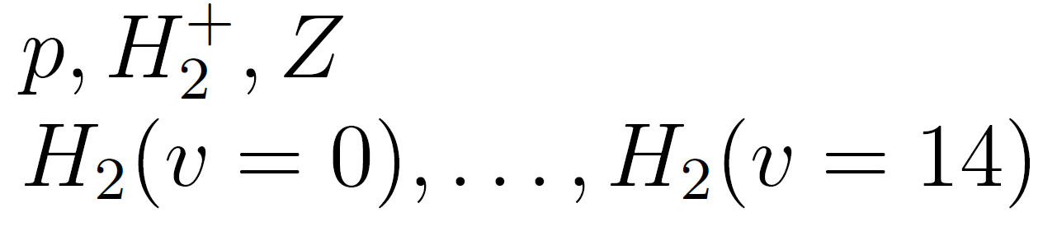
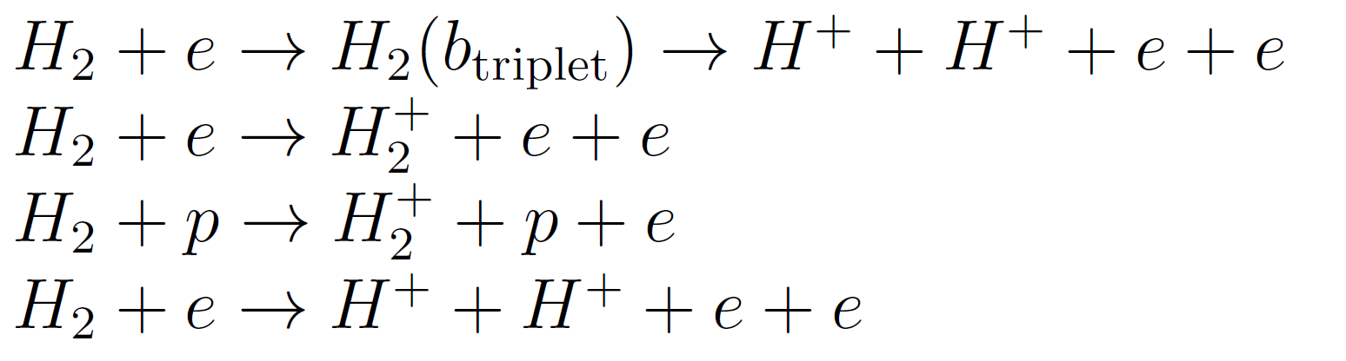
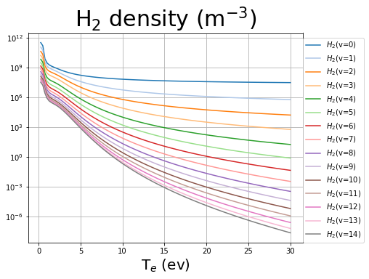
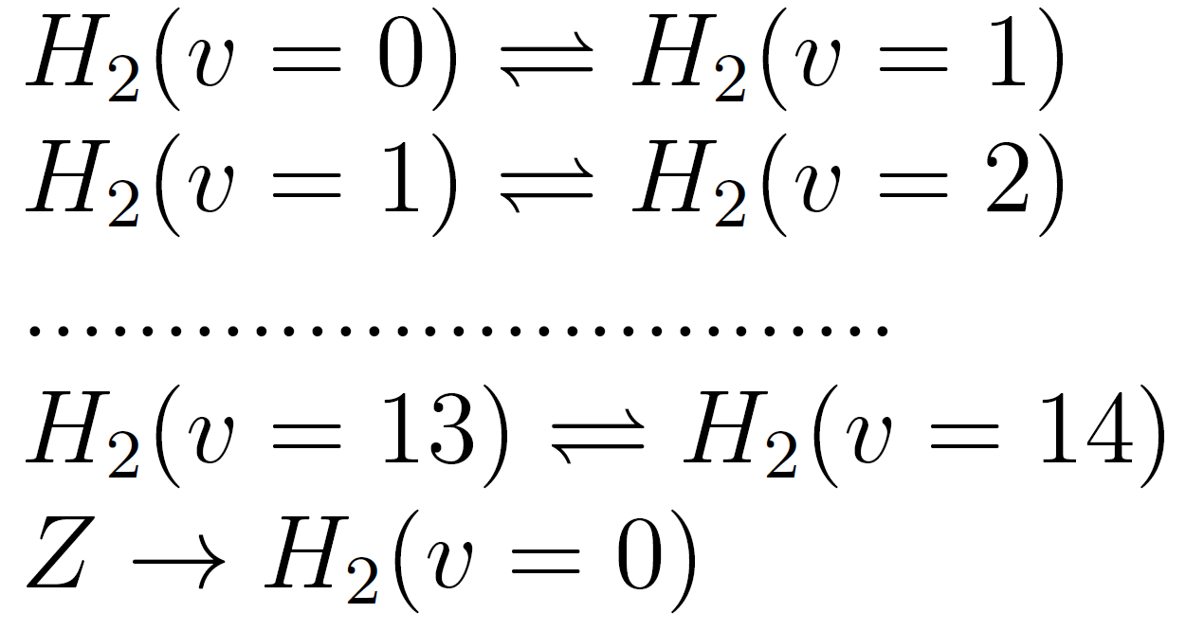
YACORA: inclusion molecular source term
Stationary run vibrationally resolved:
YACORA + Source term
adjustable to the Edge2D-EIRENE
Particle species
F.Cianfrani,
EPS-2022
Reactions
electron impact
proton impact
electron impact
vibrational transitions
H₂ source term

Slide 37
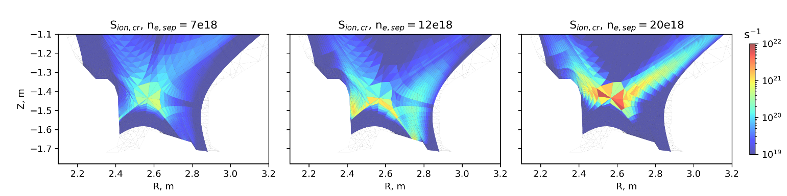
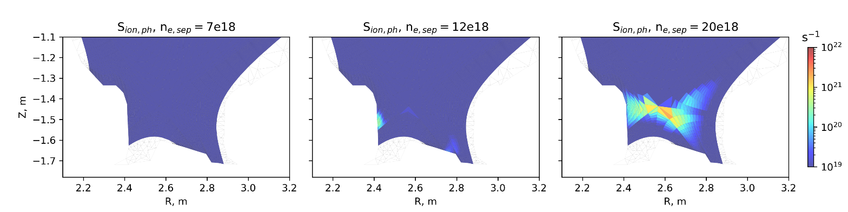
Ly-α and Ly-β opacity -1
‘Extra’ ionization contribution from photon absorption (bottom) localized to near CR ionization front (top)
Ly-α and Ly- β absorption increases population of excited D neutrals
➔ extra ionisation
$$S_{eff}=S_{(1)}+\sum_{p}{\left(C_{(1,p)}−R_{1\left(p\right)}(F_{\left(p,1\right)}+\frac{A_{1}}{n_{e}})\right)+\sum_{p}{\left(Γ_{(1,p)}−R_{ext\left(p\right)}(F_{\left(p,1\right)}+\frac{A_{1}}{n_{e}})\right) }}$$
Eff. Ionization rate from collisional-radiative process
Eff. Ionization rate from photon absorption

Slide 38
Ly-α and Ly-β opacity -2
Photon absorption adds up to ~20% of total CR ionization rate in detached conditions
Ionization rate integrated over the whole plasma volume
No effect in low recycling regimes
New plasma solution required with modified S_{ion} → future coupling to plasma codes
R. Chandra et al.
EPS 2023 P1-001

Slide 39
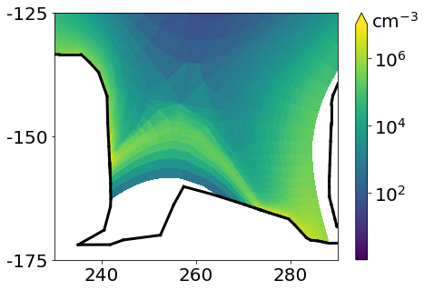

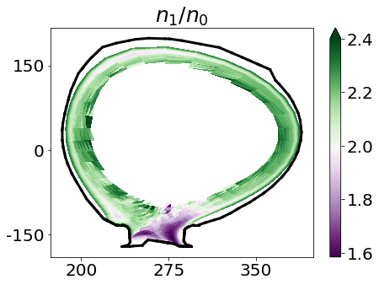
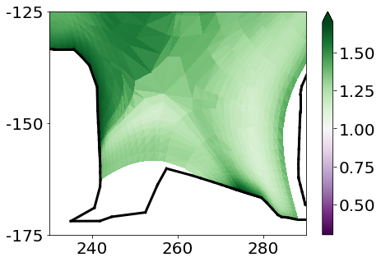
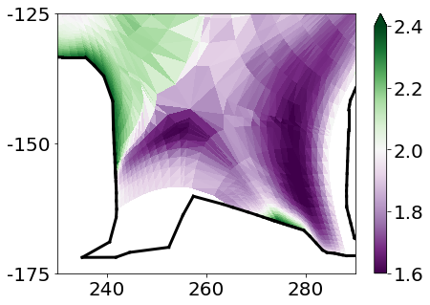
EIRENE: excited molecular states in divertor
Hydrogen (H)
Deuterium (D)
Vibrostate population ratio - 2D distribution
excited
state
d ³Π_{u}:
Vibro-
state
popu-lation
ratio
n₁/n₀:
divertor population coefficients≃1.2
divertor population coefficients≃1.6

Slide 40
CRM FOR MOLECULES : vibral resolution
H₂⁺
H₂(X)
H₂ + H⁺ → H₂⁺+H
H₂⁺ + e → 2H⁺ + 2e
ν = 5
H₂ + e → H₂⁺+ 2e
H₂⁺ + e → 2H
ν = 4
ν = 3
background
ν = 2
SOURCE
ν = 1
ν = 0
H₂ + e → 2H + e
H₂⁺ + e → H + H⁺ + e
H₂ + e → H + H⁺ + 2e
H + e → H⁺ + 2e
Plasma parameters:
H
T_{e}=T_{i}=0.2÷30eV.
n_{e}=n_{i}=10¹⁹m⁻³
n_{e}=n_{i}=10²¹m⁻³
JET
H₂(ν) + e → H₂(ν±1) + e
Databases:
AMJUEL, H2VIBR
EU-DEMO

Slide 41
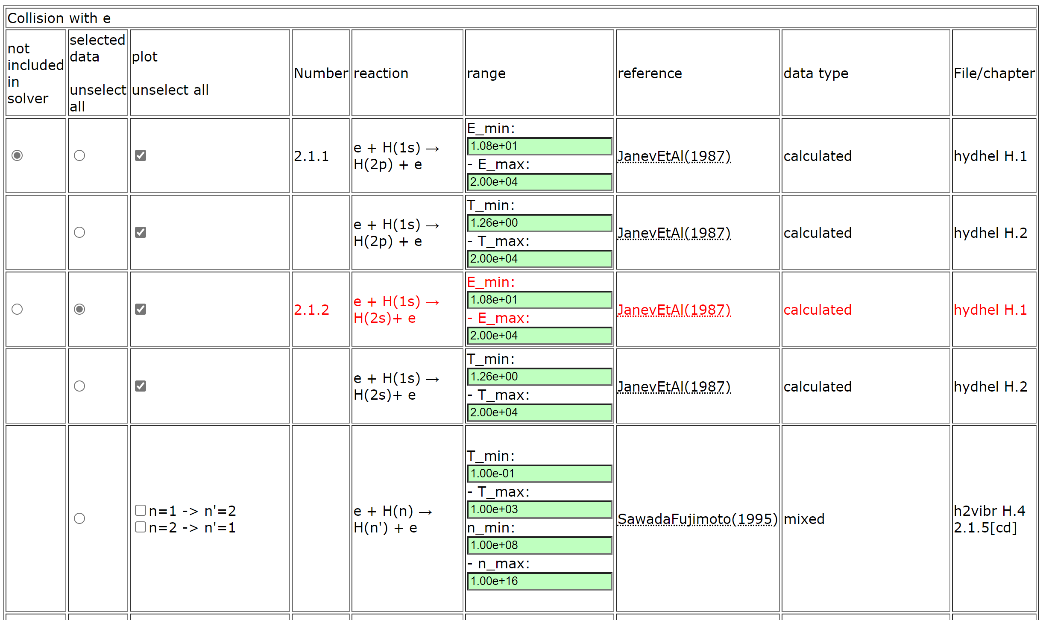
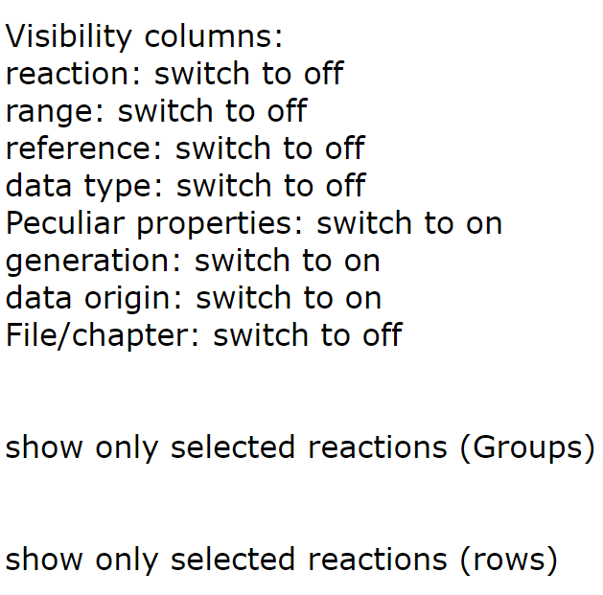
PLOUTOS – (H₂ 2022/23 case)
Buttons to adjust table content

Slide 42


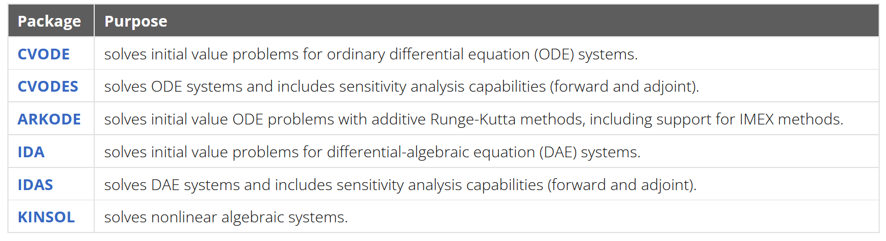
ODE Solver for ModCR
SUNDIALS: SUite of Nonlinear and DIfferential/ALgebraic Equation Solvers
Developed at LLNL - awarded the 2023 SIAM/ACM Prize in Computational Science and Engineering
repository: https://github.com/LLNL/sundials
Modern, powerful and flexible – still it is available in FORTRAN (so suits to EIRENE)

Slide 43

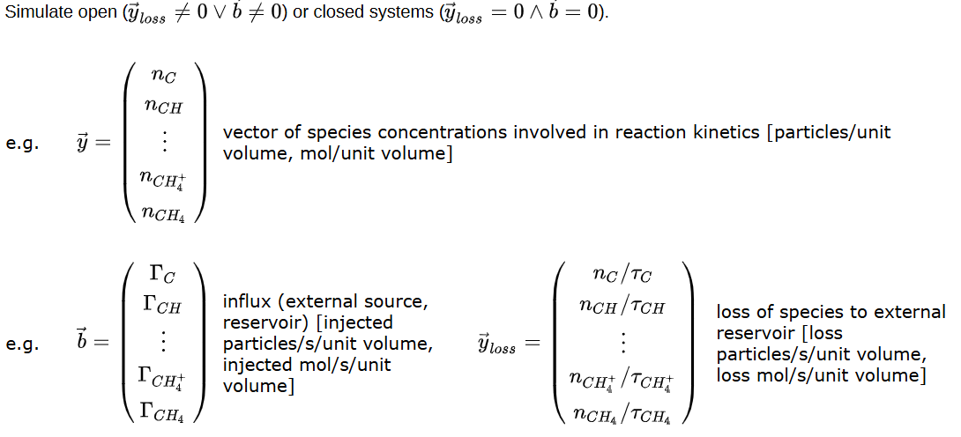
Ploutous solver math basis:
Master rate equation:
Collisional-Radiative Models Re-examined
P T Greenland, D Reiter
First published: 12 March 2007
https://doi.org/10.1002/ctpp.2150380146

