Slide 1
Financial Overview
PSD-DSD Project Board #5 30th October 2024
E. Genangeli, L. Grella, P. Haucke, Y. Kotsehub,
M. Farawana, M. Oron-Carl
PMU Admin & Coordinator Unit

Slide 2
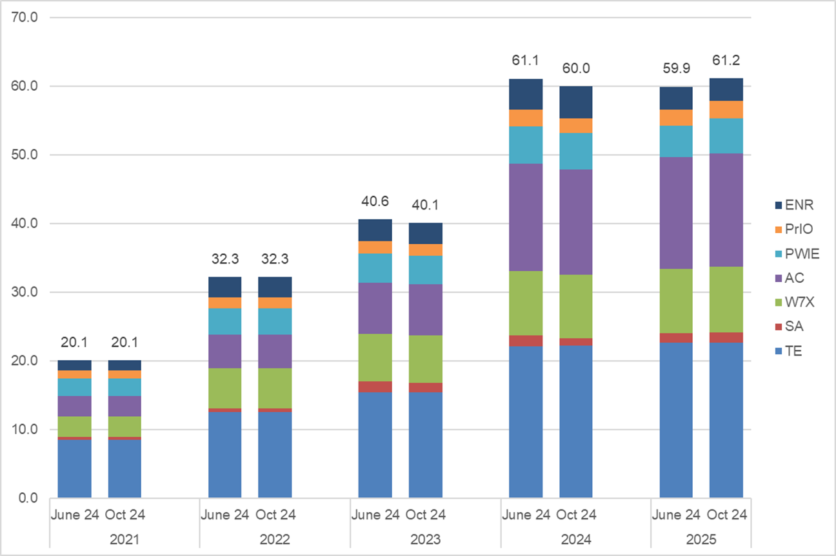
EC Evolution of 2021-25 budget
(CC M€)
2023 Budget decreased by -0.5M€ → unused PMB and PSB was moved to 2024.
2024 Budget decreased by -1.15M€:
PMB/PSB left over shift to 2024 (+0.5M€)
Shift to EPFL (-0.2M€)
Shift to IRs 2025 (-1.5M€) within the same WP or to another (PCR) as below: PrIO (-0.45M€), SA (0.42M€), PWIE (-0.28M€), AC (0.18M€), W7X(-0.15M€) and TE (0.02M€).
2025 Budget increased by +1.3M€ :
Shift to EPFL (-0.4M€): AC-TSVV.15 tasks implementation and additional SA staff costs;
Impact of salary rate change (+0.2M€);
Shift from 2024 (+1.5M€) as below PWIE (+0.56M€), TE (+038M€), W7X (+0.19M€), AC (+0.18M€), PrIO (+0.14M€) and SA (+0.04M€).
IMS data export 22.10.2024
PMB = Planned Mission Budget
PSB = Planned Secondment Budget

Slide 3

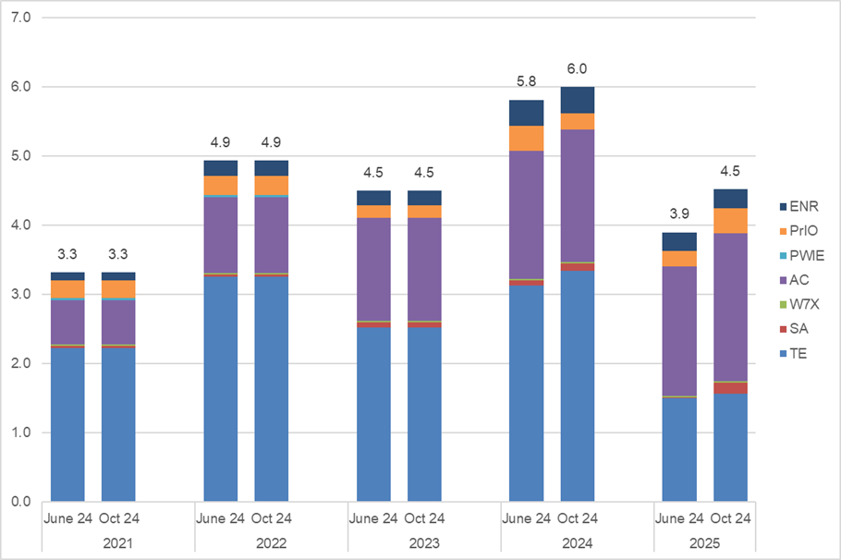
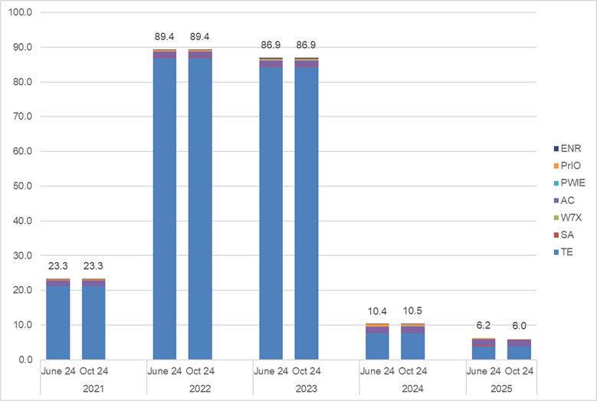
Resources 2021-25 EPFL and UKAEA
EPFL:
2024 Budget increased by +0.2M€ mainly in TE (2024 camp);
2025 Budget increased by +0.6M€:
impact of salary rate change (+0.2M€);
implementation of AC-TSVV.15 (+0.15M€);
increase of EPFL Staff costs in WP SA (+0.15M€);
increase of EPFL Staff costs in WP PrIO (+0.1M€);
UKAEA (Total resources)
2024 Budget increased by +0.1M€ mainly in PWIE (3 new 2024 del: 11 PM50%) and TE (2024 camp)..
2025 Budget decreased by -0.2M€ → reduction of staff costs in WP SA

Slide 4
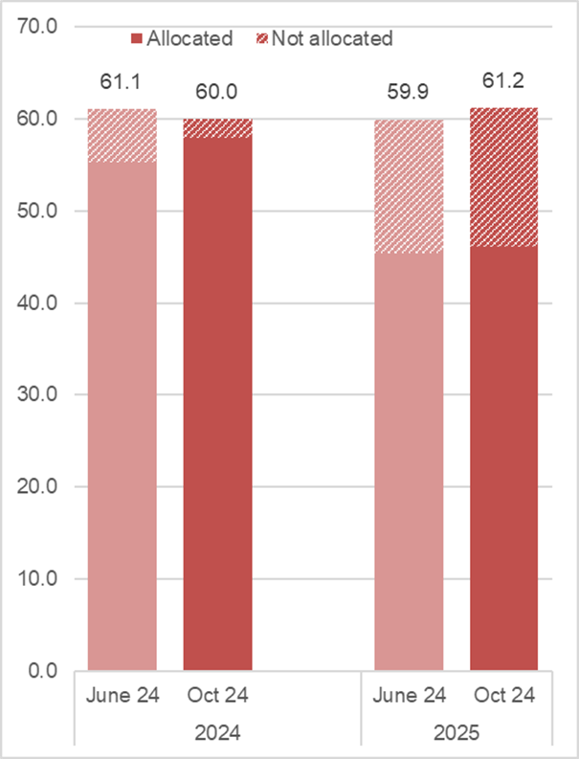
Not Allocated Resources
(CC M€)
2024
2M€ CC of resources Not yet Allocated:
TE (+1.3M€): +1.0M€ camp and +0.3M€ TE-4 Enhancements (EQ/OGS);
SA (+0.2M€): Mission Budget;
ENR (+0.2M€): Mission Budget;
PrIO (+0.1M€):Mission and Secondment Budget;
W7X (+0.15M€): Mission Budget;
PWIE (+0.04M€): Mission Budget;
AC (+0.01M€): Mission Budget.
2025
15.1M€ CC of resources Not yet Allocated:
TE (+8.4M€): +4.8M€ ScientExploit, +3.4M€ PCRs money and +0.2M€ ENH;
AC (+2.1M€): mostly PCR for LTSF not approved;
PWIE (+1.8M€): +1.5M€ PCRs money and +0.3M€ shifts from 2024;
W7X (+1.2M€): +1M€ PCRs money and +0.2M€ Budget for missions;
SA (+0. 7M€): +0.4M€ staff costs, +0.2M€ Mission budget and +0.1 PCRs money;
PrIO (+0.7M€): +0.3M€ PCRs money and +0.3M€ Budget for missions and Secondments and +0.1M€ staff costs;
ENR (+0.1M€): Mission Budget.

Slide 5
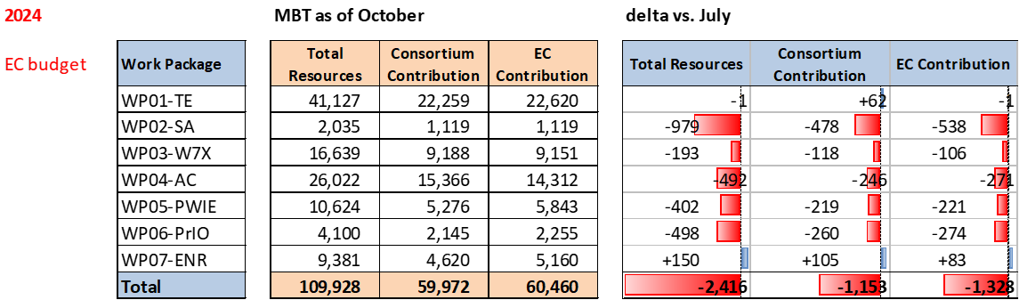
EC 2024 Budget update
SA: unused funds redirected to other WPs (PCRs)
PrIO: unused funds redirected to other WPs (PCRs)
AC: implementation of TSVV15, funds moved from 2024 to 2025
PWIE: unused funds shifted to 2025
W7X: unused funds shifted to 2025
ENR: unused mission budget from 2023

Slide 6
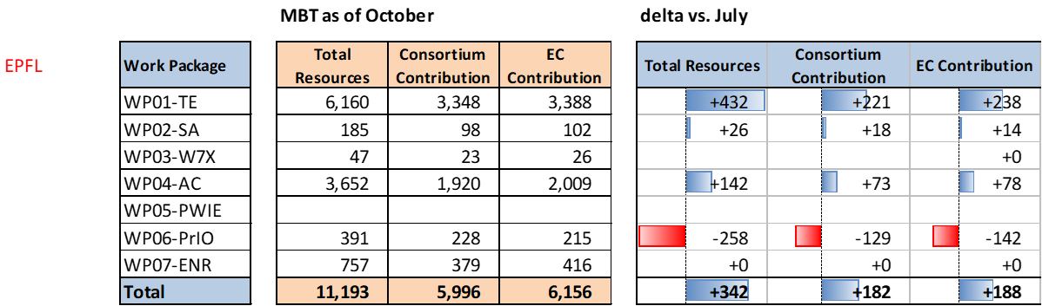
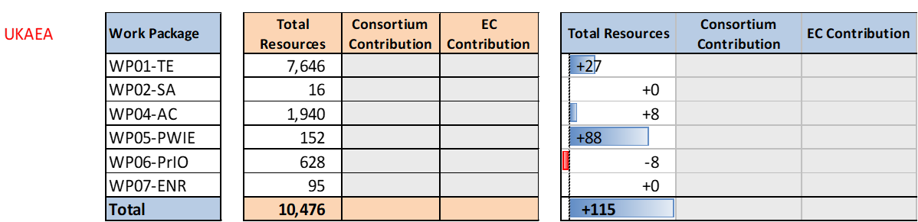
EPFL and UKAEA 2024 Budget update
TE: Campaign
AC: TSVV 15
PrIO: NBTF
TE: Campaign
PWIE: Additional PM

Slide 7
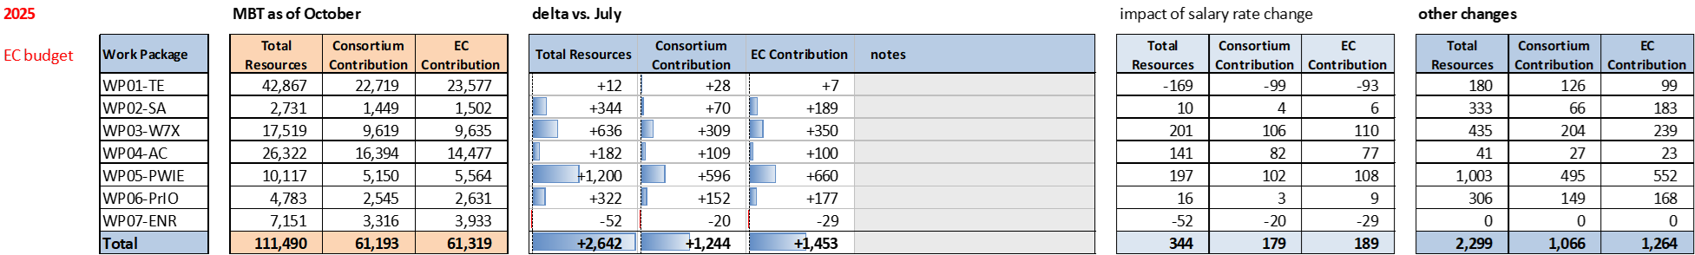
EC 2025 Budget update
2025 Indicative Resources

Slide 8
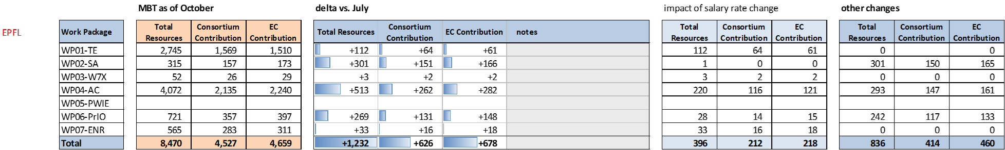
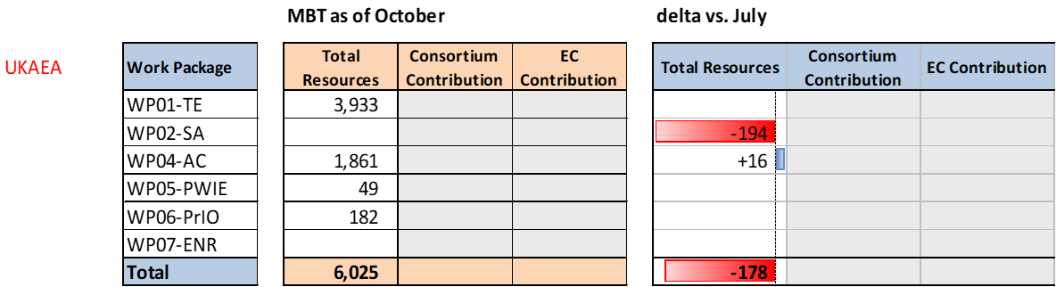

EPFL and UKAEA 2025 Budget update

Slide 9
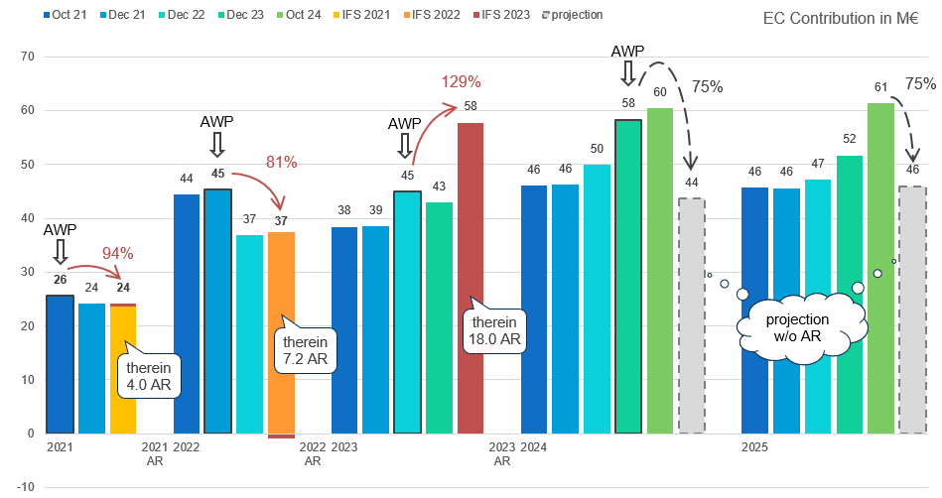
PSD+DSD reporting and projection (EC Contribution)
It looks good thanks to
he Accompanying Research,
But
what if AR is not reported?

Slide 10
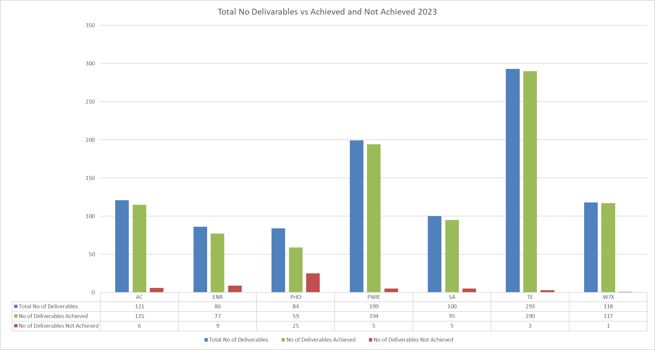
2023 IMS deliverables status of achievement
Status as of
31st August 2024
w/o EPFL and UKAEA
54 deliverables not yet achieved out of 1001, for an amount of ~1M€ to be withheld from 1st payment 2023

Slide 11
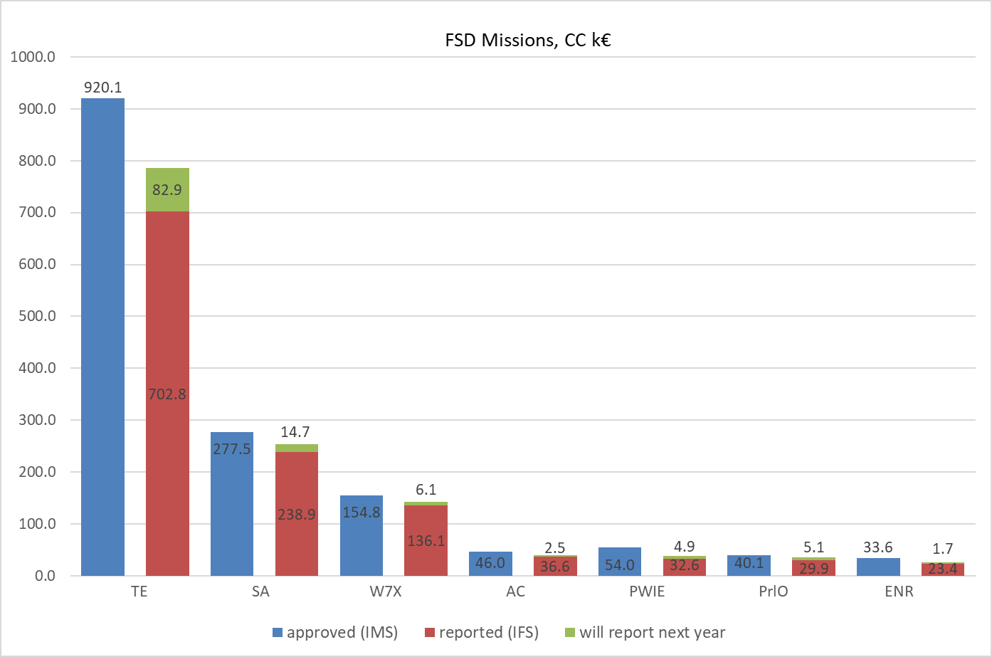
2023 Missions planned vs reported
Total budget approved: 1.5M€
Reported: 1.2M€
Will be reported: 0.1M€
Unused (?): 0.2M€

Slide 12
Conclusion
Underspending trend continues
1.5M€ already shifted to 2025 further shifts may be requested in the coming weeks (e.g. part of the 2M€ non yet allocated)
Data shows that the budget for missions is not fully used, nevertheless the WPs continue asking of an increase
Projection of costs reported vs budget shows that a fraction of 2024-25 resources will (potentially) be used in 2026-27
Level of the 2026-27 budget is not yet known

Slide 13
THANK YOU

