Slide 1
Report on the of 2024 tasks within SP-C
Reporting Meeting PWIE 2024
K. Schmid
E. Bernard, T. Morgan, A. Houben , A. Manhard, S. Markelj, T. Schwarz-Selinger, L. Ciupinski, M. Fellinger, D. Primezhofer, Y. Ferro, M. Lavrentiev, R. Bisson,
J. Zavaznik, A. Kärcher, V. Nemanic, E. Pitthan, A. Teimane

Slide 2
Tasks in 2024
Association | SPCToppic | Title | Reporting
CEA | SP-C-1 | Permeation (D,T) through liquid/solid interfaces with interface characterization | Partially complete
CEA | SP-C-1 | Kinetic of hydrogen transport across the W/Cu interface and modeling distortions in Cu at the W/Cu interface | Complete
MPG | SP-C-1 | Measurement and modelling of Ion Driven Permeation in "W-heavy alloys" | Complete
CEA | SP-C-1 | Model D-permeation on H-prefilled W foil at low temperatures | Partially complete
JSI | SP-C-1 | Study D-permeation on H-prefilled W foil at low temperatures | Complete
MPG | SP-C-1 | Study D-permeation on H-prefilled W foil at low temperatures | Complete
IPP_LM | SP-C-1 | TEM analysis of annealed, He implanted W. In cooperation with MPG | Complete
ÖAW | SP-C-1 | Studying the influence of (re-deposited) W/EUROFER layers on D retention | Complete
VR | SP-C-1 | IBA analysis of (re-deposited) W on EUROFER from ÖAW M. Fellinger | Complete
DIFFER | SP-C-1 | 2023 Continuation | Complete
CEA | SP-C-2 | Study the branching ratio of desorption products from B layers implanted with D ions | Complete
DIFFER | SP-C-2 | Evaluation of D/B ratio in co-deposited boron | "Off Topic"
JSI | SP-C-2 | Influence of B layer on permeation | Not done
FZJ | SP-C-2 | Gas driven permeation and hydrogen retention in boron coated steel or W | Complete
JSI | SP-C-3 | TEM analysis W damaged at high temperatures. In cooperation with MPG IPP | Complete
JSI | SP-C-3 | Influence of surface He pre-implantation on D retention in EUROFER | Complete
MPG | SP-C-3 | Influence of surface He pre-implantation on D retention in EUROFER | Complete
MPG | SP-C-4 | Trap site generation by displacement damage in EUROFER at high T | Complete
MPG | SP-C-4 | D plasma exposure of high-temperature self-ion irradiated W to study the dynamics of D trapping and release from cavities in W
FZJ | SP-C-4 | Quantification of LIBS | Unknown
MPG | SP-C-4 | Quantification of LIBS | Unknown
ISSP-UL | SP-C-5 | T-permeation experiments in 316L into gas and water | Complete

Slide 3
SP-C1
Transport of Hydrogen through the first wall of fusion devices

Slide 4
Transport from Plasma to coolant
Transition of different sources of D/T through different interfaces
Ions/metal: Implantation source
Gas/metal: Sievert‘s law
Atoms/metal: Complex energy landscape
Metal/metal: Thermodyn. Equil.
Metal/water: Henry‘s law vs. Sievert‘s law?
Heat-sink
Plasma/gas/neutrals
Armor
Coolant
Green model & parameters available
Yellow model is there but parameters are „unclear“
Red: Not sure about model or parameters

Slide 5
SP C.1 Transport of Hydrogen through the first wall of fusion devices: 2023
Samples were coated with Pd by the team of M. Cekada (JSI) on both sides minimize surface effect
All samples loaded with 250 mbar of pure T₂ at 250°C
→ the upstream conditions are similar for red and blue (only air downstream), water is present downstream for yellow
! High level ! ➔ but surface defects
Permeation flux (Bq/day/cm²) | 1.2 x 10⁴ (IN WATER) measurement by scintillation counting | 3.1 x 10⁶ (UNDER AIR) Measurement by Liquid scintillation counting | 4.3 x 10³ (UNDER AIR) measurement by Ionization chamber
Notes:
Jaune et bleu: aucun défaut de surface visible à l‘oeil
Dissolution+ autoradiographie sur Wapiti rouge pour comprendre si contenu T accru?

Slide 6
SP C.1 Transport of Hydrogen through the first wall of fusion devices: 2024
Samples were coated with Pd by the team of M. Cekada (JSI) on both sides to minimize surface effect
All samples were loaded with 50 mbar of pure T₂ at 250°C
→ the upstream conditions are similar (only air)
Permeation flux (Bq/day/cm²) | 1.6 x 10⁶ Under ambient Air – Measurement by Liquid scintillation counting | 1.6 x 10⁶ Under ambient Air – Measurement by Liquid scintillation counting | 1.8 x 10⁵ Under ambient Air – Measurement by Liquid scintillation counting
Notes:
! Lors du transfert: Wapiti rouge et jaune avec activité détectée plus importante (2024)
En 2023: uniquement ce pb sur le rouge…

Slide 7


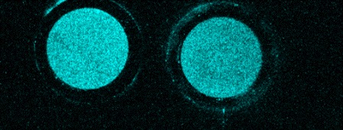
SP C.1 Permeation (D,T) through Liquid/Solid interfaces with interface characterization
Goals:
  Compare Pd coated with natural oxide EUROFER sample at different T-pressure (promising from 2023 campaign)
  Load a EUROFER sample with H using the same procedure as with T and characterize surface state
Task A: all samples were loaded with 50 mbar of pure T₂ at 150°C (Pd deposition courtesy of M. Cekada, JSI) to compare with 250 mbar in 2023 (similar upstream conditions)
  Decreasing the driving force of permeation from 250 to 50 mbar in the 2024 campaign induced an increase in permeation flux: from 4.3x10³ to 1.8x10⁵ Bq/day/cm²
  Not expected : defects in bulk
  linked with surface treatment?
  Detailed analysis under way…
Task B: autoradiography surface measured performed
  EuN2 ➔ 2.1±0.3 MBq
  EuN3 ➔ 2.3±0.3 MBq
Permeation flux (Bq/day/m²)
Defect observed on “red-cell” membrane after experiment 2023
Defect observed on “blue-cell” membrane before experiment 2024
Activity measured in downstream air for Pd coated Eurofer
+ full dissolution on one to assess bulk activity under way
Deliverable: PWIE-SP C.1.T-004-D001
Status: partially done / in progress
Facilities: e.g. Plasma device / accelerator # days or Modelling: Code name
Linked WP or TSVV: if required
« Blank WAPITI » Eurofer samples autoradiography image showing the background T contamination

Slide 8
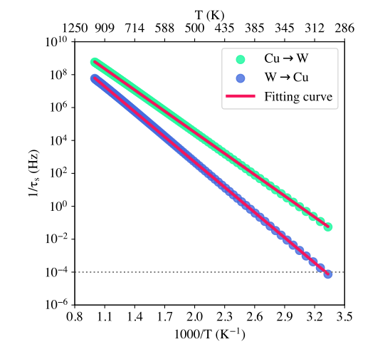
SP C.1 Transport of Hydrogen through the first wall of fusion devices: CEA/AMU
Task : Kinetic of H transport across W/Cu and modeling distortions in Cu at the W/Cu interface
Deliverable : D1 - 0D kinetic model of the interface.
D2 - Identification misfit defects by MD at the W/Cu interface with EAM potential
D1:
• diffusion coefficient of H in Cu (benchmark)
• diffusion coefficient of H // and ⊥ to the W/Cu interface
• 0D kinetic model of 17 differential equations
• a reduced kinetic model is proposed - only two equations with activation barriers 1.01eV (W ➔ Cu) and 0.85 eV (Cu ➔ W)
D2:
• no W/Cu potential available/shared
• Cu modelling only with fixing one side of the box to the geometry of the interface.
• MD reproduces the hcp reconstruction (found in DFT 2023) of Cu close to the interface
• N,P,T (1ns) followed N,V,E (100ns) simulations shows hcp does not survive to high temperature. Fcc propagates with defects up to the interface.
• High concentration of defects at the interface
Figure 1 : Inverse of the characteristic time or jump frequency vs 1/T
Deliverable: PWIE-SP C. 1.- T-004-D001 W/Cu interface – 0D model – misfit defects
Status: completed
Modelling: Quantum Espresso, LAMMPS, Python
Notes:
Deliverable 1:
• diffusion coefficient were established in Cu based on activation barriers and Wert and Zenert Theory for the attempt frequency.
• diffusion coefficient was established // to the W/Cu interface using the same methodology as before
• a 0D model of the interface was built. It connects two different paths perpendicular to the interface and one parallel to it. It is composed of 17 couple differential equations.
• based on the characteristic time to reach a steady state (plotted on the Figure 1 for various temperature), we obtained reduced kinetic model of only two equations for H diffusion across the interface: a diffusion coefficient perpendicular to the interface was established for hydrogen.
A paper is written and should be submitted next month or the month after.
Deliverable 2:
• In authors, a potential was already published. We asked for it to the authors but they never answered.
• So we did the modeling on Cu only and fixed on one side of the box to the geometry Cu adopt at the interface.
• The geometry of the model was first optimized and converged to a hcp structure in agreement with the DFT results (Figure 2).
• Upon heating, the fcc structure propagates into the hcp. The misfit defects at the boundary between fcc and bcc propagate up to the interface.
• However, these are first results. As the interface is not relaxed upon heating (no potential available for the interface), we cannot go beyond and would need to have full Cu/W potentials to identify the defects. At this stage, we can only conclude that misfit defects concentrate at the W/Cu interface.

Slide 9
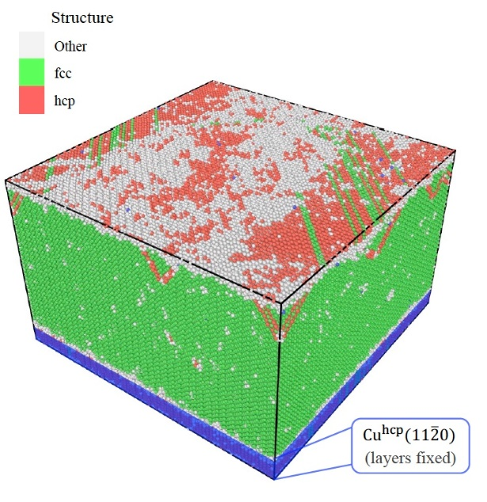
SP C.1 Transport of Hydrogen through the first wall of fusion devices: CEA/AMU
Task : Kinetic of H transport across W/Cu and modeling distortions in Cu at the W/Cu interface
Deliverable : D1 - 0D kinetic model of the interface.
D2 - Identification misfit defects by MD at the W/Cu interface with EAM potential
D2’:
• => We have to build our own W-Cu potential – ML SNAP
• We started to build two training sets, 1033 conf for Cu, 3927 confs for W
• First trials for building W-only and Cu-only potentials based on 1/3 of the training sets were done (SNAP potential).
Proposal for the next year
• Computing the full Cu and W training sets
• Building W-only and Cu only ML-SNAP potential
• Building a training set for the W/Cu interface
• First attempt of ML SNAP W/Cu potential
Figure 2 : Cu simulation box. Bottom Cu layer fixed at the geometry of the interface. On top of it, hcp structure, then fcc.
Deliverable: PWIE-SP C.1. T-004-D001
Status: completed
Modelling: Quantum Espresso, LAMMPS, Python
Notes:
Deliverable 2’:
• set of configurations was given to us thanks to our Finish colleagues (F. Granberg, J. Byggmästar)
• we started to compute by DFT both W and Cu training-sets but a large amount of computational resources is required.
• based on the configurations we computed, we started to build W-only and Cu-only SNAP potential for learning purpose.
Proposal for next year :
• Compute the full training-sets for Cu and W when resources will be available,
• Build W-only and Cu-only potential as a basis for a W-Cu SNAP potential,
• Building a full training set for the W/Cu interface
• propose a first W/Cu SNAP potential that will have to be improve upon more configurations that will have to be built by DFT

Slide 10
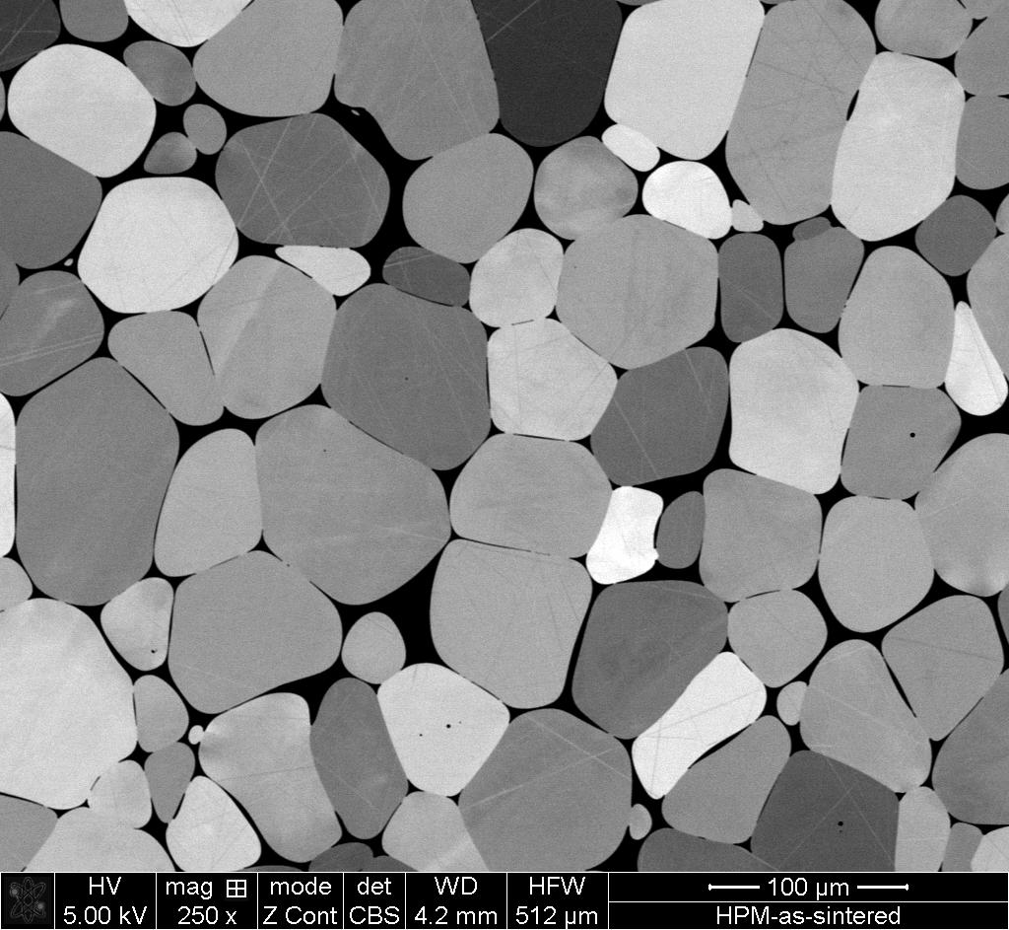
H-transport through HPM
W-alloys: W-grains „glued“ together my medium-Z alloy (Ni, Fe) matrix
→ „W-material“ with favourable mechanical properties
Solubility & diffusivity in matrix is much higher than in W
Transport dominated by matrix
Retention probably dominated by W
→ Transition across W/matrix interface
Courtesey P. Sand (IPP-Garching)

Slide 11
SP C.1 Transport of Hydrogen through the first wall of fusion devices: IPP-MPG
Task: Permeation of H isotopes through W heavy alloys (W/Fe-Ni)
  Measuring of IDP and GDP through HPM-1850
  Modelling of H transition between W and Fe-Ni phases
  Modelling of realistic W heavy alloy microstructure
Measured transport across matrix-W phase boundary in layer samples (2023)
1-D modelling indicates “fast” interface without barriers is an adequate description
IDP and GDP through HPM-1850:
currently in progress
3-D modelling of IDP in heavy alloy not yet possible with available code packages
potential barriers and traps at W-matrix interface
results can be fully described without barriers
Deliverable: PWIE-SP C.1. T-004-D002
Status: completed
Facilities: -/- or Modelling: -/-
Linked WP or TSVV: WP Education (?)
Notes:
Main IPP contributors: Philipp Sand, Armin Manhard, Udo von Toussaint
Measured times and permeation fluxes across W-matrix boundary in layered model system
Direction W>matrix: no measurable difference from W alone
Direction matrix >W: measurements somewhat above theory predictions even without barriers
- Probable reasons: uncertainty of H solubility in matrix, grain boundary effects in W
Interface modelling results:
- kinetic model of interface that by design reproduces the analytical balance of chemical potentials in steady state and without any barriers
- transmission of H isotopes across W-matrix boundary relatively insensitive to potential barriers at W-matrix interface
- Reason: interface negligibly thin compared to matrix (2.5 µm) and W (50 µm) (→realistic scales for heavy alloy!)
- combining directions W>matrix and matrix>W allows putting some constraints: barriers, if existing, <~0.8-1 eV (assuming attempt frequency ~10¹³ Hz for transitions to/from interface)
- a number of other parameters (e.g., trap density at interface) were also varied; with the result of relatively broad parameter ranges being allowed to still reproduce the empirical behaviour of the interface
- description without barriers is sufficient for all practical purposes: simply use balance of chemical potentials, i.e. ratio of heats of solution!
Currently ongoing: measurement of ion-driven and gas-driven permeation in actual HPM-1850 W heavy alloy
- will be completed before end of the year
- will fortify confidence in previous results
- will help to improve H solubility & diffusivity data in matrix phase
Modelling of full W heavy alloy composite still challenging:
- FESTIM code for 3-D diffusion-trapping in principle exists (open source, maintained by Remy Delaporte & other contributors)
- currently cannot handle ion implantation in 3-D due to meshing issues; solution in progress but not yet publicly available
- isobaric and isothermal gas loading can be solved analytically, would essentially behave like direct gas loading of W powder according to measurement results (can serve as benchmark case once new FESTIM version including 3-D ion implantation is available)
- 2-D modelling with strongly simplified microstructure currently in progress with own code by Udo von Toussaint

Slide 12
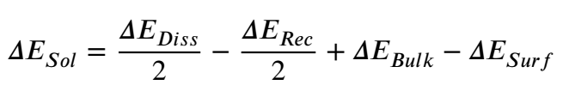
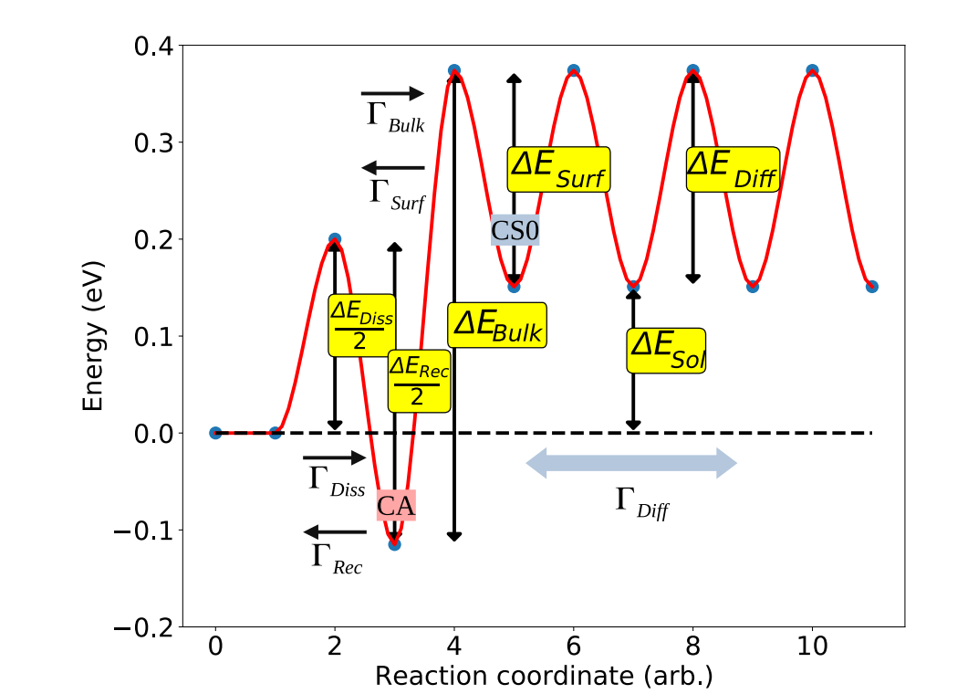
Near surface energy landscape
The uptake of H into metals is described by the Pick-Sonnenberg model
J. Nucl. Mat. 131 (1985) p. 208
Gas
Atoms
Ions
Different loading species „experience“ different parts of the energy landscape
Compare loading with different species the landscape can be mapped
K. Schmid NME 36 (2023) 101494

Slide 13

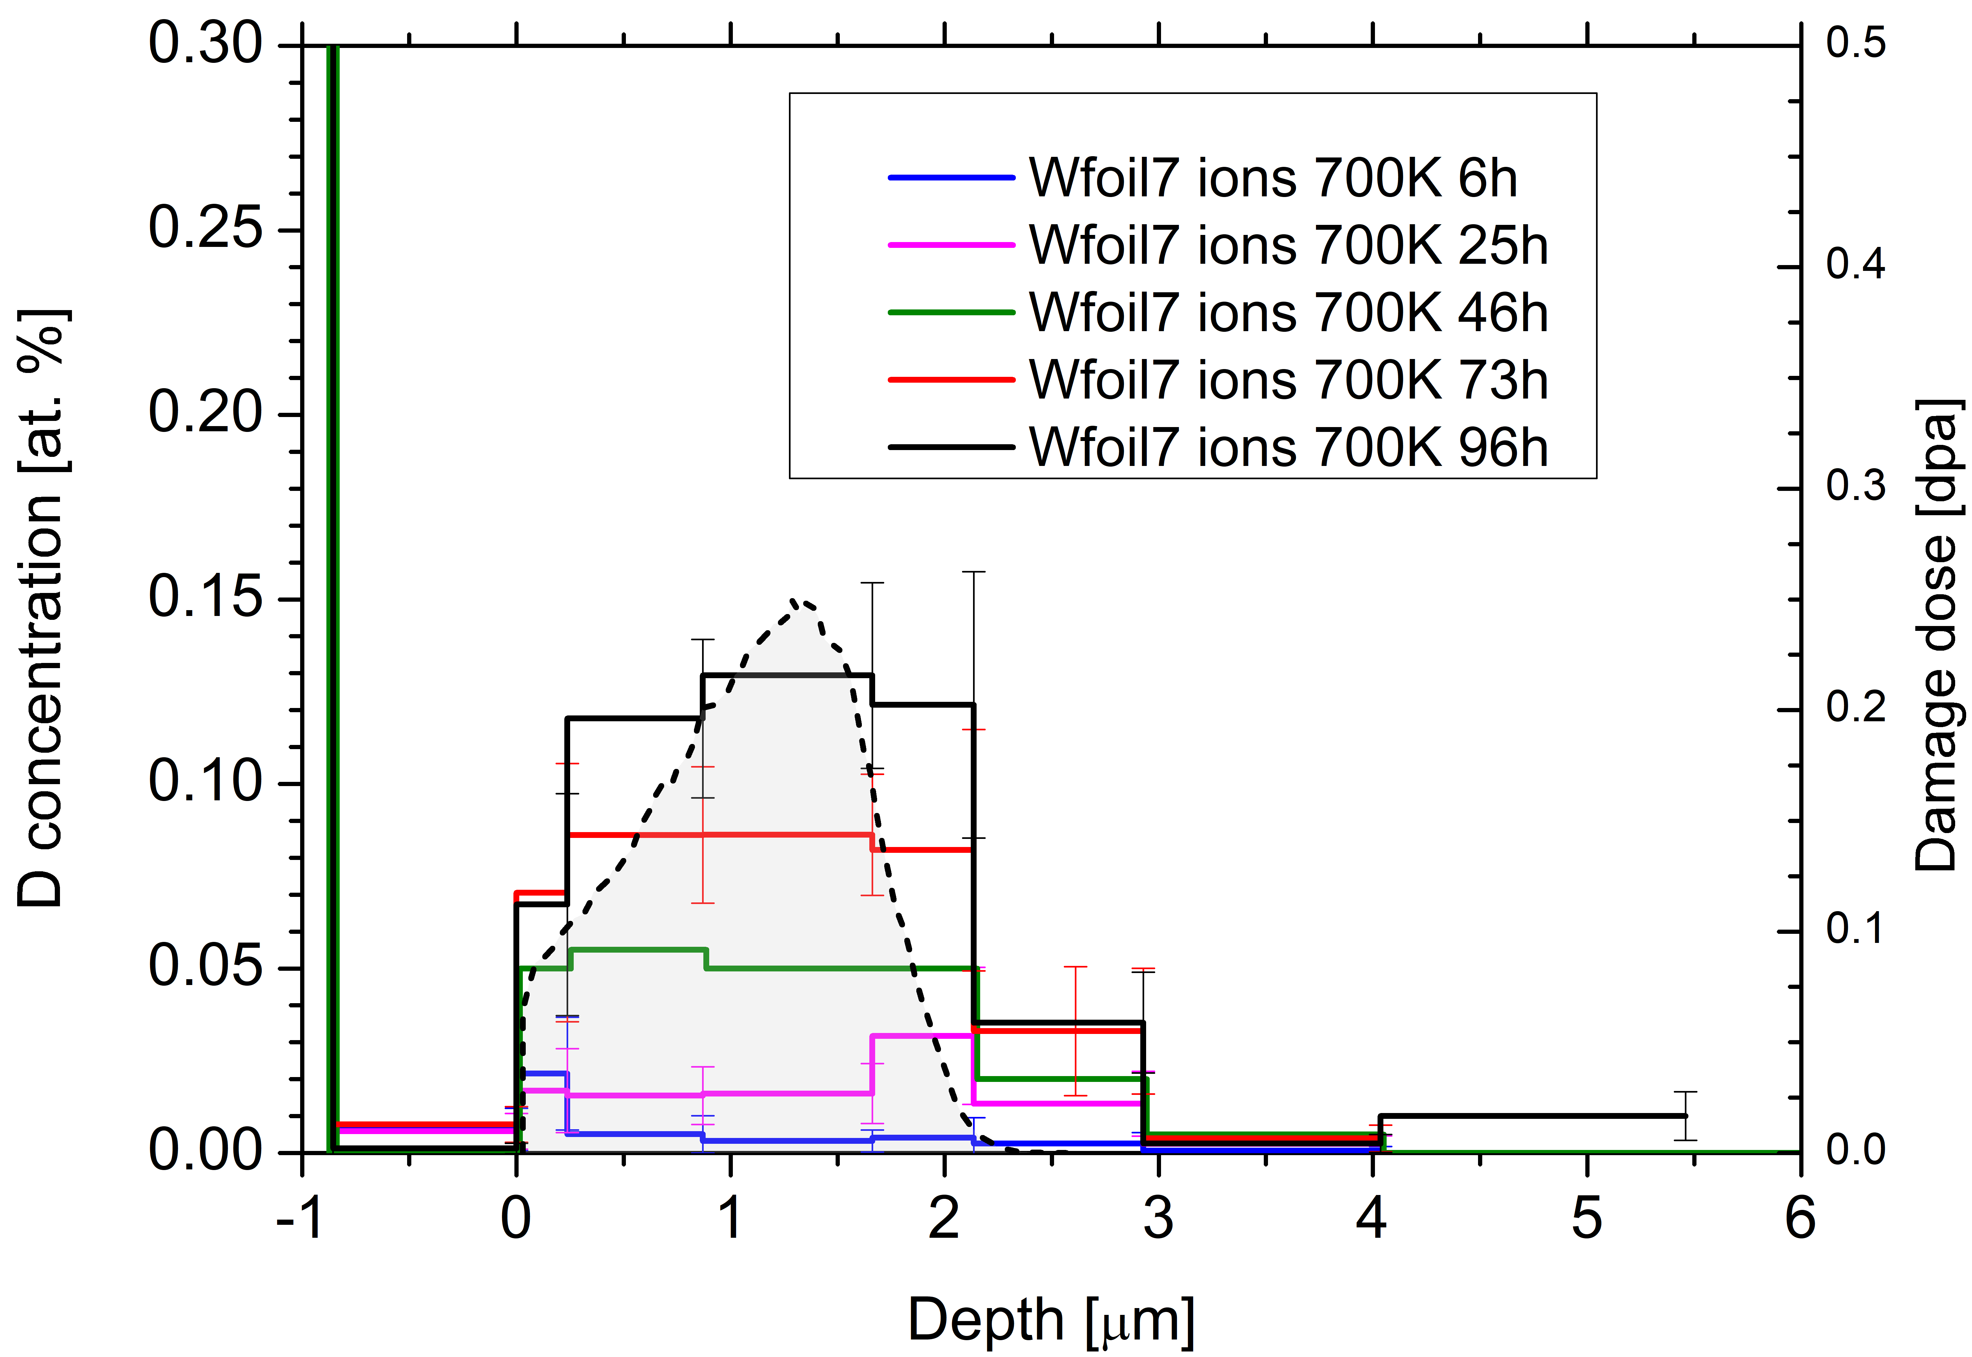
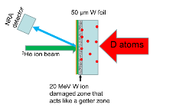
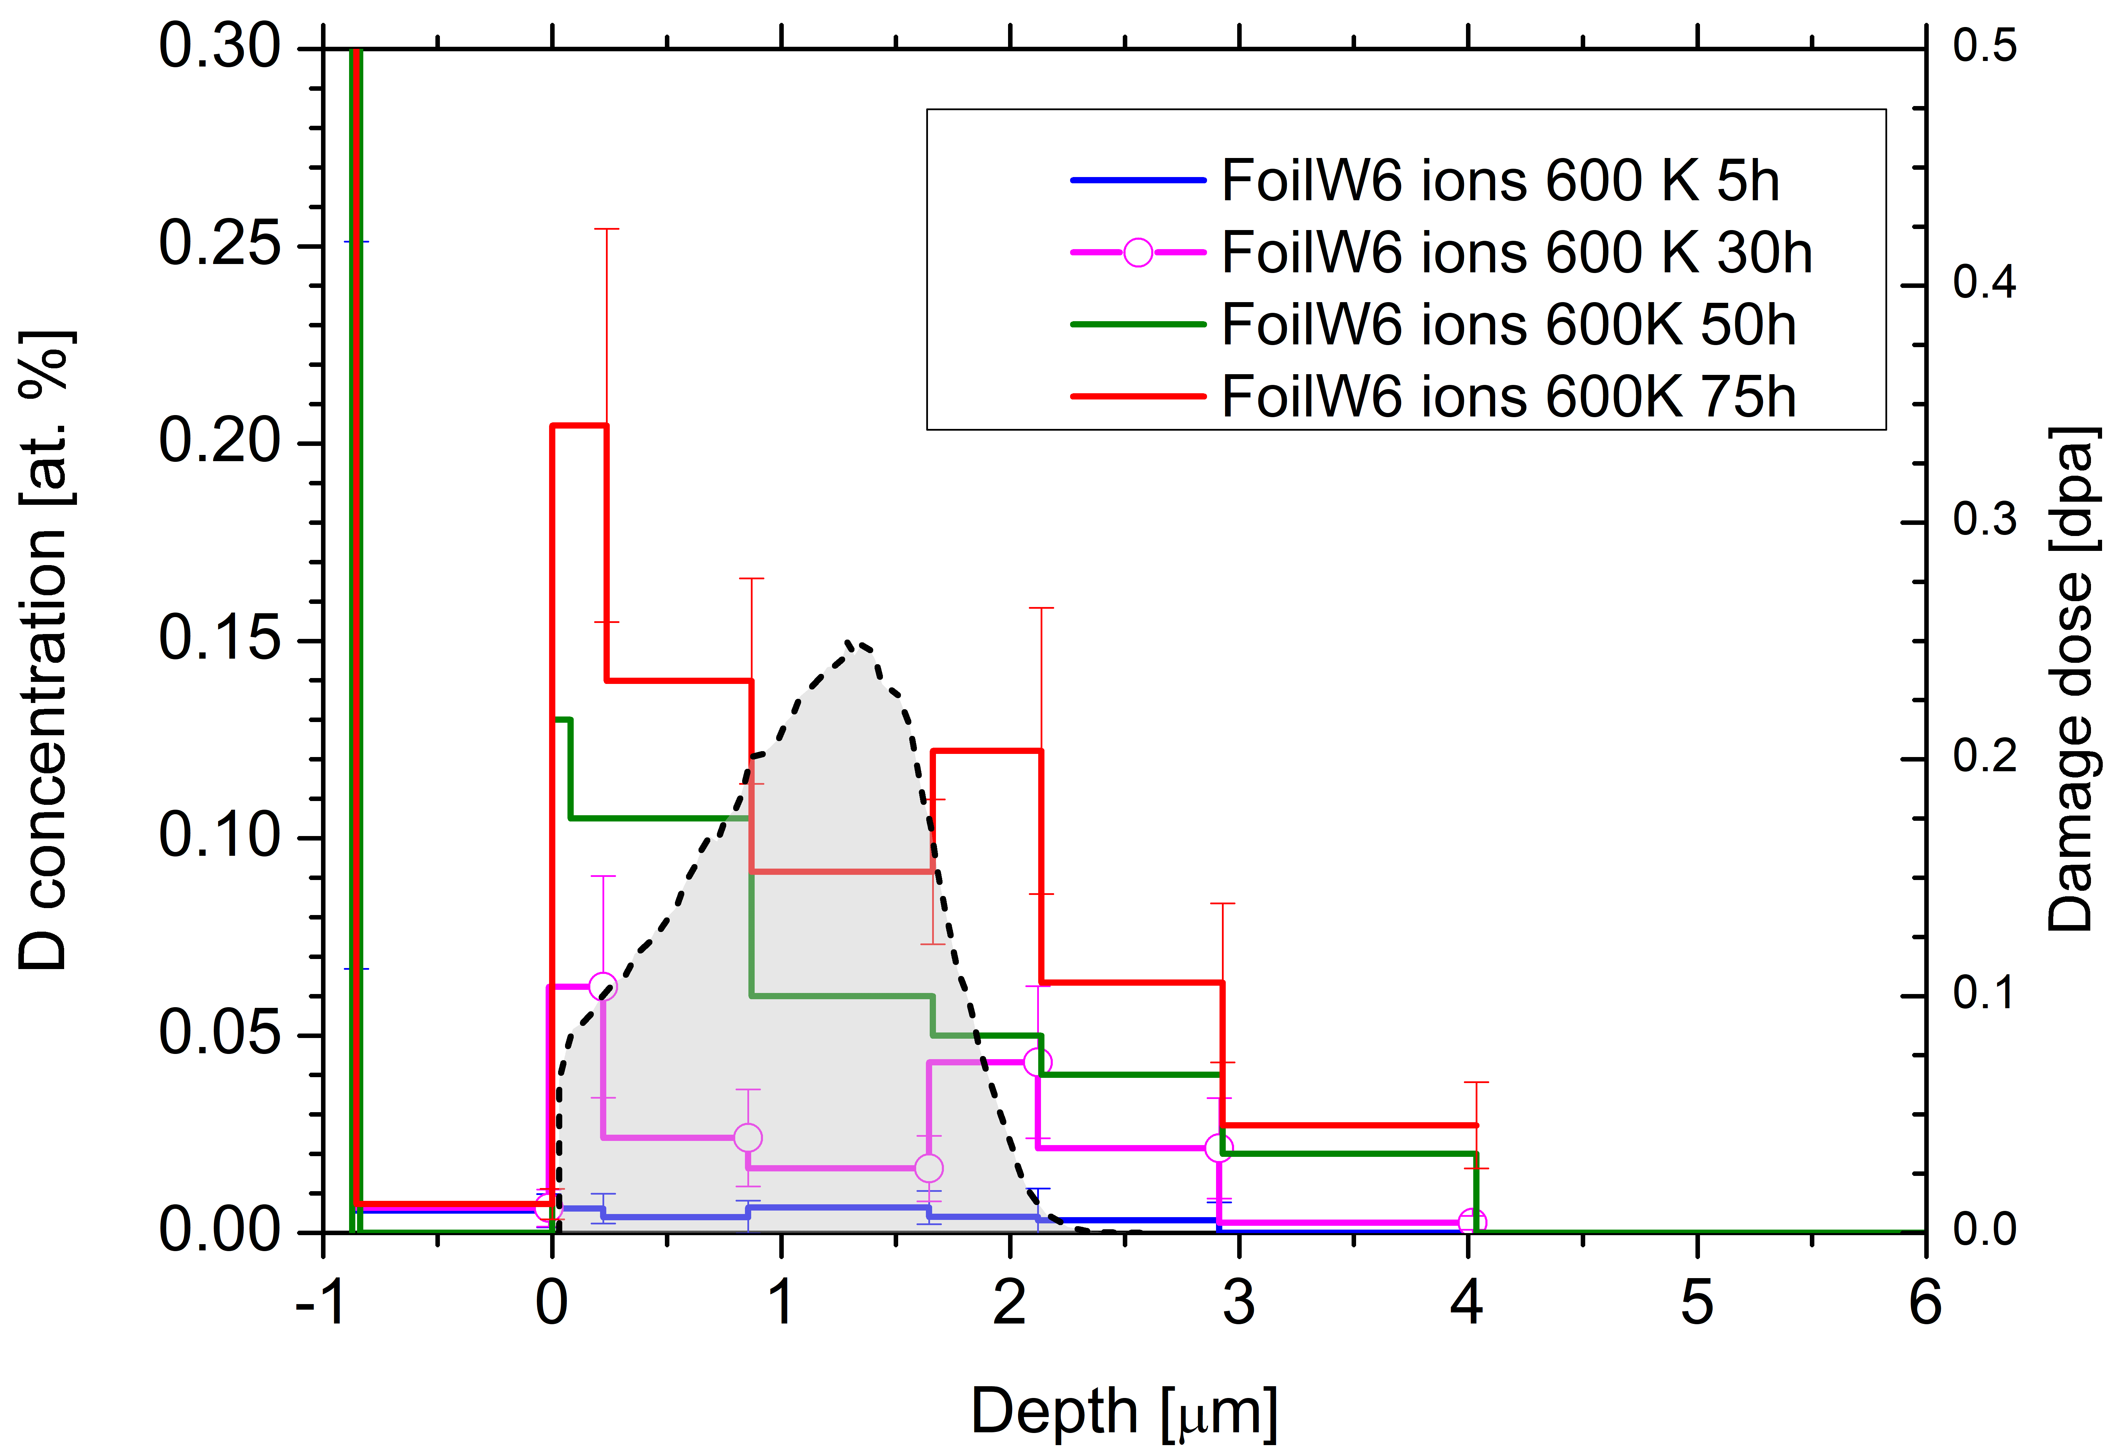

2023
Compare D permeation through W with D atoms and 300 eV/D ions
Study the differences in D transport (permeation) in a W foil (recrystallized) between 0.3 eV D atoms and 300 eV/D ions based on in situ IBA during exposure
Experiment
Exposure to
D atoms (flux 5e18 D/m²) at 600/700 K for ~ 160 h/ 250 h (134 h present - ongoing)
D ions (flux ?e18 D/m²) for ~ 600/700 K for ~ 75 h/ 96h
Observations
Measured D depth profiles on the downstream side
Ions - Surprise: No diffusion front visible but raising D concentration within damaged layer
Grain boundary diffusion?
Markelj
Notes:
The ion flux still needs to be measured by faraday cup to get the flux in the middle of the sample.

Slide 14
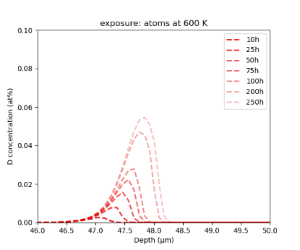
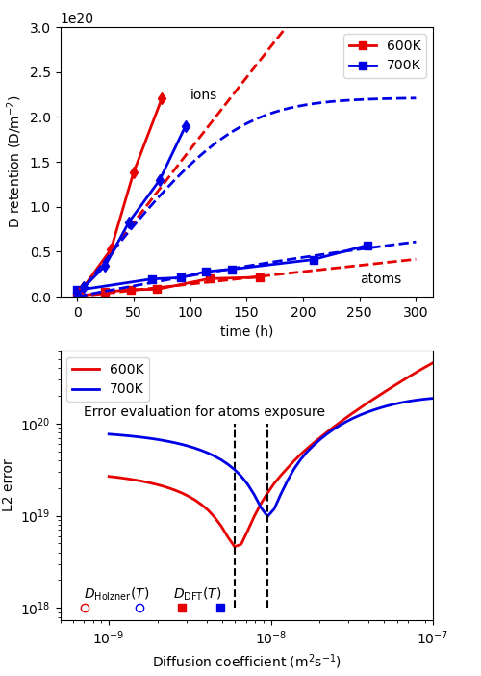
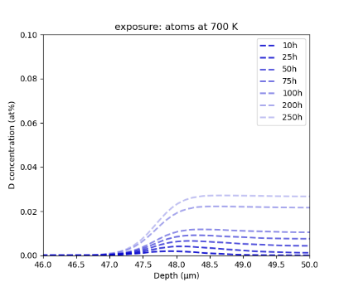
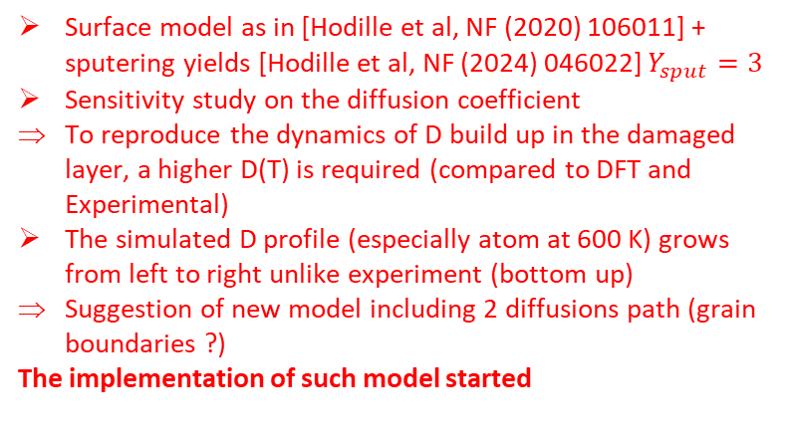
SP C.1 Transport of Hydrogen through the first wall of fusion devices: CEA
Context: S. Markelj performed atom driven permeation through a 50 µm
  Permeation is detected with the D build up in a self-damaged layer in the downstream side
Objectives: simulated the D build up inventory and depth concentration with MHIMS
Surface model as in [Hodille et al, NF (2020) 106011] + sputering yields [Hodille et al, NF (2024) 046022] $Y_{sput}=3$
Sensitivity study on the diffusion coefficient
To reproduce the dynamics of D build up in the damaged layer, a higher D(T) is required (compared to DFT and Experimental)
The simulated D profile (especially atom at 600 K) grows from left to right unlike experiment (bottom up)
Suggestion of new model including 2 diffusions path (grain boundaries ?)
The implementation of such model started
Deliverable: PWIE-SP C.1.T-004-D001
Status: partially done
Facilities: None or Modelling: MHIMS
Linked WP or TSVV:

Slide 15
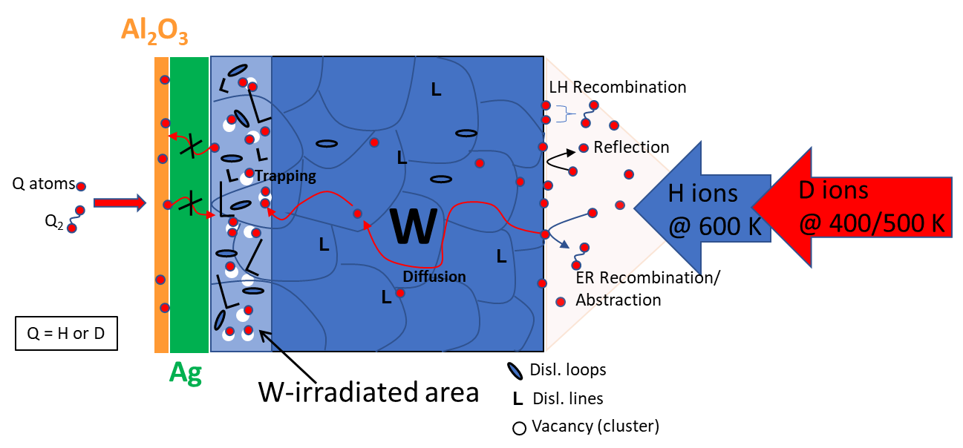
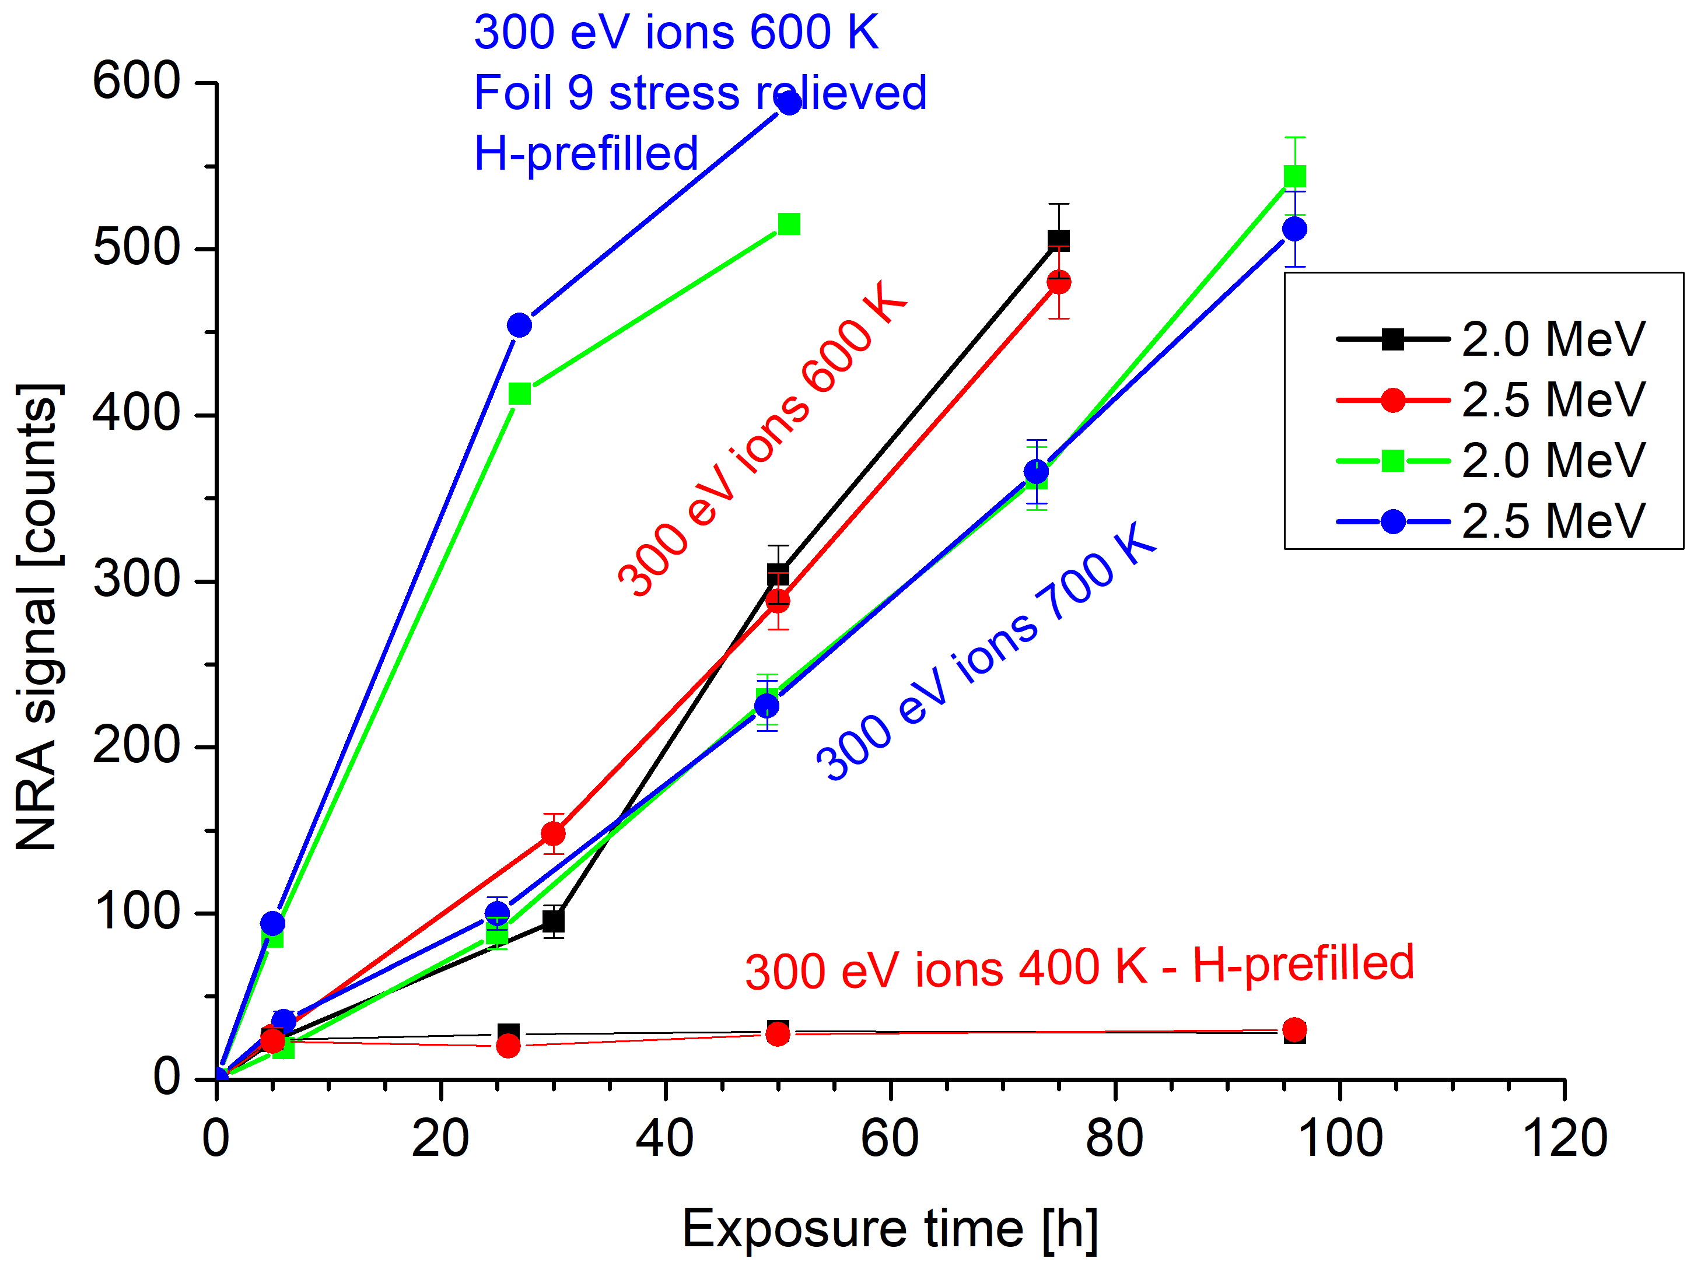
SP C.1 Transport of Hydrogen through the first wall of fusion devices: JSI
D permeation through W foil with 300 eV/D ions
Task: Study of D permeation in H-prefilled W foil at low temperatures
Experiment
Exposure of stress-relieved 50 µm W foils with protective layer Al₂O₃
Exposure to H ions (flux 3x10¹⁸ H/m²s) at 600 K for 24h
Exposure to D ions at 400 K and 500 K –
flux 2.7x10¹⁸ D/m2s
Observations
After 96 h the NRA signal the same as after 4 h
No observable D uptake at 400 K even after H prefilling at 600 K to saturate the deep traps
Graph shows comparison to previous exposures at 600 K and 700 K
500 K exposure ongoing
Deliverable: PWIE-SP C.1.T-T004-D004
Status: Completed
Facilities: accelerator 8 days
Linked WP or TSVV: if required

Slide 16
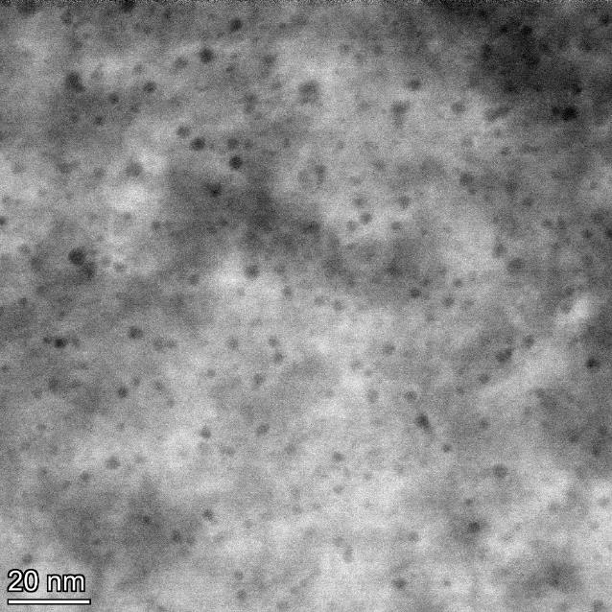
SP C.1 Transport of Hydrogen through the first wall of fusion devices: IPPLM
WUT (IPPLM): Analysis of void formation
STEM observations of bubbles on samples provided by dr. Zibrov
Quantification of bubbles density and sizes with use of micrsocopic techniques
A new methodology for imaging bubbles has been developed on the basis of Scanning Trasmission Electron Microscopy
It allows to eliminate inaccuracies in buble size related to the defocus in conventional TEM imaging
Deliverable: PWIE-SP C.C1.T-T004-D005
Status: completed
Facilities: STEM Spectra200, FIB Hitachi NB5000
Linked WP or TSVV: not required

Slide 17
SP C.1 Transport of Hydrogen through the first wall of fusion devices: VR
Task: IBA analysis of (re-deposited) W on EUROFER with ÖAW.
Deliverable: Preparation of W/EUROFER layer system + IBA analysis for ÖAW.
Atomic Depth Profile using
ToF-ERDA I⁸⁺ 36 MeV:
Investigation of the effect of re-deposited materials on the deuterium retention.
  Influence of re-deposited EUROFER on W as deuterium barrier.
Sputter-deposition and characterization of films from W and EUROFER97 targets by Ion Beam Analysis: low presence of contaminations on W layer; oxygen on surface of thin re-deposited EUROFER from air exposure (see figure).
Experimental Campaign at SIGMA Beam-Line (UU) for in-situ studies:
  Deuterium implantation followed by IBA (RBS and ERDA) for composition and depth profile of structures simultaneous to TDS.
  Influence of re-deposited EUROFER97 layer in D retention less evident than
  re-deposited W on EUROFER (summary at M. Fellinger slide).
Deliverable: PWIE-SP C.C1.T-T004-D007
Status: completed
Facilities: -
Linked WP or TSVV: -

Slide 18
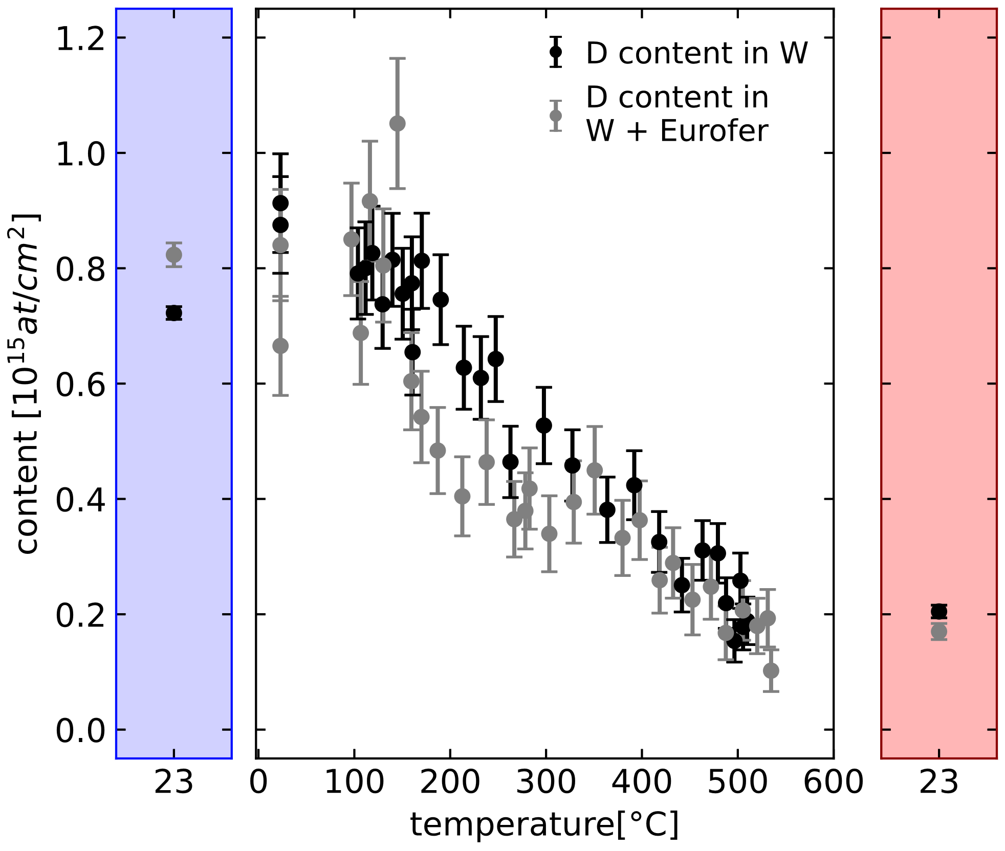
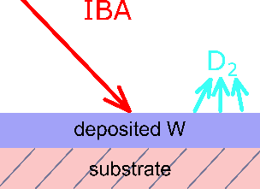
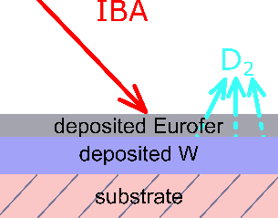
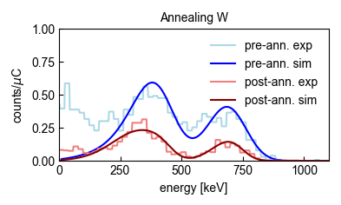
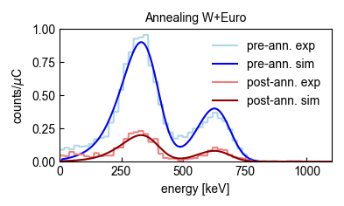
SP C.1 Transport of Hydrogen through the first wall of fusion devices: ÖAW
Task: Studying the influence of (re-deposited) W/EUROFER layers on D retention (ÖAW, VR))
Deliverable: Influence of inverted layer system EUROFER layer on D-implanted W layer on D retention
pre-
ann.
post-
ann.
exp. 1: TDS on D loaded W
exp. 2: TDS on D loaded W + Eurofer
̴20 nm
̴180 nm
̴180 nm
ERDA spectrum W
ERDA spectrum W + Eurofer
H
H
→ investigated whether a re-deposited Eurofer layer effects D retention in W by performing two comparable TDS experiments
→ found no significant difference in outgassing behaviour of D; Eurofer layer does not significantly block outgassing of retained D in W
→ Last years reverse experiment showed W layers block out-diffusion
→ elemental characterization of sample on E. Pitthan slide
D
D
Deliverable PWIE-SP C.1.T004-D006
Status: completed
Facilities: VR 1 day
Linked WP or TSVV: -

Slide 19
SP-C2
T retention Release from B layers

Slide 20
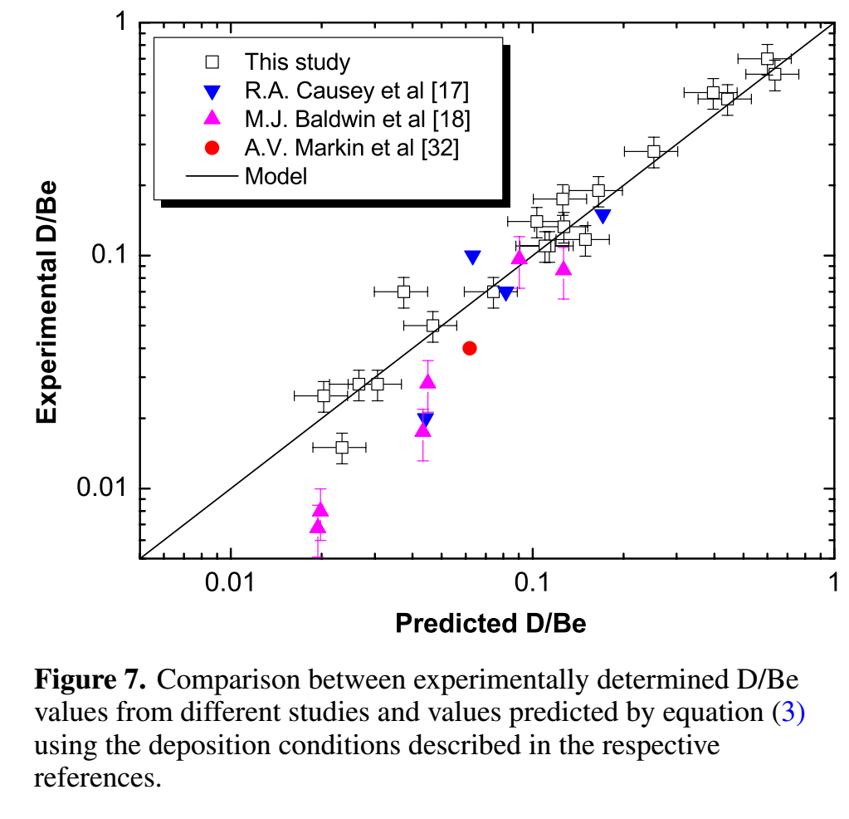
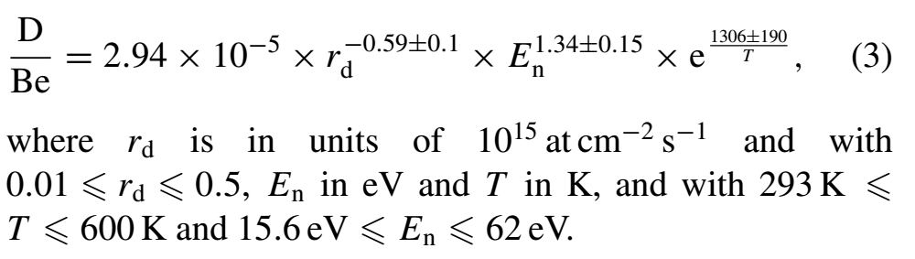
T retention Release from B layers
Ultimate goal: Scaling law for D/B like G. De Temmerman Nucl. Fusion 48 (2008) 075008
Example D/Be
a-BD layers differ greatly depending on deposition parameters:
A. Annen Thin Solid Films 300 (1997) p.101
Need to co-deposit B and D not implant into B layers
Vary temperature, deposition rate and energy

Slide 21
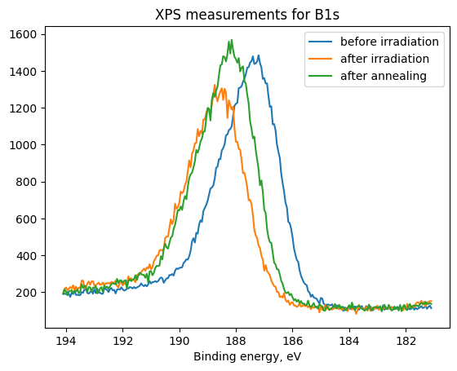
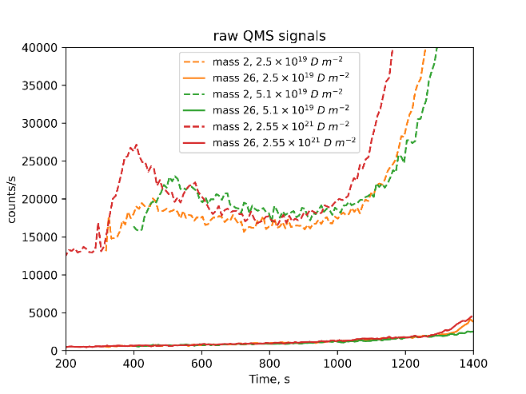
SP C.2 Study the branching ratio of desorption products from B layers implanted with D ions : CEA
Bisson, Afonin, Angot, Minissale – AMU
Branching ratio of H/D desorption products from B-layers
B bulk sample (99.9% purity)
XPS shows a chemical shift upon H₂⁺ irradiation
Reduction of chemical shift when annealing at 1023 K
Partial desorption of H ? H still retained in B at 1023 K ?
D₂⁺ irradiation on-going to beat the H₂ background for
high temperature desorption (> 1000 K)
m/z=26 (¹⁰⁻¹¹B₂H₅₋₆) should be most probable in QMS
H₂ (m/z=2) desorption < 1000 K without detection of m/z=26
Higher-limit branching ratio (based on ionization cross-sections and flux) for < 1000 K: B₂H₆ < 5.10⁻⁴*H₂
+
Deliverable: PWIE-SP C.2.T-004-D001
Status: partially done (will be completed in December)
Facilities: none or Modelling: none
Linked WP or TSVV: none

Slide 22
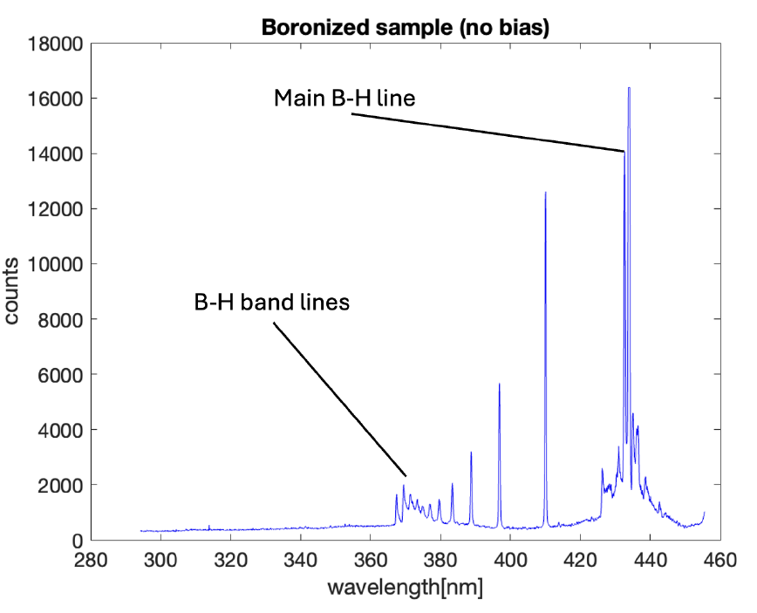
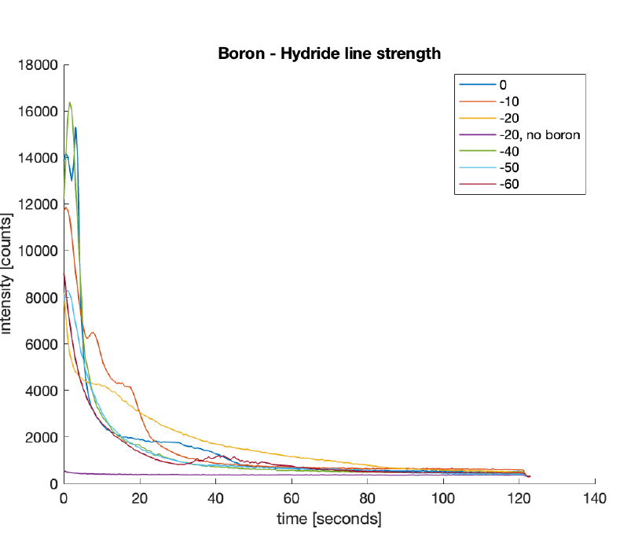
SP C.2 T retention release from B layers: DIFFER
Use of boronization in ITER will lead to B migration and co-deposition with D
Goal to create in-situ deposited B layers and implant D
Task: Evaluation of D/B ratio in co-deposited boron
Results:
B layers created using pulsed laser deposition
40 nm thick layers with low O content created
Exposure to D plasma resulted in erosion of B films thus unable to evaluate D/B ratio
This suggests chemical erosion is important at low ion energies
Planned to create new layers to evaluate this effect further
Deliverable: PWIE-SP C.2.T-004-D002
Status: partially done
Facilities: Magnum-PSI (3 days) and IB accelerator (4 days)
Linked WP or TSVV: none

Slide 23
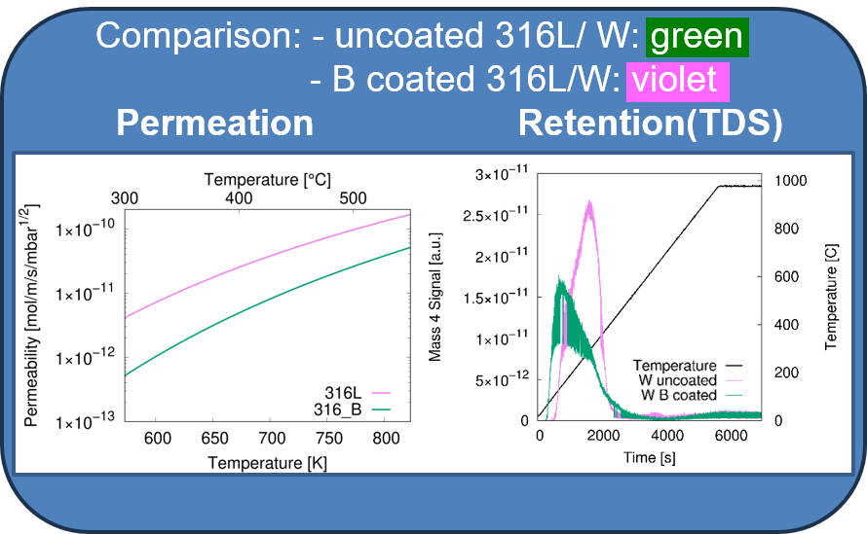
SP C.1 Transport of Hydrogen through the first wall of fusion devices: FZJ
Gas driven permeation and hydrogen retention in boron coated steel or W
Influence of boron coatings on the hydrogen permeation and retention on W or steel
Samples
Polished and annealed 316L-IG and W samples
Coated with ~100 nm B by magnetron sputter deposition
For permeation: B on 316L-IG, both sides/one side coated
For retention: B on W, D Ion loaded (250 eV D ions, fluence: 4.2∙10¹⁸ cm⁻²), loaded uncoated W for comparison
Permeation measurements:
One order of magnitude lower permeation flux compared to uncoat. 316L -> low B permeability
Retention measurements (TDS):
Deuterium release at lower temperatures compared to uncoated W
Outlook
Permeation measurement of one side coated 316L-IG sample (ongoing)
Further analysis of TDS data
Next year: same measurements on mixed B layers, e.g. B:D and B:W
Deliverable: PWIE-SP C.2.T-004-D004
Status: completed
Facilities: e.g. Plasma device / accelerator # days or Modelling: Code name
Linked WP or TSVV: if required

Slide 24
SP-C3
Influence of He, high-flux D and impurities on Hydrogen retention and transport

Slide 25
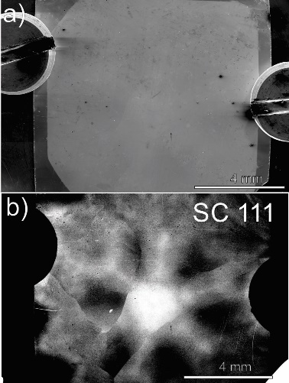
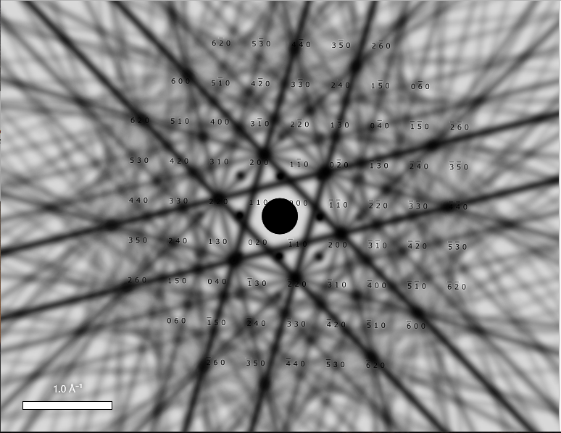
SP C.1 Transport of Hydrogen through the first wall of fusion devices: JSI
Single crystal W samples exposed to 20 MeV W ions to 0.3 dpa at 1350 K and D plasma for 72h at 370K (MPG)
Main objective: lattice defects after high-temperature W+D exposure
(Deliverable: analysis of void formation )
The sample is single-crystal W<111>, with additional few defects (dislocation lines-marked with arrows)
Lamella for TEM analysis is prepared
TEM analysis until the end of 2024
Image description:
a) low-mag SEM micrograph of the surface of W-ion irradiated single-crystal W sample in W<111> orientation, mounted in holder. Note the contrast change on the rim of the sample, marking the exposed and shadowed regions.
b) Electron backscattered channelling contrast image, generated as interaction of primary electron beam with the crystal structure of the sample. The characteristic pattern is correlated by simulation for validation of surface quality, defect identification, and azimutal positioning.
SIM W<111>
Deliverable: PWIE-SP C.3-T004-D001
Status: in progress
Facilities: EM laboratory (SEM, FIB, TEM) and sample prep facility.
Notes:
PWIE-SP C.3.T-T004‚ Influence of He, high-flux D and impurities on Hydrogen retention and transport (2024)
TASK: TEM analysis W damaged at high temperatures. In cooperation with MPG IPP (JSI, MPG)

Slide 26
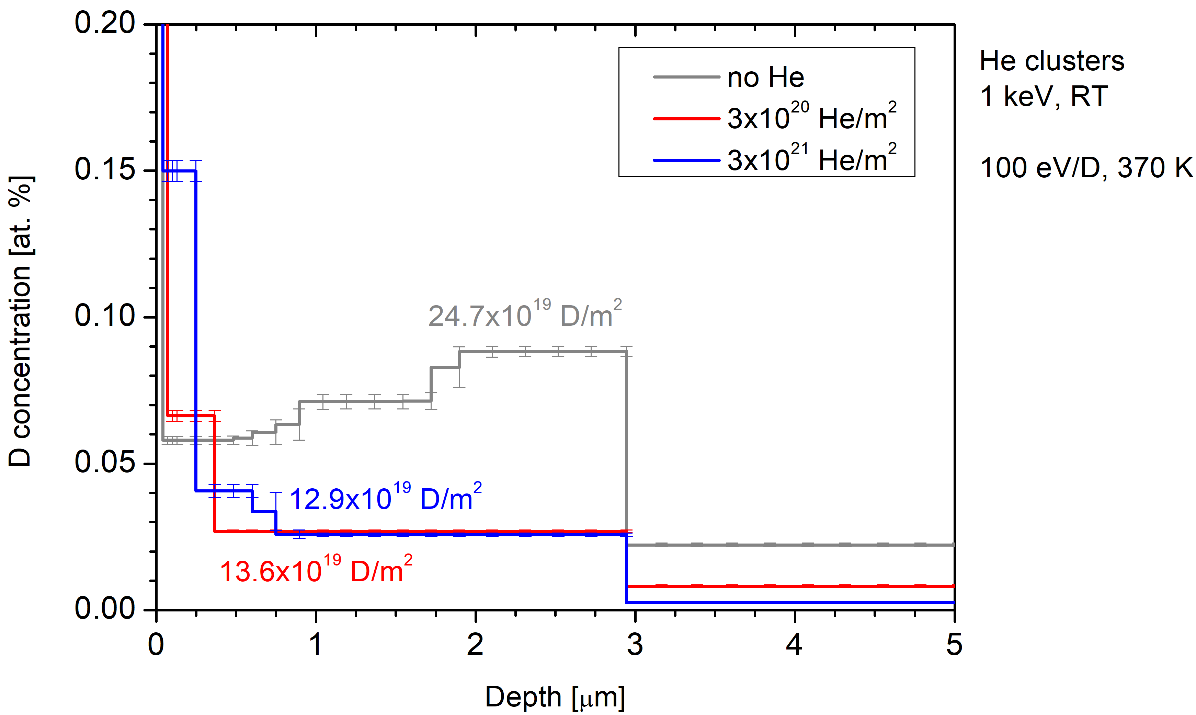
SP C.3 Influence of surface He pre-implantation on D retention in EUROFER: JSI
Surface He clusters/bubbles inhibited D uptake in tungsten (W) Will He implanted near the surface have the same effect in EUROFER?
Irradiate EUROFER by 20 MeV W, 0.5 dpa @ RT (MPG);
Irradiate by 1 keV He ions @ RT (He cluster/bubbles);
Expose to 100 eV/D ions at 370 K to study D uptake;
NRA: D depth profiles in He-irradiated samples and He-free reference sample
The effect of decreased D uptake is present
But less pronounced:
Factor of 2 in EUROFER as compared to factor of 5 in W
Still to do:
The high fluence 5.5e21 He sample is under analysis
Microscopy analysis of the He layer
Deliverable: PWIE-SP C.3.T-004-D001/D002
Status: completed
Facilities: accelerator 8 days
Linked WP or TSVV: if required

Slide 27
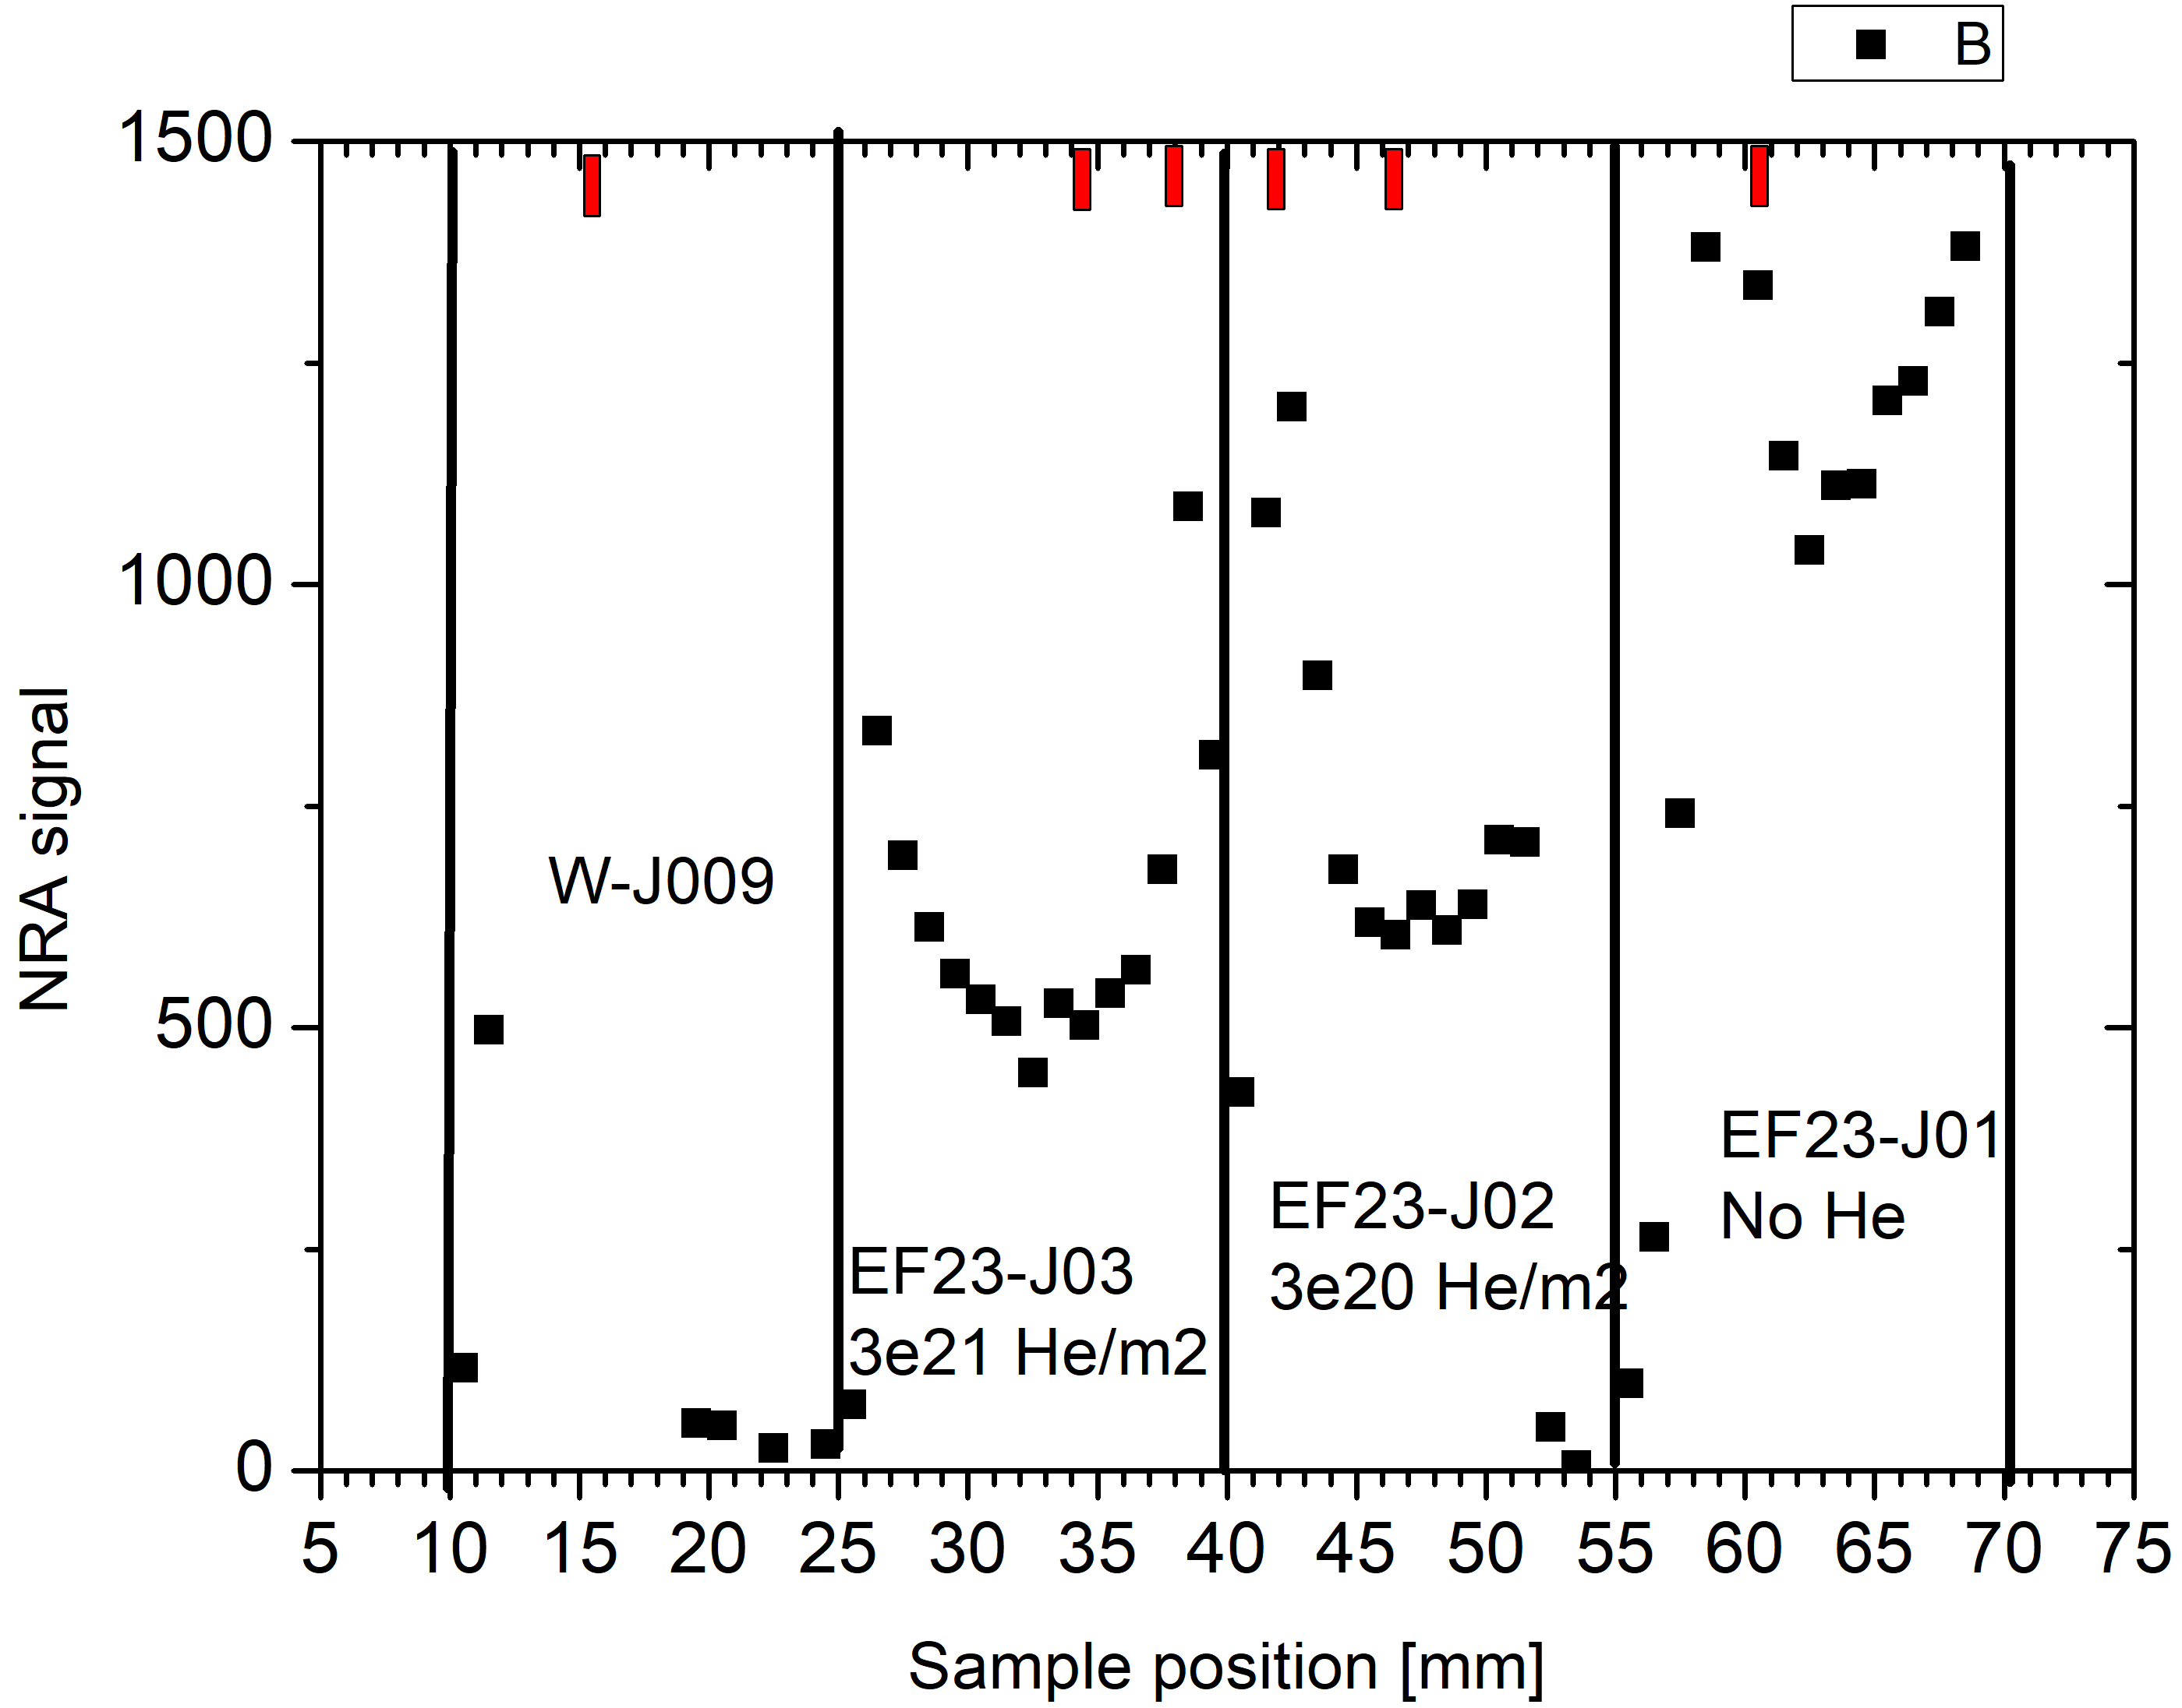
SP C.3 Influence of surface He pre-implantation on D retention in EUROFER: JSI
Surface He clusters/bubbles inhibited D uptake in tungsten (W) Will He implanted near the surface have the same effect in EUROFER?
Irradiate EUROFER by 20 MeV W, 0.5 dpa @ RT (MPG);
Irradiate by 1 keV He ions @ RT (He cluster/bubbles);
Expose to 100 eV/D ions at 370 K to study D uptake;
Scan along the samples – shows the influence of He profile od D uptake
NRA: D depth profiles in He-irradiated samples and He-free reference sample
The effect of decreased D uptake is present
The effect of He profile observed on the D uptake in line scans
Edge high amount of D are areas without He
Still to do:
The high fluence 5.5e21 He sample is under analysis
Microscopy analysis of the He layer
Deliverable: PWIE-SP C.3.T-004-D001
Status: completed
Facilities: accelerator 8 days
Linked WP or TSVV: if required

Slide 28
SP-C4
Influence of n-damage on Hydrogen retention and transport

Slide 29
SP C.4 Influence of n-damage on Hydrogen retention and transport
Trap site generation by displacement damage in EUROFER at high temperatures
Task: Compare trap concentration for annealed EUROFER and EUROFER damaged at same high temperature
Experiment:
20 MeV W-ion & 0.5 MeV He-ion irradiation at high-T up to 0.6 dpa and 0.6 at. % He & D plasma exposure at 370 K
Results:
Irradiation at high-T results in a lower trap concentration compared to irradiation at RT followed by annealing at the same T.
The presence of He atoms increases D retention compared to the only displacement damage case
He-related trap sites can survive up to 770 K
Post-irradiation cooling rate can affect trap concentration
Deliverable: PWIE-SP C.4.T-004-D001
Status: completed
Facilities: Tandem accelerator IPP

Slide 30
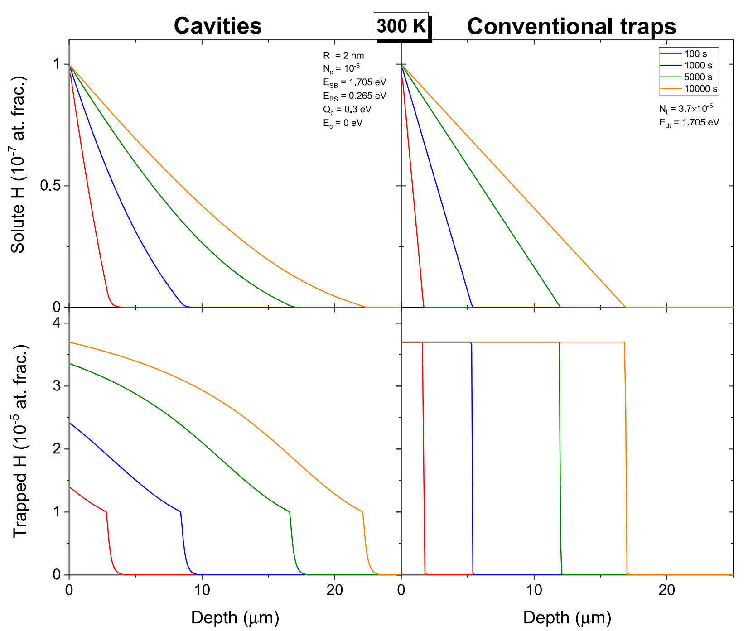
H uptake into cavities vs conventional traps
M. Zibrov and K. Schmid NME 32 (2022) 101219
Pressure builds up in cavities over time
Conventional traps have fixed fill level
„cavitiy filling direction“
„normal filling direction“
Difference goes away at high T

Slide 31
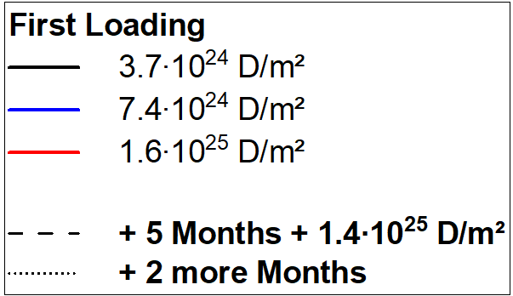
SP C.1 Transport of Hydrogen through the first wall of fusion devices: MPG
D uptake in point defects in W was studied in the past
Here: D uptake in nm-sized cavities in W single crystals
„observed filling direction“
Cavities produced by 20 MeV
W-irradiation at 1350 K
D Plasma + Nuclear Reaction Analysis for:
- Different D fluences
- After waiting time/outgassing
D-uptake starts at surface then into depth
No D loss during storage in desiccator
D uptake differs between continuous and interrupted loading
Next: TDS, More fluences; Isotope Exchange (2025)
„normal filling direction“
Deliverable: PWIE-SP C.4.T-T004-D001
Status: in progress
Facilities: 7 accelerator days so far
Linked WP or TSVV: if required
Damaging Temperature: 1350 K
D Loading Temperature: 370 K

Slide 32
SP-C5
T-permeation experiments in 316L

Slide 33
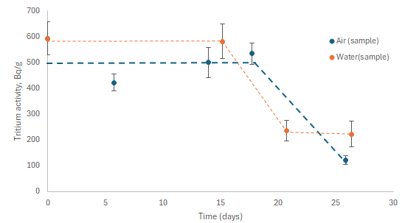
SP C.1 Transport of Hydrogen through the first wall of fusion devices: UoL
Difference between tritium diffusion through SS316 stainless steel with gas/gas, water/water and gas/water as interfaces has been assessed
3 different methods have been tested for tritium diffusion – gas permeation (HT), water permeation (HTO) and loading/outgassing
For both permeation experiments results for gas/gas and water/water interfaces have been tested up to now, but they are difficult to compare before full evaluation and calculations
For HT permeation results show that tritium is oxidized during permeation and arrives at the permeated side as HTO
Loading experiments indicate that T permeates through a H pre-loaded sample of 0.025 mm thickness within 21-26 days
Due to lack of time only a few data points have been collected as of now in the region of interest (26+ days), more will be available by the end of the year
Loaded tritium concentration decrease in sample (air atmosphere) and tritium increase in water (water atmosphere) for 0.025 mm SS316L stainless steel.
Results show similar flux for both, but there are not enough points in the region of interest to make any conclusions and different aspects must also be taken into account like form of tritium (HT/HTO)
Deliverable: PWIE-SP C.5.T-004-D001
Status: completed / partially done / in progress / delayed / cancelled
Facilities: University of Latvia
Linked WP or TSVV: if required

Slide 34
Planning
Plans for the 2025 programme
This is not a complete list but introduces new tasks

Slide 35
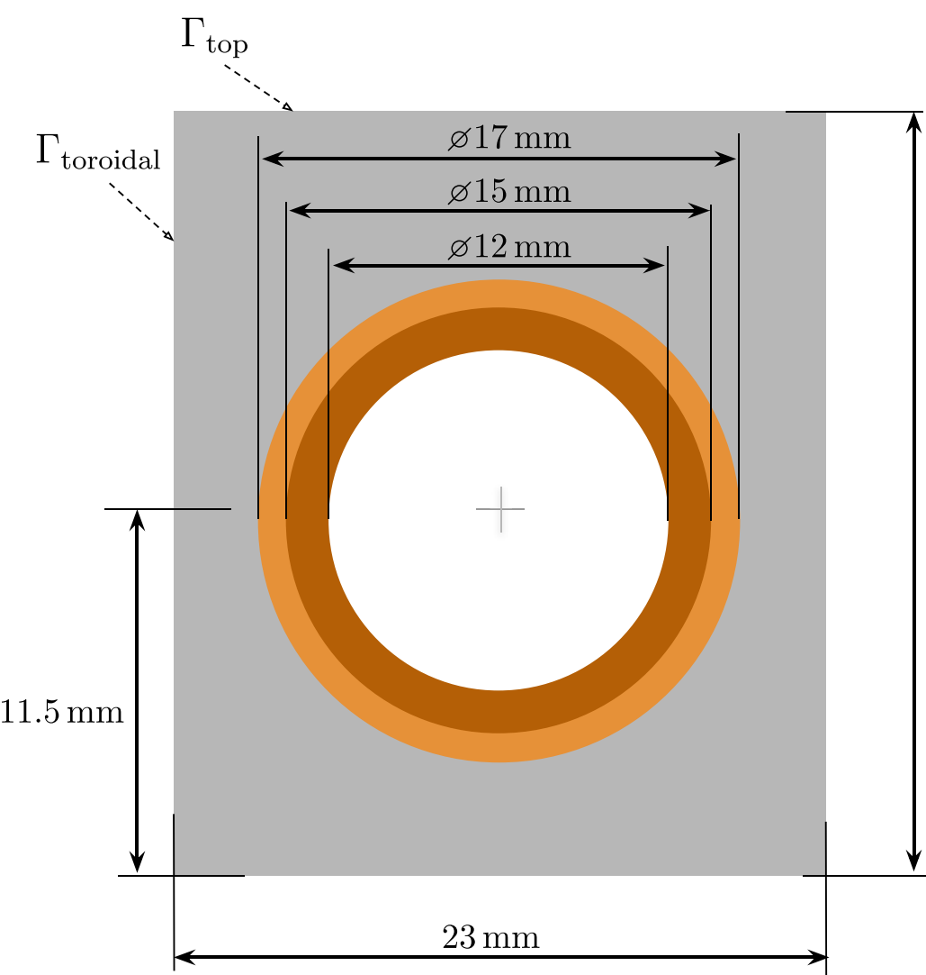
Retention in Cu and CuCrZr
W-monoblock divertor concept is based on a Cu, CuCrZr heatsink
Very little data is available on trapping in Cu or CuCrZr
NO data is available on trapping in displacement damaged Cu or CuCrZr
R. Delaporte-Mathurin et al, Nucl. Fusion 64 (2024) 026003

Slide 36
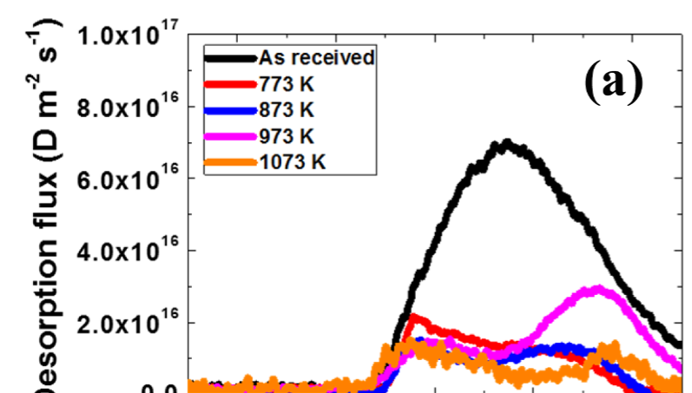
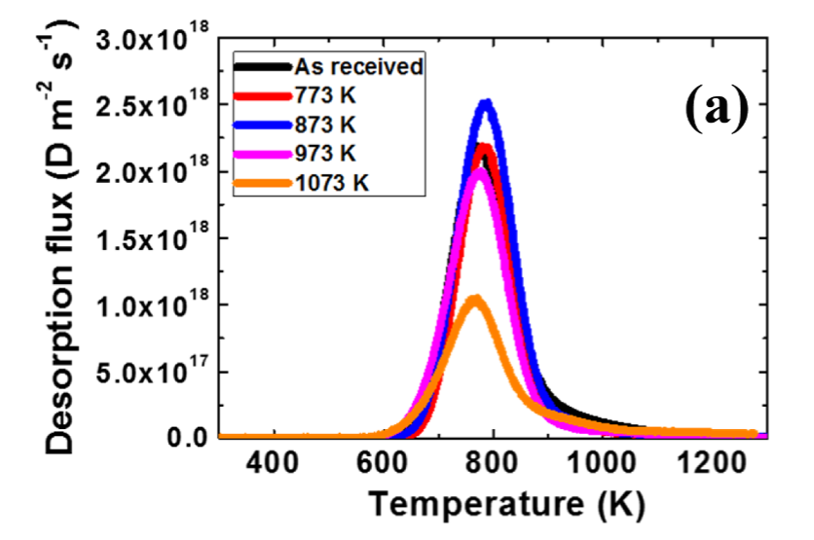
Retention in Cu and CuCrZr
Literature data on undamaged Cu and CuCrZr suggest release up to very high temperatures
Cu
Retention in CuCrZr ~ 10 x Cu
H.-D. Liu, et al, Nuclear Materials and Energy 23 (2020) 100755

Slide 37
Retention in Cu and CuCrZr
Plan for 2025
Obtain TDS spectra of: Cu and CuCrZr both with and without displacement damage
Loading of undamaged Cu and CuCrZr:
  Find reasonable loading parameters (temperature & energy):
  → No blistering
  → No excessive outgassing during cool down
  → No excessive sputtering (atom/gas/gentle plasma)
DPA series from 0.01 to 1 dpa → search for trap saturation
Planned joint effort by FZJ, JSI and MPG

Slide 38
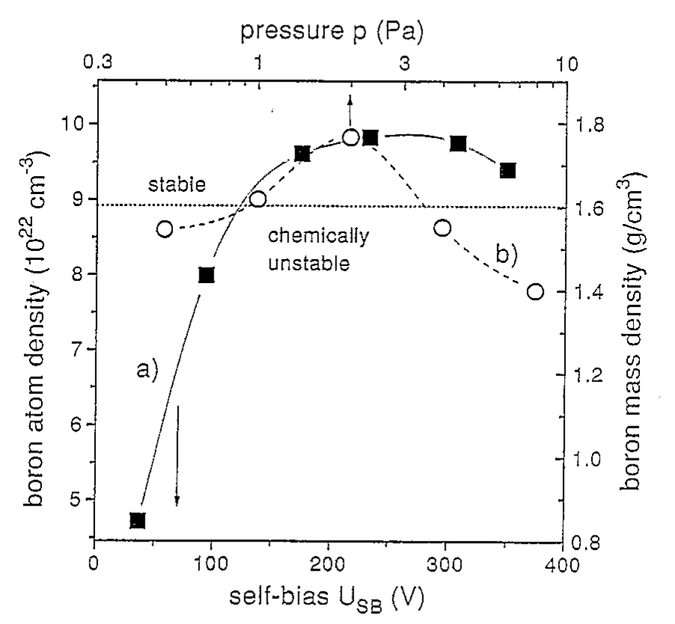
B+D co-deposition
Ultimate goal is a scaling for the D/B ratio similar to what was available for Be
→ For this we need co-deposited layer and no pre-deposited B layers that are then exposed to plasma
Co-deposit B and D in a linear plasma device varying:
Deposition rate (vary upstream B source)
Temperature (heated catcher sample)
Particle energy (bias)
→ This produces very different layers
upstream B source:
Di-borane gas (→ chalenging safety precautions nescessary)
Erode a junk of B by the plasma (→ homogenity of depostion? May be a feature?)
...

Slide 39
Permeation into water
Bulk material not too important the question is the boundary condtion at the solid/water interface
Focus should be on comparision of gas/gas vs. gas/water experiments

