Slide 1
SP B status report 2024
WPPWIE reporting meeting, virtual, 20-21 November 2024
Antti Hakola
On behalf of the SP B team and task holders

Slide 2
Introduction and original plans of SP B in 2024
SP B has the same main activity areas (SP B.1, SP B.2, SP B.3, SP B.4, and SP B.5) in 2024 as before plus a new SP B.6:
SP B.1: Physics of erosion and deposition - focus on cross-machine investigations
  Impact of flux on erosion (continuation from 2023); extend the investigations to samples with re-deposited W
  Include B-containing layers and dust-impact studies on the agenda
SP B.2: Material migration in toroidal devices - concentrate on WEST ITER-like PFUs and samples from boronization studies
  Analyses of WEST C3-C5 marker tiles and monoblock samples once available
  Production of samples for boronization studies and analyses of AUG/WEST components for their B profiles
  Continue analysis of varying samples from W7-X
SP B.3: Characterization of plasma-exposed materials - samples coming from SP B.1 and SP B.2 (+ SP B.4)
SP B.4: Reference coatings for ITER and DEMO - production of B and W layers
  Includes coatings simulating re-deposits following material migration
SP B.5: Production of metallic dust in toroidal devices – as in 2023 but include also detailed dust analyses
  Studying the formation of B and W dust particles in varying operational conditions, including water and air leaks
  Analyses of AUG, WEST, and W7-X dust following boronizations
SP B.6: B deposition on diagnostics mirrors - NEW
  Fabrication and pre-characterization of Mo mirrors before their exposure to plasmas in W7-X and AUG
  Post-exposure analyses of the mirrors for changes in their optical properties

Slide 3
Where are we with the SP B activities?
Generally work has progressed more slowly than anticipated in the midterm meeting in April
  W program (SP B.1 + SP B.4) fixed in May-June while the first plans for the B program only recently drafted
  No new samples from AUG or WEST → waiting for new campaigns and experiments in late 2024 and early 2025 → impact on SP B.2 and SP B.3
  Additional dust activities (SP B.5) ongoing only from July onwards and review tasks of old results suffered from lack of human resources
Excluding the new dust activities, no big changes implemented to the already established PM levels (=envelope integrated over all the different SP B.x) – now additional funding received from EUROfusion and more to come for B activities
The following meetings were organized under SP B - or contributing to the SP B work programme
  Kick-off meeting for the SP B 2024 tasks in 24 January → brainstorming for the contents of the tasks
  Tervaniemi meeting in 6-9 February → discussions on the new ITER baseline in the grassroots level
  Midterm meeting in Helsinki in 9-11 April → first draft for the 2024 work plan discussed
  Meeting on W samples in 6 May and their exposure program in linear machines in 13 June
  Analysis meeting to discuss the results obtained from WEST samples in 1-2 July
  TE-PWIE meeting on ITER baseline in Aix in 17-19 September → more in-depth discussions on the implications of the new ITER baseline
  Meeting on B samples in 9 October → brainstorming for their production and analyses in 2024-2025
  SP B monitoring meeting in 17 October → discussion on the status of activities and drafting plans for the next couple of months

Slide 4
SP B highlights up to now
SP B.1 – W and B programmes made progress
  W samples with FIB markers produced for cross-machine experiments on GyM, PSI-2, and MAGNUM
  Different B samples available for plasma exposures in PSI-2 and MAGNUM
  Dynamic erosion studies made for nanocrystalline W samples and delamination studies of W coatings upon exposure to dust impacts completed
SP B.2 – new results obtained from WEST and W7-X
  Erosion/deposition results obtained from WEST marker samples throughly discussed and publication plan drafted
  New samples recently becoming available for analyses from W7-X manipulator experiments
  Impact of melt events on W7-X wall components and AUG/WEST samples thoroughly investigated
SP B.3 – slow progress due to overall delay in SP B
  Main work done for the analysis of WEST samples from marker tiles and monoblocks
  Some activities on the samples from SP B.1 experiments
SP B.4 – W programme consolidated and sample production ongoing
  New batches of W samples produced and shipped (or will be shipped) to the participating labs for analyses; especially nanocolumnar W samples show interesting features on their surfaces
  First tests for in situ deposition of B layers and their erosion on MAGNUM carried out
SP B.5 – W and B dust particles produced in laboratory conditions and synthesis of previous dust remobilization studies
  Role of water leaks in the production of W dust particles clarified → increased oxidization and fuel retention
  Recipes developed for producing B dust particles
  Good understanding available on dust formation mechanisms for nanoscale particles

Slide 5
SP B milestones in 2024
WM86 | SP B | Production and detailed characterization of co-deposited boron layers (B, B-O, B-W) with varying amounts of fuel (D) for erosion and fuel-retention studies (ITER) | 31.12.2024 Only recently started
WM87 | SP B | Erosion and re-deposition rates of model systems for re-deposited W layers in metallic fusion devices as a function of plasma para-meters expected in a reactor estimated (ITER+DEMO) | 31.12.2024 W program made progress
WM88 | SP B | Comparison between deposition and surface-modification patterns on marker tiles and ITER-like PFUs after the Phase 1 and long-pulse operation of WEST done (ITER) | 31.12.2024 Marker-tile results discussed
WM89 | SP B | Characteristics of dust produced in metallic fusion devices with and without boronizations and comparison with B-containing dust produced in corresponding laboratory experiments (ITER+DEMO) | 31.12.2024 Dust analysis activities pending

Slide 6
SP B.1 - Physics of erosion and deposition

Slide 7
SP B.1 deliverables in 2024
Activity | Deliverable ID(s) | Title
SP B.1 | D001 5 PM | Erosion rates of W model systems in Ar/He/D plasmas and sputtering rates of B and W+B layers at varying D plasma conditions in MAGNUM-PSI (DIFFER)
SP B.1 | D002 4 PM | Erosion rates of W model systems in Ar/He/D plasmas and sputtering rates of B and W+B layers at varying D plasma conditions in GyM (ENEA)
SP B.1 | D003 7 PM | Erosion rates of W model systems in Ar/He/D plasmas and sputtering rates of B and W+B layers at varying D plasma conditions in PSI-2 (FZJ)
SP B.1 | D004 5 PM | Erosion rates of re-deposited W and W+B model systems following exposure to controlled D ion beams (ÖAW)
SP B.1 | D005 1 PM | Erosion and deposition patterns following high-energy dust impacts on W model systems and comparison to data from tokamaks (ENEA)

Slide 8
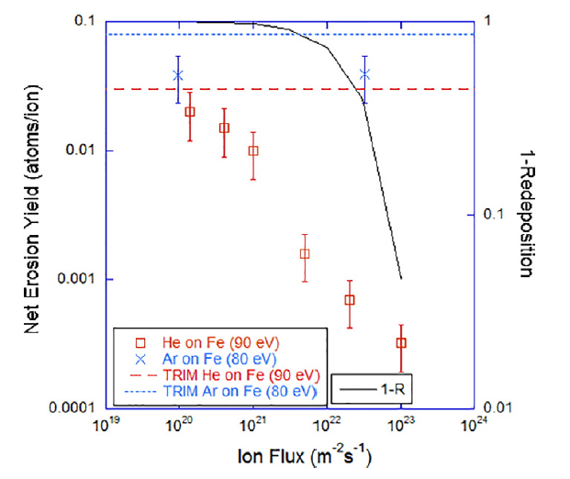
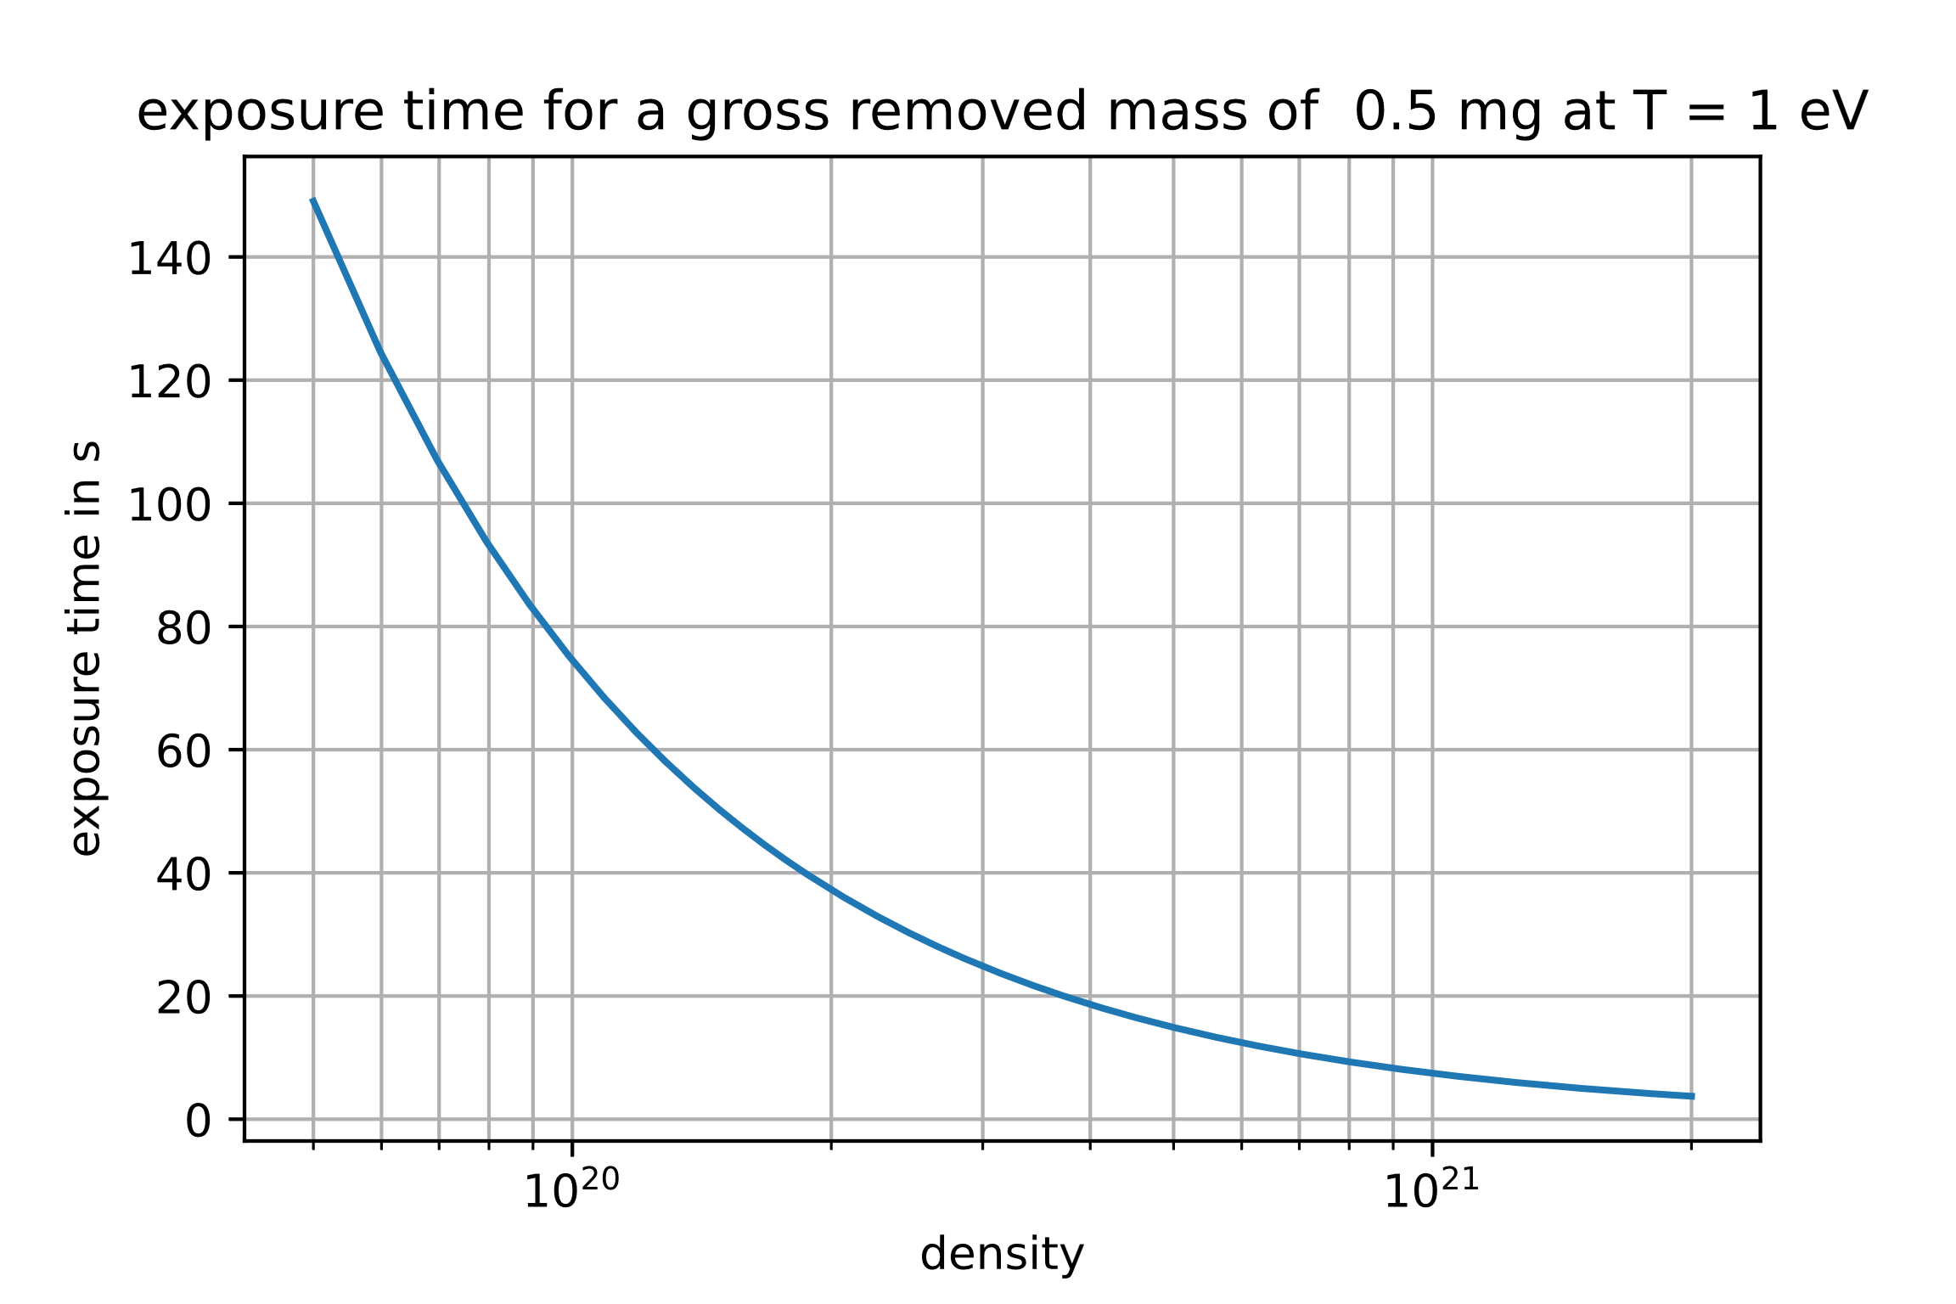
SP B.1: Erosion rates of W model systems by Ar (DIFFER)
Results from PISCES show sputtering yield discrepancy between low- and high-Z plasmas and as a function of plasma flux [1]. This motivates cross-machine study between GyM, PSI-2 and Magnum-PSI.
Task and questions to be addressed
Determine the impact of plasma flux in the erosion characteristics of different W model systems (cross-machine experiments) and re-deposited W as well as the corresponding sputtering rates of W, B, and W+B layers in MAGNUM-PSI
  Create reference conditions between 3 devices, using Ar⁺ on W
  At high flux entrainment of sputtered W in plasma strongly reduces net erosion and needs to be quantified
Approach
Use insulating plate with 7×W samples inserted, subject to Ar plasma of different densities in the range 1-10×10²⁰ m⁻³.
Characterize erosion rate using FIB-cut markers, mass change and RBS on witness plates
[1] R.P. Doerner, Scripta Materialia 143 (2018) 137-41
Deliverable: PWIE-SP B.B1.T-T004-D001
Status: ongoing
Facilities: Magnum-PSI 6 days, accelerator 5 days
Linked WP or TSVV: SP B.4
Results
Experiments recently completed – analyses pending
T. Morgan et al.

Slide 9
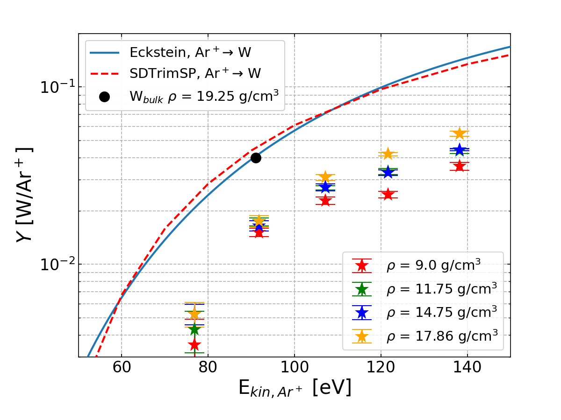
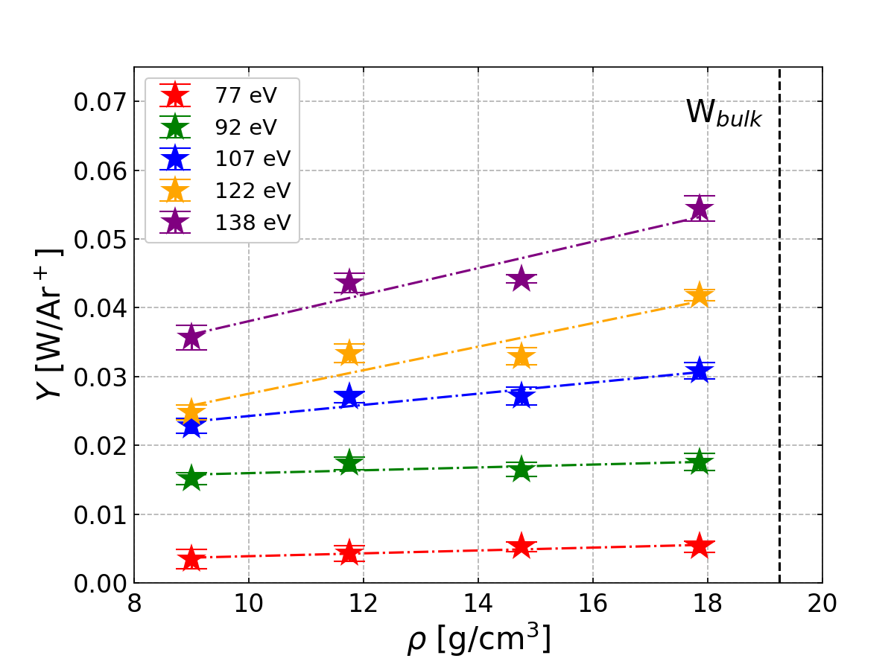
SP B.1: Erosion rates of W model systems in Ar plasmas in GyM (ENEA)
Broaden the understanding of W and B erosion physics using GyM. The work focuses on assessing erosion of different W or B-based materials or reference layers and investigating properties such as porosity or erosion yields of re-deposited W with respect to W_{bulk}
Task and questions to be addressed
Determine the impact of plasma flux on erosion characteristics of W model systems and the sputtering rates of B and W+B layers in GyM
  Study 1: impact of plasma flux on erosion of different W model systems in cross-machine experiments
  Ready for exposing available W samples to Ar plasma. Exposure conditions TBD soon w/ PSI-2 and MAGNUM-PSI colleagues
    Exposure of W_{bulk} sample already carried out to understand if Ar²⁺ plays a significant role in the experiment
  Study 2: studying erosion of W layers w/ different mass density
  Ar plasma exposure of compact W layers w/ different mass density (50-90% of bulk W) deposited on Si: done
    Y from mass loss and topography by AFM: done
    Y from thickness loss and surface structure by SEM: ongoing
Deliverable: PWIE-SP B.B1.T-T004-D002
Status: ongoing
Facilities: GyM 20 days
Linked WP or TSVV: SP B.4, SP D
      Y of W_{bulk} ≅ Y from Eckstein and SDTrimSP indicating low fraction of Ar²⁺ in plasma, consistent with SOLPS-ITER results
      [M. Sala, et al., PPCF 62 (2020) 055005]
      Y shows non-decreasing trend w/ ρ
      Non-negligible dependence of Y on ρ w/ increasing E_{kin}
A. Uccello et al.

Slide 10
SP B.1: Spectroscopic studies of W sputtering in PSI-2 (FZJ)
[1] S. Ertmer, PhD thesis, “High-resolution spectroscopy studies on sputtered atoms in the linear plasma device PSI-2”, DOI: 10.13154/294-8580
[2] M. Sackers et al, Phys. Plasma (submitted)
PSI-2
Task and questions to be addressed
Investigate erosion and re-deposition of varying W samples and reference layers using state-of-the art spectroscopic measurements
Approach
High-resolution spectroscopy measurements of W targets and layers (W fuzz) upon exposure to PSI-2 plasmas (in Ar) [1, 2]
Detailed analyses/modelling of the obtained spectra to study differences in line shapes and sputtering
Results
Different line shapes for different orientations [2]
Control of surface roughness required → huge impact on the results
Noticeable differences between W and W fuzz – until fuzz removed
Deliverable: PWIE-SP B.B1.T-T004-D003
Status: completed
Facilities: PSI-2 10 days, accelerator 2 days
Linked WP or TSVV: SP B.4, SP D
O. Marchuk et al.

Slide 11
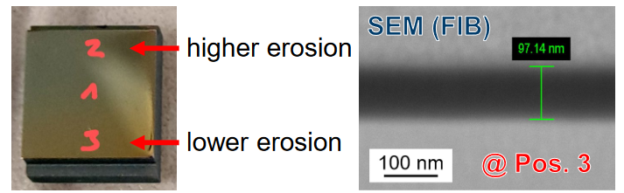
SP B.1: Erosion studies of B and W layers in PSI-2 (FZJ)
SP B.3: Surface modifications of PSI-2 samples (FZJ)
B sample after a 70-s exposure in PSI-2 together with a SEM/FIB image from the surface
Task and questions to be addressed
Investigate W erosion for cross-machine investigations
Approach
Bulk W with FIB markers exposed to Ar plasmas using manipulator systems to elucidate previous puzzling results
Task and questions to be addressed
Investigate erosion of B samples in PSI-2 plasma conditions
Approach
Expose B samples, produced under SP B.4, to D plasmas in PSI-2 by varying the exposure time
Determine erosion patterns on the layers both spectroscopically and via post-exposure SEM analyses
Results
Reasonable erosion rates (2.5-3 μm) obtained → good reference data to be compared against MAGNUM-PSI and GyM results
Results
Erosion rates 0.26 – 0.60 nm/s (low vs. high erosion regions)
Deliverable: PWIE-SP B.B1.T-T004-D003
Status: ongoing
Facilities: PSI-2 10 days, accelerator 2 days
Linked WP or TSVV: SP B.4, SP D
Deliverable: PWIE-SP B.B3.T-T004-D002
Status: completed
Facilities: accelerator 1 day
Linked WP or TSVV: SP B.4, SP D
A. Houben, O. Marchuk et al.

Slide 12
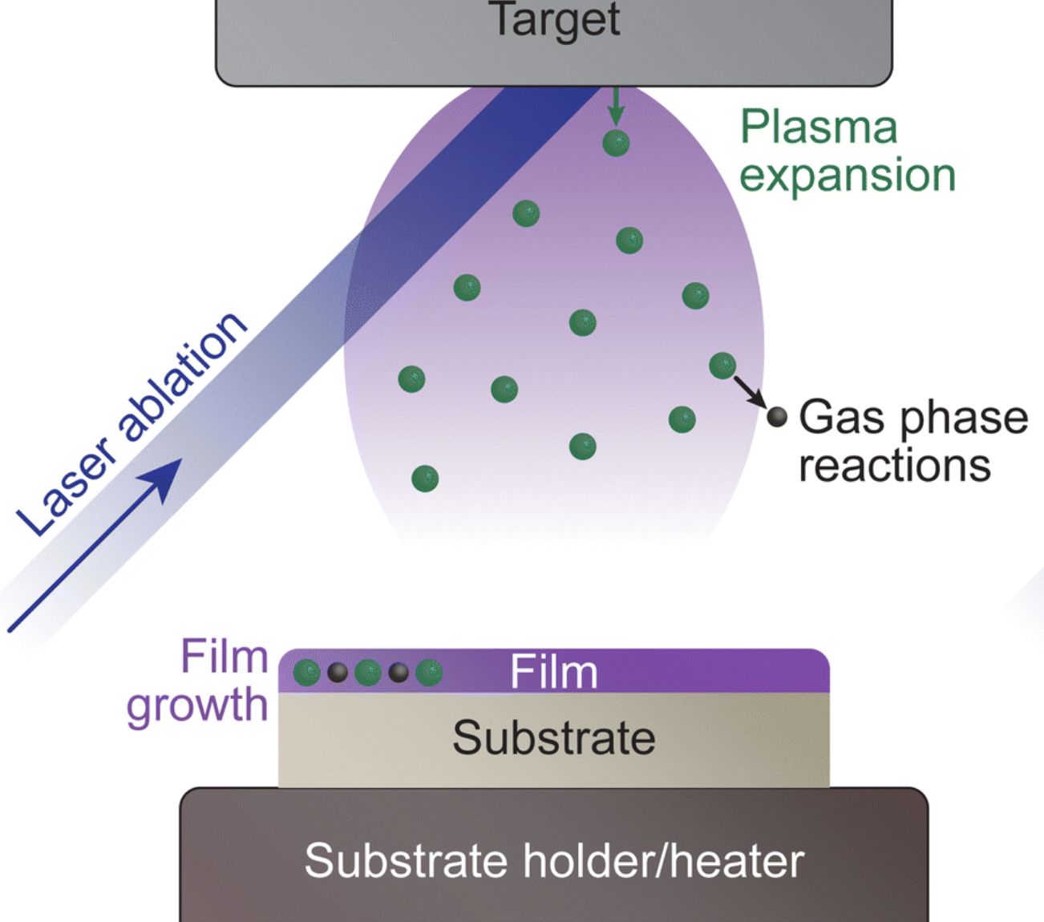
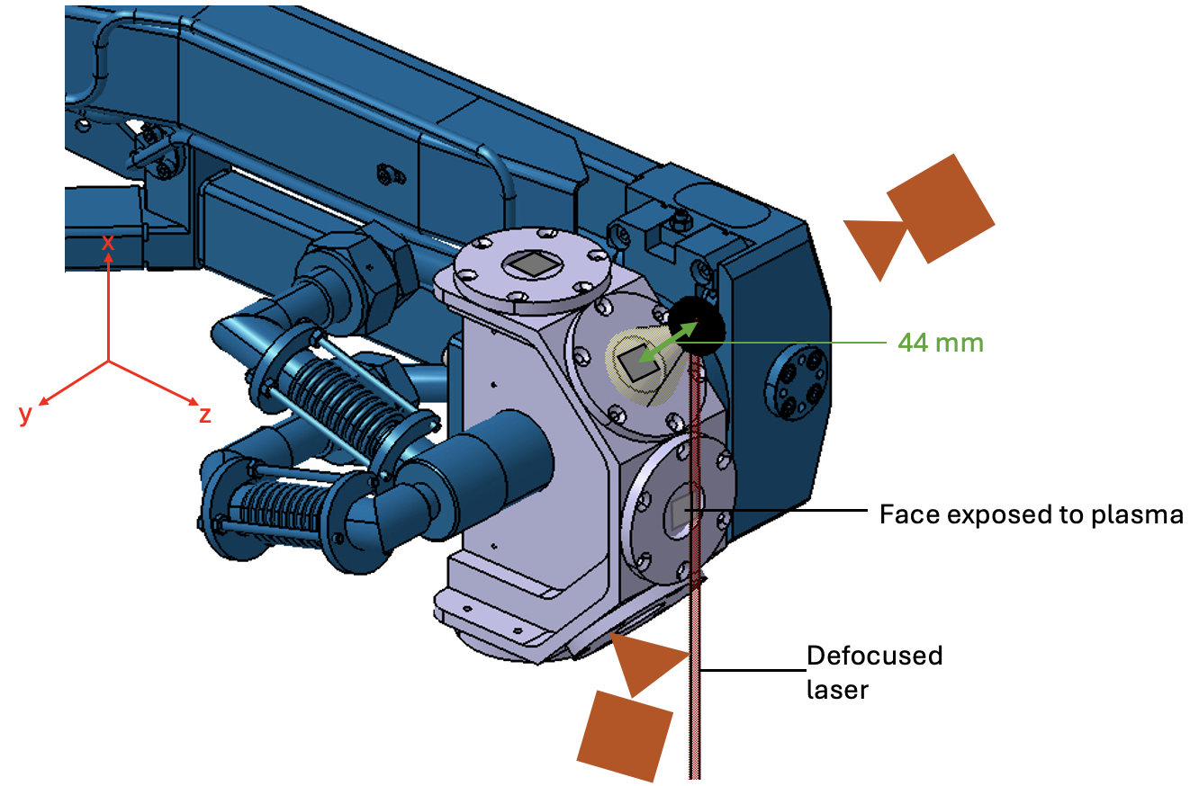
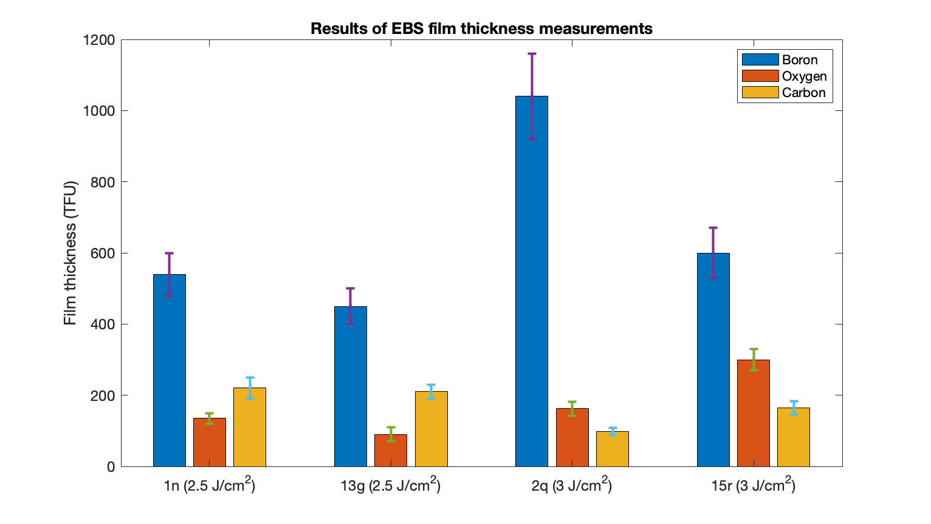
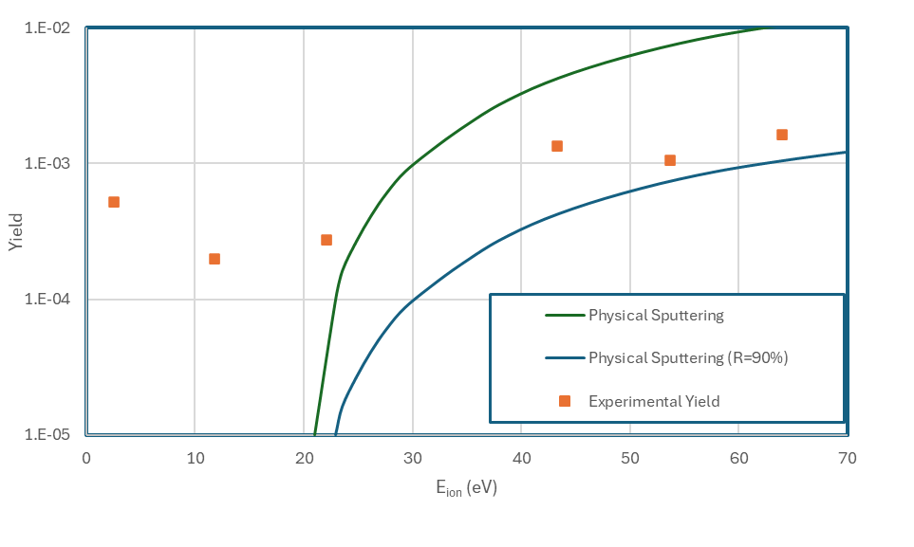
SP B.1: In situ boron layer deposition by Pulsed Laser Deposition and erosion in Magnum-PSI (DIFFER)
Using boronization in ITER means erosion rates of mixed boron layers to be determined – but these are susceptible to oxidization. Pulsed Laser Deposition (PLD) investigated as a method to produce boron layers in situ in vacuum inside Magnum-PSI and subsequently study their erosion
Task and questions to be addressed
Determine the impact of plasma flux in the erosion characteristics of different W model systems (cross-machine experiments) and re-deposited W as well as the corresponding sputtering rates of W, B, and W+B layers in MAGNUM-PSI
  create B layers using PLD
  characterize thickness and impurity content
  expose to D plasma in Magnum-PSI as function of ion-energy
Approach
PLD set-up created using Thomson scattering laser and B target
Thickness quantified using RBS and composition using EBS and EDX
~40 nm
T. Morgan et al.
Deliverable: PWIE-SP B.B1.T-T004-D001
Status: completed
Facilities: Magnum-PSI 6 days
Linked WP or TSVV: SP B.4
Results
B layers up to 40 nm thick could be grown in around 40 minutes
Relatively low O and C levels possible
Initial results suggest chemical erosion taking place at low ion energies

Slide 13
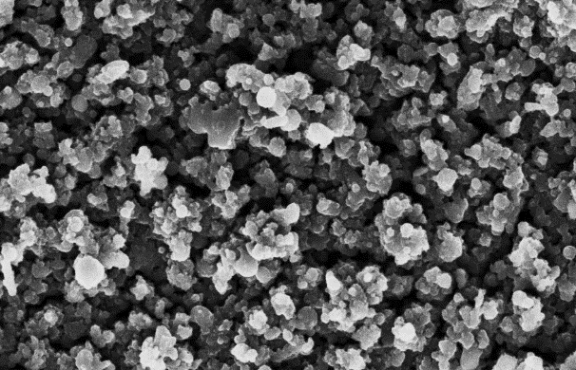
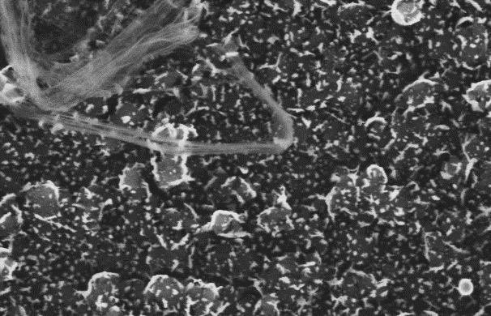
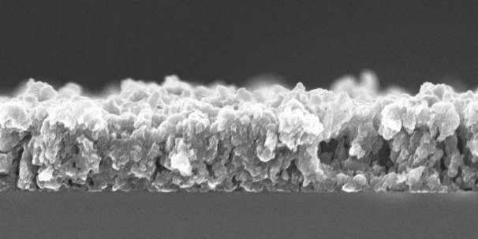
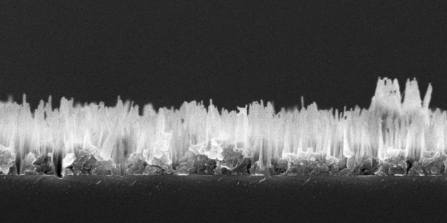
SP B.1: Erosion rates of B model systems in D plasmas in GyM (ENEA)
Broaden the understanding of W and B erosion physics using GyM. The work focuses on assessing erosion of different W or B-based materials or reference layers and investigating properties such as porosity or erosion yields of re-deposited W with respect to W_{bulk}
Task and questions to be addressed
Determine the impact of plasma flux on erosion characteristics of W model systems and the sputtering rates of B and W+B layers in GyM
  Availability and Expertise for 2025 activity: studying erosion of B and W+B layers
    Preliminary D plasma exposure of porous B and W+B layers deposited on Si substrates by fs-PLD at PoliMi: done
    Y from mass loss and surface structure-composition by SEM-EDX: ongoing
B coating as deposited
ρ = 1.05 g/cm³
After D plasma exposure
E_{kin} = 230 eV, Φ = 4.5e24 m⁻²
T_{sample} = 350 °C
1 μm
1 μm
Deliverable: PWIE-SP B.B1.T-T004-D002
Status: ongoing
Facilities: GyM 20 days
Linked WP or TSVV: SP B.4, SP D
A. Uccello et al.

Slide 14
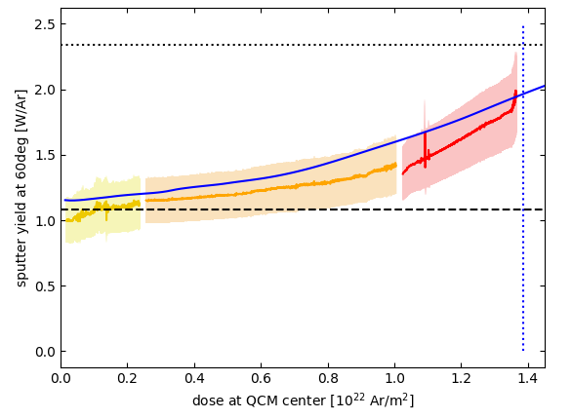
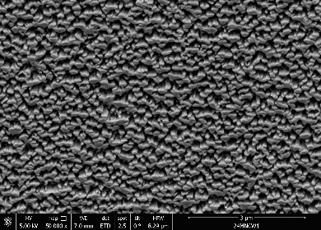
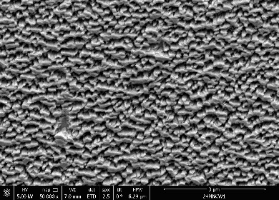
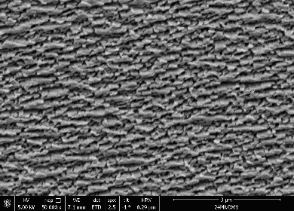
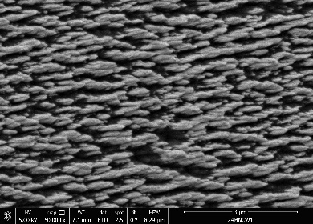
SP B.1: Experimental investigation of fluence stability of NCW structures (ÖAW)
M. Fellinger et al.
Description of Task and Deliverable
Assess the erosion characteristics of re-deposited W (and co-deposited W+B) model systems with different surface morphologies upon exposure to D ion beams in laboratory conditions
Provide erosion rates of re-deposited W (and W+B) model systems following exposure to controlled D ion beams
Approach
Investigate the stability of nanocolumnar tungsten (NCW) experimentally
Use the QCM technique and 2-keV Ar irradiation to determine the total tolerable fluence of NCWs, i.e. erosion of NCW structures until full erosion
  Investigated NCWs were approximately 600 nm high with a surface coverage of approximately 53%
Results
Fluence values for Ar irradiation can be extrapolated to D irradiation using an experimentally determined scaling factor
Determined fluence values support previous simulation results [1]
flat W (experimental)
NCW (dynamic, simulation) [1]
NCW (static, experiment) [2]
NCW (dynamic, experiment – in 3 steps)
fluence amount until NCWs are fully eroded [1]
tolerable total dose for NCW structure | determined fluence for 2 keV Ar | extrapolated fluence for 1 keV D
simulation - numerically optimized NCWs [1] | 4.00×10²¹ ions/m² | 6.46×10²³ ions/m²
simulation – based on real topography [2] | 1.39×10²² ions/m² | 2.24×10²⁴ ions/m²
experiment – real topography | 1.35×10²² ions/m² | 2.18×10²⁴ ions/m²
NCW erosion step 0
(virgin sample)
NCW erosion step 1
(after 0.24×10²² Ar/m²)
NCW erosion step 2
(after 1.00×10²² Ar/m²)
NCW erosion step 3
(after 1.37×10²² Ar/m²)
Deliverable: PWIE-SP B.B1.T-T004-D004
Status: W completed / W-B ongoing
Facilities: N/A
Linked WP or TSVV: ENR-MAT.02.VR
[1] C. Cupak et al., Phys. Rev. Mater. 7.6 (2023); [2] A. Lopez-Cazalilla et al., Phys. Rev. Mater. 6.7 (2022)

Slide 15
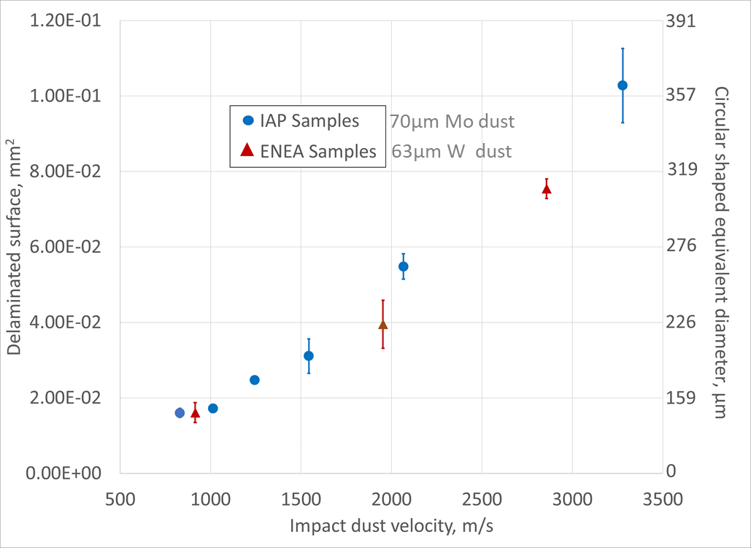
SP B.1: Influence of dust impacts on W coatings (ENEA)
Underlying idea is to study the coatings of W model systems upon dust impacts in order to understand how the presence of coatings influences the surface morphology and the erosion/migration of the material of PFCs where dust impinges.
Task and questions to be addressed
Determine the erosion, deposition, and surface-morphology patterns on W
model systems exposed to high-energy dust impacts
Approach
Shoot dust at different velocities (i.e. different impact regimes) on W model system
on W and Mo substrate (from SP B.4); analyse the resulting damaged surface.
Results
The presence of coated surface inhibits dust bounding impact regime;
The bounding impact regime vanishes even for thin coating layers;
Impacts induce coating delamination areas bigger than the dust dimension.
Delamination surface upon dust impact
on W model system IAP and ENEA
Deliverable: PWIE-SP B.B1.T-T004-D005
Status: completed
Facilities: -
Linked WP or TSVV: SP B.4
M. de Angeli et al.

Slide 16
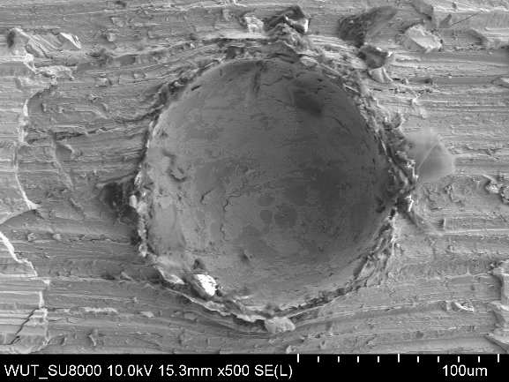
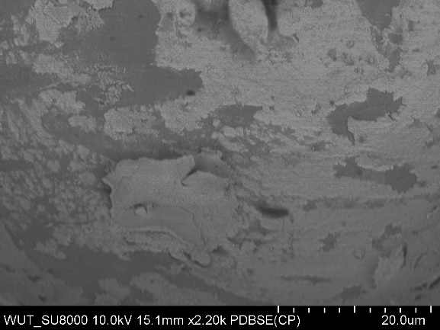
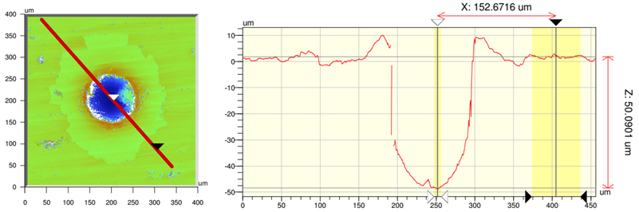
SP B.4: Microscopy investigations of W coatings following dust impacts (IPPLM)
Task and questions to be addressed
Detailed investigations on damages/delamination of the W coatings exposed to dust impacts; focus on W+O (IAP) and W (ENEA) coatings in the deformation and disintegration regimes (see previous slide)
Approach
Microscopic surface observations (incl. SEM, EDX, FIB, profilometry) of craters and the actual coatings on the samples
a)
b)
c)
d)
SEM images: (a-b) crater, (c) cross section of the edge of the crater with remnant of the coating, and d) crater depth profile.
Results (sample IAP10 – dust shot at 2066 m/s – as an example):
Large craters with depths down to ~50 µm and diameters up to 120 µm
Around the craters, W coating vanished but remnants found inside the craters
Protruding rims around the crater edge
Highly refined grains at the bottom of the crater as well as cracks
Deliverable: PWIE-SP B.B4.T-T004-D004
Status: completed
Facilities: consumables 5 k€
Linked WP or TSVV: SP B.1
E. Fortuna et al.

Slide 17
SP B.2 - Material migration in toroidal devices
SP B.3 - Characterization of plasma-exposed materials

Slide 18
SP B.2 deliverables in 2024
Activity | Deliverable ID(s) | Title
SP B.2 | D001 2 PM | WEST campaigns: erosion and deposition patterns on PFUs after WEST Phase 1 (C1-C5) and Phase 2 (C6-C7) operations (CEA)
SP B.2 | D002 2 PM | WEST campaigns: deposition profiles of He and B on PFUs after WEST Phase 1 operations (RBI)
SP B.2 | D003 3 PM | WEST campaigns: detailed investigation of selected PFUs, including side faces of marker tiles, after WEST Phase 1 and Phase 2 operations for their erosion, deposition, and surface-modification patterns (MPG)
SP B.2 | D004 3 PM | AUG manipulator experiments: pre- and post characterization of samples exposed to AUG plasmas for their erosion, deposition, and surface-modification patterns (MPG)
SP B.2 | D005 3 PM | AUG manipulator experiments: deposition profiles of B and D on samples exposed to AUG plasmas (VTT)
SP B.2 | D006 2 PM | W7-X manipulator experiments: erosion and deposition characteristics on manipulator and other samples exposed to OP2 plasmas on W7-X (FZJ)
SP B.2 | D007 4 PM | W7-X manipulator experiments: erosion and deposition characteristics of manipulator samples and wall components from OP2 experiments in W7-X (MPG)
SP B.2 | D008 2 PM | WEST campaigns: microscopy investigations of He-exposed PFUs after WEST Phase 1 (CEA)

Slide 19
SP B.3 deliverables in 2024
Activity | Deliverable ID(s) | Title
SP B.3 | D001 2 PM | Depth profiles and surface morphology of selected B or W+B layers (CIEMAT)
SP B.3 | D002 4 PM | Surface modifications and fuel content of selected AUG, WEST, W7-X, and PSI-2 samples (FZJ)
SP B.3 | D003 1 PM | Composition of layers on selected WEST monoblock samples (IAP)
SP B.3 | D004 3 PM + 3 PM (AR) | Surface modifications of selected WEST, W7-X, MAGNUM-PSI, PSI-2, and GyM samples (IPPLM)
SP B.3 | D005 3 PM | Composition and fuel content of layers on selected WEST monoblock samples (IST)
SP B.3 | D006 4 PM | Micro- and macroscale composition of layers on selected AUG, WEST, and GyM samples (JSI)
SP B.3 | D007 2 PM | Surface modifications and erosion/deposition profiles of samples and wall tiles from AUG, WEST, W7-X, and MAGNUM-PSI (MPG)
SP B.3 | D008 4 PM | Surface modifications and composition of layers on selected WEST monoblock and GyM samples (NCSRD)
SP B.3 | D009 2 PM | Micro- and macroscale composition of layers on selected AUG, WEST, MAGNUM-PSI, and PSI-2 samples (RBI)
SP B.3 | D010 2 PM | Erosion and deposition patterns on selected WEST monoblock samples as well composition of plasma-exposed B, W, or W+B layers (VR)
SP B.3 | D011 2 PM | Depth profiles and composition of deposited layers of selected samples from AUG, WEST, W7-X, and MAGNUM-PSI (VTT)

Slide 20
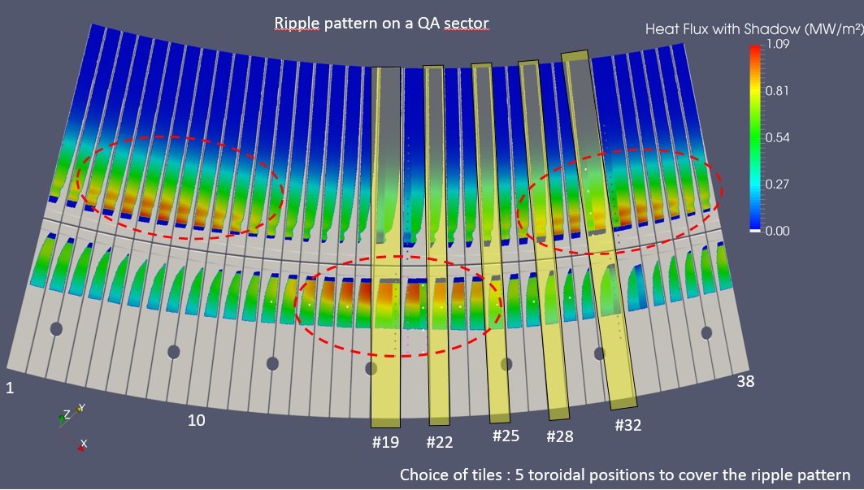
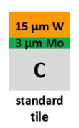
SP B.2: WEST analyses – coordination activities in 2024 (CEA)
Work on the C1-C5 marker tiles
  Surface analysis on full-scale tiles (MPG)
  Erosion/redeposition patterns with the help of a LIBS/GDOES/SIMS comparative study (VTT, IAP, UT, IPPLM)
  Cross-analysis using ion beam characterization (JSI, NCSRD, IST, VR)
Investigation of helium-exposed PFCs (standard tile + ITER-like PFU phase 1) (RBI, VTT, Aix Marseille Uni, CEA)
Investigation of deposits formed after the 2023 high particle fluence campaign (Aix Marseille Uni)
Effect of the ripple on the erosion pattern on standard tiles (MPG, IAP)
Analyses on ITER-like PFU phase 1
Surface analysis on entire components (MPG)
  Sample cutting and radioprotection control (CEA)
  Toroidal evolution of PWI on one MB (NCSRD)
Analyses on ITER-like PFU phase 2
Surface analysis on entire components (MPG)
  Assessment of net erosion on the strike points (CEA)
Evaluation of erosion/redeposition on the poloidal gaps/side surfaces (MPG)
Selection of 10 W/CFC tiles covering the ripple pattern on the lower divertor→ no sample cutting foreseen
Deliverable: PWIE-SP B.B2.T-T004-D001
Status: completed
Facilities: diamond saw cutting 12 k€
Linked WP or TSVV: WPTE
M. Diez et al.

Slide 21

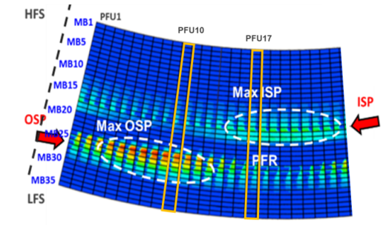



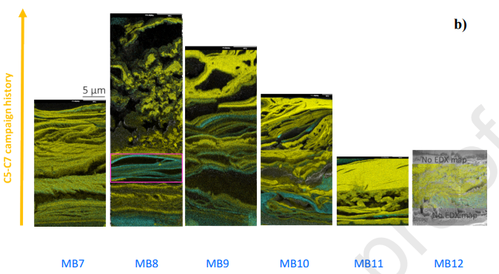
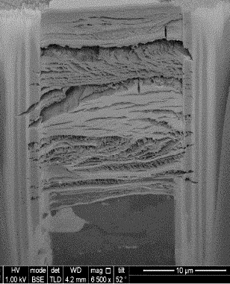
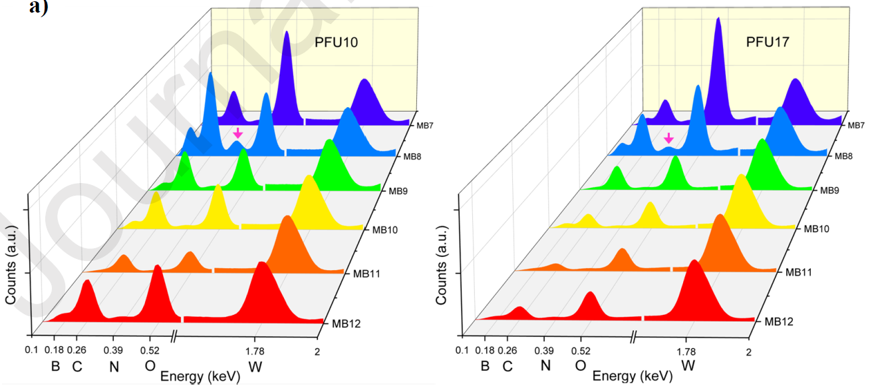
SP B.2: WEST analyses – deposits after the high-fluence campaign (CEA)
High fluence campaign in WEST (C7, 2023)
Dedicated to reach particle fluence of ITER shots (W erosion /migration expected)
Repetitive 1 min long discharges and up to 100 s pulses
Cumulated plasma time 5 h 30 min
Characterization plan and results
In-situ collection of deposits on 2 PFUs using sticky pads (CEA) - 2023
Surface analysis of the pads using confocal microscopy (Aix Mars. Uni) - done
Morphology and composition of deposited layers using SEM/EDX/FIB (Aix Marseille University) → Dense W layers of 5-40 µm thickness [1] - done
23 µm
[1] C. Martin et al., Nucl. Mater. Energy 41 (2024) 101764
Deliverable: PWIE-SP B.B2.T-T004-D001
Status: completed
Facilities: diamond saw cutting 12 k€
Linked WP or TSVV: WPTE
M. Diez et al.

Slide 22
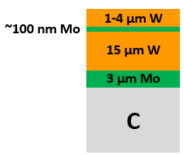
SP B.2: Analyses of WEST marker tiles (MPG)
SP B.3: Post-exposure measurements of WEST PFUs (MPG)
Task and questions to be addressed
Perform detailed surface analyses (including SEM, RBS, NRA) for selected samples exposed to Phase 1 and Phase 2 operations on WEST, including side faces of marker tiles, to characterize their erosion and deposition behaviour and changes in the surface state
Approach
SEM and IBA measurements on marker tiles after the C3, C4, C5 campaigns of Phase 1 to determine erosion and deposition patterns as well as for other tiles removed after Phase 1 plasma operations (incl. ITER-like PFUs)
Results
IBA data now available from all the campaigns: erosion 2.5 μm → 6 μm (C3 → C5), deposits 20 μm → 50 μm (C3→C5)
Gap faces of marker-tile skeletons measured, measurements for standard tiles started, ITER-like PFUs pending
Deliverable: PWIE-SP B.B2.T-T004-D003
Status: completed
Facilities: accelerator 2 days
Linked WP or TSVV: WPTE
Deliverable: PWIE-SP B.B3.T-T004-D007
Status: completed
Facilities: accelerator 8 days
Linked WP or TSVV: WPTE
M. Balden et al.

Slide 23
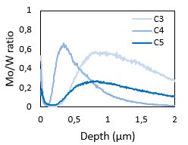
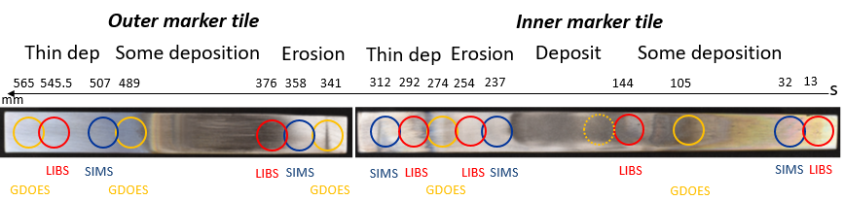
SP B.3: LIBS/GDOES/SIMS comparative study (IAP)
SP B.3: LIBS/GDOES/SIMS comparative study (VTT, UT)
Task and questions to be addressed
Carry out a detailed comparison between three independent techniques for the depth profiles of main elements on the C3, C4, and C5 marker-tile samples
Approach
Cross analysis between GDOES (IAP), SIMS (VTT), and LIBS (UT) measurements, focus on depth profiles for B and the elements on the marker layers
Results
The profiles generally agree with some discrepancies → to be discussed in the coming PFMC and IAEA conferences
Noticeable differences between C3, C4, and C5 campaigns in the profile shapes
 | C3 marker tiles | C4 marker tiles | C5 marker tiles
SIMS (VTT) | Done - 2021 | Done - 2022 | Done – 2023
GDOES (IAP) | Done – 2021 | Done - 2023 | Done in 2024
LIBS (UT) | Done - 2021 | Done - 2023 | X
LFS
HFS
SIMS
ISP erosion area
Deliverable: PWIE-SP B.B3.T-T004-D003
Status: completed
Facilities: N/A
Linked WP or TSVV: WPTE
Deliverable: PWIE-SP B.B3.T-T004-D011
Status: completed
Facilities: accelerator 2 days
Linked WP or TSVV: WPTE
E. Grigore et al.
A. Hakola et al.

Slide 24
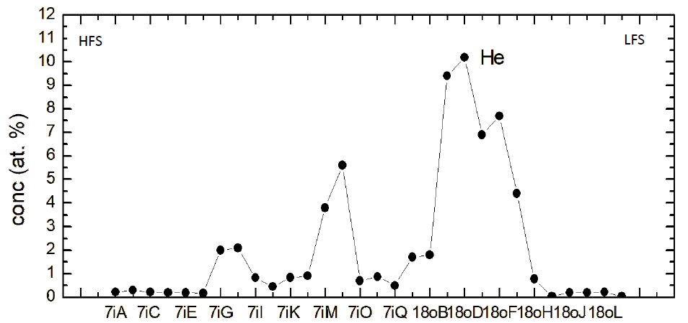
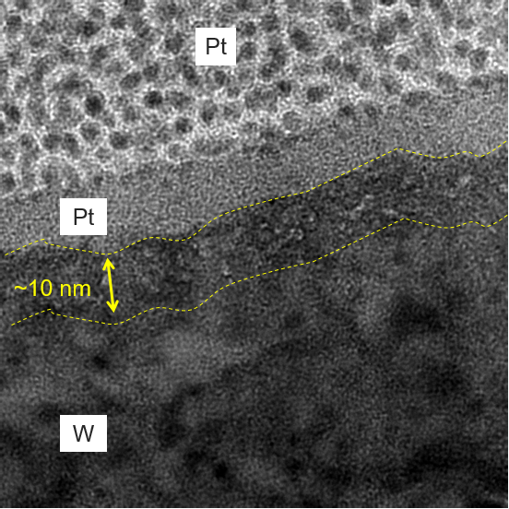
SP B.2: Deposition profiles of He and B on PFUs after WEST Phase 1 operations (RBI)
SP B.2: Microscopy investigations of He-exposed PFUs after WEST Phase 1 (CEA)
Task and questions to be addressed
Carry out ion-beam analyses for samples exposed to the helium plasma operations on WEST and determine accumulation of He and B on the PFUs
Investigate changes in the surface state of the He-exposed PFUs
Approach
TOF-ERDA analyses for samples from standard WEST Phase 1 PFUs as well as from 12 monoblock samples of the ITER-like PFU WECN001
SEM/FIB/TEM analyses on the same samples after the TOF-ERDA measurements
Results
He content up to 10 at.% on the standard tiles, data evaluation for WECN001 pending
Evidence of He bubbles found on the samples
He bubbles
deposition area
Deliverable: PWIE-SP B.B2.T-T004-D002
Status: completed
Facilities: accelerator 3 days
Linked WP or TSVV: WPTE
Deliverable: PWIE-SP B.B2.T-T004-D008
Status: completed
Facilities: N/A
Linked WP or TSVV: WPTE
I. Bogdanovic Radovic et al.
C. Martin et al.

Slide 25
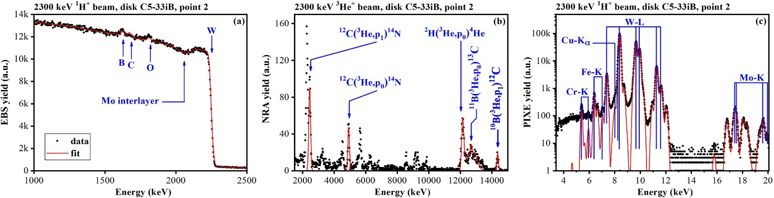
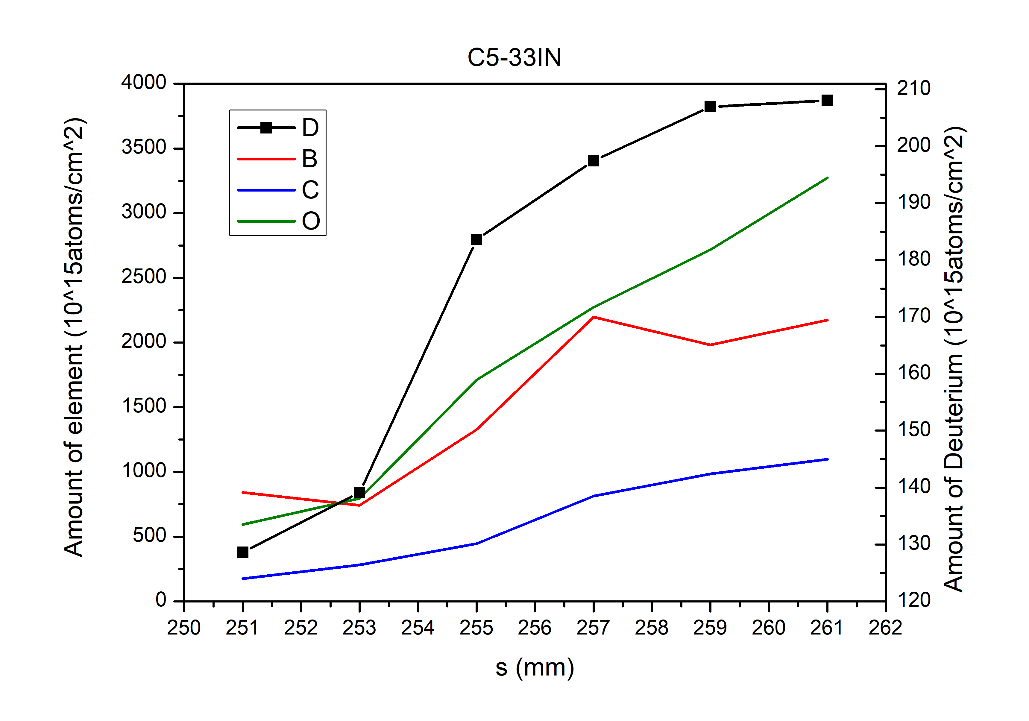
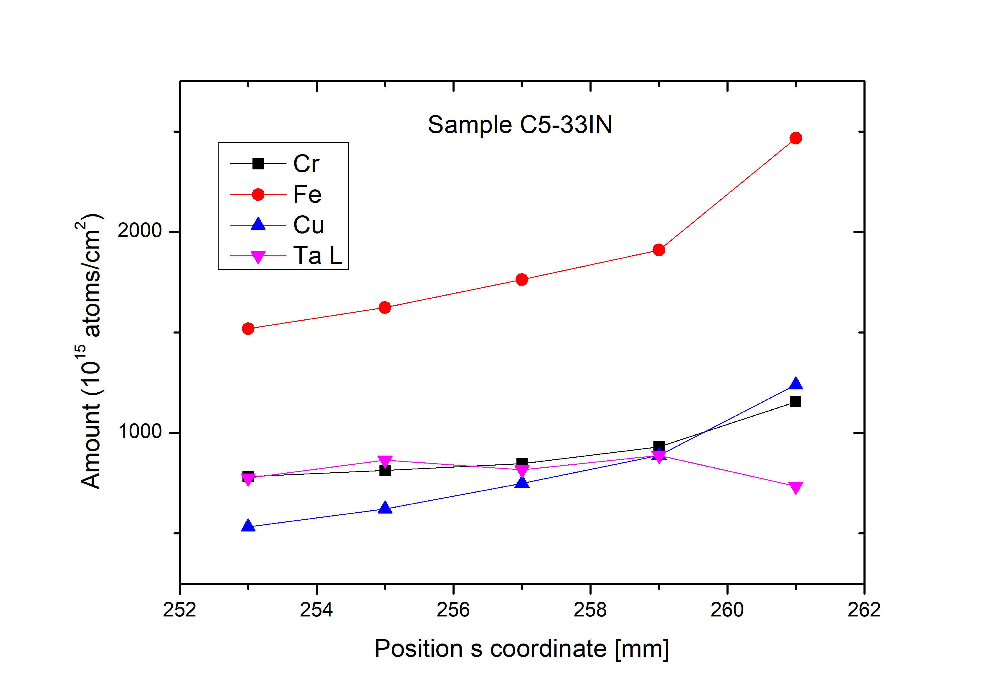
SP B.3: Composition and fuel content of layers on WEST samples (IST)
SP B.3: Composition and fuel content of layers on WEST samples (JSI)
Quantification of elemental co-deposition in exposed C5 WEST samples by IBA (NRA, RBS, PIXE)
IBA results: NRA - quantification of ²H, B, C co-deposited in the tiles
RBS - deposition areas - Mo layer easily identified except for samples with the thickest deposits (C5-33iK)
erosion areas - Mo layer largely eroded
PIXE - quantification of Cu, Fe, Cr, identified as the main heavy impurities
Example of IBA spectra collected for the elemental analysis of tile C5-33iB (IST) and C5-33iN (JSI)
PIXE
RBS
NRA
Quantified amounts: 7687 x 10¹⁵ at/cm² of W above the Mo layer ; 495 mg/g of Cr ; 1301 mg/g of Fe ; 481 mg/g of Cu
42 x 10¹⁵ at/cm² of ²H ; 476 x 10¹⁵ at/cm² of B ; 308 x 10¹⁵ at/cm² of C ;
Deliverable: PWIE-SP B.B3.T-T004-D005
Status: completed
Facilities: accelerator 3 days
Linked WP or TSVV: WPTE
Deliverable: PWIE-SP B.B3.T-T004-D006
Status: completed
Facilities: accelerator 7 days
Linked WP or TSVV: WPTE
R. Mateus et al.
M. Kelemen et al.

Slide 26
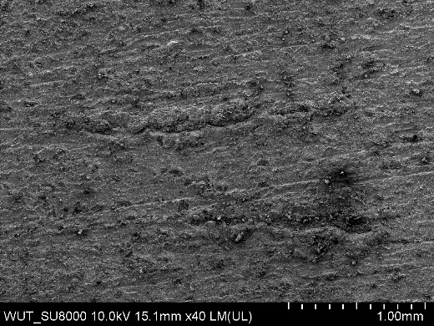
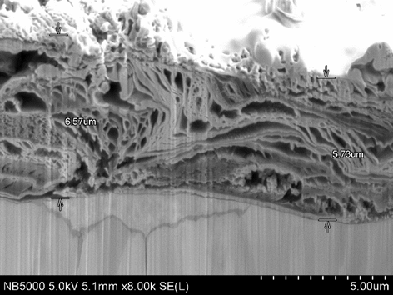
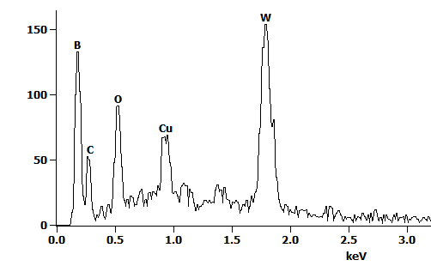
SP B.3: Surface modifications of WEST C5 marker-tile samples (IPPLM)
Task and questions to be addressed
(i) Assess surface modifications on selected WEST C5 samples due to varying plasma–wall interaction phenomena (erosion/deposition pattern), (ii) study the co-deposits formed and (iii) analyze the dust particles found
Approach
Three samples analysed (C5-21oH, C5-33iC and C5-33iL) using SEM, EDX, and FIB (4-9 cross-sections ~20 µm)
a)
b)
c)
d)
Results (sample C5-33iL as an example):
Deposits observed in locations that used to be erosion-dominated; remainders of marker layers visible as well as arc tracks (size up to 1.5 mm)
Deposit thickness 4-10 µm with a layered structure consisting of voids, cracks, delaminations etc.
Pure and oxidized W can be found in the layers
Deliverable: PWIE-SP B.B3.T-T004-D004
Status: completed
Facilities: consumables 5 k€
Linked WP or TSVV: WPTE
E. Fortuna et al.

Slide 27
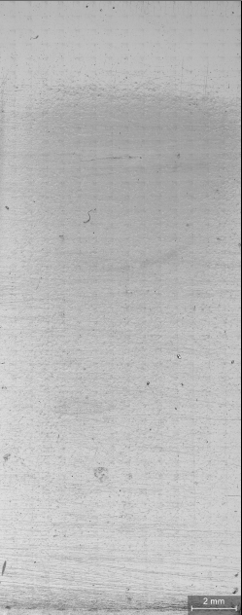
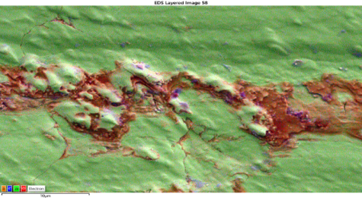
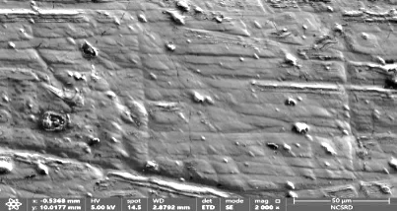
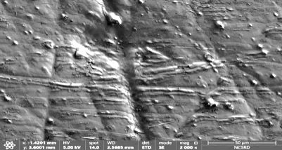
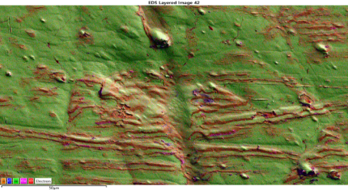
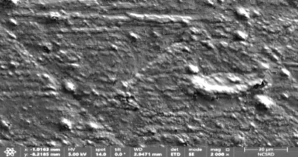
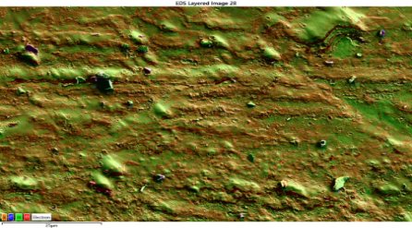
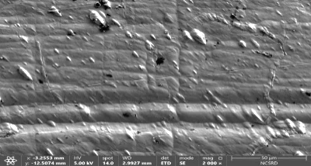
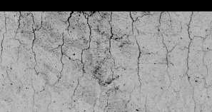
SP B.3: Surface modifications of WEST monoblock samples (NCSRD)
Trailing edge
Elemental Mapping
Cracks
Humps
Increase of roughness
Zone 4
50 μm
50 μm
10 μm
Deposition areas parallel to the edge
Toroidal direction
Zone 3
50 μm
50 μm
Highest deposition of D, B, N, Fe and Cu
10 μm
Zone 2
Dense linear deposition areas
50 μm
50 μm
Erosion
Zone 1
20 μm
56º
Leading edge
25 μm
50 μm
50 μm
Almost fully covered by B & O
Deposition covers cracks
Erosion reveals cracks
Oriented humps everywhere
B
C
O
Cu
W
Cracks mostly ⊥ to the edge
Deliverable: PWIE-SP B.B3.T-T004-D008
Status: completed
Facilities: accelerator 3 days
Linked WP or TSVV: WPTE
Ion beam analysis, SEM/EDX, XRF, X-ray diffraction & optical profilometry measurements carried out for monoblock MB28 removed after the C4 campaign and for C3/C4/C5 marker-tile samples
K. Mergia et al.

Slide 28
SP B.3: Composition and fuel content of layers on WEST samples (VR)
Task and questions to be addressed
Characterization of erosion and deposition patterns on selected WEST monoblock samples as well composition of plasma-exposed B, W, or W+B layers (VR)
Approach
Surface composition and depth profiles using ion beam analysis, with focus on RBS and TOF-ERDA.
Resonant-NRA at low energies combined with RBS performed in selected samples to obtain high-sensitivity and high-resolution boron depth profiles.
Results
Completion of characterization of C4-C5 tiles (SP-B 2023 report)
Sample | B (10¹⁵at./cm²⁾ |  |  | C(/B %) | H(/B %) | He(/B %) | Fe(/B %) | N(/B %) | O(/B %) | W(/B %)
C4-20oF | thick/rough |  |  | 8 | 0 | 0 | 44 | 26 | 121 | 1006
C4-20oK | 32 |  |  | 40 | 0 | 0 | 50 | 29 | 462 | 1327
C4-20oK | 36 |  |  | 50 | 0 | 0 | 22 | 23 | 406 | 486
C5-21oH | 185 |  |  | 56 | 0 | 0 | 49 | 11 | 184 | 279
C5-22oH | 134 |  |  | 32 | 0 | 0 | 41 | 10 | 149 | 375
C5-33iC | thick/rough |  |  | 29 | 0 | 0 | 14 | 10 | 139 | 77
C5-33iC | thick/rough |  |  | 76 | 0 | 0 | 22 | 15 | 207 | 168
C5-33iL | 251 |  |  | 47 | 0 | 0 | 36 | 24 | 268 | 269
C5-21oF | 517 |  |  | 62 | 12 | 2 | 5 | 9 | 70 | 77
C5-21oF | 643 |  |  | 54 | 11 | 2 | 5 | 7 | 73 | 112
C5-21oH | 65 |  |  | 124 | 0 | 0 | 40 | 23 | 375 | 703
C5-21oH | 65 |  |  | 149 | 0 | 0 | 37 | 29 | 339 | 938
C5-33iJ | 857 |  |  | 90 | 8 | 1 | 6 | 12 | 70 | 8
C5-33iJ | 918 |  |  | 86 | 7 | 0 | 6 | 17 | 70 | 9
Deliverable: PWIE-SP B.B3.T-T004-D010
Status: completed
Facilities: accelerator 3 days
Linked WP or TSVV: WPTE
P. Petersson et al.

Slide 29
SP B.2: Pre-analyses of AUG tiles and samples (MPG)
SP B.2: Deposition profiles of B and D on AUG samples (VTT)
General Information
Determine the boron deposition on AUG tiles on different toroidal positions and samples on the manipulators - following boronisations
Determine erosion of ICRH limiter tiles
Task and questions to be addressed
Perform surface analyses for erosion/deposition and surface-modification patterns on wall components retrieved from AUG
Approach
Pre-characterisation by SEM and IBA measurements on (i) 10 W-coated AUG graphite tiles on the heat shield, baffle, dome and outer mid plane, (ii) two Mo-coated ICRH limiter graphite tiles, and (iii) samples to be mounted on the AUG manipulators for experiments
Post exposure characterization of the manipulator samples – delayed
Results
All tiles were pre-characterized by SEM (marker and µm-ruler prepared)
The Mo-coated ICRH limiter graphite tiles and manipulator samples were analyzed by IBA
All samples and tiles expected for post-exposure analyses in 2025 after experiments done and AUG campaign completed
Deliverable: PWIE-SP B.B2.T-T004-D004
Status: ongoing
Facilities: accelerator 2 days
Linked WP or TSVV: WPTE
Deliverable: PWIE-SP B.B2.T-T004-D005
Status: delayed
Facilities: accelerator 1 day
Linked WP or TSVV: WPTE
M. Balden et al.
A. Hakola et al.

Slide 30
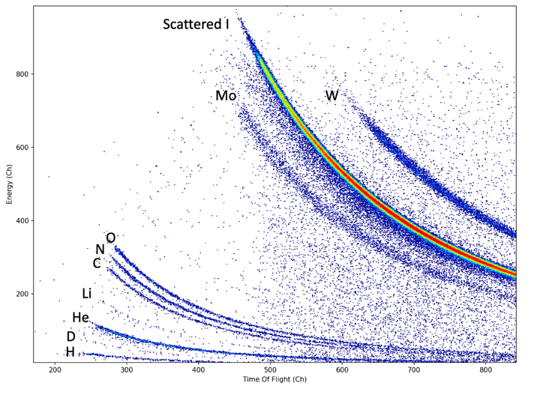
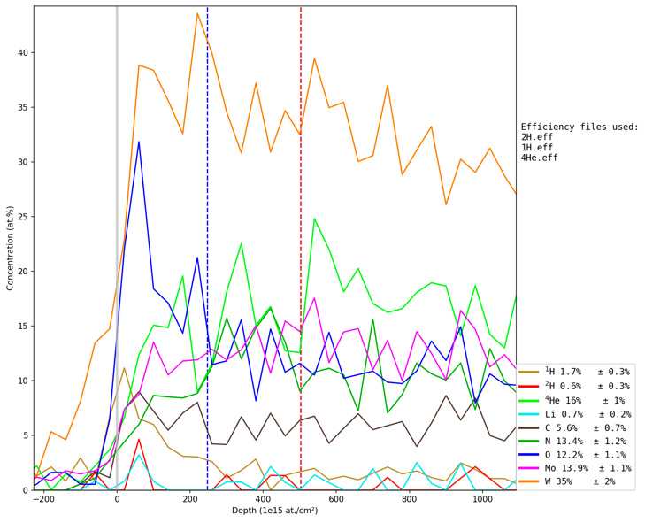
SP B.3: Post exposure analyses of W monoblocks from MAGNUM-PSI (MPG)
SP B.3: Compositional analyses of W reference layers exposed in linear devices (RBI)
Task and questions to be addressed
Surface analyses for erosion/deposition and surface-modification patterns on monoblocks exposed to Ar plasmas on MAGNUM-PSI (MPG)
Elemental composition of W reference layers exposed to He plasmas on MAGNUM-PSI and GyM (RBI)
Approach
Post exposure analyses (SEM, EDX, FIB cutting) for W-monoblock mock-ups prepared with µm-rulers and exposed in MAGNUM-PSI (2023)
TOF-ERDA analyses for the He content of varying reference layers from GyM and MAGNUM-PSI experiments
Results
Monoblocks:
  Cross-sectioning perpendicular to the trenches with µm-ruler lines allows measuring erosion up to 8 µm
  Trenches filled with redeposited material
Reference layers:
  He levels up to 15 at.% measured on the exposed samples, in particular on thin coatings with porous or columnar W layers
  He closer to the surface (30-40 nm) on GyM samples
Deliverable: PWIE-SP B.B3.T-T004-D007
Status: completed
Facilities: accelerator 8 days
Linked WP or TSVV: SP A
Deliverable: PWIE-SP B.B3.T-T004-D009
Status: completed
Facilities: accelerator 7 days
Linked WP or TSVV: SP B.1
M. Balden et al.
I. Bogdanovic Radovic et al.

Slide 31
SP B.2: Analysis of samples following boronizations on W7-X (MPG)
SP B.2: Analysis of samples from OP2 plasmas on W7-X (FZJ)
Task and questions to be addressed
Determine properties of the layers originating from boronizations
  Thickness? Homogeneity? Oxygen gettering capacity?
  Sticking coefficients for B radicals?
Approach
Analysis of wall tiles after OP 1.2b and OP 2.1
Exposure of samples during individual boronizations
in OP 2.1 and OP 2.2 using MPM
Results
10 – 60 nm B after OP 1.2b on all tiles (3 boronizations)
5 – 15 nm B during individual boronizations in OP 2.1
Oxygen gettering capacity 0.5 – 0.9 O/B
First OP 2.2 boronization experiments recently completed → analyses pending
Deliverable: PWIE-SP B.B2.T-T004-D007
Status: ongoing
Facilities: accelerator 3 days
Linked WP or TSVV: WPW7X
Deliverable: PWIE-SP B.B2.T-T004-D006
Status: ongoing
Facilities: accelerator 1 day
Linked WP or TSVV: WPW7X
M. Mayer et al.
M. Rasinski et al.

Slide 32



SP B.3: Post-exposure measurements of W7-X PFUs (MPG)
SP B.3: Analysis of samples originating from different W7-X campaigns (FZJ)
Task and questions to be addressed
Investigate erosion and deposition patterns as well as surface structure of different W7-X components and samples removed after OP 1.2b and OP 2.1
Approach
SEM, EDX, CLSM, and IBA (RBS, NRA) analyses of graphite and W-coated tiles
Results
Baffle tiles can exhibit thick deposits (>> 1 μm) while generally deposits on the wall tiles are thin
Detailed survey of melt patterns on W-coated tiles shows interesting features
Loosely bound layers and arcs observed on several locations
Deliverable: PWIE-SP B.B3.T-T004-D007
Status: completed
Facilities: accelerator 8 days
Linked WP or TSVV: WPW7X
Deliverable: PWIE-SP B.B3.T-T004-D002
Status: completed
Facilities: accelerator 1 day
Linked WP or TSVV: WPW7X
M. Balden et al.
M. Mayer et al.
C. P. Dhard et al.
M. Rasinski et al.

Slide 33
SP B.3: Depth profiles of selected B or W+B layers (CIEMAT)
This task is pending for submission of B and W samples for analyses
Deliverable: PWIE-SP B.B3.T-T004-D001
Status: delayed
Facilities: N/A
Linked WP or TSVV: SP B.1

Slide 34
SP B.4 - Reference coatings for ITER and DEMO

Slide 35
SP B.4 deliverables in 2024
Activity | Deliverable ID(s) | Title
SP B.4 | D001 3 PM | W- and B-based coatings with pre-defined composition and morphology for experiments in linear plasma facilities (ENEA)
SP B.4 | D002 2 PM | W-based coatings with pre-defined composition and morphology for experiments in linear plasma facilities (IAP)
SP B.4 | D003 6 PM | B- and W+B coatings with pre-defined composition and morphology for comparison with data from tokamaks (IAP)
SP B.4 | D004 2 PM + 2 PM (AR) | Microscopy investigations of selected B, W+B, and W reference samples (IPPLM)
SP B.4 | D005 2 PM | Raman analyses of selected B and W+B reference samples (CEA)
SP B.4 | D006 1 PM | SEM and SIMS analyses of selected B, W+B, and W reference samples (CIEMAT)
SP B.4 | D007 2 PM | LIBS and SEM analyses of selected B and W+B reference samples (FZJ)
SP B.4 | D008 5 PM | Ion-beam analyses of selected B, W+B, and W reference samples (IST)
SP B.4 | D009 3 PM | XPS and TDS analyses of selected B and W+B reference samples (JSI)
SP B.4 | D010 4 PM | Ion-beam and structural analyses of selected B and W+B reference samples (NCSRD)
SP B.4 | D011 1 PM | TOF-ERDA analyses of selected B, W+B, and W reference samples (RBI)
SP B.4 | D012 2 PM | Ion-beam analyses of selected B and W+B reference samples (VR)
SP B.4 | D013 1 PM | SIMS measurements of selected B, W+B, and W reference samples (VTT)

Slide 36



SP B.4: Production of W and B reference coatings (ENEA)
This tasks deals with production of W and B reference coatings, multilayer structures, and proxies for re-deposited layers with varying composition, morphology, and grain structure for laboratory experiments and exposures in linear plasma devices
Task and questions to be addressed
Deposition of several kinds of W layers by means of PVD techniques.
Approach
Deposition of porous W films (by PLD) and compact W films (by HiPIMS and RF-MS) for in situ LIBS studies at MAGNUM-PSI and exposures at GyM
Deposition of amorphous W-O films (by PLD) for dust formation studies at ENEA-CNR and sputtering yield studies at MPG
Deposition of a new W morphology, nanocolumnar W films (by tilted Magnetron Sputtering)
Results
Porous W-O and compact W layers (thickness 0.5 – 2 µm) produced
Compact W layers with different mass density (50-90% of bulk W) available
Amorphous W-O layers prepared for FIB sputtering
Parameter studies carried out to control the properties of W nanocolumns
Deliverable: PWIE-SP B.B4.T-T004-D001
Status: completed
Facilities: -
Linked WP or TSVV: SP B.1, SP B.2, SP X
200 nm
D. Dellasega et al.

Slide 37
SP B.4: Production of W reference coatings (IAP)
Task and questions to be addressed
Production of W reference coatings with controlled gas contents (H, D, N, O) for laboratory experiments and exposures in linear plasma devices
Approach
Deposition of W-D, W-H, W-D-H, and W-O coatings
Pre-characterization of the layers using GDOES, XRD, and TDS
Results
W-O layers:
  O levels up to 10 at.%
  Mainly α-W phase but changes during heating (TDS) to a mixture of two phases (α-W+ δ-WO₂)
W-D, W-H, and W-D-H layers:
  Uniform H and D depth profiles, concentrations up to 12 at.%
  Rapid release of hydrogenic species already at 400°C
GDOES depth profile for W-O coating
Change in XRD pattern after heating at 900°C
Deliverable: PWIE-SP B.B4.T-T004-D002
Status: completed
Facilities: -
Linked WP or TSVV: SP B.1, SP B.2, SP X
GDOES depth profiles for a W-D coating
TDS spectra for a W-D coating
E. Grigore et al.

Slide 38



SP B.4: Impact of roughness on fuel retention by ion implantation (IST)
Implanting the produced reference coatings studied earlier in [1] – goal was to produce proper samples for LIBS experiments
In 2024, the work was extended to implant rough W coatings from ENEA (see previous slides) with 15 keV ²H⁺ ion beams, at high fluence, to evaluate the role of roughness in fuel retention → ongoing
For comparison, flat W-O coatings by IAP (see previous slides) irradiated simultaneously to compare the role of surface morphology in fuel retention → ongoing
Deliverable: PWIE-SP B.B4.T-T004-D008
Status: ongoing
Facilities: accelerator 7 days
Linked WP or TSVV: N/A
[1] R. Mateus et al., Vacuum 227 (2024) 113403
R. Mateus et al.

Slide 39




SP B.4: Production of W and B reference coatings (ENEA)
This tasks deals with production of W and B reference coatings, multilayer structures, and proxies for re-deposited layers with varying composition, morphology, and grain structure for laboratory experiments and exposures in linear plasma devices
Task and questions to be addressed
Deposition of several kinds of B layers by PVD techniques varying morphology and porosity of the coatings
Approach
Deposition of compact or porous B films using both nanosecond and femtosecond PLD
Results
Porous and compact B layers, with thicknesses up to 10 µm, successfully prepared - analyses pending
1 μm
1 μm
Deliverable: PWIE-SP B.B4.T-T004-D001
Status: ongoing
Facilities: -
Linked WP or TSVV: SP B.1, SP B.2, SP F
Porous B films
Compact B films
D. Dellasega et al.

Slide 40






SP B.4: Production of B reference coatings (IAP)
Task and questions to be addressed
Production of B reference coatings with different roughnesses for studies under SP B.5 (UKAEA)
Approach
Deposition of thick B layers (up to 5 μm) using the TVA setup
Pre-characterization of the layers using SEM and AFM and determining their hardness and roughness
Results
Coatings produced and delivered to UKAEA
Experimental TVA setup to deposit B layers
Deliverable: PWIE-SP B.B4.T-T004-D003
Status: ongoing
Facilities: -
Linked WP or TSVV: SP B.1, SP B.2, SP B.5, SP F
(Top) Cross-sectional SEM measurements for the two first batches of the table
(Bottom) Morphology of the produced layers
Hardness and roughness results (500 nm layers)
C. Porosnicu et al.

Slide 41





SP B.4: Production and characterization of B reference coatings (FZJ)
Task and questions to be addressed
Production of B reference coatings for erosion and deposition studies in PSI-2 (see corresponding SP B.1 task)
Approach
Fabricate the layers using magnetron sputtering
Pre-characterize the layers using SEM, EDX, XRD, and XPS
Results
Pure, amorphous B layers can be reliably produced on W and 316L-IG steel
Thickness up to 100 nm
Annealing at 1000°C (W) or 550°C (steel) in vacuum → stable, no peeling
B on W: after some weeks: purple dots/area appears → detachment of B layer from the substrate (blisters) → due to W oxides on the surface?
4 magnetrons, simultaneous operation possible
Rotating sample stage → homogeneous layer
Biased and heatable sample stage
Gas injection ring close to sample for reactive sputtering (oxygen, hydrogen, nitrogen)
Large sample stage
Deliverable: PWIE-SP B.B4.T-T004-D007
Status: ongoing
Facilities: -
Linked WP or TSVV: SP B.1, SP B.2, SP F
A. Houben et al.

Slide 42

SP B.4: Production and analysis of B-containing samples (VR)
Task and questions to be addressed
Characterization of atomic composition, thicknesses, and depth profiles of B and W+B reference layers
Approach
Production in-house (Tandem Laboratory at Uppsala University) of sputter-deposited layers from B and W targets (co-deposition) in Ar and Ar+D₂ atmospheres on different substrates (W, QCM, Mo, Si, C, and MgO), followed by characterization (IBA, SEM, TEM+EDX).
Results
B and B+W deposited in Ar atmosphere (120-220 nm):
  Low contamination levels (B>95 at.%) – amorphous samples
  Stable in vacuum – but peeling off in air in the case of B layers
  Stable B+W layers on W (high B/W ratios will be tested)
B and B+W deposited in Ar+D₂ atmosphere (100-150 nm):
  D concentration scales with B/W ratio (up to 5.8 at.% of D)
  No peeling observed for any film/substrate (up to 73 at.% of B)
  Boron layer (no W) present the highest O content (10 at.% of O)
D
¹⁰B
¹¹B
O
Scattered I
Si
ToF-channel
W
Deliverable: PWIE-SP B.B4.T-T004-D012
Status: ongoing
Facilities: accelerator 4 days
Linked WP or TSVV: SP B.1, SP B.2, SP F, ENR MAT
Energy channel
E. Pitthan Filho et al.

Slide 43
SP B.4: Raman analyses of selected B reference samples (CEA)
SP B.4: SEM and SIMS analyses of selected B and W reference samples (CIEMAT)
These tasks are pending for submission of B and W reference samples for analyses – first W batches only recently received
Deliverable: PWIE-SP B.B4.T-T004-D005
Status: delayed
Facilities: N/A
Linked WP or TSVV: N/A
Deliverable: PWIE-SP B.B4.T-T004-D006
Status: delayed
Facilities: N/A
Linked WP or TSVV: N/A

Slide 44
SP B.4: XPS and TDS analyses of selected B reference samples (JSI)
SP B.4: SIMS measurements of selected B and W reference samples (VTT)
These tasks are pending for submission of B and W reference samples for analyses – first W batches only recently received
SIMS measurements can only be done once the new equipment has arrived in February-March 2025
Deliverable: PWIE-SP B.B4.T-T004-D009
Status: delayed
Facilities: N/A
Linked WP or TSVV: N/A
Deliverable: PWIE-SP B.B4.T-T004-D013
Status: delayed
Facilities: accelerator 2 days
Linked WP or TSVV: N/A

Slide 45
SP B.4: Ion-beam and structural analyses of selected B reference samples (NCSRD)
SP B.4: TOF-ERDA analyses of selected B and W reference samples (RBI)
These tasks are pending for submission of B samples and W samples for analyses – first W batches only recently received
Deliverable: PWIE-SP B.B4.T-T004-D010
Status: delayed
Facilities: accelerator 7 days
Linked WP or TSVV: N/A
Deliverable: PWIE-SP B.B4.T-T004-D011
Status: delayed
Facilities: accelerator 5 days
Linked WP or TSVV: N/A

Slide 46
SP B.5 - Production of metallic dust in toroidal devices

Slide 47
SP B.5 deliverables in 2024
Activity | Deliverable ID(s) | Title
SP B.5 | D001 1.5 PM | Database of the characteristics of produced W dust particles and comparison with data from tokamaks (IAP)
SP B.5 | D002 1.5 PM | Database of the characteristics of produced B dust particles and comparison with data from tokamaks (IAP)
SP B.5 | D003 2 PM | Document on the characteristics and amount of dust generated on ASDEX Upgrade during past experimental campaigns and on the connection of arcing on dust production (MPG)
SP B.5 | D004 2 PM | Document on the physical and remobilization characteristics of dust produced on ASDEX Upgrade and MAGNUM-PSI (VR)
SP B.5 | D009 2 PM | Fracture and strentgh properties of B and W reference layers on W (UKAEA)
SP B.5 | D010 4 PM | Ion-beam analyses of dust samples originating from ASDEX Upgrade, WEST, and W7-X (RBI)
SP B.5 | D011 3 PM | Report on the properties, composition, and amounts of dust produced on WEST during the Phase 1 operations (CEA)
SP B.5 | D012 2 PM | Microscopy and LIBS analyses of dust samples originating from ASDEX Upgrade, WEST, and W7-X (FZJ)
SP B.5 | D013 3 PM | Microscopy analyses of the dust samples originating from WEST and W7-X (VR)

Slide 48









SP B.5: Production of W dust in the presence of water leaks (IAP)
MSGA experimental setup:
W dust synthesis rate:
Deuterium TDS spectra:
Deuterium retention:
The synthesis rate decreases with H₂O in discharge.
D₂ retention increases
with H₂O leaks.
TDS spectra: Deuterium (left); H₂O, HDO, and D₂O (right).
SEM results:
XPS results:
NO H₂O
6.7 % H₂O
Main gases: D₂ (90%) and Ar (10%);
H₂O leaks added (up to 10% partial pressure). Deposition duration: 3h for one sample;
P_{RF} =130 W.
10-20 nm
25-50 nm
W dust dimension increases with H₂O in discharge.
H₂O leaks in discharge promote formation of W oxides (mainly WO₃).
Conclusions:
The increase of H₂O leaks in discharge leads to:
Increased D retention even if the dust synthesis rate decreases
Increased diameter for W dust particles and strong oxidation of the dust
Formation of D₂O and HDO
Deliverable: PWIE-SP B.5.T-T002-D001
Status: completed
Facilities: N/A
Linked WP or TSVV: TSVV 7
T. Acsente et al.

Slide 49









SP B.5: Production of B dust using magnetron sputtering (IAP)
MSGA experimental setup:
First B particles synthetized by MSGA - SEM results :
Comments:
Ar, Kr and mixtures with H₂ or N₂ leads to sparse B NPs on the substrate.;
Addition of O₂ leads to an increase of the number of NPs;
Possible, N₂, O₂ impurities lead to the formation of B-N and B-O type nucleation centers.
50 nm
~10 nm agglomerated
~10 nm agglomerated
30-40 nm
20-40 nm
~180 nm from small NPs
30-40 nm
Boron is known for low sputtering yield;
RF (130W ,13.56 MHz) is used for sputtering;
Ar or Kr used as main sputtering gases;
H₂ (20 %) N₂ (1.5%) O₂ (1.5%) were added for increasing the nucleation rate;
Deposition duration: 3h for one sample.
Conclusions on B dust by MSGA:
The synthesis rate of the B dust is much smaller when compared to W
It seems that H₂ does not increase the synthesis rate (like happened with W)
Synthesis rate for boron nanoparticles influenced by the impurities present
Deliverable: PWIE-SP B.5.T-T002-D002
Status: completed
Facilities: N/A
Linked WP or TSVV: TSVV 7
T. Acsente et al.

Slide 50
SP B.5: Production of B and W dust using arcing (IAP)
Task and questions to be addressed
Production of B and W dust particles by arcing to simulate conditions expected in fusion reactors
Approach
Produced in a reactor with D, Ar and air - expected dust size 0.5 -1 μm
Results
Dust produced and characterized, expected size successfully achieved, high purity and production rate
W dust particles – photograph during the production (left) and SEM images of the produced particles (center, right)
Deliverable: PWIE-SP B.5.T-T002-D002
Status: completed
Facilities: N/A
Linked WP or TSVV: TSVV 7
B dust particles – photograph during the production (left) and SEM images of the produced particles (right)
C. Porosnicu et al.

Slide 51
SP B.5: Dust studies on AUG, WEST, W7-X, and in a lab device (MPG)
This task is connected to assessing the amount of dust that will be produced in toroidal devices during their normal and off-normal experimental operations. The information will serve as a basis for extrapolating metallic dust generation (W) in DEMO and assist ITER in estimating the production of W/B-containing dust
Task and questions to be addressed
Investigate (including SEM and EDX) the properties of W and B-containing dust observed on AUG, WEST, and W7-X + in a lab device
Approach
Analyze dust particles collected in W7-X after OP 2.1 and the latest dust collector samples from AUG
Compare W-particle size distributions collected in lab arc device with those measured optically therein and with those observed in AUG
Results
Documentation on existing knowledge on dust generation in AUG finalized
Automated dust analyses by SEM/EDX re-established
Size distribution of W particles collected in lab arc device fitted by exponential functions in contradiction of the lognormal distribution found for particles collected in AUG of the Si collector
Deliverable: PWIE-SP B.5.T-T002-D003
Status: completed
Facilities: N/A
Linked WP or TSVV: WPSAE
Still image of dust-particle production in a lab setup and tracking of the ejected particles
M. Balden et al.

Slide 52
SP B.5: Overview of dust remobilization studies (VR)
General
This task was to review the experiments carried out and the available data to which extent and under which conditions dust can be remobilized in future fusion reactors.
Main conclusions - W dust adhered on planar W PFCs in steady-state plasmas
Plasma remobilizes larger dust much easier than small dust - a rough empirical rule is that dust with diameter larger than >10 μm can be remobilized by plasma
Plasma remobilizes agglomerates much easier than isolated dust
There are no hysteresis effects in dust remobilizatios → for steady state operation, remobilization only takes place during the start-up
Plasma incidence does not only break the dust-PFC contact by inducing direct lift-up, but also by causing sliding and rolling.
Main conclusions - W dust adhered on planar W PFCs in transient plasmas
Remobilization activity in ELMy H-mode plasmas not enhanced compared to the remobilization activity under steady-state plasmas
Melting of W agglomerates consistently observed for heat flux factors that are much less than the melting threshold of bulk W
Wetting-induced coagulation takes place that transforms small dust clusters to single near-spherical dust.
Despite their larger size, spherical dust grains formed by wetting-induced coagulation have a low remobilization tendency
W dust can survive on hot surfaces and the more it survives the harder it is to remove
Deliverable: PWIE-SP B.5.T-T002-D004
Status: completed
Facilities: N/A
Linked WP or TSVV: WPSAE
S. Ratynskaia et al.

Slide 53
SP B.5: Overview of dust remobilization studies (VR)
General
This task was to review the experiments carried out and the available data to which extent and under which conditions dust can be remobilized in future fusion reactors.
Main conclusions - W dust adhered on castellated W PFCs in steady-state or transient plasmas
The bottom and side surfaces of the castellations can efficiently trap locally adhered dust.
Dust that remobilizes from the top surface of the castellated PFCs does not preferentially move towards the gap → castellations do not constitute dust accumulation sites given their small relative plasma-projected area.
Main conclusions - miscellaneous
Ferromagnetic or strongly paramagnetic dust can be remobilized in the course of or even before the discharge start-up under the action of magnetic moment forces arising during the magnetic field ramp up
In case of different material composition for the dust and the PFC, mixed material effects are important within the contact region
Limited exposures of adhered W dust under controlled disruptions revealed consistently higher remobilization activities and multiple instances of isolated dust grains re-arranging into clusters / strings
Experimental knowledge gaps
Is dust remobilization caused by direct lift up or by initial sliding/rolling with the surface roughness acting a ramp?
Nearly all dust remobilization experiments concerned monolayers – how about multilayers?
All W dust remobilization experiments and adhesion measurements involved spherical dust – role of morphology?
All dust remobilization experiments involved industrial dust – how about post mortem dust from tokamaks?
Deliverable: PWIE-SP B.5.T-T002-D004
Status: completed
Facilities: N/A
Linked WP or TSVV: WPSAE
S. Ratynskaia et al.

Slide 54



SP B.5: Fracture and strength properties of B and W reference layers on W (UKAEA)
The aim of this task is to use micromechanical testing techniques (bending of FIB-produced microcantilevers in a nanoindenter) to determine interfacial and bulk mechanical properties (strength and toughness) of reference B and W layers on W substrates.
Task and questions to be addressed
Information about mechanical properties of reference layers and layer-substrate interface is to be used to improve the fundamental understanding of the propensity of deposit layers relevant for full-W device (i.e., B, W and mixed) for dust generation, and provide materials data for modeling of dust formation due to deposits fracture and exfoliation.
Focus on a dependence of mechanical properties on thickness, consistency and composition of layers, and surface state of substrates.
Mo
substrate
W layer
Approach
Task uses instruments and facilities in Materials Research Facility (UKAEA):
  FEI Helios NanoLab 600i dual-column SEM-FIB for manufacturing of microcantilevers using FIB (focused ion beam) micromachining.
  Agilent G200 nanoindenter for bending/fracture testing of microcantilevers.
Results
Preliminary proof-of-principle experiments performed on model W-layers on Mo substrates.
Methodology for sample preparation and FIB-machining of microcantilevers established.
First batch of samples procured – produced by IAP, received at UKAEA. These include two sets of 10x10x1 mm W substrates with 5 µm thick B layers, with different consistency (compact vs porous).
1 µm
5 µm
1 µm
Deliverable: PWIE-SP B.5.T-T002-D009
Status: ongoing
Facilities: N/A (MRF at UKAEA)
Linked WP or TSVV: N/A
Y. Zayachuk et al.

Slide 55

SP B.5: Ion-beam analyses of dust samples (VR)
Task and questions to be addressed
Characterization of dust samples from ASDEX Upgrade, WEST, and W7-X using µ-beam as main tool.
Approach
Characterization using the µ-beam at 5 MV Tandem accelerator:
  PIXE, RBS, STIM, ERDA and NRA.
  A spot size down to 1.5 µm x 1.0 µm can be achieved.
  Area of 2 mm x 2 mm can be scanned.
  Digital image processing techniques can be performed on recorded IBA maps to automatically identify and analyze individual micrometre-sized particles.
Results
Waiting for samples to start measurements, in the meantime methodology developed and the relevant equipment commissioned for dust measurement purposes
Deliverable: PWIE-SP B.5.T-T002-D013
Status: ongoing
Facilities: accelerator 2 days
Linked WP or TSVV: WPSAE
G. Nagy et. al. Nucl. Instrum. Methods Phys. Res. B, 533, 66-69 (2022).
E. Pitthan Filho et al.

Slide 56

SP B.5: Characterization of dust originating from WEST (CEA)
Task and questions to be addressed
Report on the properties, composition, and amounts of dust produced on WEST during the Phase 1 operations
Approach
Dust collection using (i) dust boxes, (ii) double-sided carbon tape, and (iii) filtered vacuum technique
SEM/EDX analyses and optical microscopy to characterize the shape, size, and composition of the dust particles
Tritium loading of representative W dust particles @CEA Saclay
Results
Up to now all the work has been under WPSAE but the activities will be continued in 2025 under PWIE umbrella – up to now difficult to obtain a link between the analyzed particles and WEST campaigns
Deliverable: PWIE-SP B.5.T-T002-D011
Status: ongoing
Facilities: N/A
Linked WP or TSVV: WPSAE
M. Diez et al.

Slide 57
SP B.5: Ion-beam analyses of dust from AUG, WEST, and W7-X (RBI)
SP B.5: Microscopy and LIBS analyses of dust from AUG, WEST, and W7-X (FZJ)
These tasks are pending for delivery of dust samples for analyses
Deliverable: PWIE-SP B.5.T-T002-D010
Status: delayed
Facilities: accelerator 2 days
Linked WP or TSVV: WPSAE
Deliverable: PWIE-SP B.5.T-T002-D012
Status: delayed
Facilities: accelerator 2 days
Linked WP or TSVV: WPSAE

Slide 58
SP B.6 – B deposition on diagnostic mirrors

Slide 59
SP B.6 deliverables in 2024
Activity | Deliverable ID(s) | Title
SP B.6 | D001 5 PM | Preparation, Pre-Characterisation and Post-Characterisation of Mo Mirrors (FZJ)
SP B.6 | D002 1 PM | Handling and Exposure of Mo Mirrors at AUG LBO- Maipulator during Boronisation (in cooperation with WPTE)
SP B.6 | D003 1 PM | Handling and Exposure of Mo Mirrors at W7-X Multi-Purpose Manipulator during Boronisation (in cooperation with WPW7X)
Design of the required holders for manipulators completed
Post mortem analyses capabilities surveyed → EPFL (University of Basel) is the best option
Exposure of the mirrors on AUG delayed, to be done in 2025
Mirrors exposed on W7-X – no big changes observed, 15 nm of B layers observed on top
Deliverable: PWIE-SP B.6.T-T001-D001
Status: ongoing
Facilities: Mo mirrors 20 k€
Linked WP or TSVV: WPTE
Deliverable: PWIE-SP B.6.T-T001-D002
Status: delayed
Facilities: N/A
Linked WP or TSVV: WPTE
Deliverable: PWIE-SP B.6.T-T001-D003
Status: completed
Facilities: N/A
Linked WP or TSVV: WPTE

Slide 60
Concluding remarks
SP B activities have proceeded at a low speed in 2024 but have gained more momentum towards the end of the year
  Production of B-based samples started but discussions on coordinated production efforts could only be done in early October → new Master File being prepared and expected to be ready soon
  Preparation of W-based samples started quite late in the summer → experiments scheduled into late 2024
  AUG samples and their characterization largely deferred into very late 2024 or 2025 and the same holds for W7-X due to the boundary conditions set by the campaigns
  Dust analysis tasks obtained additional resources just before the summer break → not much work could be done in the autumn
Progress made in exposing different W- (or B-)based samples in linear facilities (SP B.1)
  However, cross-machine experiments required much more preparatory work and discussions than originally anticipated
WEST analyses actively pursued (SP B.2) and results reviewed in a number of meetings
No big changes to the SP B programme in 2025 – we are talking more like a two-year ”campaign” 2024-2025
  In 2025, more emphasis on AUG and W7-X samples following experiments carried out during the 2025 campaigns
  In 2025, first batches of B samples expected to be available → most of the delayed tasks can be initiated

