Slide 1
PWIE SP F: Presentation of 2024 Task Results
Reporting Meeting PWIE 2024
Andrei Goriaev
LPP-ERM/KMS

Slide 2
Restructuring of WPPWIE and Tasks related to B
Existing subprojects with
additional focus on boron
New subproject F with
focus on wall conditioning
SP B:
Characterisation of B layers (different techniques)
Production of artificial B layers with D and/or O content and associated characterisation
SP F1:
Coordination of activities related to wall conditioning and boronisation with strong links to activities of machines in TE/W7-X
Recapitulation of existing knowledge
Benchmark in TE/W7-X experiments: manipulator / full device
SP C:
Fuel retention and release properties of B layers exposed to fuel species and build with fuel
Simulation related to fuel trapping and release
SP F2:
(In-situ) laboratory experiments with B layers (PSI-2, MAGNUM, GYM) focus on B erosion, deposition, retention within capabilities
Generic wall conditioning studies
SP D:
Modelling of toroidal devices w/wo boronization, W and B sources and migration
Global fuel retention simulations
Production of atomic and molecular data with B
SP F3:
Activities at TOMAS with test of ITER conditions and needs: ECWC, ICWC, GDC
Cleaning activities of B-layers from lab or tokamaks in TOMAS
Application of in-situ LID-QMS or LIBS in those systems
SP X:
Qualification of LIBS on thin B-layers
Qualification of LID-QMS on B-layers with fuel
Existing teams, good existing knowledge,
well progressing
Credits to S. Brezinsek

Slide 3
Example: usage of LIBS to study B layers and D in boron layers
B-layer sample development in laboratories (not linear devices): under SP B
LIBS qualification on thin B layers (technique development): under SP X
W7-X samples during boronisation exposed: coordination via SP F (contact person in boronisation experiments at W7-X) and WP W7X
LIBS analysis of generic B layers exposed in tokamaks and stellarators: under SP B
In-situ LIBS of B layer ertosion or properties in linear devices: under SP F2
LIBS as part of TOMAS exploitation: under SP F2
Complicated, but scheme worked for W, Be, steel ….
=> Coordination and regular meetings needed to be efficient
SP F leader act as interface, but detailed expertise given by leaders of
SP B, SP C, SP D, SP X and SP F.
=> On team approach here needed
Credits to S. Brezinsek

Slide 4
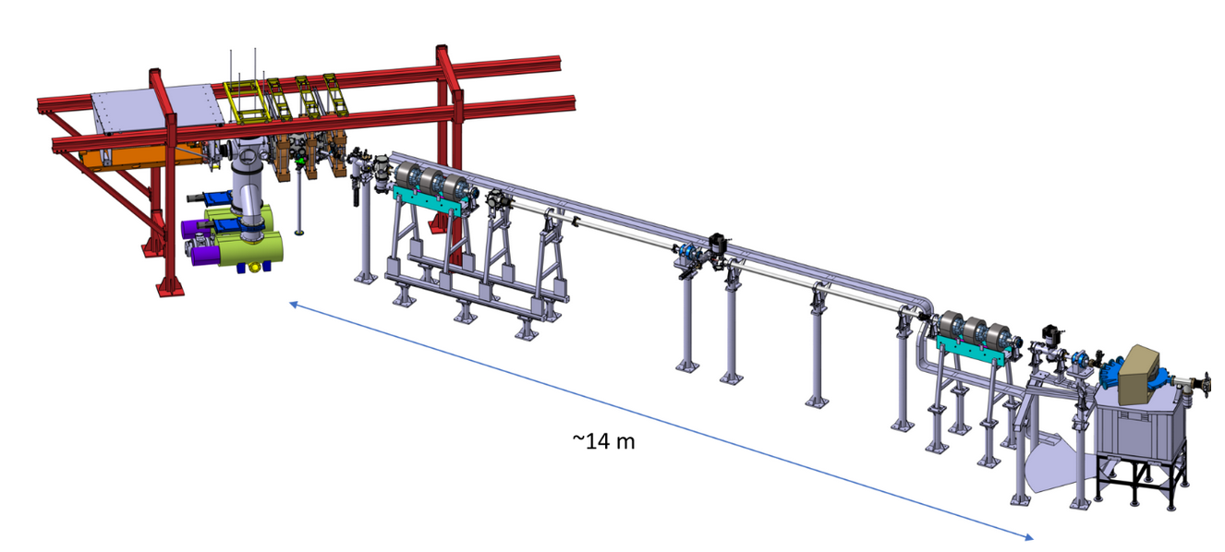
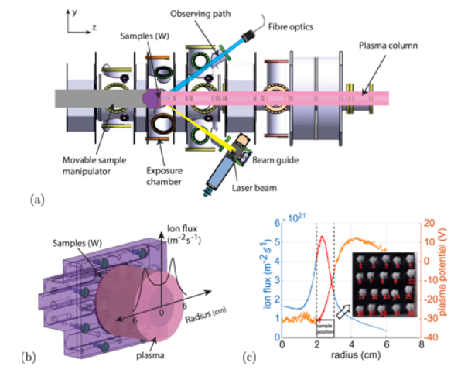
Boron-related in-situ/vacuo fuel retention and recovery studies
SP B + SP C + SP F + SP X (in-vacuo)
Fuel retention and release properties of B layers exposed to fuel species and build with fuel
Simulation related to fuel trapping and release
SP B + SP C + SP F + SP X (in-operando)
Fuel retention and release properties of B layers exposed to fuel species and build with fuel
Simulation related to fuel trapping and release
Recycling-studies on surface
X. Jiang et al.
FZJ
H. van Eeck et al.
DIFFER
In-situ deuterium content measurement by in-operando LIBS (PSI-2) or in-operando NRA (UPP) in 2025 foreseen without breaking vacuum and controlled B+D interaction
Credits to S. Brezinsek

Slide 5
Outline
SP F3 activities
  TOMAS technical upgrades
  Diagnostic commissioning
  IC and mixed plasma characterization
  ICRH system development
  GDC characterization
  EC plasma characterization
SP F2 & SP F3 activities
  Studies of boron layer erosion in PSI-2
  Studies of boron layer erosion in TOMAS
    Contribution of VR
    Contribution of LPP-ERM/KMS
  Further plans

Slide 6
SP F3: TOMAS upgrades and wall conditioning plasma characterization

Slide 7
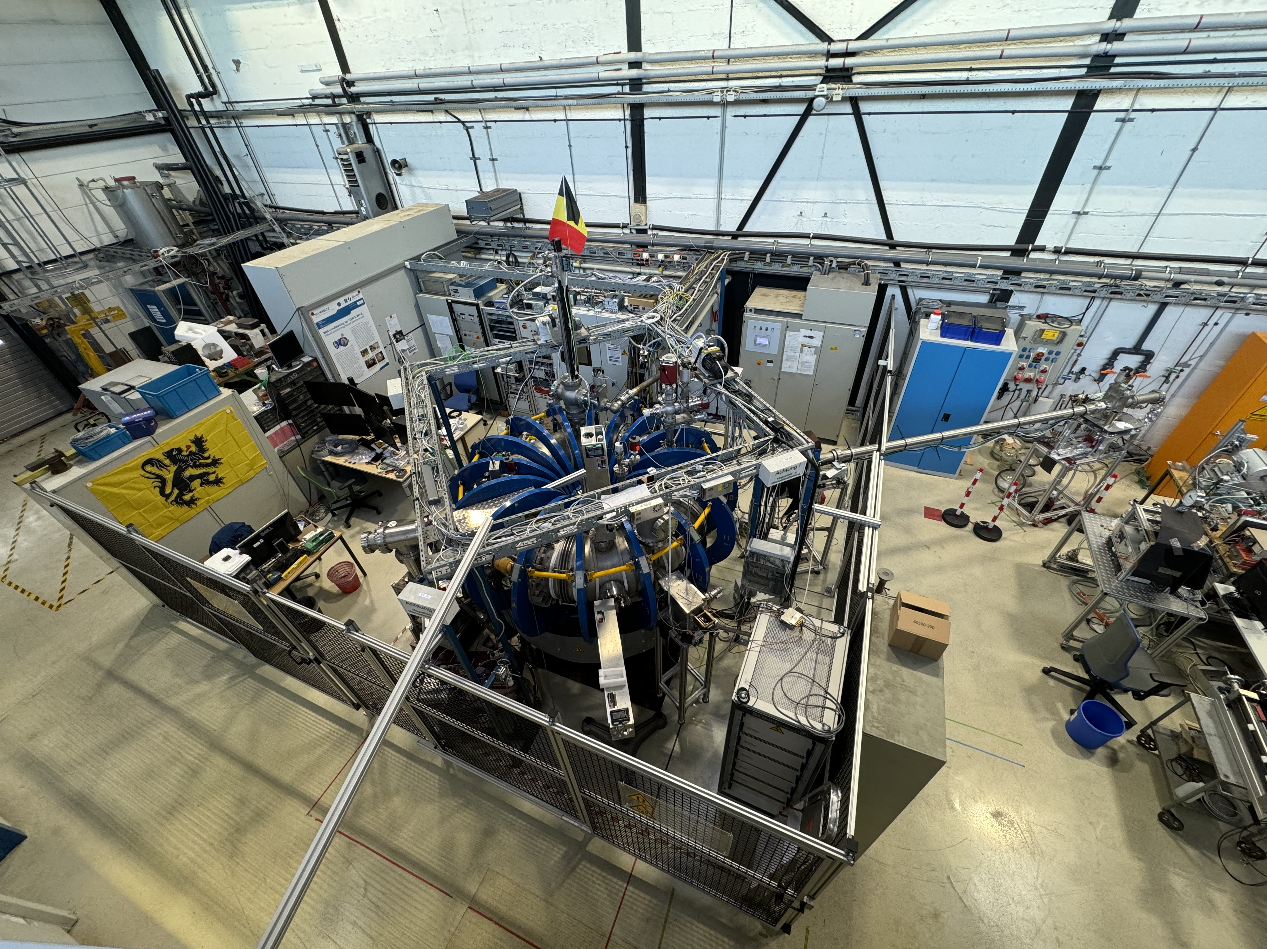
Technical upgrades
Safety and control
  Safety fence installation
  New elements integration into Control System
    Magnetic field system
    ECRH system
    Gas injection system extension
Diagnostics
  Assembly of new horizontal and vertical Langmuir probes
  Installation of MW interferometer
Auxiliary systems
  Extension of gas injection with deuterium mass flow controller

Slide 8
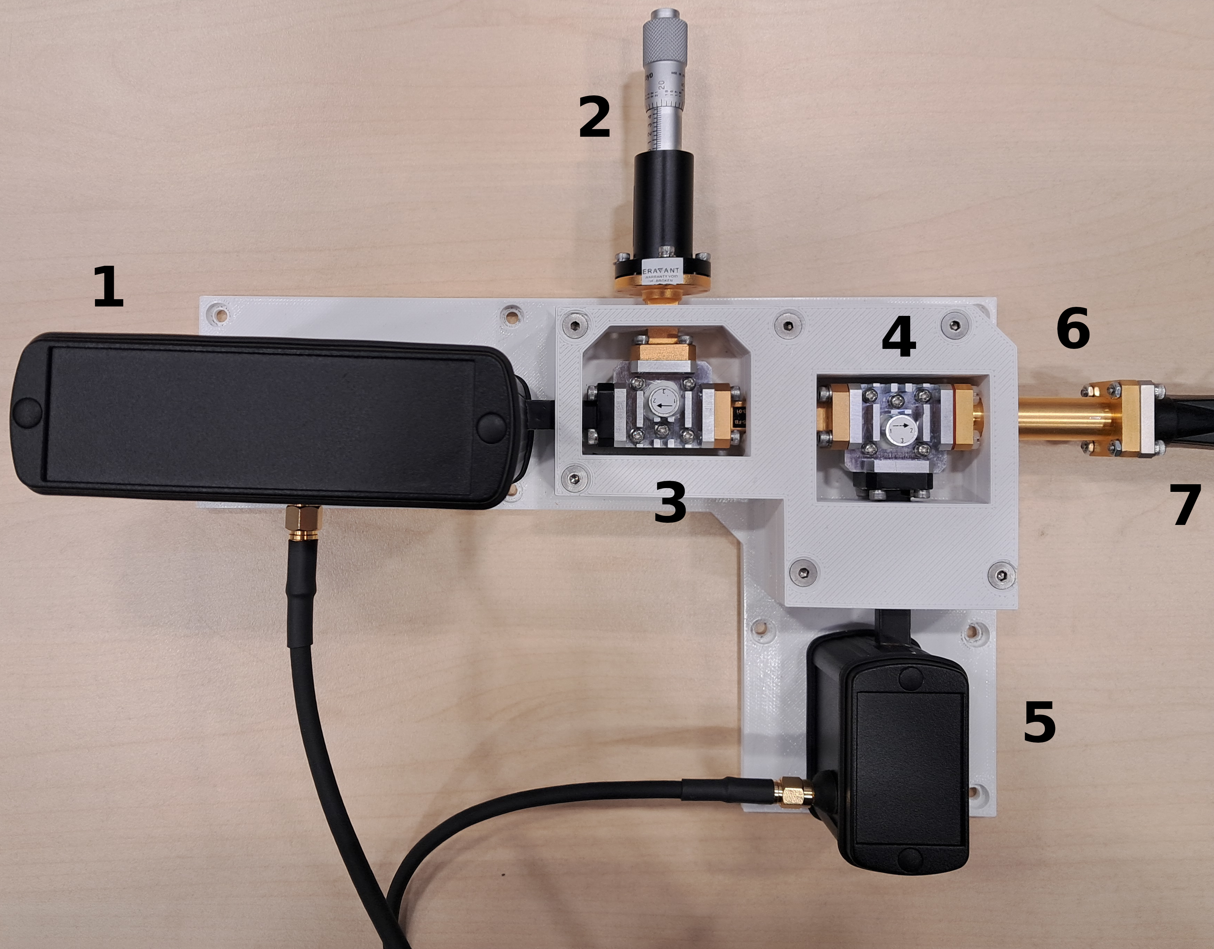
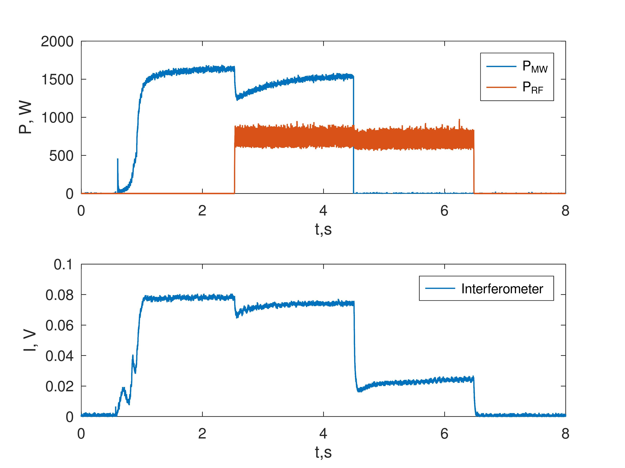
Commissioning of MW interferometer (KIPT)
Finished work
  Installation of the Microwave Interferometer MWI 2650 (Frequency 26.50 GHz) in single emitting/receiving antenna scheme
  Diagnostic commissioning in EC, EC+RF and RF discharge plasma have been performed.
Principle scheme Microwave Interferometer. Transmitter (1), short (2), circulator (3, 4), receiver (5), Waveguide (6) Flexible Waveguide (7).
Ongoing work
  Analysis and comparison of triple LP and MW interferometer data
Example of MW interferometer raw data for different plasma types

Slide 9
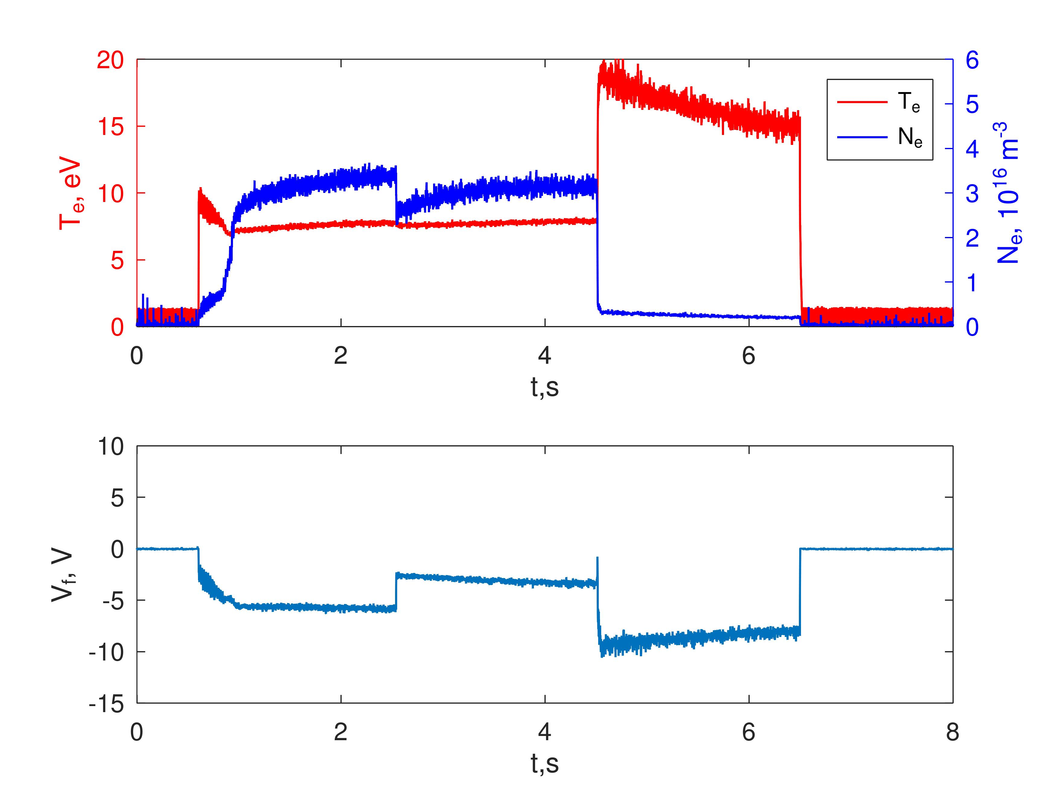
Improvement of Langmuir probe data collecting circuit
Finished work:
  Installation and tests of new measuring module for the triple Langmuir probe
  Implementation of two sub-modules: "floating" and "ground” allowing for simultaneous measurements of density, temperature and floating potential
Ongoing work:
  Characterization of GDC plasmas by triple Langmuir probe,
  Studies of Combined glow discharge + microwave plasmas using triple Langmuir probe
New triple Langmuir probe circuit scheme
Participation in the experiments on TOMAS in Forschungszentrum Jülich.
KIPT (Y. Kovtun) PWIE -visit to FZJ in 29/01/2024-9/02/2024
Example of density and density measurements in combined EC+RF discharge

Slide 10
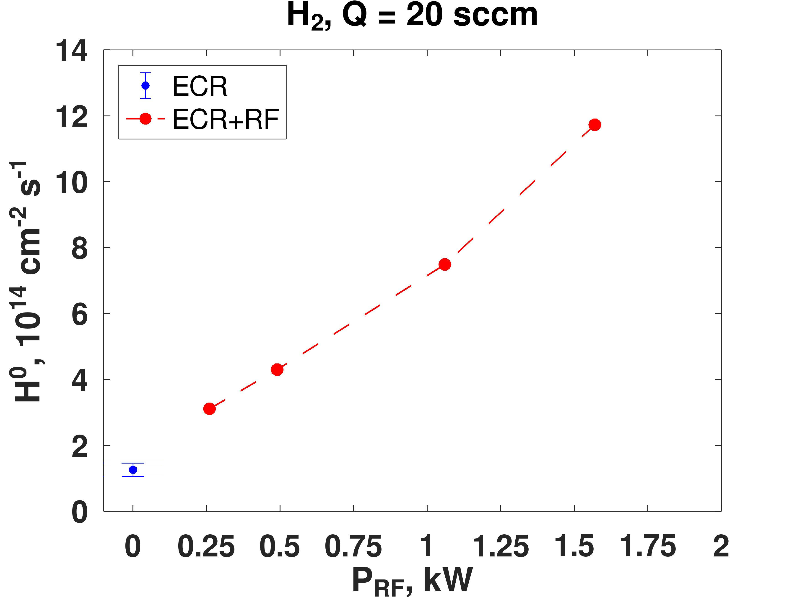
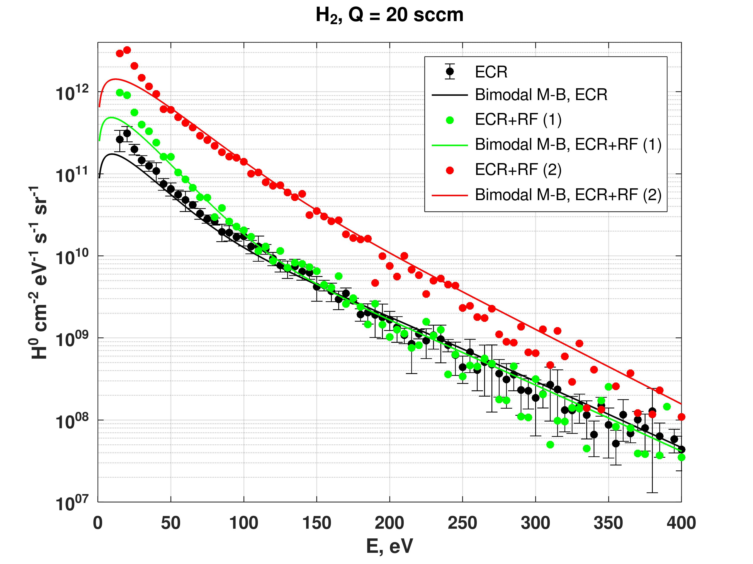
Characterization of combined EC+IC discharges
Additional RF power injection into the ECR discharge allows changing neutral particle flux and distribution function.
Even the injection of small RF power ≈ 0.26 kW relative to microwave power ≈ 1.7 kW leads to an increase of the hydrogen flux by a factor of ~ 2.5. At RF power PRF ≈ 1.57 kW, the H0 flux increases by a factor of ~ 9.3.
Dependence of the atomic hydrogen neutral flux on RF power PRF, initial pressure p₀ = 6×10⁻² Pa, ECR discharge P_{MW}(max) ≈ 1.7 kW, combined ECR+RF discharge f = 25 MHz).
Differential flux spectra of neutrals for ECR and ECR+RF discharges. The experimental data: ECR, ECR+RF (1) for PRF ≈ 0.26 kW, ECR+RF (2) for P_{RF} ≈ 1.57 kW See experimental conditions see in the caption of Figure 15. Distribution: Bimodal M-B, ECR for T_{c} = 18 eV (73%) and T_{h} = 50 eV (27%); Bimodal M-B, ECR+RF (1) for T_{c} = 18 eV (90%) and T_{h} = 50 eV (10%); Bimodal M-B, ECR+RF (2) for T_{c} = 23 eV (83%) and T_{h} = 45 eV (17%)
* Yu. Kovtun et al. submitted to Phys. Plasmas

Slide 11
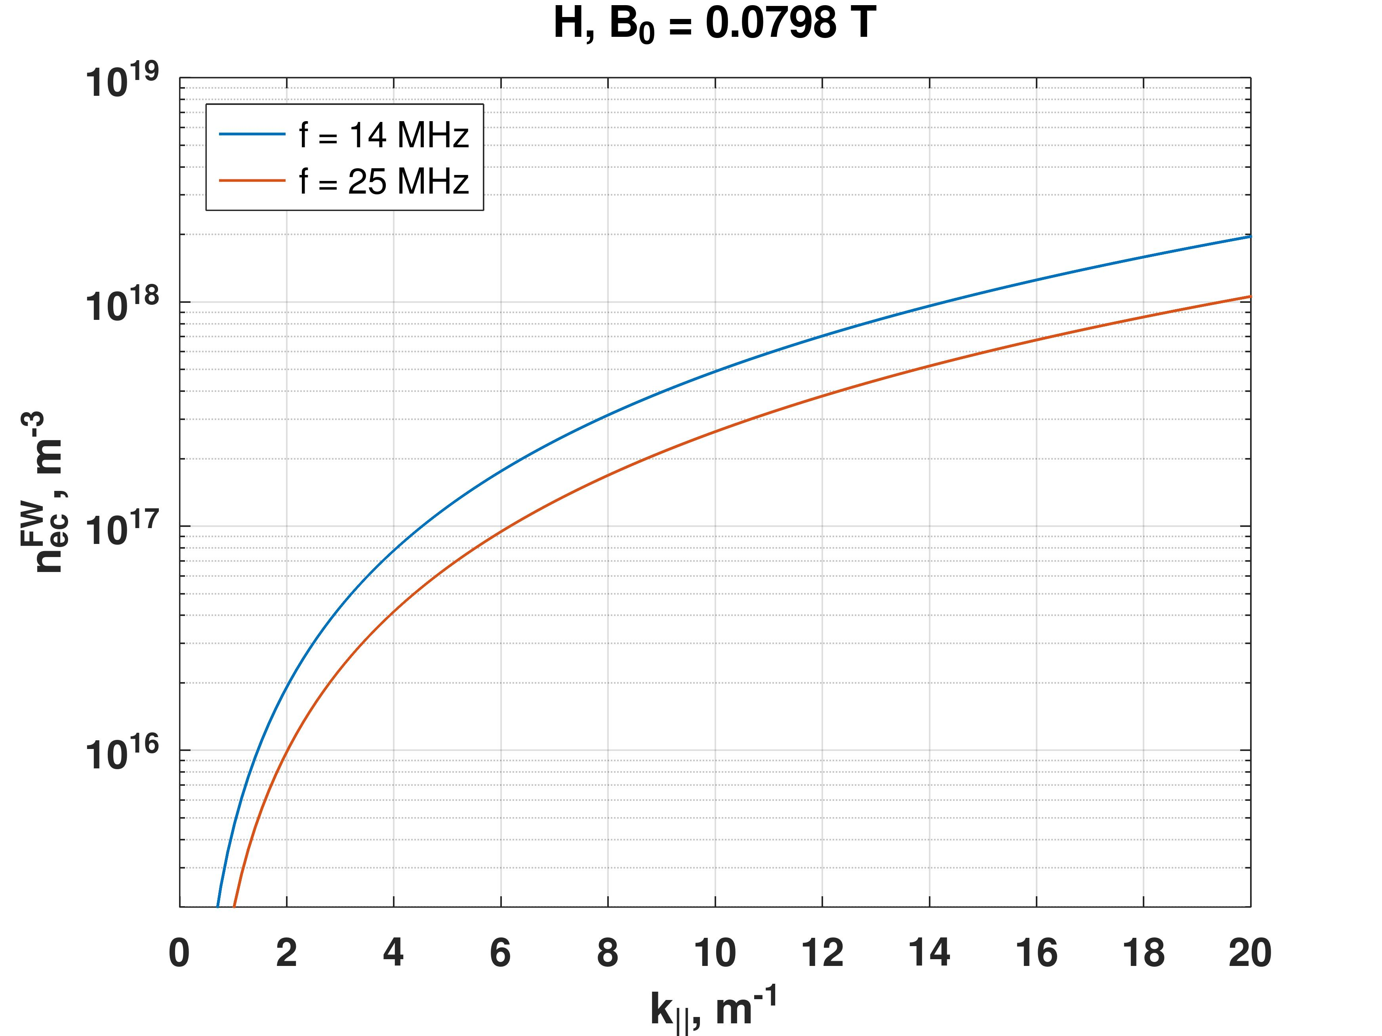
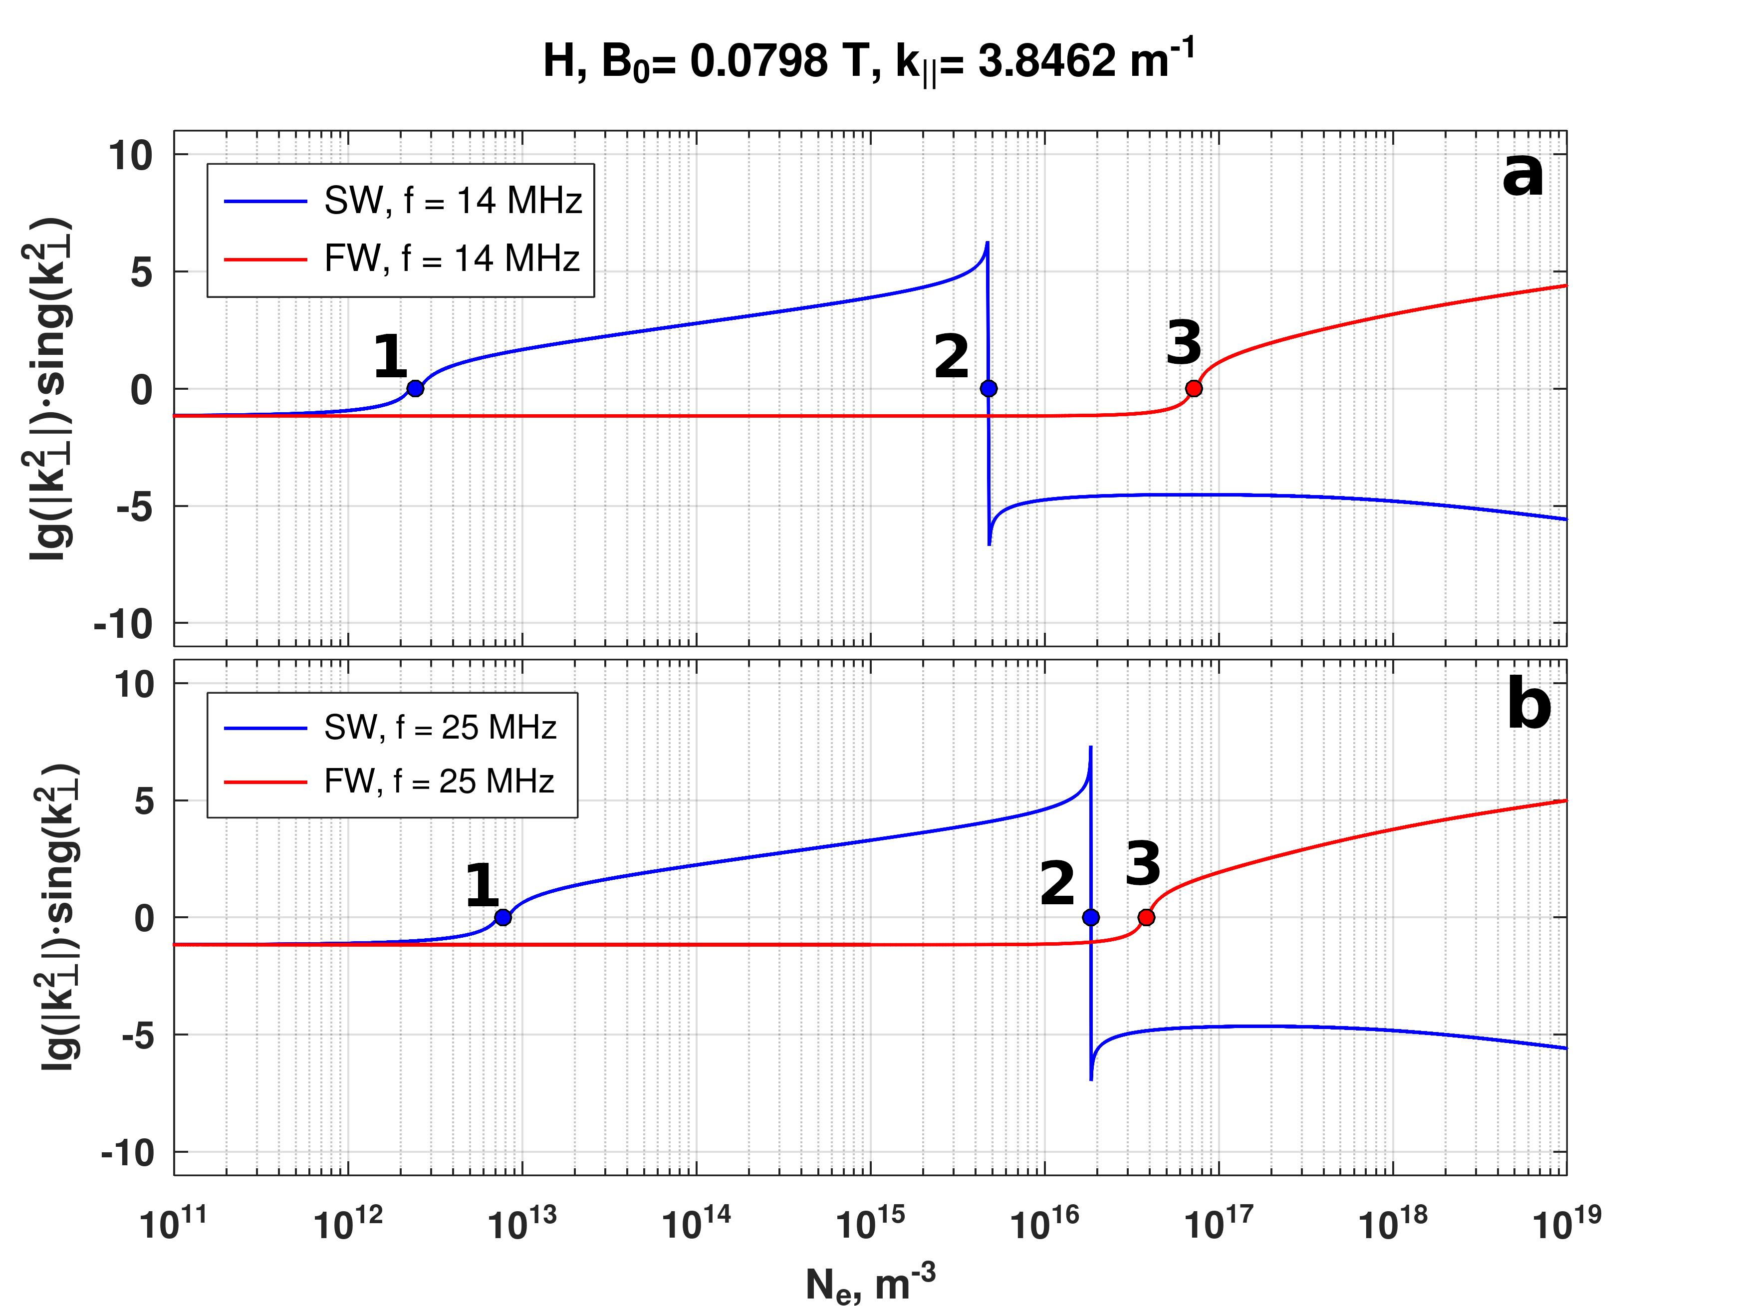
Studies of RF waves propagation in hydrogen plasmas
The propagation of radio frequency (RF) waves in hydrogen plasma in a weak magnetic field is analysed.
Depending on RF frequency and experimental conditions such as radial distribution of plasma density and magnetic field there can be several cases: only slow wave (SW), simultaneously slow and fast waves (FW), only fast wave can propagate.
The square perpendicular wave numbers of SW and FW for 14 MHz (a) and 25 MHz (b) as a function of the hydrogen plasma density. The cut-off points: (1) the SW critical density; (2) the SW critical density (the lower hybrid resonance); (3) the FW critical density.
The dependence of Fast wave critical density as a function of the parallel k║ wavenumber for frequency 14 MHz and 25 MHz.

Slide 12
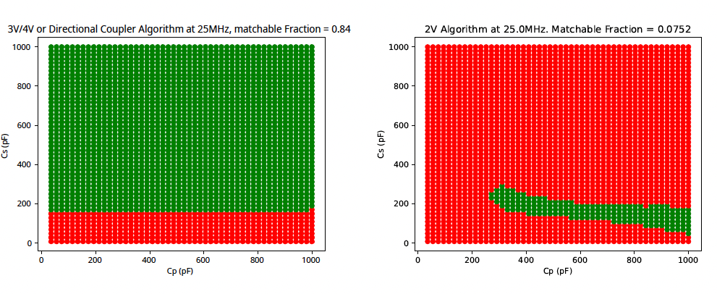
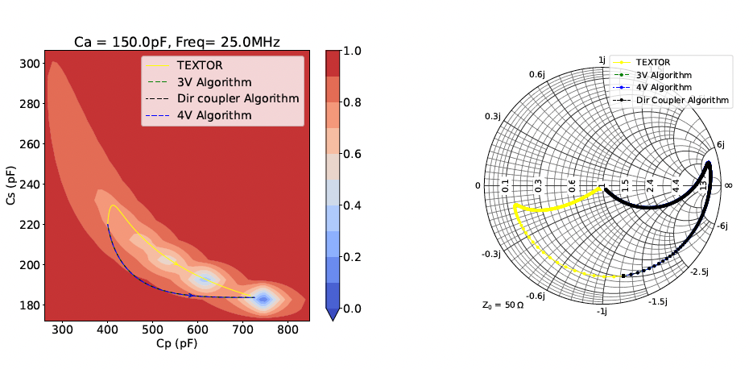
Improvement of TOMAS ICRH system matching
New automatic matching algorithm[1] is implemented
  proposed algorithm outperforms the TEXTOR[2] one
  lower number of steps to match
  significantly larger matchable domain
New power calibration is implemented
  New electrical circuit for power measurements
  New calibration scheme using phase measurements
RF amplifier is repaired & new power feedthroughs
  Operation at full power (6 kW)
  Extended pulse operation
New matching algorithm
TEXTOR matching algorithm
[1] A. Adriaens et al., submitted to Fusion Engineering and Design
[2] F. Durodié and M. Vervier 1991 Elsevier 1186–1190
Simulation of different matching algorithm performance for the ICRF system.

Slide 13
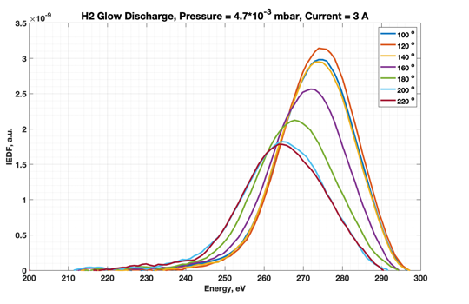
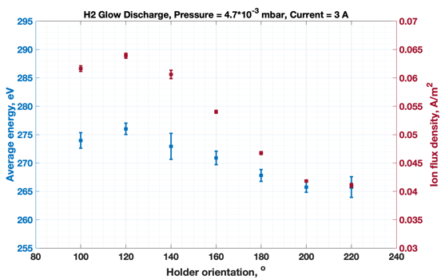
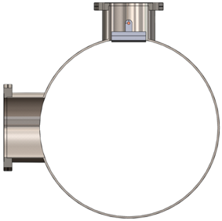
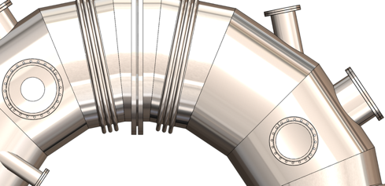
Glow discharge characterization
Characterization of local glow discharge ion energy distribution [1]
  In hydrogen, helium and argon
  At different neutral pressures and anode currents
Studies of glow discharge homogeneity with RFEA*
  Mimicking different distance from GD anode by changing detector orientation and its in-plasma depth
  Input for ITER GD model validation ?
Local ion energy distributions
115 mm
RFEA button probe
100º
GD anode
[1] K. Crombé et al., IAEA FEC 2023, London, 2023.

Slide 14
Studies of MW wave absorption and propagation
Studies of electron cyclotron power deposition in helium [1]
  Characterization of ECRH power source
  Influence of input power, magnetic field and gas pressure on the absorption mechanisms
  Influence of the Langmuir probe position and wave polarization on reflected power fraction
Determination of suitable scenarios for plasma start-up and pre-ionization.
Tunneling and conversion fraction for various levels of the injected power PEC and the magnetic field B₀
X-wave deposition mechanisms for increasing density (a→d)
[1] J. Buermans et. al., submitted to Physica Scripta

Slide 15
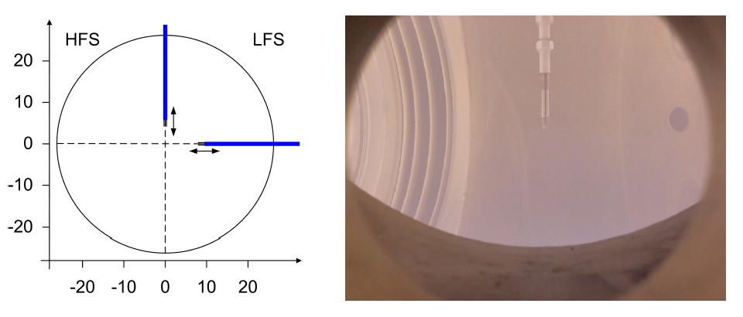
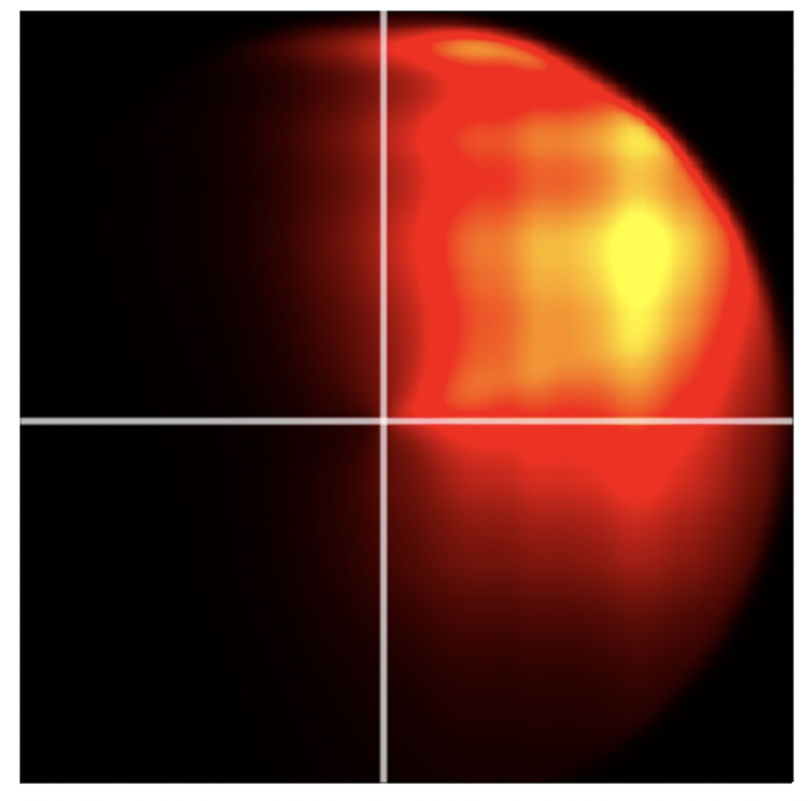
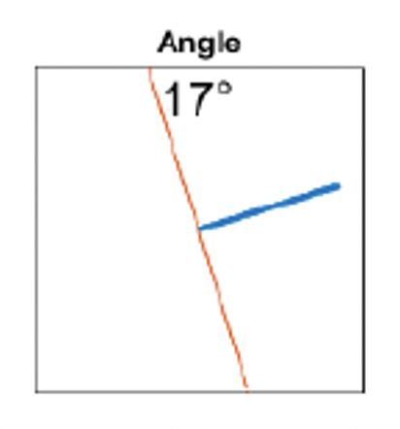
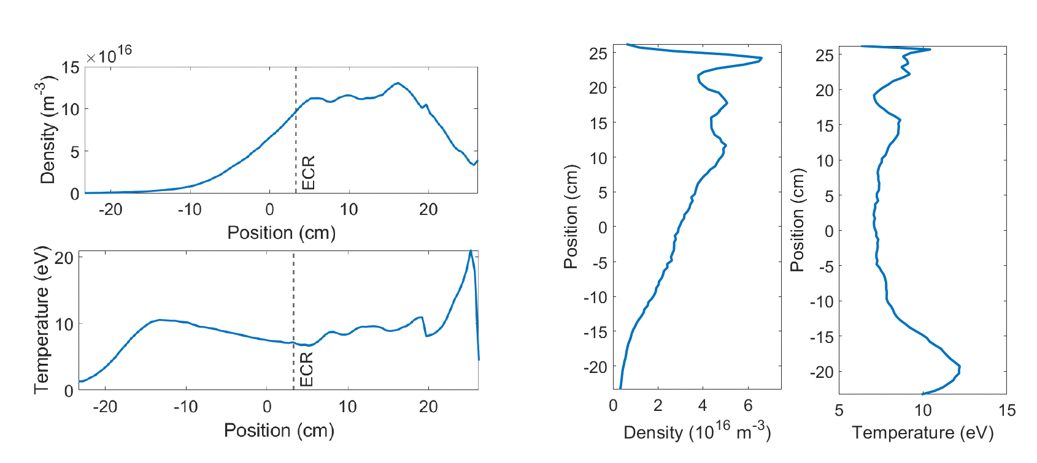

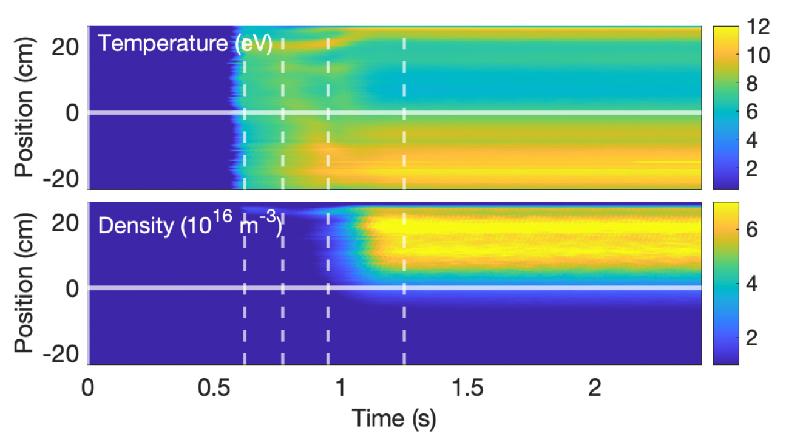
EC plasma characterization by probes
2D scans by triple Langmuir probes (TLP) (vertical + horizontal)
Variations power, B_{t}, pressure, EC mode
Supported by theory of EC wave propagation
2D extrapolation of density
Plasma drift visible in purely toroidal field
J. Buermans et al., Phys. Plasmas 31, 052510 (2024)

Slide 16
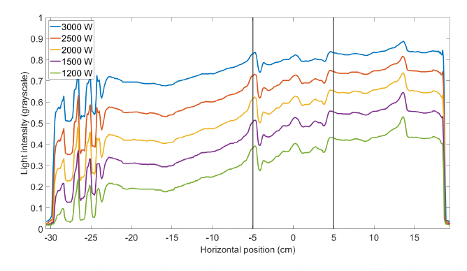
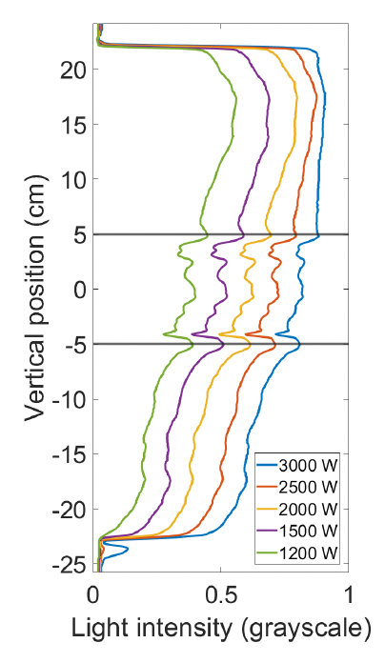
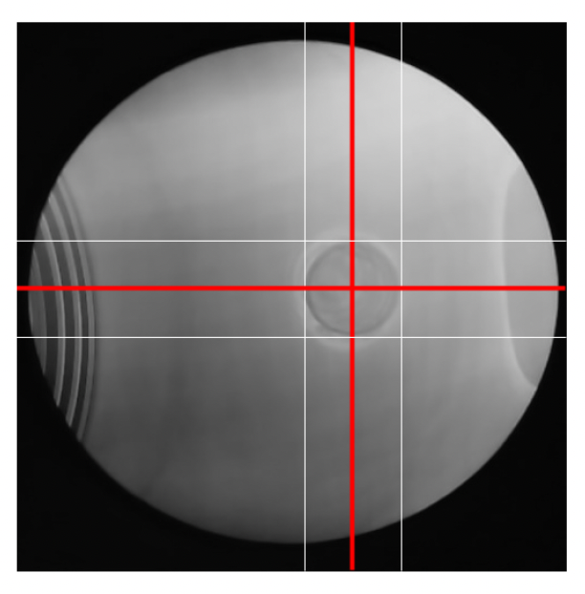
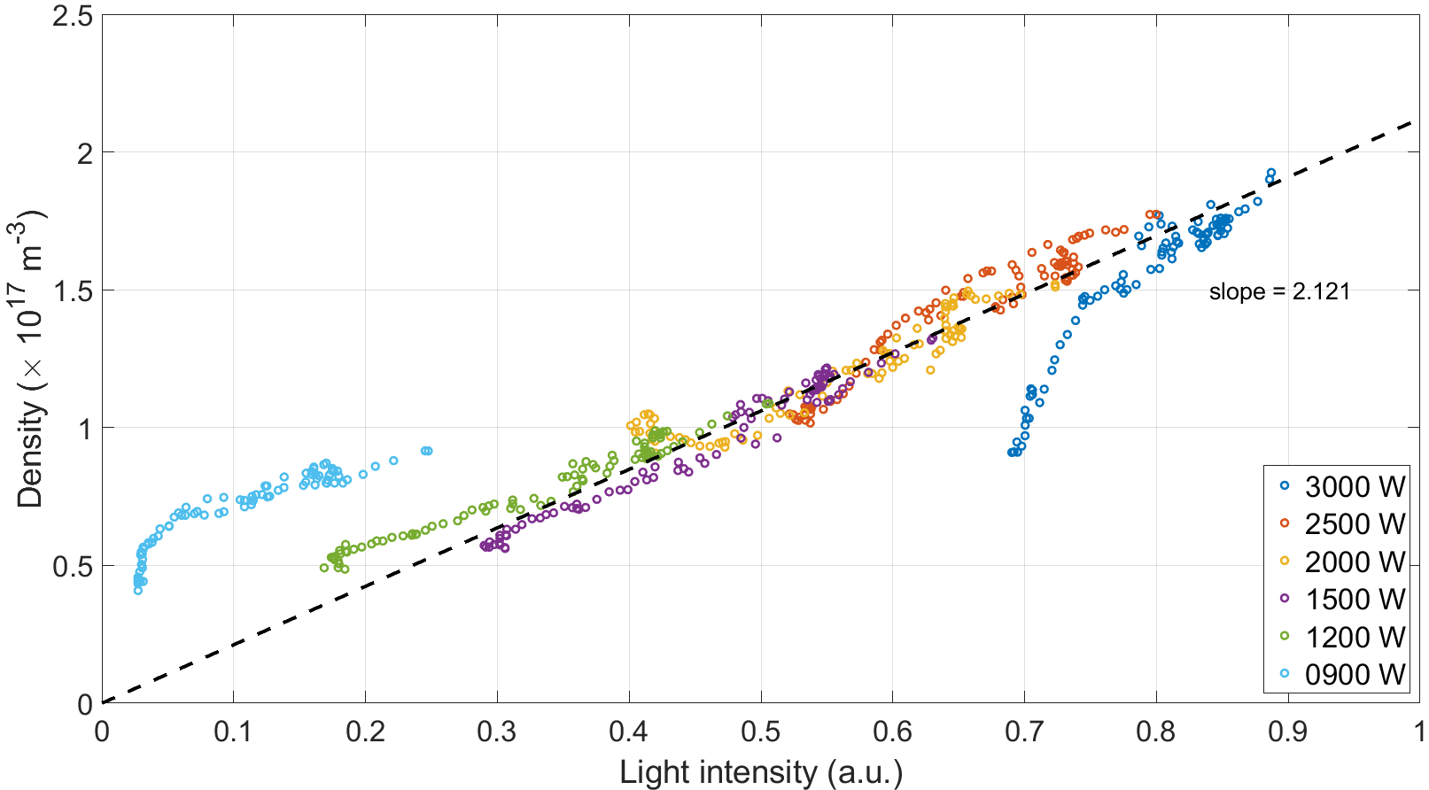
EC plasma characterization by camera images
Comparison of probe measurements of horizontal and vertical densities with visible light intensities of webcam
Linear fit found in broad parameter domain for various power EC level
This allows for a quick estimate of the density in 2D without the need to insert a probe
K. Crombé et al., ICFDT7 (2024)
J. Buermans, PhD thesis, Ghent University (2024)

Slide 17
RF plasma characterization (modelling)
Implementation of a new RF module (ANTITER IV [1]) to TOMATOR-1D code [2] for TOMAS RF plasma modelling
  Studies energy transfer mechanisms
  Characterization of RF waves absorption and propagation
  Generation of charge-exchanged neutrals based on plasma parameters
Characterization of RF plasma
  exploring ion and neutral particle energy distribution using using probes, ToF NPA and RFEA
  TOMATOR-1D model validation
[1] A. Messiaen et al., Plasma Phys. Control. Fus. 63, 045021 (2021)
[2] T. Wauters et al., Plasma Phys. Control. Fus. 62, 105010 (2020)
First modelling attempt to reproduce electron temperature oscillations in radial scan

Slide 18
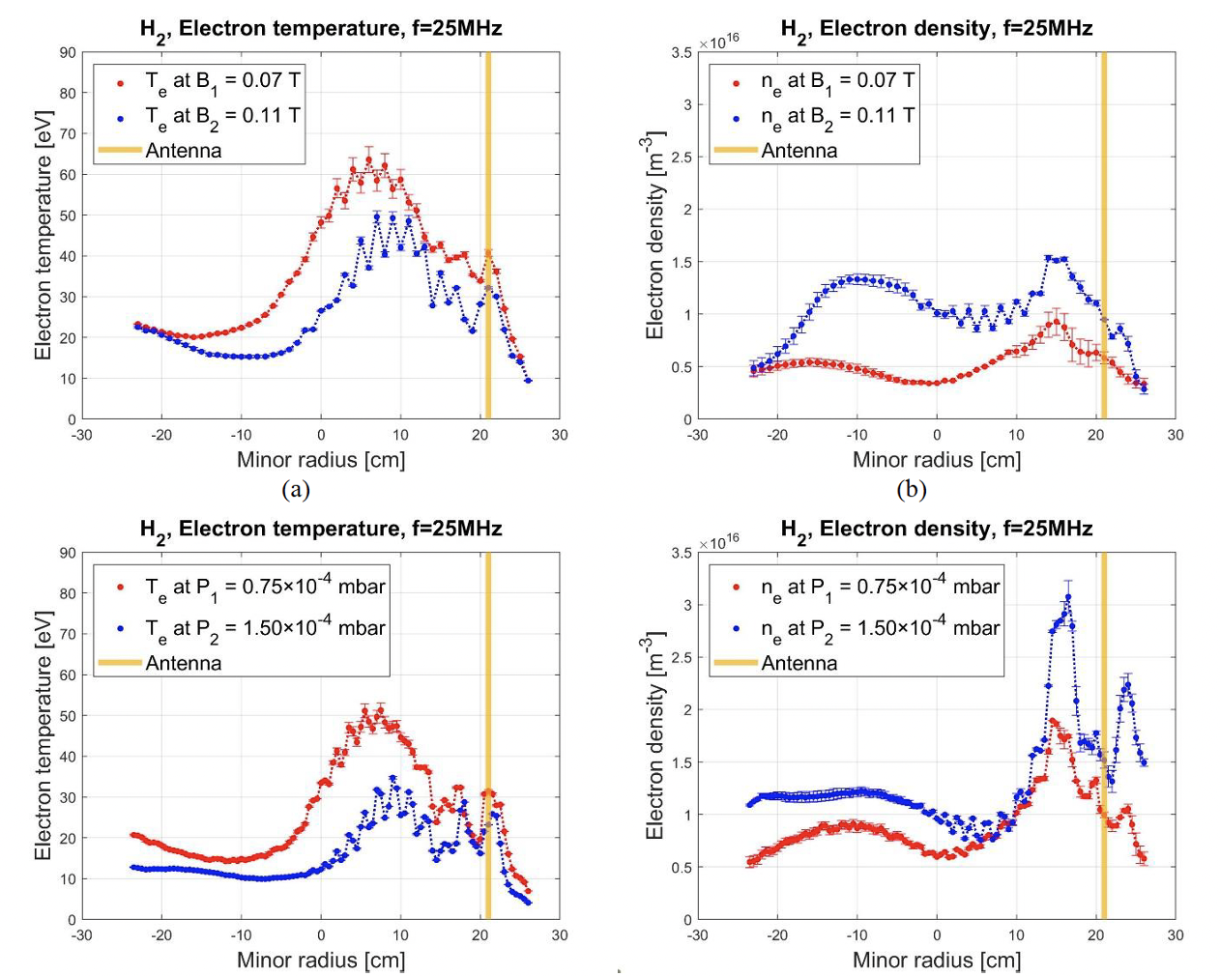
RF plasma characterization by triple Langmuir probe
Profiles n_{e} and T_{e} by movable triple Langmuir probe
Higher n_{e} and lower T_{e} for higher magnetic field
Higher ne and lower T_{e} for higher pressure
Comparison with IC power deposition models ongoing

Slide 19
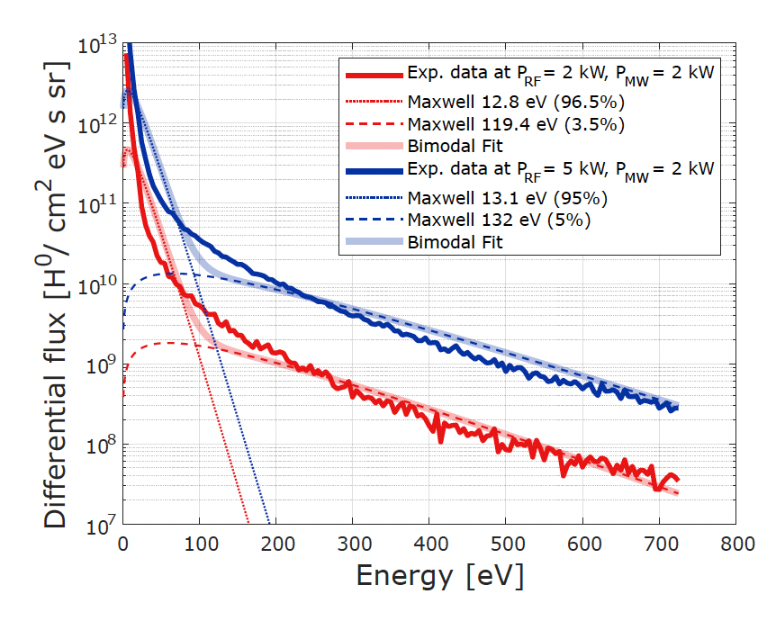
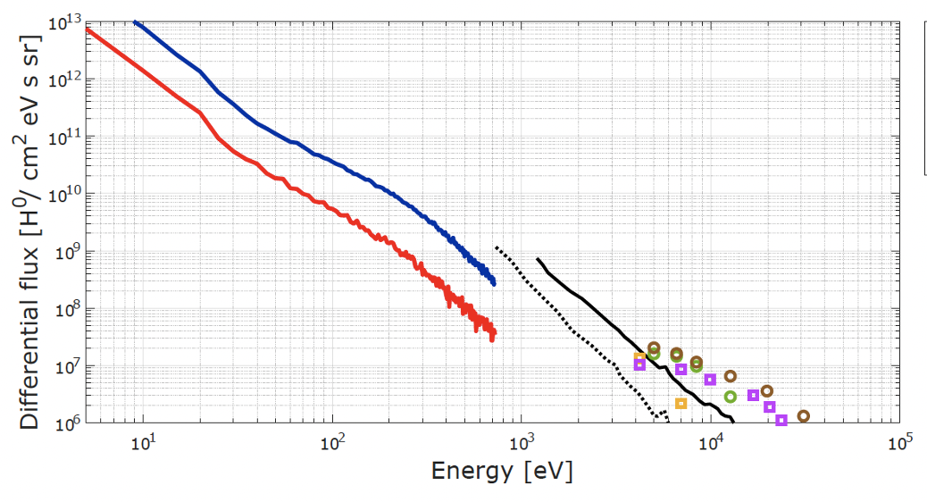
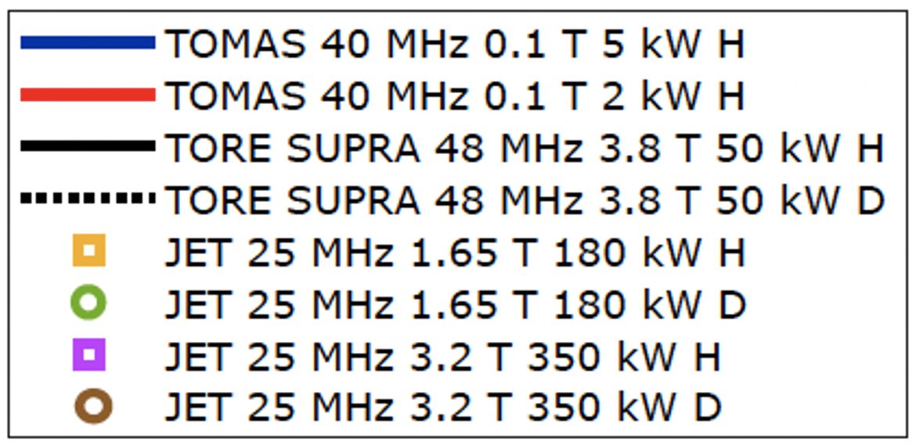
RF plasma characterization by ToF NPA
Increases ion energy and, after charge exchange, also energy of neutrals
TOMAS data : neutral fluxes at low energies, complementary to TORE SUPRA and JET data
Operation in Deuterium is planned in December 2024
p = 1.0 10⁻⁴ mbar, Bt = 0.10 T, RF_{frequency} = 40 MHz
D. Lopez et al., Rev. Sci. Instrum. 95, 083542 (2024)

Slide 20
SP F2 & F3: Boron layer erosion studies

Slide 21
“Synergy ” of FZJ devices, tools and diagnostics for boronization studies
FZJ has all the necessary facilities and competencies to tackle a wide range of boronization studies
Sample preparation (1x1 cm²)
  Manufacturing, polishing, annealing
  Boron coating by physical vapor deposition (PVD) using RF magnetron sputter device
  Deuterium insertion close to substrate during deposition process
Sample pre-characterization and post-mortem analysis
  Boron layer characterization (crystal phase, microstructure, thickness and elemental composition)
  -> XRD, FIB/SEM, EDX
  Deuterium content -> NRA, TDS
Sample exposure to ITER – relevant plasmas
  PSI-2
    Transient ion flux and fluence plasmas for erosion and isotope exchange studies
    ELM, disruptions influence on boron coated PFCs
  TOMAS
    ICWC and GDC wall conditioning plasmas
    Simulation of fuel removal and boron layer erosion by charge-exchange neutrals
Modelling support

Slide 22
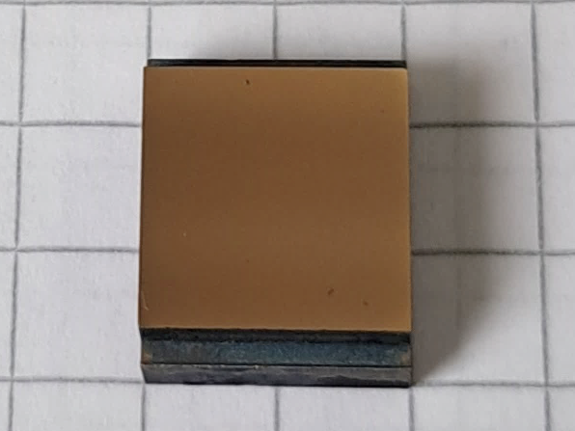
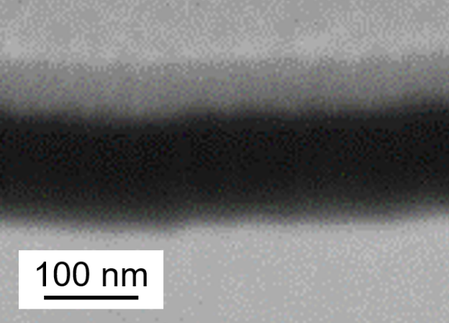
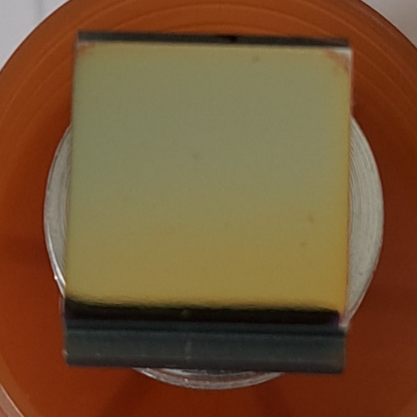
Deuterium plasma exposure of B layers at PSI-2
Boron layer fabrication: Magnetron sputter deposition at FZ Jülich
RF-mode with pure boron target and Ar plasma, ~ 6 h deposition -> ~115 nm thickness on polished and annealed W PSI-2 substrates -> Fig. 1
Deuterium plasma exposure at PSI-2 for B erosion studies:
Deuterium plasma: ion energy: ~40 eV; density: 4e21 m⁻²s⁻¹
Simultaneous imaging spectroscopy for boron, calibrated
Non-cooled PSI- sample holder with Mo mask (Fig. 2)
Two exposures: identical plasma conditions, identical samples, different exposure times: a) 70 s, b) ~26 min
Comparison: B erosion time from FIB/SEM analysis and spectrometer data:
Case a) 70 s: first try to see B by spectrometer: visible remains of boron layer, PSI-2 profile visible (Fig. 3) -> FIB/SEM studies
Case b) ~26 min: no remains of boron layer, detailed imaging spectrometer signal data -> Analysis of spectrometer data
Estimation of B layer erosion time possible!
Fig. 1
Fig. 2 W with B
Other 7 sample:
W dummy
Fig. 3
SEM (FIB)
Pt
B
W
2024-09-17
A. Houben, O. Marchuck, M. Rasiński, M. Sackers

Slide 23
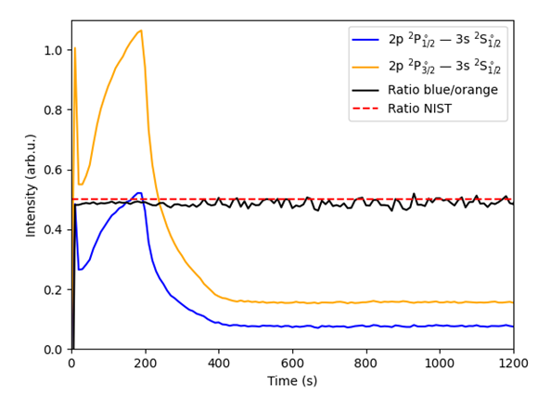
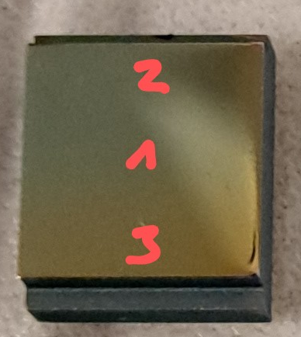
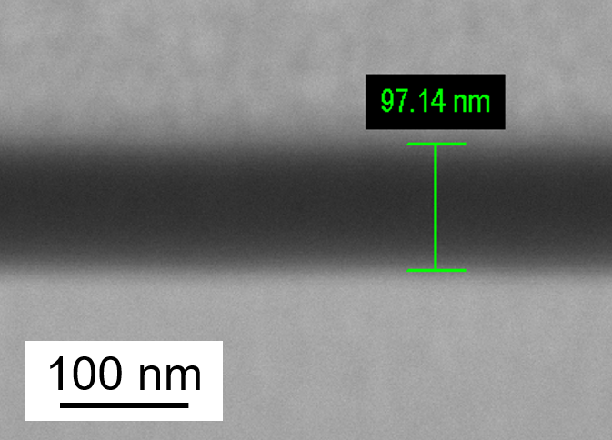
Deuterium plasma exposure of B layers at PSI-2
Comparison: B erosion time from FIB/SEM analysis and spectrometer data:
Case a) 70 s plasma exposure
Measurement of the remained B layer thickness at three different positions by FIB/SEM:
higher erosion
lower erosion
Higher erosion region: Pos. 2: ~85 nm B -> erosion rate: ~0.43 nm/s
Lower erosion region: Pos. 1 and 3: ~97 nm B -> erosion rate: ~0.26 nm/s
Case b) ~26 min plasma exposure
B I line intensity versus exposure time:
Interpretation: 3 zones:
1) up to 200 s:
high erosion zone
2) 200 s to 400 s:
low erosion zone
3) from 400 s:
background signal
Higher erosion: zone 1 -> erosion rate: ~0.575 nm/s
Low erosion: zone 2 -> erosion rate: ~0.29 nm/s
SEM (FIB)
@ Pos. 3
Please note: Preliminary results, further analysis and estimation of error bars is ongoing!
Outlook: other ion energies / temperatures at PSI-2, similar experiments at TOMAS
Very good agreement of erosion rate between the values obtained by FIB/SEM and spectroscopy!
+ It is possible to observe the boron (erosion) by spectroscopy!
A. Houben, O. Marchuck, M. Rasiński, M. Sackers

Slide 24
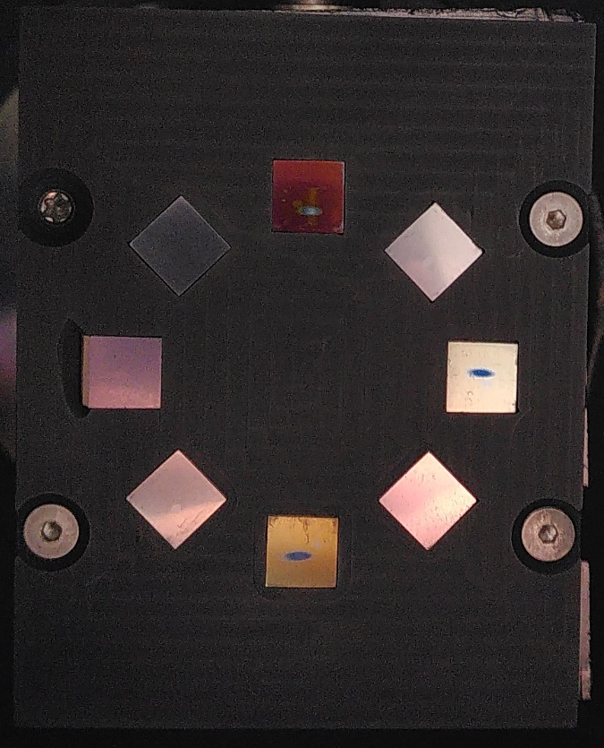
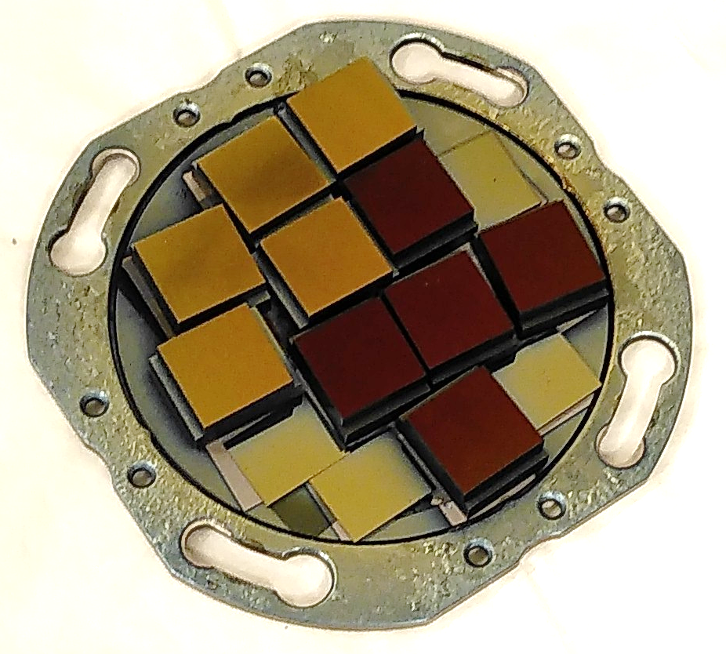
Research on B deposits: Samples & Exposures (VR)
Production of homogeneous sputter deposited samples:
→ Sputter deposition of B and mixed layers at Uppsala University
Produced samples on polished graphite substrates:
  B layers: 70 – 100 nm
  B+W mixed layer: approx. 75 nm
  B+D mixed layer: approx. 100 nm
  B+W+D mixed layer: approx. 75 nm
  W or redeposited EUROFER interlayers: 150 – 200 nm
Exposed in seven TOMAS exposures:
Exposure | 1 | 2 | 3 | 4 | 5 | 6* | 7
Gas | He | He | H₂ | H₂ | He | He | H₂
Type | GDC | ICWC | ICWC | GDC | ICWC | ICWC | ICWC
Duration [min] | 180 | 1.7 | 1.7 | 180 | 0.9 | 24 | 24
Energy [kJ] | 9040 | 190 | 190 | 11500 | 200 | 5830 | 6040
*
Exposure 6 composed of 3 interrupted exposures

Slide 25
Boron layer thickness
Pre- and post-exposure analysis with IBA:
Elastic recoil detection analysis (ERDA) - 36 MeV I⁺⁸ or 44 MeV I⁺¹⁰ beam
Erosion of B layers:
Exposures erode up to 18 nm of B for H₂ and He GDC exposures.
Minimal erosion of B observed at 5th He IC exposure (52 s, 200 kJ).
However, unexposed reference B sample eroded by 15 nm.
Mixed B+W layers:
Similar results for B+W layer erosion, with strong preferential erosion of B.
Layers containing B and D:
B content decreased on nearly all samples on average by 10 nm, on unexposed 6 nm.
Study stability of B layers under exposure to atmosphere.

Slide 26
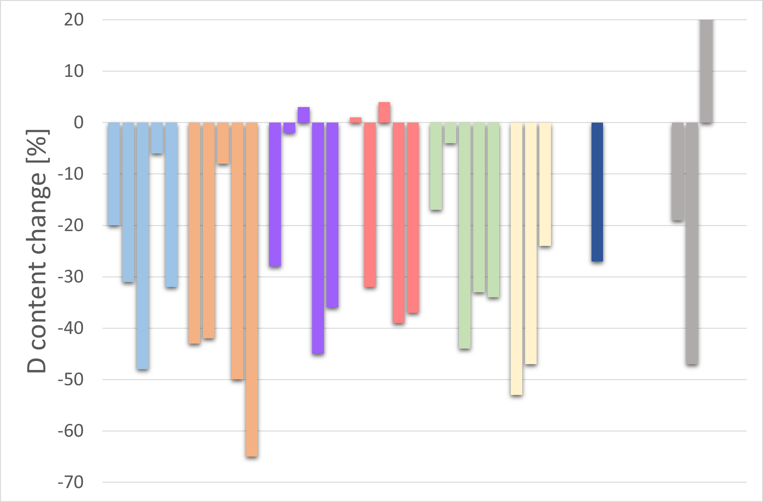
Development of deuterium content
Pre- and post-exposure analysis with IBA:
Nuclear reaction analysis (NRA) - 3 MeV ³He²⁺ beam
60%
1st exposure
(GDC, He)
4th exposure (GDC, H₂)
2nd exposure (IC, He)
3rd exposure (IC, H₂)
5th exposure (IC, He)
6th exposure (IC, He)
7th exposure (IC, H₂)
Unexposed

Slide 27
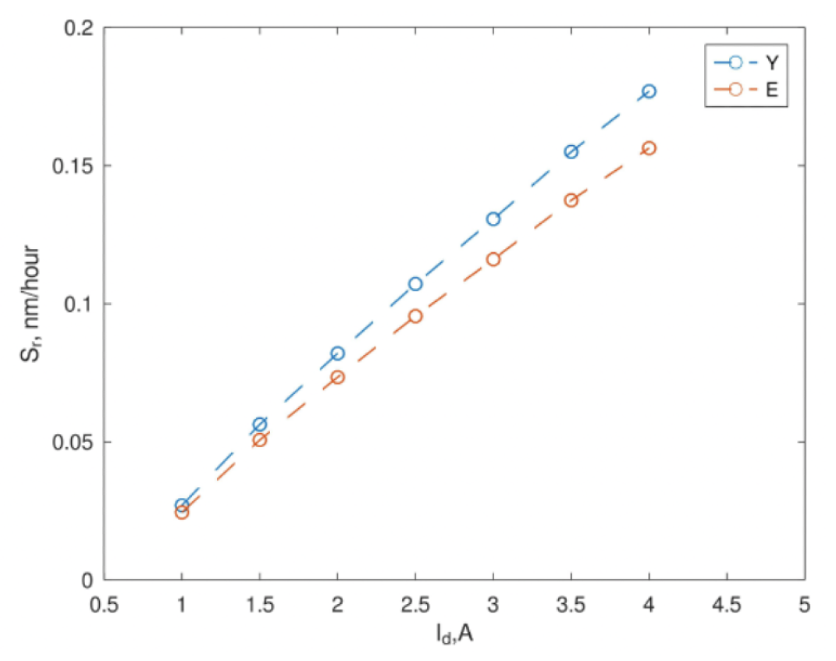
Comparison of RFEA data with sample erosion
H₂ GDC plasma
RFEA measurements:
Experimental erosion data on B+D layers:
Exposure duration 3 h
First results, data collected in March
→ Erosion rates roughly 40 times higher
GDC at 3A | Erosion rate [nm/h]
Sample I | 5
Sample II | 5
Credit: A. Bäckman
K. Crombé et al., IAEA FEC (2023)
Obtained sputtering erosion rates at 3 A: 0.12 – 0.13 nm/h
Possibly due to impurities in plasma
Notes:
Y. Yamamura, H. Tawara, “Atomic Data and Nucl. Data Tables” 62, 149–253 (1996)
R. Behrisch, W. Eckstein Springer-Verlag Berlin, Heidelberg (2007)

Slide 28
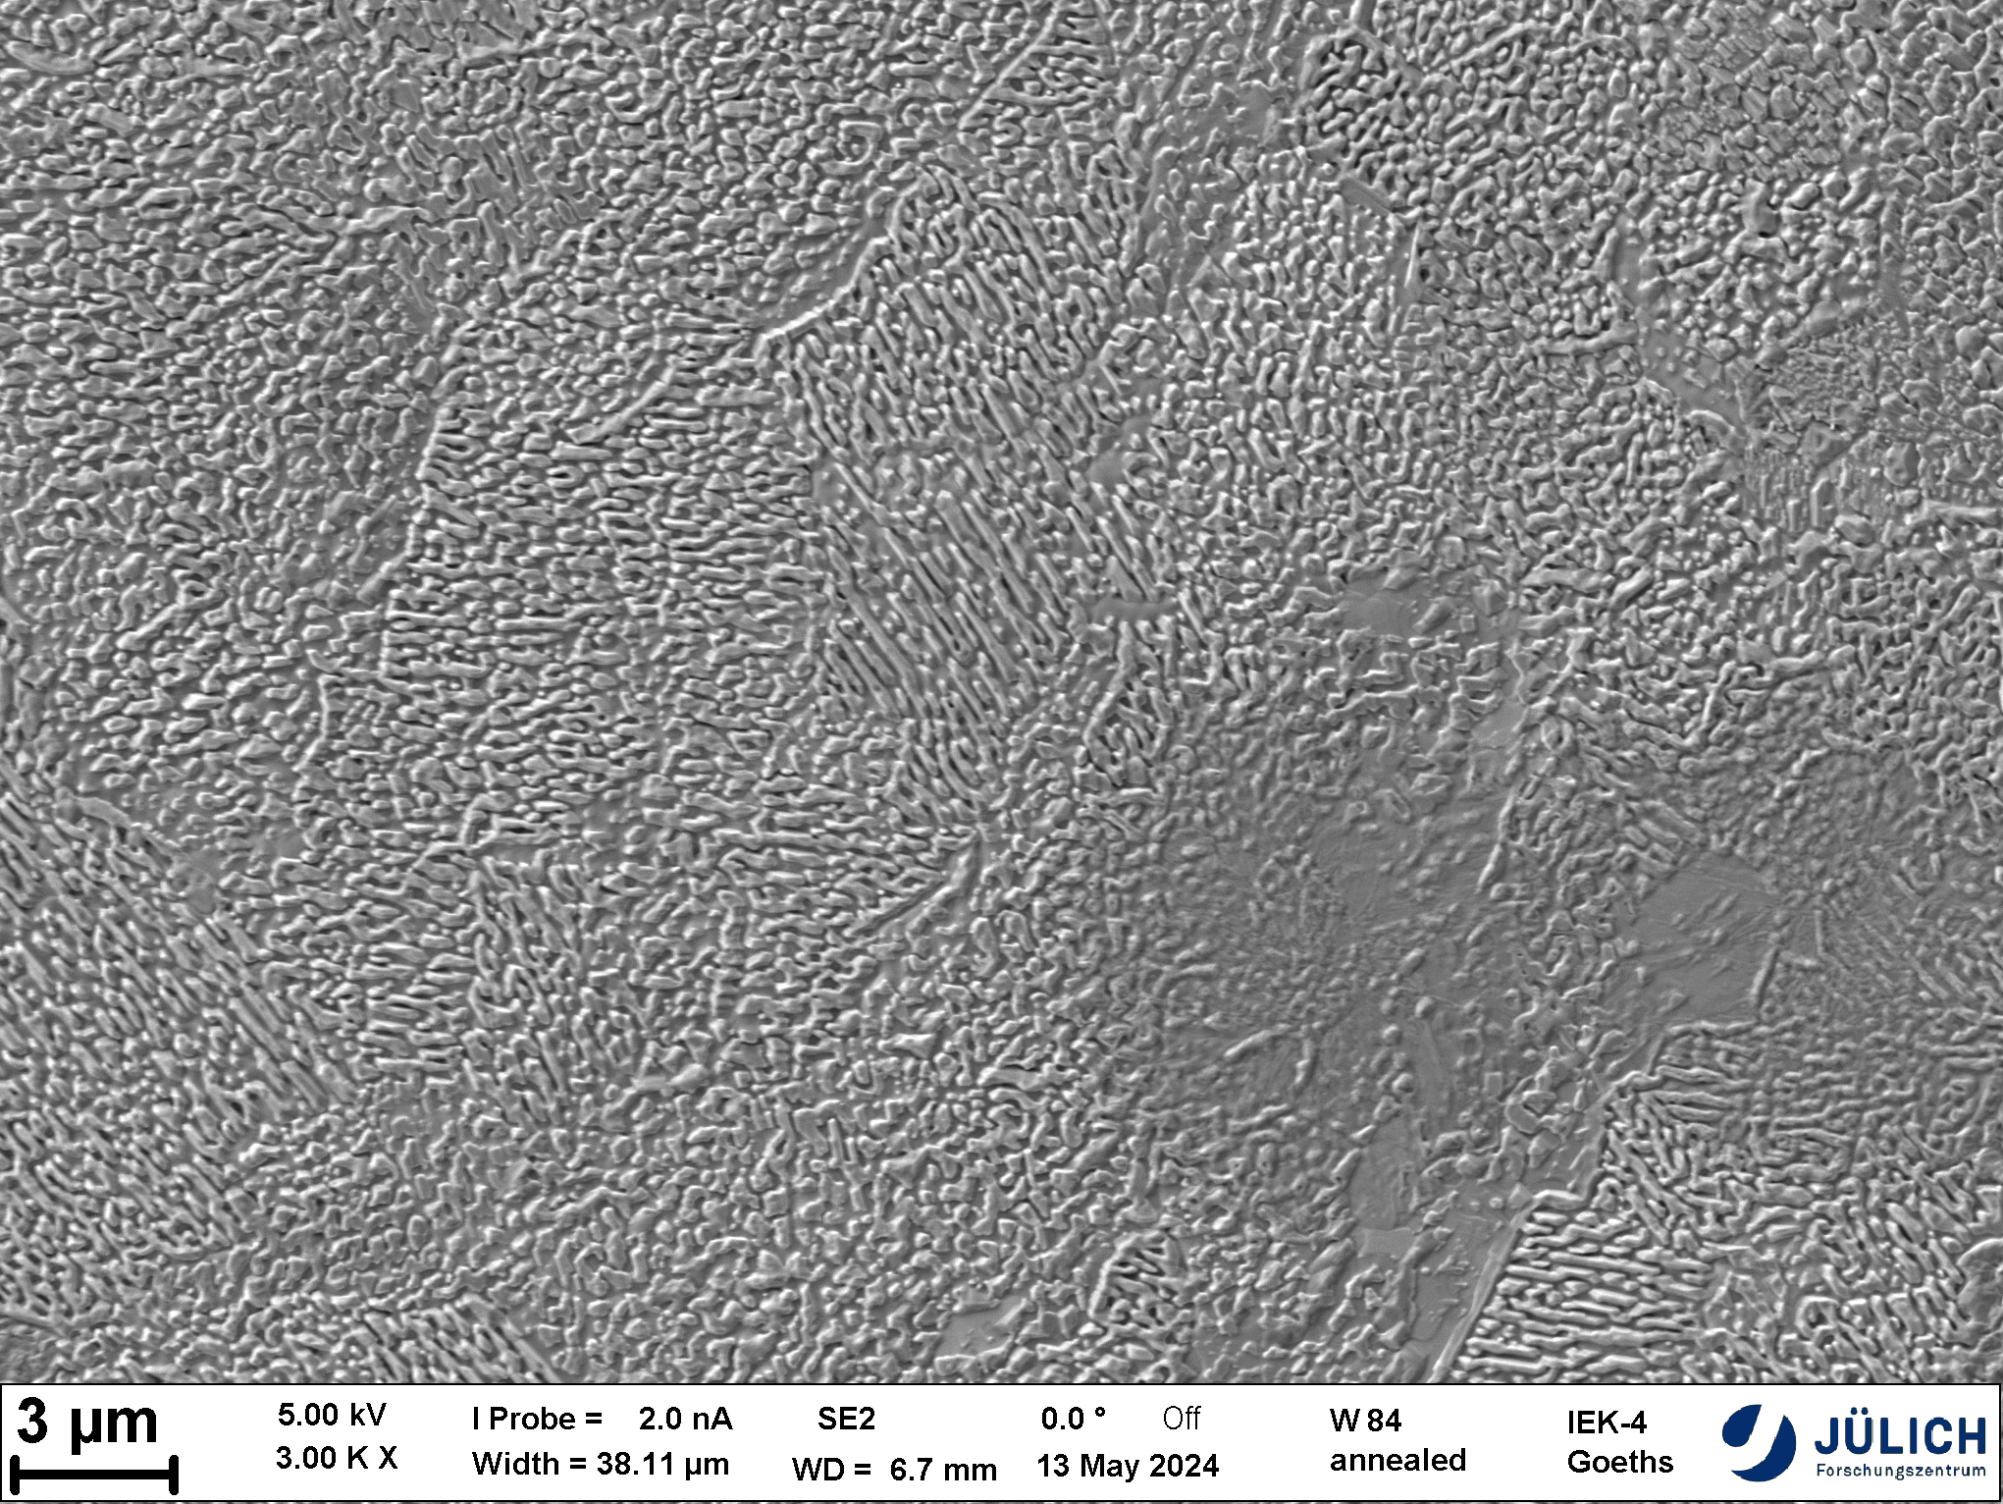
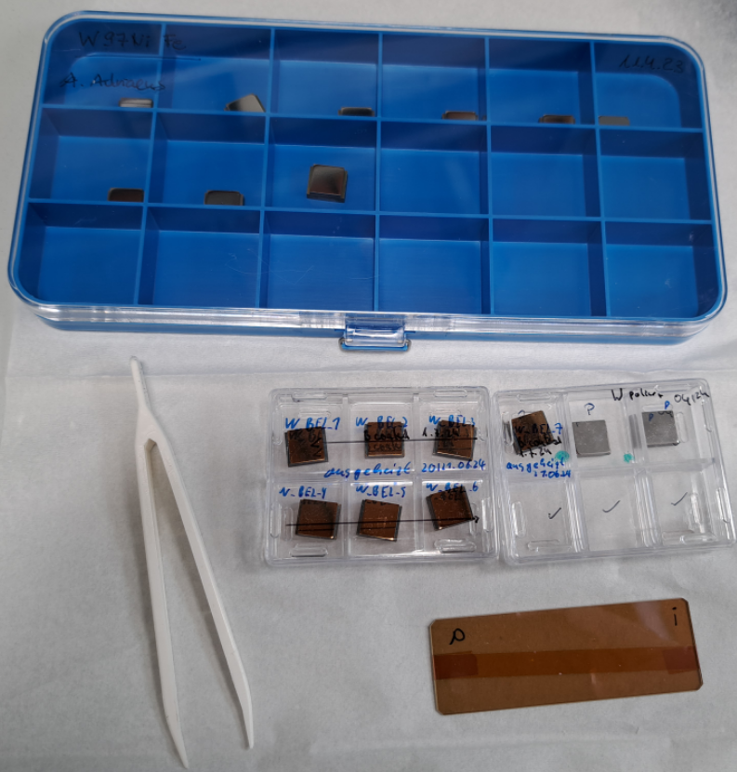
TOMAS contribution to W7-X boronization studies
ICWC operation at future W actively cooled divertor
Samples preparation and analysis
Samples (9 of each species provided by W7-X team) -> polished
Pure W
  annealed
  issues with surface roughness - > replaced by FZJ samples (only 7)
  coated ~ 100 nm (similar to previous case)
W95Ni3.5Cu1.5
W97Ni2Fe1
W95Ni3.5Fe1.5
Sample surface characterization (coated pure W samples)
Boron coating thickness by FIB/SEM
Boron coating density by IBA
Profilometry (on exposed samples) -> additionally
Exposure with W mask without active sample heating
A. Houben, A. Adriaens

Slide 29
TOMAS contribution to W7-X boronization studies
Studies of ICWC influence on boronized wall at reduced (1.7/1.8 T) magnetic field operation
Plasma characterization and exposure parameter selection
ICWC plasma parameters
  ~ 40 MHz
  Input power of 1.5 kW, 3.5 kW and 5.5 kW (2 samples per exposure)
  Hydrogen neutral pressure of 1e-4 mbar
Estimation of plasma exposure time (modelling of erosion rates)
  Neutral particle energy distribution (ToF NPA)
  Ion energy distribution (RFEA + Saha equation)
Comparison with boron-coated graphite sample exposure
  Preliminary analysis -> experimental erosion rates = 10-s * theoretical erosion rates
A. Houben, A. Adriaens

Slide 30
Further steps (TOMAS)
Energy dependency of isotope exchange in PSI-2
  detailed analysis of the erosion and fuel exchange of the B:D layer by a hydrogen plasma
  Test of in-situ diagnostics on B:D layers (spectroscopy, LID-QMS, LIBS)
Studies of fuel retention/removal (by ICWC and GDC, W samples) on TOMAS
  Commissioning of deuterium plasmas on TOMAS - > December 2024
In-situ diagnostic commissioning on TOMAS (erosion and isotope exchange)
  Imagine spectroscopy
  Sample load-lock system upgrade - > 1st half of 2025
  Installation of LID-QMS - > 2nd half of 2025
Collaboration with DTU (NORTH tokamak)
  Joint experiments on EC parametric decay studies

Slide 31
Publications and other achievements
J. Buermans et al., “Study of the Electron cyclotron power deposition in TOMAS”, Physica Scripta, vol. 99, no. 8, p. 085606, 2024
D. López-Rodríguez et al., “Characterization of plasma parameters and neutral particles in microwave and radio frequency discharges in the Toroidal Magnetized System”, Rev. Sci. Instrum. 95, 083542 (2024).
J. Buermans et al., “Characterization of ECRH plasmas in TOMAS”, Phys. Plasmas 31, 052510 (2024).
A. Adriaens et al., “An automatic matching system for the ICRF antenna at TOMAS: Development and experimental proof” submitted to Fusion Engineering and Design
Yu. Kovtun et al., "Combined electron-cyclotron resonance and radio-frequency discharges in the TOMAS facility”, submitted to Phys. Plasmas
L. Mestdagh, “Analyse van lichtintensiteit en dichtheidsprofielen in een ECR-plasma in het TOMAS-apparaat”, Master thesis, University of Antwerp, 2024
J. Buermans, “Characterization and Modelling of ECRH Discharges in Magnetic Confinement Fusion Devices”, PhD thesis, Ghent University, 2024
A. Goriaev, “Experience in manufacturing and operating 3D-printed ICRF antenna in TOMAS device”, AM2F workshop, MIT, Boston, USA, 2024
A. Adriaens, “An automatic matching system for the ICRH antenna at TOMAS”, SOFT conference, Dublin, Ireland, 2024
K. Crombé, “Diagnostics for Wall Conditioning Studies of Magnetically Confined Plasmas on
the TOMAS Device”, ICFDT7 conference, Rome, Italy

