Slide 1

Reporting meeting PWIE: SP X
Hennie van der Meiden

Slide 2
PWIE 2024: SP X
SP X consists of 2 parts:
SP X.1: Atomic and molecular processes in attached/detached plasmas
SP X.2: Optimization of laser-based surface analysis diagnostics

Slide 3
SP X.1: Atomic and molecular processes in attached/detached plasmas

Slide 4
SP X.1: Atomic and molecular processes in attached/detached plasmas ➔
Motivation
Without precautions divertor components are subject to unacceptable high particle fluxes
Neutral particles are beneficial for mitigating plasma fluxes: removing momentum/energy
However, reaction rates can vary orders of magnitude with the level of rovibrational excitation of the ground state hydrogen molecule, causing major deviations in predicting plasma performance
To obtain this missing ro-vibrational distribution of ground state hydrogen and isotopes, the focus of SP X.1 will be mainly on molecular spectroscopy in linear devices

Slide 5
Activities 2024: active and/or passive spectroscopy on linear plasma generators: PSI-2, Magnum-PSI, UPP, JULE-PSI
Atomic density (TALIF) measured in MAGNUM-PSI and CARS installed in MAGNUM-PSI or UPP. VUV OES results H/H2 and ne/Te measurements in UPP and/or Magnum-PSI (DIFFER)
VUV OES hydrogen atom and molecule analysis of MAGNUM-PSI/UPP results H/H2 (CU)
Interpretation spectroscopy results (Magnum) using spectra simulation and (CR) modelling with YACORA (MPG)
OES results H/H₂, ne, Te and 2D distribution in JULE-PSI. VIS molecular and atomic spectroscopy in PSI-2 under ionising and recombining plasmas (FZJ)
Deliverable owners: D001 (Differ), D002 (FZJ), D003 (CU) and D004 (MPG)
In general: good progress

Slide 6
Tasks DIFFER for 2024: DIFFER(MPG)
Repeat atomic density (TALIF) measurements in UPP
Measure atomic density (TALIF) in MAGNUM-PSI
Install CARS in UPP and/or MAGNUM-PSI
ne/Te measurements in UPP and/or Magnum-PSI
In collaboration with MPG: Fulcher band and TALIF measurements in Magnum-PSI
Deliverable: PWIE-SP X.X1.T-T004-D001
Status: completed
Facilities: MAGNUM-PSI, UPP
Linked WP or TSVV:

Slide 7
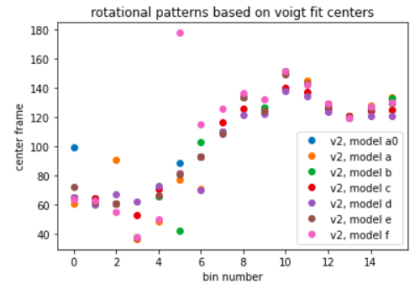
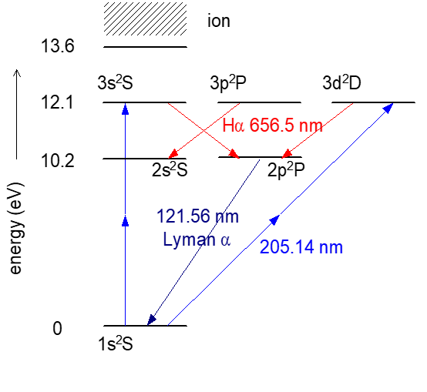
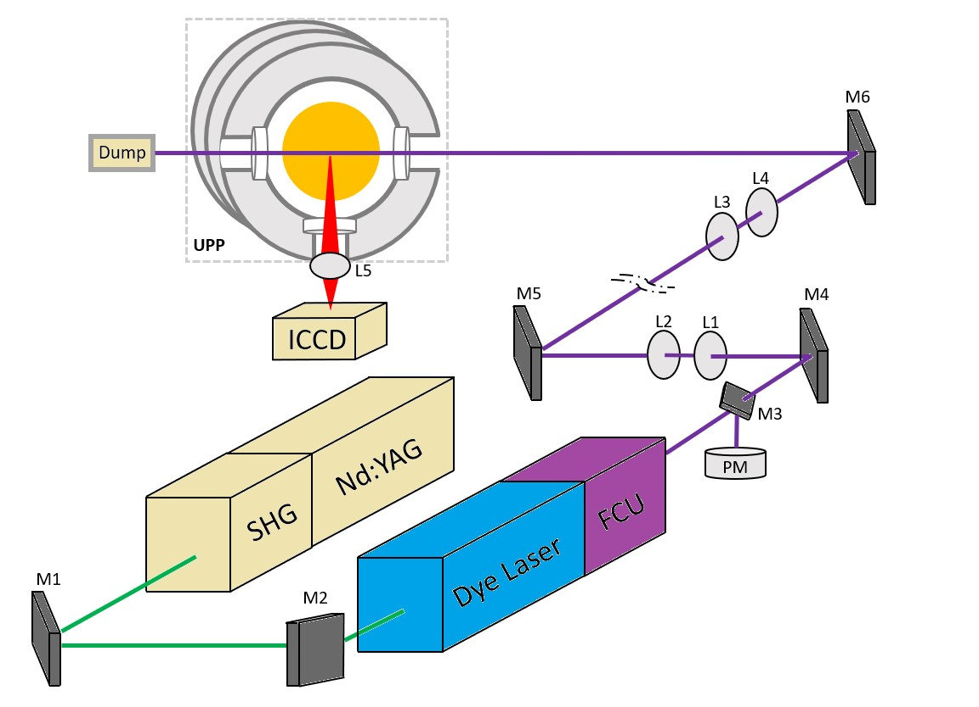
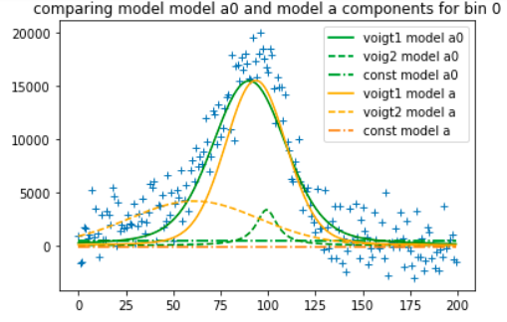
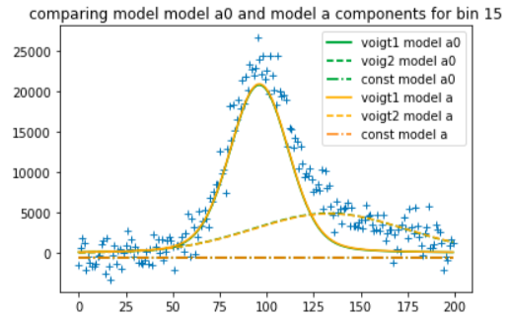
SPX.1: Atomic density by TALIF in MAGNUM-PSI and UPP DIFFER(MPG)
First TALIF (atomic neutral densities) obtained at UPP
cold
hot
TALIF 2024:
TALIF performed on UPP at lower P_{laser} to avoid ionization effects and improving statistics ➔
Kaden Jay Loring et al (new data not shown, analysis ongoing)
TALIF performed in Magnum-PSI, and repeated with lens based relay system:
New data (not shown) available, but analysis ongoing

Slide 8
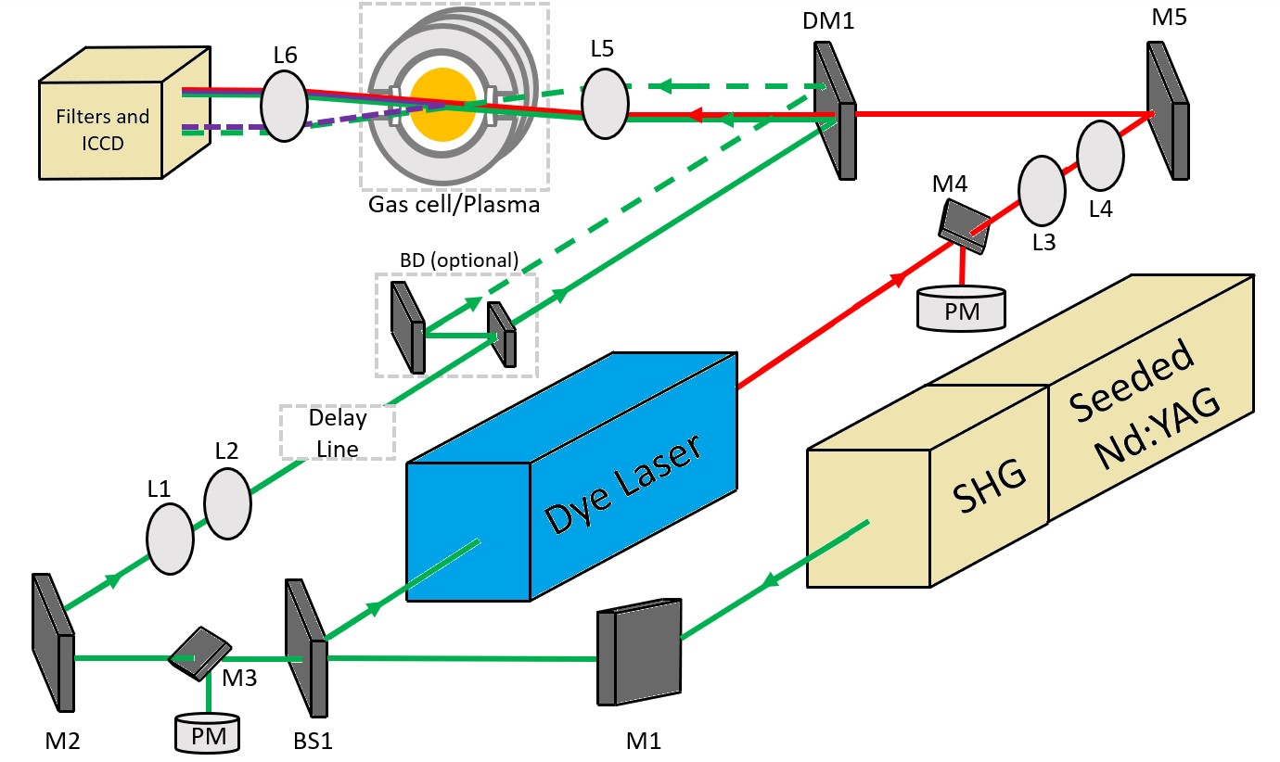
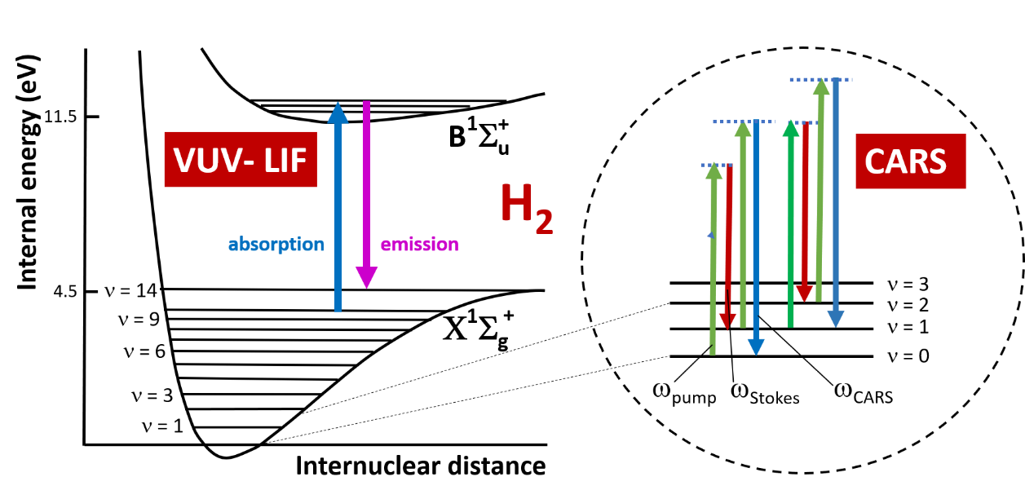
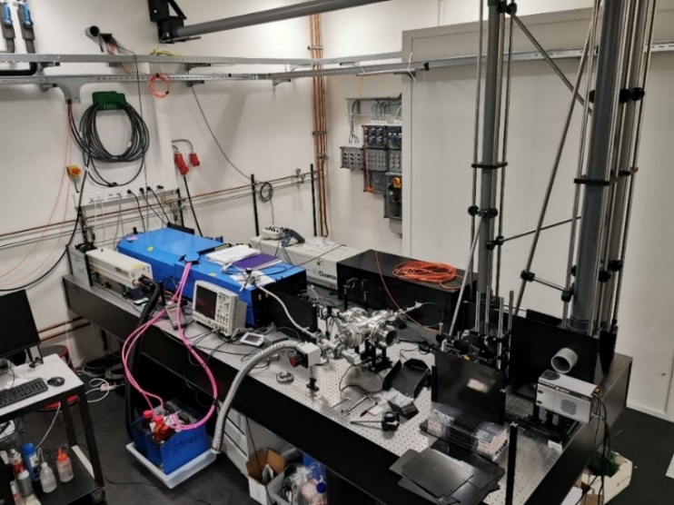
SPX.1: CARS: probing first ro-vibrational states of H₂ DIFFER

Slide 9
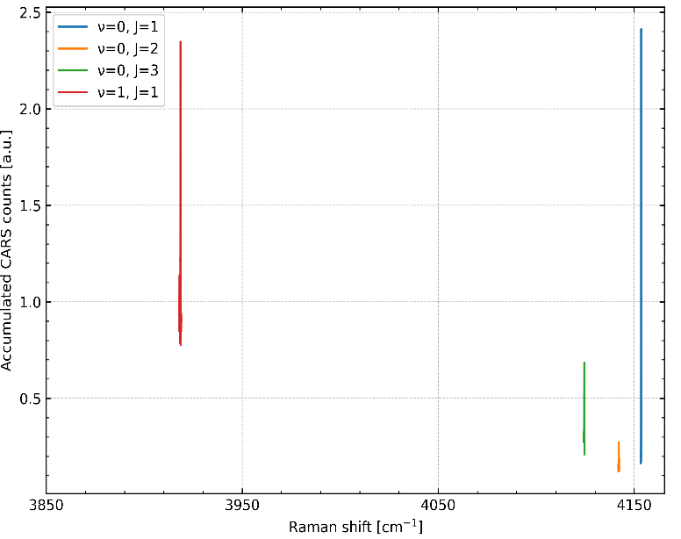
SPX.1: CARS: probing first ro-vibrational states of H₂ DIFFER
First CARS signals UPP measured. (top). Able to measure first and second vibrational state A CARS was also performed at Magnum (general problem: interfering non-resonant CARS).
Lessons learned: crossed beam configuration (real BOXCARS) required → Sensitivity increased in lab by factor 15 to 10^19 m^-3. Corresponds to partial pressure of 0.05 Pa
2025 plan: deploy improved CARS in Magnum-PSI.
Deliverable: PWIE-SP X.X1.T-T004-D001
Status: completed
Facilities: Magnum-PSI, UPP
Linked WP or TSVV: WPTE

Slide 10
MPG contribution to SP X.1 Atomic and molecular processes in attached/detached plasmas
TASK: Atomic and molecular hydrogen spectroscopy in ionizing and recombining plasmas
D004: Interpretation spectroscopy results using spectra simulation and (CR) modelling with YACORA (MPG)
Ursel Fantz, Dirk Wünderlich, Richard C. Bergmayr, Julian Hörsch

Slide 11
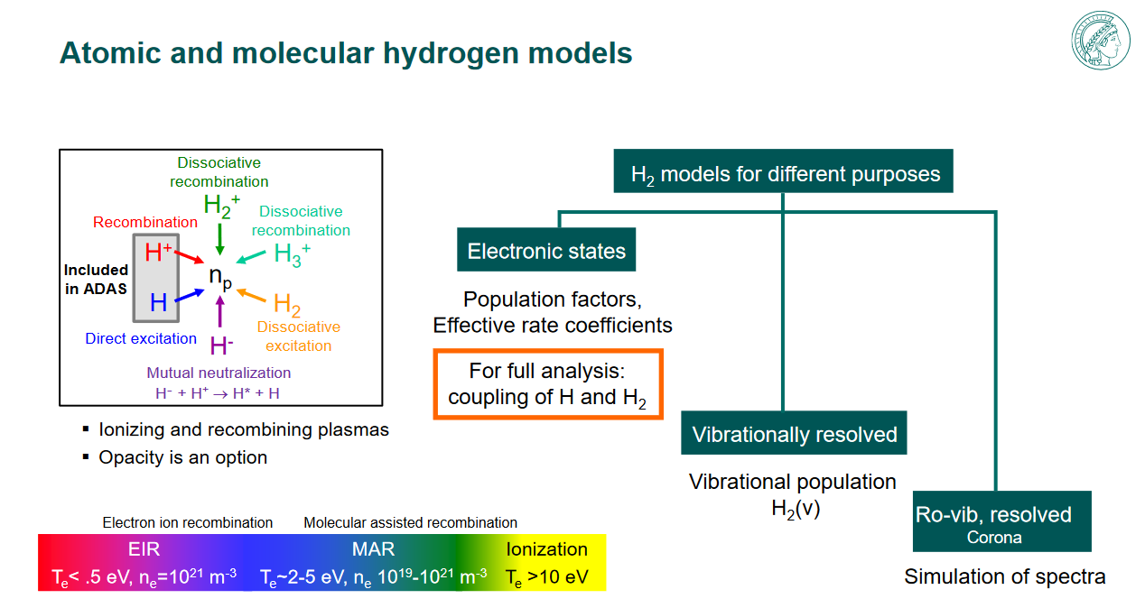
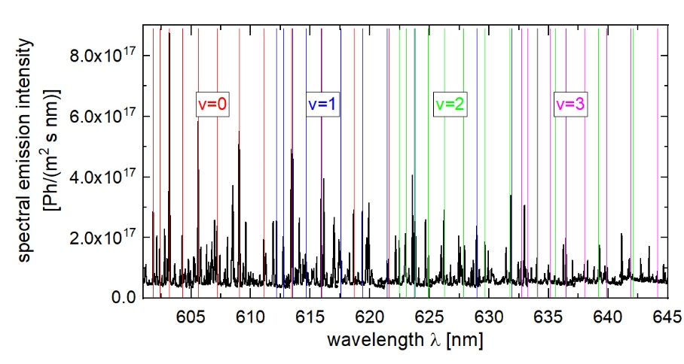
Analysing Magnum data and participation in experiments MPG
Task: VIS molecule and atomic hydrogen spectroscopy in ionizing and recombining plasma conditions
Interpretation spectroscopy results using spectra simulation and (CR) modelling with YACORA (MPG: U. Fantz, D. Wünderlich, R.C. Bergmayr, J. Hörsch)
Approach
Planning, preparing and performing joint OES measurements (Balmer lines + Fulcher-α band) with DIFFER team at Magnum-PSI (Jarrel-Ash spectrometer, 2400 ln/mm, 30 LOS, CCD) during TALIF campaign.
Assistance to TALIF measurements at Magnum-PSI.
Results and Outlook
Preprocessing of measured signals (LOS determination, wavelength calibration, absolute intensity calibration) finished.
Interpretation of absolutely calibrated spectra ongoing.
VUV measurements planned for 2025.
Deliverable: PWIE-SP X.1.T-T004-D004
Status: ongoing
Facilities: Magnum-PSI, Yacora
Linked WP or TSVV: --

Slide 12
D001: OES results H/H2, ne, Te and 2D distribution in JULE-PSI . VIS and VUV molecular and atomic spectroscopy in PSI-2 under ionising and recombining plamas (FZJ)
FZJ
Michael Reinhart, Rahul Rayaprolu, Oleksandr Marchuk, Marc Sackers, Gennady Sergienko
Institute of Fusion Energy & Nuclear Waste Management - Plasma Physics
Forschungszentrum Jülich

Slide 13
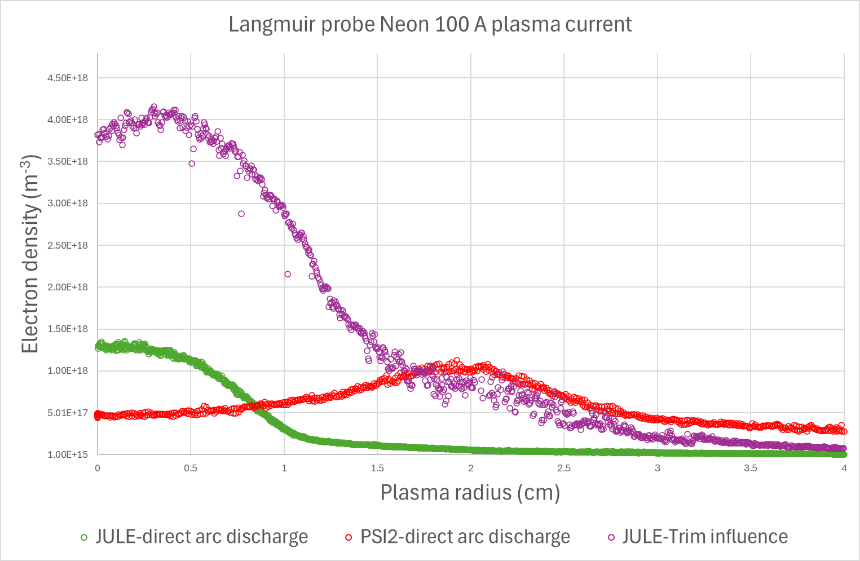
D001: OES results H/H2, ne, Te and 2D distribution in JULE-PSI . VIS and VUV molecular and atomic spectroscopy in PSI-2 under ionising and recombining plamas (FZJ)
General Information
The deliverable contains plasma diagnostic efforts in the linear plasma devices PSI-2 and JULE-PSI. JULE-PSI: Goal: characterize plasma, and investigate the possibility to replace Langmuir probes with OES.
PSI-2: Main goal: configure and use a VUV spectrometer at PSI-2, which would give input to H/H2 modelling tasks.
Approach
JULE-PSI: Utilize Langmuir probe, optical emission spectroscopy, Hyperspectral camera, and
segmented plasma dump for plasma characterisation.
PSI-2: Setup and test VUV spectrometer on test stand, then install at PSI-2
Results
JULE-PSI plasma performance similar (with higher peak values) to PSI-2 for Ne and Ar plasmas.
OES does not yet replace Langmuir probe (inconsistencies of results from OES)
Hyperspectral camera delivers 2D profiles of the emission lines
Hydrogen plasma was not yet tested due to permission issues, but technically device is ready for H plasma.
VUV spectrometer was successfully operated at the test stand and is currently being installed at PSI-2. First tests are planned for December 2024.
Electron density from center to edge of plasma column for PSI-2 and JULE-PSI (cathode-anode direct arc contact vs. reduced contact)
Deliverable: PWIE-SP X.X1.T-T004-D001
Status: completed/ongoing
Facilities: JULE-PSI, PSI-2
Linked WP or TSVV: --
← Single frame of the JULE-PSI plasma column recorded by the Hyperspectral camera (Camera produces 200 frames from 400-1000nm per recorded picture)
Notes:
summary
JULE-PSI Plasma characterised (radial profiles of n_{e}, T_{e}, plasma flux) for Neon and Argon Plasmas
Optical emission spectroscopy and Hyperspectral camera are operational, goal is to substitute the Langmuir probe to reduce dependence on moving parts inside the hot cell
Hydrogen plasma was not yet tested due to pending permission
VUV Spectrometer for PSI-2 is operational
VUV Spectrometer will be mounted at PSI-2 and used for first measurements of ionizing and recombining plasmas, also in comparison with visible light spectrometer, in the next weeks

Slide 14
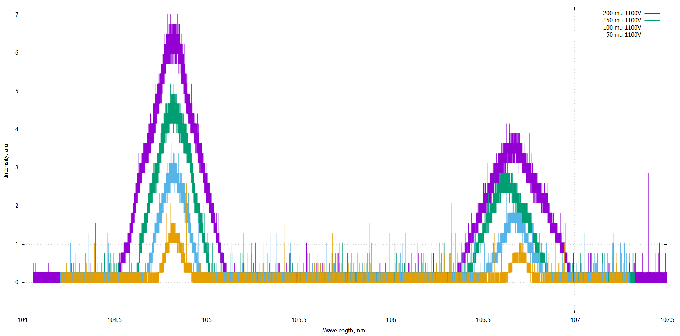
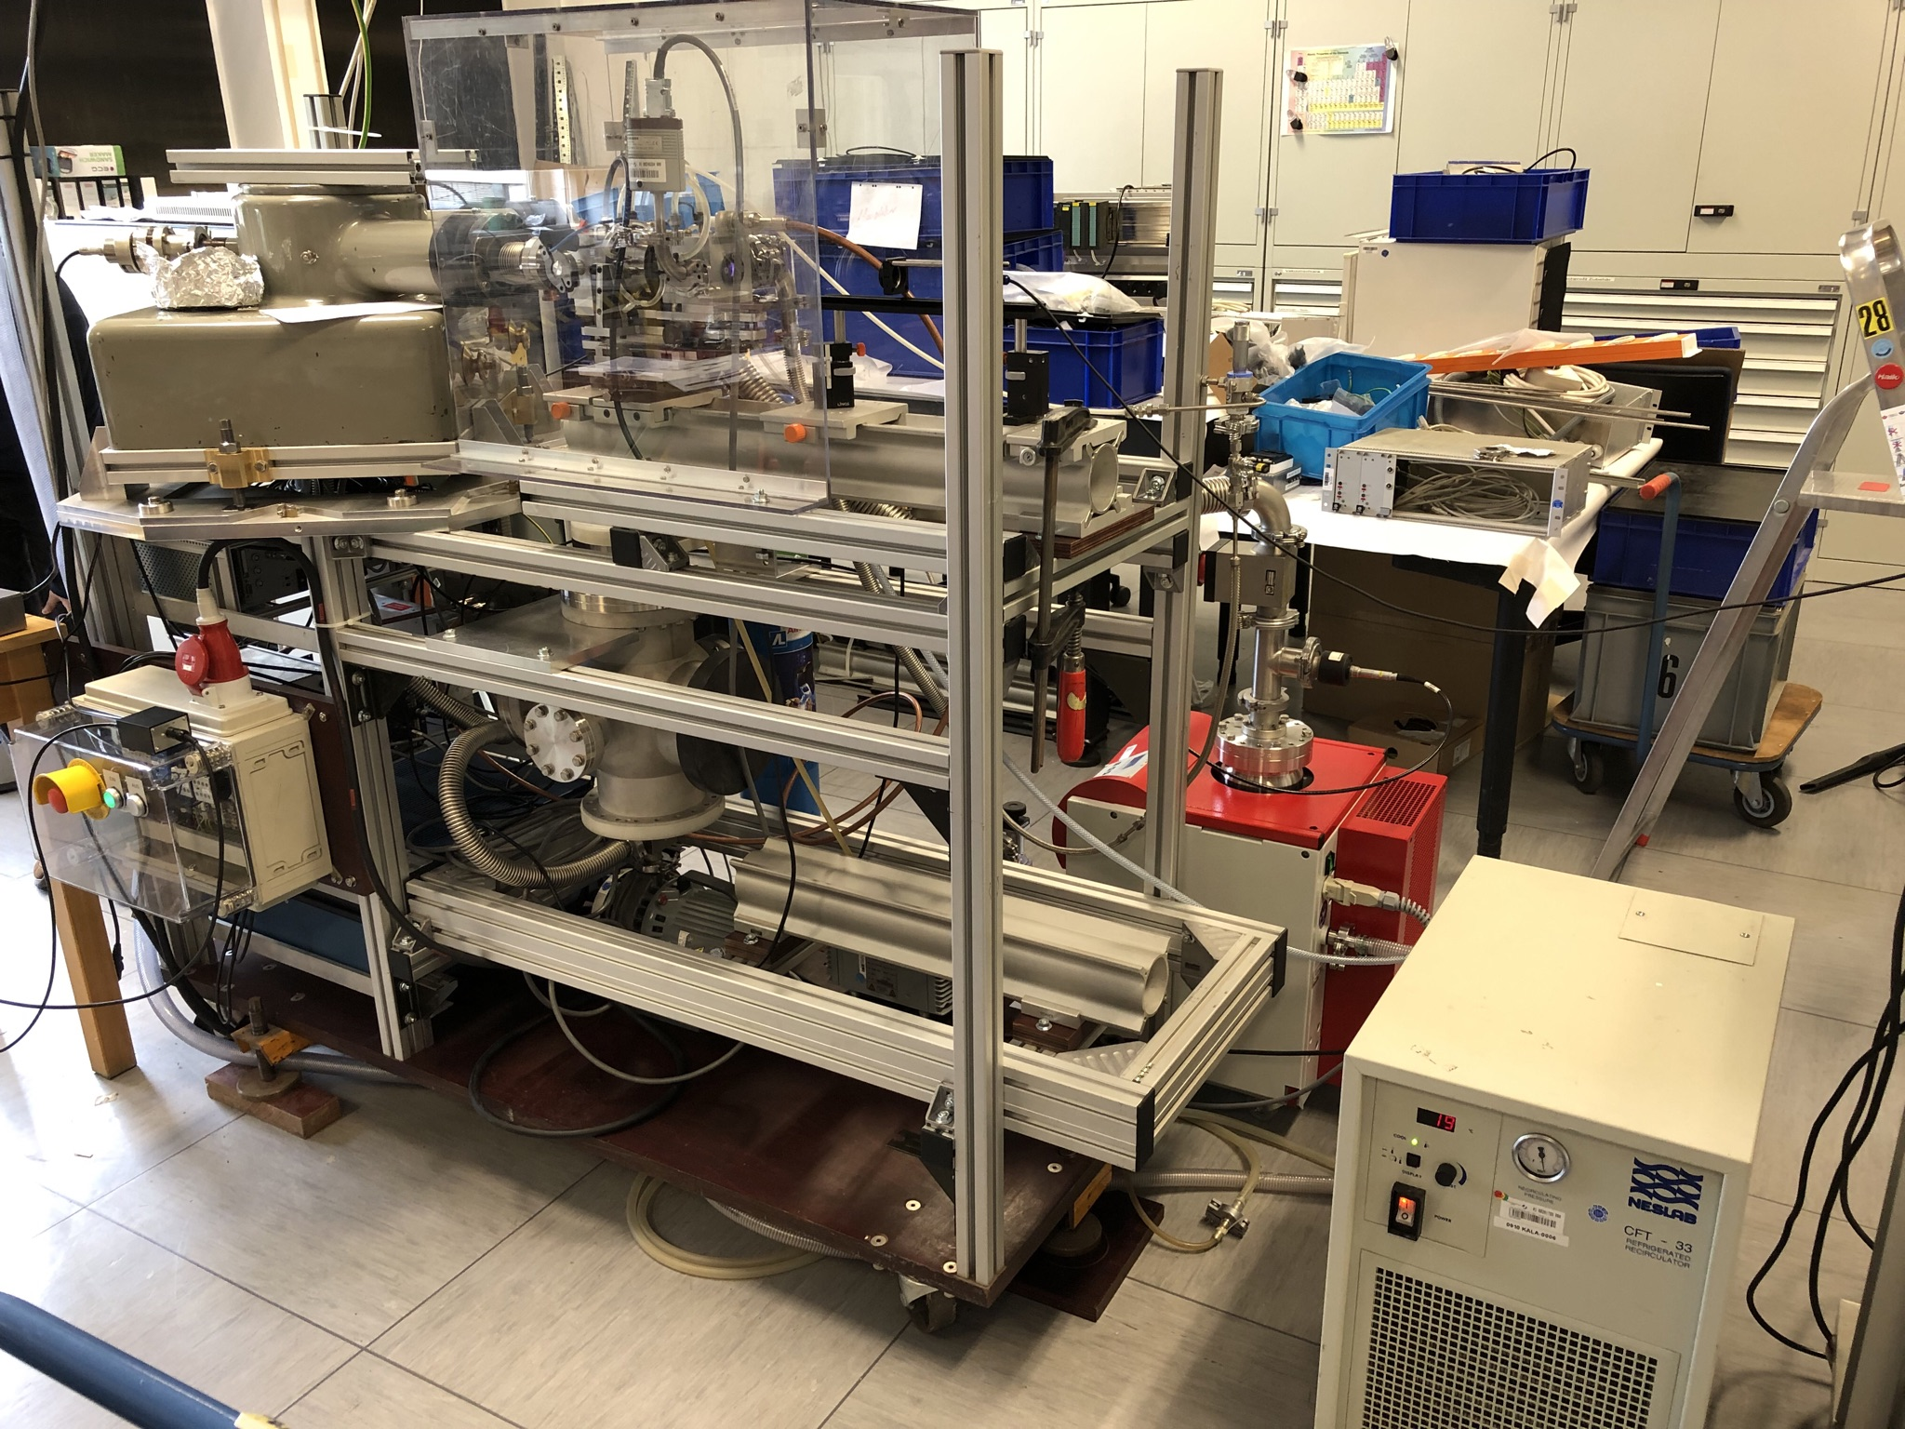
VIS and VUV molecular and atomic spectroscopy in PSI-2 under ionising and recombining plamas
Spectrometer is operational at test stand (with hollow cathode light source)
Parameters VUV Spectrometer:
McPherson Seya-Namioka ½ m
Grating: 1200 g/mm Blaze wavelength – 150 nm
Detector: PMT R6095 (Hamamatsu) + Scintillator (McPherson) ➔ Spectral range: 104 nm – 300 nm
Scheduled to be installed at PSI-2 end of November
First measurements at PSI-2 scheduled for December
VUV spectrometer view is at the same plasma section as VIS spectrometer, for good comparability
104 105 106 107
Ar I lines (104.8 and 106.67 nm) at different entrance slit widths (50-200 µm)
Entrance slit (5mm x W)
DUV Parabolic Mirror, f = 8“
VUV Spectrometer test setup and measurement of Ar lines (104.8 and 106.67 nm) at different entrance slit widths (50-200 µm)
W = 20.. 50 m
to PSI-2 Plasma
(edmond optics)
DUV Mirror
(movable)
LiF window
(to supress 2nd order and protect DUV mirror)
Optics size~ 1“

Slide 15

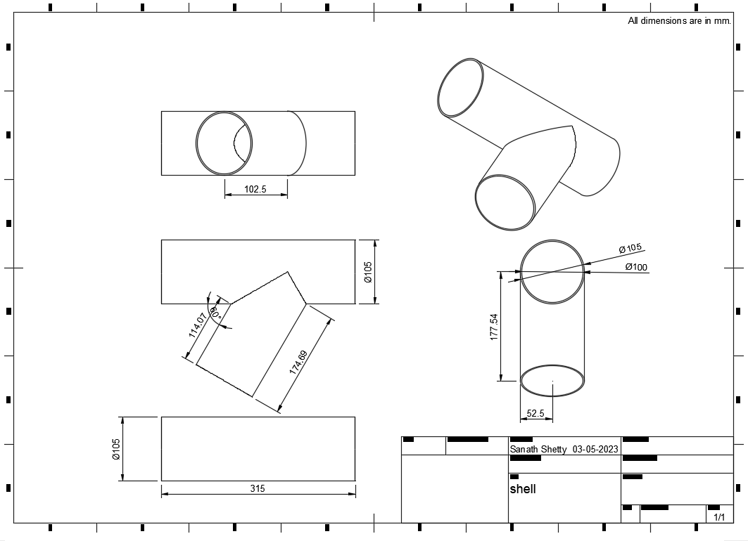
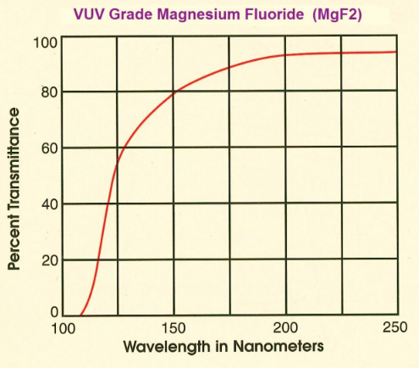
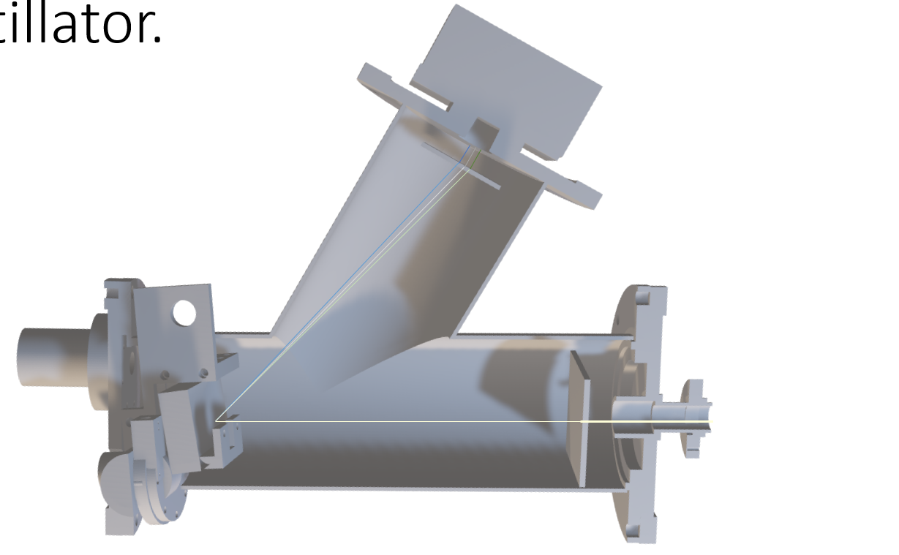
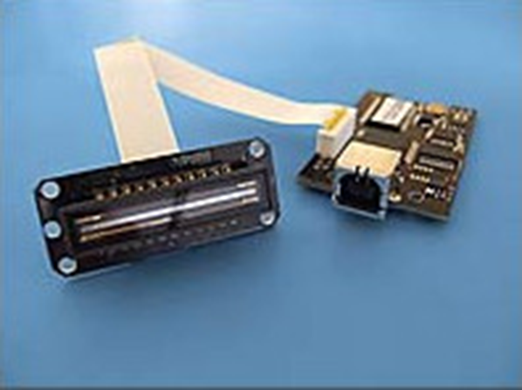
VUV OES hydrogen atom/molecule analysis of MAGNUM-PSI/UPP
CU
Design and testing of the VUV spectrometer for H plasma OES
Pavel Veis, Sahithya Atikukke, Sanath Shetty, Shweta Soni, Pavitra Bhat, Michal Stano, Matej Veis, Dhanada VS, Ivan Urbina et al.
The CAD designs were completed using Autodesk Fusion 360.
Usage of Toroidal grating with spectral and VUV grade Magnesium fluoride optical elements.
Testing Scintillator in combination with detector and optimisation – To get fluorescence from the VUV radiations.
OEM CCD from electronic devices is used as a detector. The CCD array (TCD1304AP) bears 3648 pixels, each pixel of size - 8𝜇𝑚 x 200 𝜇𝑚.
Initial setup constructed and the CCD array configured.
Deliverable: PWIE-SP X.X2.T-T004-D003
Status: in progress
Facilities: or Modelling:
Linked WP or TSVV:
Installation at UPP expected in January 2025 (?)

Slide 16
SP X.2: Optimization of laser-based surface analysis diagnostics

Slide 17
SP X.2: Optimization of laser-based surface analysis diagnostics
LIBS has to be optimized as a research tool for exploring thin layers
Ablation rate, how to obtain a depth resolution in the 10-20 nm range?
Line distinguishability for fuel detection at elevated Ar pressures (now with boron lines in!)
Machine Learning
In addition in support of RH LIBS at JET:
Be campaign at VTT
This year was a very buzy one for the people involved in SP X2: they did a great job at JET and
some first results will be shown by Jari (SP E)
Notes:
.

Slide 18
SP X.2: Optimization of laser-based surface analysis diagnostics
Deliverable ID | Deliverable Title
D001 | Comparison of ps vs. ns LIBS: absolute content and composition / Comparison SP vs. DP LIBS, or alternative LIBS signal enhancement methods: absolute fuel content in W samples and composition (CEA)
D002 | Reference measurements of outgassing, recycling, and retention after D plasma loading: absolute content and composition in W and reference samples (DIFFER)
D003 | Comparison SP vs. DP LIBS, or alternative LIBS signal enhancement methods: absolute fuel content in W samples and composition / (CF)-LIBS results He loaded samples and surface modifications (ENEA)
D004 | Comparison of ps vs. ns LIBS: absolute content and composition / Comparison SP vs. DP LIBS, or alternative LIBS signal enhancement methods: absolute fuel content in W samples and composition / Reference measurements of outgassing, recycling, and retention after D plasma loading: absolute content and composition in damaged and undamaged Wsamples / LAMIS measurements and identification of C and N containing molecules /Explore TALIF and LIBS for W isotope identification (FZJ)
D005 | Report on LIBS analysis by application of machine learning algorithm (IPPLM)
D006 | Comparison of ps vs. ns LIBS: absolute content and composition / (CF)-LIBS results He loaded samples and surface modifications. (CF-)LIBS on Be containing coatings with different type of fuel content (CU)
D007 | Analysis of B containing coatings and/or W coatings with (CF)-LIBS: absolute content and composition / (CF)-LIBS results He loaded samples and surface modifications / Reference measurements of outgassing, recycling, and retention after D plasma loading: absolute content and composition in W and reference samples. (CF-)LIBS on Be containing coatings with different type of fuel content (UT)
D008 | Comparison of ps vs. ns LIBS: absolute content and composition (ISSP-UL)
D009 | (CF-)LIBS on Be containing coatings with different type of fuel content (VTT)
Main tasks for this year 2023:
Comparizon performance different LIBS systems (ablation rate)
Sensitivity LIBS
LIBS on Be coatings (in support of JET campaign)
D retention and outgassing
Maschine learning for LIBS analysis

Slide 19
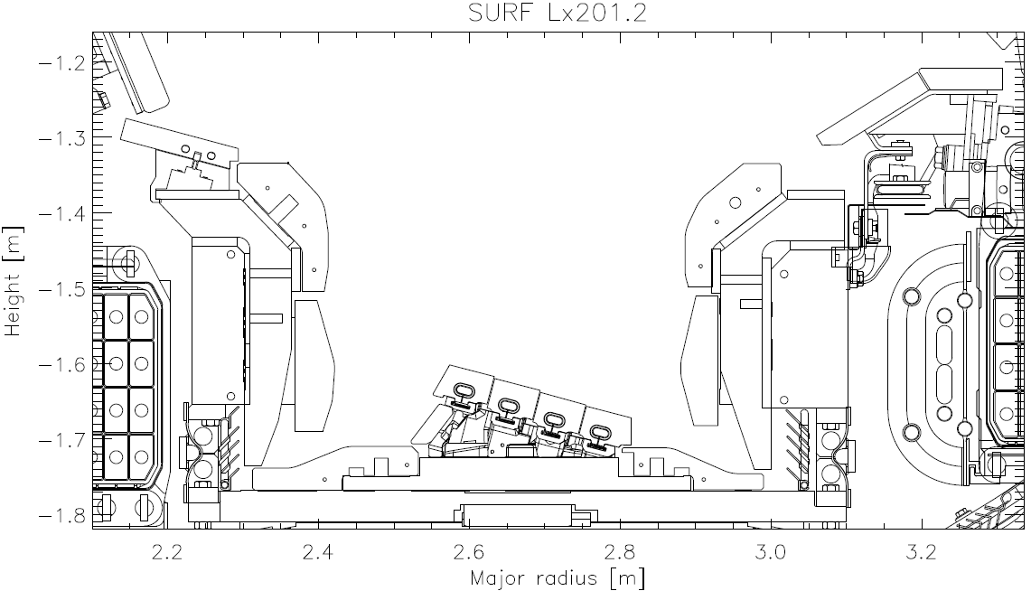
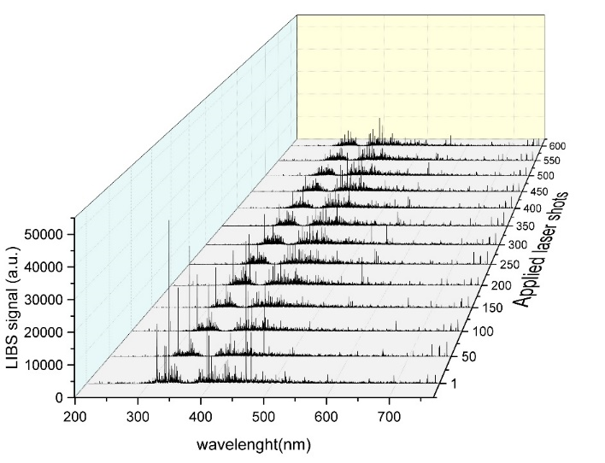
LIBS on Be-containing coatings with different type of fuel content (VTT)
General Information
LIBS experiments were made at VTT: JET-relevant conditions to support activities under
PWIE-SP E.E1.T-T003-D007 before the actual commissioning of the LIBS tool for JET
Task and questions to be addressed
(CF-)LIBS on Be containing coatings with different type of fuel content
Approach
LIBS system at VTT was upgraded and JET samples from limiters and
divertor tiles were analyzed
Results
Several JET divertor and limiter samples were successfully analyzed
Main spectral lines for H/D, Be, Mo and W were identified
Co-deposition of Be was observed on several samples
0
1
6a
3
4
JET sample 2IWG3A_6a
W lines
Be lines
Mo lines
Deliverable: PWIE-SP X.X2.T-T004-D009
Status: completed
Facilities: -
Linked WP or TSVV: WPTE
Notes:
He detection difficult with LIBS due to high background pressure (Stark broadening) and low plume brightness (low laser fuence)

Slide 20
Summary
FZJ
Depth resolved measurements of B and W on boron coated W substrate by ps-LIBS in vacuum were performed with depth resolution about 67nm/pulse
In situ measurement of dynamic deuterium retention in different tungsten alloys by ns-LIBS was made in PSI-2 plasma facility
Ex situ measurements of ¹³C/ ¹³C +¹²C by single pulse ps-LAMIS and collinear double pulse ps-LAMIS (Laser Ablation Molecular Isotopic Spectrometry) on W7-X divertor fingers. LAMIS data good fit with NRA for thin deposit but have discrepancy for thick deposits.
Deuterium retention in displacement-damaged W samples having about 1at% D was measured by ps-LIBS in vacuum with ≈ 15 nm depth resolution
In support of T content measurements by LIBS on JET, fitting procedure for Balmar-α line profile based on experimentally observations was introduced

Slide 21
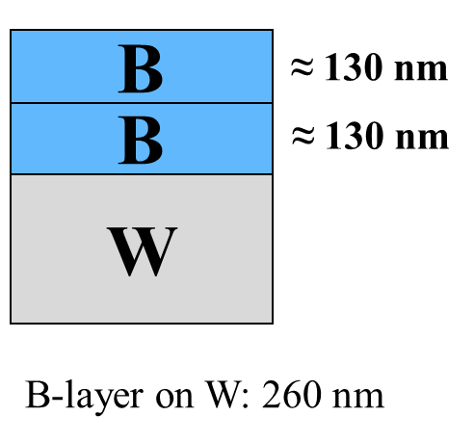
LIBS measurement of boron film on tungsten sample
General Information
There is no suitable technique to obtain the homogeneity and lifetime information of boron films deposited on PFCs in a real time.
But ps-LIBS in vacuum enables the measurement of boron film on W
Task and questions to be addressed
Feasibility study of boron film analysis by LIBS in vacuum :
Selection suitable spectral range for boron and tungsten detection
Optimisation of gate parameters for spectral acquisition
Approach
Tungsten samples were coated with a ~260 nm boron layer: magnetron sputtering
Single pulse LIBS (λ=355nm, 35 ps) in vacuum pressure 3 10⁻⁵ Pa
Results
Optimized gate parameters for spectral acquisition: delay 30 ns, width 1000 ns
Average ablation rate 66.98 ± 0.29 nm/pulse
Depth resolution of boron layer: ps-LIBS is better than ns-LIBS
Deliverable: PWIE-SP X.X2.T-T004-D004
Status: completed
Facilities: NA
Linked WP or TSVV: if applicable

Slide 22
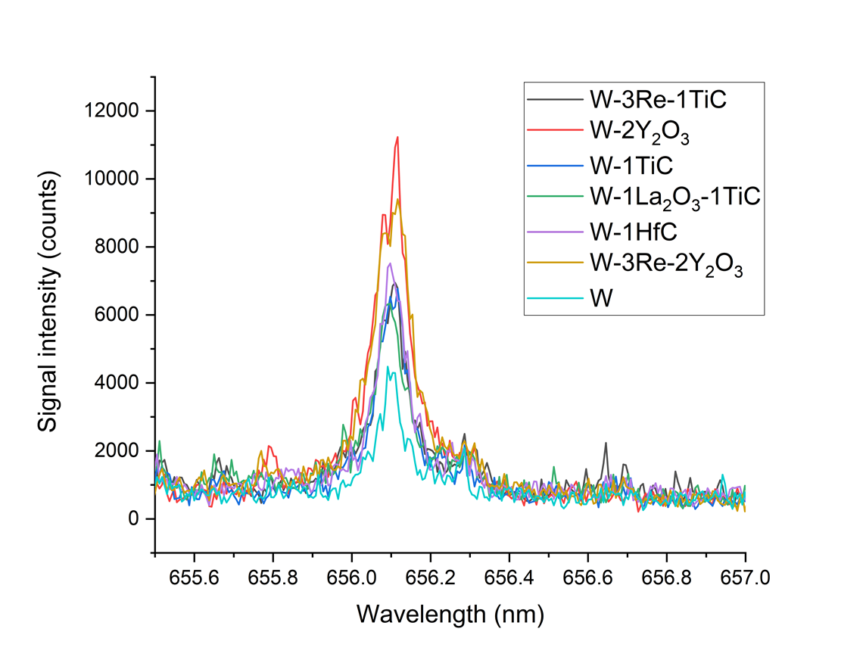
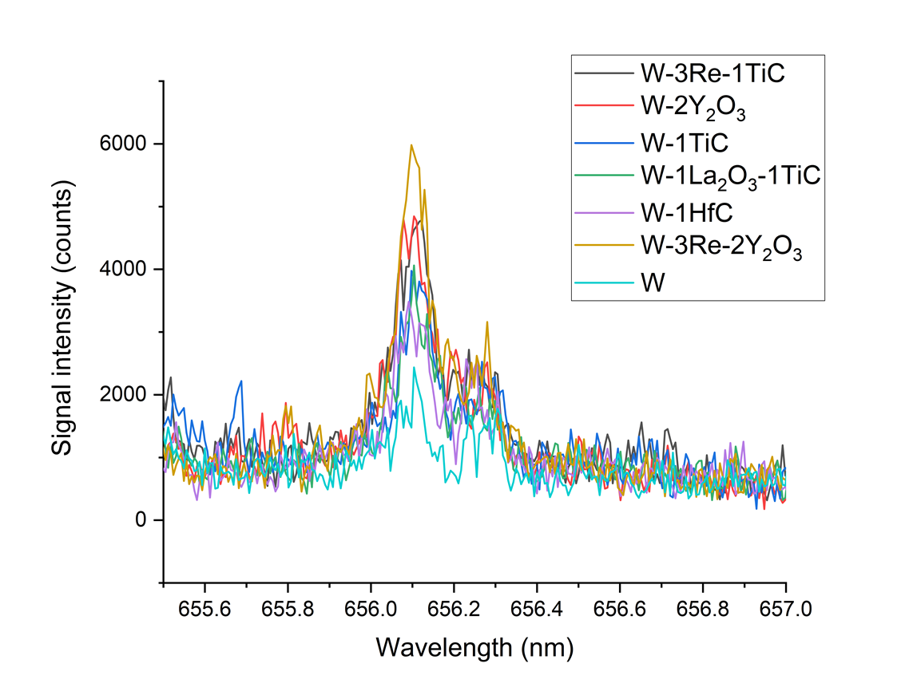
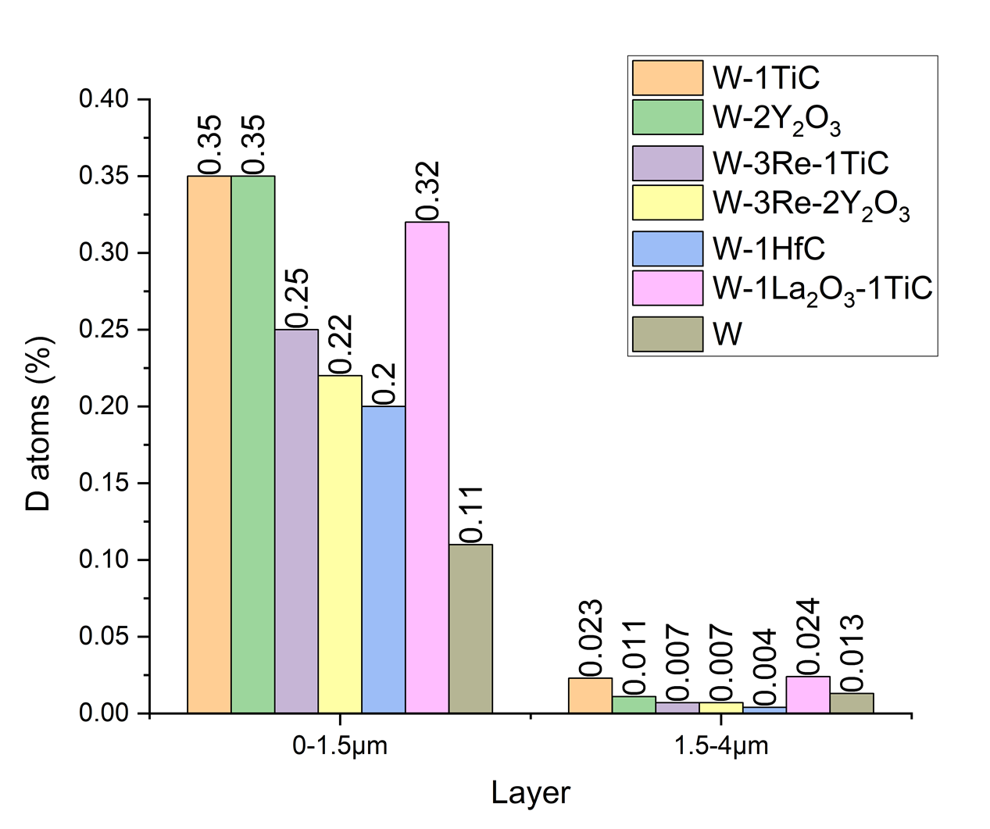
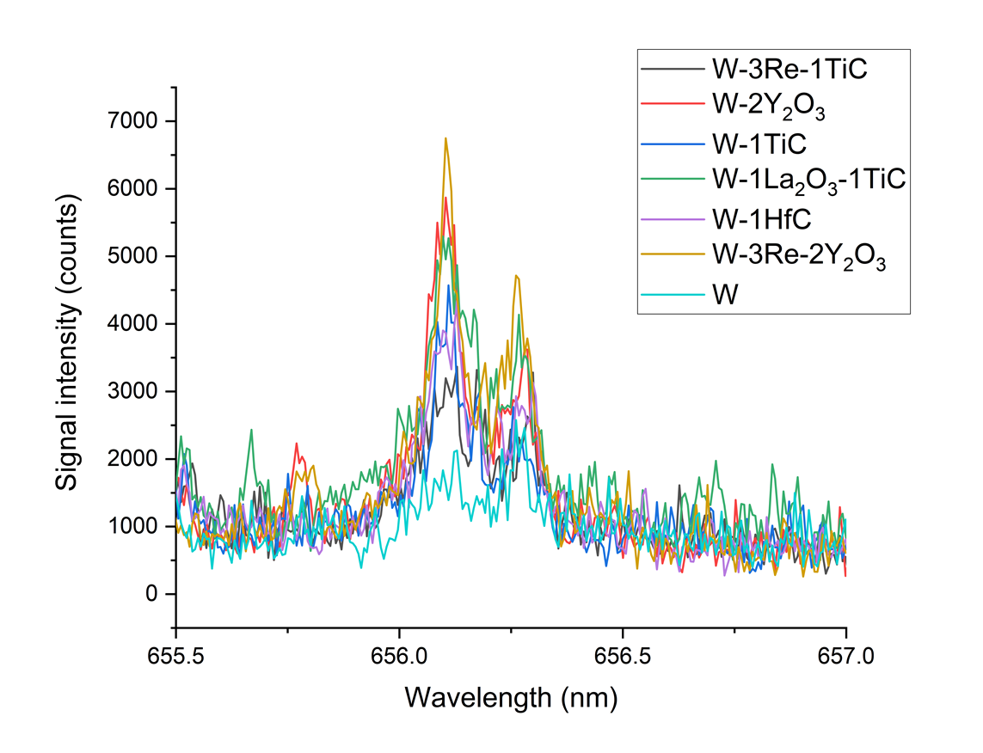
LIBS measurement of D retention in tungsten alloys
General Information
Tritium retention behavior in powder injection molding tungsten alloys should be investigated
Task and questions to be addressed
In situ measurement of dynamic deuterium retention in different tungsten alloys and ITER-grade tungsten by ns-LIBS in PSI-2 plasma facility
Long term deuterium retention mesurement by NRA, 6 moths after exposure
Approach
W-1TiC , W-2Y₂O₃ , W-3Re-1TiC , W-3Re-2Y₂O₃ , W-1HfC , W-1La₂O₃-TiC alloys samples were produced
SP LIBS (λ=1064 nm, 7 ns, 0.7 J, spot ∅ 0.8 mm) was applied on each sample (as well as ITER-grade tungsten sample) during and after (1 h and 20 h) deuterium plasma (50 min total exposure time) in PSI-2
During plasma
D_{α}
1 h after plasma
D_{α}
H_{α}
Results
Tungsten with Y₂O₃ have the highest deuterium dynamic retention, all other alloys showed a relatively similar retention
Most retention is in the first 1.5 μm near-surface layer
ITER-grade tungsten have the lowest overall D retention (long term lowest in the top 1.5 μm layer but highest in the deepest layer, except TiC containing alloys)
NRA measurements
20 h after plasma
D_{α}
H_{α}
Deliverable: PWIE-SP X.X2.T-T004-D004
Status: completed
Facilities: PSI2 (12 days)
Linked WP or TSVV: if applicable

Slide 23
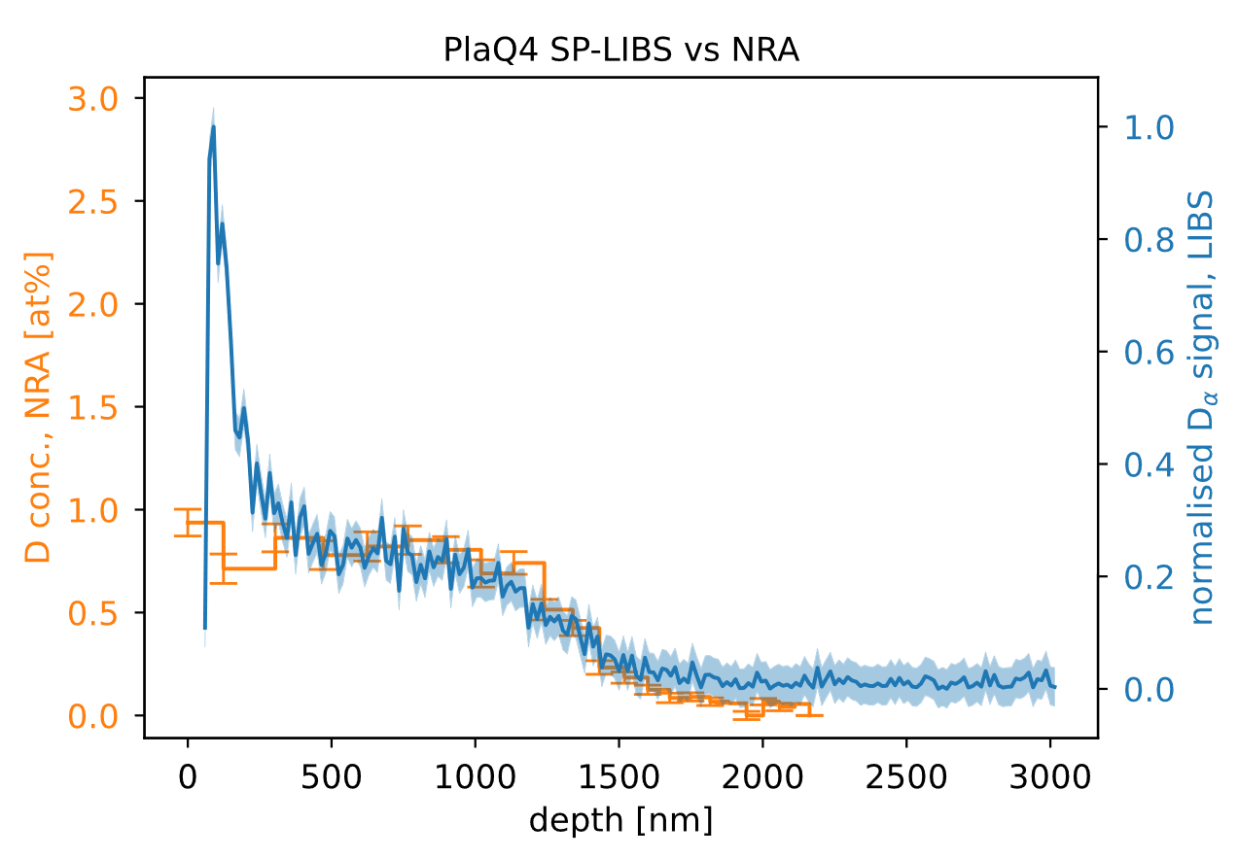
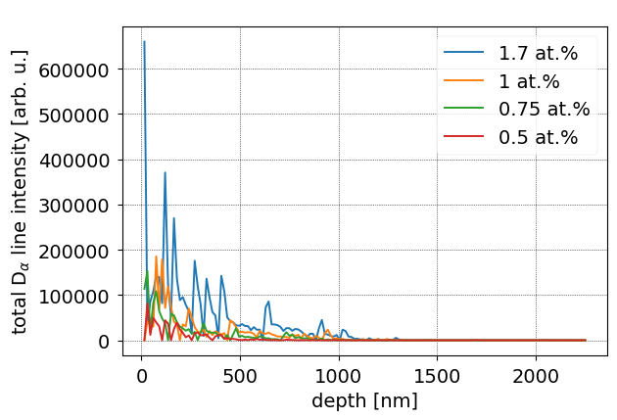
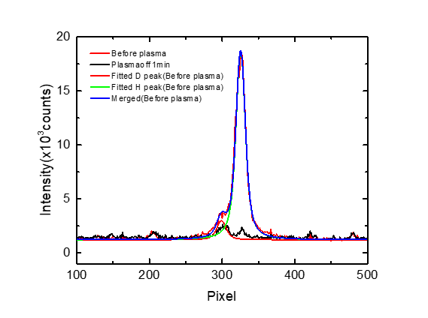
Deuterium retention measurements in pre-damaged tungsten material by LIBS.
SP ps-LIBS and NRA depth profiles
General Information
Pre-damaged tungsten material could have enhanced reservoir for hydrogen isotopes
Measurements: ex situ by single pulse ps-LIBS and double pulse ps-LIBS; in situ by ns-LIBS in PSI-2
Task and questions to be addressed
Measurement of deuterium retention ax situ in pre-damaged tungsten by using ps-LIBS
Measurement of deuterium retention in situ in pre-damaged tungsten by using ns-LIBS in PSI-2
Approach
Displacement-damaged W samples were prepared by using W³⁺-ions with an energy of 10.8 MeV up to a damage dose of 0.23 dpa. All samples were loaded by D in plasma at 370K and were partially outgassed under different conditions and D content measured by NRA
SP&DP ps-LIBS (λ=355nm, 35 ps, ≈20 mJ, spot ∅ 0.75 mm) in vacuum pressure 5 10⁻⁵ Pa at the lab
SP ns-LIBS (λ=1064 nm, 7 ns, 0.7 J, spot ∅ 0.8 mm) in PSI-2 fasility
Results
SP ps-LIBS can detect deuterium concentrations of ≈1at.% with ≈15 nm depth resolution
DP ps-LIBS has higher sensitivity but larger signal fluctuations, which needs further investigation
According to ns-LIBS measurements, the deuterium content in pre-damaged tungsten was slightly reduced after plasma exposure in PSI-2, probably, due to higher surface temperature during plasma
Outgassing T_{max}= 641 K
D content 1at.% by NRA
DP ps-LIBS and NRA depth profiles
by NRA
SP ns-LIBS in PSI-2
Fitted D+H before plasma
Fitted H before plasma
Fitted D before plasma
1min after plasma
Deliverable: PWIE-SP X.X2.T-T004-D004
Status: completed
Facilities: PSI2 (3 days)
Linked WP or TSVV: if applicable

Slide 24
Absolute fuel content in W samples and composition
General Information
Absolute content of hydrogen isotopes measurement in W by ps-LIBS in Ar (CF LIBS approch)
Measurement of the hydrogen isotopes composition by ps-LIBS in Ar (in support LIBS in JET)
Task and questions to be addressed
Applicability of CF-LIBS method for the W spectral line in the visinity of Balmer-α lines
Develop procedure for extraction isotopes composition from measured Balmer-α lines
Approach
W samples with “natural“ H content and W coated Mo sample loaded with D
SP ps-LIBS (λ= 1064nm, 35 ps, ≈10 mJ, spot ∅ 0.3 mm) in Ar at atmospheric pressure
Results
Plasma density from H_{α} fitting by single Lorentzian function
Reduction of nr. of fitting parameters for H_{α} line by using experimental H_{α} line shift-width dependence
By using 2 Lorentzian functions, fitting can be improved
Only WI (656.320 nm) and WI ( 657.393 nm) lines have defined parameters for CF analysis: broader spectral range required
SP ps-LIBS H_{α} line profile fitting
Deliverable: PWIE-SP X.X2.T-T004-D004
Status: completed
Facilities: NA
Linked WP or TSVV: if applicable
Electron density from H_{α} line FWHM
H_{α} line shift vs H_{α} line FWHM

Slide 25
Improvement of depth resolution by RLIBS. CF-LIBS study on B CU containing coatings. ps and/or ns CF-LIBS analysis of relevant samples.
Comenius University in Bratislava
Pavel Veis, Sahithya Atikukke, Sanath Shetty, Shweta Soni, Pavitra Bhat, Michal Stano, Matej Veis, Dhanada VS, Ivan Urbina et al.

Slide 26
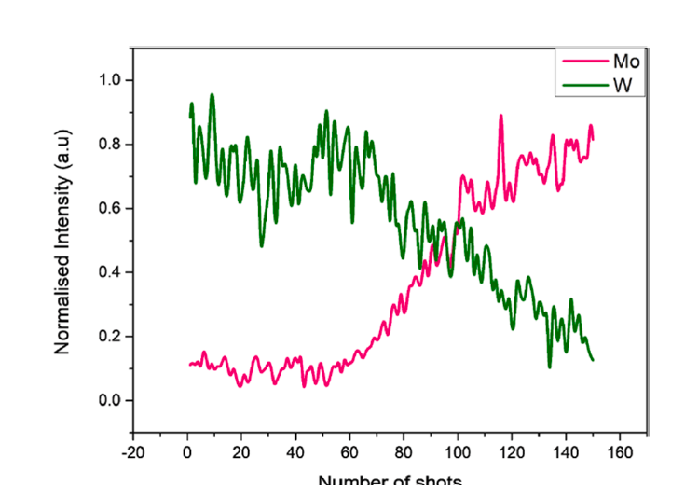
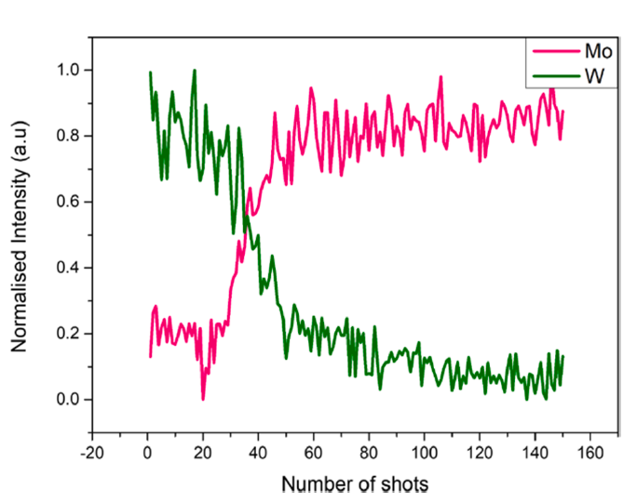
Resonant-LIBS
This study explores Resonant Laser-Induced Breakdown Spectroscopy (RLIBS) for depth profiling.
A key advantage of RLIBS over conventional LIBS is its reduced ablation rate, leading to higher-resolution in-depth profiles.
Depth profiling conducted using a tunable EKSPLA NT342C nanosecond laser system.Laser range: 210–2600 nm; energy levels at 2 mJ per pulse (UV).
Tungsten and Tantalum-coated Mo substrate used as sample. Laser tuned to 255.14 nm for resonant W I transition and 222.75 for off-resonant ablation.
• Depth profiling comparison:
- Resonant condition requires ~90 laser shots to reach substrate
- Off-resonant condition requires ~30 laser shots
• Ablation rate observed:
- Resonant: 90 nm/pulse
- Off-resonant: 248 nm/pulse
• RLIBS demonstrates greater depth resolution compared to conventional LIBS
S. Atikukke et al., NME, 2024

Slide 27
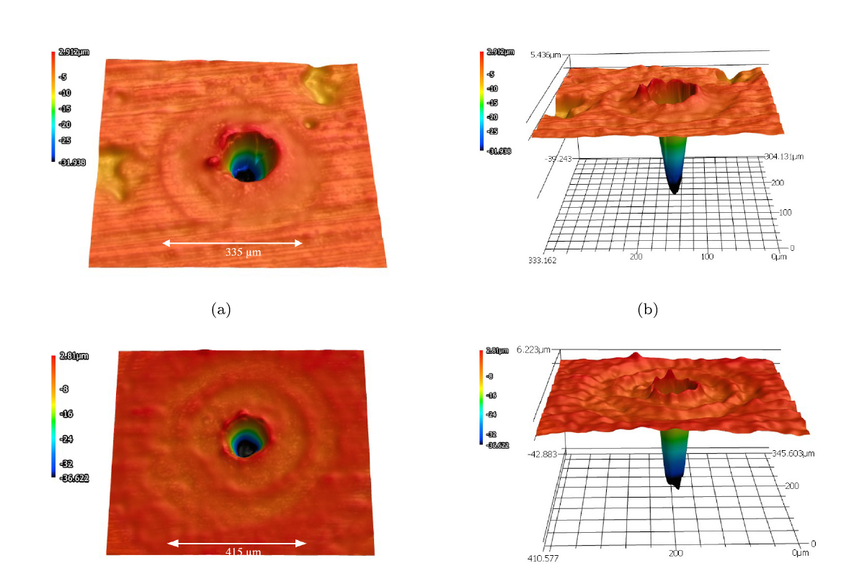
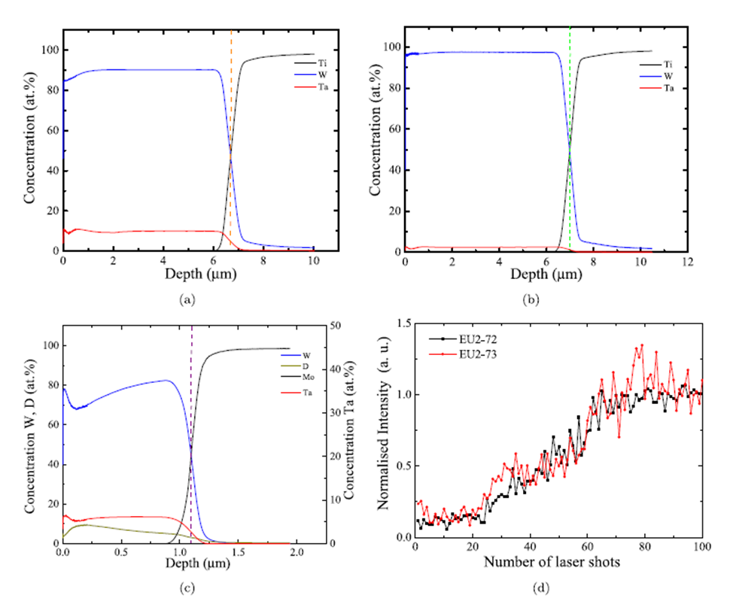
Depth profiling with ps-LIBS:
2 different laser energies tested on
coating with and without D
• Samples:
- EU2–72, EU2–73 (WTa coatings on Mo)
- EU2–75 (WTa+D coating on Mo)
• Experimental Setup:
- Chamber pressure: 5 ± 0.2 mbar, Argon gas
- Picosecond Nd:YAG laser at 532 nm (29 ± 4 ps pulse duration)
- Two laser energies tested: 1 mJ and 3 mJ
• Depth profiling using GDOES and LIBS techniques for layer thickness
• Confocal microscopy was used to analyze crater dimensions formed by ps-LIBS
• Ablation rates:
- EU2–72: 133 nm/pulse (1 mJ), 280 nm/pulse (3 mJ)
- EU2–73: 131 nm/pulse (1 mJ), 178 nm/pulse (3 mJ)
S. Soni et al., SCAB, 2024
Deliverable: PWIE-SP X.X2.T-T004-D006
Status: completed :
Linked WP or TSVV:

Slide 28
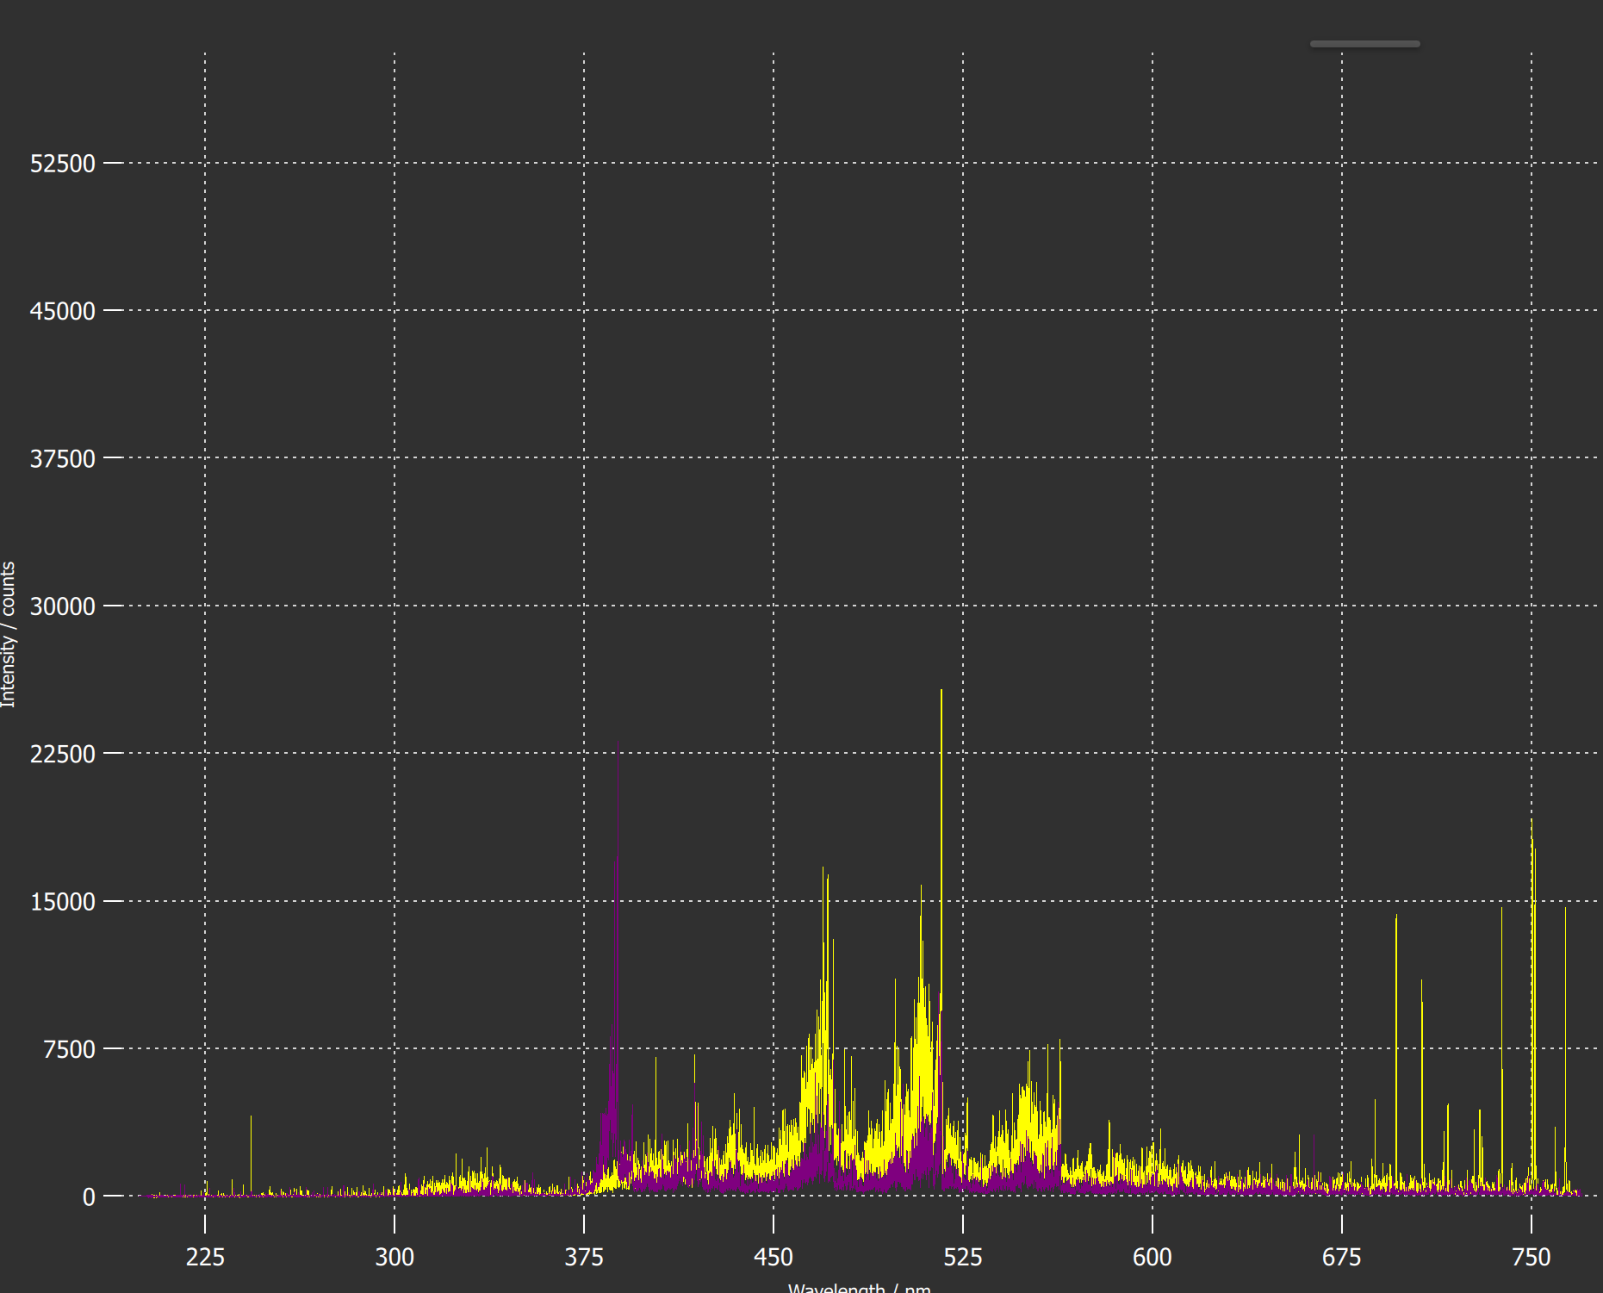
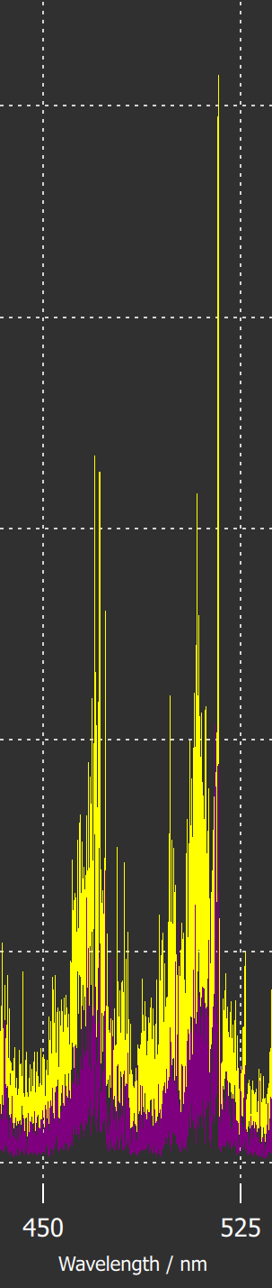
Comparison SP vs. DP LIBS/ (CF)-LIBS results He loaded samples ENEA
General Information
The scope of this task is the optimization of laser-based techniques for the quantification of fuel content and material composition of PFCs (tungsten, boron, graphite) and deposits of those materials (oxygen, seeding and fuel species) in laboratory devices in view of in-operando operation in larger devices.
Task and questions to be addressed
Comparison SP vs. DP LIBS, or alternative LIBS signal enhancement methods: absolute fuel content in W samples and composition / (CF)-LIBS results He loaded samples and surface modifications
Approach
Use of argon as a background gas (instead of air) for the enhancement of the LIBS spectral signal.
Consider vacuum condition or low Ar pressures for the detection of implanted or redeposited He
Results
Using argon as background gas (instead of air) for the LIBS signal enhancement proved to be effective when applied to the compact LIBS system used on the JET MASCOT arm.
LIBS spectra acquired on He-enriched Be coatings in vacuum or at low Ar-pressure showed that He could be better detected by LIBS in vacuum or low pressure Ar conditions compared to air, mainly because of the large Stark broadening of the strongest He emission line at 587.56 nm
The development of MATLAB routines for automising of CF processing on the LIBS spectral data is ongoing and will be applied to data from JET
LIBS under Ar flux
LIBS in air
*
He I @ 587.56 nm
Deliverable: PWIE-SP X.X2.T-T004-D003
Status: completed/ongoing
Facilities: MAGNUM-PSI, PSI-2
Linked WP or TSVV: PWIE-SP E
*Nuclear Materials and Energy 39 (2024) 101677

Slide 29
Comparison and improving of ablation rates ISSP UL
General Information
Comparison of ps vs. ns LIBS: (CF)-LIBS (ps/ns or SP/DP) in reference and ITER-relevant coatings: absolute composition and D content (in depth)
Task and questions to be addressed
Comparison and improving of ablation rates for regular and nanostructured W coatings
Approach
The analysis of ablation rates is planned to be addressed using EKSPLA SL 315 Nd:YAG laser (λ = 1046 nm), 150 ps pulse width, repetition rate of 10 Hz, 1.5-2 Torr Ar atmosphere
Results/summary
LIBS spectra of the regular W coatings have been obtained. Ablation rate was around 200 nm @ 20mJ/pulse
D signal disappears within the first 4 pulses
Due to the laser malfunction, the nanostructured W samples will be investigated later
Nanostructured coatings are expected to have higher impurity retention
Porous coatings are expected to have higher ablation rate due to the differences in surface structure and densities
Deliverable: PWIE-SP X.X2.T-T004-D008
Status: ongoing

Slide 30
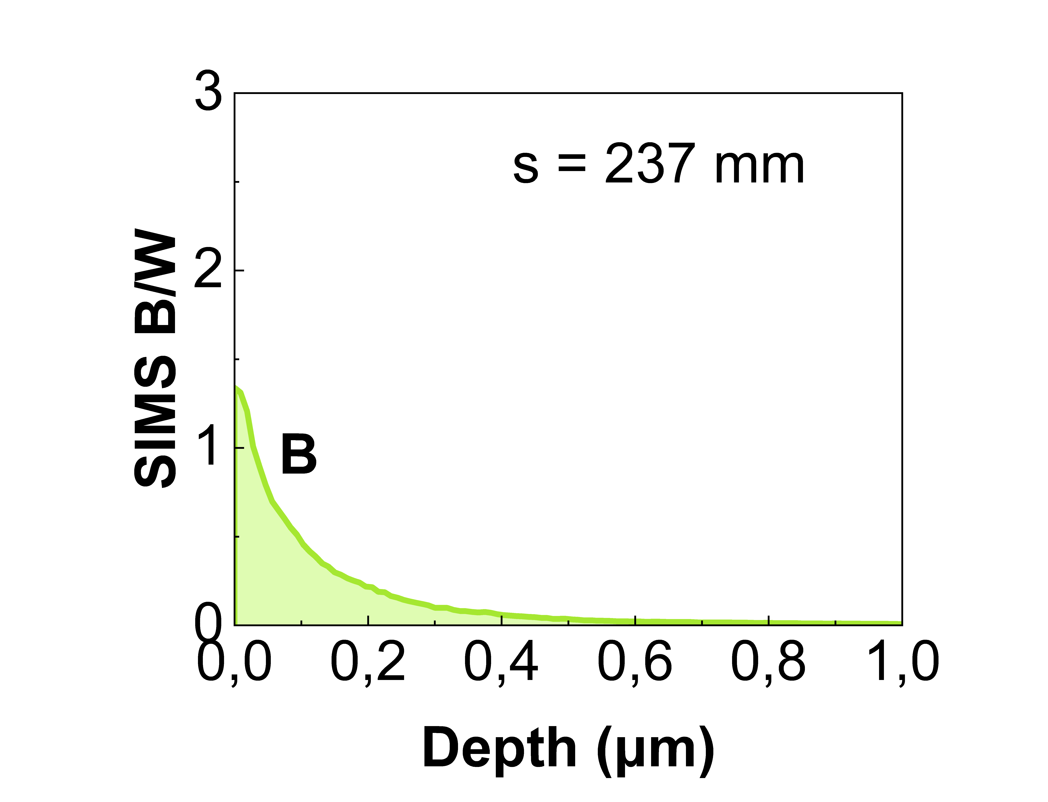
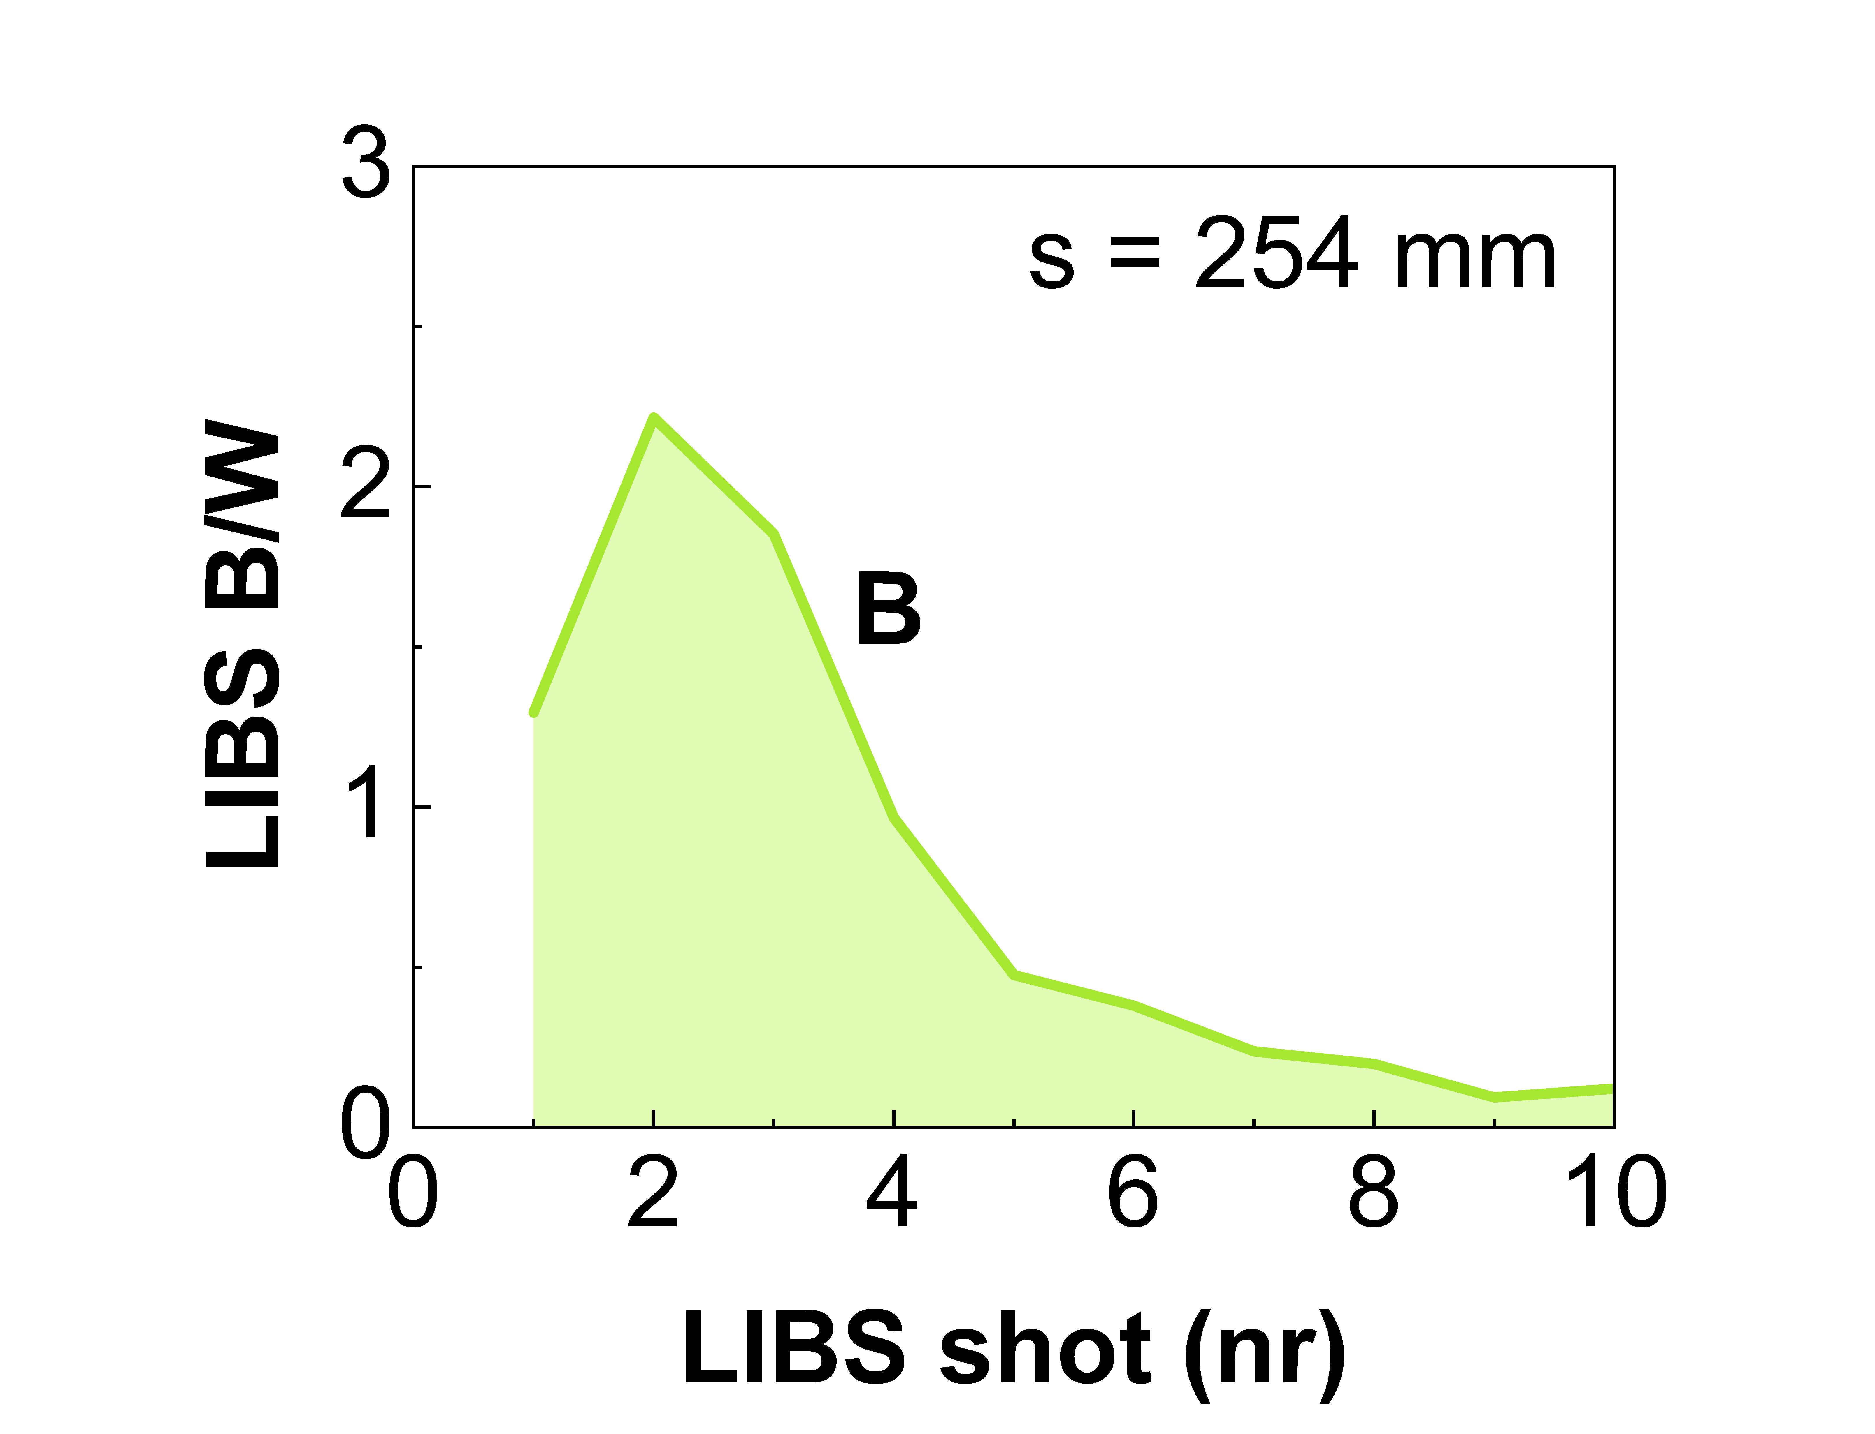
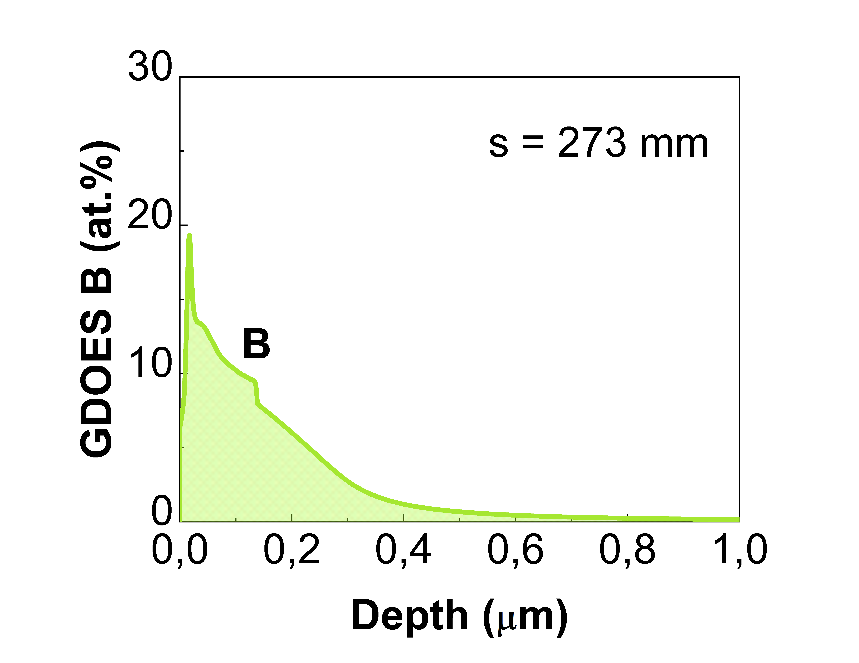
Analysis of B containing coatings and/or W coatings with LIBS UT
Comparison of B depth profiles and total B determined by LIBS, SIMS and GDOES on WEST 32i/20o tiles after C4 campaign
LIBS spectrum
shot nr
B depth distribution in C4-32i erosion region
B I lines
C I line
0.26
GDOES
SIMS
LIBS
W – 0.9 to 2 μm
Mo marker – 100 nm
W – 12 μm
14
32
311
356
415
453
489
89
104
142
199
237
254
274
293
341
376
507
546
565
s (mm)
Mo – 3 μm
C
LIBS
SIMS
SIMS
GDOES
LIBS
SIMS
SIMS
LIBS
GDOES
LIBS
SIMS
GDOES
SIMS
LIBS
SIMS
SIMS
GDOES
SIMS
LIBS
GDOES
Thin deposits
Thick deposits
Erosion
Erosion
Thin deposits
Thin films

Slide 31
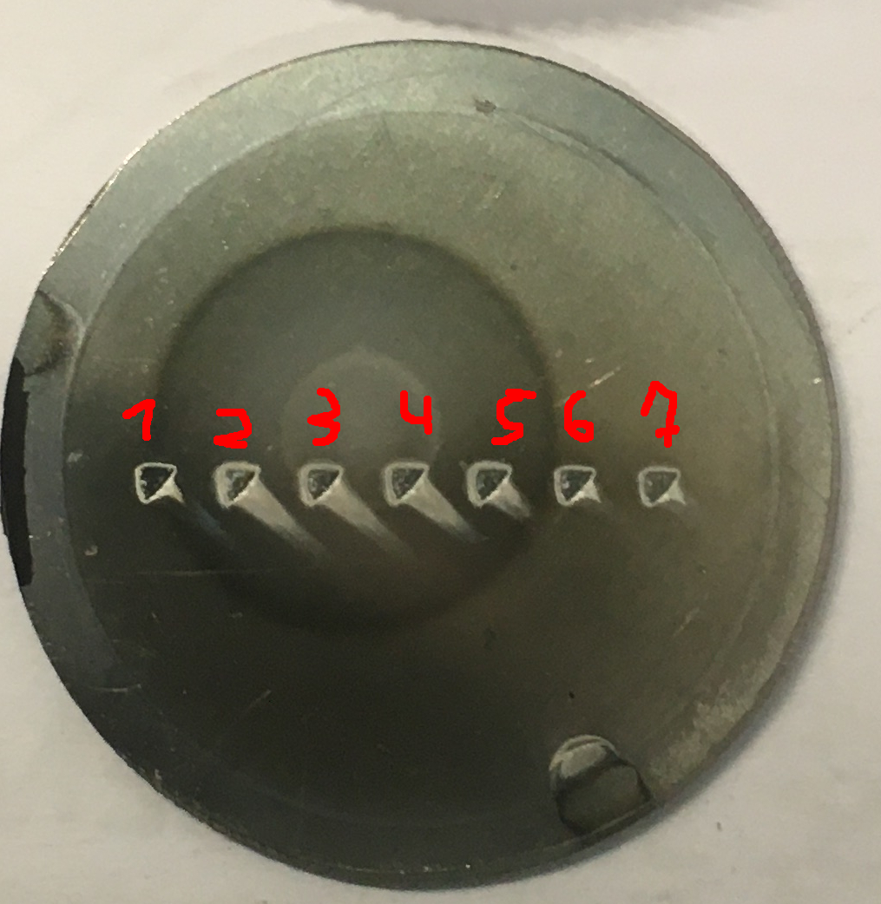
LIBS results on He loaded samples and surface modifications
Magnum-PSI He plasma exposure 2700 s
LIBS He intensity
He spatial distribution
LIBS Depth profiles
He
He
He detectable during first LIBS shot
ToF-ERDA He retention (150 nm)
Edge 16·10¹⁵ at/cm²
Center 247·10¹⁵ at/cm²
Deliverable: PWIE-SP X.X2.T-T004-D007
Status: ongoing
Formation of Ta/Mo rich surface layer in the Center (up to 4 shots)
1 μm c-W
Retention campaign in Magnum (UT,DIFFER, CU) will be performed in week 2-6/12

Slide 32
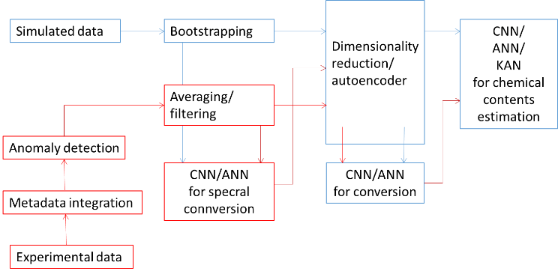
Investigation of Machine Learning algorithms for LIBS IPPLM
General Information
The task is aimed on the development of machine learning models for processing LIBS data with quantitative chemical analysis as the final goal. The work has been initiated on synthetic spectra and in the present stage is focused on experimental data.
Task and questions to be addressed
Verification of possibility of conversion between experimental and simulated LIBS data.
Verification of the efficiency of chemical contents estimation ML algorithms for experimental LIBS data.
Approach
Application of pre-processing methods as dimensionality reduction and spectral filtering.
Application of ML models for anomaly detection for spectra with too low quality to be employed in training.
Application of DNN (Deep Neural Networks) and CNN (Convolutional Neural Network) for chemical contents estimation.
Results
For experimental data obtained in laboratory conditions the chemical contents estimation gives very good results which are even better after dimensionality reduction (because of eliminating noise).
Experimental data obtained during the Be campaign at VTT are noisy and samples are relatively often rejected by anomaly detection algorithms; however, they significantly benefit from preprocessing.
Deliverable: PWIE-SP X.X.2-T004-D005
Status: ongoing
Facilities: Device name (days allocated)
Linked WP or TSVV: if applicable

Slide 33


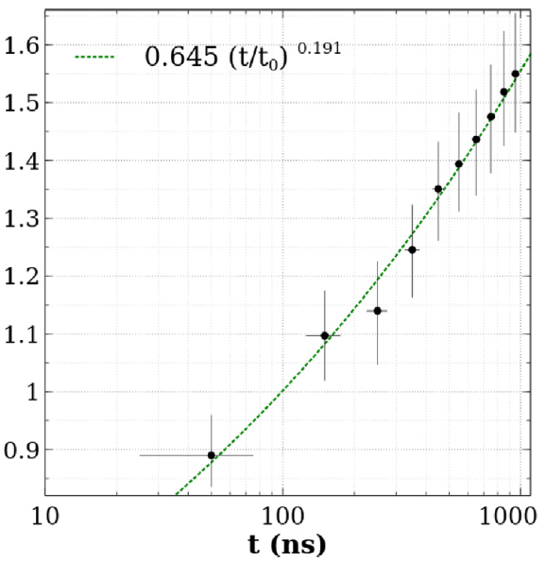
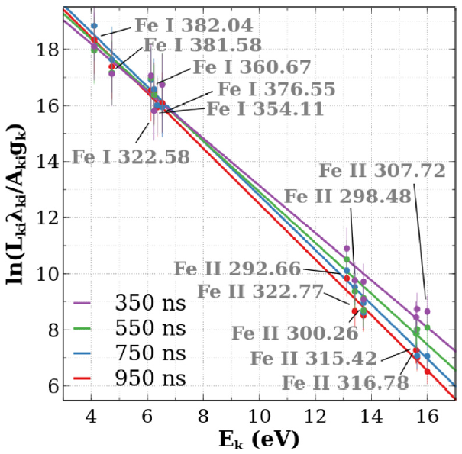
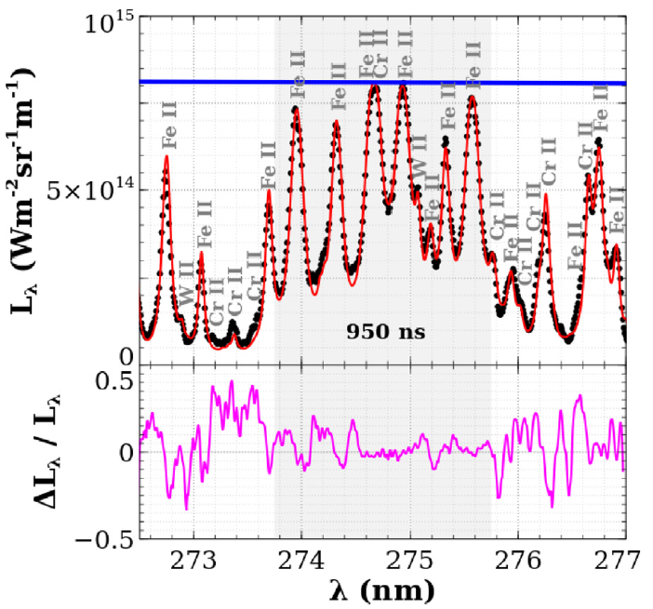
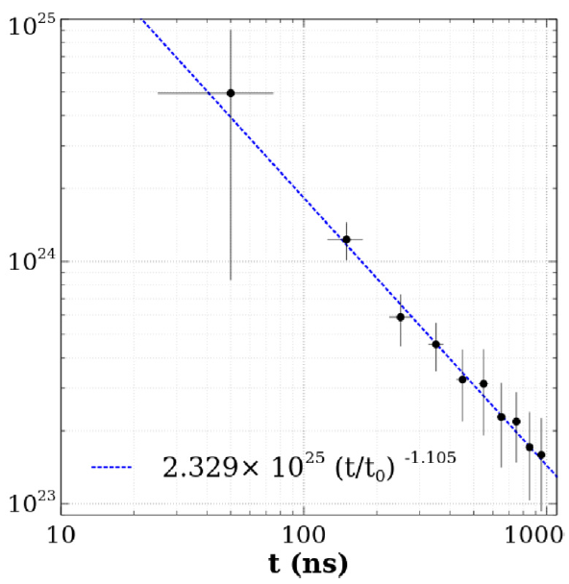
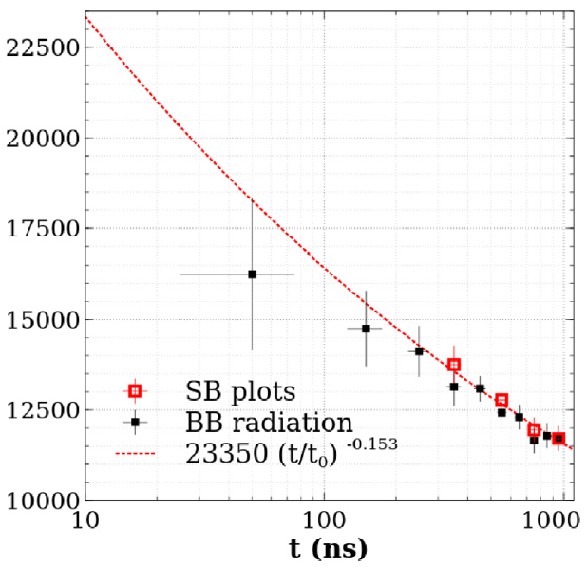
LIBS on Eurofer97 containing Fe, Cr, Cu, W, Na, Mn, V (measured by XRF, x-ray fluorescence) and reconstruction using the MERLIN code
CORIA
A. Bultel, A. Favre – Validation of the MERLIN code (spectra calculations)
At time t = 950 ns:
experimental spectrum
reconstruction by MERLIN
blackbody radiation
Plasma thickness (mm)
Saha-Boltzmann plot
t₀ = 10 ns
t₀ = 10 ns
t₀ = 10 ns
Spectral radiance
Electron density (m⁻³)
Temperature (K)
Spectral radiance
relative difference
A. Favre, A. Bultel et al. JQSRT 330 (2025) 109222
https://doi.org/10.1016/j.jqsrt.2024.109222
Notes:
The first slide makes the point on our code calculating the spectra in LIBS relevant conditions. This code (baptised MERLIN) has been validated in complex mixtures, especially on steels, in particular in the case of black body iron transitions.

Slide 34
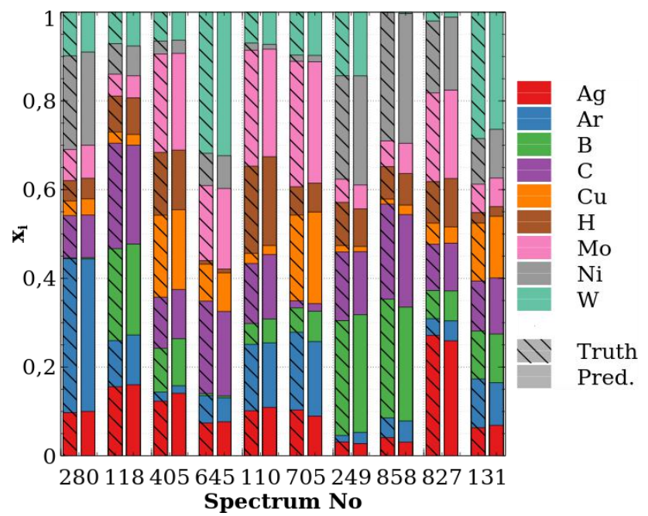
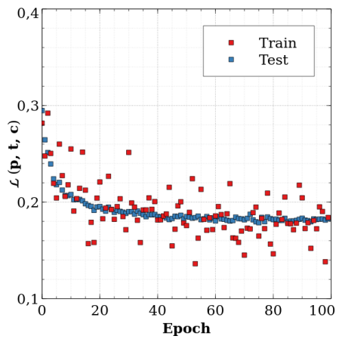
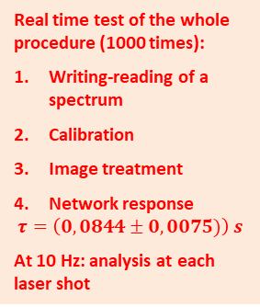
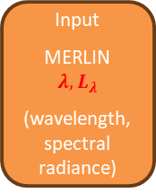

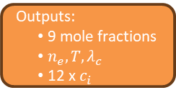
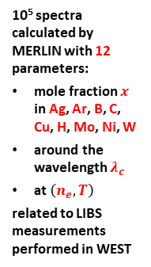

A. Favre, A. Bultel et al. Phys. Scr. 99 (2024) 035609
https://doi.org/10.1088/1402-4896/ad2826
A. Favre… A. Bultel accepted in Spectrochim. Acta Part B
A. Bultel, A. Favre – Coupling between Machine Learning and MERLIN for real time CF-LIBS
x 6
Tests for the quantification:
Best prediction!
Lowest predicted value for H: $x_{H}=0,1 \%$
Input
MERLIN
$$λ, L_{λ}$$
(wavelength, spectral radiance)
DENSE + ReLU + DENSE
CONVOLUTION
DENSE + ReLU x5
RESIDUAL BLOC x4
MAX POOL
FLATEN
DENSE + ReLU + DENSE
DENSE + ReLU + Softmax
10⁵ spectra calculated by MERLIN with 12 parameters:
mole fraction $x$ in Ag, Ar, B, C, Cu, H, Mo, Ni, W
around the wavelength $λ_{c}$
at $\left(n_{e}, T\right)$
related to LIBS measurements performed in WEST
Multi-layer perceptrons: decision
Outputs:
9 mole fractions
$n_{e}, T, λ_{c}$
12 x $c_{i}$
Real time test of the whole procedure (1000 times):
Writing-reading of a spectrum
Calibration
Image treatment
Network response
$$τ=\left(0,0844±0,0075)\right) s$$
At 10 Hz: analysis at each laser shot
NORMALISATION
CONVOLUTION
ReLU
STACK
Learning  Loss function:
$$ℒ\left(p,t,c\right)=\sum_{1}^{12}{c_{i}^{2}{\left(p_{i}−t_{i}\right)}^{2}}+\sum_{1}^{12}{{\left(1−c_{i}\right)}^{2}}$$
where $p_{i}$ is the prediction, $t_{i}$ the target and $c_{i}$ the prediction confidence on the parameter $i$
Convolutional Neural Network: information extraction
Deliverable: PWIE-SP X.x.y-Txxx-Dxxx
Status: ongoing
Linked WP or TSVV: if applicable
Notes:
Here we show the procedure of training a CNN (convolutional neural network) based on the implementation of MERLIN putting forward the very good capacity of the network to recover the composition of a 9 elements mixture including H (up to a mole fraction of 0.1 %) in relation with experiments we did on WEST. In addition, the time required is short enough (less than 0.1 s, excluding of course the training) to allow a real time implementation in future developments.

Slide 35
THE END…

Slide 36

OES results H/H2, ne, Te and 2D distribution in JULE-PSI FZJ
Current Status:
Langmuir probe:
Spectrometer
Vacuum pumps
Langmuir Probe
Magnets
Aperture
Plasma source
Plasma dump
Hyperspectral camera
Anode cooling and shape has been improved
Tests with argon and neon plasma performed, main focus: Plasma performance, magnetic fieldline configuration
Cathode vacuum vessel cooling has also been updated and is currently being installed
Next steps: Operation with Helium (less erosion at dump and cathode) and hydrogen (pending permission)
Radial profiles of n_{e}, T_{e}, plasma flux
Plasma reaches higher peak values compared to PSI-2 at similar discharge power
Performance strongly depends on magnetic fieldlines in source area

Slide 37
OES results H/H2, ne, Te and 2D distribution in JULE-PSI FZJ
Optical Emission Spectroscopy:
Hyperspectral camera
Spectrometer
Vacuum pumps
Langmuir Probe
Magnets
Ne I
Aperture
Ne II
Plasma source
Plasma dump
Hyperspectral camera
Comparison of langmuir probe results with simple methods (Boltzmann plot, Line ratios) seems inconclusive, maybe also due to systematic problems (line-integrated signal, no spatial resolution, not same position as Langmuir Probe)
Upgrade to 2D-Spectrometer dismissed in favour of hyperspectral camera
Good for detecting plasma impurities
Pictures from the camera provide radial profiles of the plasma column at different wavelengths
Selection of wavelengths is limited due to low spectral resolution

Slide 38

SP X.1: Atomic and molecular processes in attached/detached plasmas ➔
Motivation
Without precautions divertor components are subject to unacceptable high particle fluxes
Neutral particles are beneficial for mitigating the plasma
fluxes, by removing momentum and energy
MAR is thought to be important for power mitigation, but MAR rates vary orders of magn. with ro-vibrational levels (v,j)!! ➔ (1e step MAR) H₂(v,j) + H⁺ ➔ H₂⁺ + H(1s)
This lack of ro-vibrational data can lead to major deviations in predicting plasma performance
To obtain this missing ro-vibrational distribution of ground state hydrogen and isotopes, the focus will be on molecular spectroscopy in linear devices

Slide 39


Slide 40

SPX.1: CARS: probing first ro-vibrational states of H₂ DIFFER
[au]
H2 population scans for different axial positions relative to target (UPP).
The (v=0,J=1) state population is measured for different plasma conditions.
First CARS signals UPP measured. (top left). Able to measure first and second vibrational state (problem: interfering non-resonant CARS signal)
Lessons learned: crossed beam configuration (real BOXCARS) required → Sensitivity increased in lab by factor 15 to 10^19 m^-3. Corresponds to partial pressure of 0.05 Pa
2025 plan: deploy improved CARS in Magnum-PSI.
Deliverable: PWIE-SP X.X1.T-T004-D001
Status: completed
Facilities: Magnum-PSI, UPP
Linked WP or TSVV: WPTE

Slide 41


LAMIS measurements of ¹³C at the surface of W7-X divertor fingers
General Information
Carbon transport study in W7-X by local injection of ¹³CH₄ gas
Measurements of ¹³C/ ¹³C +¹²C ax situ by single pulse ps-LAMIS and double pulse ps-LAMIS
Task and questions to be addressed
LAMIS measurements of ¹³C content at the surface of W7-X divertor fingers
Comparison LAMIS results with NRA measurement and ERO2.0 simulation.
Approach
Local injection of ¹³CH₄ gas in W7-X during plasma discharge
Divertor fingers at the vicinity of the injection nozzle were removed from W7-X and were transported to FZJ in LIBS lab
The divertor fingers were analysed by SP&DP(collinear) ps-LAMIS (λ=355nm (1064nm), 35ps, ≈10 mJ, spot ∅ 0.7 mm) in 150 Pa N₂ to improve signal-to-noise ratio
Results
Both SP LAMIS and DP LAMIS provide ¹³C profiles similar NRA data at the areas with thin deposit.
At the area with thick deposit, which required several laser pulses for complete ablation, collinear DP LAMIS shows smaller ¹³C content in comparison with NRA data. This could be because second laser pulse did not absorbed in the deposit layer but mainly in the graphite substrate.
SP LAMIS
DP LAMIS
Deliverable: PWIE-SP X.X2.T-T004-D004
Status: completed
Facilities: NA
Linked WP or TSVV: if applicable

Slide 42




Lev- LIBS Boron Analysis for future thing Boron LIBS analysis CU
The acoustic levitation system was employed for making analysis in H₃BO₃. The solutions were prepare from a mother solution 0.099M. The doublet recorder by the detector are show below.
H₃BO₃(ac) 20mM
DT = 1µs
GT = 3µs
H₃BO₃(ac) 1mM
DT = 1µs
GT = 3µs
Deliverable: PWIE-SP X.X2.T-T004-D006
Status: completed
Facilities: or Modelling:
Linked WP or TSVV:
The acoustic levitation system.
(Lev-LIBS)

