Slide 1
WPPrIO: Preparation of ITER Operation
PSD AWP25 Planning Meeting- Garching 07-09 October 2024
Xavier LITAUDON* (CEA Project Leader), Gloria FALCHETTO (CEA Project Support Officer),
João FIGUEIREDO (Coordinator Officer @ Programme Management Unit)
CEA lead lab. for WP-PrIO
*xavier.litaudon@cea.fr

Slide 2
Introduction
WP created in 2021 to implement some of the recommendations from 2020 General Assembly¹ on “EUROfusion role in ITER operation and scientific exploitation”
“Operation” to be understood in the global sense encompassing integrated commissioning, plasma & machine/sub-systems operation including scientific exploitation to be carried out in advance of the start of ITER plasma operation
In the context of the ITER revised baseline with the aim of achieving Q=10 as soon as possible, EUROfusion should ensure that operational tools, broadly defined to include methods, codes and procedures are ready before ITER application (tested, validated and reliable)
Overview PRiO activity (2021-2023) published in 2024 Nuclear Fusion: EUROfusion activity commended by the external referees [2024 Nucl. Fusion 64 112006 https://iopscience.iop.org/article/10.1088/1741-4326/ad346e]
¹EUROFUSION GA (20) 32 - 4.7 - ITER White Paper Report WG1 Issue 1 10-Dec-2020 (Decision).docx and EUROFUSION GA (20) 32 - 4.7 - ITER White Paper Report WG2 Issue 3 7-Dec-2020 (Decision).docx

Slide 3
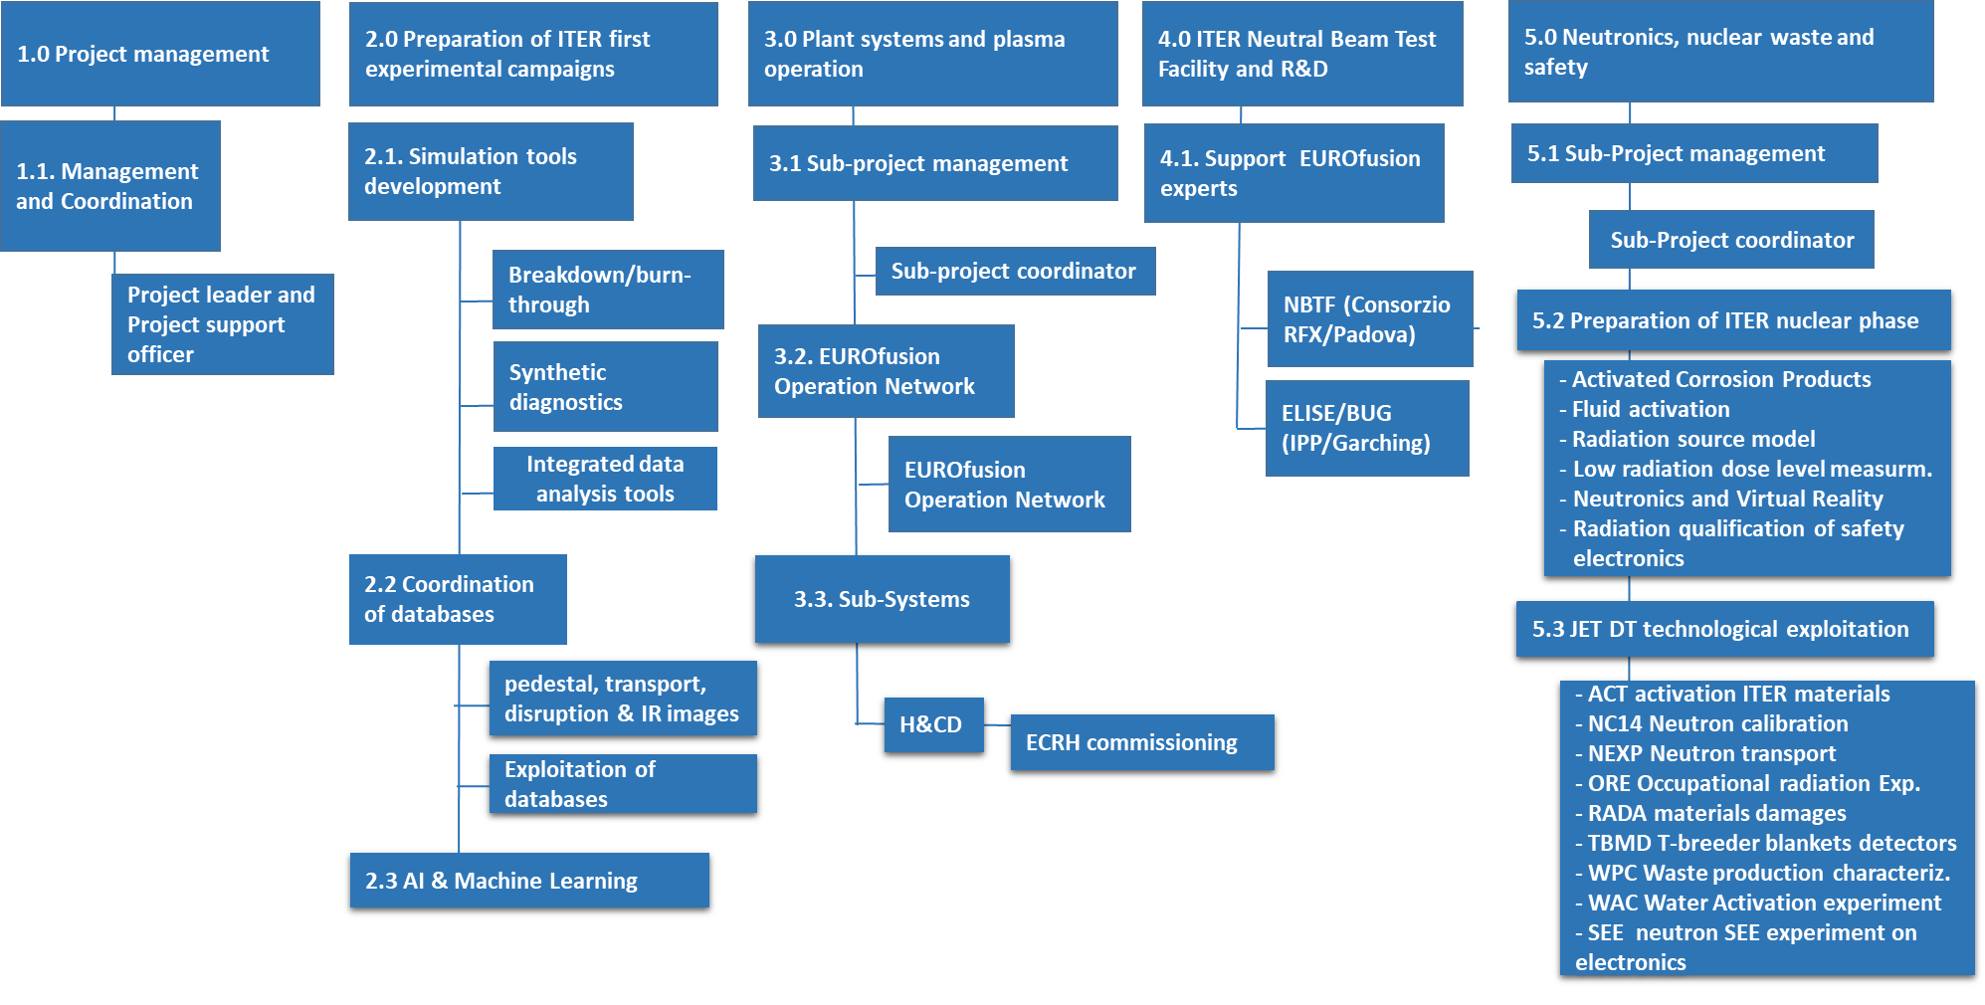
PrIO Main structure (WBS)
Beneficiary | PM 2024
CEA | 60.00
CIEMAT | 30.50
ENEA | 106.00
IPPLM | 54.60
IST | 12.00
JSI | 23.40
KIT | 2.00
LPP-ERM-KMS | 2.40
MPG | 61.00
NCSRD | 13.00
VR | 7.00
VTT | 3.00
Not Allocated | 30.20
Sum | 405.10
5 Sub-Projects with delegation and gender equality
  SP-1 Project management (G. Falchetto)
  SP-2 Preparation of ITER first experimental campaigns (X. Litaudon)
  SP-3 Plant systems and plasma operation (E. Belohony)
  SP-4 ITER Neutral Beam Test Facility and R&D (U. Fantz, D. Marcuzzi)
  SP-5 Neutronics, Nuclear waste and Safety (S. Villari)
Prior to July 2024 GA

Slide 4
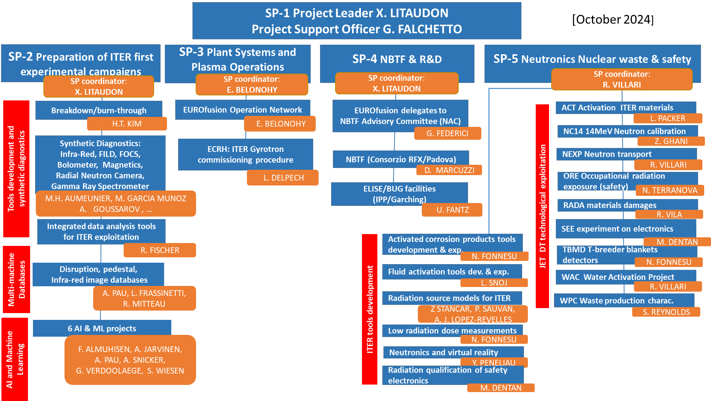
Major changes
2024 call for 5 positions
2024 AI call
Completion of the JET neutronics activity in 2025
Participation in the decommissioning ?

Slide 5
New activities initiated in 2024 (new call / extra resources following July 2024 GA decision) that will be expanded in 2025
SP-2: Synthetic diagnostics
  Bolometer diagnostics for ITER and tomographic reconstruction software , Analysis Tools & Calibration Techniques for the ITER magnetic measurements, Radial Neutron Camera and Gamma Ray Spectrometer
SP-2: multi-machine Infra-Red image database (experiments & simulations)
SP-2: Integrated multi-diagnostics data analysis tool in view of ITER (density & temperature)
SP-2: new Artificial Intelligence projects related to operation and/or use of multi-machine databases
  Tokamak operation Conversational AI Interface Using Multimodal Large Language Models
  AI-assisted Plasma State Monitoring for Control and Disruption-free Operations
  Identification and confinement scaling of hybrid scenarios across multiple devices
  Applying AI/ML for NBI ionization and slowing-down simulations using ASCOT/BBNBI
  Machine learning accelerated pedestal MHD stability simulations
  Machine learning accelerated SOL simulations: SOLPS-NN
SP-3: foundation courses for operation (TRED ?); ECRH commissioning procedures transferable to ITER-plant
SP-4: NBTF agreement with IO beyond 2025 ?; Long pulses on ELISE limited by the RF generator to be replaced by solid state RF generator (cf PCR)
SP-5: Special issue in Plasma Physics & Controlled Fusion on JET D-T neutronics

Slide 6
Status on PrIO calls (FSD-AWP24-PrIO-25 and 26) issued in July 2024 with deadline end of September
SP-2: EUROfusion support to ITER diagnostics procured by the EU, focusing on the development of synthetic diagnostics, analysis tools and calibration techniques
  Allocated resources ~75k€ CC 26 PM
  5 proposals from EK-CER, ENEA, JSI; joint with MPG, EPFL, IPPLM, VR for a total of 51PM
  Review of the proposals with IO experts to develop collaborative activity
  Two proposals (ENEA, JSI) will be combined on the neutron camera (link with SP-5)
  Action to reduce down to ~42.5 PM and get resources within PrIO (cf PCR)
SP-3: EUROfusion support to ECRH system commissioning for ITER
  Allocated resources ~360k€ CC for 2024 /2025: 60 PM, 50k€ of Hardware and 30k€ of mission costs
  Joint coherent proposal from CEA, IPP, EPFL/SPC, KIT within the budget. Strong support letter from IO.
  IO and F4E experts participation in the proposed project
  Selection meeting organised with IO, results to be communicated to the proponent
SP-4 : Call for Experts to be seconded to IPP-Garching and NBTF in Padova in the frame of the Support Activities by EUROfusion
  Call for 3 positions at IPP and 2 at NBTF
  Only 2 replies for one job description at IPP.
  Interviews to be organised but call to be re-opened for the other 3 positions

Slide 7
Other activities highlights
SP-2 databases
  call for the new L-H database coordinator not issued, pending discussion (with TE) at AWP 2025 within the new PMU structure
  The transport database coordinator (ENEA) has resigned in 2024 and this activity is on hold
  Extra-resources allocated to database exploitation (pedestal, disruption) but (still) lack of local support from MAST-U & AUG
  Availability to EUROfusion users via web interface & authentication procedure pending dabases transfer to the new Gateway
  Action on PMU pending since Sept 2023: prepare an Agreement for users to sign before accessing the DB.
    Strong interests from ITPA and Private sectors – How to deal with the request
SP-3 :
  Face to Face meeting of the EU facilities heads of operation: to be organised in 2025 but not in 2024
  Develop the EON foundation course on Session Leading : task initiated within the EON, to be moved to 2025
  Request for SL training could not be accomodated within the 2024-2025 budget
SP-5 :
  New tasks implemented within the existing PRIO team using part of the extra resources allocated by GA in support to ITER new baseline and safety issues
  Strong collaboration with F4E and IO but recent departure from IO of Y LE TONQUEZE
  Neutronic activities during the JET decommissioning phase: pending agreement between UKAEA ?

Slide 8
SP-2 Multi-machine databases 2025 Activity -with WPTE and WPAC
Pedestal multi-machine database
  Deployment of the database on the new EUROfusion Gateway (pending ACH support)
  Extend including the recent TCV and MAST-U data
  Update with new parameters (in particular for JET)
  Exploit for pedestal prediction (using Artificial Intelligence techniques )
Disruption multi-machine database
  Extend validation and pipelines to access/include WEST, MAST-U and JT60-SA in the future
  Make available the DEFUSE framework on the new EUROfusion Gateway (with ACH) and local installation of the EUROfusion Disruption Database (including plasma state and events characterization) for large scale analysis and scientific exploitation, leveraging Statistical and Artificial Intelligence techniques in connection with AI & ML EUROfusion projects.
  Update the mapping to IMAS as far as the IDS for disruptions - to be provided by IO is concerned, including the deployment in production of automated data mapping tools integrated in DEFUSE.
  Adapt the web catalogue and interface for data browsing and visualization including characteristic times, events and main disruption precursors (with ACH)
Infra-Red (IR) images database (new activity following 2024 call)
  set-up a multi-machine IR database (WEST and W-7X) to support the development of the IR synthetic diagnostic and to further develop wall thermal events and hot spot monitoring system in view of ITER applications.
  Develop common definitions and data format for IR images database

Slide 9
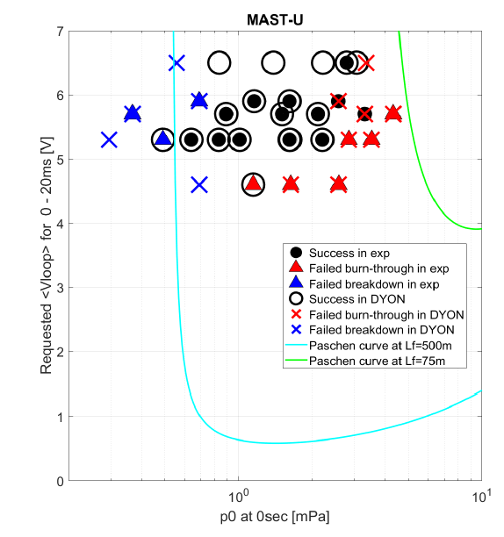
SP-2 Develop plasma breakdown/burn-through simulation tools and apply to ITER operation (with TE & SA)
Grant Del. report completed ”Validated models for plasma burn-through and breakdown adapted to ITER conditions (passive structure and the poloidal field coils)” pending internal review
Operating space for plasma initiation in MAST-U experiments and in DYON prediction
ITER predictive simulations using a strongly coupled CREATE-BD/BKD0/GRAY scheme fully integrated within the IMAS framework with the new W Wall
  Improved model and sensitivity studies for ECRH absorption in the very initial phase of the breakdown
  Automatic determination of the plasma initiation region from magnetic data, to be utilized in GRAY for absorption and in BKD0 for plasma volume assessment
Validation of plasma initiation operation space prediction capability against multi-devices data in the frame of ITPA international collaboration (e.g. EAST, DIII-D and KSTAR)
Development in DYON of the radial force balance solver for the plasma initiation phase and the early plasma current ramp-up phase.
Improvement and validation of the early plasma current ramp-up modelling with the free boundary equilibrium solver
Development and maintenance of GUI and user interface of the DYON-IMAS interface scripts
[ Kim et al to appear in Nuc Fus 2024]

Slide 10
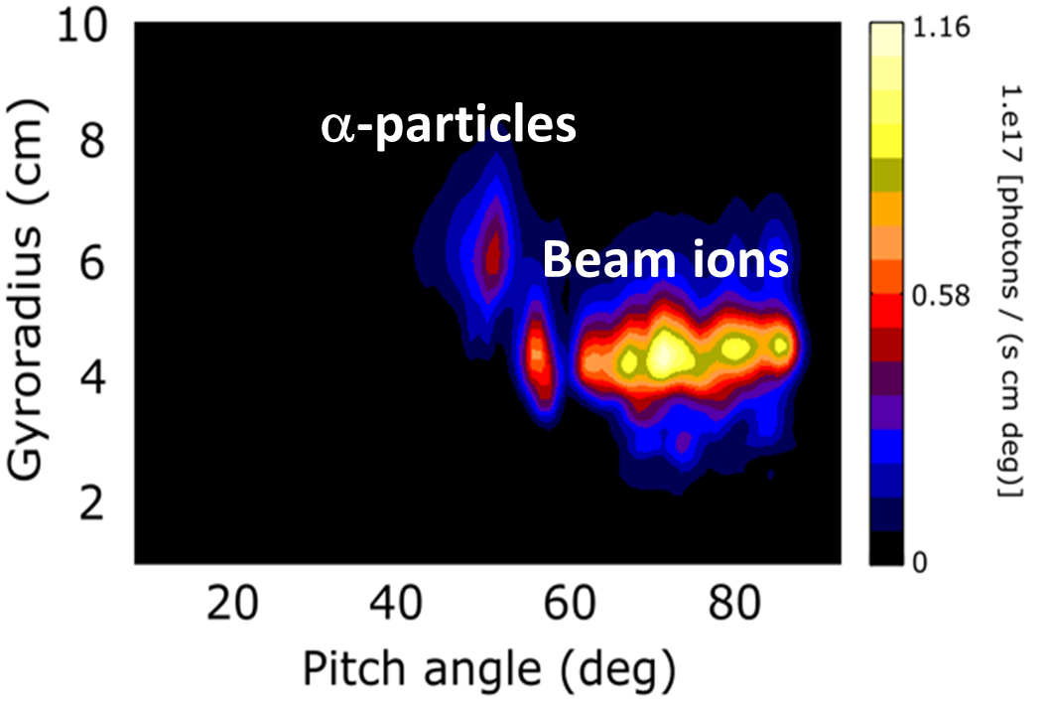
SP-2: ITER fast ion loss detector diagnostic design and synthetic diagnostic
with WPSA-TE
Simulated FILD measurements of the velocity-space distribution (as a function of gyroradius and pitch angle) of the escaping ions for ITER baseline scenario
  synthetic diagnostic FILDSIM + ASCOT simulation for calculating the fast ion losses at diagnostic location.
Hybrid kinetic-MHD MEGA simulations to self consistently obtain the Alfvénic mode structures, for transfer to ASCOT to estimate the Alfvénic instabilities induced fast-ion flux on the FILD head.
Apply FILDSIM to estimate the signals induced on the camera and photo-multipliers by a combination of MHD instabilities and associated magnetic perturbations; identification of alpha-particle losses versus neutral beam ion losses in the simulated FILD strike maps.
Assess impact of the new magnetic configuration (W wall) on the radial profile of fast ion losses (pending IO to provide reference scenarios).
Validate the FILDSIM workflow on JET DT experiments. (PCR 2024)
Beam ions

Slide 11
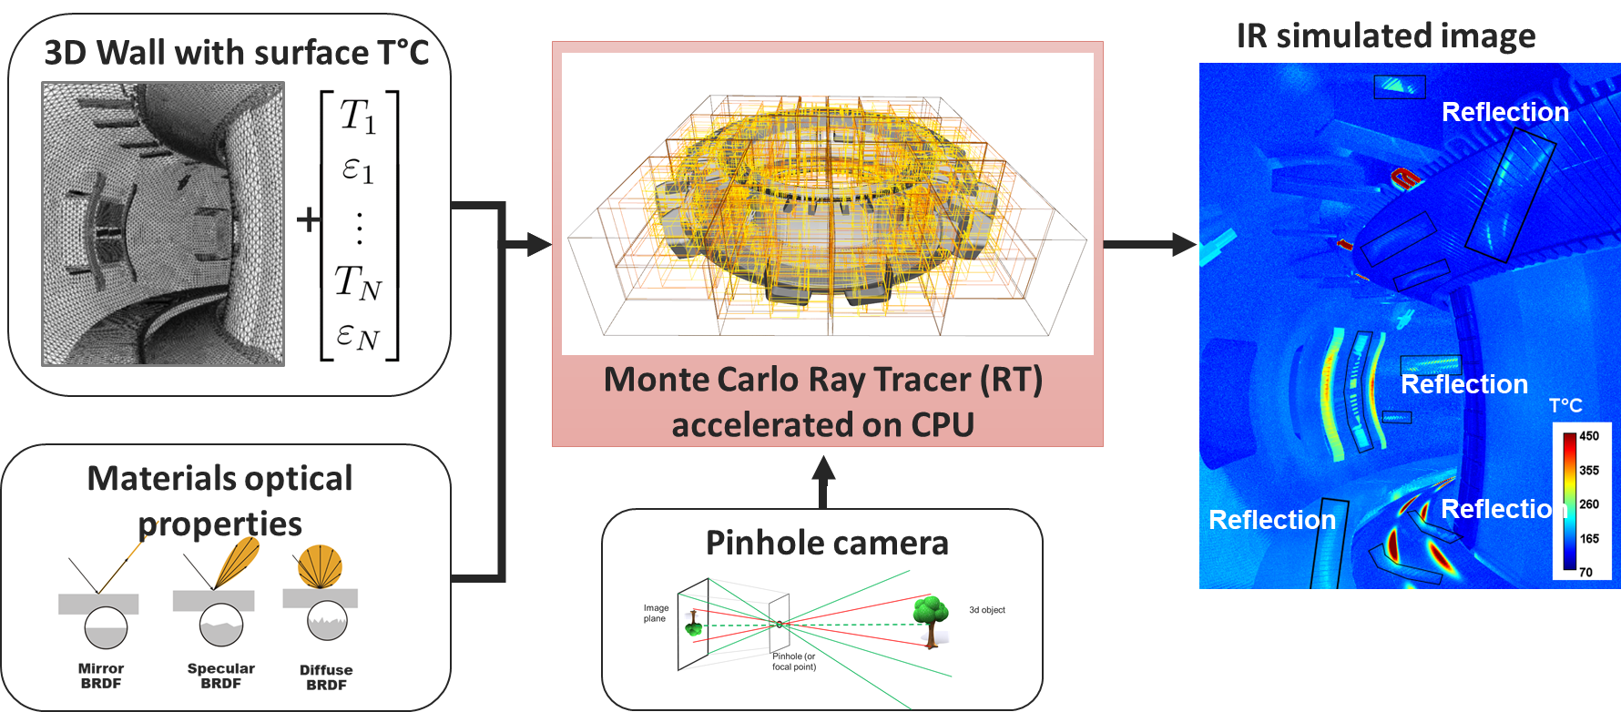
SP-2 Progress of IR synthetic diagnostics in IMAS
Accelerated CPU of IR RT code done, ready to connect to IMAS
New IDS required for IR synthetic diagnostics
  Modification of camera_ir IDs to add pinhole camera model in progress
  Adding a new structure to wall IDs to define the materials optical properties (reflectivity/BRDF) in progress
  Saving synthetic data and associated

Slide 12
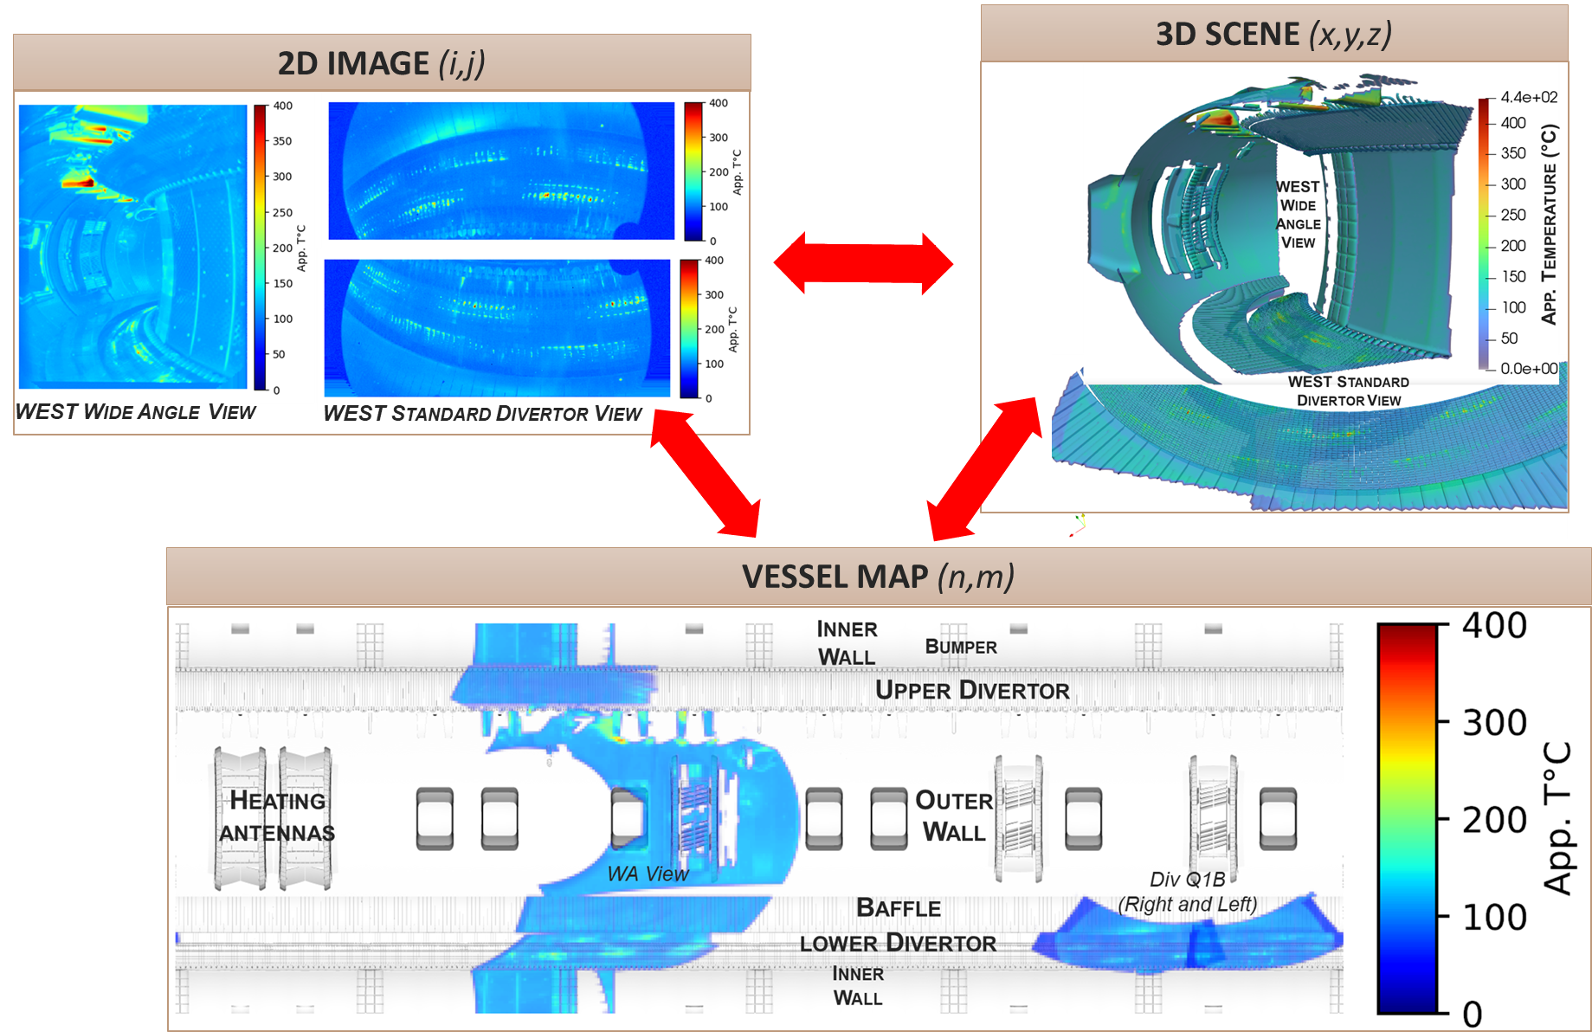
SP-2 A new tool for evaluating and mapping (simulated and experimental) data of optical diagnostics for ITER, validated on WEST
check the compliance with the scientific requirements
identify the operating limits (uncovered area or poorly resolved camera)
Support operation for the interpretation and localisation of thermal events or surface change between pulse
1st demonstration on WEST
(pulse #59763)
Linked EEG proposal
shortlisted for interview

Slide 13
SP-2 : Develop IR temperature synthetic diagnostic for off-line analysis and ITER real-time application – 2025 activity
Develop mapping tool to assess spatial coverage and spatial resolution of ITER optical diagnostics:
  upgrade the prototype code and add new optical diagnostics
Simulation of ITER IR synthetic images in presence of plasma emission in IR range
  Modelling Bremsstrahlung radiations for inclusion in IR ray tracing code (new module)
  Simulate IR synthetic images while including Bremsstrahlung radiation
Integration of IR synthetic diagnostics in IMAS
  test the whole chain of simulation using WEST IMAS data for a standard plasma scenario
Validation of temperature inversion model on calibrated test bed (MAGRYT at CEA)
  tests the temperature inversion model on MAGRYT test-bed
  theoretical and experimental characterization of metallic materials properties
Development of temperature inversion tools
  demonstrate algorithm of temperature inversion using Machine Learning method exploiting a large training database of simulated IR images in various plasmas scenarios

Slide 14
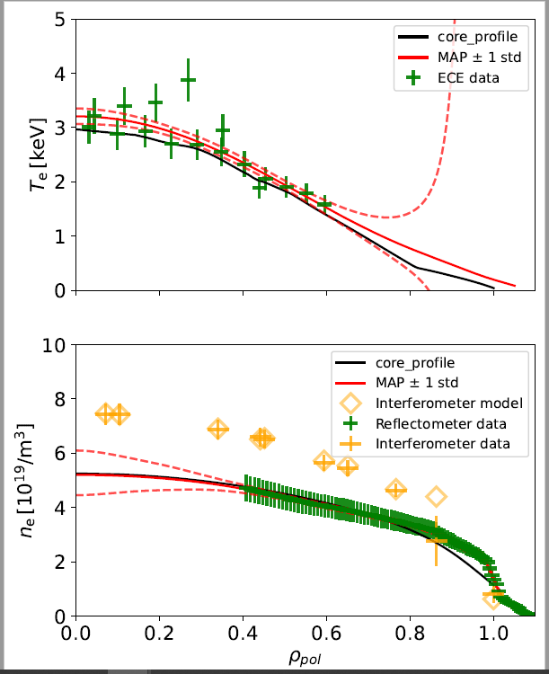
SP-2 Develop Integrated multi-diagnostic Data Analysis (IDA) tools for ITER operation
developing methods and tools to provide a coherent combination of measurements from various diagnostics that can be validated on existing facilities before being transferred to ITER applications
  Extension from AUG to WEST: fully based on IMAS
Develop integrated multi-diagnostic data to full maturity with a workflow for routine density and temperature profile estimation; workflow validation and validation of measurement uncertainties using WEST IMAS database with the multi-diagnostics data (ECE, interferometer, reflectometer, Thomson scattering).
Extend Integrated Data analysis Equilibrium code to be IMAS compatible for use in ITER and to be applied to WEST for studying equilibrium uncertainties.
Implement the ECrad (optically thin plasmas, etc.) forward model for ECE data interpretation within IMAS and validation on existing facilities.
Coupling of IDA actors with MUSCLE3 for ITER applications: IDA framework for combining synthetic diagnostic forward modelling codes and transport codes written in different languages.

Slide 15
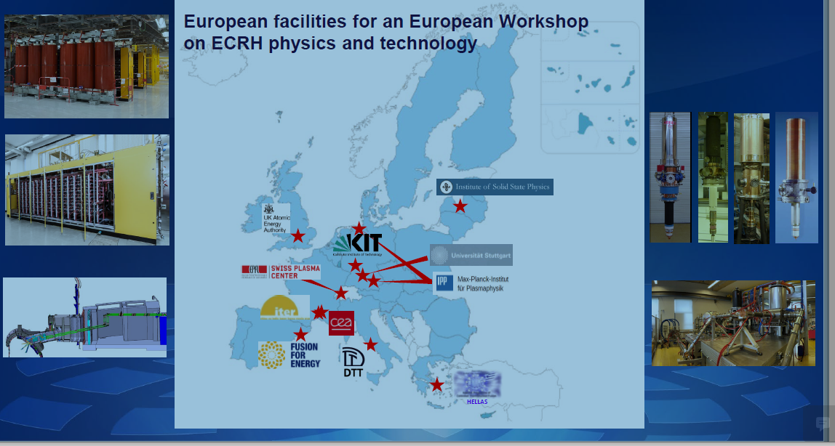
SP-3 Sub-systems, Heating & Current, ECRH (new activity following 2024 call) with IO and F4E expert participation
2024 increase ECRH EUROfusion effort in support to ITER revised baseline
  ITER Significant transition from 24 Gyrotron procurements to 80 in the revised baseline
  commissioning on test beds will be on the critical path of the timeline
Develop EON subnetwork on Electron Cyclotron Resonance Heating (ECRH) together with F4E
Provide a validated (on existing facilities) commissioning procedure of the CW ECRH system or one of its major parts that is directly transferable to ITER applications and the ECRH plant
Support the development and training of operators: hands-on participation in the ECRH plant commissioning with the WPTRED (WP Training & Education)

Slide 16
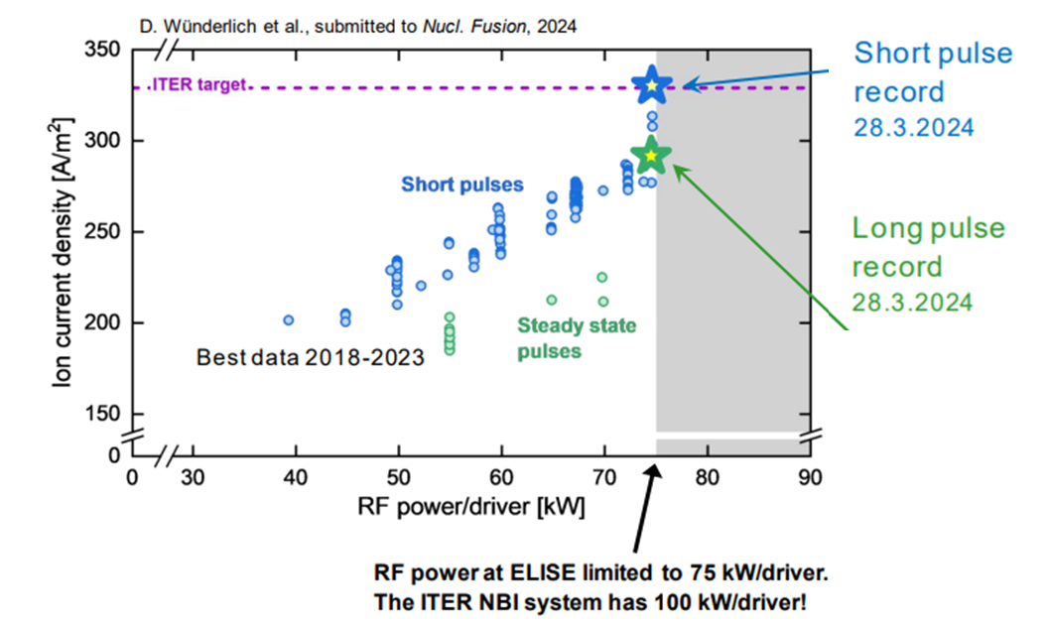
SP-4 ELISE breakthrough but significant concerns without new RF generator
ITER target extracted ion current density in hydrogen in short pulses (10 s)
For long pulses (600 s): 90 % of the target values were achieved.
solid-state RF generators (from AUG during shutdown) operated at that time only provided 75 kW/driver (150 kW/generator), i.e. 75 % of the RF in the ITER NBI systems
ELISE is now using the RF generators (180 kW each) that are based on amplifier tubes: serious limitation for ELISE operation
PCR 2025 & beyond (extra resources): Replace the two 180 kW amplifier tube RF generators by 200kW solid-state RF generators for reliable high power long pulse operation (i.e. to avoid frequency jumps leading to the loss in matching conditions).

Slide 17
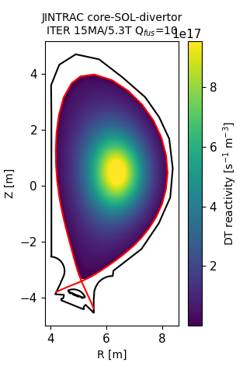
SP-5.2.4 Bridging plasma Physics and Neutronics
Advanced computational workflow comprises plasma transport (JINTRAC), Fast ion transport (ASCOT), neutron spectrum calculations (DRESS), and MCNP neutron transport code : Validation on JET and application to ITER in 2025
ITER 15MA baseline Q_{fus}=10 scenario
adaptation of the neutronics calculations for ITER in the context of the revised ITER research plan
Modelling for ITER updated D-D and D-T-1 phases with the full-W wall, exploitation of DD scenarios with RF H minority heating with Boron impurities (H/D plasmas), demonstration of JINTRAC-DRESS-MCNP workflow compatibility with IMAS and application to neutron synthetic diagnostics studies
Studies of runaway electrons in W: analysis of W activation due to runaway electrons and dose rate assessment; model validation in WEST
Optimisation of decomposition algorithm and application to ITER of GEOUNED open-source tool for geometry conversion from CAD-based models to neutronics calculations using Monte Carlo (MC) particle transport codes. GEOUNED based on the Constructive Solid Geometry (CSG) approach for complex geometry generation such as ITER.
Total neutron emissivity
[Ž. Štancar et al 2021 Nucl. Fusion 61 126030]

Slide 18
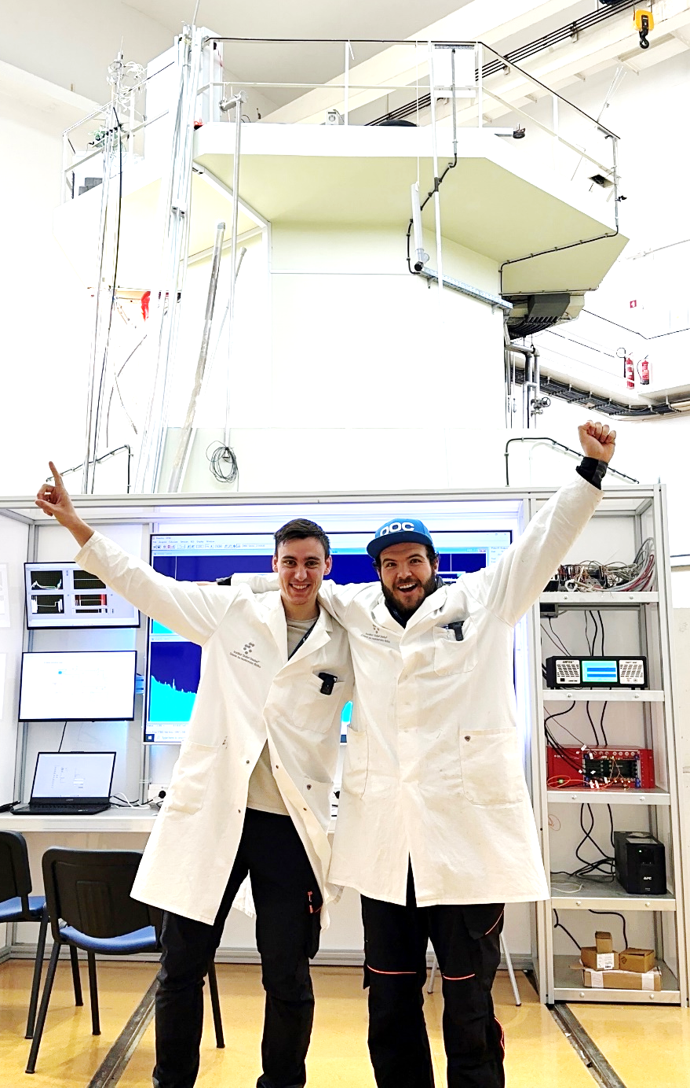
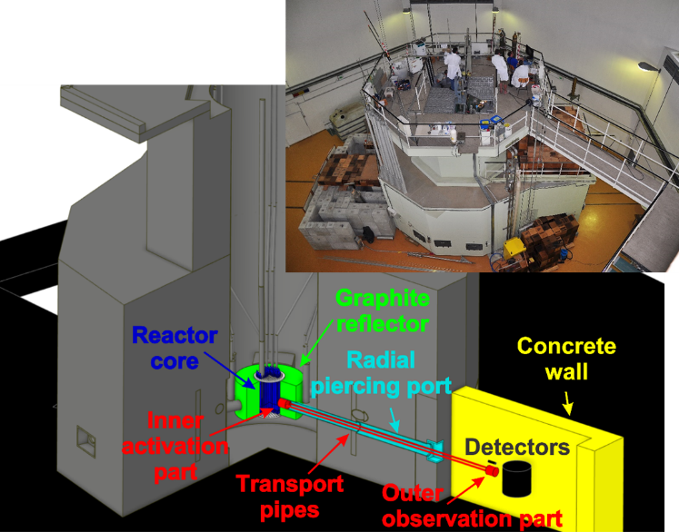

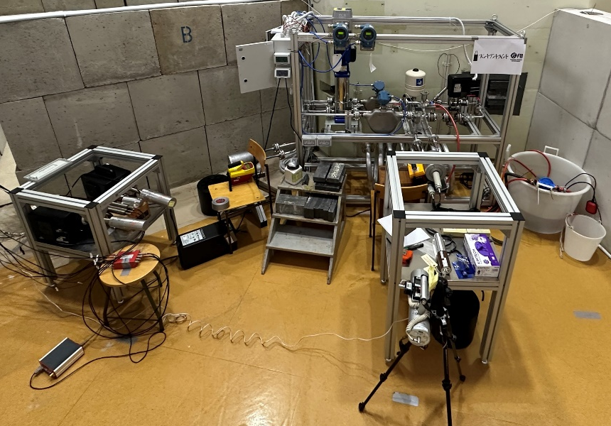
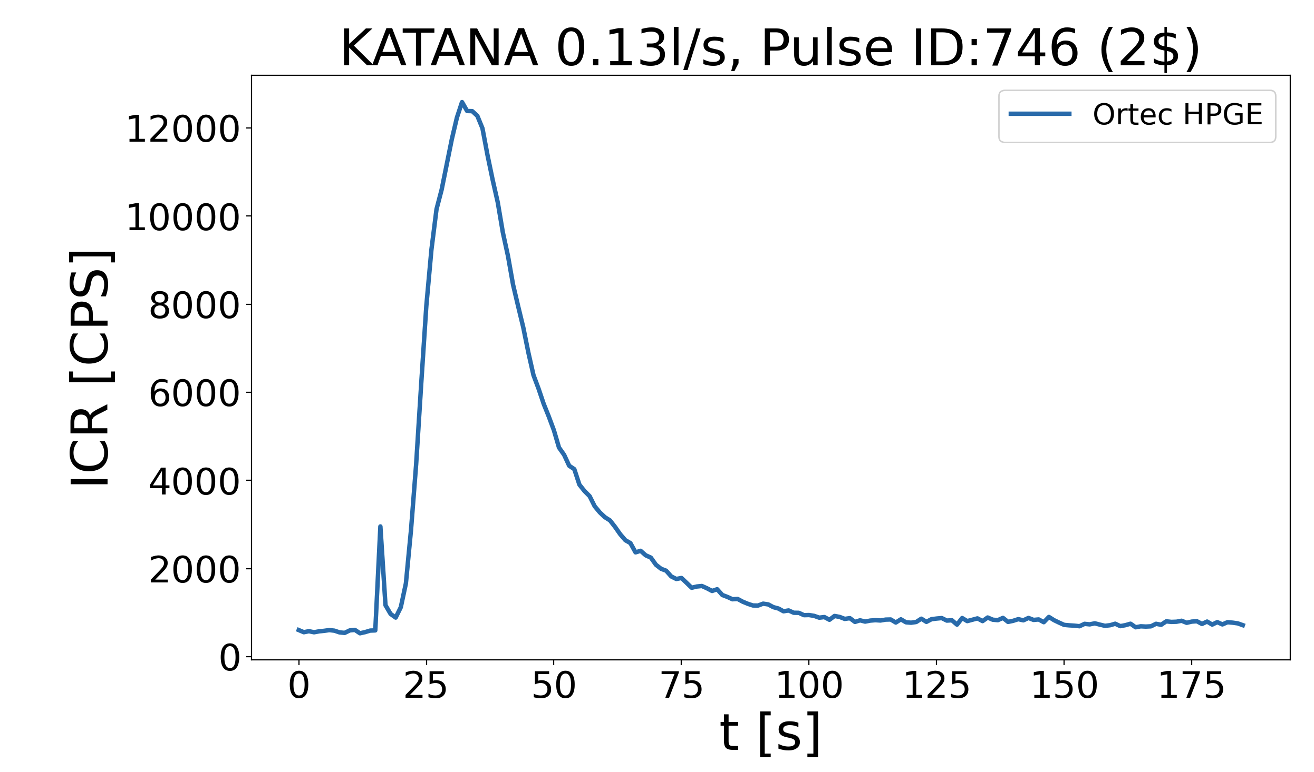
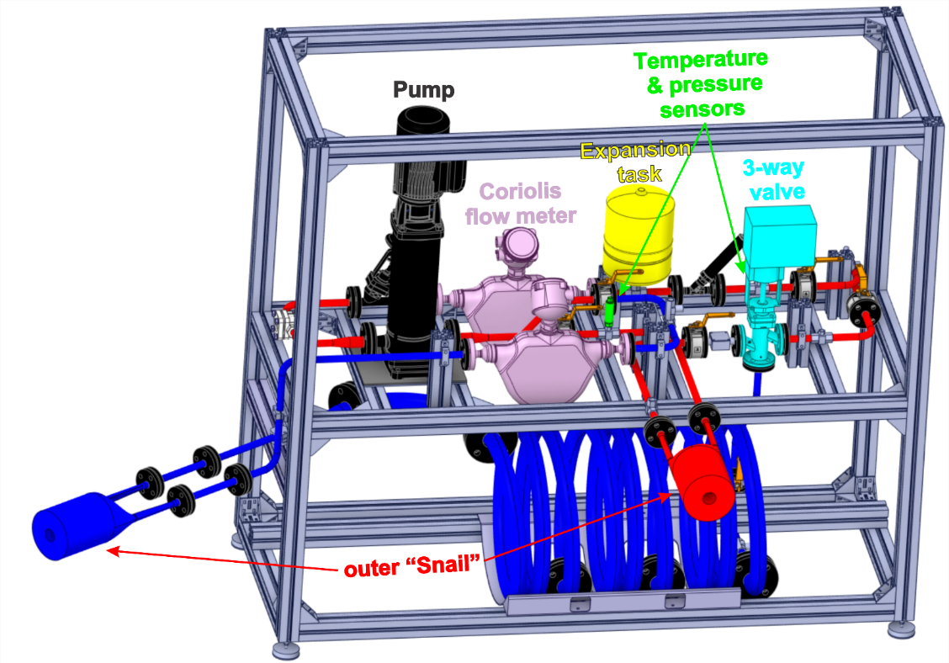
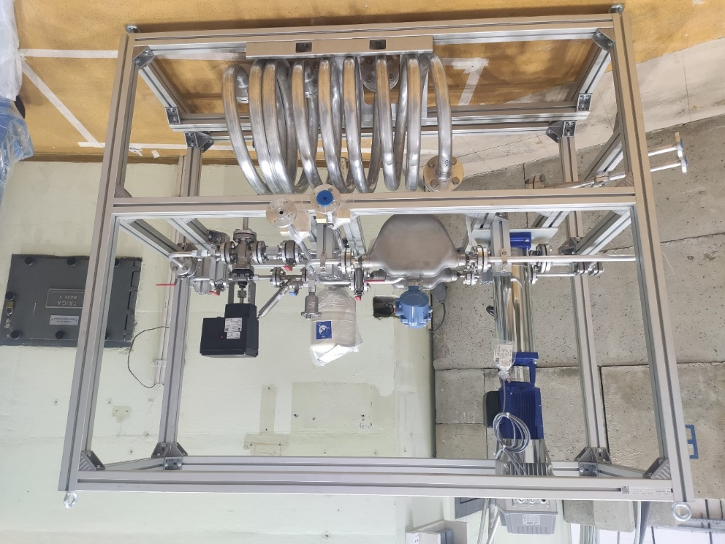
SP-5.2.3 KATANA, new closed-water activation loop at JSI TRIGA fission reactor to validate water activation codes for ITER
Design, construction and first experiments 20th Dec. 2023
Connecting fusion with fission
Gamma count rate after TRIGA pulse
(water activation)
Gamma count rate during TRIGA PULSE 746
  2025: KATANA loop design & manufacturing with new ITER relevant head 20 k€ (extra resource)
[Snoj, Kotnik, Peric, Lengar, Radulović et al. ]

Slide 19




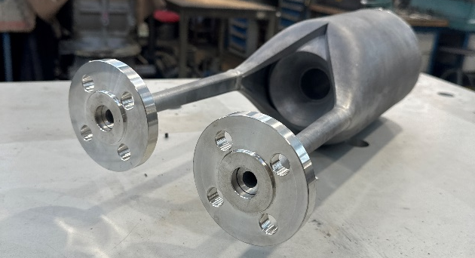
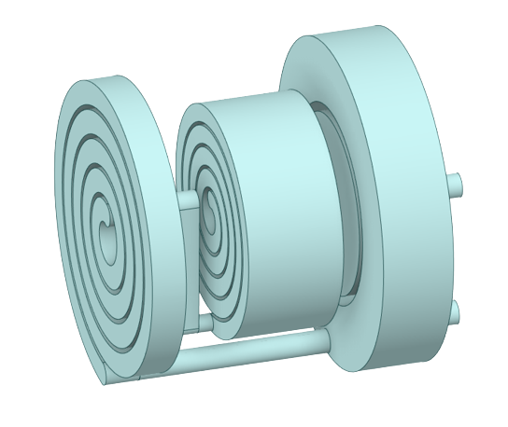
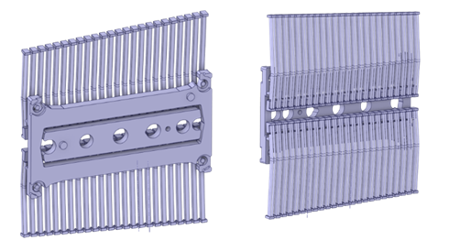
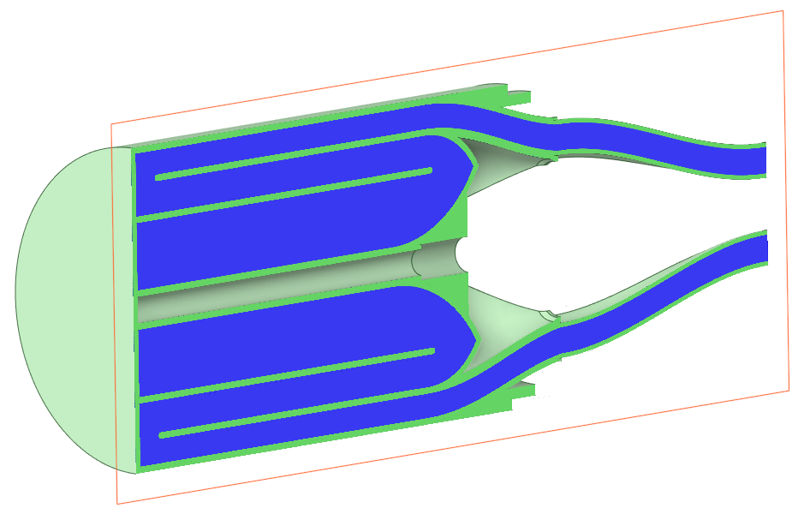
SP-5 KATANA, Expands activity with different cooling loop
Replacing Snail head with ITER relevant FW head (2025)
neutronic & hydraulic simulations in 2024
Conceptual design is to preserve:
  Hydraulic features: pipework, water boxes, fingers
  Residence time: adjusted flow rate (same regime, i.e. Reynolds #)
  Orientation of neutron flux gradients
Snail head to be replaced by
ITER-relevant head
ITER FW cooling channel
Challenging Computational Fluid Dynamics effects: vortexes, stagnation points, etc.
[SNOJ ]

Slide 20
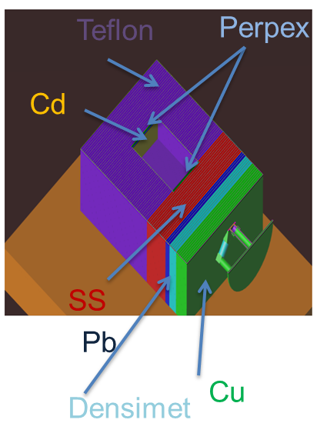
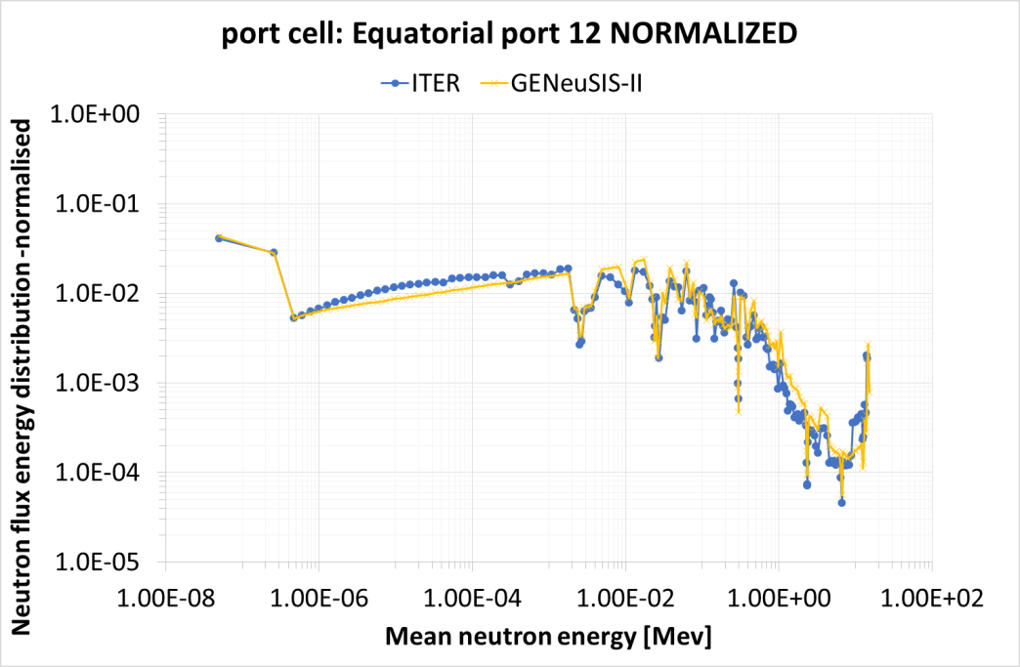
SP-5 Replicate ITER neutron energy spectra shape at FNG
General Experimental Neutron Systems Irradiation Station: Novel neutron test bed facility for testing diagnostics, electronics and critical ITER components
Support from ITPA, IO
Materials assembly as moderator in front of 14MeV neutron flux to replicate the required neutron energy spectra distribution.
Neutron energy spectra as in ITER Port Cell: unique facility for testing Single Event Effects (SEE) on electronics with ITER-like neutron spectrum
FNG target
Procurement, installation and characterization of GENeuSIS (General Experimental Neutron Systems Irradiation Station) at FNG: a novel neutron test bed facility for testing diagnostics, electronics and critical ITER components. Database for AI training to reproduce any neutron and development of advanced algorithms for testing electronics under neutron irradiation.
Experiment and analyses on neutron induced Single Events Effects (SEE) on electronics for ITER and DTT at FNG with GENeuSIS station under 14MeV neutron and at WEST from long DD plasma including tests of electronics shield and study of reliability prediction of electronics for power components.

Slide 21
PrIO PCR 2025
 | SP | Description | Justification | ressources 2024 to be moved
1 | SP-2 | FILD: validation of FILDSIM workflow on the JET DT | Team already fully committed in 2024 | 7 PM to 2025 | For information
2 | SP-2 | Data-base L-H transition | No call issued | 1.5 PM to 2025 | For information
3 | SP-2 | IDAV | Team already fully committed in 2024 – expand activity in 2025 | 5.2 PM to 2025 | For information
4 | SP-2 | Synthetic diagnostic (July 2024 call) | 25.5PM could not cover 5 approved proposals (51 PM requested down 42.5PM) | Increase of 8 PM + 8 PM EPFL in 2025 (within PrIO budget) | For information
5 | SP-3 | Support to ITER operation and session leading courses | Activity in delay due to committment of the SP-3 coordinator into other duties | 12 PM NA + 1 PM EPFL to 2025 | For information
6 | SP-4 | ELISE: Replace two 180 kW amplifier tube RF generators by 200kW solid-state generators | For reliable high power long pulse operation (loss in matching conditions) | 800 K€ HW depreciation over 2 years 2026 and 2027 | NBTF agreement to be renewed
7 | SP-4 | ELISE/ NBTF secondees | Secondee left departure in May 2024. Only 1 open position to be filled(pending interview) starting 1st Nov 2024 | 5 PM MPG in 2024 to be released | For information
8 | SP-4 | ELISE/ NBTF secondees | Not used EPFL resources (2nd EPFL secondee left) | 20.45 PM EPFL : 8PM to SP-2 2025 (synthetic diag call), 12.45 PM + 200k€ secondement to be released | For information
9 | SP-5 | Neutronics code development & validation in support to ITER new baseline | Team already fully committed in 2024 – expand activity in 2025 | 8PM to SP-2 2025 (neutronic synthetic diag following 2024 call) + 5.4 PM + 4.5k€ HW to 2025 | For information

Slide 22
Back-up

Slide 23
SP-2 Pedestal multi-machine Database – status
L Frassinetti
JET
  database available on JDC since 2021*
  stored in IMAS on the EUROfusion Gateway contains all the data till DTE2. to be updated by the end of 2024 to include all the JET pulses till the end of 2023.
TCV database is stored in IMAS on the EUROfusion Gateway, being extended, by the end of 2024 it should be significantly larger.
MAST-U & AUG dataset (no 2024 Task): lack local contact person.
The plan is to have a web interface to download from the Gateway a simplified version of the DDB in text format (easy to transfer to excel)- when the new Gateway is ready.
Concerning the availability, two options:
  At end 2024 when the JET version will reach its final state (or almost final) and the TCV version is extended, provide scripts to download it from the present Gateway.
  Wait for the new Gateway, provide all the tools to download the database (both scripts to download the full database and the web-interface to download a simple text/csv file)
! Action on PMU pending since Sept 2023 : prepare an Agreement for users to sign before being allowed to download the database.
*https://wiki.jetdata.eu/tf/index.php?title=EUROfusion_JET_Pedestal_database_GUI
Xavier LITAUDON | PSD AWP25 Planning Meeting | Garching | 07-09 October 2024

Slide 24
SP-2 Disruption multi-machine database – status
A Pau
DEFUSE framework released as open source by the end of the year
Codes and data in the process of being migrated from SPC cluster to the new EUROfusion Gateway
  The interfaces for mapping data to IMAS have been developed and are currently under test before the migration to the EUROfusion Gateway by the end of October.
  Urgent to discuss the update of the IDS for disruptions to accommodate the various related quantities.
  authentication and the availability of the data for a given machine needs to be carefully discussed
JET: the validation of the entire JET-ILW completed and a an SQL/noSQL currently hosted for tests in a dedicated server at SPC with IMAS tools available
TCV: large database validated and available locally to EUROfusion users with access to TCV data. Ready to be mapped to IMAS after the update of the disruption IDS.
MAST(-U): successful extension to MAST data. data-mapping for MAST-U is currently being finalized, and while MAST data are already publicly available, MAST-U access / availability needs to be discussed.
AUG: good progress with recover/update of the various data-processing pipelines and DEFUSE installed and working also on IPP TOK clusters
WEST: first contacts with local experts to identify data sources and key diagnostics.
JT60-SA: proposal to include also JT60-SA disruptions in the EUROfusion database as well as for implementing the mapping to IMAS.

Slide 25
SP-2 Pedestal multi-machine Database – status
L Frassinetti
JET version already available on JDC since 2021 to all EUROfusion users with a JET account (https://wiki.jetdata.eu/tf/index.php?title=EUROfusion_JET_Pedestal_database_GUI). This version contains only the data before DTE2.
JET version stored in IMAS on the Gateway contains all the data till DTE2. It will be updated by the end of this year to include all the JET pulses till the end of 2023.
TCV database is stored in IMAS on the gateway, being extended, by the end of 2024 it should be significantly larger.
MAST-U dataset (no 2024 Task): lack local resources. There is a chance to extend by end of 2024.
AUG dataset (no 2024 Task): lack local resources.
The plan is to have a web interface to download from the Gateway a simplified version of the DDB in text format (easy to transfer to excel)- when the new Gateway is ready.
Concerning the availability, two options:
At end 2024 when the JET version will reach its final state (or almost final) and the TCV version is extended, provide scripts to download it from the present Gateway.
Wait for the new Gateway, provide all the tools to download the database (both scripts to download the full database and the web-interface to download a simple text/csv file)
! Action on PMU pending since Sept 2023 : prepare an Agreement for users to sign before being allowed to download the database.
Xavier LITAUDON | PSD AWP25 Planning Meeting | Garching | 07-09 October 2024

Slide 26
SP-2 Disruption multi-machine database – status
A Pau
- DEFUSE framework being released open source by end 2024 (various requests also in the context of international collaborations).
Agreement for a "code camp" at the very beginning of 2025.
Codes and DDB in the process of being migrated from SPC clusters to the EUROfusion Gateway by the end of October (GUB request for resources accepted).
Interfaces for mapping data to IMAS developed and currently under test in the aforementioned server.
Urgent to discuss the update of the IDS for disruptions to accommodate the various related quantities.
- JET: validation of the entire JET-ILW (identified as the main priority) completed and SQL/noSQL (MongoDB) currently hosted for tests in a dedicated server at SPC with IMAS tools available
- TCV: large database validated and available locally to EUROfusion users with access to TCV data. Ready to be mapped to IMAS after the update of the disruption IDS.
- MAST(-U): successful extension to MAST data, with fully functional processing pipeline, UKAEA first run for 3k shots (vast majority ending up with a disruption). Data-mapping for MAST-U being finalized. While MAST data are already publicly available, MAST-U access / availability needs to be discussed.
- AUG: good progress with recover/update of the various data-processing pipelines and DEFUSE installed and working also on IPP TOK clusters. Collaboration with Gabriella Pautasso to advance in the validation (data and corresponding DDB should also be available in the EUROfusion Gateway at least for people with access to AUG data).
- WEST: first contacts to identify data sources and key diagnostics for the construction of the DDB.
- JT-60SA: proposal accepted to include also JT-60SA disruptions in the EUROfusion database as well as implement mapping to IMAS (as far as plasma states events and disruptions are concerned).
“Availability” according to the recent discussions with WPTE TFLs and JET people:
migrate to the new Gateway, providing tools and documentations to download and query the DDB, both for data-sources and metadata (disruption derived characteristic quantities) from a MongoDB versioned multimachine DDB (already tested locally). It is essential to have this additional layer, because not all the events and plasma state descriptions relevant for disruption analysis are mapped in IMAS .
A server-client installation on the Gateway would allow to handle user access with authentication (tested already locally).
Proposal : local MongoDB instances (and DEFUSE tools) in the computational nodes of the various machines to make data access and validation as efficient as possible, and then move the validated DDB to the Gateway for final checks and IMAS mapping. This scheme allows the needed flexibility for the various applications. The authentication and the availability of the data for a given machine needs to be carefully discussed.

