Slide 1

AWP 2025 WPPWIE:
Plasma-Wall Interactions and Exhaust
2025 Planning Meeting II
Sebastijan Brezinsek (PL)
Forschungszentrum Jülich
Heinrich-Heine-Universität Düsseldorf
J.W. Coenen (FZJ), A. Hakola (VTT), K. Schmid (MPG),
A. Kirschner (FZJ), J. Likonen (VTT), H.v.Meiden (DIFFER)
M. Reinhart (FZJ, PSO) and D. Douai (CEA, CO)

Slide 2
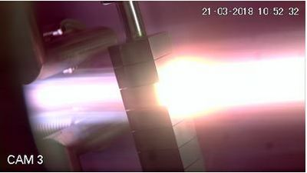
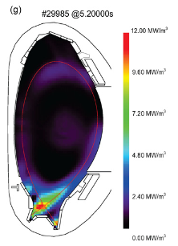
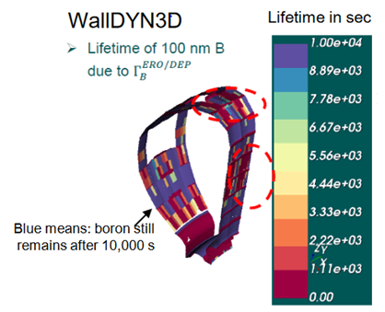
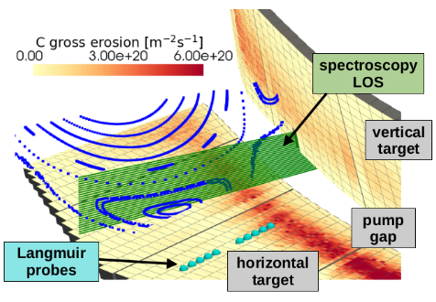
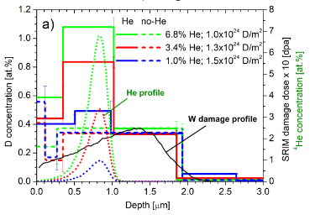
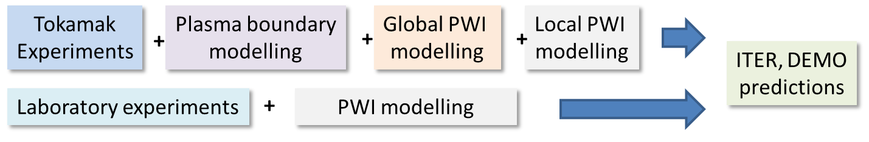
Scope: Work Package Plasma-Wall Interactions and Exhaust
Focus on ITER and DEMO materials, H and isotopes, He, seeding gases, and impurities
Cold divetor operation
Tungsten +
seed gas (Ne, Ar, Kr)
Support in WPTE exploitation
In AUG, WEST and JET in PWIE
area with metallic PFCs
Particle and heat flux
Tungsten + Deuterium
Goal: steady-state operation
MAGNUM
AUG
Support in WPW7X exploitation
operating with Graphite
towards Tungsten PFCs
ITER
[T. Morgan]
[M. Bernert]
[K. Schmid]
[S. Markelj]
3D erosion & deposition modelling
Tungsten, (Beryllium), Boron
Fuel (Tritium) retention
Tungsten + Deuterium/Helium
Recombining plasmas in PSI-2 and MAGNUM-PSI
[J. Romazanov]
Material qualification and synergistic effects of W and advanced W materials
PWI diagnostic development

Slide 3
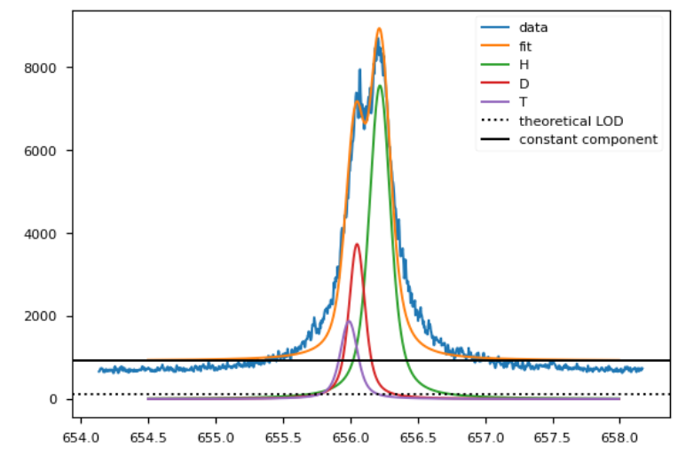
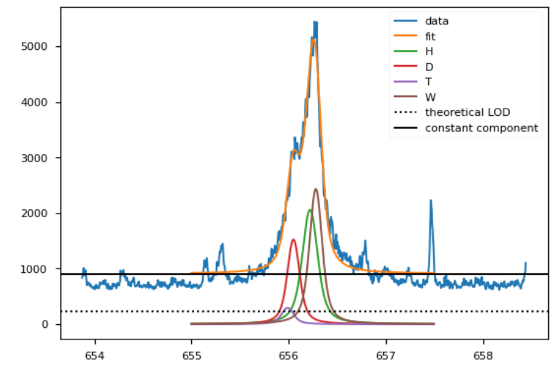
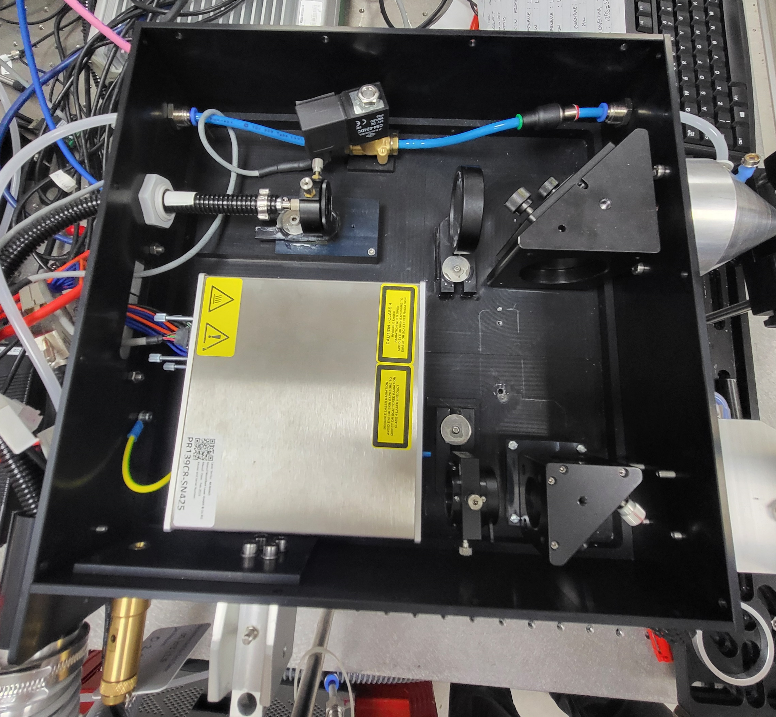
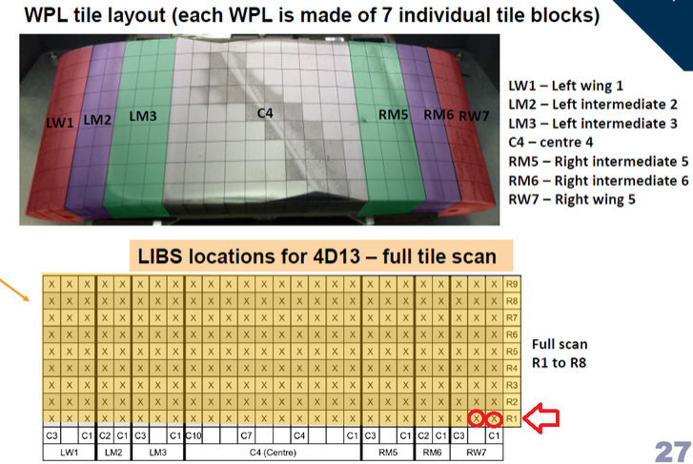
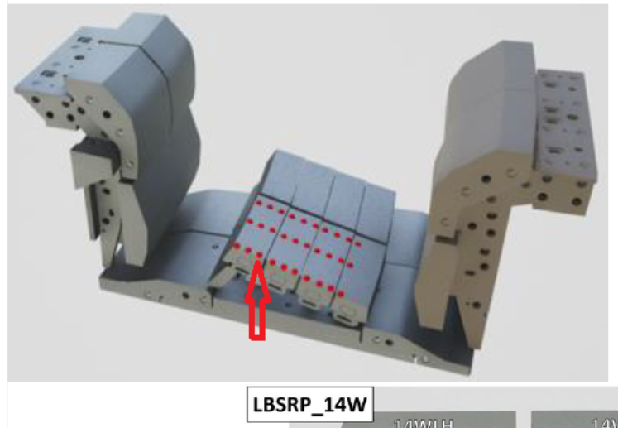
First JET-LIBS data on RH (October 2024!)
little D and T – no W at this place
W is prominent, little D / T below limit
Technical demonstration of LIBS on RH arm in a nuclear activated device
SUCCESSFUL
PERFORMED! GD done!
Opens new area of in-situ
material composition and fuel content analysis!
Bulk-Be part with Be deposit
Thanks to Jari, Salvatore, Rongxing, Gennadj, Pavel, Juso, Elena, Pavel, Rahul, Anna, Ionut … and the JET RH-team and UKAEA!
Bulk-W part without Be coverage:
Several 10 000 of spectra to be analysed using also AI
2025 analysis campaign
Input to PWIE modelling

Slide 4
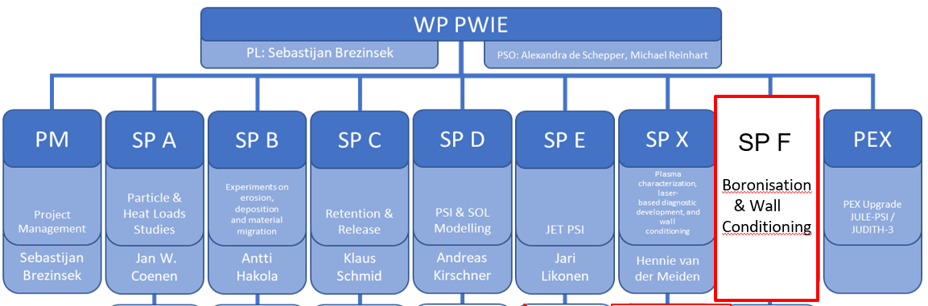
AWP 2025 – Revision of the original program / WBS WPPWIE
Main structure and activities for reactor remain as in initial 2021 plan with some adaptions
In view of the ITER re-baselining changes to indicative plan
  General activities related to Be (LIBS, fuel recovery assessment, ITER simulations etc.) were closed in 2023
  Remaining activity is the JET-DT tile analysis (LIBS and ex-situ) with Be and W tiles to assess retention, migration, dust formation. Data feeds into benchmark of PWIE codes to validate physics models (low Z can be exchanged)
  Number of new activities to high priority ITER items related to clean W first wall operation and usage of Boron added
PCR in July 2024 provided support for critical activities for DEMO, ITER and COMPASS

Slide 5
PCR July 2024 - reprise
WP | PCR proposal description | 2024 [k€ CC] | means of expenditure | 2025 [k€ CC] | means of expenditure | Implement 2024/2025
PWIE1 | Support in the analysis of the impact of boronization on the new ITER re- baseline (O getter, fuel retention and removal, lifetime, properties) and associated A&M data calculations / modelling (SP B, SP C, SP D, SP X, SP F) | 100 | 21PM 11.5k€ mission 15k€ use of facilities | 100 | 21PM 11.5k€ mission 15k€ use of facilities | Fraction done! SPF HR open
PWIE2 | Analysis of JET tiles including some extracted post DT tiles (2025) and JET RH LIBS analysis completion [Note containers call done after first PCR in April – not yet allocated] |  |  | 200 | 46PM 23k€ mission | 2024 na 2025 prep
PWIE3 | SPA: Experiments and modelling of W recrystallisation and impact on power handling and retention. Support for W samples and OG&S (different SPs) | 50 | 9.5 PM 25k€ HW | 50 | 9.5 PM 25k€ HW | 2024 in 2025 prep
PWIE4 | SPB: dust studies for DEMO with W (and B dust) | 75 | 16 PM 25 k€ use of facility | 75 | 16 PM 25 k€ use of facility | 2024 in 2025 prep
PWIE5 | Charaterisation of ITER/DEMO Mo mirrors exposed to B flux [Note mirrors also in PCR April – allocated and used] |  |  | 77 | 20 k€ HW, 15.5PM 2 k€ Mission 10k€ use of facilities | 2024 in 2025 prep
PWIE6 | SPC: increase ressources for permeation / retention studies with real T (T-lab in USPPL) incl facility costs | 29 | 7.5PM | 70 | 18PM | 2024 in 2024 prep
PWIE7 | Support to COMPASS-U PFCs selection, qualification and W source estimation. | 200 | 50 k€ use of HHFF 25 k€ use of an. facilities 25 k€ use of plasma facilities, 38.5PM | 200 | 50 k€ use of HHFF 25 k€ use of an. facilities 25 k€ use of plasma facilities, 38.5PM | 2024 in 2025 prep
Proposal: PWIE1 => 12 PM unallocated to shift into 2025 for (delayed) boronisation activities => Call for a person and activites

Slide 6
AWP 2025 – Main objectives I
Material qualification for DEMO and other facilities with plasma and combined load, damage evolution, limits
Support of WEST and ASDEX Upgrade experiments, analysis, and interpretative modelling
(PWIE aspects only e.g. migration, 3D aspects) => TSVV-6, PWIE-AI-SOL
Address T-retention by trapping/diffusion/permeation in damaged tungsten/EUROFER PFCs
Prompt re-deposition physics of W and properties of re-deposited W (experiments and modelling) => TSVV-7
Analysis of JET-LIBS data and prepare/start for post-DT tile analysis => PWIE-AI-LIBS
Support of W7-X PWIE in long-pulse operation, wall conditioning, material migration, dust, transfer to W
Properties of cold, recombining plasmas in view of molecular assisted processes in H,D => TSVV-5
Development and application of laser-based technologies for in-situ and in-operando studies (W, steel, B)
Support of COMPASS-U (and JT60SA regarding transfer to W by modelling, divertor design, and PFC test)
In general very strong links with: WPTE and WPW7X as they offer platform to bridge: laboratory results with tokamak / stellarator via modelling
Links in specific areas with WPAC, WPMAT, WPDIV, WPPRIO, WPSA, WPDC….

Slide 7
AWP 2025 – Main objectives II
Supporting ITER re-baselining and addressing critical question in experiments / modelling:
  Simulation of first wall W erosion, W deposition, and W screening in limited, start-up and diverted plasmas
  Boronization and B layers: homogeneity, B layer properties, lifetime, and impact of B on wall conditions
  T retention (scaling law), T removal techniques (ICWC, ECWC), T quantification (laser-techniques),
  active removal of B layer by erosion, dust formation, dust properties, and dust removal (=>TOMAS and other facilities)
  Advanced modelling of B physical and chemical erosion process as input for PWIE models (MD simulations)
  Qualification of ITER TFW design solutions in HHF devices (inertial and actively cooled) PFCs
  W PFCs damage predictions under VDE and RE impact in ITER
  Supporting ITER first mirror performance in the presence of boron (boronization / boronization + plasma)
Linked to ITPA activities and
needs of revised ITER research plan

Slide 8
New/updated activities in 2025: Focus on WEST support
SP B : Understanding the formation of WEST-like deposits with W
  Final analysis of WEST-like deposits from long-pulse operation: stability and dust conversion factor
  Mimic WEST-like divertor plasma conditions and pulses in MAGNUM-PSI (and PSI-2)
    Thermal cycling of actively cooled W PFCs in NAGNUM-PSI and secondary upstream W source
    Role of surface temperature, thermal stresses, impurities, oxide formation, duty cycle etc. as parameters
    Pre- and post-characterisation and spectroscopy
  ERO simulations for linear plasma experiments (same A&M data for WEST)
  Dust formation and characteristics (tbc with FTD)
SP D: Simulation of WEST long-pulse plasmas in full 3D geometry (incl. ripple)
  Plasma boundary simulation with SOLEDGE3X-EIRENE
  ERO2.0 simulation of WEST long-pulse devices incl. W local redeposition and MB shaping
  Dust simulation
SP A: HHF exposure of W MB exposed in WEST
  Damage evolution under e-beam loading
  Deposit stability assessment
Joint Meeting WPTE/PWI in Aix in September

Slide 9
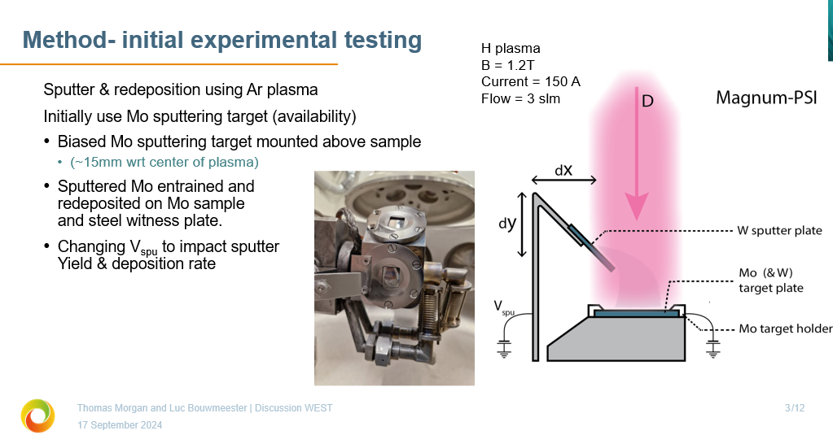
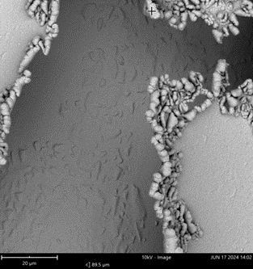
MAGNUM-PSI: Simulation of WEST high fluence campaign
MAGNUM-PSI is used to mimic WEST high fluence campaign
Mimic high W influx from WEST main chamber into W divertor by artificial impurity source
Test experiments in Ar plasma to get high W source in plasma
Final step: try to mimic ITER conditions => Lower W flux from wall into divertor => different balance of W erosion/deposition
Flaking Mo layers observed

Slide 10
New/updated activities in 2025: Focus on first wall W erosion
SP D : Simulation of fluxes to the first wall and W sputtering
  CXN and ion flux composition in simulations for COMPASS-U, AUG, (JET), ITER and DEMO
  SOLPS-ITER H-mode plasma simulations (ELM-averaged)
  Poloidal distribution of CXN with energy and angular distribution (universal EIRENE solution)
  Role of inner and outer wall W source variation with change of CXN, D+, impurity ionisation level
  ERO2.0 simulations / WallDYN-3D simulations for AUG, JET, ITER
  Comparison of cases with extended grid to the wall and normal grid to assed far-SOL profiles
SP B: Gross and net W erosion at the first wall (manipulators) jointly with WPTE
  Experiments with RIG/ROG variation and light impurity seeding
  Pre- and post characterisation of materials with different sputtering threshold and FIB cuts
  Comparison with PSI-2 plasma experiments
WPTE/PWIE Proposal of dedicated W (and B) migration experiment in AUG at high fluence (2 days identical plasmas)
Joint Meeting WPTE/PWI in Aix in September

Slide 11
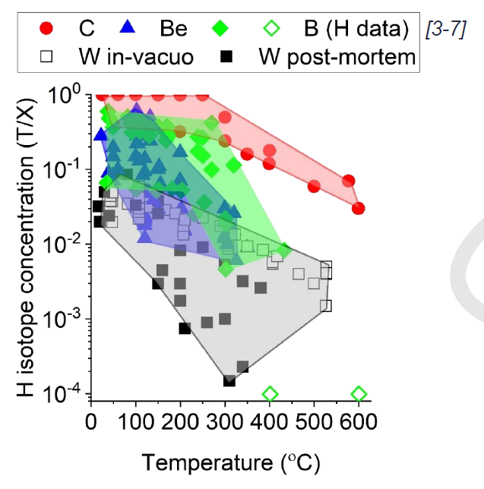
New/updated activities in 2025: Focus on boronisation and retention
SP C+ SP F : Database or matrix of artificial B layers for physics studies: stability, fuel content, release as function of temperature, flux ratio
Use of TOMAS (upgrade) and new facilities in IAP and labs to create variety of Boron layers
Magnetron-sputtering or laser-ablation-induced used as replacement for boronization => (currently) not possible
Transfer knowledge from Be to B => need for B database with D content in B layers
Y. Gasparyan et al.
ITPA 2024
Joint Meeting WPTE/PWI in Aix in September

Slide 12
Status PEX-FZJ Upgrades
PEX-FZJ upgrades include JULE-PSI (plasma) and JUDITH-3 (e-beam) in the hot material laboratory (HML) in FZJ. Controlled area, licensed for activated and toxic materials.
FREDIS with LID-QMS analysing JET tiles is installed in the HML.
Main plan for JULE-PSI in PWIE when FP9 was set-up for 2024+:
  Study of neutron-damaged materials for DEMO regarding properties, retention, power handling, erosion, etc.
  Study of (damaged) Be materials for ITER – as the only facility running after closure of JET
  Jule-PSI plasma operation with limited tritium amount possible
JULE-PSI device is built and operates in Argon / Hydrogen in FZJ outside of the hot cell
  Deuterium measurements this year with plasma characterisation
  Analysis and simulation of the plasma started (SOLPS-ITER) + EIRENE (alone)
JUDITH-3 constructed and operates outside of the hot cell
Three required new hot cells are not yet installed due to substantial cost increase Corona/Inflation
FZJ director agreed in spring 2024 to pay the additional cost of a few M€ to complete the HML
Construction in 2024 and 2025 => Transfer of facilities in 2025 and 2026 => Full operation in 2026.
Grant deliverable withdrawn. No operation with activated or toxic materials in 2025.=> Shift 2026

Slide 13
Status PEX-FZJ Upgrades II
Situation changed with respect to start of FP9: ITER decision to abandon Be!
Focus of PEX-FZJ Upgrades now purely on activated, neutron damaged materials, and tritium
  Neutron-damaged materials from fission application for plasma exposure also delayed (WPMAT)
  Studies with boron in principle possible, but PSI-2 and JUDITH-2 exist and are easier accessible (cheaper)
Delay of hot cell has only moderate impact on the mid-term research program
Risk of not having PEX Upgrade in time in risk register tabulated:
Use other linear plasma facilities if applicable for physics studies
  No other facility for activated, neutron damaged materials, and tritium available => delay
  Operation with Be not required anymore => need to study B => other facilities
Note, operation of PSI-2 in the indicative plan for 2025 reduced to half of 2021

Slide 14
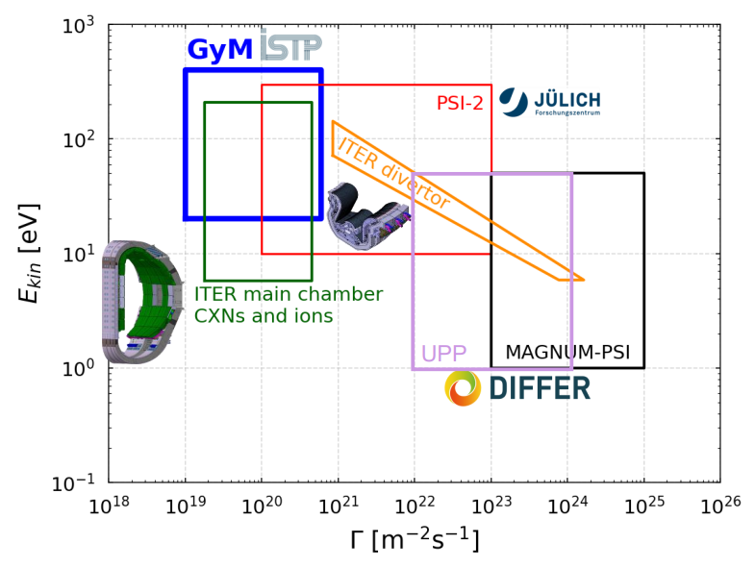
Risk Mitigation Proposal => Refocus on boron and WEST-related studies
Proposal to re-use indicative JULE-PSI budget [40 days] for other linear facilities (all 70% funding rate):
Increase the experimental days in PSI-2 in 2025 to cover substantial studies on boron layers on boron PWI including in-situ LIBS for fuel retention and fuel removal [add ~45 days => 90 days]
Increase budget of experimental days in UPP in 2025 to include substantial studies on boron PWI including in-operando NRA for fuel retention and removal from layers [add ~30 days => 40 days]
Residual budget for additional MAGNUM days on existing subjects => priority WEST W simulation [add ~10 days => 50 days]
Additional 100 k€ to be converted to mission under WPPWIE for 2025 (also 70% funding rate). Mission for experiments and associated analysis meetings.
The increase in experimental days in these machines and mission for exploitation and analysis meeting is fully covered by the indicative „JULE-PSI“ budget
No machine capable of boronisation in the moment!
Other ways to introduce B layers developed!

Slide 15
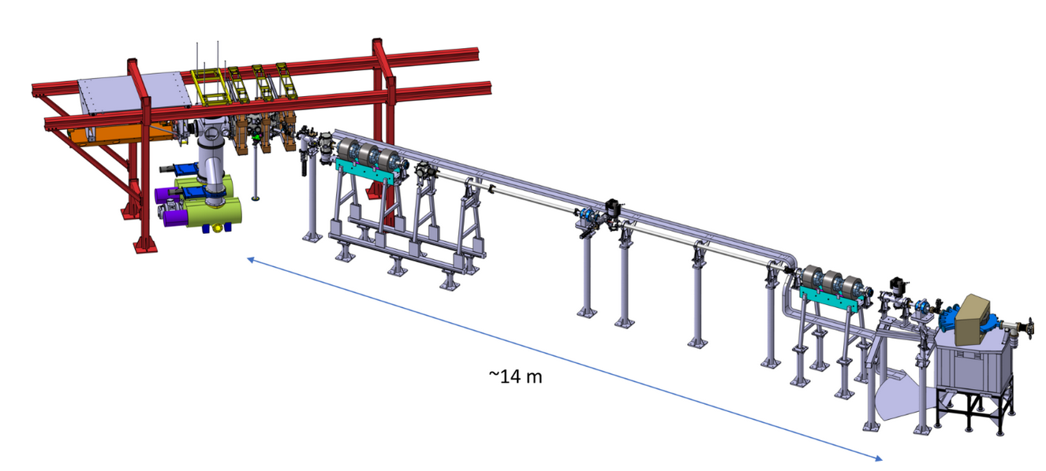
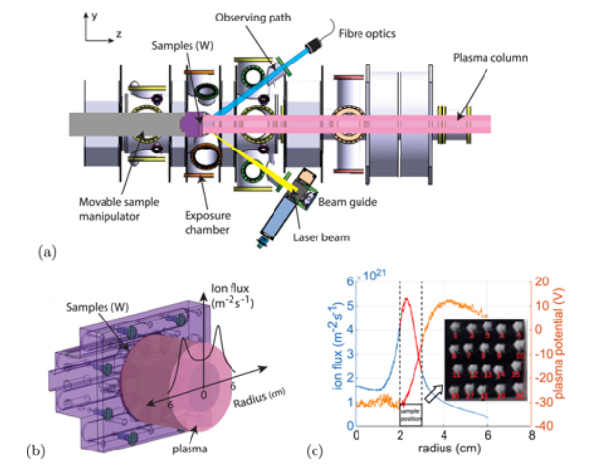
Boron-realted fuel retention and recovery studies
SP C + SP F + SP X (in-vacuo)
Fuel retention and release properties of B layers exposed to fuel species and build with fuel
Simulation related to fuel trapping and release
Ion-damage W material studies
SP C + SP F + SP X (i-operando
Fuel retention and release properties of B layers exposed to fuel species and build with fuel
Simulation related to fuel trapping and release
Recycling-studies on surface
H. van Eeck et al.
DIFFER
In-situ deuterium content measurement by in-operando LIBS (PSI-2) or in-operando NRA (UPP) in 2025 foreseen without breaking vacuum and controlled B+D interaction
Challenge is high erosion rate of B during plasma loading even with D … needs B erosion and D retention studies

Slide 16
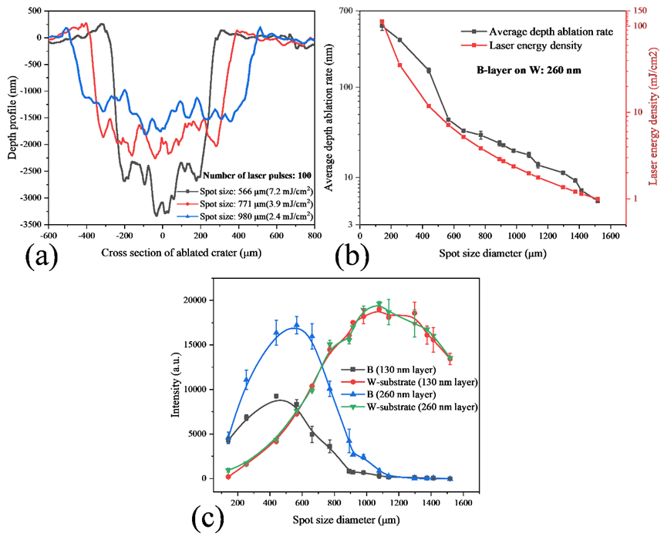
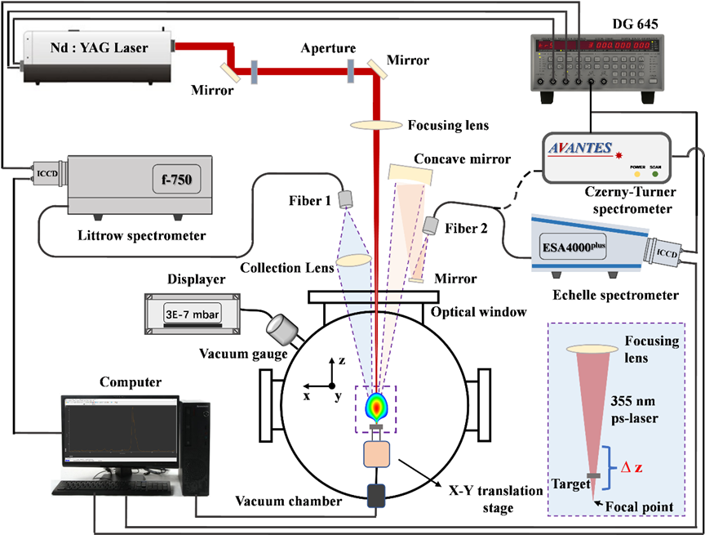
Examples: Development of LIBS to measure thin B layers (>5 nm) in 2024
SP X:
Qualification of LIBS on thin B-layers
Qualification of LID-QMS on B-layers with fuel
H. Wu et al. submitted to NME
ps-LIBS technique optimized to measure thin B layers on W substrate
Thin deposits can be studied considering thin layer effects (reflection)
Tests on artificial boron layers from magnetron sputtering (130/260 nm)
Successful test on boron layer samples from Wendelstein7-X pure boronization exposure with deposits below 10nm on W samples
Limitations due to B and W line overlapping
Parallel recording of O, H, C and other impurities possible
=> Diagnostic tool for fast in-situ or ex-situ studies of boron layers
FZJ

Slide 17
PCR Request Summary
Facility costs increase and hardware increase: 140 k€ CC
  Includes cost for TOMAS (40 days) with about 35 k€ in addition
  Includes cost for GYM (30 days) with about 35 k€ in addition
  Includes cost for ion beam facilities and new facilities to analyse samples with about 50 k€
  Includes cost for additional materials (e.g. bor,, gas) beyond what is in stock (bought by FZJ as lead lab) ~ 20k€
Mission cost increase: 100 k€ CC
  No mission money from initial indicative budget left (additional cost for JET-LIBS transferred into 2025, additional cost meetings, end of 5-years-project essential) => 50 k€
  Mission costs for extensive use of TOMAS exploitation by ERM-KMS team to FZJ => 30 k€
  Mission costs for COMPASS support (was not in the PCR) => 20 k€ (including training)
Human resource increase: 1ppy (in addition to the proposed shift of 1 ppy from 2024 to 2025)
  Support in analysis and interpretation of boron retention analysis matrix and new sets of experiments and diagnostics

Slide 18
PCR Request Summary II
Change of use of allocated JULE-PSI budget as suggested within WPPWIE
  PSI-2, UPP+Ion beam, MAGNUM-PSI and related campaign missions and analysis meetings
Transfer of 1 ppy from 2024 into 2025 from last PCR within boronization task
Potential transfer of “container and transport” cost for JET-post DT analysis into 2024 (tbd)
Additional support related to WPW7X path to full-W will require resources (tbd)

Slide 19
WPPWIE 2025 Activities (Tasks) List
ID | Title
SP A.1 | Synergistic Load Studies of Plasma-Facing Materials for ITER & DEMO
SP A.2 | High Particle Fluence Exposures of Plasma-Facing Components for ITER
SP A.3 | Advanced Materials under thermo-mechanical and plasma loads
SP A.4 | High Temperature performance of Armour Materials: Recrystallization and Melting
SP A.5 | COMPASS-U – Materials Assessment
SP B.1 | Physics of erosion and deposition
SP B.2 | Material migration in toroidal devices
SP B.3 | Characterization of plasma-exposed materials
SP B.4 | Reference coatings for ITER and DEMO
SP B.5 | Production of metallic dust in toroidal devices
SP B.6 | B-deposition on diagnostic mirrors
SP C.1 | Transport of Hydrogen through the first wall of fusion devices
SP C.2 | T retention Release from B layers
SP C.3 | Influence of He, high-flux D and impurities on Hydrogen retention and transport
SP C.4 | Influence of n-damage on Hydrogen retention and transport
SP C.5 | T-permeation experiments in 316L
Notes:
Info: Human Resource estimate (if you have one)

Slide 20
WPPWIE 2025 Activities (Tasks) List
ID | Title
SP D.1 | Plasma Boundary Modelling
SP D.2 | Production of Atomic/Molecular and Surface Data
SP D.3 | Impurity Migration Modelling
SP D.4 | Neutral Particles Modelling
SP D.5 | COMPASS-U
SP E.1 | LIBS at JET
SP E.2 | Comparison of hydrogenic retention quantification by different techniques and fuel removal assessment
SP E.3 | Post-mortem analysis of PFC and other objects in JET
SP F.1 | Coordination
SP F.2 | Boronisation
SP F.3 | TOMAS
SP X.1 | Atomic and molecular processes in attached/detached plasma
SP X.2 | Optimization of laser-based surface analysis diagnostics
AIP.1 | AIP: LIBS data-processing with Deep Neural Networks and Convolutional Neural Networks for chemical composition quantification in the wall of the next step-fusion reactors
AIP.2 | AIP: AI-augmented SOL modelling for capturing impact of filaments on transport and PWI in mean field codes simulations
PEX | PEX commissioning of hot cells and test facilities
Notes:
Info: Human Resource estimate (if you have one)

Slide 21
Plans of SP A for AWP2025
Jan Willem Coenen
Forschungszentrum Juelich – IFN-1
PWIE Leadership
S. Brezinsek (PL) J.W. Coenen, A. Hakola, K. Schmid, A. Kirschner, J. Likonen, H. van der Meiden. M. Reinhart (PSO), and D. Douai (CO)
WPPWIE

Slide 22
SPA.1 Main Objective and Activities
ACTIVITY: continuation of 2024 work
Scientific question: This task contributes to the qualification of current baseline materials and beyond by different heat load treatment techniques and quantifying the difference in damage behavior by the different loading techniques as well as the additional impact of fuel species and other fusion relevant conditions.
What shall be done:
• Material Testing and Qualification: Develop a test matrix for ITER and WEST materials like tungsten, focusing on synergistic loads and high-cycle, impurity exposure. Qualify materials across various devices (DIFFER, FZJ, MPG).
• Damage and Behavior Analysis: Perform post-mortem analyses to assess surface damage and material properties like crack propagation and recrystallization (FZJ, MPG, DIFFER).
• Plasma Load Synergies and Fatigue Studies: Study synergy effects of sequential plasma loads and fatigue damage in tungsten materials under pulsed and steady-state loading (FZJ, DIFFER, MPG, KIPT).
Main Goals:
Qualification of Baseline Materials for use in Current and Future Devices / Synergistic Load Studies of Plasma-Facing Materials for ITER & DEMO
Involved RU: FZJ,DIFFER,CIEMAT,MPG,KIPT
Status: Continuation
Special resources: PSI-2,JUDITH,MAGNUM-PSI,OLMAT,
Accelerator (FZJ), UPP, GLADIS, QSPA
WP collaboration: WPW7X / WPTE
Notes:
Info: Human Resource estimate (if you have one)

Slide 23
SPA.2 Main Objective and Activities
ACTIVITY: continuation of 2024 work
Scientific question: This task is envisioned to utilize existing high fluence devices such as MAGNUM-PSI, but also in future e.g. machines under construction to allow extrapolation of data from existing materials studies towards the effect of high flux and fluence on materials and components.
What shall be done:
Recrystallization behavior of DEMO tungsten grades and other releveant materials under high flux/fluence plasma loading
Pre- and post-analysis of materials and components (MPG)
Further analysis linked to facilities and staffing in SP B
Main Goals:
Qualification of Baseline Materials for use in Current and Future Devices / High Particle Fluence Exposures of Plasma-Facing Components for ITER
Involved RU: DIFFER, MPG
Status: continuation
Special resources: MAGNUM, UPP
WP collaboration: WPDIV, WPMAT in FTD
Notes:
Info: Human Resource estimate (if you have one)

Slide 24
SPA.3 Main Objective and Activities
ACTIVITY: continuation of 2024 work
Scientific question: Develop qualification methods for advanced materials for ITER & beyond by different thermos-mechanical test procedures, heat load treatment techniques, and laboratory experiments as well as linear plasma devices.
Apply advanced test and characterization techniques to validate advanced materials for PFC use. Contribute to long-term activities in WPPWIE to mitigate limitations in PFCs currently available.
What shall be done:
• Plasma Qualification: Test advanced materials (e.g. Wf/W, SMART alloys) under thermal and plasma loading to assess plasma-facing properties (FZJ, KIPT, DIFFER, MPG).
• Thermo-Mechanical Studies: Examine thermo-mechanical properties of divertor materials, including W-yarn testing and neutron-irradiated sample comparison (LPP-ERM/KMS, SCK-CEN, MPG).
• Surface and Damage Analysis: Investigate surface and structural changes, focusing on recrystallization, cracking, and fatigue under plasma loading (FZJ, MPG, KIPT).
Main Goals: Qualification of Advanced Materials for use in Current and Future Devices / Advanced Materials under thermo-mechanical and plasma loads
Involved RU: FZJ, DIFFER, KIPT, LPP_ERM/KMS, MPG
Status: continuation
Special resources: PSI-2,JUDITH,MAGNUM-PSI,OLMAT,
Accelerator (FZJ), UPP, GLADIS, QSPA
WP collaboration: WPW7X etc.
Notes:
Info: Human Resource estimate (if you have one)

Slide 25
SPA.4 Main Objective and Activities
ACTIVITY: continuation of 2024 work
Scientific question: Melting and its effect on plasma performance and PFC lifetime in particular melting under relevant conditions or ITER and DEMO is still a partly unanswered issue. Here both, experiments in controlled environments and dedicated modelling shall be connected, Via Modelling. The lifetime of PFUs for ITER / WEST is crucially linked to operation near and close to the point of recrystallization. Thus, the study of recrystallization in linear plasma devices including the role of the plasma composition shall be further explored.
What shall be done:
• Microstructural Characterization: Investigate tungsten-based materials exposed to plasma, analyzing mechanical and microstructural profiles to identify heterogeneities and restoration mechanisms (DTU).
• Plasma Exposure and Heat Load Effects: Study tungsten exposed to giant ELMs and plasma heat loads, assessing surface melting, recrystallization, and microstructural changes (KIPT, CEA, VR).
• Recrystallization and Joint Activities: Assess the effects of H and He on tungsten recrystallization, and conduct experiments on damaged components, linking with WP TE and SP A1 (FZJ, DTU, VR).
Main Goals: Qualification of ITER/DEMO Relevant Materials with respect to High Temperature performance of Armour Materials: Recrystallization and Melting
Involved RU: CEA, DTU,VR,KIPT,FZJ,VR
Status: continuation
Special resources: PSI-2,KIPT, Accelerator
WP collaboration: WPTE
Notes:
Info: Human Resource estimate (if you have one)

Slide 26
SPA.5 Main Objective and Activities
ACTIVITY: continuation of 2024 work and addition of HIVE in 2025
Scientific question: Task under SP A5 include the preparatory work on assessing and analysing the material candidates for COMPASS-U this includes particularly heat flux performance as well as material evolution on microstructure, and surface condition.
What shall be done:
• Material Pre-characterization and Exposure: Nine candidate tungsten materials will undergo pre-characterization, with down-selection to main suppliers (Plansee, ALMT, AT&M). Exposures will be conducted at facilities such as JUDITH, PSI-2, OLMAT, and Magnum.
• Disruption Simulation and Damage Threshold: Disruption simulations on COMPASS-U W armor will focus on damage thresholds in terms of power density (up to ~7 GW/m²) and pulse number, especially at the edges. This data will help assess mild or mitigated disruptions expected in DEMO (~30 GW/m²).
• Post-characterization and Nano-crack Detection: Pre- and post-characterization using advanced techniques will include nano-crack detection in the first wall surface using IR laser heating and scanning. Comparative material analysis will follow across multiple techniques.
Main Goals: Particle & Heat Load Studies in preparation of the exploitation of ITER and DEMO based on COMPASS-U material mix
Involved IPP.CR, CIEMAT,CU,DIFFER,ENEA,FZJ,IPPLM, UKAEA
Status: New and continuation
Special resources: MAGNUM, PSI-2,OLMAT, HIVE
WP collaboration: WPTE
Notes:
Info: Human Resource estimate (if you have one)

Slide 27
Plans of SP B for AWP2025
A. Hakola
VTT
PWIE Leadership
S. Brezinsek (PL) J.W. Coenen, A. Hakola, K. Schmid, A. Kirschner, J. Likonen, H. van der Meiden. M. Reinhart (PSO), and D. Douai (CO)
WPPWIE

Slide 28
SPB.1 Main Objectives and Activities
Physics of erosion and deposition
Scientific questions to be addressed
Assess the erosion characteristics of reference coatings simulating re-deposited W layers in metallic fusion devices
Determine the erosion and formation rates for W- and B-based co-deposited layers (with SP F)
What shall be done?
Expose reference coatings to D plasmas in linear devices and laboratory setups (production and pre-characterization under SP B.4) – vary plasma and target parameters, including thermal cycling
Determine sputtering rates of the exposed samples and properties of co-deposited layers on witness plates – data for modelling under SP D, post exposure analyses under SP B.3
Investigate the role of dust impacts on sample erosion – vary the size distribution and speed of the dust particles
Main Goals
Database on the erosion/deposition rates for representative layers expected in ITER and DEMO – comparison to bulk W
Cross-comparison between different machines and against data from fusion devices (AUG, WEST, W7-X – under SP B.2)
Understand the formation of WEST-like thick deposits consisting of B and W
Involved RU: DIFFER, ENEA, FZJ, OEAW
Status: continuation from 2024
Special resources: MAGNUM-PSI, PSI-2, GyM, accelerator usage
WP collaboration: WPMAT, WPDIV, WPTE
Notes:
Info: Human Resource estimate (if you have one)

Slide 29
SPB.2 Main Objectives and Activities
Material migration in toroidal devices
Scientific questions to be addressed
Understand erosion of W components and formation of W- and B-containing co-deposited layers in tokamaks and stellarators under conditions relevant for future fusion reactors
Identify material migration pathways for W and B with the focus on the main chamber
What shall be done?
Procure/produce and pre-characterize specific marker samples for dedicated experiments in fusion facilities (AUG, WEST, W7-X) – reference coatings to be developed under SP B.4
Post exposure analyses of the exposed samples after experiments or experimental campaigns (long-term samples) – data for modelling under SP D, part of the analyses under SP B.3
Analyse deposition of B on samples exposed during boronizations
Main Goals
Gross and net erosion profiles for the exposed B- and W-based samples – comparison against SP B.1 data
Roles of different mechanisms in eroding W in the main chamber – including remote areas and CX neutrals
Effect of boronization procedures on material migration and deposition patterns
Involved RU: CEA, MPG, RBI, FZJ, VTT
Status: continuation from 2024
Special resources: usage of accelerator and SEM facilities
WP collaboration: WPTE, WPW7X
Notes:
Info: Human Resource estimate (if you have one)

Slide 30
SPB.3 Main Objectives and Activities
Characterization of plasma-exposed materials
Scientific questions to be addressed
Identify changes in the surface characteristics of selected samples and plasma-facing components removed from tokamaks and stellarators (AUG, WEST, W7-X)
Determine erosion, deposition, and fuel-retention patterns on samples following extended exposure in fusion facilities or specific experiments in linear plasma devices
What shall be done?
Post exposure analyses of the available samples or wall components – AUG, WEST, and W7-X wall tiles (partly under SP B.2), reference samples from MAGNUM-PSI, PSI-2, and GyM experiments (under SP B.1)
Comparing the results of individual analyses, in particular for WEST components removed after Phase 1 and Phase 2
Main Goals
Erosion and deposition patterns of the analyzed components – to be compared against sputtering data from SP B.1 and results from individual migration experiments under SP B.2
Structure and morphology of co-deposits on the analysed components
Retention of D on the components – to be used for benchmarking retention studies in SP C
Involved RU: CIEMAT, ENEA, FZJ, IAP, IPPLM, IST, JSI, MPG, NCSRD, RBI, VR, VTT
Status: continuation from 2024
Special resources: usage of accelerator and SEM facilities
WP collaboration: WPTE, WPW7X
Notes:
Info: Human Resource estimate (if you have one)

Slide 31
SPB.4 Main Objectives and Activities
Reference coatings for ITER and DEMO
Scientific questions to be addressed
Develop methods to produce and pre-characterize reference coatings to simulate re-deposited W layers, B/W-based co-deposits, and B layers originating from boronizations
Produce marker layers for agreed experiments under SP B.1 and SP B.2
What shall be done?
Production of B, W, and B/W layers with pre-defined specifications for the SP B.1 and SP B.2 experiments as well as for studies under SP A, SP C, SP F, SP X, WPTE, and WPW7X
Pre-characterization of the produced layers before their exposure
Main Goals
Established recipes to produce B, W, and B/W layers – inlcuding controlling their O content and surface morphology
Qualified workflow for characterizing the produced samples – especially critical for the B layers
Involved RU: CEA, CIEMAT, ENEA, FZJ, IAP, IST, IPPLM, JSI, NCSRD, RBI, VR, VTT
Status: continuation from 2024
Special resources: usage of accelerator and SEM facilities
WP collaboration: WPTE, WPW7X
Notes:
Info: Human Resource estimate (if you have one)

Slide 32
SPB.5 Main Objectives and Activities
Production of metallic dust in toroidal devices
Scientific questions to be addressed
Assess the amount and properties of dust produced in metallic (W) fusion devices during varying operational conditions
Investigate parametric dependencies in producing particles resembling dust observed in fusion devices
What shall be done?
Characterization of dust samples removed from fusion devices (AUG, WEST, W7-X) for their structure and composition
Production and characterization of W and B dust particles in laboratory conditions for comparison against dust removed from tokamaks and stellarators
Carry out remobilization experiments for big W/B dust flakes in linear devices – if necessary for modelling under SP D
Main Goals
Database on the analyzed dust samples from tokamaks and stellarators – identify the underlying physics determining the properties of the dust generated and make predictions towards ITER and DEMO
Established recipes to produce B, W, and B/W dust particles in laboratories – focus on air/water leaks to extrapolate to ITER and DEMO
Fracture and strentgh properties of B and W reference layers (produced under SP B.4) – role in dust production
Involved RU: CEA, FZJ, IAP, IPPLM, MPG, RBI, UKAEA, VR
Status: continuation from 2024
Special resources: accelerator and SEM facilities, possibly MAGNUM-PSI
WP collaboration: WPTE, WPW7X
Notes:
Info: Human Resource estimate (if you have one)

Slide 33
SPB.6 Main Objectives and Activities
B-deposition on diagnostic mirrors
Scientific questions to be addressed
Determine possible changes in the properties of Mo-mirrors upon exposure to boronizations (AUG, W7-X)
What shall be done?
Post exposure characterization of Mo-mirrors following their exposure to boronizations
Main Goals
Information for deciding if B contamination is an issue for diagnostics mirrors in ITER and making proposals for cleaning solutions
Involved RU: FZJ, MPG
Status: continuation from 2024
Special resources: N/A
WP collaboration: WPTE, WPW7X
Notes:
Info: Human Resource estimate (if you have one)

Slide 34
Plans of SP C for AWP2025
K. Schmid
IPP-Garching
PWIE Leadership
S. Brezinsek (PL) J.W. Coenen, A. Hakola, K. Schmid, A. Kirschner, J. Likonen, H. van der Meiden. M. Reinhart (PSO), and D. Douai (CO)
WPPWIE

Slide 35
SPC.1 Transport of Hydrogen through the first wall of fusion devices
ACTIVITY: continuation of 2024 work
Scientific question:
The transport of Hydrogen Isotopes (HIs) through the first wall of fusion devices is the driving process for HIs retention but also for permeation to the coolant. Both of these processes have fundamental implications for the safety and the tritium self-sufficiency of a fusion reactor.
What shall be done:
Investigate kinetics of H-transport across multi material interfaces both in experiment and modeling
Measure H-transport trough W heavy alloys in permeation experiments
Perform co-permeation experiments of D and H in W
Main goals:
Obtain arrhenius paramters for kinetic interface modeling
Determine the dominant transport channel through W heavy alloys
Determine the influence of isotope exchange on retention and transport speed in W
Involved RU: MPG, CEA, JSI, IPP_LM, ÖAW, VR
Status: Continuation
Special resources: N. A
WP collaboration: N. A.
Notes:
HR = 28 PM

Slide 36
SPC.2 T retention Release from B layers
ACTIVITY: continuation of 2024 work
Scientific question:
The retention in and release from B co-deposition layers, expected in ITER due to the foreseen need for boronization in an all W ITER, needs to be quantified to asses their effect on the in vessel T inventory.
Different layers are expected depending on whether they should shield the underlying W from erosion or getter impurities
What shall be done:
Co-deposit B + D as function of temperature at fixed particle energy and layer growth rate
Measure influence of different boronization layer types on permeation as function of temperature
Main goals:
Temperature dependence of D/B ratios. First step to derive scaling laws
Measure boronization layer permeability to assess their influence of H uptake
This will collaboration between different WP-PWIE SP‘s for layer deposition and characterization
Involved RU: MPG, FZJ, DIFFER, CEA
Status: Continuation
Special resources: MAGNUM
WP collaboration: WP-TE
Notes:
HR = 26

Slide 37
SPC.3 Influence of He, high-flux D and impurities on Hydrogen retention and transport
ACTIVITY: continuation of 2024 work
Scientific question:
The n-bombardment of armor and structural materials in the first wall of DEMO and ITER leads to formation transmutation products (e.g. He, Re). Due to self-trapping in metals He tends to form bubbles which in the bulk act as trap sites for T and form open porosity close to the surface.
What shall be done:
Create He based defects in the bulk of EUROFER and W at high temperture
Characterize the created defects by decoration with D and by TEM
Measure retention in W/Re mixtures and compare to pure W
Main goals:
Evolution of He based defects in EUROFER and W at high temperatures
Retention on He based defects created at high temperature
Influence of Re on retention in W
Involved RU: JSI, MPG, FZJ, IPP_LM
Status: Continuation
Special resources: PSI-2
WP collaboration: N. A.
Notes:
HR = 9PM

Slide 38
SPC.4 Influence of n-damage on Hydrogen retention and transport
ACTIVITY: continuation of 2024 work
Scientific question:
The n-bombardment of armor and structural materials in the first wall of DEMO and ITER leads to formation open volume defects by displacement damage. These open volume defects are strong traps for T.
What shall be done:
Create displacement damage in W at high temperture
Search (TEM) for large cavitites that may allow for T storage in molecular form
Main goals:
Measure D₂ molecule retention in large cavities
Correlate D retention with void size from TEM
Involved RU: JSI, MPG, FZJ, IPP_LM
Status: Continuation
Special resources: MAGNUM, GLADIS etc.
WP collaboration: WPW7X etc.
Notes:
HR = 14

Slide 39
SPC.5 T-permeation experiments
ACTIVITY: continuation of 2024 work
Scientific question:
To make predictions about the permeation of T to the coolant the metal/water interface needs to be understood.
What shall be done:
T-gas-permeation experiments through steels with downstream side immersed into water compared to inert gas.
Main goals:
Compare permeated amount into water & atmosphere above it to permeated amount into inert gas
Characterization of surface state
Involved RU: ISSP-UL, CEA
Status: Continuation
Special resources: N. A
WP collaboration: N. A.
Notes:
HR for both CEA and ISSP-UL: 22 PM
Maybe reduce CEA if they fail to deliver again in 2024

Slide 40
Plans of SP D for AWP2025
SPL Andreas Kirschner
FZJ – IFN-1
PWIE Leadership
S. Brezinsek (PL) J.W. Coenen, A. Hakola, K. Schmid, A. Kirschner, J. Likonen, H. van der Meiden. M. Reinhart (PSO), and D. Douai (CO)
WPPWIE

Slide 41
SPD PSI and SOL Modelling
SP D.1: Plasma boundary modelling
Scientific question: Plasma (T_{e,i}, n_{e}, flows, …) and sheath parameter are needed as input for impurtiy migration and PSI modelling and have to be provided in 2D or 3D by simulation codes.
What shall be done: Modelling (SOLPS-ITER, EMC3-EIRENE, SOLEDE3X, …) of plasma background parameter, including tokamaks, W7-X and linear devices. Modelling of sheath parameter (PIC-based codes).
Main Goals: Provide plasma background parameter and sheath characteristics, which can be used for impurity migration and PSI modelling in SP D.3.
Involved RU: CEA, DIFFER, ENEA, FZJ, IPP.CR, VTT
Status: continuation
Special resources: HPC requests
WP collaboration: WPW7X, WPTE, TSVVs, IO, ITPA DivSOL
Notes:
Info: Human Resource estimate (if you have one)

Slide 42
SPD PSI and SOL Modelling
SP D.2: Production of atomic/molecular and surface data
Scientific question: Ionisation, dissociation, recombination data are needed for impurity migration modelling. Erosion yields and reflection coefficients are needed for PSI modelling.
What shall be done: Focus on the production (MD, SDTrimSP) of erosion and reflection data for W-B-O-H(D,T) surfaces for varous projectiles (fuel, seeding species, …). Development of missing interaction potentials.
Main Goals: Provide erosion yields and reflection data in dependence on impact energy and angle.
Involved RU: CEA, ÖAW, VR, VTT, MPG
Status: continuation
Special resources: HPC requests
WP collaboration: WPTE, TSVVs
Notes:
Info: Human Resource estimate (if you have one)

Slide 43
SPD PSI and SOL Modelling
SP D.3: Impurity migration modelling
Scientific question: Erosion and redeposition is critical issue in fusion devices. Life time of wall components, possible dust sources from deposited layers, main plasma impurity content.
What shall be done: Modelling (ERO2.0, WallDYN) of impurity transport, erosion and deposition characerestics in comparison to experiments (spectroscopy and post-mortem data from tokamaks, W7-X, linear devices). Predictive modelling for ITER. Focus on full-W devices, consideration of boronisation.
Main Goals: Understanding of erosion and deposition by means of modelling in comparison to experimental results e.g. from WEST, AUG, linear devices, W7-X. Predictions for ITER.
Involved RU: CEA, ENEA, FZJ, MPG, VTT, VR
Status: continuation
Special resources: HPC requests
WP collaboration: WPW7X, WPTE, TSVVs, IO, ITPA DivSOL
Notes:
Info: Human Resource estimate (if you have one)

Slide 44
SPD PSI and SOL Modelling
SP D.4: Neutral particles modelling
Scientific question: Performance of particle exhaust. Neutral fluxes as erosion sources in particular at main wall areas.
What shall be done: Modelling (DIVGAS) of particles gas dynamcis and exhaust for W7-X and DEMO. Modelling (EIRENE) of neutral wall fluxes (including energy and angular distribution) for various devices – to be used in impurity migration codes.
Main Goals: Optimisation of particle exhaust systems. Assessment of erosion due to neutral wall fluxes.
Involved RU: KIT, VTT
Status: continuation
Special resources: HPC requests
WP collaboration: WPW7X, WPTE, TSVVs, IO, ITPA DivSOL
Notes:
Info: Human Resource estimate (if you have one)

Slide 45
SPD PSI and SOL Modelling
SP D.5: Plasma background and PWI modelling for CAOMPASS-U
Scientific question: Erosion and deposition assessment in COMPASS-U. Evaluation of COMAPSS-U PFCs.
What shall be done: Plasma background modelling (SOLPS-ITER, SOLEDGE3X, PIC-based codes) for COMAPSS-U with drifts and currents. Impurity migration and PSI modelling (ERO2.0) for COMAPSS-U.
Main Goals: Assessment of W erosion and redeposition in COMPASS-U.
Involved RU: IPP.CR, CEA, FZJ
Status: continuation
Special resources: HPC requests
WP collaboration: WPTE, TSVVs, IO, ITPA DivSOL
Notes:
Info: Human Resource estimate (if you have one)

Slide 46
Plans of SP E for AWP2025
Jari Likonen
VTT
Involved RUs: CU, ENEA, FZJ, IAP, IPP_LM, ISPP_UL, IST, UT, VR, VTT
PWIE Leadership
S. Brezinsek (PL) J.W. Coenen, A. Hakola, K. Schmid, A. Kirschner, J. Likonen, H. van der Meiden. M. Reinhart (PSO), and D. Douai (CO)
WPPWIE

Slide 47
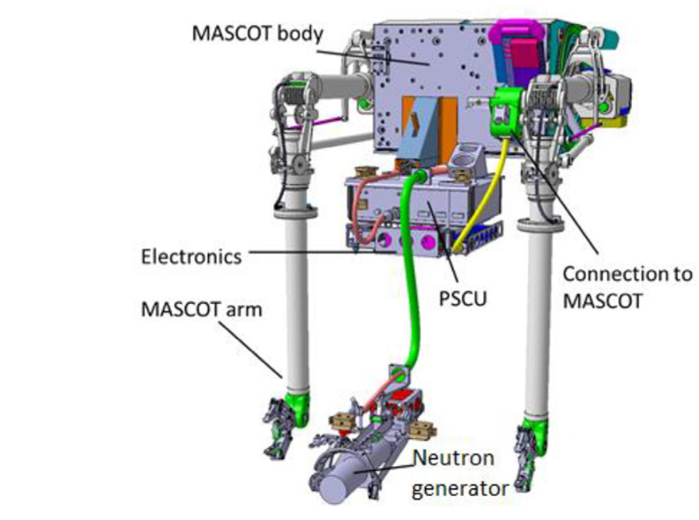
SPE.1 LIBS at JET Main Objective and Activities
Scientific question:
Task will concentrate on in-vessel analysis (H isotope retention, composition of layers) using LIBS on a remote handling arm at JET
What shall be done:
LIBS experiment at JET in October 2024
Over 900 locations inside JET vacuum vessel
will be analysed
Main goals:
Data analysis of LIBS spectra
Determine H isotope ratios and composition
of co-deposited layers
LIBS head
LIBS head
Involved RU: CU, ENEA, FZJ, IPP_LM, ISPP_UL, UT, VTT
Status: Continuation
WP collaboration: UKAEA
Notes:
Info: Human Resource estimate (if you have one)

Slide 48
SPE.2 Cutting of DTE3 tiles and sample distribution
Main Objective and Activities
Scientific question:
The Task will concentrate on coordination (VTT), sample preparation and sample distribution for DTE3 divertor and limiter tiles, and diagnostics components removed during the 2024 shutdown.
What shall be done:
Samples from W-coated CFC divertor tiles will be prepared using coring
technique (VTT)
IAP will cut samples from Be limiter tiles and metallic diagnostic components
Samples will be distributed between RUs participating in SPE programme
Main goals:
Completion of sample preparation and distribution of samples
Involved RU: IAP, VTT, FZJ
Status: New
WP collaboration: UKAEA
Notes:
Info: Human Resource estimate (if you have one)

Slide 49
SPE.3 Completion of ILW3 post-mortem analyses and first analysis of DTE3 samples
Main Objective and Activities
Scientific question:
Investigation of material migration from the limiters and the main wall towards the divertor resulting in formation of co-deposited layers on the divertor tiles, and characterisation of hydrogen isotope retention including tritium.
What shall be done:
Post-mortem analysis of ILW3 and DTE3 samples and components using various analysis techniques (ion beams, TDS, electron microsopy…)
Main goals:
Completion of characterisation of remaining ILW3 tiles and metallic components, and first analyses of JET DTE3 divertor and limiter samples.
Involved RU: FZJ, IAP, IPPLM, ISPP_UL, IST, VR, VTT
Status: New
WP collaboration: UKAEA
Notes:
Info: Human Resource estimate (if you have one)

Slide 50
Plans of SP X for AWP2025
Hennie van der Meiden
DIFFER
PWIE Leadership
S. Brezinsek (PL) J.W. Coenen, A. Hakola, K. Schmid, A. Kirschner, J. Likonen, H. van der Meiden. M. Reinhart (PSO), and D. Douai (CO)
WPPWIE

Slide 51
SPX.1 Main Objective and Activities
Scientific question:
- Determine distribution of ro-vibrationally exited states of H2 and isotopes
What shall be done?
- Passive spectroscopy: VUV-flux measurements with SI VUV diode system (MPG)
and VIS/VUV spectrometer (FZJ, MPG, DIFFER)
- Active spectroscopy: Continuation CARS and VUV-LIF development (DIFFER)
- Continuation development of Machine learning algorithms for LIBS analysis
Main goal:
- Obtaining the missing atomic and molecular ro-vibrational data as input for modelling for understanding energy and momentum losses in detached plasma
Involved RU: MPG, FZJ, DIFFER, CU
Status: partly new other continuation
Special resources: MAGNUM, GLADIS etc.
WP collaboration: WPW7X etc.
Notes:
Info: Human Resource estimate (if you have one)

Slide 52
SPX.2 Main Objective and Activities
Scientific(technical) question:
- Can we realize a laser based techniques for quantitative determination of composition and fuel content in W, B and C layers with depth resolution close to 10 nm
What shall be done?
- LIBS performance tests on relevant layers with varying thickness
- Comparizon performance different LIBS based methods: ns/ps-LIBS, res-LIBS, sp/dp-LIBS and
other methods
- LIBS performance tests for He detection(?)
- Test in situ LIBS in linear devices, using NRA/RBS or LIA-QMS/EDX as a reference
- Continuation development of Machine learning algorithms for LIBS analysis
Main goal:
- Understanding LIBS physics and realizing of LIBS as a tritium monitor for fusion devices
Involved RU: CEA, DIFFER, ENEA, FZJ, IPPLM,
CU UT, ISSP UL, VTTMPG, FZJ, VTT
Status: continuation
Special resources: MAGNUM, PSI-2, UPP, Accelerator
WP collaboration: WPTE, WP7X, ITER and ITPA DIAG
Notes:
Info: Human Resource estimate (if you have one)

Slide 53
2024-2025 Summary and Plans for Boronisation Studies within WPPWIE
Joint WPTE and WPPWIE Technical Meeting on
Plasma-Wall Interactions in full-W devices
Sebastijan Brezinsek
Forschungszentrum Jülich
Heinrich-Heine-Universität Düsseldorf
J.W. Coenen, A. Hakola, K. Schmid, A. Kirschner, J. Likonen, H. van der Meiden. M. Reinhart (PSO), and D. Douai (CO)

Slide 54
Revised ITER first wall material selection and new research plan
Old ITER plan: Use full-W first wall in ITER at the later stage of exploitation once main ITER goals (Q=10 and 400s & Q=5 and 5000s) with Be/W material mix were achieved!
New ITER plan: Start with full-W first wall, demonstrate plasma compatibility and control, demonstrate low retention and low dust production for the regulator, and show as soon as possible Q=10 for 100s (=> compensate the delay)
See T. Wauters et al.
Basic scientific input to the ITER decision to change the first wall:
Successful operation in full-W and full-C devices (with boron for wall conditioning)
Experience from JET operation with W divertor
Experience from AUG operation in full-W PFCs with start-up “without” boronisation
Progress in knowledge regarding operation with W (ECRH, RF design etc.)
Identified issues:
Tungsten first wall requires a new wall conditioning strategy in ITER as main technique „use Beryllium“ gone
Be gettered oxygen and ensured low pollution of the plasma core, has a moderate erosion source due to
absence of severe chemistry (contrast to C) and has a low radiation potential (contrast to W)
Residual O in the vessel and associated W sputtering can thread start-up and Q=10 due to high core radiation
ITER strategy:
ITER reached out to community to address open questions, develop risk mitigation strategies, cure problems, make predictions => ITPA, EUROfusion WPs, ITER partners … => results feed into ITER new Research Plan
General observation:
JET with “W divertor + Be wall” behaves in general like AUG “with W divertor + W wall + transient B coverage”
ITER has made enormous effort to predict PWI with Be and a lot of knowledge can be translated to B

Slide 55
New WPPWIE focus on revised ITER first wall material selection and new ITER research plan needs
Open issues:
Initially no boronisation system in ITER foreseen => design done in 2023 => number of anodes and gas valves sufficient?
Huge volume and large surface area in ITER vessel => homogeneity of protective layers? => full coverage needed?
Lifetime of the boronisation? Short-term and long-term effects => weeks or days? => start-up location coverage or O getter?
Boronisation or boron dropper as key tool to be used? => reliability after 15 years of operation required
Impact of B on fuel retention and removal? => fuel accounting, mixed layers with O => impact on “safety case” of ITER
Impact of B on material migration and dust formation? => safety issue as dust, if boronisation permanent in use
Will boronisation cause deposition on first wall mirrors in ITER => need to use shutters, redesign, clean mirror techniques?
Required changes and critical issues for ITER identified by the PWIE team in 2023 and implemented into initial 2024 plan
Closure of Be activities by end of 2023, apart from JET-LIBS, JET post-DT sample analysis, and associated modelling
Identification of critical questions, physics processes and folding those with capabilities of PWIE team and facilities
Parallel review of existing knowledge, publications, reports regarding B / W / D / O complex (studies in 2000s done)
Set-up of a physics program within the capabilities of WPPWIE to study basic processes related to B
Main issue: no facility to handle B₂H₆ for boronisation and boron layer change properties and oxidise if exposed to air
Strong link to toroidal devices with boronization capabilities and short as possible exposure to air mandatory
New dedicated facilities or upgrades of existing facilities with in-situ diagnostics considered (co-funding is not sufficient!)
Additional funding in January and July 2024 for 2024 and 2025 granted / 2025 program details in preparation
Majority of initial planed laboratory activities now in plan; possibilities to modify program to tackle observed issues
Joint proposals with WPTE and WPW7X have been “granted” time: pre- and post-characterisation and PWI simulation
New tasks in liaison with IO included in the plan (first wall mirrors)

Slide 56
Restructuring of WPPWIE and Tasks related to B
Existing subprojects with
additional focus on boron
New subproject F with
focus on wall conditioning
SP B:
Characterisation of B layers (techniques)
Production of artificial B layers with D and/or O content and associated characterisation
SP F1:
Coordination of activities related to wall conditioning and boronisation with strong links to activities of machines in TE/W7-X
Recapitulation of existing knowledge
Benchmark in TE/W7-X experiments: manipulator / full device
A. Hakola et al.
SP C:
Fuel retention and release properties of B layers exposed to fuel species and build with fuel
Simulation related to fuel trapping and release
SP F2:
Activities at TOMAS with test of ITER conditions and needs: ECWC, ICWC, GDC
Cleaning activities of B-layers from lab or tokamaks in TOMAS
Application of in-situ LID-QMS or LIBS in those systems
D. Matveev et al.
A. Goriaev et al.
SP D:
Modelling of toroidal devices w/wo boronization, W and B sources and migration
Global fuel retention simulations
Production of atomic and molecular data with B
SP F3:
Laboratory experiments with B layers (PSI-2, MAGNUM, GYM) focus on B erosion, deposition, retention within capabilities
Generic wall conditioning studies
SP X:
Qualification of LIBS on thin B-layers
Qualification of LID-QMS on B-layers with fuel
A. Goriaev et al.
F1 challenging as experts are „machine experts“ and „no time“
F2 challenging if „infrastructure“ needs to be implemented
Still open issues and human resources required!
Existing teams, good existing knowledge,
well progressing

Slide 57
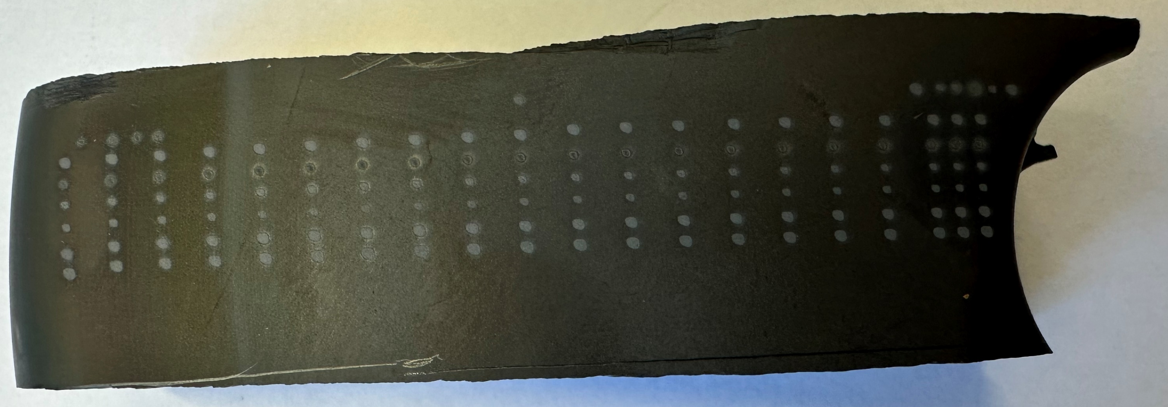
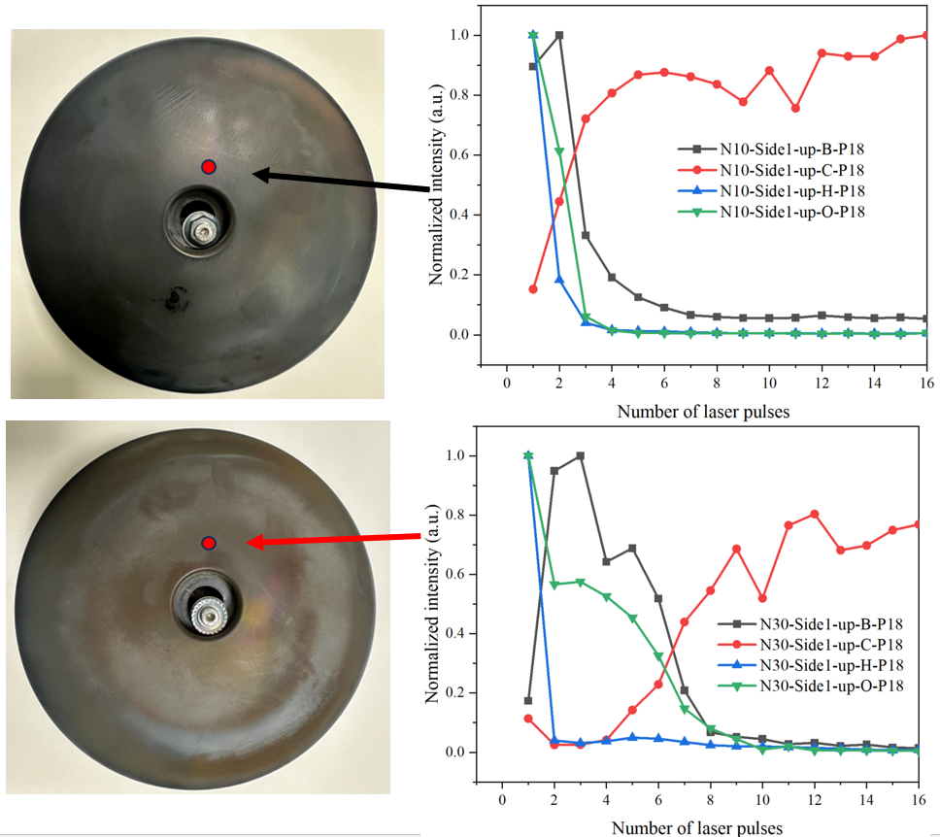
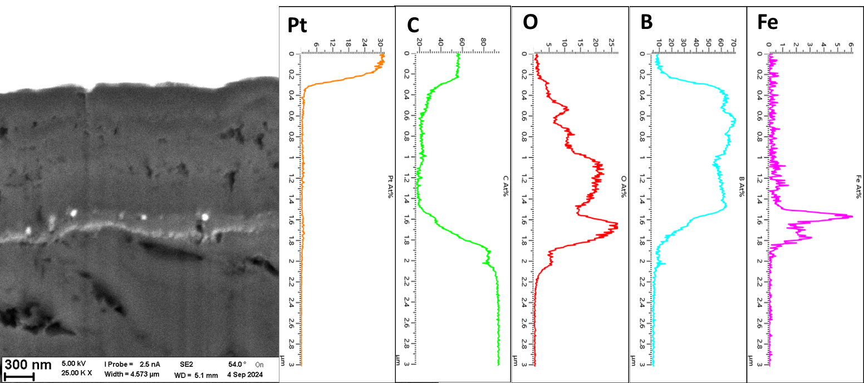
Examples: Analysis of anodes for boronisation in W7-X
SP B:
Characterisation of B layers (techniques)
Production of artificial B layers with D and/or O content and associated characterisation
SEM & FIB
R3
Anode-DCB10
Boron
layers
1.7 μm
O getter
in layers
Anode-DCB30
vessel
sputtering
Graphite
MPG & FZJ
M. Rasinski et al.
H. Wu et al.
W7-X analysis studies planed before ITER considered B
Materials available to study boronization homogeneity, role of valve, and anode
O gettering capability quantification
=> New dedicated experiments in W7-X foreseen (with C.P. Dhard as contact):
thick B layer on W, Mo (mirror) and steel
4 anodes for boronisation used in W7-X analysed
Toroidal asymmetry: Local B thickness 2µm
Global B deposits on FW: <30nm (campaign)
Local B deposits in divertor: µm (campaign)
M. Mayer et al.
D. Zhao et al.

Slide 58
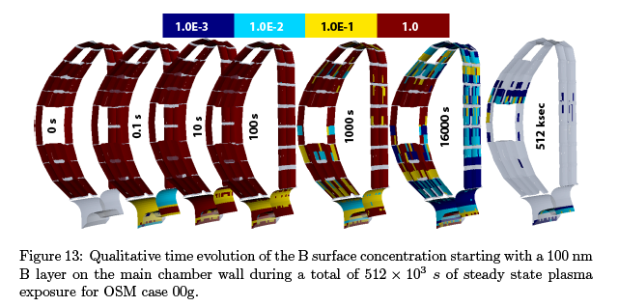
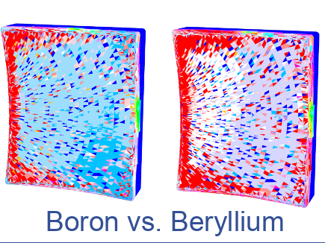
Examples/needs: Simulations about B erosion, transport, deposition
SP D:
Modelling of toroidal devices w/wo boronization, W and B sources and migration
Global fuel retention simulations
Production of atomic and molecular data with B
JET with Be used as reference for Be and fuel retention studies with ERO2.0 and WallDYN-3D => C30C reference experiment
In-situ spectroscopy, gas balance, and post-mortem analysis used to benchmark those codes => ITER predictions for Be/W ITER
Predictive modelling of full-W ITER with B done under IO lead
ITER first Mo mirror:
B vs. Be depostion
K. Schmid et al.
PSI2024
S. Rode et al.
PSI2024
Simulations strongly linked with IO activities/tasks
Example to compare: Be vs. B in ERO2.0
Impact of boronization on mirrors =>
linked to mirror studies under WPPWIE
Boron chemistry not considered => data calculations
Benchmark experiment in full-W device after ITER-like boronization (100nm), in-situ characterisation and sample removal is missing.
Next step: predictive modelling for AUG or WEST with the same codes
Wish from WPPWIE: dedicated campaign on those devices post-bpronisation over a significant period to assess global B pattern (~100 s)

Slide 59
Next steps
SP F KOM was foreseen in April, but delayed as funding appeared mid of July: new date
Call for a “project scientist” as contact person for boronization in WPPWIE/TE/W7X:
up to 1 ppy in 2025 with 50% EUROfusion co-funding and mission support
Post this meeting and outcome => Brainstorming meeting with stake holders
  Experts from laboratories with boron experience including facility owners
  Representatives from WPs TE/W7X with PWIE context about joint experiements
  Involved SPLs from PWIE
  Partners from ENR on “boron layer characteristics”
  Selected experts on layer production, low-Z analysis techniques, thin layer analysis techniques, laser analysis techniques
Budget allocation for 2024 tasks in SP B, SP C, SP D, SP X, SP F done. Implementation phase.
Plan for 2025 in the next months to be developed by PL, SPLs and CO

