Slide 1
PSD planning meeting Garching, 09th October 2024
PSD team

Slide 2
Reporting, why is it needed? who reads them? what is it good for?

Slide 3
Technical report &
Grant Ag. Deliverables
Level 3 reports
Contractual obligation of the beneficiaries to the Consortium.
Written by the beneficiaries (SCs & Sub-PLs) reviewed by PMU, eventually others as agreed, and approved by PLs/TFLs.
An internal progress monitoring tool that serve as a check on work done within sub-projects and RTs.
Upon an approved delivery, funds will be released to the beneficiaries.
Contractual obligation of the Consortium to EC.
Annual technical and scientific report of the WP activities as a whole, including the list of references and status of the Grant Ag. Ds/Ms for that year, written by PLs/TFLs, reviewed by PMU and approved by PM.
Technical report will be reviewed by STAC before submission to EC.
A final Technical report for the duration of the programme (2020-2025/27) is expected at the end of the grant.
Deliverables are specific reports on defined topics within the given deadline, written by PLs/TFLs, reviewed by PMU and approved by PM.
Upon an approved delivery, funds will be released to the Consortium.

Slide 4
Level 3 Reporting:
Areal tool to monitor progress by R&D goals rather than activities
Recommendations:
WPTE: a report per RT
WPW7-X: a report per RT that also includes the modeling tasks outside the campaigns.
WPPWIE: a report per SP
WPPrIO: a report per SP
WPSA: a report per area (or combination of tasks in topics)

Slide 5
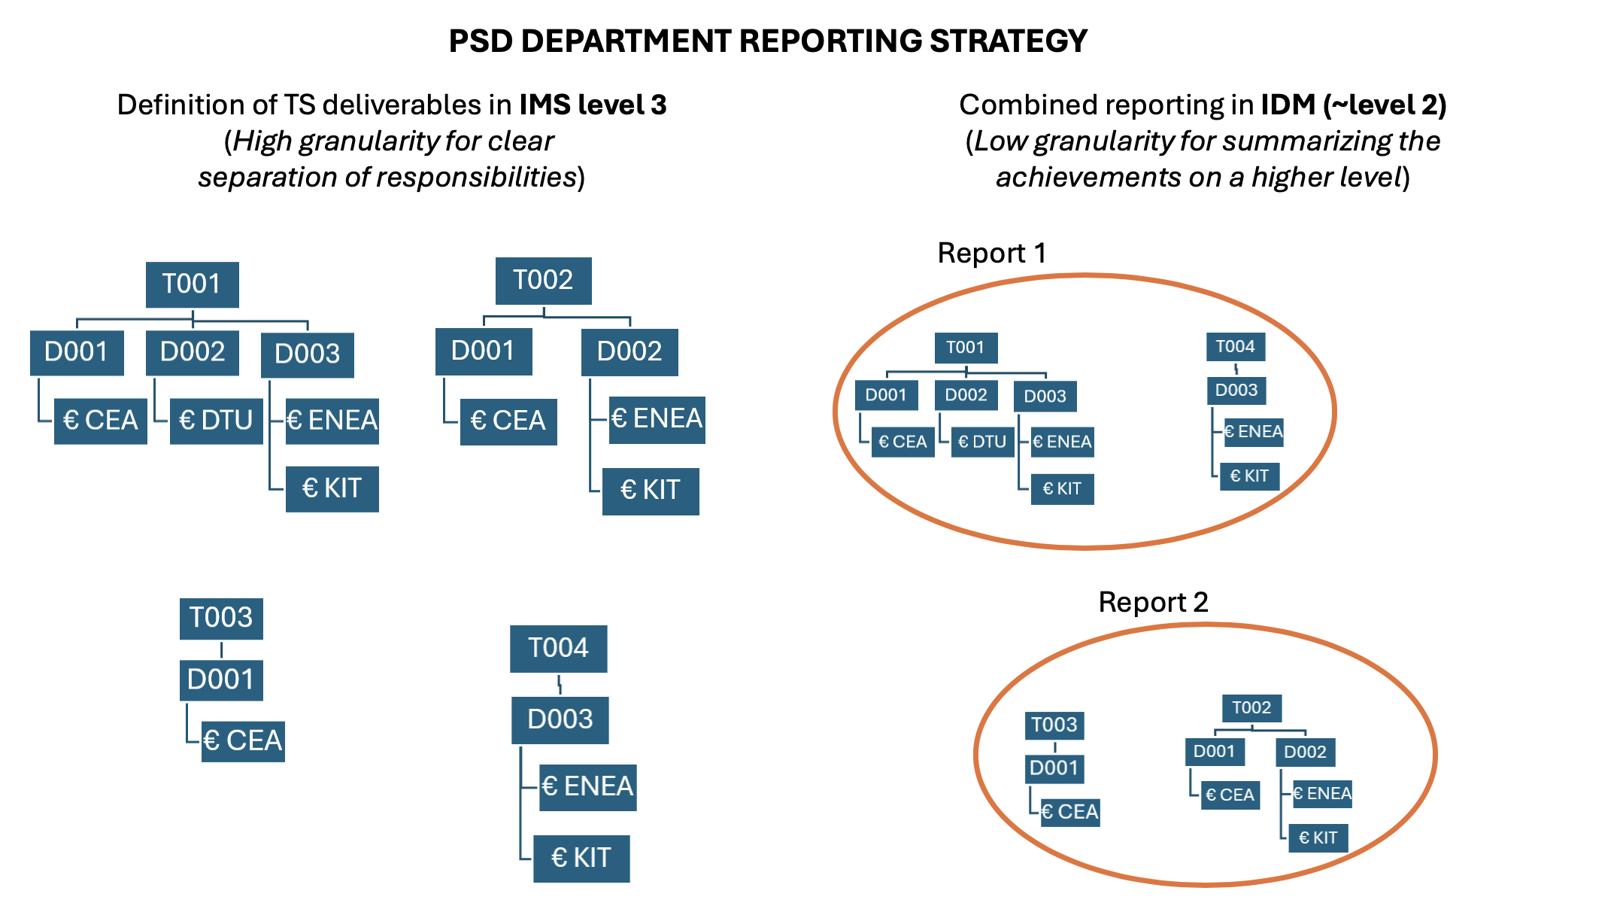

Slide 6
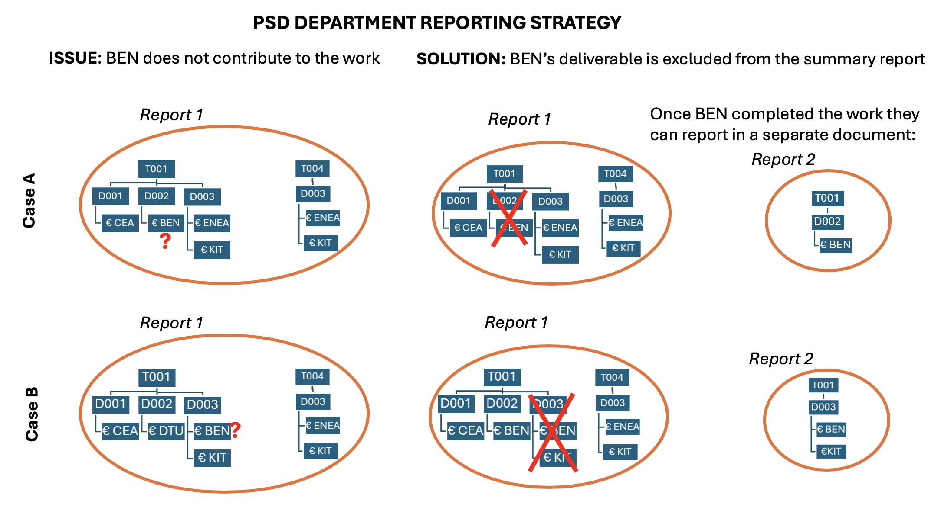
09 October 2024
PSD planning meeting

Slide 7
Measuring progress, Who is this for? Why? What are we monitoring? What to use as measuring tool? How not to loose the continuity? What is suitable for WPs/TSVVs?

Slide 8
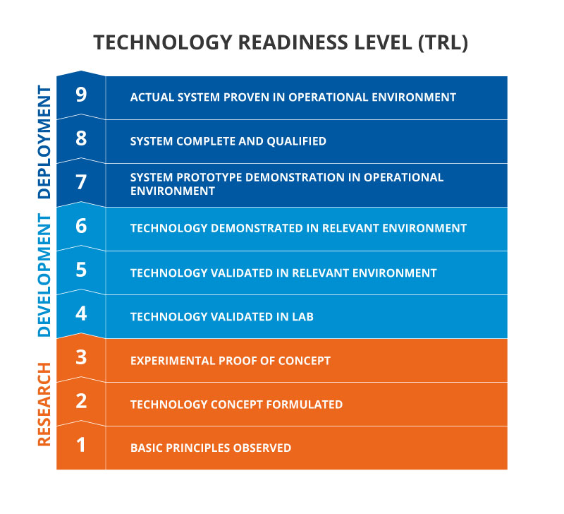
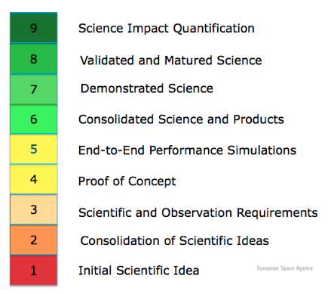
Scientific Readiness Levels (SRL)

Slide 9
WPTE Subjective scientific readiness levels
Established
Understanding is well developed and can be applied to ITER or DEMO
Mature
Needs support
A good understanding has been achieved (on WP TE devices), further research exploring ITER or DEMO relevant parameters
Mature
Needs underpinning
Good understanding of controlling physical processes (on WP TE devices), but major uncertainty in view of transposing ITER/DEMO
Judgmental
Controlling physical processes has been assessed (on WP TE devices), but extrapolation to ITER/DEMO requires scalable parameters and further investigation
Exploratory
Physical process is assessed (on WP TE devices), transposing to ITER or DEMO is uncertain
Emerging
Little or no understanding yet
(on WP TE devices)

Slide 10
RT01- D1: Assess the core transport properties of IBL scenarios with dominant electron heating (low nu*, low rotation) and
He seeding.
C1 Campaign 2021:
[Judgmental]
C2 Campaign 2022:
[Mature – needs underpinning]
C3 Campaign 2023:
?
C2 Campaign 2024:
?

