Slide 1
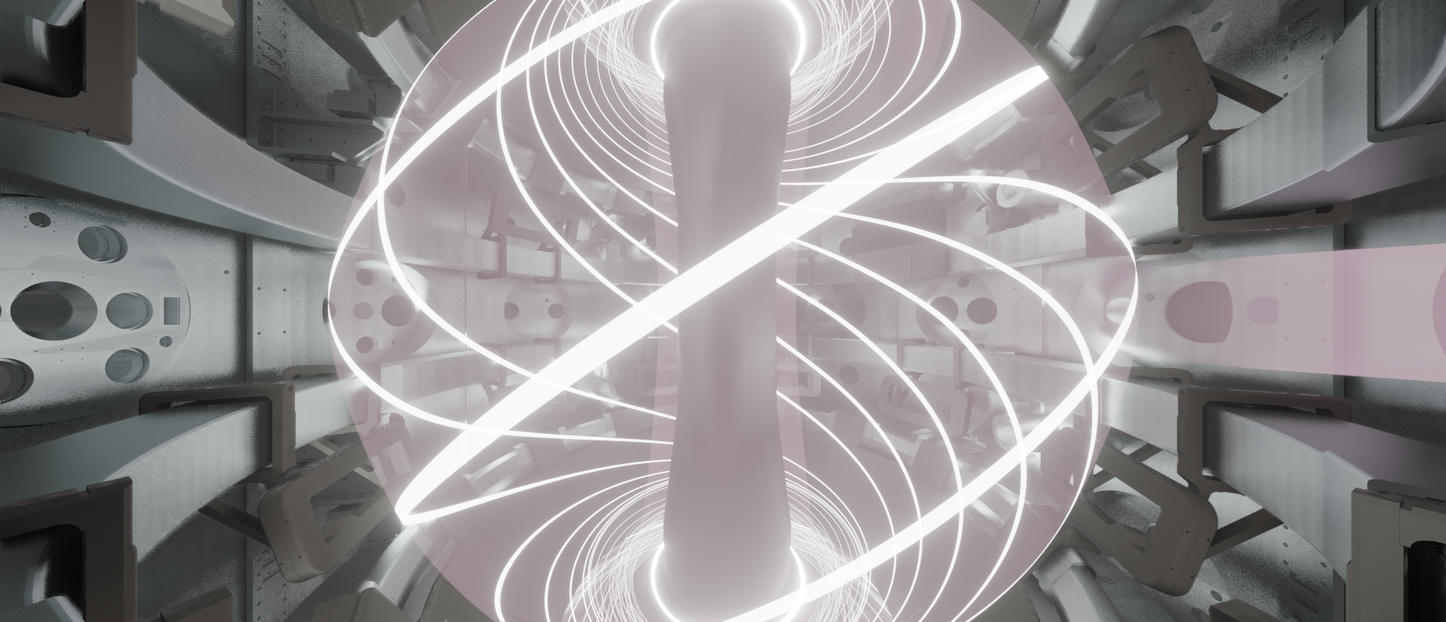
MAST Upgrade
Capabilities in 2025
J. Harrison on behalf of the MAST-U team

Slide 2
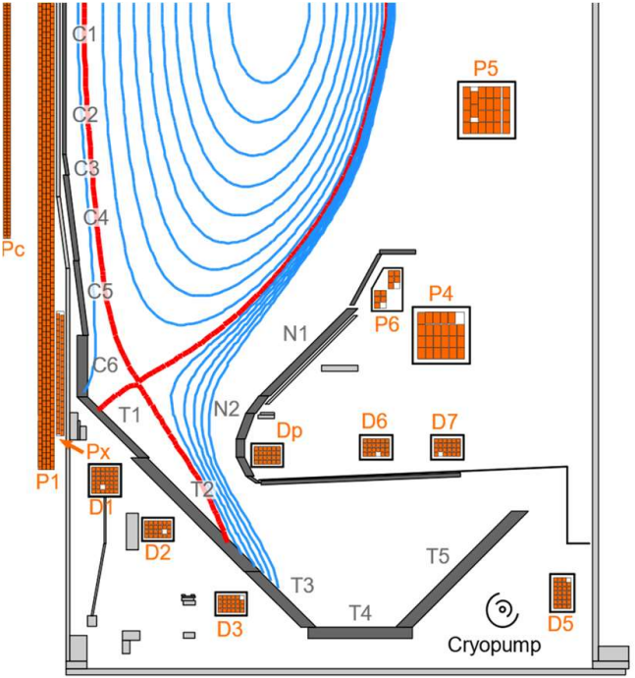

Machine Parameters
Parameter | Design value | 2025
R / a (m) | 0.7 / 0.5 | 0.7 / 0.5
Bφ (at 0.8 m) | 0.8 T | 0.72 T
Max Ip (MA) | 2.0 | 1.0
Max κ | 2.5 | 2.5
Maximum δ | 0.6 | 0.6
Divertor pumping | Closed, cryopumped | Closed, lower cryopump
Max NBI heating power (MW) | 8.8 MW for 5s | 3.6 MW for 1s
Ohmic heating (MW) | 0.2 – 1.0 | 0.2 – 1.0
NBI geometry | 1x on-axis, 2x off-axis, 1x intermediate | 1x on-axis, 1x off-axis

Slide 3
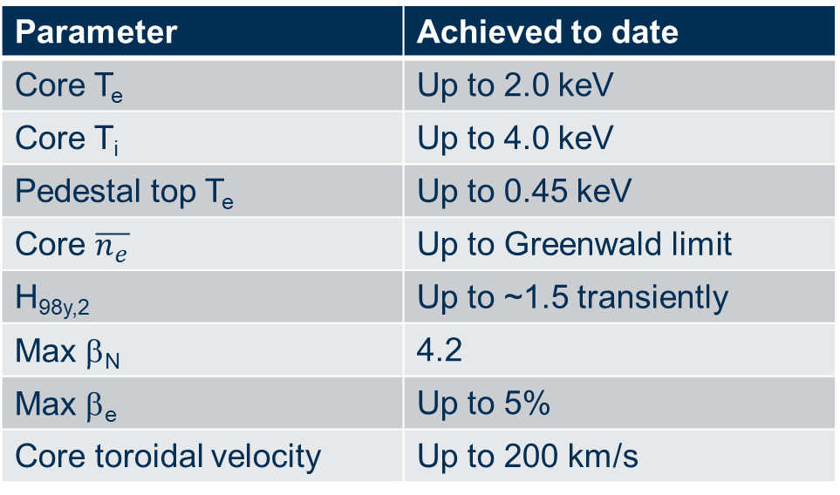
Achieved Plasma Parameters
Parameter | Achieved to date
Core T_{e} | Up to 2.0 keV
Core T_{i} | Up to 4.0 keV
Pedestal top T_{e} | Up to 0.45 keV
Core $\overline{n_{e}}$ | Up to Greenwald limit
H_{98y,2} | Up to ~1.5 transiently
Max β_{N} | 4.2
Max β_{e} | Up to 5%
Core toroidal velocity | Up to 200 km/s

Slide 4
Machine Capabilities
Gas
D₂ as the main fuel gas only
Seeding possible with He, Ne, CD₄ (no clean-up pulses required) and N₂ (clean-up pulses required)
I_{p} / B_{φ}
Operation in standard mode only (I_{p} anti-clockwise, B_{φ} clockwise, viewing from above)
RMP & EFCCs
In-vessel (RMP) and ex-vessel (EFCC) coils available to produce non-axisymmetric fields for ELM control and/or error field correction. Requests for specific coil configurations need to be made at least 1 week in advance.
  RMP coils – 8 in lower row (up to n=4), 4 in upper row (up to n=2)
  EFCC coils – 2 pairs of ex-vessel coils

Slide 5
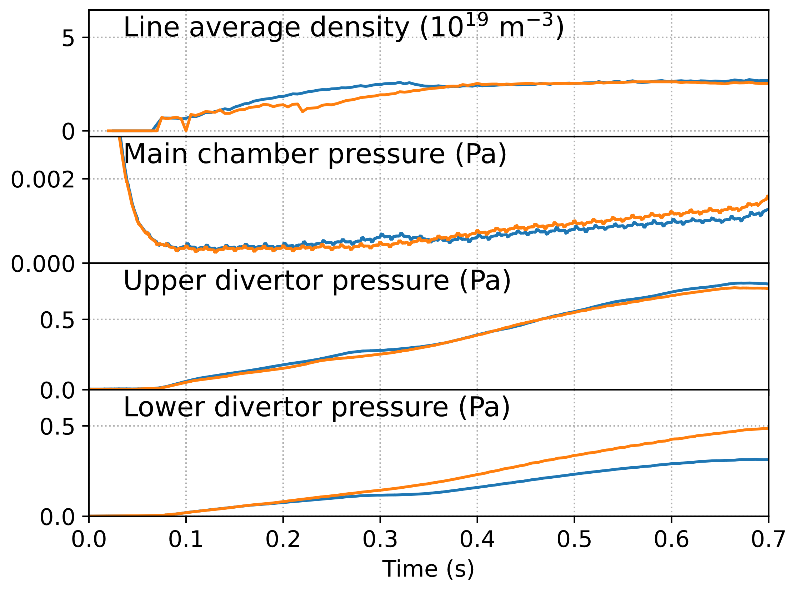
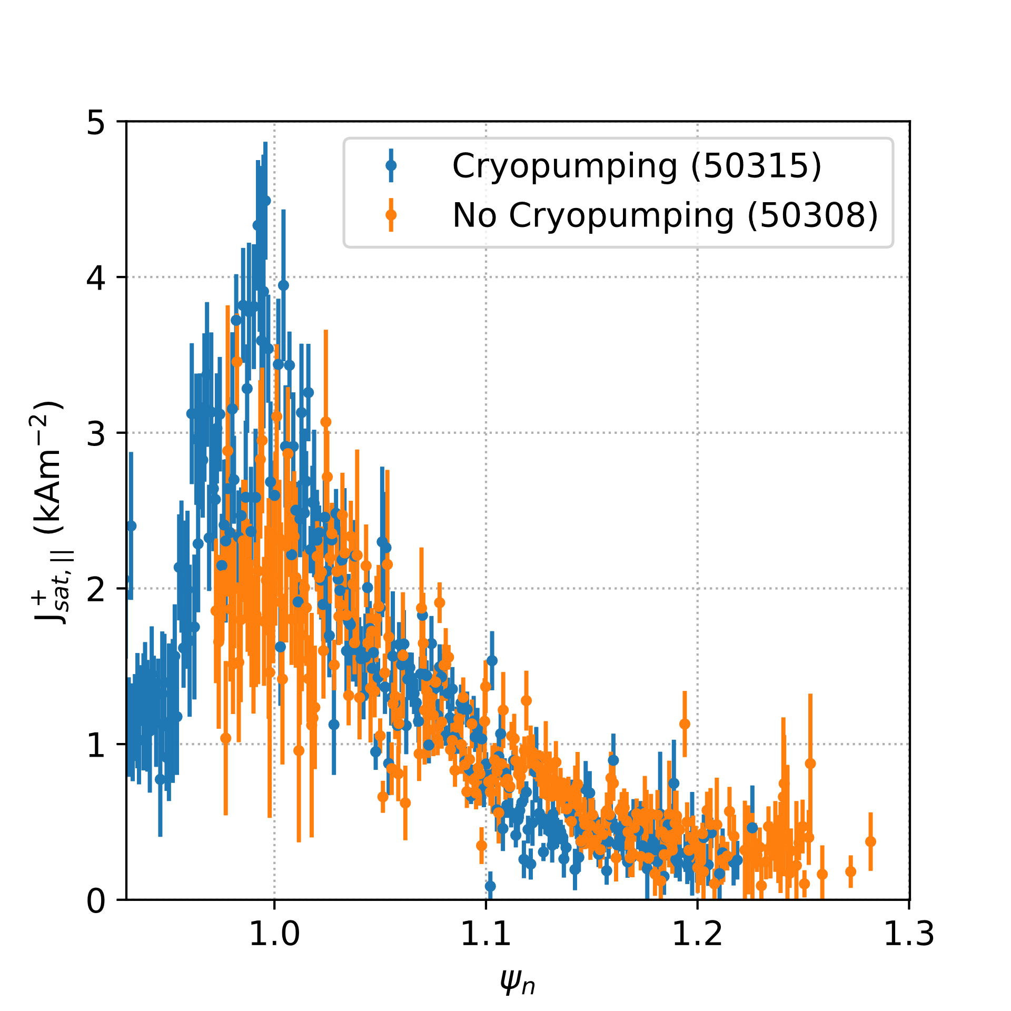
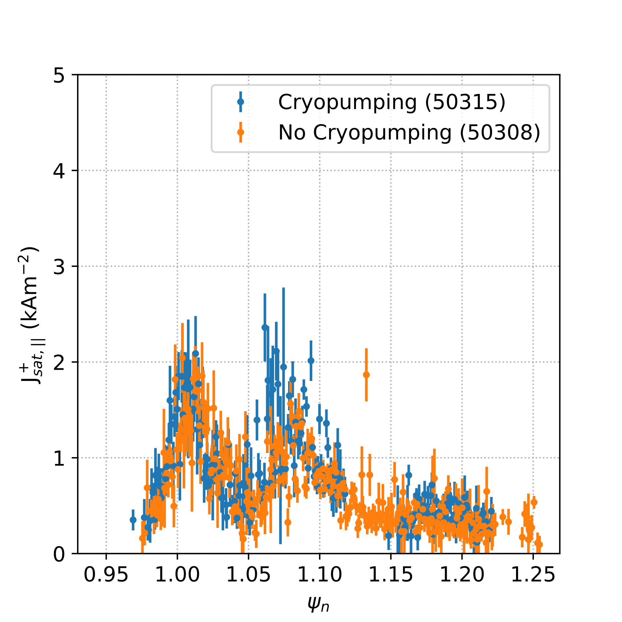
New Capabilities in 2025
The lower divertor cryopump will be active as standard
  Max pumping speed 50 m³/s per divertor, ~10x increase over existing pumps and comparable to estimated wall pumping early in MAST-U pulses
Lower divertor
Upper divertor

Slide 6
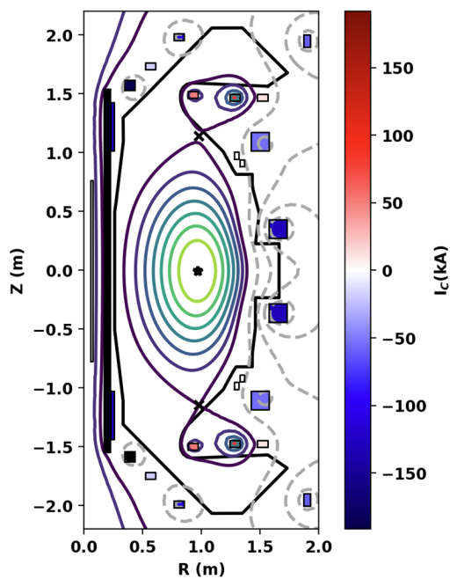
Plasma Scenarios
Standard Plasma Scenarios
L-mode and H-mode scenarios with I_{p} = 450 kA, 600 kA, 750 kA and conventional or Super-X divertor configurations will be available
H-mode 1 MA scenario conventional divertor scenario available
Non-standard scenarios being developed in internal campaign
Negative triangularity
High elongation (κ~2.5) high-performance H-mode (Ip = 750kA)
Open divertor configuration
X-point target divertor
Snowflake divertor configuration (Ip = 600kA)
From A.O. Nelson et al 2024 Nucl. Fusion 64 124004

Slide 7
Diagnostics
Information on the available diagnostics can be found here:
WPTE wiki page (https://wiki.euro-fusion.org/wiki/WPTE_MAST-U)
MAST-U diagnostics handbook (https://intranet.ccfe.ac.uk/mastu-handbook, needs VPN connection to UKAEA network )
New systems
Upper X-point fast imaging from LLNL
Ultra-fast (800kHz) spectroscopy of lower divertor
GEM soft x-ray imaging camera from University of Milano-Bicocca
Fast imaging of lower divertor under commissioning
Filtered imaging of lower x-point, upper divertor system under development

Slide 8
Plasma Control
Shape control:
R_{in}, R_{out}, Z_{x}, R_{OSP} in Ip flat-top phase
  Calculated using linearised controllers based on a “standard” reference equilibrium; more exotic scenarios may need dedicated controllers
Secondary null formation for X-divertor and X-point target divertor configurations
Density control:
Available for routine use, may need tailoring to some scenarios
Detachment control:
Based on Fulcher band emission front measured with lower divertor chamber Multi-Wavelength Imaging, requests for use need to be made well in advance
Fuelling from divertors or main chamber are the main actuator

Slide 9
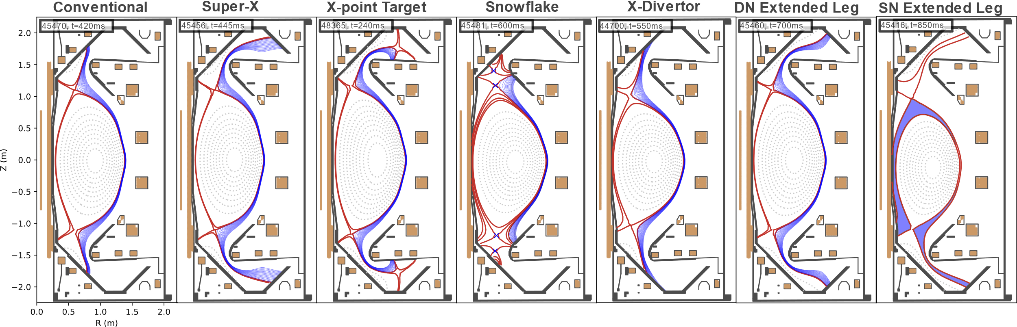
Divertor Configurations

Slide 10
Session Leaders
Experiments are executed by shift session leader
A reference session leader will be allocated to work with RTCs to guide the development of shot plans. RTCs are strongly encouraged to contact their reference session leader to start preparing shot plans.
Shot plans should be communicated to the shift session leader at least 1 week in advance of the experiment
Plans can be submitted via the Research Topic pages on the WPTE wiki or the MAST-U Users pages (links to WPTE wiki)

Slide 11
Operation schedule
The standard operating schedule has operations on Tue, Wed, Thu each week with Fri as contingency
2 sessions per operating day, normally 8 shots / session (16 total shots per day)
Typically 10 shots per day on Fridays
Programme for the following week is presented to the Friday MAST-U Science Meeting, reporting results from the previous week

Slide 12
Operation schedule
Experiments in 2025 will start in mid-January until the end of June
Aiming to execute ~1,100 total pulses plus 500 contingency
346 pulses allocated for the Tokamak Exploitation programme
Internal programme will concentrate on studying confinement at high β, low υ* and power exhaust during and between transients

Slide 13
General Information
Useful links for information about MAST Upgrade:
WPTE device information page: https://wiki.euro-fusion.org/wiki/WPTE_MAST-U
MAST-U Users: https://users.mastu.ukaea.uk/ (requires UKAEA IT account)
MAST-U visualiser: https://users.mastu.ukaea.uk/internal/mastu-visualiser (requires UKAEA IT account)
MAST-U diagnostics handbook: https://intranet.ccfe.ac.uk/mastu-handbook (requires UKAEA IT account and VPN connection)
To access MAST-U data, please request a data access form (available on WPTE device information page for MAST-U) and return signed copy to me
For any further information, please feel free to contact me: james.harrison@ukaea.uk

