Slide 1
Wrap up and next steps
19th November 2024
E. Tsitrone
On behalf of WPTE TFLs
E. Tsitrone, N. Vianello, M. Baruzzo, V. Igochine, D. Keeling, A. Hakola, B. Labit

Slide 2
Call cycles in preparation for 2025
Call for proposals 2025
Call for participation 2025
2025 Campaign
Completed : Deadline 11th of October
Review meeting by RTC in September (23rd and 26th) ➔ Guidance for proposals
Ongoing : Deadline 27th of November
GPM meeting by TFL in November 18-19 ➔
Building the WP TE experimental programme for 2025
+ guidance for participation
Staffing selection by TFL to be completed before Xmas 2024
(pending final approval by ET for JT-60SA)
Strategy meetings by RTC in January 2025

Slide 3
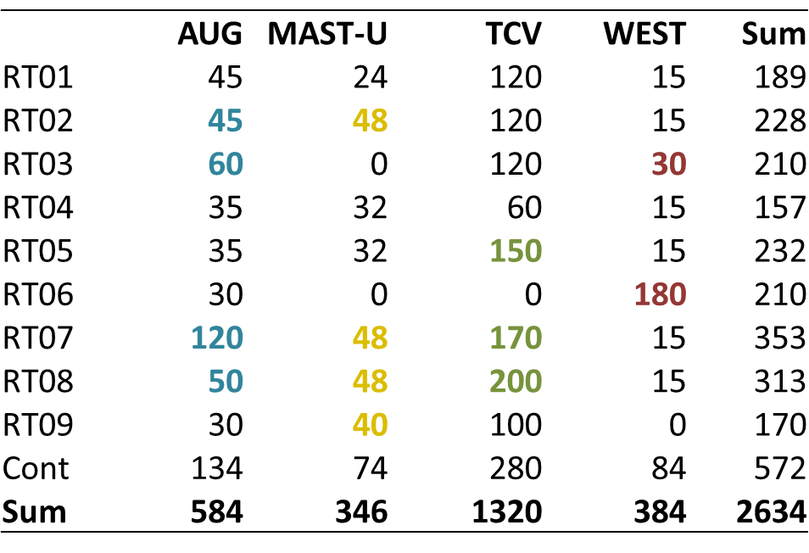
Next steps : TE TFL
Revise shot allocation where / if needed … keeping priorities stated below
For instance :
RT01 : some of P2 (momentum transport) could fly on TCV/MAST-U, L2H transition ➔ D2
RT02 : figure of merit, “spider plot” to be updated by end 2025
RT04 : further streamlining required to fit allocated budget (not all P1 will fly)
RT05 : strong overbooking …
RT06 : link with PWIE (boronisation), TSVV7/ERG on Migraine proposal in AUG internal programme ?
RT07 : dedicated meeting between RT07 / DCT (most compact configuration, controlability), document main chamber loads in addition to divertor, try to do it under no ELM conditions (RT02)
…
Discussion during GPM essential
AUG: PEX exploitation, SPI
MAST-U: ADC, high-β
WEST: High fluence campaign
TCV: ADC, high-β

Slide 4
Next steps : RTC
Start preparing consistent programme for 2025 based on prioritization discussed at this meeting ➔ strategy meetings in January 2025
2025 TE experiments starting (starting date tbd with MR)
Staffing selection
for 2025
RT strategy meetings

Slide 5
Next steps : TE participants
Answer the call for participation under IMS before Wednesday November 27
Some advice :
Read the documents annexed to the call
Provide adequate workplan, related to scientific objectives of the RT you apply to
Focus your participation on a restricted number of RT with significant involvement
Addressing issues related to the TE priorities for 2025 is encouraged (upper divertor and SPI exploitation in AUG, high fluence in WEST, high beta/ADC on TCV/MAST-U, issues related to ITER new baseline, remaining JET analysis, transition to W for JT-60SA …)
Specific resources are available for interpretative modelling + extrapolation from TE devices findings to ITER/DEMO
Training on TSVV modelling tools now becoming available, focused on specific physics issues, will also be organized in 2025 (discussion ongoing for instance on GRILLIX, integrated modelling tools from TSVV11 …)
If you need any help : contact RTC and/or ref TFL

Slide 6
Your feedback is welcome !
You are welcome to suggest improvements in the various processes involved for building the TE programme :
Call for proposals / call for participation ?
General Planning Meeting : shall we keep it on site or go back to remote meetings ?
Any other suggestions ?

