Slide 1
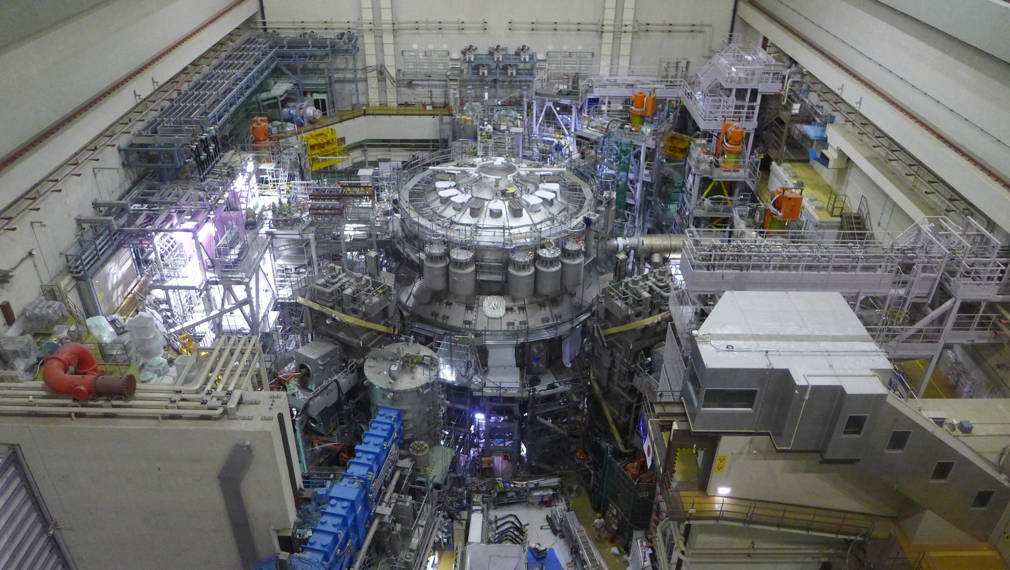


Participating in JT-60SA analysis (RT12 to RT18)
J. Garcia on behalf the JT-60SA experiment team

Slide 2
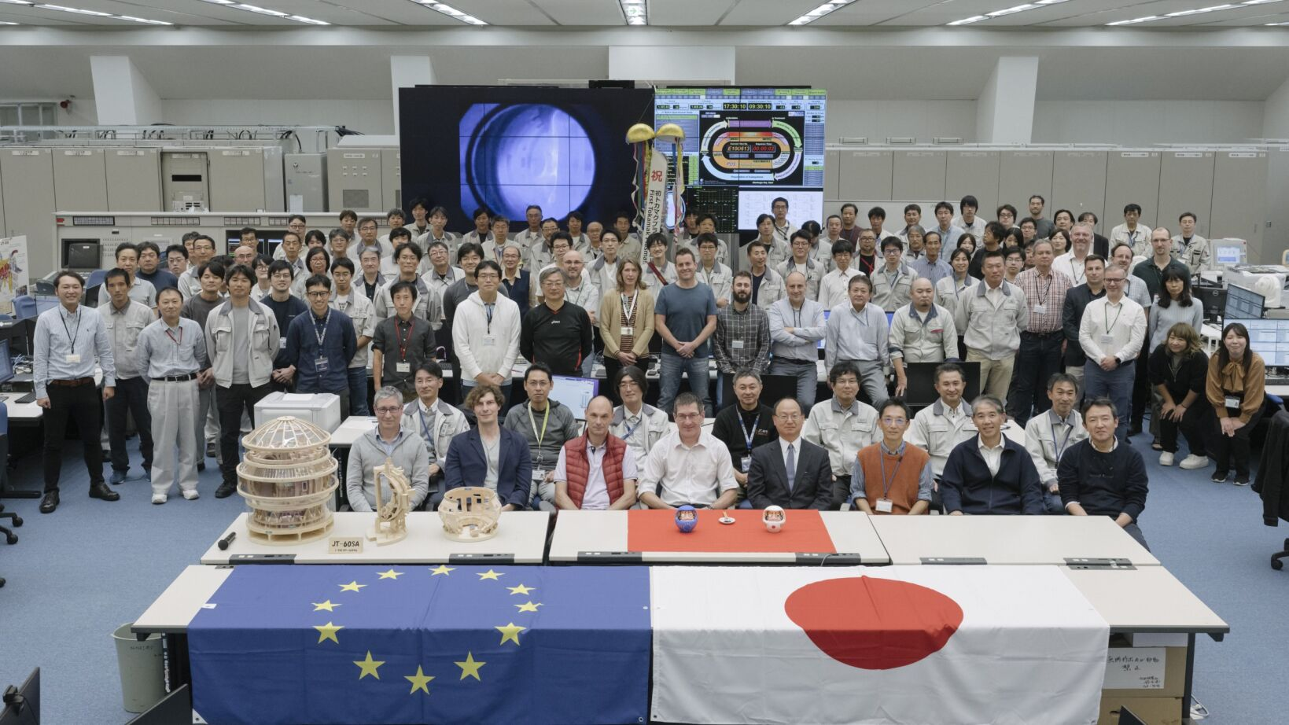
JT-60SA context
JT-60SA is jointly constructed and exploited by Europe and Japan in the framework of the Broader Approach

Slide 3

JT-60SA context
JT-60SA is jointly constructed and exploited by Europe and Japan in the framework of the Broader Approach
First plasma achieved on the 23/10/23

Slide 4
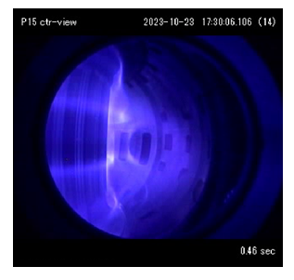
JT-60SA context
JT-60SA is jointly constructed and exploited by Europe and Japan
First plasma achieved on the 23/10/23
>1MA already obtained

Slide 5
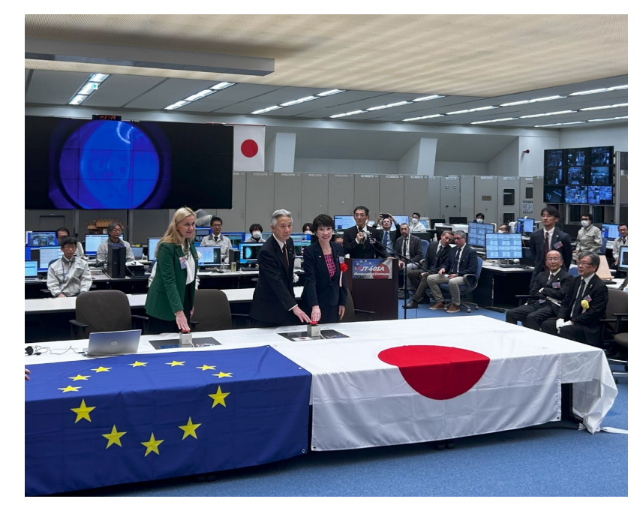
JT-60SA context
JT-60SA is jointly constructed and exploited by Europe and Japan in the framework of the Broader Approach
First plasma achieved on the 23/10/23
>1MA already obtained
Inaguration ceremony held on December 1st 2023

Slide 6
Integrated Comissioning and OP1
Integrated commissioning and OP1 successfully performed in 2023 by QST as part of phase I
Important set of topics relevant to ITER studied in this phase
  JT-60SA is the largest tokamak in the world with the largest plasma ever achieved in laboratory conditions
  First plasma achieved on 23rd October 2023
  Plasmas at >1MA obtained in X point configuration
Next phases of JT-60SA exploitation will be coordinated by the experiment team
Jeronimo Garcia| WPTE-GPM| 19/11/2024| Page 6

Slide 7
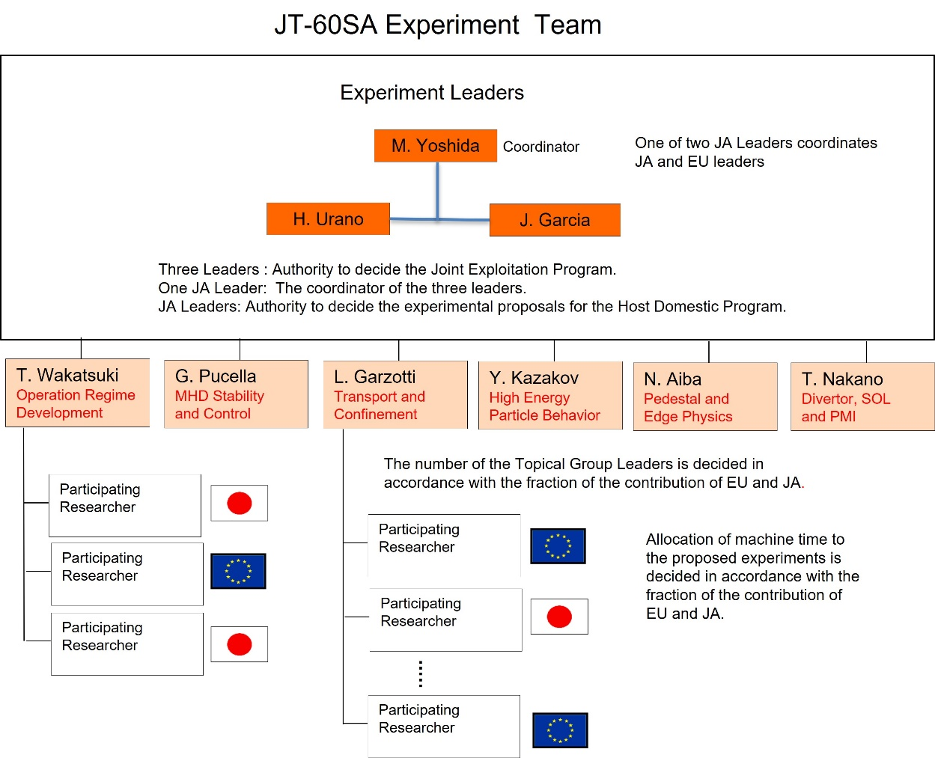
JT-60SA Experiment Team
The JT-60SA Experiment Team is the unified EU-JA Experiment Implementation Structure for the JT-60SA experiment
Three Experiment Leaders
Six topical group leaders
Jeronimo Garcia| WPTE-GPM| 19/11/2024| Page 7

Slide 8
The JT-60SA initial phased operation plan
Research phase | Operation Campaign | Expected operation schedule |  | Divertor | P-NB 85keV | N-NB 500keV | ECRF | Max. usable aux. power
Initial research phase I | Op-1 | 2020-2021 (6M) 2023 (6M) First plasma 2023 | H | Inertially cooled in C | 0 | 0 | 1.5 MW | 1.5MW
 | Op-2 | 2026-2027 (9M) |  |  | 16MW (with H) 23.5 MW (with D) | 10MW | 3.0 MW | 19MW
 |  |  | D
 |  |  |  |  |  |  |  | 26MW
Initial research phase II | Op-3 | 2027-2028 (9M)
 | Op-4 | 2028-2029 (8M) |  |  | 30 MW |  |  | 33 MW

Slide 9
The JT-60SA initial phased operation timeline
After successful IC+OP1 JT-60SA enters into ME1 phase
Input power upgrade:
  EC: 1.5 MW → 3 MW​
  NB: 0 MW → 16 MW(H) / 23.5 MW(D)​: Including 10 MW of 500 keV negative-ion NBI​
Lower divertor, Cryo-pump​, Stabilizing plate + in-vessel coil (FPPC)
Non-axisymmetric coils (EFCC, RWMC)​
Diagnostics, Pellet injection​, Massive gas injection
Jeronimo Garcia| WPTE-GPM| 19/11/2024| Page 9

Slide 10
Strategy towards initial phases and EUROfusion paticipation
During 2023-2024 Experiment Leaders and Topical Group leaders discussed about main scientific topics to develop in the initial experimental campaigns
Detailed assessment about the scientific possibilities during Initial Research phase I and II has been performed
Detailed scientific topics are shown in the ET and WPTE call for participation
WPTE handles and provides the proposed participation of EUROfusion in the experiment team for the scientific exploitation
Final participation agreed by Experiment Leaders and JT-60SA project leader (Sam Davis) at the level of the BA project
Anybody who wants to have access to JT-60SA experimental data must belong to the Experiment Team
Jeronimo Garcia| WPTE-GPM| 19/11/2024| Page 10

Slide 11
RT-12: Operation Regime Development (JT-60SA)
Mission: M1.1
TFLs: J. Garcia
Scientific Coordinators: L. Garzotti
Scientific objectives
#
D1 | Safe increase of toroidal current up to 5.5MA in L-mode
D2 | Test of plasma control schemes: current, position, density, heating
D3 | Break down and plasma formation studies in conditions of low loop voltage
D4 | Initial integrated scenarios development towards ITER standard H-mode scenario
D5 | Initial development of high beta integrated scenarios
D6 | Integration of advanced real time control techniques , e.g. beta or ELMs control, in scenario development
D7 | Characterize, by means of integrated modelling, scenarios compatible with W as PFC in conditions of full machine capabilities
Key aspects: OP1 analyses, plasma start-up, equilibrium, OP2-OP4 preparatory scenario integrated modelling and W integrated modelling
Jeronimo Garcia| WPTE-GPM| 19/11/2024| Page 11

Slide 12
RT-13: MHD Stability and Control (JT-60SA)
Mission: M1.1
TFLs: J. Garcia
Scientific Coordinators: G. Pucella
Scientific objectives
#
D1 | Disruption and runaway electrons studies
D2 | Creation of disruption databases
D3 | Sawtooth activity and modification by ECH
D4 | Tearing Modes during ramp-up, flat-top, and ramp-down phases
D5 | Neoclassical tearing modes destabilization with ECH/ECCD and NBI
D6 | Neoclassical tearing modes control with ECCD
D7 | Resistive wall mode studies
D8 | Characterization of MHD activity in high beta plasmas
D9 | Error field measurement, characterization and impact on locked mode and NTM activity
Key aspects: Disruption and runaway electrons (studies, predictors, AI), generic MHD (including OP1 analyses), error field
Jeronimo Garcia| WPTE-GPM| 19/11/2024| Page 12

Slide 13
RT-14: Transport and Confinement (JT-60SA)
Mission: M1.1
TFLs: J. Garcia
Scientific Coordinators: L. Garzotti
Scientific objectives
#
D1 | Heat transport in electron heated dominated plasmas in L-mode and/or low β
D2 | Characterization of L-mode confinement
D3 | Initial characterization of H-mode confinement
D4 | Isotope studies by comparison of H and D plasmas
D5 | Heat transport in electron heated dominated plasmas in H-mode
D6 | Heat, particle and impurity transport in high β plasmas
D7 | Characterization of H-mode confinement in type-I ELMs plasmas
D8 | H/D ratio control by gas-puff and pellet
D9 | Characterise potential core W screening
D10 | Perform fully integrated core+edge+SOL simulations capturing the impact of W PFC on core confinement.
Key aspects: modelling of transport/turbulence in expected JT-60SA plasmas (high electron heating, high beta), core W screening, L-mode confinement characterization from OP1
Jeronimo Garcia| WPTE-GPM| 19/11/2024| Page 13

Slide 14
RT-15: High Energy Particle Behaviour (JT-60SA)
Mission: M1.1
TFLs: J. Garcia
Scientific Coordinators: Y. Kazakov
Scientific objectives
#
D1 | Shine-through studies in H and D, especially with N-NBI
D2 | Initial studies of Alfvén modes destabilization by N-NBI
D3 | Characterization of fast ions loses
D4 | Neutron emission studies and reproducibility with codes
D5 | Studies of Alfvén modes destabilization by N-NBI in high beta plasmas and impact on fast ion confinement
D6 | Characterization of fast ions loses at high N-NBI power with FILD
D7 | Interplay between fast ions and turbulence and Transport reduction by fast ions
D8 | Compatibility of RMP with fast ion confinement
D9 | Initial studies of alpha particle behavior in D-3He plasmas
Key aspects: Shine-through, FI modes destabilization and interplay with turbulence, alpha particle generation by D-³He, fast ion losses
Jeronimo Garcia| WPTE-GPM| 19/11/2024| Page 14

Slide 15
RT-16: Pedestal and Edge Physics (JT-60SA)
Mission: M2.1
TFLs: J. Garcia
Scientific Coordinators: Y. Liang
Scientific objectives
#
D1 | L-H power threshold characterization in H and D
D2 | ELMs generation studies in different plasma conditions
D3 | Characterization of the access to type-I ELMs and comparison to plasmas with no/small ELMs
D4 | ELMs control with RMP and pacing pellets
D5 | Investigate potential W screening capabilities of predicted pedestal for JT-60SA foreseen scenario at full machine capacity
Key aspects: L-H power threshold characterization in view of OP2-OP4, ELM generation in view of OP2-OP4, pedestal W screening, ELM control
Jeronimo Garcia| WPTE-GPM| 19/11/2024| Page 15

Slide 16
RT-17: Divertor, Scrape Off Layer and Plasma-Material Interaction
Mission: M2.1
TFLs: J. Garcia
Scientific Coordinators: G. Falchetto
Scientific objectives
#
D1 | SOL width scaling at high Ip
D2 | Neutral compression by the V-shaped corner
D3 | Wall conditioning
D4 | Neutral compression by the V-shaped corner, He pumping
D5 | Initial seeding studies and impact on the heat flux to divertor
D6 | Determine the compatibility of the expected heat flux in foreseen JT-60SA at full machine capabilities with W PFC components, including the use of seeded impurities for heat flux mitigation
D7 | Investigate divertor W erosion in different scenarios including the potential role of extrinsic seeded impurities for heat flux mitigation and characterise potential SOL W screening
Key aspects: Wall conditioning (OP1), heat flux to divertor mitigation techniques, impact of W divertor (erosion, extrinsic impurities)
Jeronimo Garcia| WPTE-GPM| 19/11/2024| Page 16

Slide 17
RT-18: Integrated data validation and data access with IMAS
Mission: M2.1
TFLs: J. Garcia
Scientific Coordinators: F. Imbeaux
Scientific objectives
#
D1 | Integrated data validation
D2 | Data access with IMAS
Jeronimo Garcia| WPTE-GPM| 19/11/2024| Page 17

Slide 18
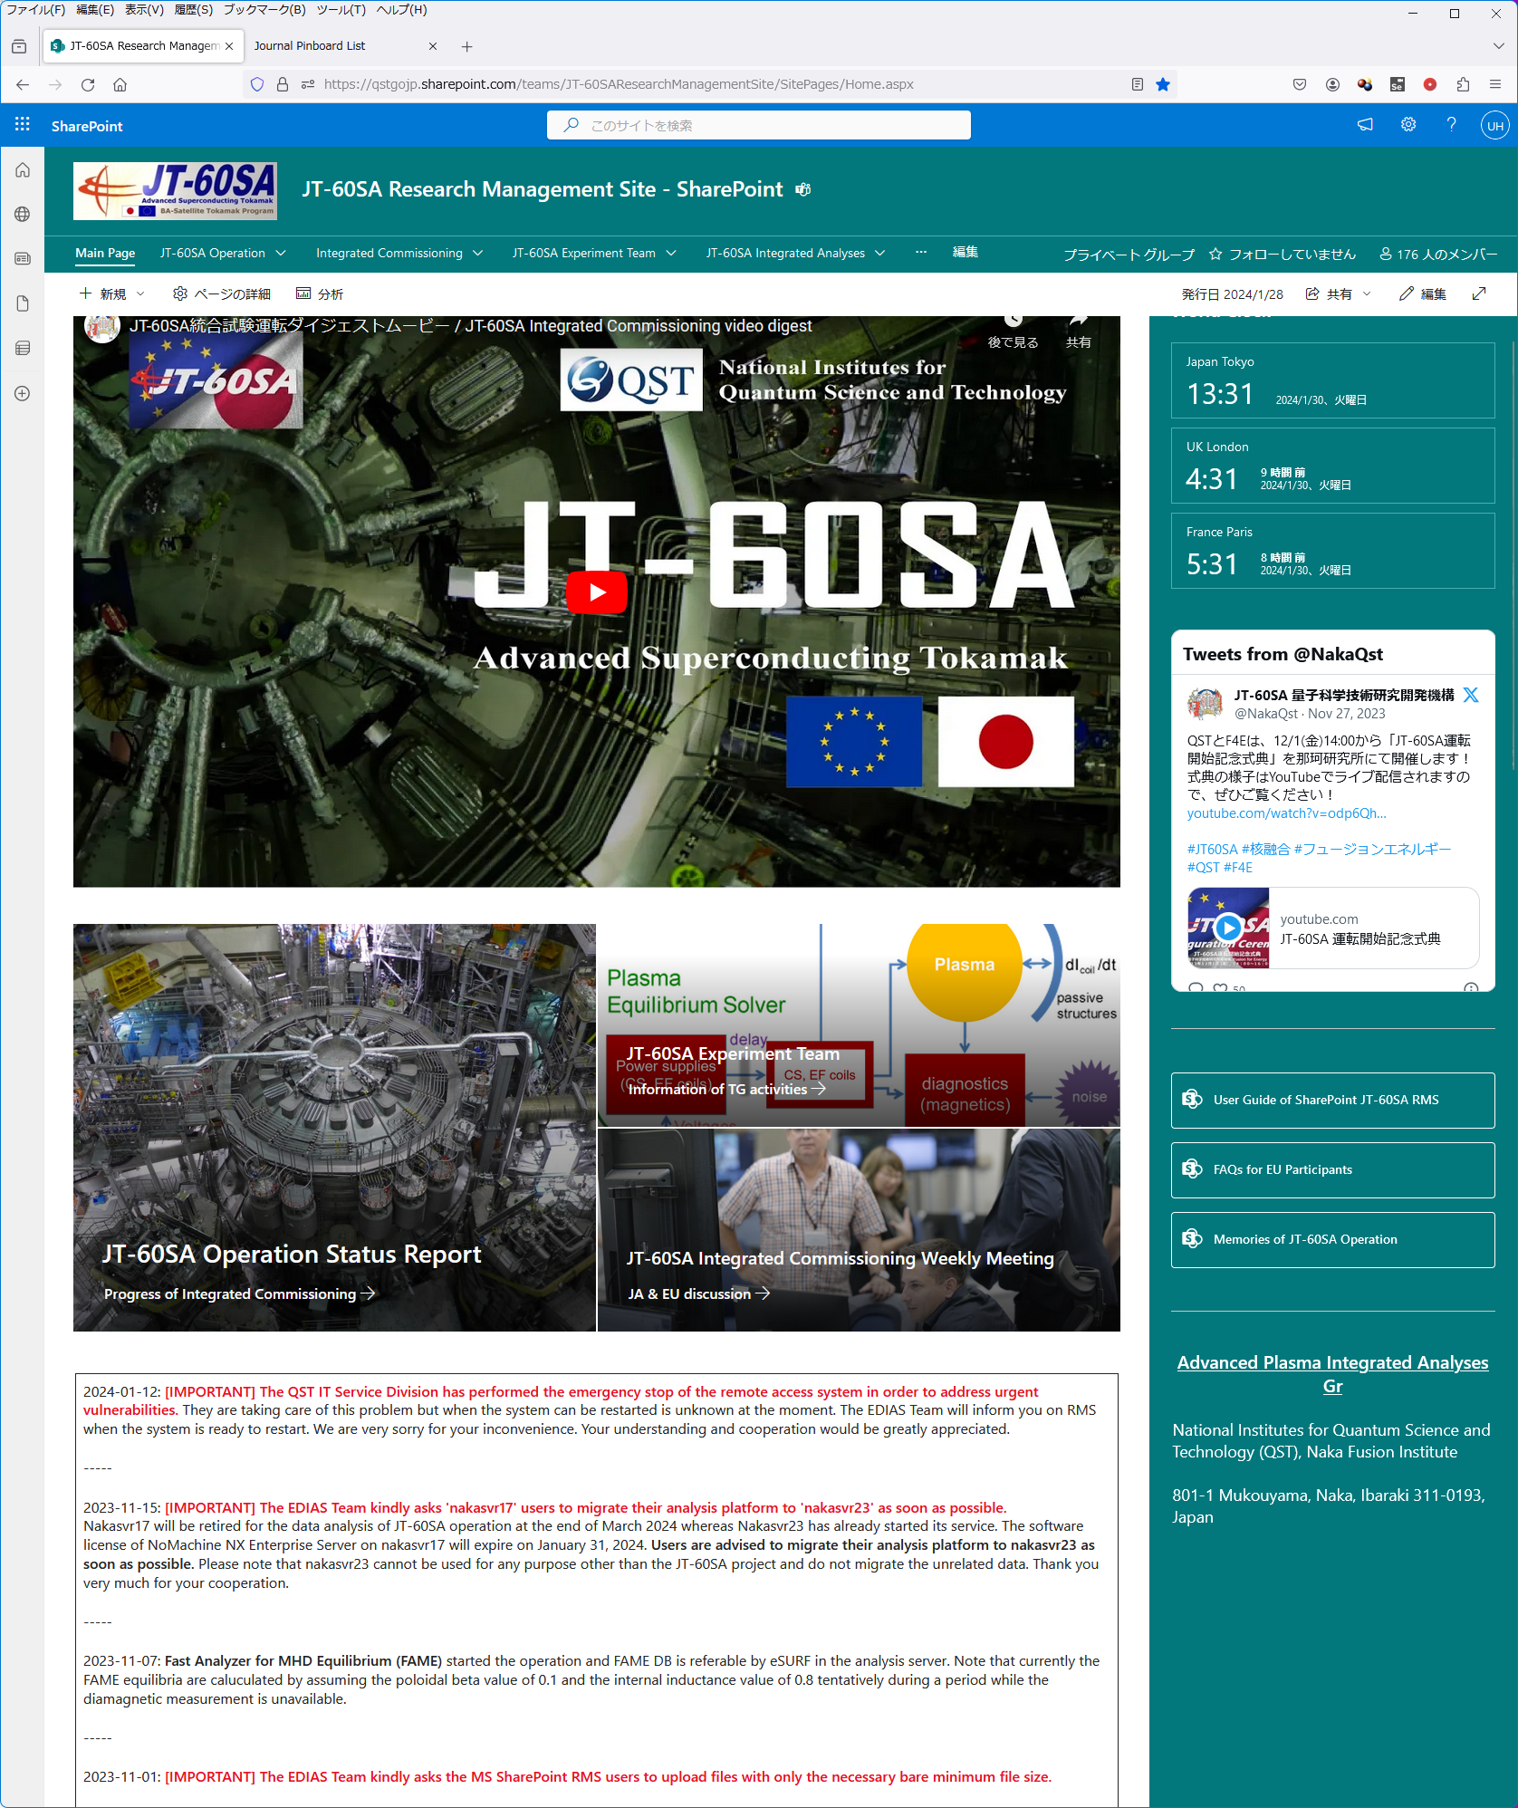
JT-60SA Research Management Site (RMS: MS SharePoint)
RMS has been operated to share information among JA and EU participants, e.g. current status of experiment and hardware system, experiment log and daily reports of hardware system, etc
Participation to experiment and data analysis
Diagnostic status, documentation of DB system, Data Handbook, Analysis Server, Data Access Library, Web API, Analysis codes, link to HMI
JT-60SA Pinboard
Automate and visualize approval process, manage centrally presentation materials and paper manuscripts, etc
Jeronimo Garcia| WPTE-GPM| 19/11/2024| Page 18

Slide 19
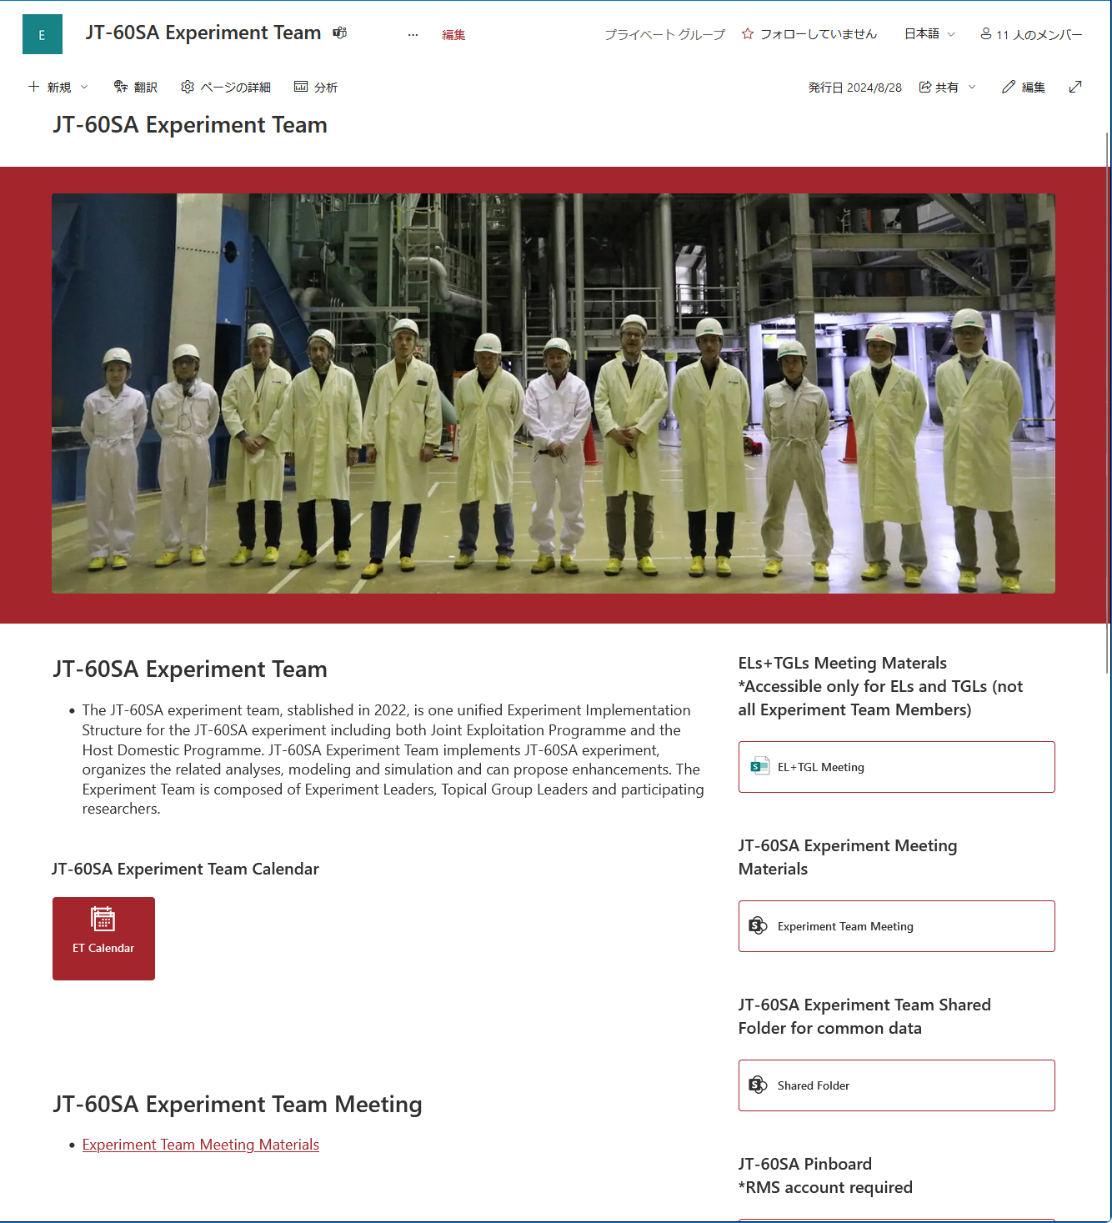
MS SharePoint page on JT-60SA Experiment Team
MS SharePoint page for JT-60SA Experiment Team provides you with the information of the experiment team activities.
Links to the materials on TG activities, such as meeting materials, scenario analysis results, etc.
Dedicated TG pages and WG pages can be arranged for particular purpose of discussion.
Shared folder has been implemented for common data of analysis.
Jeronimo Garcia| WPTE-GPM| 19/11/2024| Page 19

