Slide 1

Sp B.1 Exposure of W samples to PSI-2 plasmas
O. Marchuk, M. Sackers, M. Rasinski, S. Brezinsek, A. Houben and A. Kreter
Forschungszentrum Jülich GmbH – Institute of Fusion Energy and Nuclear Waste Management - Plasmaphysik,
Partner of the Trilateral Euregio Cluster (TEC), 52425 Jülich, Germany

Slide 2
Plans for 2024
High resolution (HRS) and imaging spectroscopy (IS) of bulk and redeposited W and B layers in PSI-2
Study of sputtering rates of W+B layers in PSI-2
B I lines in visible range only at different flux of D
Erosion rates of W in linear cross machine comparison study
VUV Spectroscopy for W and D atomic and molecular lines

Slide 3
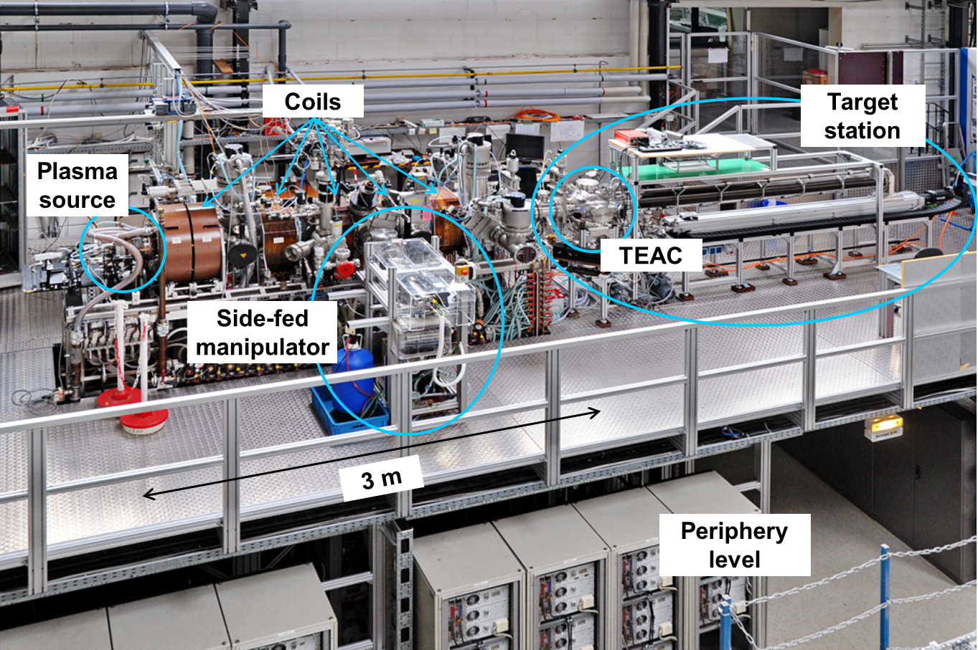
Setup of Psi-2

Slide 4
Spectroscopic studies on W in PSI-2
5
Plasma pressure : 0.01…0.1 Pa
Electron temperature: 1..20 eV
Electron density: 10¹⁰…10¹² cm⁻³
Magnetic field: 0.025…0.1 T
Ionization degree: 1-5%
Targets: 13x13mm²
(1-5 are the line-of-sights)
Study of erosion and redeposition of W atoms/ ions using spectroscopy
W targets: poly W, W (111), W (110), W (100)

Slide 5
High resolution spectroscopy
a
photons
spectrometer
Energy distribution
of sputtered atoms :
Kinetic energy , ΔΕ ~ 10 eV
Doppler Effect Δλ/λ₀ = v/c
λ₀ − is the wavelength of transition,
v − is the velocity of W atoms
c – is the speed of light.
λ₀ @ 500 nm : Δλ_{W}/λ₀ = 10⁻⁵
Δλ_{FWHM}/λ₀ = 7∗10⁻⁶
b
Spectral dispersion ~ 0.7 … 1.0 pm/ch
FWHM (Full Width Half Maximum) ~ 5-7 ch
PSI-2
Measurements
of energy distribution
S. Ertmer , PhD thesis, High-resolution spectroscopy studies on sputtered atoms in the linear plasma device PSI-2
RUB Bochum, https://doi.org/10.13154/294-8580

Slide 6
Calibration/Measurements/Modelling of the W spectra
498 nm
M. Sackers et al, Phys. Scripta (2023) 98 115603
Effect of finite –size target
Zeeman Effect
Instrumental Broadening
Hyperfine structure splitting
Finite lifetime of excited levels
Energy and angular distribution
Sackers M et al, Phys. Plasma (submitted)

Slide 7
Different W ORIENTATION
Different line shapes for
different orientation [1]
Comparison with
PARCAS MD simulations [2]
Information on energy
and angular distribution of W atoms for the ion energy close to threshold
Control of surface roughness is required
[1] Sackers M et al, Phys. Plasma (submitted)
[2] Nordlund K, Comput. Mat. Science 3, 448-456 (1995)

Slide 8
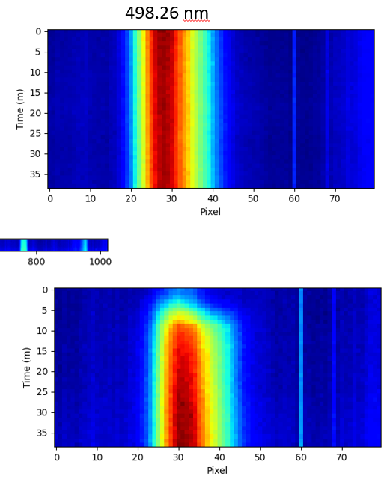
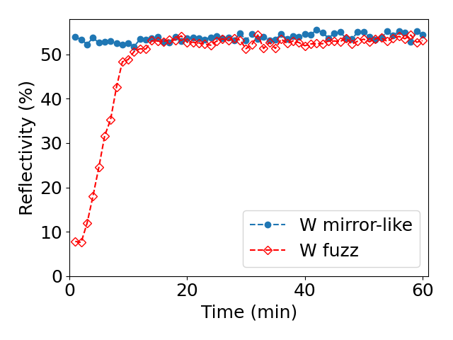
Application of HRR Spectroscopy for Layers
W target
Intensity and line shape stays constant for W target
Intensity and reflectivity increase for W fuzz target
within of 15-20 min (removal of fuzz)
W target with fuzz
Monitoring the processes on the surface

Slide 9
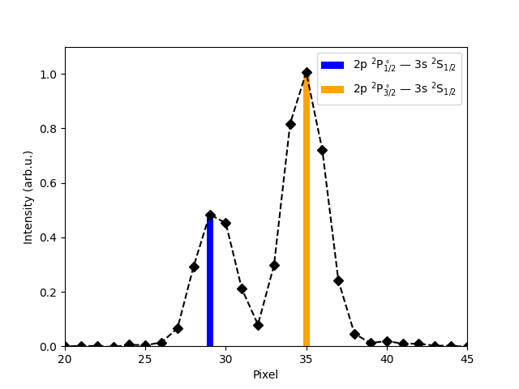
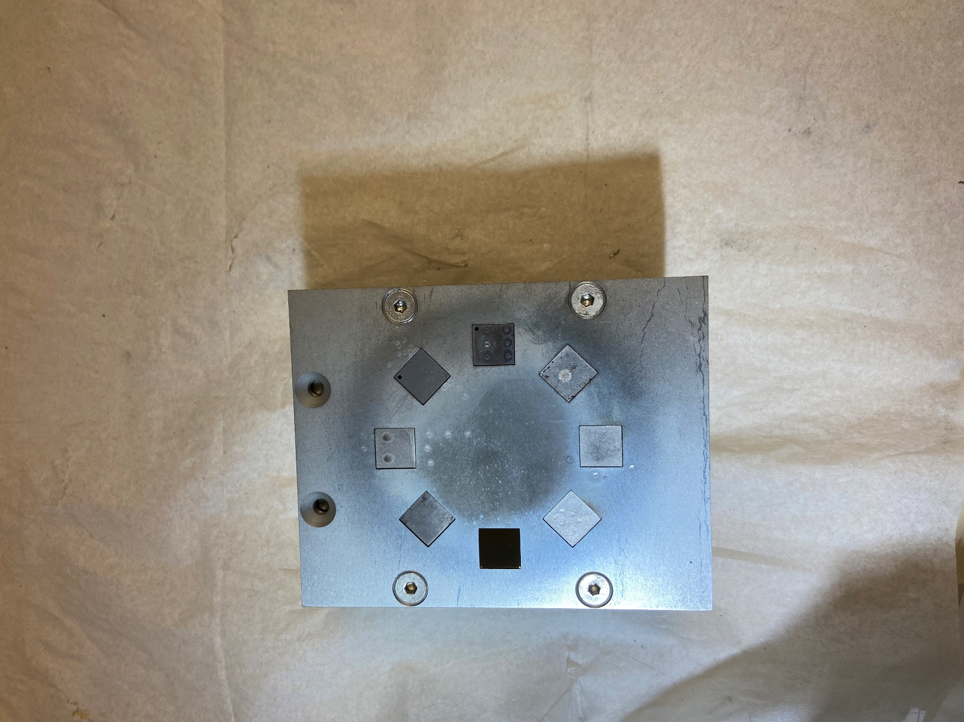
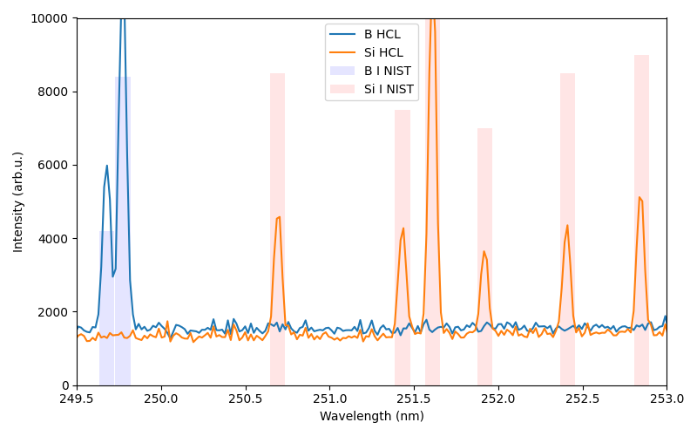
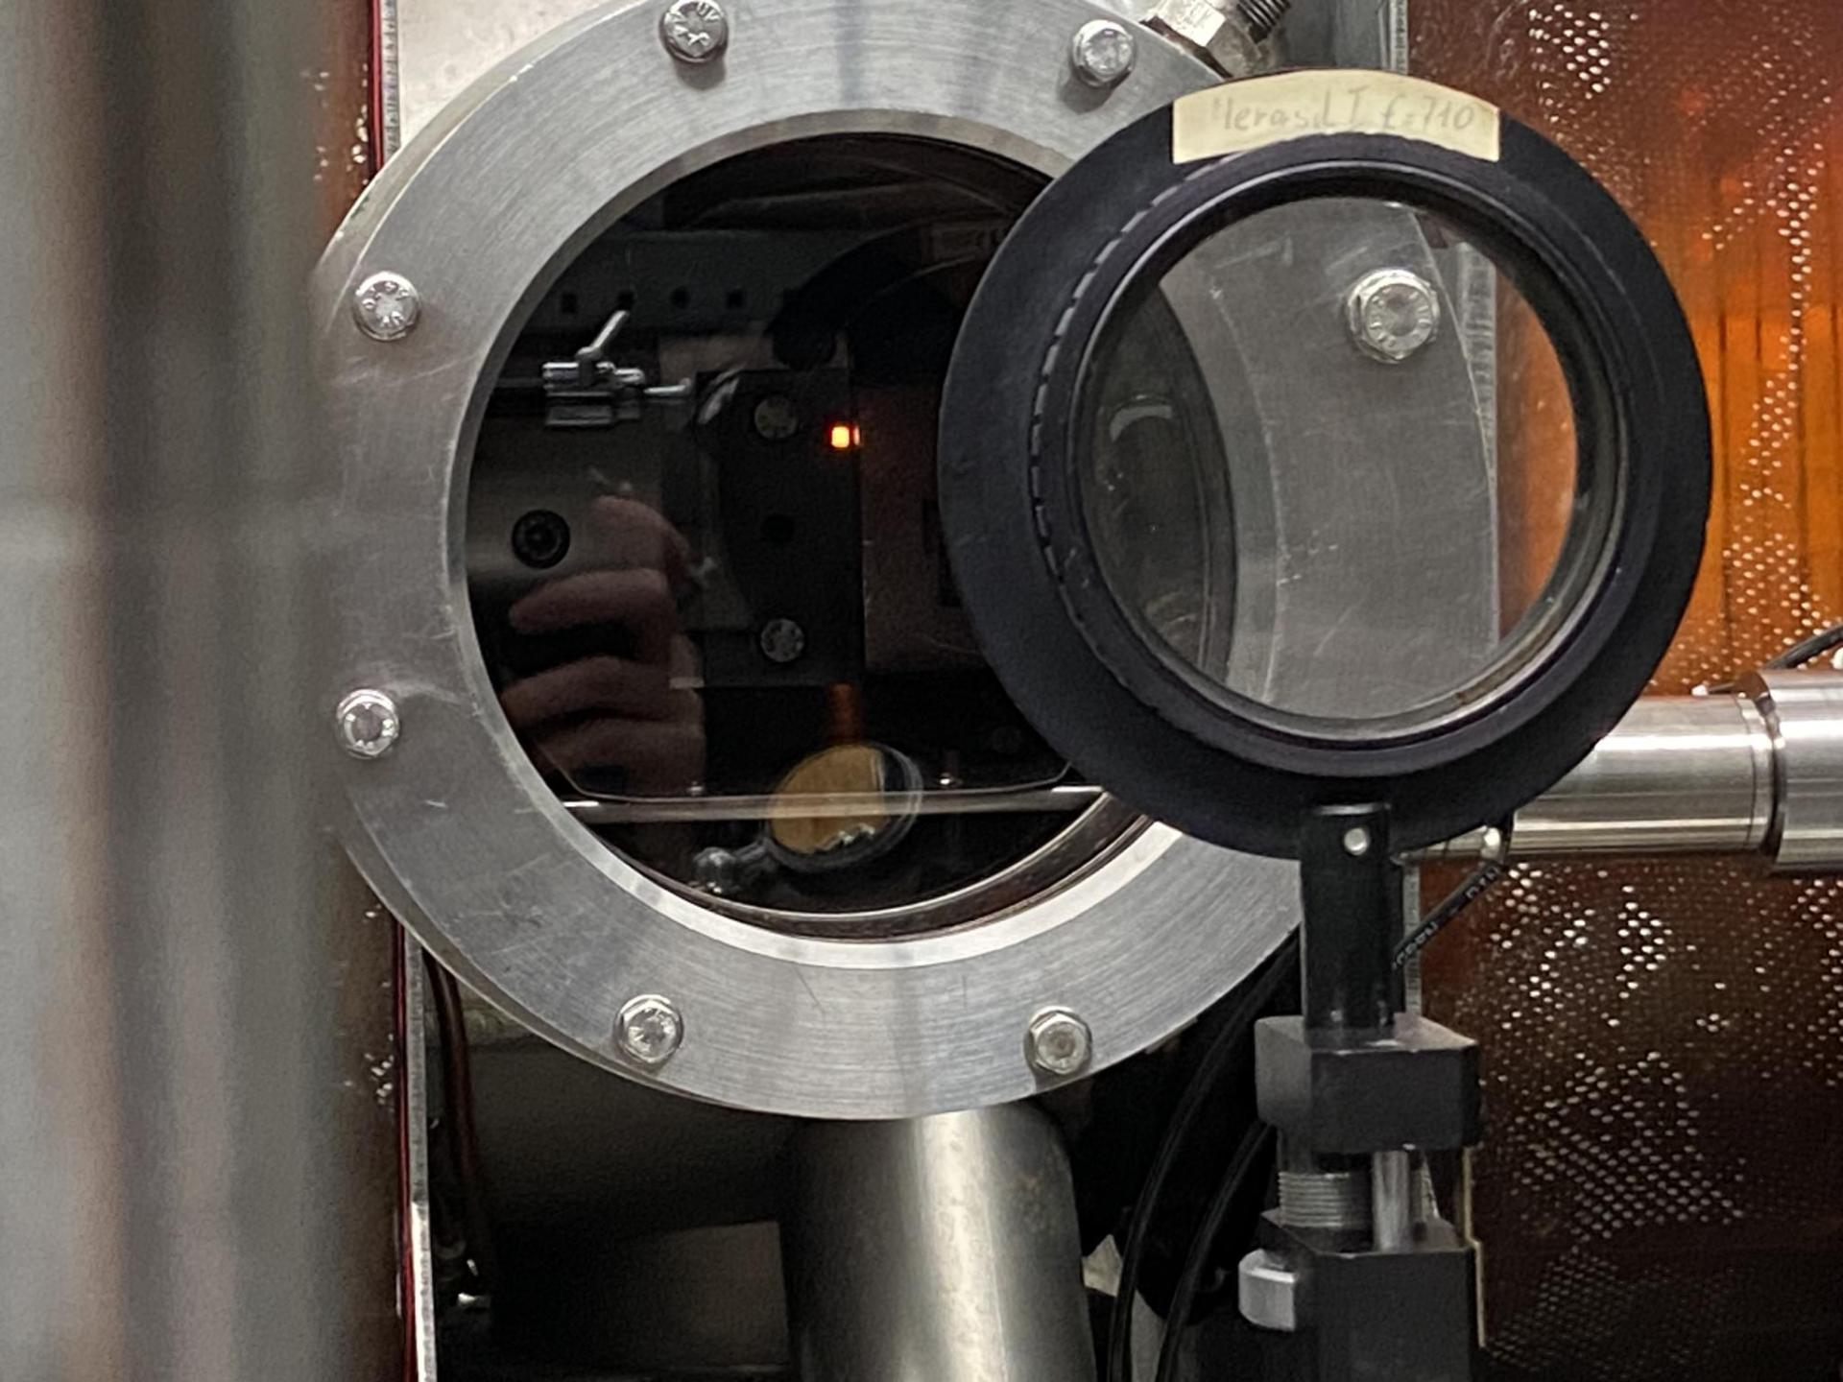
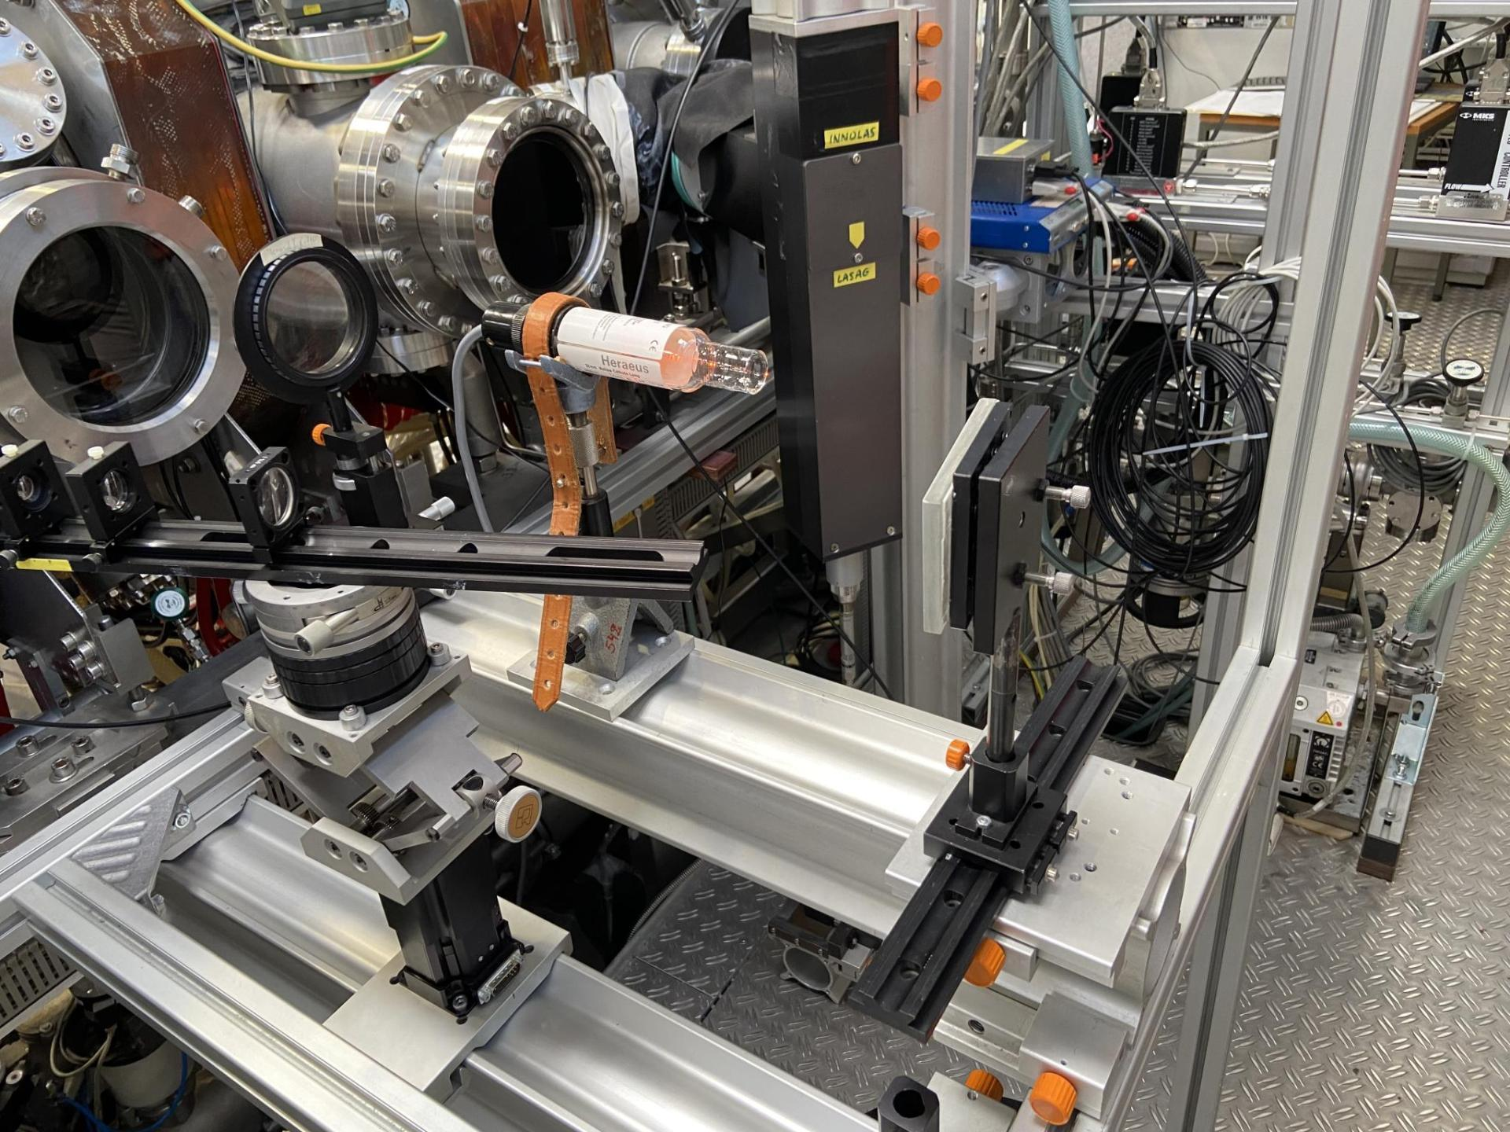
Spectroscopy of B I @ 250 nm on W at PSI-2
B I @ 250 nm
los
PSI-2 (D₂)
Δt=10s
W-target /100 nm B layer
Mo mask
W dummy
To PSI-2 using line of sight (#4)
(Backillumination)
(Calibration HCL)
(see talk A. Houben SP B.4 @ 14:35)

Slide 10
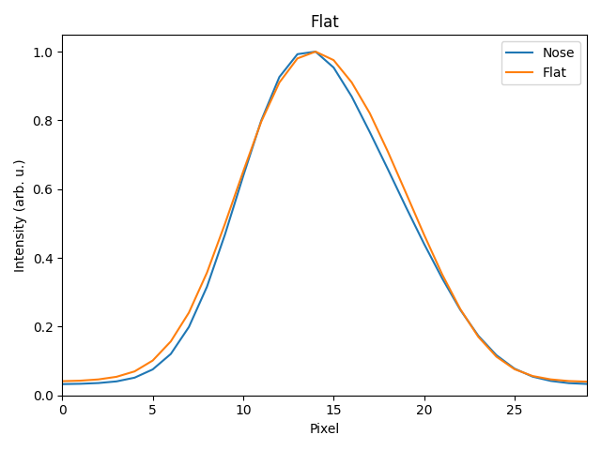
Problem with Erosion rate of W @ Psi-2
Presence of Ar ⁺⁺ in the plasma of PSI-2 [1] (spectroscopically not detected)
Sputtering by heavy Z elements (Mo and W from the manipulator)
Incorrect estimation of ion flux to the target
Measurements using two different manipulators were performed
at the same position.
Line shape at 90°
[1] Sorokin et al, Nuclear Materials and Energy 12 (2017) 1243–1247

Slide 11
Comparison in EROSIOn Rate
Plasma parameters:
Plasma current 150 A
Exposure time – 20 min
Bias -60 V
Pressure 0.04 Pa
1. Small manipulator. Erosion length is about 2.5 μm.
2. Large manipulator. Erosion length is about 3 μm.
Sputtering by Mo or W ions could be excluded at our conditions
Ion flux data and presence of Ar++ must be still investigated ( fast reflected Ar)
Experiments with Ne gas are foreseen (higher ionization potential)

Slide 12
CONCLUSIon
High resolution (HRS) and imaging spectroscopy (IS) of bulk and redeposited W and B layers in PSI-2 (partially done)
Study of sputtering rates of W+B layers in PSI-2 (done)
B I lines in visible range only at different flux of D (done)
Erosion rates of W in linear cross machine comparison study (partially done)
VUV Spectroscopy for W and D atomic and molecular lines (to be installed within 1 Month)

